Slide 1
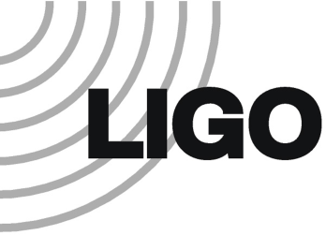

Thermal Compensation in LIGO
Rupal S. Amin
Notes:
Hello, my name is Rupal S. Amin, Louisiana State University. I am here to talk about Thermal Compensation in LIGO.

Slide 2
Outline
LIGO Layout
Thermal Aberrations
Thermal Issues
Compensation Systems
Model
Closing Remarks
Notes:
Here is a short outline for you to keep up. (Walk through the outline.)

Slide 3
Optical Layout
ETMy
Carrier
Resonant Sideband pair
Non-resonant sideband pair
Power Recycled Michelson
ITMy
Fabry-Perot Cavity
RM
ITMx
ETMx
BS
Notes:
Let’s first begin with a refresher. This is the optical layout of the LIGO detectors. This set of six mirrors can be though of as three resonators. The RM, BS, and 2 ITMs form the Power Recycled Michelson. The ITMs and ETMs form twin Fabry-Perot cavities.
The 3 colors represent the three types of phase modulated light that are used. To first order you can think of these as being actual laser colors. The Carrier laser is the only laser that runs throughout the entire detector and is stored in the arms to interact with the passing gravitational-waves.
The other colors are used to control positions of the mirrors since resonators act like large filters.
I want to call you attention to the four colored mirrors. These arm mirrors see the highest incident powers and therefore heat up the most.

Slide 4
Thermal Aberrations
Causes
HEAT GRADIENT
  Thermal Lensing
  Thermal Expansion
  Induced Birefringence
  …
Effects
  Differential Expansion
Cold ρ
Hot ρ
Aberrations
Main
Laser Beam
LIGO-G0900358. Rupal S. Amin GCGW 17 April 2009
Notes:
When these optics heat up, they do not heat up uniformly. Rather a thermal gradient is formed. Uniform heat distributions will not cause thermal aberrations. But thermal gradients differentially change local index of refraction = thermal lensing, differentially expand the optic, and can generate differential stresses.
Take the second example as a demonstration of the interferometer’s arm cavities can be affected. As the input test masses differentially expand, their radius of curvature can become larger. If absorption levels are too high, the curvature can rapidly affect inteferometer performance.

Slide 5
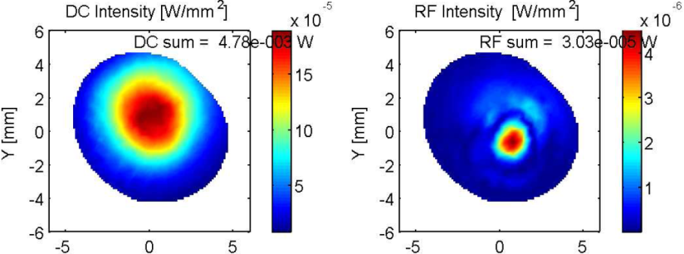

Thermal Issues: eLIGO
PRM Stability Issues
Not stable for RSB
Cavity g-factor > 1
No containment in cold state
Contrast Defect
Imbalanced thermal lenses increases junk light output
Notes:
There are several effects to the initial and enhanced LIGO detectors. A one of the issues is the power recycled michelson’s stability. The PRM is where the resonant sideband “lives.” The lack of cold stability means that the RSB light fields diffract out of the cavity than stay within. Additionally the contrast defect or junk light escaping from the AS port grows as ITMs there must be heated

Slide 6
Thermal Compensation System
Towards
4 km arm
Initial Test Mass
Pointing optics
CO₂ laser light
TCS Laser Box
Notes:
To control the thermal lensing in initial and enhanced LIGO, a heating system based around CO2 lasers are used to “write” in a counter thermal lens by either heating the center of the optic or heating the edges. Initially TCS used an 8 W laser. The latest version uses a 35 W laser to counter stronger lenses anticipated at higher power levels.

Slide 7
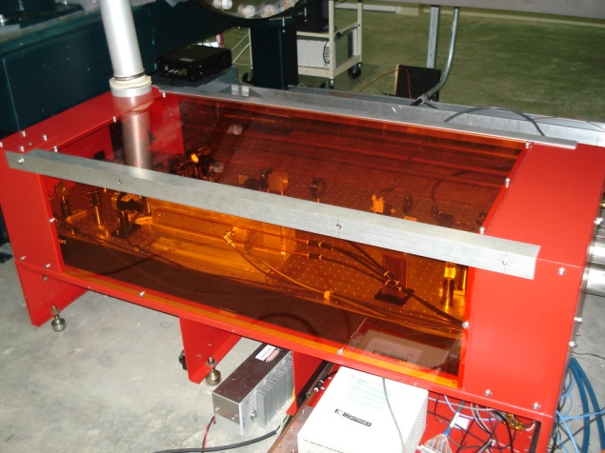
TCS Hardware
Notes:
Here is a pretty picture of some hardware. This is one of two laser boxes that enclose the TCS system at the Livingston detector. You can see the laser head and the associated projection optics. This box sits roughly 30 m away from its respective ITM.

Slide 8
Solution for eLIGO
Need a thermal model
of the
INTERFEROMETER
(Dramatic music)
Notes:
To control and analyze the TCS and its effect on the detectors, we need a thermal model of the detector. Another part of the motivation is that the control signals, the figures of merit, used in initial LIGO do not make much sense or are going to be removed from the detectors altogether. “We” collectively at the sites hope that a thermal model of the interferometer will point out what optical signals to look at to determine the state of the detector.

Slide 9
Model: Matlab+Comsol+Finesse
1)Comsol
FEM
of
ITMs
0) Matlab
1
Interferograms,
t(f) results,
Power build up,
Beam parameters
2
2) Matlab
3
FINESSE
4
Notes:
LIGO has access to several in-house interferometer models. I decided to build a model of the interferometer using one of these programs, FINESSE, and combine it with a commerically available finite element analysis program, COMSOL. I use Matlab as intermediary to invoke the generation of a thermal aberration and the level of correction in Comsol. Following this, FINESSE is able to use the phase maps and surface maps from Comsol to generate various interferometer related outputs.

Slide 10
Step 1: FEM of ITMs
Comsol Finite Element Analysis
Simulate mirror heating patterns with and without TCS
Inputs: Boundary Conditions
Substrate Materials
Outputs: Deformed Surface
Thermally Dependent n
Notes:
Let me elaborate a little by showing you the primary steps. Using Comsol I simulate the heating of a right cylinder that is the size of the ITM. Absorption coefficients, laser heating profiles, the thermal response of Young’s modulus are all encoded as either constants or parts of the governing equation. A mesh is formed in either 2 or 3-D, and Comsol solves for the surface deformation and new values of the index of refraction.

Slide 11
Step 2: In-house sim. code
Optical interaction only
No mechanical interactions
No radiation pressure
Luxor GUI config builder
Finesse: http://www.rzg.mpg.de/~adf/
Luxor: http://www.aei.mpg.de/~jah/luxor.html
Config file
With layout and simple instructions
Notes:
Next comes FINESSE. This program written by Andreas Freise uses a userbuilt text file to construct an interferometer, its optical parameters, and laser parameters Here I have used FINESSE’s front end “Luxor” to graphically illustrate a layout representing the LIGO detectors. The box and ellipse enclose the PRM and FP cavities respectively.
Along with configuration instructions, FINESSE requests user input to determine what tests are to be performed and what results are to be plotted. Such as, for example, a plot of the output beam shape if one of the thermal compensation systems is misaligned on its respective mirror.

Slide 12


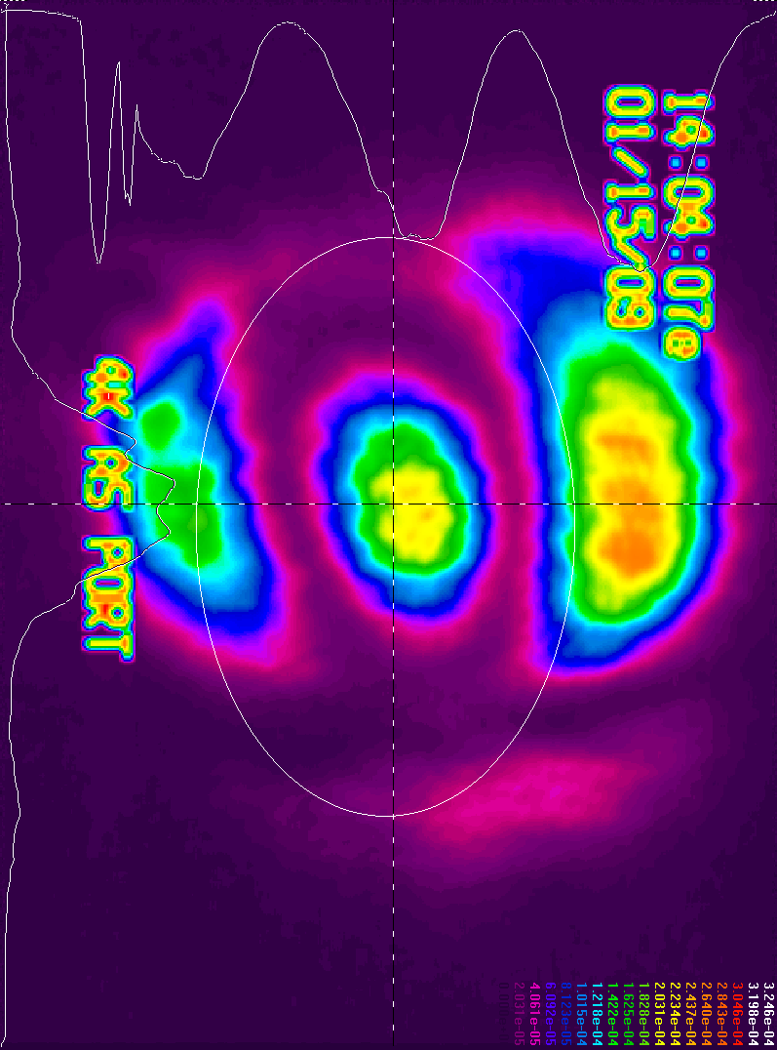
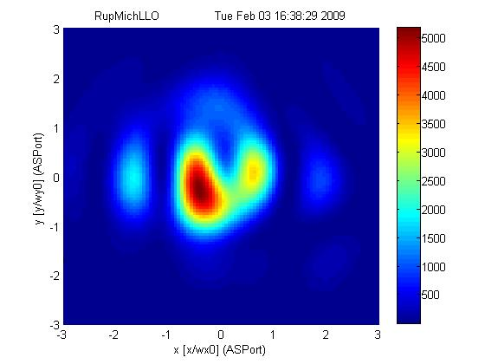
Step 3: FEM + Simulation
LHO AS patterns Mich only
Jan 15, 2009
Simulated Interferogram
K. Dooley ilog LHO
Notes:
The plot on you left is an image capture or the output port from Hanford’s detector. We were aware that the TCS on one of the mirrors was misaligned. On the right, you see my attempt at simulating the thermal offset. The axes on the plot corresponds to directions transverse to the beam image. So the AS beam is coming towards the audience in this image. The colors on the right plot indicate intensity.

Slide 13
Closing
Interferometers require thermal compensation to maintain stability at high power
Thermal model construction in progress
Sensible control signals are needed
Cannot assume that new TCS behave exactly like old TCS
Notes:
In closing, we see that high power stability requires the control of thermal abberations.
In order to control the TCS, a sensible thermal model can be constructed to find signals indicative of TCS’s effectiveness.
The thermal model continues to evolve and hopefully will be able to simulate the impact of the enhanced TCS on the detector.

Slide 14
Thanks to…
Special Thanks to
J. Giaime LSU Associate Prof. of Physics
Phil Willems TCS Group Leader CIT
Aidan Brooks
Cheryl Vorvick
Carl Adams
Viginio Sannibale
Mohana Mageswaran
NSF grant number:
  NSF-PHY-0605496
Notes:
(Walk through this slide)

Slide 15
Problems with cut and paste
Unexpected TCS induced ASC signals
  Due to surface expansion and mirror expansion
OSEMs
Cold
lzr
Heated w/ TCS
Optical lever response
Magnets
lzr
~10 μrad
Half-story
OSEM response

Slide 16
Problems with cut and paste
Common
Differential
Sideband power build-up
iLIGO
AS_I
In-phase demodulation
eLIGO
Sideband power build-up?
Working on it

Slide 17
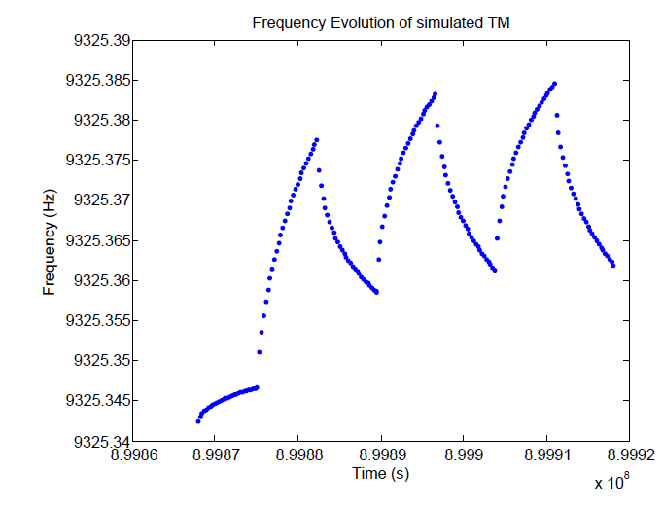
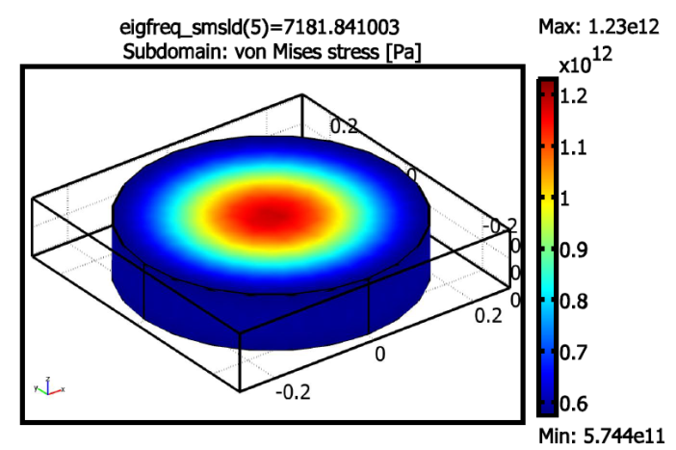
Step 1: Model actual heating
Need to measure mirror absorption ratios
Heat and cool interferometer mirrors
FEM of drumhead mode
freq. evolution
f (Hz)
f₀
f_{hot}
Results in frequency shifts

Slide 18
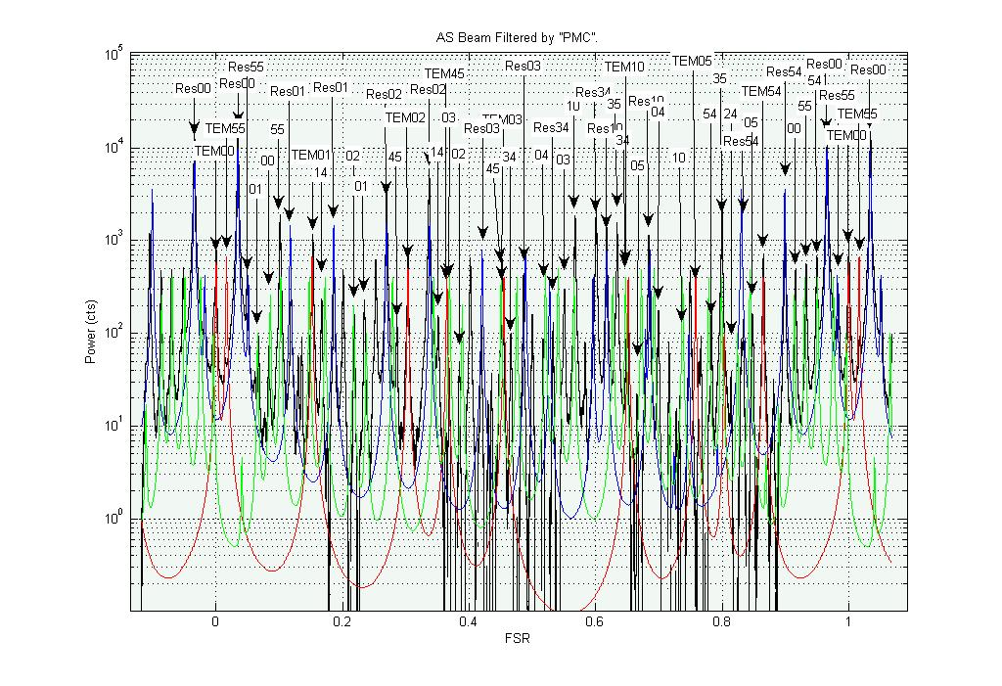
Thermal issues: eLIGO

Slide 19
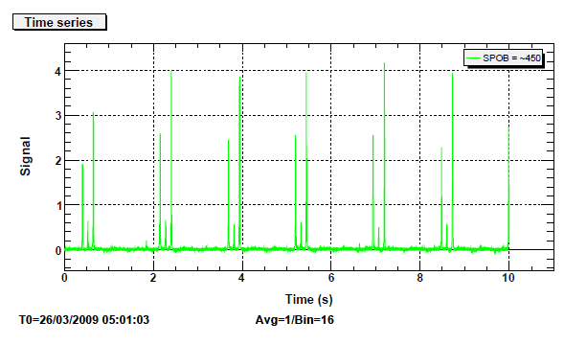
Problems with cut and paste
Resonant Sideband Imbalance Still Here

Slide 20
Thermal Issues: iLIGO
Resonant Sideband Build-up
-2003-2004 LHO ilog
Indicate poor power build-up PRIOR to mirror replacement
Due to excessive thermal lensing
Sideband overlap and imbalance NOT controlled
-LLO Phase Cam. (A. Gretarsson LLO ilog 2004)
Pwr
PRM
Pwr
in
S. Ballmer (MIT thesis, 2006)

Slide 21
Thermal issues: iLIGO
Effects on Strain Sensitivity
Decrease arm cavity gain → Arm length sensing
Decrease PRM carrier gain → Shot noise
Decrease PRM SB gain → Locking and alignment precision
Increase total carrier contrast defect → Shot noise
R. Lawrence (MIT Thesis, 2003)
Notes:
Here are a few effects to the detector performance. (Walk through)

Slide 22
Thermal Compensation System
Objective
Control thermal aberrations with auxiliary lasers
  Reduce optical noise
  Improve high frequency sensitivity
  Reduce down time with pre-heating

Slide 23
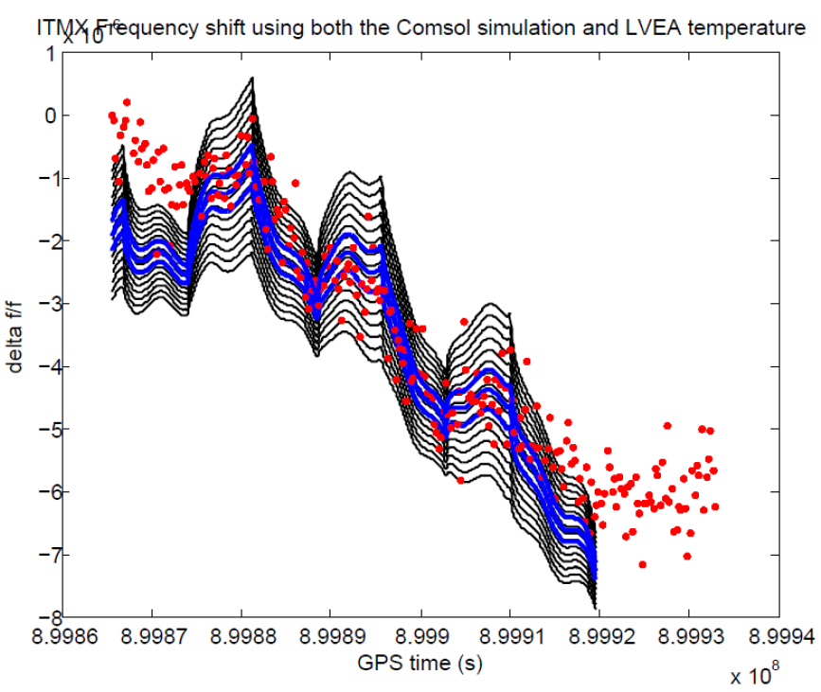
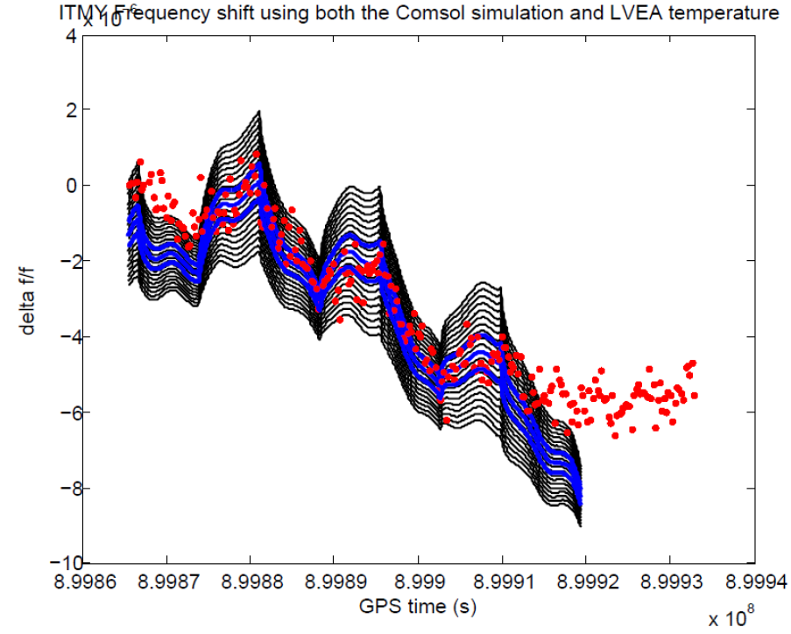
Step 1: Result
Result:
Absorption ratio for ITMX = 3.5 ppm
ITMY = 5 ppm +/- 10%

