Slide 1
.
SURF
ORIENTATION
17 JUNE 2009

Slide 2
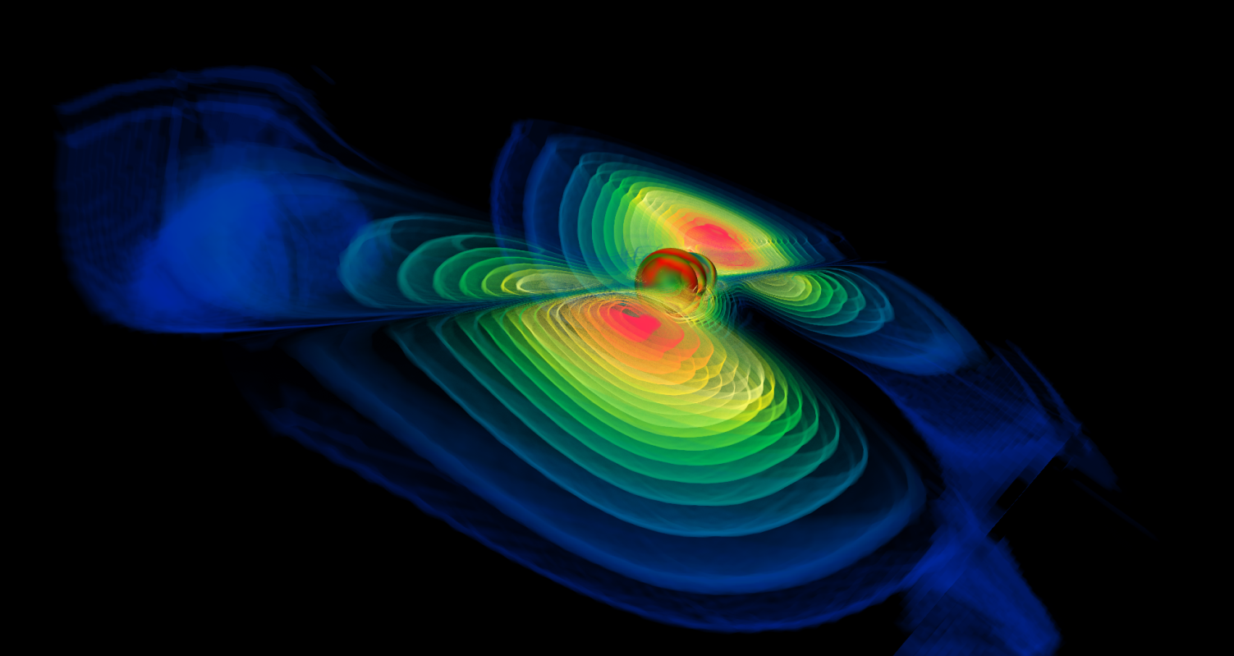
WELCOME!
Dr. Ken Libbrecht

Slide 3
Ice Breaker
Name, School, Mentor and SURF Project

Slide 4
LIGO Administration
Jullie Hiroto
If you have any questions or need help, stop by the LAB office, 102 E. Bridge.

Slide 5
Human Resources
Cindy Akutagawa
Incoming Form

Slide 6
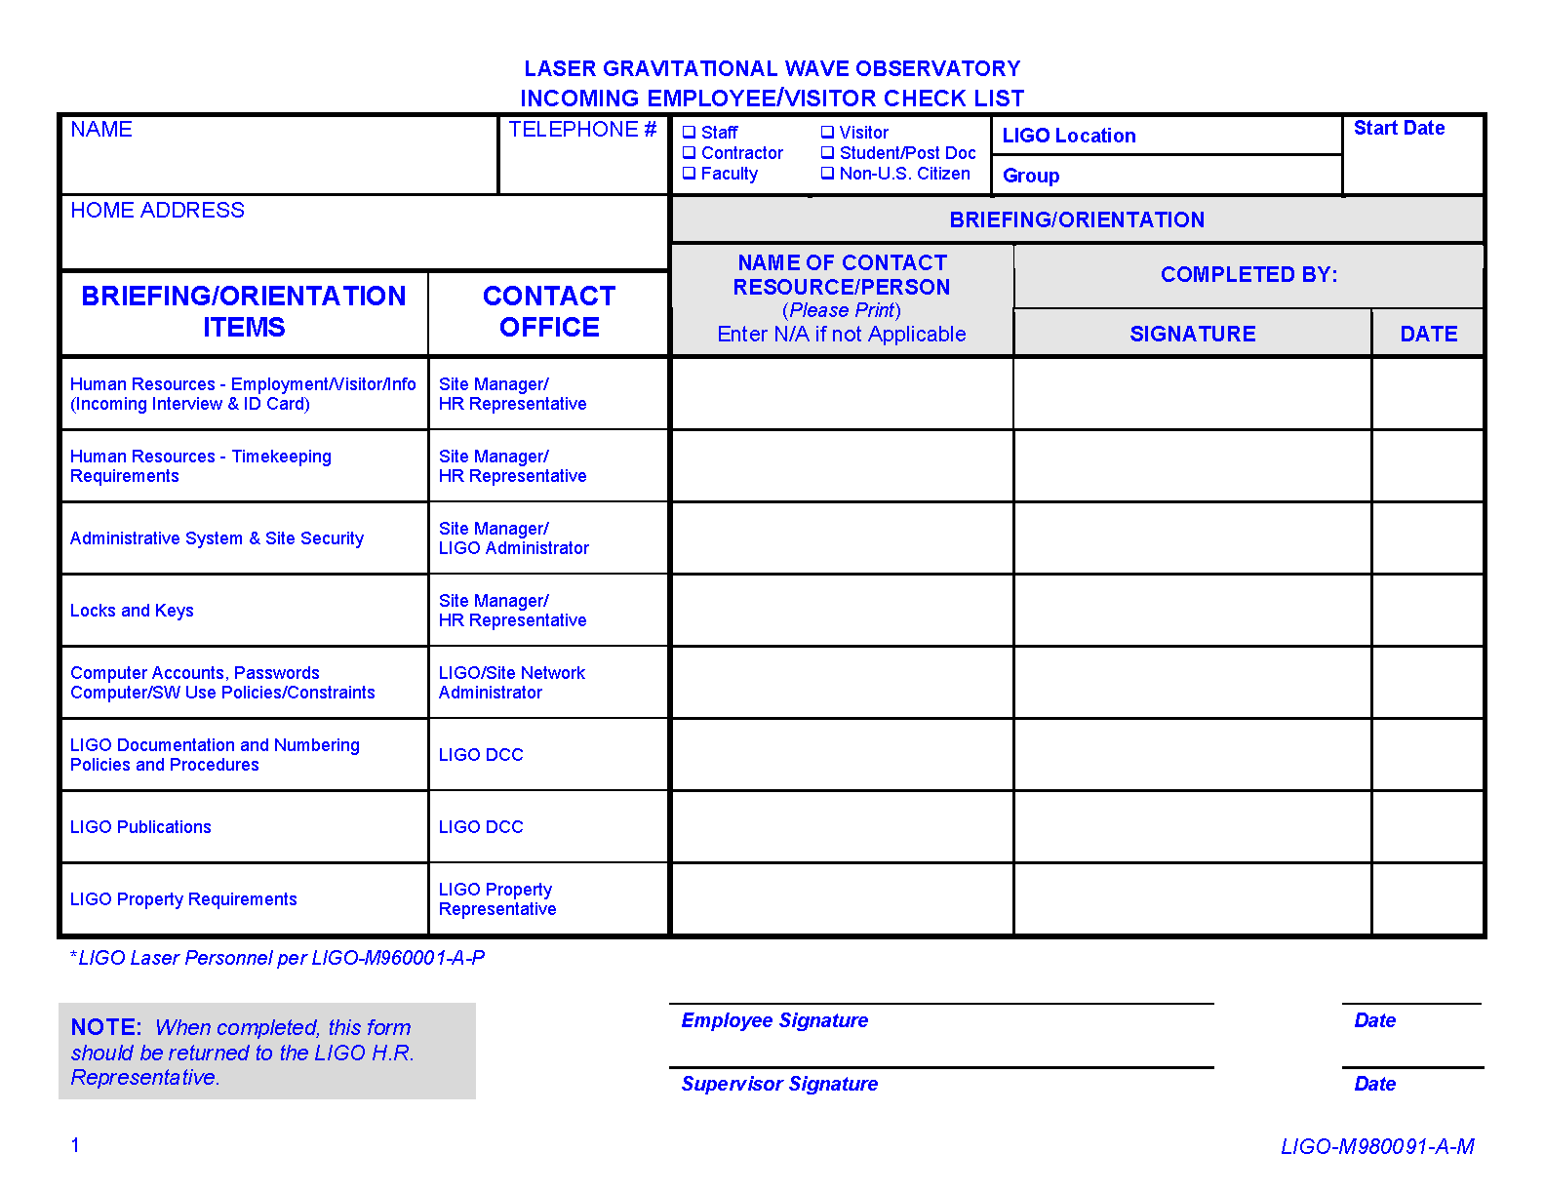

Slide 7
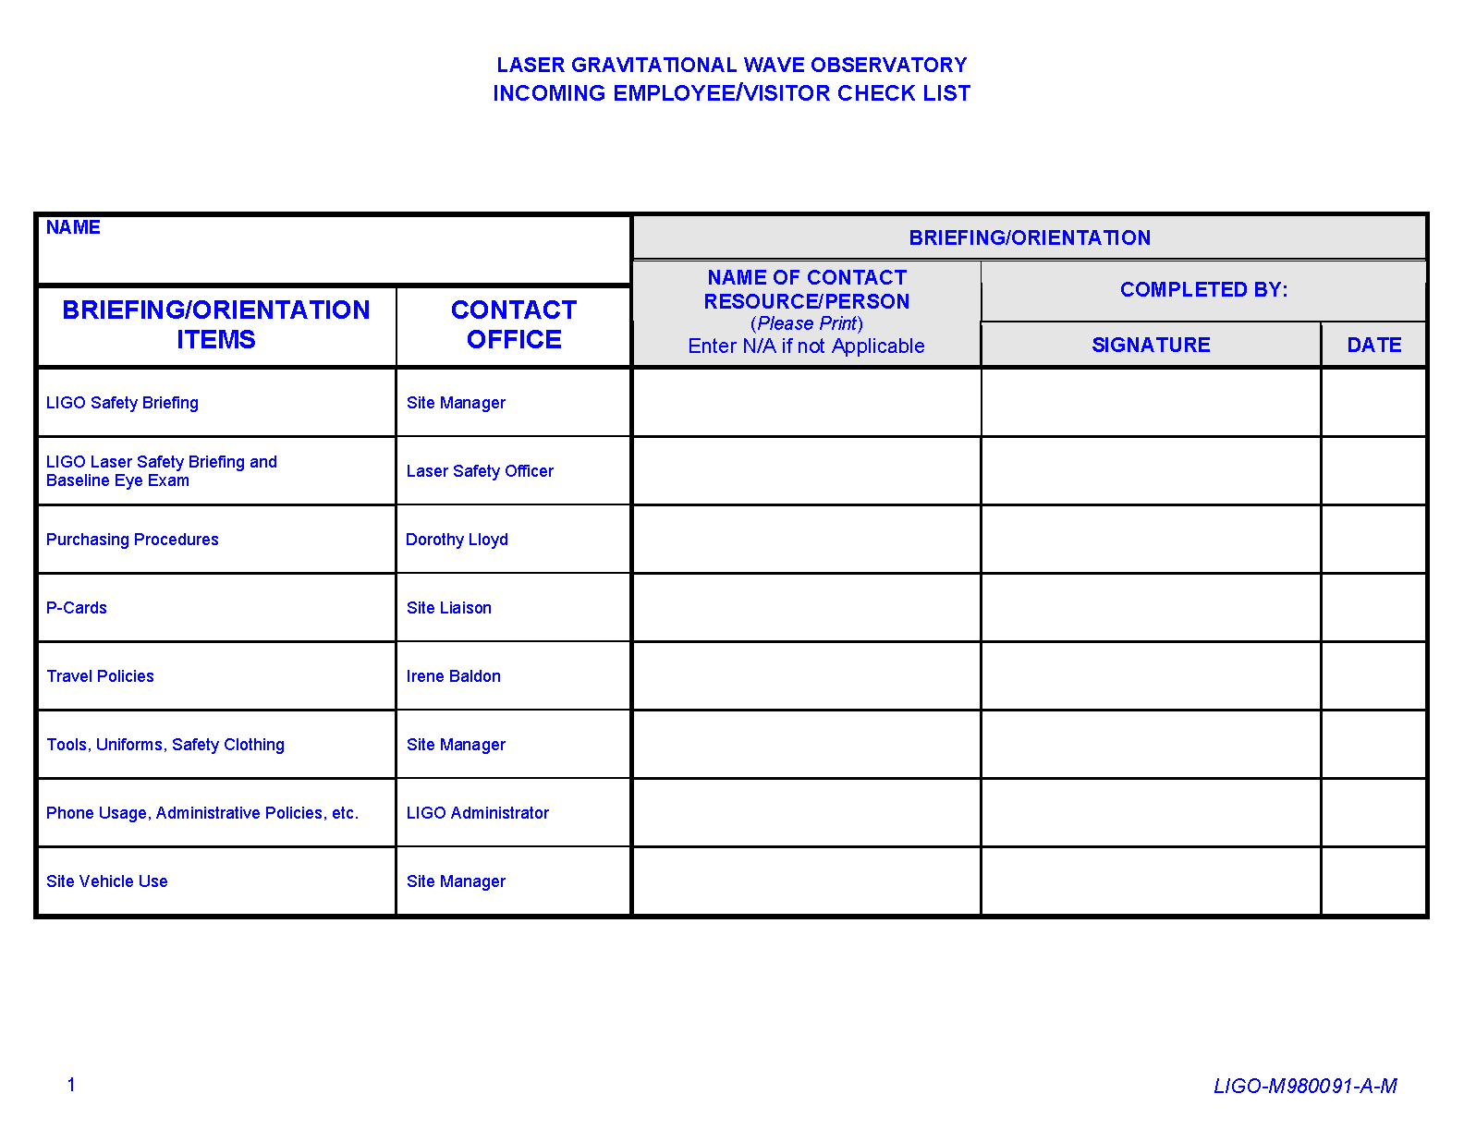

Slide 8
Human Resources
Cindy Akutagawa
Email me at cindy@ligo.caltech.edu with your phone extension so I know where to call you
and which email address to use.

Slide 9
Human Resources
Cindy Akutagawa
Take the cards provided to the
lock shop to get your keys.

Slide 10
Human Resources
Cindy Akutagawa
Exit Form must be completed before leaving.

Slide 11
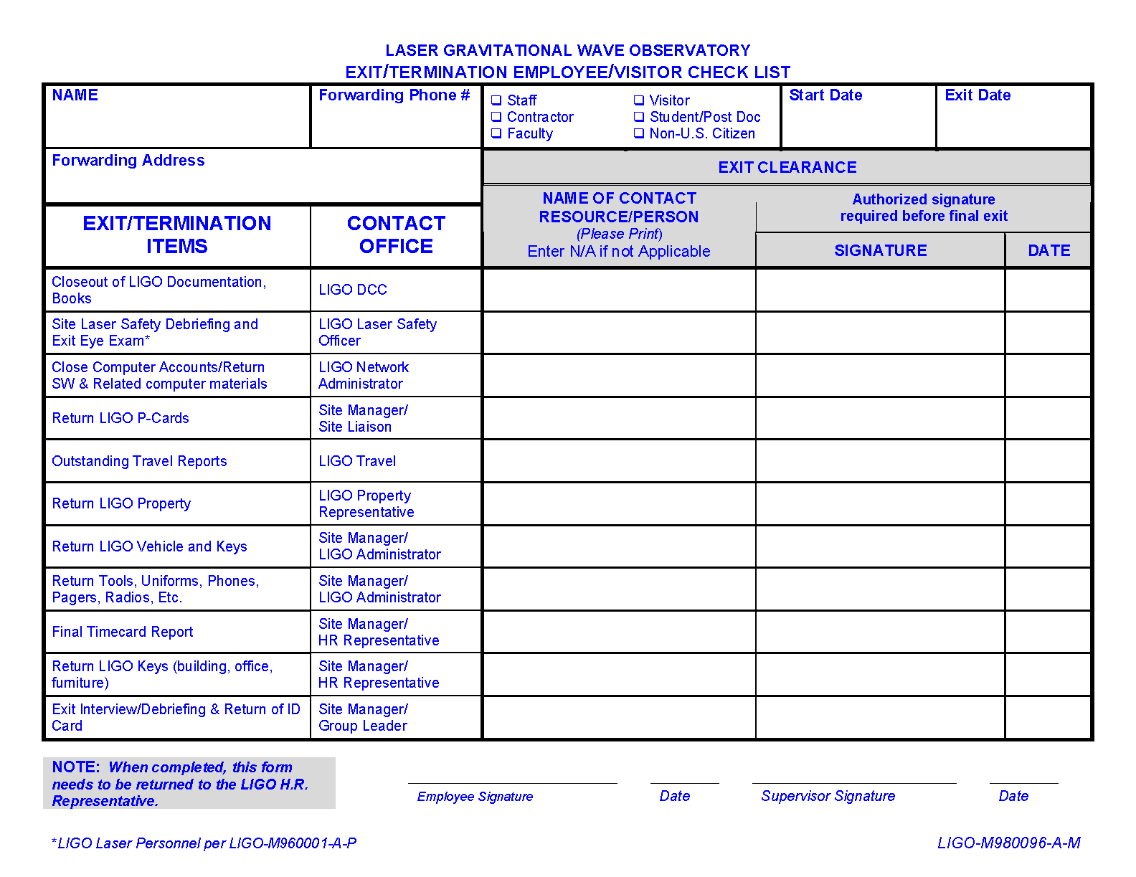

Slide 12
Property Accountability
Rod Luna

Slide 13
Property Accountability
Rod Luna
Why is equipment tagged?
What constitutes Tagged Equipment?
What is Caltech’s Policy concerning property accountability?

Slide 14
Property Accountability
Rod Luna
What is the Government Policy concerning
property accountability?
How to dispose of Government property.
Who has overall responsibility for property
accountability and maintainability?

Slide 15
THE
DOCUMENT CONTROL CENTER
Cleveland Mak

Slide 16
Document Control Center (DCC)
What is the DCC:
A web-based document management system
The central repository for all electronic documents related to LIGO
A convenient and secure location for colleagues to share documents

Slide 17
Document Control Center (DCC)
What is a document?
Contract/Proposal/Quote
Drawing
Email/Fax/Letter
Report/Policy
Meeting minutes/informal notes
Presentation slides/movie files/photos

Slide 18
Document Control Center (DCC)
You will be responsible for submitting two types of documentation to the DCC at the end of your term:
A “T” classification type of document. This is a final report of your research/work performed.
A “G” classification type of document. This will be the slides from your presentation you will be giving during your final week.

Slide 19
Document Control Center (DCC)
How to access the DCC
DCC homepage: https://dcc.ligo.org
A LIGO user account and password is required to upload documents and access non-public documents.
Access to public documents do not require a username and password.

Slide 20
Document Control Center (DCC)
Contact information
Email: mak@ligo.caltech.edu
Ext: 3314
Office: Bridge Annex, Room 21 (basement)
If you have any questions, please don’t hesitate to contact me.

Slide 21
General Computing
Larry Wallace
Computer accounts
Passwords
Computer/SW Use Policies/Constraints
Office vs. Lab and Observatories
Engineering/Data Analysis
Loan of equipment

Slide 22
Travel
Marilyn Wright
Contact me for all travel related issues.
mwright@ligo.caltech.edu

Slide 23
Travel
Marilyn Wright
Contact me for all travel related issues.
Turn in all airline and ground transportation receipts.
You can email or fax receipts to me for return trip.

Slide 24
Safety
Bill Tyler
The general safety philosophy of the laboratory may be simply stated as:
“It is each person’s responsibility to ensure
his/her own personal safety, as well as that
of all others in the vicinity.”

Slide 25
Safety
LIGO SURF task/work RESTRICTIONS
Any person or SURF student under the age of 18 years is NEVER permitted to work alone at any time.
SURF, INTERNS & UNDERGRADUATE students may never work along whenever engaged in a hazardous task (i.e. work involving Class 3 or Class 4 lasers, or the use of certain kinds of equipment, areas of exposed energized lines, etc.
SURF students may NOT act as visitor escorts for SURF students in any “LASER HAZARD AREA.”

Slide 26
Safety
LIGO CAMPUS SAFETY
SAFETY OFFICER
Peter King, extension 3099
Alternate: Bill Tyler, extension 2976
LASER SAFETY OFFICER (LSO)
Garilynn Billingsley, extension 2184

Slide 27
Safety
Review Caltech Emergency Response Guide
For any emergency
Campus Phone: dial 5000
Other Phone: dial 626.395.5000
Indicate situation and location to operator
Fire Alarm Sounds – Must Evacuate!
Use stairs for Fire or Earthquake – Do not use elevator
Assemble at the designated evacuation assembly area
Evacuation information is posted near stairwells on each floor

Slide 28
Safety
In case of earthquake
“Duck-Cover-Hold”
Stay in place until motion stops
Beware of falling items and fire hazards

Slide 29
Safety
Reminders:
Caltech is an “Open Campus”
Maintain an awareness of surroundings
Use buddy-system for work and play
Walk with group
If working late at night, contact Caltech Security for escort
Ask questions – insist that Mentor provides adequate safety information (potential hazards)
If you have residual concerns or questions, contact LIGO Campus Safety Officer (Peter King)

Slide 30
Safety
Reminders:
See Mentor or Supervisor for safety items:
Hard hats, steel-toed shoes, and gloves
Face shields & aprons for chemical and machine shop work
Laser safety goggles
Put away/secure valuable items
Make sure you have required keys for building access
No open-toe shoes or sandals are allowed in the labs.
Check out LIGO & Caltech websites
Safety classes are offered

Slide 31
Safety
SURFers working with/near lasers must attend Laser Safety Class.
Laser Safety Class “TBD”
Monday, June 22nd @ 10:00 a.m.
Room 39, Bridge Annex (ECR)

