Slide 1


Nanostructured Optics
With transparencies from
Bryan Barr
Michael Britzger
Frank Brückner
Alexander Bunkowski
Oliver Burmeister
Daniel Friedrich
Bernard Kley
Roman Schnabel
Harald Lück, AEI
GWADW - May, 10-15, 2009

Slide 2
Gratings in Interferometers
Gratings as cavitiy mirrors
1st order Litrow
2nd order Litrow
Gratings as Beam Splitter
Waveguide Coatings

Slide 3
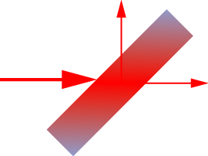
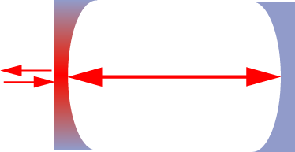
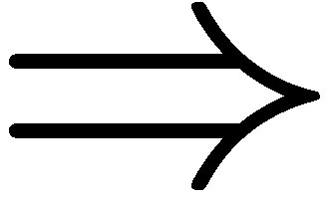
Gratings: Why?
transmissive Optics
Thermal Effects from Absorption
Thermal Lensing
Thermal deformation
Thermal effects limit power
Avoid Transmission using reflective optics

Slide 4
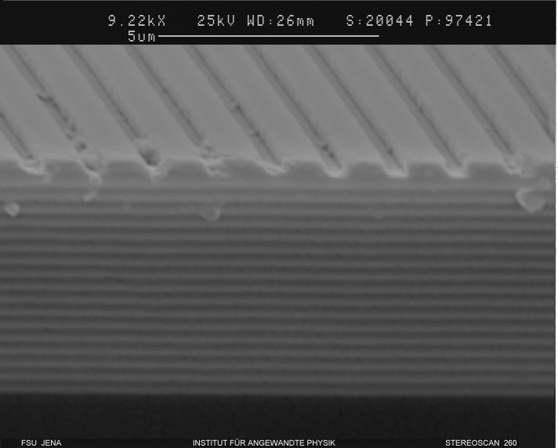
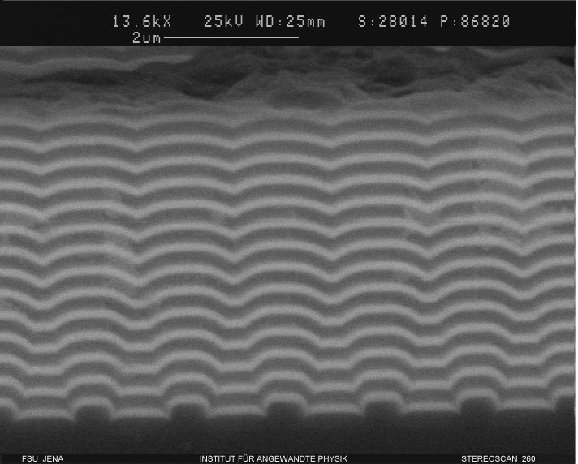
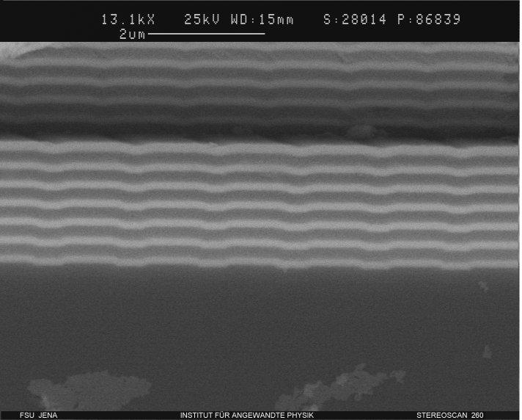
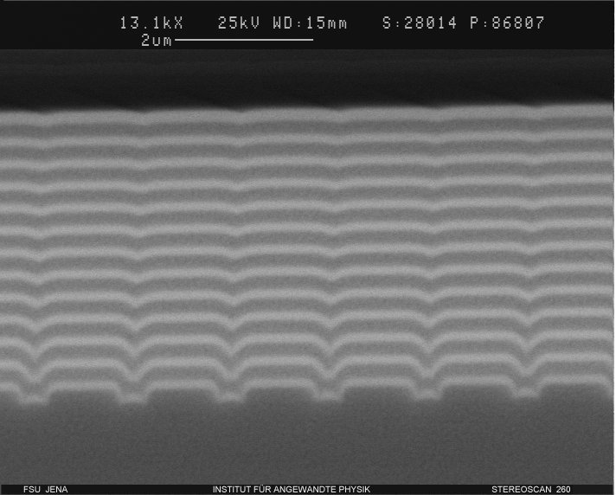
Examples
Notes:
Cross sections of these gratings look like this
Here we have a rectangular pattern etched in the top layer of a multilayer stack which is the conventional approach to produce gratings with high diffraction efficency
The others images show grating where the sructure is etched in the substrate first and are then overcoated.
On the right hand side we see same groove depth (150nm) but different fill factors
On the left hand side we see a very shallow grating with a groove depth of 40-50 nm which is useful if low diffraction efficencies are desired

Slide 5
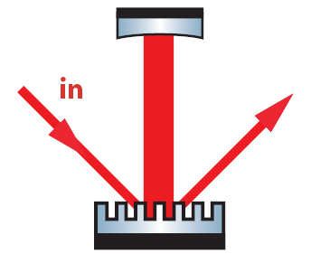
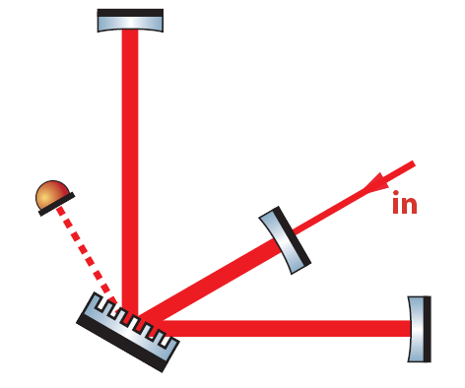
Basic Ideas
cavity
coupler
2-port-grating
1st order Littrow
3-port-grating
2nd order Littrow
conventional
transmissive optics
diffractive
optics
50/50
beam
splitter
Appl. Opt. 45, 5795 (2006);
Appl. Opt. 46, 24 (2007); Opt. Lett. 33, 101 (2008)

Slide 6
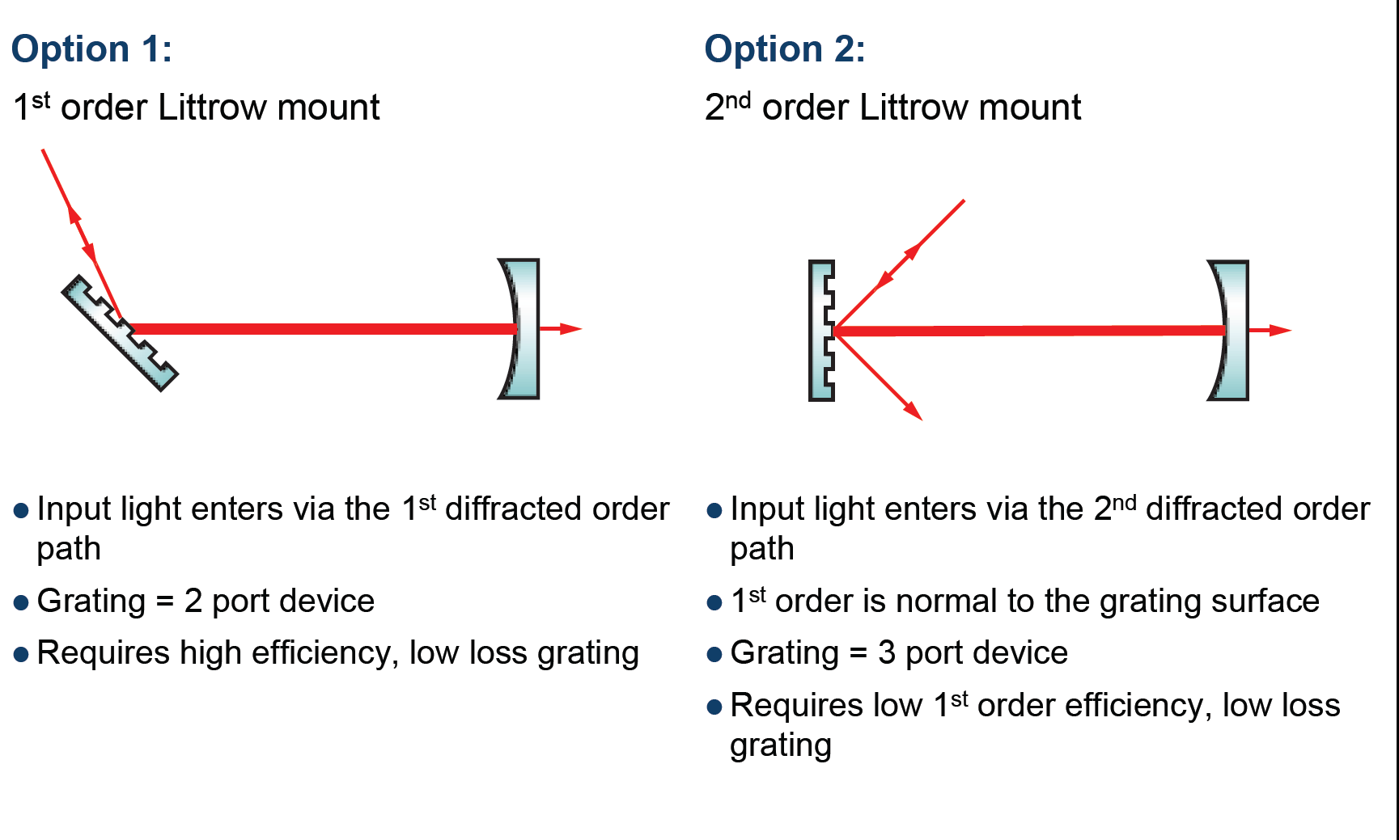
Cavity couplers

Slide 7
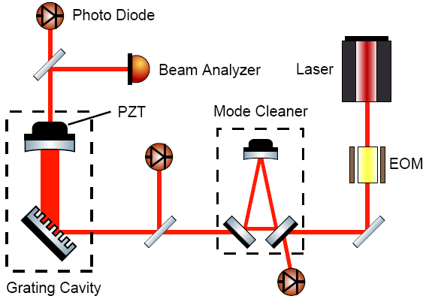
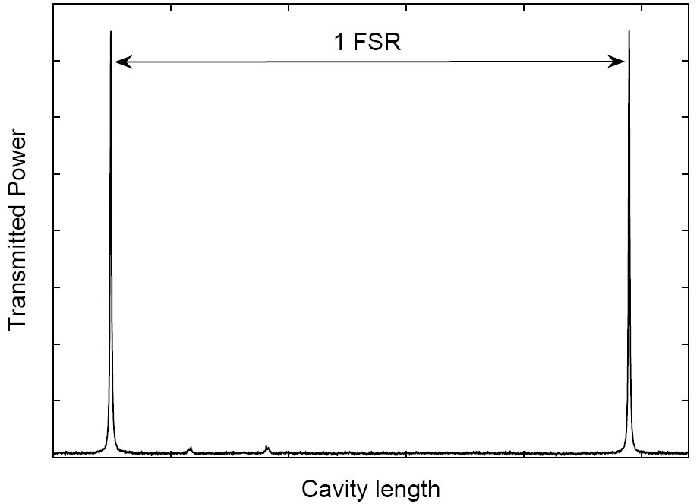
1st order Littrow cavity
Notes:
1st order Littrow mounting is much simpler because only two ports couple and we have the analog to a normal mirror.
But to reach high finesse values one needs very high diffraction efficiency which is hard to obtain.
We designed a grating with high diffraction efficency.
This setup was used to investigate our cavity in 1st order Littrow mount:
Laser light is phase modulated and spatially filtered via a triangular ring cavity before it is sent to the grating.
(PZT mirror allows for cavity length control and the reflected and transmitted light can be monitored with photodiodes.)
Here one sees the transmitted light as a function of cavity length

Slide 8
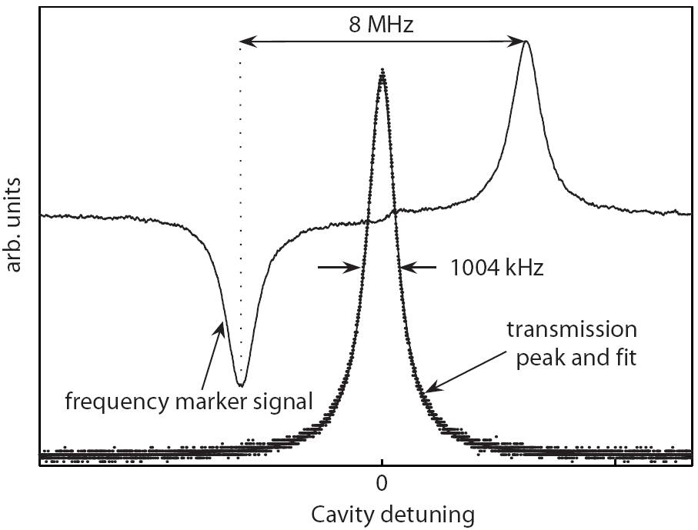
1st order Littrow cavity
Results:
Finesse: 1580 ⁺ 60
Diffr. eff.: 99.63% ⁺ 0.02%
Loss: 0.19 %
₋
₋
Bunkowski et al.
Notes:
We used sidebands as frequency markers and measured the linewidth of the transmission peak.
From the macroscopic cavity length we could calculate the Finesse and hence the diffraction efficnecy of the grating
The finesse had a value of 1580 corresponding to the remarkable value for the 1st order diffractin efficiency of 99.6% and and an overall loss smaller than 0.2 %
These values look very promising.

Slide 9
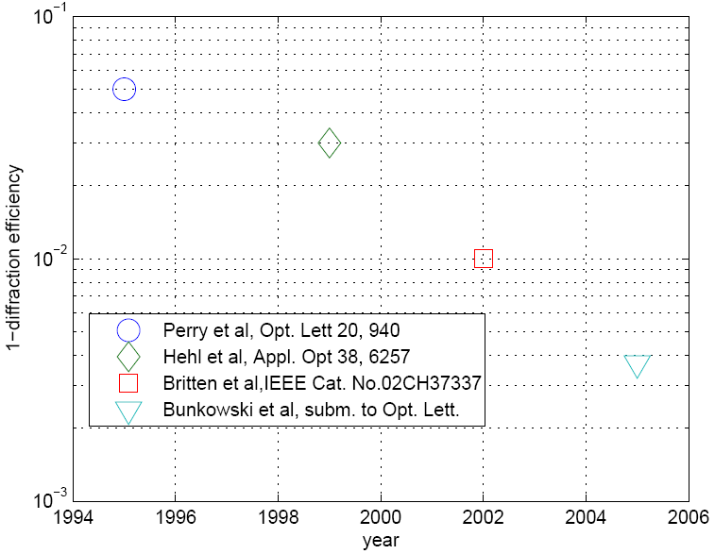
Diffraction efficiency evolution
Appl. Opt. 45, 5795
Notes:
That brings me to the question of where we are in terms of diffraction efficiency
Here I have plotted 1-the highest published values for diffraction gratings against time
So zero would be the perfect grating.
It is a logarithmic plot since it gets harder the closer you come to 0
The trend is clear and we hope to get down soon.

Slide 10
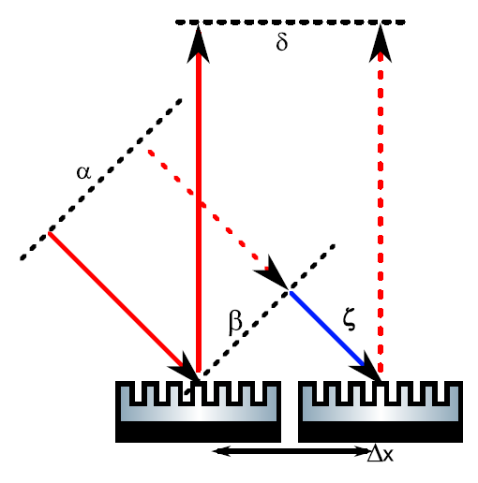
A Problem: Lateral motion
Well known effect, e.g. in acousto-optic Modulators
Phase of diffracted beam changes with lateral motion between the beam and the grating
Discussed in: J. Hallam J. Hallam Hallam et al., arXiv:0903.3324v2 [gr-qc] 5 May 2009

Slide 11
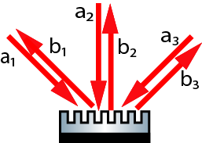

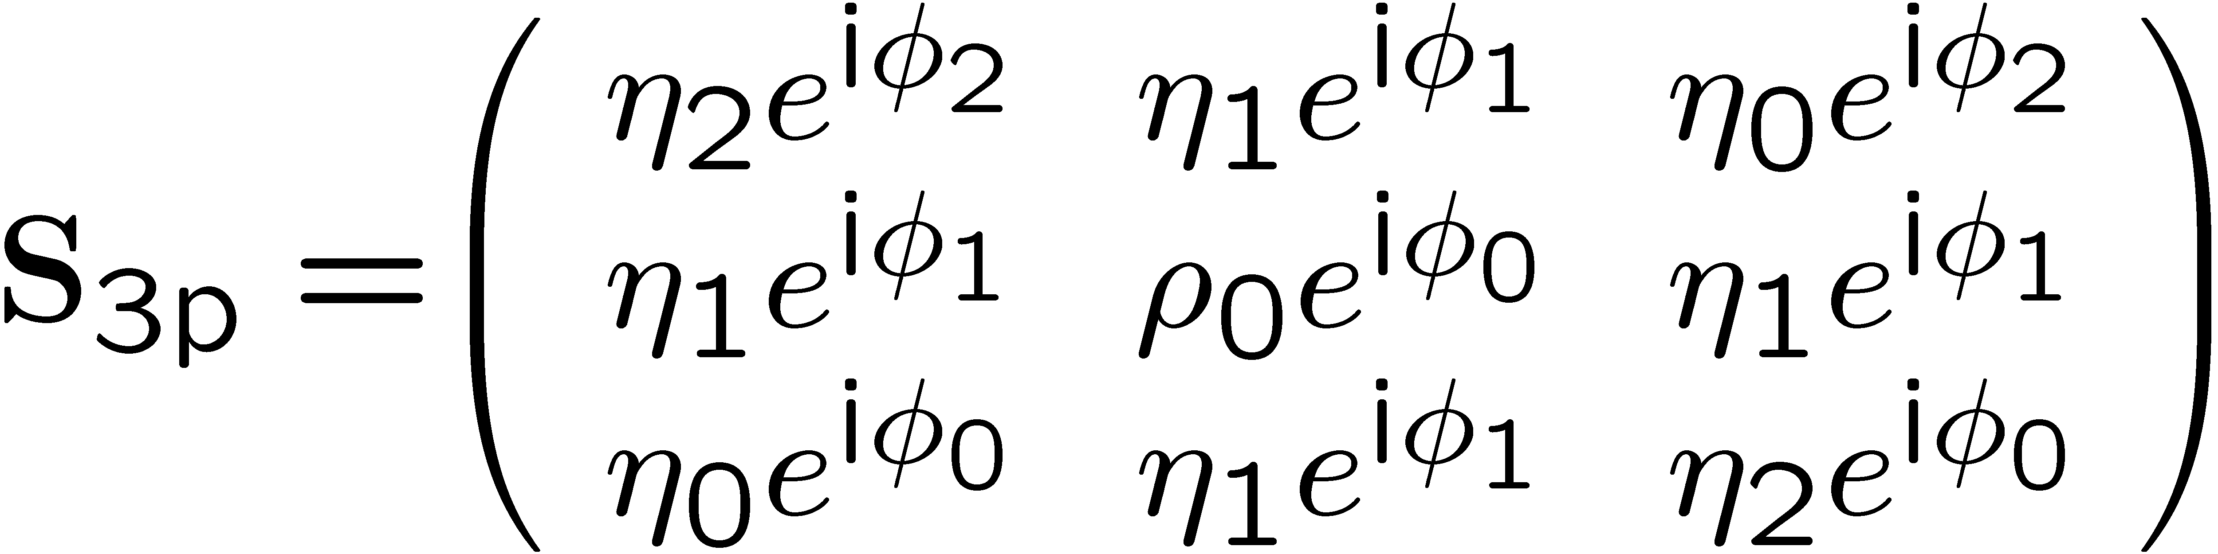
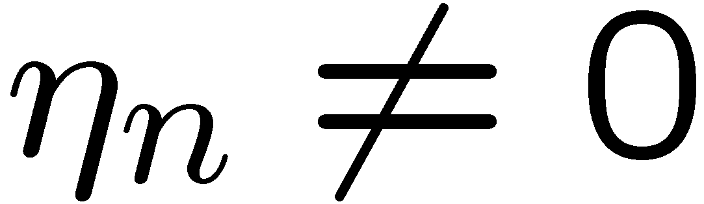
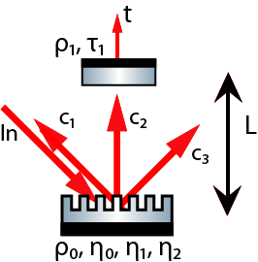
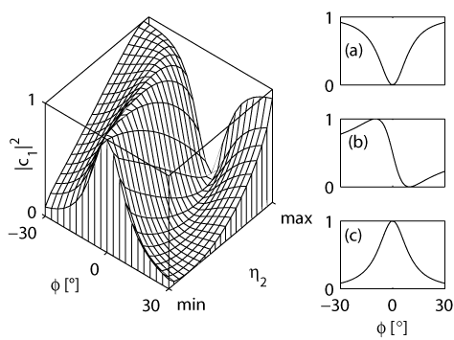
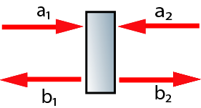
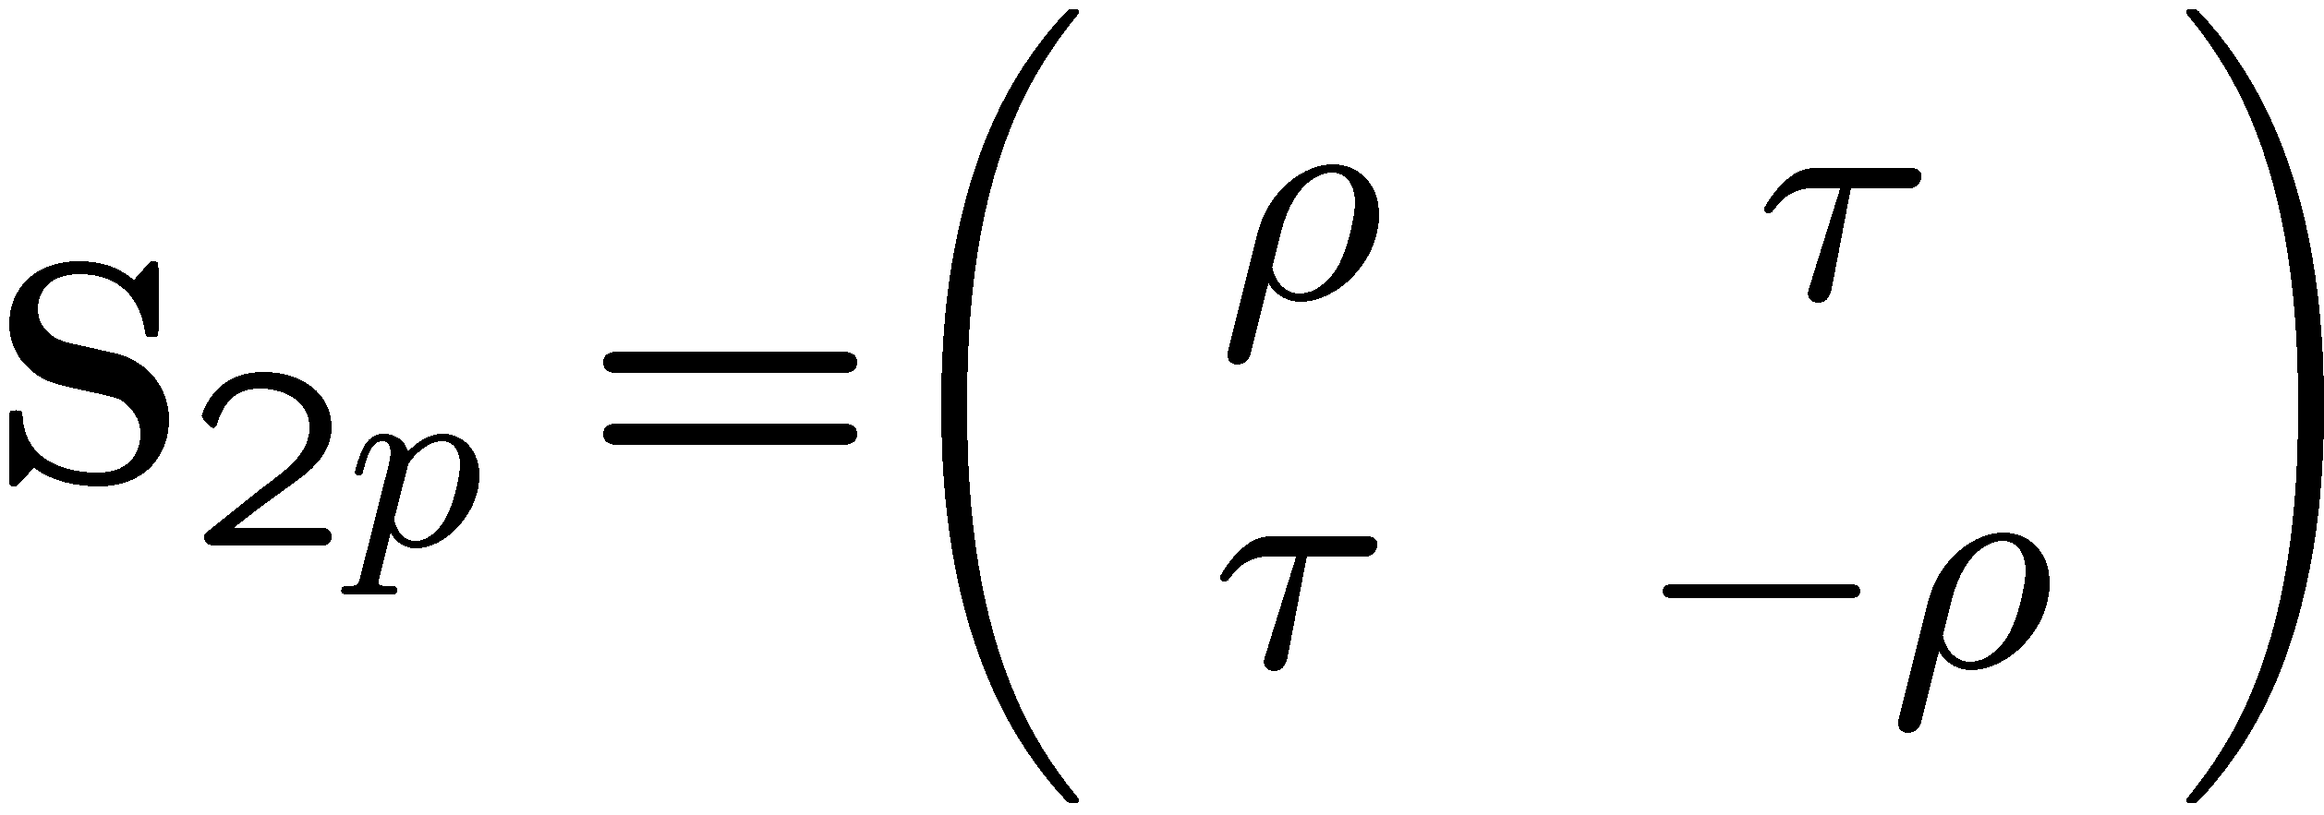
Three-port-grating
Scattering-matrix-formalism
Phases depend on diffraction efficiencies
Non vanishing matrix elements
Coupling to an optical resonator via 1st diffraction order
Low diffraction efficiency η / high reflectivity ρ
Two reflection ports c /c
Grating design defines ratio of the radiation at the output ports
1
0
1
3
Opt. Lett. 29, 2342 (2004), Opt. Lett. 30, 1183 (2005),
Opt. Lett. 31, 658 (2006), Opt. Lett. 31, 2384 (2006)

Slide 12
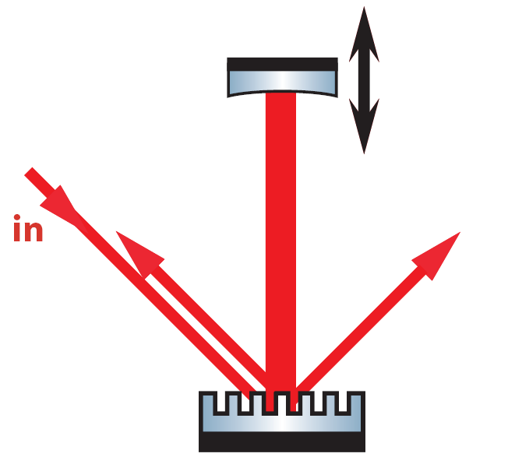
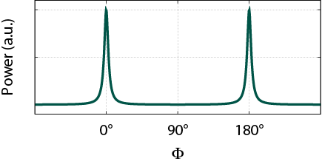
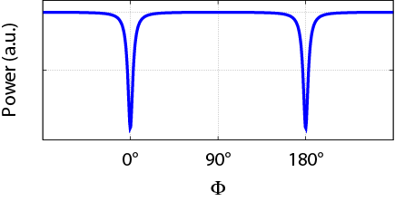
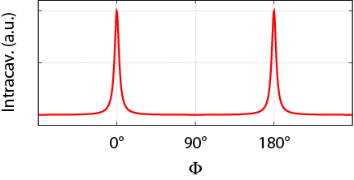
Three-port-grating resonator
η -configuration
Three-port-grating
2min
ΦEM
ΦEM
Port C1
Three orders of diffraction (m=0,1,2)
2nd order Littrow
Additional port C3
Coupling to an optical resonator via 1st diffraction order
Grating design defines ratio of the radiation at the output ports
C1
C3
Port C3
ΦEM
Resonant light reflected towards laser
Modeselective mirror
One degree of freedom (ΦEM)
linear resonator
ΦEM
ΦEM

Slide 13
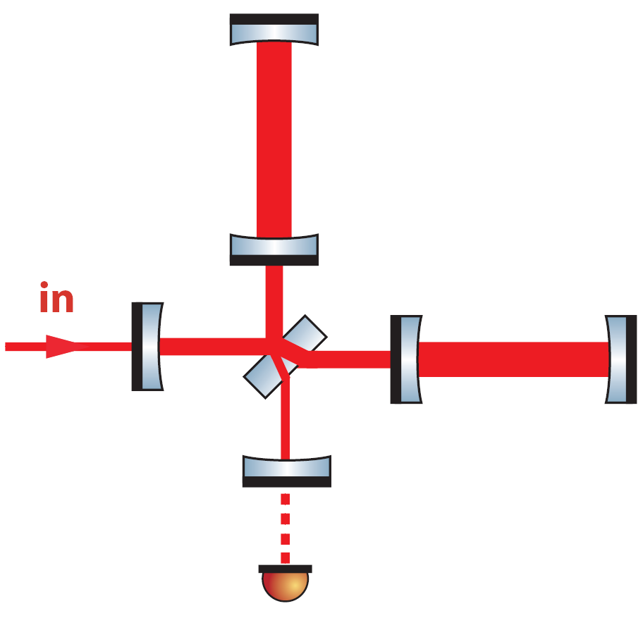
Grating resonator with PR
Power-recycling
ΦEM
Power-recycling mirror (MPR) in reflection port C1
Additional power build-up in the grating cavity
Grating-coupled double-resonator
Two degrees of freedom (ΦEM, ΦPR)
Mode
selectivity
ΦPR
ΦPR
ΦEM

Slide 14

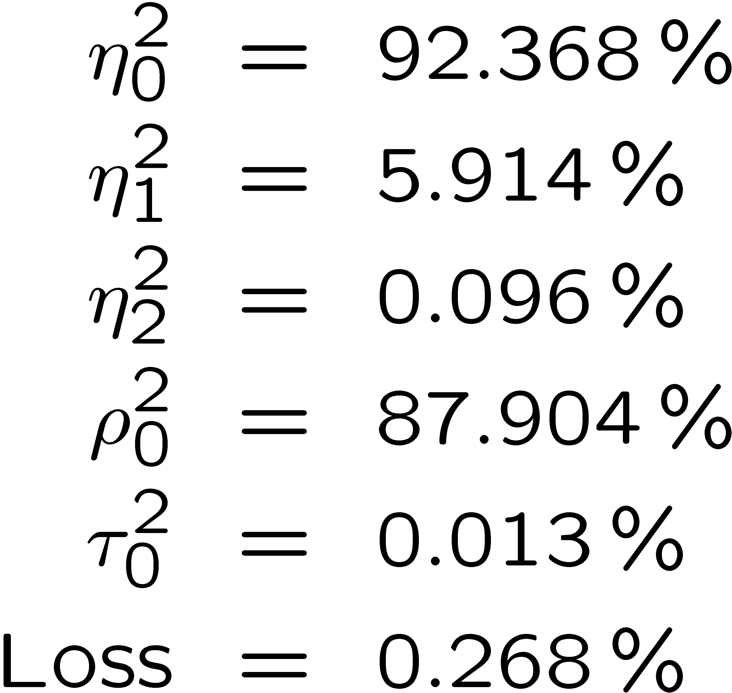
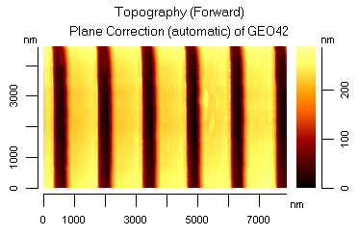
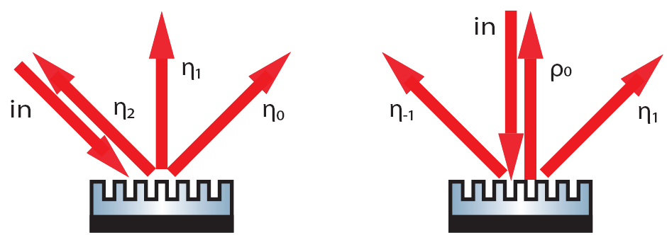
Facts I
Grating GEO42
Fused silica substrate
HR-coating beneath grating structure
d=1450nm / fill factor 0.47
Efficiencies:

Slide 15
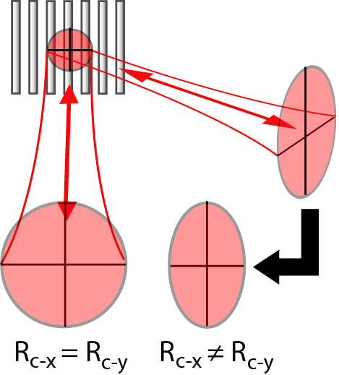
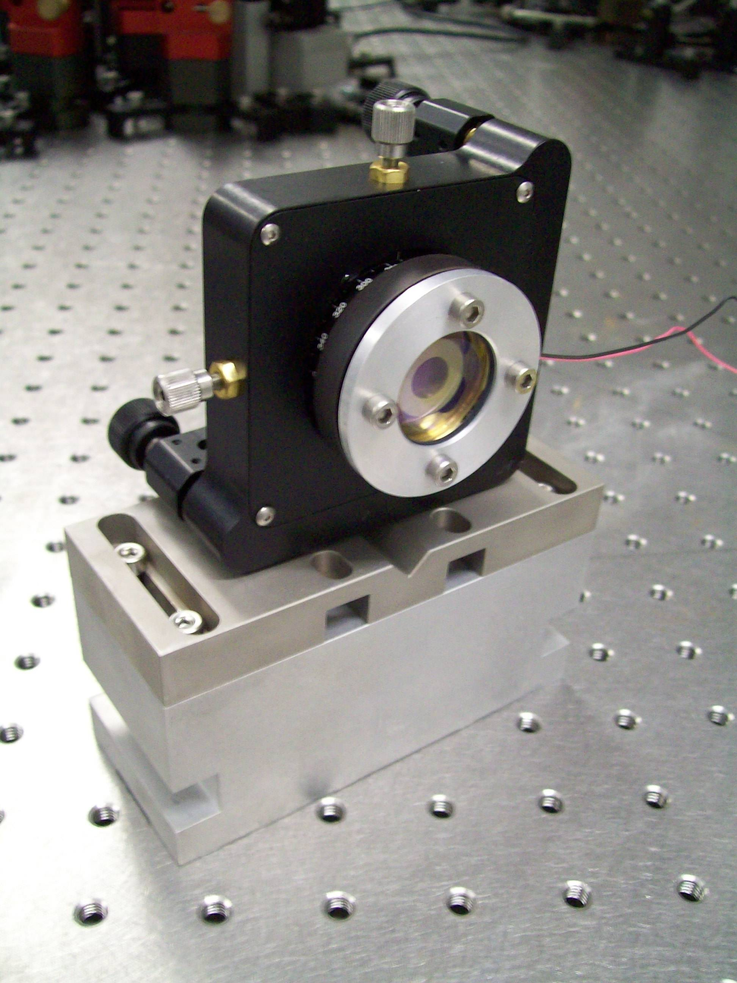
Facts II
Elliptical beam profile due to different diffraction angles
Modematching in two dimensions (cylindrical lenses)
PR-mirror with two different radii of curvature (toroidal mirror)

Slide 16
Grating Cavity + Power Recycling
Power build-up in arm w.r.t. input : ca. 300 (Britzger)

Slide 17
Reduced scattering by over-coating
Small fill factor
same diffraction efficiency
groove depth 40nm
fill factor 50%
systematical errors
reduced
statistical background
reduced
Notes:
small and large fillfactors differ also in the scattering, so we again performed ARS measurement
here: groove depth 40nm, ff 50%
compared to the grating on top of the multilayer
same diffraction efficiency but with significantly reduced scattering

Slide 18
Reducing scattering by over-coating
Grating changes dielectric stack performance. Hard to predict
Stack changes grating performance hard to predict
Grating manufacturing process improvements -> less scattering -> over coating will probably not be used in the future

Slide 19
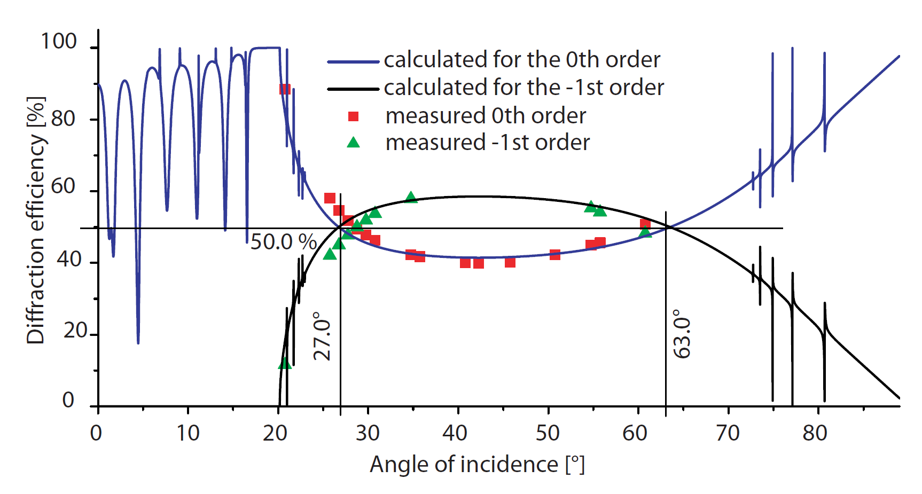
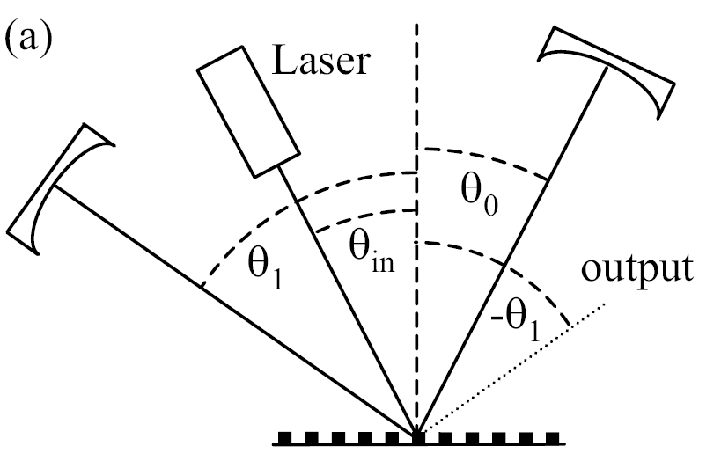
50/50 beamsplitter
Interesting for GEO-like ifos,
since full power at BS
Friedrich et al., Journal of Physics: Conference Series 122 (2008) 012018

Slide 20
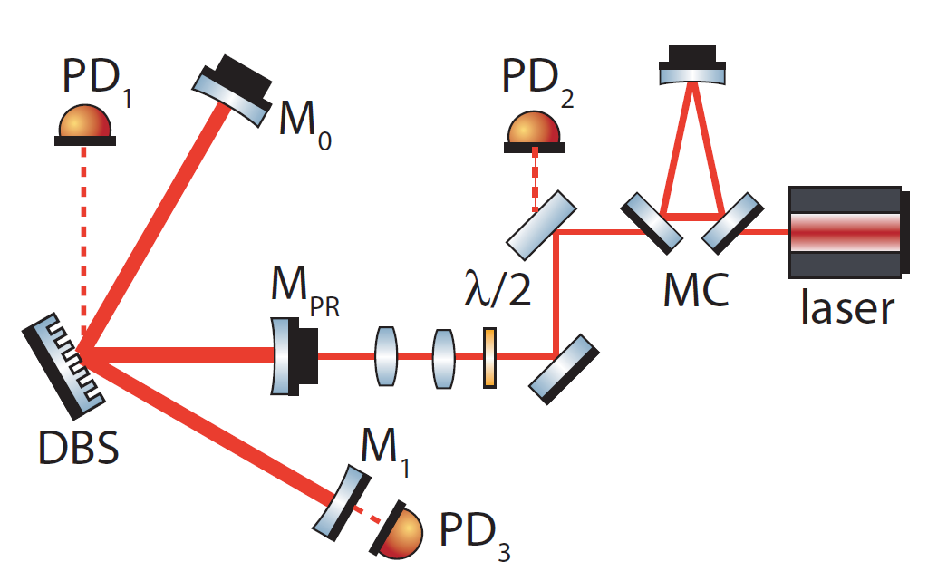
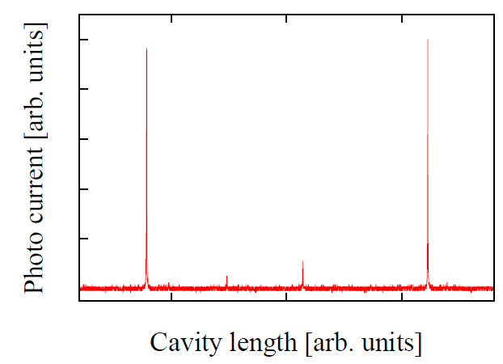
Grating BS Experiment
Finesse PRC ~880
Intra cavity losses 0.46%

Slide 21
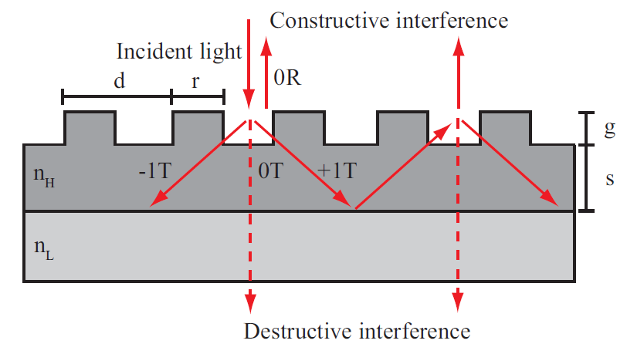
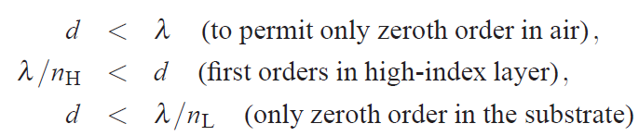
Waveguide coatings
Brückner et al., OPTICS EXPRESS, 17, No. 1, pp. 163--, (2009)

Slide 22
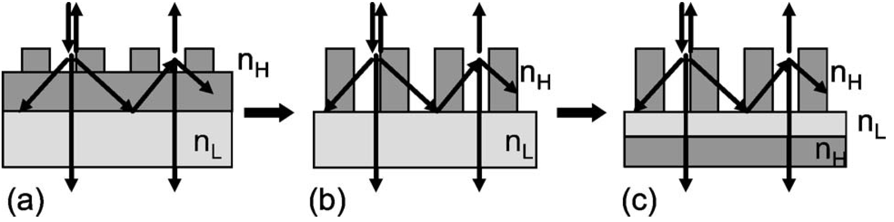
Nanostructured Surfaces
Reduce the waveguide to the grating itself and still fullfil conditions for waveguiding
Replace intuition by solving Maxwell equations for optimization
Monolithic 100% reflection “coating”
[Brückner et al., Opt. Lett., 33, 264 (2008)]

Slide 23
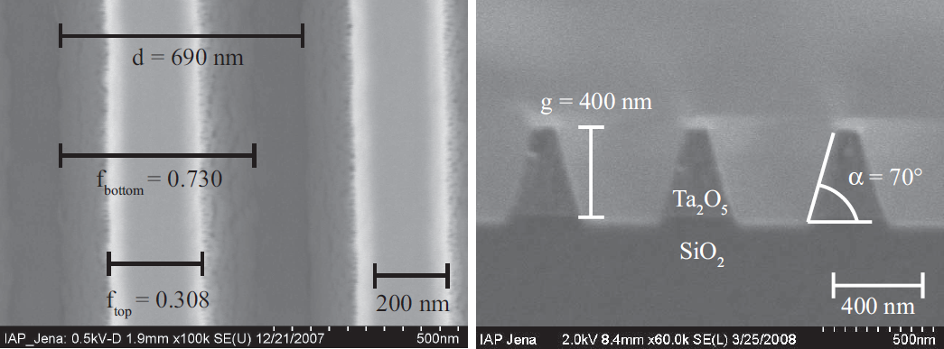
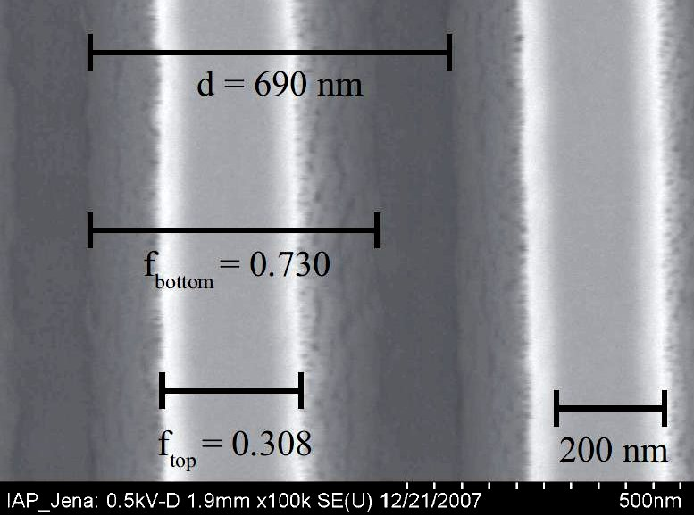
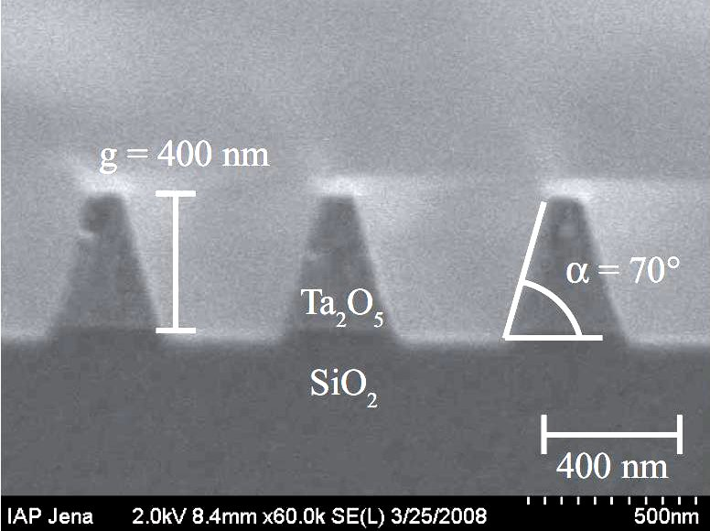
Experimental realization
Compound structure SIO₂ / Ta₂O₅
99.1% reflectivity realized:
Brückner et al., OPTICS EXPRESS, 17, No. 1, pp. 163--, (2009)
Contrast enhanced for better visibility

Slide 24
Nanostructured Surfaces
Monolithic 100% reflection “coating”
[Brückner et al., Opt. Lett., 33, 264 (2008)]

Slide 25
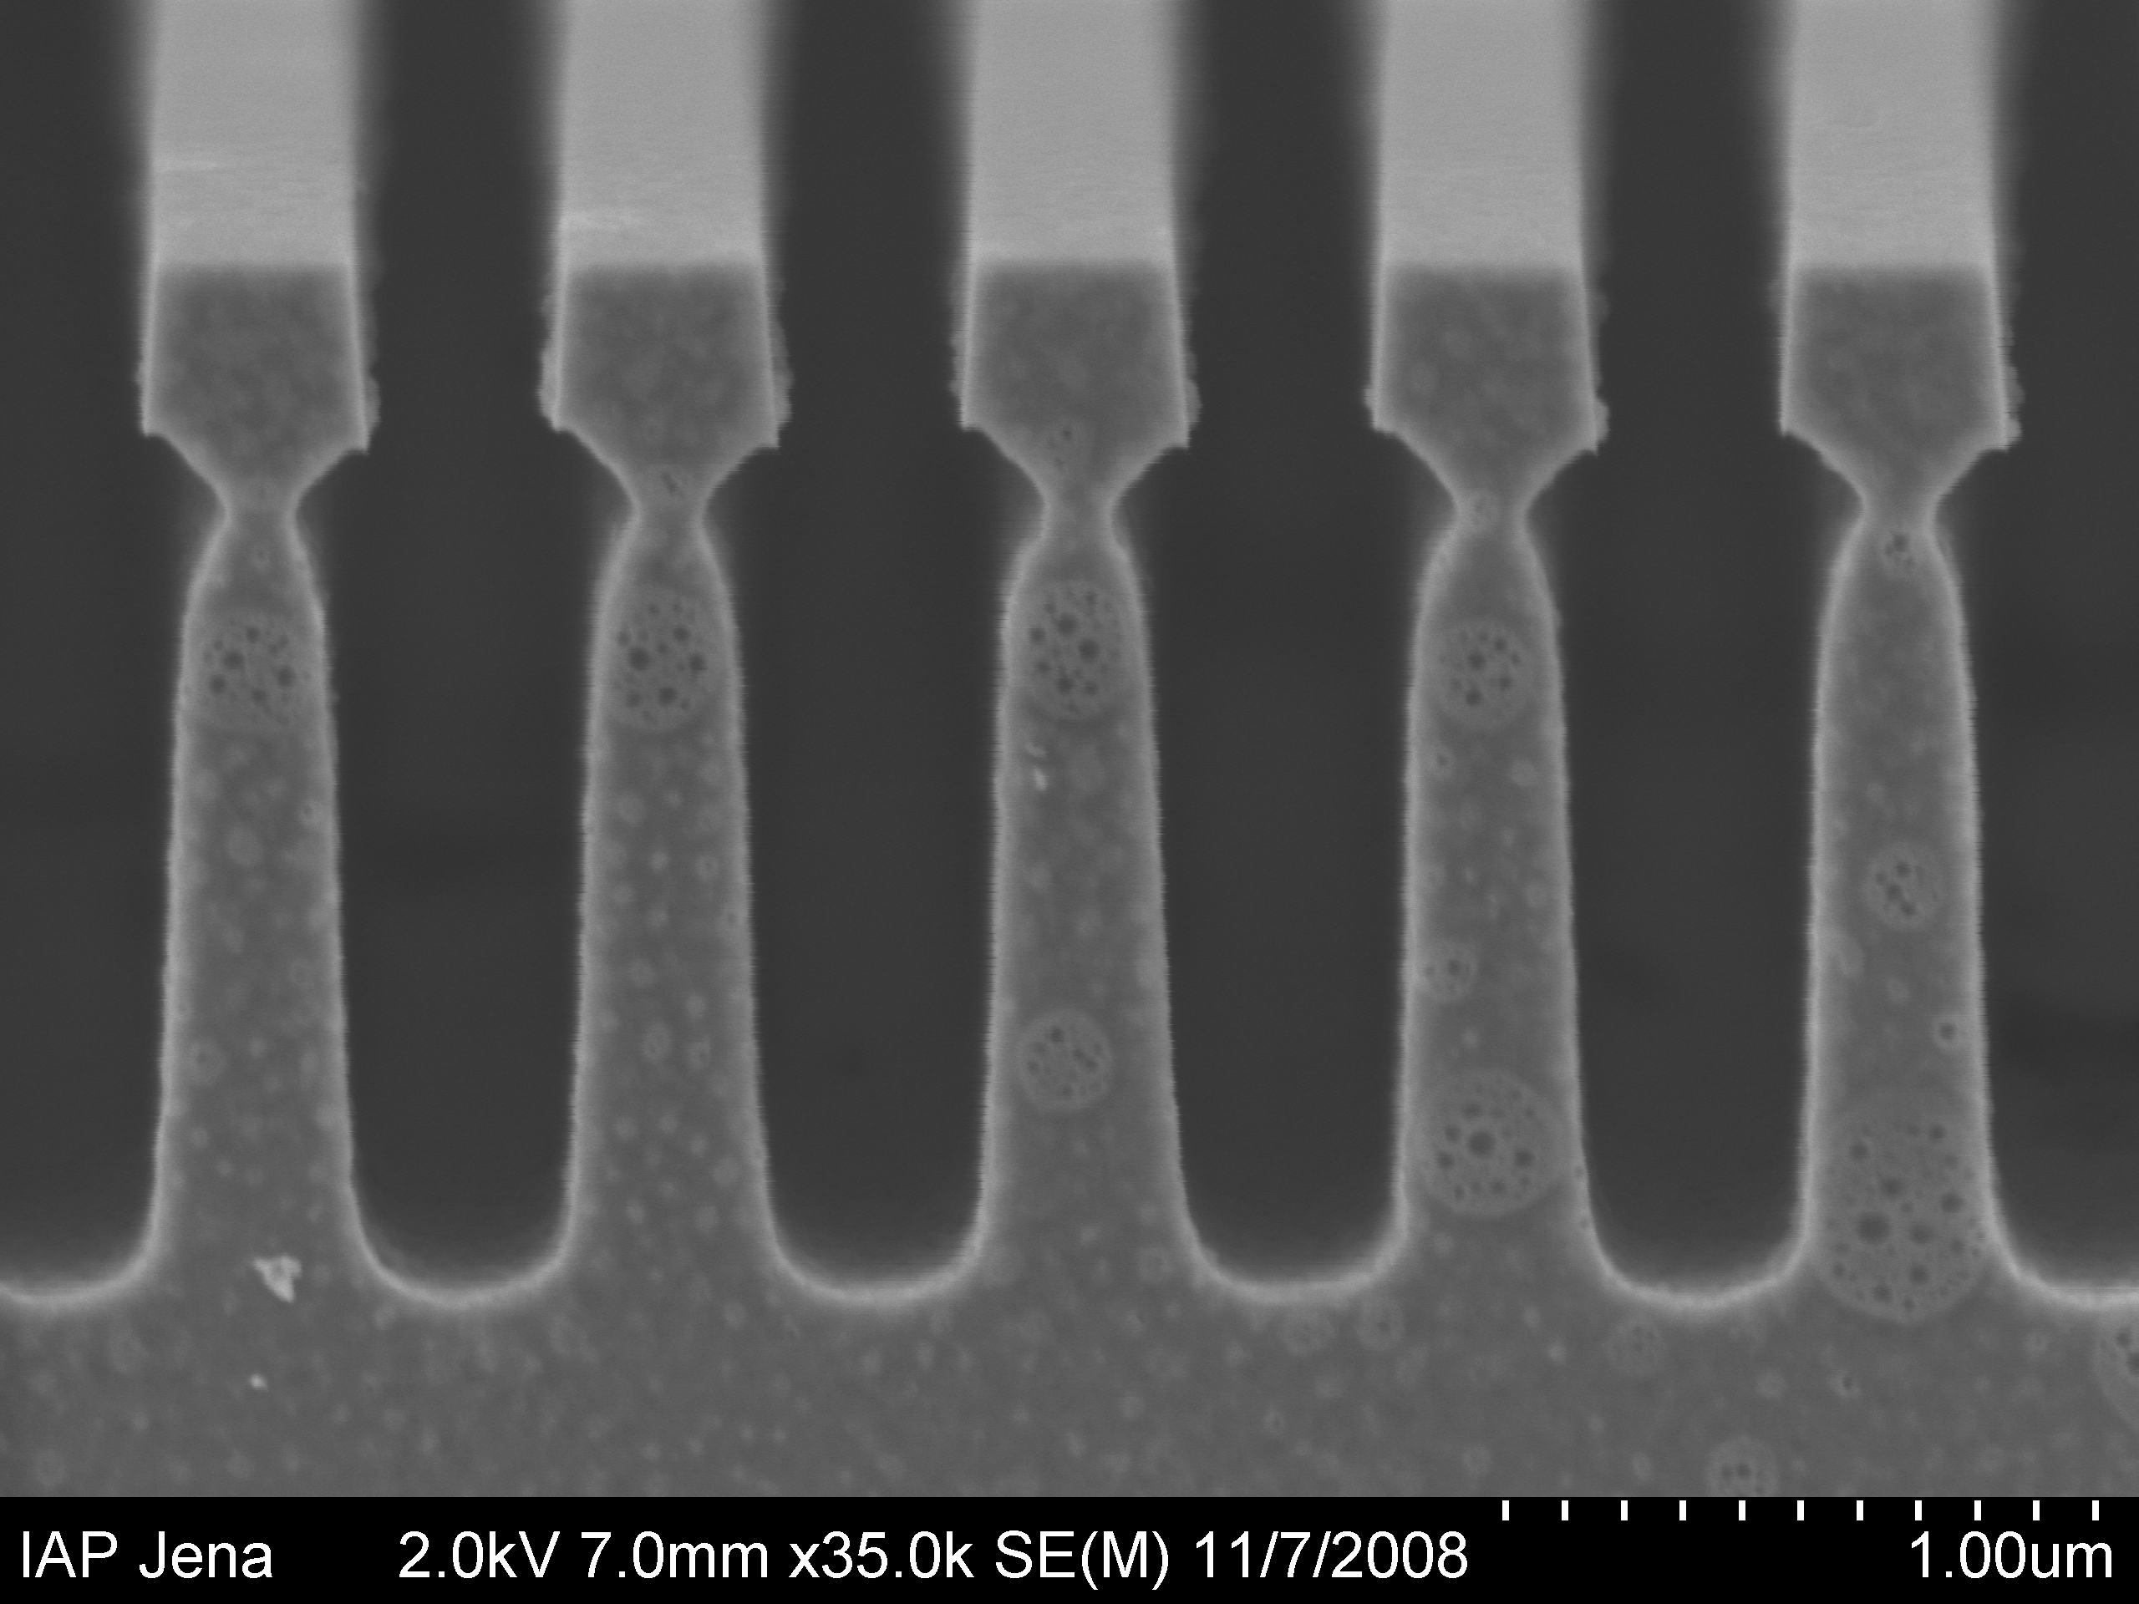
Promising new results
Si
500 nm
R > 99.8%, private communication, Brückner via Schnabel

Slide 26
Numbers
Application | Performance
Littrow 1st order | Efficiency 99.6%
Littrow 2nd order | Finesse 1580
BS | Losses 0.46%
Wave-guide coating | Reflectivity >99.8%

Slide 27
Lateral motion of the wave-guide structure
The arguments:
Symmetry of the problem
rigorous calculation shows no phase change
Diffraction order changes sign

Slide 28
Sign convention and corresponding grating equation
+
-
n1
Light coming from Superstrate
n2
Refl.: n1*sin(out)+n1*sin(in)=mL/d
Trans.: n2*sin(out)+n1*sin(in)=mL/d
+
-
+
-
n1
Light coming from Substrate
n2
Refl.: n2*sin(out)+n2*sin(in)=mL/d
Trans.: n1*sin(out)+n2*sin(in)=mL/d
+
-

Slide 29
Refl.: n2*sin(out)+n2*sin(in)=mL/d
Trans.: n2*sin(out)+n1*sin(in)=mL/d
Trans.: n1*sin(out)+n2*sin(in)=mL/d
+
-
+
-
in
+1T
n1
n1
in
n2
n2
+1T
0T
-1T
+2R
+1R
0R
-> Between coupling in and out the sign of the diffraction order switches

