Slide 1


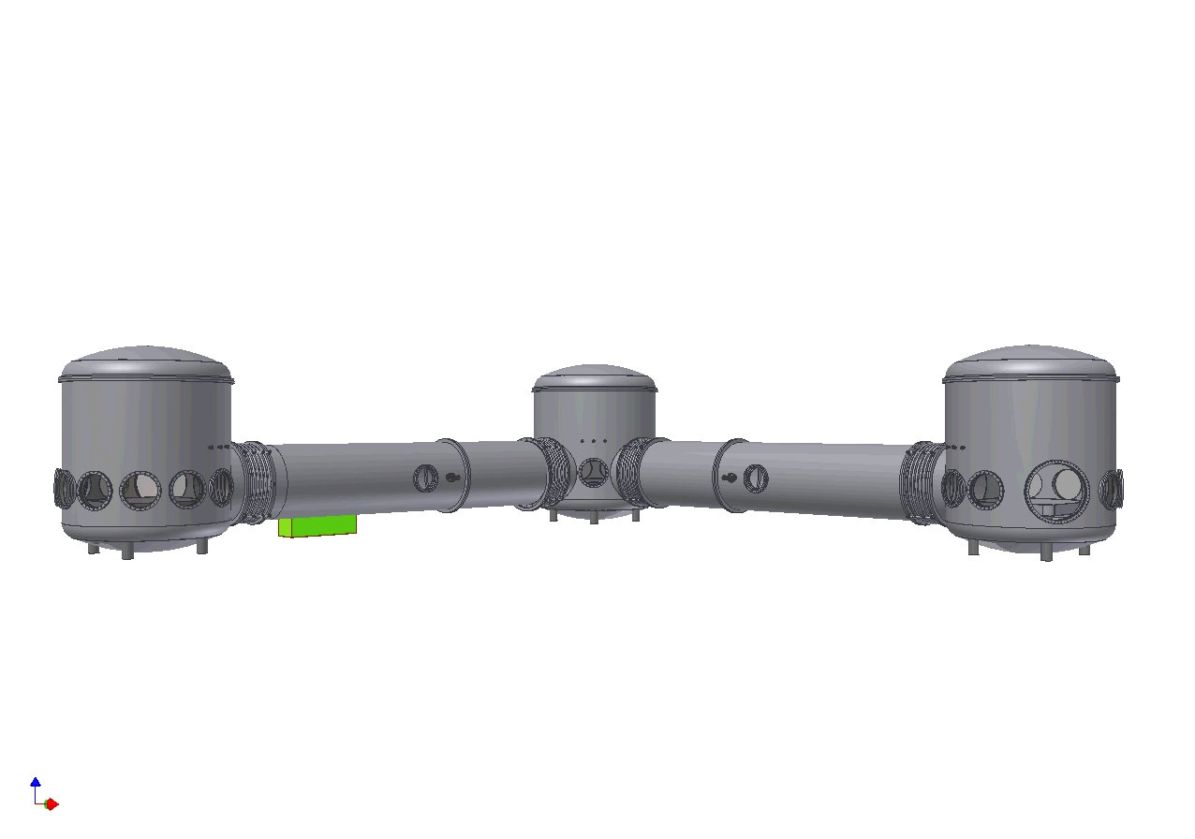

The AEI
10 m prototype interferometer
Stefan Goßler for the 10 m prototype team
QUEST Project Partners

Slide 2
Purpose of our prototype
Maximal overlap with GEO-HF subsystems
  develop and prove as many of the techniques needed for GEO 600 upgrades as possible (e.g. laser, digital control infrastructure)
  provide training for people who will install and run GEO-HF
Ultra-low displacement noise test environment
  to probe at and beyond the Standard Quantum Limit (SQL) for of order 100 g to kilogram scale masses
  Entanglement of macroscopic test masses

Slide 3
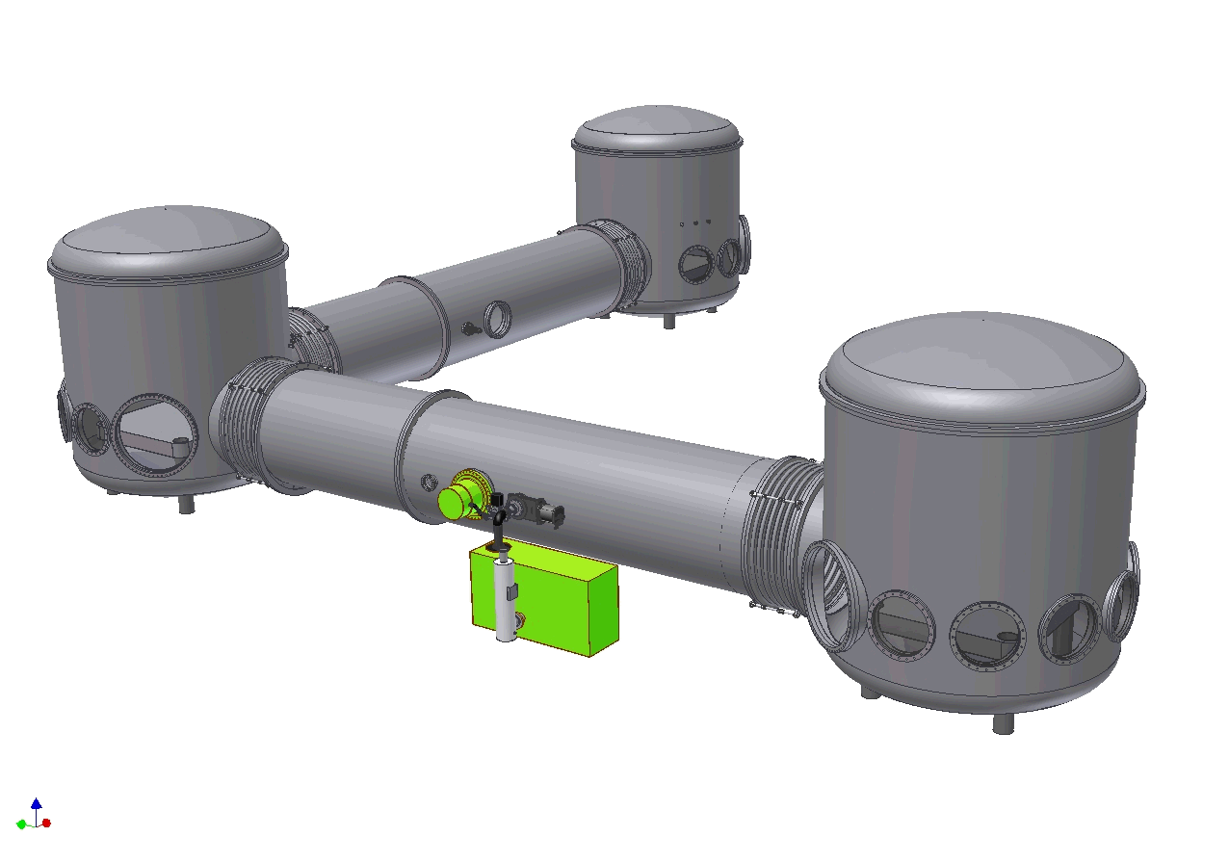
Layout vacuum system
Volume ca. 100 m³
22 t stainless steel
Tubes:
1.5 m diameter
Tanks:
3 m diameter, 3.4 m tall
Roughing: One 170 l/s screw pump
Main pumps: Two 2000 l/s turbo-molecular pumps
Backing and differential pumping: Two scroll pumps
All-metal gaskets for flanges up to 600 mm
Differential pumping system with viton O-rings at all bigger flanges
10⁻⁶ mbar after about 12 hours

Slide 4
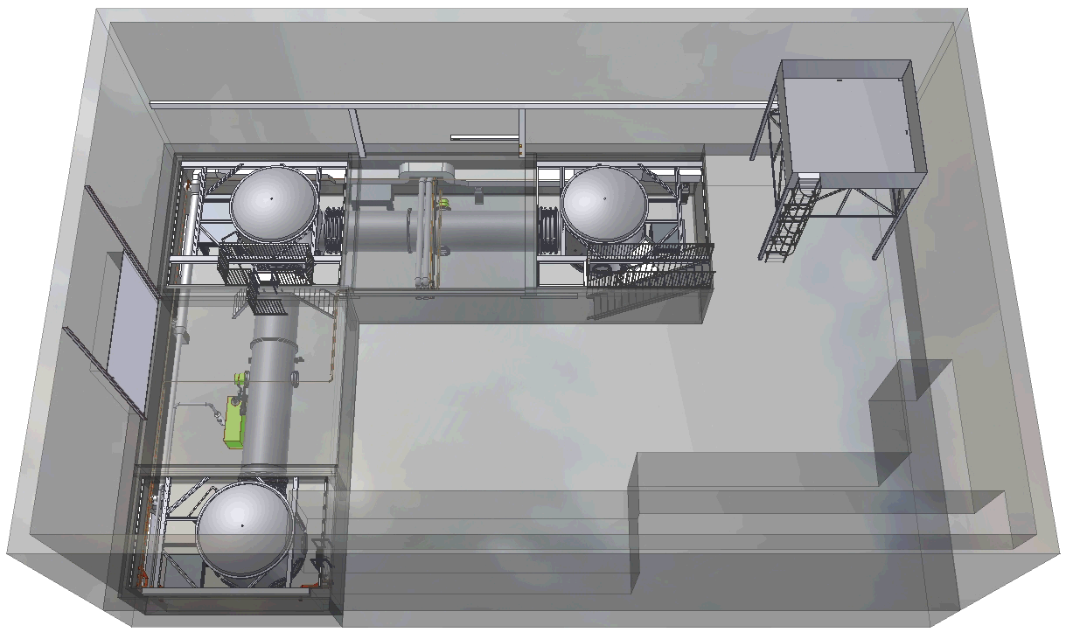
The prototype hall
Prelimn.
control room
Assembly area
SPI laser & modulation bench
LISA lab
CDS test & training setup

Slide 5
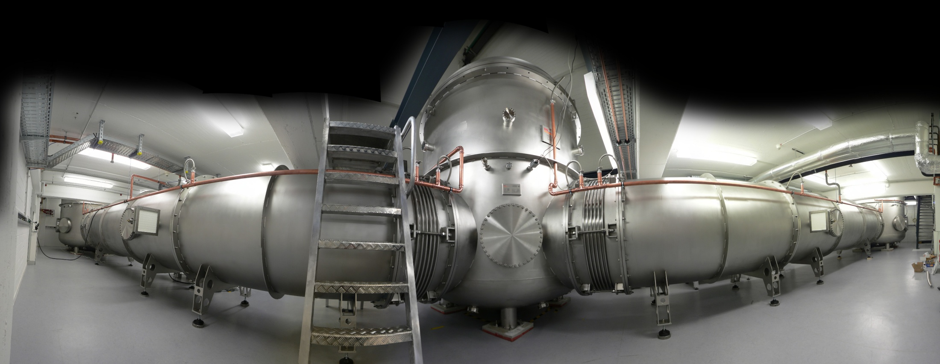
Vacuum system 180° view
100 m³ volume @10⁻⁷mbar after about 2 weeks of pumping
He leak check: 1500 mm flanges are leaky, thicker O-rings are installed as we speak

Slide 6
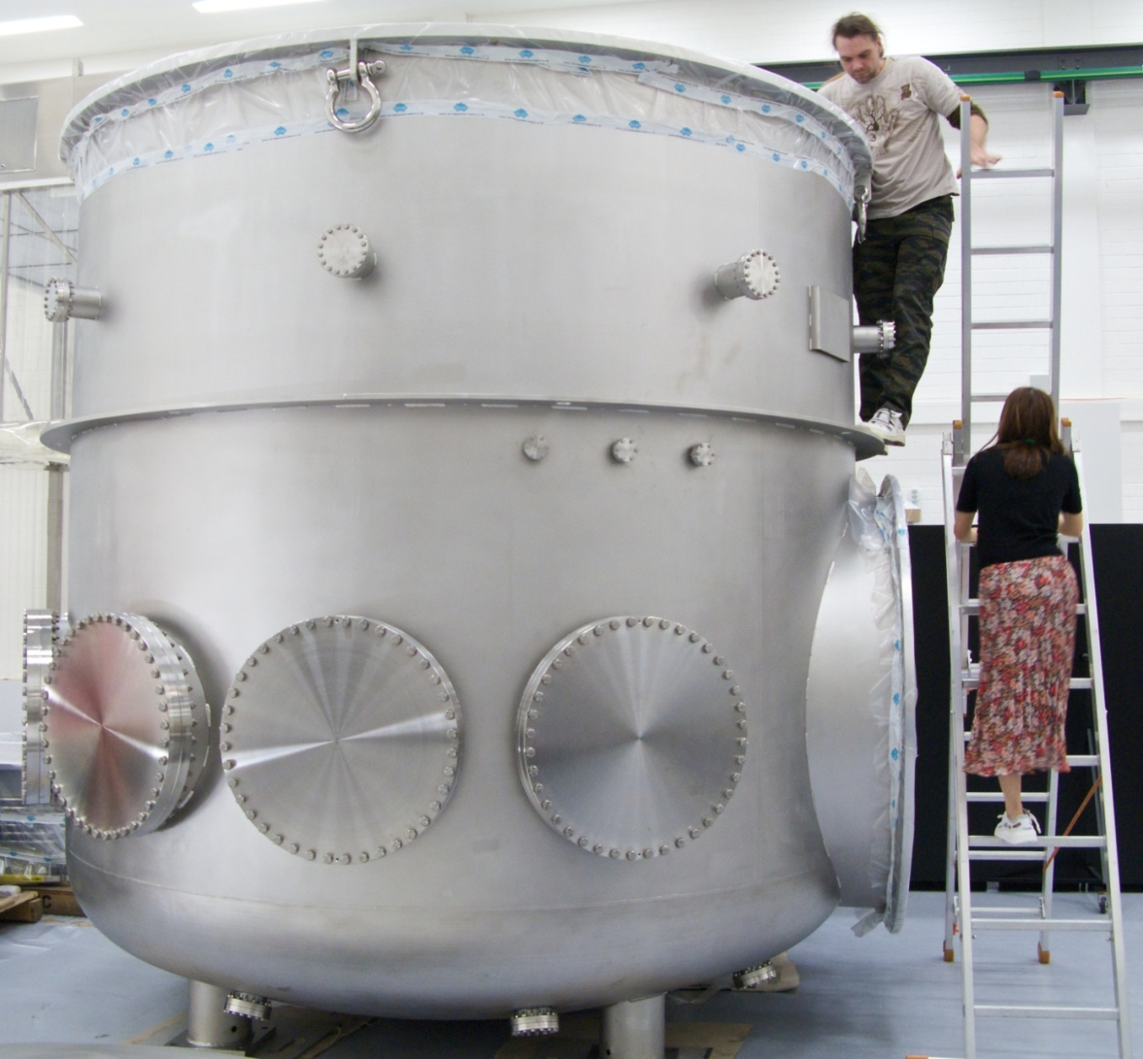
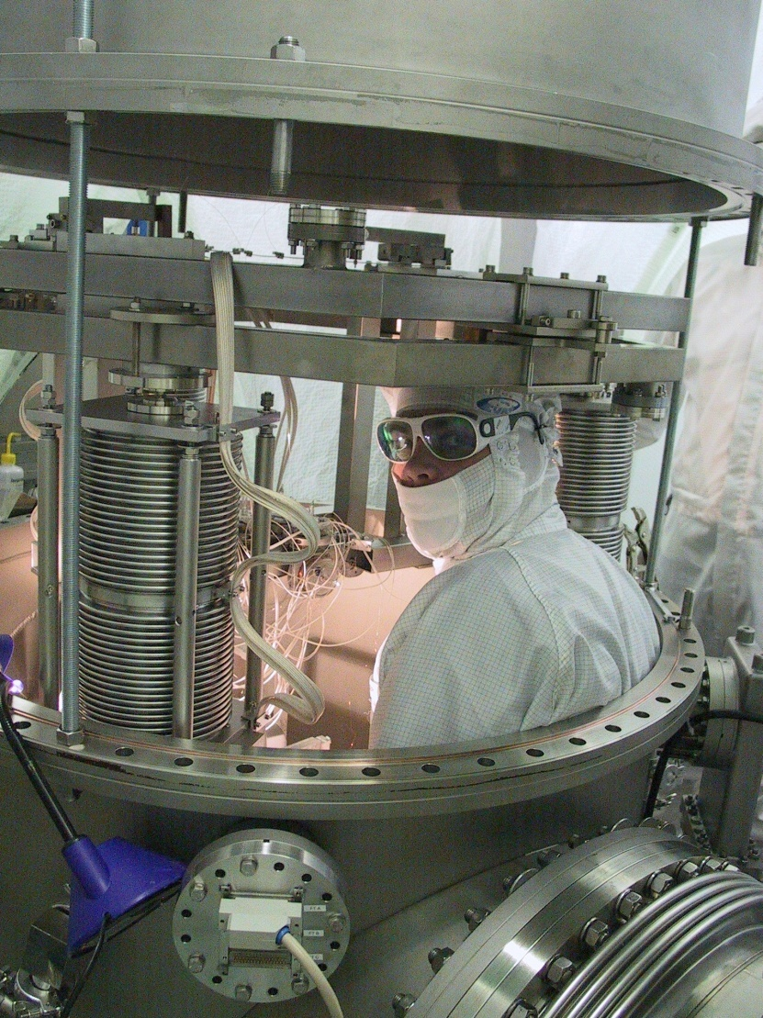
Walk-in tanks
100 mm flanges
to fit feed throughs
600 mm flanges
to fit viewports
100 mm flanges
to fit feed throughs

Slide 7
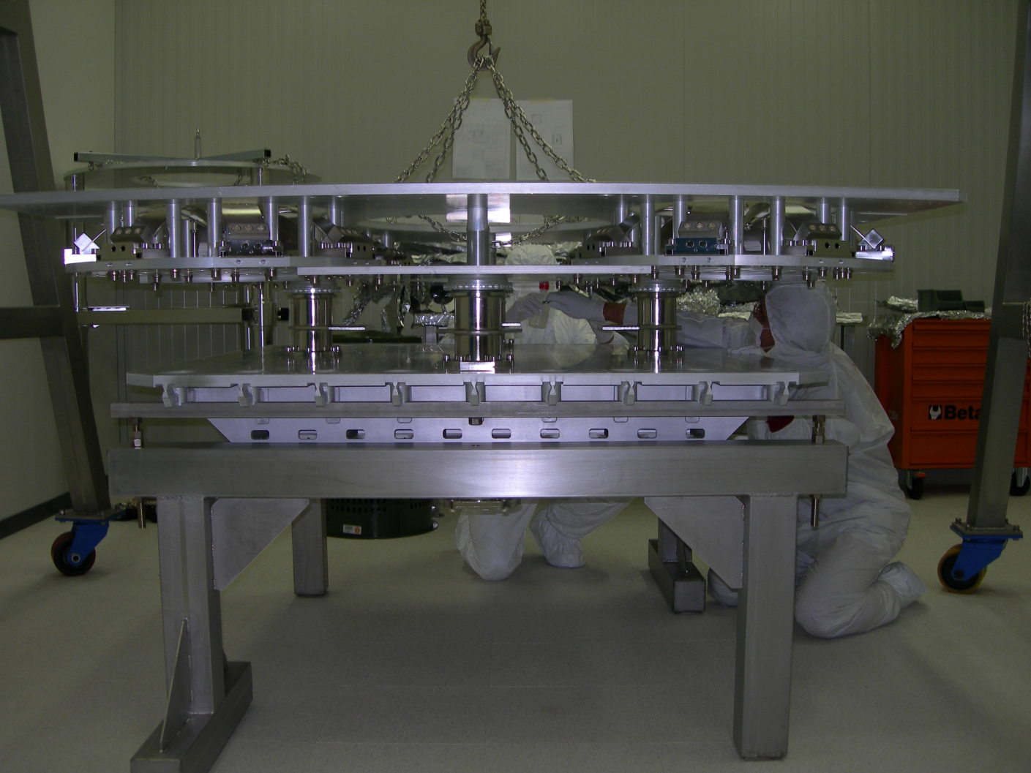
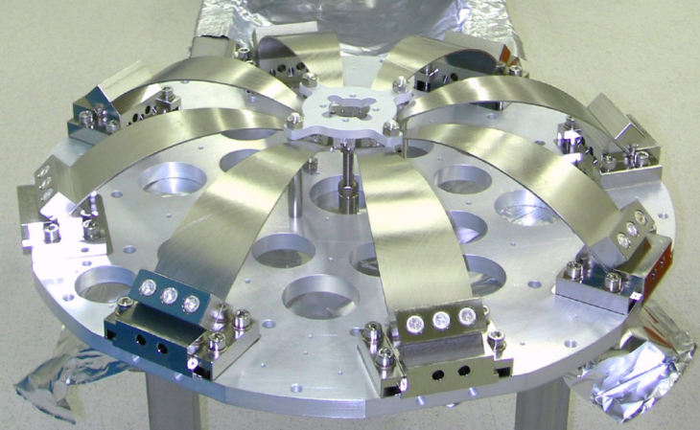
Soft isolation tables
Experimental platform
GAS Filters
Inverted pendulum legs

Slide 8
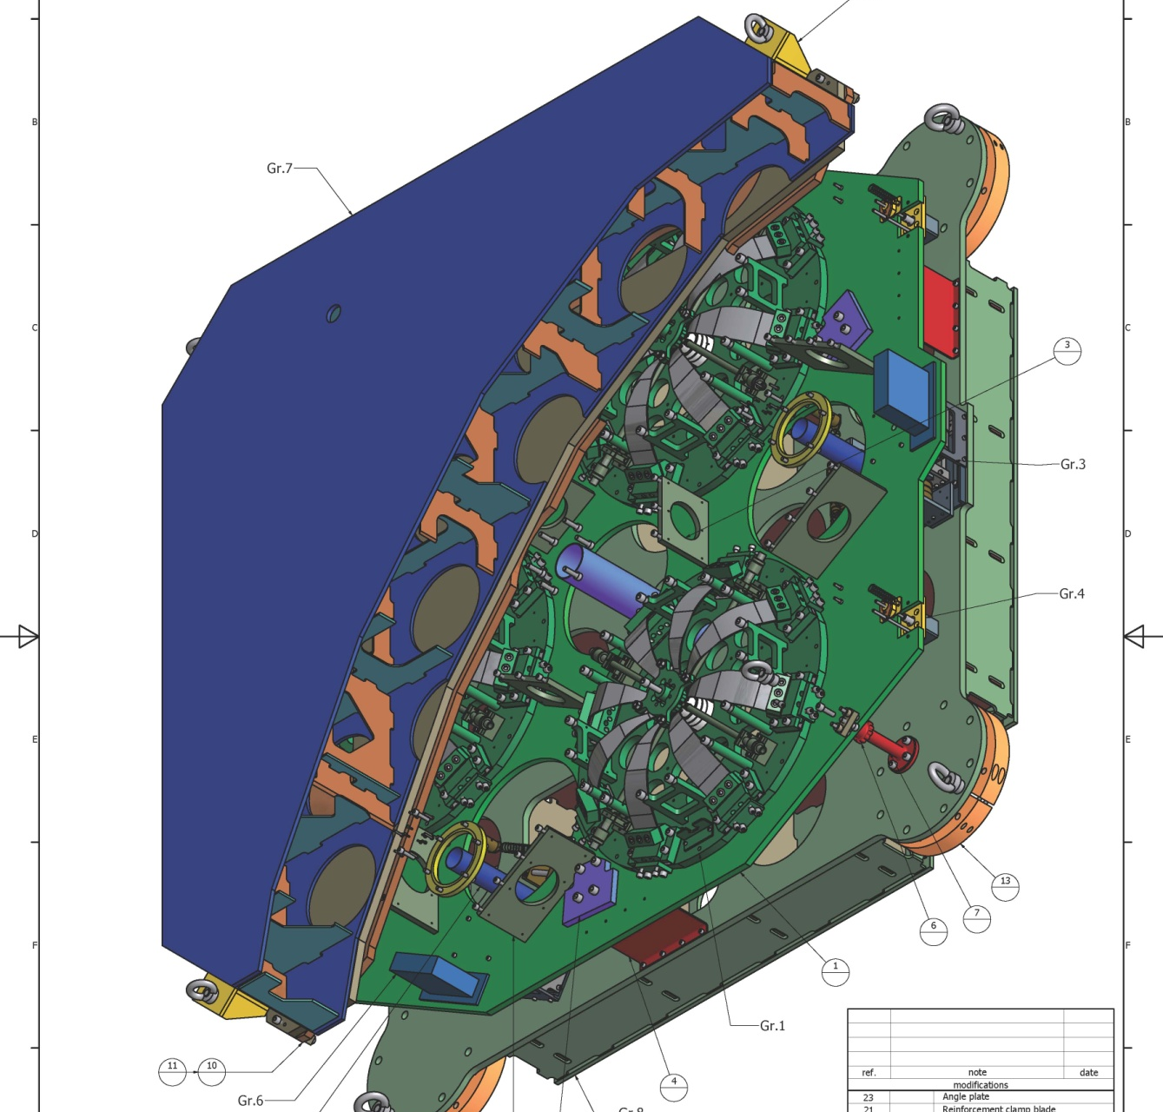
Table assembly

Slide 9
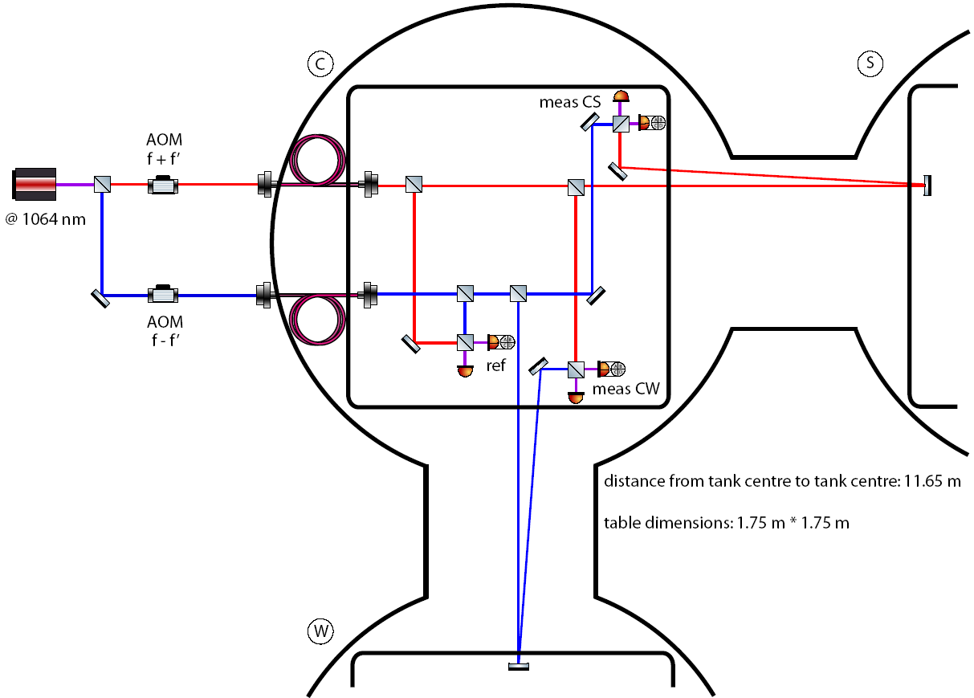
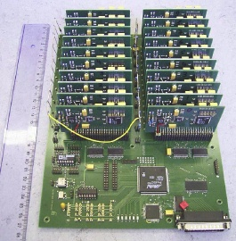
Interferometric link between tables: SPI
Suspension Platform Interferometer based on LISA Pathfinder phasemeter
Mach-Zehnder interferometer with unequal arm length (by 20 m), requires stable laser to reach design sensitivity of 100 pm/sqrt(Hz) @ 10 mHz: Iodine-stabilised Nd:YAG
Thermal drift requires components to be bonded onto plate with low CTE
Designed custom interface between
FPGA based phasemeter and digital control system

Slide 10
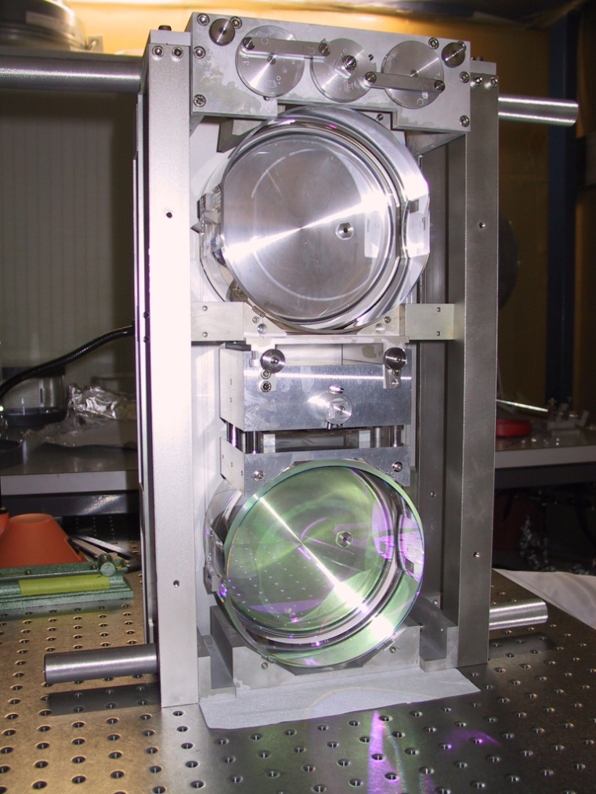
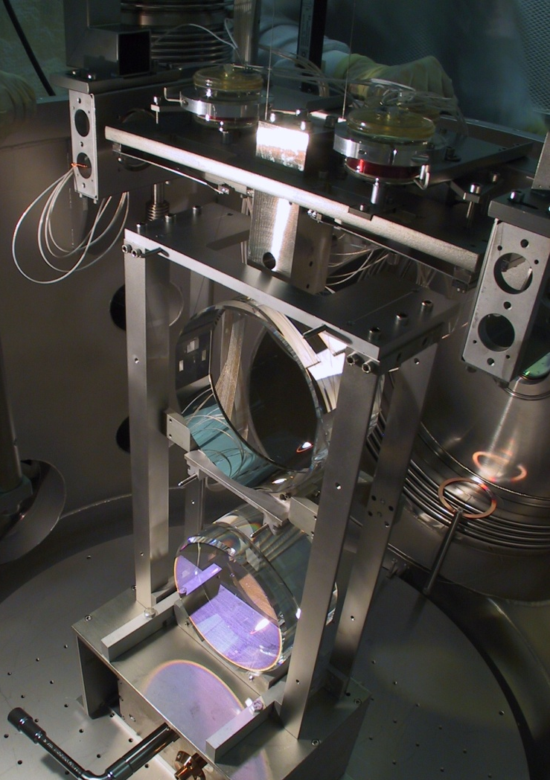
Mirror suspensions
Upper mass with 2nd vertical stage
Middle
mass
Mirror
Monolithic last stage
100 g mirror, four 28 µm silica fibres
Pre-installed suspension
cartridge

Slide 11
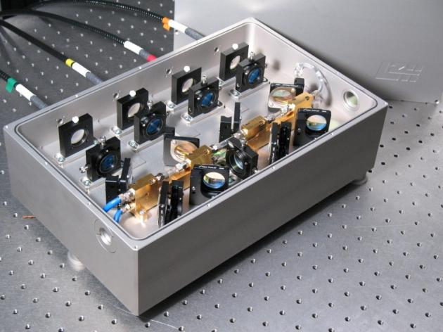
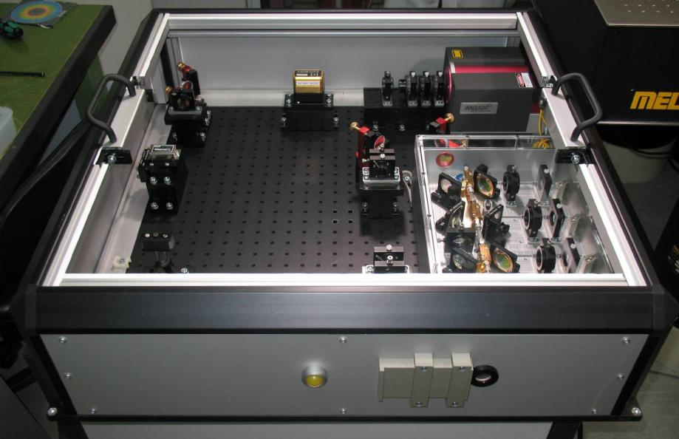
Light source: 35 W @ 1064 nm
Crystals:
3 x 3 x 10 mm³ Nd:YVO₄
8 mm 0,3 % dot.
2 mm undoped endcap
Pump diode:
808 nm, 45 W
400 µm fiber diameter
NA=0,22
Amplifier:
38 W for 2 W seed and 150 W pump
Notes:
11

Slide 12

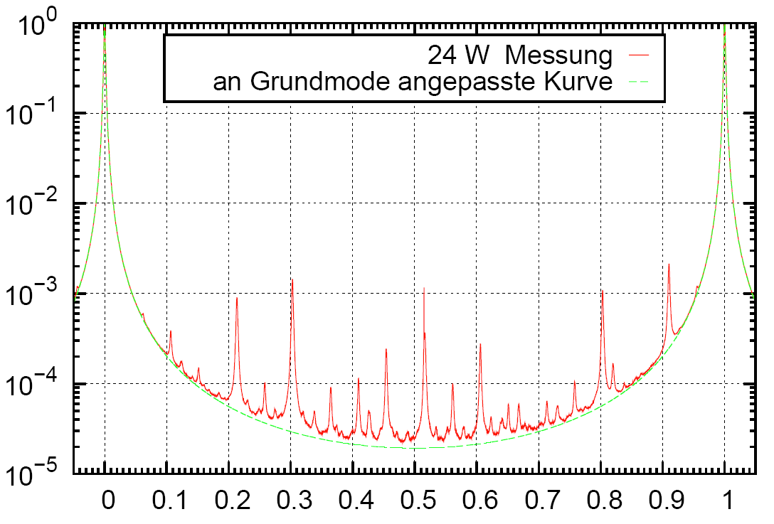
Fibre coupling/modecleaning
Conventional single-mode fibre was found to be limited by SBS to about 30 W transmission at a length of 1.7 m
Fibre coupling via PCF
is promising:
24 W with 3 m fibre
TEM₀₀ > 99%
High degree of modecleaning
Well defined polarisation
24 W measurement
TEM₀₀ model
Normalised power
To be solved:
UHV compatible cladding and feed through
Thermal drift at incoupler
Frequency [FSR]

Slide 13
Frequency-reference cavity
Mirror mass: 850 g
Triple cascaded suspension
4 steel wires of 30µm diameter
Pre-modecleaner
(optional)
Fibre
coupling
Length: 12.3 m
Finesse: 7300
Input: 133 mW
Laser
35 W
1064 nm
R: 99.945 %
R: 99.994 %
ROC: 37.5 m
R: 99.965 %
BS
Main IFO
E
N
To West tank

Slide 14
Noise budget ref. cavity
Suspension
Thermal
20 Hz – 1 kHz
Total
Requirement
Displacement eq. noise [m/ sqrt Hz]
Radiation pressure
Coating Thermal
With safety Factor 10
Shot noise
Seismic vertical
Seismic longitudinal
Frequency [Hz]

Slide 15
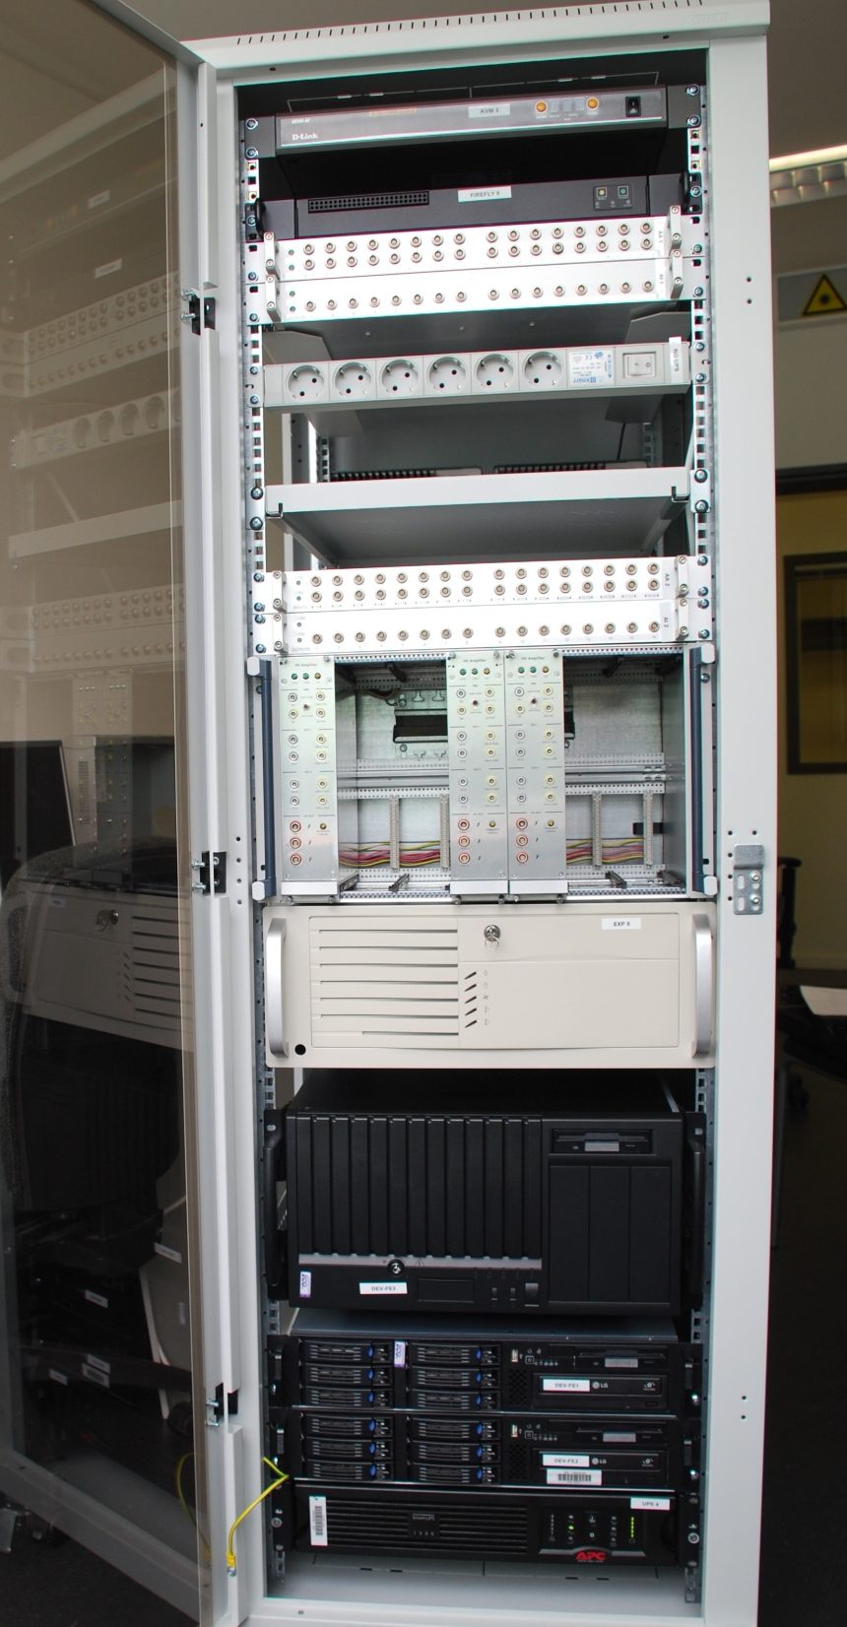
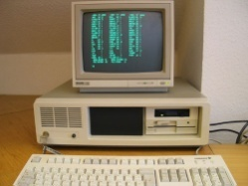
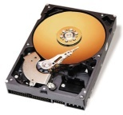
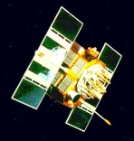
Digital control
Based on real-time Linux system and EPICS software
6 x 32 channel PCI-X
DA/AD & DIO
Opteron based,
64bit real-time Linux
Experiment
sensors
&
actuators
Field box
Expansion
chassis
Front end
Workstation
10 GHz
Signal conditioning
AA/AI
Linux,
Simulink
based input
Fibre link for
real-time network
Timing slave
Frame
builder
Timing master
GPS clock

Slide 16
Design of sub-SQL IFO
Optional:
Signal recycling
~ 5 W input @ 1064 nm
Tap off
~135 mW
10 m Fabry-Perot arm cavity
Finesse ca. 670
Optional:
Power recycling
BS
ITM
100 g mirrors
triple cascaded pendulum suspensions
with monolithic all-silica last stage
four filaments of 28 µm diameter
Frequency-reference cavity:
Length: 12.3 m
Finesse: 7300
Triple pendulum suspension
Mirror mass: 850 g
Anti-resonant Fabry-Perot cavity
as compound end mirror
to minimise coating thermal noise
IETM
cETM
EETM

Slide 17
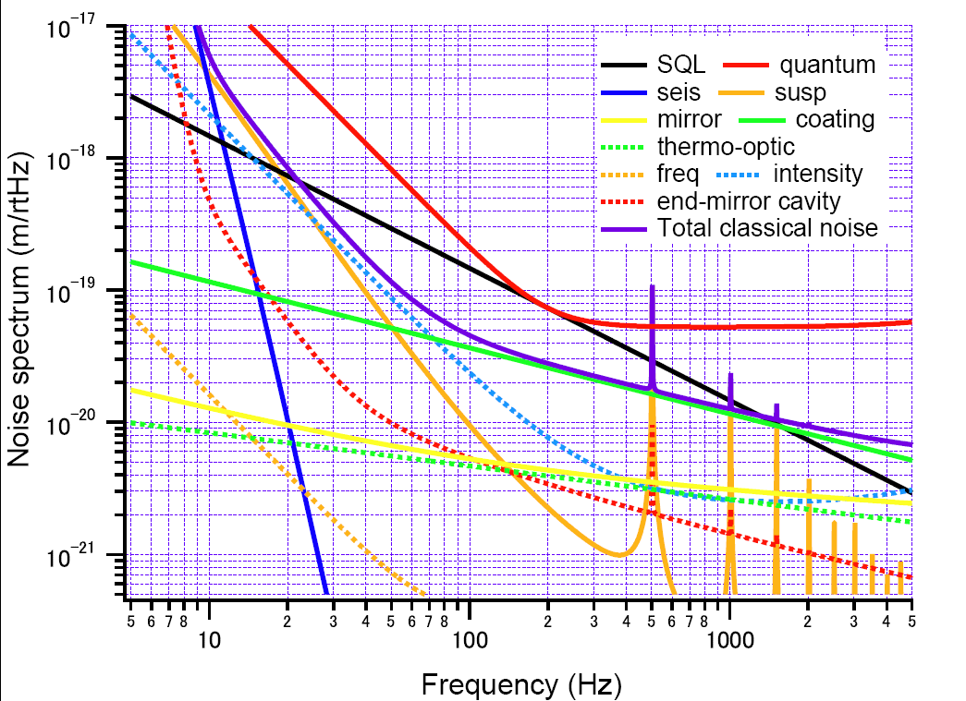
Noise budget

Slide 18
The 10 m team
Ken Strain: Scientific leader
Stefan Goßler: Coordinator
Kasem Mossavi: Vacuum system and pumps control
Jens Breyer: Mechanical design
Benno Willke: High power laser
Gerhard Heinzel: LISA/LPF related experiments
Yanbei Chen, Kentaro Somiya, Stefan Danilishin, Helge Müller-Ebhardt: Noise analysis, experiment design
Roman Schnabel: Squeezing and QND experiments
Harald Lück: Vacuum system and GEO 600 related experiments
Hartmut Grote: Electronics and GEO 600 related experiments
Gerrit Kühn, Michael Born, Martin Hewitson: Real time control system
GEO operators: Filter design and construction, environmental monitoring
Andreas Weidner: Electronics design
Henning Ryll: Laser and fibre-modecleaner
Katrin Dahl (PhD), Oliver Kranz (diploma): Suspension platform interferometer
Bob Taylor (postdoc): Seismic isolation and control
Alexander Wanner (PhD): Inertial control
Fumiko Kawazoe (postdoc): Frequency reference cavity and global control
Alessandro Bertolini: Seismic isolation
Tobias Westphal (PhD): Monolithic suspensions
Christian Gräf (PhD): RT control
Thomas Brockt (Diploma): DC-Power supplies and voltage distribution
Daniel Gering (Diploma): Interface SPI - CDS

