Slide 1
The search for Vela pulsar in Virgo VSR1 data
S.Frasca on behalf of LSC-Virgo collaboration
New York, June 23rd, 2009

Slide 2
The Vela Pulsar
Right ascension: 8h 35m 20.61149 s
Declination: -45º 10’ 34.8751 s
Period: ~89.36 ms
Distance: 290 pc
Glitch occurred between day 24 July and 13 August of 2007
Ephemerides supplied by Aidan Hotan and Jim Palfreyman using the Mt. Pleasant Radiotelscope (Hobart, Tasmania) (period 25 Aug – 6 Sept)
Spin-down limit: 3.3e-24
Presumed ψ=131º, ι=61º (ε=0.51)

Slide 3
The data used
The selected Virgo data are from 13 Aug 2007 6:38 to the end of the run (1 October)
Ephemerides, given for the period 25 August – 6 September, were extrapolated
The same data have been used also for a similar search by the POLGRAW group led by A.Krolak

Slide 4
The source and the antenna
For a gravitational wave described by
where the two κ are real positive constants. The response of the antenna is
with
where the constants a and b depend on the position of the source and of the antenna.
So the whole information on a signal (and on the noise) is in 5 complex numbers.

Slide 5
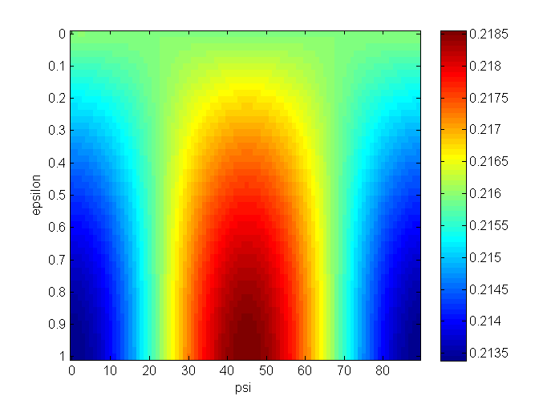
The source and the antenna
Energy of the wave that goes into the antenna, for all types of waves from Vela
If we describe the wave with an elliptical polarization of semi-axes a and b normalized such that
we have (being a ≥ b )
ψ is the polarization angle of the linearly polarized part.

Slide 6
Scheme of the procedure
Create the (cleaned) SFT data base (after this step all the analysis is done on a workstation with Matlab)
Extract a 0.25 Hz band
Reconstruct the time signal with the Doppler and spin-down correction
Eliminate bad periods and disturbances
Apply the “Noise Wiener filter”
Simulate four basic signals
Apply the 5 components matched filter
Find the best source for the data
Enlarge the analysis to the near frequencies

Slide 7
The SFT data base
Our Short FFTs are computed on the length of 1024 s and interlaced
In our period we have about 7000 FFTs
Our h data are multiplied by 10²⁰

Slide 8
Band extraction and Time data reconstruction
The data of the SFTs in the band 22.25~22.50 are extracted in a single file of about 15 MB
From these we reconstruct a time series with 1 Hz sampling time (and zero where there are holes), correcting for the Doppler effect and the spin-down. We obtain data with “apparent frequency” 22.38194046 Hz.

Slide 9
Data selection

Slide 10
“Noise Wiener Filter”
The data are not stationary, so the sensitivity of the antenna is not constant in the observation period. To optimize for this feature we introduced the “Noise Wiener Filter” as
where σ²(t) is the slowly varying variance of the data.
W(t) multiplies the time data.

Slide 11
Noise Wiener Filter

Slide 12
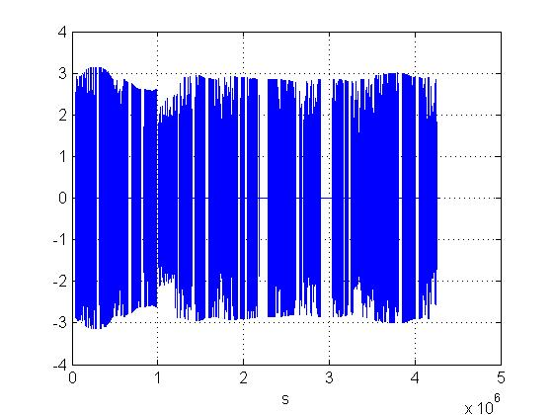
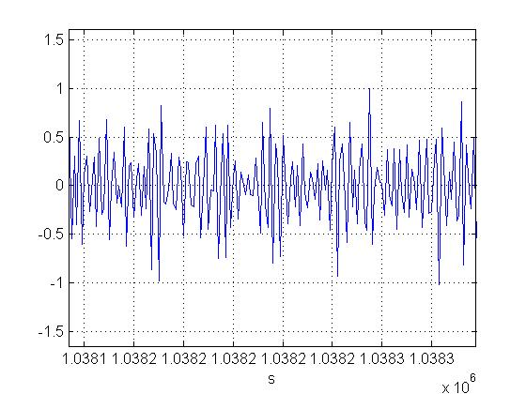
Wiener filtered data (clipped)

Slide 13
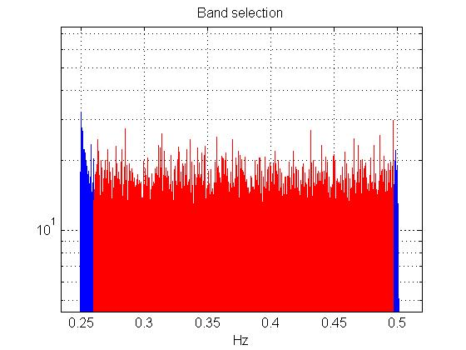
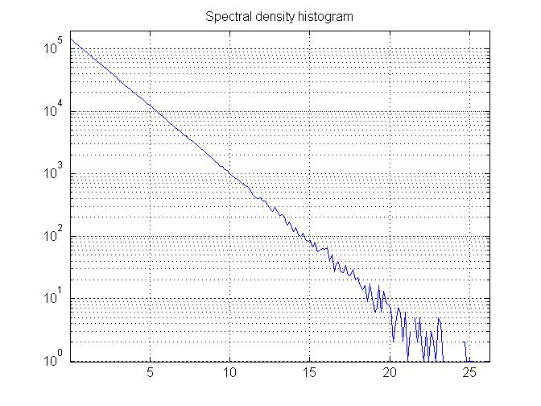
Spectrum of the selected data (after the NWF)
Full band (1 Hz), selected part and histogram of the Wiener filtered data power spectrum.
Spectrum : µ = 2.0063, σ = 2.0070
selected about 2 million spectral data
(resolution=2)

Slide 14
The Signal and the simulations
The same band extraction function is used to simulate the basic signals from Vela.
The same Doppler and spin-down correction, the same cuts and the same Wiener filter, that we applied to the Virgo data, have been applied to the signals data.
The simulated signals were the 2 linearly polarized signals and the 2 circularly polarized signals in both left and right rotation.
The amplitude was h₀=10⁻²⁰.

Slide 15
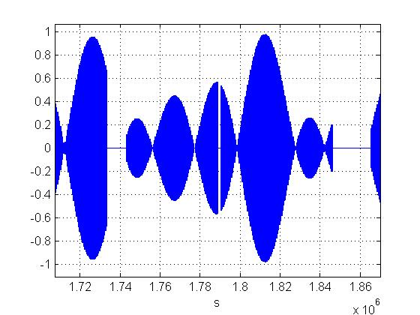
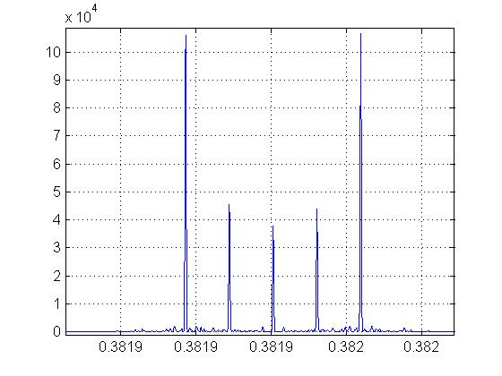
Simulated signals (linearly polarized signal, ψ=0)

Slide 16
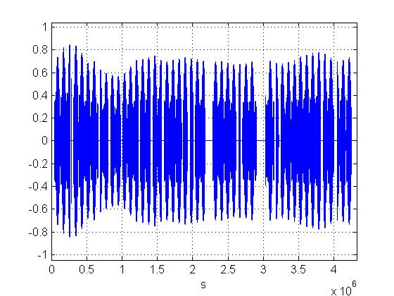
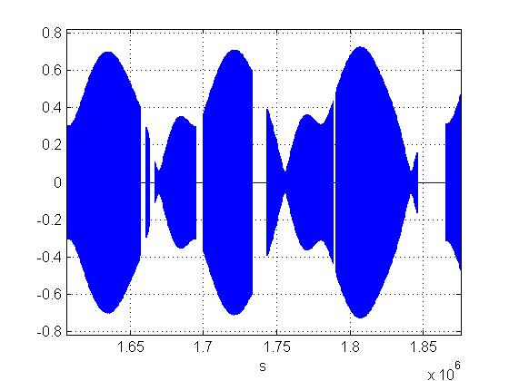
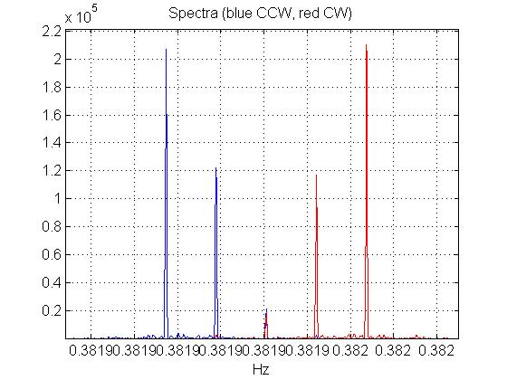
Simulated signals (circularly polarized signal)

Slide 17
The Matched filter
As it is well known, the signal contains only the 5 frequencies f₀, f₀±F_{s} and f₀±2F_{s} , where f₀ is the (apparent) frequency of the signal and F_{s} is the sidereal frequency. So we can consider only the components of the signal and of the noise at that frequencies, that means 5 complex numbers. For two signal that differ only in phase, these 5 numbers are all multiplied for the same complex coefficient e^{jφ}.
The basic idea of the 5-components matched filter is that the best way to detect a signal s (bold means a quintuplet of complex numbers) in a signal+noise combination
d = A s + n
we do the estimation of the complex number A=A₀ e^{jφ} as
where s’ is the complex conjugate.
We obtain the 5-components for any signal from the simulated basic signals, that has been treated exactly as the data.
It is convenient to consider the squared value of the estimated A₀; in this case, in absence of signal, we have an exponential distribution.

Slide 18
The Coherence
For each evaluation of the matched filter we compute also the squared coherence of the estimated signal with the data as
where s and d are the signal and data quintuplets, as in the previous slide.

Slide 19
Application of the 4 basic matched filters
Squared output of the matched filter applied to the data and to all the signals
 | Lin0 | Lin45 | CircCCW | CircCW | data
Lin0 | 1 | 0.002 | 0.454 | 0.454 | 2.70e-6
Lin45 |  | 1 | 0.550 | 0.550 | 10.72e-6
CircCCW |  |  | 1 | 0.004 | 5.12e-6
CirdCW |  |  |  | 1 | 9.13e-6
Data |  |  |  |  | 1
Coherences for the above filters
 | Lin0 | Lin45 | CircCCW | CircCW | data
Lin0 | 1 | 0.002 | 0.478 | 0.476 | 0.098
Lin45 |  | 1 | 0.526 | 0.524 | 0.429
CircCCW |  |  | 1 | 0.005 | 0.196
CirdCW |  |  |  | 1 | 0.348
Data |  |  |  |  | 1
Notes:
compute_mat_matfiltC

Slide 20
Application of the 4 basic matched filters: background
Blue: Linear ψ=0
Green: Linear ψ=45
Red: Circular CCW
Cyan: Circular CW
Mean Std Signal
4.67e-6 4.67e-6 2.78e-6
4.39e-6 4.39e-6 1.064e-5
4.53e-6 4.52e-6 5.15e-6
4.53e-6 4.53e-6 9.08e-6
(the signal is estimated by linear approximation)

Slide 21
Application of the 4 basic matched filters: background
Histograms of the squared modulus of the 4 matched filters applied to the sub-band.

Slide 22
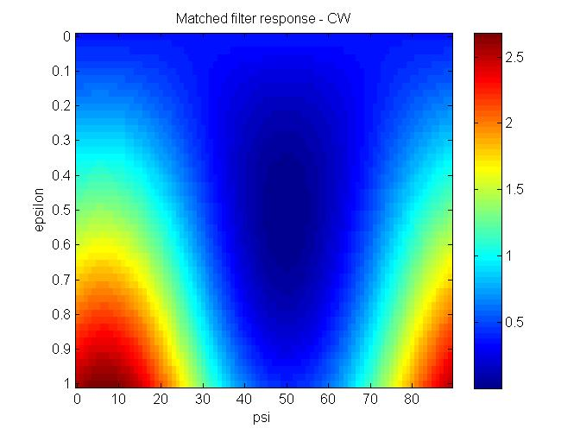
Application of the 4 basic matched filters: results for all the signals
The maximum is for ε=0.78, ψ=57º, CW ; here the value of the map is about 12.6e-6. This means amplitude 3.6 10⁻²³ .
The squared SNR is about 2.8 and Prob=exp(-2.8) ~ 0.061 . So the upper limit is 3.6 10⁻²³ .
Fake signal
Notes:
apply_all_mfC

Slide 23
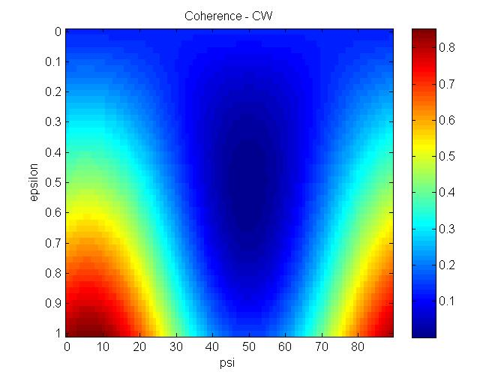
Application of the 4 basic matched filters: Coherence for all the signals
Fake signal
For the maximum, the coherence is about 0.51 .

Slide 24
Browsing around (about 8 million frequencies in 0.24 Hz)
Coherence (crosses) with normalized quadratic response of the 4 matched filters

Slide 25
Coherence distribution
Notes:
crea_4matfil_coheC

Slide 26
Coherence probability
Probability to have a coherence bigger than a certain value.

Slide 27
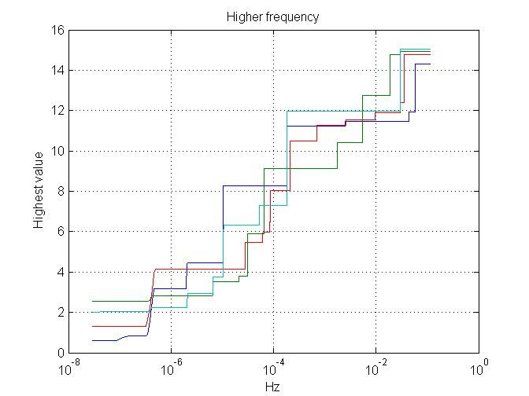
Browsing around
The graph shows the maximum of the normalized absolute square of the 4 basic matched filters applied at frequencies near the apparent frequency. The abscissa is the distance from the apparent frequency.

