Slide 1
Squeezer Update Review
February 9, 2010
H1 Squeezer Experiment
ANU, AEI, MIT, CIT and LHO collaboration

Slide 2
Highlights
New postdoc: Lisa B.
ANU OPO development
Ready to ship (schedule says March 2010).
Traveling wave bowtie design works.
Grad. students will travel to MIT to set it up.
LHO
RF electronics: built, 50% installed, working.
TTFSS for laser locking: built, installed, working.
Demodulator design by Rich A., 1st unit in hand, working.
Servo board (CM): 2 units built, ready for testing.
Slow controls (Beckhoff): 1 unit built, working.
Completion expected: May 2010.
MIT
Lasers fully operational, locked with 1MHz bandwidth.
Optics ordered for SHG mirrors, HR mirrors, beam splitters, dichroics.

Slide 3
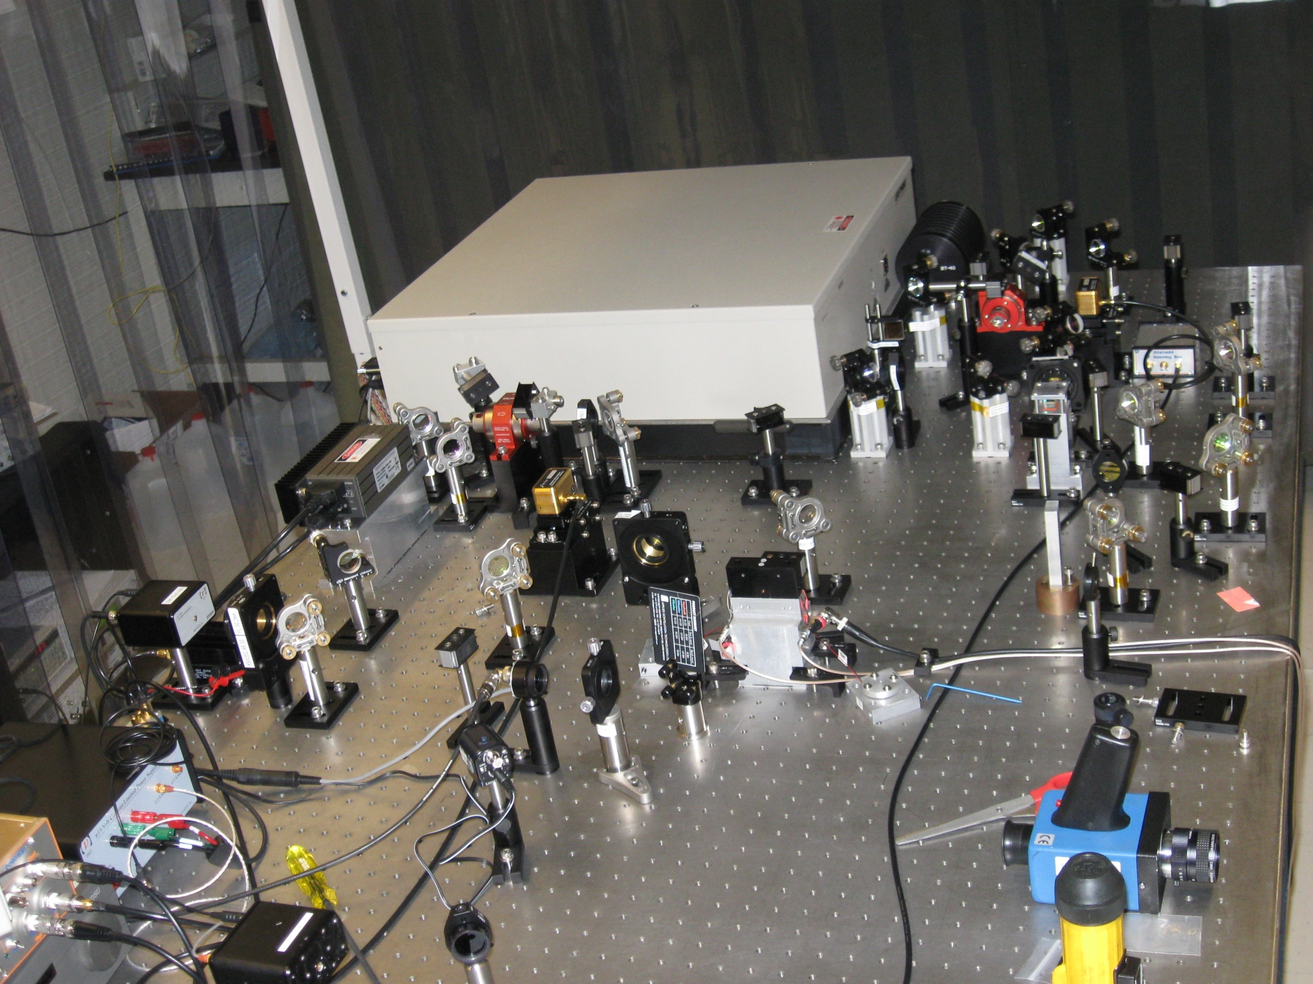

Slide 4
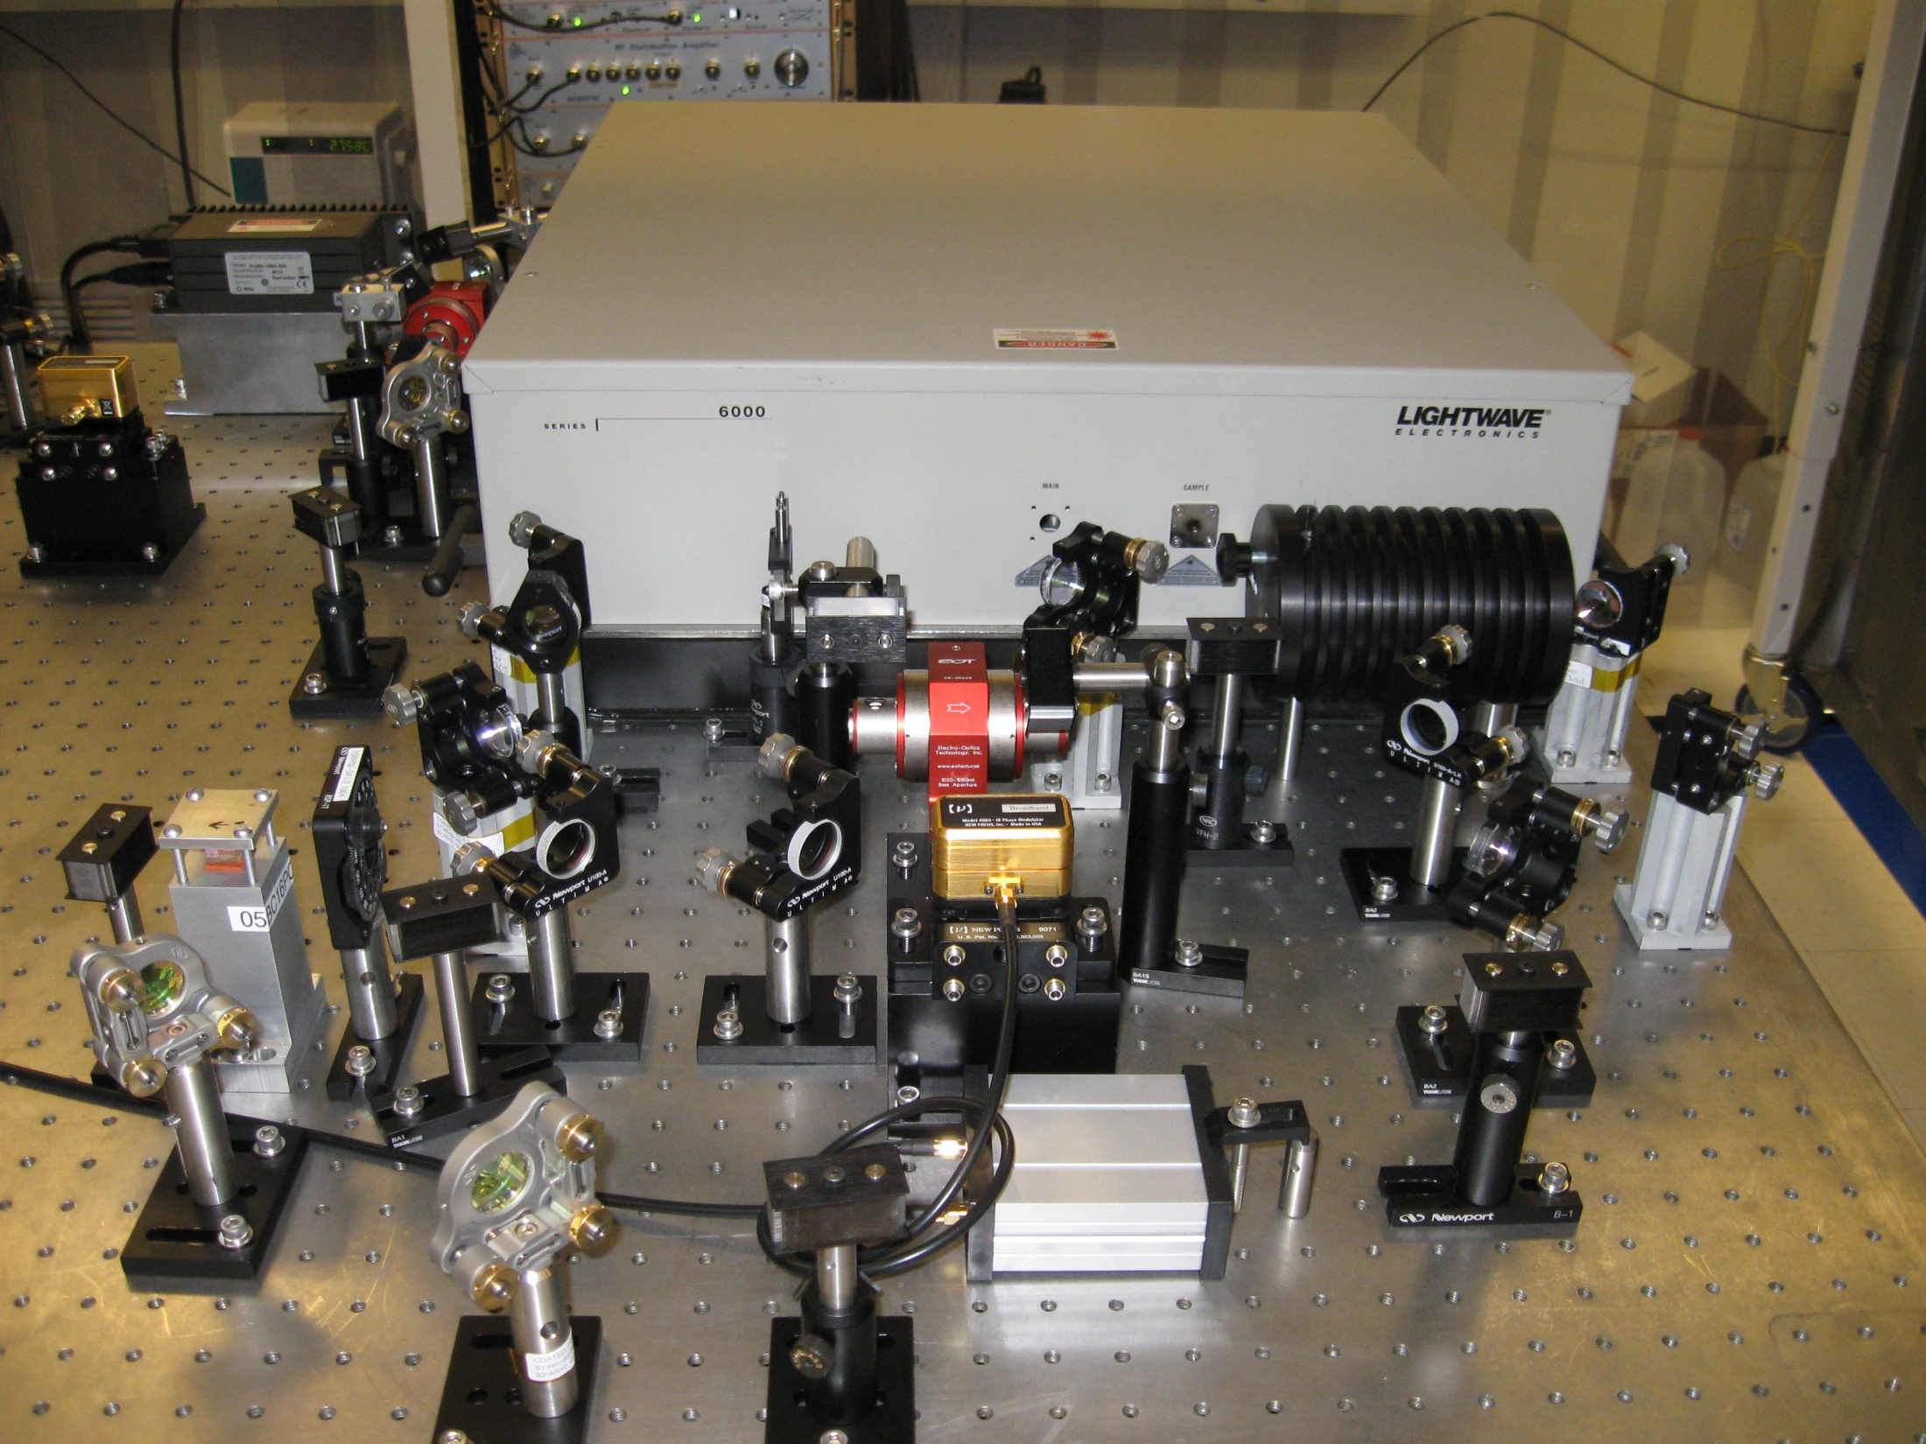

Slide 5
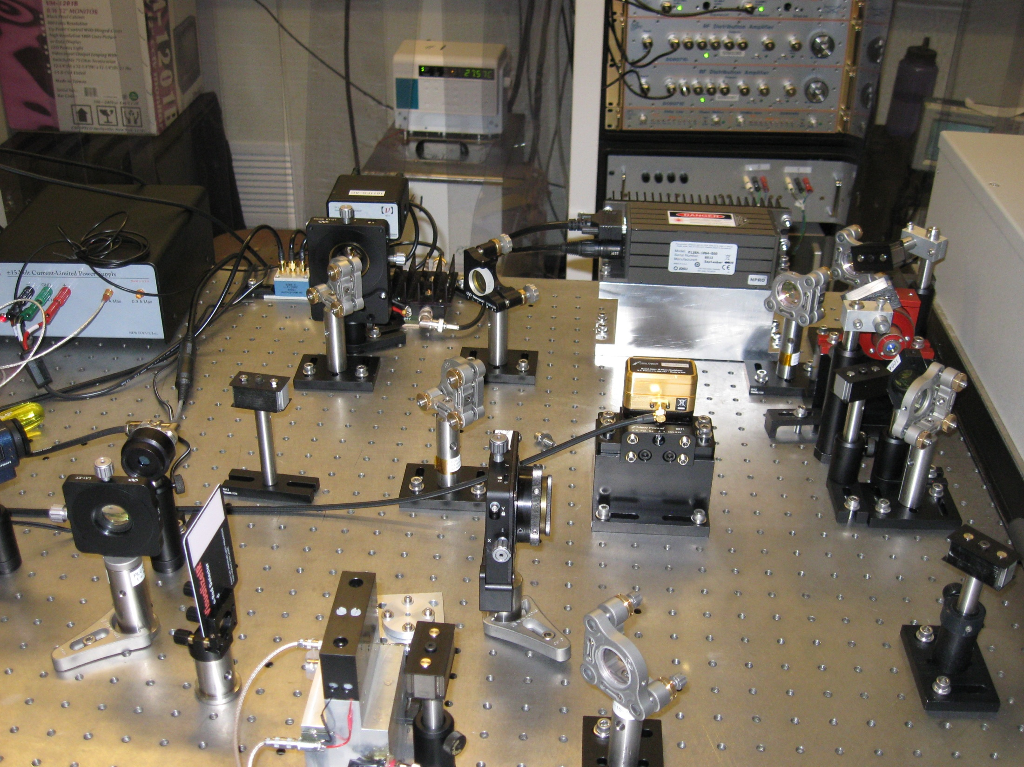

Slide 6
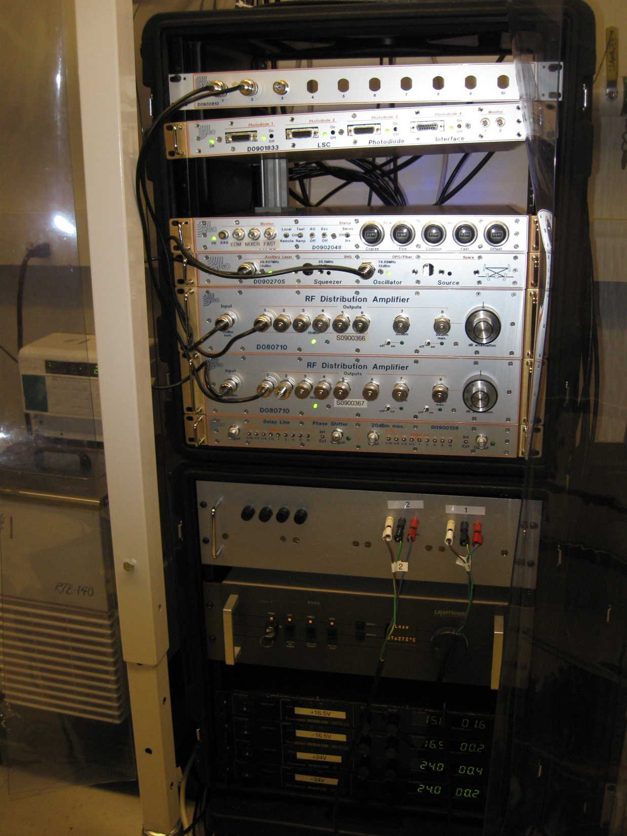

Slide 7
ANU Traveling wave OPO

Slide 8
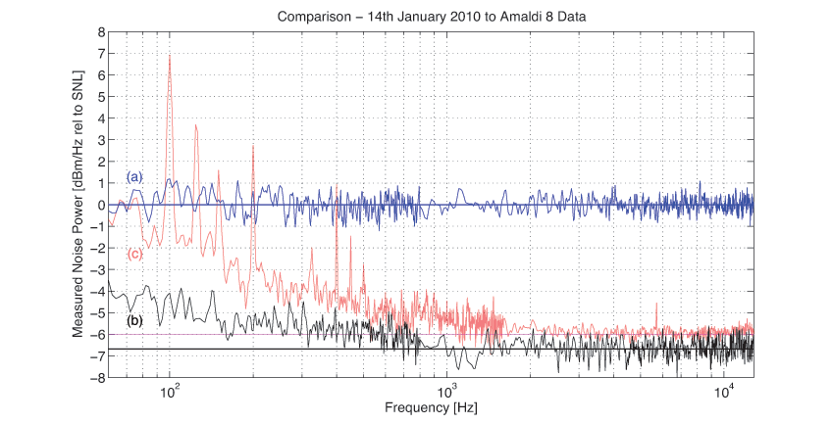
OPO Performance

Slide 9
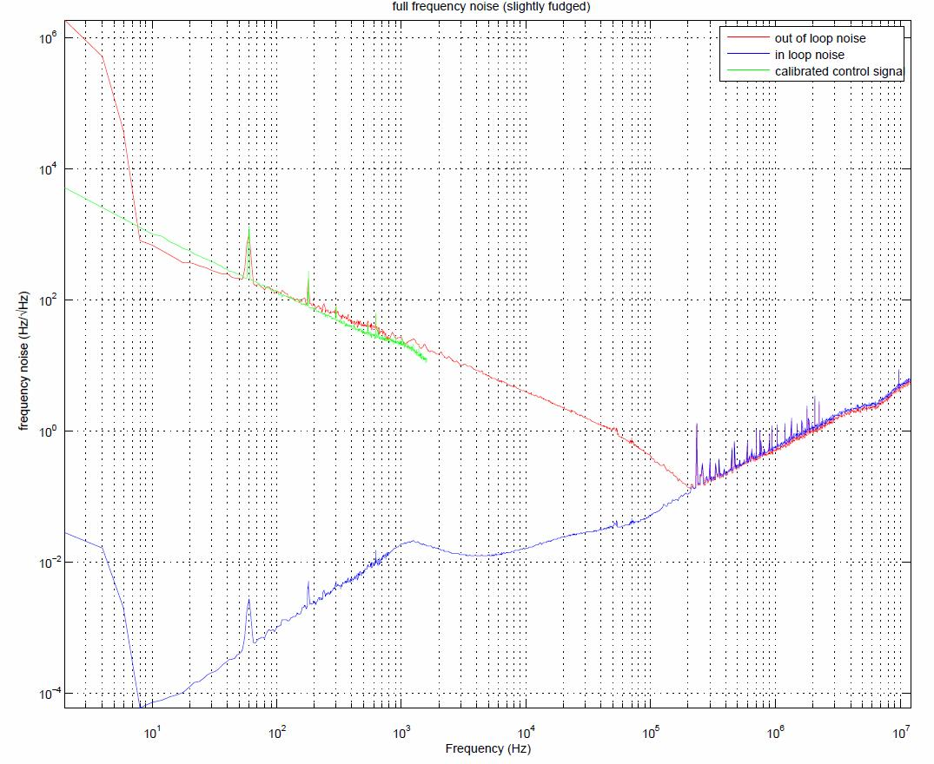

Slide 10
Previously
Grad. students Sheila D. (MIT), Sheon C. (ANU) and Michael S. (ANU)
OPO development at ANU
6 dB of squeezing observed, traveling wave bowtie design works
AEI loaner SHG at MIT
Noise model and simulation completed
Showed we can eliminate fiber stabilization
All network compensation filters are designed
No show stopper

Slide 11
Schedule
OPO development at ANU basically completed on schedule
AEI homodyne detector at ANU
Noise model completed
Assembly at MIT
Lasers, laser locking done
Optics procurement about ~2 months late
OPO integration will be about ~2 months late (will start May 2010)
Electronics production at LHO
About 80% complete, on schedule to complete May 2010

Slide 12
Plan
Continue to test AEI SHG Built our own when we get the optics
OPO to arrive in May 2010
OPO integration will start immediately afterwards
Electronics production will wrap up in May 2010
Advanced LIGO Faraday isolator (Mike S.) assembled by June 2010
Need to start thinking about in-vacuum work
Initial funding (210k) is exhausted

Slide 13
Budget Request
Task | Remainder | FY10: Q3/Q4
Electronics | 55k | 55k
Remote beam alignment | 25k | 0k
Remaining optics (e.g., lenses) | 50k | 50k
OPO super polished optics | 25k | 25k
In-vacuum stuff (excl. Faraday) | 10k | 10k
Travel | 60k | 20k
Total | 225k | 160k
Past request: 210k (all spent and committed by end of January)
Original request: 430k total

Slide 14
Summary
Lasers and OPO ready
Electronics is nearing completion
No major roadblocks so far
More funding is required now
On budget & on schedule

