Slide 1
We define the orientation of the BSC ISI using the grey isosceles triangle below.
Corner 3
V2
Corner 2
Corner 1
The base of the triangle spans the support tubes; the rest of the triangle follows the shape of the keel plate

Slide 2
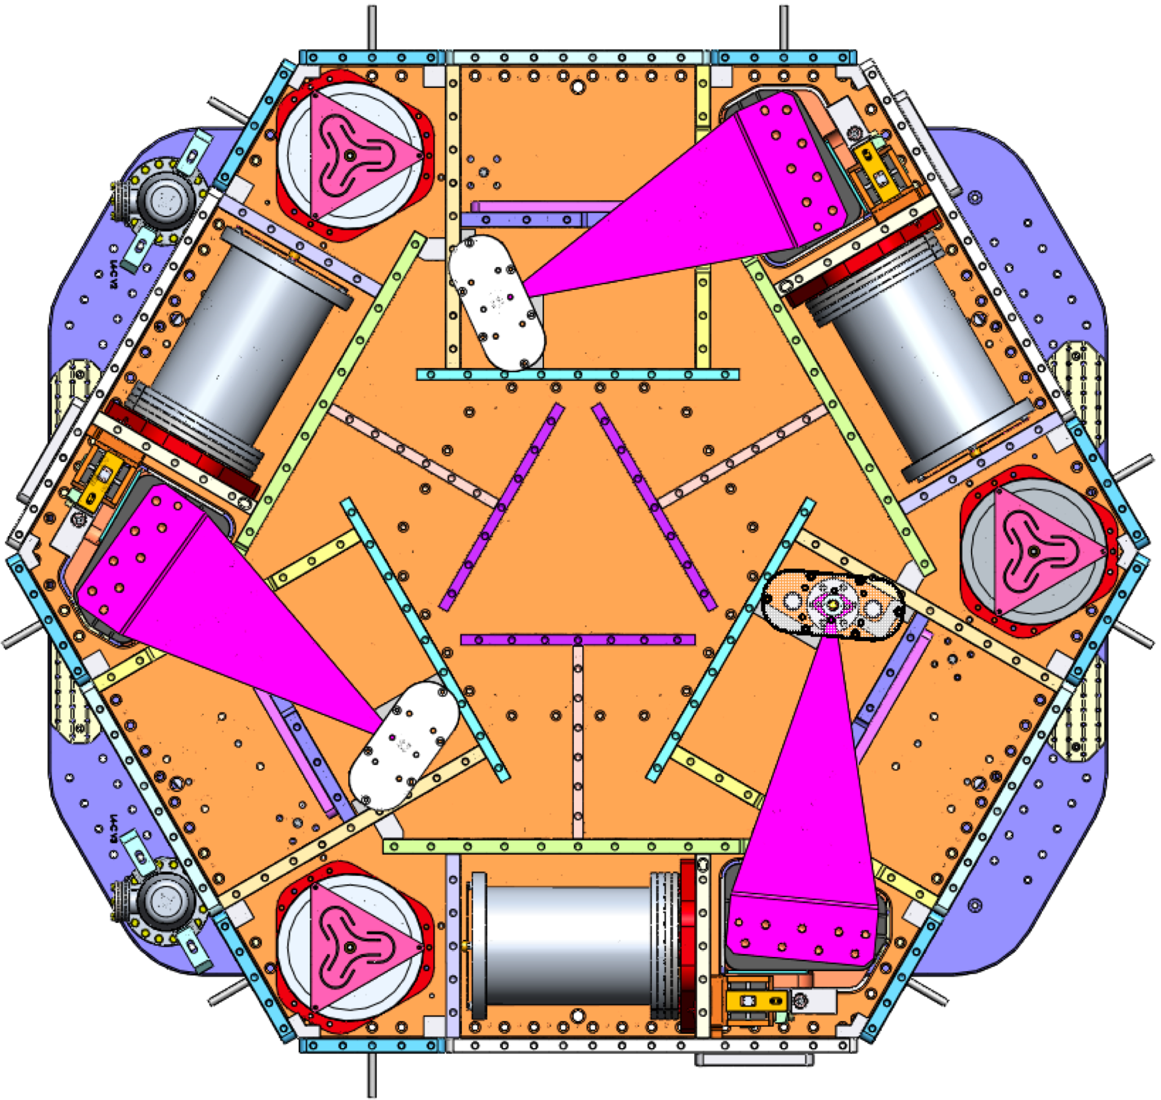
We define the orientation of the HAM ISI using the grey isosceles triangle below.
Corner 2
Exposed L4-C Pods
V1
V1 GS-13 pod
Corner 1
Corner 3
From a top-down view, the base of the triangle is formed by the two exposed L4-C pods, and the tip of the triangle is formed by the V1 GS-13 pod.

Slide 3
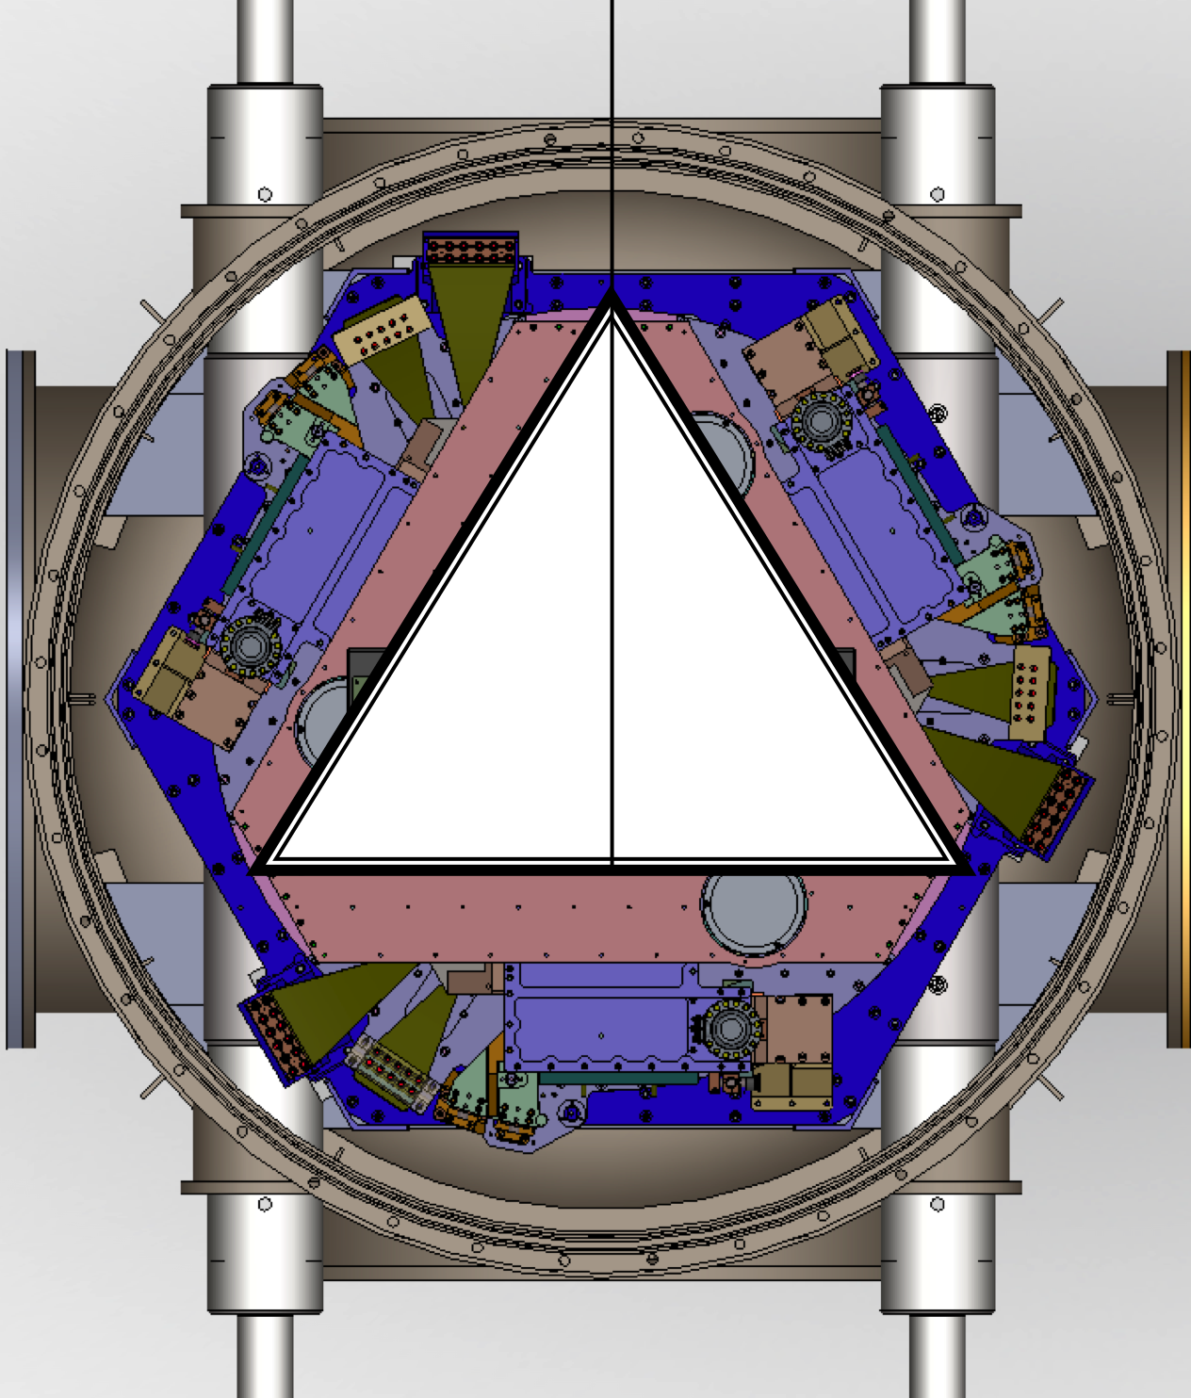
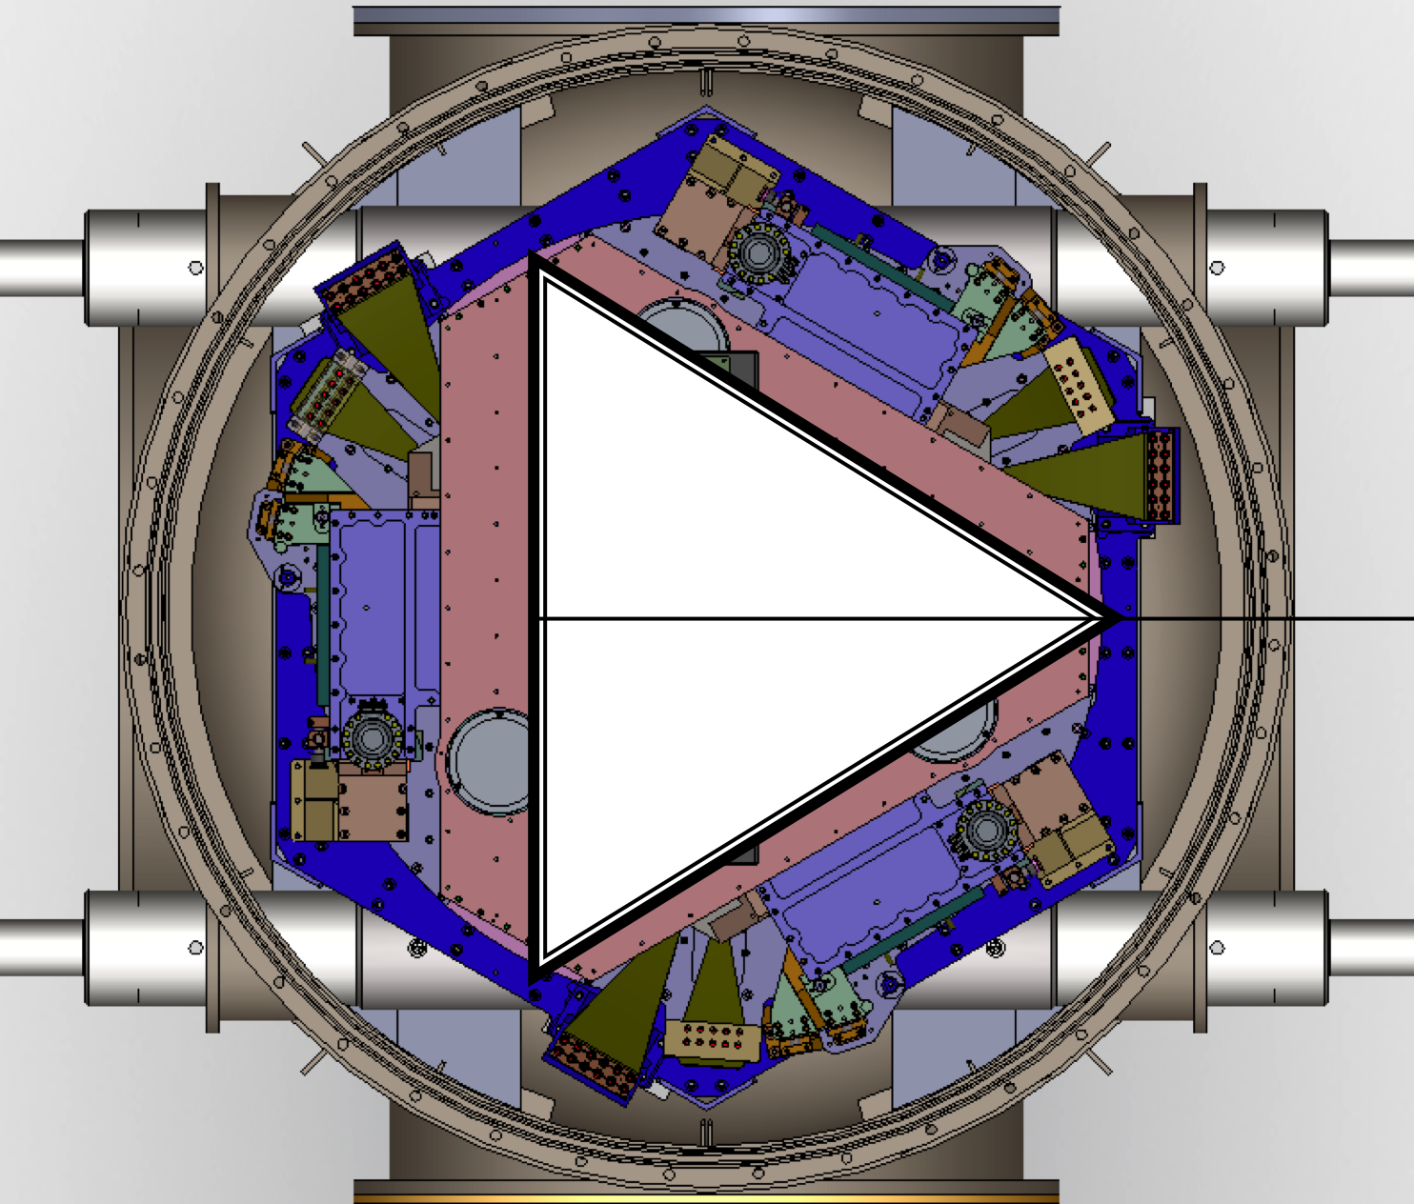
2
1
2
1
BSC6
HAM12
3
4
3
4
2
1
2
1
HAM11
BSC10
3
4
3
4
2
1
HAM10
Y
3
4
HAM9
HAM8
2
1
2
1
2
1
2
1
BSC8
3
4
3
4
3
4
3
4
2
1
BSC4
BSC1
X
HAM2
HAM3
3
4
2
1
1
1
1
1
2
1
2
1
2
2
2
2
1
2
3
4
3
4
3
4
4
3
3
4
3
4
3
4
3
4
BSC2
2
1
BSC3
BSC7
BSC9
BSC5
HAM4
3
4
2
1
Using these triangles, we define the orientation with respect to the IFO global coordinate system
For H1 and H2
HAM5
1
HEPI Pier #
HEPI Actuator Orientation
3
4
2
1
HAM6
3
4

Slide 4
2
1
BSC5
3
4
Y
2
1
BSC1
X
HAM2
HAM3
3
4
1
1
2
1
2
1
2
1
2
2
3
4
3
4
3
4
3
4
3
4
BSC2
2
1
BSC3
BSC5
HAM4
3
4
Using these triangles, we define the orientation with respect to the IFO global coordinate system
For L1
2
1
HAM5
1
HEPI Pier #
HEPI Actuator Orientation
3
4
2
1
HAM6
3
4

Slide 5
2
1
BSC5
3
4
HEPI Cross Beams
Orientation
L1&H1
Y
2
1
BSC1
X
HAM1
HAM2
HAM3
3
4
1
1
1
2
1
2
1
2
1
2
2
2
3
4
3
4
3
4
3
4
3
4
3
4
BSC2
2
1
BSC3
BSC5
HAM4
3
4
2
1
HAM5
1
HEPI Pier #
HEPI Actuator Orientation
3
4
2
1
HAM6
3
4

Slide 6
BSC6
H2:ISI-ETMY
h2isietmy.mdl
BSC-ISI/H2/ETMY/
HAM12
H2:ISI-HAM12
h2isiham12.mdl
HAM-ISI/H2/HAM12/
We define the naming with
respect to the chambers as follows:
CHAMBER NAME
CHANNEL PREFIX
MODEL NAME
~/SeismicSVN/seismic/ Folder
HAM11
H2:ISI-HAM11
h2isiham11.mdl
HAM-ISI/H2/HAM11/
BSC10
H1:ISI-ETMY
h1isietmy.mdl
BSC-ISI/H1/ETMY/
HAM10
H2:ISI-HAM10
h2isiham10.mdl
HAM-ISI/H2/HAM10/
BSC8
H2:ISI-ITMY
h2isiitmy.mdl
BSC-ISI/H2/ITMY/
HAM8
H2:ISI-HAM8
h2isiham8.mdl
HAM-ISI/H2/HAM8/
BSC1
H1:ISI-ITMY
h1isiitmy.mdl
BSC-ISI/H1/ITMY/
BSC4
H2:ISI-BS
h2isibs.mdl
BSC-ISI/H2/BS/
HAM9
H2:ISI-HAM9
h2isiham9.mdl
HAM-ISI/H2/HAM9/
HAM2
H1:ISI-HAM2
h1isiham2.mdl
HAM-ISI/H1/HAM2/
BSC7
H2:ISI-ITMX
h2isiitmx.mdl
BSC-ISI/H2/ITMX/
BSC2
H1:ISI-BS
h1isibs.mdl
BSC-ISI/H1/BS/
BSC3
H1:ISI-ITMX
h1isiitmx.mdl
BSC-ISI/H1/ITMX/
BSC9
H1:ISI-ETMX
h1isietmx.mdl
BSC-ISI/H1/ETMX/
BSC5
H2:ISI-ETMX
h2isietmx.mdl
BSC-ISI/H2/ETMX/
HAM3
H1:ISI-HAM3
h1isiham3.mdl
HAM-ISI/H1/HAM3/
Y
HAM4
H1:ISI-HAM4
h1isiham4.mdl
HAM-ISI/H1/HAM4/
HAM6
H1:ISI-HAM6
h1isiham6.mdl
HAM-ISI/H1/HAM6/
HAM5
H1:ISI-HAM5
h1isiham5.mdl
HAM-ISI/H1/HAM5/
X

Slide 7
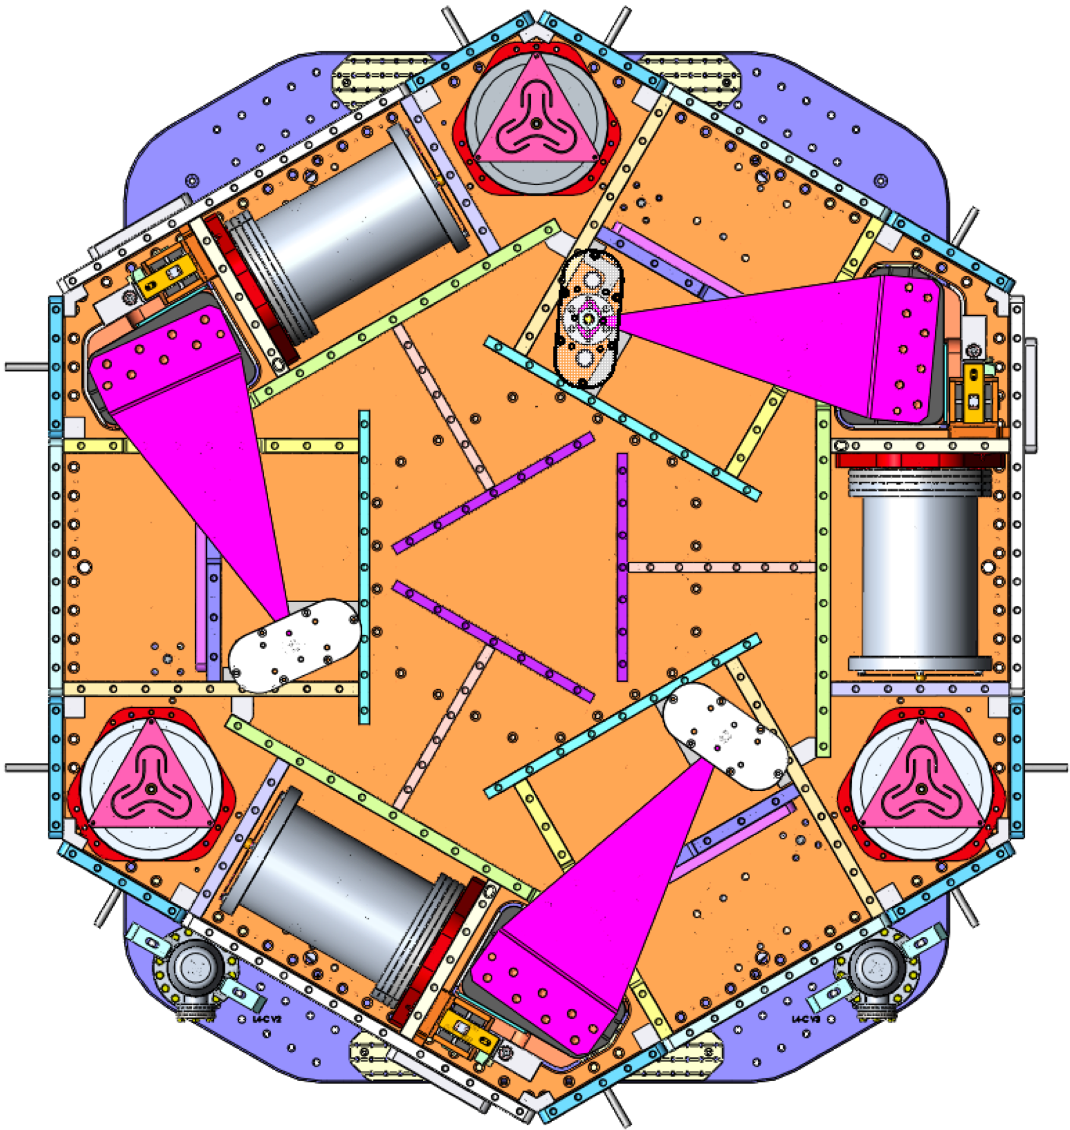
BSC5
L1:ISI-ETMY
l1isietmy.mdl
BSC-ISI/L1/ETMY/
We define the naming with respect to the chambers as follows:
CHAMBER NAME
CHANNEL PREFIX
MODEL NAME
~/SeismicSVN/seismic/ Folder
BSC1
L1:ISI-ITMY
l1isiitmy.mdl
BSC-ISI/L1/ITMY/
HAM2
L1:ISI-HAM2
l1isiham2.mdl
HAM-ISI/L1/HAM2/
BSC3
L1:ISI-ITMX
l1isiitmx.mdl
BSC-ISI/L1/ITMX/
BSC2
L1:ISI-BS
l1isibs.mdl
BSC-ISI/L1/BS/
BSC4
L1:ISI-ETMX
l1isietmx.mdl
BSC-ISI/L1/ETMX/
HAM3
L1:ISI-HAM3
l1isiham3.mdl
HAM-ISI/L1/HAM3/
Y
HAM4
L1:ISI-HAM4
l1isiham4.mdl
HAM-ISI/L1/HAM4/
HAM6
L1:ISI-HAM6
l1isiham6.mdl
HAM-ISI/L1/HAM6/
HAM5
L1:ISI-HAM5
l1isiham5.mdl
HAM-ISI/L1/HAM5/
X

