Slide 1
Speculations about Newtonian-Noise Filtering
Jan Harms
LIGO-G1000673-v2

Slide 2
Newtonian Noise in a Nutshell
Seismic sources
Displacement field
Density perturbations
Gravity perturbations
Transient v. stationary
Pressure and shear waves
Atmospheric
Integral effects
Anthropogenic
Gutenberg Richter
Fundamental Rayleigh
Zone of influence
Distant v. local
Rayleigh overtones and Love waves
Surface v. underground
Reflection from free surface and underground interfaces
Mie and Rayleigh scattering
Refraction

Slide 3
The Challenge
Notes:
NN subtraction for Adv LIGO will be a piece-of-cake or a complete disaster.

Slide 4
Outline
Surface versus underground
Geology
Seismometers
Seismic arrays
Noise subtraction

Slide 5
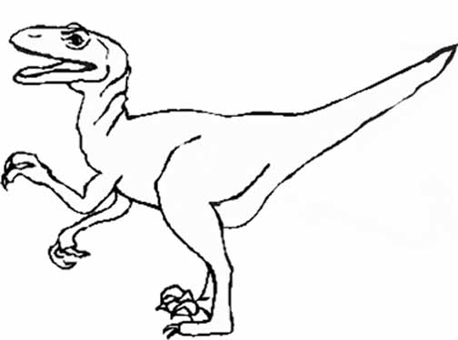
SurfacevUG::Problems.3G
Atmospheric Newtonian noise.
People don’t want to work underground.
Strong surface seismicity.
Restrictive transportation of materials.
I would expect seismic surface field to be less stationary (definitely true for Homestake v. LIGO sites).
Higher costs.
Need cost estimate for surface detector (boreholes + domes).
Valli (surface proponent)
Jan (UG proponent)

Slide 6
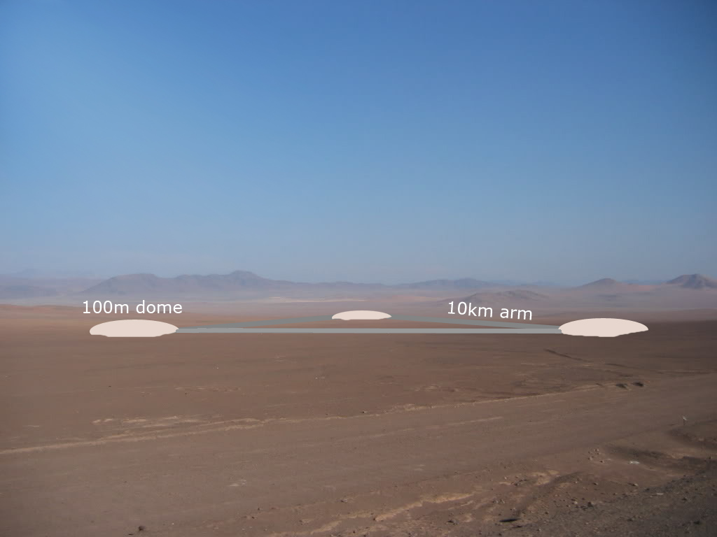
SurfacevUG::Surface.Design

Slide 7
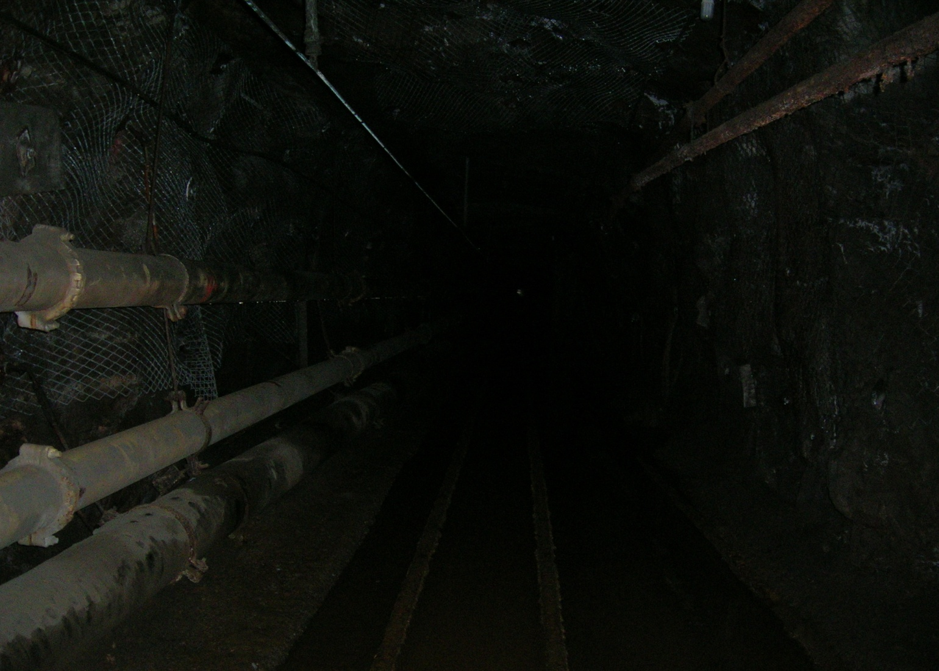
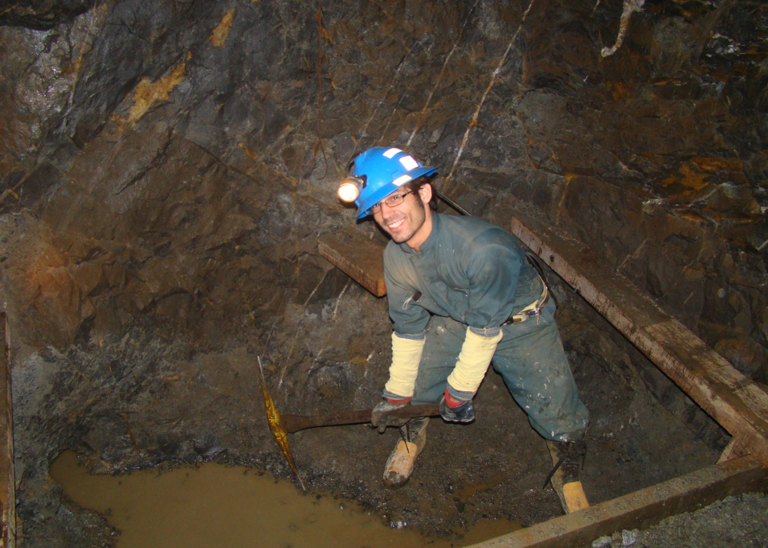
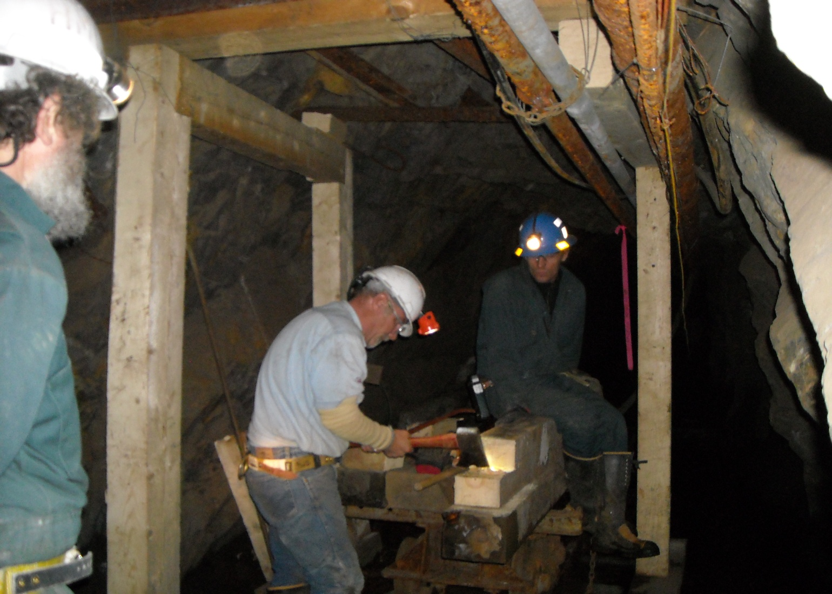
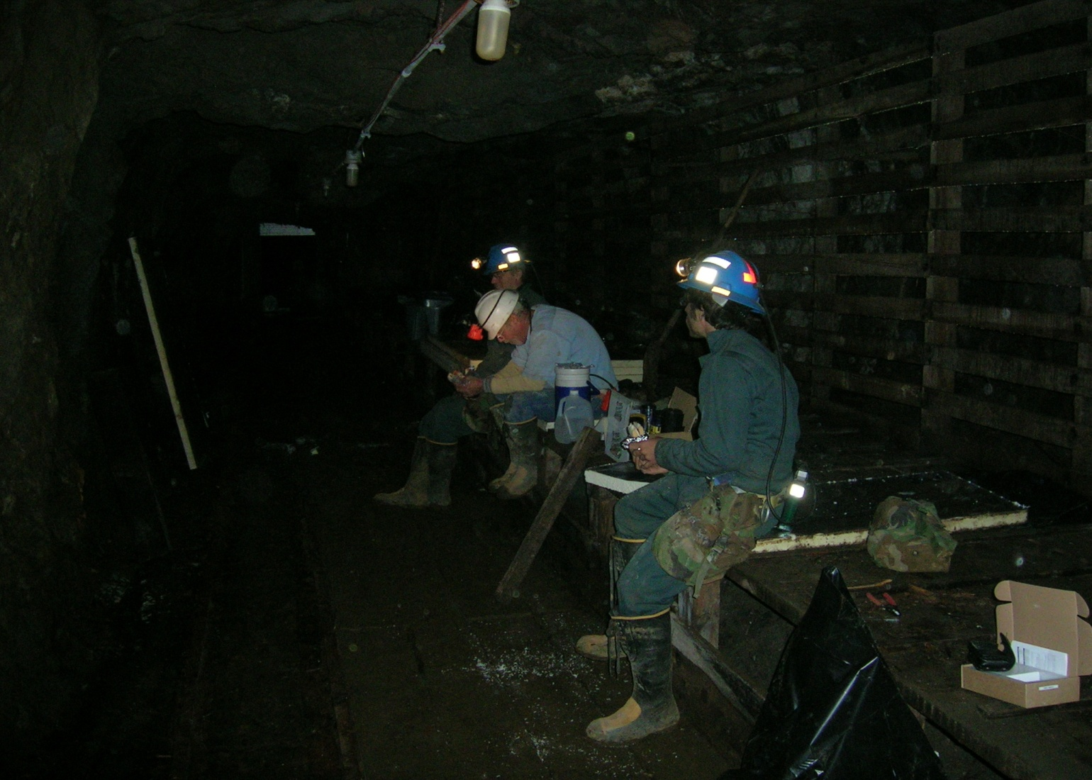
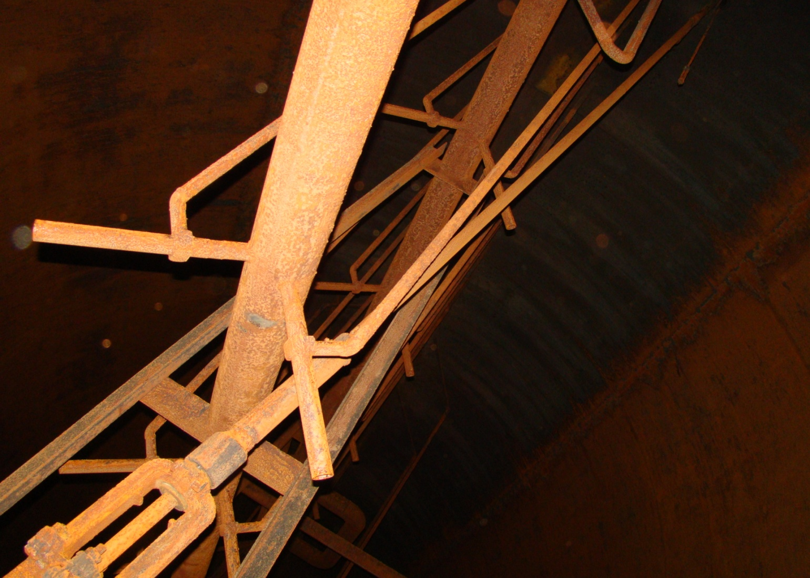
SurfacevUG::UG.Design

Slide 8
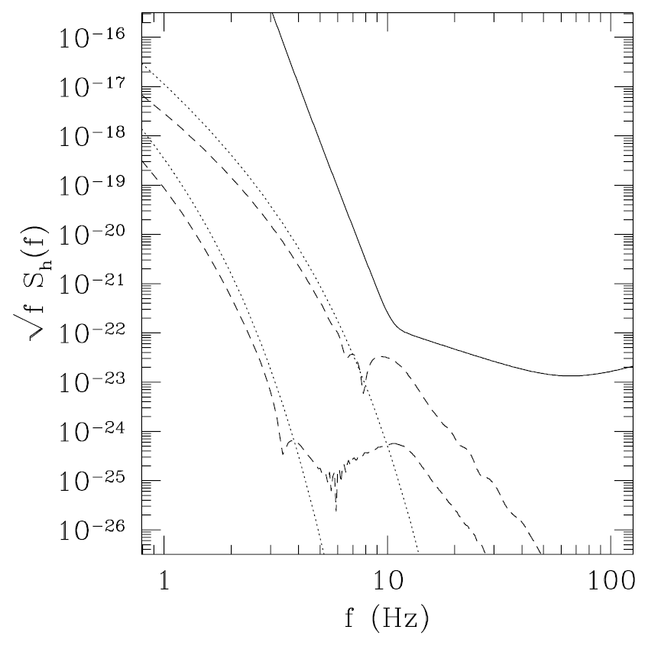
SurfacevUG:: Surface.Atmosphere
Temperature fluctuations advected along smooth streamlines (dotted lines in graph)
Temperature fluctuations advected by turbulent vortices around buildings (dashed lines in graph)
Atmospheric pressure fluctuations
T. Creighton (2008)

Slide 9
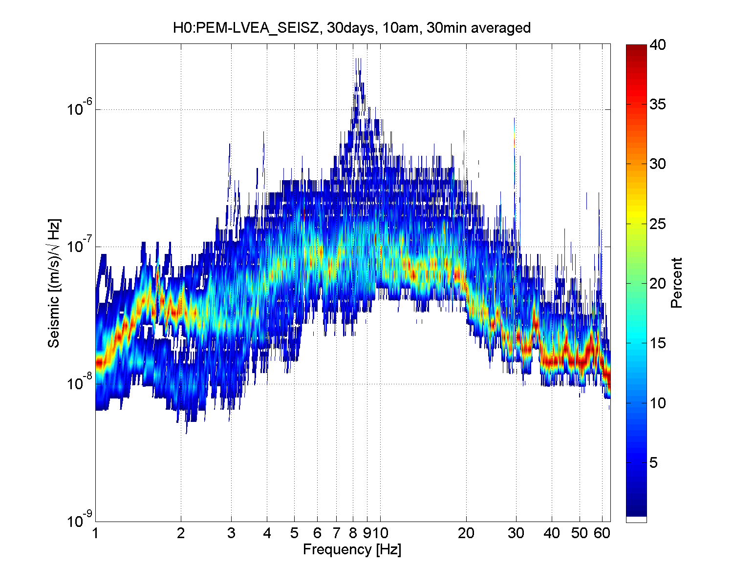
SurfacevUG::SeismicNoise
4100ft below surface
LIGO Hanford

Slide 10
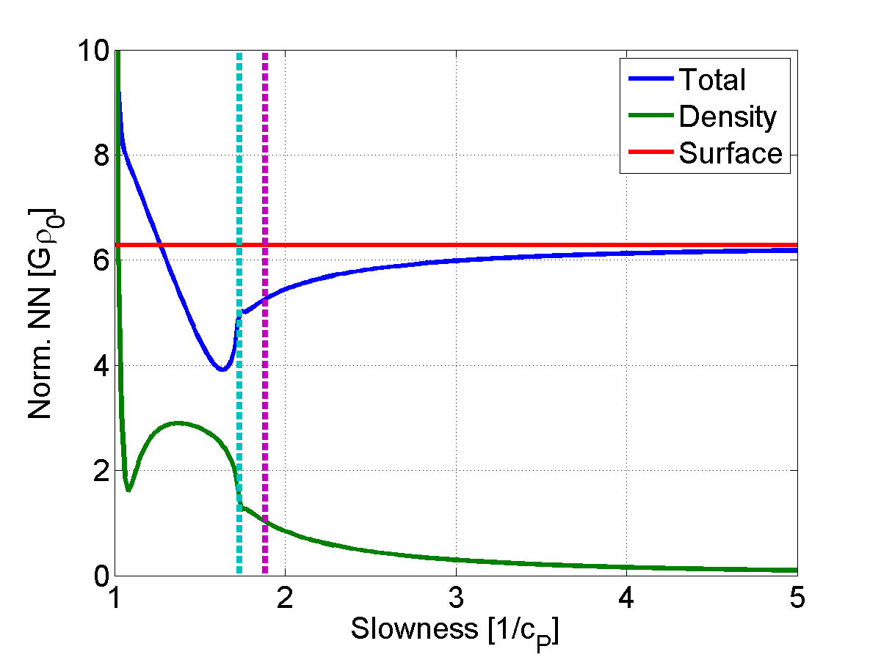
SurfacevUG::Surface.NN
Surface NN (acc) normalized by vertical ground displacement (test mass height h=0).
Calculation is for Rayleigh waves.
Frequency dependence:

Slide 11
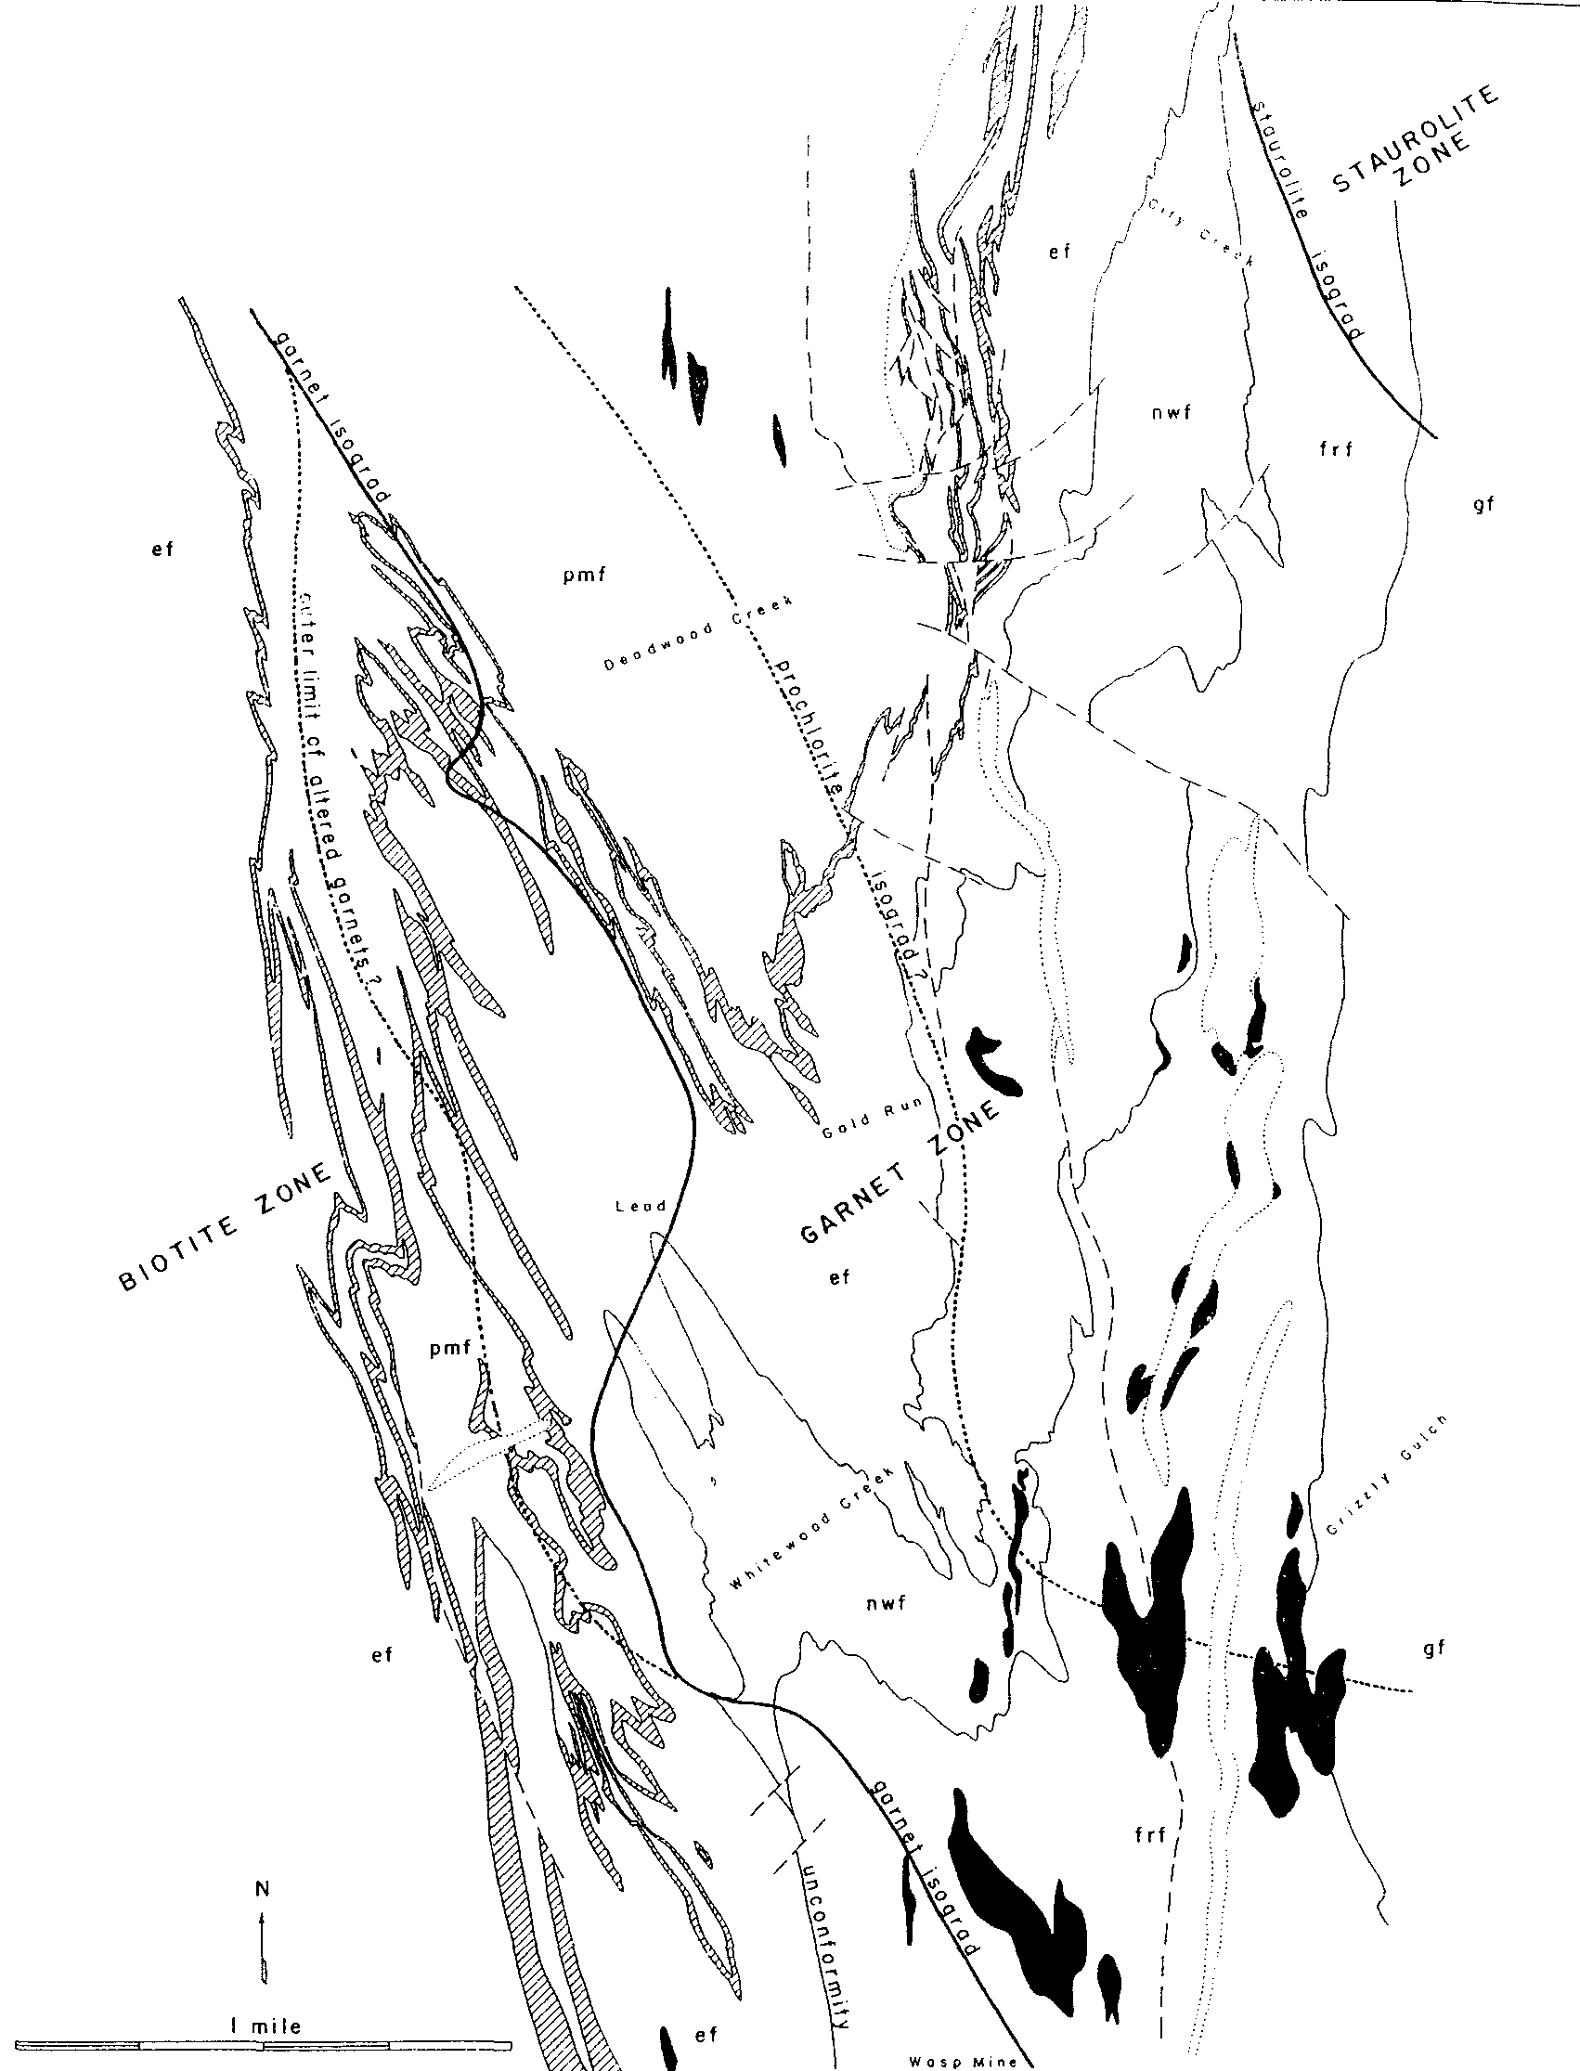
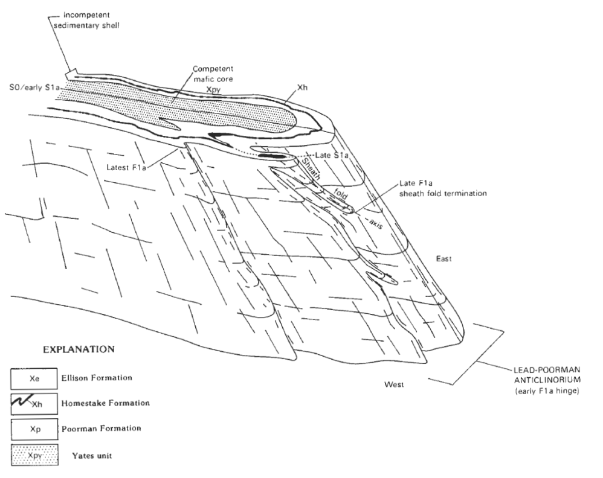
Geology::UG.Homestake
Notes:
Proterozoic (2500 - 542 Myr), Trans-Hudson Orogeny (2 Gyr), Laramide orogeny (Homestake: 65-60 Myr)

Slide 12
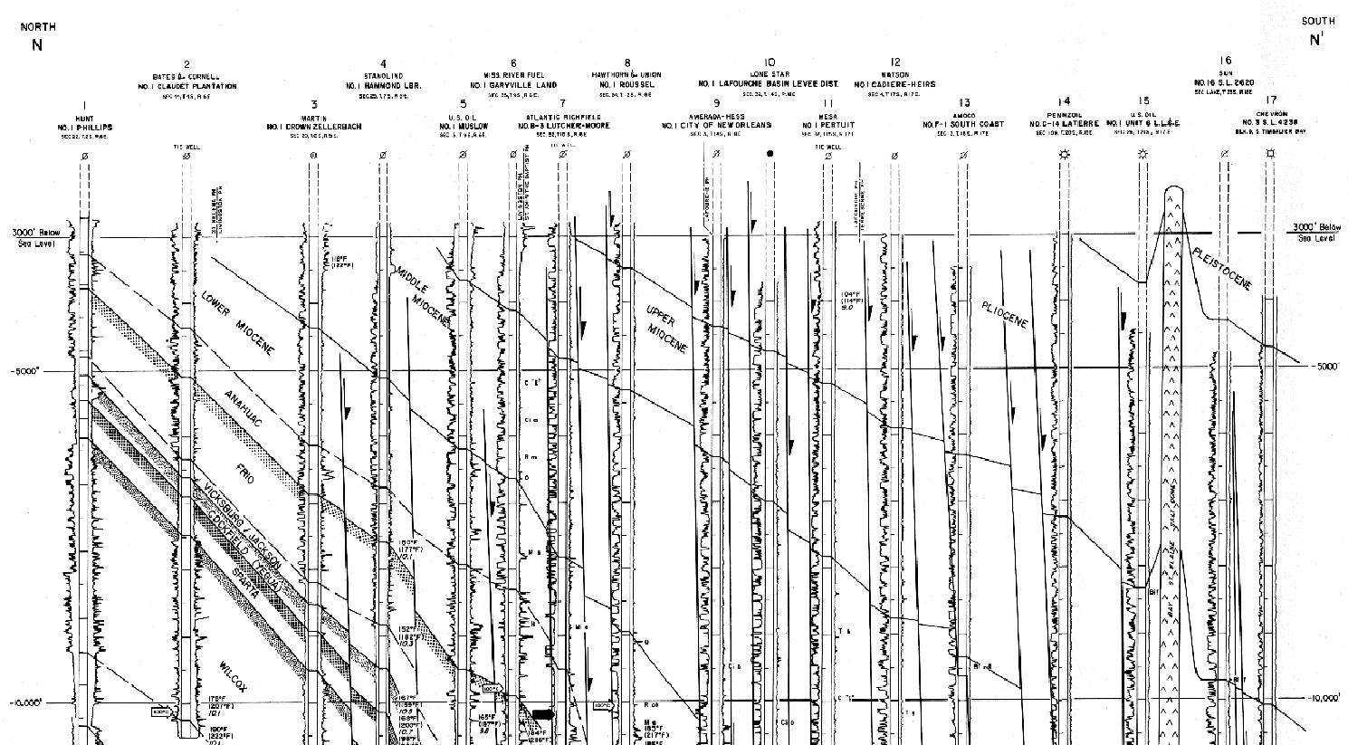
Geology::UG.LLO
Notes:
Bebout and Gutiérrez (1983). Series: Miocene (23-5.3Myr), Pliocene (5.3-2.6Myr), Pleistocene (2.6Myr – 12kyr).

Slide 13
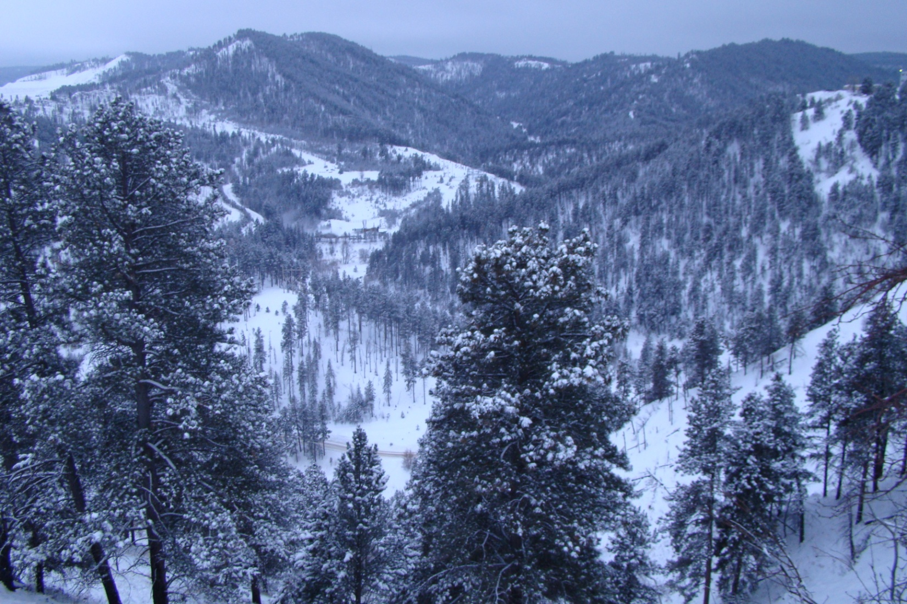
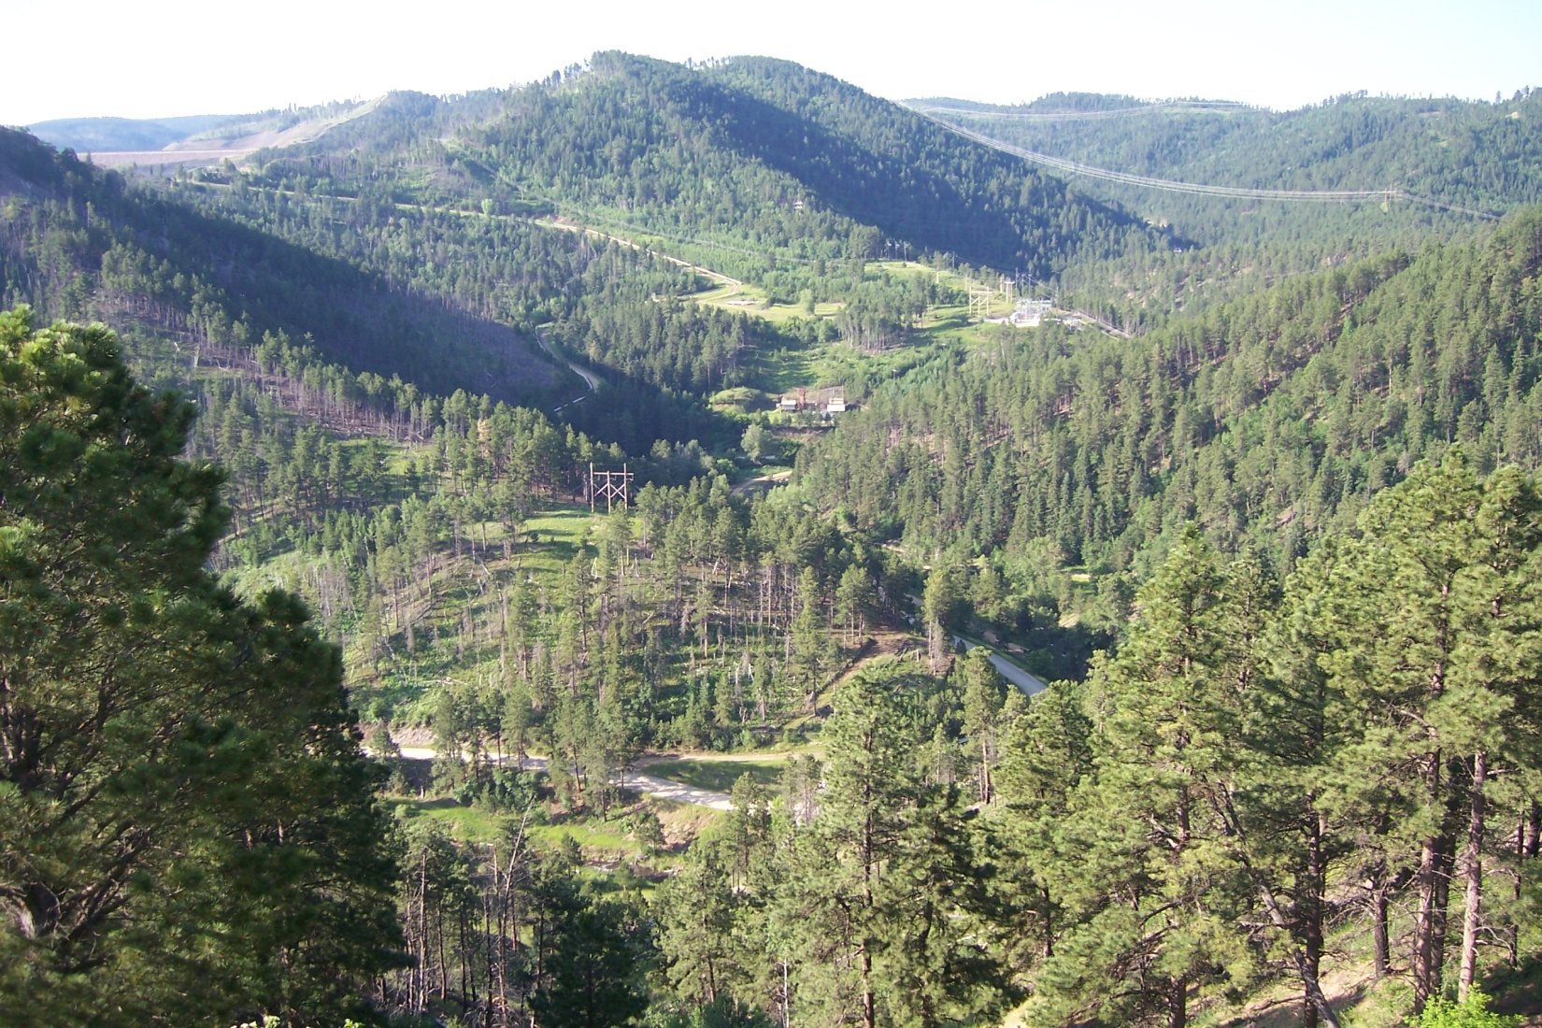
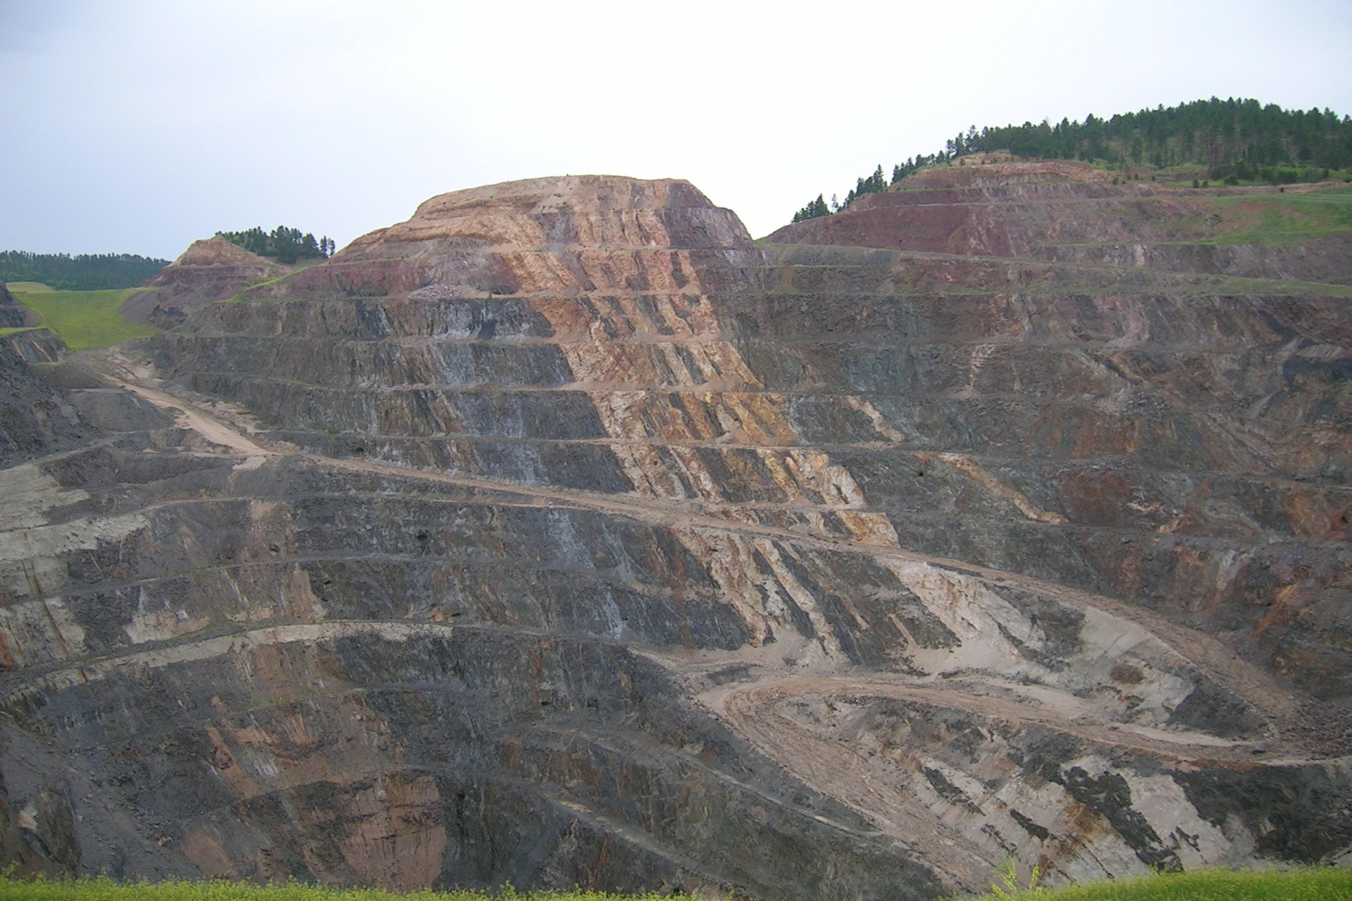
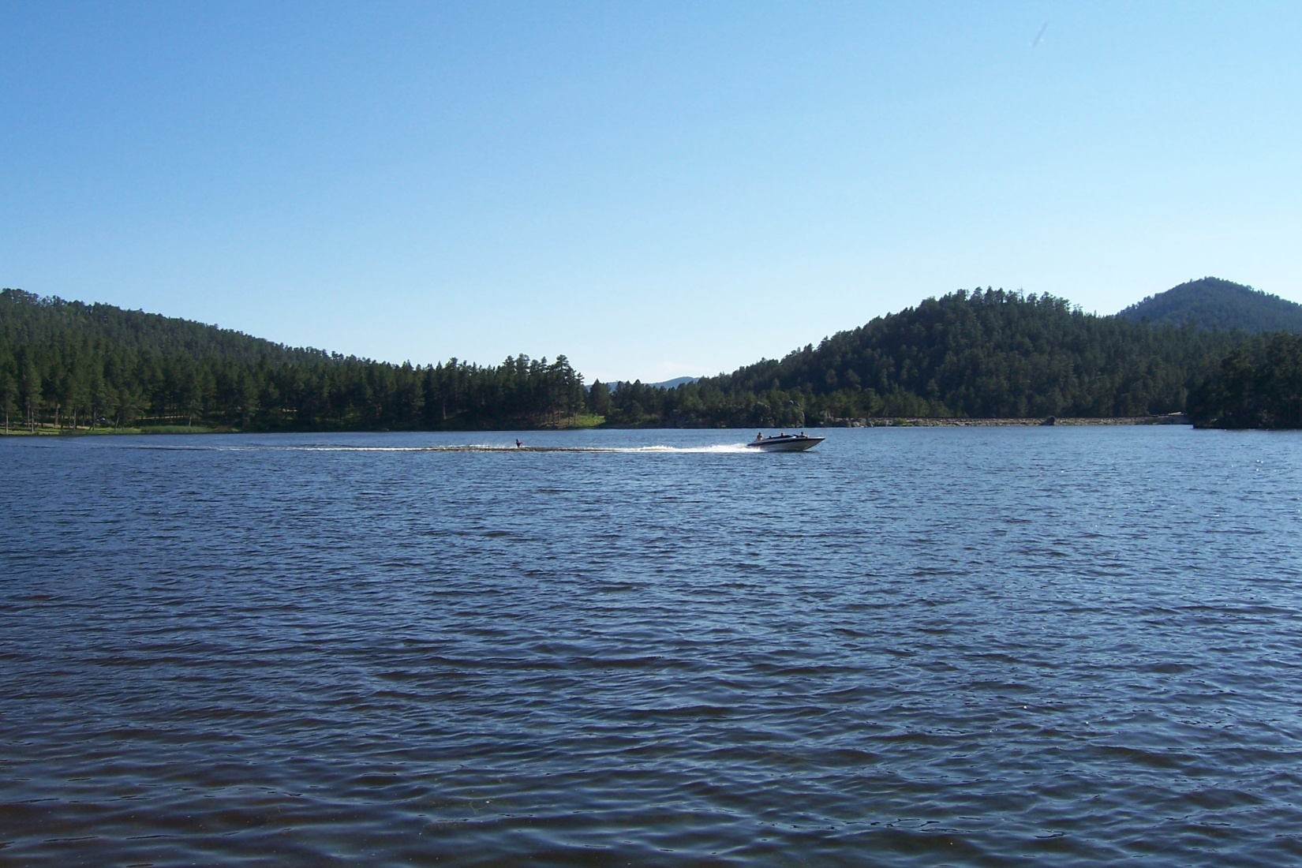
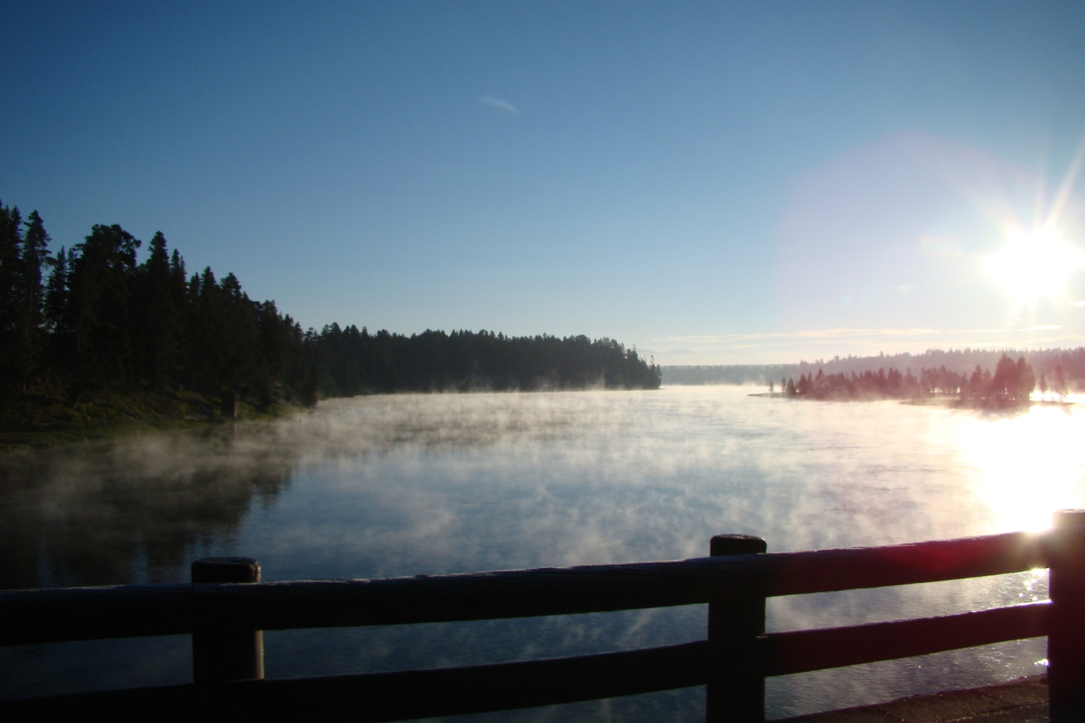
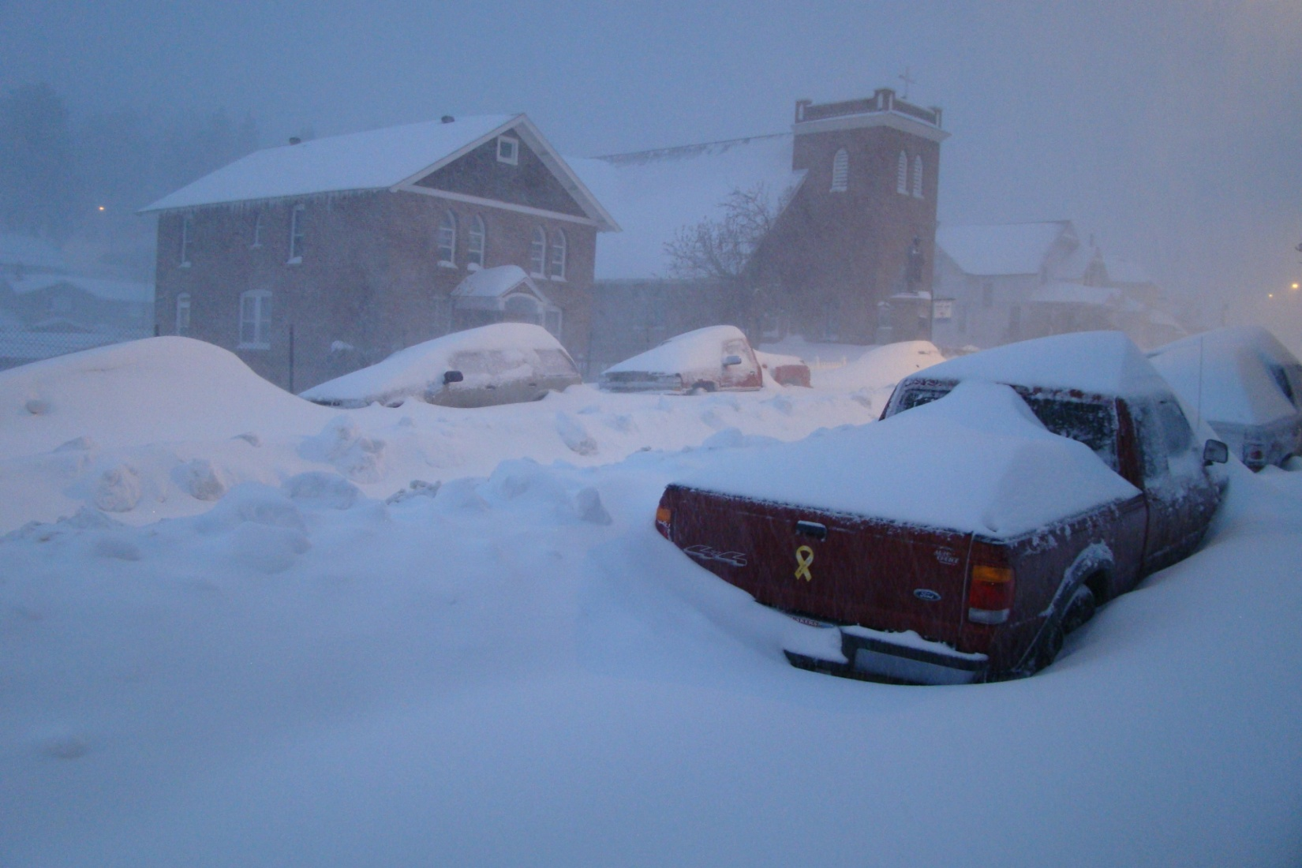
Geology::Surface.Homestake
Notes:
Rhyolite: felsic volcanic rock

Slide 14
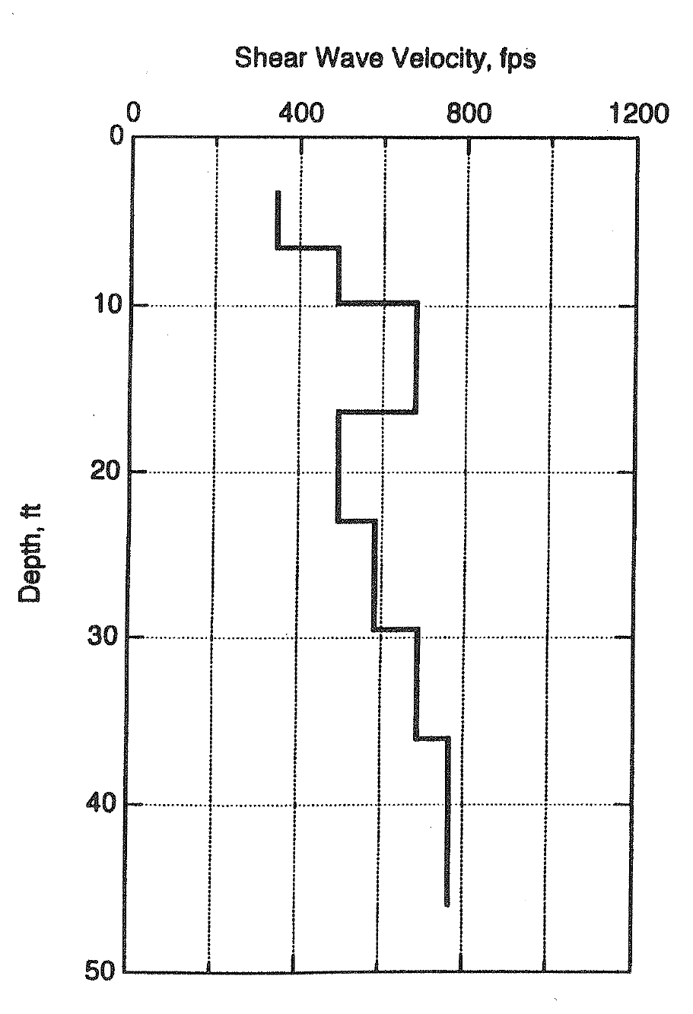
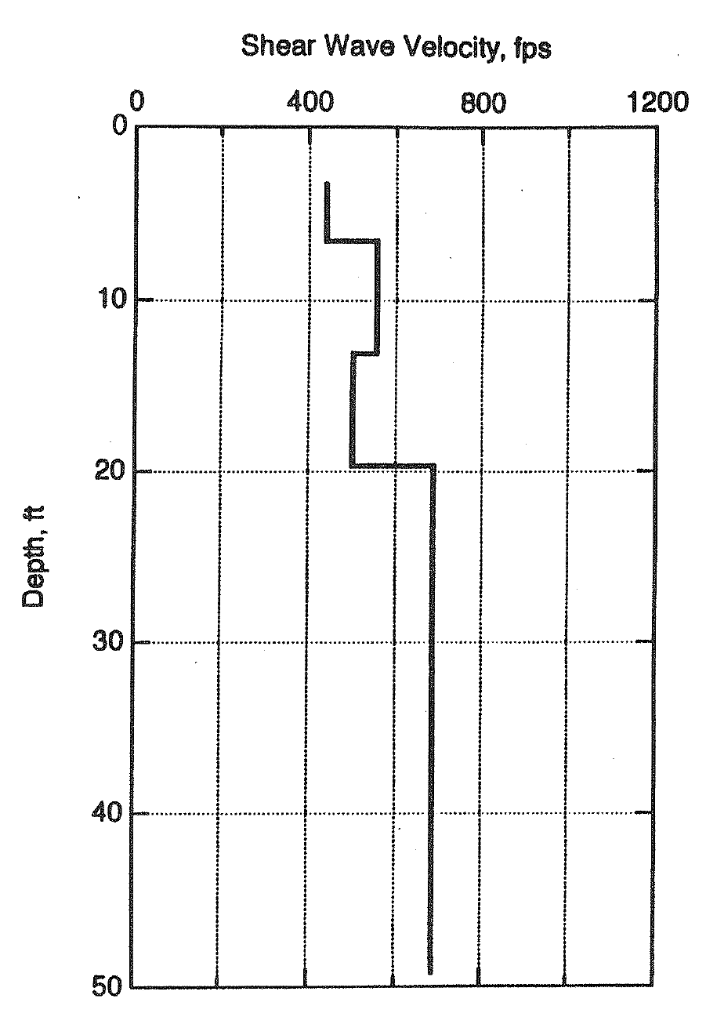
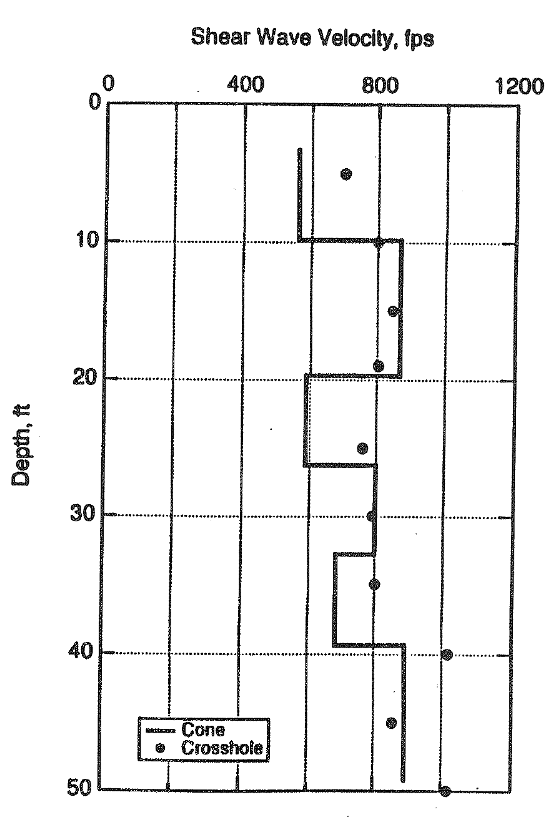
Geology::Surface.LLO
Borehole measurements at different points along LIGO arm
Notes:
Data from 1995. Woodward for LIGO.

Slide 15
Geology::Surface.WhyItMatters
Rf
R
R
M
P
P
P
P
SV
S
Pressure-wave to shear-wave (vertical polarization) conversion and vice versa happens at reflection from all interfaces and free surfaces.
Matrix M depends on amplitudes of spatial spectrum of surface topography.
Negligible effects if spatial amplitudes are small for .
Notes:
Holography (Dennis Gabor). Rg: short period Rayleigh waves from near-surface explosions and rock burst.

Slide 16
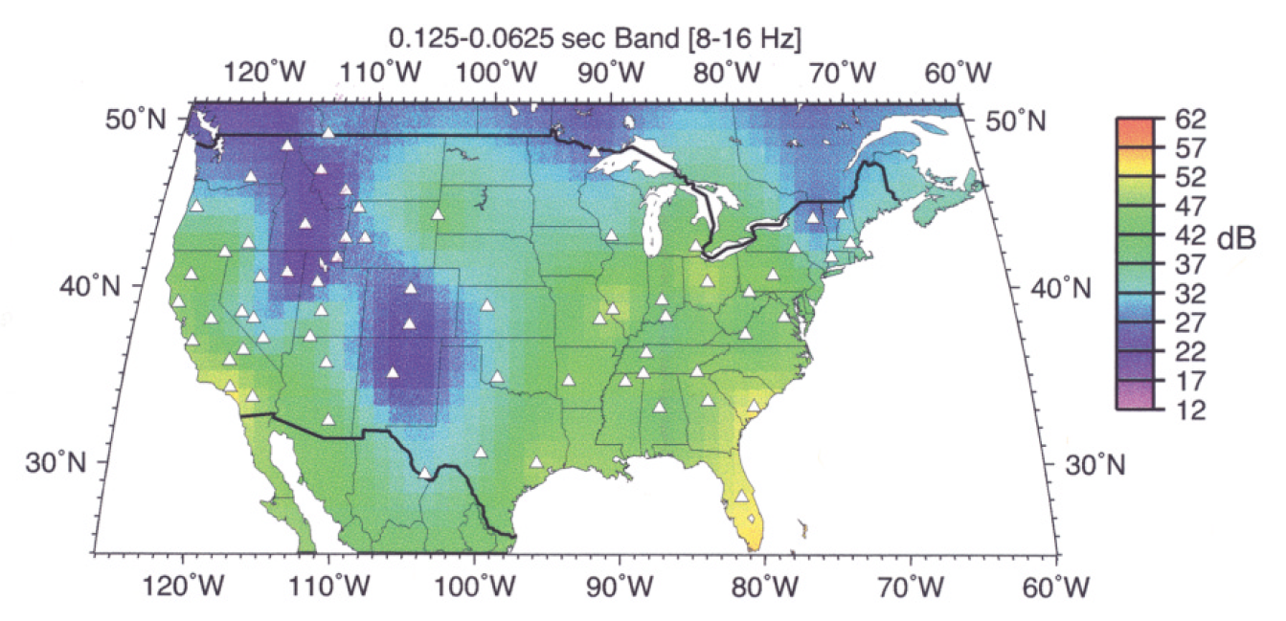
Geology::Seismicity.(10Hz)

Slide 17
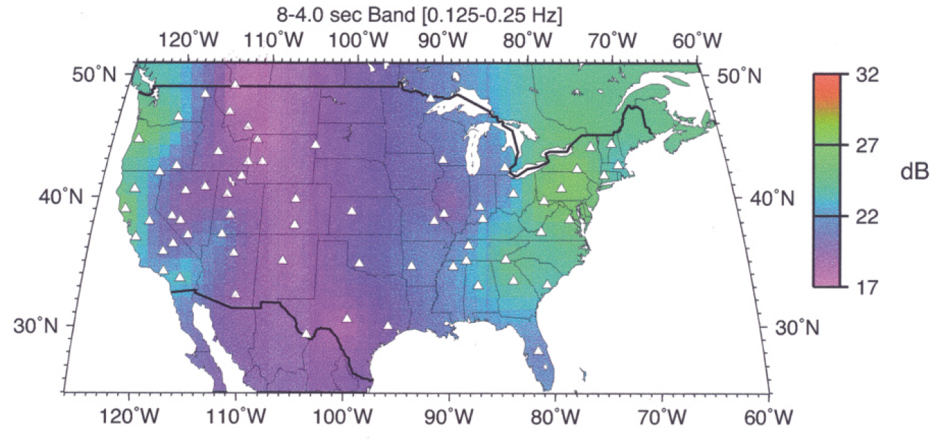
Geology::Seismicity.(0.2Hz)

Slide 18
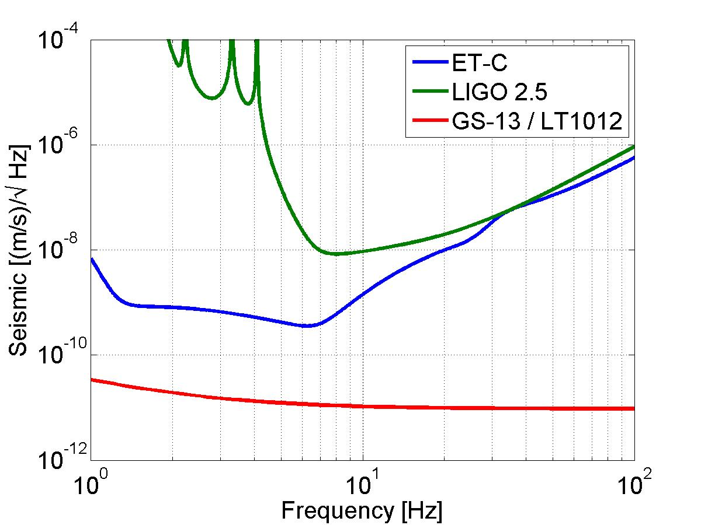
Seismometers:: InstrumentalNoise
GWD sensitivity > NN > ground motion
Instrumental noise of GS-13 lies well below target curves for ET-C and LIGO 2.5.
Better version of ET-C (extending slope between 7Hz-100Hz down to 1Hz) would require improvement of GS-13.
Notes:
Assumes that all the vertical displacement comes from Rf

Slide 19
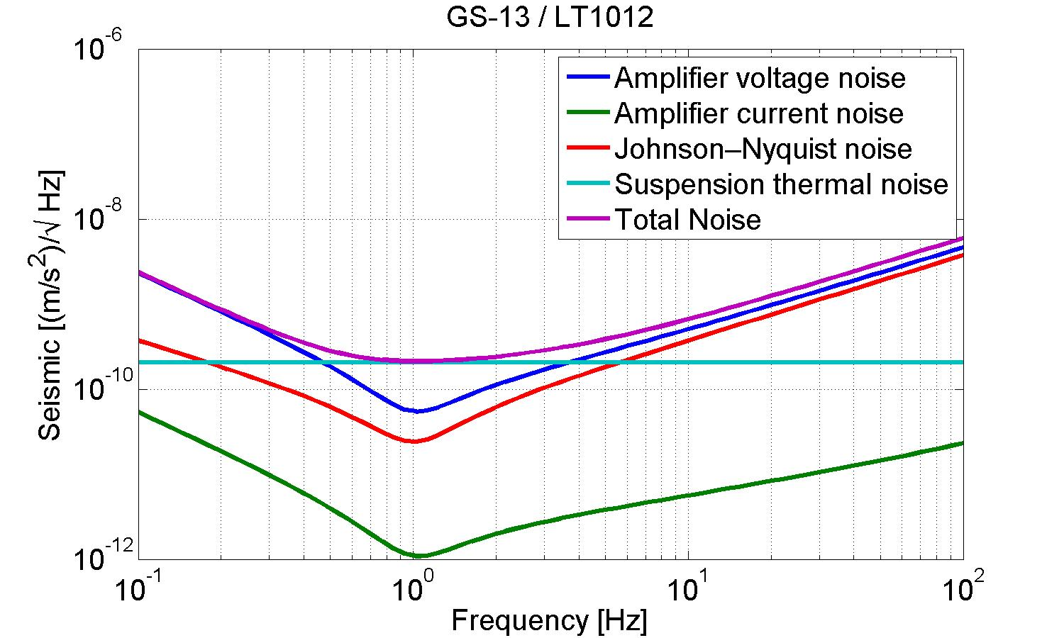
Seismometers::GS-13.Noise
Sensitivity of GS-13 at low frequencies is limited by amplifier-voltage noise (in combination with LT1012 amplifier).

Slide 20
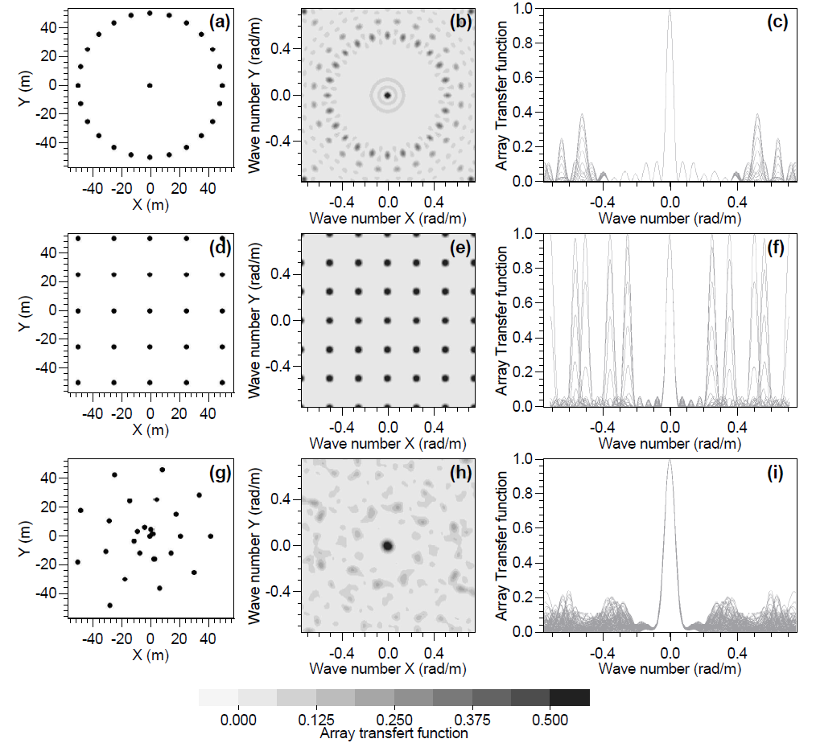
SeismicArrays:: Configurations.2D
Optimize configuration for anti-aliasing and spatial resolution.
There may be better methods to calculate spatial spectra (plane-wave templates for MLE).
Marc Wathelet (2005)

Slide 21
SeismicArrays:: NumberofSeismometers
Brain-free, interpolation:
Thousands of 3-axes seismometers per test mass.
Ideal, deep underground:
One 3-axes seismometer and one 3-axes strainmeter per test mass.
Ideal, near surface:
About 100 seismometers for surface and underground arrays (needs more research before final answer can be given).
Non-ideal:
Add seismometers to monitor seismic field near large-scale scattering centers.

Slide 22
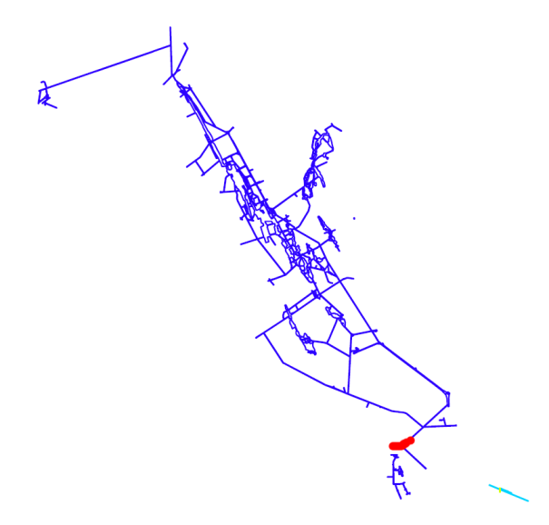
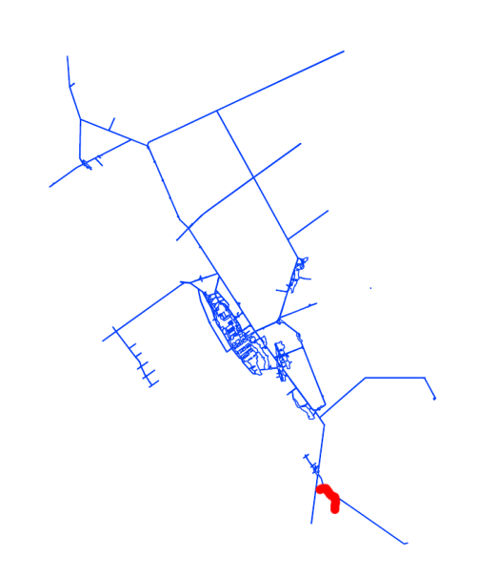
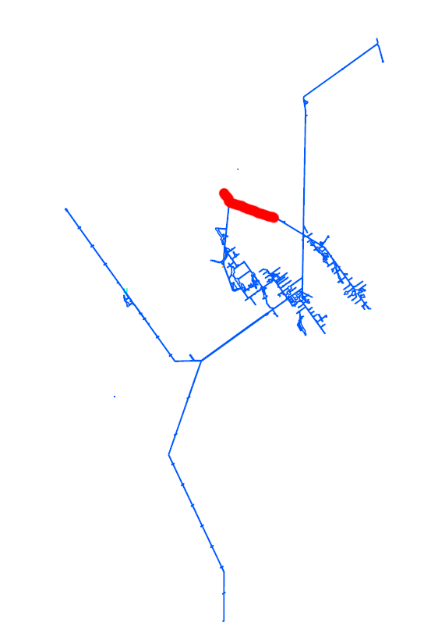
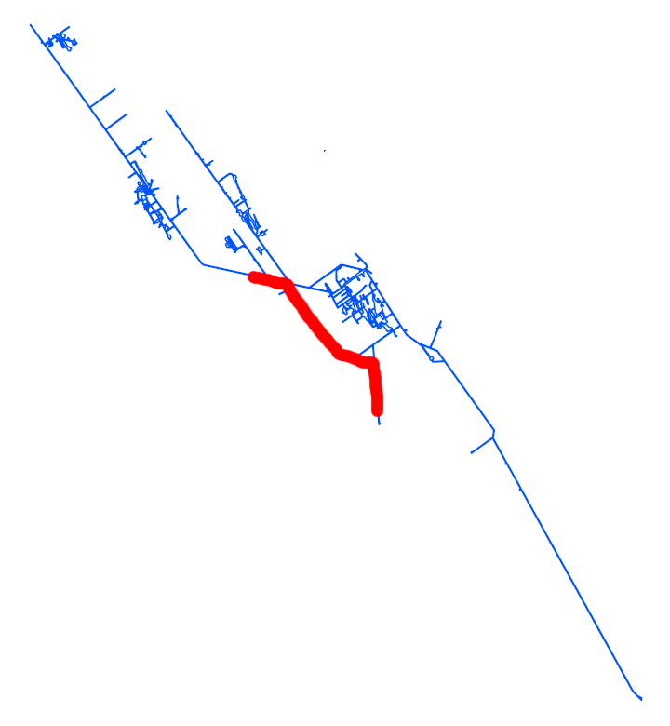
SeismicArrays:: Homestake.DUGL
300ft
800ft
4100ft
2000ft
Current extent of seismic array

Slide 23
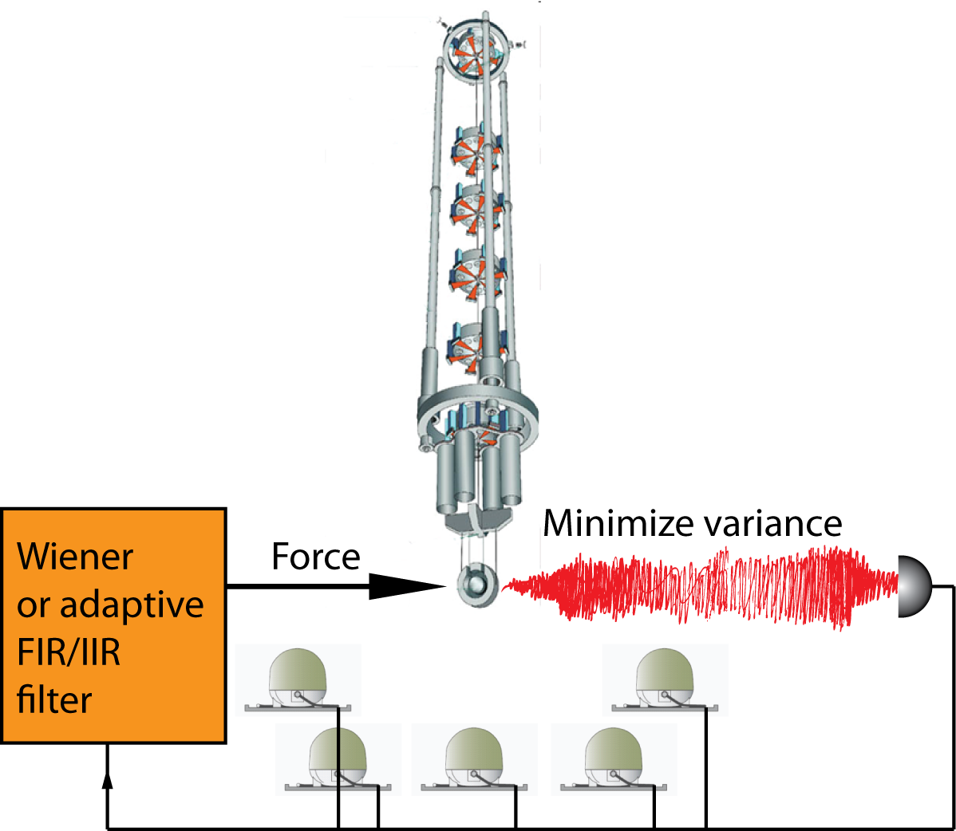
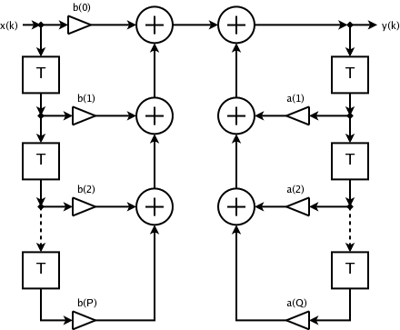
NoiseSubtraction:: AdaptiveFilter.FeedForward
FIR IIR
Wiener or adaptive filters are established technology and indispensable in modern industry
FIR is easy, IIR is not so easy
Adaptive-filter algorithms are related to
MCMC
Machine learning

Slide 24
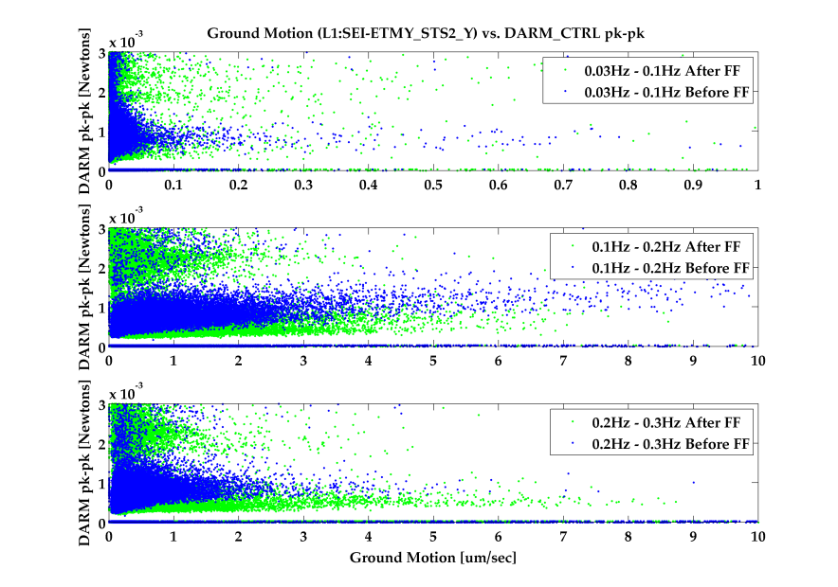
NoiseSubtraction::Example.LLO
DARM_CTRL quantifies the force on test masses. DARM_CTRL is smaller with feed-forward (FF).
PRC-CTRL spectra prove that FF substantially decreases noise over many frequencies.

Slide 25
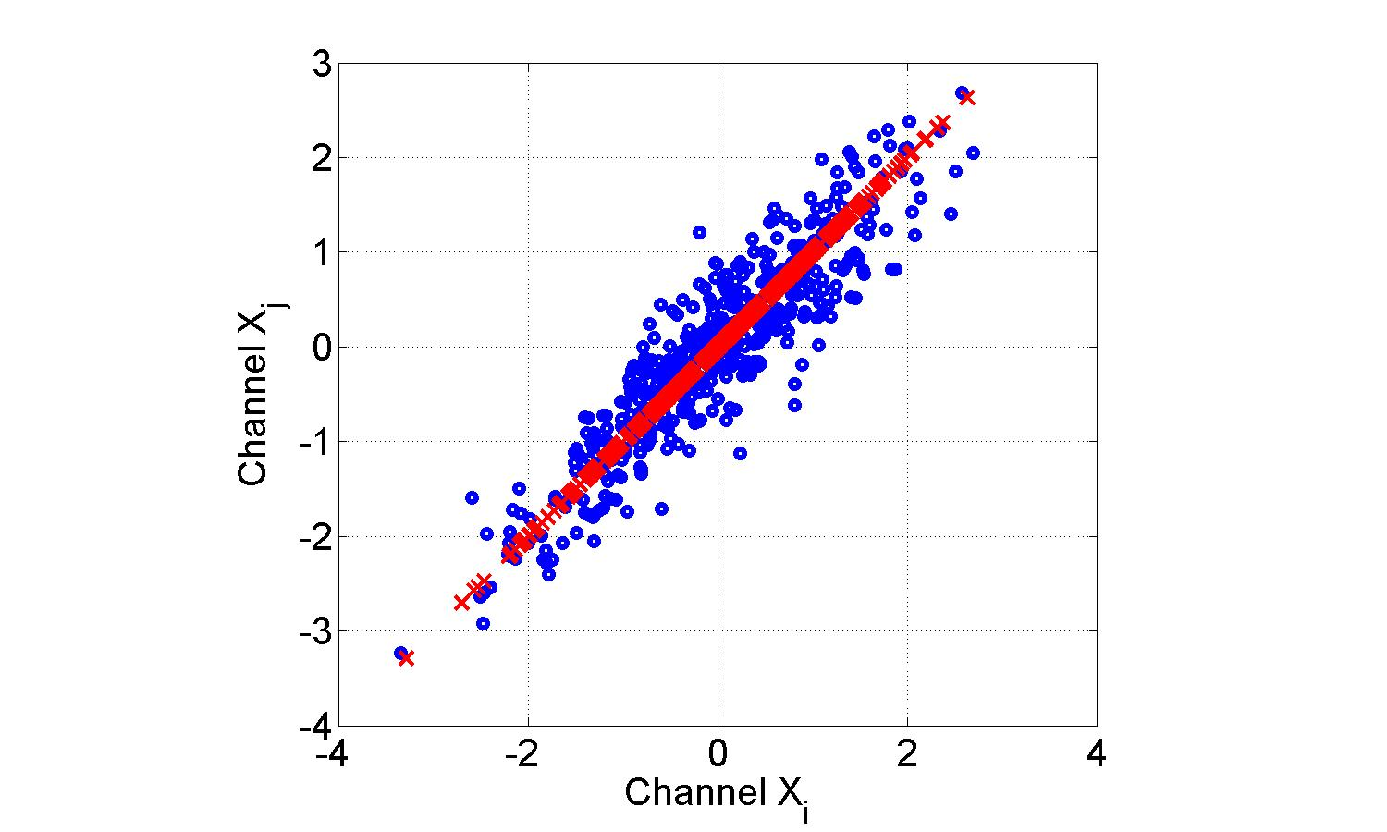
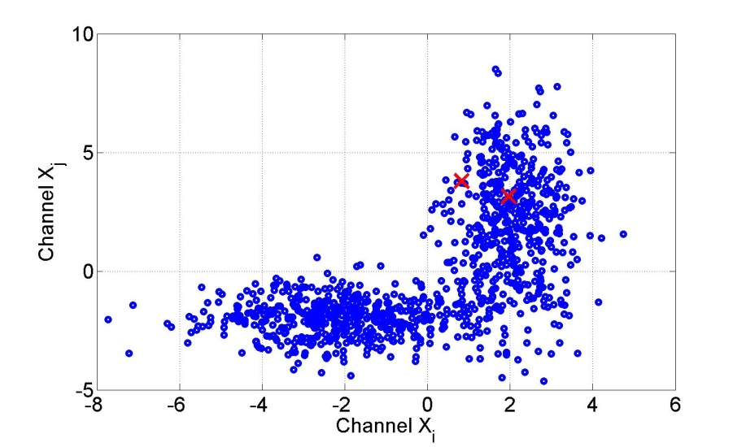
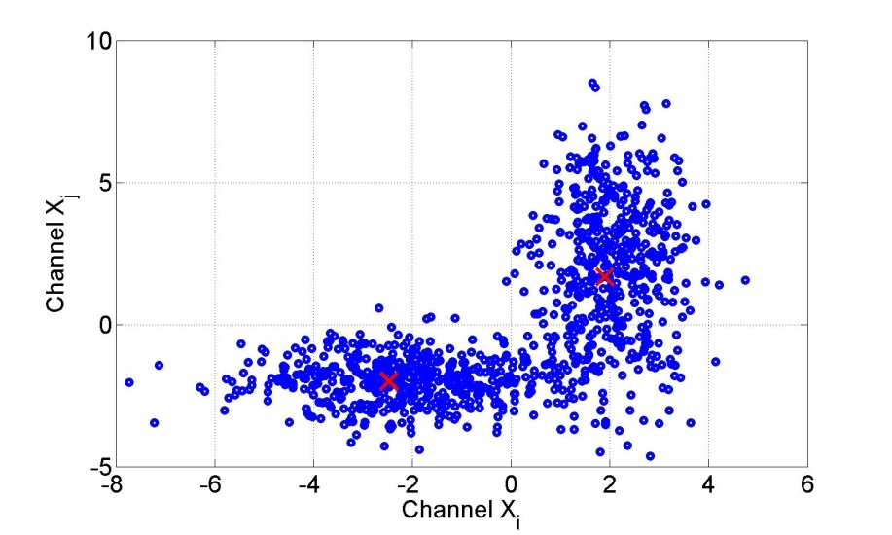
NoiseSubtraction:: Algorithms.Optimization
Principle-component analysis:
Avoids redundant information
Projects data onto subspace that contains all useful information
Not yet known if useful:
Clustering algorithm
Pattern recognition (unsupervised learning)

Slide 26
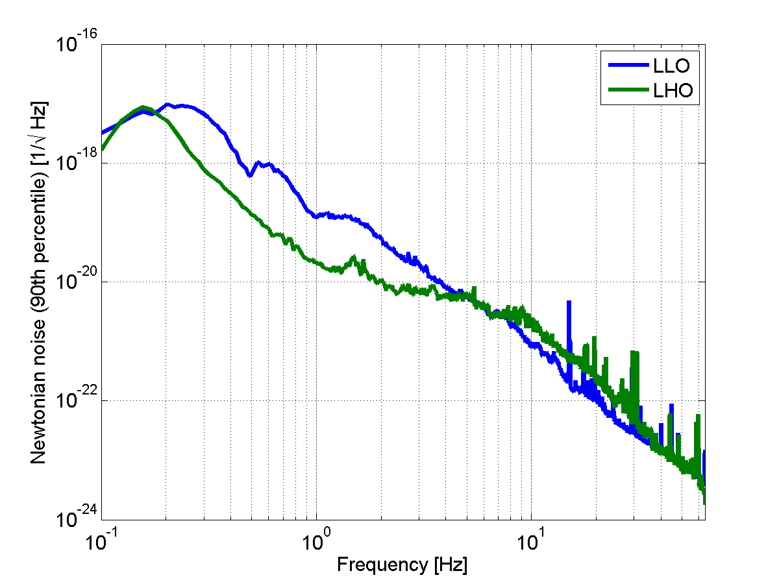
NoiseSubtraction:: Gedankenexperiment
Seismic spectra measured in April/May 2010 (30 days), 10am
4 orders of magnitude noise mitigation required at 3Hz to achieve .
Correlation between test masses is taken into account (based on estimate of Rayleigh-wave speed).
Will we ever be able to mitigate
99.99999% of the Newtonian noise…?

Slide 27
NoiseSubtraction:: Gedankenexperiment.Assumptions
Detector site is underground neglect atmospheric NN above 1Hz
Detector site is chosen wisely no large-scale scattering centers below average seismic-noise spectra plane surface
Sensitivity target is per rtHz
Surface seismicity model from LIGO sites

Slide 28
NoiseSubtraction:: Gedankenexperiment.(10Hz)
Source mystery.
Easy to mitigate.
Seismometers already exist.
Zone of influence: about 200m
Seismic filter = local filter
Gravity filter = global filter
Zone of influence = distance to most distant significant density fluctuations
1/100 by site selection + underground
1/5 by seismic filtering

Slide 29
NoiseSubtraction:: Gedankenexperiment.(1Hz)
No source mystery.
Difficult to filter due to residual surface effects.
Seismometers already exist.
Zone of influence: about 12km
1/5 by
seism. filt.
1/5 using
surface data
1/20 by site sel. + u.g.
1/20 by grav. filt.

Slide 30
NoiseSubtraction:: Gedankenexperiment.(0.1Hz)
No need to go (deep) underground.
Atmospheric Newtonian noise may be relevant.
Seismometers need to be developed.
Zone of influence: the whole Earth ; does NN average out to some extent?)
1/1000 by
matched filtering
1/5 by site sel.
1/1000 by higher-order noise projection
Seismic=1,000 x Instr.
1/5 by site sel.
1/10 by seism. filt.
1/100000 by grav. filt.
Seismic=1,000,000 x Instr.

