Slide 1
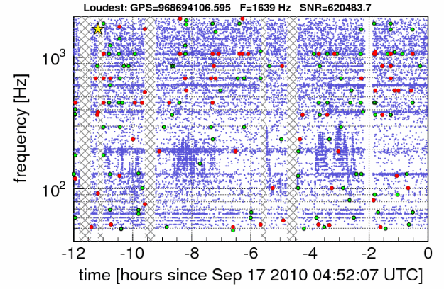
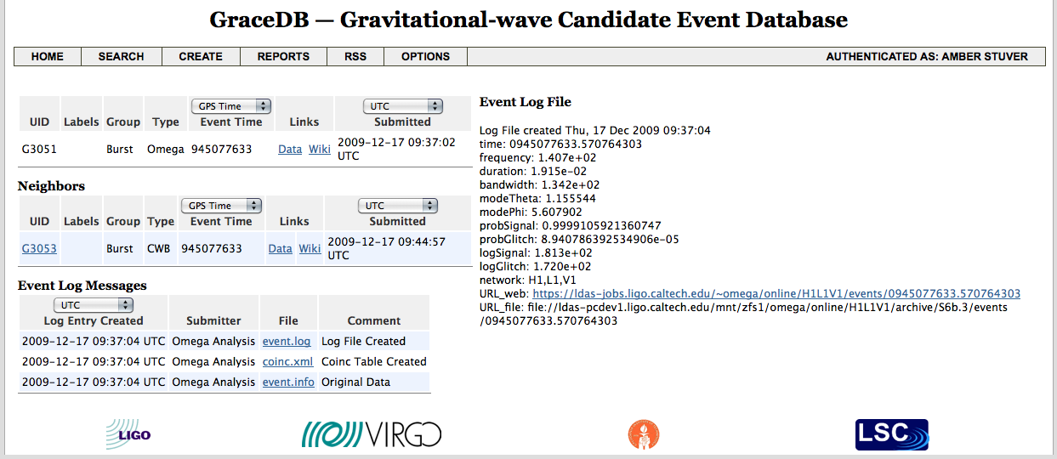
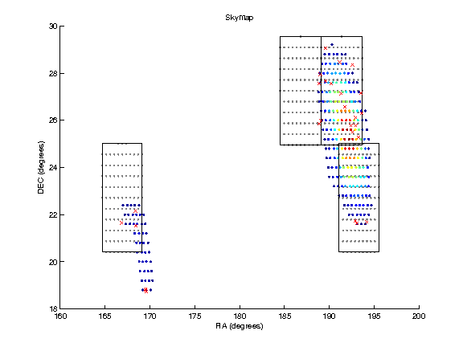
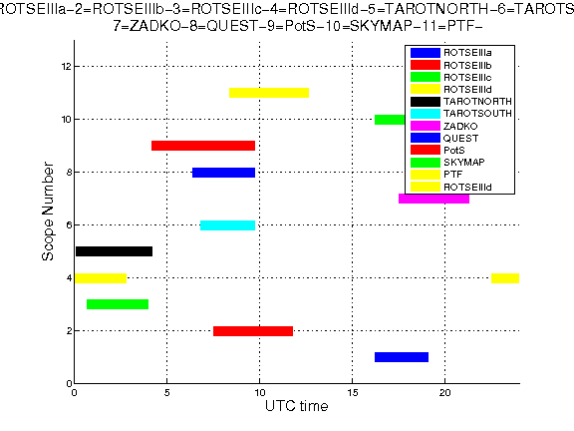
Low-latency Selection of Gravitational-wave Event Candidates
for Wide-field Optical Follow-up Observation
Amber L. Stuver
(LIGO Livingston Observatory)
For the LIGO Scientific Collaboration and the Virgo Collaboration
Abstract
Interferometric gravitational wave (GW) detectors have reached the sensitivity and refinement in data analysis to begin to participate in the multi-messenger astronomy community as an event generator. The LIGO and Virgo Collaborations have entered into MOUs with wide-field optical telescopes and developed an infrastructure to implement low-latency Target-of-Opportunity (ToO) requests in search of optical transients accompanying a candidate GW event. This infrastructure begins with the aggregation of near real-time candidate GW events in a database along with their significance estimation. If sufficiently significant, an automated set of scripts generates a proposed observing plan and vetting experts are notified via email, SMS and control room alerts. These experts then evaluate the observing plan and the performance of the interferometers to decide on the execution of a ToO request. Once a ToO is executed and the images and other post-processing information are collected from the telescopes, image-processing pipelines will seek to reveal candidate optical transients and measure their significance. Presented here is the detailed overview of this infrastructure as refined and executed during a winter 2009-2010 and summer 2010 follow-up run.
Generating Candidate Follow-up Events
Generating low-latency gravitational wave event candidates requires a maturity in every aspect of data analysis, including collecting data from various sites in a single location, calibration, event generation and cataloging. The LIGO and Virgo detectors have achieved this maturity and can now serve as an event source in the multi-messenger astronomy community.
Event Generators
Burst
Coherent Waveburst – a coherent network algorithm based on constrained likelihood analysis; returns reconstructed signal and most likely source location map.
Omega Pipeline – a multi-resolution time-frequency search for excess power on a single-interferometer basis followed by a coherent follow-up to coincident candidate events, which generates a source likelihood map and the strength of the event.
Compact Binary Coalescence
MBTA (Multi-band Template Analysis) – 2nd order post-Newtonian matched filter inspiral search which searches between 1-35 M and requires at least one mass to be consistent with a neutron star (<3.5 M).
Database Aggregation and Significance Estimation
Once a data analysis method has identified a candidate gravitational wave event, this information is stored in a central database called GraceDB (Gravitational-wave candidate event Database). Once the details of the event are cataloged, GraceDB contacts the central software control tool for the EM follow-up infrastructure called LUMIN (an analogous software package called GEM controls the selection of event candidates for follow-up by the Swift satellite.). LUMIN then determines the false alarm rate (FAR) for this event. If the FAR is below a certain threshold, for the summer 2010 run was <0.25 events per day, LUMIN will notify GraceDB which will then issue alerts in the form of control room notices and emails and/or SMS messages to follow-up experts.
Observing Plan Development
Candidate events are accompanied by a sky map which expresses the probability that the event’s source was located in a particular part of the sky. LUMIN will create an observing plan for each of the partner wide-field optical telescopes once it identifies an event for follow-up. This plan takes into account the number of images allowed by each telescope, the geographic location and field of view for each telescope, the probability densities of the sky map and the number of nearby galaxies in the areas of high probability.
Human Vetting for Follow-up
A trained expert on vetting candidate GW events for follow-up is continuously on duty. Their role is to rapidly coordinate with scientists at the detectors to evaluate their performance and suitability of an event for EM observation. Many steps in the vetting process can be, and are, automated; but until the low-latency follow-up infrastructure is mature and thoroughly tested, humans perform the final event vetting and decision making regarding ToO observing requests.
Check that the event is not near the beginning or end of a data segment
The data near the beginning and end of a data segment is not always free of transients. Because of this, we require that a candidate event for follow-up not be within the first minute of a data segment (there is still a small possibility that transients from realigning the interferometer are present) or within 2 minutes before the end of a data segment (instrumental effects that may have caused the end of the segment may be present). This has been incorporated into an automated vetting suite.
Check the data quality around the time of the event
As the data are being acquired, background processes index times when issues that can affect data quality are present (e.g. the sound in a microphone beside the detector showing an airplane passing, etc.). These indices are checked to insure that no critical data quality issues during the candidate event are present. This has been incorporated into an automated vetting suite.
Check the detector ‘glitch’ rates around the time of the event
Other noise transients, known as glitches, can contaminate the data besides known issues as described above. There are 2 online glitch monitors that allow rapid checks on the rates of these at a given time:
Discuss each detector’s performance with the on site scientist
A continual internet conference exists between the detector control rooms and the vetting expert. When there is a candidate event for follow-up, the scientist on duty at each site actively participates in the vetting and describes if there are any issues obvious to them that would preclude this event from being followed up with EM observations.
Omega – a reapplication of the core algorithm of the Omega Pipeline. A visual inspection of the time-frequency scatter plot allows an effective check for times or frequencies with unusually high glitch rates.
KleineWelle – a wavelet-based analysis that identifies times and frequencies with excess energy. KleineWelle glitch rates need to be <1/sec for the 5 minutes before and 1 minute after the event. This has been incorporated into an automated vetting suite.
To the right is a GraceDB report of a blind-injection event that was used to test the EM follow-up infrastructure.
Above is a the time-frequency scatter plot of Omega glitches. Consistent density is sought when vetting, e.g. between -2 and 0 hours but not around -8 hours or between -4 and -2 hours.
After Vetting…
Once a candidate GW event has been successfully vetted for EM follow-up, a ToO observing request is issued to participating telescopes. They will then image the requested areas that are in their field of view as environmental conditions allow. Raw images and/or other post-processing information are returned to the GW EM follow-up effort and are analyzed by for optical transients.
Besides Wide-field Optical…
The LIGO and Virgo Collaborations have also entered into MOUs with gamma & UV (Swift), radio (LOFAR) and narrow-field optical (Liverpool) telescopes. With a few exceptions (e.g. lower FAR for Swift follow-up), the event generation and vetting for these events are the same.
Sample source localization probability map with selected areas for imaging framed in black boxes.
Sample plot of times when each wide-field optical telescope is able to image a requested area of the sky.
This document is in the LIGO DCC as LIGO-G1100001-v3.

