Slide 1
Low-latency Selection of Gravitational-wave Event Candidates for EM Follow-up Observation
Amber L. Stuver
LIGO Livingston Observatory
for the LIGO Scientific Collaboration &
the Virgo Collaboration

Slide 2
GW and EM Multi-messenger Astronomy
Gravitational Waves:
Bulk motion dynamics
Luminosity distance
Progenitor mass
Direct probe of central engine
Light Curve & Spectrum:
Host galaxy
Gas environment
Red shift distance
Precise sky location
Combining these observations will also increase detection
confidence, give a full picture of progenitor physics and allow
a measurement of the local Hubble constant.
Notes:
Coupled observations with GW observations can lead to refined models of the system:
GW signals directly trace the bulk motion of the mass in the source
EM signals refine source position from degrees to arcseconds and can give redshift information

Slide 3
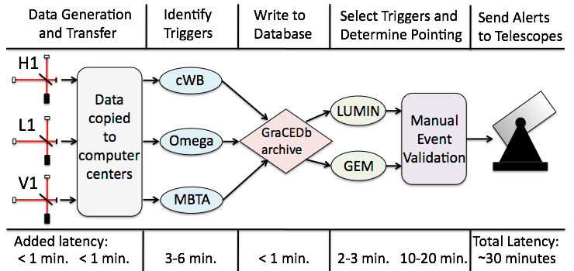
Low-latency Event Selection Pipeline
The speed and sophistication of LIGO’s data analysis methods and other infrastructure have developed to the point that we can now produce low-latency candidate GW detections for EM follow-up.
Notes:
Data Generation & Transfer -> Trigger Generation -> Database Writing -> Selection of Triggers and Area -> Send Alert

Slide 4
Data Analysis Methods
Burst
Coherent Waveburst – a coherent network algorithm based on constrained likelihood analysis; returns reconstructed signal and most likely source location map.
Omega Pipeline – a multi-resolution time-frequency search for excess power on a single interferometer basis followed by a coherent follow-up to coincident candidate events, which generates a source likelihood map and the strength of the event.
Compact Binary Coalescence
MBTA (Multi-band Template Analysis) – 2nd order post-Newtonian matched filter inspiral search which searches between 1-35 M and requires at least one mass to be consistent with a neutron star (<3.5 M).

Slide 5
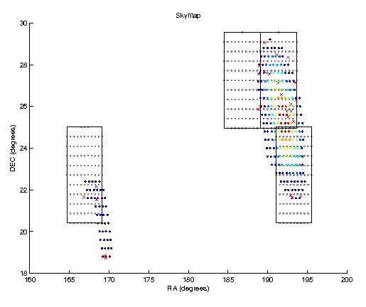
Source Localization and EM Partners
Source localization up to 10s of square degrees.
Partner with wide-field optical (FOV of several degrees), X-ray & radio telescopes and prioritize observations to areas with known galaxies within expected sensitivity range.
LIGO & Virgo have run generating ToO observing requests during 2 periods of the last data run.

Slide 6
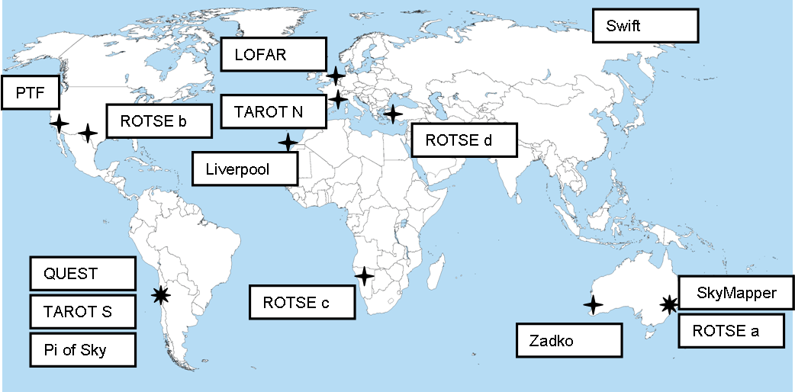
Telescope Network
Used in:
winter ‘09 and
autumn ‘10 run
autumn ‘10 run only

Slide 7
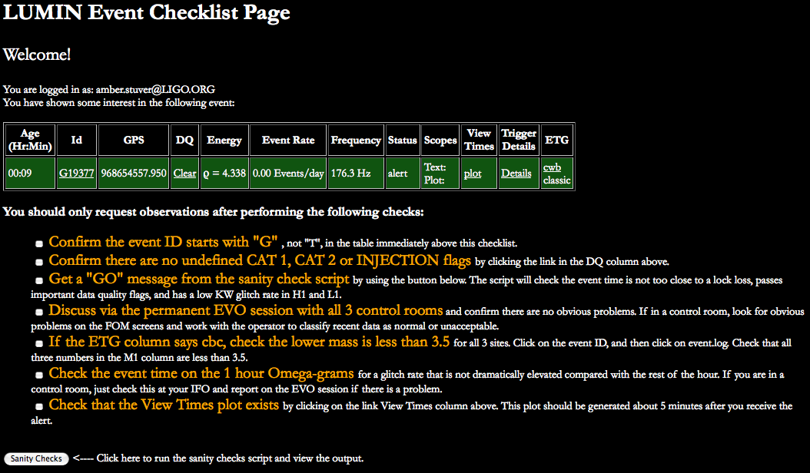
Human Vetting of Events

Slide 8
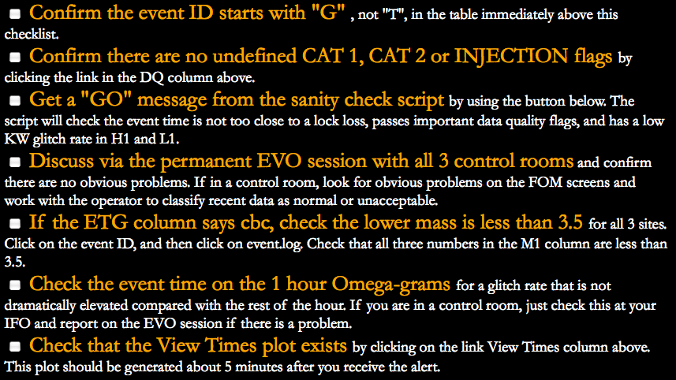
Human Vetting of Events

Slide 9
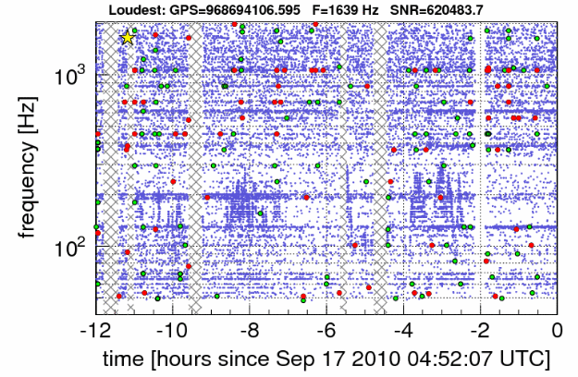
Example Omega-gram
Omega-grams are a reapplication of the Omega pipeline seeking noise transients (glitches).
Consistent, low density is sought in the glitches on the time-frequency plot.
Consistent
density
Elevated
glitch rates

Slide 10
Example Event: The “Big Dog”
In the early morning of 16 Sept. 2010, an exceptional event was seen in the LIGO-Virgo network localized within the Canis Major constellation.
An alert was sent to human vetters for validation within 8 minutes and the event was sent out for ToO observation within 40 min.
The areas of interest were first observed 44 minutes after event by TAROT (later by ROTSE, SkyMapper, ZADKO, and Swift).
This event was later revealed to be a blind injection.
Notes:
tiles: TAROT (1), ROTSE (1), SkyMapper (5), Zadko (5 points), Swift (2 points).

Slide 11
Continuing Work
A methods paper for this work is being prepared for publication.
The development of image analysis pipelines are being undertaken by a number of LIGO and Virgo collaborators.
This includes work to evaluate the efficiencies of these pipelines and to measure the background for each telescope.
A results paper will be published in the future.

