Slide 1
Radiative Cooling Thermal Compensation for Gravitational Wave interferometer mirrors.
Justin C. Kampª, Hinata Kawamura^{b}, Roberto Passaquieti^{c}, and Riccardo DeSalvo^{d}
a) Chalmers University of Technology, SE-412 96 Goteborg, Sweden
b) Yokoyama middle school, Sanda, Hachioji, Tokyo, 193-0832, Japan
c) Dipartimento di Fisica ‘‘Enrico Fermi’’ and INFN Sezione di Pisa, Universita` di Pisa, Largo Bruno Pontecorvo, I-56127 Pisa, Italy
d) LIGO Observatories, California Institute of Technology, Pasadena, CA 91125, USA

Slide 2
High power interferometers
The main Fabry Perot mirrors of advanced interferometers will be subject to almost a MW of standing laser light over a Gaussian spot size of ~6 cm radius
high reflectivity coatings absorb >0.25 ppm
The mirrors receives 0.25 ~ 0.5 W of heating
The deposited power distribution matches the stored beam profile

Slide 3
Thermal lensing problem
Thermal lensing impede the performance of the interferometer
Problem already present in Virgo and LIGO at lower power, due to the higher absorption of their mirrors

Slide 4
Present solution
Thermal Compensation System (TCS)
shape an annular CO₂ laser beam and project it on the mirror periphery
generate counter thermal lensing
Problem for Advanced interferometers:
Radiation pressure and thermoelastic noise on test mass affect the GW signal

Slide 5
Advanced solution
Hot ring on a compensation plate
Generates negative thermal lensing on an optical element that does not otherwise affect the interferometer performance
Technique tested on main mirrors by GEO

Slide 6
Advanced Virgo problem
Very difficult to implement compensation plate

Slide 7
Alternative solution
Directional cooling of the stored beam spot
Passive, no forces on the test mass

Slide 8
Directional Radiative Cooling (DRC) working principle
Image a cold surface on the laser spot
The thermally radiated heat from the spot is absorbed by the cold target
The cold target, being colder, returns less heat to the laser spot

Slide 9
DRC basics
DRC takes advantage of the heat emitted by the spot BECAUSE it is at room temperature
Simply balances the laser deposited power with robbed thermal power
DRC applied in absence of stored power would generate a cold spot on the mirror

Slide 10
DRC Facts
The mirror is subject to less thermal radiation radiation pressure
actually quieter than without cooling
  (no practical advantage though)

Slide 11
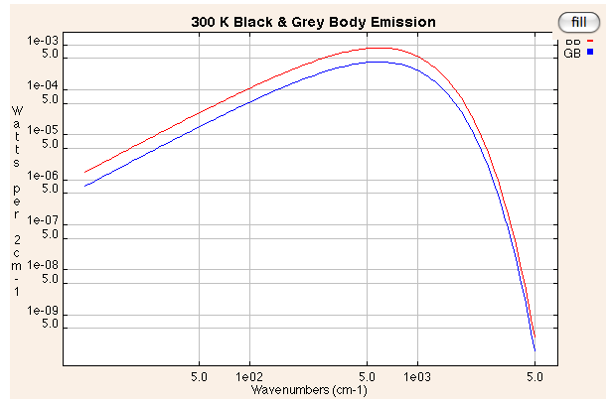
Feasibility of DRC
At room temperature a black body emits 146W/sr-m²
Fused silica emissivity is close to that of a black body 0.93 engineering toolbox http://www.engineeringtoolbox.com/
A 6 cm radius spot emits 1.64W/sr
Black Body Emission Calculator http://infrared.als.lbl.gov/calculators/bb2001.html
0.25-0.5 sr coverage sufficient to
rob the 0.25—0.5W deposited
by the laser spot

Slide 12
DRC required temperature
Liquid nitrogen cooled black bodies emit only 0.4% thermal radiation than a room temperature body
Li-N₂ targets would be 99.6% efficient

Slide 13
How to “direct” radiative cooling
Proximity cooling
Baffled cooling
Imaging cooling

Slide 14
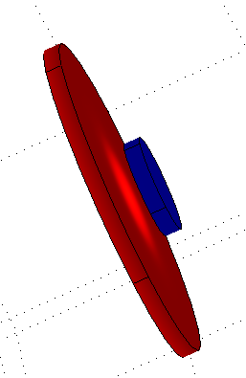
Proximity DRC
A 6.2 cm radius, liquid-nitrogen-cooled disk placed in front of the test mass would suck out 5.1 W
Advantages:
  simple solution
Disadvantages:
  Obstruct the stored light beam
  Suck out too much power

Slide 15
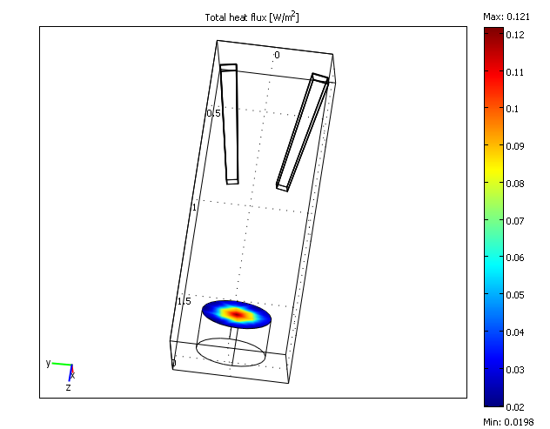
Baffled DRC
A large Li-N₂ target is used
Pyramidal Baffles restrict the line of view of the cold target to the stored beam spot
Pyramids can be located outside the beam line outer envelope

Slide 16
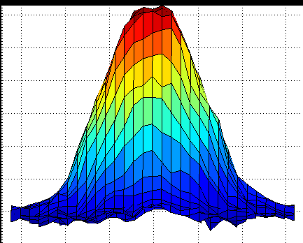
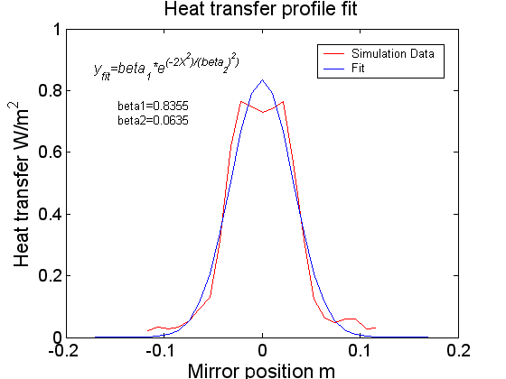
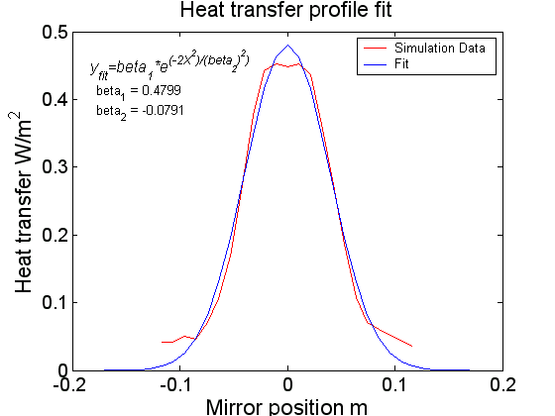
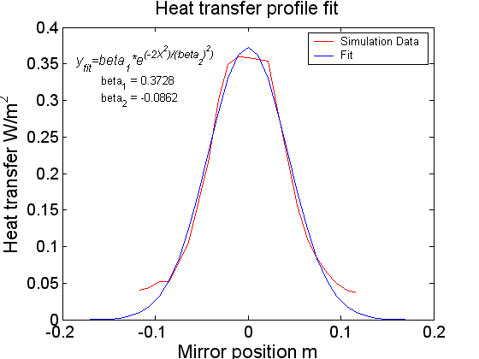
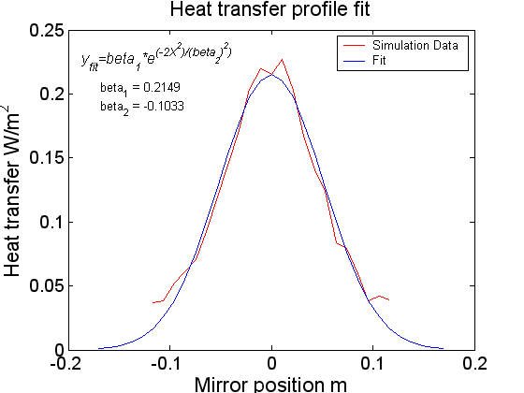
Baffled DRC de-focussing
Cooling spot can be defocussed to mimic a Gaussian by playing with longitudinal positioning of the baffles

Slide 17
Baffled DRC disadvantages
Advantages
  Large cooled surface acts as cryo-pump for organics
Disadvantages
  Bulky baffle array,
  Large Li-N₂ cooled target
  Large cooling power requirement, potentially mechanically noisy

Slide 18
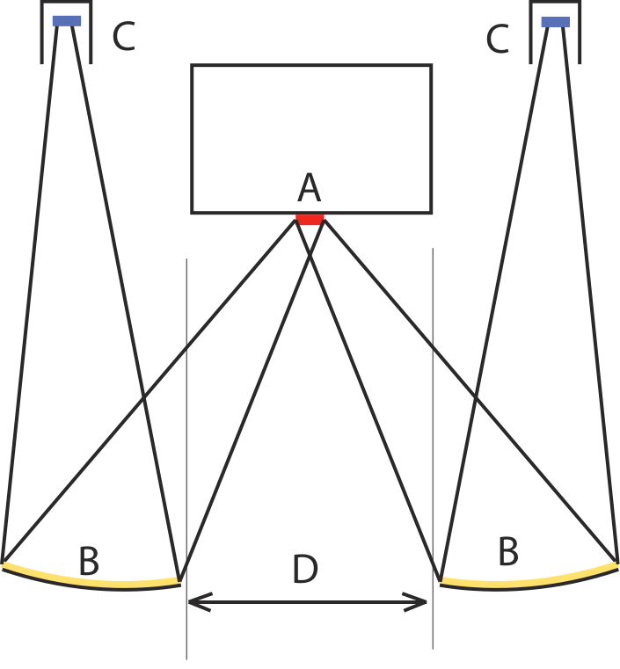
Mirror focused DRC
One or two small Li-N₂ cooled targets focused with Au plated spherical mirrors on stored beam spot
Mimic Gaussian spot profile by moving cold targets out of focus

Slide 19
Controlling DRC power
Three methods
  Iris control
  Target temperature control
  Hot resistor power balance

Slide 20
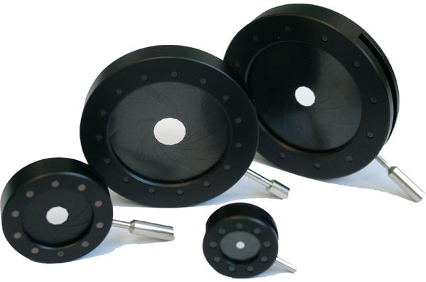
Iris DRC power Control
The DRC cooling power is directly proportional to the cold target area used.
An iris placed in front of each target would naturally tune the cooling power
Disadvantage:
  Mechanical parts in vacuum

Slide 21
Iris DRC power Control
Advantage:
  A fixed iris can be used for static cooling power controls, to match the absorption of individual coatings and minimizing the dynamic range of active power controls

Slide 22
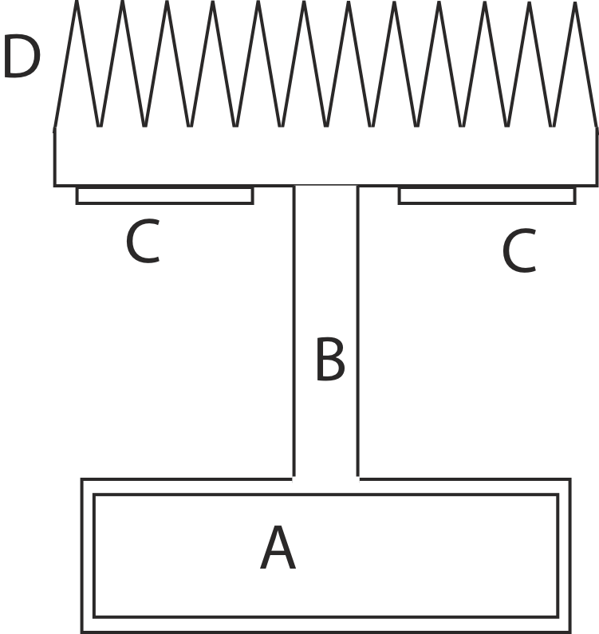
Target temperature Control
The cold target “D” is separated from the Li-N₂ cooling bath “A” by a thermal resistor “B”
The cold target temperature is controlled by a resistor “C” mounted on the cold target
Disadvantages:
  Reaction time of several seconds
  Dumps power in thermal bath
Advantages:
  Can be used for small corrections

Slide 23
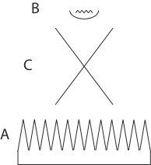
Hot resistor DRC power Control
The cold target “A” is placed behind the mirror focal plane “C”
A back shielded resistor “B” is placed in front of the focal plane
Both defocused to generate Gaussian profile, the heating modulatable
Disadvantages:
  Heating power fluctuations can generate thermo-elastic noise on the main mirror,
    can use with interferometer off,
    need to limit the resistor applied power
Advantages:
  Fast reaction times (low resistor heat capacitance)
  Does not dump power in thermal bath

Slide 24

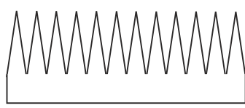
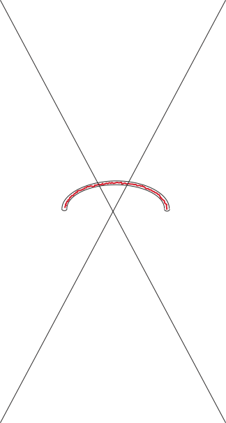
Focused RTC further option
Hot ring placed in focal plane
is imaged on the mirror, can change mirror focal length
Advantage:
  Fine mirror focal length controls even in absence of beam power
Disadvantage:
  Possible thermo-elastic noise
    Useful with interferometer off

Slide 25
Experimental measurements

Slide 26
Experimental Setup schematics
Spherical mirror
Liquid N₂ trap
(or heating lamp)
Separation wall
Thermometer array
External structure

Slide 27
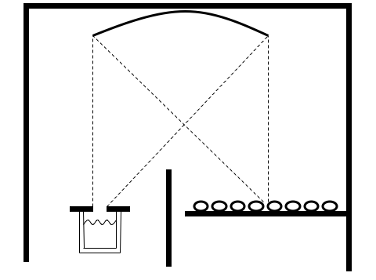
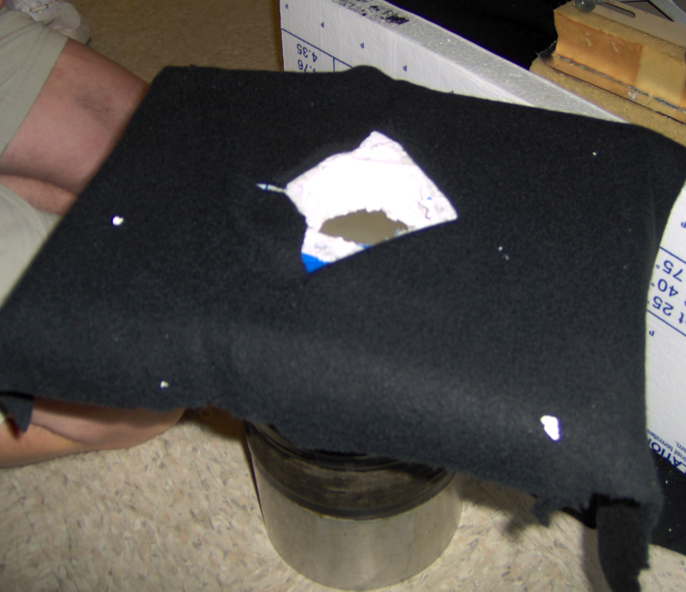
Liquid Nitrogen trap
62.5mm diameter orifice
Dewar

Slide 28
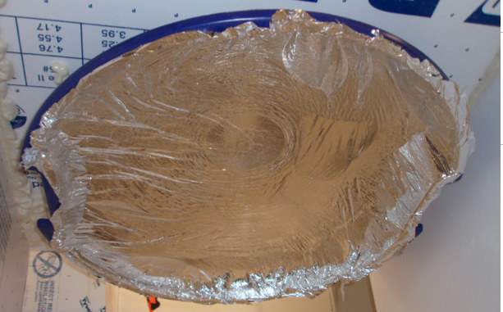
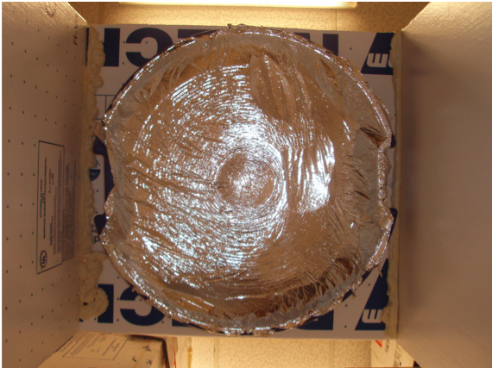
Parabolic mirror
We made the parabolic mirror with super insulation foil glued on a circular sled as support.
Super insulation
foil
Circular sled

Slide 29
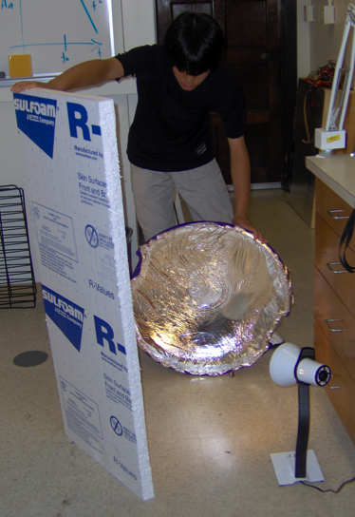
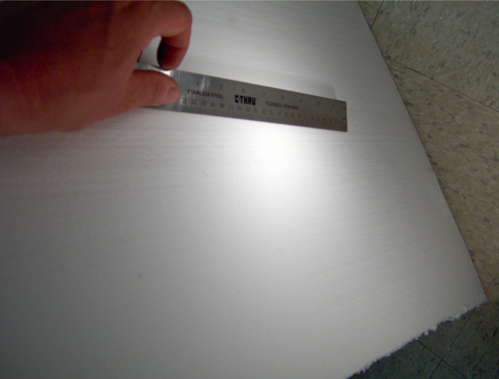
Building and testing the mirror

Slide 30
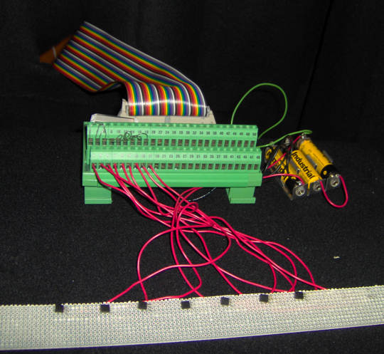
Thermal sensors
Thermometer
array
(LM19)
2.5cm
There were 8 thermal sensors, one broke half way. At the end only 7 thermal sensors left.

Slide 31
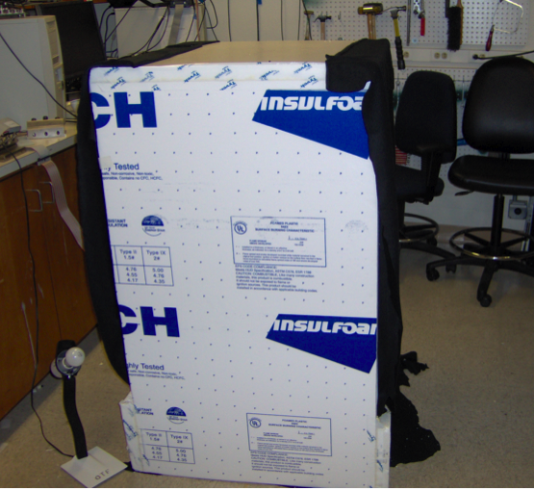
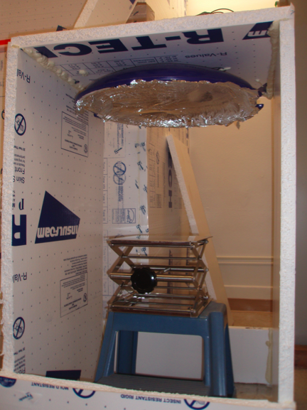
Building the box
Lined with black
Felt to absorb
Diffused radiation
Before lining

Slide 32
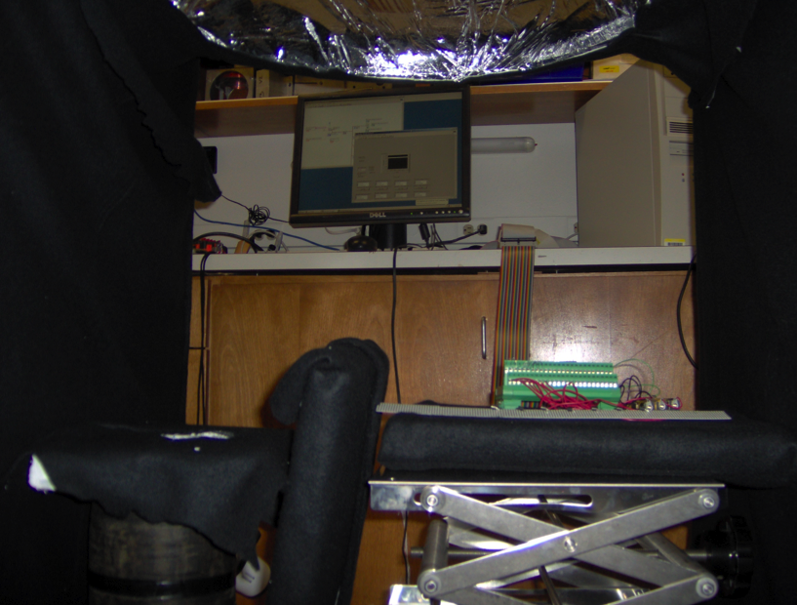
Cold trap set-up
Acquisition computer
Parabolic mirror
Liquid Nitrogen
Thermal sensor array

Slide 33
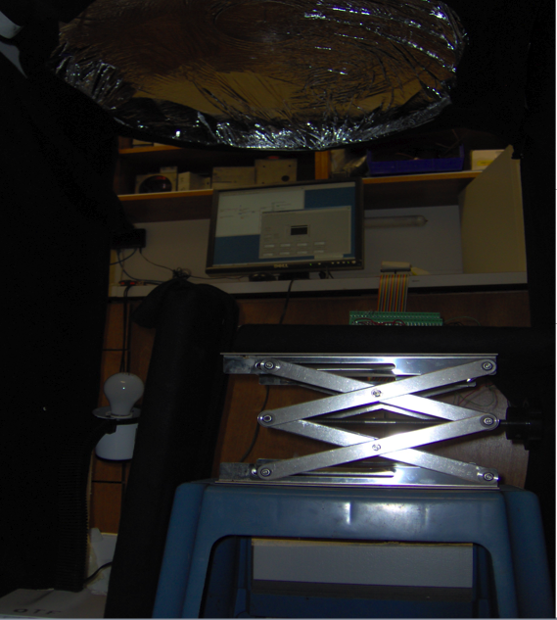
40 W heater Lamp setup
Parabolic mirror
Acquisition computer
Thermal sensor array
40 W Lamp

Slide 34
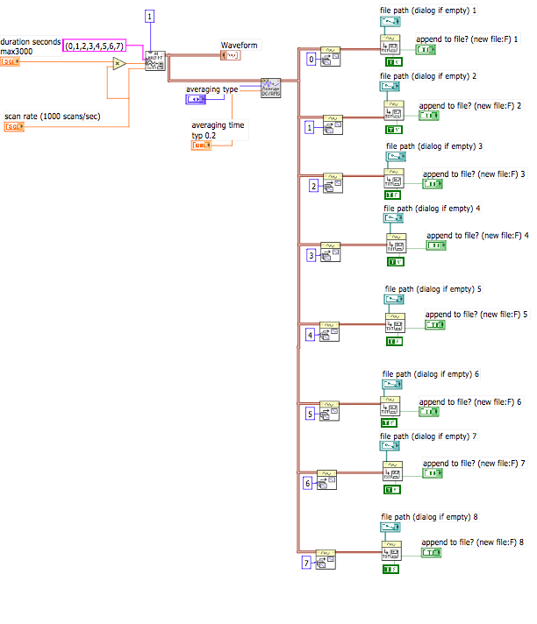
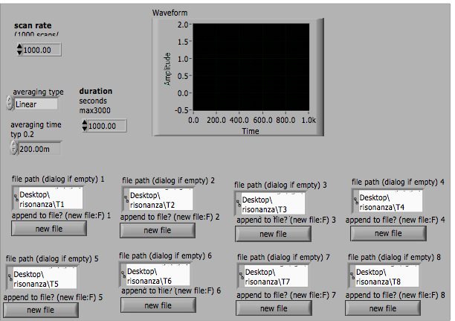
display
Write on disk
Acquisition
Averaging

Slide 35
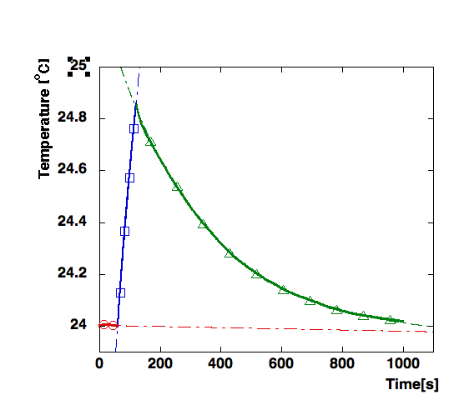
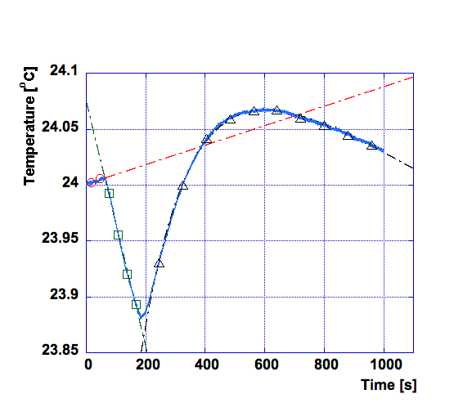
Warming and cooling cycle
Heating lamp on
Linear rise fit
Cold trap open
Linear cooling fit
Baseline linear fit
A
Exponential decay
and slope fit
B
Exponential decay fit
B
Baseline linear fit
A
Thermal Power= slopeA - slopeB [oC/s]

Slide 36
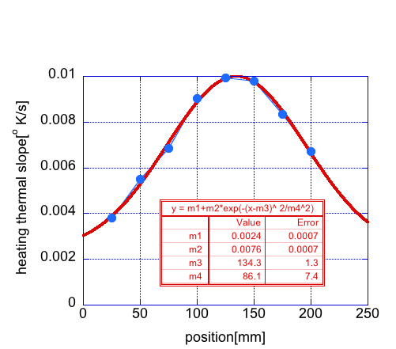
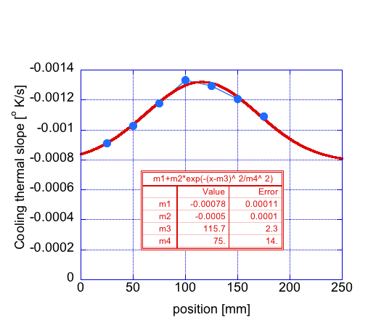
Energy deposition/extraction
cooling
heating
m4
m2
Exchanged power = Gaussian spot surface S = m2*m4

Slide 37
Results
Gaussian fit area results
  1.9W heating => S = 0.685±0.02
  Li-N₂ cooling => S = 0.056±0.028
Cooling power
  Measured
  1.9 [W] x (0.685/0.056) = 155±78±39 mW
  Theoretical (all ε= 1) 262 mW

Slide 38
Conclusions
Demonstrated the feasibility of
focused radiative cooling
Directly suck heat from mirror laser spot
Passive and remote operation (low risk)
Neutralize thermal lensing without perturbing the test masses
Remote mirror focal length tuning capabilities
Cryo pumping of organics impurities

