Slide 1
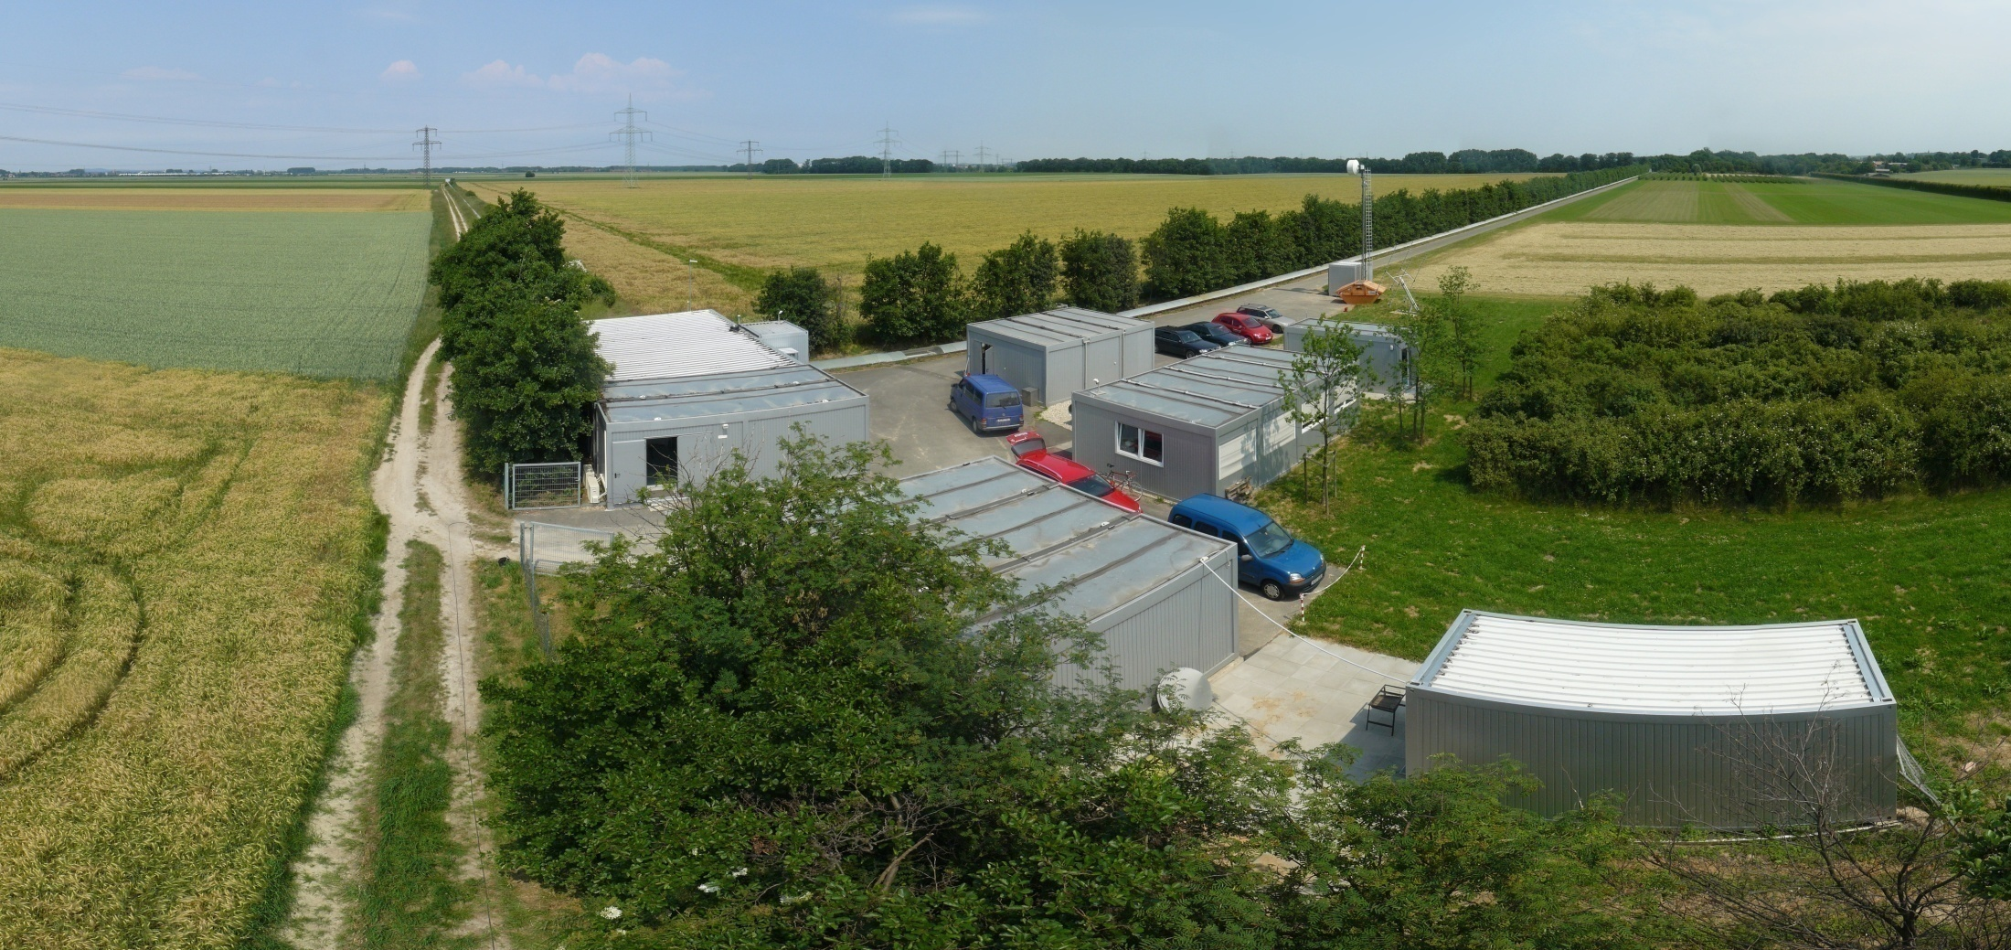
GEO Status
Harald Lück
LVC meeting
Amsterdam September 22nd 2008

Slide 2
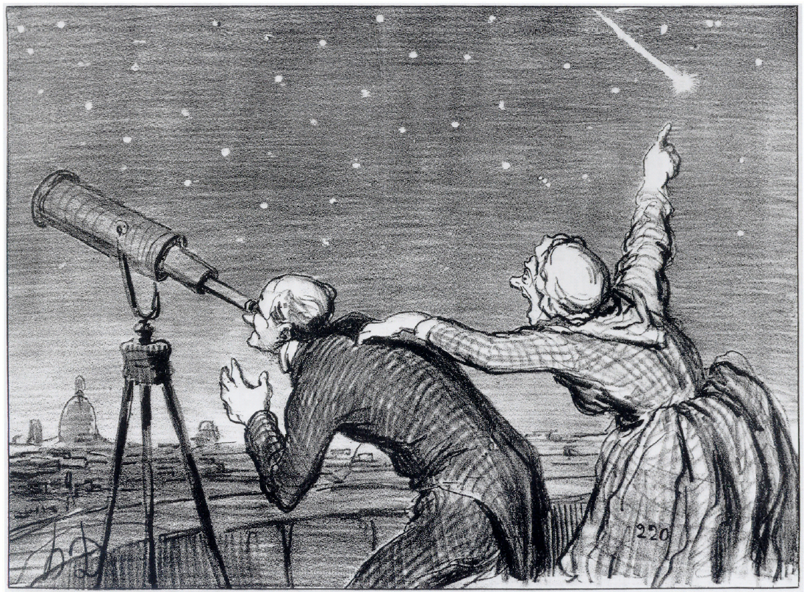
GEO600 still in Astrowatch (Oct.2007 – Spring 2009)
Always observing but only doing triggered data searches

Slide 3
GEO600 Sensitivity Evolution

Slide 4
Astrowatch science time
November 2007: 81.1%
December 2007: 81.5%
January 2008: 89.1%
February 2008: 86.6%
March 2008: 76.0% (DAQS problems)
April 2008: 90.9%
May 2008: 92.1%
June 2008: 91.2%
Juli 2008: 83.1%
August 2008: 83.6%
Sept. < 16. 2008 91.6%
______________________________________
TOTAL 10.5 mon.: 85.8% y 275 days

Slide 5
Maintaining the sensitivity
...a constant effort to keep entropy constant...
Electronics aging
MTTF's
~100.000 Solder joints -> ~1 / year (~3)‏
~5000 Opamps -> ~1/50 years (~1)‏
29 LC modules -> ~1/8 months (~1)‏

Slide 6
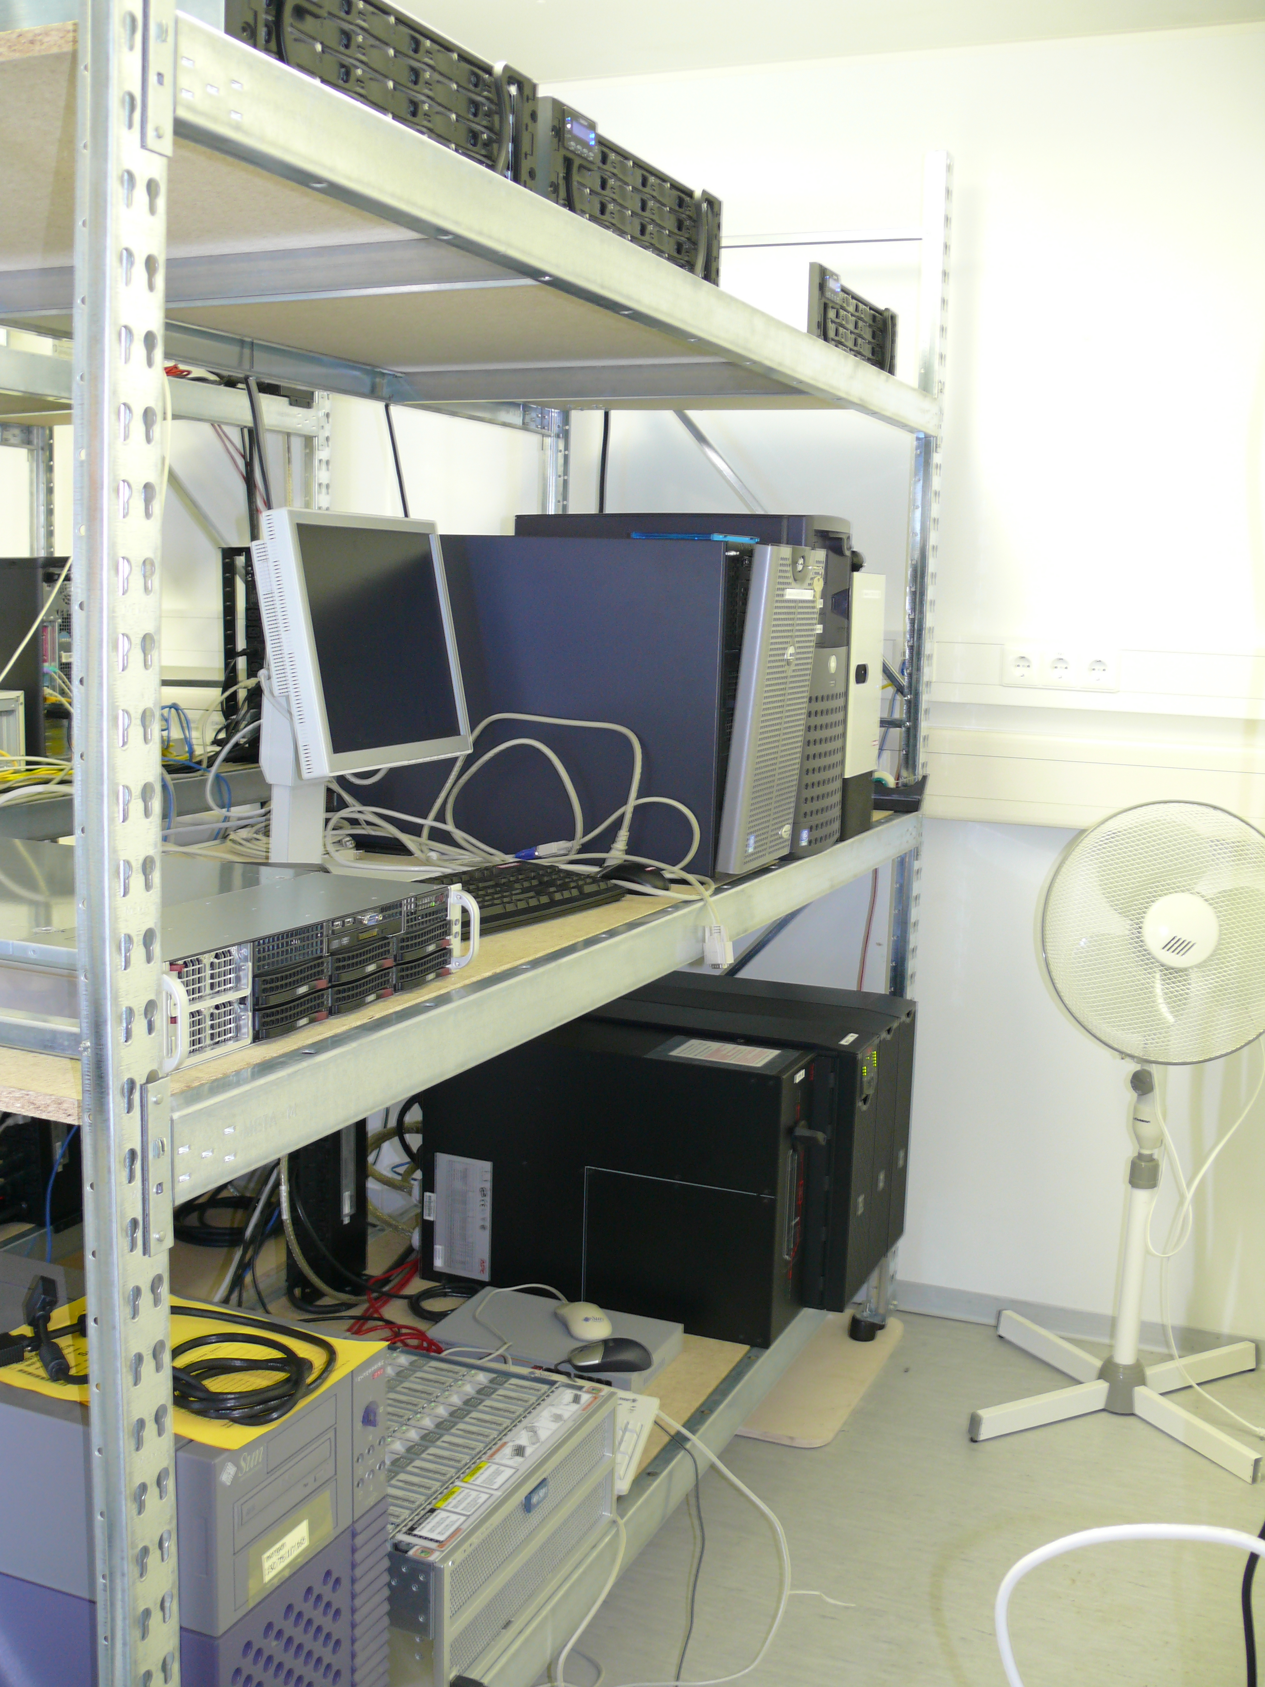
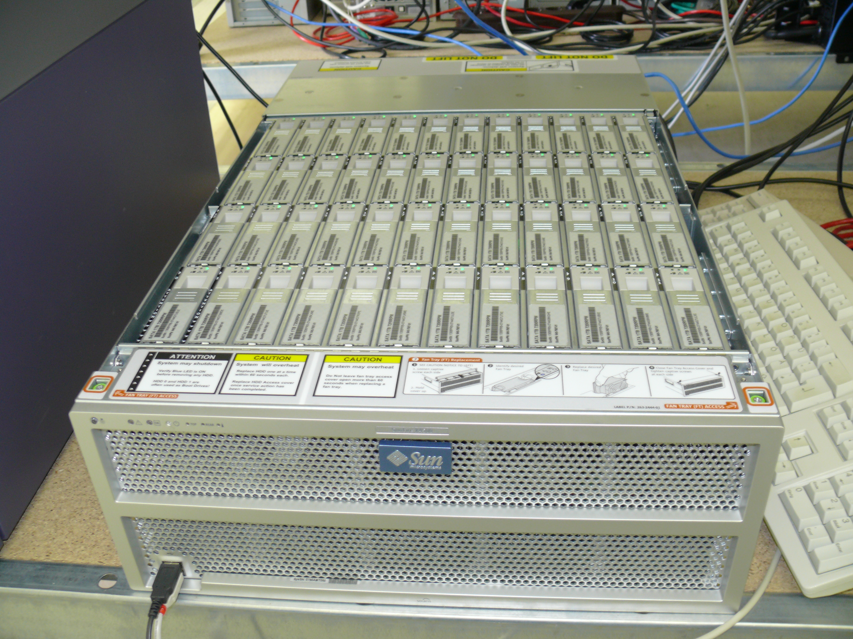
New on-site data storage and processing system
8TB
8TB
8TB
48TB + 3x8TB + 2TB
100 days of h(t) frames
200 days of raw data
10 days of frame data
2TB
4x4 XEON
48TB

Slide 7
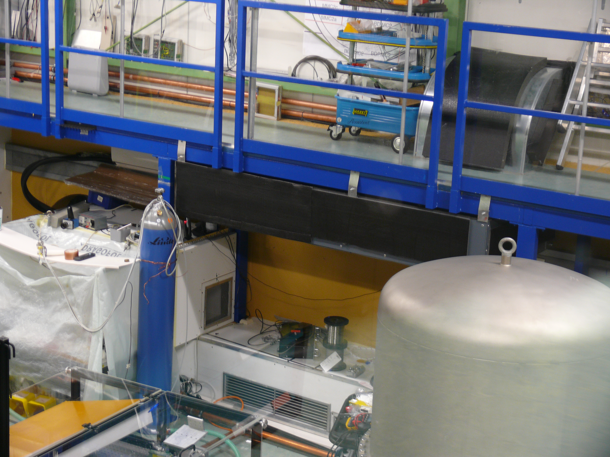
AC inlet
Silencer

Slide 8
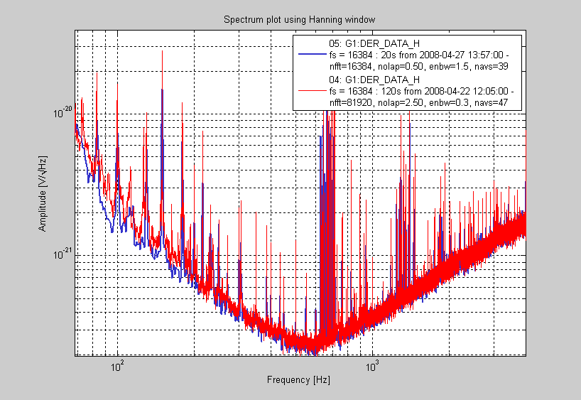
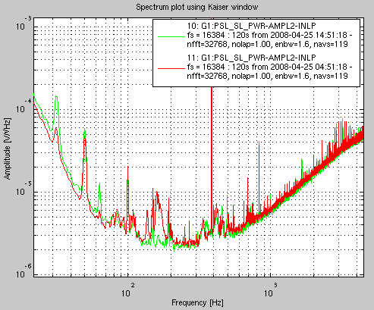
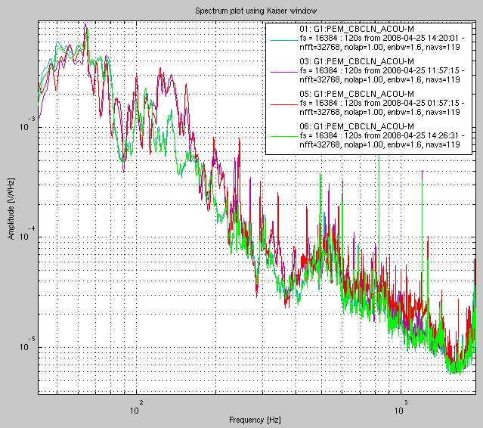
Some small improvements from silencer
Acoustics
Laser intensity noise

Slide 9
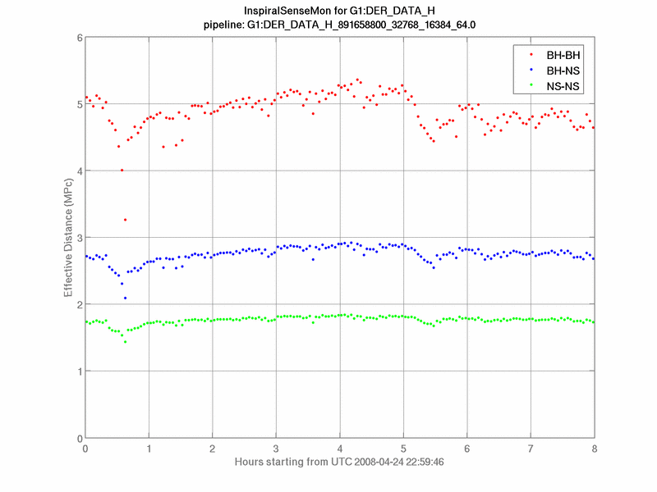
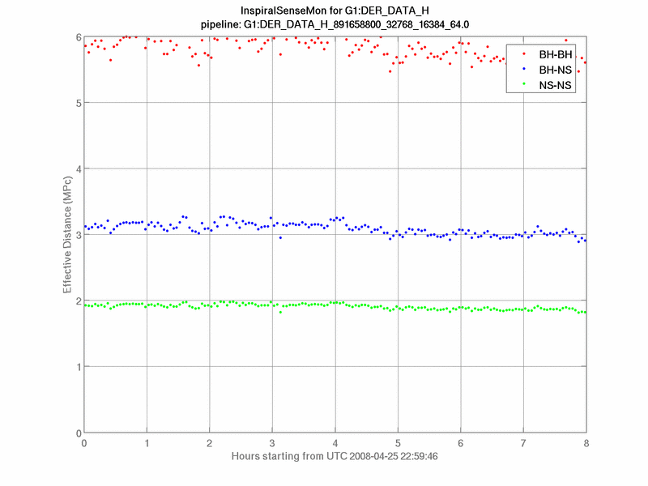

Slide 10
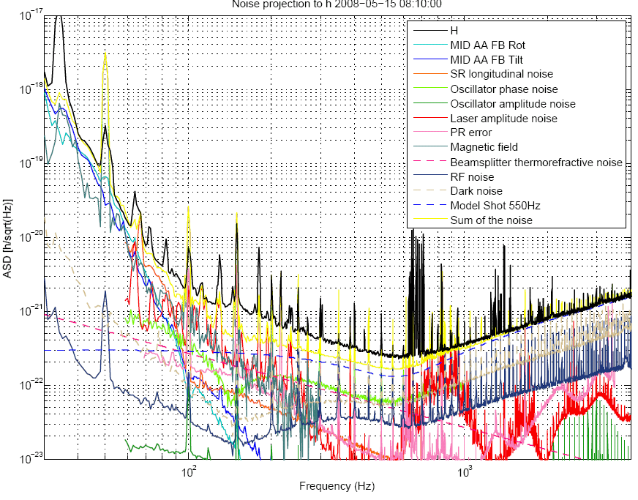
Understanding the noise… Noise projections

Slide 11
Plans
Until Spring 2009: Astrowatch + low-risk commissioning until Enhanced IFOs come online
After Spring 2009: Upgrade GEO600 towards GEO HF
Keywords: DC readout, squeezing, tuned SR, lower SR factor, OMC, higher power, thermal comp., extend digital control...

Slide 12
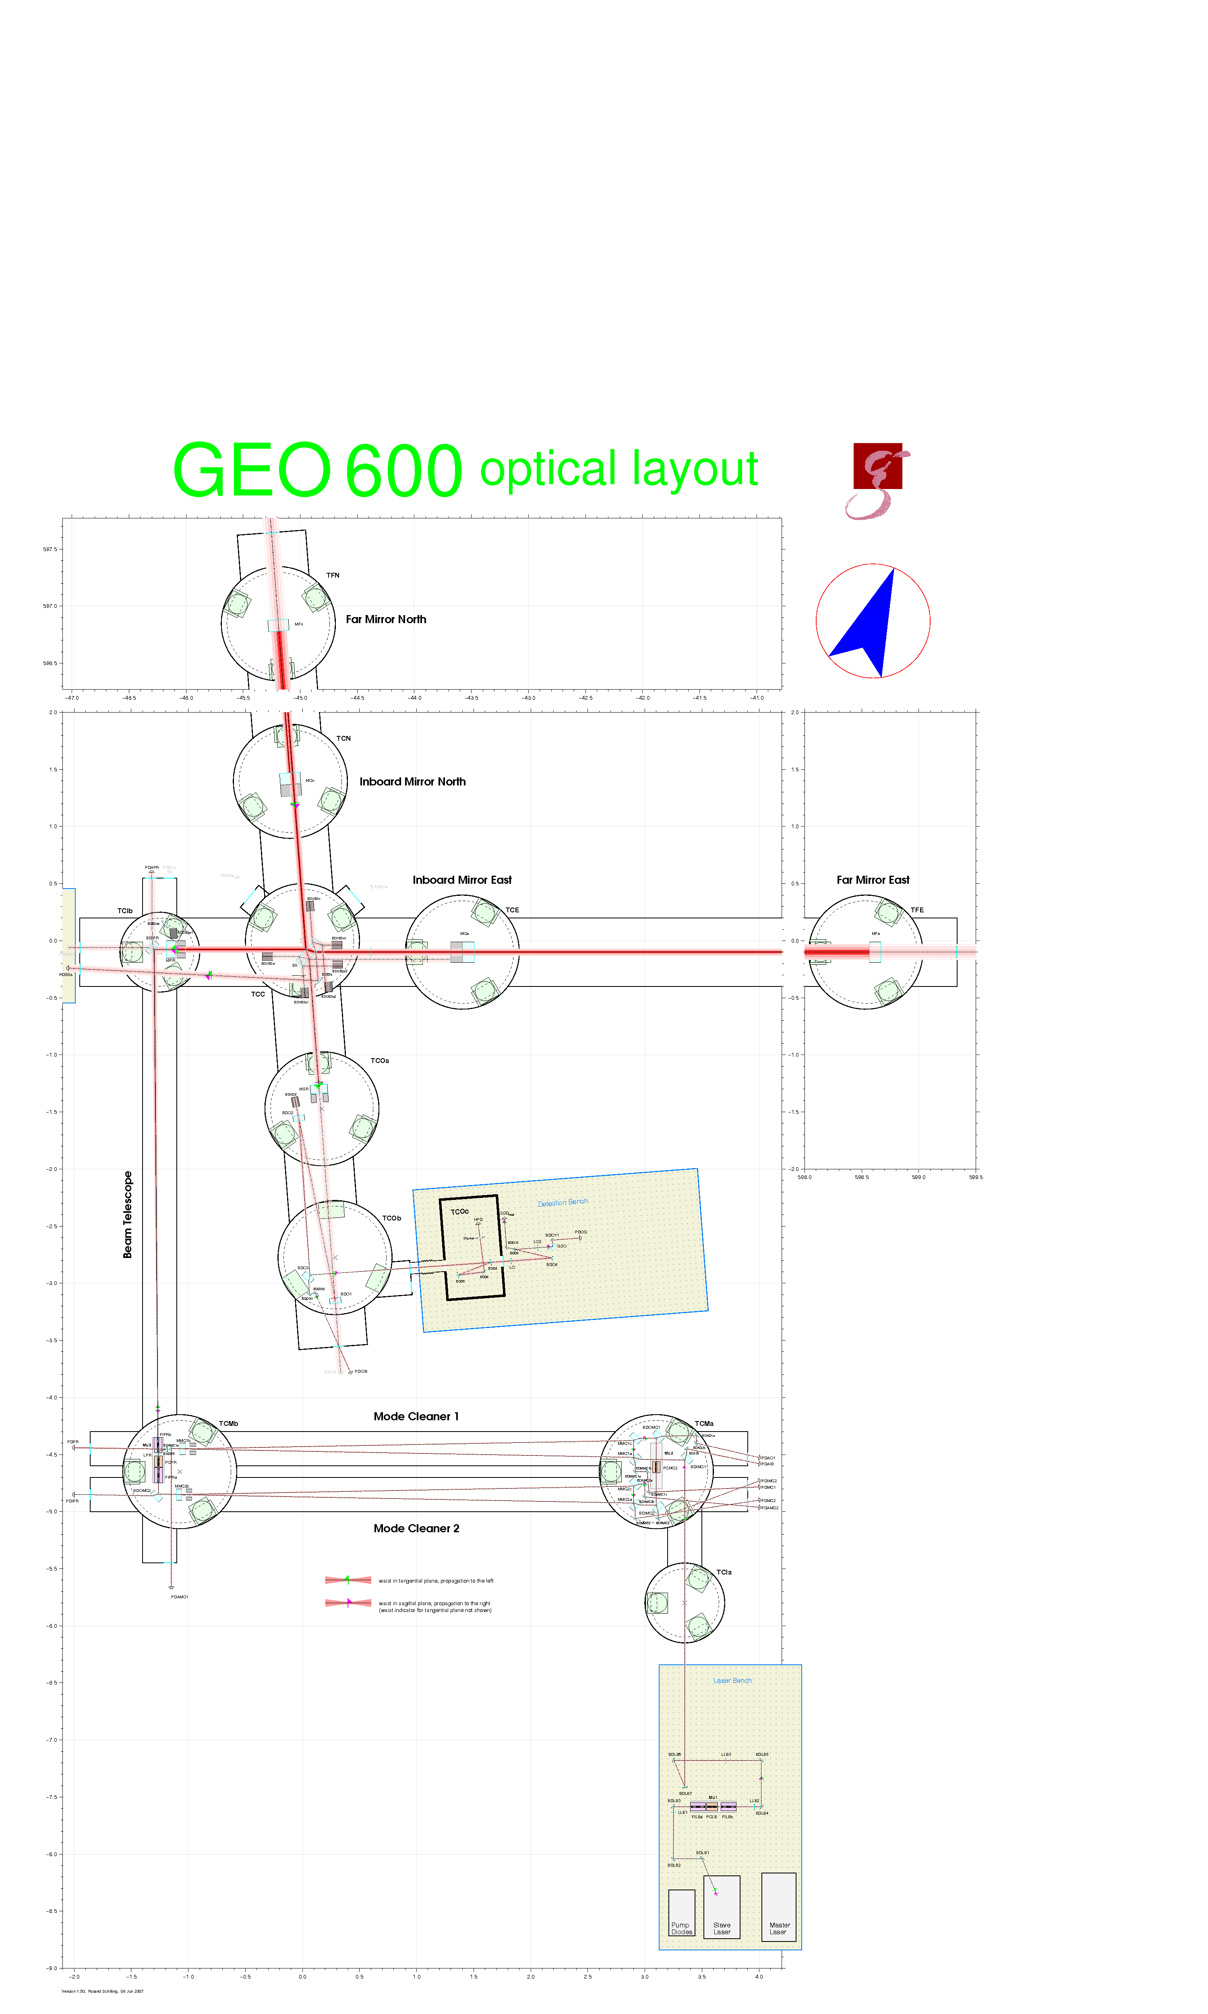
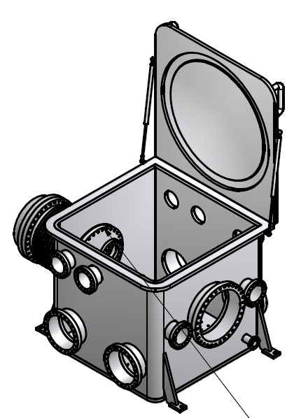
Now:
Auto Alignment on detection bench
Main photo detector on detection bench outside vacuum system
Then:
Auto Alignment on new AA bench
Main photo detector in additional vacuum tank
OMC to reduce higher order TEM mode contributions to detected light

Slide 13
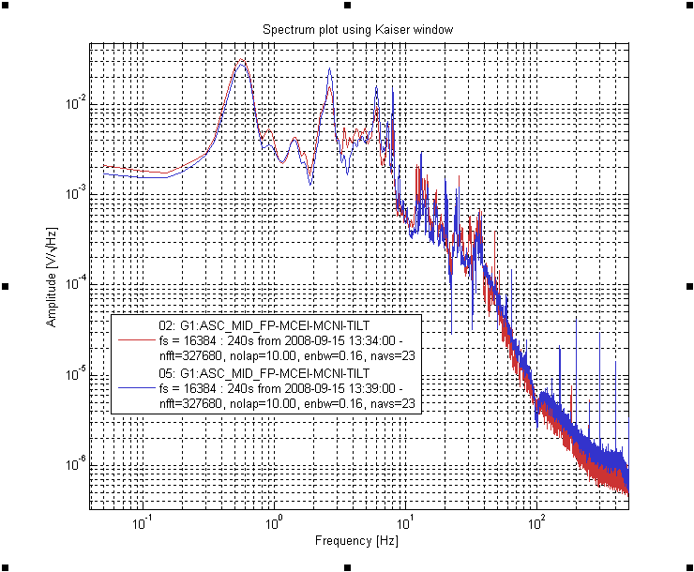
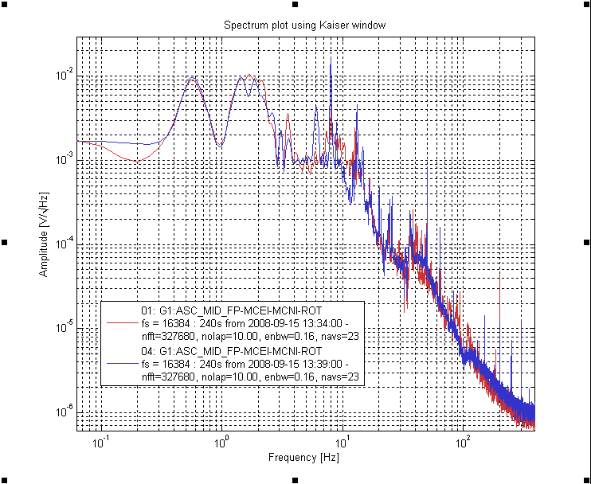
New and old AA board
1% of DF
5% of DF
Tilt/Pitch Rotation/Yaw

Slide 14
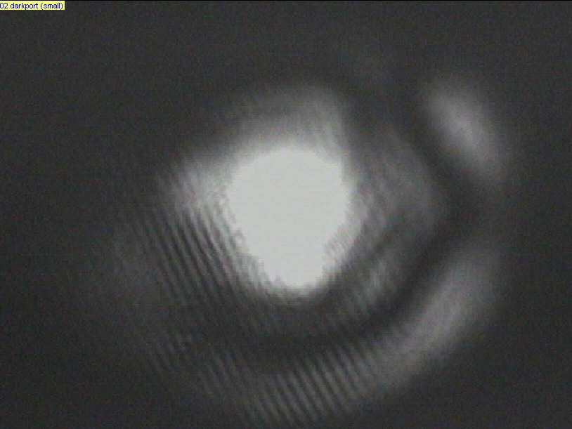
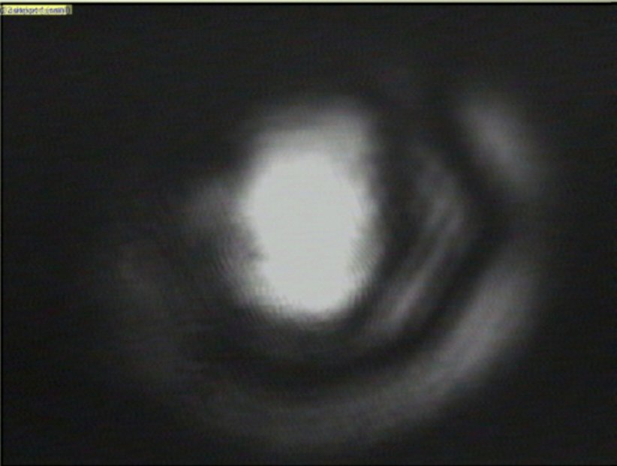
DC-readout without OMC (Hild 2007)
Turning down the RF-modulation (factor 10 is possible)
Using an offset from dark fringe (of the order of 20pm)
⇒ Dark port dominated by carrier light
~40mW
~15mW
~40mW
Nominal heterodyne
Heterodyne with only
10% modulation
Offset to dark fringe

Slide 15
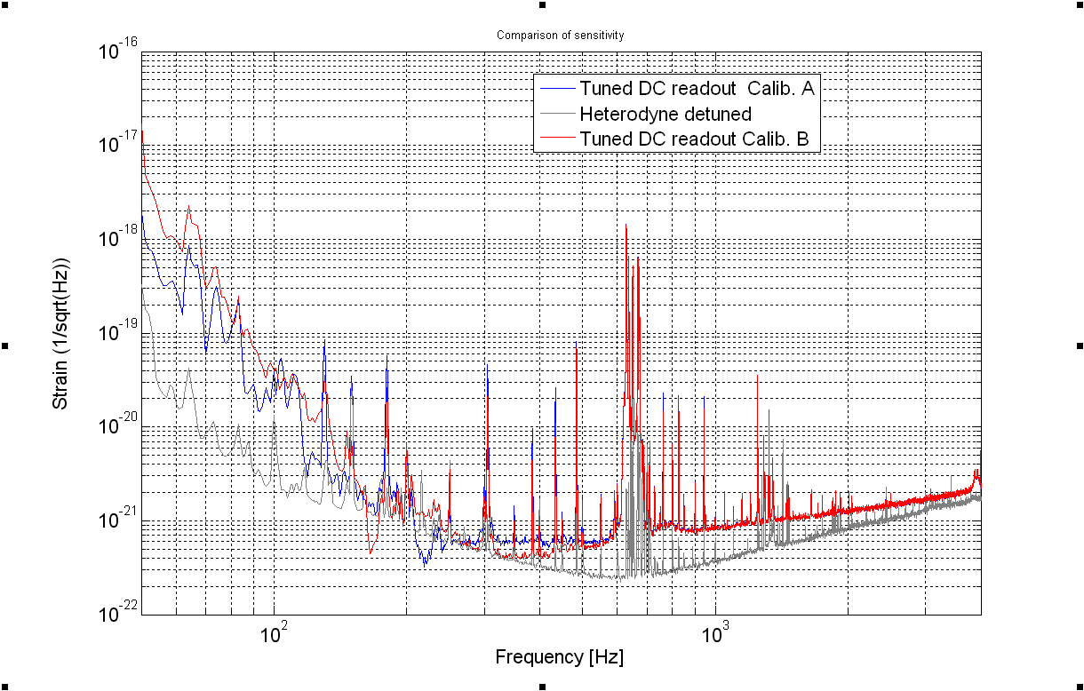
Going to tuned DC readout & DC locking, preparations for 2009
Preliminary calibration

Slide 16
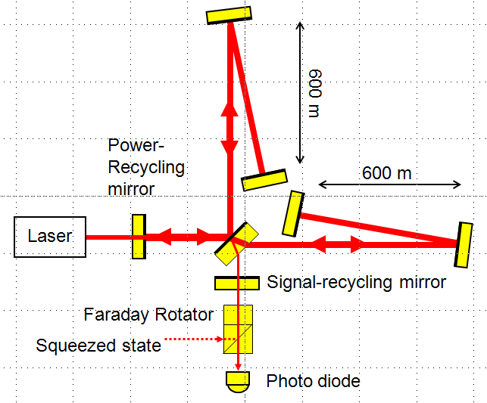
Schematics of injecting squeezed light
More about squeezed light:
Wednesday morning in AIC
Moritz 1550nm, André Twin SR

Slide 17
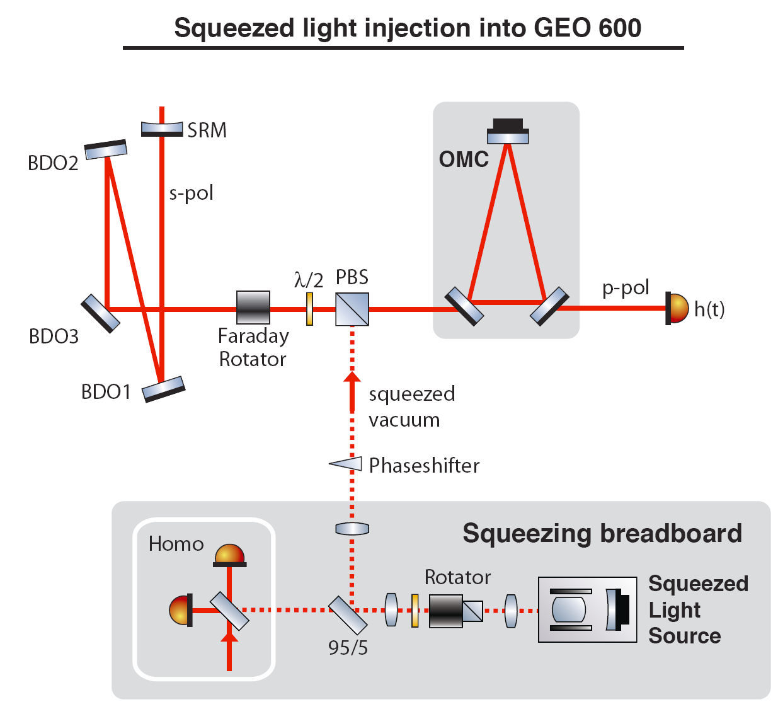
Thursday morning in AIC: Henning Vahlbruch

Slide 18
What can be gained with squeezed light?

Slide 19
What can be gained with squeezed light?

Slide 20
Squeezed light and optical losses
6 dB

Slide 21
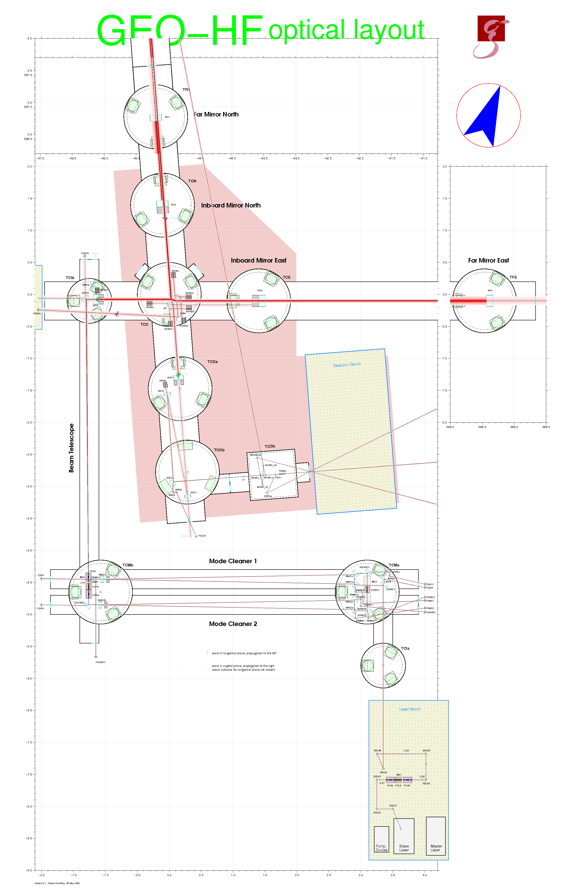
Power increase
Currently 3.5kW @ MPR
Increase laser power 10 W (6 W) -> 35 W
Exchange MC mirrors
-> increase throughput 2x
-> 30kW @ MPR

Slide 22
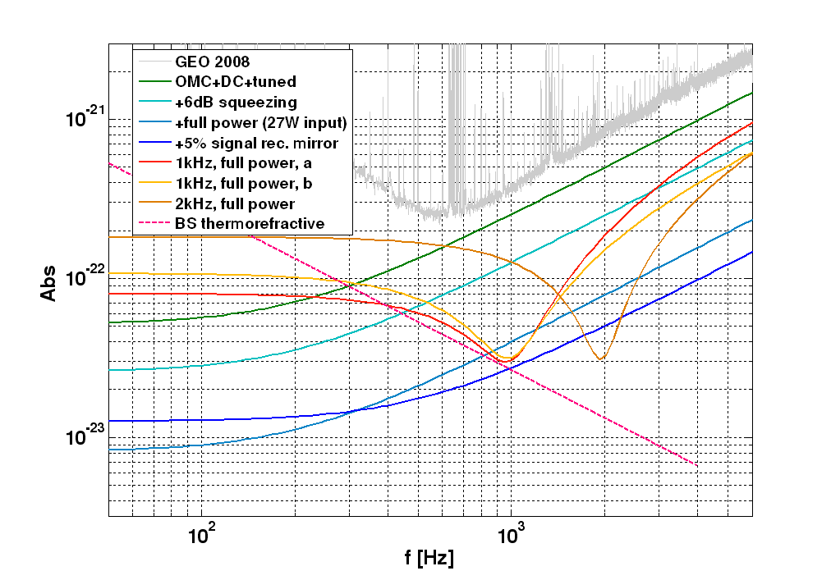
Options Towards GEO-HF
Strain / sqrt(Hz)
Frequency [Hz]

Slide 23
Quantum Noise GEO600 vs. GEO-HF
GEO600: 7kW, Schnupp Modulation, 350Hz detuning
GEO-HF: 30kW, DC Readout, OMC, Tuned, broadband

Slide 24
GEO HF Noises

Slide 25
Timeline / Summary
Spring 2009
DC readout
OMC
In vacuum read out
Squeezed light into output port
Increase laser power
Exchange main mirrors
Towards 2010

Slide 26
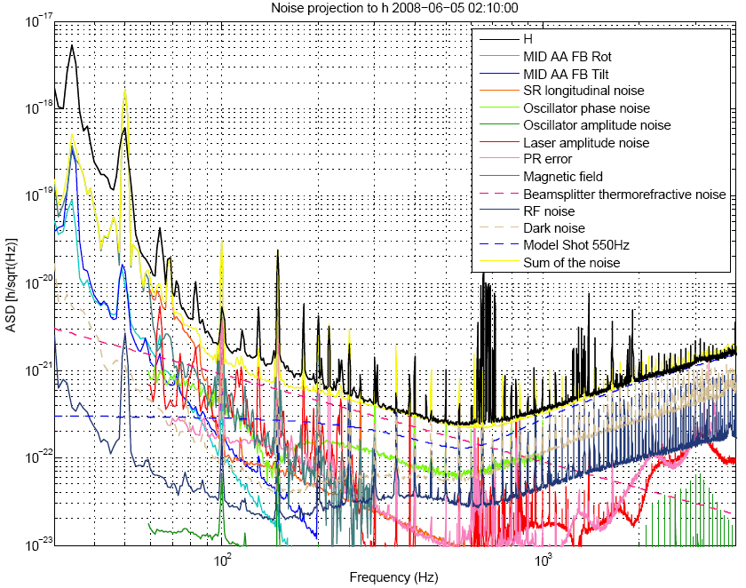
Assuming thermorefractive noise is 3 times higher -> fits…

