Slide 1
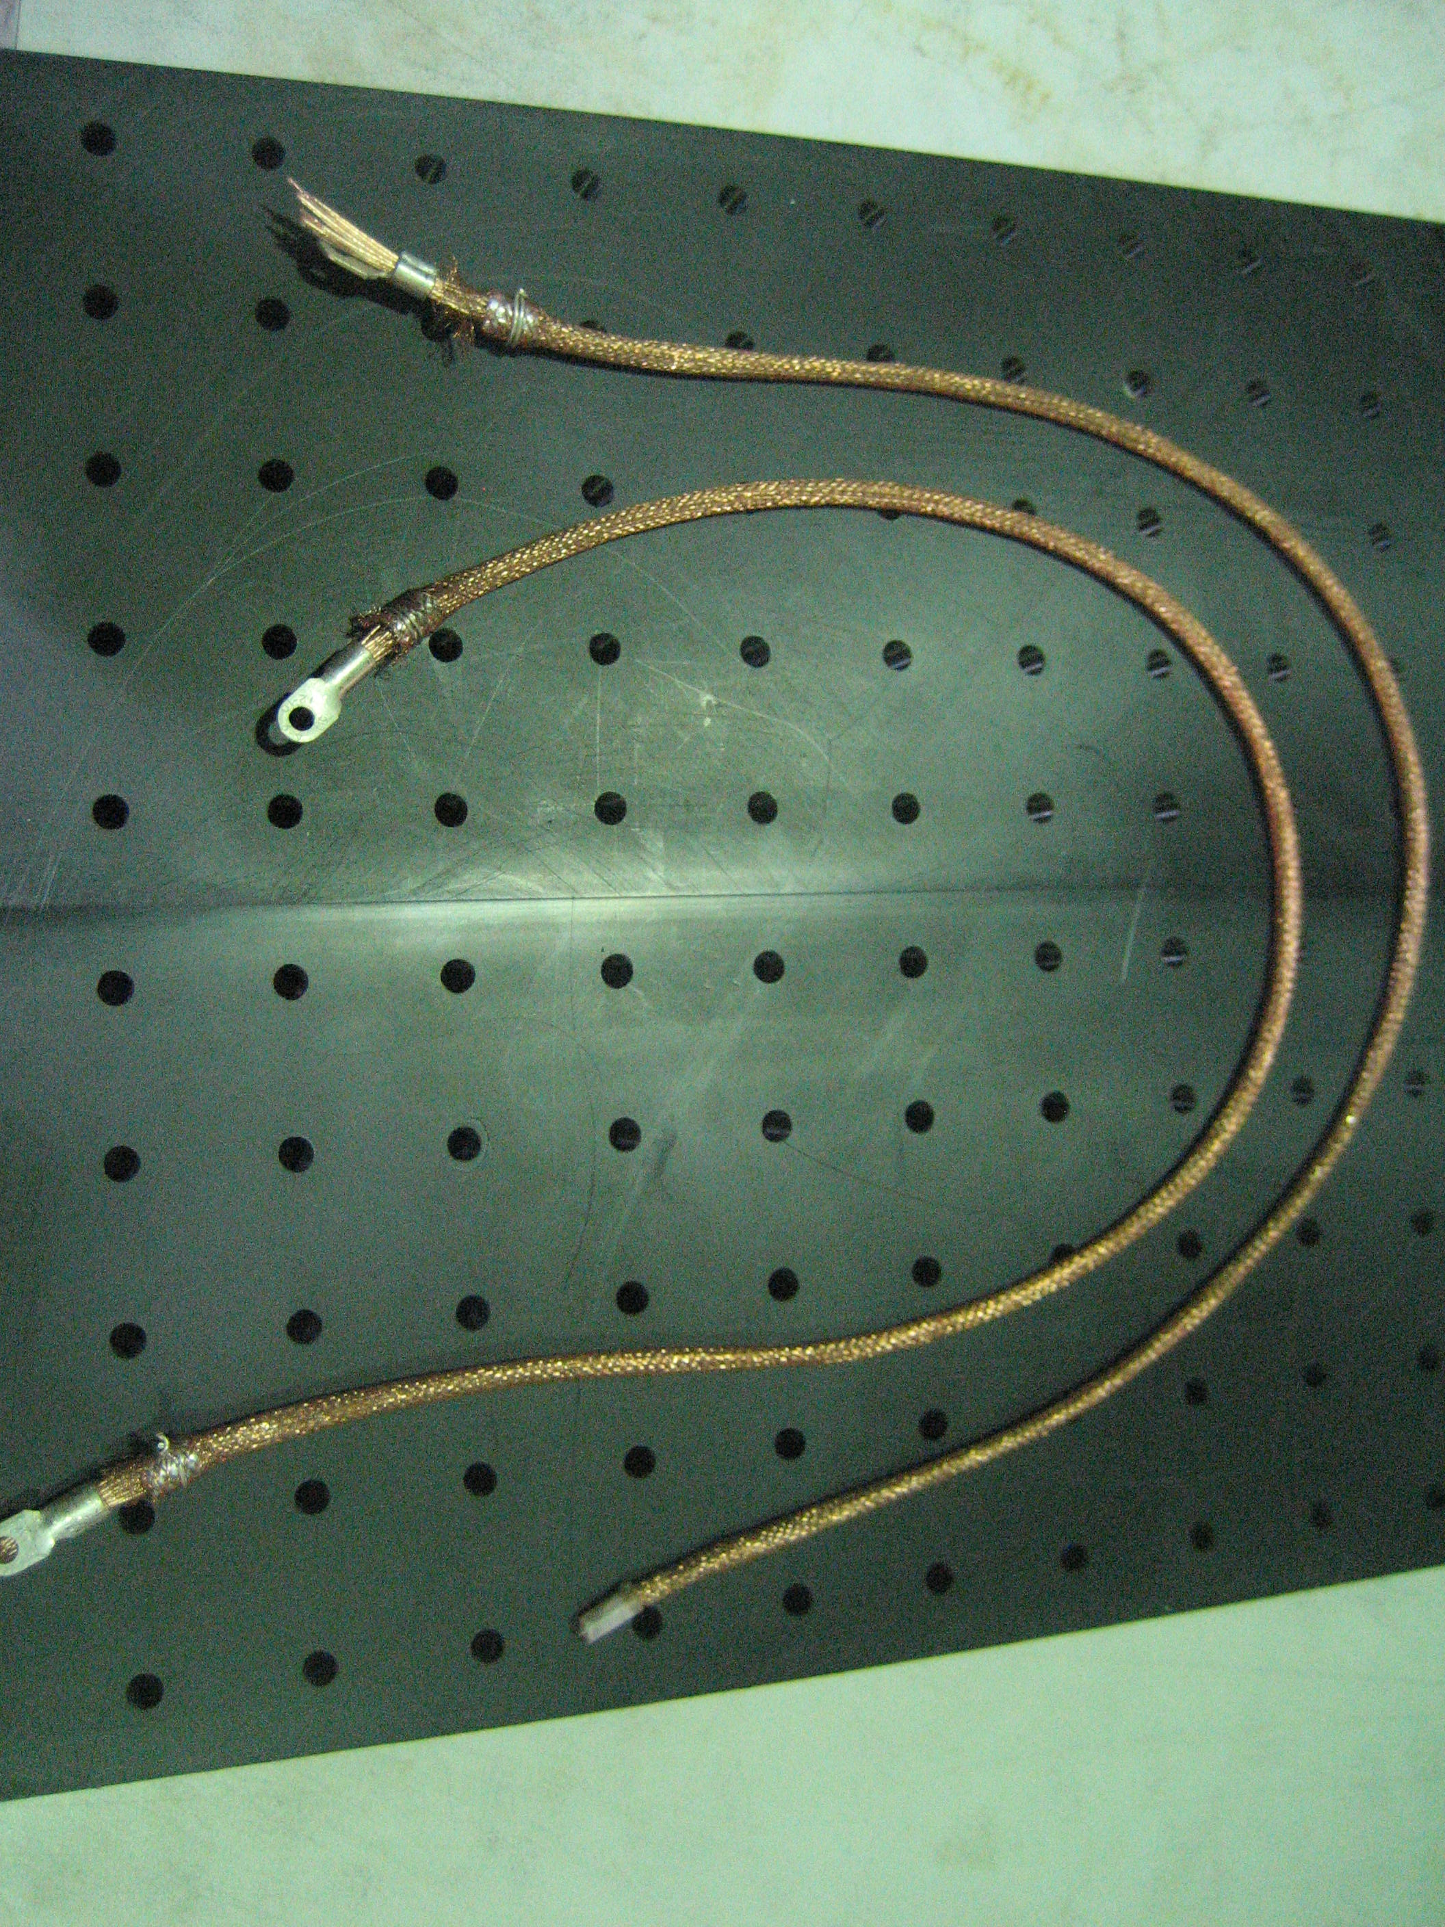
Understanding Cabling Noise in LIGO
Chihyu Chen
Lafayette College
Mentors: Mark Barton
Norna Robertson
Helpful Researcher: Calum Torrie
Co-SURF: Julian Freed-Brown

Slide 2
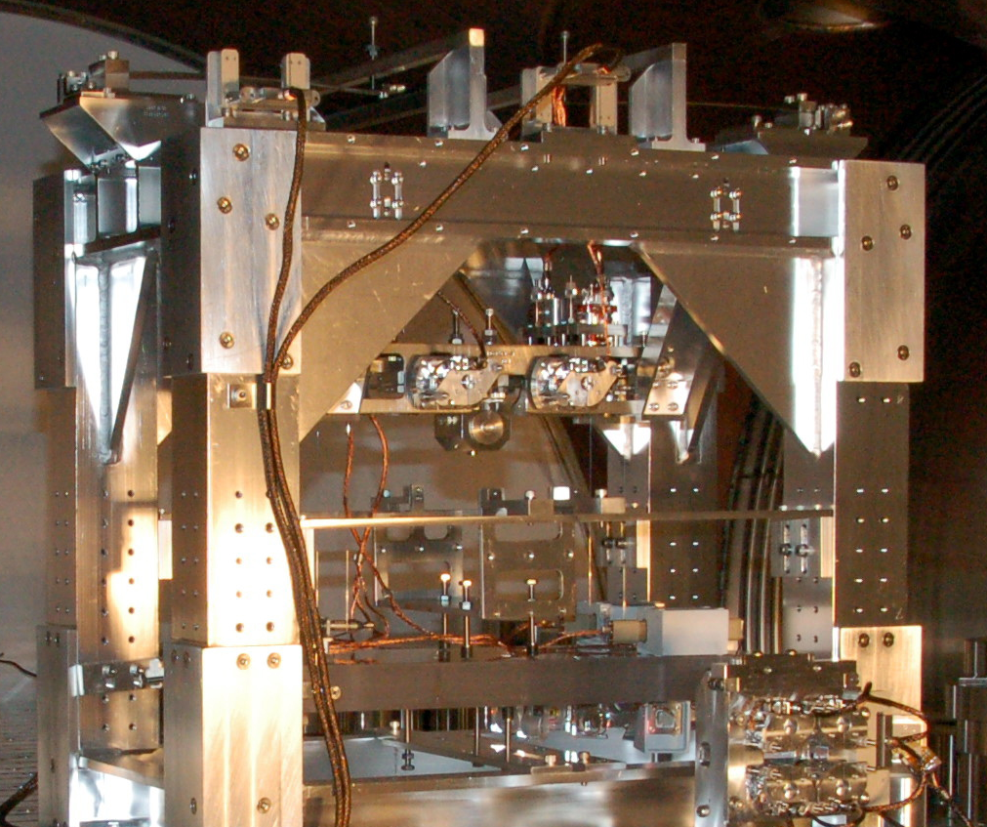
E.g. Cabling on OMC
Suspension
Cabling connecting the OMC bench to the cage
OMC double pendulum suspension

Slide 3
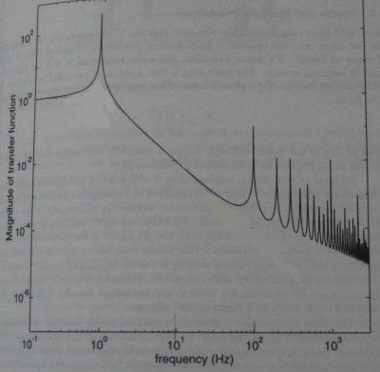
Pendulum as a vibration isolator
?
How would the cabling deteriorate the isolation?
Single pendulum resonant at 1 Hz

Slide 4
For structural damping
For velocity damping

Slide 5
Method
Experimental characterization of the cabling’s damping function.
-Jimmy Chen
Computer modeling to apply the damping function to specific cabling-attached-to-suspension systems.
-Julian Freed-Brown

Slide 6
Apparatus
Two wire torsion pendulum
Support structure for the pendulum
Cabling
Apparatus Design Goals
1. An order of magnitude variability in yaw and pitch frequency
2. Cases that can be easily modeled
3. Stiff support structure

Slide 7
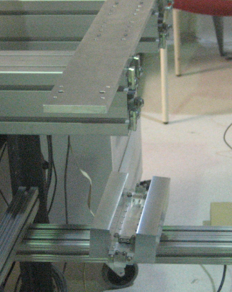
Varying pitch frequency
Varying yaw frequency
Yaw frequency range:
0.14 Hz – 1.27 Hz
Pitch frequency range:
0.41 Hz - 2.97Hz

Slide 8
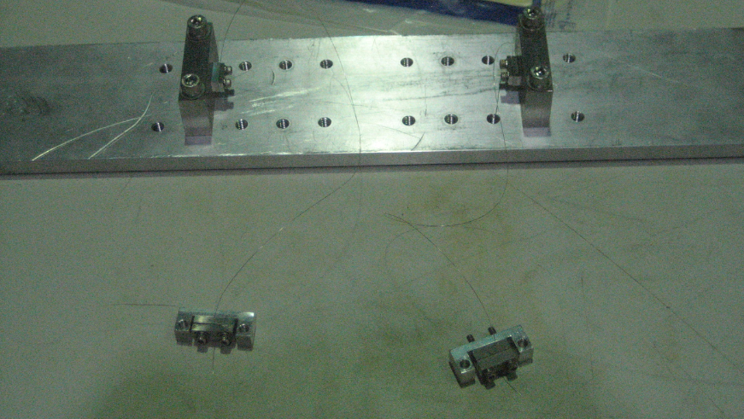
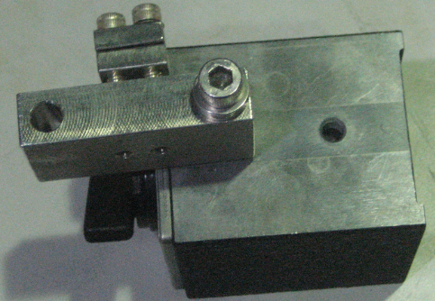
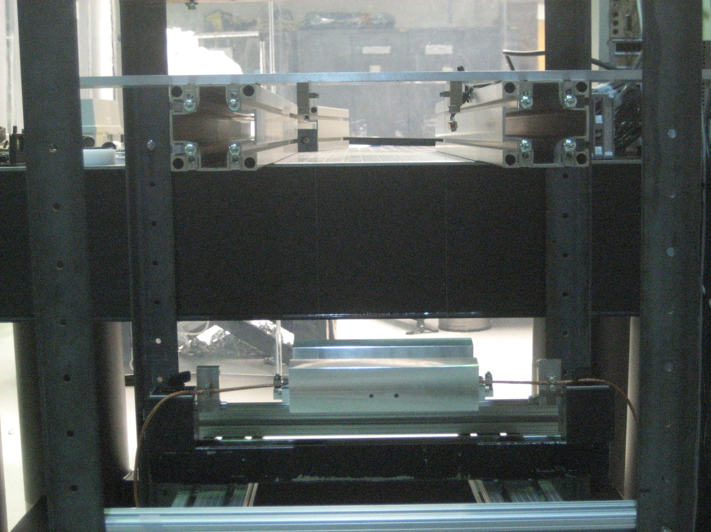
Clamps ensure straight connection pts.
Optics table helps stiffen the support structure

Slide 9
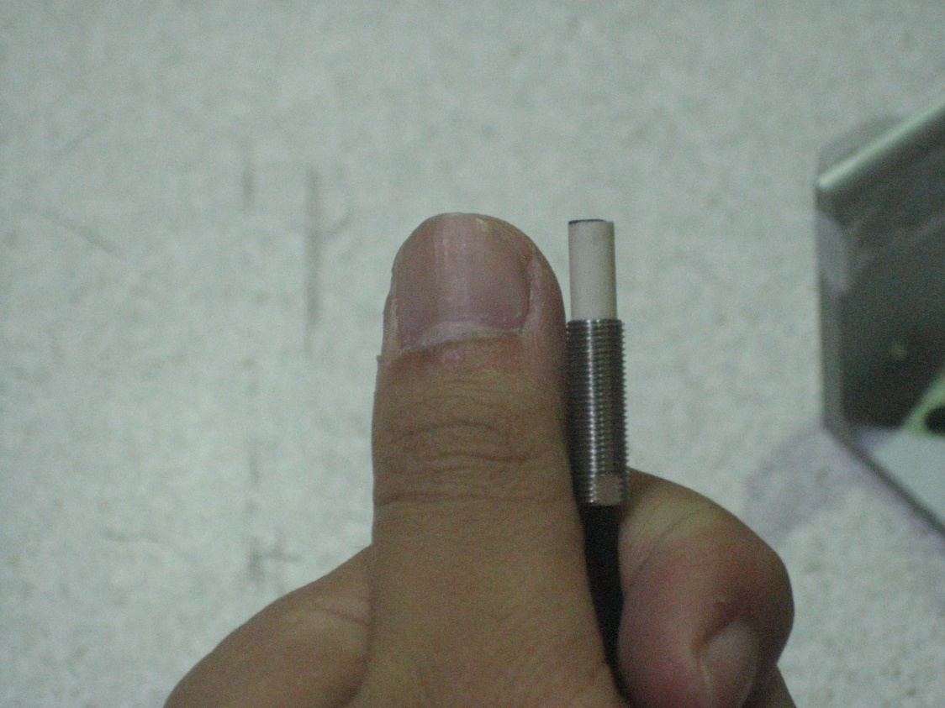
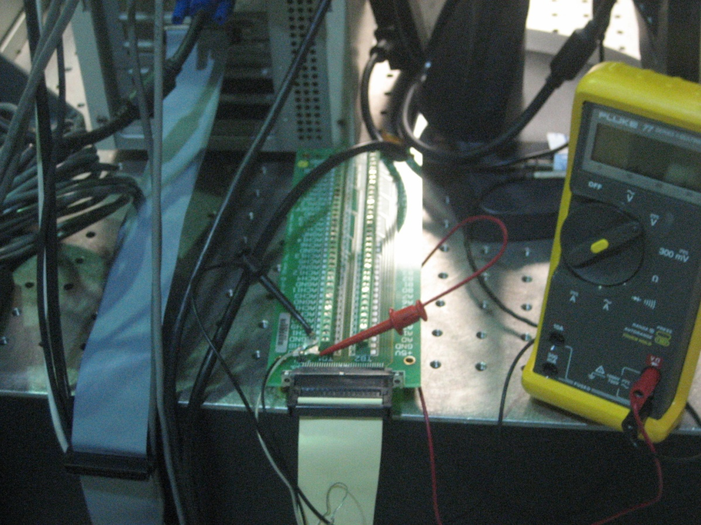
Data Collecting
Equipment used:
Kaman eddy current displacement sensor
LabVIEW data logging system

Slide 10
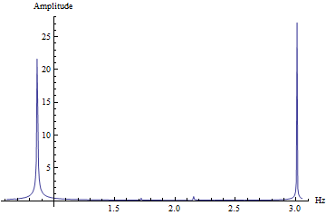
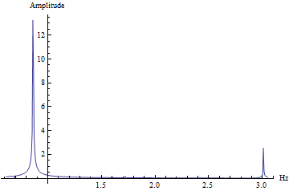
Data Analysis
Data analysis method and computer program by Mark Barton

Slide 11
Results
Yaw mode
Pitch mode
 | frequency |  |  |  | frequency
 | measured | predicted |  |  | measured | predicted
n=1 cm | 0.134 | 0.1366 |  | 0 plate | 0.656 | 0.414
n=3 cm | 0.4089 | 0.4098 |  | 1 plate | 1.56 | 1.458
n=5 cm | 0.6836 | 0.683 |  | 2 plates | 2.14 | 2.066
n=7 cm | 0.958 | 0.956 |  | 3 plates | 2.61 | 2.559
n=9 cm | 1.227 | 1.229 |  | 4 plates | 3.01 | 2.97
Model predictions by
Julian Freed-Brown, based on
equations by Calum Torrie.

Slide 12
Results
 | pitch mode |  |  |  | n = 5 cm
 | without cabling |  |  |  | with cabling
 | frequency | Q |  |  | frequency | Q | Q^0.5
0 plate | 0.656 | 1703 |  |  | 1.2 | 34.8 | 5.899152
1 plate | 1.56 | 2376 |  |  | 2 | 62.9 | 7.930952
2 plates | 2.14 | 3775 |  |  | 2.57 | 93.8 | 9.68504
3 plates | 2.61 | 4627 |  |  | 3.14 | 202 | 14.21267
4 plates | 3.01 | 6293 |  |  | 3.43 | 211 | 14.52584

Slide 14
Results
Future Work
Feed results into Julian’s Mathematica model
Check for agreement between the model and
experiment frequency results.
Study the resulting transfer functions and make
recommendations on cabling dressing.

