Slide 1
Core Optics Components
Technical Status
NSF Review of Advanced LIGO Project April 2011
GariLynn Billingsley

Slide 2
Core Optics Functions
Subsystem cost : $18M
Design, fabricate and characterize the Core optics
Test Masses (20ea) – Fabry Perot arm cavity surfaces are the most critical in LIGO.
Recycling Cavity optics (27ea) - compensation plates, beam splitter, recycling mirrors and folding mirrors
Fabrication
Procure substrates
Procure polishing services – qualify with in house metrology
Procure coating services – characterize with in house metrology
Provide transport and handling equipment
Prescribe cleaning and handling

Slide 3
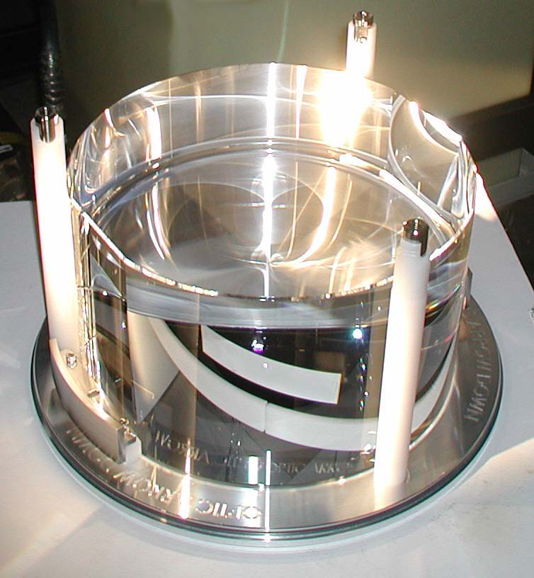
Design approach
Fused silica substrates
Low OH Fused silica used for in-cavity optics:
Beam Splitter
Input Test Mass
Two step polish:
Superpolish: ~1 Å microroughness, within 100nm of figure
Ion Beam Figuring: Corrects figure, maintains microroughness
Ion Beam sputtered coating
Coating performance at multiple wavelengths to support control system

Slide 4
Arm Cavity Loss: Early results are in line with budget
Total cavity loss requirement < 75 ppm
Cavity loss – 2 surfaces (ppm) | Budget 2010 based on specifications (ppm) | Actuals 2011 based on (n of 20) (ppm)
Microroughness scatter (>1/mm) | 8 | 4 (avg. of 12)
Defects (Polish, Coating, Contamination) | 26 | 8 (1) pol, coat
Coating Absorption | 0.6 | 0.6 (1)
Surface Figure Error & Diffraction | 24 | 7 (max of 12) polish only
ETM Transmission | 5 | No data yet
Total | 64 | 25
50ppm budget remaining for contamination and coating induced surface figure error.
Notes:
Scatter: calculation based on 0.12 nm rms average microroughness>1/mm for the final 9ITM +3ETM on hand
Defects: LMA quoted 6ppm 6-2(microroughness) = 4 from total defects. For one surface
Surface error: Max ETM is 4.6, Max ITM is 2.5, cavity total 7.1
LMA does not yet have a trial run on ETM HR – no transmission data available

Slide 5
Project phase status Material
All original orders are filled and met specification
Heraeus
11 Input Test Masses (ITM)
4 End Test Masses contributed by U.K.
6 Beam Splitters (BS)
9 Compensation Plates
Corning
9 Recycling Telescope #3 (R3)
Stability problems with:
6 of 10 End Test Masses (ETM)
3 Fold Mirrors (FM)

Slide 6
Project phase status Material
Corning 7980 substrate material is not stable at typical annealing temperatures.
6 of 10 End Test masses
4 were Heraeus 311
3 Fold Mirrors
9 R3, - not a problem
No instability seen on prototype
Heraeus Suprasil 311, 312, 3001 have all tested as stable. LIGO-T1100162
Reordered material for FM and ETM-Heraeus 312
8 nm stability is required for most large COC elements (except R3 400 nm)

Slide 7
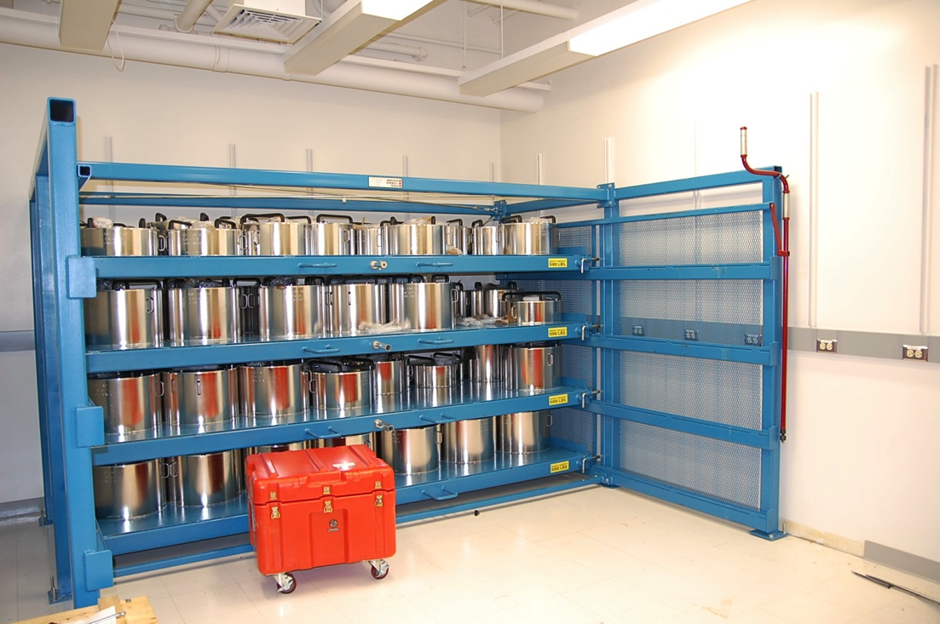
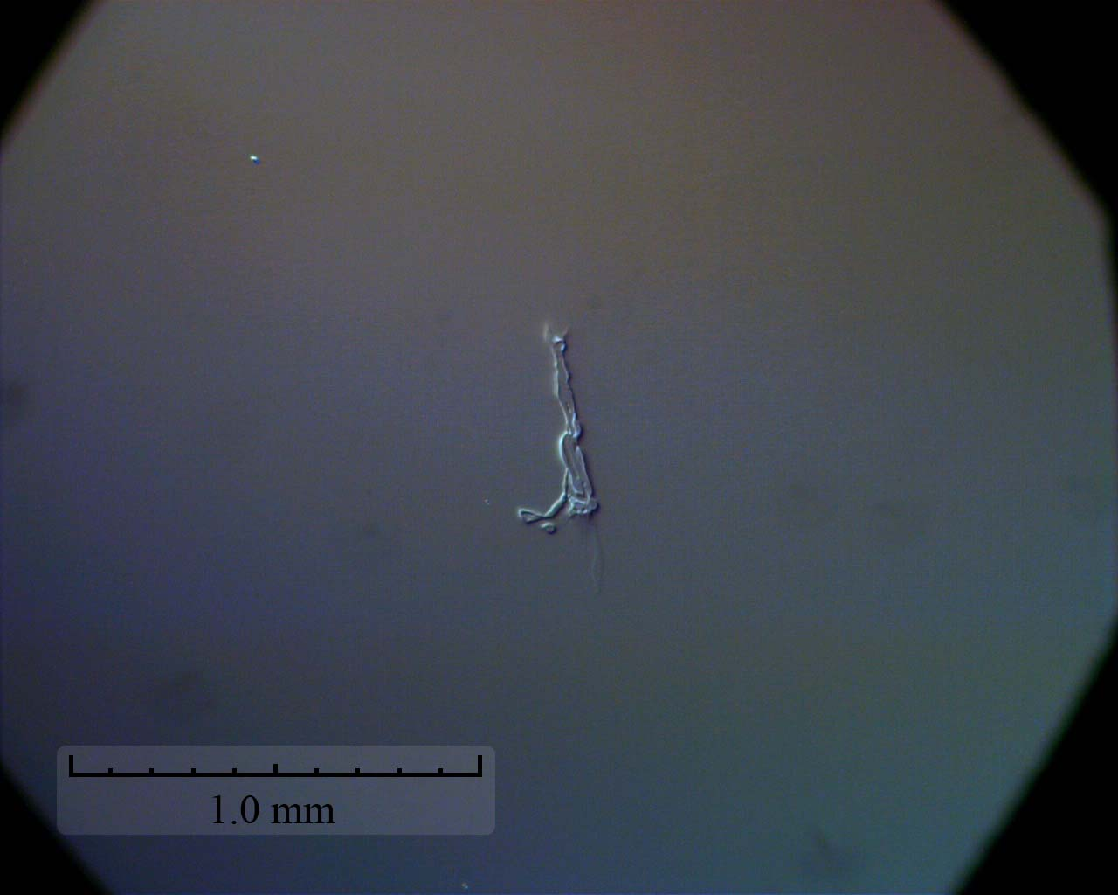
Project phase status Polishing
All original mirror blanks have been received
One year delay in delivery due mostly to contamination leaving etching reliefs on the Test Mass surfaces
Polishing is in process, 23% remaining are:
2 Compensation Plates
3 Fold Mirrors
8 Test Masses
Exceptional control of figure
0.6 meter standard deviation on 1938 meter ROC (9 pieces)
0.12 nm rms average figure error over 160 mm diameter (9 pieces)
Notes:
Let it be known that we are pleased with the vendors

Slide 8
Project phase status Recycling Cavity Coating
Recycling Cavity – CSIRO
All fixtures in place
Final Beam Splitter and Fold Mirror coating designs are pending
(additional accommodation for Hartman Wavefront Sensor)
End Reaction Masses are complete
Compensation plates next
AR coating absorption is found to be extremely sensitive to surface contamination and annealing temperature.
Thinner layers of Tantala crystalize at lower temperature.

Slide 9
Project phase status Arm Cavity Coating
Arm Cavity – LMA
All designs approved
Test masses will be coated with an “optimized” design of silica and titania doped tantala. This results in the lowest thermal noise performance demonstrated to date.
The ITM for the single arm test is at Hanford with bonds curing
All parameters are reported by the vendor as being within specification with the exception of figure change due to coating uniformity.
It is well known that IBS coatings stress substrates and impart a change in saggita . For the LASTI prototype this change was measured at 3 nm.
Uniformity requirement: …not change the Sagitta more than 8 nanometers, …Zernike terms …amplitude < 0.5 nanometer

Slide 10
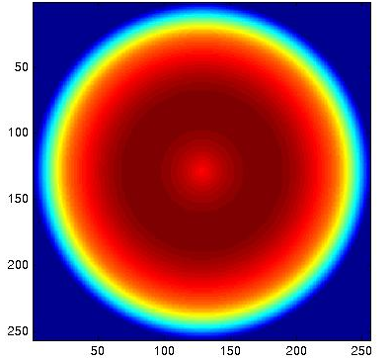
Project phase status Arm cavity coating continued
Trial one coating uniformity:
Using a Corning ETM
Coat two optics at once to match transmission
11nm Peak to Valley
Estimated Cavity loss ~200ppm
Trial two coating uniformity:
Model based on witness samples
Coat one optic, spinning in center
2nm Peak to Valley over beam size
Estimated Cavity loss ~55ppm
150 mm
250 mm

Slide 11
Project phase status Arm cavity coating continued
Better Uniformity: two approaches in parallel
Remaining information on this slide is removed at the request of the vendor

Slide 12
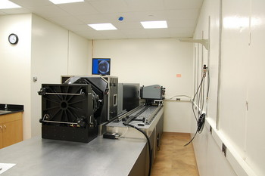
Project phase status Metrology
Zygo full aperture interferometer is installed and operating at Caltech
All metrology flats are complete, the Test Mass reference sphere is complete
R3 measurement spheres finish in May 2011
The instrument and environment are quite stable, showing a uniform noise floor of 0.1 to 0.15 nm rms.
Polishing requirement is 0.3 nm rms
Vendor reports some surfaces at 0.08 nm rms
Instrument transfer function using the four apertures is >50% out to > 10/mm

Slide 13
Challenges, risks, and mitigations
Risk Registry – Major Threats - COC
If coating vendor cannot meet overall COC specs, then performance will suffer.
Control of figure for optics remains a concern
LIGO is seeking a back up coater for arm cavity optics
CSIRO has most all infrastructure (would need tooling for thicker pieces) short on labor.
Other vendors – pending meetings
REO – is cautiously interested
ATF
MLD
LMA is pursuing near and mid-term modification to improve uniformity

Slide 14
Subsystem Project organization
LIGO staff manage the procurement and test of the core optics
Procure blanks – Corning and Heraeus (Billingsley)
Inspection at LIGO (Billingsley, Zhang)
Procure polishing services – Tinsley (Billingsley)
Qualification tests at LIGO (Billingsley, Zhang)
Procure coating services – LMA and CSIRO (Billingsley, Harry, Phelps)
Qualification tests at LIGO (Zhang, Phelps)
Cleaning process qualification at LIGO (Phelps, Zhang)
Final Metrology/Characterization at LIGO (Billingsley, Zhang, Phelps, Murphy)
Characterization data to model interferometer performance (Kells, Yamamoto)

Slide 15
Core Optics Development Status
Advanced LIGO Development phase is complete
Final Design Review October 17, 2008
Actively supporting our coating vendors with absorption studies.

Slide 16
Ongoing Coating development
Recommendation from December 2010 review: Mirror coating and suspension noise. We continue to support the idea of an ongoing, and perhaps increased, research effort to study the science and technology of the thermal noise in optical materials and the fabrication and processing methods. This should include basic material science and theoretical analysis to develop a deeper understanding of the fundamental science and ultimate physical limitations. Risk reduction and performance improvement research and development on mirror coatings should continue through aLIGO
Recently Presented at the March LSC Meeting – emphasizing first principals analysis.
Zirconia Coatings, S. Penn
Thermorefractive Noise Update, A. Gretarsson
Effective Medium Theory, I. Pinto
Thermal Noise in Optimized Mirror Coatings, M. Gorodetsky
Glasgow Coating Research, M. Abernathy
Linear and Non-linear Optical Properties of Coatings, I. Bilenko
Coating Modeling, Y. Wu
Glasgow Coating Modeling Work, K. Evans

Slide 17
Core Optics Near term activities
Working with vendor to improve coating uniformity
Prepare for incoming mirror test
Dummy dress rehearsals
Now preparing for characterization testing:
First coated ITM has arrived, is bonded, will ship to Caltech for characterization.

