Slide 1
e-Traveler
An Overview presentation
R. Abbott
13 July 2011

Slide 2
What is it and How do I find it?
The eTraveler is a tool to document the life history of CDS electronics
The form can be used for: Circuit boards, Chassis, and even racks
The eTraveler is available within the DCC.
https://dcc.ligo.org/e-traveler/
A link will be added to the DCC soon

Slide 3
What does it look like?
When you first open the form, a default screen offers you guidance
Note the “Browse Existing Data” section

Slide 4
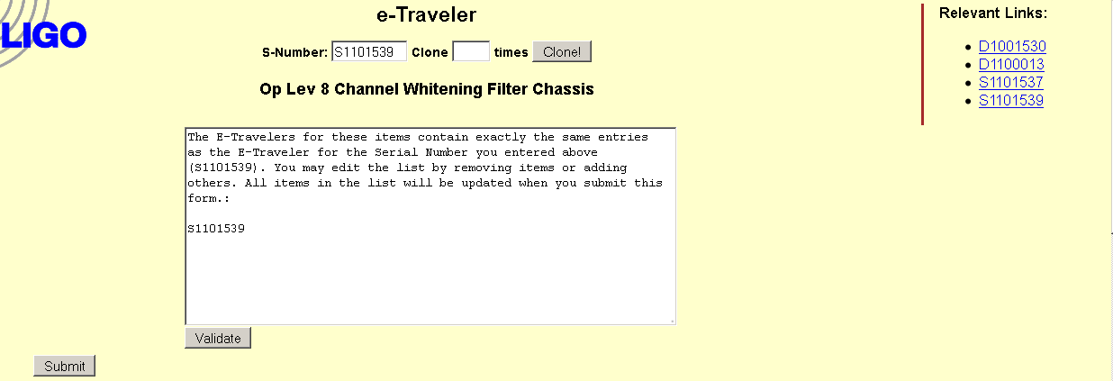
What does it look like?
Upon entering a valid serial number, the tool presents more information to the user
The scope of the change is detailed in the white box
Related documents are automatically scraped from the DCC
The Validate button tells you what’s about to happen
The Submit button makes your entry occur

Slide 5
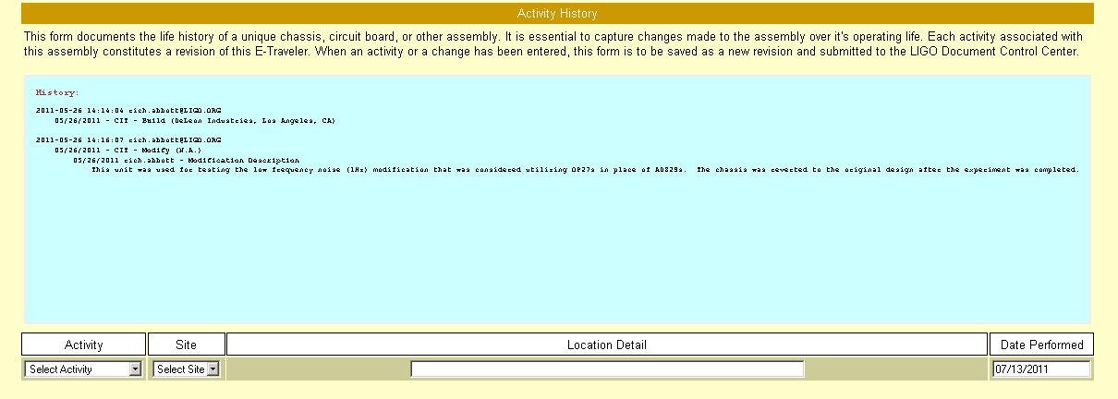
What does it look like?
The Activity History has the life history of the associated serial number
The “Select Activity” dropdown menu is used to identify the type of transaction you wish to document

Slide 6
Key Features
Each entry automatically generates a revised entry in the DCC
The file format is plain text
Any special entry (D-numbers, S-numbers, etc.) are automatically recognized and appear as active hyperlinks
The system allows cloning of metadata for duplicating similar parts
Identical entries can be added to multiple S-numbers
No user manual or special training needed
All cleverness attributed to Phil Ehrens, Programmer Par Excellence
No mention is made yet of the existing PDF forms

Slide 7
What does it look like?
Three sections allow specific types of events to be documented (Modification, testing, manufacturing)

