Slide 1
H2 TMS Y QPD Sled - As Built -
Bram Slagmolen, Keita Kawabe, Matt Evans
LIGO-T1100476

Slide 2
QPD Sled Telescopes
The TMS/ISC Breadboard has two QPD sleds, one for IR and one for Green.
Each sled, has a small Gouy phase beam reducing telescope to steer the beam onto the QPDs.
The Gouy phase between the two QPDs needs to be close to 90 degrees (for a diagonal sensing matrix in the near- and far field).

Slide 3
Mode-Matching Approach
The sleds are assembled, and the telescope optics (2” lens and a 1” lens) are placed as illustrated in figures 8 and 10 in document T1000247.
The nominal location for L1 and L2 as listed in the tables 8 and 9 are used.
For mode-matching measurements, the IR and GRN Laser Diode sources as per T1100474 are used.
The Coherence ModeMaster is used to measure the waist location and size behind the telescope.
The location of L2 is adjusted to match the measured waist location and size as close as possible according to T1000247.

Slide 4
Mode-Matching Validation
Once the telescopes are aligned, a matlab model (alm) is used to validate the location of the QPDs with respect to the measured waist locations.
This is done by adjusting the model (changing the distance between L1 and L2) such that the waist location is similar to the measured results (using the LD sources as input to the telescope).
With these telescope settings and ‘injected’ the IFO arm cavity beam parameters (e.g. out of the TMS Telescope), adjust the location of the QPDs so the difference in Gouy Phase is nominal 90 degrees.

Slide 5
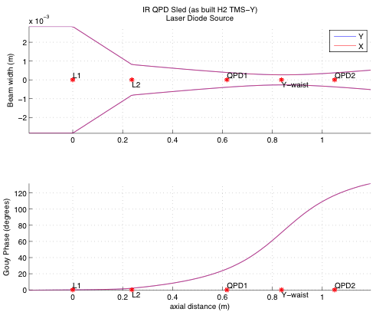
IR QPD Sled /w LD Source
Adjusted the L2 location in the model until the output waist coincided with the measured waist location (Y-waist).
Waist location target: 0.80m
(as per T1000247, table 8, fig 7)
Laser Diode Source
modematching = 0.99412
IRxpath.components list
Measured Parameters:
(* = adjusted z(m) parameter)
label z (m) type parameters
----- ----- ---- ----------
L1 0 lens focalLength: 0.3330
* L2 0.2370 lens focalLength: -0.111
QPD1 0.6180 flat mirror none:
Y-waist 0.8366 flat mirror none:
QPD2 1.0498 flat mirror none:

Slide 6
IR QPD Sled /w IFO Beam (as-built)
Using the model to locate the QPDs.
IFO Arm Beam Parameters
modematching = 0.96367
IRxpath.components list
Modeled Parameters:
(* = adjusted z(m) parameter)
label z (m) type parameters
----- ----- ---- ----------
L1 0 lens focalLength: 0.3330
L2 0.2370 lens focalLength: -0.111
*QPD1 0.6180 flat mirror none:
Y-waist 0.8366 flat mirror none:
*QPD2 1.0498 flat mirror none:
Gouy Phase-x (QPD1): 20.0427
Gouy Phase-y (QPD1): 20.0427
Gouy Phase-x (QPD2): 109.0697
Gouy Phase-y (QPD2): 109.0697

Slide 7
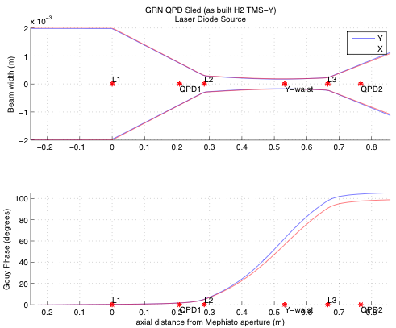
GRN QPD Sled /w LD Source
Adjusted the L2 location in the model until the output waist coincided with the measured waist location (Y-waist).
Waist location target: 0.619m
(as per T1000247, table 9, fig 9)
Laser Diode Source
modematching = 0.94505
GRNxpath.components list
Measured Parameters:
(* = adjusted z(m) parameter)
label z (m) type parameters
----- ----- ---- ----------
L1 0 lens focalLength: 0.3330
QPD1 0.2078 flat mirror none:
* L2 0.2840 lens focalLength: -0.056
Y-waist 0.5320 flat mirror none:
L3 0.6650 lens focalLength: -0.056
QPD2 0.7666 flat mirror none:

Slide 8
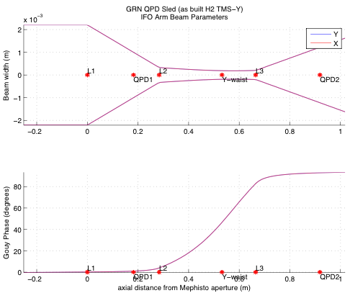
GRN QPD Sled /w IFO Beam (as-built)
Using the model to locate the QPDs.
IFO Arm Beam Parameters
modematching = 0.95444
GRNxpath.components list
Modeled Parameters:
(* = adjusted z(m) parameter)
label z (m) type parameters
----- ----- ---- ----------
L1 0 lens focalLength: 0.3330
*QPD1 0.1824 flat mirror none:
L2 0.2840 lens focalLength: -0.056
Y-waist 0.5320 flat mirror none:
*L3 0.6650 lens focalLength: -0.056
*QPD2 0.9190 flat mirror none:
Gouy Phase-x (QPD1): 1.0042
Gouy Phase-y (QPD1): 1.0042
Gouy Phase-x (QPD2): 92.9226
Gouy Phase-y (QPD2): 92.9226

