Slide 1
Power Monitoring – Requirements (1)
Provide, install, and commission a Honeywell SXB36 Network Power Meter at each of the following electrical services:
Corner Station Mechanical Room (2000 amp 480/277 volt)
Maintenance Building/Chiller (2000 amp 480/277 volt)
Science Education Center (xxx amp xxx volt)
X West Tunnel (800 amp 480/277 volt)
Y South Tunnel (800 amp 480/277 volt)
Provide, install, and commission five Honeywell WEBs Network Area Controllers to collect data and provide and provide an operator interface for the power meters as follows: Network Area Controller #1: Corner Station Mechanical Room Network Area Controller #2: Maintenance Building/Chiller Network Area Controller #3: Science Education Center Network Area Controller #4: X West Tunnel Network Area Controller #5: Y South Tunnel

Slide 2
Power Monitoring – Requirements (2)
* Provide a graphical user interface to allow for real-time data monitoring, historical data trending and report generation, and system critical alarm notification. (Note: Honeywell WEBs Network Area Controllers provides this user interface.) * Provide access to the Network Area Controllers from any computer, smart phone or internet appliance with network connectivity and an internet browser. Note: The Honeywell WEBs system does not require any software to be resident on the local access device. Information can be made accessible through the owner's WAN, LAN or through the internet if desired. * Provide and pull network transmission wiring from the Staging Building to the Corner Station Mechanical Room in existing underground conduit. * Provide operator training.

Slide 3
Power Monitoring – Required Parameters
1) Variations in the peak and RMS voltage
2) Spikes, Impulses, or Surges
3) Undervoltage events
4) Overvoltage events
5) Variations in Frequency
6) Variations in Harmonic Content
7) Non-zero Low- and High-frequency Total Load Impedance
8) Total Power Factor

Slide 4
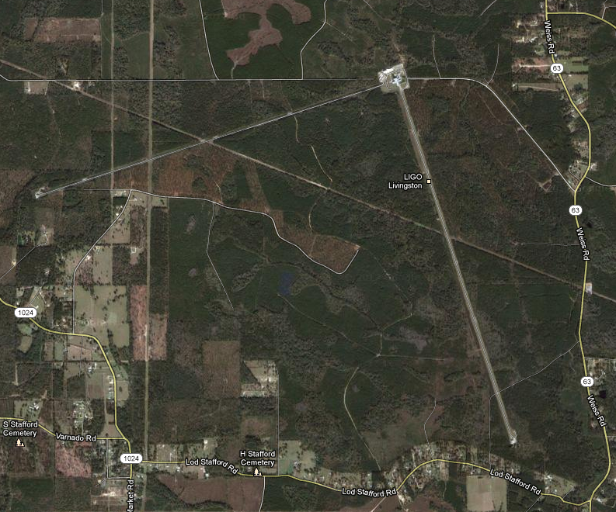
LIGO Livingston Observatory
Corner Network Controllers #1, #2, and #3
Network Controller #4
Network Controller #5

Slide 5
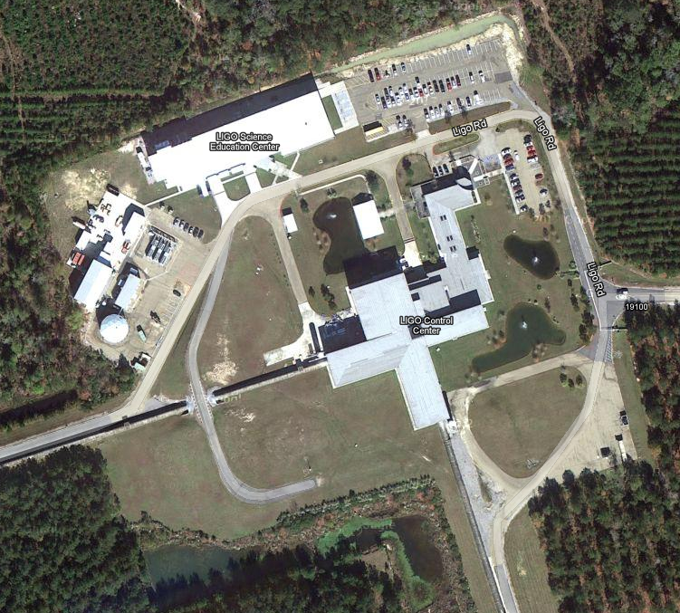
Corner Station
Science Education Center Network Controller #3
Mechanical Room
Network Controller #1
Maintenance Building/Chiller
Network Controller #2

Slide 6
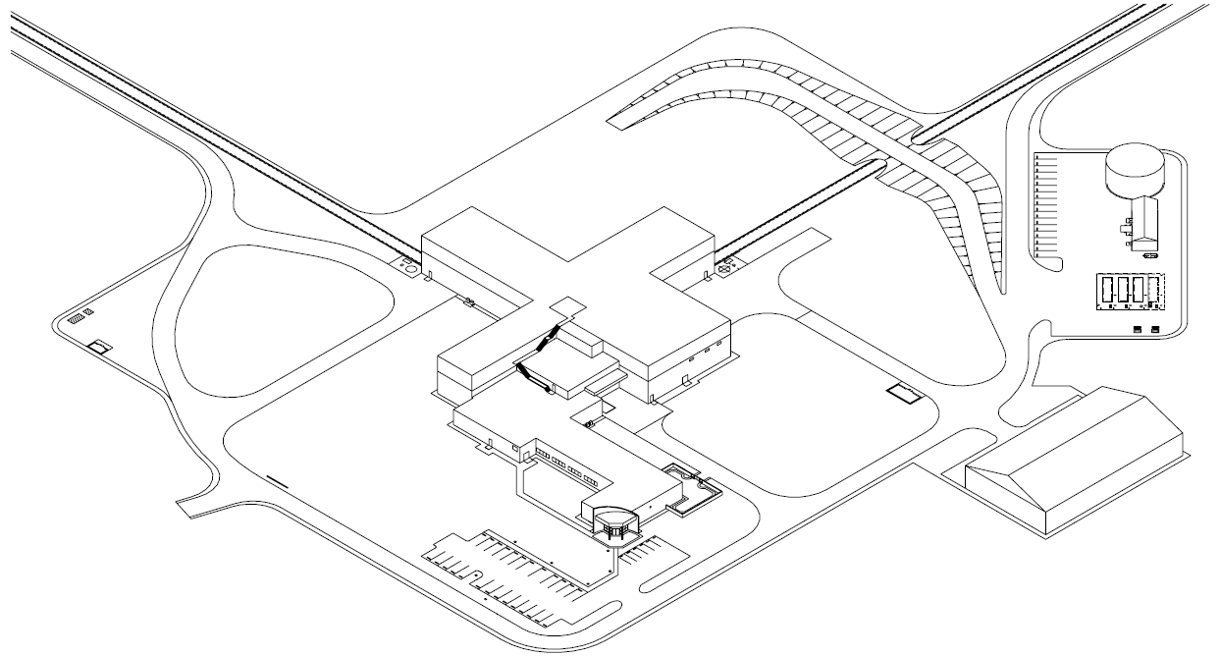
LLO Fiber Optics Cable Run
(If no PULL STRING, use ELECTRICAL SNAKE to fish PULL STRING.)
1. Use existing PULL STRING to PULL ROPE.
2. Use PUL ROPE to PULL CABLE and NEW PULL STRING.
10’
142’
20’
136’
160’
112’
83’
63’
36’
20
83
136
160
142
10
---
551 Mechanical Room to Maintenance Building

Slide 7
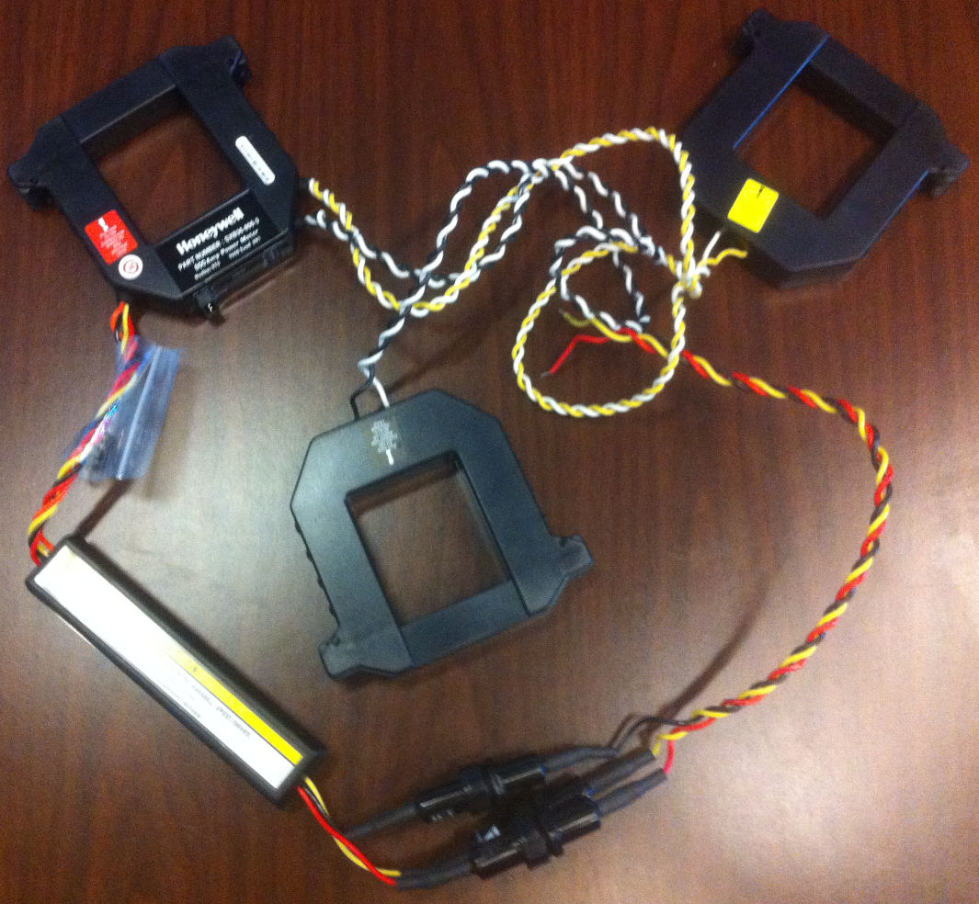
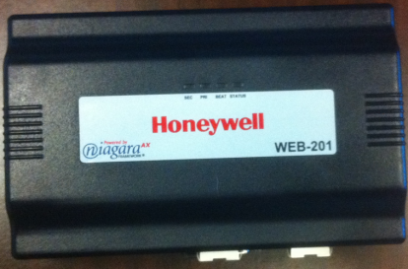
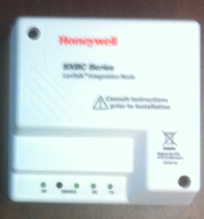
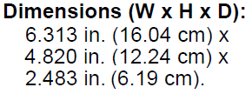
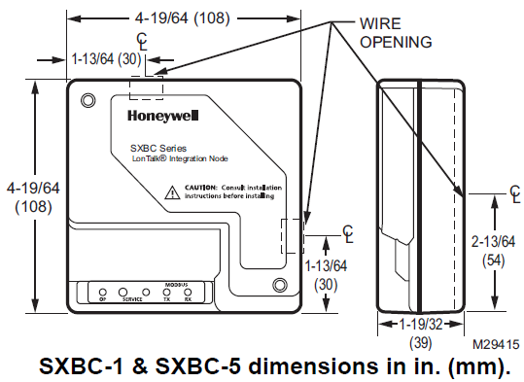
CTs and Controller Components

Slide 8
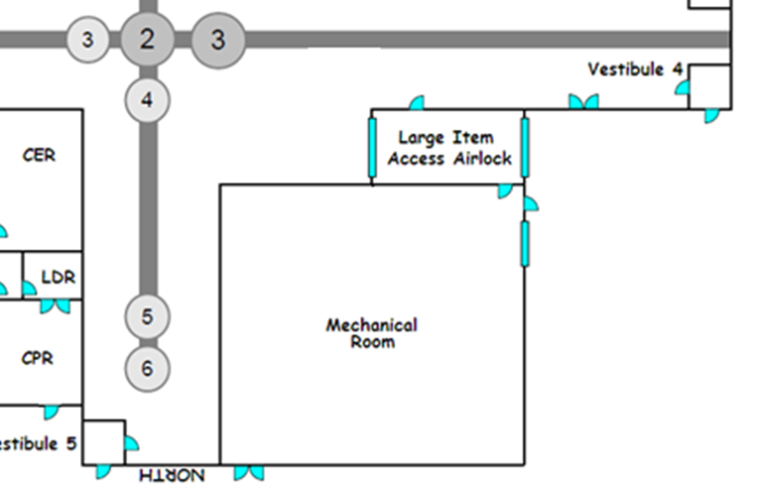
LVEA Access Points
<< LVEA, Corner Station
Network Switch
Mechanical Room VAC
SXBC - MAINS
WEB201
Media Converter
SXBC - CER
Network Switch
Controller #1
Patch Panel
CER Transformer
Network #1
Siemens Systems
CTs for CER Transformer
CTs for Corner MAINS Power

Slide 9
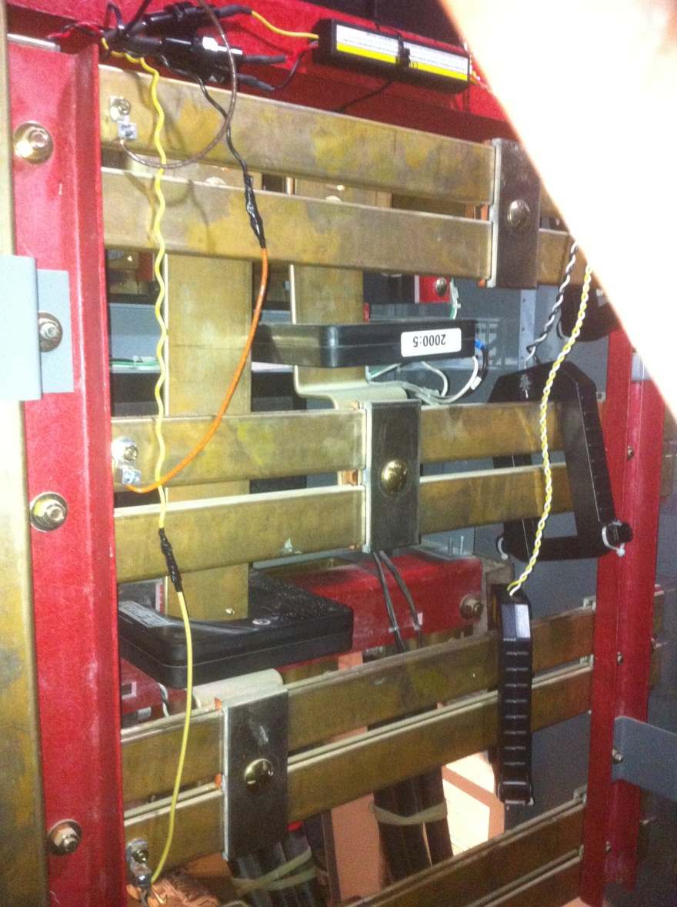
CTs for Corner MAINS

Slide 10
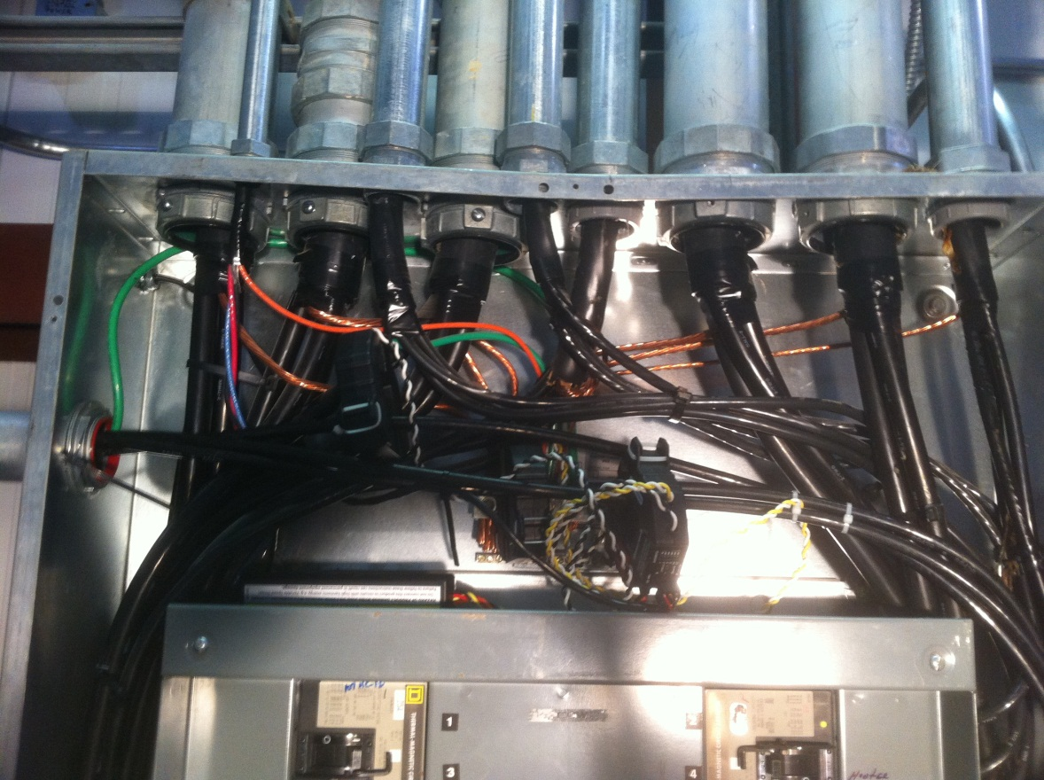
CTs for CER Transformer

Slide 11
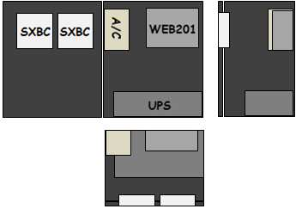
Controller #1 (at C MAINS)

Slide 12
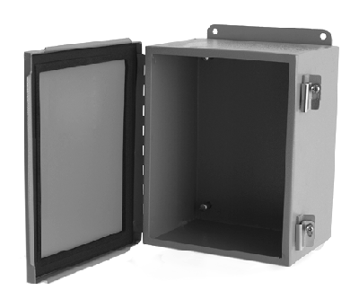
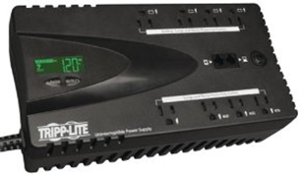
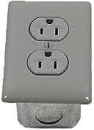
Controller #1 (at Corner MAINS)
6.313 x 4.82 x 2.483
4.14 x 4.14 x 1.2
14 x 12 x 8 (plus .5 door depth)
3 x 10.75 x 5.75
3 x 5 x 5

Slide 13
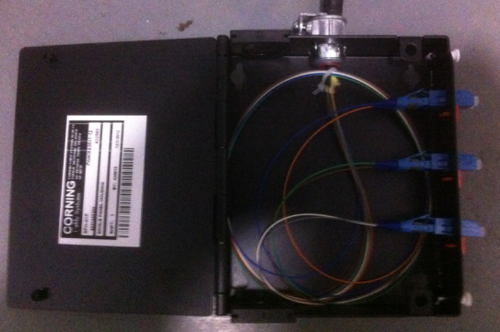
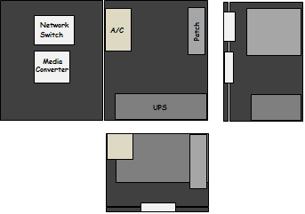
Network #1 (at Corner MAINS)
Fiber Patch
Mechanical Room
Port | Left | Right
1 | Blue | Orange
2 | Green | Brown
3 | Gray | White

Slide 14
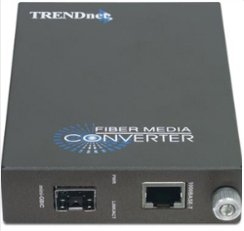
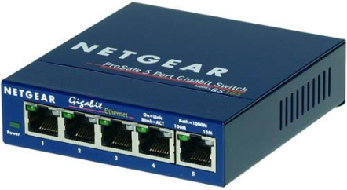
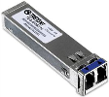
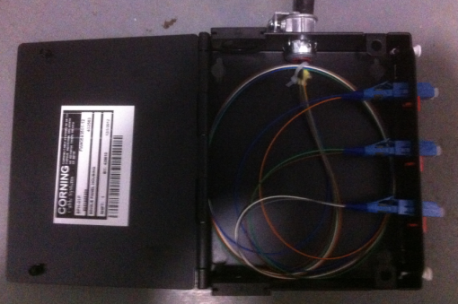
Network #1 (at Corner MAINS)
4.7 x 3.5 x 1
3.7 x 4.1 x 1.1
6.3 x 5.5 x 2
14 x 12 x 8 (plus .5 door depth)
3 x 10.75 x 5.75
3 x 5 x 5

Slide 15
Chiller Access Points
<< LVEA, Corner Station
Media Converters
Network Switch
Patch Panel
Network #2
Siemens System
SXBC - MAINS
WEB201
Controller #2
CTs for Chiller MAINS Power

Slide 16
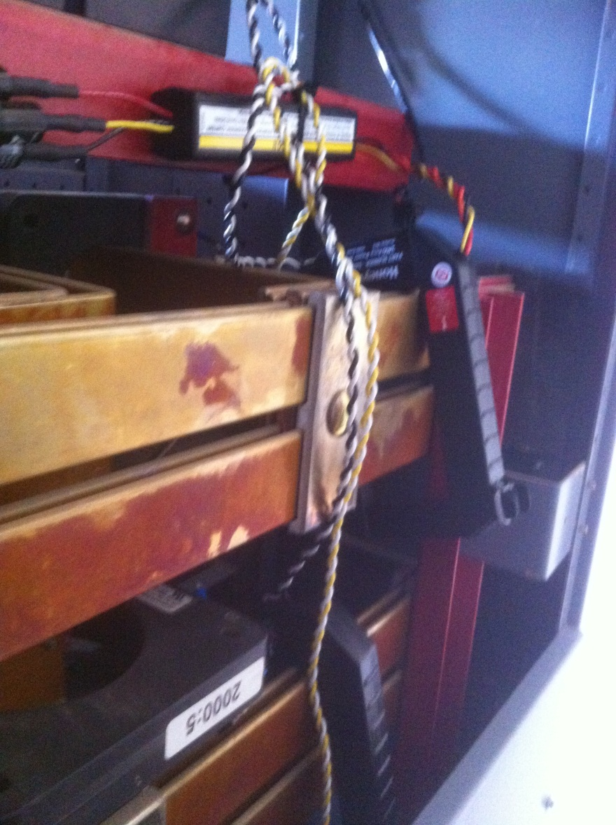
CTs for Chiller MAINS

Slide 17
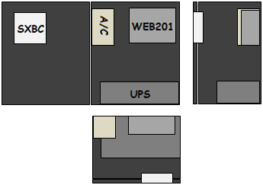
Controller #2 (at Chiller MAINS)

Slide 18
Controller #2 (at Chiller MAINS)
6.313 x 4.82 x 2.483
4.14 x 4.14 x 1.2
14 x 12 x 8 (plus .5 door depth)
3 x 10.75 x 5.75
3 x 5 x 5

Slide 19
Network #2 (at Chiller MAINS)
Fiber Patch
Chiller Room
Port | Left | Right
1 | Blue | Orange
2 | Green | Brown
3 | Gray | White

Slide 20
Network #2 (at Chiller MAINS)
4.7 x 3.5 x 1
3.7 x 4.1 x 1.1
6.3 x 5.5 x 2
14 x 12 x 8 (plus .5 door depth)
3 x 10.75 x 5.75
3 x 5 x 5

Slide 21
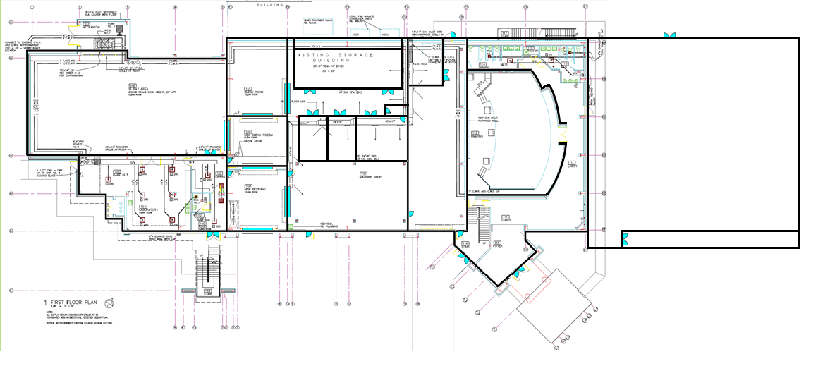
Staging Building, HPLF, SEC As Built
<< LVEA, Corner Station
LIGO-D000294
SXBC
WEB201
Controller #3

Slide 22
SEC As Built
90’
SXBC
WEB201
Controller #3
100’

Slide 23
CTs for SEC

Slide 24
Controller #3 (at SEC)
6.313 x 4.82 x 2.483
4.14 x 4.14 x 1.2
14 x 12 x 8 (plus .5 door depth)
3 x 10.75 x 5.75
3 x 5 x 5

Slide 25
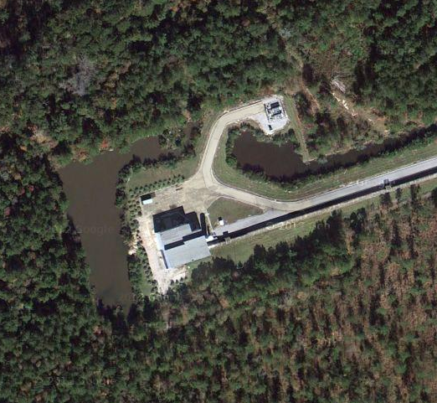
X-End Station (West)
Network Controller #4

Slide 26
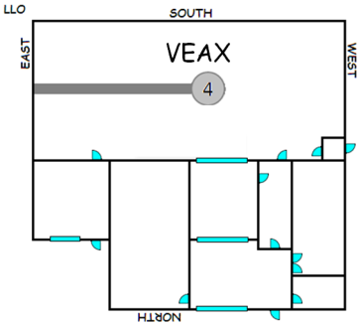
VEAX Access Control Locations
<< X-End, VEAX
SXBC
WEB201
Controller #4
CTs for X-End MAINS Power
26

Slide 27
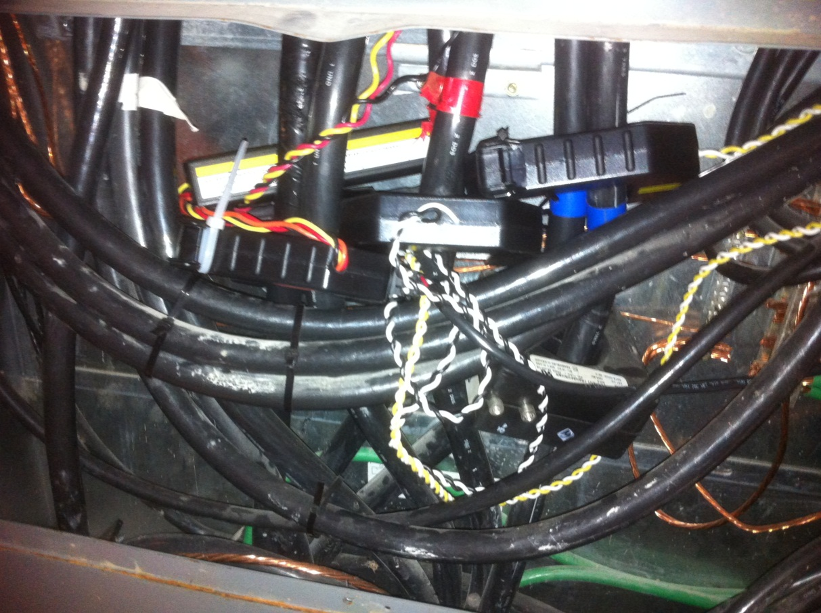
CTs for X-End MAINS

Slide 28
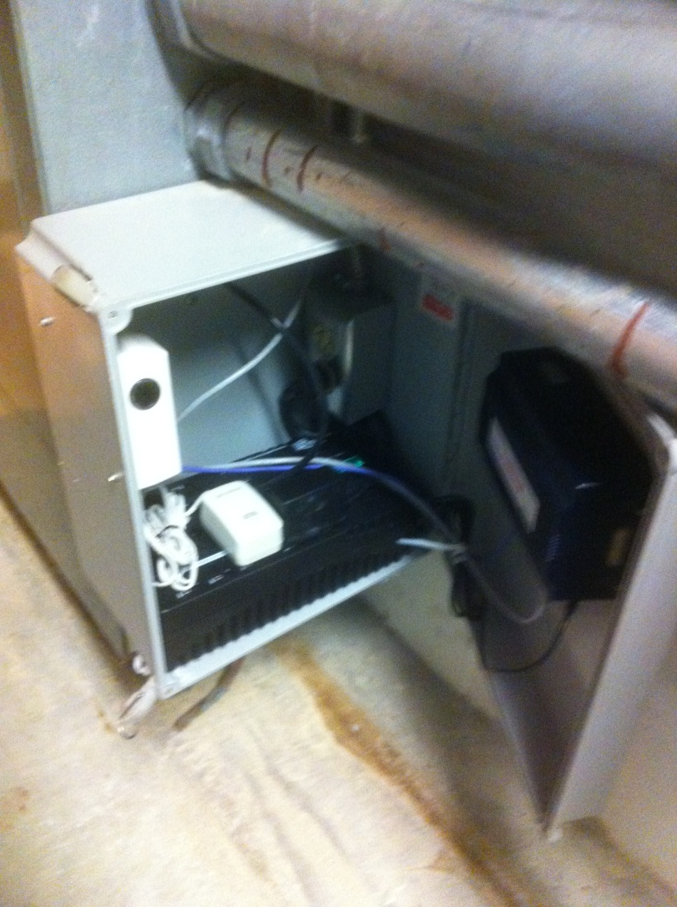
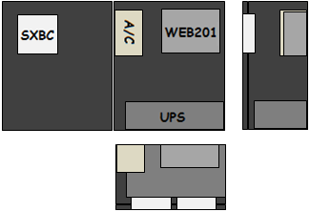
Controller #4 (at X-End MAINS)

Slide 29
Controller #4 (at X-End MAINS)
6.313 x 4.82 x 2.483
Similar
4.14 x 4.14 x 1.2
12 x 14 x 6.5 (plus .5 door depth)
3 x 10.75 x 5.75
3 x 5 x 5

Slide 30
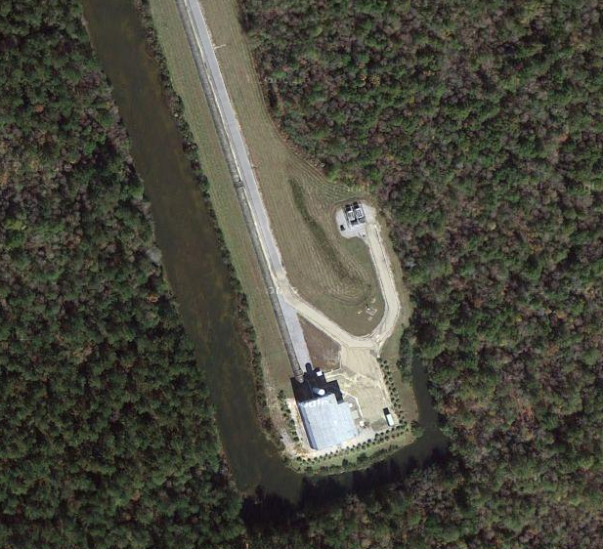
Y-End Station (South)
Network Controller #5

Slide 31
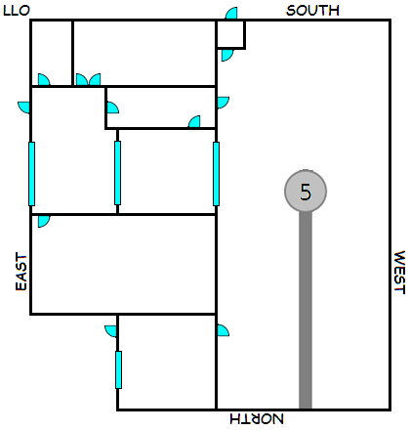
Y-End Access Points
<< Y-End, VEAY
SXBC
WEB201
Controller #5
CTs for Y-End MAINS Power

Slide 32
CTs for Y-End MAINS

Slide 33
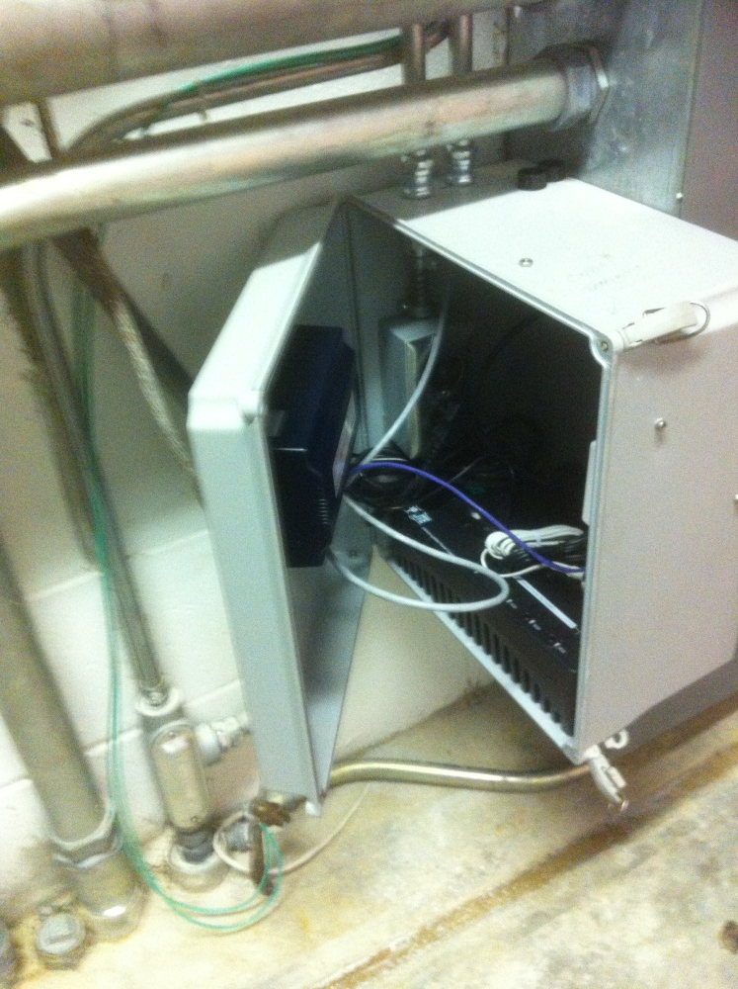
Controller #5 (at Y-End MAINS)

Slide 34
Controller #5 (at Y-End MAINS)
6.313 x 4.82 x 2.483
Similar
4.14 x 4.14 x 1.2
12 x 14 x 6.5 (plus .5 door depth)
3 x 10.75 x 5.75
3 x 5 x 5

Slide 35
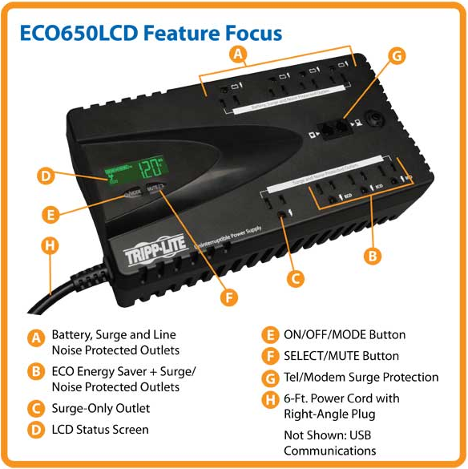
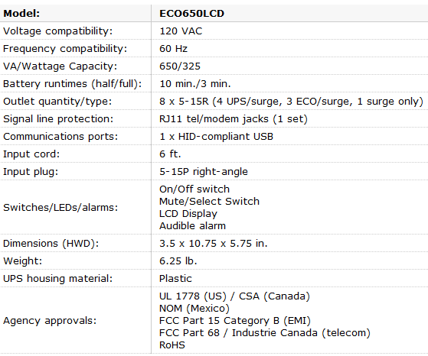
UPS Systems
Tripp-Lite ECO650LCD
Location | Model | Serial Number
Corner MAINS | ECO650LCD | 2225EYOBC794100399
Corner Network | ECO650LCD | 2225EYOBC7941xxxxx
Chiller MAINS | ECO650LCD | 2225EYOBC794100055
Chiller Network | ECO650LCD | 2225EYOBC7941xxxxx
X-End MAINS | ECO650LCD | 2225EYOBC794100400
Y-End MAINS | ECO650LCD | 2225EYOBC794100386

Slide 36
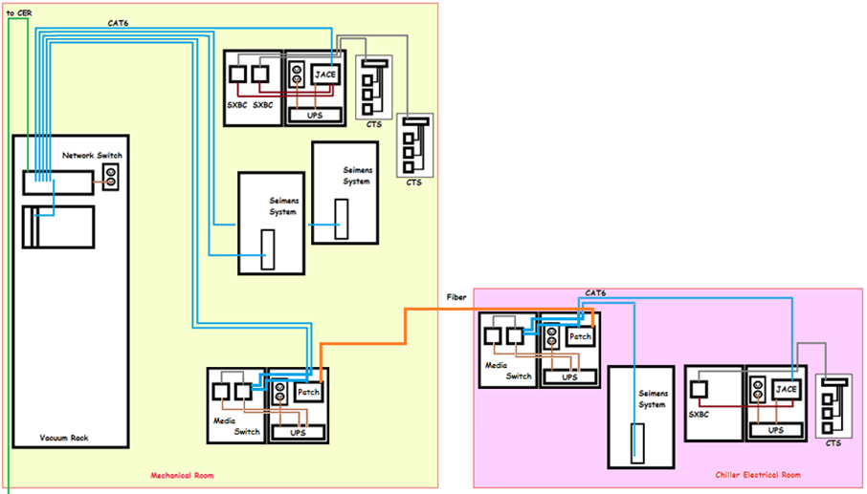
Network Integration – LLO Corner

Slide 37
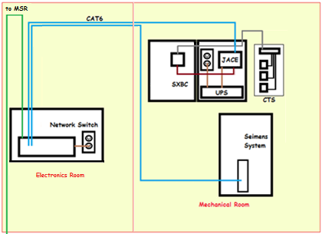
Network Integration – LLO X-End

Slide 38
Network Integration – LLO Y-End

Slide 39
IP Addresses
Entity | IP Address
WEB201 – Mechanical Room
WEB201 – Maintenance Building
WEB201 – Science Education Center
WEB201 – End X Mechanical Room | 10.110.70.10
WEB201 – End Y Mechanical Room | 10.110.70.30
Mechanical Room Siemens 1
Mechanical Room Siemens 2
Maintenance Building Siemens
End X Siemens | 10.110.70.11
End Y Siemens | 10.110.70.31
Gateway | 10.110.70.1
Network | 255.255.255.6

