Slide 1
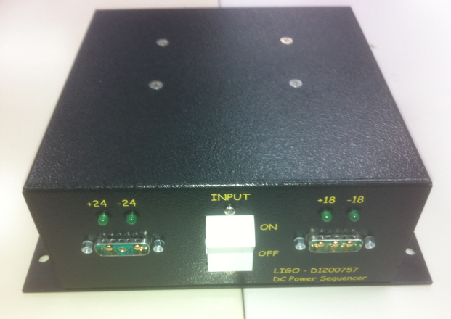
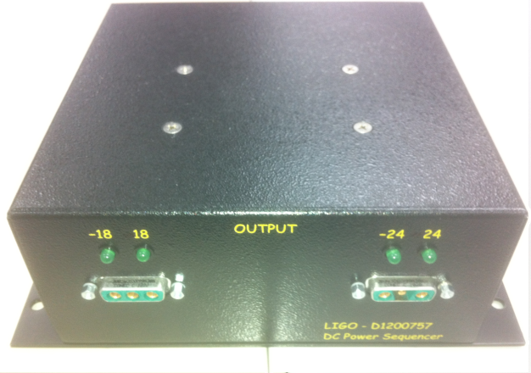
D1200757 Sequencer – Insertable
Input is from 4 (four) DC Power Supplies: +24VDC, -24VDC, +18VDC, and -18VDC. This sequencer prohibits the 18V supplies from being present prior to the 24V supplies. When the ON/OFF Switch is in the ON position, +24 and -24 are passed to the Output side, and the internal relay switches are closed so that +18 and -18 are passed to the Output side as well.
The relays are operated independently. The +24VDC controls the +18VDC and the -24VDC controls the -18VDC. Output is intended to go to two standard power strips: 0ne +- 24VDC strip and one +-18VDC strip.

Slide 2
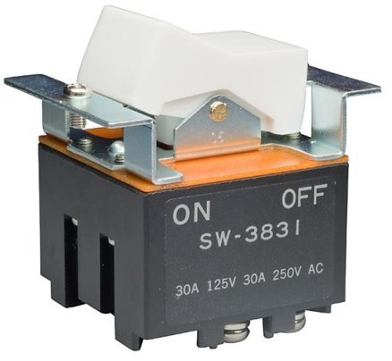
Sequencer – On/Off Switch
SW-3831

Slide 3
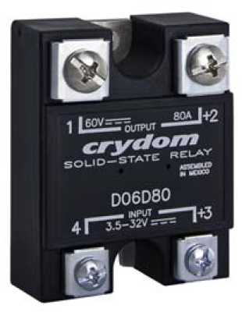
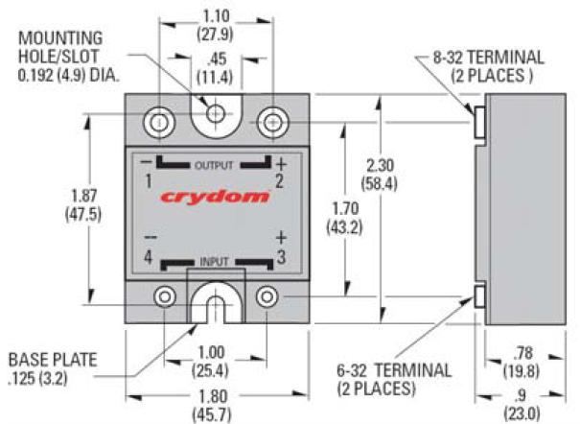
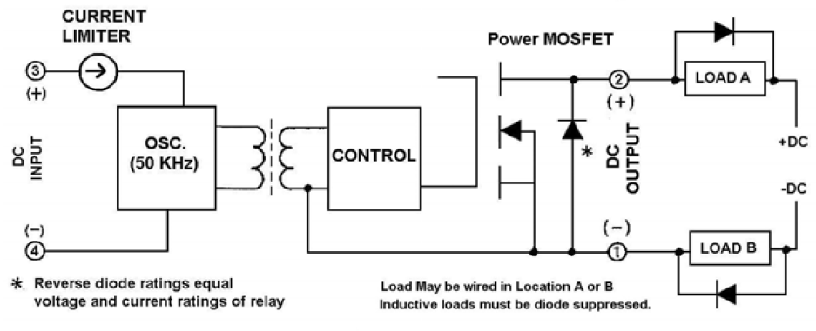
Sequencer – Relay
D06D100

Slide 4
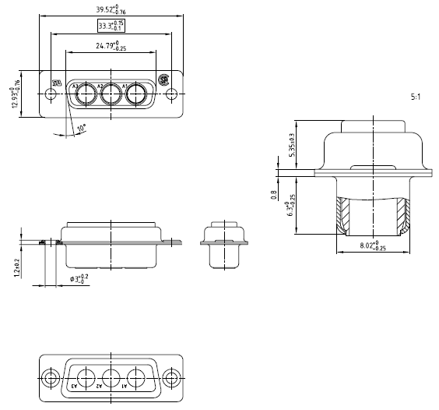
Sequencer – Connectors
3003W3SXX99A30X

Slide 5
Sequencer – Connectors
3003W3PXX99A30X
3003W3PXX99A30X are ordered directly from CONEC. It is unusual to have plugs that are panel mounted, but not unheard of. These boxes are intended to be insertable, and thus require these connectors.

Slide 6
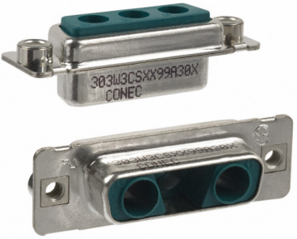
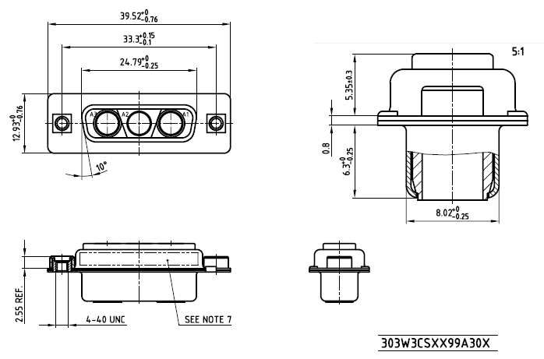
Sequencer – Connectors
303W3CSXX99A30X

Slide 7
Sequencer – Connectors
303W3CPXX99A30X
303W3CPXX99A30X are ordered directly from CONEC. It is unusual to have plugs that are panel mounted, but not unheard of. These boxes are intended to be insertable, and thus require these connectors.

Slide 8
Sequencer – Jack Sockets
MDVS44-ND (3341-1S)
x 4 (Kit)

Slide 9
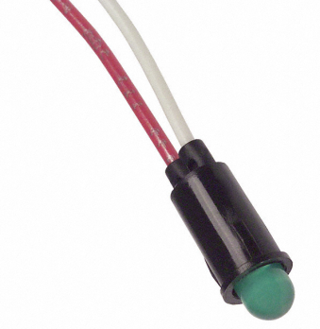
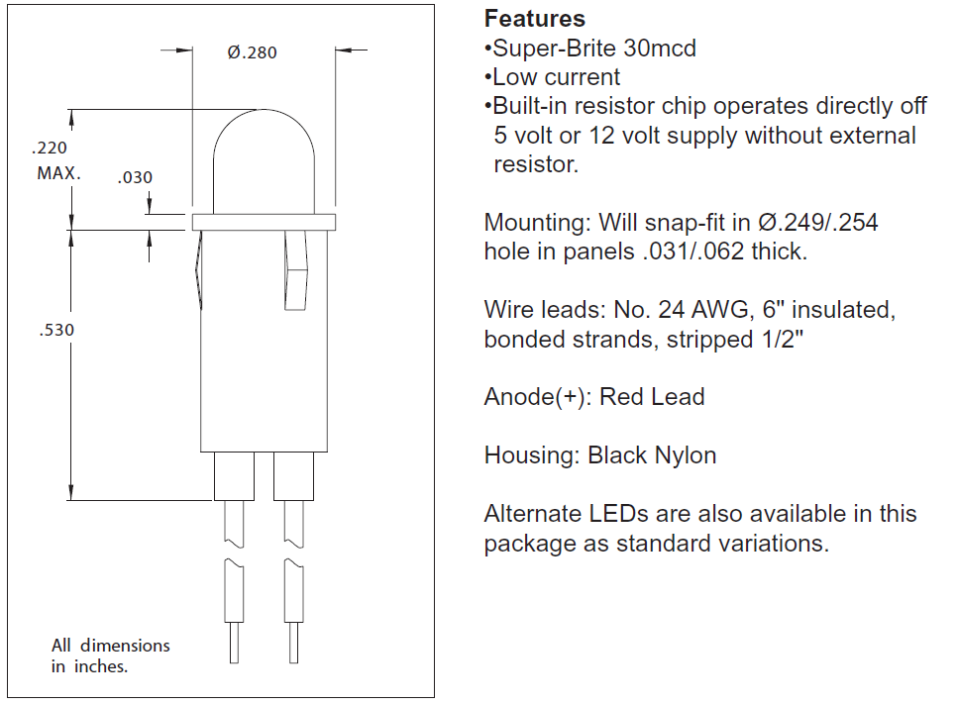
Sequencer – LED
5100-H5
x 8

Slide 10
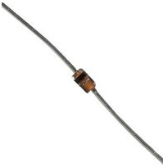
Sequencer – Current Regulator Diode
1N5314
x 8

Slide 11
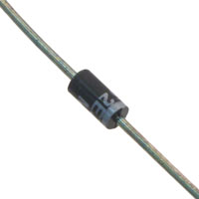
Sequencer – Zener Diode
2EZ18D5MSCT-ND
x 2
DIODE ZENER 18V 2W DO-41

Slide 12
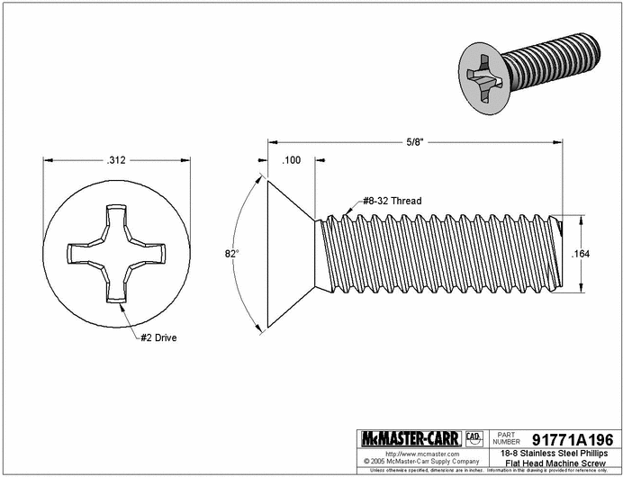
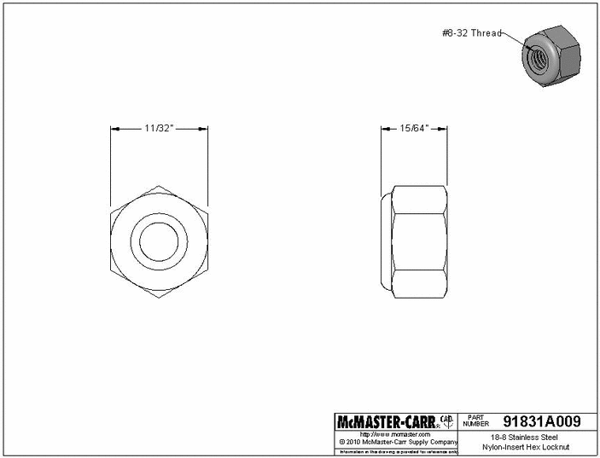
Sequencer – Screws and Nuts for Relays
91099A266
91831A009
x 4
x 4

Slide 13
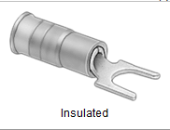
Sequencer – Spade Terminals for LEDs
69145K69
Crimp-on Spade Terminal Block, Vinyl Insulated, 22-18 AWG, #10 Stud
x 4

Slide 14
Sequencer – Spade Terminals for Wires
69145K78
Crimp-on Spade Terminal Block, Vinyl Insulated, 12-10 AWG, #10 Stud
x 8

Slide 15
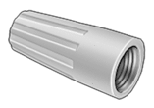
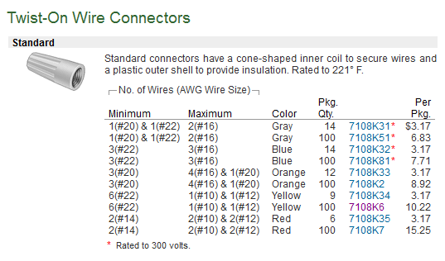
Sequencer – Wire Nuts
7108K6
x 2

Slide 16
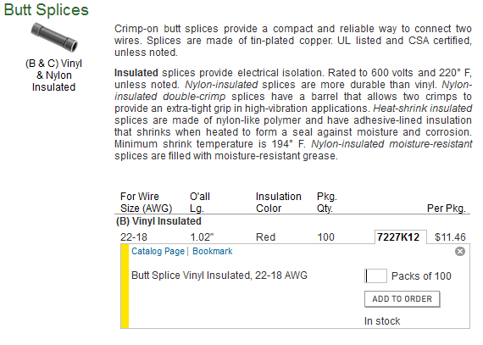
Sequencer – Butt Splice
7227K12
x 1

Slide 17
Sequencer – Layout – Side View
Box 7” (4U) x 7” (4U) x 3”
Relay
In
Plugs
Switch
Sockets
Out
(Front)
(Rear)
Bottom Plate 8.75” (5U)

Slide 18
Sequencer – Layout – ‘In’ View (Front)
Box 7” (4U) x 7” (4U) x 3”
Input
0.5”
0.5”
+24
-24
+18
-18
On
Center at 1.25 x 2.25”
Switch
Center at 5.25 x 2.25”
Center at 1.5” x 1.5”
Off
Center at 5.5” x 1.5”
Center at 3.5” x 1.5”
LIGO-D1200757
DC Power Sequencer
(0,0)
Bottom Plate 8.75” (5U)

Slide 19
Sequencer – Layout – ‘Out’ View (Rear)
Box 7” (4U) x 7” (4U) x 3”
Output
0.5”
0.5”
-18
+18
-24
+24
Center at 1.25 x 2.25”
Center at 5.25 x 2.25”
Center at 1.5” x 1.5”
Center at 5.5” x 1.5”
LIGO-D1200757
DC Power Sequencer
(0,0)
Bottom Plate 8.75” (5U)

Slide 20
Sequencer – Layout – Box Bottom
Inches
Rack Units
Hole pattern for Box Bottom:
8 – 6-32 PEM Nuts arranged so that the Bottom Plate can mate with the Box at both 0 degrees and 90 degrees rotation
In
Out
Box 7” (4U) x 7” (4U) x 3”
(0,0)
Inches

Slide 21
Sequencer – Layout – Box Top
Inches
Hole pattern for Box Bottom:
4 – holes as per diagram, – countersunk for 8/32 Phillips flathead screws
1.87” Center to Center
Relay 1
Center at 5.0” x 5.0””
In
Out
Relay 2
Center at 5.0” x 2.0””
Box 7” (4U) x 7” (4U) x 3”
(0,0)
Inches

Slide 22
Sequencer – Layout – Bottom Plate
Inches
Bottom Plate 8.75” (5U)
Rack Units
Hole pattern for Bottom Plate:
8 - ¼” holes centered ¼” from edge and centered at the center of every 1U (Rack Unit)
8 – holes arranged so that the Bottom Plate can mate with the Box at both 0 degrees and 90 degrees rotation – countersunk for 6/32 Phillips flathead screws
In
Out
Box 7” (4U) x 7” (4U) x 3”
Inches

Slide 23
Hole Pattern for Rack Units
Inches
Rack Units
0.500
0.625
0.625
1.750
1.500
0.875
0.250
0.000
0.250 (¼”) holes centered at:
0.000 + 0.250 = 0.250
0.000 + 0.875 = 0.875
0.000 + 1.500 = 1.500
1.750 + 0.250 = 2.000
1.750 + 0.875 = 2.375
1.750 + 1.500 = 3.250
3.500 + 0.250 = 3.750
3.500 + 0.875 = 4.365
3.500 + 1.500 = 5.000
5.250 + 0.250 = 5.500
5.250 + 0.875 = 6.125
5.250 + 1.500 = 6.750
7.000 + 0.250 = 7.250
7.000 + 0.875 = 7.875
7.000 + 1.500 = 8.500
8.750 + 0.250 = 9.000
8.750 + 0.875 = 9.375
8.750 + 1.500 = 10.250

Slide 24
Sequencer – Layout – Bottom View
Inches
Plugs
Sockets
Inches
-18
4
1
-18
A3
A3
A2
Relay 1
A2
+18
A1
A1
+18
+3
+2
7
8
9
In
4
5
6
Switch
Out
1
2
3
4
1
-24
Relay 2
-24
A3
A3
A2
A2
+24
A1
A1
+24
+3
+2
Inches

Slide 25
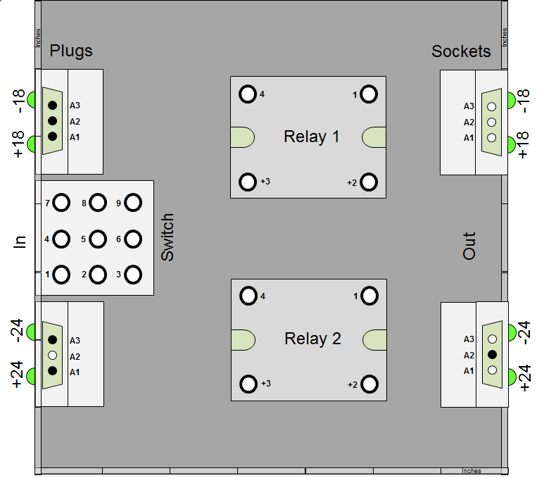
Sequencer – Layout – Bottom View - bmp

Slide 26
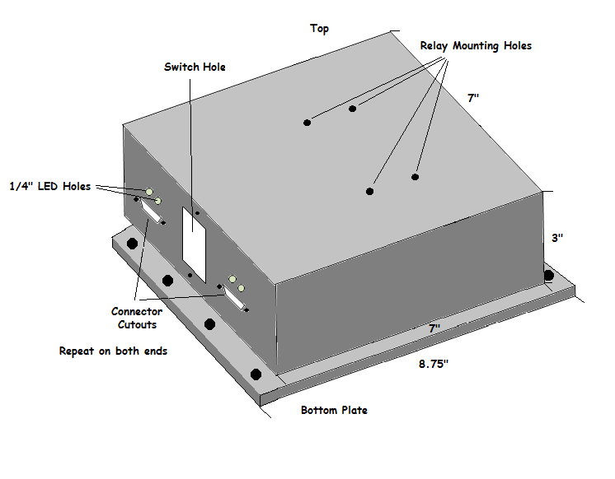
Sequencer – Layout – 3D

Slide 27
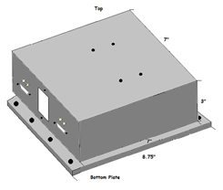
Sequencer – Layout – Labels
Input
Output
+24
-24
+18
-18
-18
+18
-24
+24
On
Off
LIGO-D1200757
DC Power Sequencer
LIGO-D1200757
DC Power Sequencer
Silk screen labels. Please note carefully the LED labels.

Slide 28
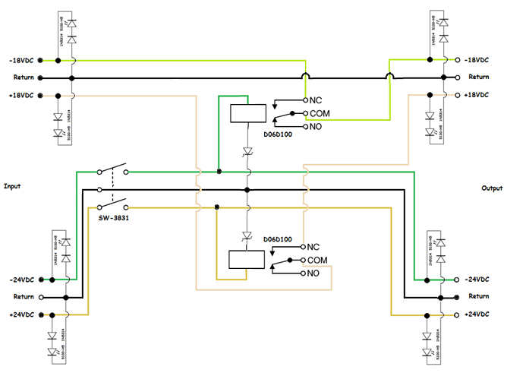
Sequencer – Schematic

Slide 29
Sequencer – Wiring
2EZ18D5
1N5314

Slide 30
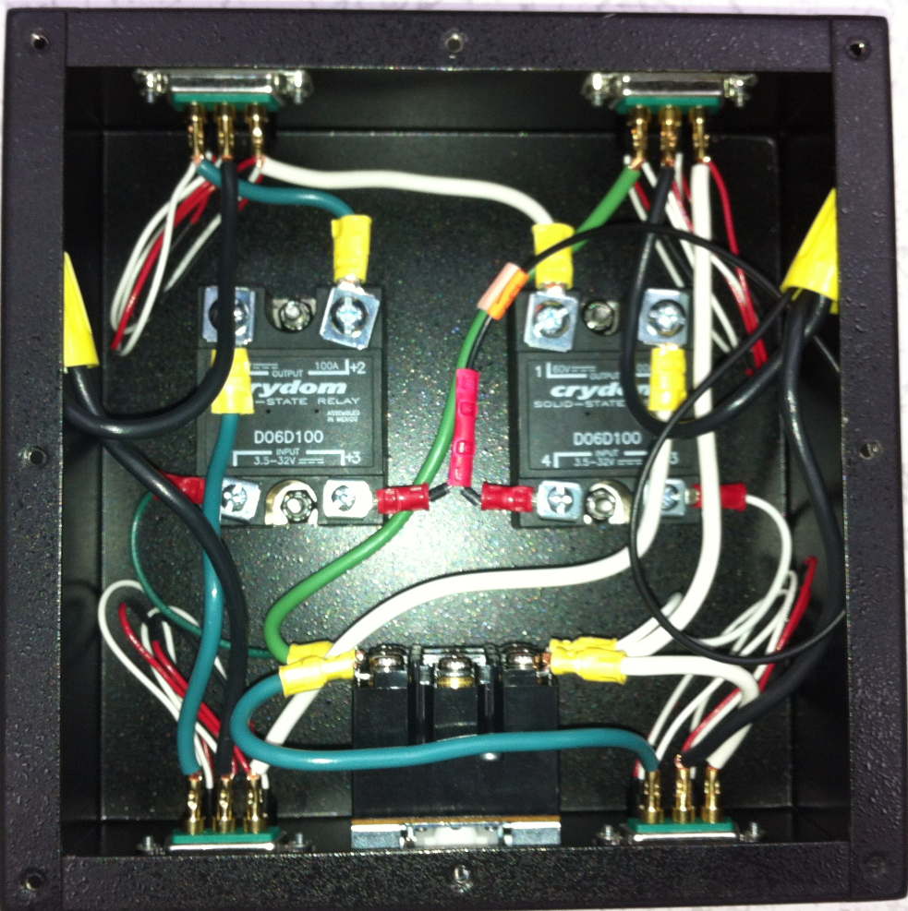
D1200757 Sequencer – Internal

Slide 31
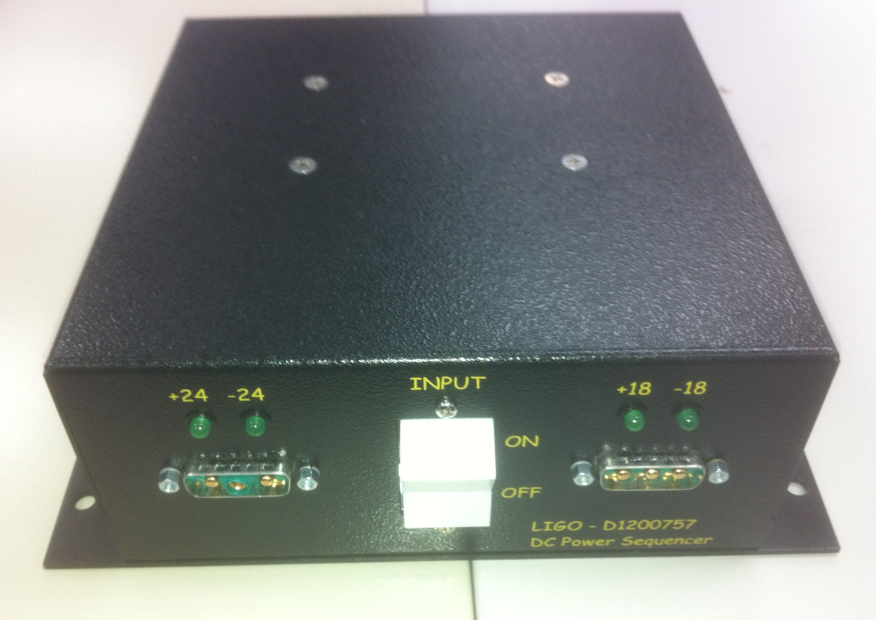
D1200757 Sequencer – Front

Slide 32
D1200757 Sequencer – Rear

