Slide 1



The Study of Evanescent-Wave Heat Transfer in a Parallel Plane Geometry
Richard S. Ottens*, V. Quetschke†, G. Mueller*, D.H. Reitze*, D.B. Tanner*
*University of Florida, †University of Texas at Brownville
NSF PHY-0555453
DCC# LIGO-G1200547

Slide 2
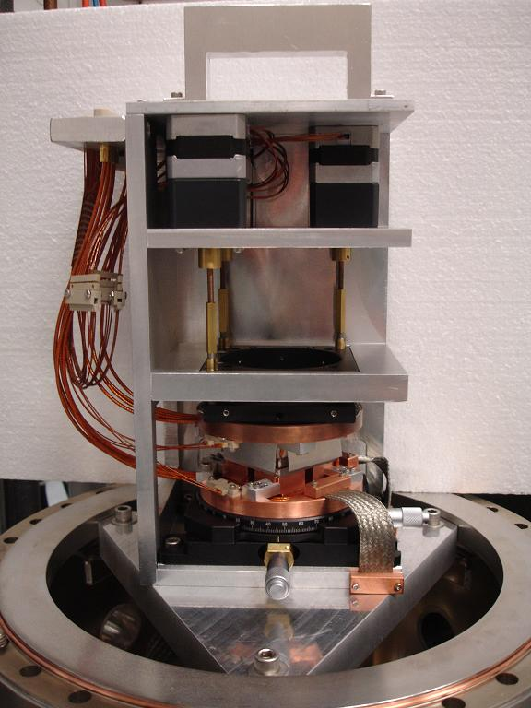


Outline
Theory
Experimental setup
Results
Application in LIGO
Current standing

Slide 3
What is Evanescent-Wave Heat Transfer?
Exponentially decaying EM field outside a material medium
  Produced by total internal reflection inside a medium.
For a propagating wave in the transmitted medium
  k_{tx} and k_{tz} can be found by using Snell’s Law.
  In the case of total internal reflection (sinθ_{i} > n_{t}/n_{i})
Thus resulting in,
  E_{tz} is exponentially decaying
θ_{t}
k_{t}
n_{t}
n_{i}
θ_{i}
θ_{r}
k_{i}
k_{r}

Slide 4
What is it Good For?
If another medium is brought near the interface, then some of the energy emitted in the z direction can propagate into the new material.
This condition known as frustrated total internal reflection (photon tunneling).

Slide 5
Theory
k
Heat transfer coefficient W is the sum of two parts W_{sin} and W_{exp}
W_{sin} is for propagating fields (far-field)
W_{exp} is for the near-field
d
ε
k_{v}
1
0
k
ε
k
ε
d
1
0
k
ε

Slide 6
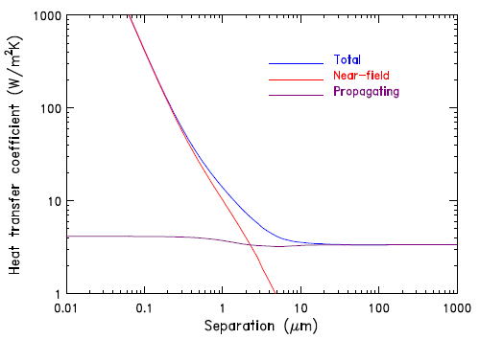
Theory

Slide 7
Heat Transfer Measurements
To measure the heat transfer we take the ratio of power going to the heater to the area times the difference in temperature of the two plates
By moving the two plates closer together we should see an increase of the power going to the heater
T_{Hot}
R_{Conduction}
R_{FF}
R_{NF}
T_{Cold}

Slide 8
Experiment
Kinematic Mount
Capacitor Plates
Heater
Support Structure
Macor Spacer
Temperature Sensors
Sapphire Plate

Slide 9
Experiment

Slide 10
Experiment
Kinematic Mount
Capacitor Plates
Heater
Macor Spacer
Support Structure
Temperature Sensors

Slide 11
Experiment

Slide 12
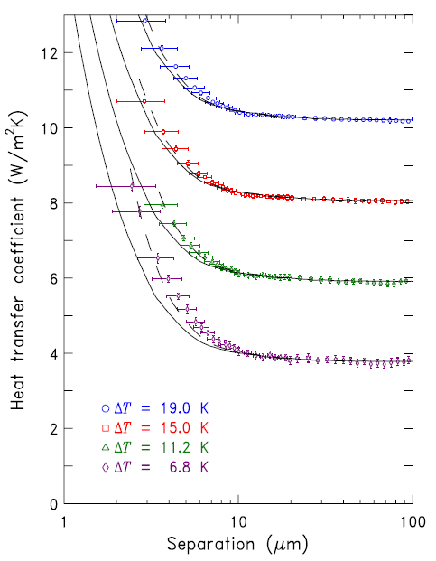
Results
Four data runs at four different temperature differences (offset by 2 W/m²K from each other)
Model prediction is in solid black
Correction for bend in sapphire plate is in dashed black

Slide 13
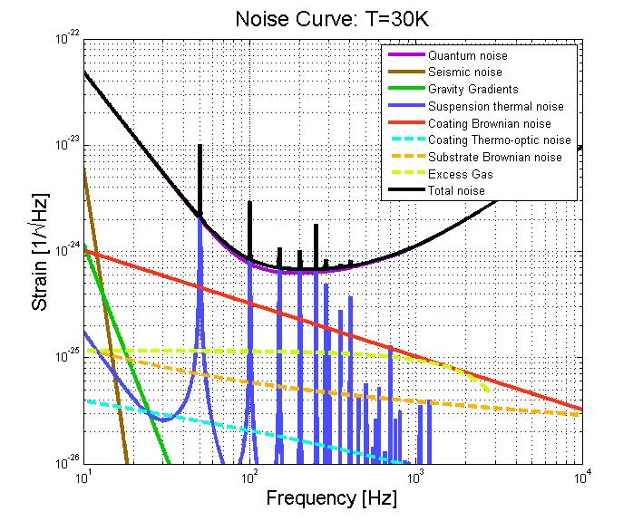
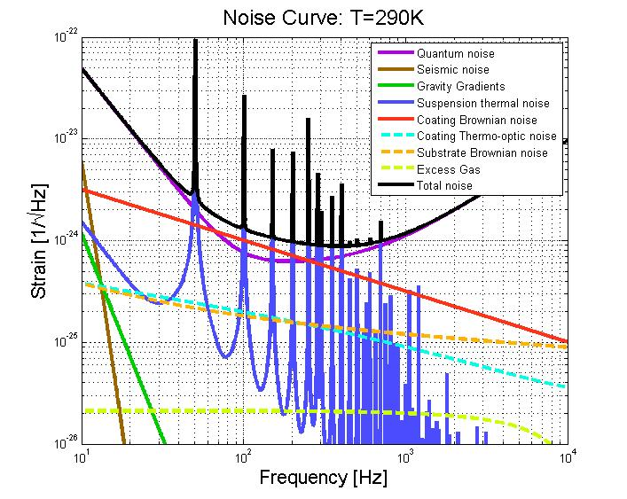
Cooling LIGO
Future versions of LIGO may be cryogenic
  To reduce thermal noise
  A need arises to
  remove absorbed
  laser power from
  the test masses ~3W
Methods of Heat
Transfer
  Convection <<1μW
  Conduction ~60mW
  Radiation ~700mW
  (far field)
Pushing towards the ET sensitivity using ‘conventional’ technology, Stefan Hild et al, 2008
Gravitational Wave Interferometer Noise Calculator (GWINC) , Sam Finn et al, 1999

Slide 14
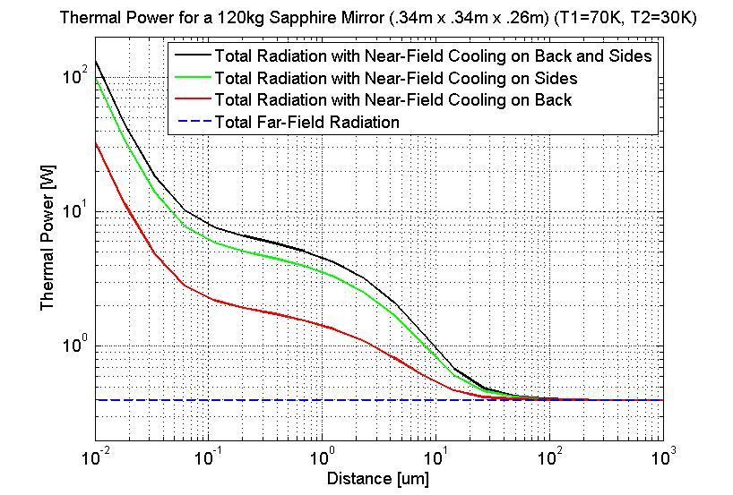
Evanescent waves and LIGO
Implementing near field cooling
  Back
    Only have to deal with one surface
    Have to deal with noise coupling due to electrostatics and Casimir force
  Sides
    Have to deal with multiple surfaces
    Noise coupling has minimal impact
  Back and Sides
Conduction through the fibers: 4.4x10⁻⁶ W/K (<< far field radiation)

Slide 15
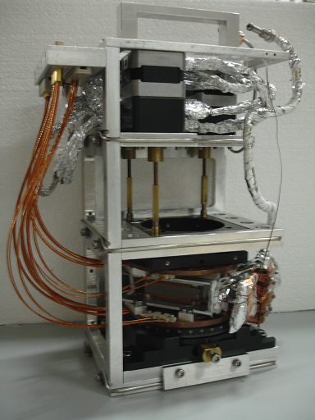
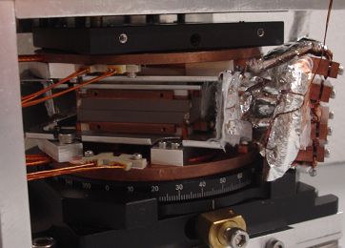
Modifications
Modified to work in cryogenic conditions
Thicker Sapphire plates
Both sapphire plates will be thermally controlled

Slide 16
Capacitance Measurements
The new sapphire plates have a bigger bevel.
This adds a stray capacitance to the total which causes our distance measurements to be less accurate
A work in progress
TOP VIEW
ANGLED VIEW
SIDE VIEW

Slide 17
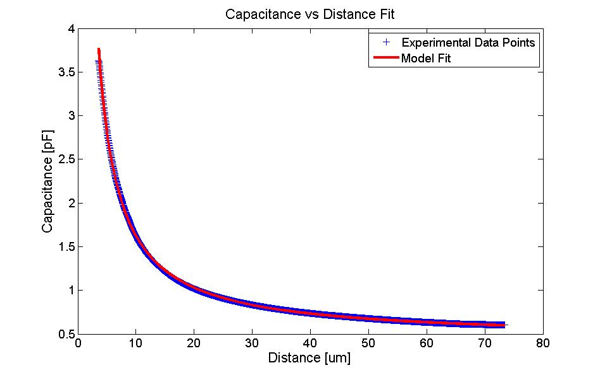
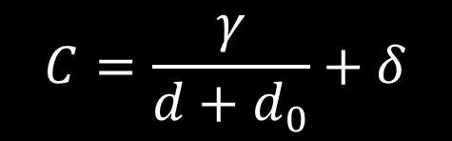

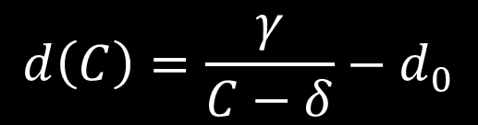
Capacitance Measurements
Originally we fit to the equation
$$C=\frac{γ}{d+d_{0}}+δ$$
  Where $γ,δ,$ and d₀ are fitted values.
Once these values were determined we could easily find d(C).
$$d\left(C\right)=\frac{γ}{C−δ}−d_{0}$$

Slide 18
Capacitance Measurements
Depending on which case we use and if we approximate we can get different values for the fits
These fits can be about 5 µm off from one another
CASE 1
CASE 2
CASE 3
CASE 4

Slide 19
Cleaning
With thicker sapphire plates
  Less bend
  Dirt becomes a bigger problem
Even in the UF LIGO clean room there is still dust from wipes and sticky sediment from unknown origin (likely from the clean solutions).
We are working on a method for cleaning to clean the sapphire plates.
  Drag wipe with acetone
  Drag wipe with methanol
  Coat with first contact (but not on capacitor plates)

Slide 20
Conclusion
Measured evanescent-wave heat transfer across a small gap and it agrees with theory
Can potentially be used to take excess heat from mirrors in LIGO
Working on important issue to ensure proper measurements

