Slide 1

GWADW: Gravitational Wave Detectors for 2015, 2020, and 2025
Setting the Stage
Dave Reitze
LIGO Laboratory
http://surfing-place.blogspot.com/2011/06/hawaii.html

Slide 2
Ground-based Detectors--
Past, Present, & Future
2010 -- First Generation Interferometers:
‘We built km scale interferometers. They work.’
2015 -- Second Generation Interferometers:
‘We’re building more sensitive interferometers. We have ‘knobs’ to play with – signal recycling, input power. We can tune to go after specific astrophysical targets, We’ll soon make detections of binary mergers. And if we get lucky, maybe something else.’
2020 -- Global Gravitational-wave Network
‘We’re doing multi-messenger astronomy with the network.’
2025+… -- Third Generation Interferometers:
‘We’ll building interferometers that will be even more sensitive and probe astrophysics at cosmological distances. They’ll provide stringent tests of GR. Their designs will be influenced as much by astrophysics as by the limits of technology.’

Slide 3


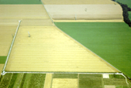




The Advanced Ground-based
GW Detector Network in 2015
Advanced LIGO
Hanford
GEO600
Advanced LIGO
Livingston
Advanced
Virgo
3
3

Slide 4
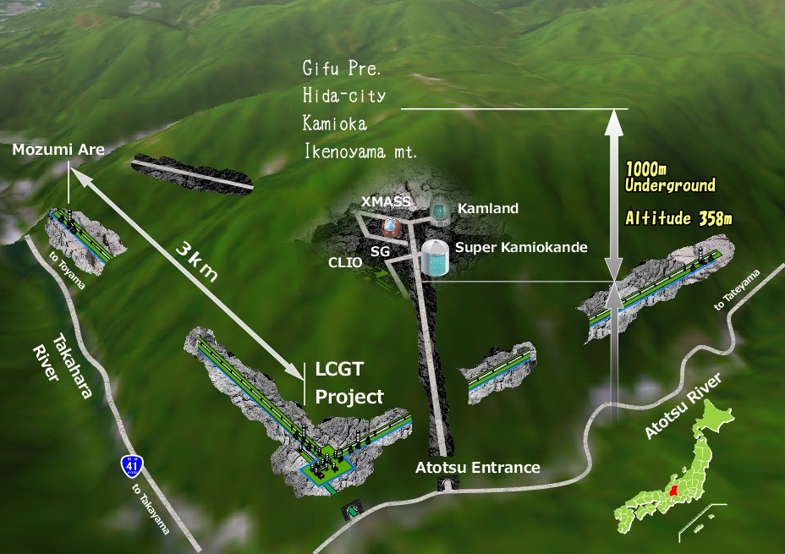
The Advanced Ground-based
GW Detector Network in 2020
Advanced LIGO
Hanford
GEO600
KAGRA
Advanced LIGO
Livingston
Advanced
Virgo
LIGO-India
(anticipated)
4
4

Slide 5
The Advanced Ground-based
GW Detector Network in 2025?
Strain (1/√Hz)
?
?
?
?
?

Slide 6
Timescales for a US third generation detector
Assumptions:
  aLIGO completed in 2015
  2 - 3 years needed to reach design sensitivity
  First detections come between 2015-2018
  Depending on NS-NS, NS-BH, BH-BH rates or surprises, 2 or more years of science running after detection
Constraints and Prerequisites:
  Advanced LIGO: our first priority must be to get aLIGO operational and sensitive
  Science: any major upgrade proposal (~$100M scale) will have to wait until we have detections
Near Term Possibilities (2016-2020):
  Incremental, lower cost upgrades which improve sensitivity by small factors and/or in different frequency bands, eg.
    Squeezing
    Mirrors possessing optical coatings with significantly lower thermal noise
    ???

Slide 7
Next generation timescales
Longer Term Possibilities (2020-2030):
  Upgrades which have a high price tag will require a dedicated proposal to NSF.
    It takes a years to get on to and work though the queue of Major Research Equipment and Facilities Construction projects.
  A 3G proposal will need to have a thorough conceptual design underpinning the proposal
    The design will be strongly motivated by astrophysics goals, exploring trades
    The ‘Catch-22’ problem
Recall History
  Initial LIGO – ‘Blue book’ design in 198? → first science run (S1) in 2002, design sensitivity in 2005
  Advanced LIGO – Conceptual design in 1998 → first science slated for 2015
It takes 15-20 years to go from design to working interferometers; this points to an operational 3G interferometer in the late 2020’s
  Could possibly be accelerated by breakthrough science by 2G detectors, a more limited scale upgrade

Slide 8
What’s needed? An partially complete list…
Source Development: high power, stabilized 1.5-1.6 μm lasers, modulators, isolators
Interferometer Network Development: multi-messenger astronomy, event position reconstruction
Optical Materials Science: large silicon optics, metrology, optical coating development, materials science
Quantum-enhanced interferometry: quantum non-demolition, squeezing, displacement-free interferometry
Low Frequency Interferometry: gravity gradient sensing and feed forward, mirror suspension, cryogenic mirrors, underground location

Slide 9

RGB: R&D for third generation detectors
LIGO Scientific Collaboration ‘Strawman’ design approach – ‘how do we design an interferometer to the facility limits of the LIGO sites?’
  Not underground, not (necessarily) a wholesale upgrade (a la Advanced LIGO)
Strawman design will evolve in a conceptual design
What research should we not be doing?
Prioritization is important, but I think it’s too early to be picking winners and losers
  Many of the cool ideas are simply too untested to know they’ll work.

Slide 10
Pulsar Timing
Pulsar timing arrays are in the thick of the hunt to directly detect the first gravitational wave
  Bruce Allen: "I think they have a really solid chance of beating the ground-based detectors. It's a real race.” (Nature 463, 147 (2010))
Progress driven by discovery of new millisecond pulsars by Fermi and radio telescopes
Consortium of collaborations (NANOGrav, EPTA, PPTA) hunting for nHz gravitational waves
More in Thursday “Pulsar Timing” Session
  Talks by Finn, Cordes, Lazio

Slide 11
Space – the Final Frontier
April 2012 decision by ESA to select JUICE (Jupiter Icy Moon Explorer) over eLISA/NGO for first L-class mission
  Some good news in this - the ESA scientific review committee placed eLISA/NGO #1 in science value/impact
LISA pathfinder – launch expected in 2014, will test key LISA technologies
eLISA/NGO will compete for L2 slot
  Launch late in the next decade (2028?)
More in Thursday’s “Space Antennae” session
  Talks by McKenzie, Sato, Ward, Buchmann

Slide 12
Exotica: Cool Ideas for Gravitational-wave Detectors
Most of us here work on mainstream gravitational-wave detectors
Nonetheless, there are other ideas being pursued – atom interferometers, torsion bars, superfluidity
These ideas may seem exotic, but then again so did km scale gravitational-wave interferometers when they were proposed!
More in Thursday’s ‘Novel Technologies’ session
  Talks by Ando, Shoda, Schwab, Muller

Slide 13

Summary
2015 → On track to bring second generation detectors Advanced LIGO & Advanced Virgo on line
2020 → Global ground-based gravitational wave network operational
2025 → Third generation detectors under construction & space-based interferometer nearing launch
http://wallpapers.free-review.net/42__Kalalau_Valley,_Kauai,_Hawaii_-_Pacific_Breezes.htm

Slide 14

Enjoy the meeting!
http://hawaiiw.net/wp-content/uploads/2011/11/hawaii-red.jpg

