Slide 1
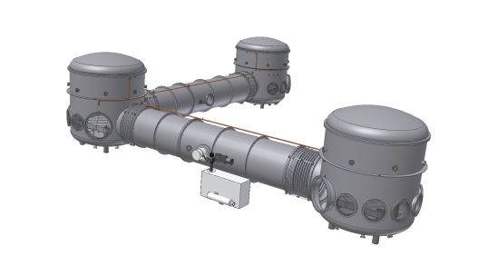




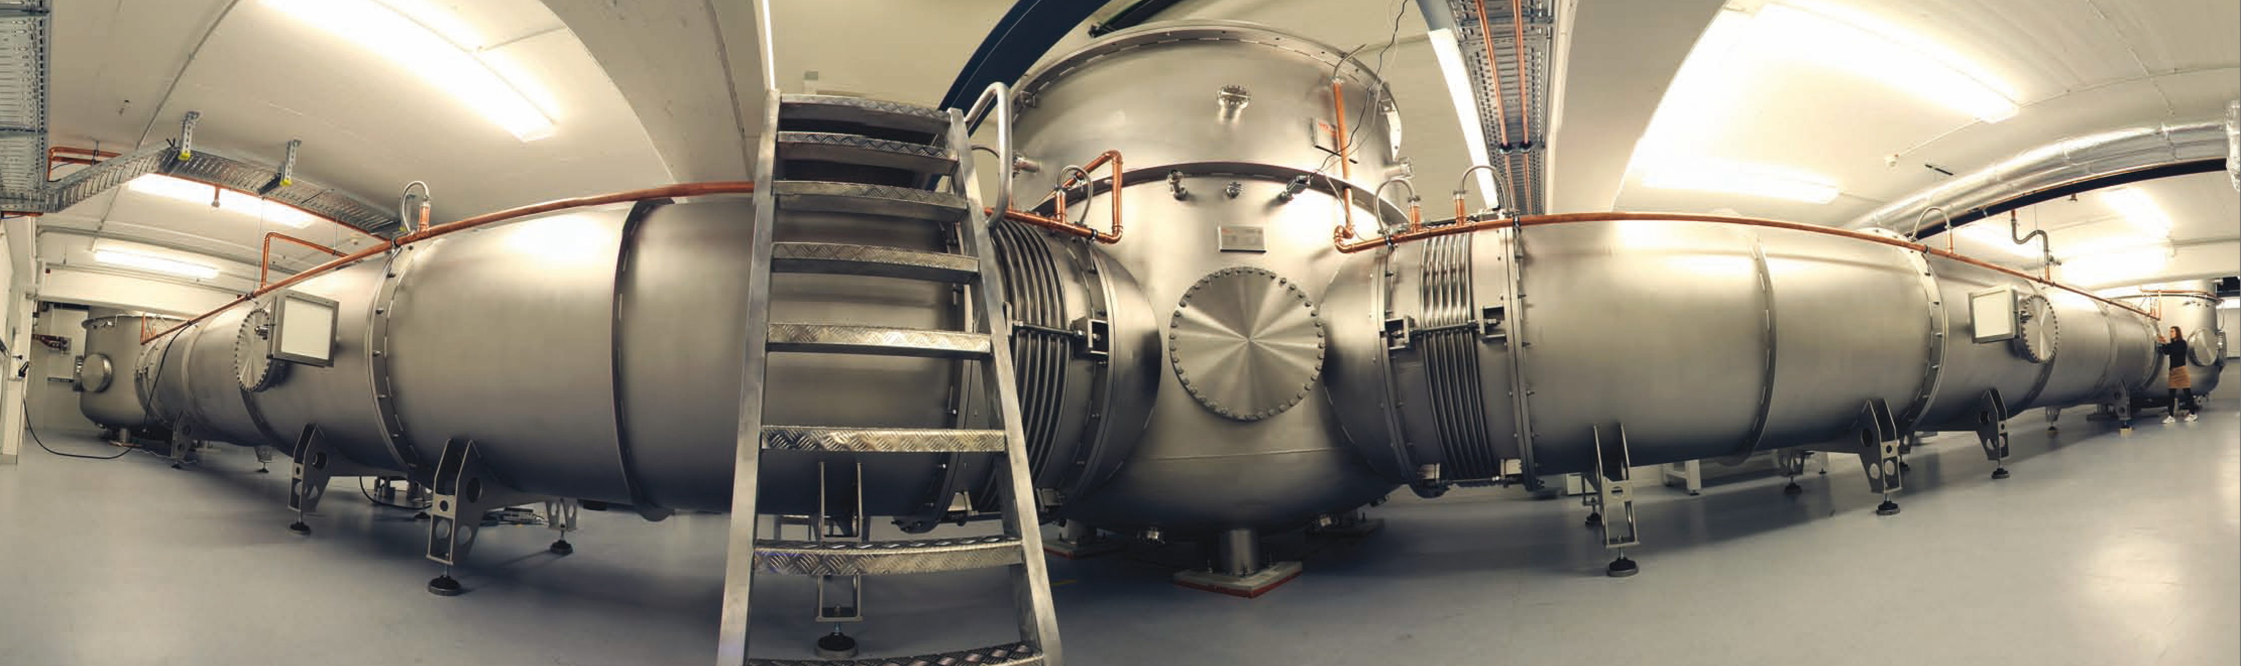
(Coating) thermal noise interferometer
Tobias Westphal, AEI 10 m Prototype team
http://10m-prototype.aei.uni-hannover.de
LIGO G-1200560
GWADW, May 2012

Slide 2
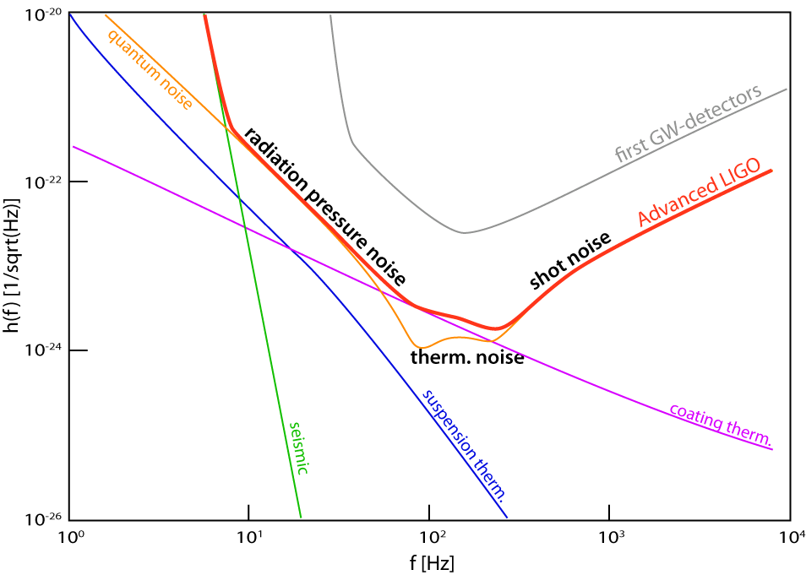
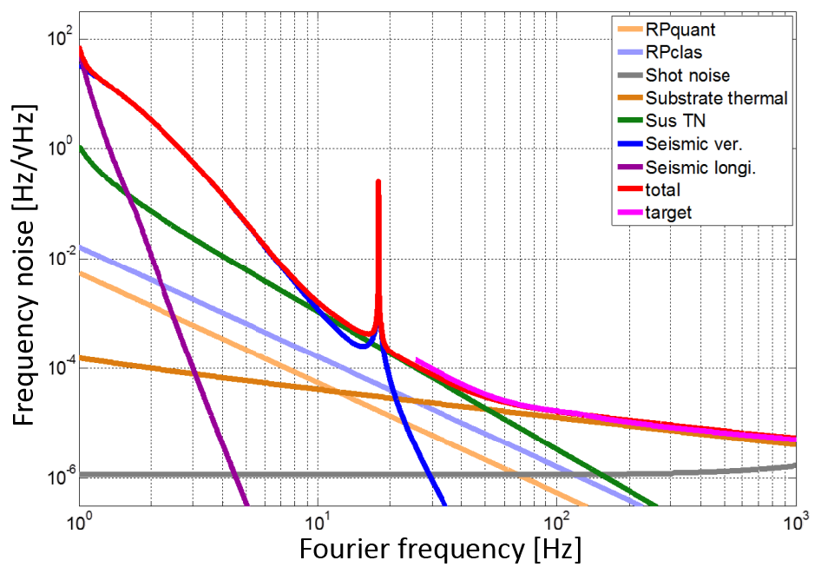
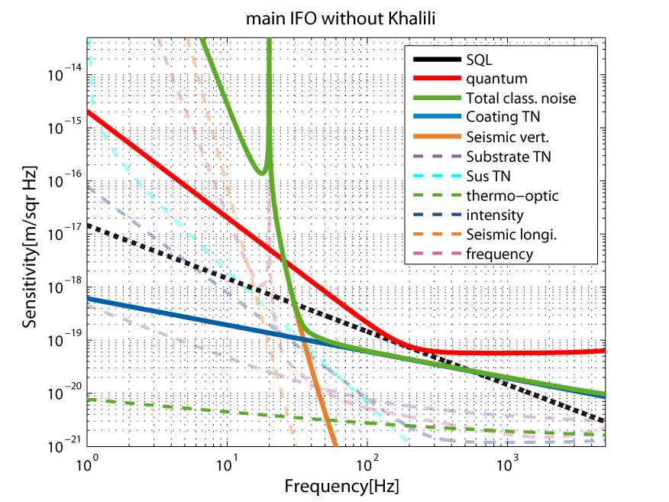
Coating thermal noise basics
Advanced LIGO
Origin:
High reflective coatings are based on amorphous thin films
Mechanical losses couple mirror and heat bath
→ Thermal fluctuations «» Displacement noise
(Fluctuation Dissipation Theorem)
Workarounds:
Lower temperature (change everything)
Change materials
Change structure
Remaining problem:
Test theory
Measure offresonant thermal noise
(done @ high f > 500Hz)
AEI 10m Reference cavity
AEI 10m SQL Interferometer

Slide 3
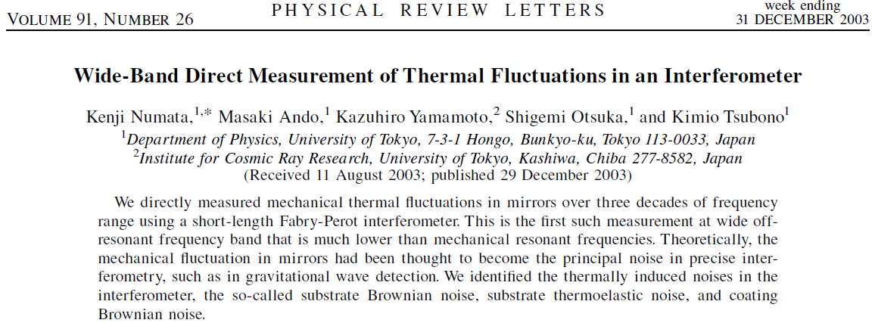
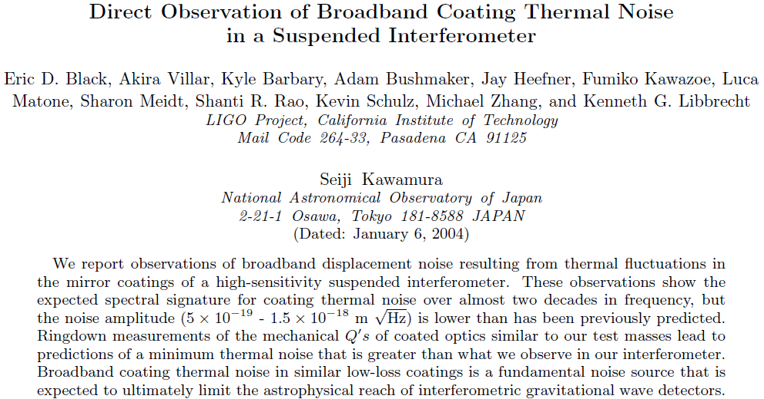
History of CTN
Longlasting discussion about theory
Frequency independent loss: structural damping
Velocity proportional damping: viscous damping
Experimental work:
Structural damping in rotating rods: 1927
Viscous damping of a torsion balance: 1995
Fluctuation dissipation theorem validated for low loss material (fishing line): 1995
→ Assuming FDT validity, only frequency dependence of loss needs to be measured
Off resonant thermal noise (coating) measured 2003
Again 2004: 5x lower loss angle than expected

Slide 4
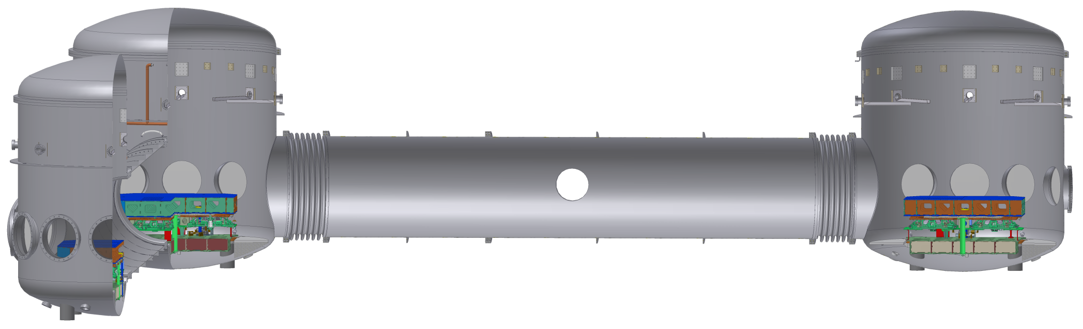
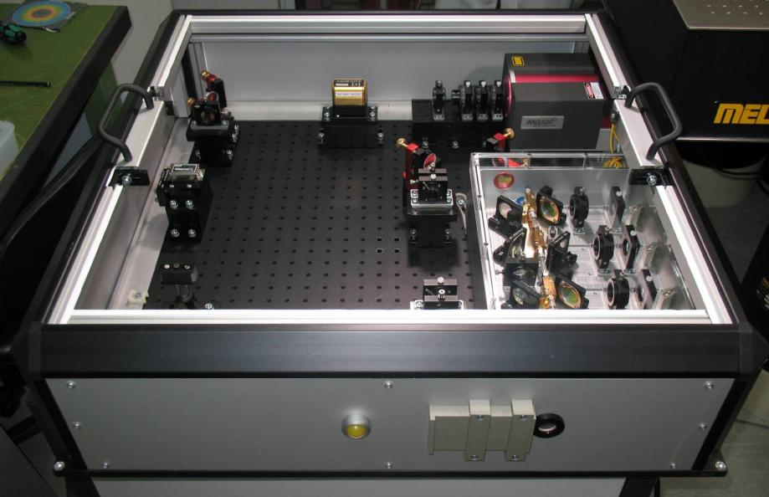
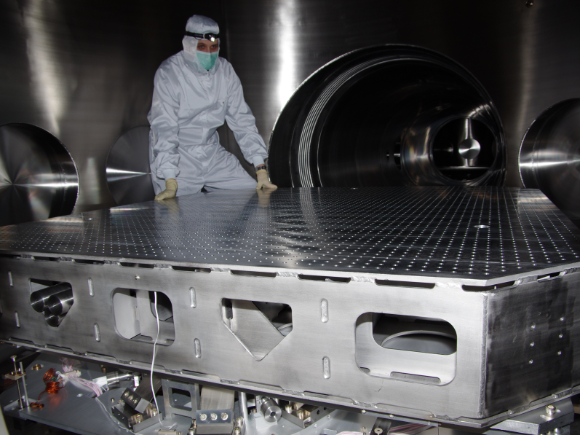
Planned observation of CTN
Problem:
Required sensitivity comparable to big interferometers
→ Similar effort!
Use infrastructure of AEI 10m Prototype
Vacuum space available
Stabilized laser
Seismic pre-isolation
→ Shrink frequency reference cavity
& make it sensitive to CTN

Slide 5
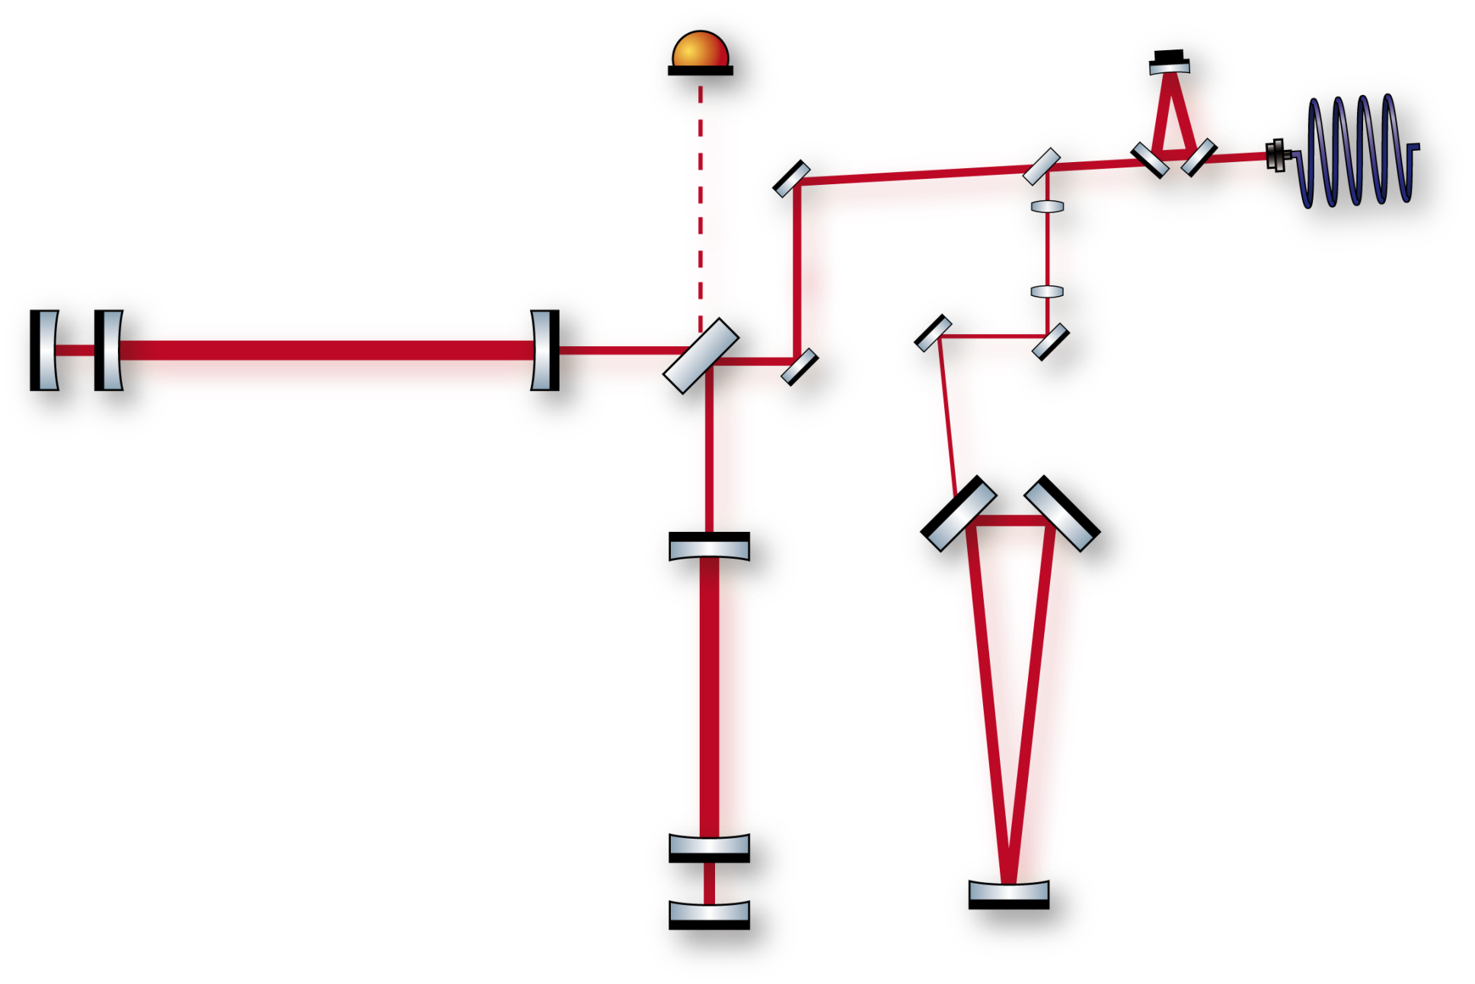
AEI 10m Prototype layout
Pre mode
cleaner
Khalili
cavity
10 m Fabry-Perot
arm cavity
Finesse ca. 670
Tap off
10%
~ 8 W input
@ 1064 nm
BS
ITM
Frequency-reference cavity:
Length: 10.6 m
Finesse: 7300
IETM
EETM

Slide 6
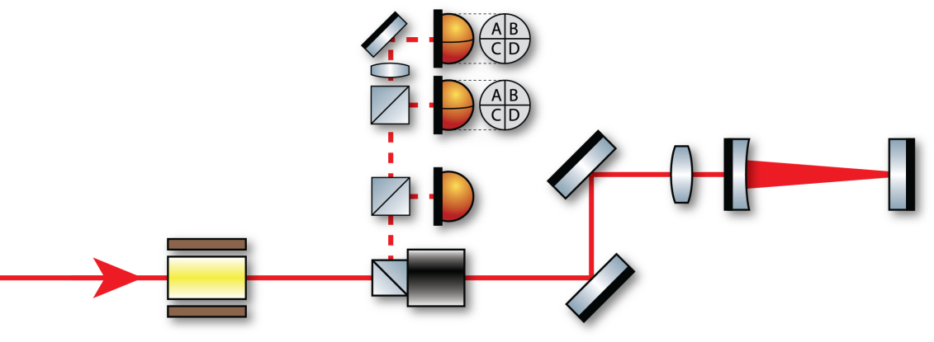
TNI design
Fabry Perot Interferometer
Suspended 860g mirrors
  Substrate: Fused silica
  Coating: Tantala/Silica
10 cm length (on one table)
Plane/concave design
Small spotsize (tunable)
Alignment & Control
Pound Drever Hall locking
Differential wavefront sensing
Spot position controls?
Local control
Beyond thermal noise
Test suspended interferometry close to optical instability
The future (exchange a single mirror)
AlGAs coatings
Gratings
Bonding loss
Notes:
6
Inter table distance as basis for length reference

Slide 7
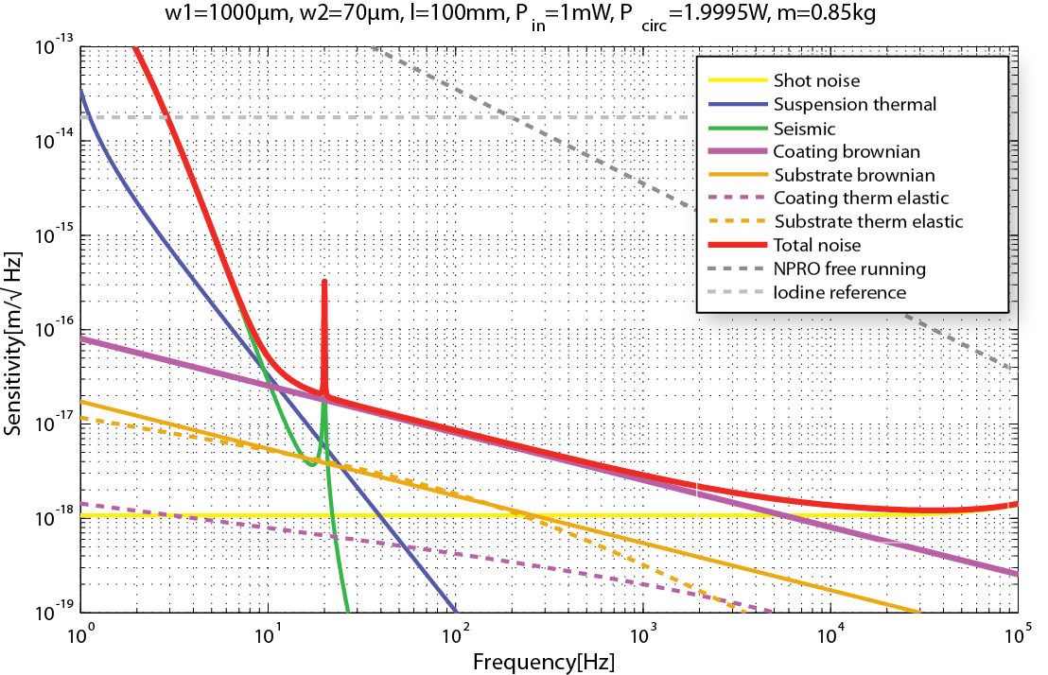
TNI sensitivity
TNI in a nutshell
Input power: 1mW
Circ. power: 2W
Finesse: ≈ 6000
Big spot: 1mm
Small spot: 70µm
Limitations:
Seismic (low f)
Coating Brownian (≈20Hz-5kHz)
Shot noise (high f)
Pay attention to
thermo elastic noise
→ shallower slope at low frequencies!
Notes:
7
Inter table distance as basis for length reference

Slide 8
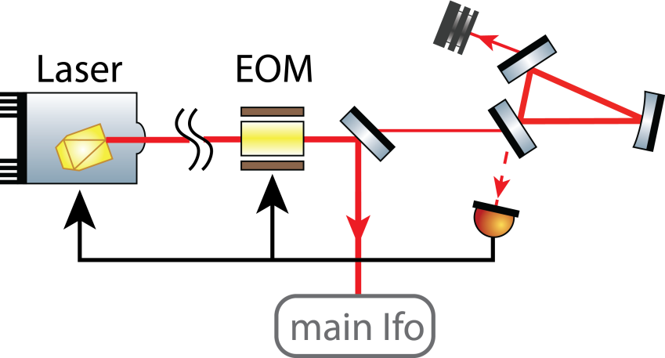
Frequency reference cavity
Inter table distance → length reference
Round trip length 21.2 m
Finesse 7300
Input power 130 mW
Mirror mass 860 g (→ GEO MC)
Feedback:
Laser temperature (< 1Hz)
Laser PZT (< 10 kHz)
Phase correcting EOM (< 250 kHz)
Notes:
8
Inter table distance as basis for length reference

Slide 9
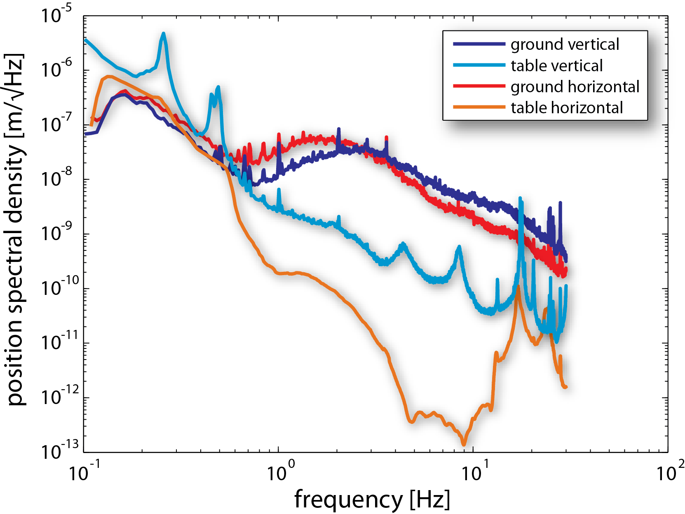
Seismic pre isolation
Passive low frequency isolation tables
Reduce rms seismic noise
Isolation around mirror suspension resonances → weaker actuators
Ease lock aqquisition
Notes:
9
Inter table distance as basis for length reference

Slide 10
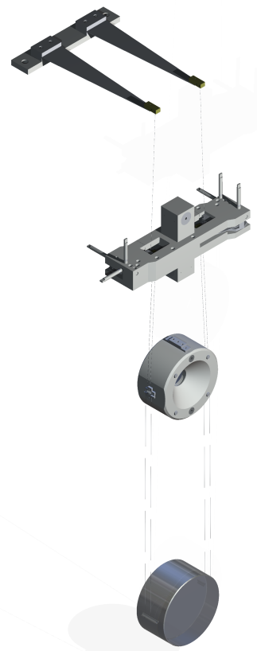
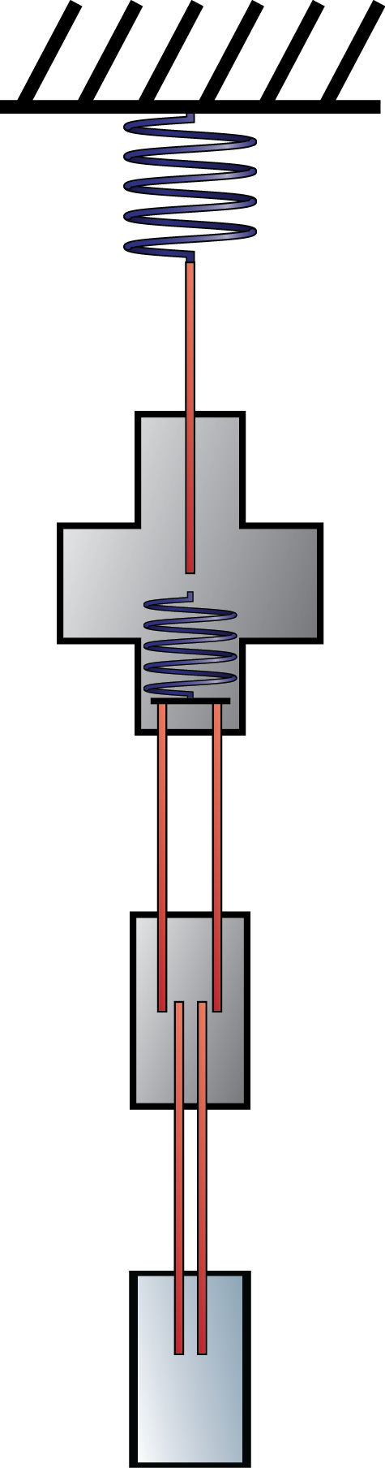
Mirror suspensions
Seismic noise isolation above resonance
Ultimate limit: Thermal noise @ last stage
Almost Reference cavity design:
Three horizontal, two vertical stages
Cantilevers inside the upper mass
two wires attached to each
→ better pitch damping
850 g per stage (mirror 10 cm x 5 cm)
Steel wires, last stage 55 µm Ø (≈30% loaded)
Local control at uppermost stage
(passive filtering of actuation noise)
Fast alignment by steering mirrors
Reaction pendulum for fast longitudinal actuation

Slide 11
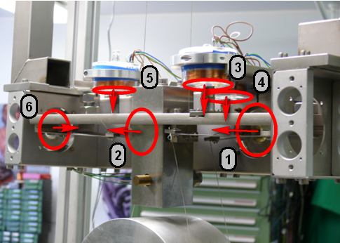
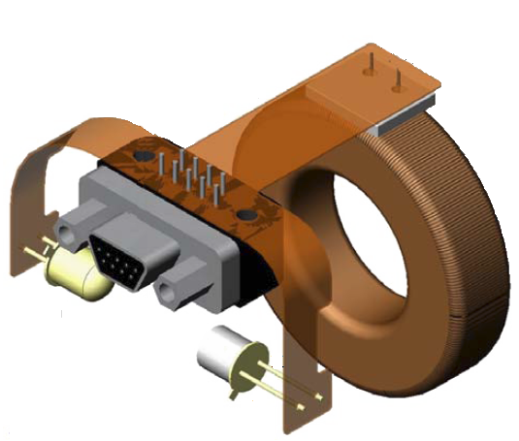
Local control design
Position sensing
6 Shadow sensors per upper mass (BOSEMs)
  3E-10m/√Hz @ 1Hz
  0.7mm dynamic range
One suspension equipped with OSEMs for
higher dynamic range?
Signal processing
Digital basis transform & filtering (CDS)
Two separate paths (alignment, damping)
Hardware watchdog (rms current readout)
Spot position
Alignment control
lowpass
Local damping
BOSEM 1
whitening
long Filter
dewhitening
watchdog
BOSEM 1
Basis
Transform:
Sensors
→
Upper mass
DOFs
pitch Filter
Basis
Transform:
Upper mass
DOFs
→
Actuators
side Filter
roll Filter
vert Filter
yaw Filter

Slide 12
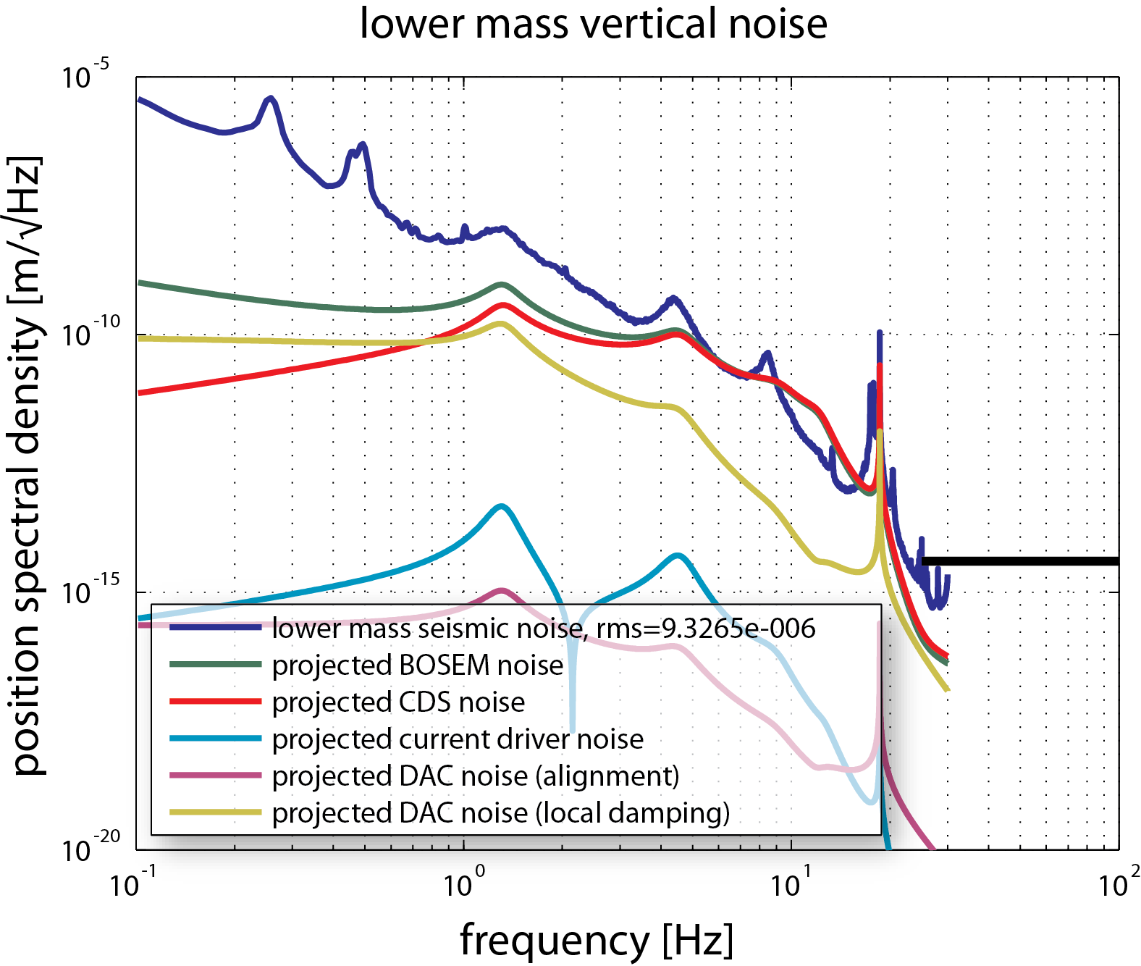
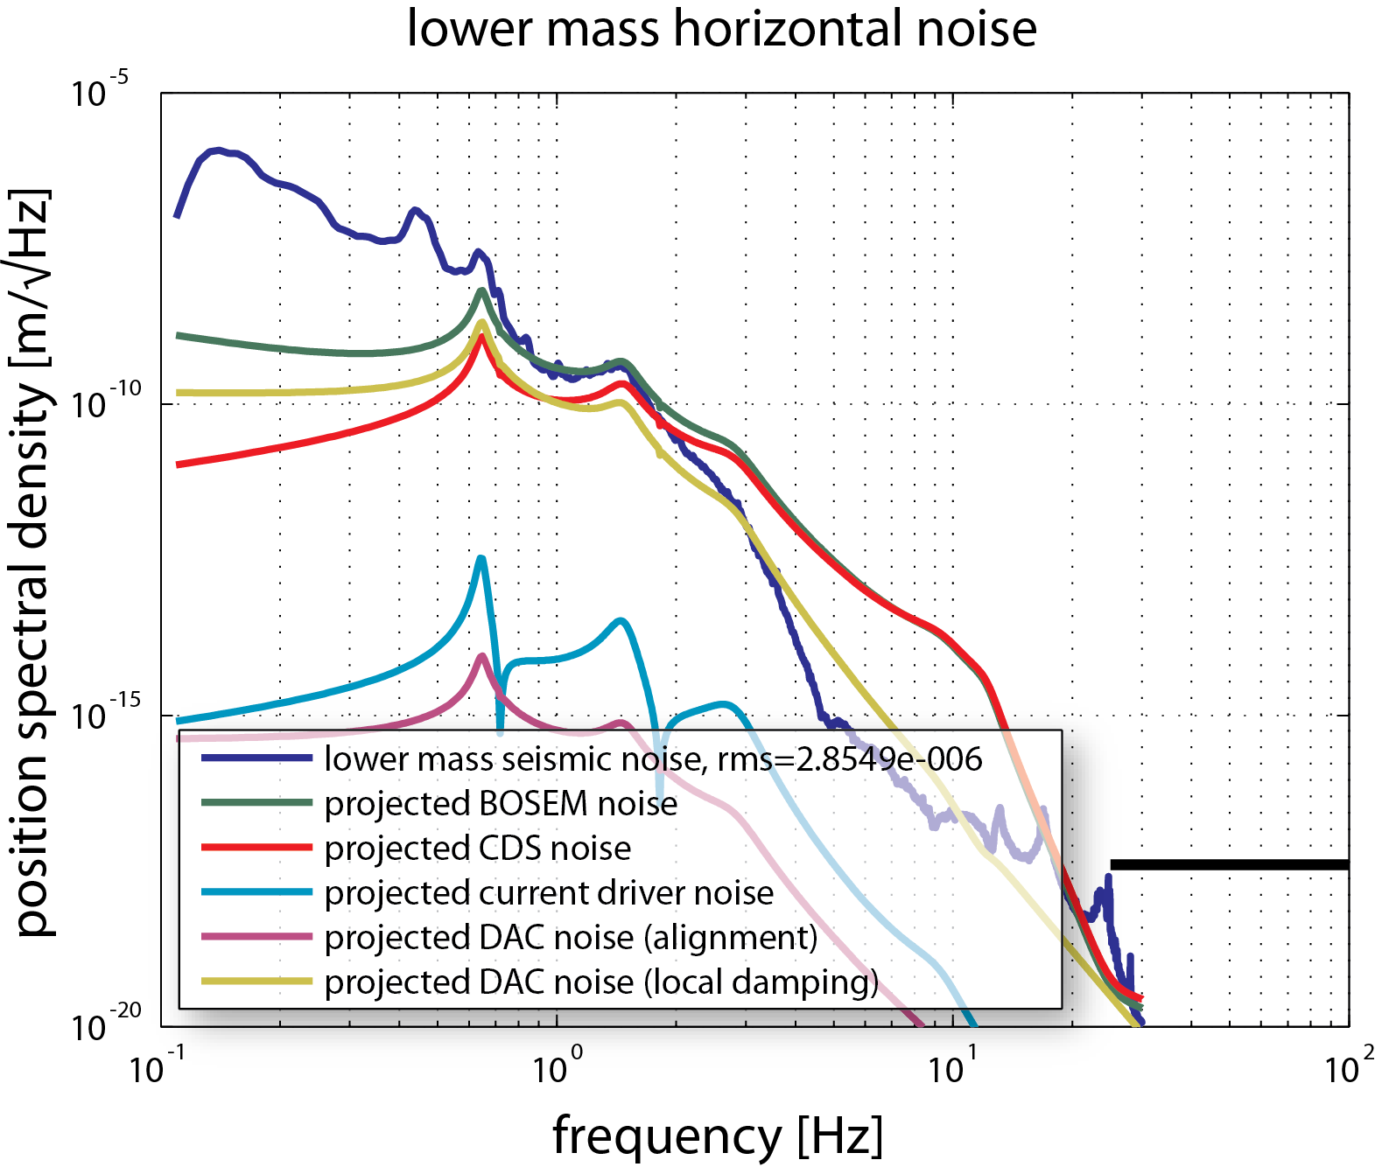
Local control performance
Projection of suspension noise @ lower mass
→ results fulfill (reference cavity) requirements

Slide 13
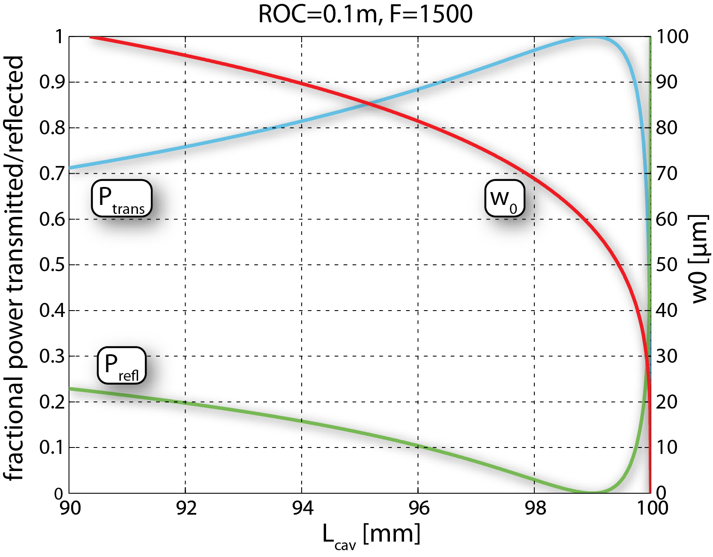


Spotsize tunability
Cavity basics
Radius of curve mirror is fixed to 100mm
Optical stability requires
L < radius of curvature (ROC)
Close to instability (L≈ROC)
spotsize (w₀) drops quickly
Setup & Performance
Modematching optimized for w₀=58µm
Scanning ±1mm reaches to instability
Modemismatched light is reflected
Junk light contributes only shotnoise

Slide 14
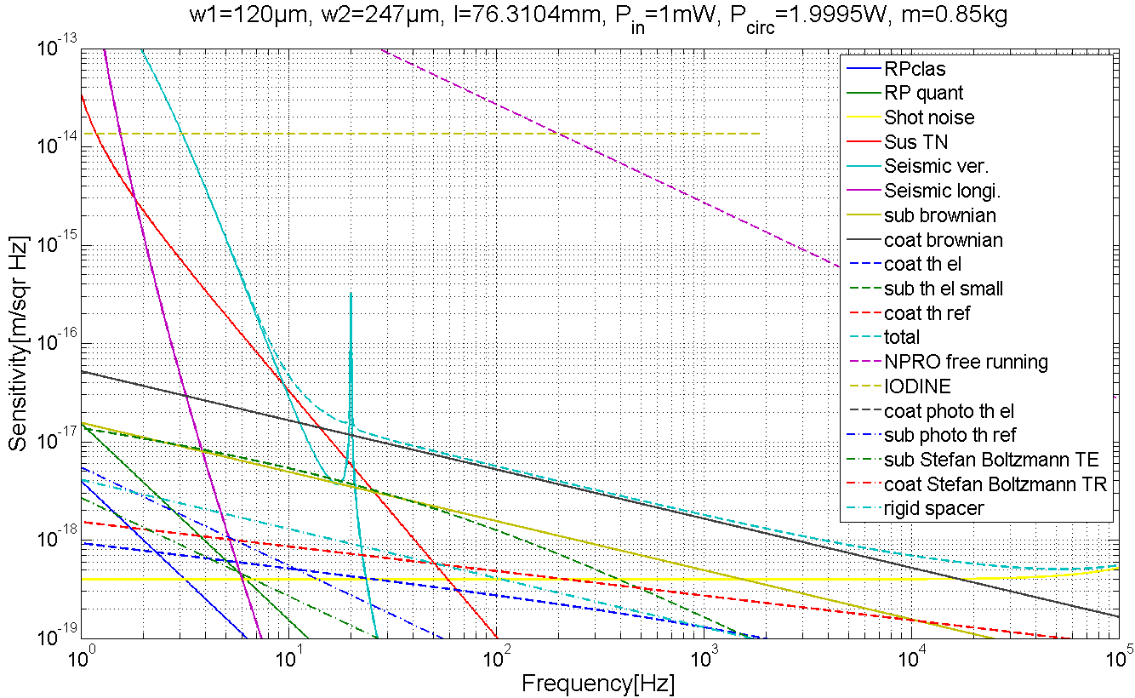
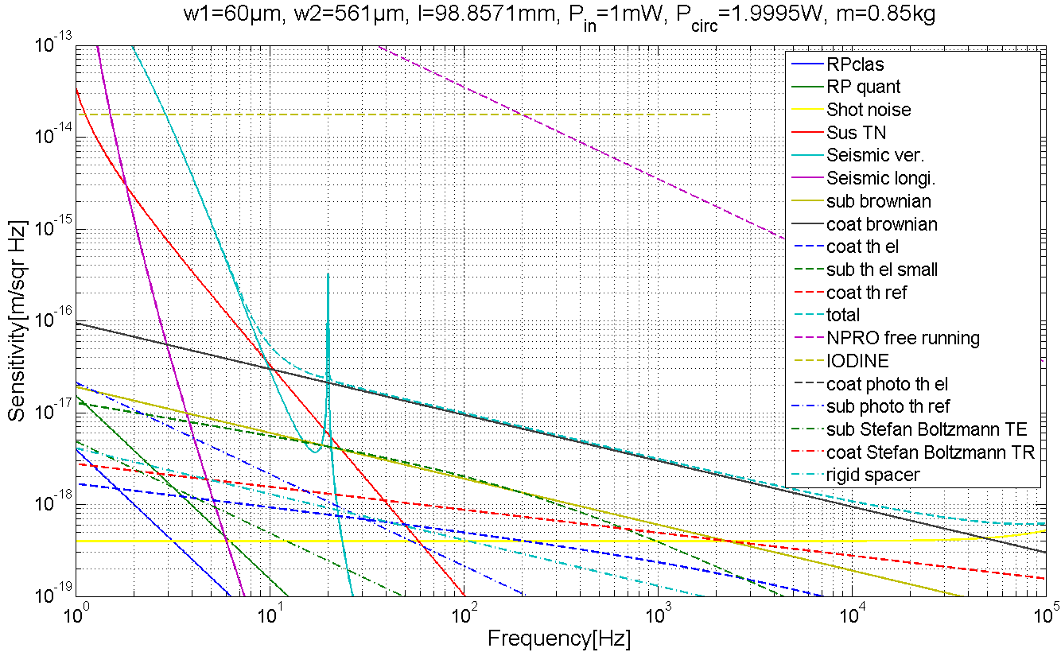
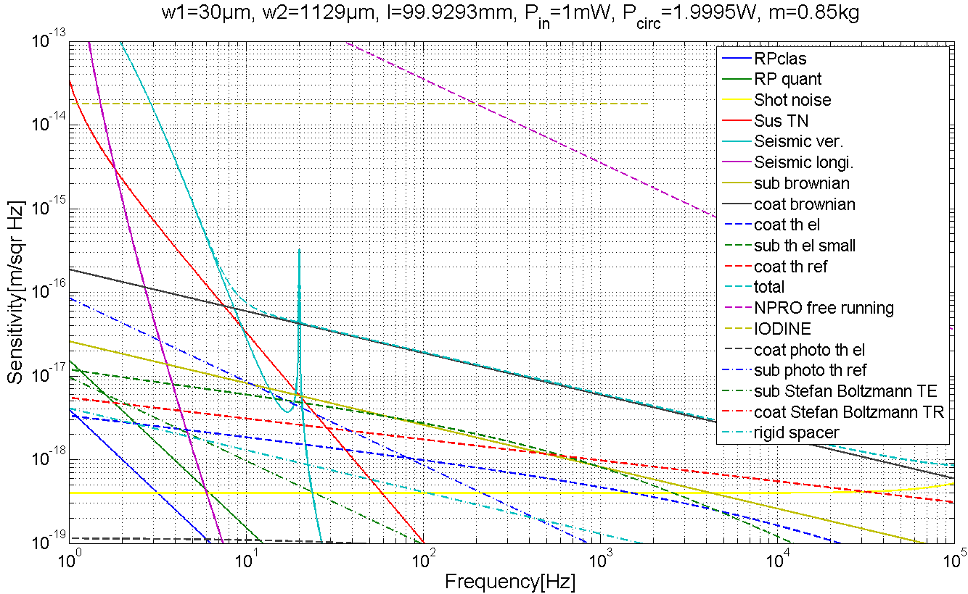
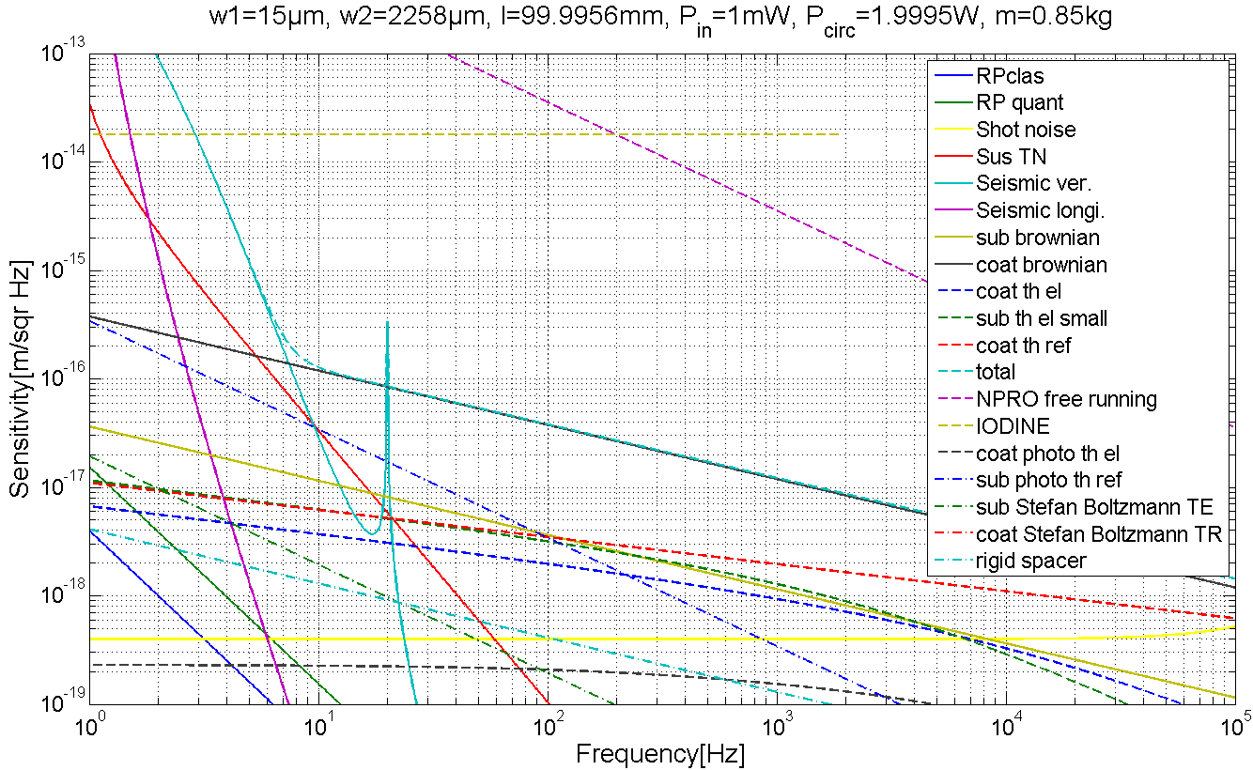
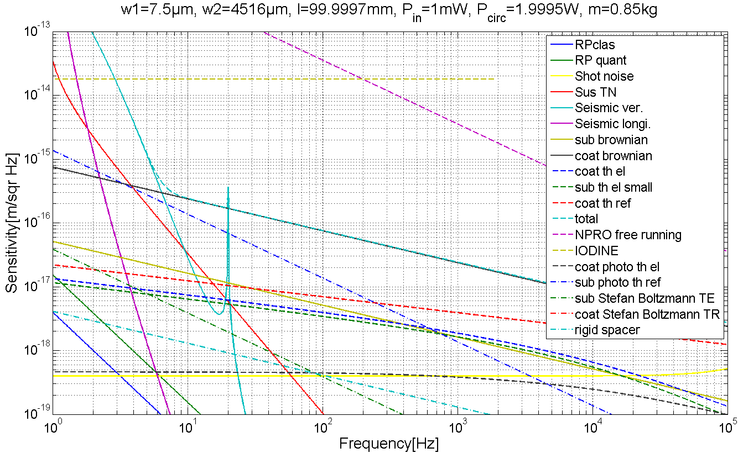
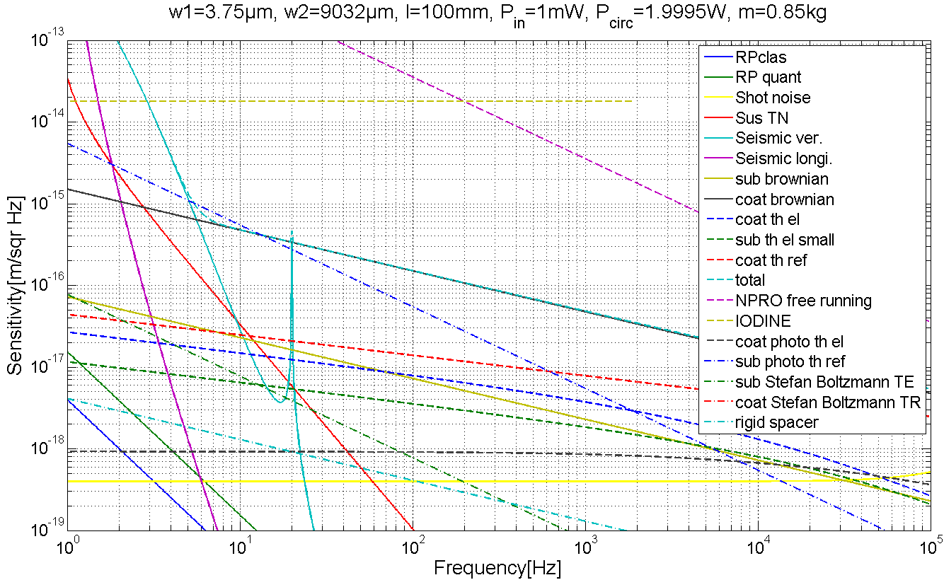
Spotsize changing
Assuming perfect modematching
→ Lenses need to be moved
→ Every setup is different

Slide 15
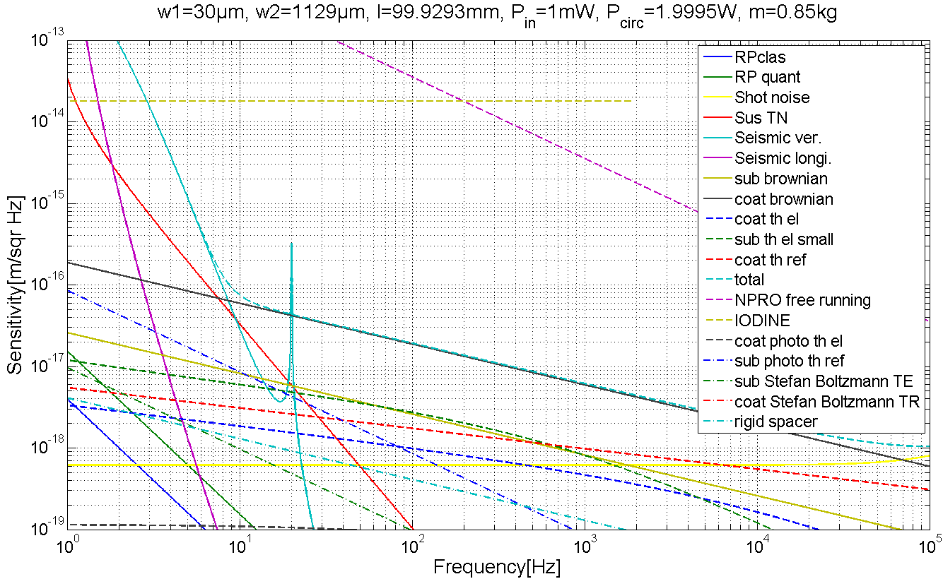
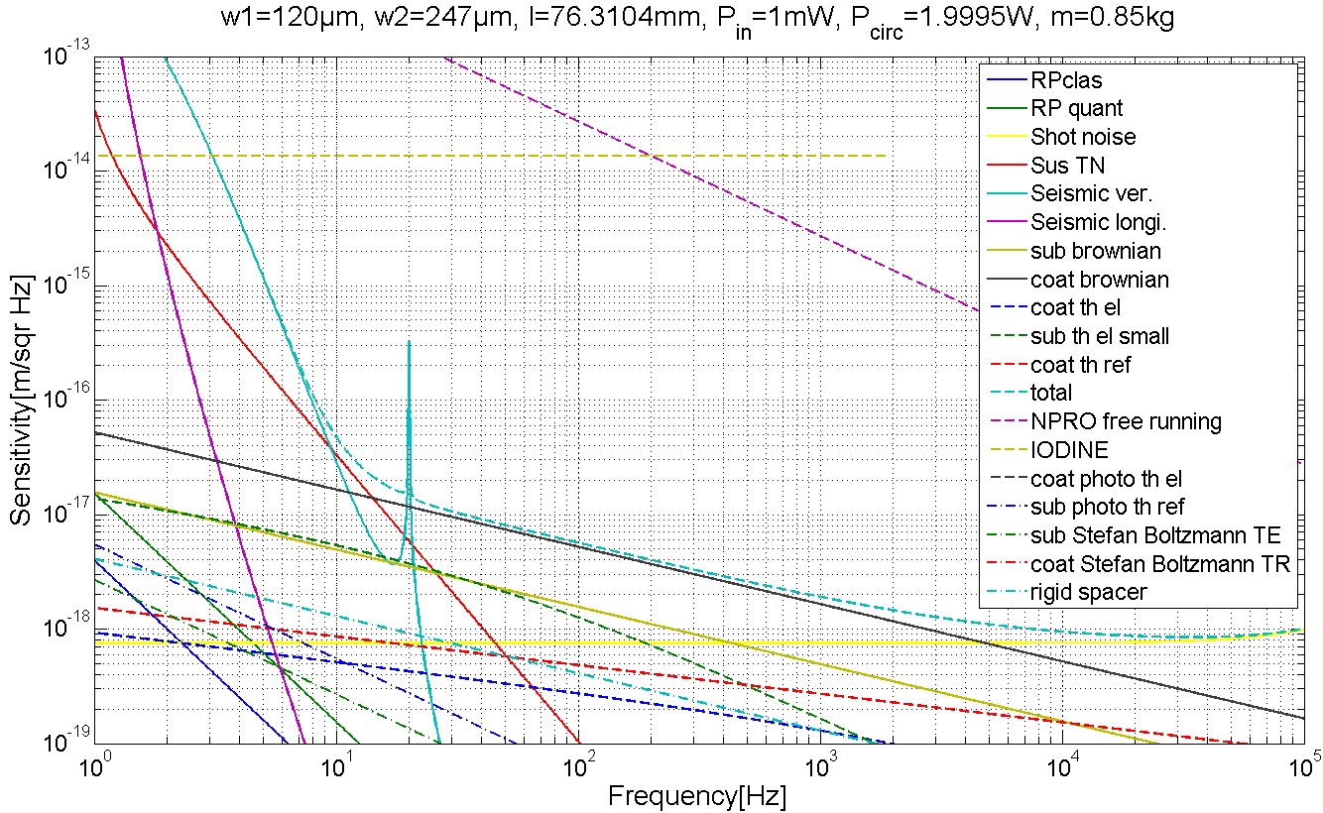
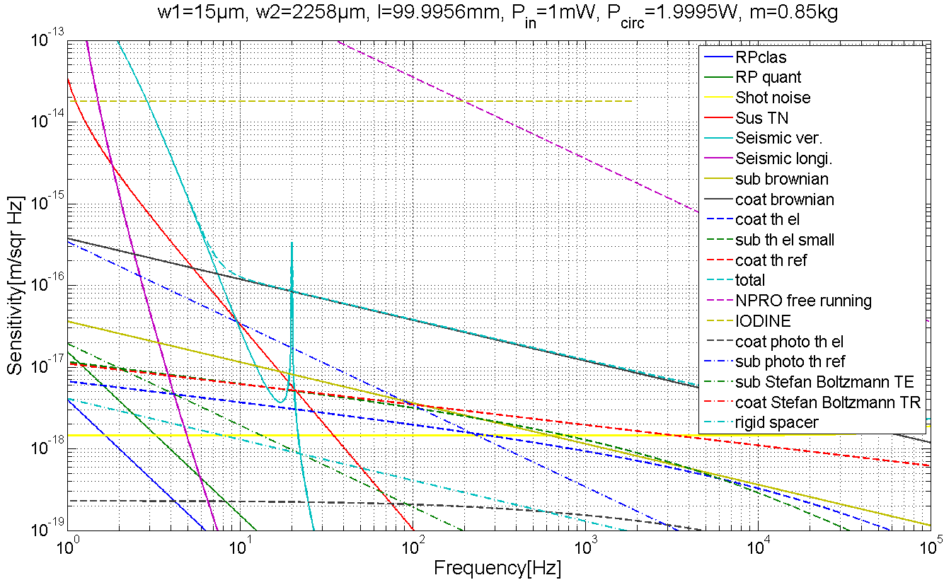
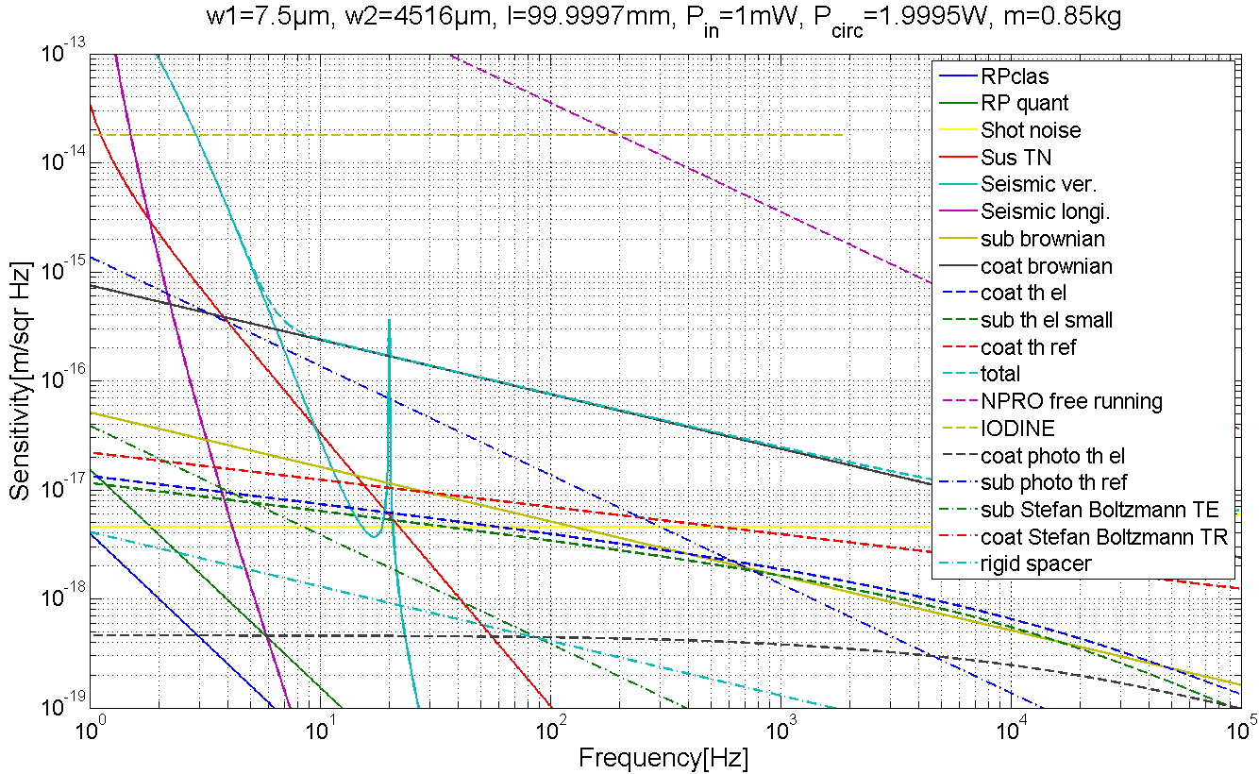
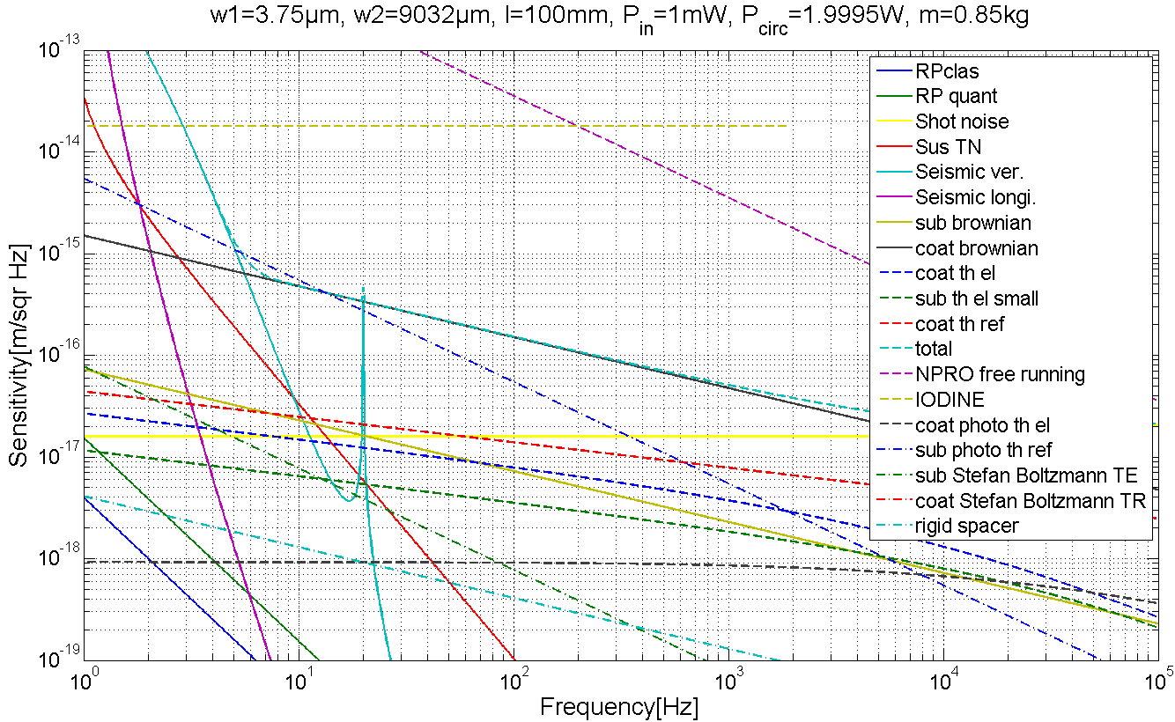
Spotsize changing
Assuming fixed modematching
→ optimized for ≈58µm
→ non modematched light contributes shotnoise
(is directly reflected)

Slide 16
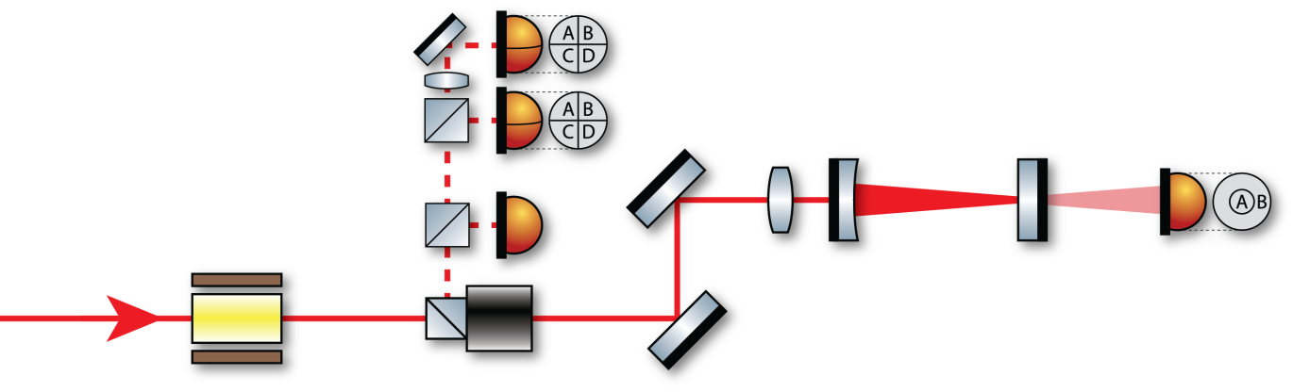
Spotsize sensing
Problem:
Thermal noise depends on spotsizes on mirrors
Spotsize strongly changes with cavity length (close to instability)
→ Online monitoring of waist
Solution:
Bulls eye photo detector behind TNI
Calibration via CCD beam analyzer

Slide 17
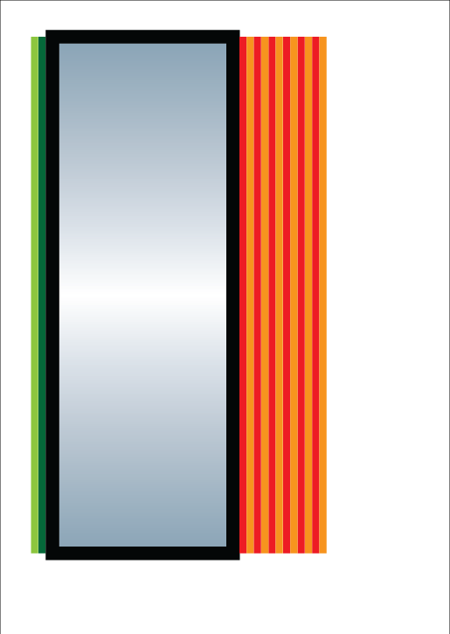

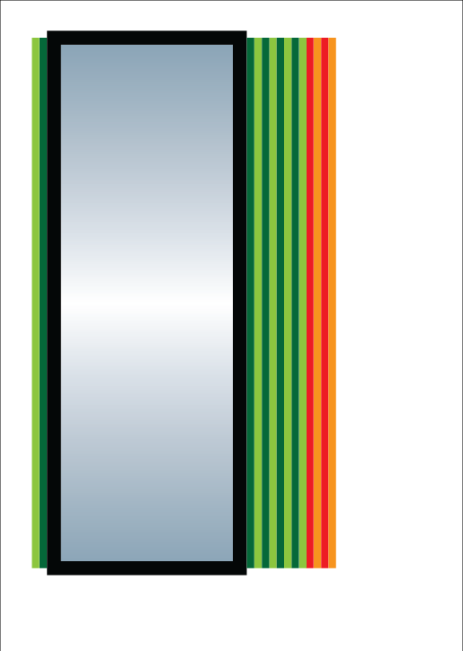
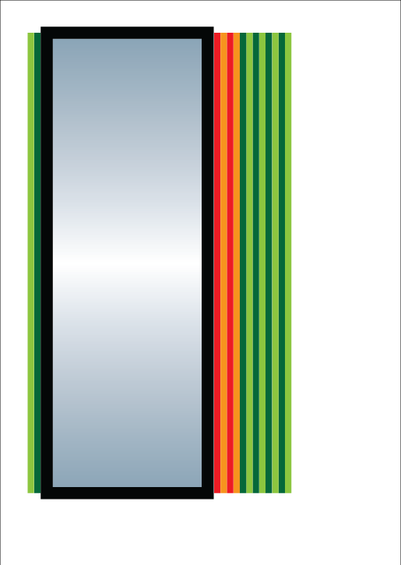
Crazy mirrors
Extra thick HR coating
No transmitted beam
AR coating underneath HR
Raise Brownian and
thermo elastic noise
Same reflectivity
AR coating on top of HR
Raise thermo refractive noise
Same reflectivity
Increase losses
(thermal noise ~ √N)
AR HR

Slide 18


The team
http://10m-prototype.aei.uni-hannover.de
Ken Strain: Scientific leader
Stefan Goßler: Coordinator
Gerhard Heinzel: LISA/LPF related experiments
Yanbei Chen, Kentaro Somiya, Stefan Danilishin: Experiment design, noise analysis
Roman Schnabel: Squeezing and QND experiments
Harald Lück: Vacuum system and GEO 600 related experiments
Hartmut Grote: Electronics and GEO 600 related experiments
GEO operators: Filter design and construction, environmental monitoring
Andreas Weidner: Electronics design
Kasem Mossavi: Vacuum system and pumps control
Benno Willke, Jan Hendrik Pöld, Patrick Oppermann, Thimoteus Alig: High power laser
Gerrit Kühn, Michael Born, Martin Hewitson: Real time control system
Alessandro Bertolini, Alexander Wanner, Gerald Bergmann: Isolation tables
Katrin Dahl: Suspension Platform Intererometer
Sina Köhlenbeck: Digital interferometry
Fumiko Kawazoe, Manuela Hanke: Frequency reference cavity
Stefan Hild, Sabina Huttner, Christian Gräf: Interferometric sensing & control
Giles Hammond, Tobias Westphal: (Monolithic) suspensions

Slide 19
overview
GWD’s seriously suffer from coating thermal noise
Current materials are mechanically lossy (tantala)
Amorphous thin films are always lossy
Observe coating thermal noise in GWD limiting band
Ifo layout
Thermal noise projections
Frequency stabilisation noise projection
Seismic isolation, suspension noise projection
Waist size tunability w(z)
Online tuning w/o mode matching -> Shot noise
Size detecor (bulls eye)
Test close to instability (g~0)
Where to get OSEMs (tuning range >> BOSEM)
Test crystaline AlGAs coatings (yet only small, plane surface)
Investigate other coating noise (thermo refractive, thermo elastic?)
Add lossy layers in front and behind
Watchdogs (hardware)
Suspended spacer?

Slide 20
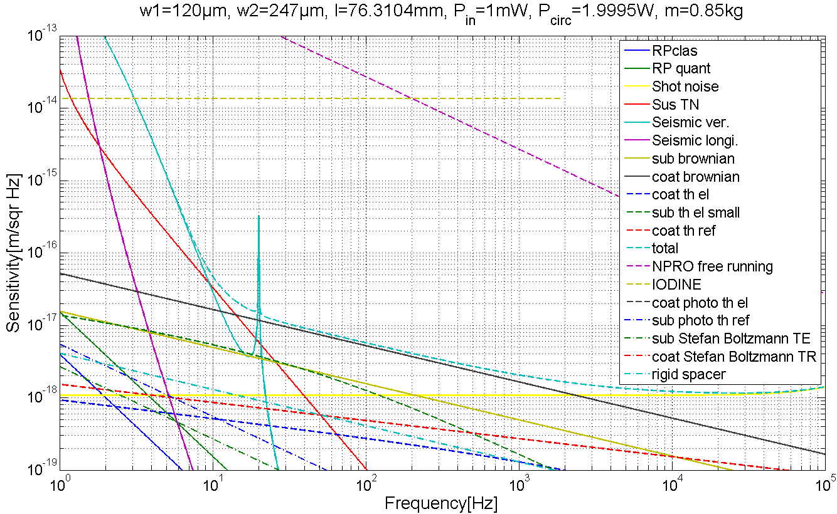
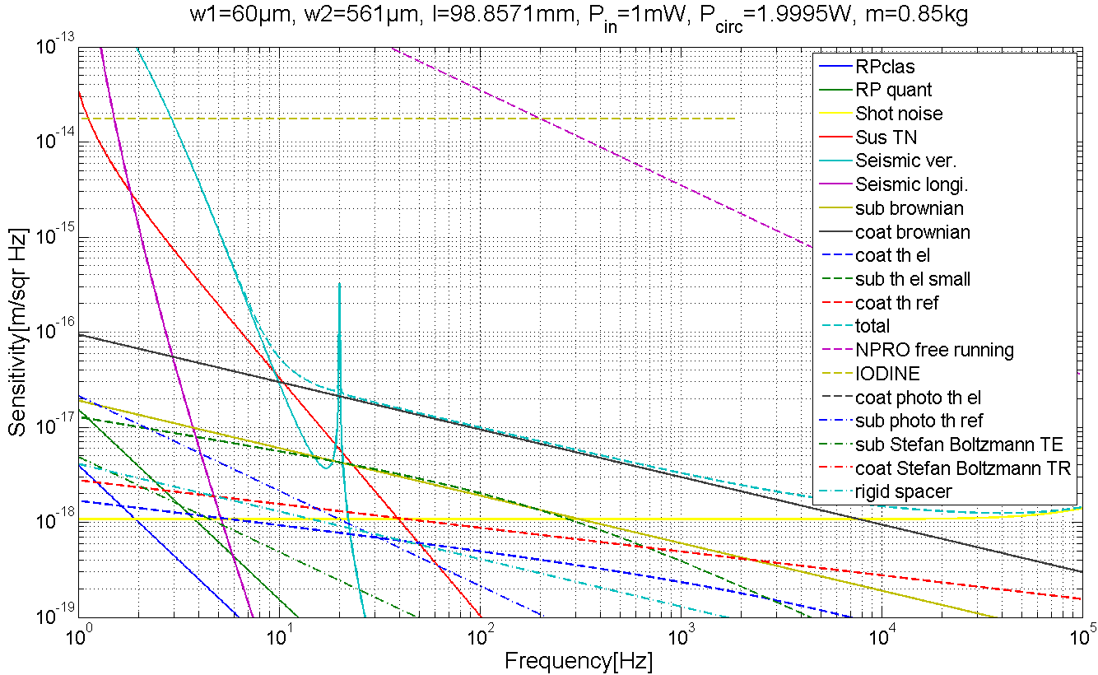
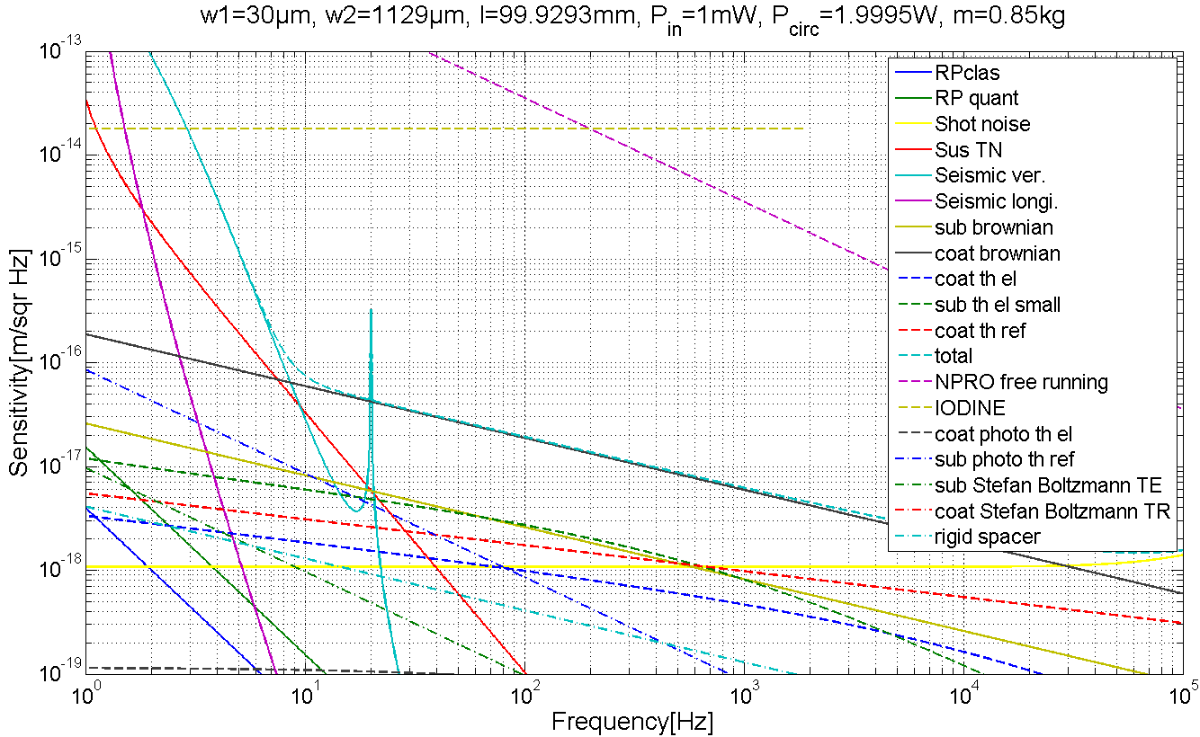
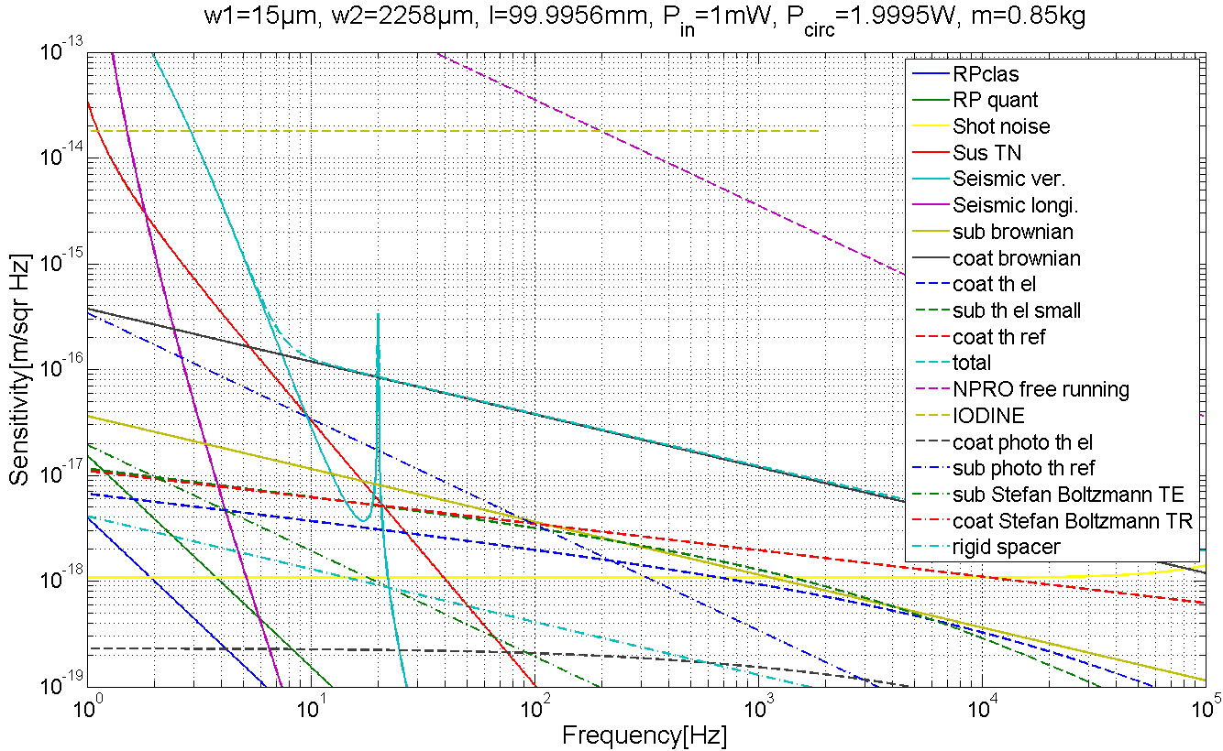
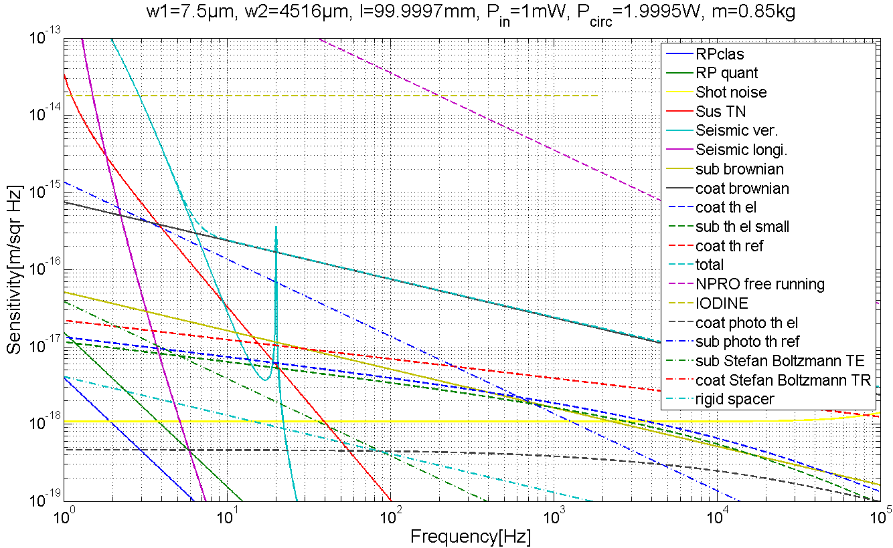
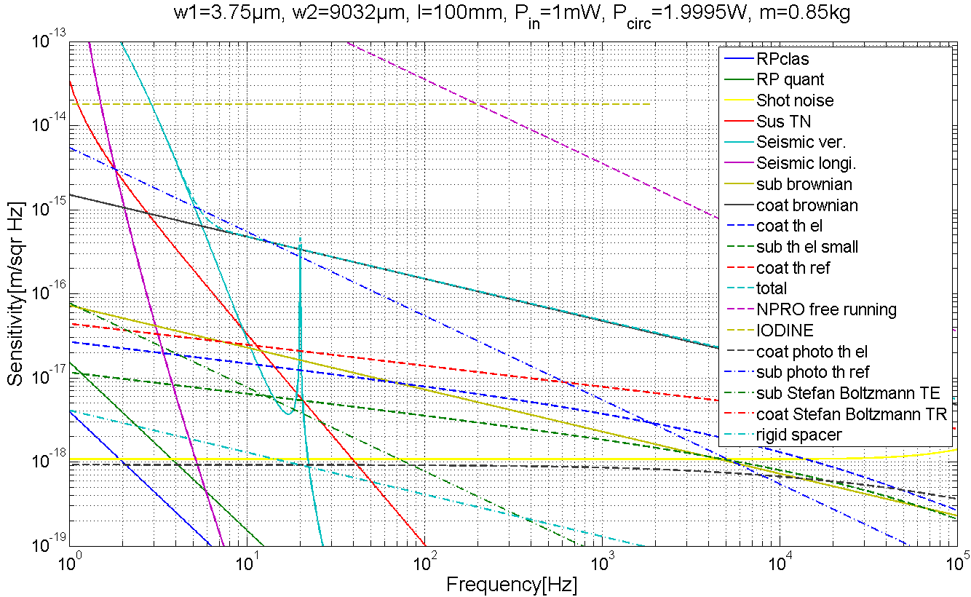
Spotsize changing
Assuming perfect modematching
Otherwise shotnoise (SN) increases

Slide 21
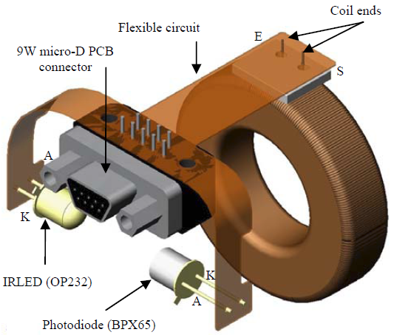
Local position readout
6 Shadow sensors per upper mass
BOSEMs
3E-10m/√Hz @ 1Hz
0.7mm dynamic range
OSEMs for higher dynamic range?
sensor 1
whitening
Basis
Transform:
Sensors
→
Upper mass
DOFs
long Filter
Basis
Transform:
Upper mass
DOFs
→
Actuators
dewhitening
actuator 1
sensor 2
whitening
pitch Filter
dewhitening
actuator 2
sensor 3
whitening
side Filter
dewhitening
actuator 3
sensor 4
whitening
roll Filter
dewhitening
actuator 4
sensor 5
whitening
vert Filter
dewhitening
actuator 5
sensor 6
whitening
yaw Filter
dewhitening
actuator 6

