Slide 1
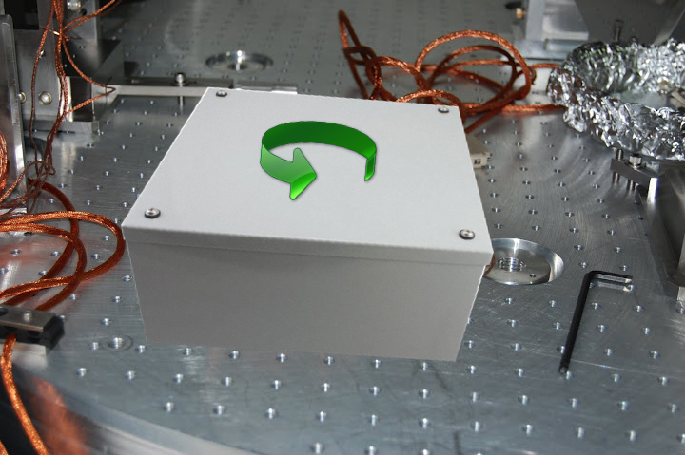
Ponderomotive rotator: requirements
Zach Korth (Caltech) – GWADW ‘12 – Waikoloa, HI

Slide 2
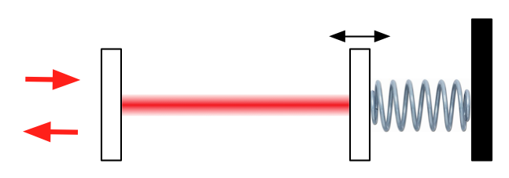
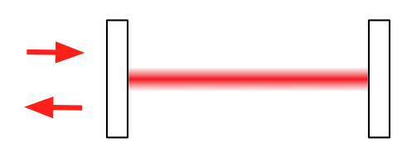
The optomechanical advantage
Simple cavity: interference between optical pathways produces amplitude/phase shifts
Optomechanical cavity: Added pathway through mechanical system → modification of dynamics

Slide 3
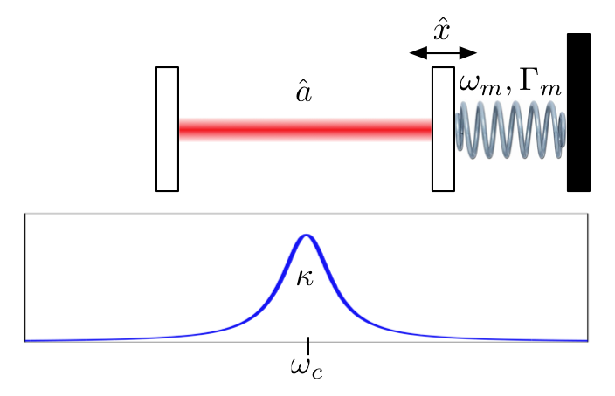
Optomechanical dynamics

Slide 4
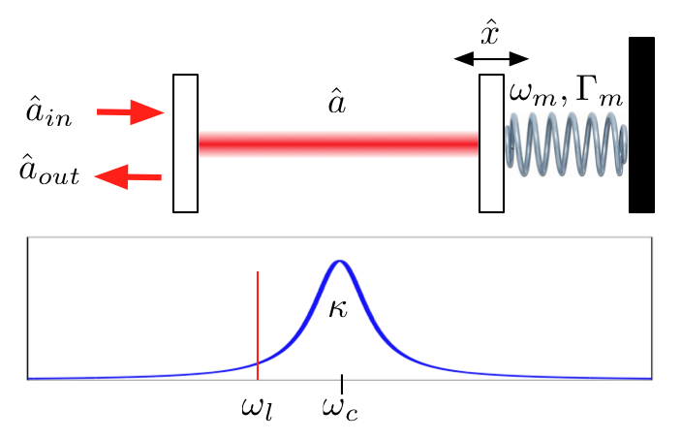
Optomechanical dynamics

Slide 5
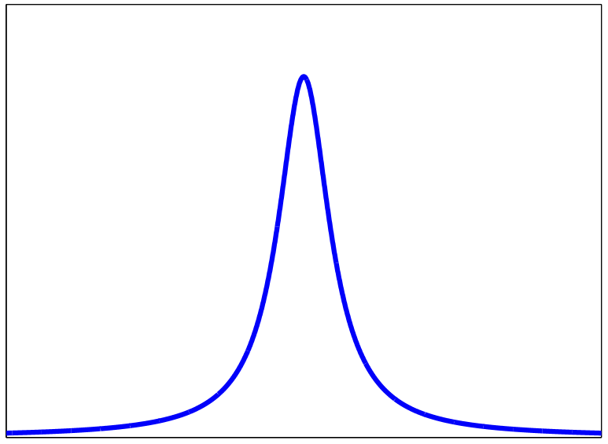
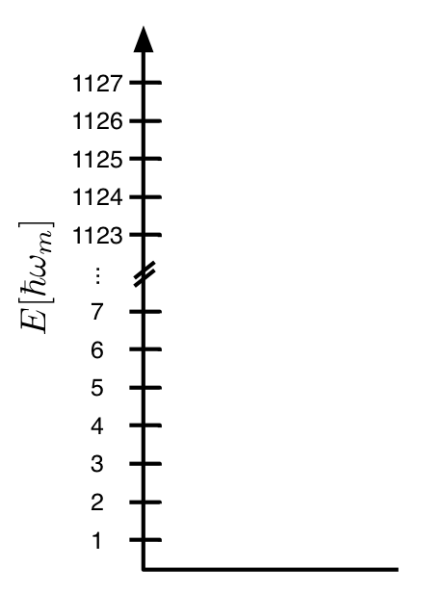
Sideband cooling
Upshifted SB is resonant →
Cooling limit: → want

Slide 6
OMIT
Introduce second, “probe” beam at
Produces radiation pressure force at laser beat frequency,

Slide 7
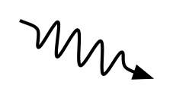
OMIT
RP force excites mechanical oscillator
As it cools, it scatters a photon up by

Slide 8
OMIT
Optomechanical coupling rate:
To preserve quantum state, must have

Slide 9
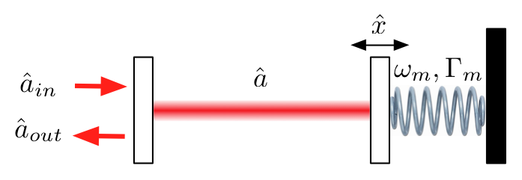
OMIT as a rotator
FI squeezing →
FD squeezing ←

Slide 10
Thermal noise
FI squeezing →
FD squeezing ←
SIGNAL
NOISE
Pump detuning
→ Rotation frequency ←
Thermal force spectrum

Slide 11
Thermal noise
Need
Or,

Slide 12
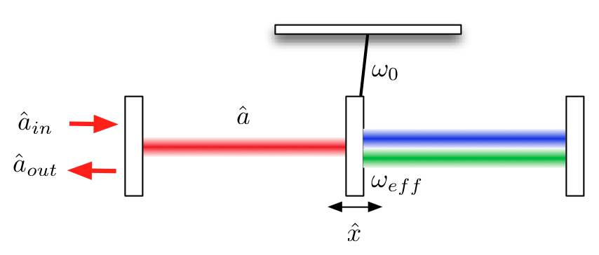
Solutions?
One idea: optical dilution

Slide 13
The End
ANYONE HAVE ANY IDEAS? LET US KNOW!
Acknowledgements
  Haixing Miao
  Thomas Corbitt
  Amir Safavi-Naeini (O. Painter group, CIT)
References:
  Weis, et al., “Optomechanically induced transparency,” Science 330 (6010), 2010
  Safavi-Naeini, et al., “Electromagnetically induced transparency and slow light with optomechanics,” Nature 472, 2011
  Corbitt, et al., “Optical Dilution and Feedback Cooling of a Gram-Scale Oscillator to 6.9 mK,” Phys. Rev. Lett. 99 160801 (2007)

