Slide 1
Growth and characterization of III-V epitaxial mirror coatings on silicon
Angie C. Lin¹, Ashot S. Markosyan¹, Riccardo Bassiri¹, Alan Cumming², Iain Martin², Karen Haughian², Roger Route¹, Brian Lantz¹, James S. Harris¹, Sheila Rowan², Martin M. Fejer¹
¹ Stanford University
² University of Glasgow
Gravitational Wave Advanced Detector Workshop
May 14, 2012

Slide 2
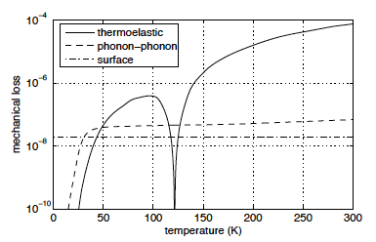
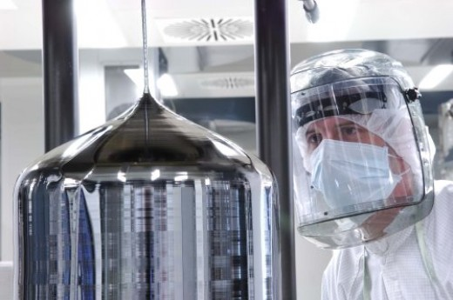
Single crystalline coatings
Loss sources in a Si flexure¹
For third generation detectors operating at cryogenic temperatures:
Low mechanical loss in silicon at low T
Silicon is available in large sizes:
  Commercially available: 300 mm (12”)
  Research: 450 mm (18”)
Single crystalline coatings have already been shown to have low mechanical loss²
[1] Nawrodt et al. arXiv:1003.2893v1 (2010). [2] Cole et al. Appl. Phys. Lett. 92, 261108 (2010).
Notes:
Silicon high Q, good bonding with epitaxial coating
Amorphous at low temp

Slide 3
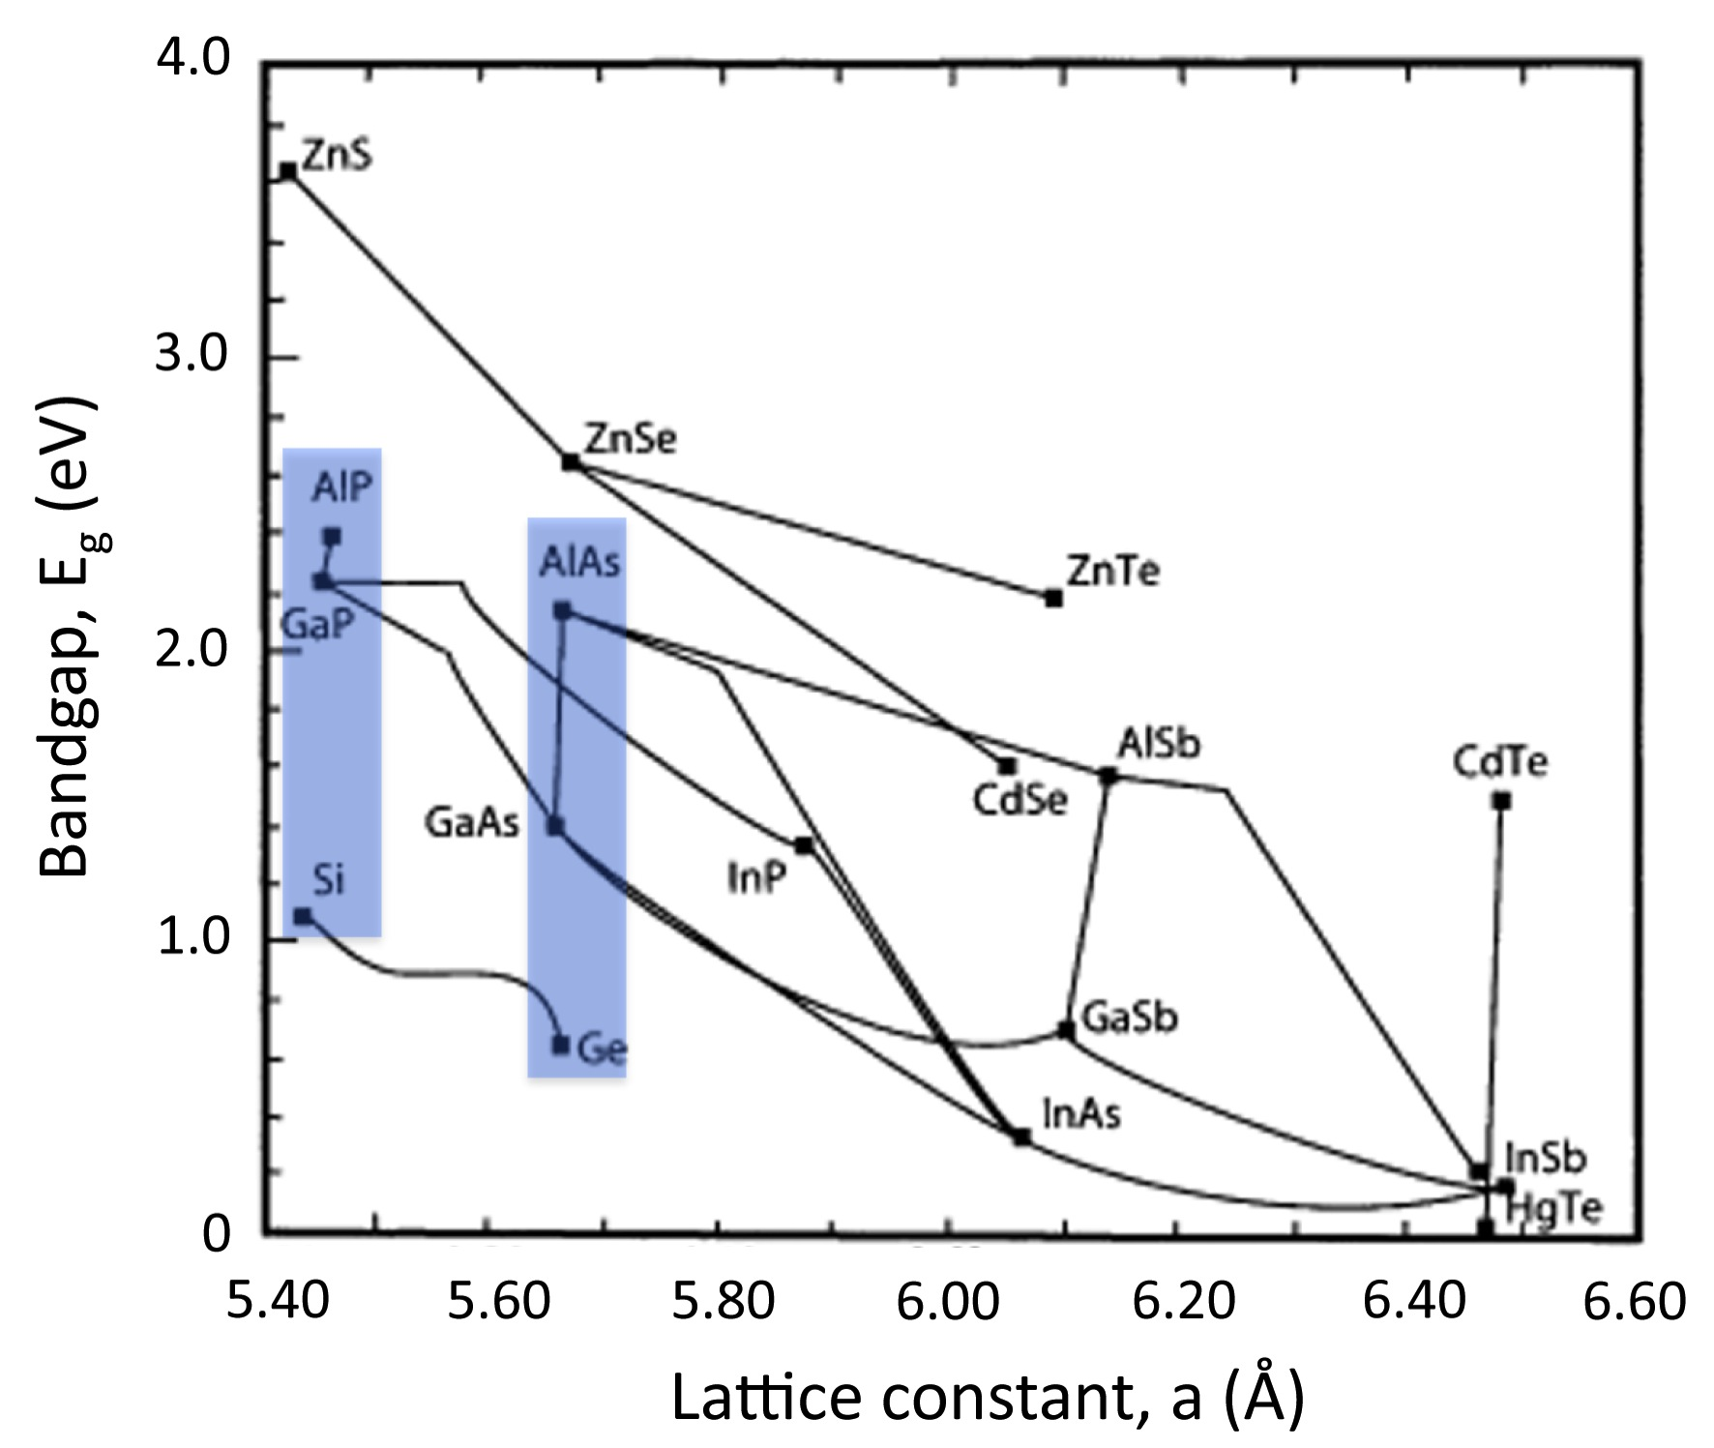
Direct integration of mirrors onto Si
Materials systems with index contrast but no change in lattice constant

Slide 4
Integration approaches
AlAs
GaAs
Lift-off from GaAs substrate and bond to Si
AlAs
GaAs
Ge
SiGe buffer
AlP
GaP
Si substrate
Si substrate
Si substrate
Commercially available GaAs: 6”
Dislocations in SiGe arise from 4% mismatch between Si and Ge
Lattice-matched system, but less studied

Slide 5
Outline
Epitaxial integration of III-V coatings on Si
Anticipated challenge: antiphase domains
  Growth technique: molecular beam epitaxy
  Film characterization techniques
  Reducing antiphase domains through growth conditions
GaP/AlP mirror coating on Si: initial results
  Materials characterization
  Optical absorption
  Mechanical loss
Summary and future work

Slide 6
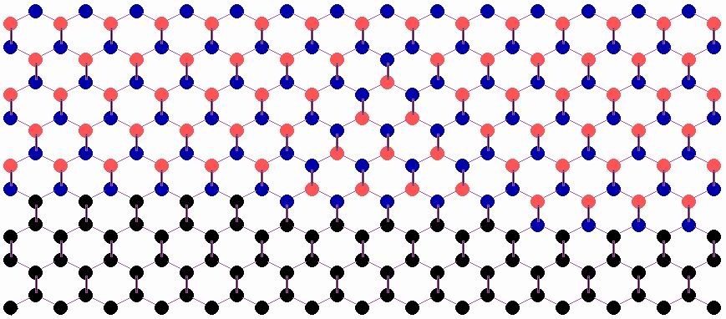
Anticipated challenge: antiphase defects
Antiphase boundary (APB): defect with incorrect bonds (P-P or Ga-Ga)
APB
GaP
antiphase domain (APD)
Si
Double atomic steps on Si surface
→ correct bonds
Single atomic steps on Si surface
→ wrong bonds
Notes:
Si and GaP have the same crystal structure, except that there are two different atoms in GaP that make up the face-centered cubic sublattices. Because there’s no natural preference for Ga or P to settle into one sublattice versus the other, both will occur. When this happens, this defect is an antiphase boundary.

Slide 7
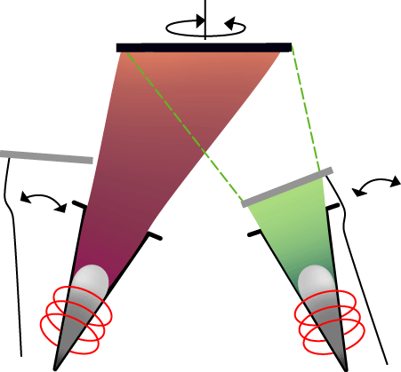
Growth by molecular beam epitaxy
Sources and components:
Group III: Ga, Al, In
Group V: As, P
Group IV: Ge, Si
In-situ reflection high-energy electron diffraction (RHEED)
Advantages of using MBE:
Low impurity incorporation (UHV)
Monolayer control
Growth rate and substrate temperature decoupled
substrate
shutter
sources
Control over growth rate, substrate temp, V/III flux ratio
Notes:
MBE is done under ultra-high vacuum where high-purity, elemental sources are evaporated onto a substrate. The sources are contained inside a crucible that is heated up to a temperature where the material starts to evaporate or sublimate and there is direct line-of-sight from the source to the substrate, where deposition occurs. Each source has a shutter in front of it to block the material from reaching the substrate when that material isn’t being deposited.

Slide 8
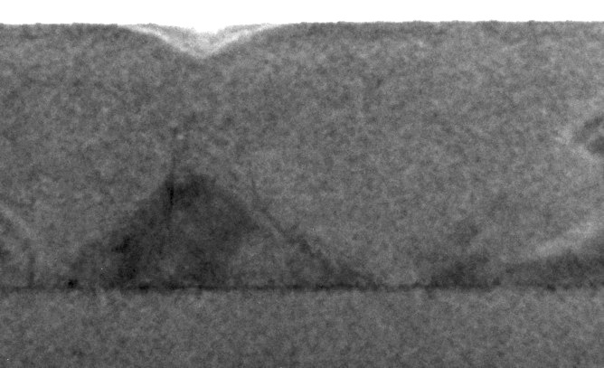
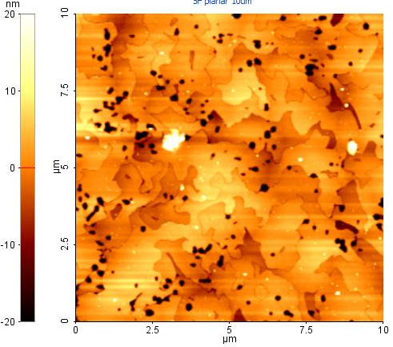
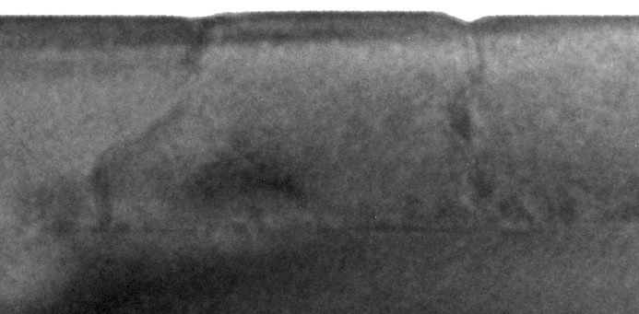
Ex-situ characterization techniques
Detect APDs with atomic force microscopy (AFM) and transmission electron microscopy (TEM)
AFM: surface pit density
TEM: how APBs propagate in the film
100 nm
A film with many antiphase domains
100 nm
Sample courtesy of D. Liang, Y. Kang (Stanford)

Slide 9
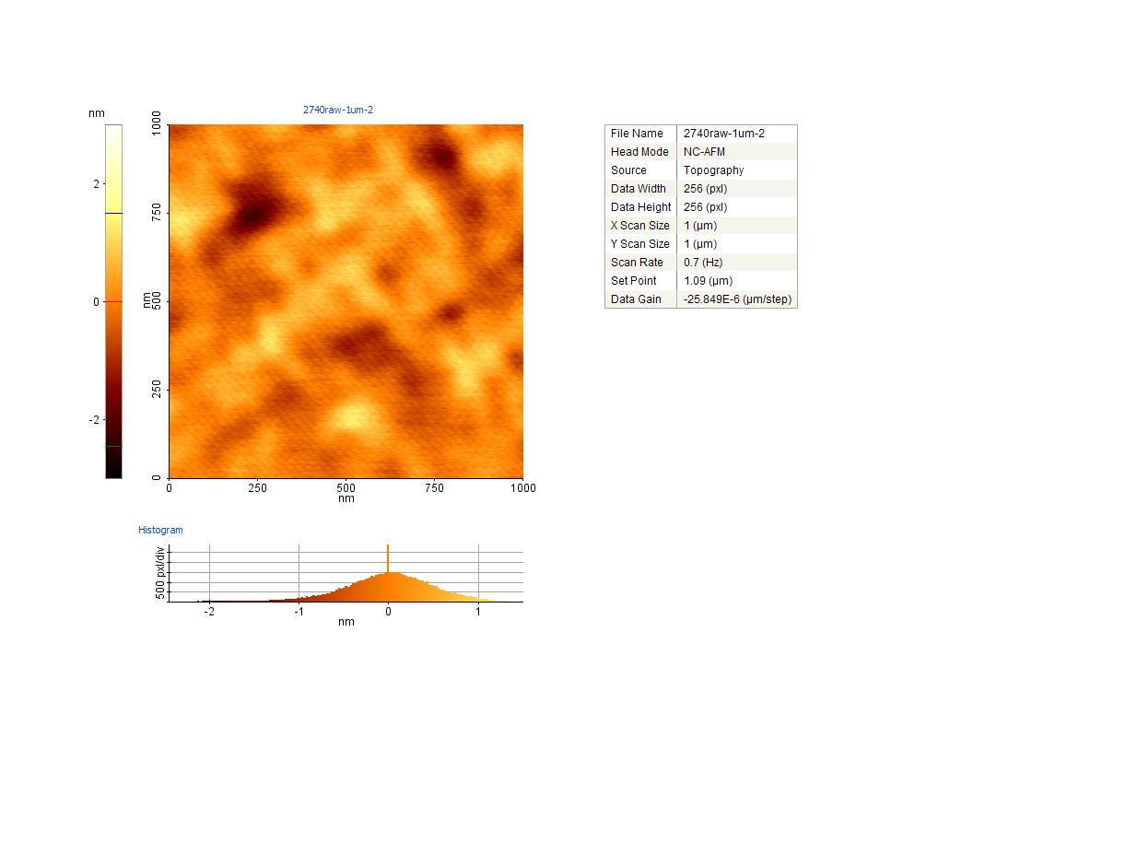
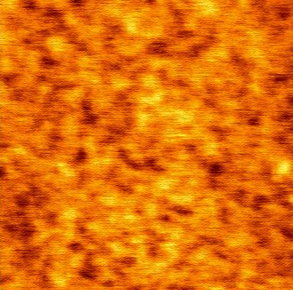
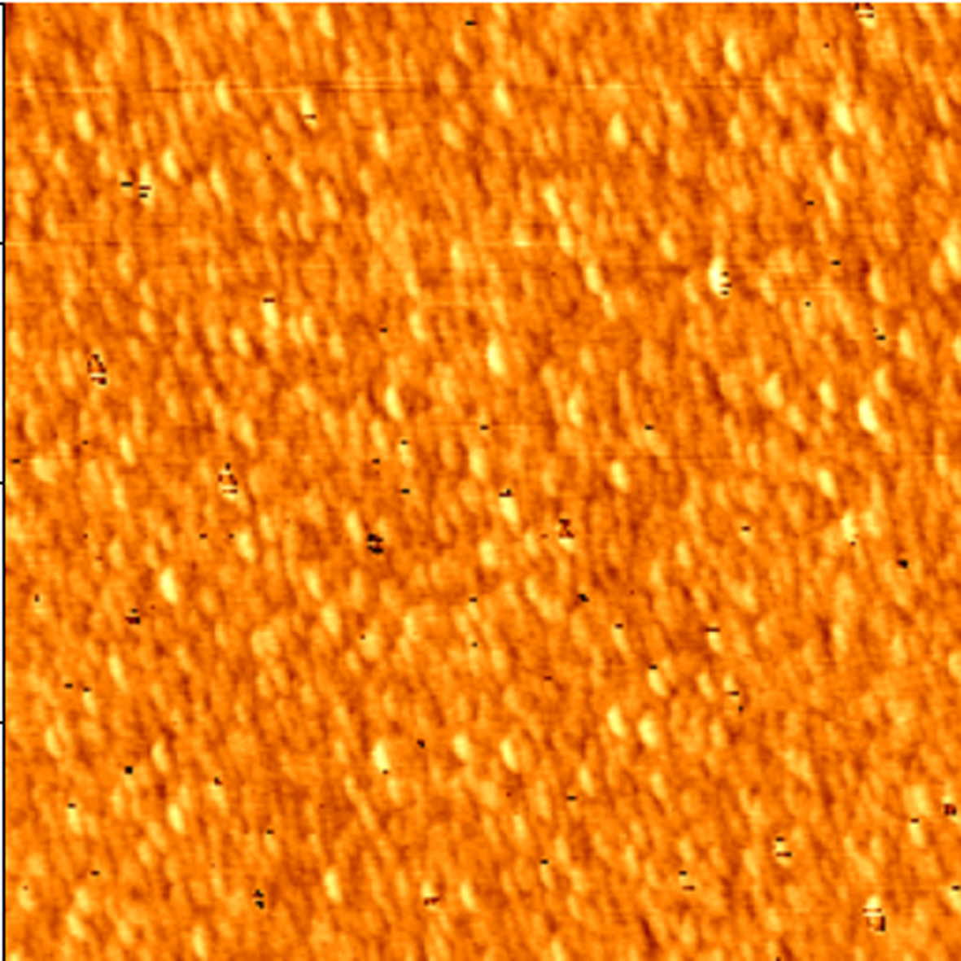
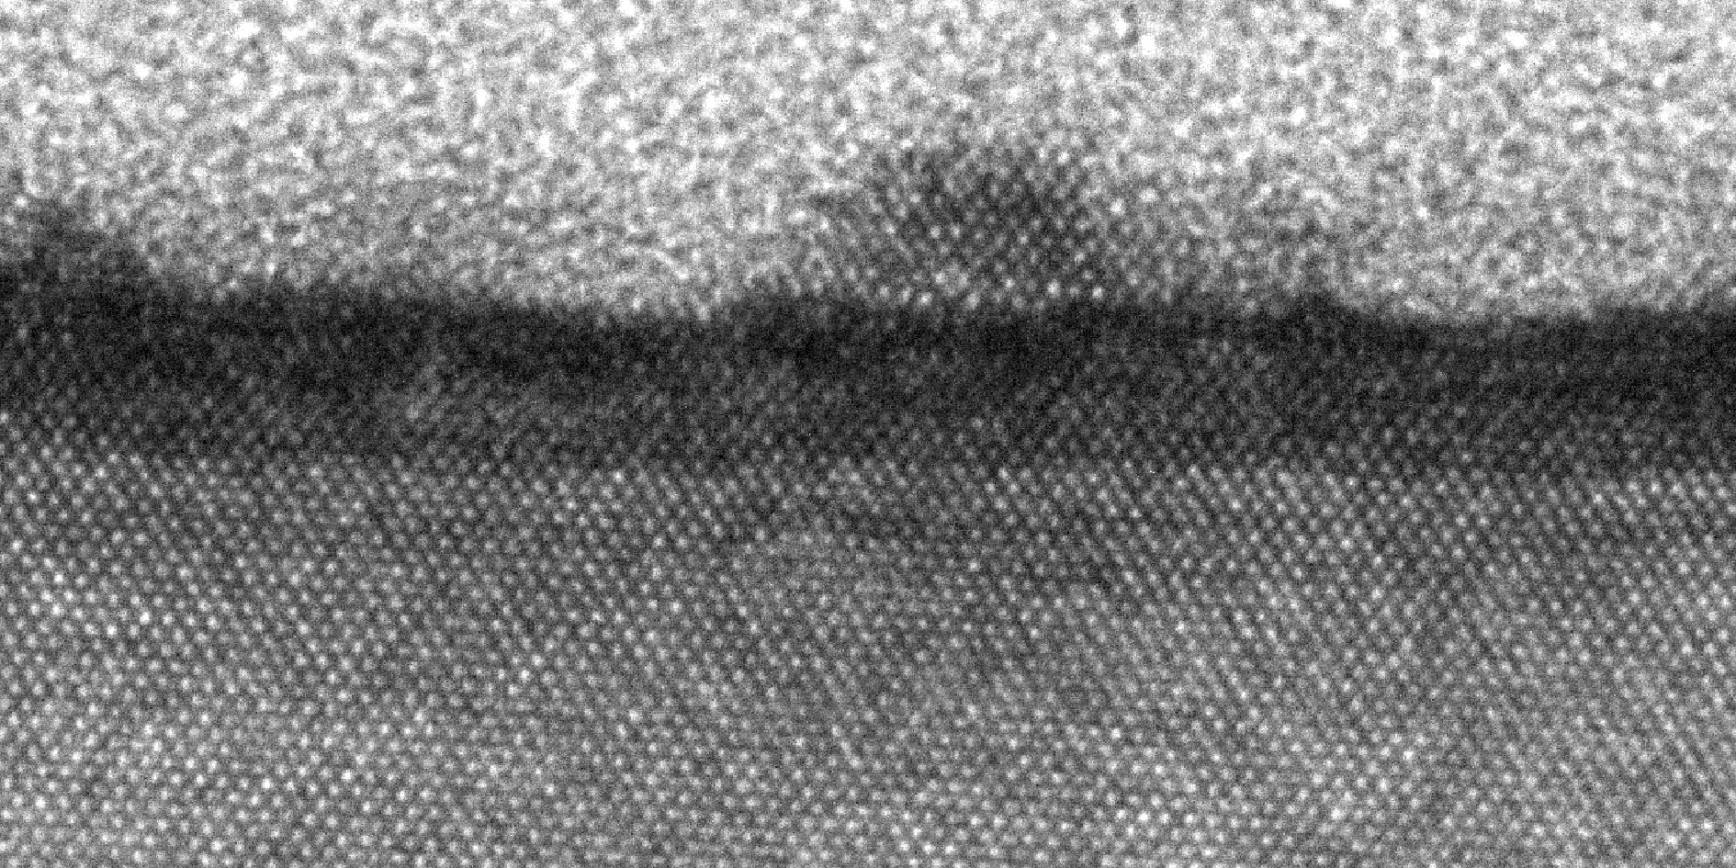
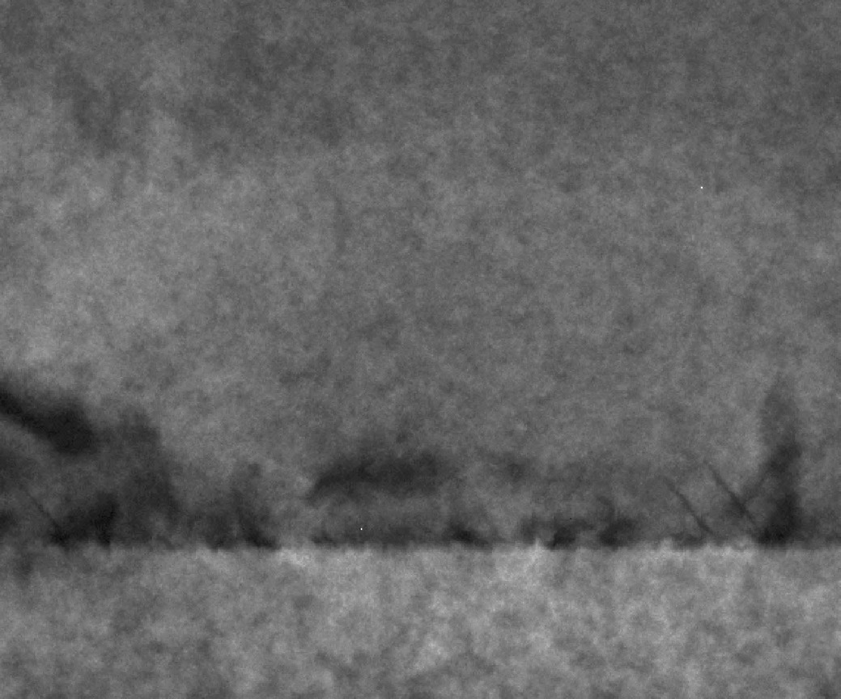
Achieving high quality GaP on Si
GaP
Si
Si
Si
nm
nm
nm
1
1 μm
2
3
0
0
0
-1
0
1 μm
-2
-3
0
III-V
Si surface prep:
Standard clean
Si buffer
High T anneal
Si
2 nm
GaP
III-V nucleation:
2D growth
50 nm
Si
GaP overgrowth:
Annihilate defects
A.C. Lin et al. J. Vac. Sci. Technol. B 29 (2011) 1201.
Notes:
AFM shows film surface: start with a Si surface with rms roughness of about 0.1-0.2 nm.

Slide 10
Outline
Epitaxial integration of III-V coatings on Si
Anticipated challenge: antiphase domains
  Growth technique: molecular beam epitaxy
  Film characterization techniques
  Reducing antiphase domains through growth conditions
GaP/AlP mirror coating on Si: preliminary results
  Materials characterization
  Optical absorption
  Mechanical loss
Summary and future work

Slide 11
Epitaxial GaP/AlGaP layers on Si
83%
GaP
Al_{0.9}Ga_{0.1}P
Mirror pairs
Theoretical reflectivity (%)
At 1550 nm:
n_{GaP} = 3.05
n_{AlGaP} = 2.77
n_{Si} = 3.42
127 nm GaP
140 nm Al_{0.9}Ga_{0.1}P
200 nm GaP buffer
Si substrate (~525 μm)
Number of pairs
Index contrast Δn = 0.28
Pure AlP oxidizes easily
Dispersion relations from N.A. Pikhtin et. al. Soviet Phys. 9 (1967) 107.
Transfer matrix Matlab code courtesy of Tomás Sarmiento (Stanford)

Slide 12
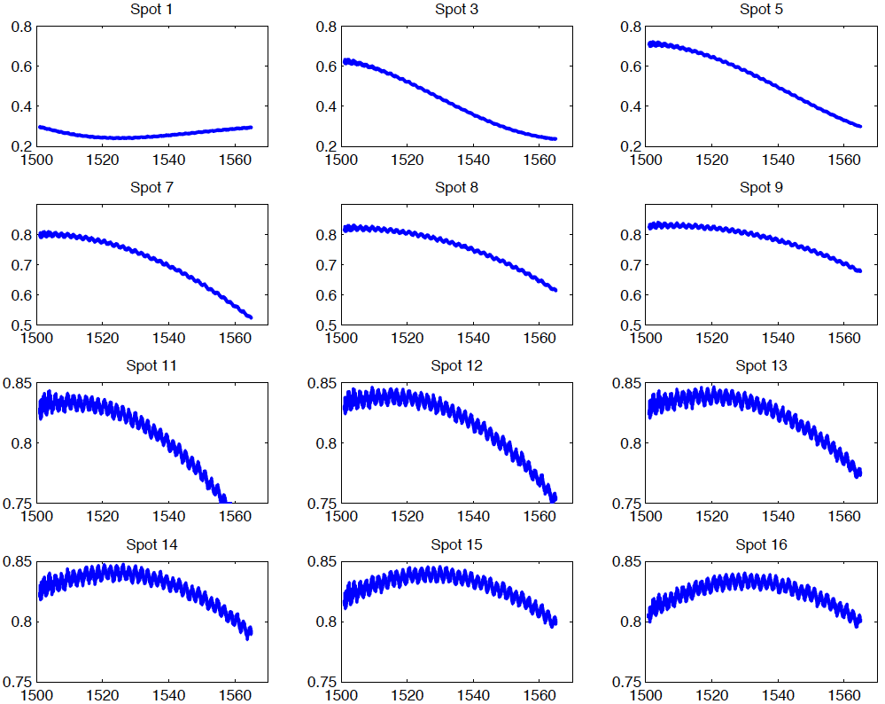
Achieved expected reflectivity
measured
simulated
Measured reflectivity (%)
Reflectivity (normalized)
Wavelength (nm)
Wavelength (nm)
For 10 pairs: measured reflectivity matches theoretical reflectivity (83%)

Slide 13
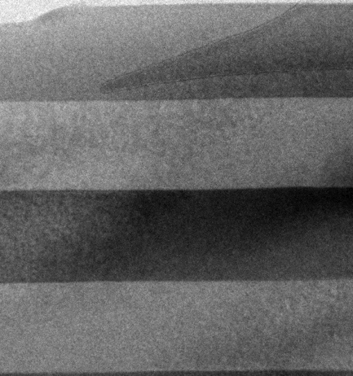
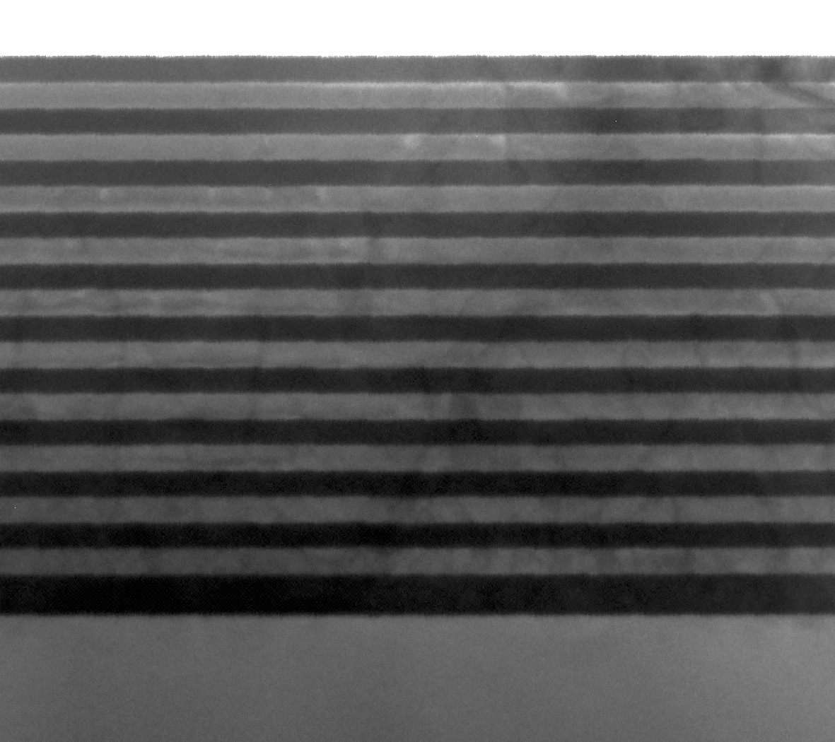
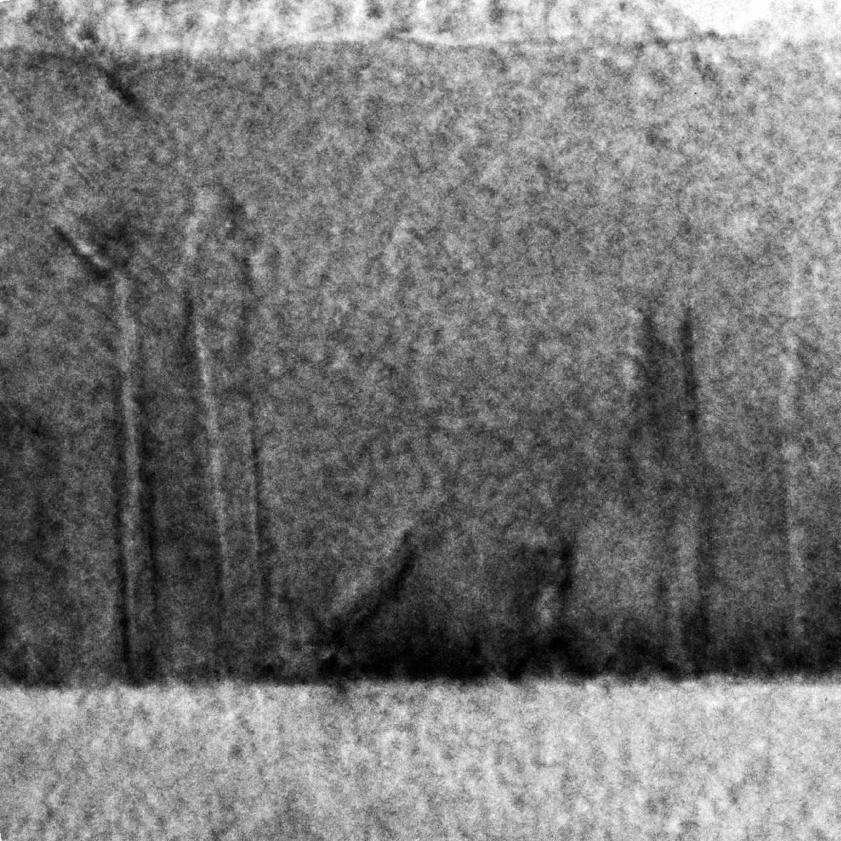
Transmission electron microscopy
Bright-field 110 TEM: mass contrast
mirror pairs
100 nm
buffer
1 μm
100 nm
100 nm

Slide 14
Optical absorption
Using photothermal common-path interferometry (PCI) to measure absorption
Possible source of absorption: free carriers in GaP^{1,2}
  Si outdiffusion from substrate
  Carbon, oxygen incorporation
  Antiphase domains (Ga-Ga, P-P)
Low temperature will freeze out the carriers
E_{c}
Si (E_{D} = 80 meV)
P_{Ga} (E_{D} = 230 meV)
2.2 eV
Si (E_{A} = 204 meV)
C (E_{A} = 48 meV)
E_{v}
[1] P.J. Dean et al. J. Appl. Phys. 39, 5631 (1968).
[2] K.W. Nauka, Imperfections in III/V Materials (1993).
Notes:
A possible source of absorption is the presence of free carriers. This can come from impurities in the mirror layers, such as Si outdiffusion from the substrate or carbon and oxygen incorporation from substrate cleaning processes or growth itself. The antiphase domains may also act as acceptors and donors due to the fact that they are not charge neutral. While free carriers can be a problem at room temperature, they are expected to freeze out at low temperature and not contribute free carrier absorption. Low temperature absorption measurements are underway.

Slide 15
Secondary ion mass spectroscopy
GaP
Is there a source of free carriers?
C, O present at Si/GaP interface
Si diffusion limited to GaP buffer layer
AlGaP
GaP buffer
Si substrate
SIMS done by Evans Analytical Group
Notes:
C, O present at Si/GaP interface, likely due to transfer between the Si and GaP deposition steps. No significant Si diffusion- the concentration of Si drops from 5e22, the concentration in the Si substrate to below 1e16 or the background noise level within 50 nm. This is contained in the GaP buffer layer.

Slide 16
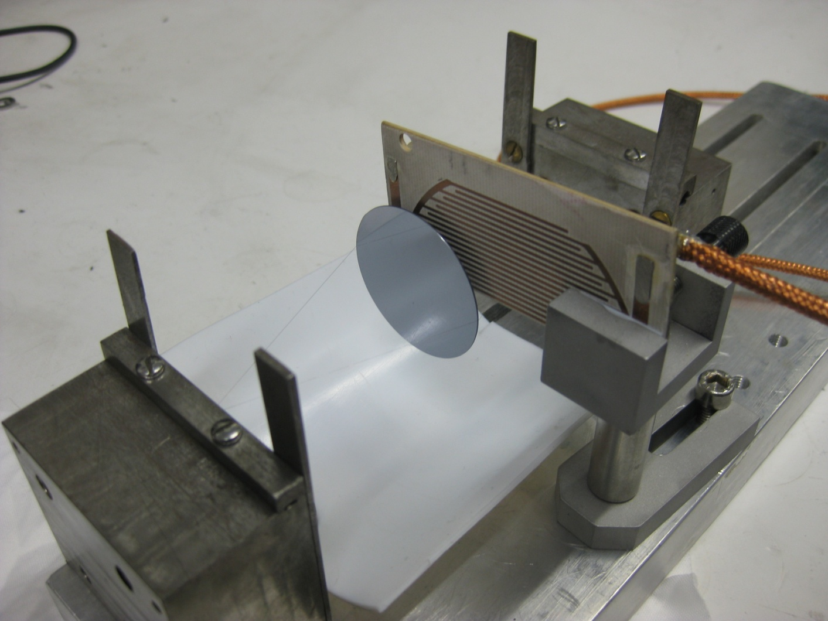
Initial results for mechanical loss
1×10⁻⁴
Uncoated Si disk
8×10⁻⁵
Coated Si disk
6×10⁻⁵
Measured loss
4×10⁻⁵
2×10⁻⁵
0
8000
12000
16000
18000
20000
Frequency (Hz)
No discernible difference between lowest measured losses in coated and uncoated samples

Slide 17

Summary and future work
GaP/AlP mirrors can be grown directly on Si
Challenges with epitaxial integration onto Si can be addressed by nucleation and growth conditions
Preliminary structural, optical absorption, and mechanical loss measurements have been done on GaP/AlGaP mirrors
Future work:
Low temperature absorption measurements
Low temperature mechanical loss measurements
Investigating other growth conditions to further reduce defects and impurities
Acknowledgements: This work was supported by NSF grant PHY-10 68596.

Slide 19
Material properties
Material | Lattice constant (Å) | Mismatch (%) | Refractive index (near-IR) | Linear thermal expansion coefficient (°C⁻¹)
AlP | 5.4510 |  | 2.75 | 6.10*10⁻⁶
GaP | 5.4505 | 0.4 | 3.02 | 4.65*10⁻⁶
Si | 5.4310 |  | 3.42 | 2.60*10⁻⁶
AlAs | 5.6611 |  | 2.86 | 5.20*10⁻⁶
GaAs | 5.6533 | 0.08 | 3.30 | 5.73*10⁻⁶
Ge | 5.6580 |  | 4.00 | 5.90*10⁻⁶
z

Slide 20
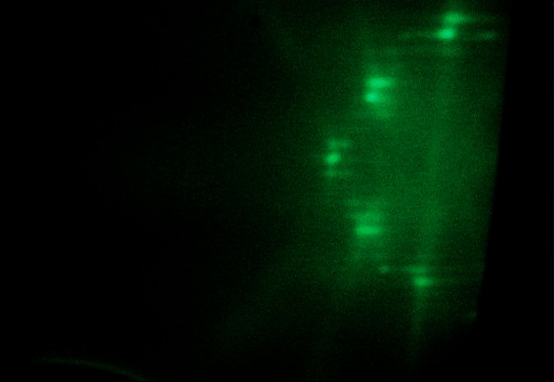
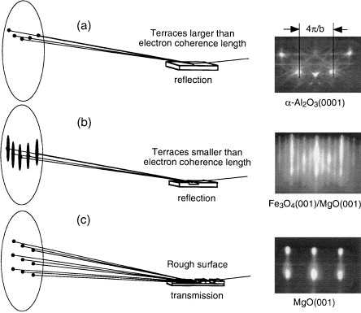
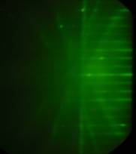
In-situ characterization: RHEED
Monoenergetic
electron gun
1-3°
Sampling size ~ 1x5 mm
Phosphor screen
wafer
Smooth surface
GaP (001) 2x4 surface
Rough surface
Beam along [110]
S.A. Chambers, Surf. Sci. Rep. 39, 105 (2000).
Ga
P
Beam along [110]
Observe how the film is growing: island or 2D growth mode
Notes:
RHEED is especially important for characterizing polar-on-nonpolar films because you can tell what the orientation of the film is. A streaky pattern is observed when the surface is reconstructed and atoms have periodic order. RHEED indicates 2-dimensional growth, whereas spots would indicated island growth. So during the deposition process, we already have an idea of the film quality. These are examples the streaky RHEED patterns we see when we deposit GaP on Si in a well-controlled manner.

Slide 21
Achieving high-quality GaP on Si
In order of growth sequence:
Start with a smooth, double-stepped Si surface
  High temp anneal under H₂ flow ¹
Reduce APD formation
  2D nucleation of GaP on Si ²⁻⁵
Encourage APD annihilation
  Control APB propagation ⁶
Si
Si
GaP
Si
¹ B. Kunert et al. Thin Solid Films 517 (2008) 140. ⁴ I. Nemeth et al. J. Crys. Growth 310 (2008) 1595.
² K. Yamane et al. J. Crys. Growth 311 (2009) 794. ⁵ A.C. Lin et al. J. Vac. Sci. Technol. B 29 (2011) 1201.
³ T.J. Grassman et al. Appl. Phys. Lett. 94 (2009) 232106. ⁶ X. Yu et al. J. Crys. Growth 301-302 (2007) 163.

Slide 22
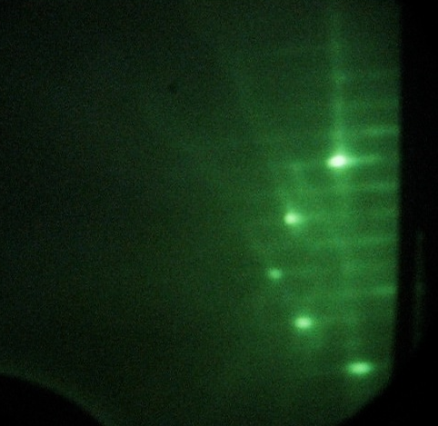
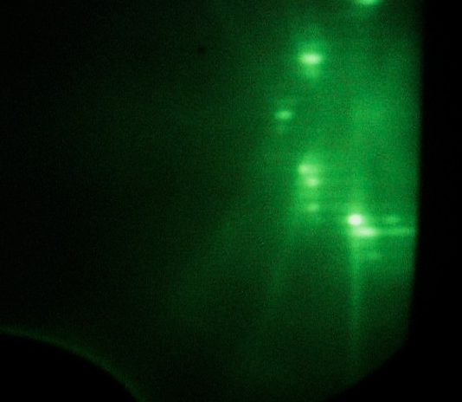
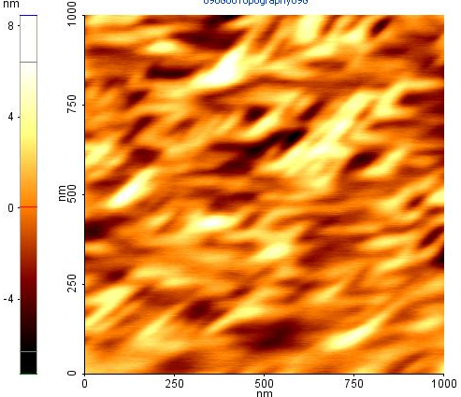
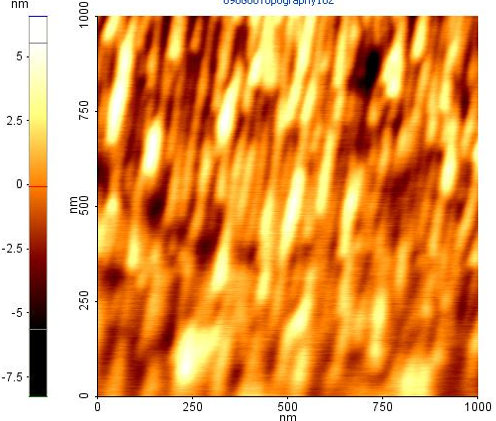
Control GaP orientation with temperature
High T nucleation
Low T nucleation
Sample | A | B | C | D
Nucleation layer | 525°C | 500°C | 325°C | 325°C
GaP film | 525°C | 550°C 600°C | 550°C | 550°C 600°C
RHEED | 4x2 | 4x2 | 2x4 | 2x4
orientation | - | - | + | +
2x
A
D
[110]
4x
[110]
rms = 1.93 nm
rms = 1.74 nm
Notes:
I previously mentioned that in MBE, we have 3 main parameters to work with: growth rate, V/III flux ratio, and substrate temperature. In fact, we use substrate temperature to select the orientation that we wish to grow. The table shows 4 different samples, all grown using a two-step process with a nucleation step and a subsequent growth step.

Slide 23
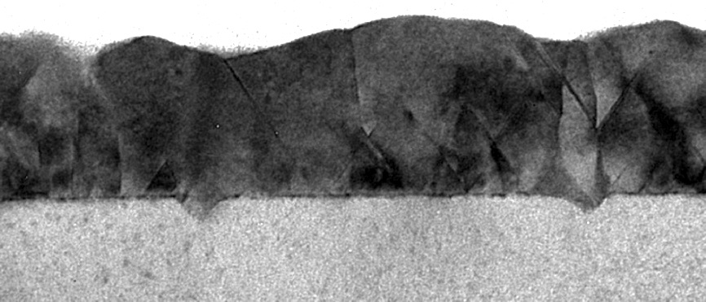
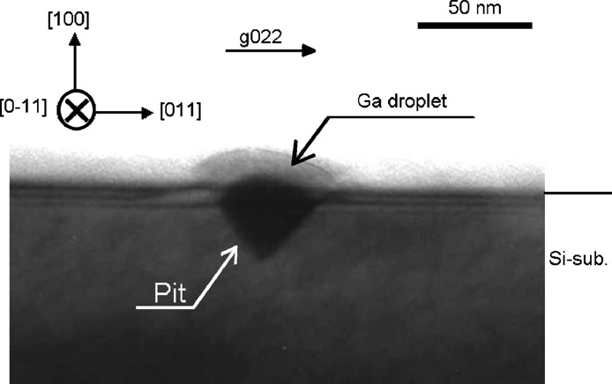
Need well-controlled nucleation
GaP film nucleated with
migration enhanced epitaxy (MEE)
GaP
MBE
Ga
Si
P
20 nm
MEE
Ga
P
K. Yamane et al. J. Crys. Growth 311 (2007) 794-797.

Slide 24
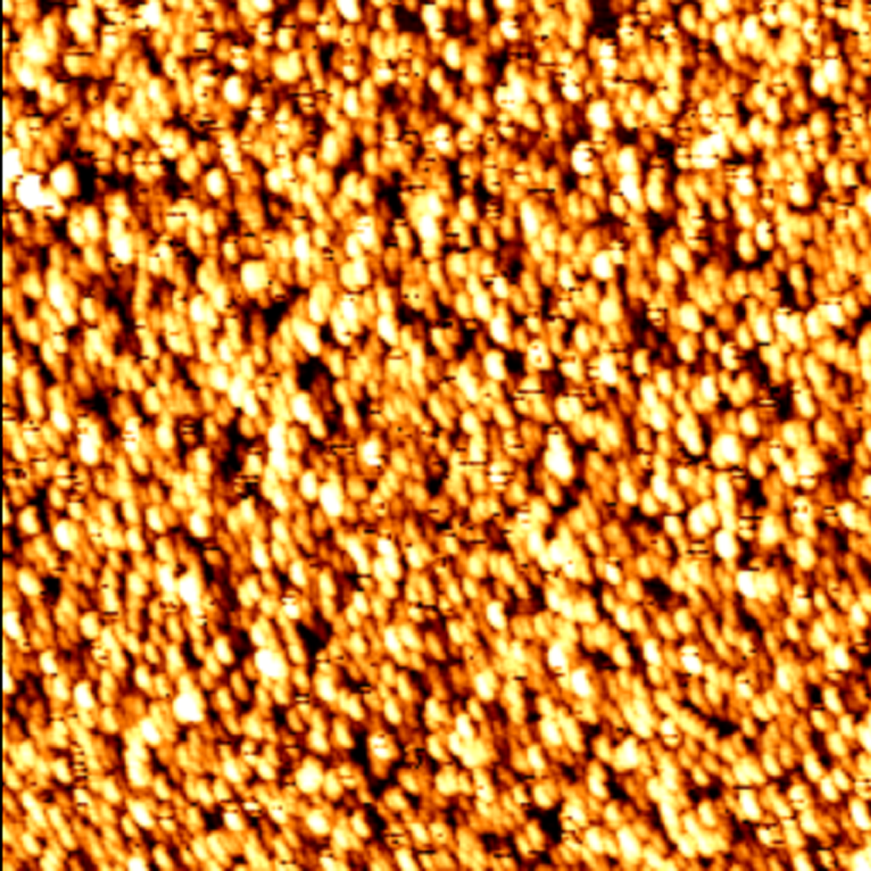
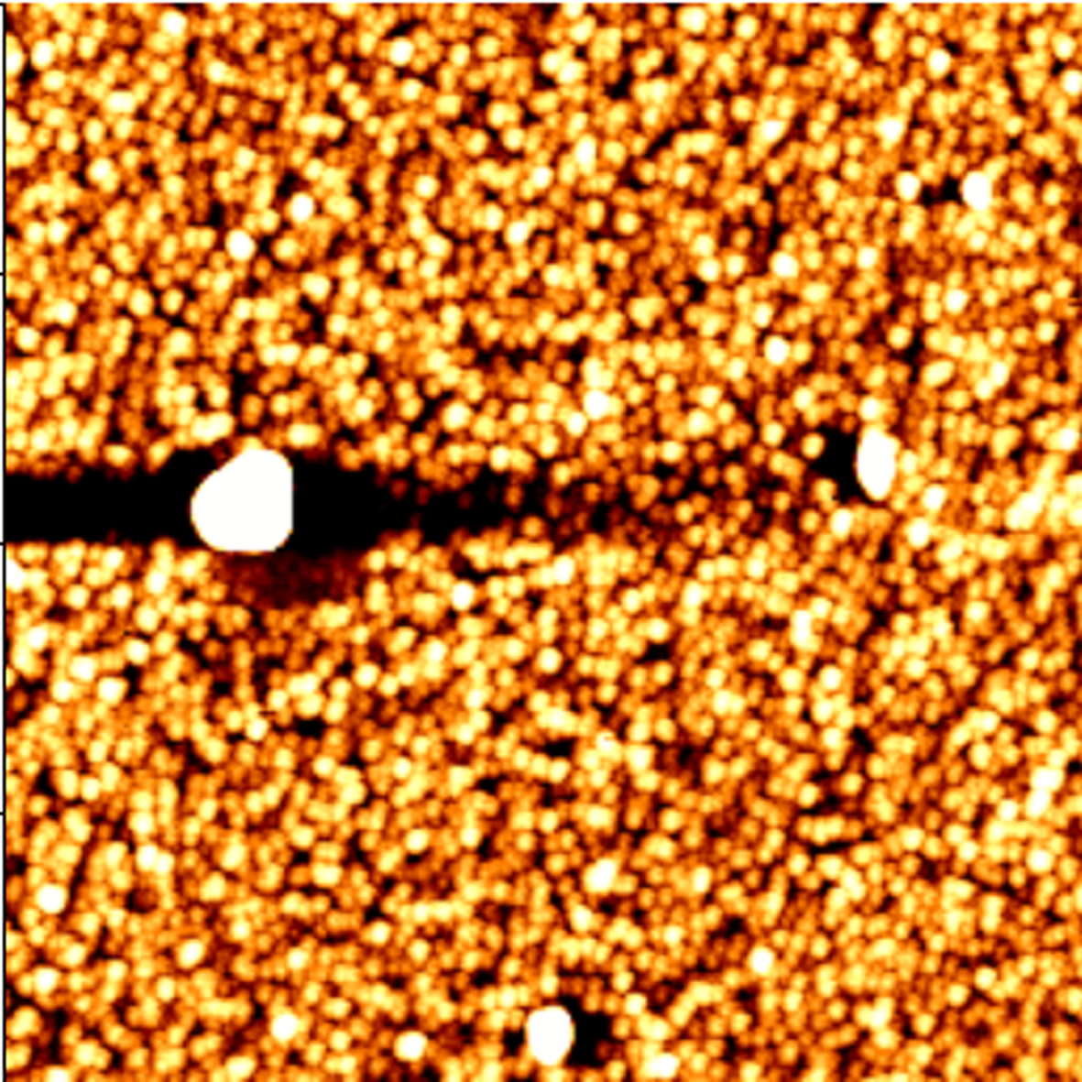
Two-dimensional III-V film on Si
nm
1000
2
nm
0
500
-2
0
1000
0
500
nm
rms = 0.863 nm
rms = 0.279 nm
rms = 0.961 nm
4 ML MEE Al_{0.5}Ga_{0.5}P
2 ML MBE Al_{0.5}Ga_{0.5}P
Si
4 ML MEE GaP
2 ML MBE GaP
Si
4 ML MEE GaP
Si
growth direction
3x reduction in rms roughness with addition of Al
A.C. Lin et al. J. Vac. Sci. Technol. B 29 (2011) 1201.

Slide 25
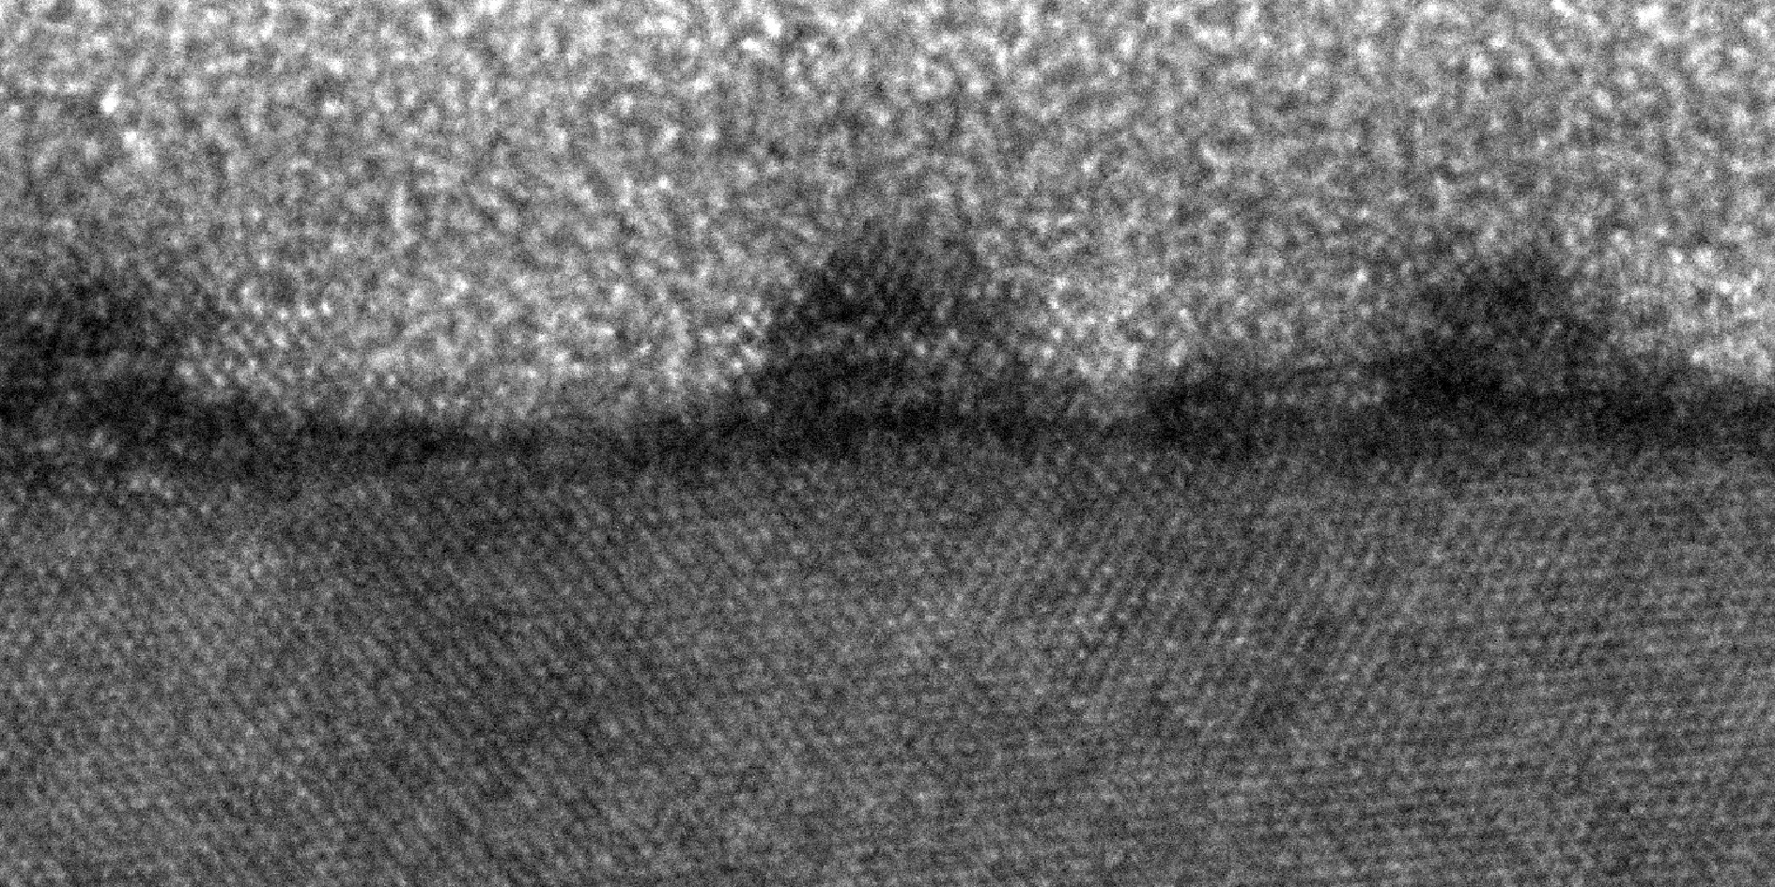
Abrupt interface between III-V and Si
glue
GaP MEE
GaP MBE
Si
3 nm
glue
AlGaP MEE
AlGaP MBE
Si
2 nm
A.C. Lin et al. J. Vac. Sci. Technol. B 29 (2011) 1201.

Slide 26
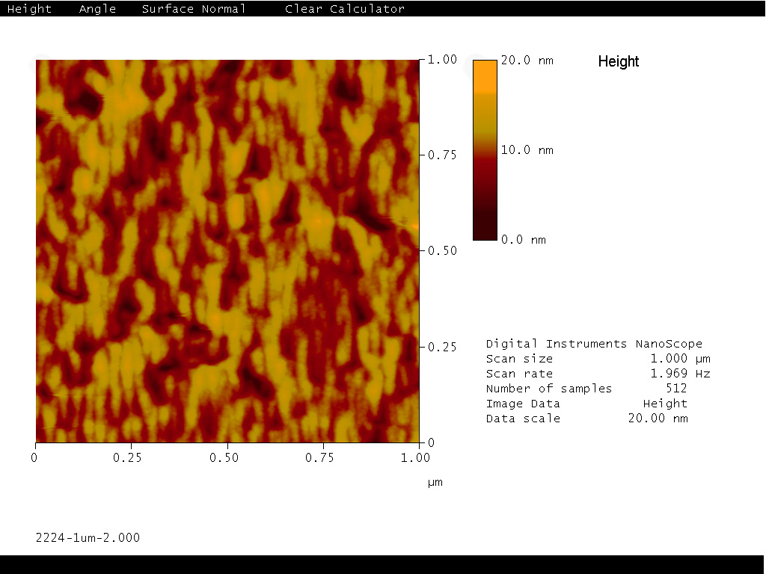
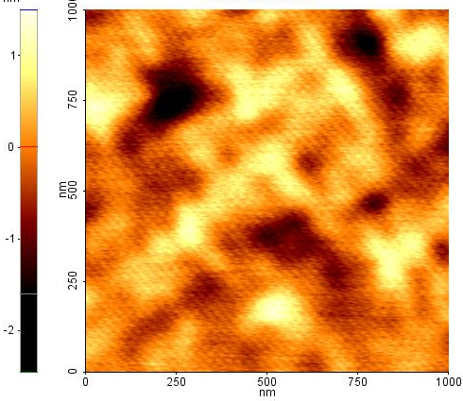
Effect of the first 5 monolayers
200 nm GaP
5 ML GaP
Si
rms = 2.28 nm
200 nm GaP
5 ML Al_{0.5}Ga_{0.5}P
Si
GaP
Si
50 nm
rms = 0.50 nm
A.C. Lin et al. J. Vac. Sci. Technol. B 29 (2011) 1201.

Slide 27
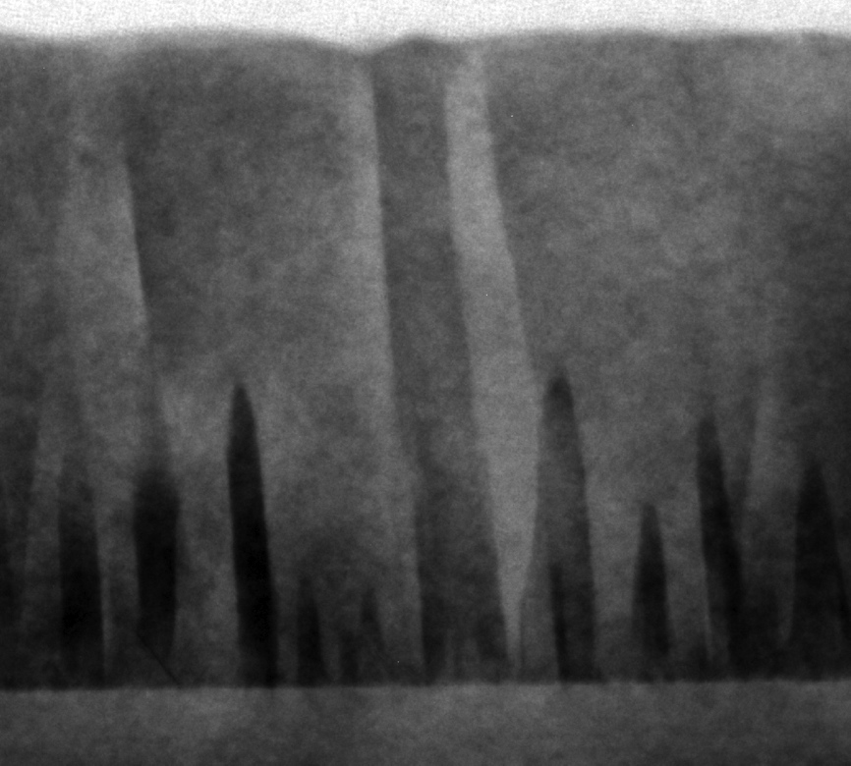
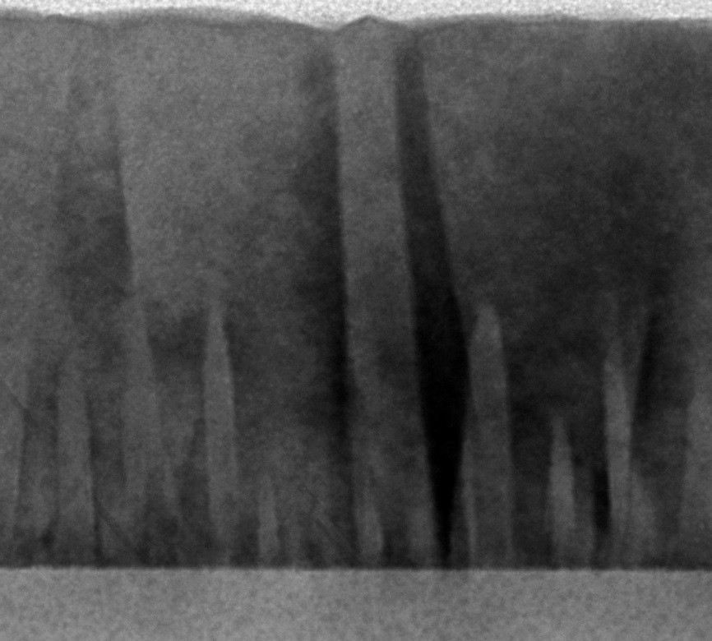
Using TEM to view APDs
DF 200
DF 200
GaP
Si
50 nm
50 nm
APDs of opposite polarity have contrast under certain diffraction conditions → distinguish antiphase boundaries from other defects (stacking faults, dislocations)

