Slide 1

Recent Progress in Substrate-Transferred Crystalline Mirrors
Garrett D. Cole
Notes:
1

Slide 2
Outline
Brownian noise and crystalline multilayer motivation
  applications, crystal growth, and basic properties
Confirmation of high reflectivity and low loss angles
    damping and thermal noise in micro- and meso-scale mirrors
Crystalline mirrors for precision measurement
    bonded “macroscopic” mirrors for optical reference cavities
Path towards low-thermal-noise LIGO-scale mirrors
    exploit existing infrastructure for IC fabrication

Slide 3
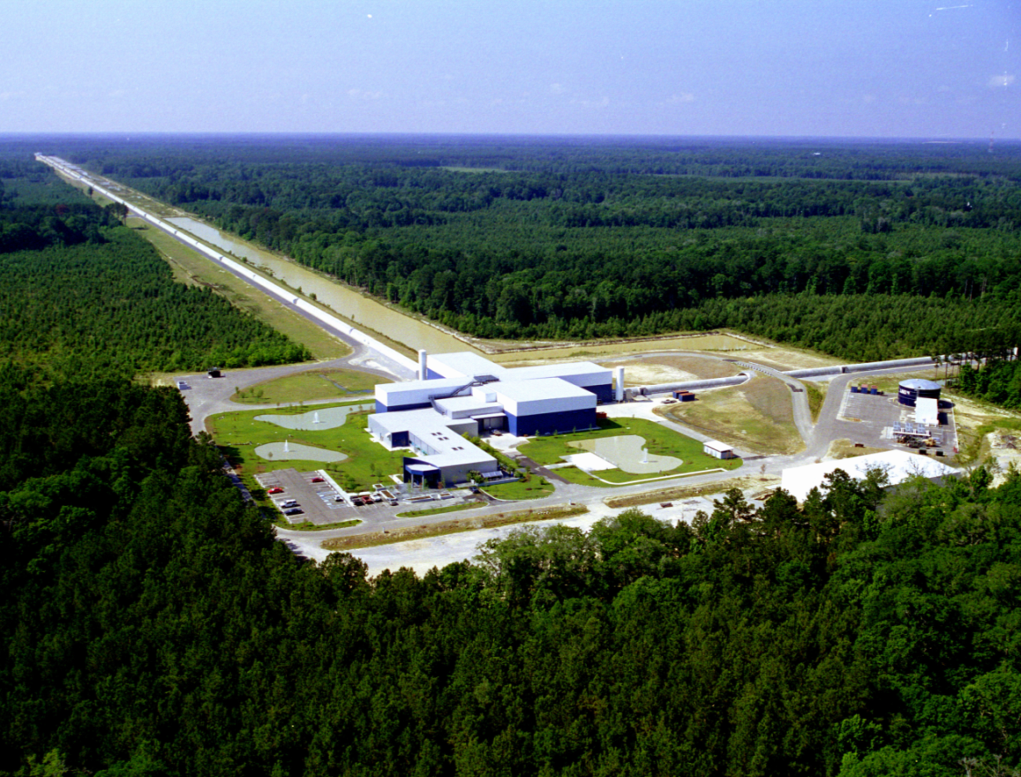
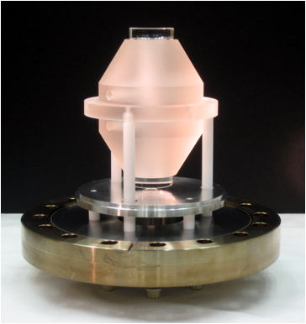
Different Scale, Similar Requirements
JILA/NIST
LIGO Observatory, Livingston, LA
Brownian noise poses a significant hurdle for a number of endeavors
  micro- and nanoscale scale resonators for cavity optomechanics
  reference cavities for laser stabilization (optical atomic clocks, freq. comb)
  kilometer-length gravitational wave interferometers

Slide 4
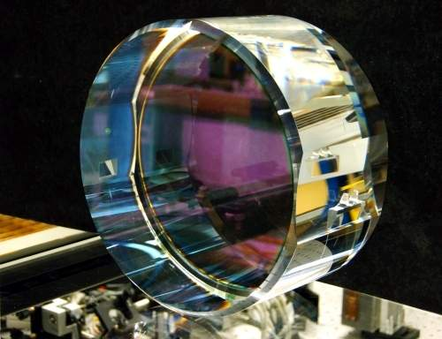
Coating Thermal Noise Basics
Mirrors are limiting factor in high-stability resonator performance
  not optical, but rather poor mechanical properties of the mirror
Excess mechanical damping in multilayer leads to significant noise
  dissipation: coupling of mechanical motion to a heat reservoir
  mechanical loss → thermal fluctuations → mechanical fluctuations

Slide 5
Coating Thermal Noise Consequences
State-of-the-art systems now limited by dielectric multilayer mirrors
  from LIGO-relevant studies by Penn, Harry, etc. Ta₂O₅ is the culprit
  only incremental changes realized in the last decade
Completely new solution is required here – crystalline coatings!
    semiconductor industry has a long history with such materials systems
Kessler, Hagemann, Grebing, Legero, Sterr, Riehle, Martin, Chen, Ye, arXiv:1112.3854v2

Slide 6
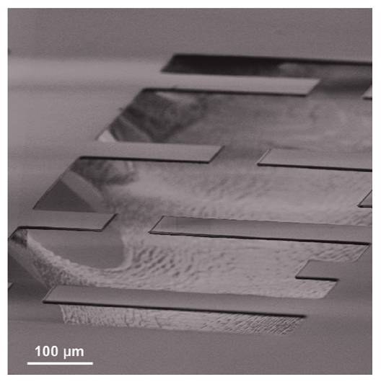
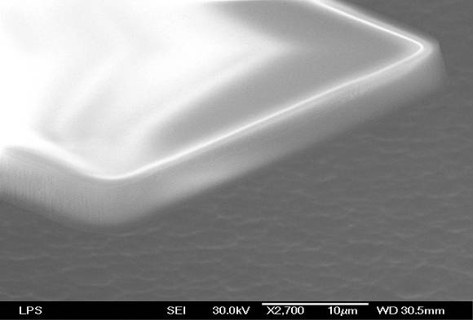
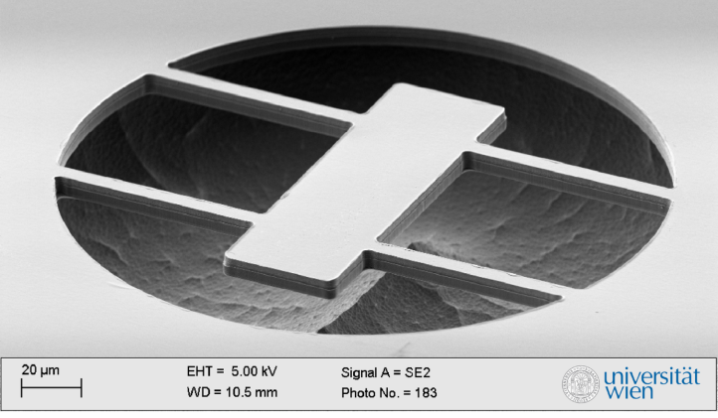
Optomechanics: Sculpted DBRs
Dielectric
Resonators
Epitaxial
AlGaAs Bragg Mirrors
Collaboration with Keith Schwab (Cornell)
FBH and Aspelmeyer Group (UniVie)
in collaboration with Keith Schwab
free-standing Ta₂O₅/SiO₂ HR coating
Reflectivity > 0.9999, Q ~ 2000 – 6000
loss angle (Q⁻¹) similar to LIGO data
free-standing epitaxial AlGaAs DBR
Reflectivity > 0.9999, Q ~ 2×10⁴ – 2×10⁵
Significantly reduced damping, similar R
S. Gröblacher, S. Gigan, H. Böhm, A. Zeilinger, M. Aspelmeyer, Eur. Phys. Lett. 81, 54003 (2008)
a) Cole, et al., Appl. Phys. Lett. 92, 261108 (2008)
b) Cole, et al., Appl. Phys. Lett. 96, 261102 (2010)

Slide 7
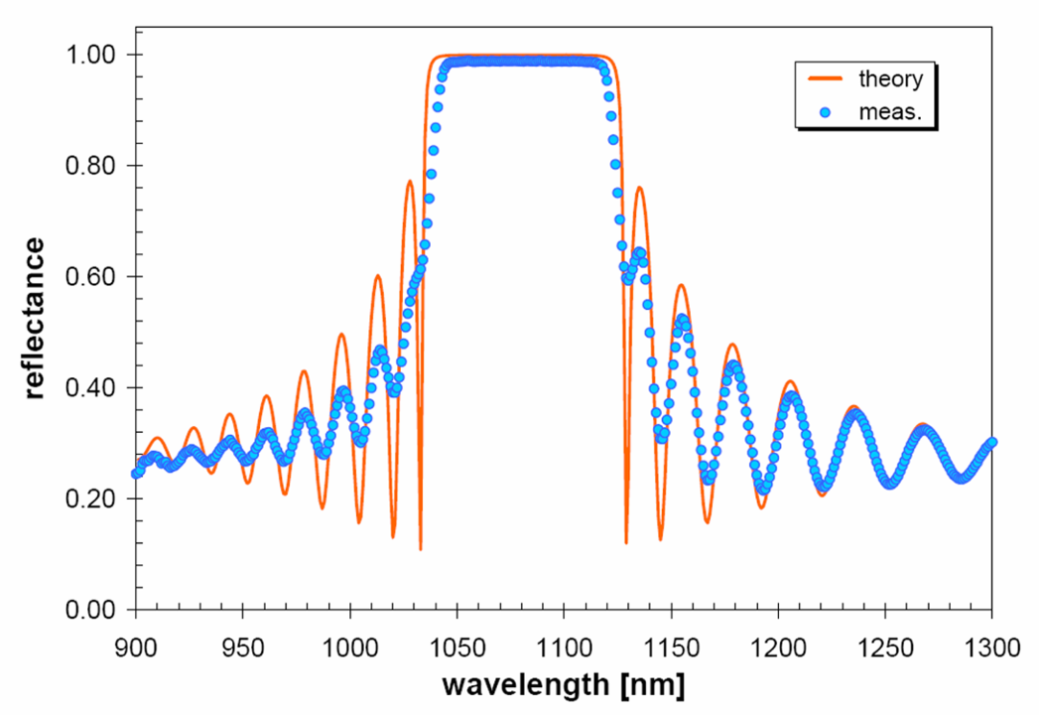
Multilayer Details
AlGaAs multilayer with varying Al content for index contrast
  high index layers contain low Al content (0-12%)
  8% Ga incorporated in low index film to slow oxidation
  in ambient
High quality epitaxy requires a lattice matched substrate
  same crystalline symmetry
  minimal deviation of lattice parameter (atomic spacing)
Potential for high reflectivity from ~600 nm – 3 μm
  measurements @ 1064 nm
32 - 40x
G. D. Cole, et al., Appl. Phys. Lett. 92, 261108 (2008)

Slide 8
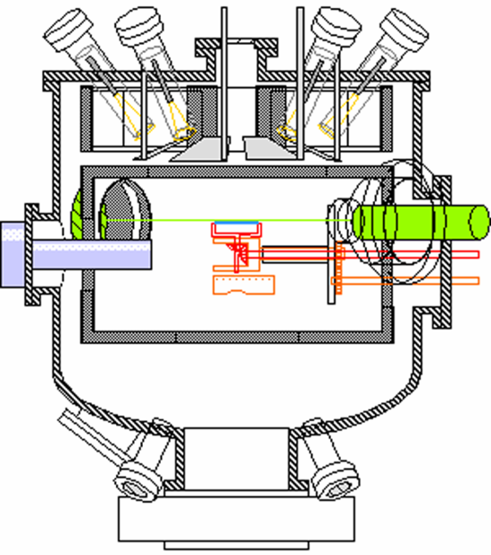
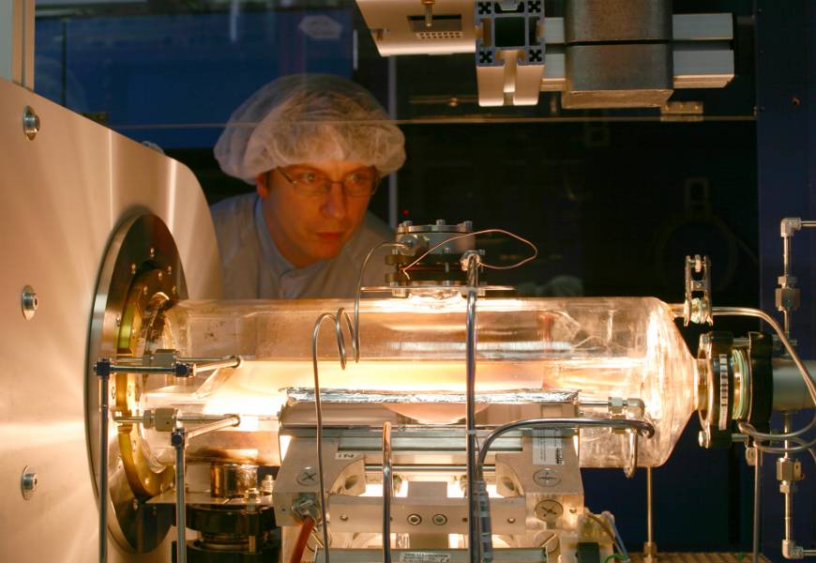
Crystal Growth Techniques
molecular beam epitaxy
metal organic chemical vapor deposition
effusion cells
sample
RHEED
cryopanels
vacuum chamber
Material | Crystal structure | Lattice const. (A) | Modulus (GPa||,┴) | Density (kg/m³) | CTE (x10⁻⁶ K⁻¹) | Index (1064 nm)
GaAs | zinc blende | 5.6455 | 85.3/121.3 | 5320 | 5.73 | 3.4804
AlAs | zinc blende | 5.6533 | 83.5/120.4 | 3760 | 5.20 | 2.9383
Al₂O₃ | hexagonal | 4.785 (a) | 345 | 3980 | 5.50 (┴) | 1.755

Slide 9
Outline
Brownian noise and crystalline multilayer motivation
  applications, crystal growth, and basic properties
Confirmation of high reflectivity and low loss angles
    damping and thermal noise in micro- and meso-scale mirrors
Crystalline mirrors for precision measurement
    bonded “macroscopic” mirrors for optical reference cavities
Path towards low-thermal-noise LIGO-scale mirrors
    exploit existing infrastructure for IC fabrication

Slide 10
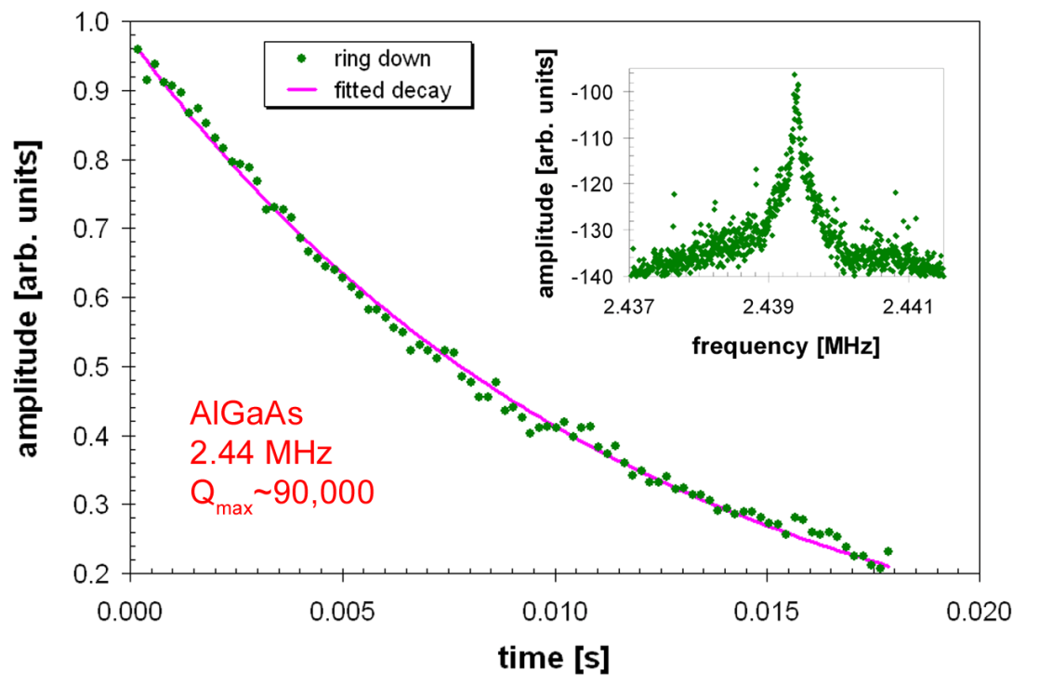
High-Performance Resonators
Highest measured quality factors exceed 1.0×10⁵ at ~20 K
Damping appears to be frequency independent (constant loss angle)
Maximum finesse of ~20k (limited by scatter and absorption)
G. D. Cole et al., Nature Communications (2011) | G. D. Cole, et al., IEEE MEMS conf. (2010)

Slide 11
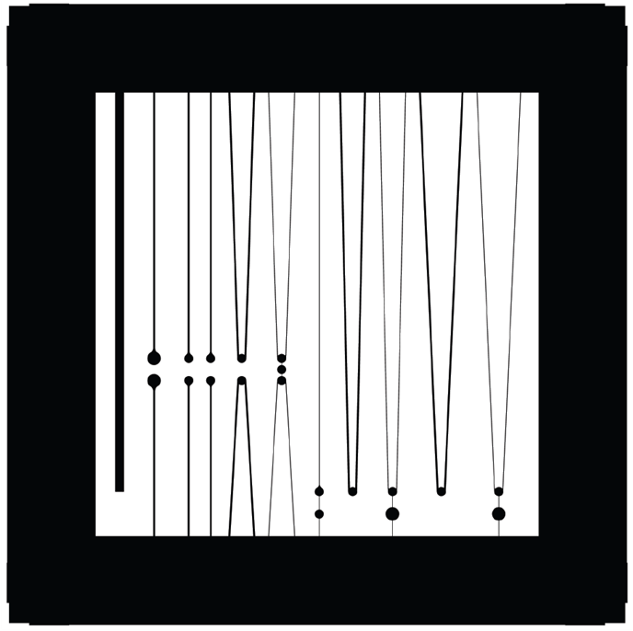
Low Frequency Cantilevers
7 mm
Monocrystalline mirror sculpted into suspended mm-scale cantilevers
  aspect ratio (length:min. lateral dimension) = ~1000:1, quite fragile!
Very low fundamental-mode frequencies and small effective masses
  4.5 mm x 6.1 μm x 6.88 μm → 164 Hz (lateral), 184 Hz (out-of-plane)
  modal mass (out-of-plane with respect to cavity): 500 ng

Slide 12
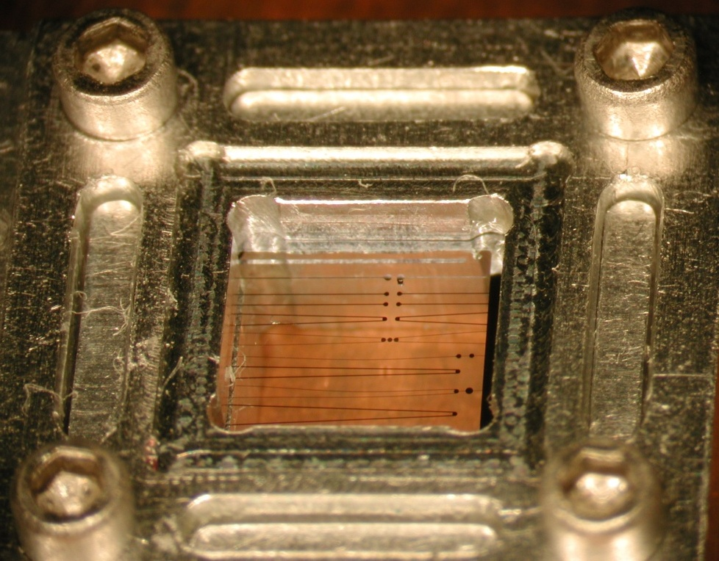
Ultra-Low Cryogenic Loss Angle
Monocrystalline mirror sculpted into suspended mm-scale cantilevers
  aspect ratio (length:thickness) = ~1000:1, quite fragile!
Very low fundamental mode frequencies and small effective masses
  4.5 mm x 6.1 μm x 6.88 μm → 164 Hz (lateral), 184 Hz (out-of-plane)
  modal mass (out-of-plane) with respect to cavity: <500 ng
Finesse up to 30k measured on the suspended cantilever (100 μm pad)
  reflectivity ultimately limited by scatter and absorption losses
Ringdown yields Q values 30-40k at RT and exceeding 2×10⁵ at 10 K
  loss angle φ of 4.5×10⁻⁶, two orders of magnitude below dielectric mirrors
  ringdown ~10 minutes (τ ≈ 400 s), extreme vibration isolation required

Slide 13
Room Temp. Thermal Noise
300 K
Q: 30k
F: 20k
P_{ext}: 5 μW
S. R. Sankar, G. D. Cole, T. Corbitt, M. Aspelmeyer, N. Mavalvala, manuscript in progress (2012)

Slide 14
Cryogenic Thermal Noise
19 K
Q: >100k
F: 20k
P_{ext}: 5 μW
S. R. Sankar, G. D. Cole, T. Corbitt, M. Aspelmeyer, N. Mavalvala, manuscript in progress (2012)

Slide 15
Outline
Brownian noise and crystalline multilayer motivation
  applications, crystal growth, and basic properties
Confirmation of high reflectivity and low loss angles
    damping and thermal noise in micro- and meso-scale mirrors
Crystalline mirrors for precision measurement
    bonded “macroscopic” mirrors for optical reference cavities
Path towards low-thermal-noise LIGO-scale mirrors
    exploit existing infrastructure for IC fabrication

Slide 16
Ion Beam Sputtered Dielectric Films
source target
State-of-the-art mirrors
alternating dielectric films, typically SiO₂/Ta₂O₅
Allows for deposition onto essentially arbitrary substrates
ion beam
carrier substrate
Multilayer of sputtered amorphous films generated via IBS
Phenomenal optical properties (high R, low absorption and scatter)
Flexible choice of substrates (assuming proper surface properties)
  super-polished SiO₂, Si, ULE, sapphire, etc.

Slide 17
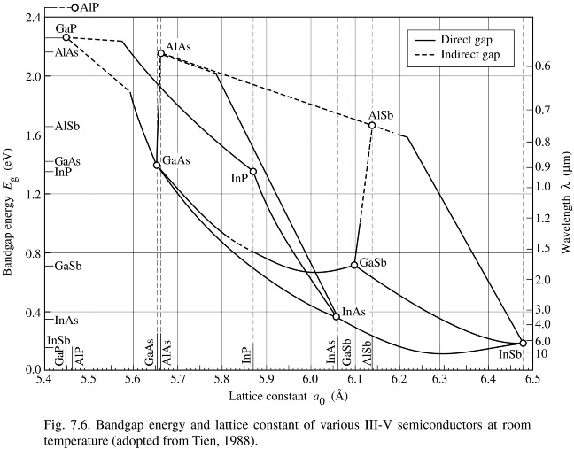
Bonded Monocrystalline Mirrors
Minimizing coating thermal noise
Macroscopic mirrors from epitaxial AlGaAs alloys
Direct deposition onto arbitrary substrates precluded by lattice matching condition
  Employ semiconductor microfabrication techniques to transfer AlGaAs multilayers onto arbitrary substrates (SiO₂, sapphire, etc.)
  ideal process allows for used of curved mirror blanks
  identical form factor, no change in overall system design

Slide 18
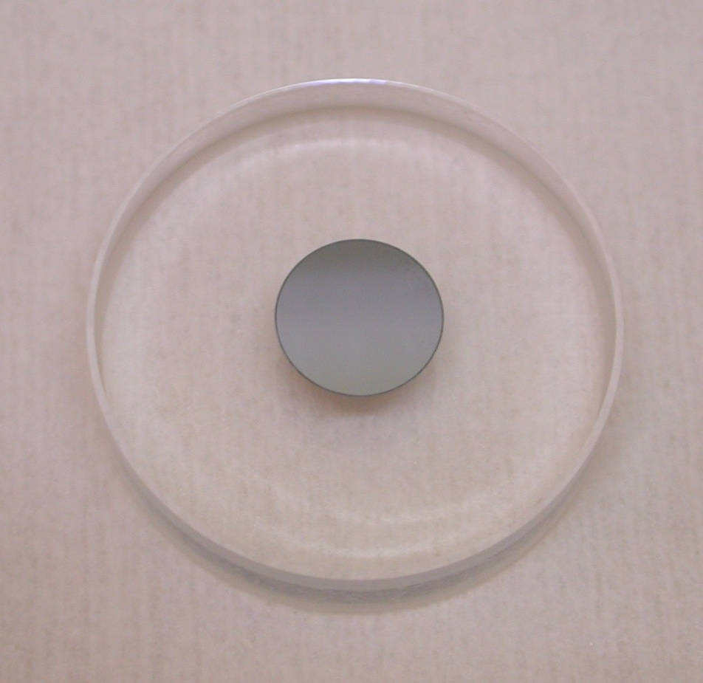
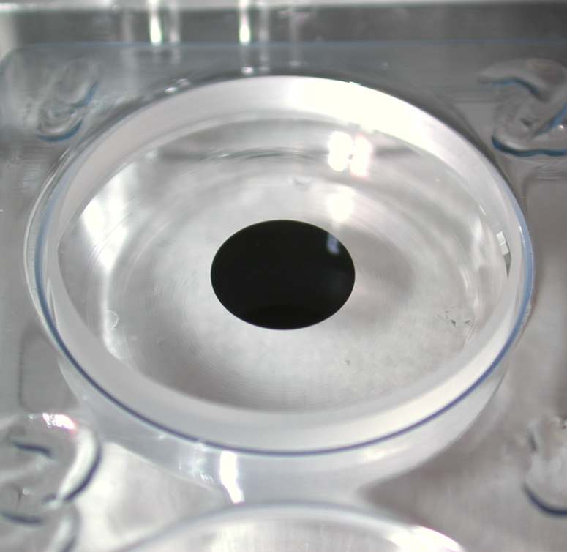
Transferred Mirror Development
Top view: patterned mirrors on a crystalline
substrate
Side view: bonding
Side view: bonding
Released mirror discs
Bonding
fixture
Bonding
fixture
25 mm Ø
  Free-standing mirror discs transferred onto arbitrary substrates
  cleanliness and proper handling is crucial for high-yield
  interfacial energy must be optimized for intended application

Slide 19
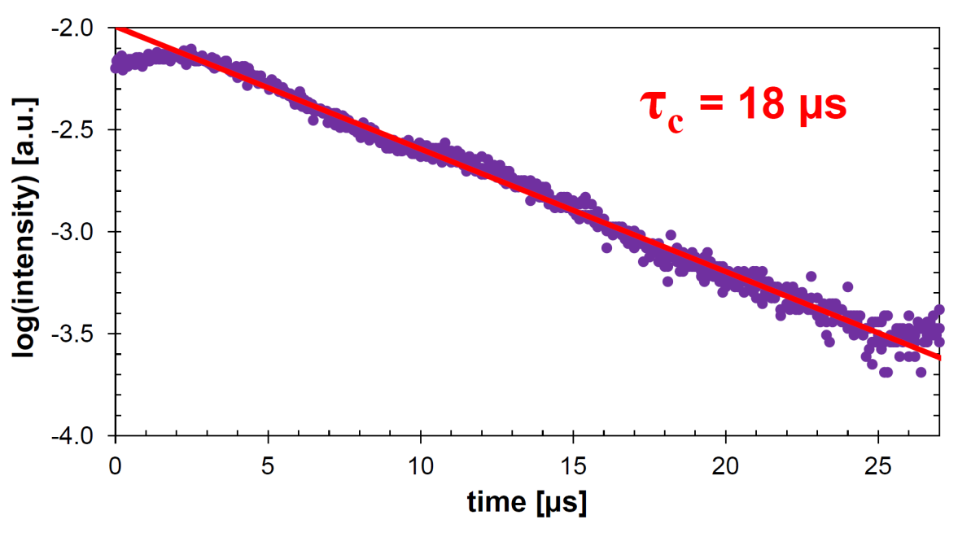
Preliminary Cavity Results
Hybrid cavity at JILA
  ULE spacer with clamped AR-coated end mirrors
  planar and 1-m ROC fused-silica substrates
  Length = 24 cm
Initial finesse of 0.75×10⁵
  theory ~ 1.4×10⁵
  cleanliness limited?
Next steps:
  clean thoroughly
  contact to fixed spacer
  double check finesse and measure thermal noise
in collaboration with Mike Martin and Craig Benko from Jun Ye’s group at UC Boulder / JILA

Slide 20
Outline
Brownian noise and crystalline multilayer motivation
  applications, crystal growth, and basic properties
Achieving high reflectivity and ultra-low loss angles
    damping and thermal noise in micro- and meso-scale mirrors
Crystalline mirrors for precision measurement
    bonded “macroscopic” mirrors for optical reference cavities
Path towards low-thermal-noise LIGO-scale mirrors
    exploit existing infrastructure for IC fabrication

Slide 21
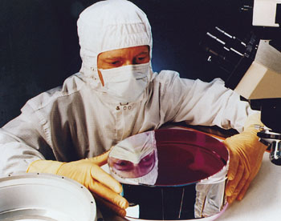
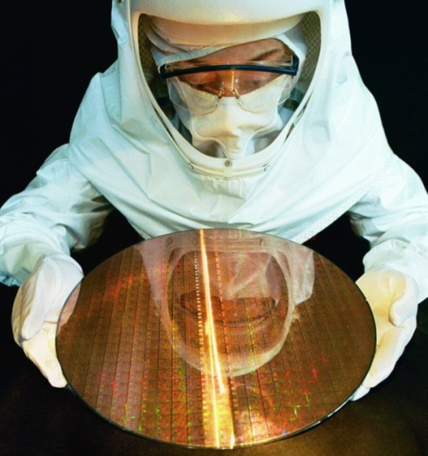
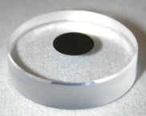
Towards LIGO-scale Mirrors
Leverage infrastructure for semiconductor fabrication
  high-uniformity epitaxial growth on large-diameter substrates
  void-free direct bonding of crystalline semiconductors
  $ burning a hole in your pocket? LIGO-scale tools available!

Slide 22
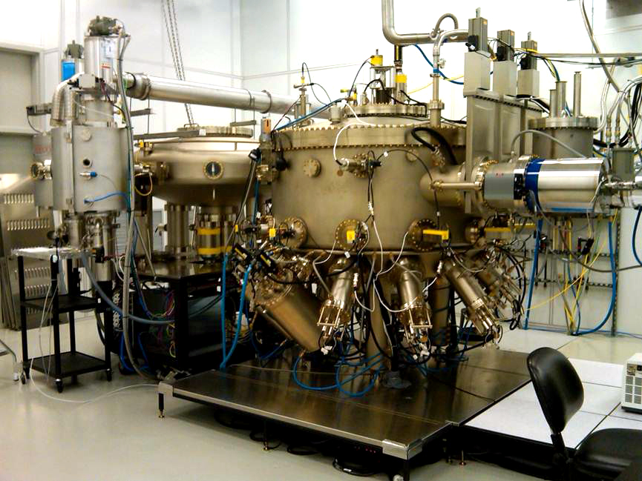
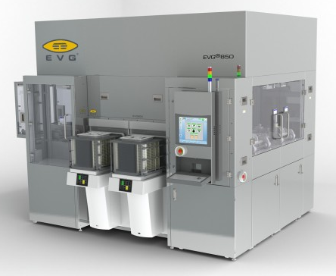
Towards LIGO-scale Mirrors
Production MBE reactors for microwave electronics
  7 x 150-mm or 4 x 200-mm wafers (Veeco GEN2k/Riber R7k)
Direct bonding systems for SOI wafer production
  industrial tools capable of bonding 450-mm diam. wafers
* Photo credit: Bob Yanka, RFMD; Veeco GEN2000 multi-wafer production MBE system

Slide 23
Summary of AlGaAs Mirror Properties
Substrate-transferred crystalline mirrors are a promising avenue for future gravitational wave detectors
More than 100× decrease in mechanical loss angle
  cryogenic Q-values >1×10⁵ (φ_{min}=4.5×10⁻⁶) at 180 Hz-4 MHz
  room temperature Q-values ~4×10⁴ (φ_{min}=2.5×10⁻⁵)
  compares with typical φ of ~3×10⁻⁴ for SiO₂/Ta₂O₅
Potential for very low scatter loss and absorption
  MBE-grown films: 1-2 Å RMS surface roughness
  ~10 ppm (α=0.2 cm⁻¹) absorption at 1064 nm (2 W, 70 μm Ø)
Reflectivity >99.99% measured for 40.5 layer pairs
  potential for finesse ~10⁵ (preliminary results from JILA)

Slide 25
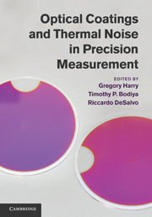

Blatant Self-Promotion
Available now at Amazon.com ☺
Editors:
Gregory Harry
American University, Washington DC
Timothy P. Bodiya
Massachusetts Institute of Technology
Riccardo DeSalvo
Università degli Studi del Sannio, Italy
Chapter 16, “Cavity Optomechanics,”
by G. D. Cole and M. Aspelmeyer
contains the compiled results of our work on AlGaAs-based epitaxial Bragg mirrors

Slide 26
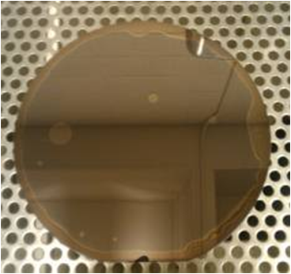
Macroscopic DBR Development
Direct bonding of GaAs to silicon and SiO₂ has been demonstrated for wafers with diameters up to 150 mm
  direct and LT oxide/oxide bonding
  limited to flat structures
Reference cavity relevant bonding
  25-mm Ø fused silica mirror blanks
  planar and curved mirrors required
Enemies: voids and inclusions
  will research lab environment be sufficient for prototyping?
  optimized cleaning and handling procedure is key to success!
150 mm
Y. Bai, G. D. Cole, M. T. Bulsara, E. A. Fitzgerald, Journal of the Electrochemical Society (2012)

Slide 27
Open Questions
What are the ultimate limits of Q for these materials?
Are we approaching the minimum absorption level?
Can we minimize for thermo-optic effects at RT?
Is damping of bonded interface a potential roadblock?
What is the minimum achievable radius of curvature?

Slide 28
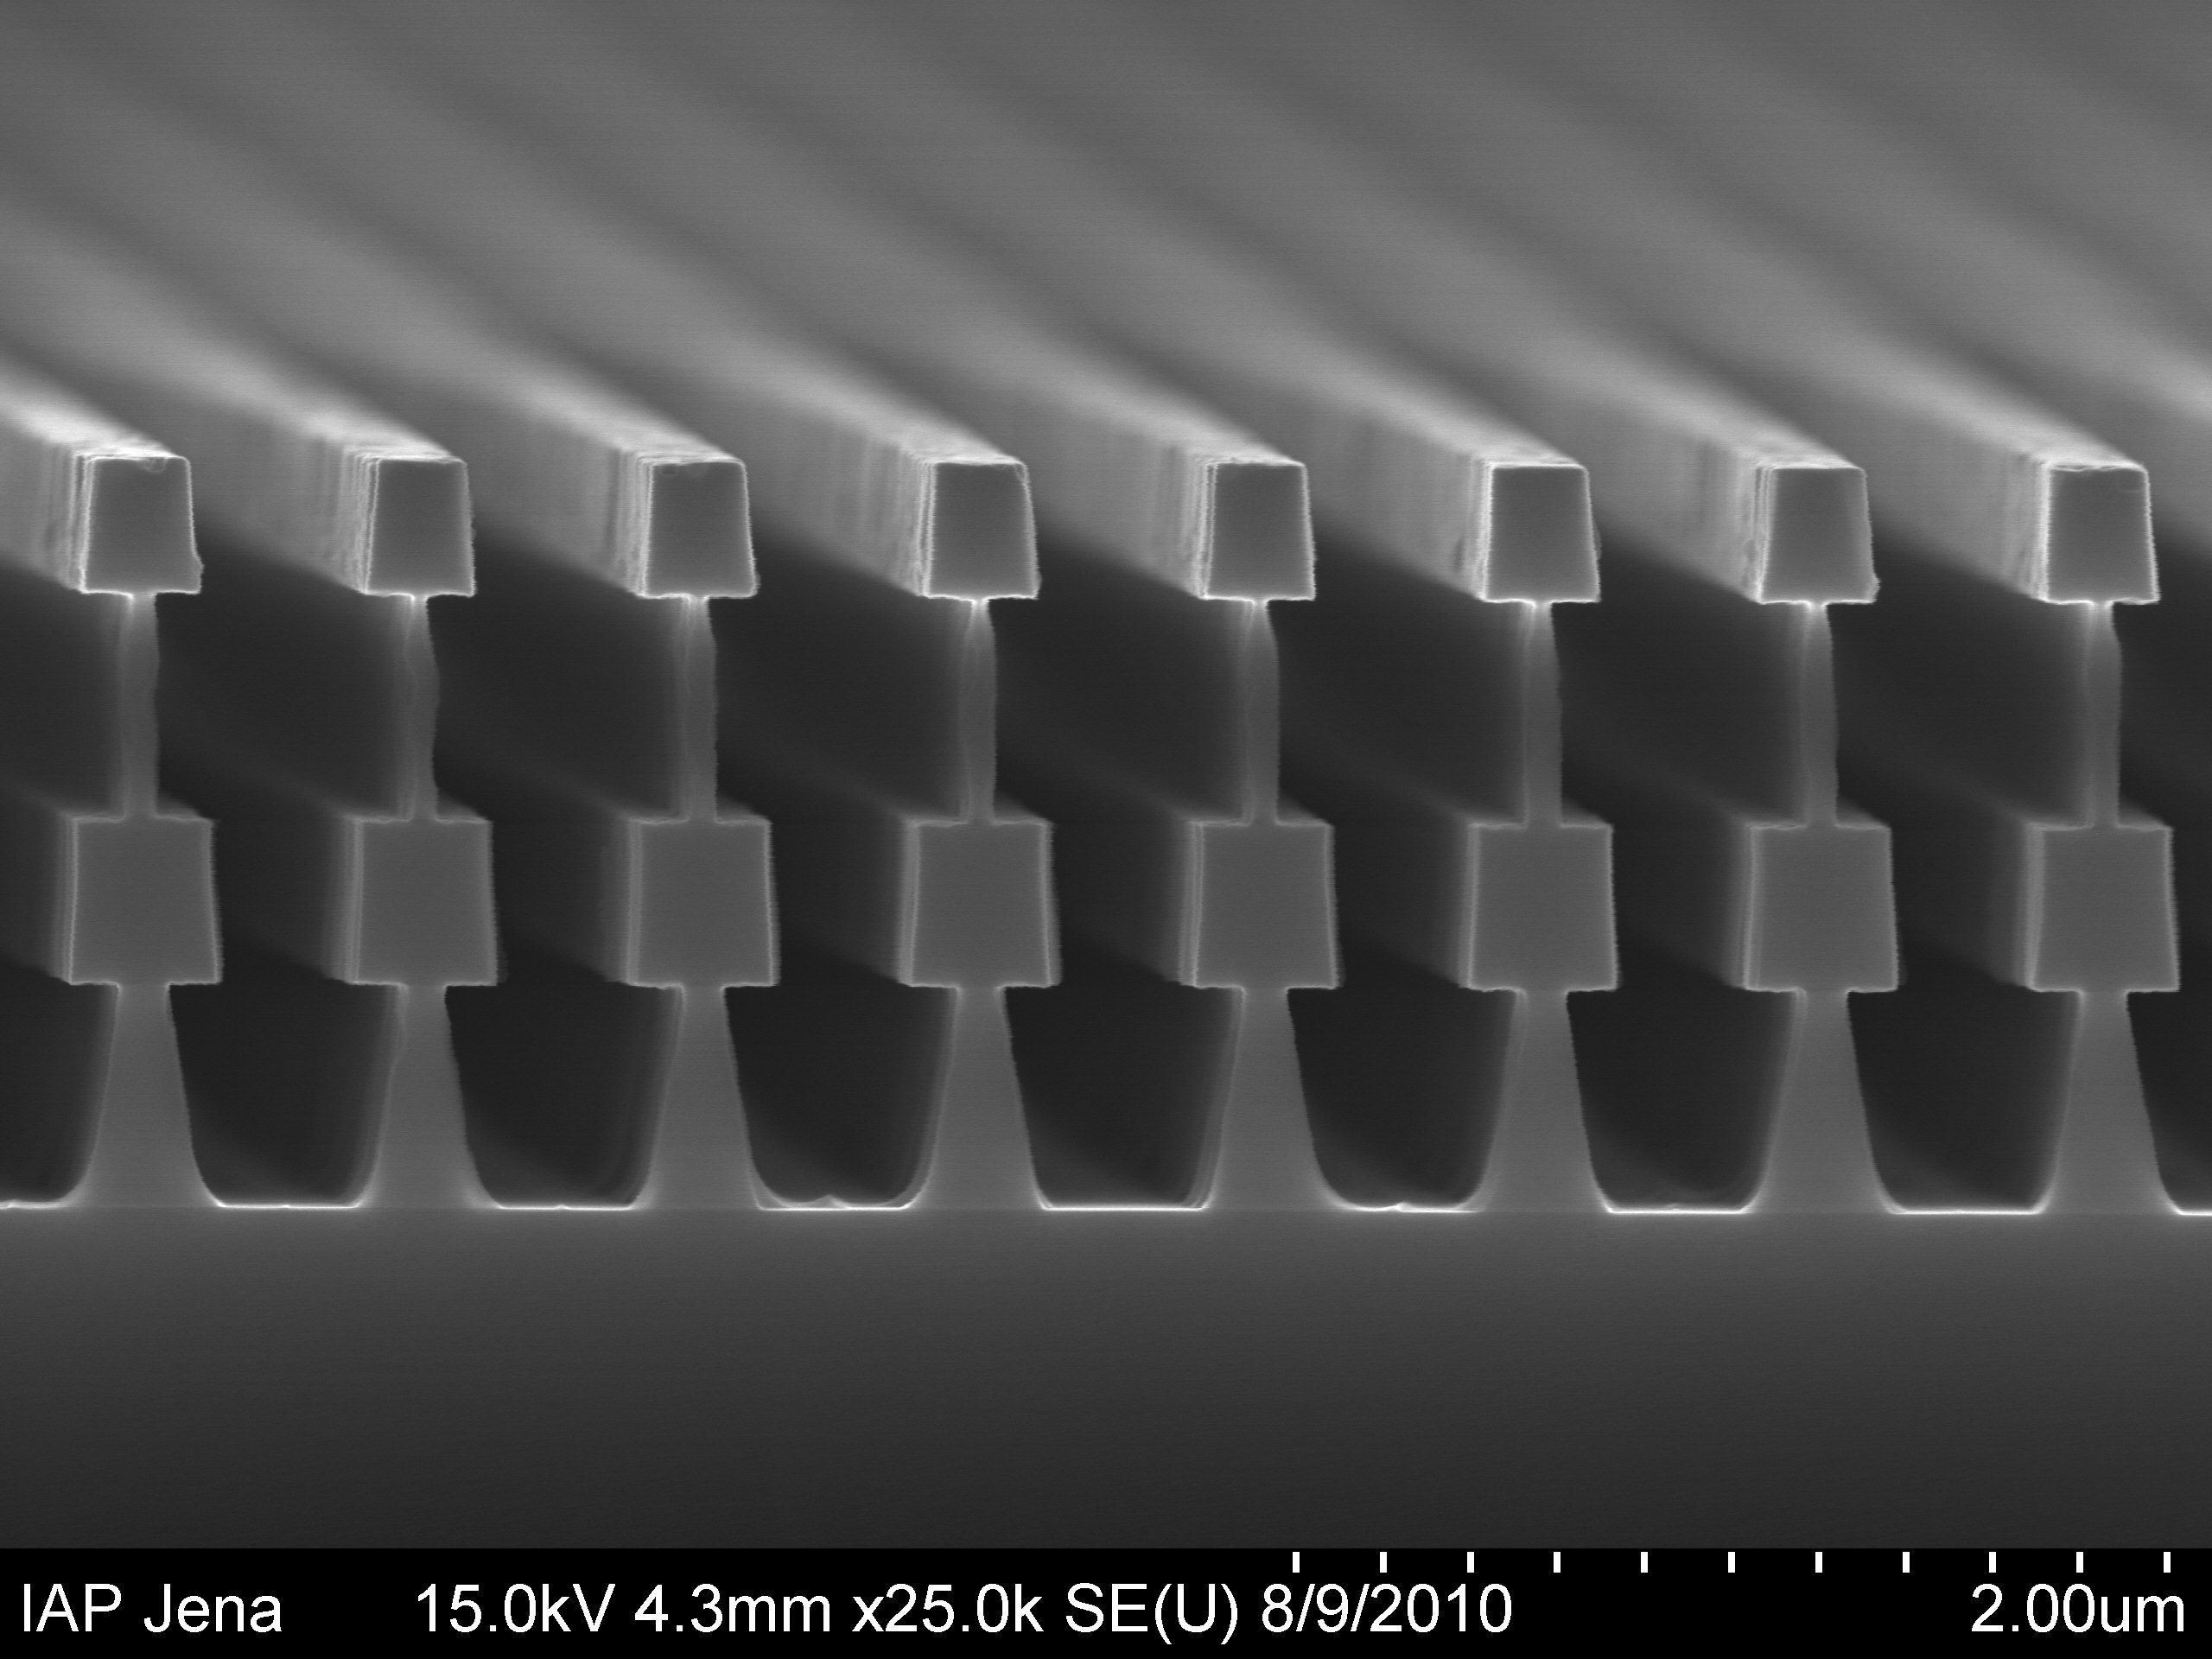
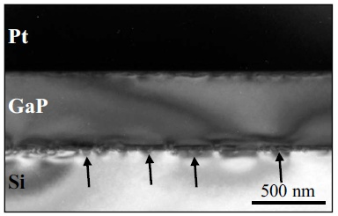
Alternative Reflector Technologies
Resonant waveguide grating-based reflectors (Jena)
  polycrystalline-Si/SiO₂ ‘double T’ grating structure
  R_{theory} ~99.95%, first iteration R=89%, limited bandwidth
Epitaxial films on crystalline Si substrates (Stanford)
  possibility of realizing crystalline AlGaP/Si multilayers
  initial work on MBE grown films pioneered in mid ‘80s
S. Kroker, et al., Optics Express 19 (2011) | T. J. Grassman, et al., Appl. Phys. Lett. 94 (2009)

Slide 29
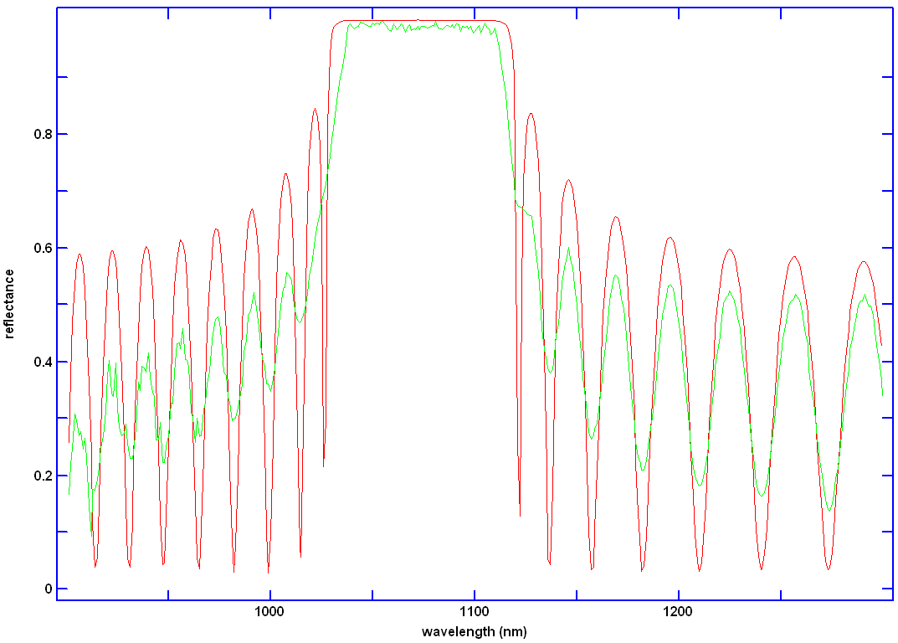
Measurement of Bonded Prototype
AlGaAs on SiO₂
theory (red)
measurement (green)

Slide 30
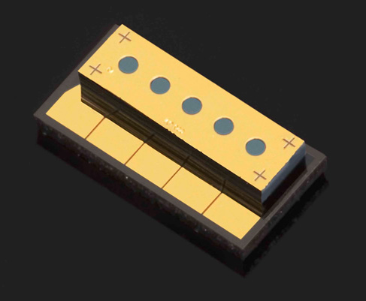
Epitaxial Multilayer Applications
Epitaxial DBRs originally developed for VCSELs
    demonstrated in 1983 by K. Iga’s group at the Tokyo Institute of Technology
  VCSEL consists of high-reflectivity mirrors surrounding a semiconductor microcavity
  circularly symmetric emission normal to the substrate surface
  (very efficient fiber coupling)
Lattice matching constraint limits substrate choices
  AlInGaAs:GaAs, InGaAsP:InP
Substrate-emitting
VCSEL (cross-section)
DBR 1
Gain Region
DBR 2
Heat sink

Slide 31
III-V “Map of the World”

Slide 32

Radiation Pressure Shot Noise
Noise experienced by a suspended body due to photon number fluctuations in incident laser beam
  quantum back-action of optical displacement measurement
  ideal system would simultaneously achieve low frequency and low mass (nanogram and sub-kHz in same structure)
reflectivity and Q
units: m/√Hz
frequency & mass
Thermal noise of mechanical system is a major obstacle for
observing this effect, solution: low-loss crystalline mirrors

Slide 33
Thermal Noise Theory
units: m/√Hz
Thermal noise spectrum: sum of noise of all modes
  requires eigenfrequency, effective mass, and loss angle
Eigenfrequencies and effective masses via FEM
  elastic constants of AlGaAs single-crystal (proper orientation)
  as-fabricated geometry (measured modes as guidelines)
  Gaussian “probe” for optically-sampled effective mass
  measured Q value for obtaining proper loss angle
P. R. Saulson, Phys. Rev. D 42, 2437 (1990)

Slide 34
Predicted Cryogenic Results
Q: 120k
F: 20k
P_{ext}: 10 μW

Slide 35
Experimental Details

Slide 36
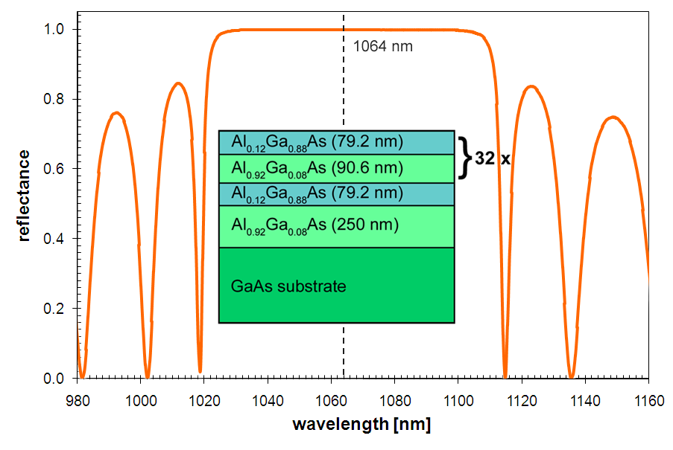
Monocrystalline Optomechanics
fabricated at Lawrence Livermore National Lab.
32.5 period undoped Al_{x}Ga_{1-x}As distributed Bragg reflector (MBE)
  high index layers contain 12% Al for substrate etch selectivity
  8% Ga incorporated in low index film to slow oxidation in ambient
Single- and doubly-clamped beams, dimensions: 100s x 50 x 5.5 μm³
  eigenfrequencies up to 2 MHz (sideband resolved operation κ/ω_{m}~0.2)
G. D. Cole, et al., Appl. Phys. Lett. 92, 261108 (2008)

Slide 37
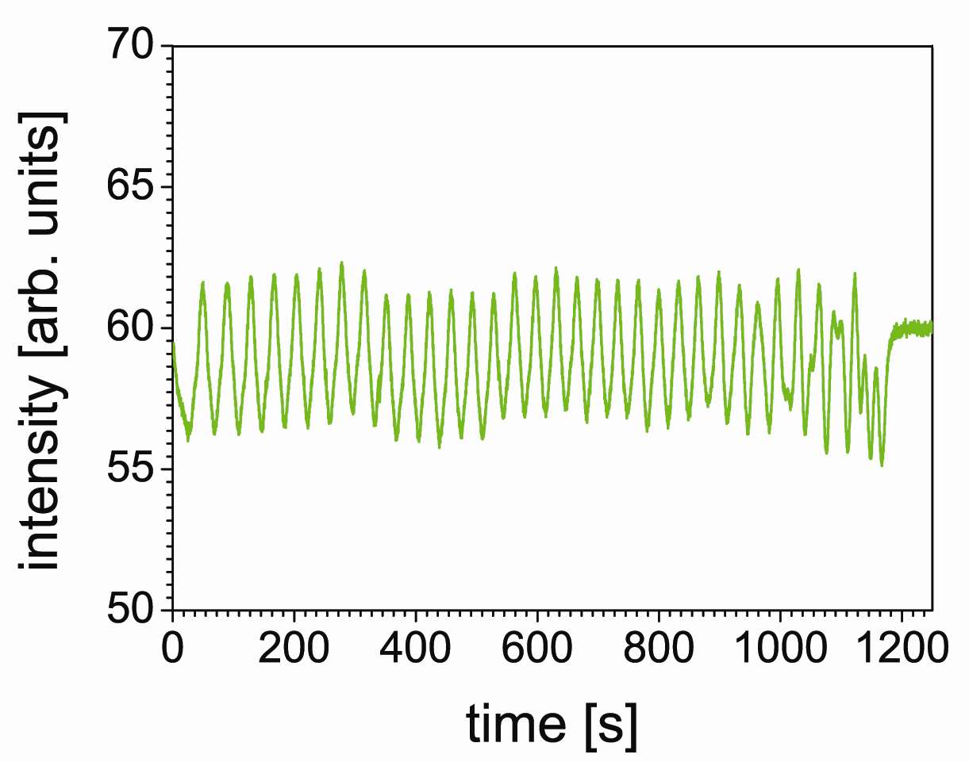
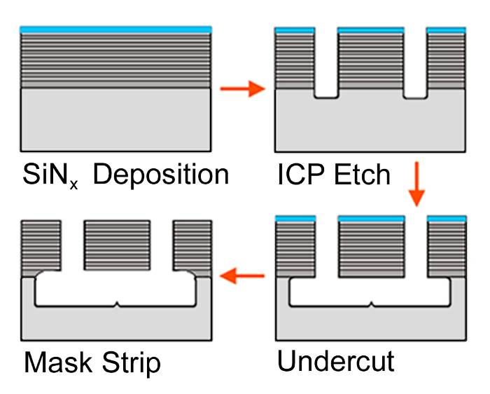
AlGaAs Micromirror Process Flow
DBR layers + etch stop
Mirror surface protection: PECVD SiN_{x} (300 °C, 100-nm thickness)
Define mechanics: SiCl₄/N₂ ion etch through DBR and into substrate
Undercut: selective GaAs wet etch with buffered citric acid solution
Strip mirror protection: dilute HF for SiN_{x} and Al_{0.92}Ga_{0.08}As removal

Slide 38
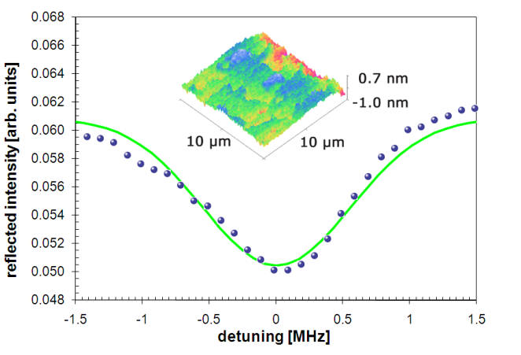
Finesse and Surface Roughness
Atomic force microscopy reveals roughness values below 2 Å
Material allows for an impedance matched Finesse of 1×10⁴

Slide 39
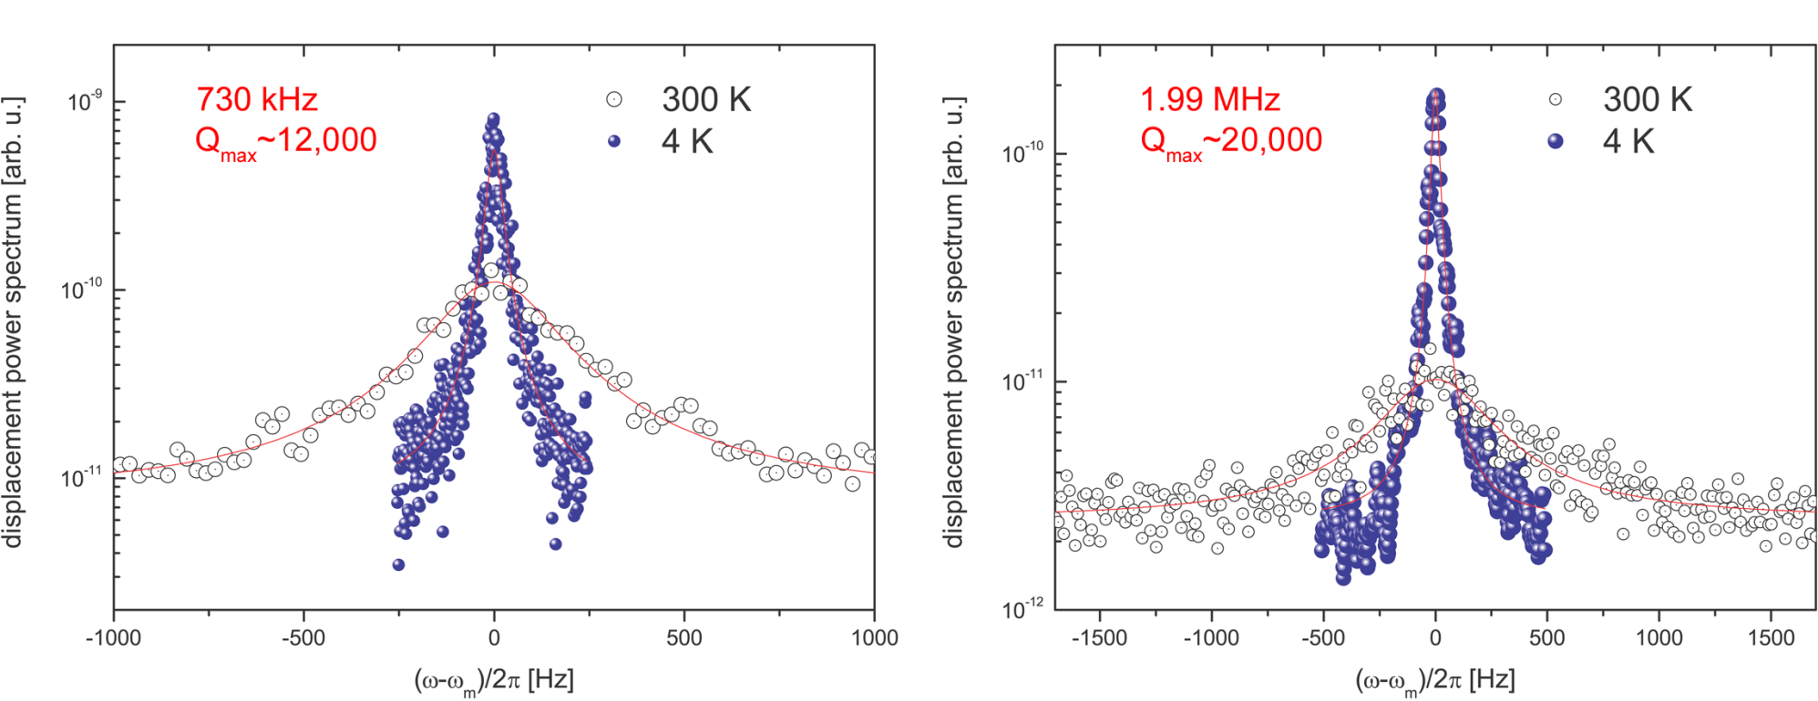
Gen. I Crystalline Mirror Performance
Mechanical Q shows significant improvement over SiO₂/Ta₂O₅
    doubly-clamped beams: 2×10⁴ versus 0.3×10⁴ at 4 K
    further analysis revealed Q to be anchor-loss limited
Optical properties are promising: low scatter and absorption loss
  absorption ~10 ppm, transmission limited R of ~99.98%

Slide 40
Outline
Motivation for exploring monocrystalline mirrors
  basic properties, crystal growth, and initial devices
High-performance “free-free” resonators
    minimizing mechanical damping through geometric design
Floppy mirrors: low-frequency microgram cantilevers
    towards the observation of radiation pressure shot noise
Crystalline mirrors for precision measurement
    AlGaAs DBRs for macroscopic cavity end mirrors
Summary of properties and path forward
  outlook and discussion of remaining questions

Slide 41
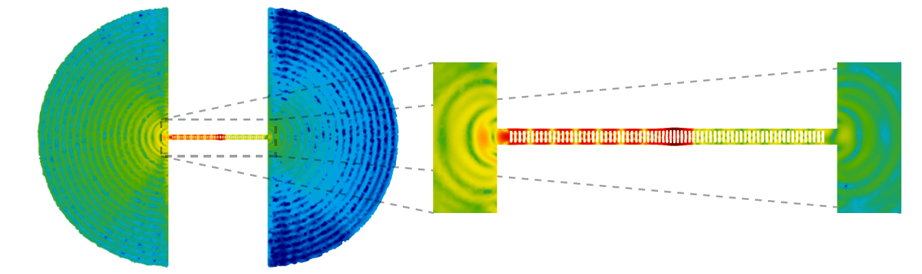
“Phonon-Tunneling” Dissipation
Lossy contact pads
Resonator of interest
Fundamental loss mechanism in all suspended resonator structures
  temperature independent process; intrinsic limitation to quality factor
Previous approaches to modeling this process are quite cumbersome
  simulations include large contact area; artifical loss introduced to substrate
  rigorous solution to elastic wave propagation beyond suspension points
M. Eichenfield, J. Chan, R. M. Camacho, K. J. Vahala, O. Painter, Nature (2009)

Slide 42
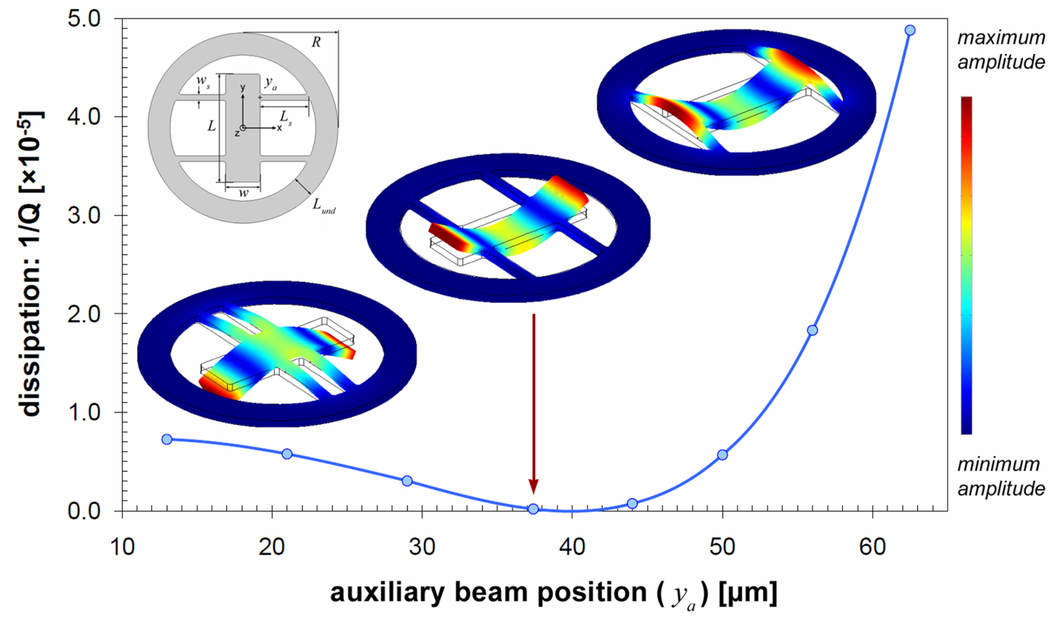
Design Dependent Damping
Ideal resonator design for isolating support-induced losses
Geometry variation with ~ constant frequency & surface-to-volume ratio
G. D. Cole and I. Wilson-Rae, et al., Nature Communications 2, 231 (2011)

Slide 43
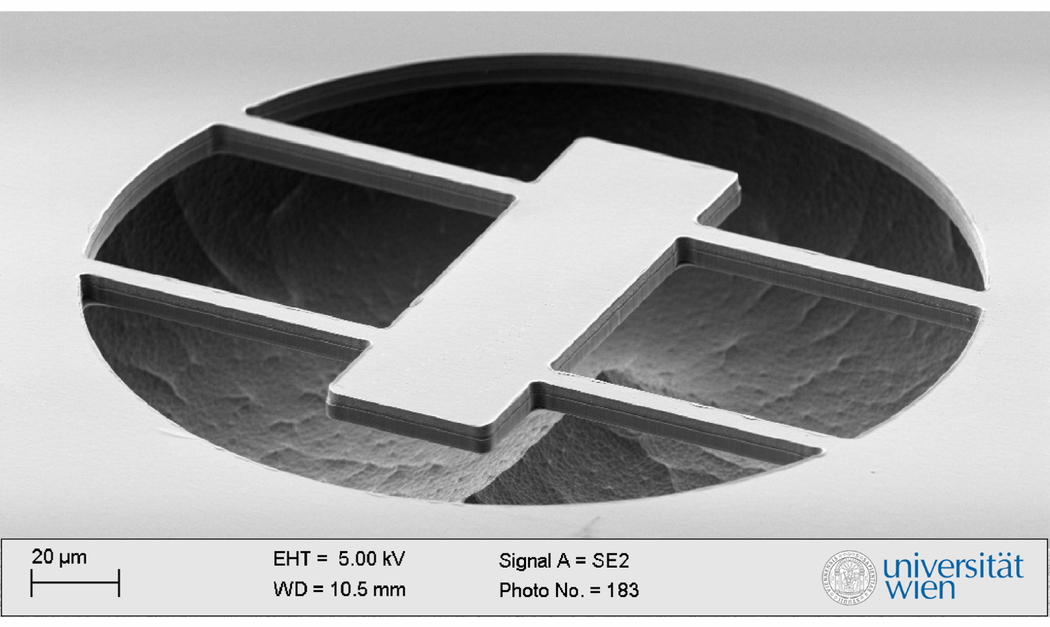
Fabricated Free-Free Resonator
Single-mask bulk micromachining process, excellent geometric control
XeF₂ provides near infinite selectivity in Ge etch over GaAs/AlAs DBR
G. D. Cole, Y. Bai, M. Aspelmeyer, and E. A. Fitzgerald, Appl. Phys. Lett. 96, 261102 (2010)

Slide 44
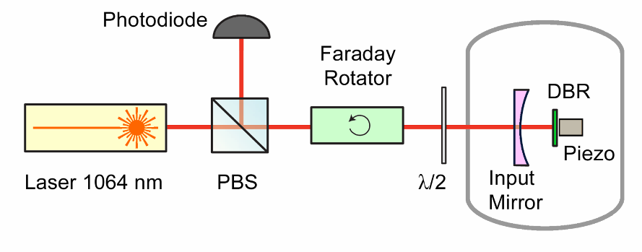
Updated Epitaxial DBR
Identical materials structure
as DBR in initial experiments
  40 periods rather than 32 to minimize transmission losses
In-situ growth monitor leads to excellent thickness control
  target wavelength 1077 nm, measured peak at 1079 nm
  thickness deviation of ~8 nm over 7.1 μm (0.11 % error!)
Measured reflectivity >99.99%
  matched finesse of 1.75×10⁴

Slide 45
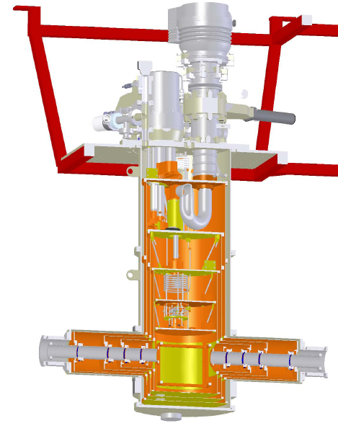
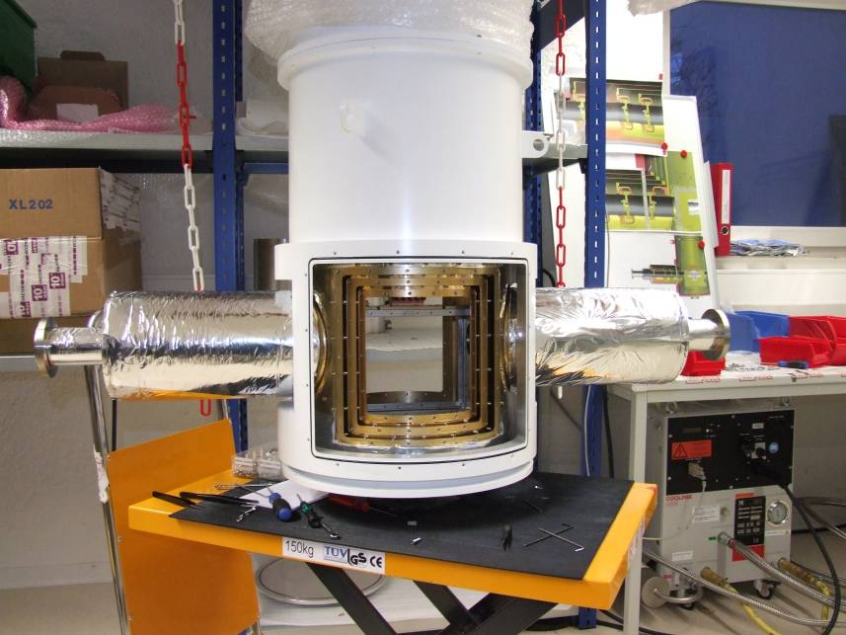
Minimizing the Bath Temperature
Closed cycle dilution fridge with double-sided optical access
Base temperature ~25 mK (no input laser), experiments @ 100 mK
Stable operation of optomechanical cavity recently realized (F >10,000)
k_{B}T/ħQ << κ << ω_{m}, g₀α
floating- suspension
optical access
sample
chamber

Slide 46
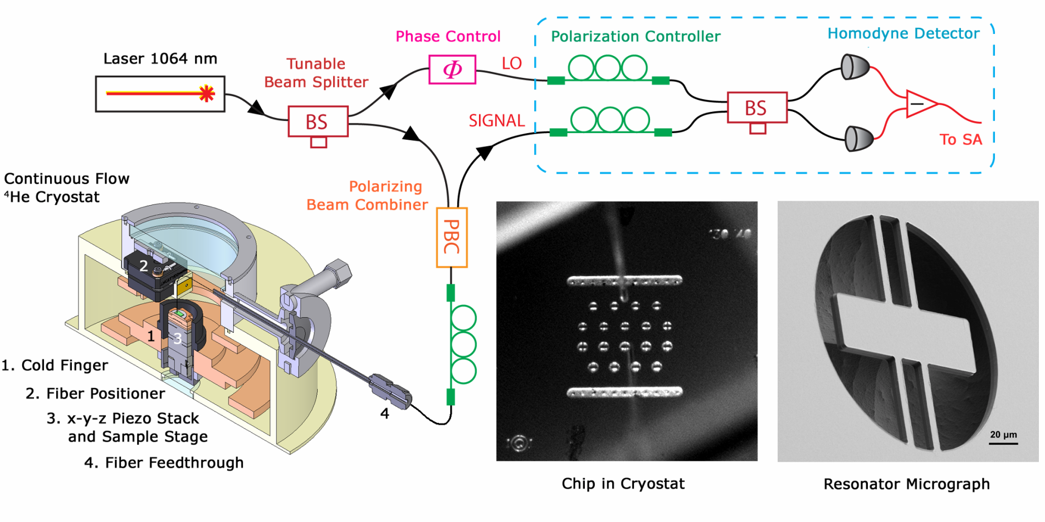
Cryogenic Fiber Interferometer
All-fiber setup, continuous flow ⁴He cryostat for sample chamber
Operation from 300 K to 20 K, minimum pressure of 2.5×10⁻⁷ millibar
Homodyne detection yields sensitivity of 6×10⁻¹² m/√Hz (near 2 MHz)

Slide 47

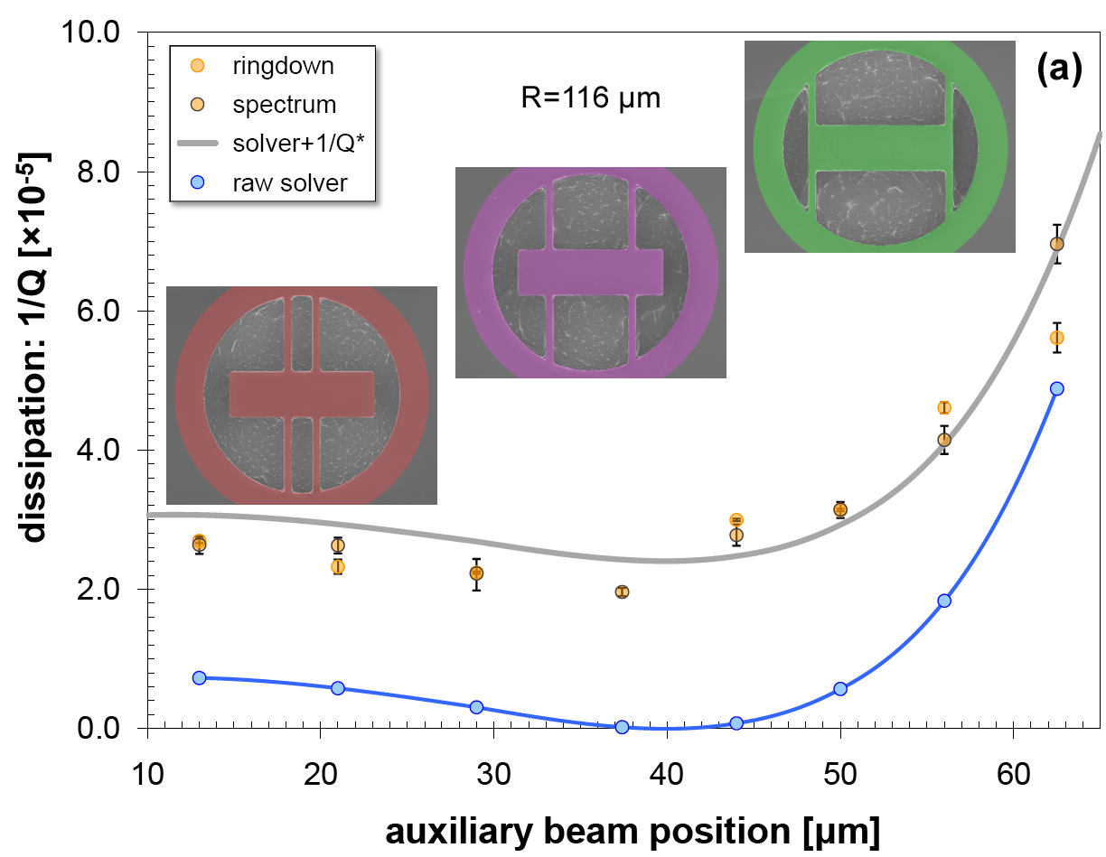
Compiled Results: R = 116 μm
Inset images: micrographs of resonators with CAD overlay
Simultaneously fitting all devices
  both radii (x 2)
  two chips
Free parameter
  1/Q* (offset) for background dissipation
G. D. Cole and I. Wilson-Rae, et al., Nature Communications 2, 231 (2011)

Slide 48
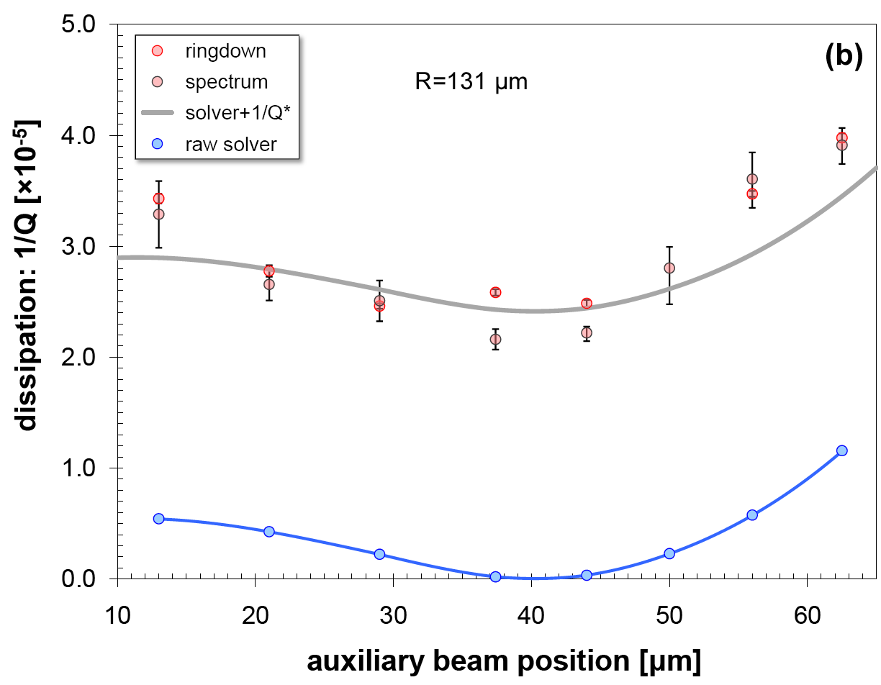
Compiled Results: R = 131 μm
1/Q* offset of 2.41×10⁻⁵ for optimal fitting
  material related damping mech.
Substrate props:
  grade 2 Ti
  E: 116 GPa
  ρ: 4540 kg/m³
Excellent match
  single free parameter

Slide 49
Mechanical Loss Mechanisms
Four key factors contribute to total dissipation
First two mechanisms are well understood:
Fluidic: results from air flow around moving structure or squeeze-film effects from trapped gases
  - simply alleviated by operating in vacuo
Thermoelastic: strain driven thermal gradient dissipated via irreversible heat conduction
- reduced via thermal design or cryogenic operation
1: Langlois (1962), Griffin (1966), Blech (1983) | 2: Zener (1937), Lifshitz (2000), Duwel (2005)

Slide 50
Mechanical Loss Mechanisms
Four key factors contribute to total dissipation
Remaining mechanisms require further investigation:
Materials: intrinsic to the specific microstrucutre, e.g. two-level fluctuators in amorphous materials (SiO₂)
- solutions: known low loss materials or strain
Anchor: acoustic transmission from the resonator into the supporting medium (i.e. phonon tunneling)
  - ideal limiting Q for any non-levitating system
(3) Mihailovich & MacDonald (1995), Yasumura (2000) | (4) Wilson-Rae (2008)

Slide 51
Modal Analysis (Measured and FEM)

Slide 52
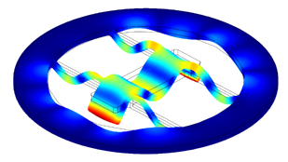
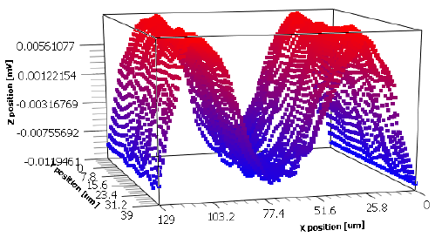
Mode Tomography System
Updates:
1) focused probe beam
2) encoded stage
Eigenmodes are selectively excited with a narrow driving frequency
Fiber focuser (10 μm Ø) allows for pointwise probing of displacement
Encoded attocubes yield position data for modal analysis

Slide 53
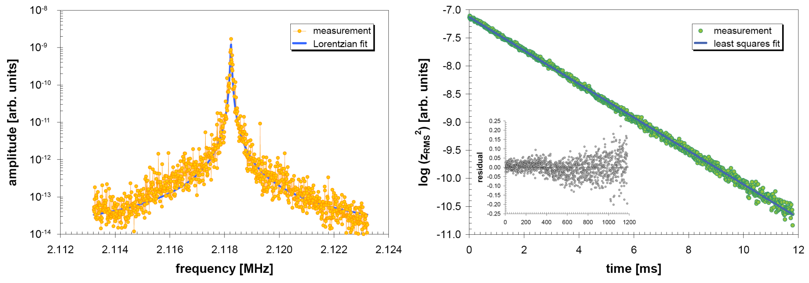
Dissipation Characterization
Resonance
Ringdown
Two methods for Q determination: white noise and resonant driving
  white noise excites all modes simultaneously, Lorentzian fitting for Q
  coherent drive and cessation for free-ringdown response, exponential fit
G. D. Cole and I. Wilson-Rae, et al., Nature Communications 2, 231 (2011)

Slide 54
Phonon Tunneling Concept
Mechanical Resonator
(Phononic Cavity)
Optical Resonator
(Photonic Cavity)
Goal: calculate scattering modes of mechanical resonator
Analogy: resonator as a mechanical Fabry-Perot interferometer
  transmission and reflection of phonons at 3D-1D junction
Resonator → phononic waveguide: 4 branches lacking infrared cutoff
  compression (c), torsion (t), vertical (v), and horizontal (h) bending
Phononic modes of resonator/substrate calculated via elasticity theory
  inverse aspect ratio (d/L) yields natural small parameter
I. Wilson-Rae, Phys. Rev. B 77, 245418 (2008)

Slide 55

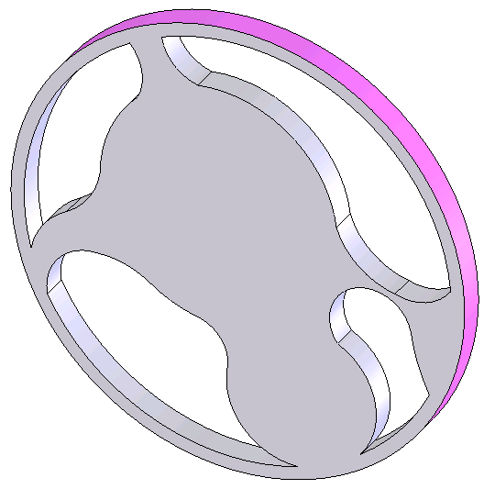
Phonon Tunneling Q-Solver
Coupling of the free modes of the substrate and suspended resonator
    applying Fermi's Golden Rule to phonon decay with the interaction Hamiltonian between the resonator volume and supports
  Calculation enabled by a standard eigenfrequency analysis via FEM
    resonator mode and stress distribution via COMSOL
    cylindrical modes assumed for support; substrate modelled as elastic half-space
contact
area S
generic
resonator
I. Wilson-Rae, Phys. Rev. B 77, 245418 (2008)

Slide 56
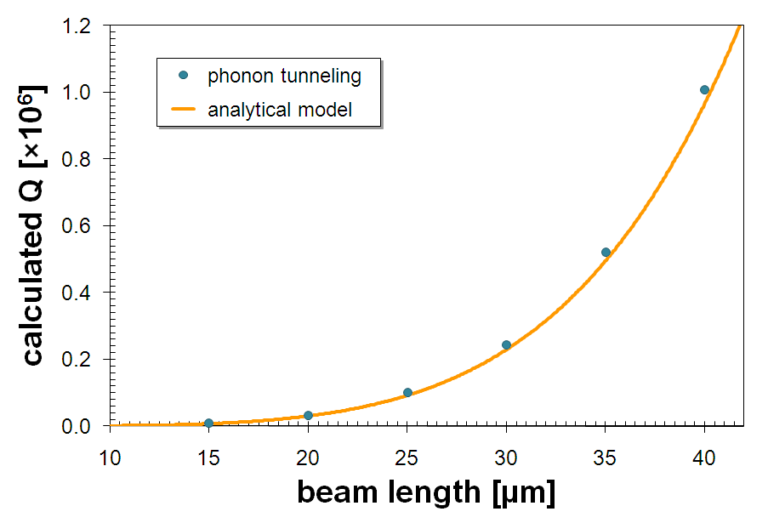
Initial Verification of Numerical Solver
Simple beam geometries tested to ascertain errors in numerical simulation
  plot: results for 1x1 µm² bridges with aspect ratios from 15:1 to 40:1
Compares well with analytical expressions developed previously
  FEM-derived Q values scale as length⁵ for doubly-clamped beams
  we record a maximum error of 20% for this initial test (failure of the weak coupling approx.)
D. M. Photiadis, et al., Appl. Phys. Lett. (2004) | I. Wilson-Rae, Phys. Rev. B (2008)

Slide 57
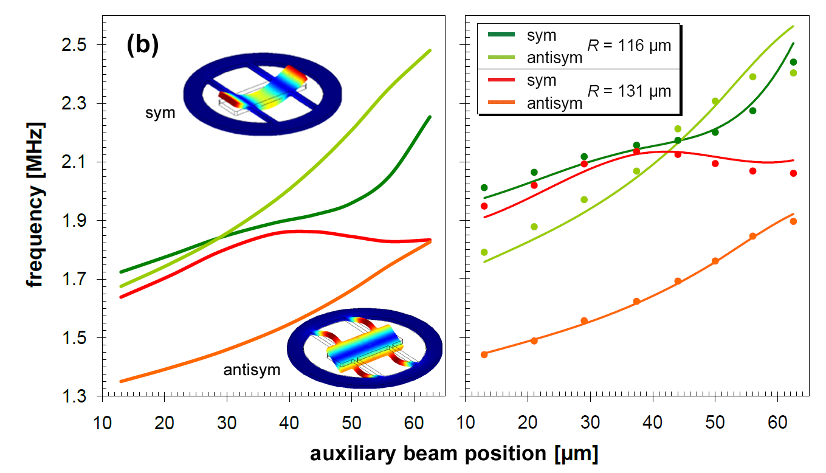
Mode Identification
FEM accurately captures geometric dependence of the resonances

Slide 58
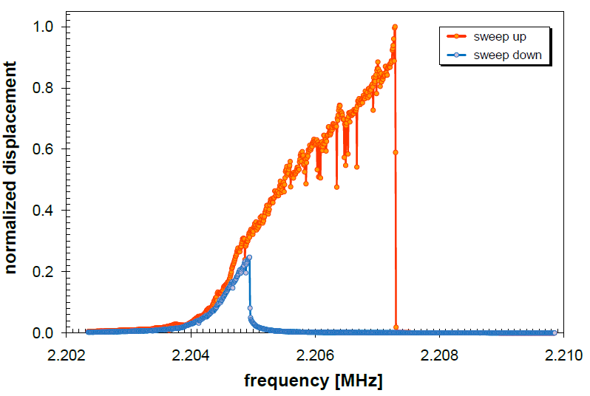

Mode Identification
Antisymmetric mode displays hardening-spring Duffing response

Slide 59
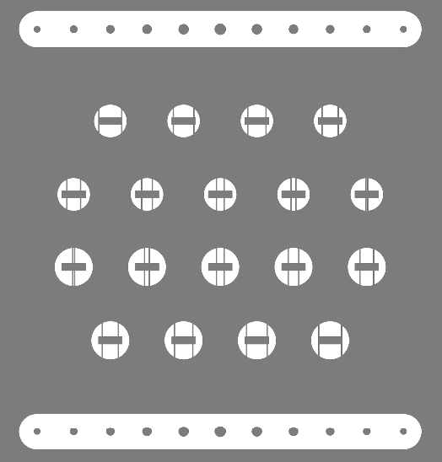
Experimental Parameters
Fixed central resonator dimensions: 130 x 40 μm
Varying auxiliary beam attachment points (8)
  13, 21, 29, 37.4, 44, 50, 56, and 62.5 μm
  aux. beams sample resonator mode shape
Two distinct outer radii of 90 and 105 μm
    investigate Q-variation in aux. beam length
Undercut process monitoring structures

Slide 60
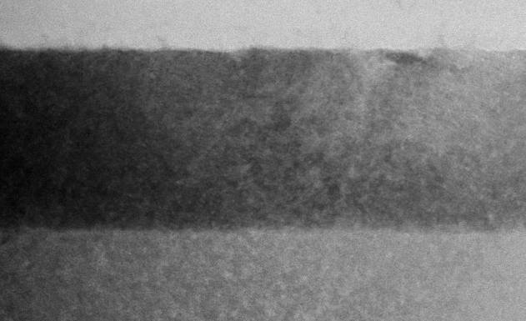


Heteroepitaxial Monocrystalline DBR
AlAs
GaAs
Ge substrate
GaAs
AlAs
GaAs
Ge substrate
40-period GaAs/AlAs crystalline multilayer grown on a Ge substrate
  Ge sacrificial material allows for increased flexibility in processing
Surface roughness due to lattice mismatch limits reflectance (99.87%)

Slide 61

Crystal Growth Details
Thomas Swan/AIXTRON low- pressure MOCVD reactor with a close-coupled showerhead configuration
2” diameter, 375-um thick, epi- ready (100) Ge substrates, offcut 6° toward the [011] direction
Offcut substrate necessary to inhibit the formation of anti- phase boundaries (APBs)
N₂ is used as the carrier gas and chamber pressure is maintained at 100 Torr during crystal growth
S. M. Ting and E. A. Fitzgerald, “Metal-organic chemical vapor deposition of single domain GaAs on Ge/Ge_{x}Si_{1-x}/Si and Ge substrates,” Journal of Applied Physics vol. 85, 2618, 2000.

Slide 62


AlGaAs on Ge Crystal Quality
DBR exhibits significant roughness (>30 Å measured via AFM)
  interfacial misfit dislocations, residual anti-phase boundaries (APBs)
Ge and GaAs lattice mismatch is small but significant (~ 0.3%)
  calculated critical thickness of GaAs on Ge is approximately 1 µm
  In and P incorporation can be used to achieve lattice matching to Ge

Slide 63

Microfabricated Optomechanics Gen I
Laser Ablation
Dry Etching
with Dieter Bäuerle (Linz) and Keith Schwab (Cornell)
with Keith Schwab (Cornell)
in collaboration with Keith Schwab
free-standing HR coating (TiO₂/SiO₂)
dimensions: 520 x 120 x 2.4 μm³
Reflectivity > 0.998, Q ~ 10,000
free-standing HR coating (Ta₂O₅/SiO₂)
dimensions: 250 x 50 x 6 μm³
Reflectivity > 0.9999, Q ~ 2,000
H.R. Böhm, S. Gigan, G. Langer, J. Hertzberg, F. Blaser, D. Bäuerle, K. Schwab, A. Zeilinger, M. Aspelmeyer, Appl. Phys. Lett. 89, 223101 (2006)
S. Gröblacher, S. Gigan, H. Böhm, A. Zeilinger, M. Aspelmeyer, Eur. Phys. Lett. 81, 54003 (2008)

Slide 64
Microfabricated Optomechanics Gen II
fabricated at Lawrence Livermore National Lab
Single Crystal Bragg
Mirrors
Hybrid
SiN_{x} &
Ta₂O₅/
SiO₂
with G. Cole
(LLNL)
with K. Schwab and R. Lalezari
collaboration with Schwab group
and ATFilms
free-standing epitaxial AlGaAs DBR
dimensions: 100s x 50 x 5.5 µm³
Reflectivity > 0.9998, Q ~ 10⁴ (κ/ω_{m}~0.2)
dielectric mirror pad (Ta₂O₅/SiO₂) on SiN_{x}
dimensions: 100s x 50 x 6 µm³
Reflectivity > 0.9999, Q ~ 10⁴ (κ/ω_{m}~0.2)
G. D. Cole, S. Gröblacher, K. Gugler, S. Gigan, M. Aspelmeyer, Appl. Phys. Lett. 92, 261108 (2008)
S. Gröblacher, J. B. Hertzberg, M. R. Vanner, G. D. Cole, S. Gigan, K. C. Schwab, and M. Aspelmeyer, Nature Physics 7, 485 (2009)

Slide 65


Completed Free-Free Resonators
Single-mask bulk micromachining process, SiCl₄/N₂ ICP for DBR etch
Selective etching of binary GaAs over ternary Al_{0.12}Ga_{0.88}As for release

