Slide 1
Coating-reduced interferometer optics
Resonant waveguide gratings
S. Kroker, T. Käsebier, E.-B. Kley, A. Tünnermann

Slide 2
Coating-reduced interferometer optics Outline
Outline
RWGs as mirrors
Advanced grating concepts
Fabrication
Optical losses
Summary & Outlook
Notes:
RWG mirrors … advanced grating concepts?

Slide 3
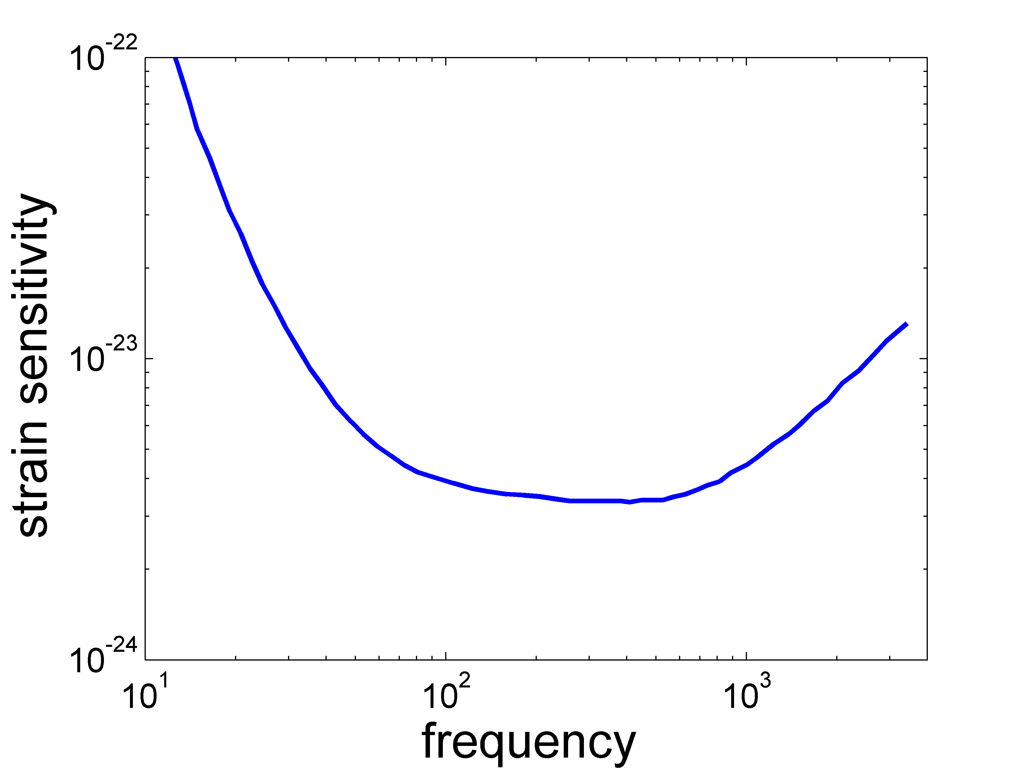
Coating-reduced interferometer optics Introduction
Introduction – coating thermal noise
seismic /
radiation pressure
strain sensitivity
shot noise
coating thermal noise
frequency
Notes:
„Brownian“ in Überschrift?

Slide 4
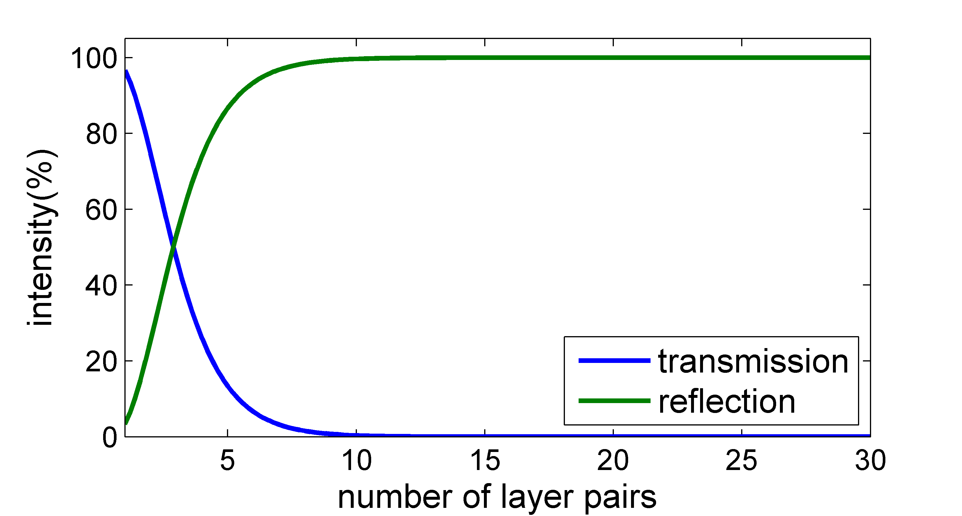
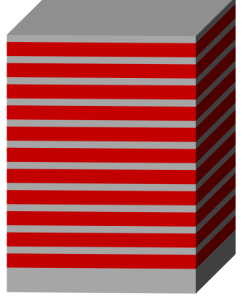
Coating-reduced interferometer optics Introduction
Introduction – reducing coating thermal noise
crystalline
conventional: dielectric amorphous multilayer stack
multiple beam interference:
SiO₂/Ta₂O₅
~3…8 µm
99.996% reflectivity
Harry et al. , CQG (2002)
reflectivity
Brownian coating thermal noise
Possibility- optimization materials: crystalline coatings (Al_{x}GaAs)
See talk by G. Cole!

Slide 5
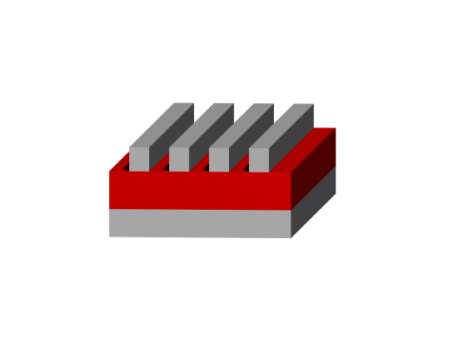
Coating-reduced interferometer optics
Introduction - RWGs
Possibility- alternative optical concepts + material optimization:
Resonant waveguide gratings (RWGs)
Origin: weakly modulated high-index grating
on low-index substrate (narrow band)
Popov et al., Opt. Comm .(1985)
Stronger modulation: larger bandwidth
<1 µm
Replace low-index substrate
Replace low-index material
no coating
high-index
low-index
Brückner et al., PRL (2010)

Slide 6
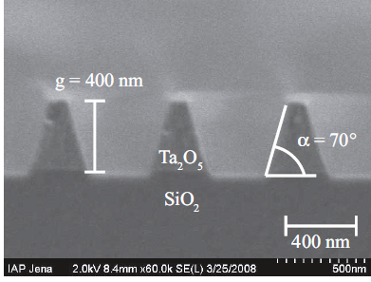
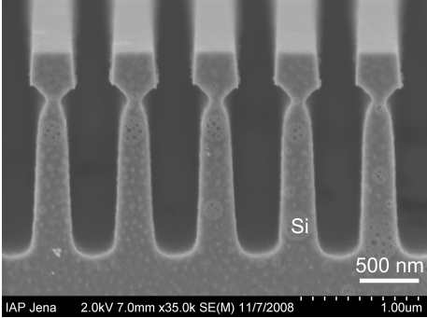
Coating-reduced interferometer optics RWG mirrors
RWGs as mirrors – so far
Tantala grating on silica for 1064 nm
Monolithic silicon gratings for 1550 nm
Brückner et al., Opt. Express (2008)
Brückner et al., PRL (2010)
$$R\left(1064 nm\right)=\left(99.08±0.05\right)\%$$
$$R\left(1550 nm\right)=\left(99.77±0.01\right)\%$$
reflectivity
measurements
in cavity
Friedrich et al., Opt. Express (2011)
Notes:
Unterschied in den setups im wesentlichen nur, dass tantala als einkoppelspiegel, daniels rauschpaper noch zitieren

Slide 7
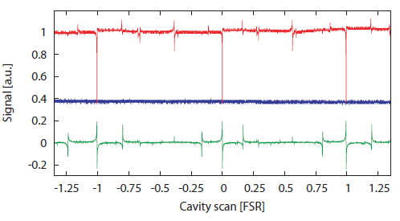
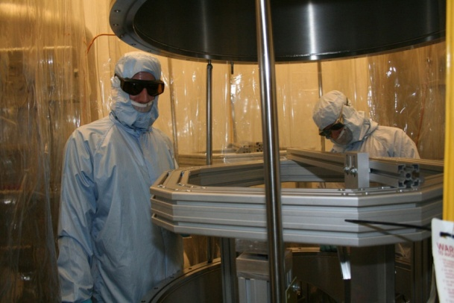
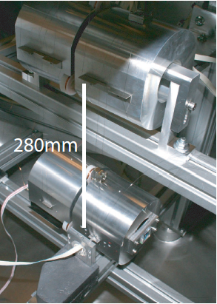
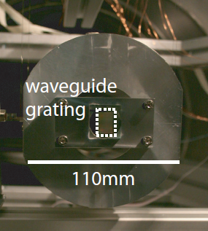
Coating-reduced interferometer optics Characterization of RWGs
Tantala RWG
Reflected light
Stabilized
PDH-error signal
Finesse= 790 (±100) → R ≥ 99.2(±0.1)%
Cavity stabilization with standard PDH-technique
D.Friedrich et al. Opt. Express 19, 14955 (2011)
Notes:
Technical feasability was shown

Slide 8
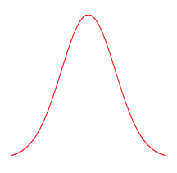
Coating-reduced interferometer optics
Functionality of RWGs
Functionality of RWGS – horizontal modes
~ 100% reflectivity
n=1
silicon as high-index material
(n_{h}=3.48 @ λ=1550 nm)
n_{h}
n_{l}
-1
1
transmission
1st diffraction orders
in grating
0th diffraction order
outside grating
λ/n_{h}<p<λ/n_{l}
p… grating period
Notes:
Raypicture oder perturbed waveguides

Slide 9
Coating-reduced interferometer optics
Functionality of RWGs
Functionality of RWGS – vertical (Bloch-) modes
periodic array of slab waveguide
incident
light
x
grating
ridge
z
fundamental
mode
1st mode
2nd mode
TM-Modes
Botten et al., Opt. Act. (1981)

Slide 10
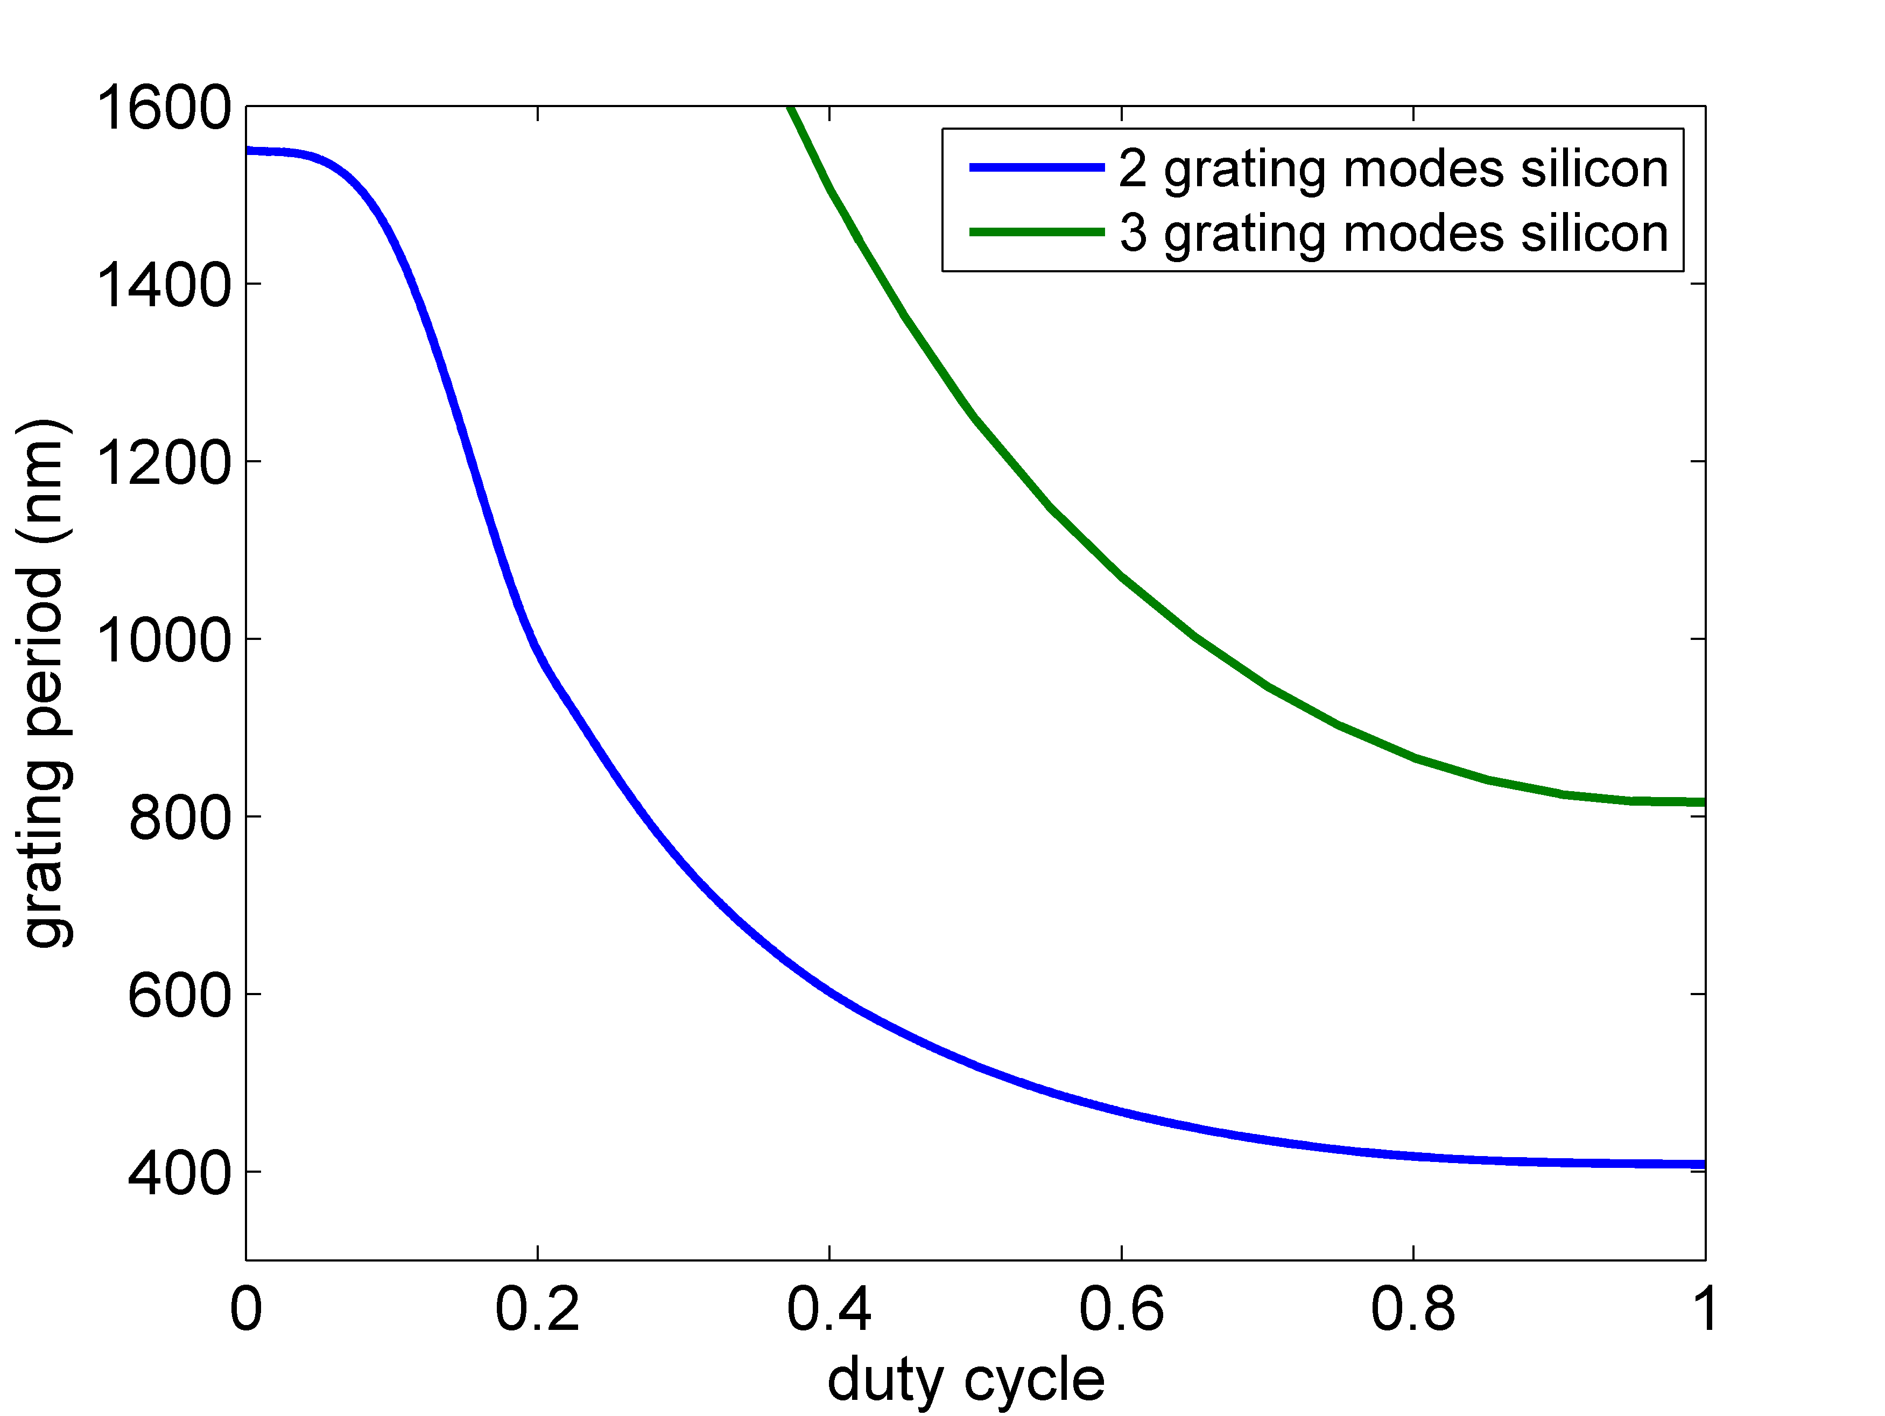
Coating-reduced interferometer optics
Functionality of RWGs
Effective index dependent on:
fill factor
period/ wavelength
polarisation
angle of incidence
TM-polarization
High efficiency:
2 propagating modes (n_{eff}²>0)
2 modes in
upper layer
x
1 mode in
lower layer
1 propagating mode

Slide 11
Coating-reduced interferometer optics
Functionality of RWGs
x
mechanism for R=100%:
phase difference due to different effective indizes (different k_{z}),
reflection/ interference at boundaries
no additional phase in lower grating
Amplitudes of grating modes need to
cancel out
z
incident
light
exact intensities and phases + physical insight
Lalanne , J. Lightwave Tech. (2006)
Karagodsky et al., Opt. Express (2009)

Slide 12
Coating-reduced interferometer optics
RWGs
… interaction of light with surface structure…
S. Vyatchanin
D. Friedrich
K. Yamamoto
D. Heinert
R. Nawrodt
S. Kroker
S. Hild
Feel free to join!
Notes:
Homogene schichtgeschichte von daniel und kazuhiro erwähnen

Slide 13
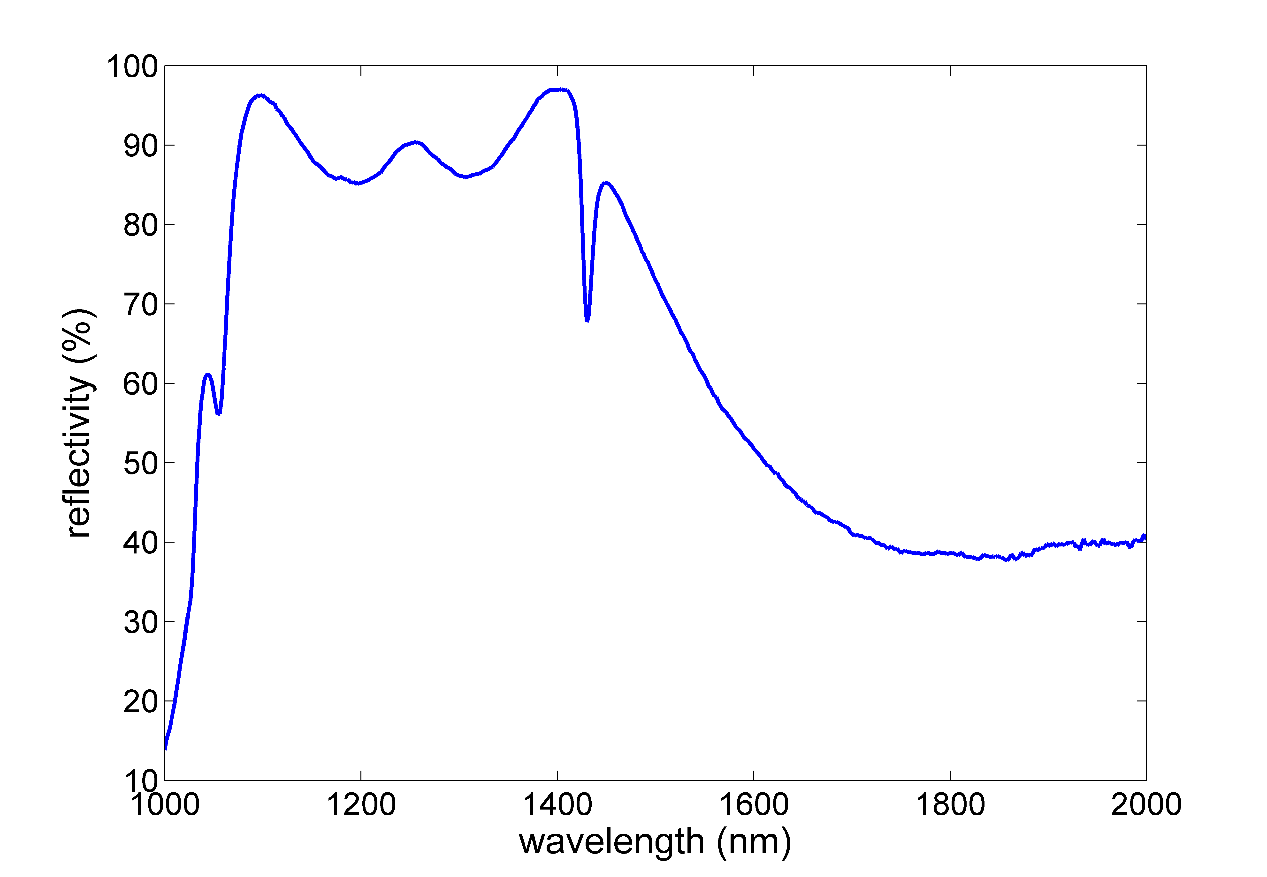
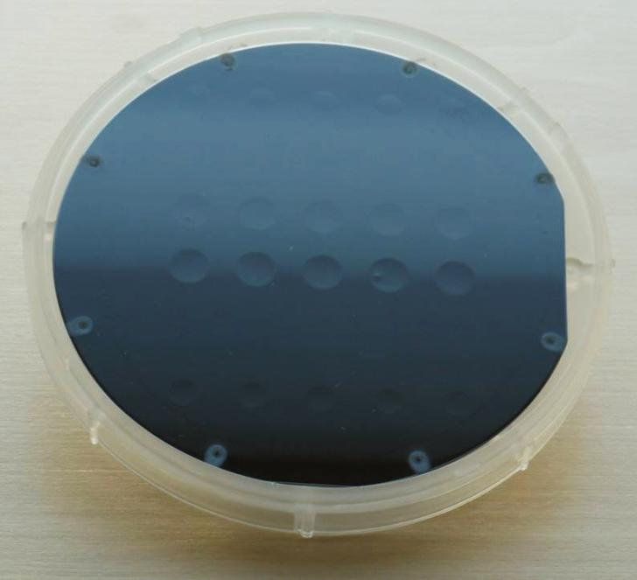
Coating-reduced interferometer optics
Advanced grating concepts -Focusing Mirrors
Mirrors on Curved Substrates
depth
platinum
240 nm
1 µm
pre-structured wafer
 | grating | LIGO
ROC (m) | 0.6 | ~2000
r_{Mirror} (m) | 0.0035 | 0.17
depth (µm) | ~10 | ~7
maximum reflectivity : 97% ( λ=1396 nm, θ=5°)
resonance to larger wavelength with larger period/thickness...
Notes:
ET: ~8 µm

Slide 14
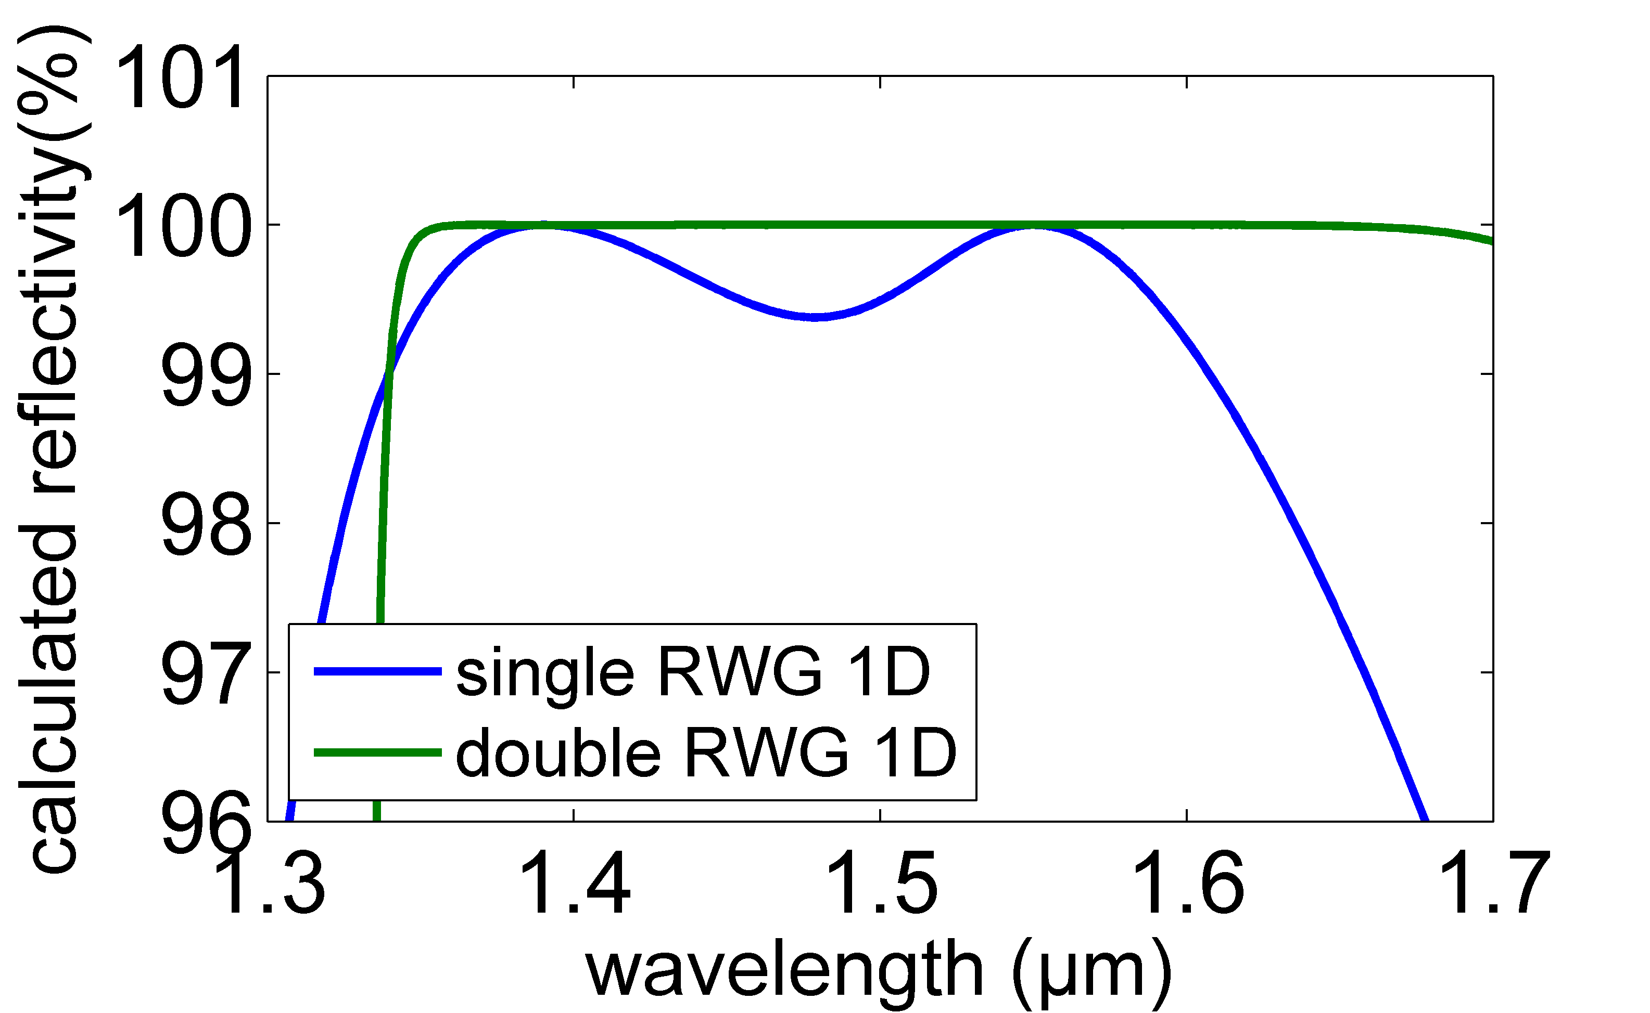
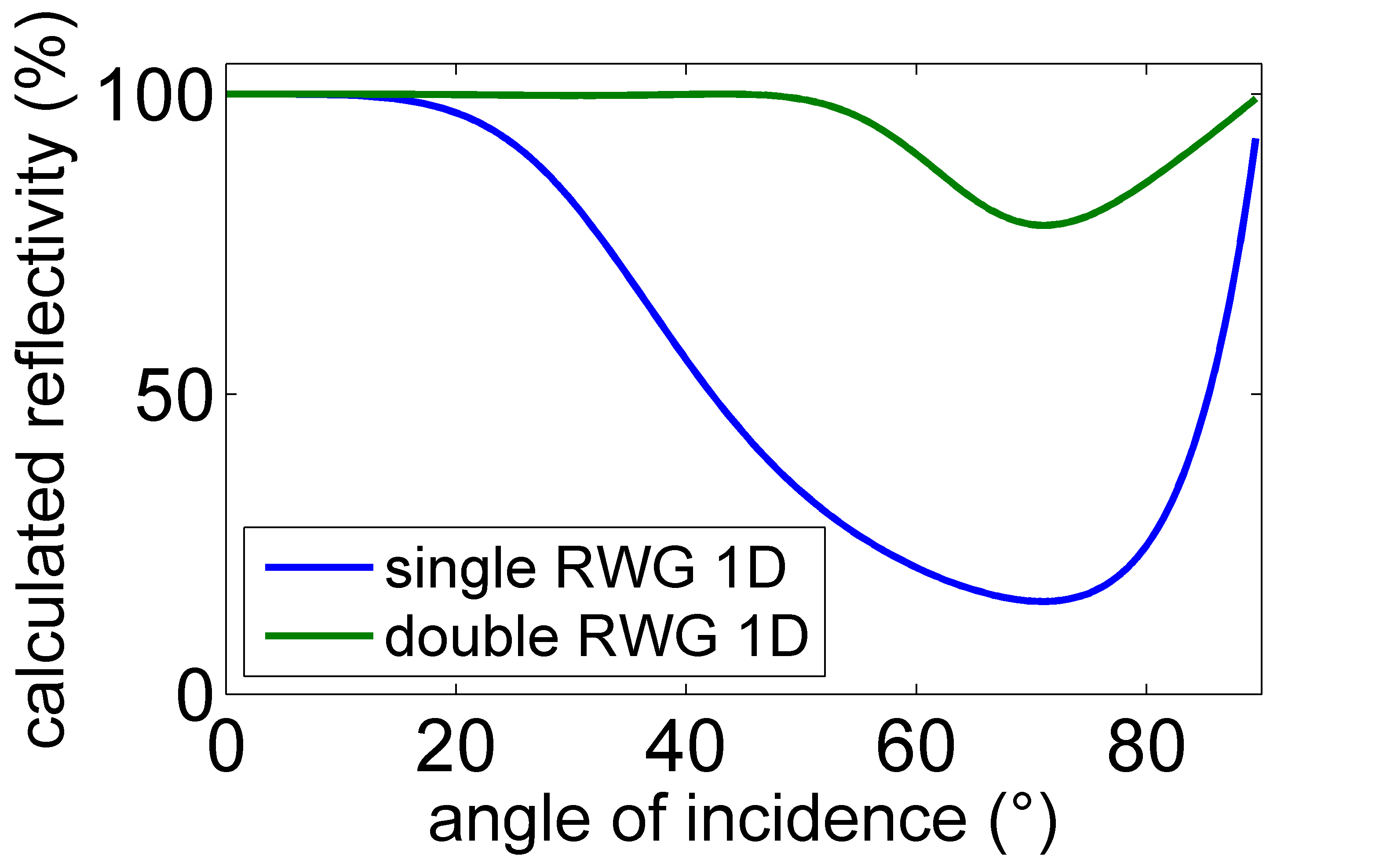
Coating-reduced interferometer optics
Advanced grating concepts – stacked RWGS
1. stacked RWGs
grating 1
entire
system?
grating 2
Thickness determines wavelength/ angle of max. reflection
enhance angular/ spectral bandwidths
enhance experimentally feasible reflectivity
Notes:
Brauch noch ein Spektrum

Slide 15
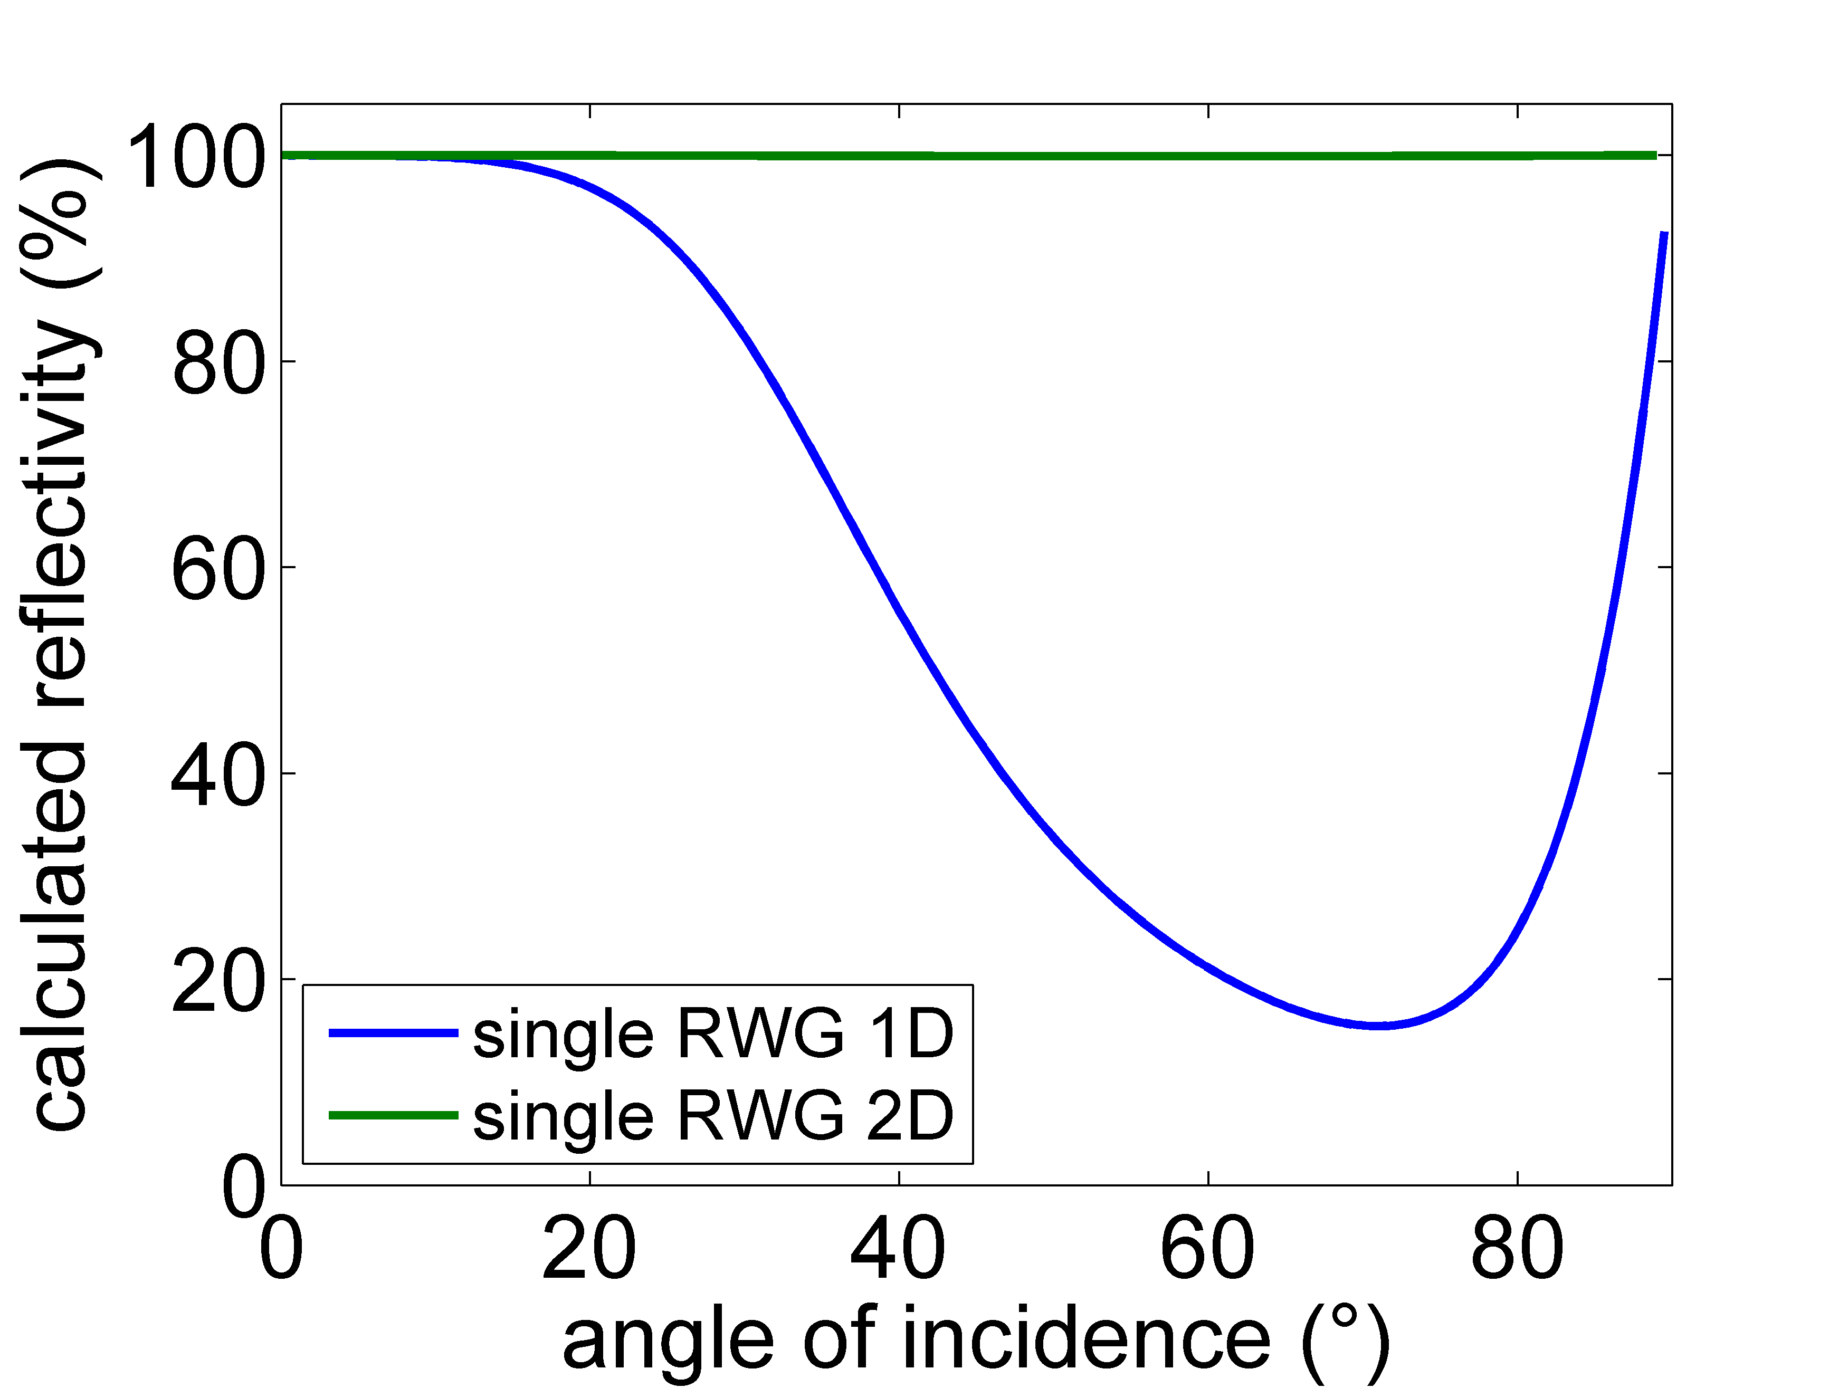
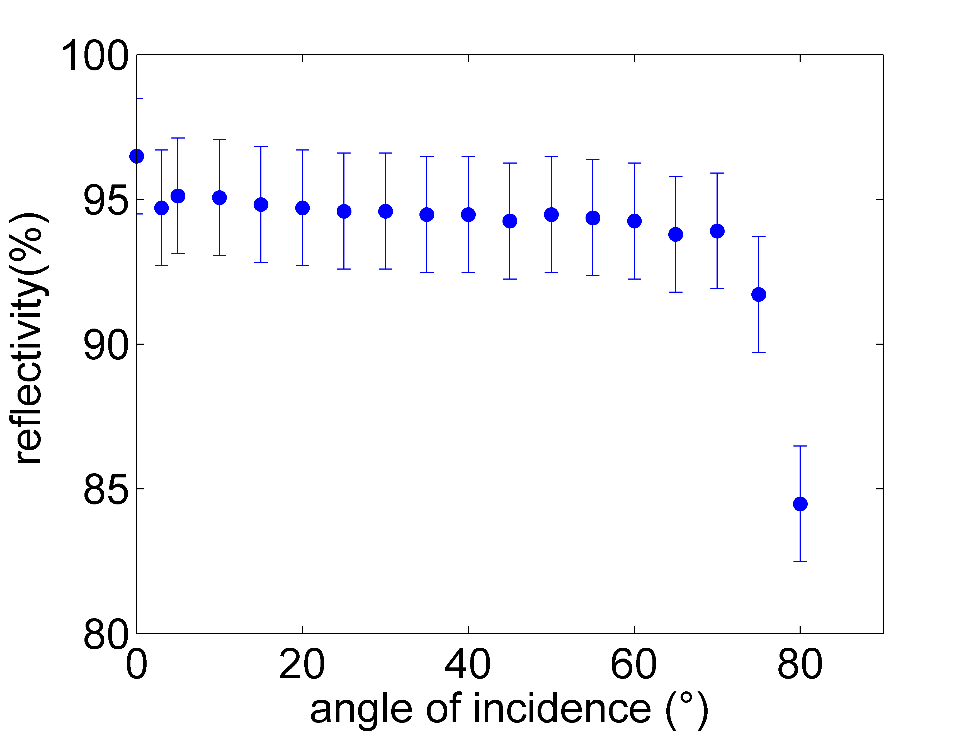
Coating-reduced interferometer optics
Advanced Grating Concepts - 2D RWGs
2. RWGs with 2D periodicity
1 µm
2d a-Si grating
basis for flat focusing mirrors

Slide 16
Coating-reduced interferometer optics
Diffractive elements
Combination von highly efficient mirrors with diffraction grating
Highly efficient mirror
Diffraction grating
p_{mirror}<λ
p_{diff}=λ... 2λ
only 0th order
0th, ±1st orders
transversal
modulation:
Grating depth
lateral
Modulation:
Ridge width/
-position
high Finesse
→only weak perturbation
High angular tolerance of reflector necessary

Slide 17
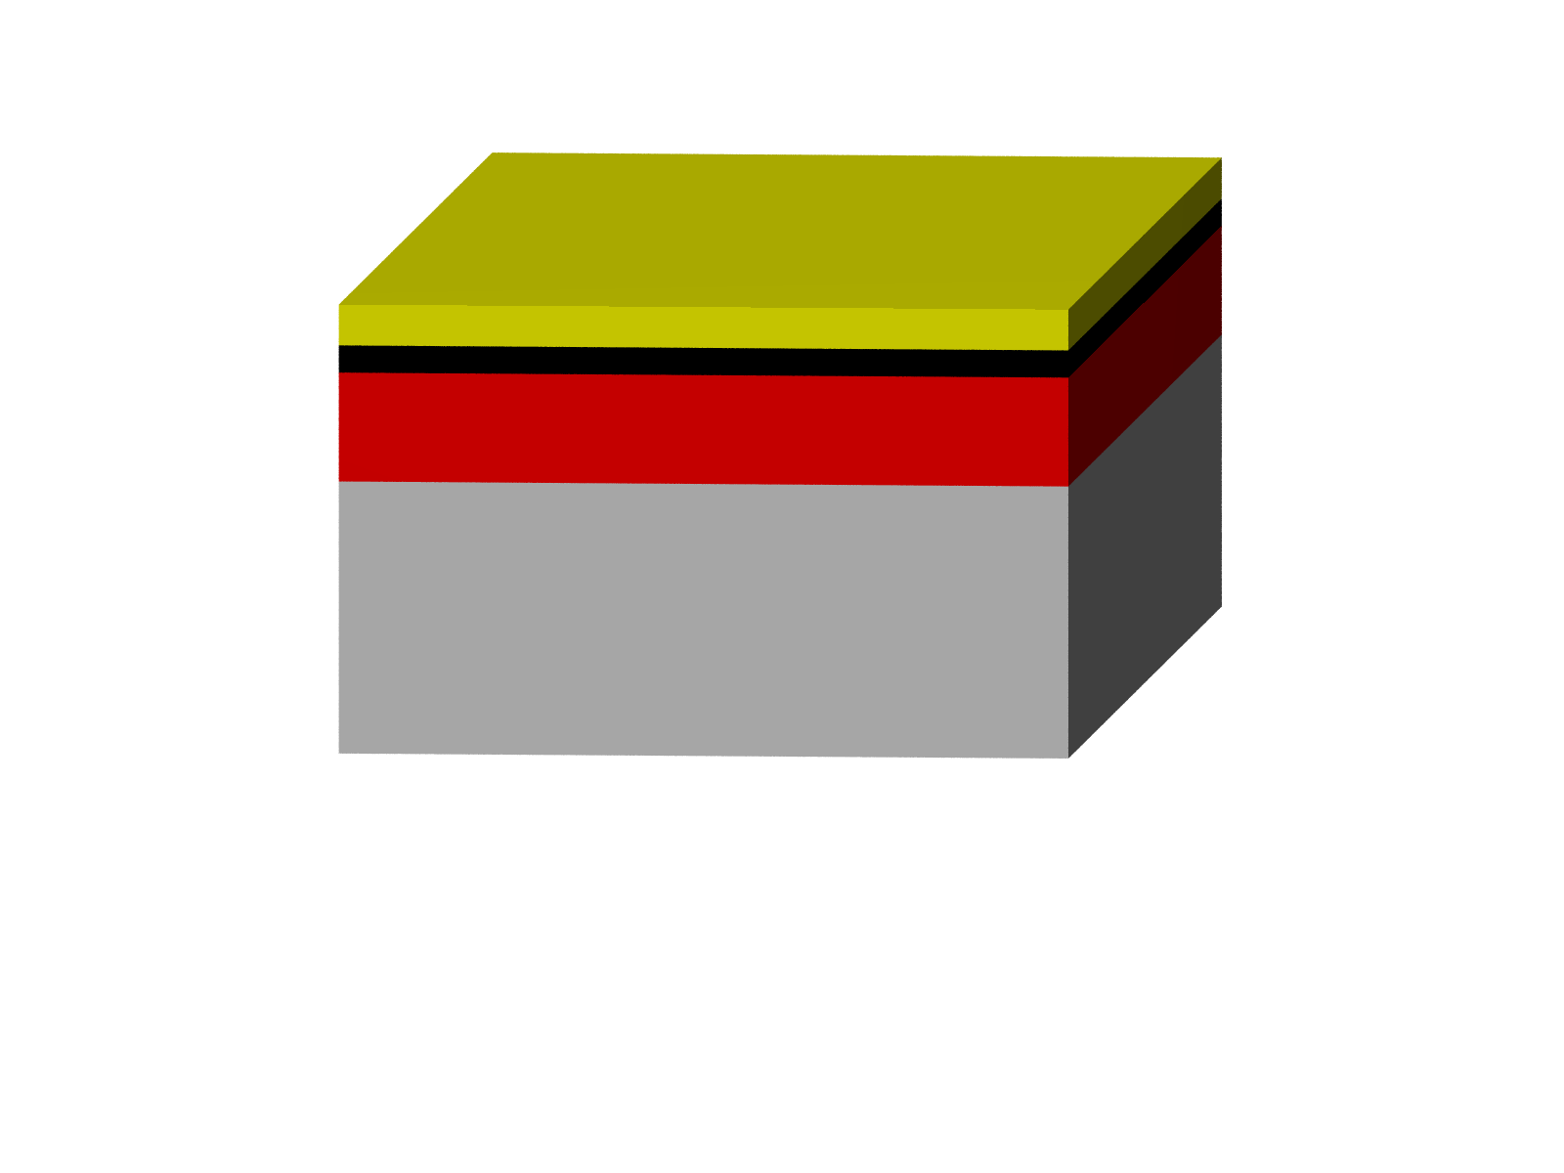
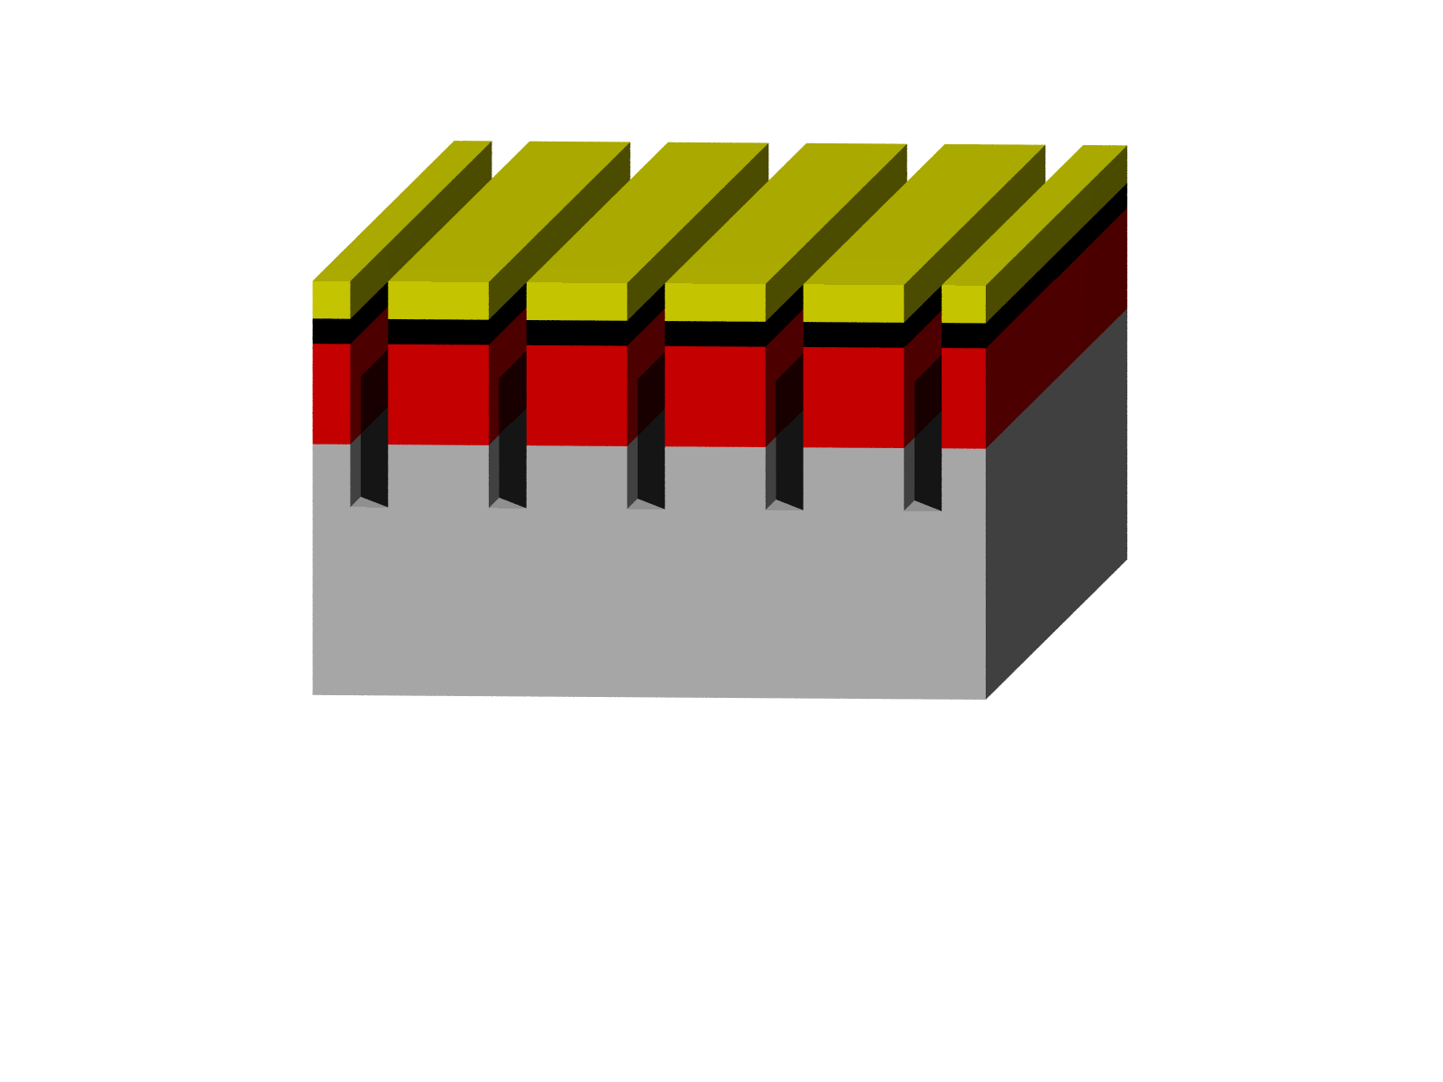
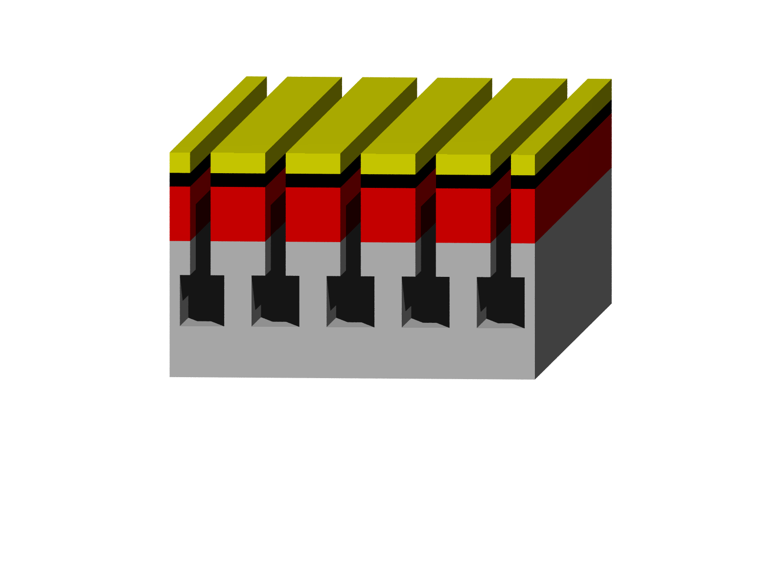
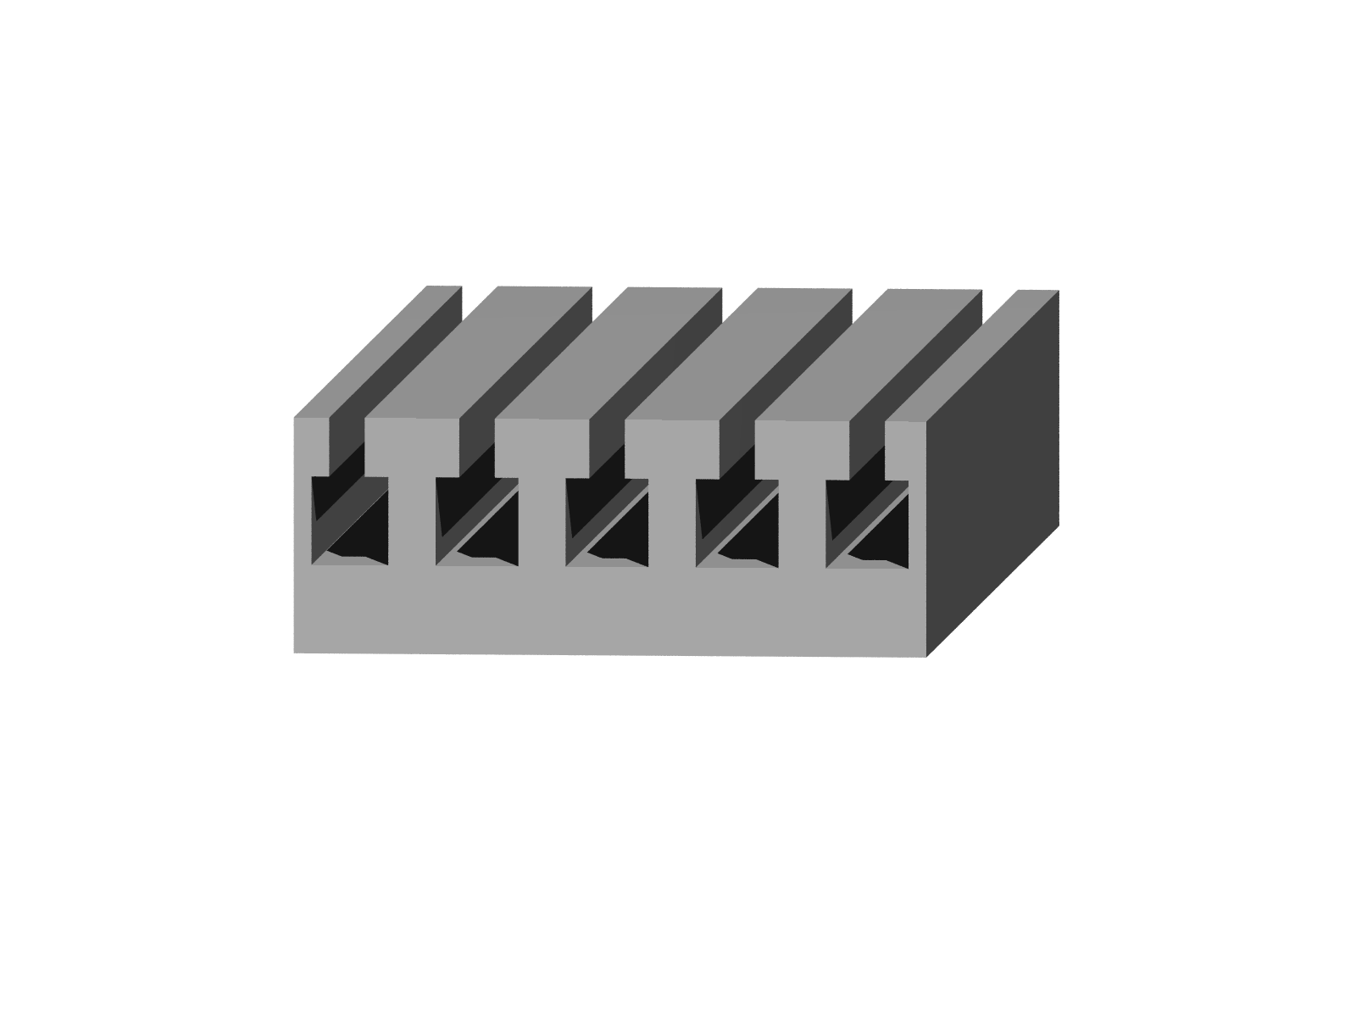
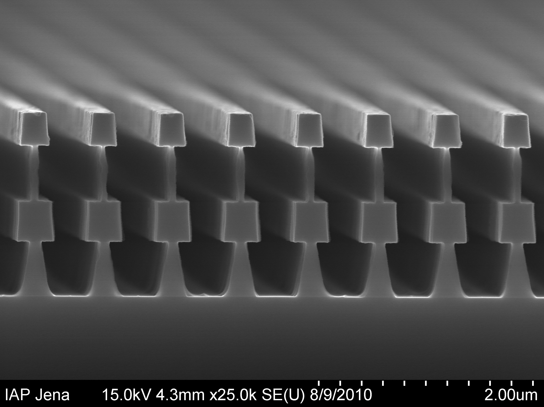
Coating-reduced interferometer optics
Fabrication
Fabrication
anisotropic etching
process+
sidewall
passivation
isotropic
etching process
electronbeam-
lithography +
development
More complex
structures?
5 µm
2 µm
electron-
beamresist
silicon
SiO₂
chromium

Slide 18
Coating-reduced interferometer optics
Optical losses
Where is the missing light?
R=(99.8±0.01)%
scattered
light
absorption
transmission
material properties
structure
deviations
See talk by J. Komma!
systematic
(ridgewidth/-depth)
stochastic
(line edge roughness)
2 µm
Notes:
Strukturen… Kantenrauhheit… Resist.. lack

Slide 19
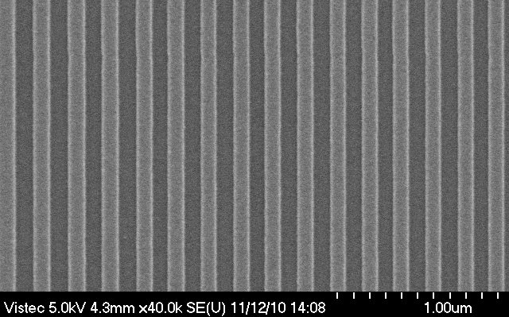
Coating-reduced interferometer optics
Optical losses
Line edge roughness due to particle statistics in the lithographic process
electron impacts
low sensitivity
(8000 e⁻/100 nm²)
HSQ (1300 µC/cm²)
100 nm ridges and grooves
10nm
FEP 171 (9.5 µC/cm²)
high sensitivity
(60 e⁻/100 nm²)
10nm
M. Heusingen, diploma thesis (2011)
Notes:
Problem existiert – geringe Empfindlichkeit hohe Empfindlichkeiten, sehr aufw. Rigor. Rechnungen, einfluss auf Streulicht nachgewiesen -> neue Lösungen her – Bezug zu den anderen 2 Gebieten –

Slide 20
Coating-reduced interferometer optics
Optical losses
Grating accuracy
wave-front measurement (1 µm period grating + technology, Littrow-Mount, λ=633 nm)
19 mm
+ 6.3 nm
50mm
- 6.6 nm
 | wavefront | placement
PV | 12.8 nm | < 10.3 nm
rms | 1.4 nm | < 1.1 nm
period variation (pm)
position [mm]
significantly better than interferometric gratings
period variation < 5 pm
Notes:
Experiment set up…. To measure scattered light @ 1550 nm

Slide 21
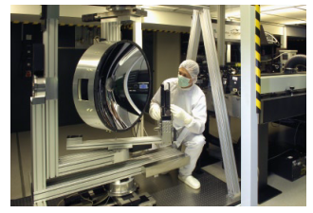
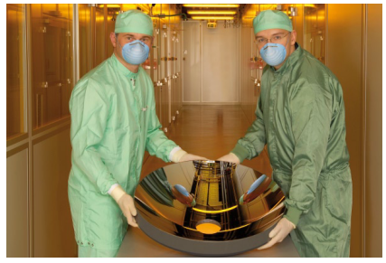
Coating-reduced interferometer optics
Optical losses
Sophisticated device for measurement of scattered light ALBATROSS
at Fraunhofer Institute IOF
Measurements of scattered light at 1550 nm set up right now!

Slide 22
Coating-reduced interferometer optics
Summary
Summary
RWGs capable of providing high reflectivity
Experiments for higher R running
Origin of optical losses to be identified
Thermal noise to be investigated

