Slide 1
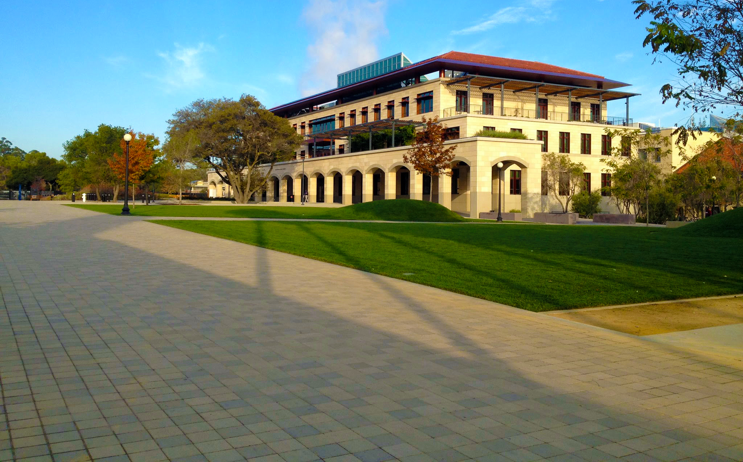


Investigating coating material properties for future generations of gravitational wave detectors
Center for Nanoscale Science and Engineering
R. Bassiri^{1,2}, K. B. Borisenko³, R. L. Byer¹, K. Evans², M. M. Fejer¹, J. Hough², N. Kim¹, B. Lantz¹, A. Lin¹, A. Markosyan¹, I. W. Martin², R. K. Route¹, S. Rowan², J. F. Stebbins¹
1. LIGO Group, Stanford University,
2. SUPA, School of Physics and Astronomy, University of Glasgow,
3. Department of Materials, University of Oxford
GWADW 2012 - Waikoloa, Hawaii
rbassiri@stanford.edu

Slide 2
Overview
Introduction
Optical absorption measurements
  Photothermal Common-path Interferometry (PCI) measurements
  Preliminary temperature dependent results amorphous silicon coatings
Atomic structure investigations
  Atomic structure investigations using Transmission Electron Microscopy (TEM)
  Nuclear Magnetic Resonance (NMR) measurements
Single crystalline coatings
  GaP/AlGaP Molecular Beam Epitaxial (MBE) coatings
Summary of key experimental techniques
Conclusions
GWADW 2012
2

Slide 3

Introduction
Research into the materials used in the detector optics is vitally important to improve the sensitivity of future detectors
  Advanced LIGO is pushing the limits for current coating materials
  In order to improve upon this, new materials and technologies will need to be developed
In order to investigate the coating material properties several experimental techniques have been developed
Aim is to relate loss sources to changes in the atomic structure for amorphous coatings
Investigate possible alternative to amorphous coatings such as single crystal GaP/ AlGaP coatings
LIGO Livingston
GWINC Advanced LIGO noise budget
GWADW 2012
3

Slide 4
Overview
Introduction
Optical absorption measurements
  Photothermal Common-path Interferometry (PCI) measurements
  Preliminary temperature dependent results amorphous silicon coatings
Atomic structure investigations
  Atomic structure investigations using Transmission Electron Microscopy (TEM)
  Nuclear Magnetic Resonance (NMR) measurements
Single crystalline coatings
  GaP/AlGaP Molecular Beam Epitaxial (MBE) coatings
Summary of key experimental techniques
Conclusions
GWADW 2012
4

Slide 5
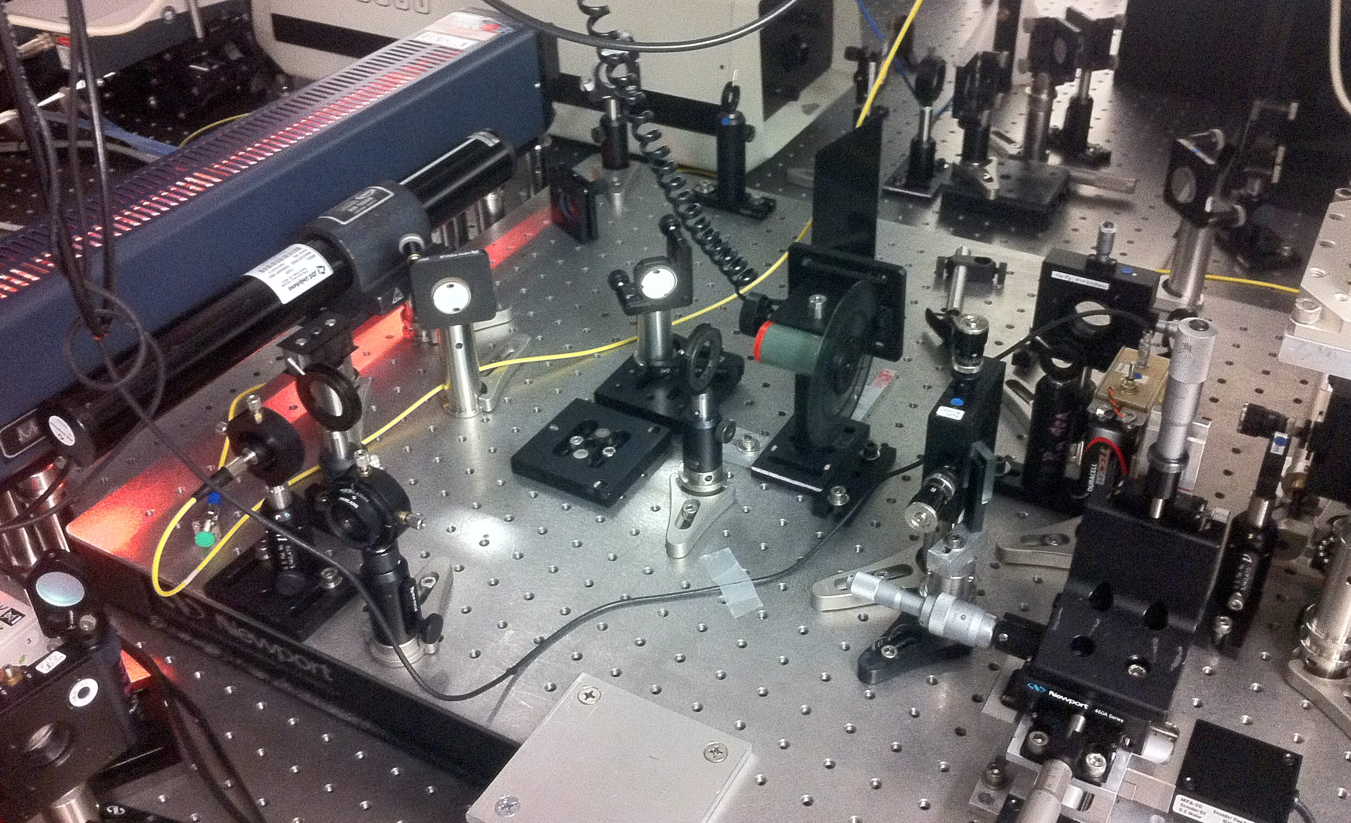
Optical absorption measurements
PCI optical absorption measurements:
Photo-thermal Common-path Interferometry (PCI)
  Allows measurement of bulk and coating optical absorptions
  Capability for T-dependent measurements from 15 K from recent addition of cryostat
  Measures thermal lensing of the pump beam caused by optical absorption
  Maximum sensitivity at 9 W pump beam for coatings is 0.05 ppm and bulk is 0.2 ppm/cm
photodetector
pump laser
photo-detector
sample
chopper
probe laser
chopper controller
Photo of PCI setup at Stanford University
Schematic of PCI setup
lock-in amplifier
PC
Ashot Markosyan - ashotm@stanford.edu
GWADW 2012
5
Notes:
Pump beam width 70 um, probe beam has 20 um, phase mismatch of pump beam – due to thermal lensing effect – these areas interfere with each other, imaging system is optimised to be sensitive to the region where the interference is maximised.
Sensitivity of coatings, with 9W of pump, can be 0.02 ppm

Slide 6
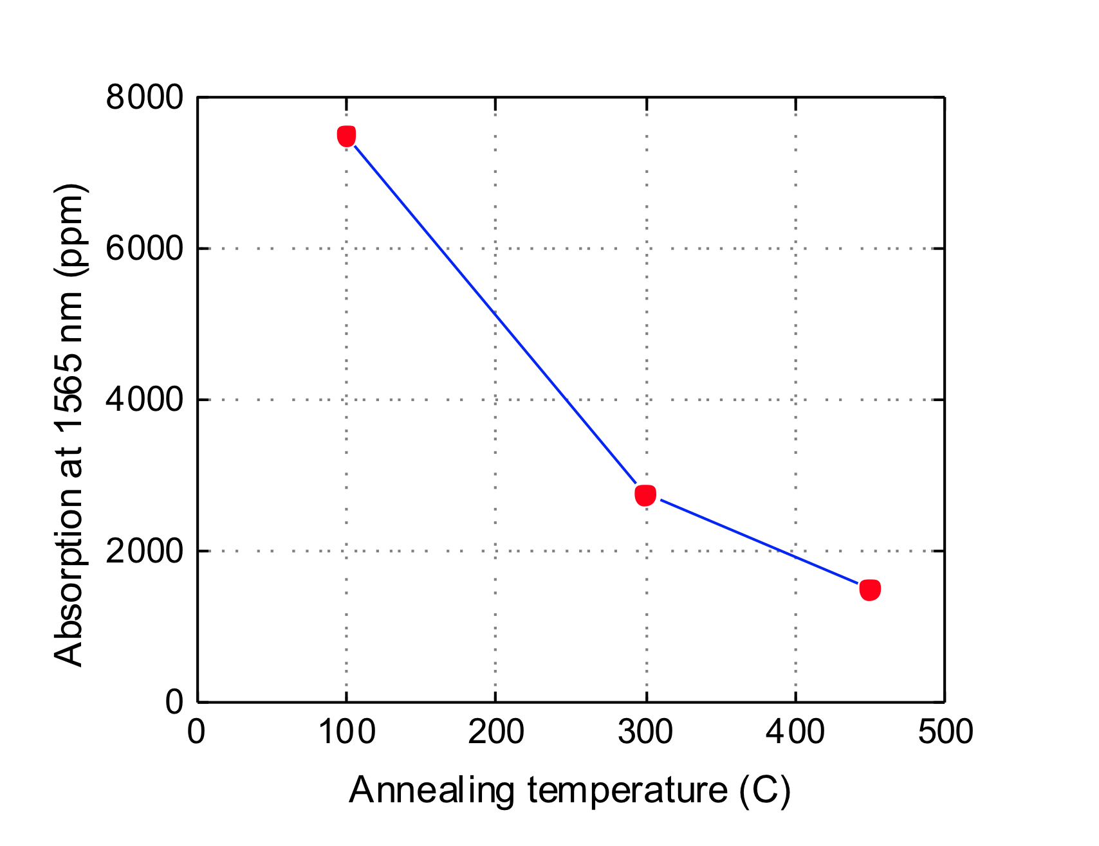
Optical absorption measurements
Preliminary α-Si coatings room temperature measurements
Optical absorption of three amorphous (α) Si coatings
  Measurements made at 1556 nm for as-deposited, 300ºC and 450ºC annealed
  Shows ~70% drop in absorption between as-deposited and 450ºC annealed
  Similar trend to silica/ tantala coatings
  Further study is required in deposition techniques and post-deposition treatments which can reduce absorption
photodetector
pump laser
Absorption at 1556 nm (ppm)
photo-detector
sample
chopper
probe laser
chopper controller
Optical absorption of α-Si coatings vs. annealing temperature (in air at room temperature)
lock-in amplifier
PC
Ashot Markosyan - ashotm@stanford.edu
GWADW 2012
6
Notes:
Pump beam width 70 um, probe beam has 20 um, phase mismatch of pump beam – due to thermal lensing effect – these areas interfere with each other, imaging system is optimised to be sensitive to the region where the interference is maximised.
Sensitivity of coatings, with 9W of pump, can be 0.02 ppm

Slide 7
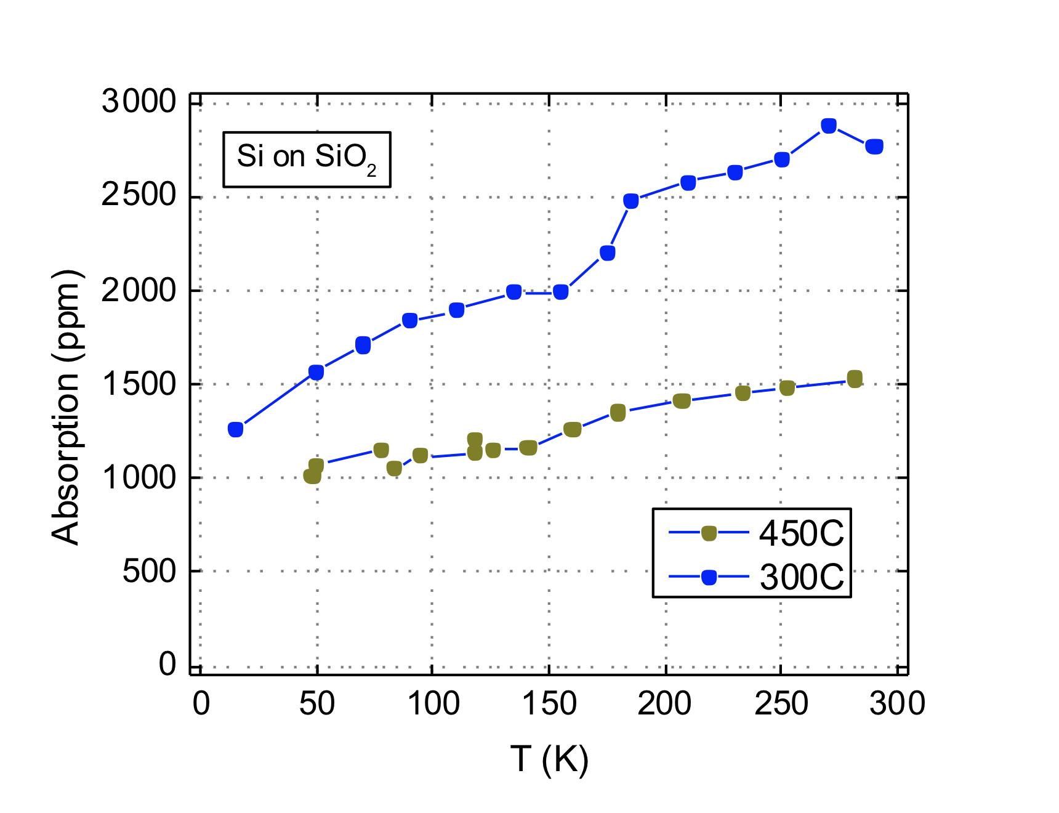
Optical absorption measurements
Preliminary α-Si coatings T-dependent measurements
Recent integration of a flow cryostat to the PCI setup has given the capability for temperature dependent absorption measurements
photodetector
pump laser
photo-detector
sample
chopper
probe laser
Absorption at 1556 nm (ppm)
chopper controller
lock-in amplifier
PC
Temperature variation of the optical absorption of two annealed amorphous Si coatings
Preliminary temperature dependent optical absorption for the 300ºC and 450ºC annealed α-Si coatings
  Results show decrease in optical absorption at 1556 nm as temperature is decreased
Ashot Markosyan - ashotm@stanford.edu
GWADW 2012
7
Notes:
Pump beam width 70 um, probe beam has 20 um, phase mismatch of pump beam – due to thermal lensing effect – these areas interfere with each other, imaging system is optimised to be sensitive to the region where the interference is maximised.
Sensitivity of coatings, with 9W of pump, can be 0.02 ppm
Respective corrections of the setup responsivity due to the temperature variation of the thermal diffusivity of fused silica substrate have been made using the recommended data by: Y.S. Touloukian “Thermophysical Properties of Matter” (New York, IFI/Plenum, 1985)
The sample in the cryostat was in vacuum and the temperature uniformity was +/- 15K at 25K and gradually decreases with increasing temperature
Respective corrections of the setup responsivity due to the temperature variation of the thermal diffusivity of fused silica substrate have been made using the recommended data by: Y.S. Touloukian “Thermophysical Properties of Matter”

Slide 8
Optical absorption measurements
Ongoing and future work
Continue to develop T-dependent measurement capabilities
Aim to measure absorption of bulk single crystal silicon
  Currently obtaining high quality float-zone silicon for measurements
  T-dependent measurements planned
photodetector
pump laser
photo-detector
sample
chopper
probe laser
chopper controller
lock-in amplifier
PC
Ashot Markosyan - ashotm@stanford.edu
GWADW 2012
8
Notes:
Pump beam width 70 um, probe beam has 20 um, phase mismatch of pump beam – due to thermal lensing effect – these areas interfere with each other, imaging system is optimised to be sensitive to the region where the interference is maximised.
Sensitivity of coatings, with 9W of pump, can be 0.02 ppm
Respective corrections of the setup responsivity due to the temperature variation of the thermal diffusivity of fused silica substrate have been made using the recommended data by: Y.S. Touloukian “Thermophysical Properties of Matter” (New York, IFI/Plenum, 1985)
The sample in the cryostat was in vacuum and the temperature uniformity was +/- 15K at 25K and gradually decreases with increasing temperature
Respective corrections of the setup responsivity due to the temperature variation of the thermal diffusivity of fused silica substrate have been made using the recommended data by: Y.S. Touloukian “Thermophysical Properties of Matter”

Slide 9
Overview
Introduction
Optical absorption measurements
  Photothermal Common-path Interferometry (PCI) measurements
  Preliminary temperature dependent results amorphous silicon coatings
Atomic structure investigations
  Atomic structure investigations using Transmission Electron Microscopy (TEM)
  Nuclear Magnetic Resonance (NMR) measurements
Single crystalline coatings
  GaP/AlGaP Molecular Beam Epitaxial (MBE) coatings
Summary of key experimental techniques
Conclusions
GWADW 2012
9

Slide 10
Atomic structure investigations
Atomic structure investigations: RDF investigations
Tecnai F20 TEM
Diagram showing electron beam interactions
Transmission Electron Microscopy (TEM)
  Ideal tool for studying the atomic structure and chemistry of the coatings
  Major tools are imaging, diffraction and spectroscopy
  Extensive capabilities at both Stanford and Glasgow
  Major tool for amorphous materials is the Reduced Density Function (RDF)
GWADW 2012
10

Slide 11
Atomic structure investigations
Atomic structure investigations: RDF investigations
RDFs provide a statistical representation of where nearest neighbor atoms sit with regards to a central atom:
TEM diffraction pattern of a typical amorphous Ta₂O₅ coating
RDF of Ta₂O₅ coating
RDF analysis:
  1st peak relates mostly to metal – oxygen bonds
  2nd peak relates mostly to metal – metal distances
  Peak positions indicate most likely place for atomic neighbors to sit
  Peak height indicate and peak width indicates level of homogeneity or ‘local order’ in structure
GWADW 2012
11

Slide 12
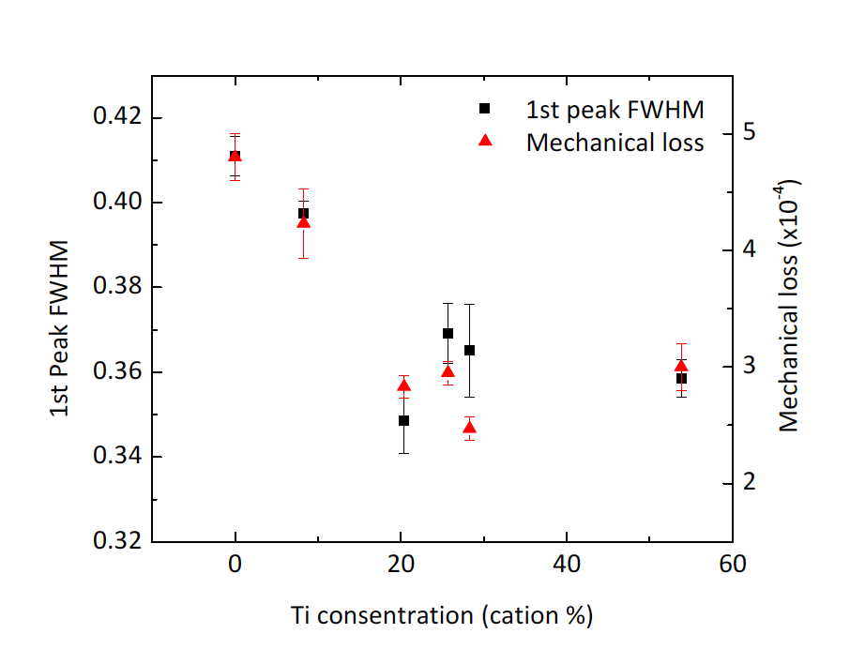
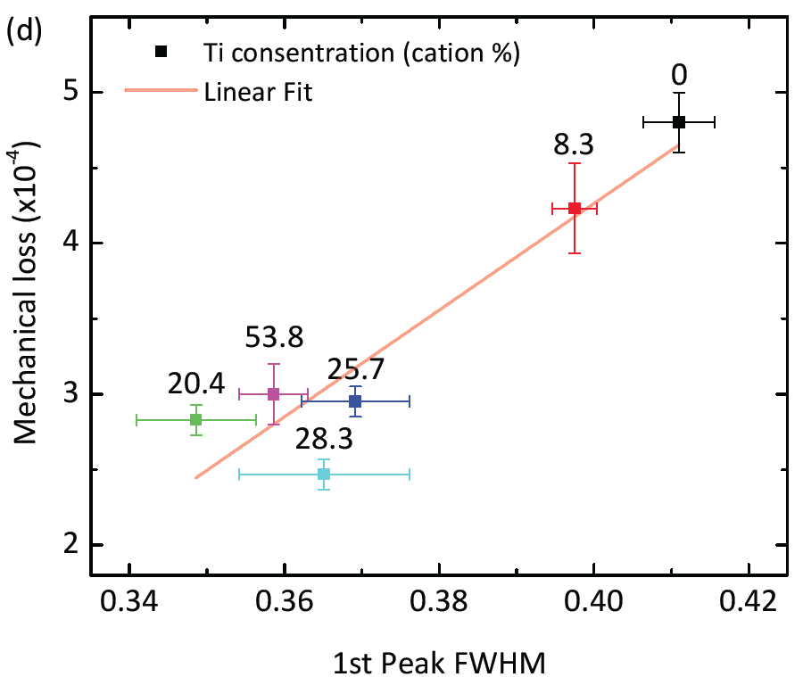
Atomic structure investigations
Atomic structure investigations: TiO2 doped Ta2O5
Relationship to mechanical loss
  Strong relationship from changing properties in the experimental RDFs
  Strong correlation between mechanical loss and changing atomic structure properties
  Pearson correlation coefficient, r = 0.93
RDFs 1st peak FWHM and mechanical loss Vs. Ti concentration
Correlation between Mechanical loss and 1st peak FWHM
GWADW 2012
12

Slide 13
Atomic structure investigations
Atomic structure investigations: TiO2 doped Ta2O5
Ta₂O₂
TaTiO₂
Crystalline building blocks
Atomic model of the 20.4% TiO₂ doped Ta₂O₅ coating, highlighting the Ta₂O₂ and TaTiO₂ crystalline building blocks
  Models are generated from experimental diffraction data using Reverse Mote Carlo (RMC) and Molecular Dynamics (MD) simulations
  Crystalline ring building blocks seen in all models
  Atomic models provide many different possibilities for understanding the material properties
  Studying these building blocks, and larger structures, may provide an insight into the mechanisms responsible for mechanical loss (as in the case for silica)
GWADW 2012
13

Slide 14
Atomic structure investigations
Atomic structure investigations: TiO2 doped Ta2O5
  Bond and distance analysis provides detailed understanding of the local structure environments
  Distance type and angle type distributions show clear differences between the 20.4% Ti and 53.8% Ti doped models
  In contrast angle type distributions show only subtle changes
  Ta-O-Ta, Ta-O-Ti shows reduced peak position by 10° as Ti doping is increased
(c)
(d)
Bond and distance distributions for TiO2 doped Ta2O5 coatings
GWADW 2012
14

Slide 15
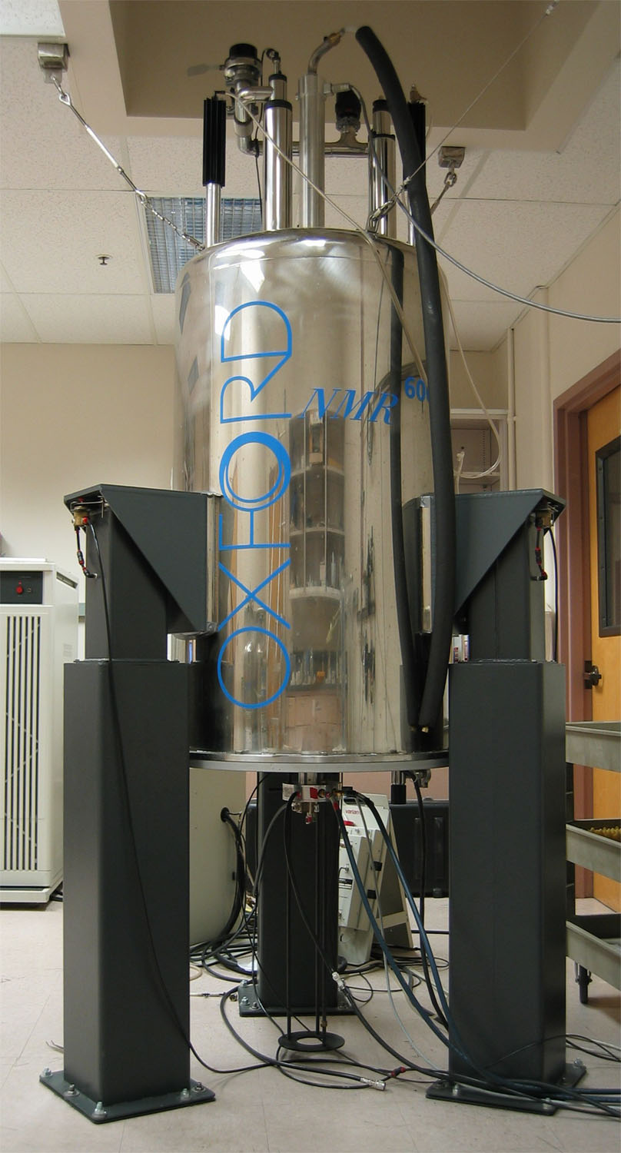
Atomic structure investigations
NMR measurements
Nuclear Magnetic Resonance (NMR) spectroscopy
  NMR uses splitting of nuclear spin energy level of specific nucleus in a magnetic field
Capable of quantifying the distributions of and connections among structural units
Sensitive to the local structure
  Nuclear specific, e.g. ¹⁷O NMR
Varian NMR with Oxford Magnet
Namjun Kim - njkim@stanford.edu
GWADW 2012
15

Slide 16
Atomic structure investigations
NMR measurements: ¹⁷O NMR of sol-gel and IBS Ta2O5
Two peaks were assigned based on the known crystalline structure
^{[3]}O:^{[2]}O ~ 3:2
The difference in relative intensities between amorphous and crystalline Ta₂O₅ suggests a difference in OTa₂/OTa₃ ratio in amorphous Ta₂O₅
Amorphous Ta₂O₅ from different preparation methods do not show any significant difference
Subtle differences can be observed (linewidths, peak positions, etc.) and is currently under investigation
* spinning sidebands
Namjun Kim - njkim@stanford.edu
GWADW 2012
16

Slide 17
Atomic structure investigations
Electron Paramagnetic Resonance (EPR) Spectroscopy measurements: heat-treated Ta2O5 coatings
EPR detects unpaired electrons in the sample
Only the unannealed amorphous tantala shows an unpaired electron
EPR signal is most likely due to oxygen deficiency in un-annealed sample, estimated ~ 0.2%
Oxygen deficiency may play an important role in improvement of optical and mechanical properties upon annealing
Namjun Kim - njkim@stanford.edu
GWADW 2012
17

Slide 18
Atomic structure investigations
Ongoing and future work
Experimental techniques which are important for accurate atomic structure investigations:
  Density (X-ray Reflectometry)
  Stoichiometry (Electron Energy Loss Spectroscopy)
  Atomic nearest neighbor distributions (RDFs)
  Other constraints (Crystal structures, NMR)
X-ray absorption spectroscopy
  Complimentary measurements to RDF studies
  Direct measurement of local structure around Ta and Ti atoms in TiO₂ doped Ta₂O₅ coatings
Further investigations are planned
  TiO₂ doped Ta₂O₅ – NMR/TEM comparison to optical absorption and mechanical loss
  Understanding changes in performance of coated silica vs. bulk silica
  Medium range atomic structure of α-Si coatings
Continuing development into linking coating loss to atomic structure measurements
GWADW 2012
18

Slide 19
Overview
Introduction
Optical absorption measurements
  Photothermal Common-path Interferometry (PCI) measurements
  Preliminary temperature dependent results amorphous silicon coatings
Atomic structure investigations
  Atomic structure investigations using Transmission Electron Microscopy (TEM)
  Nuclear Magnetic Resonance (NMR) measurements
Single crystalline coatings
  GaP/AlGaP Molecular Beam Epitaxial (MBE) coatings
Summary of key experimental techniques
Conclusions
GWADW 2012
19

Slide 20
Single crystalline coatings
GaP/ AlGaP epitaxial coatings
Effort to develop an alternative to amorphous IBS coatings
For use in cryogenic third generation detectors working at around 1550 nm
The advantages of these coatings:
  Can be grown on single crystal Si
    Low bulk mechanical loss in Si (and crystalline films) at cryogenic temperatures
  Large-area substrates (commercially-available 12” Si)
Continued development to understand and minimize defects
Schematic of GaP/ AlGaP coatings
TEM image of GaP/ AlGaP coatings highlighting defects being annihilated in the GaP buffer layer
Angie Lin - angiel@stanford.edu
GWADW 2012
20

Slide 21
Overview
Introduction
Optical absorption measurements
  Photothermal Common-path Interferometry (PCI) measurements
  Preliminary temperature dependent results amorphous silicon coatings
Atomic structure investigations
  Atomic structure investigations using Transmission Electron Microscopy (TEM)
  Nuclear Magnetic Resonance (NMR) measurements
Single crystalline coatings
  GaP/AlGaP Molecular Beam Epitaxial (MBE) coatings
Summary of key experimental techniques
Conclusions
GWADW 2012
21

Slide 22
Summary of key experimental techniques
Atomic structure investigations (in collaboration with Glasgow)
Experimental techniques that aim to link macroscopic material properties to the coating atomic structures:
RDF
Modeling
Structure
NMR
XAS
EPR
XPS
RBS
EELS
EDX
Stoichiometry
Coating material properties
Density
XRR
SIMS
Text color key:
Current capability
Developing
External
Absorption
(T-dependent)
Loss
Mechanical loss
(T-dependent)
RDF – Reduced Density Function
NMR – Nuclear Magnetic Resonance
XAS – X-ray Absorption Spectroscopy
XPS – X-ray Photoelectron Spectroscopy
EPR – Electron Paramagnetic Resonance
RBS – Rutherford Backscattering Spectrometry
EELS – Electron Energy Loss Spectroscopy
EDX – Energy Dispersive X-ray (Spectroscopy)
XRR – X-ray Reflectometry
SIMS – Secondary Ion Mass Spectrometry
GWADW 2012
22

Slide 23
Conclusions
Optical absorption measurements
  PCI optical absorption measurements to probe both bulk and coating absorption at
  1064 nm and 1556 nm
  Preliminary measurements on amorphous silicon coatings show:
    As increased post-deposition annealing (450°C current max) increases optical absorption decreases
    T-dependent absorption decreases for 300°C and 450°C coatings as temperature decreases
  Continued development into T-dependent measurement, with emphasis on bulk Si measurements
Atomic structure investigations
  TiO₂ doped Ta₂O5 show strong correlation between atomic structure properties and mechanical loss
  NMR and EPR spectroscopy probe local co-ordination of Ta₂O₅ coatings which show signs of oxygen deficiency when coating is un-annealed
  Continued development and use of a number of experimental techniques to accurately investigate the atomic structure and relate to sources of loss
Single crystalline coatings
  GaP/ AlGaP single crystal coatings provide an alternative to IBS coatings
  Can be directly deposited onto silicon substrates
  Continued development to understand and minimize defects
Acknowledgements:
NSF for financial support: PHY-10 68596, PHY-07 57896, PHY-08 55350
GWADW 2012
23

Slide 24
Investigating coating material properties for future generations of gravitational wave detectors
Center for Nanoscale Science and Engineering
R. Bassiri^{1,2}, K. B. Borisenko³, R. L. Byer¹, K. Evans², M. M. Fejer¹, J. Hough², N. Kim¹, B. Lantz¹, A. Lin¹, A. Markosyan¹, I. W. Martin², R. K. Route¹, S. Rowan², J. F. Stebbins¹
1. LIGO Group, Stanford University,
2. SUPA, School of Physics and Astronomy, University of Glasgow,
3. Department of Materials, University of Oxford
GWADW 2012 - Waikoloa, Hawaii
rbassiri@stanford.edu

