Slide 1
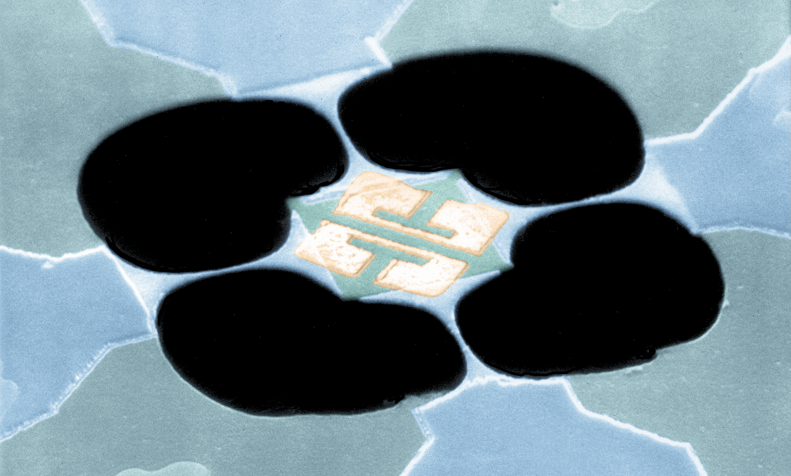
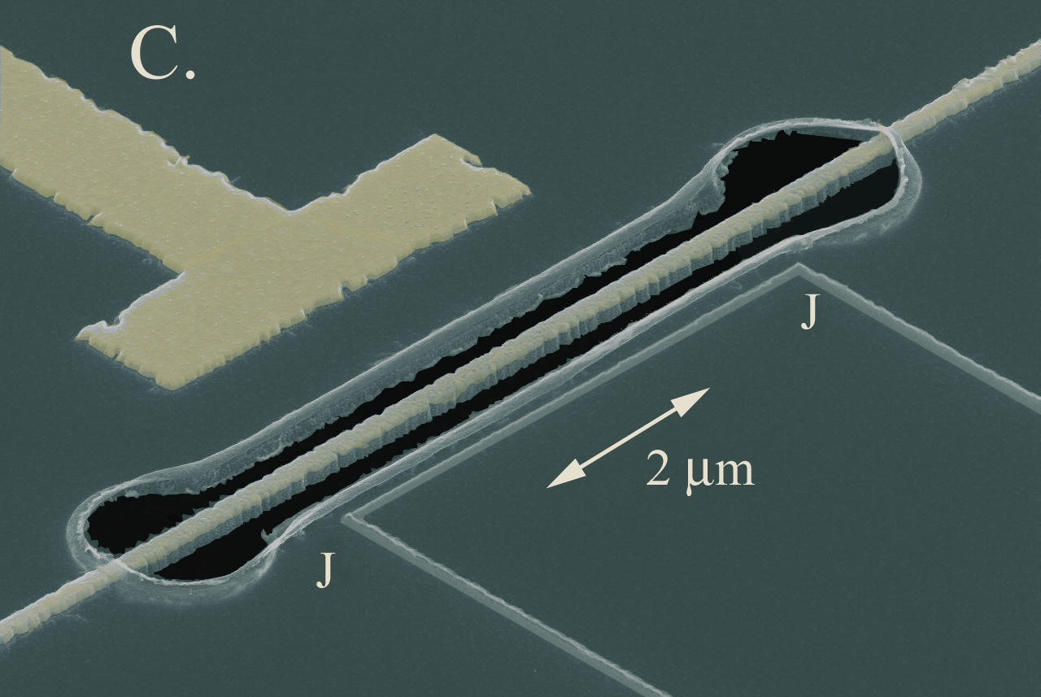
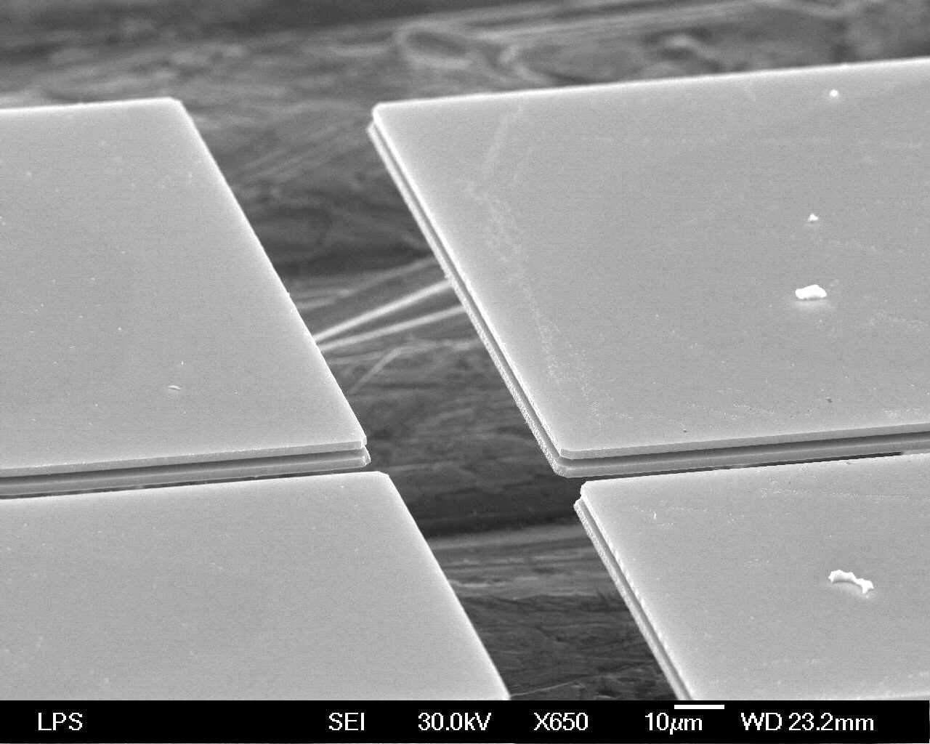
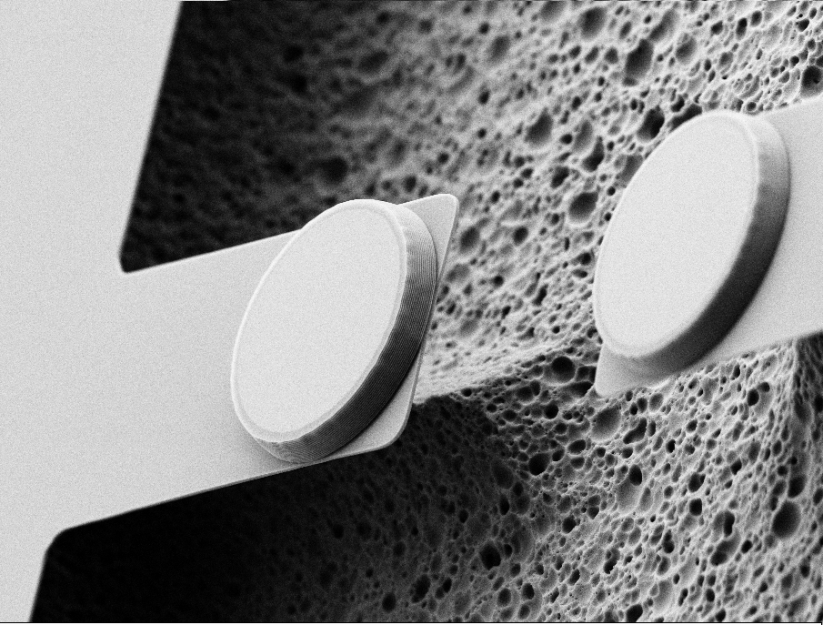
Development of an Ultra-low loss Superfluid He-4
Acoustic Resonator
Keith Schwab
and
Laura De Lorenzo
Applied Physics
Caltech
May 2012

Slide 2
Outline
Motivation
Properties of superfluid He-4, what is known
Estimation of the loss mechanisms
  Intrinsic loss in the fluid - phonon-phonon coupling
  He-3 impurities
  Container radiation losses
Microwave cavity readout near the SQL
Sensitivity estimates to accelerations, forces, and gravitational waves
Other possibilities, configurations

Slide 3
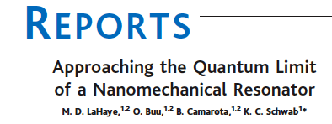
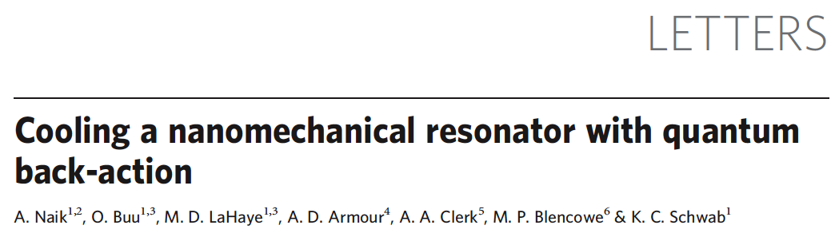
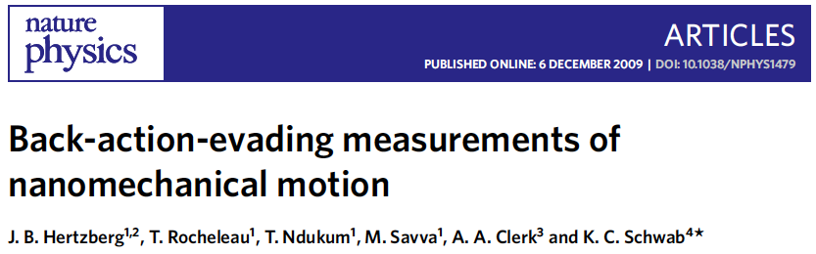
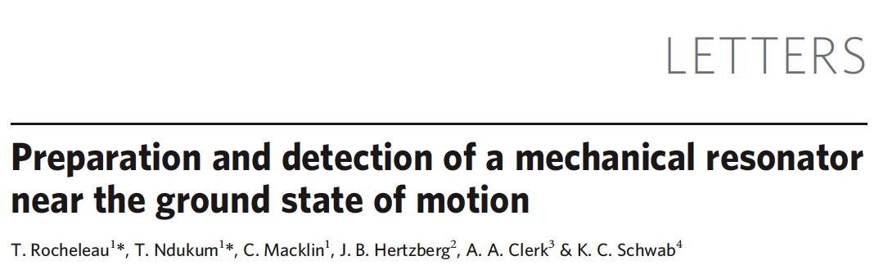
Our work in quantum limits of nanomechanics in the past years
2004: Approaching the SQL and the ground state with nanomechanics
2006: Observation of the back action forces due to shot noise, and cooling
2009: Back action evading measurement:
2010: Sideband cooling to near the ground state:
<N> = 4

Slide 4
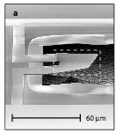
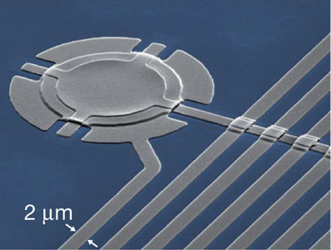
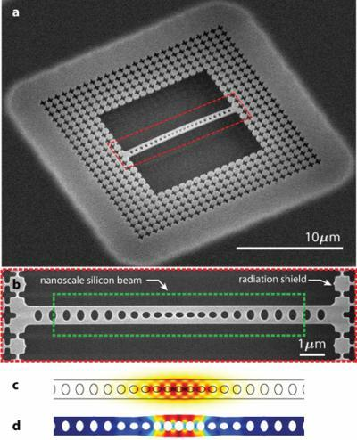
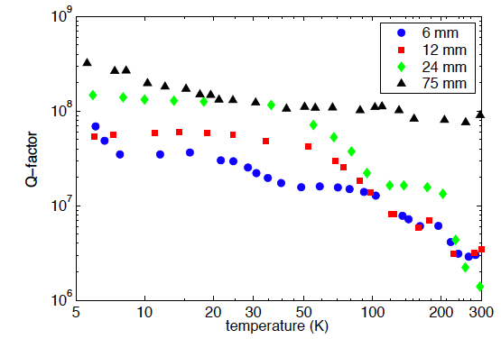
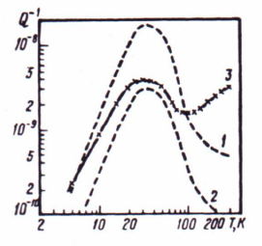
Studies of motion in the quantum regime – dissipation is key
AlN
Q = 900
Al
Q = 3 10⁵
SiO2
Q = 10⁵
Silicon:
Q = 4 10⁸
Sapphire:
Q=3 10⁹
O’Connel, et al, Nature (2010).
Teufel, Dale, Harlow, Allman, Cicak, Sirois, Whittaker, Lehnert, Simmonds, Nature 475, 359 (2011).
J. Chan, T. Alegre, A. Safavi-Naeini, J. Hill, A. Krause, S. Groblacher, M. Aspelmeyer, O. Painter, Nature 478, 389 (2011).
Braginsky, Mitrofanov, Panov, “Systems with Small Dissipation.” Univ. of Chicago Press (1985.)
Nawrodt, et al, “High mechanical Q-factor measurements on silicon bulk samples.” J. Phys.: Conf. Ser. 112, (2008).

Slide 5
Basic Properties of Superfluid He-4
Speed of first sound: c=240 m/s (x10 smaller than most metals)
Density: ρ=145 Kg/m³ (x10 less than most solids)
Dielectric constant: 1.05
Chemically pure (impurities freeze to container walls)
Isotopic impurities: He-3, concentration of n=10⁻⁷. Concentration of n<10⁻¹⁴ has been achieved
Transition temperature: T_{λ}= 2.17K, below this a macroscopic order parameter appears, Ψ
Entropy resides in normal fluid density composed of rotons (e^{-8K/kbT}) and phonons (T⁴)
Shows persistent mass currents (frictionless flow) below T_{λ}, quantized circulation around loops.

Slide 6
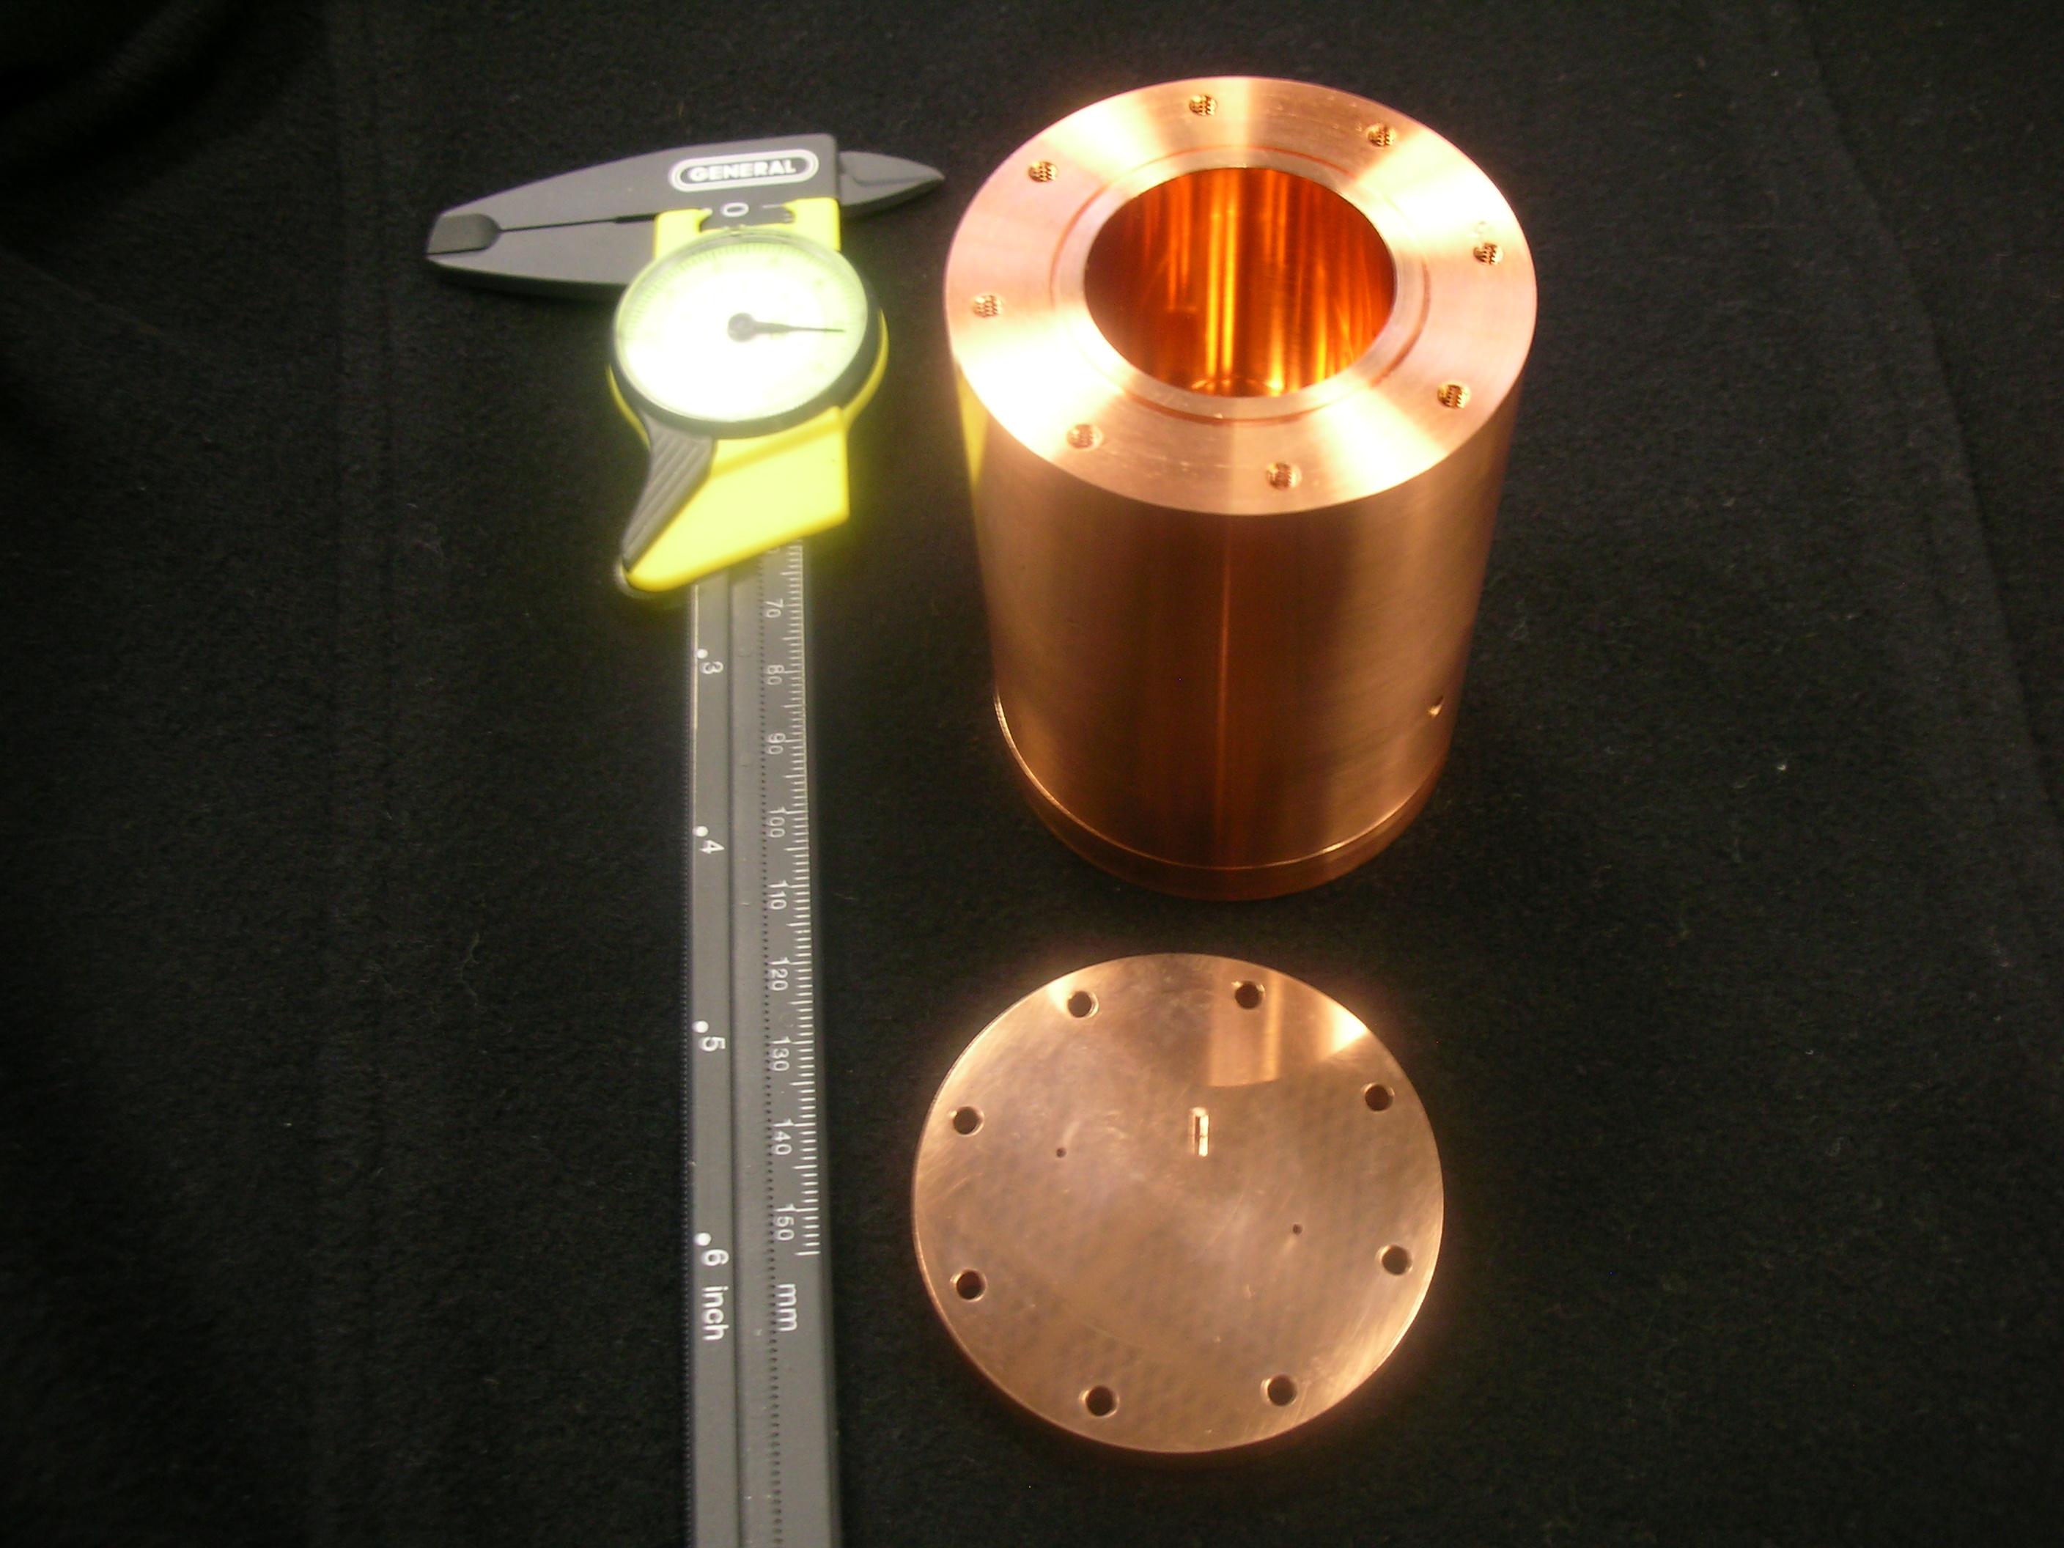
Basic concept: superfluid acoustic resonator coupled to microwave resonator

Slide 7
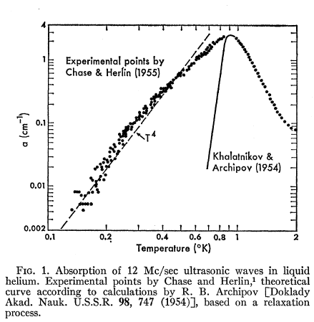
Dissipation of first sound in He-4 – phonon-phonon coupling
Non-linear acoustic response:
Dispersion relationship for sound:
For γ<1, three phonon acoustic damping process is possible where phonons scatter off of thermal phonons in fluid
Acoustic attenuation length:
T=10mK, ω=2π 3KHz ⇒ 1/α = 3 10⁹ m
T= 1mK, ω=2π 3KHz ⇒ 1/α = 3 10¹³ m
C.E. Chase, Proc. Roy. Soc. (London) A220, 116 (1953).
Humphrey Maris, “Attenuation and Velocity of Sound in Superfluid Helium.” Phys. Rev. Lett. 28, 277 (1972).

Slide 8
Dissipation due to He-3 impurities
Treat He-3 atoms as dilute, viscous classical gas.
When mean free path is smaller than container, acoustic attenuation is density independent:
When concentration of He-3 drops to 10⁻⁸, mean free path is equal to the size of the container, ~10cm.
There is some uncertainty about the nature of the scattering of the He-3 atoms on the container walls. We will assume diffuse scattering after N bounces off the walls.
Kerscher, Miemetz, Schoepe, “Viscosity and mean Free Path of Very Dilute Solutions of 3He in 4He,” JLTP 124, 163 (2001).

Slide 9
Expected intrinsic dissipation of He-4: phonons and impurities
He-3 concentration

Slide 10
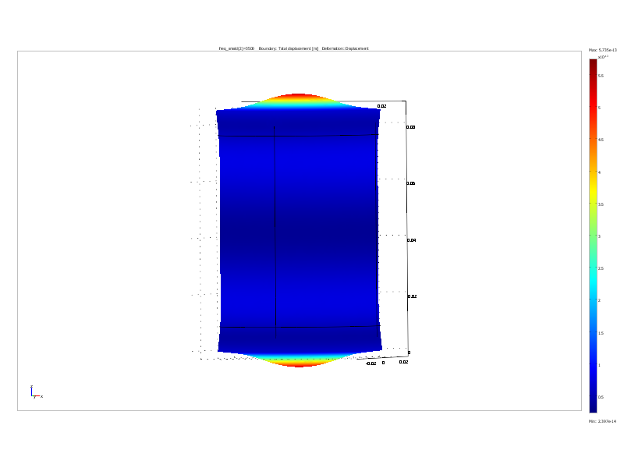

Acoustic coupling and losses in container
Copper: c_{Cu}=3900 m/s
Niobium: c_{Nb}=3500 m/s
First normal modes of container is at:
12.5KHz, 13.2KHz, 13.6KHz
Superfluid resonance is at 3.5KHz
Energy stored in Cu or Nb container for design shown in photo:
Quality factor at 50mK:
Cu Q =10⁵
BeCu Q = 8 10⁶
Nb Q = 40 10⁶
This will limit Q of superfluid resonance to
Cu: Q = 10¹¹
BeCu: Q = 10¹³
Nb: Q = 10¹⁴
Duffy, W. “Acoustic quality factor of copper, brass, and beryllium copper from 50mK to 300K.” Cryogenics 32, 1121 (1992).

Slide 11
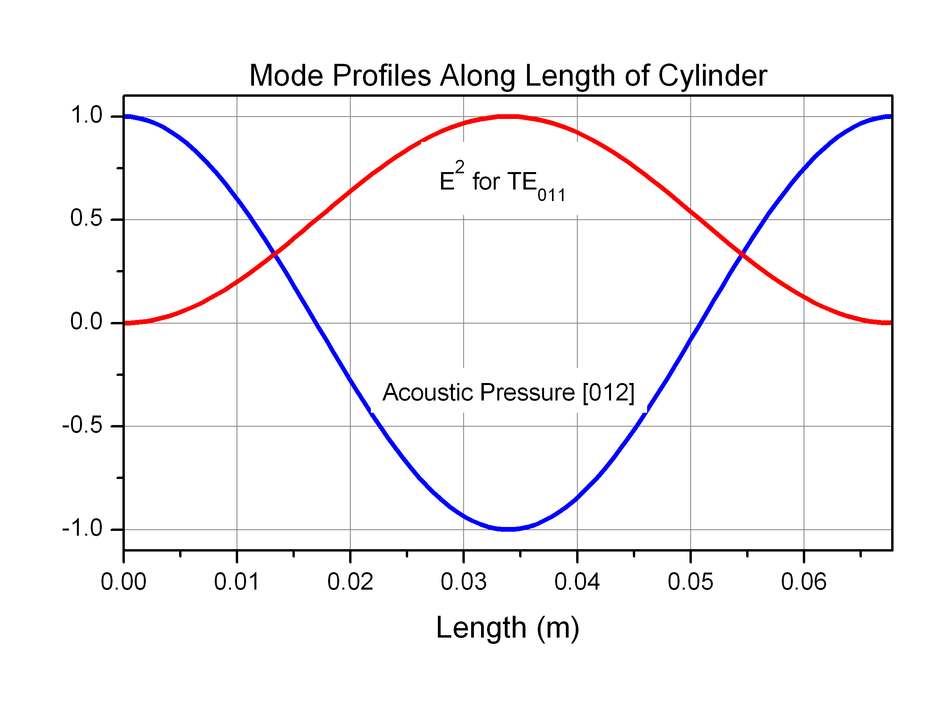


Acoustic resonator coupled to a microwave resonance
L=6.8 cm
D = 3 cm
M= 7g
ω = 3.5 kHz
ω = 12 GHz
Opto-mechanical Hamiltonian
Coupling per quanta…very weak

Slide 12
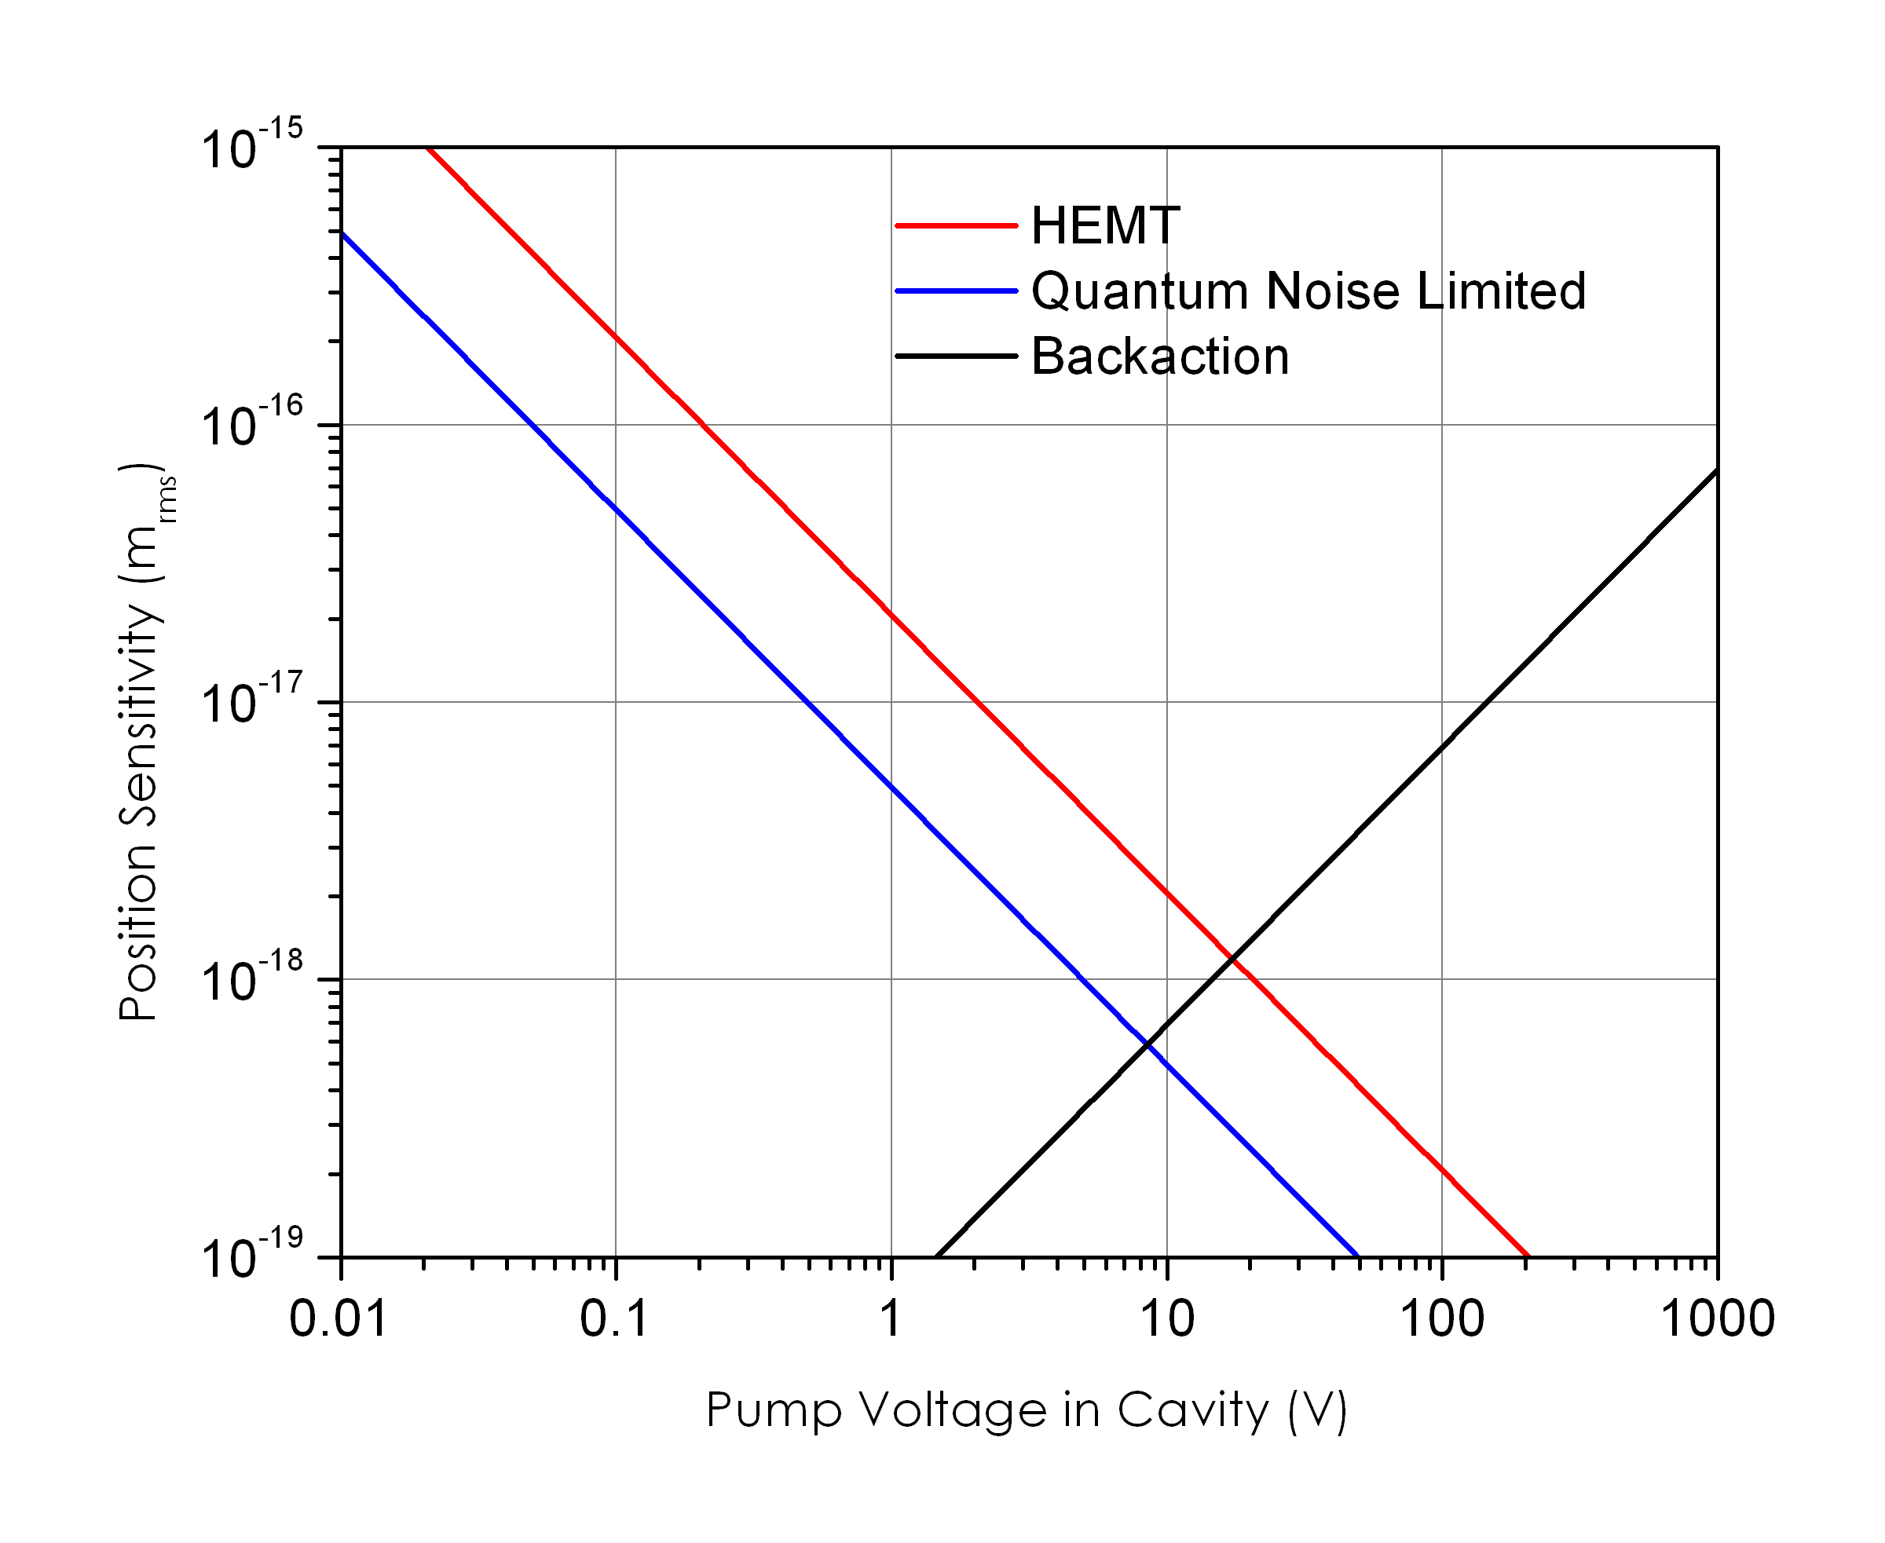
“Position” sensitivity

Slide 13
Sensitivity to sudden gravitational wave pulse
Imagine sudden pulse, of duration
Pulse energy density:
Energy deposited into resonant bar detector:
Energy sensitivity:
Vol (m³) | F (Hz) | h
1 | 120 | 10⁻²¹
0.1 | 250 | 10⁻¹⁸
0.01 | 500 | 10⁻¹⁵
0.001 | 1000 | 10⁻¹²
Strain sensitivity:
Blair, “The Detection of Gravitational Waves.” Cambridge University Press, Cambridge (1991).

Slide 14
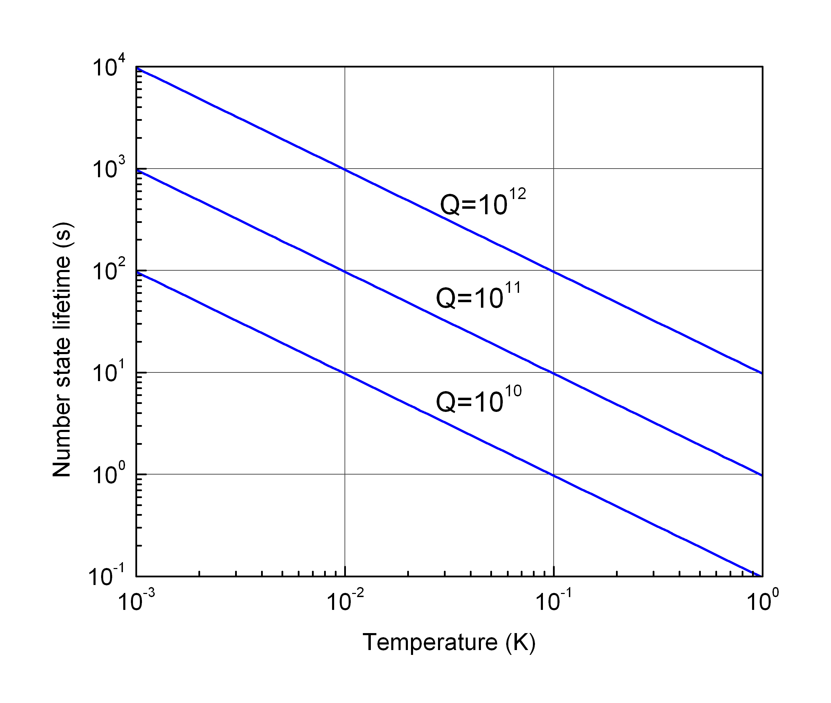

Time for one phonon to enter acoustic resonator

Slide 15
Sensitivity to linear displacements and gravitational gradient forces
M=10g
F = 3.5KHz
K = 10⁶ N/m
T = 10mK
Q=10¹⁰
k
m
This is the gravitational force of 10g at 10m, oscillating 1 cm

Slide 16
Further challenges….
Phase noise of microwave source will require superconducting cavity filter to achieve SQL.
Nb cell will be required to avoid ohmic heating to achieve less than 10mK.
Coupling the microwave circuit without spoiling the mechanical Q: antenna coupling?
Holding onto the cell and providing strong thermal link, without spoiling mechanical Q.
Filling the cell: pre-filling at 300K at 1K bar will avoid a fill line

Slide 17
Conclusions
This will never work.
Life is a dark and bitter place.
I should spend a lot more time in Hawaii and stop worrying so much about low temperature physics.
Superfluid resonators offer an extremely low dissipation material for mechanical resonators with very long coherence times and extreme sensitivity to accelerations.
This could be an excellent system to manipulate the quantum state of motion of a gram sized object.
schwab@caltech.edu

Slide 18
Meanwhile, at the other end of parameter space….
Acceleration of nanomechanical resonator
Neutron star accelerations in the laboratory
What physics can be probed with this extreme parameter?

Slide 19
Acoustic resonator coupled to a microwave resonance
Treat He-3 atoms as dilute, viscous classical gas.
When the mean free path is smaller than the container size:

Slide 20
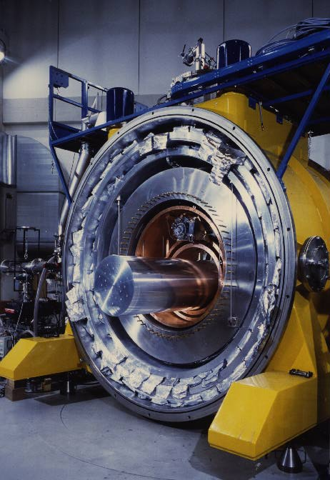
Gravitational wave antenna – Weber bars
Auriga
2 Ton Acoustic Resonators

Slide 21
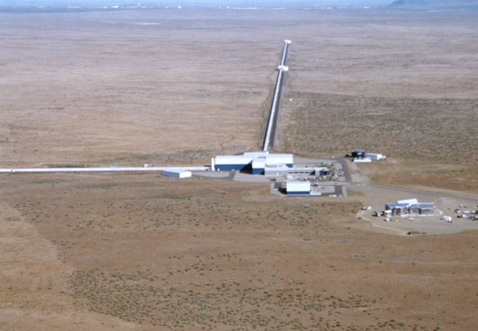
Gravitational wave antenna – Interferometers
LIGO
4 km Interferometer

Slide 22
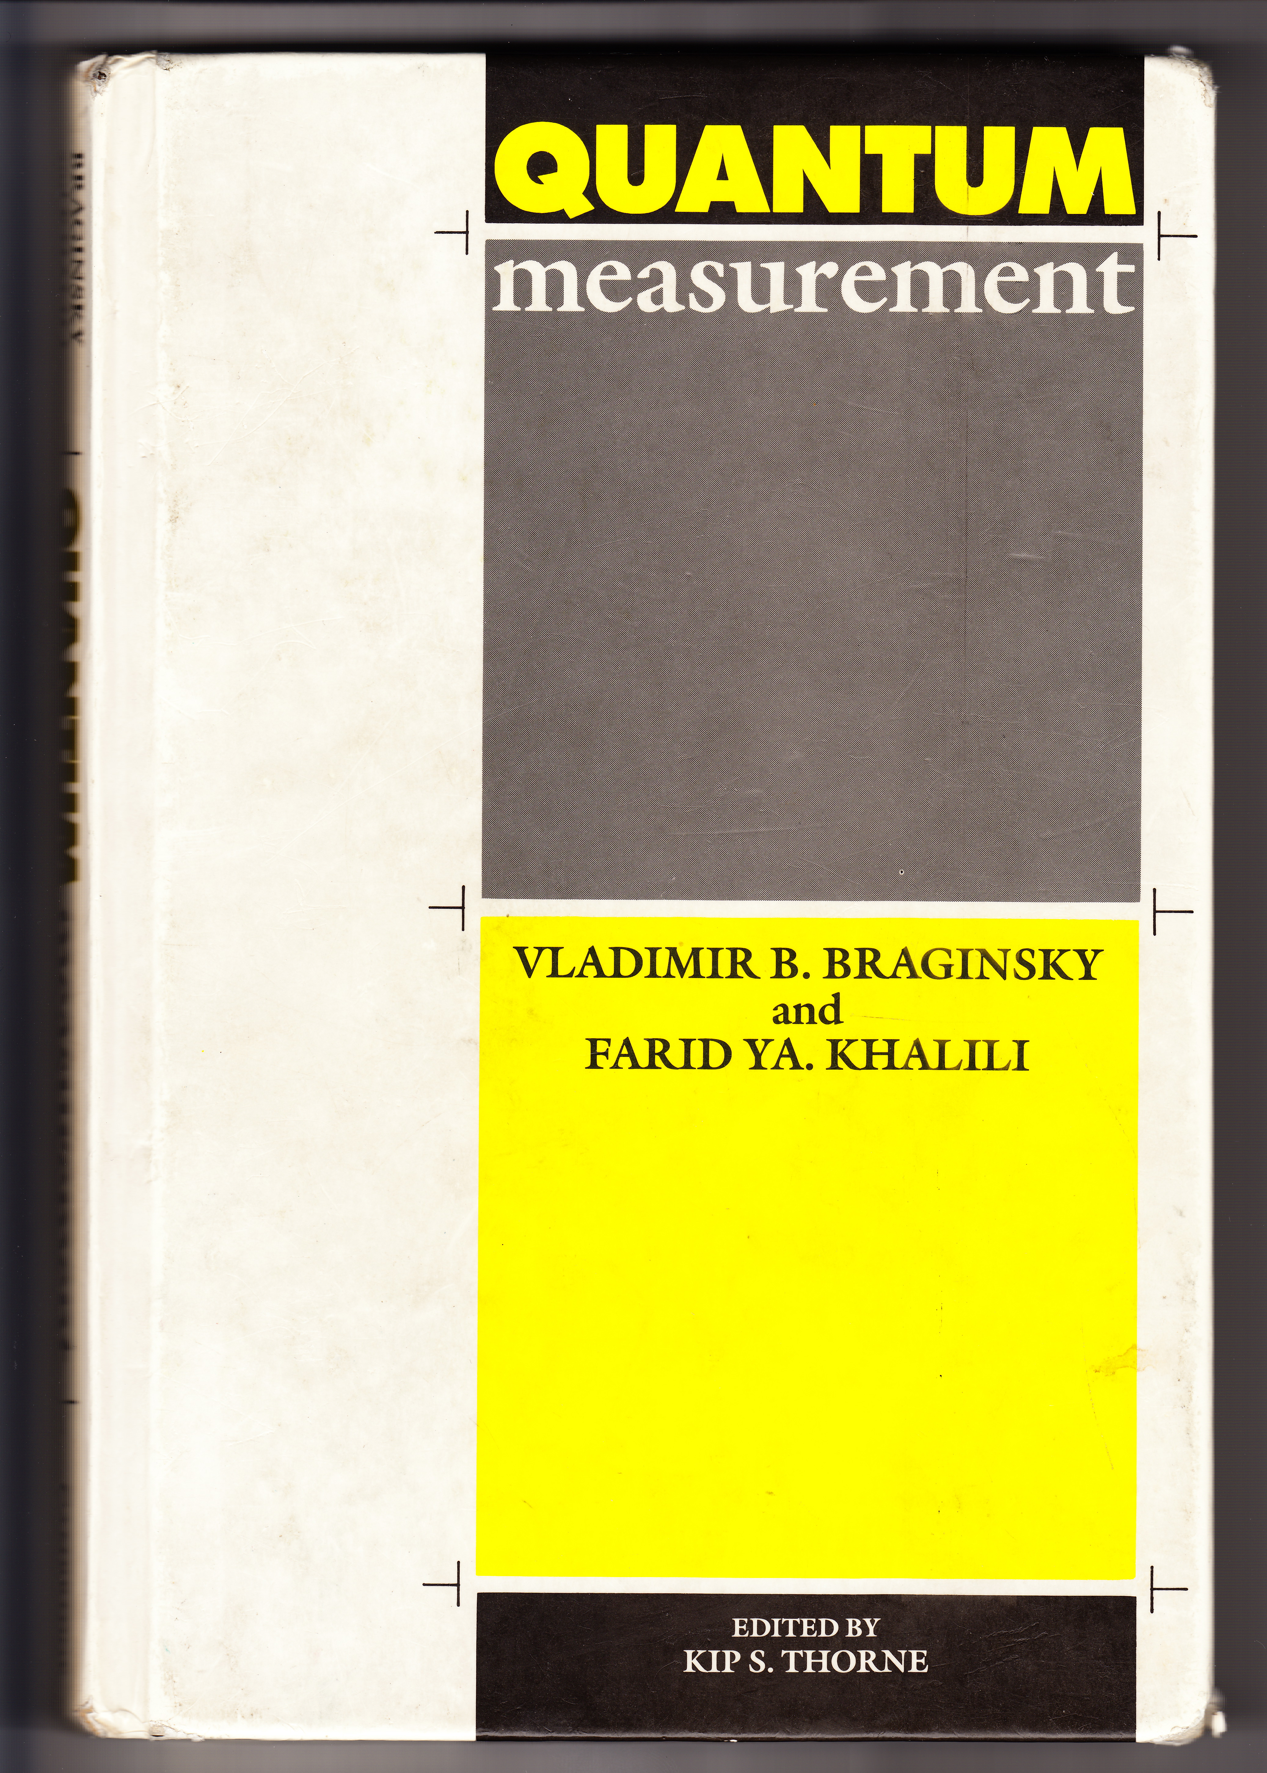
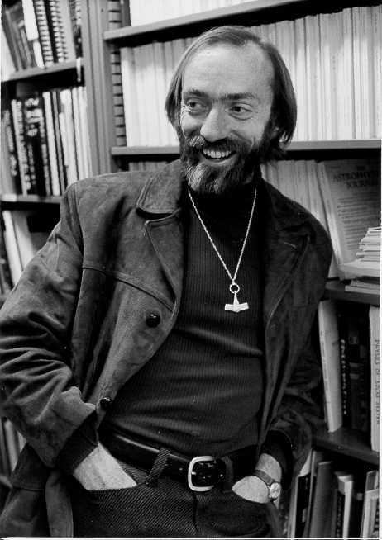
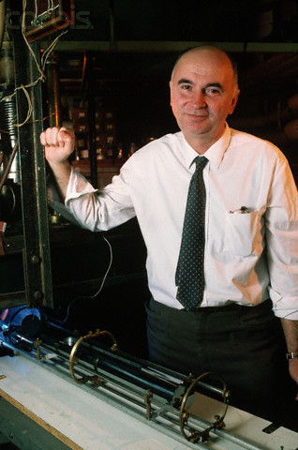
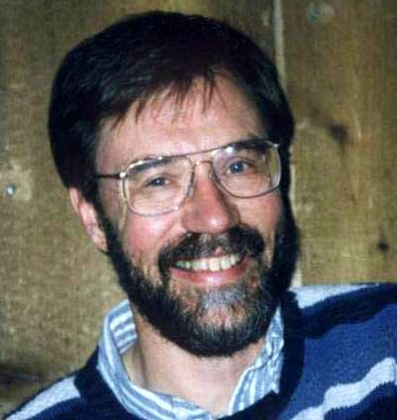
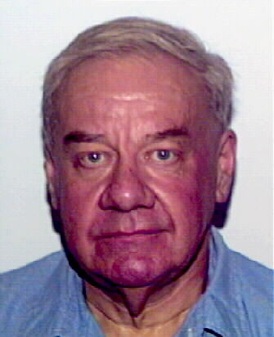
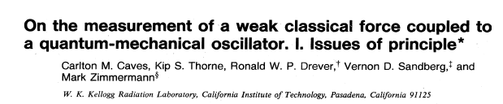
Gravitational wave antenna – Early literature starting in the 1970’s
Kip Thorne
V. Braginsky
Carlton Caves
Ron Dreaver

Slide 23
Opto-mechanical structures

Slide 24
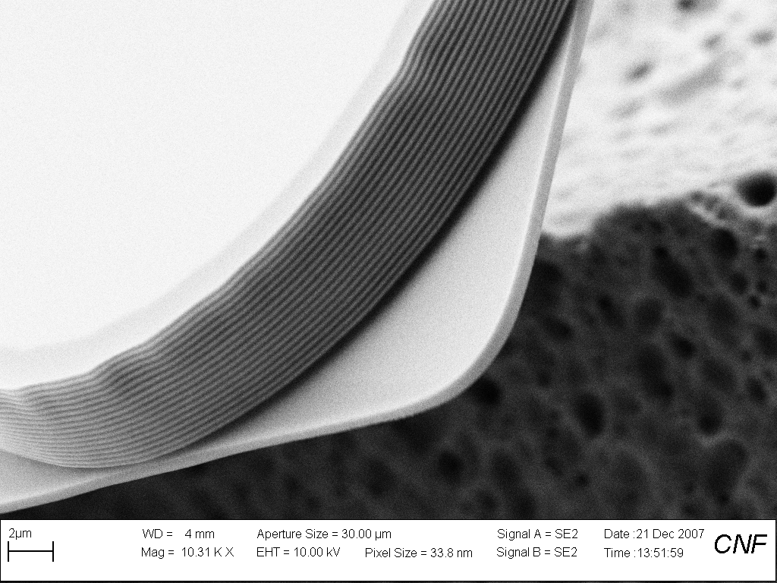
Fabrication of devices by Jared Hertzberg

Slide 25
Electro-mechanical structures

Slide 26
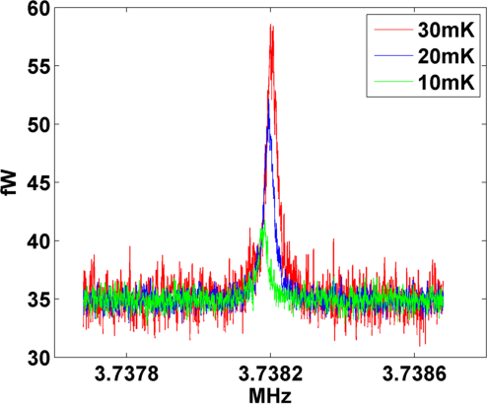
Membrane thermalizes down to 10mK

Slide 27
Schrödinger's Whisker
Cantilever
Armour, Blencowe, and Schwab, Phys. Rev. Lett. 88, 148301 (2002).

Slide 28
Schrödinger's Whisker
Cantilever
Armour, Blencowe, and Schwab, Phys. Rev. Lett. 88, 148301 (2002).

Slide 29
Schrödinger's Whisker
Cantilever
Armour, Blencowe, and Schwab, Phys. Rev. Lett. 88, 148301 (2002).

Slide 30
Schrödinger's Whisker
+
Quantum Two Level Systems
Nuclear Spin
Electron Spin
Artificial Atoms - Qubits
10⁻²¹ Nt ……………….
10⁻¹⁸ Nt……………….
10⁻¹³ Nt……..
Cantilever
Best qubits to date
t_{1 ,} t₂ ~ 10-100 μsec
Armour, Blencowe, and Schwab, Phys. Rev. Lett. 88, 148301 (2002).

Slide 31
Coherence time and Fock state lifetime
Lifetime for number state:
Decoherence time for superposition of coherent states:
Zurek, Habib, Paz, Phys. Rev. Lett. 70, 1187 (1993).

Slide 32
Parametric Transducer
L
R
V_{p}
Frequency
Johnson, Warren W., Bocko, Mark, Approaching the Quantum “Limit” for Force Detection. Phys. Rev. Lett. 47, 1184-1187 (1981).
Braginsky, V. B., Khalili, F. Ya., Quantum Measurement (Cambridge Univ. Press, Cambridge, 1995).
Blair, Ivanov, Tobar, Turner, Kann, Heng, High Sensitivity Gravitational Wave Antenna with Parametric Transducer Readout. Phys. Rev. Lett. 74, 1908 (1995).
Bocko, Mark F., Onofrio, Roberto, On the measurement of a weak classical force coupled to a harmonic oscillator: experimental progress. Rev. Mod. Phys. 68, 755-799 (1996).

Slide 33
Up and down conversion -- Raman process
Up-conversion from pump
→ Cooling, positive damping of mechanics
Down-conversion from cavity
→ Heating of mechanics

Slide 34
Detailed Balance
Thermal Bath (fridge)
Mechanical Mode
Thermal Bath (cavity field)

Slide 35
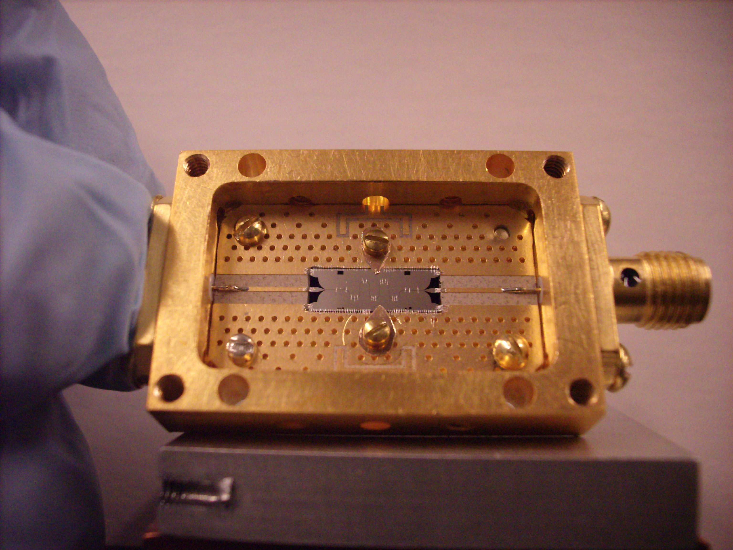
Devices

Slide 36
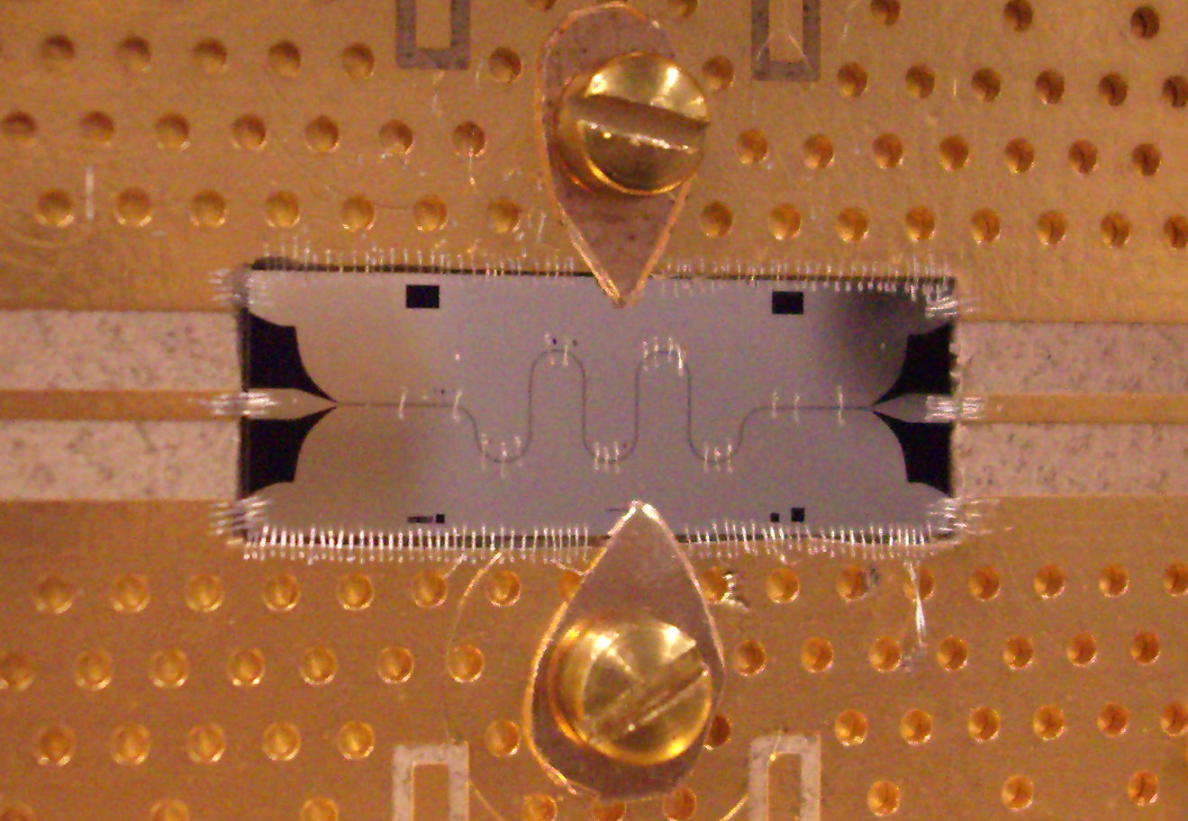
P. Day, R. LeDuc, B. Mazin, A. Vayonakis, J. Zmuidzinas, Nature 425, 817 (2003).

Slide 37
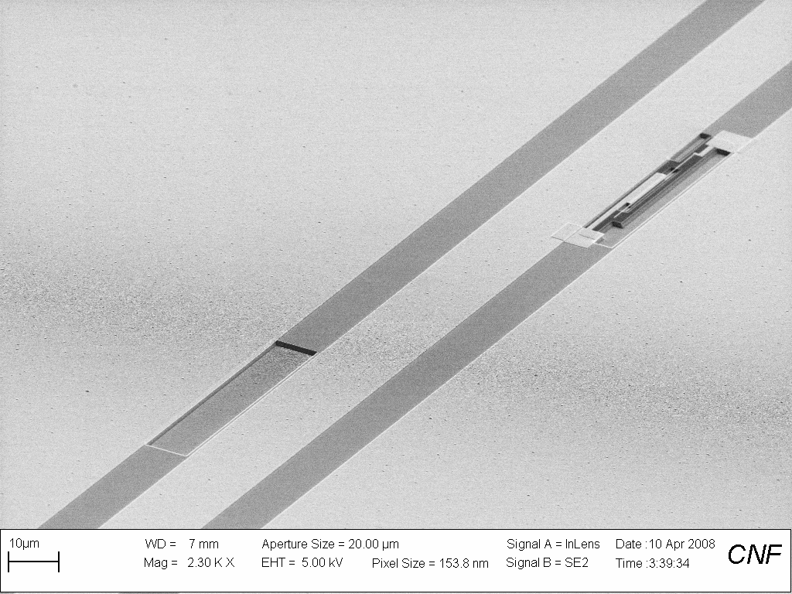
Recent device pics
NEMS
Ground plane
Ground plane
CPW

Slide 38
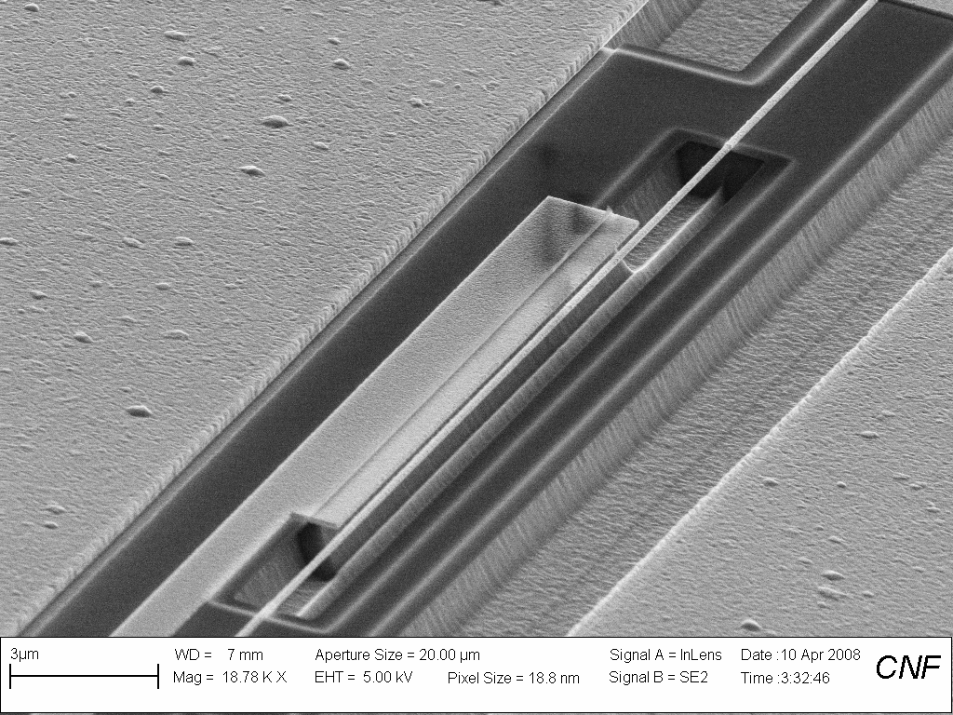
Mechanical resonator
Coplanar
Waveguide
Gate
Ground plane

Slide 39
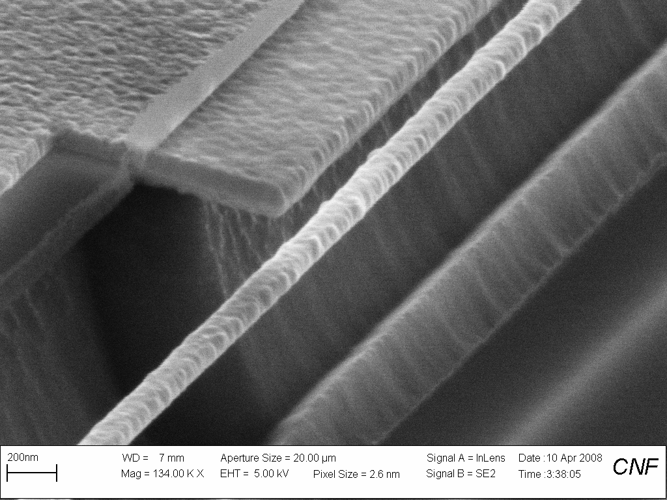
Gate
SiN
NEMS
5-6 MHz
Q>1,000,000
Si

Slide 40
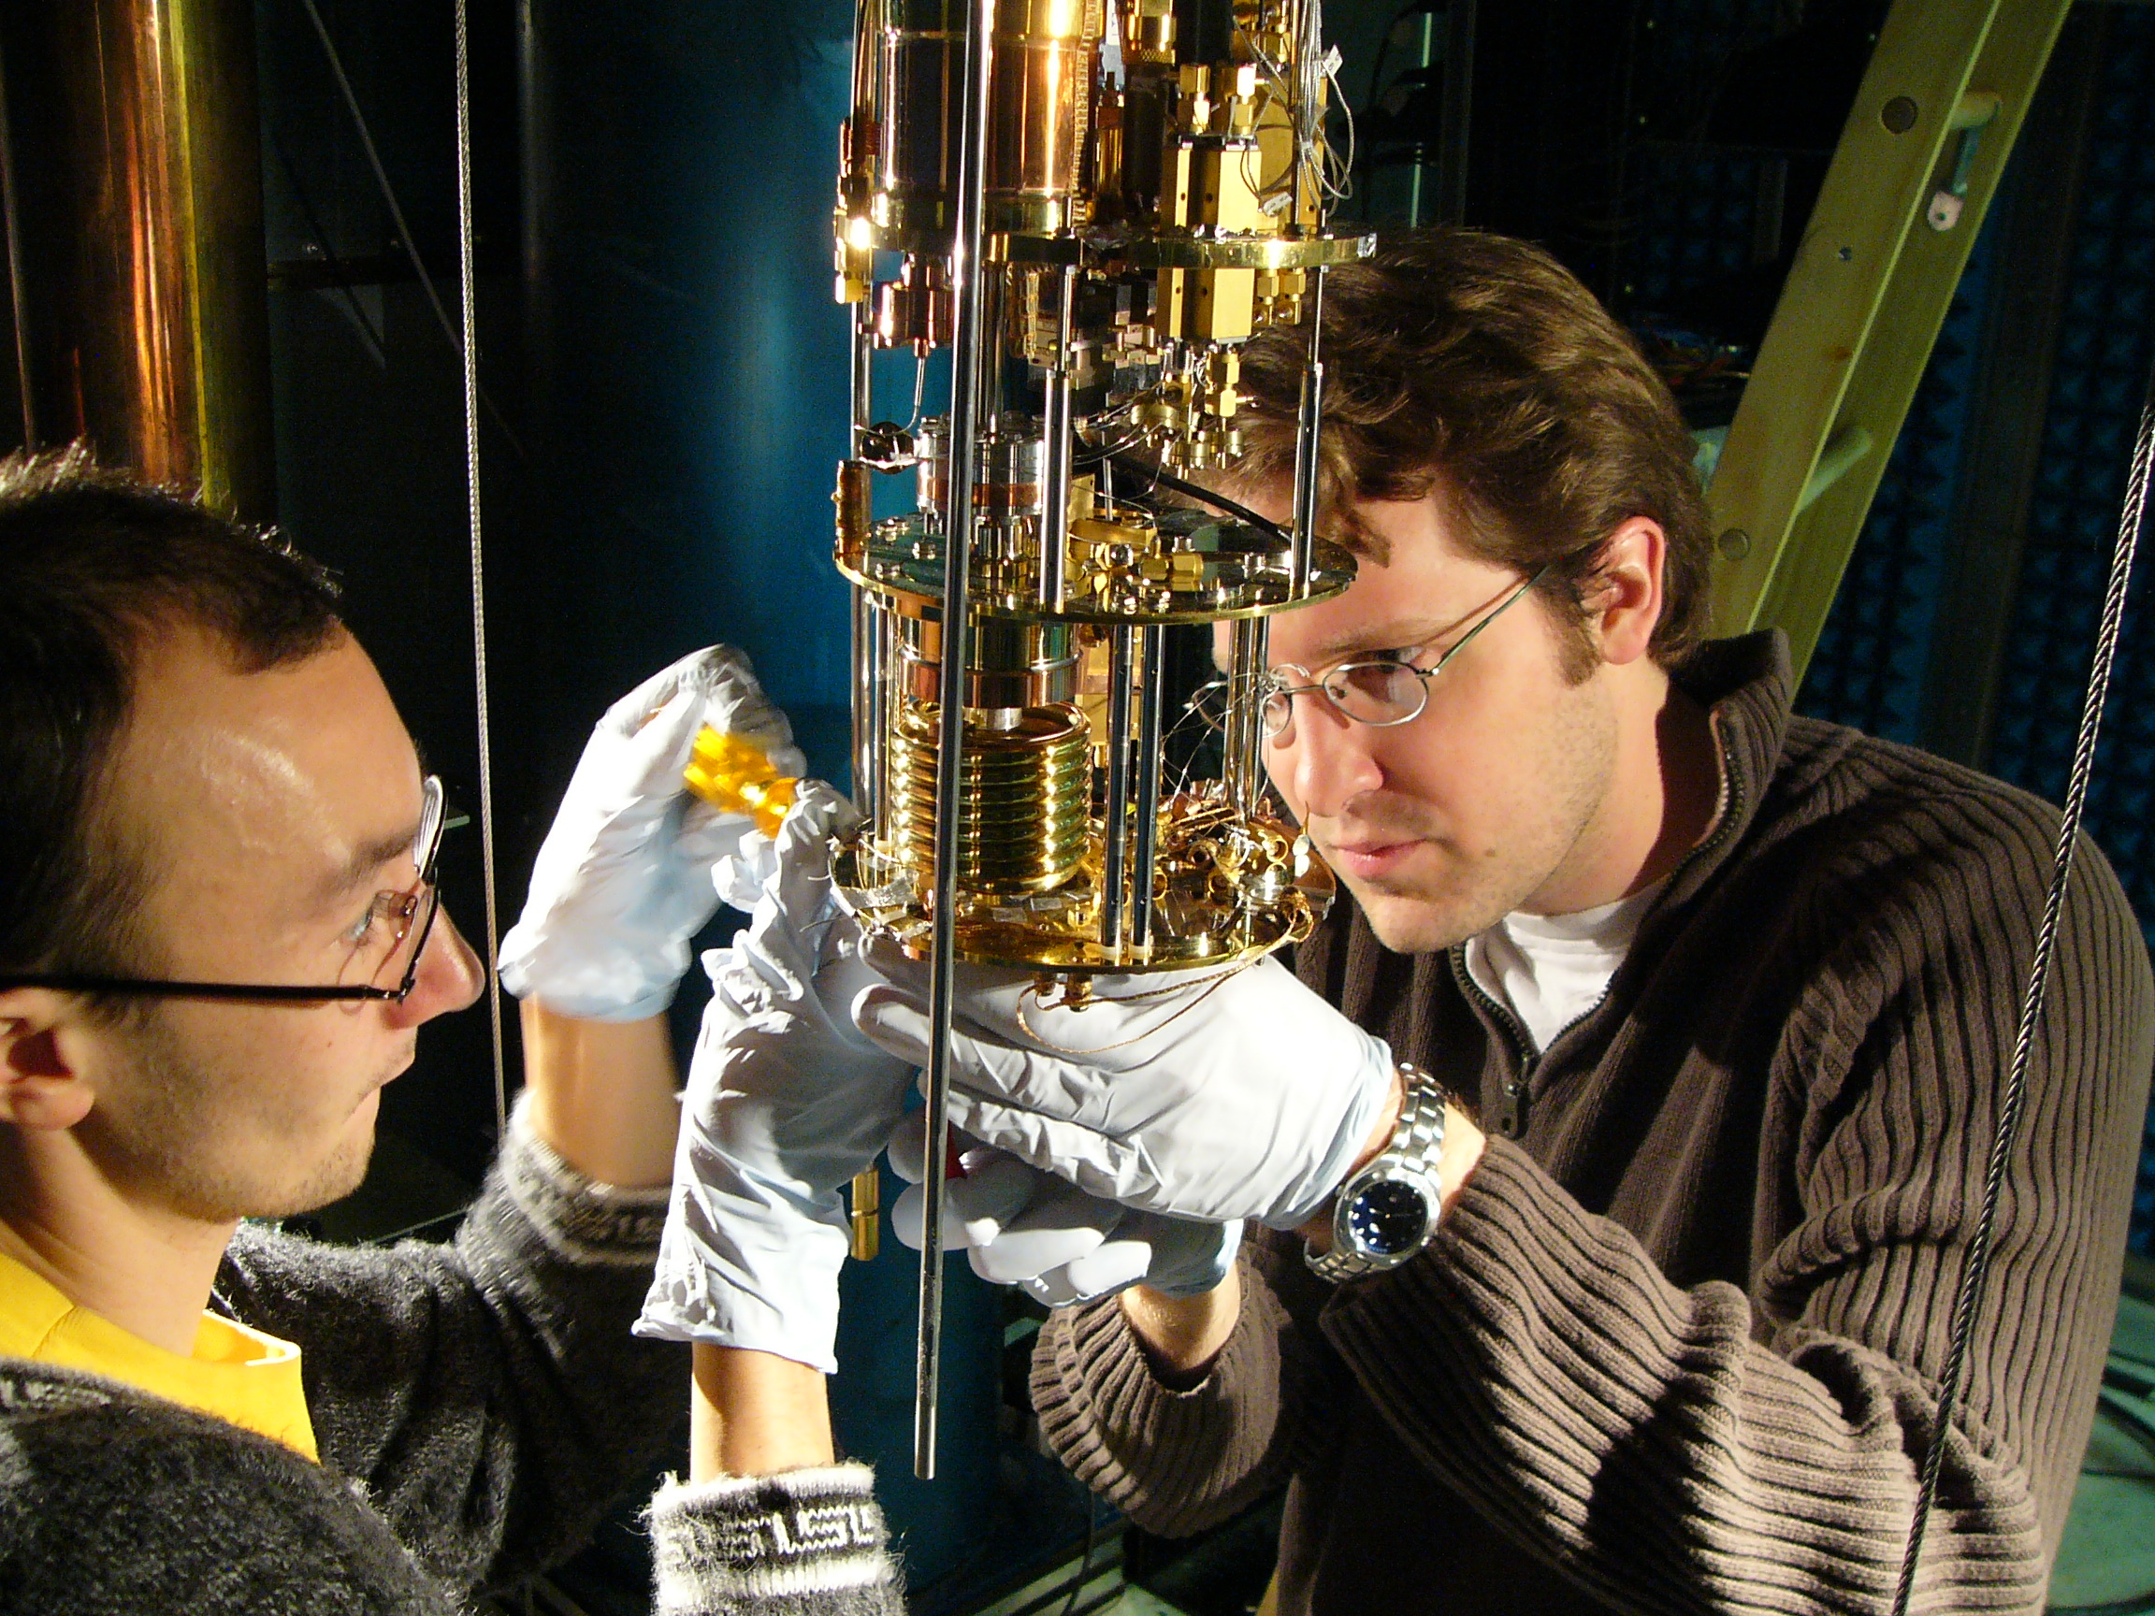
Installing samples onto the fridge

Slide 41
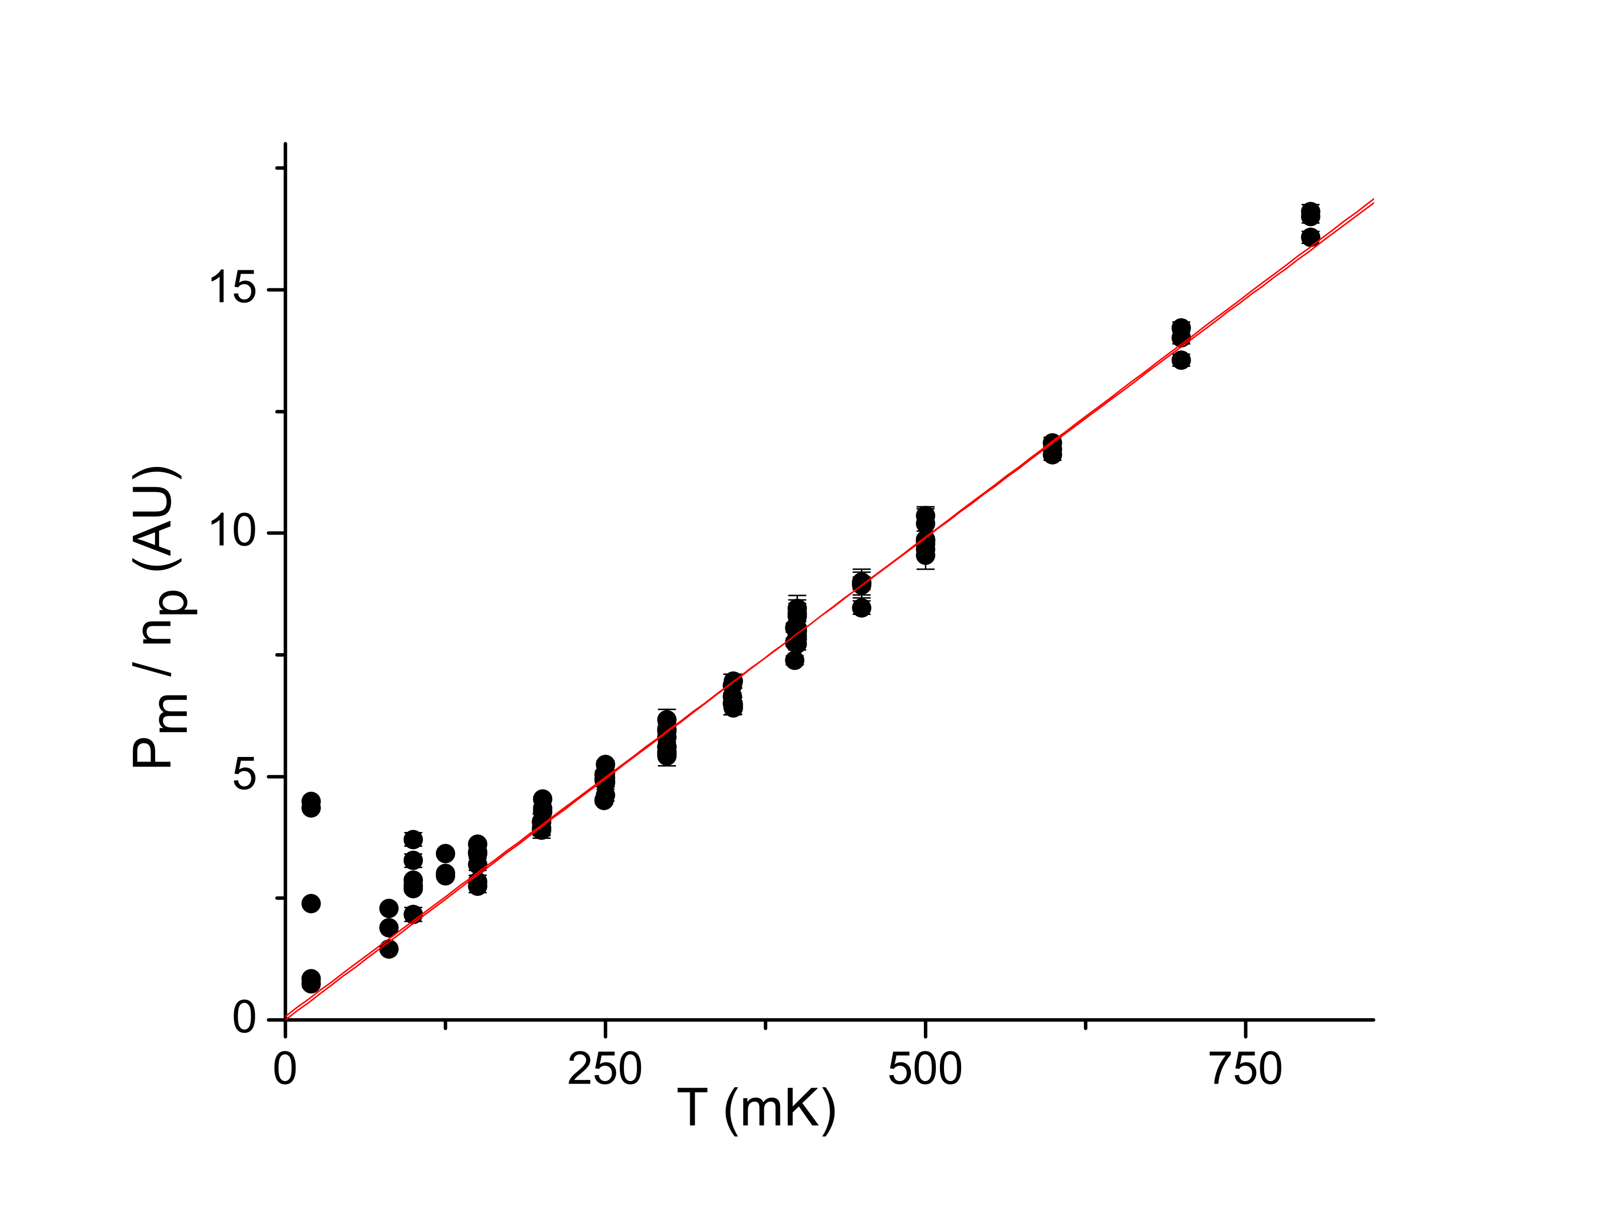
Brownian Motion – Equipartition

Slide 42
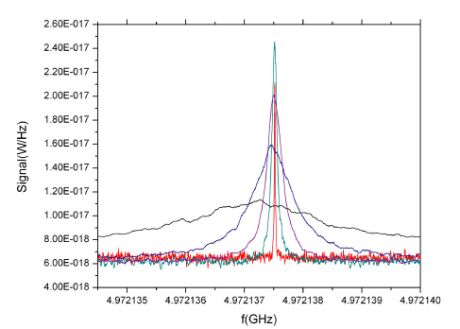
Damping and Cooling
Blair, et al, Phys. Rev. Lett. (1995).

Slide 43
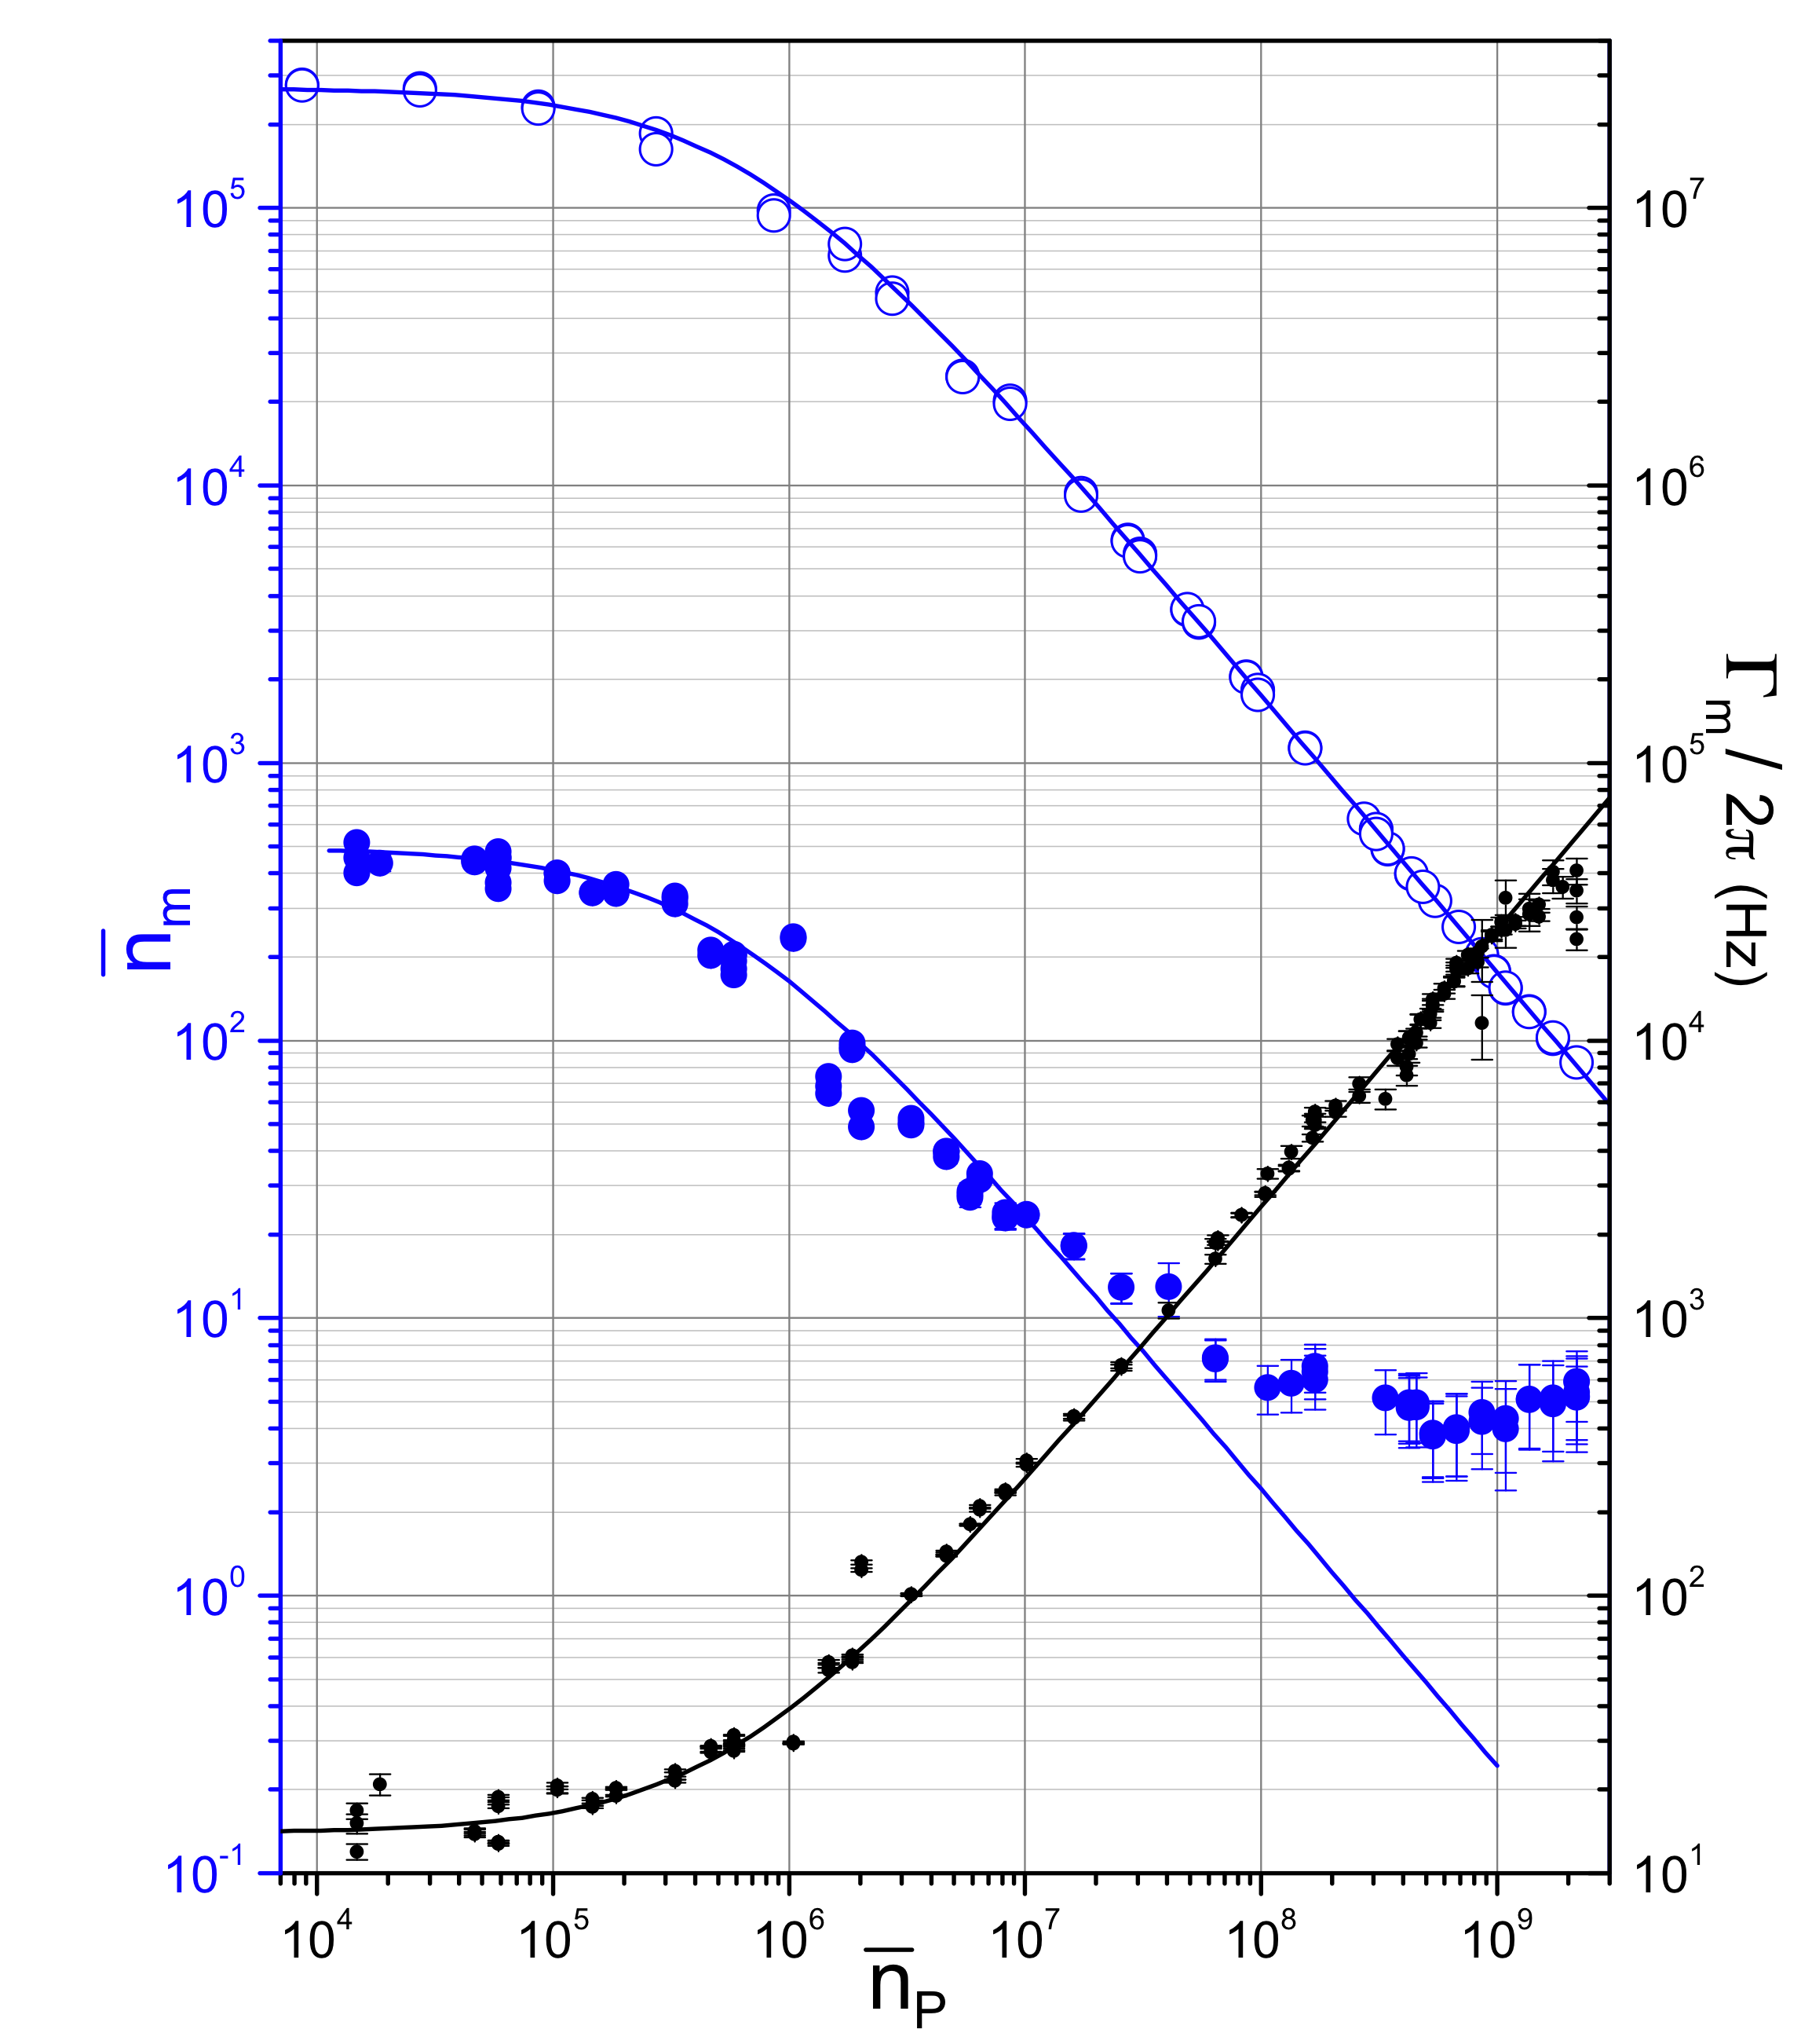
Damping and Cooling
"Preparation and Detection of a Mechanical Resonator Near the Ground State of Motion," T. Rocheleau, T. Ndukum, C. Macklin, J.B. Hertzberg, A.A. Clerk, K.C. Schwab, Nature 463, 72-75 (2009).

Slide 44
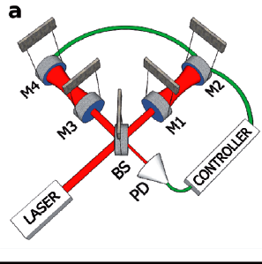
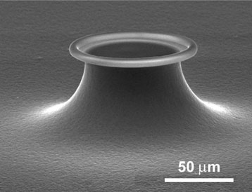

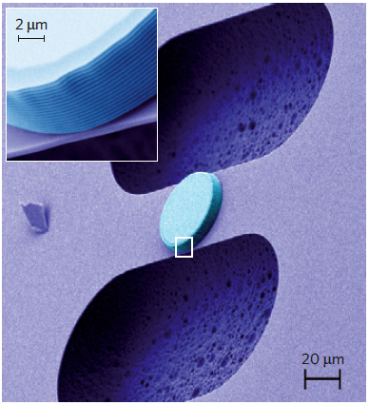
Progress in Opto-mechanics
Abbott, et al., New J. Phys. 11, (2009).
N=200
(100Hz)
Schliesser, Arcizet, Riviere, Anetsberger, Kippenberg, Nature Phys. 5, (2009).
N~few
(58MHz)
Park and Wang, Nature Phys. 5, (2009).
N=37
(100MHz)
Groblacher, Hertzberg, Vanner, Cole, Gigan, Schwab, Aspelmeyer, Nature Phys. 5, (2009).
N=30
(1MHz)

Slide 45
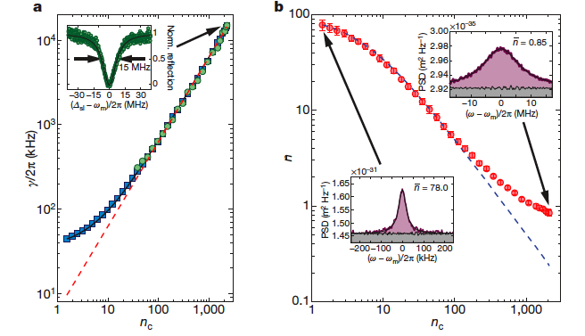
Progress in Opto-mechanics -- ground state
J. Chan, T. Alegre, A. Safavi-Naeini, J. Hill, A. Krause, S. Groblacher, M. Aspelmeyer, O. Painter, Nature 478, 389 (2011).
A. Safavi-Naeini, J. Chan, J. Hill, T. Mayer Alegre, A. Krause, O. Painter, PRL (2012).

Slide 46
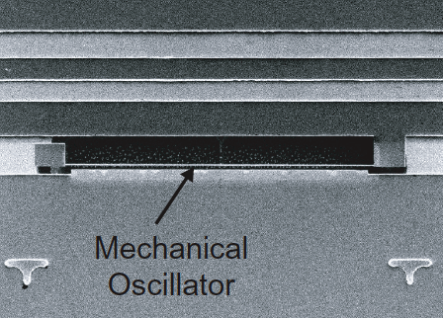
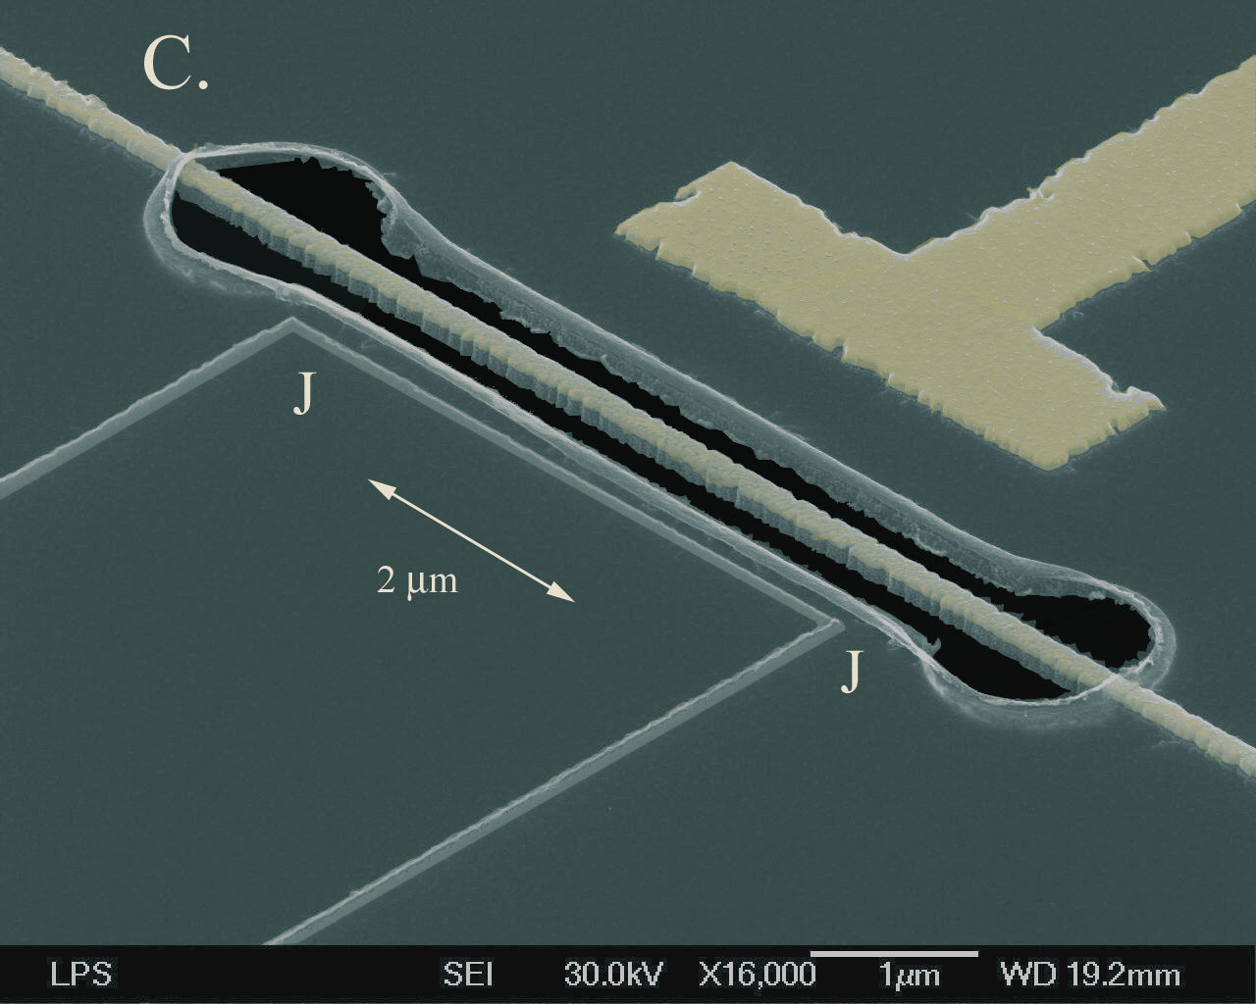
Progress in Electro-mechanics -- ground state
Teufel, Harlow, Regal, Lehnert, Phys. Rev. Lett.. 101, (2008).
N=140
(1MHz)
Naik, LaHaye, Buu, Clerk, Blencowe, Armour, Schwab, Nature. 443, (2006).
N=25
(20MHz)
This work….
Rocheleau, Ndukum, Macklin, Hertzberg, Clerk, Schwab, Nature (2010)
N=3.8 +/- 1
(5MHz)
O’Connel, et al, Nature (2010).
N<0.1
(6GHz)

Slide 47
Progress in Electro-mechanics -- ground state
N=0.4 !
Teufel, Dale, Harlow, Allman, Cicak, Sirois, Whittaker, Lehnert, Simmonds, Nature 475, 359 (2011).

Slide 48
Control at the single quanta level
mirror
energy
atom
mode
atom/qubit
resonator
resonator
Interaction with exchange of quanta
Two state system
E. Irish, K.C. Schwab, PRB 68, 155311 (2003).

Slide 49
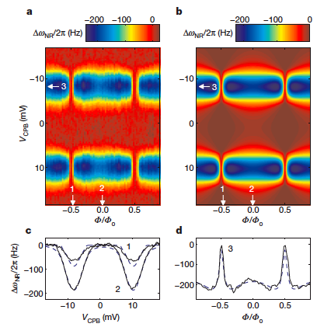
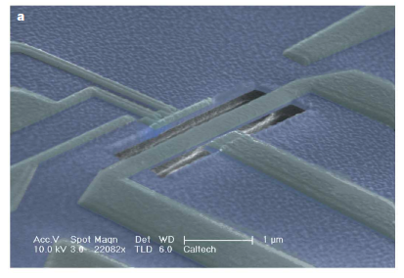
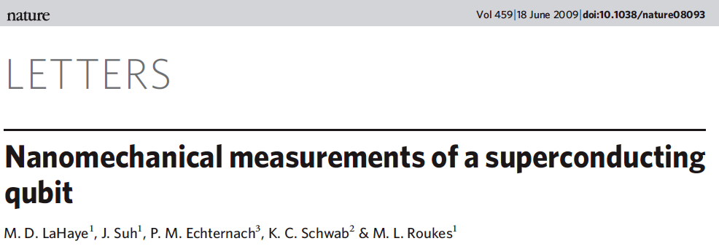
NEMS + qubit in dispersive limit
NEMS coupled to superconducting qubit

Slide 50
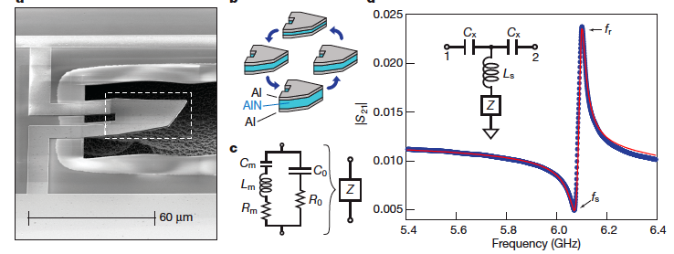
Control at the single quanta level
O’Connell, et al, Nature 464, 697 (2010).

Slide 51
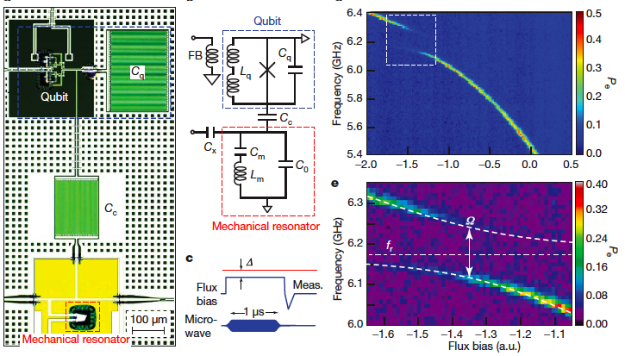
Coupling to a superconducting qubit
O’Connell, et al, Nature 464, 697 (2010).

Slide 52
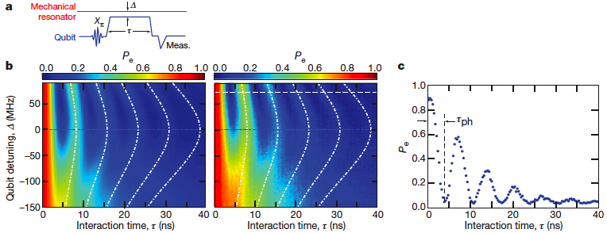
Exchanging a single quanta
O’Connell, et al, Nature 464, 697 (2010).

Slide 53
The Standard Quantum Limit

Slide 54
QND Measurement of Quadratures
Braginskii, V.B., Vorontsov, Yu.I., Quantum-mechanical limitations in macroscopic experiments and modern experimental design. Sov. Phys.Usp. 17, 644 (1975).
Thorne, Kip S., Drever, Ronald W.P., Caves, Carlton M., Zimmerman, Mark, Sandberg, Vernon D., Quantum Nondemolition measurements of Harmonic Oscillators. Phys. Rev. Lett. 40, 667-671 (1978).

Slide 55

Summary, take home messages, and good things to know
Small particles (photons, electrons, ect) don’t behave in a way consistent with our classical/ancient notions of reality.
Large molecules (Buckyballs and now larger) can act like waves, going both ways around an obstacle and interfering with itself.
There is probably no limit to the size where quantum behavior stops; we are building small mechanical devices to see the wave behavior or larger objects.
Our community has recent produced the quantum ground state of mechanical structures in both electro-mechanical and opto-mechanical devices.
The Uncertainty Principle fluctuations of a mechanical mode have been recently measured.
Manipulation of a single phonon, using a qubit, has recently been demonstrated.
www.kschwabresearch.com

Slide 56
Mechanical Brownian Motion – Signal in Microwave Oscillator
Problem #1: Device does not thermalize below ~100mK

Slide 57

Schrödinger's cat
Wave function for a single atom:
After measurement:
What if a microscopic degree of freedom is coupled to a macroscopic state?
Can something as complex as a cat become entangled with microscopic entity?
Before you look, is the cat in a superposition of alive and dead?
Schrodinger, Naturwissenschaften (1935).

