Slide 1

Quantum Optomechanics
Outside the GW Community
Garrett D. Cole
Aspelmeyer Group
Notes:
1

Slide 2
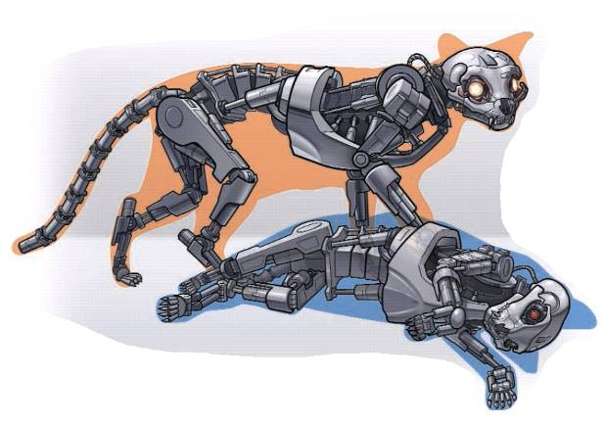
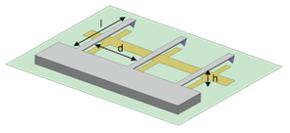
Quantum Regime of Microsystems
Motivation: investigation of complex quantum systems
Quantum Foundations
macroscopic quantum superposition involving up to 10²⁰ atoms
→ Is there a limit to the size of Schrödinger cats?
Mechanical Sensing
present performance: zeptogram, zeptonewton, attometer, etc.
→ What are the quantum limits to mechanical sensing?
Quantum Information
potential hybrid quantum information architectures on a chip
→ Can mechanical systems serve as a universal quantum bus?
Approach: combine quantum optics with
high-performance micro and nanomechanics

Slide 3
Optomechanical Systems

Slide 4
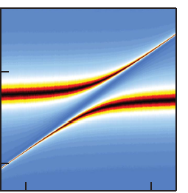
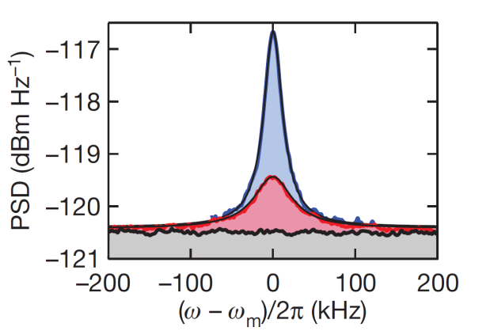
Progress Towards Quantum Control
Mechanical coupling to quantum systems
Resonator probes a quantum system
LaHaye 2009: Dispersive coupling with a CPB qubit
→ first step towards quantum control of mechanics
Strong optomechanical coupling
Coupling strength exceeds individual dissipation rates
Gröblacher 2009, Teufel 2011, Verhagen 2012…
→ enables coherent energy exchange (OM polariton)
Ground state cooling
Freezing out thermal fluctuations, <n> below 1
Demonstrated in both optical and microwave systems
→ +strong coupling: full control of mech quantum state

Slide 5
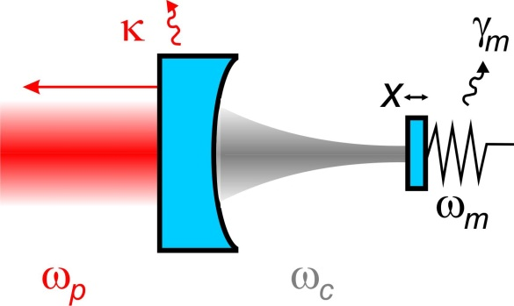




Coupling Mechanics with Light
detuned optical field can substantially modify the dynamics of the resonator
Back-action damping
(cooling)
κ
ω
ω
ω
pump
cavity
Radiation pressure interaction:
Intensity-dependent mirror displacement (optical bistability)
Intensity-dependent phase shift (Kerr-like interaction)
Retarded forces (modification of the mechanical susceptibility)
Doppler-shift of reflected light due to mirror motion
κ
Parametric ampl.
(heating)
ω
ω
ω
cavity
pump
Rokhsari et al., OpEx 13 5293 (2005)
Gigan et al., Nature 444, 67 (2006)
O. Arcizet et al., Nature 444 71 (2006)

Slide 6
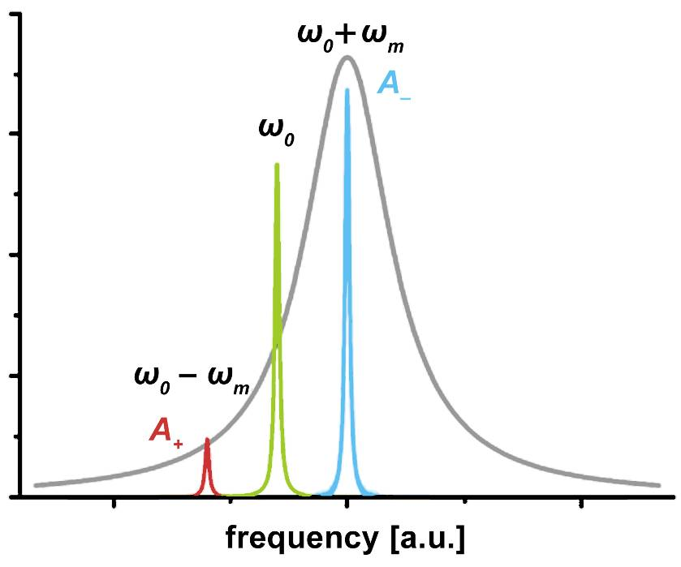
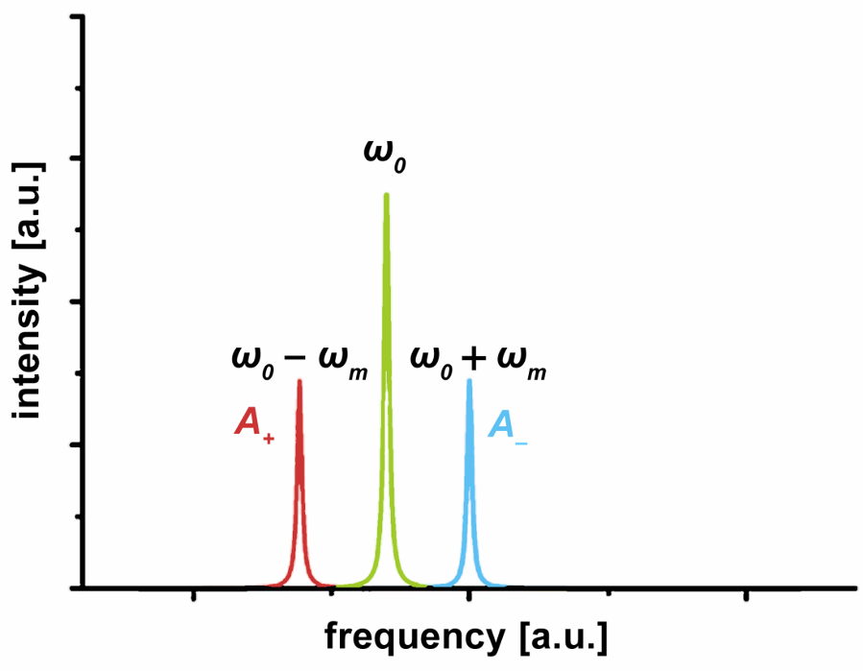
Cavity-Assisted Laser Cooling
Requirements
*resolved sideband: <n>_{min}=(κ/4ω_{m})²
absence of optical absorption
shot-noise limited optical pump
weak coupling to environment
→ cryogenic cavity (mK temp.)
→ large Q (minimal dissipation)
Laser-cooling via
radiation pressure
α
κ
Q⁻¹
ω_{m}
To achieve full quantum control:
k_{B}T/ħQ << κ << ω_{m}, g₀α
zero entropy
mechanics
strong coupling

Slide 7
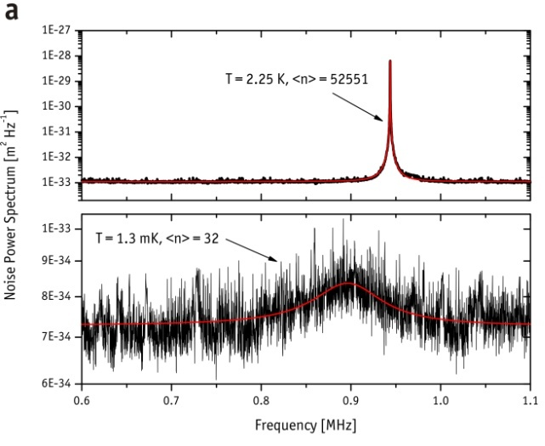
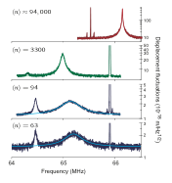
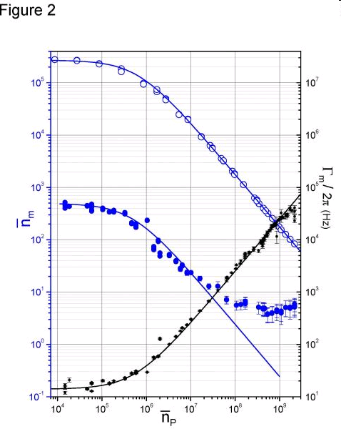
Ultra-Cold Mechanical Systems
Optomechanical Devices
<n> ~ 30
<n> ~ 60
Schliesser et al., Nature Physics 5, 509 (2009)
Gröblacher et al., Nature Physics 5, 485 (2009)
Nanoelectromechanical Systems
→ cooling via microwave photons
Mechanics capacitively coupled to a superconducting microwave resonator
<n> ~ 4
Rocheleau et al., Nature 463, 72 (2010)

Slide 8
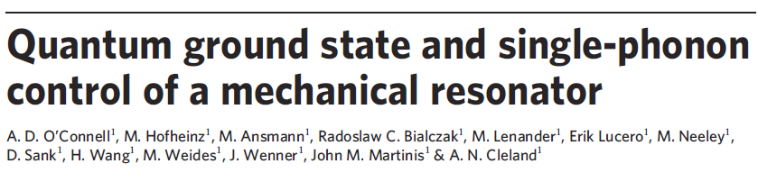
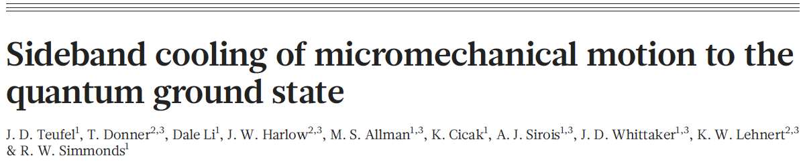
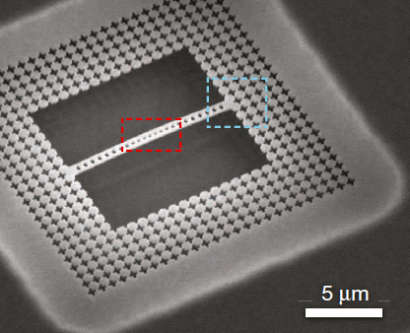
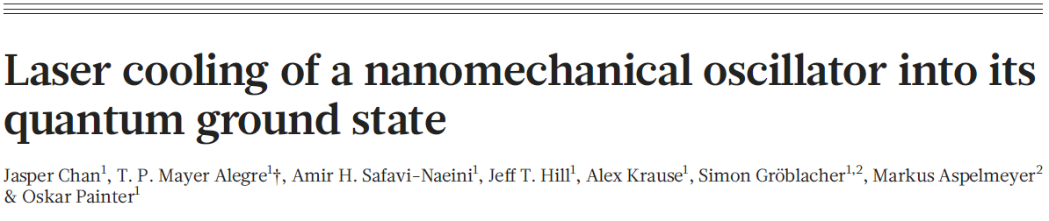
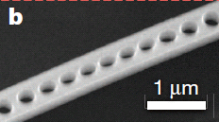
Mechanics in the Quantum Regime
Nature 464, 697-703 (2010)
Nature 475, 359-363 (2011)
Nature 478, 89-92 (2011)

Slide 9
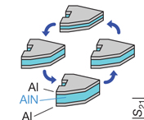
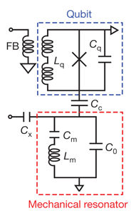
Single-Phonon Control of a Resonator
Ramsey-type interference
Qubit-coupled 6 GHz piezoelectric bulk acoustic wave resonator
  conventional cooling to reach ground state (<n> ~ 0.07 at 20 mK)
Single-phonon readout and quantum control is the key advancement
  verification of ground-state and qubit-resonator swap oscillations
  generation of coherent phonon states in the resonator via the qubit
O’Connell, et al. Nature. 464, 697 (2010)

Slide 10
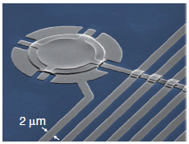
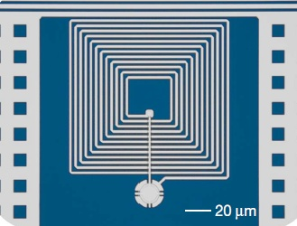
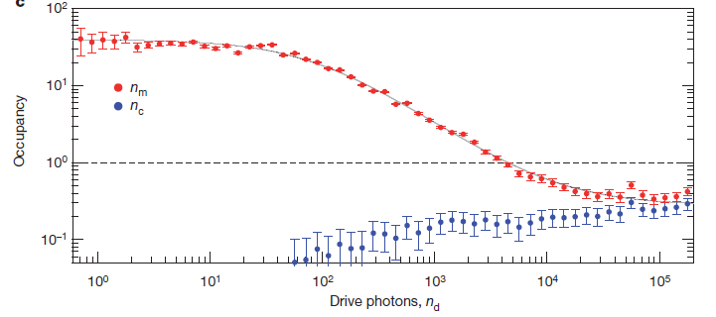
Sideband Cooling with Microwaves
Mechanical resonator coupled to a µ-wave resonant circuit
  superconducting (Al) vacuum gap capacitor
Membrane motion modulates frequency
  spiral inductor shunted by resonator
  parametric interaction allows for cooling of the membrane motion
<n> ~0.3 and strong coupling achieved
Teufel, et al., Nature, 475, 359 (2010)

Slide 11
Laser Cooling of an OM Crystal
Resonator: single-crystal-silicon-based optomechanical crystal
  simultaneous photonic (1550 nm) and phononic (3.5 GHz) bandgap
Laser-mediated ground-state cooling of a localized mechanical mode
  m_{eff} of 311 fg; Q_{optical} of 4×10⁵ (500 MHz linewidth); Q_{mech} ~1×10⁵
  current performance limited by absorption effects (TPA and FCA)
Chan, et al. Nature, 478, 89 (2011)

Slide 12
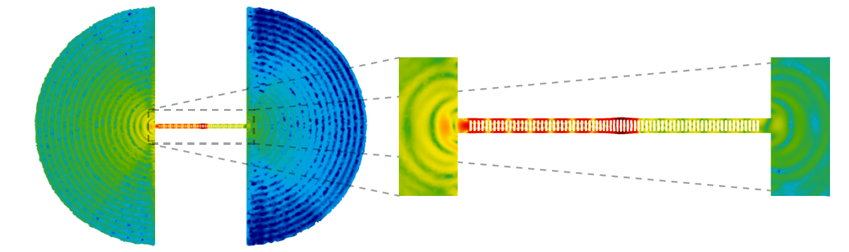
Dissipation: The Root of All Evil
phonon tunneling
confined mode
Mechanical damping is currently the most significant roadblock
  similar requirements as GW systems, particularly Fabry-Pérot implementation
Cavity optomechanics enables exploration of alternatives
  simultaneous high reflectivity and high Q: crystalline materials systems
  eliminating support-induced losses: levitating resonators
M. Eichenfield, J. Chan, R. M. Camacho, K. J. Vahala, O. Painter, Nature (2009)

Slide 13
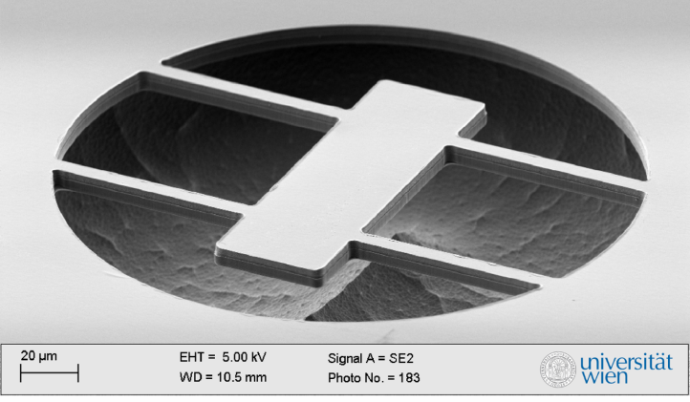
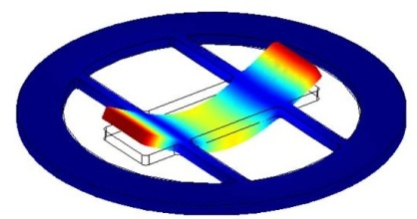
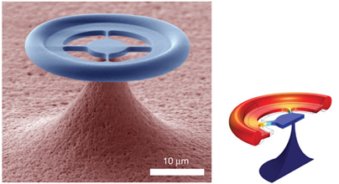
Minimizing Mechanical Losses
Eichenfeld
(2009)
Crystalline Materials
Hybrid Geometry
Phonon Tunneling
Cole
(2011)
Gröblacher
(2009)
Anetsberger
(2008)
Kleckner
(2011)

Slide 14
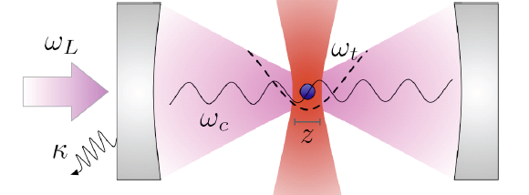
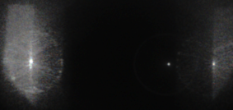
Eliminating the Support Structure
Optically levitated nanospheres
Dielectric particle acts as harmonic oscillator in an all-optical potential
  no anchor losses to degrade Q
Dynamic control of spring constant
  modulation of the confining potential
Quantum-optical control via cavity optomechanics protocols
  radiation pressure interaction for laser cooling, state transfer, etc.
Levitation in Cavity @ 4mbar
Silica
d=250nm
Mirror
Mirror
Generating quantum states of the center-of-mass motion
Laser cooling plus quantum state preparation and transfer
  Barker, PRA 81, 023826 (2010); Chang, PNAS 107, 1005 (2010); Romero-Isart, PRA 83, 013803 (2011)
Superposition, free fall experiments, and interferometry
    Kaltenbaek et al., Exp. Astronomy (2012); Romero-Isart et al., PRL 107, 020405 (2011)

Slide 15
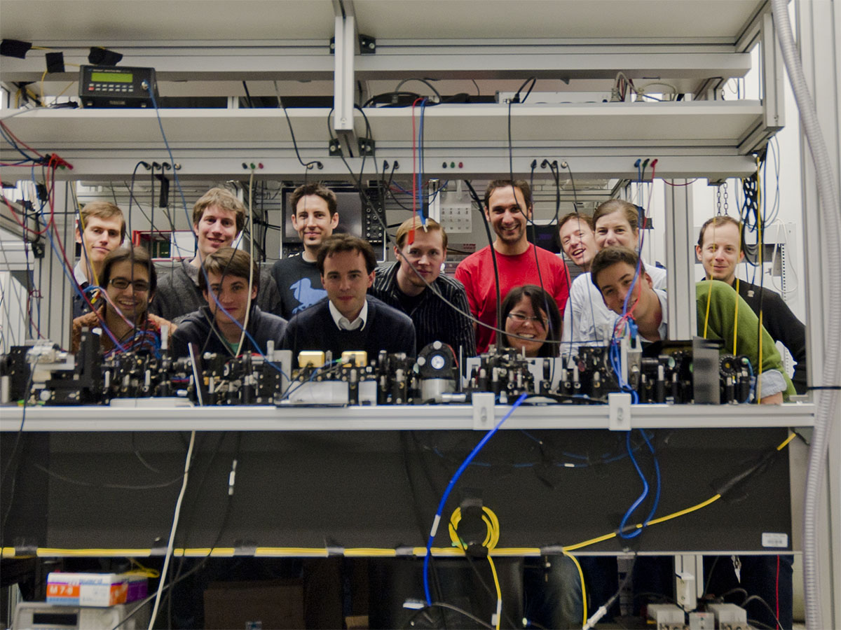








_{Witlef Wieczorek (Humboldt /}
_{Marie Curie)}
Rainer Kaltenbaek (APART / Marie Curie)
_{Michael Vanner (DOC)}
_{Garrett Cole (Marie Curie)}
_{Nikolai Kiesel (Humboldt)}
_{Florian Blaser}
_{Jonas Schmöle}
_{Alex Seiringer}
_{Sebastian Hofer}
_{(CoQuS)}
_{Simon Gröblacher}
_{(Marie Curie)}
_{Markus}
_{Aspelmeyer}
_{Uros Delic}
_{Dilek Demir}
_{+ Alexey Trubarov}
_{+ Katharina Werbach}

Slide 17
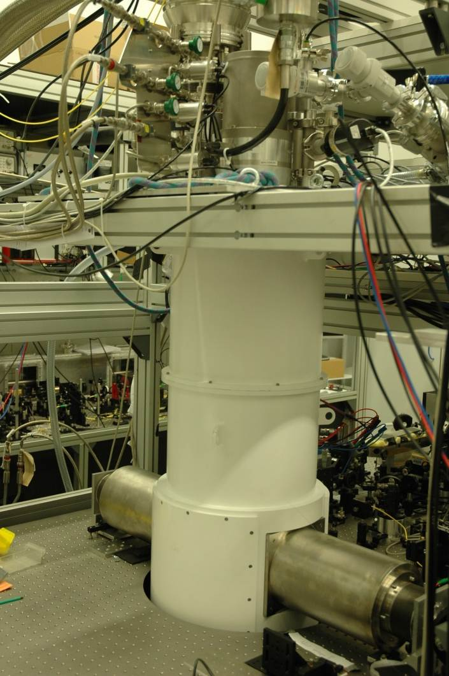
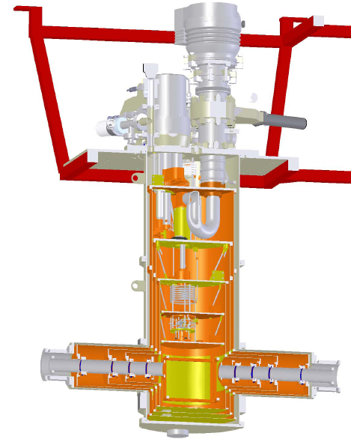
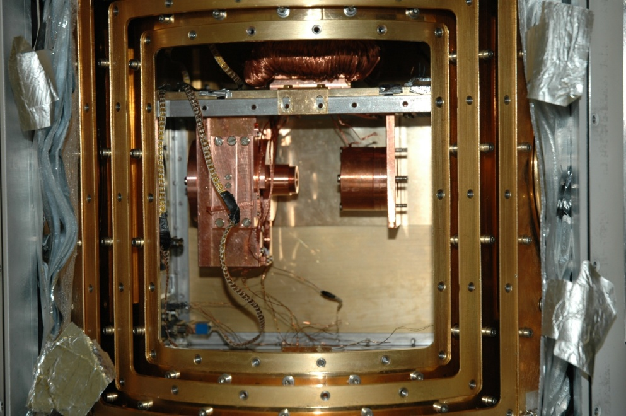
Minimizing the Bath Temperature
Closed cycle dilution fridge with double-sided optical access
Base temperature ~25 mK (no input laser), experiments @ 100 mK
Stable operation of optomechanical cavity recently realized (F >10,000)
k_{B}T/ħQ << κ << ω_{m}, g₀α
floating- suspension
optical access
sample
chamber

Slide 18
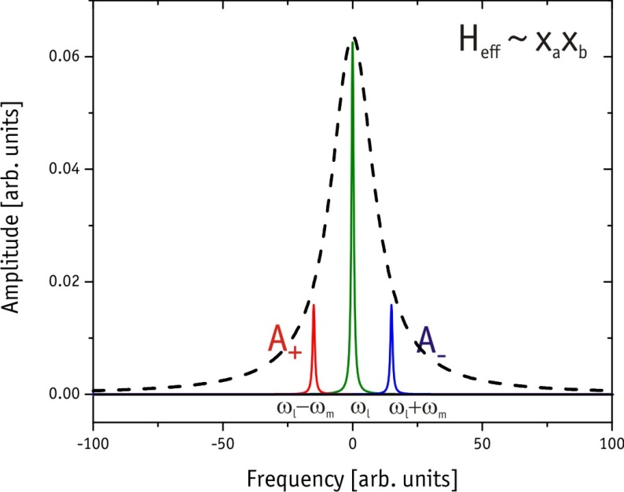
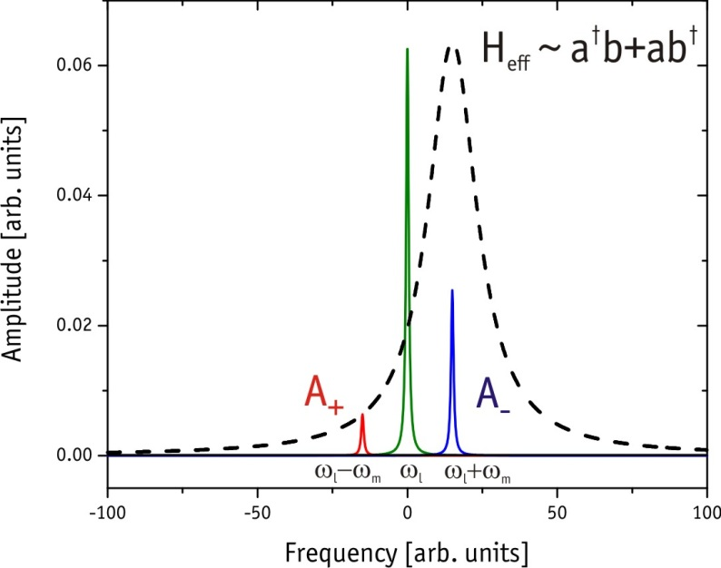
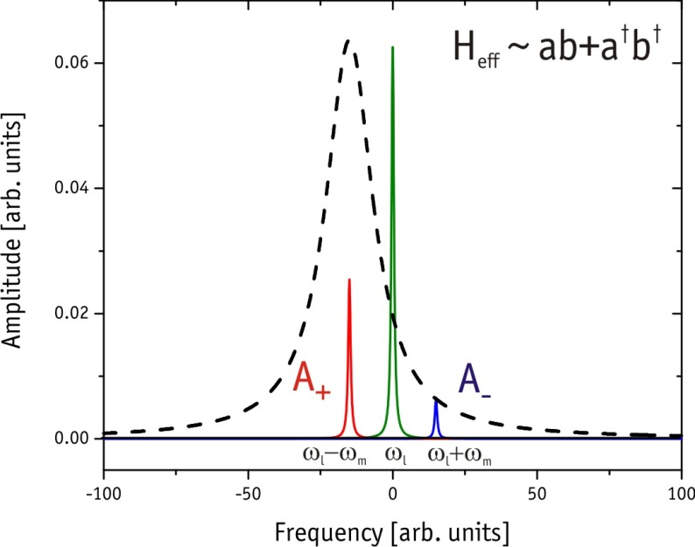
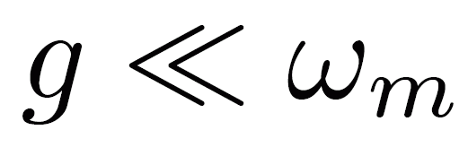
Detuning Driven Interactions
QND
Beamsplitter
TM Squeezer
quantum optics toolbox to prepare and control mechanical states via photonic states
approximations:
-linearization
-
J. Zhang et al., PRA 68 (03)
M. Aspelmeyer et al., JOSAB 27 (10)

Slide 19
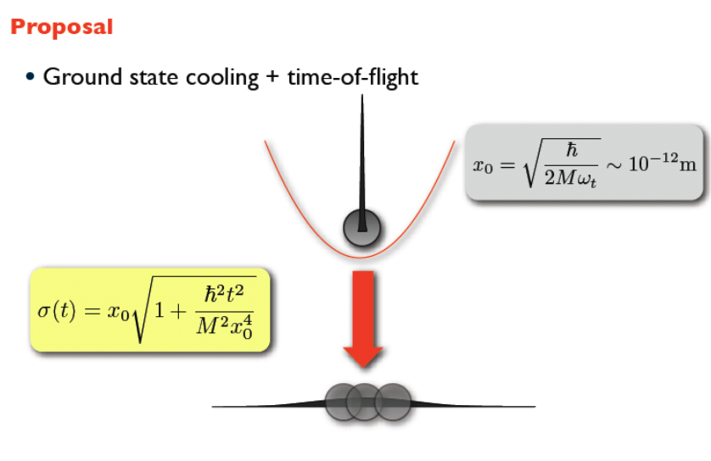
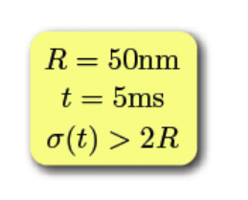
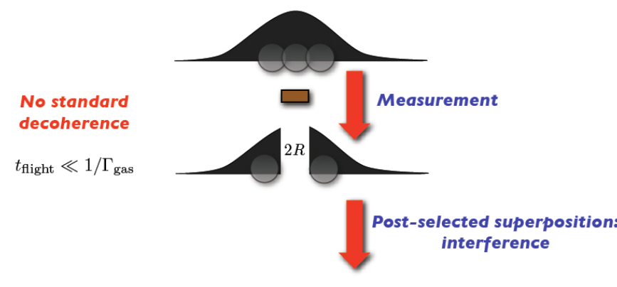
Large Quantum Superpositions
O. Romero-Isart et al., PRL 107, 020405 (2011)

Slide 20
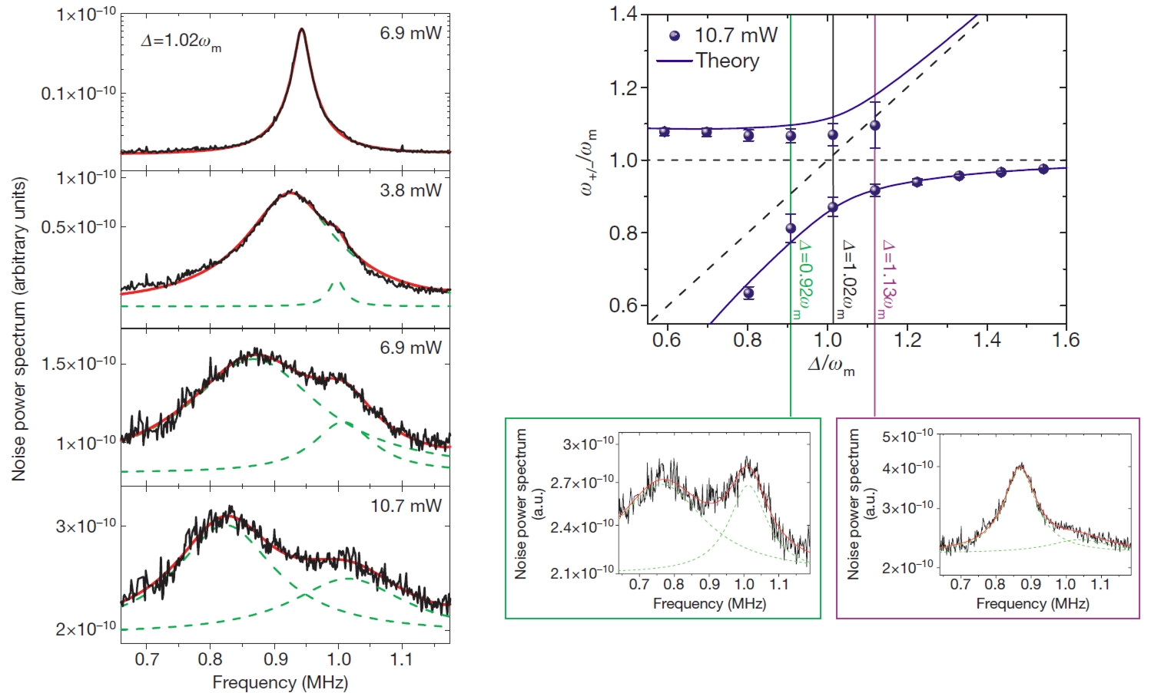
Normal mode splitting
g
0.6
optomechanical normal mode splitting @ RT
g ≈ 2π × 325 kHz
κ= 2π × 215 kHz
𝛾_{m}= 2π × 140 Hz
first observation of strongly coupled micromechanics
S. Gröblacher et al., Nature 460 (09)

Slide 21


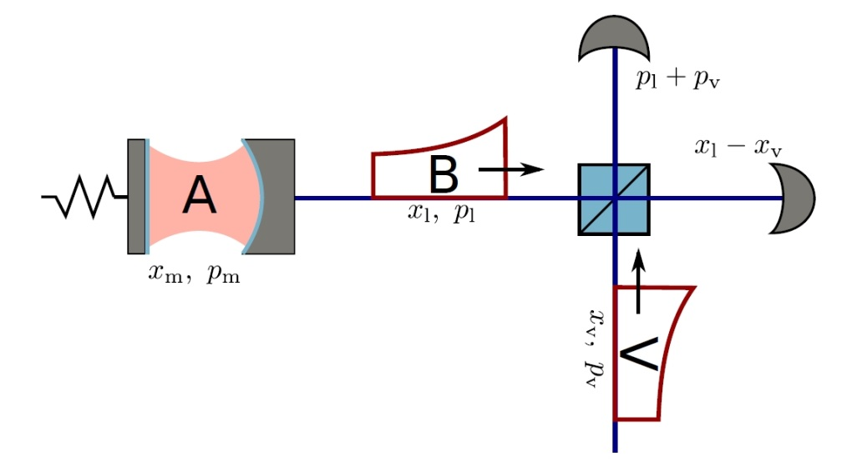

Optomechanical entanglement
Optomechanical correlations: towards EPR
(entangled)
requires: (correlated)
(anticorrelated)
use entanglement for optomechanical teleportation

Slide 22
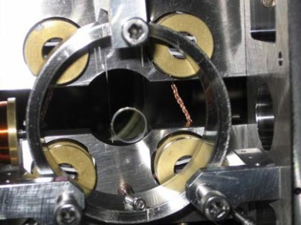
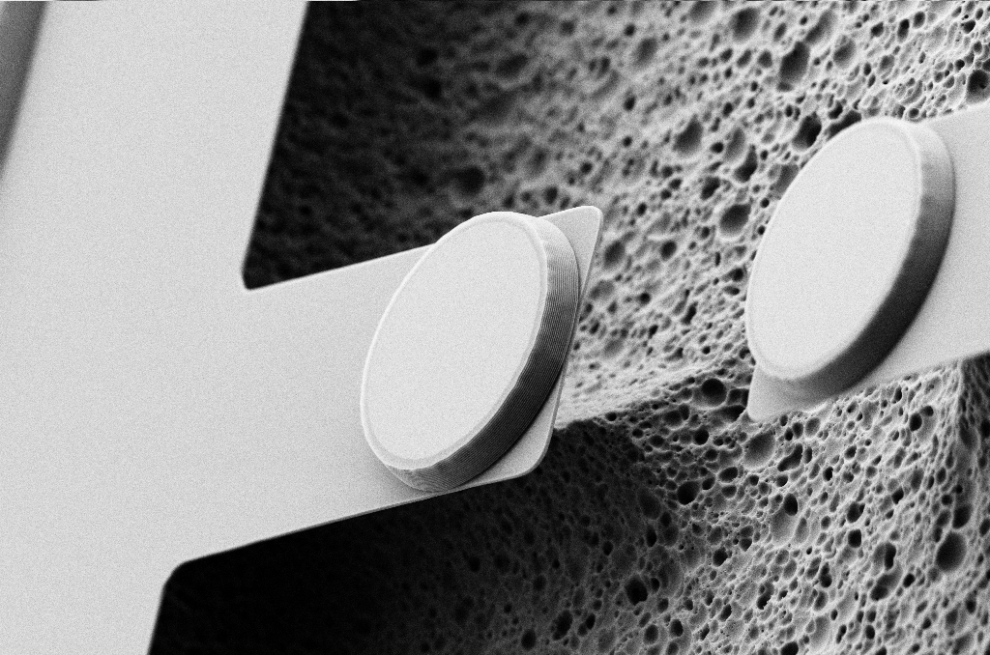
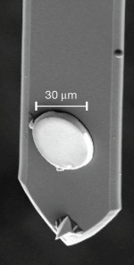
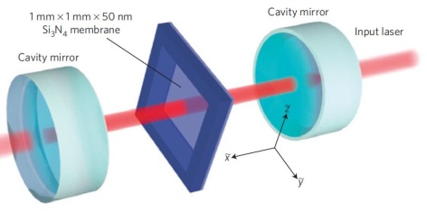
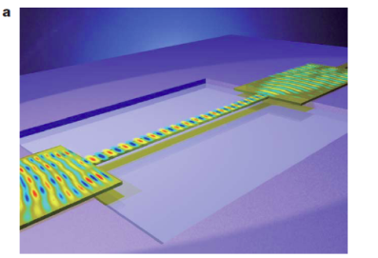
Example Optomechanical Systems
FP cavity
O(kg-ng)
Mavalvala (LIGO, MIT)
Heidman (Paris)
Aspelmeyer (Vienna)
Bouwmeester (UCSB)
Toroidal
microcavity
O(ng)
Kippenberg (Lausanne) Bowen (UQ)
Vahala (Caltech)
Dispersive
coupling
O(zg-ng)
Harris (Yale), Kimble (Caltech)
Karrai (Munich), Favero (Paris)
Gradient
force
O(pg)
Painter (Caltech)
Tang (Yale)
Kippenberg/Weig/Kotthaus
(Munich)

Slide 23
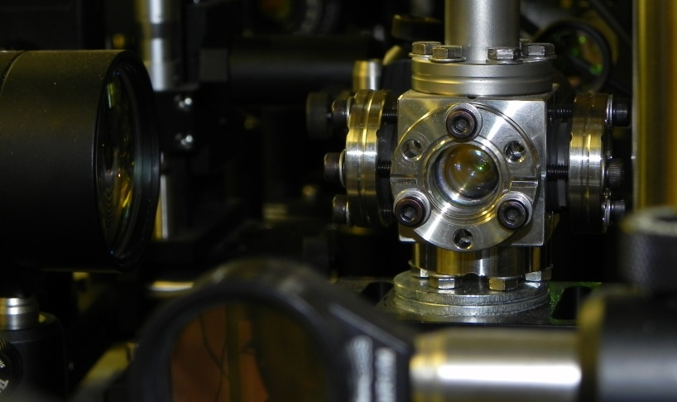

Trapped Nanoparticles in Vienna
Mechanical oscillator…
Ashkin since 1967
Raizen group, Science 2010
Optical trapping… (R~20nm – 2µm)
Thermal noise squeezing of a nanosphere in phase space…
N. Kiesel, F. Blaser, U. Delic, M. Aspelmeyer (unpublished)

