Slide 1
Hierarchical Control Notes – Blending Style
Follows quad example
Note: coil drivers and ESD are LASTI style; seismic noise is outdated

Slide 2
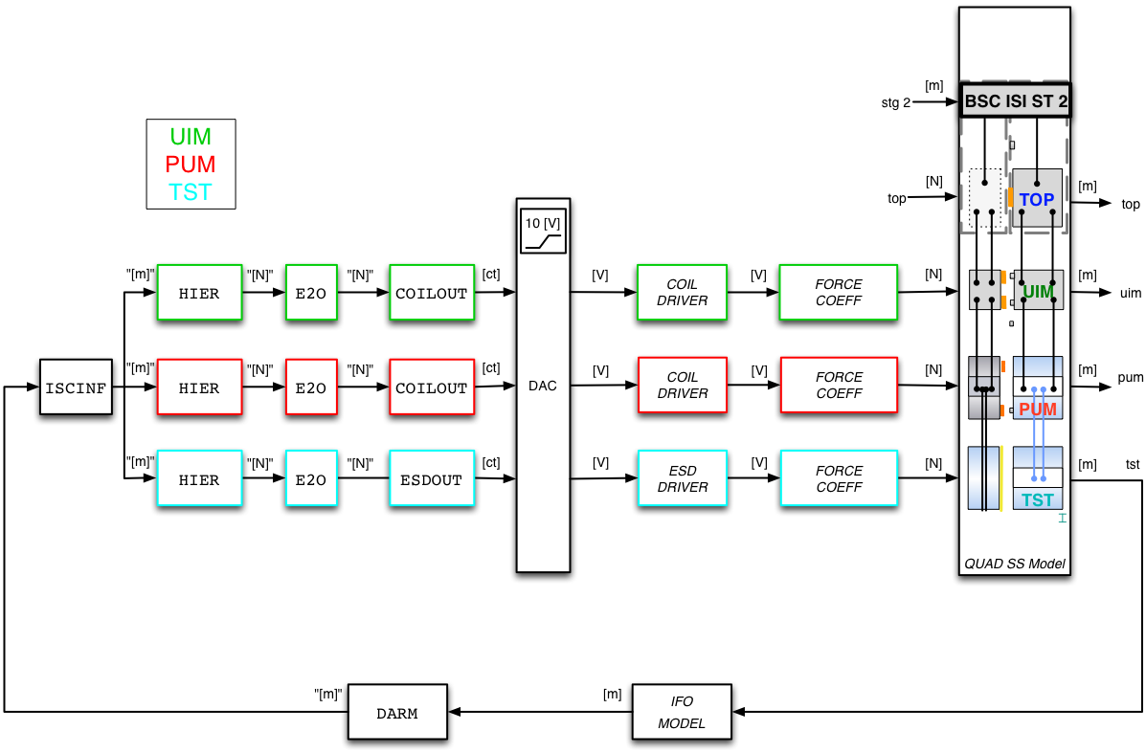
Longitudinal Hierarchical Architecture

Slide 3
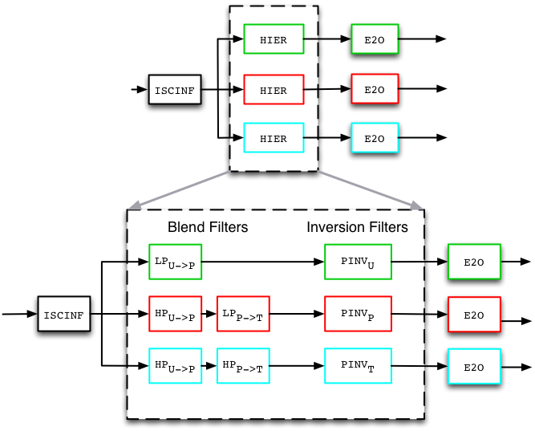
Longitudinal Hierarchical Architecture
Low Pass = “LP”
High Pass = “HP”

Slide 4
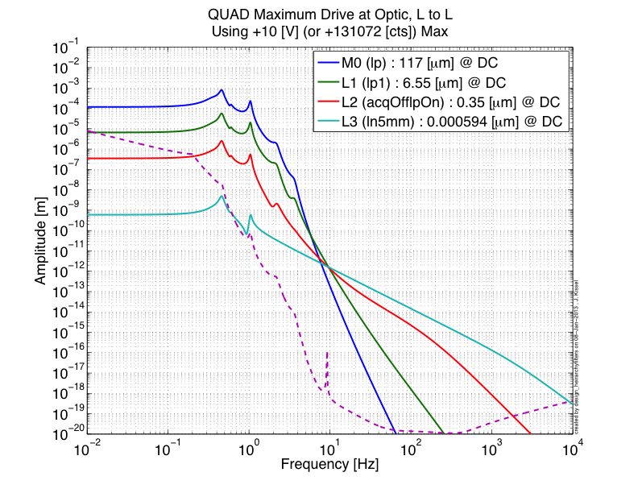
Complimentary Blend Filter Design
Blend Design Process:
Chose blend frequencies based on actuator range cross overs
The high pass filters are generated as compliments of the low pass filters, so only low pass filter design is needed
Start building blends from UIM Low Pass (LP_{U->P})
Work your way through the filters down to TST Low Pass (HP_{P->T})

Slide 5
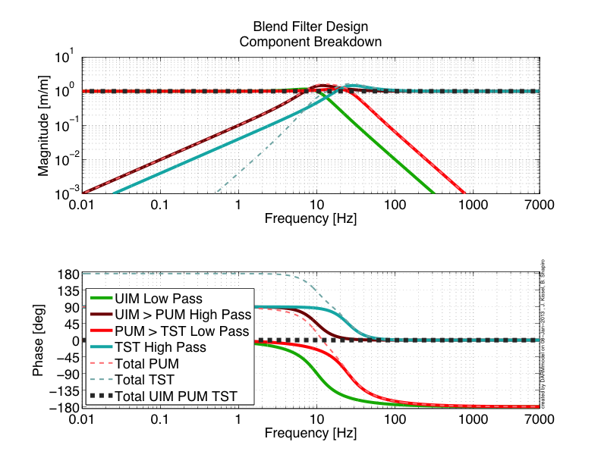
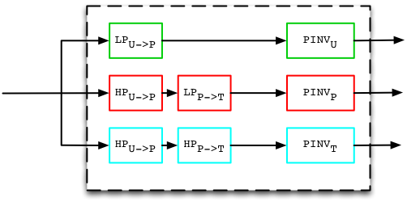
Complimentary Blend Filter Design
Our first attempt at the design:
The UIM Low Pass (LP_{U->P}) is just a complex pair of poles at UIM / PUM crossover (@ 8 Hz, 60 deg phase)
The PUM High Pass (HP_{U->P}) is the compliment of the UIM Low Pass
The PUM Low Pass (LP_{P->T}) is a pair of complex poles at the PUM / TST crossover (@ 15 Hz, 60 deg phase)
The TST High Pass (HP_{P->T}) is the compliment of the PUM Low Pass

Slide 6
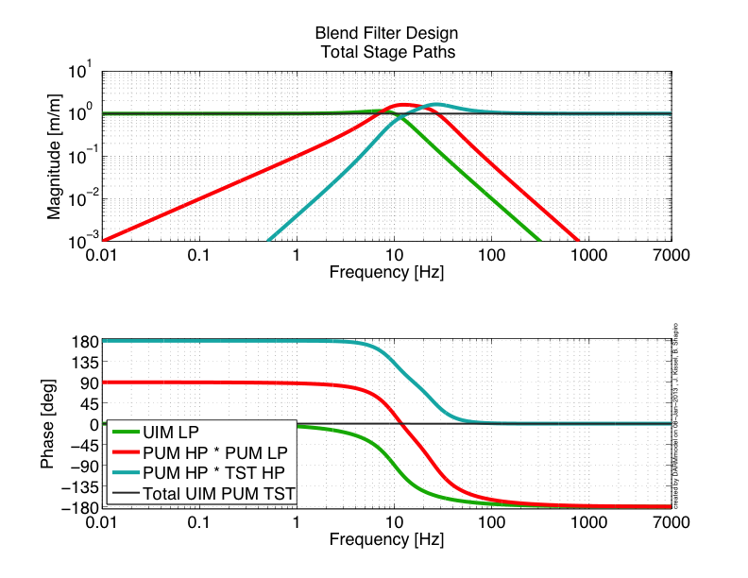
Complimentary Blend Filter Design
TOTAL sums to one
Gain peaking is no more than 2
PUM “band pass” comes up as f^2, false as 1/f^2
TST High Pass comes up as f^4

Slide 7
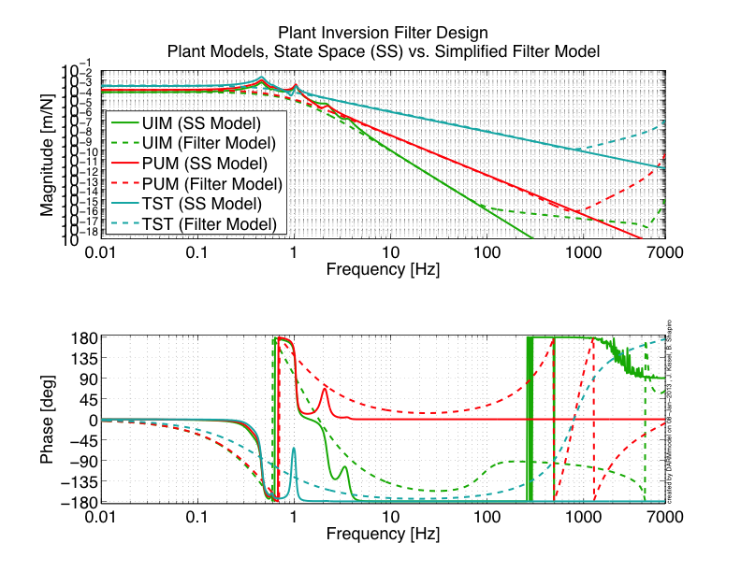
Plant Inversion Filter Design
Complimentary blending/distribution only works if paths are in the same units in the region where the signals are blended
As discussed in G1200632, ISC desires that “from the outside” the transfer function looks as TST Drive > TST Displacment transfer function
So, must invert the *ratio* of dynamics between [UIM or PUM] Drive > TST disp and TST Drive > TST disp
For starters, we use a simplified version of the model that ignores the complicated resonant dynamics (“fit” by hand, and scaled to match the State Space model)
We do include a high-frequency roll-off so gain of inversion filter does not go to infinity
High frequency roll-up to truncate gain
Complicated dynamics are ignored

Slide 8
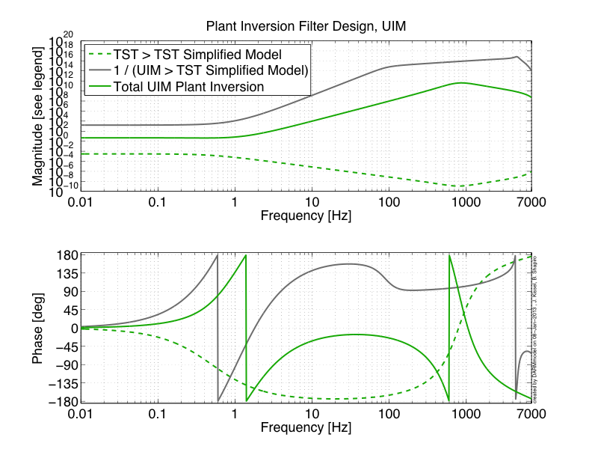
Plant Inversion Filter Design
UIM Example
HF Cut-Off
Total Plant Inversion Filter is ratio:
TST>TST / UIM > TST
Scaled to SS model
f^6
f^4
f^-2
flat at DC
f^-2
Frequency (Hz)

Slide 9
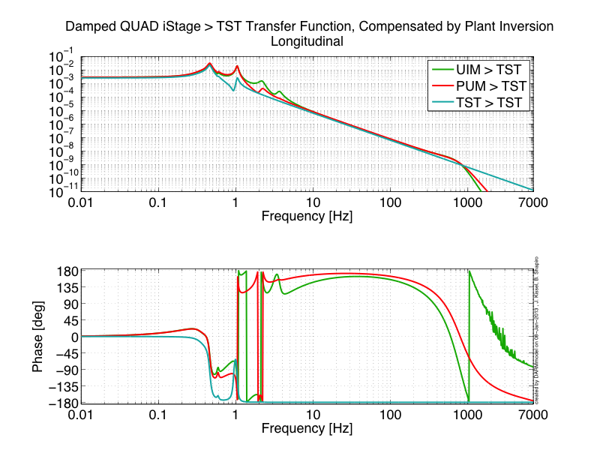
Plant Inversion Filter Design
The same in the region of blending

Slide 10
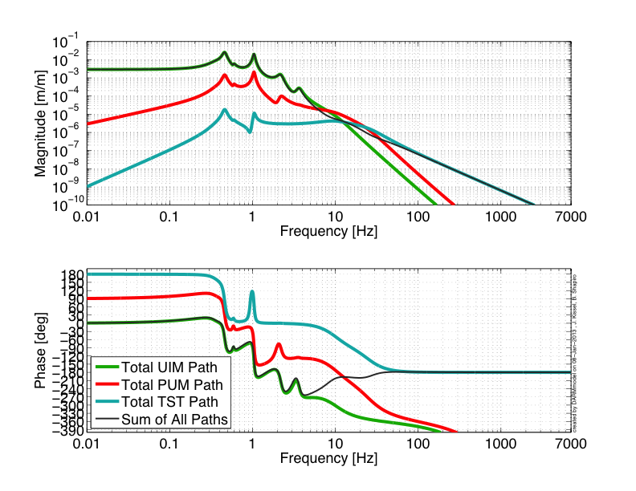
Total Distributed Path Gain
Stability Analysis

Slide 11
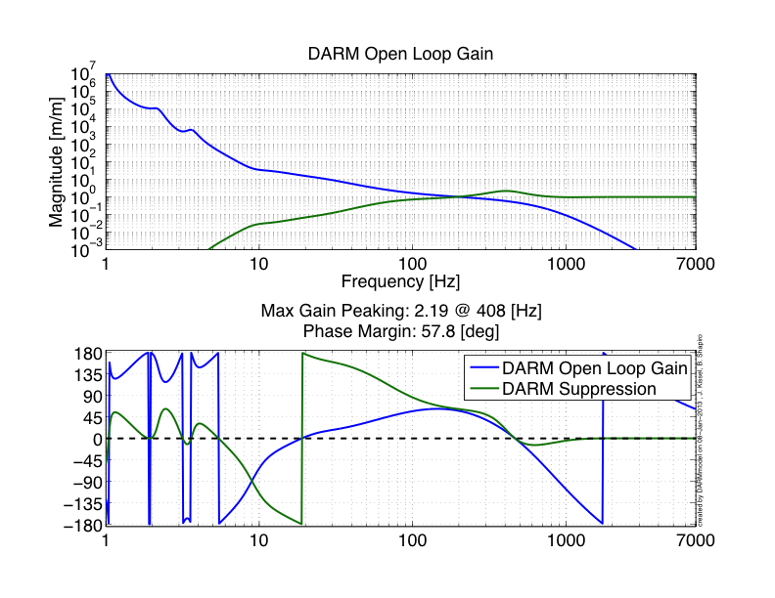
DARM Model

Slide 12
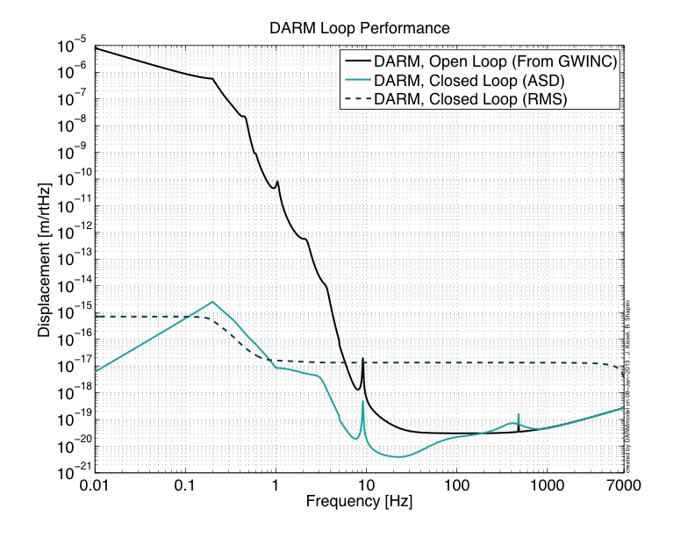
DARM Model

Slide 13
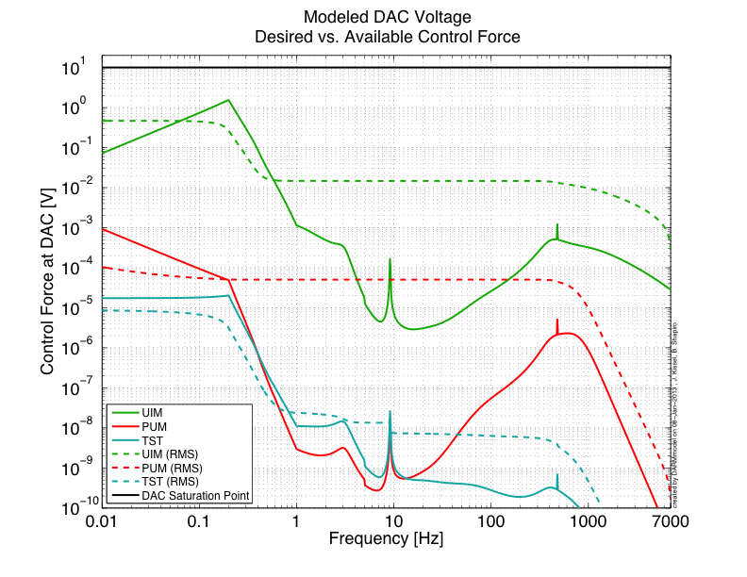
Closed Loop DAC voltages (10 V limit)

