Slide 1

Global longitudinal quad damping vs. local damping
LIGO
Brett Shapiro
Stanford University

Slide 2
Summary
LIGO
Background: local vs. global damping
Part I: global common length damping
  Simulations
  Measurements at 40 m lab
Part II: global differential arm length damping without OSEMs
  Simulations
  Measurements at LIGO Hanford
Conclusions

Slide 3
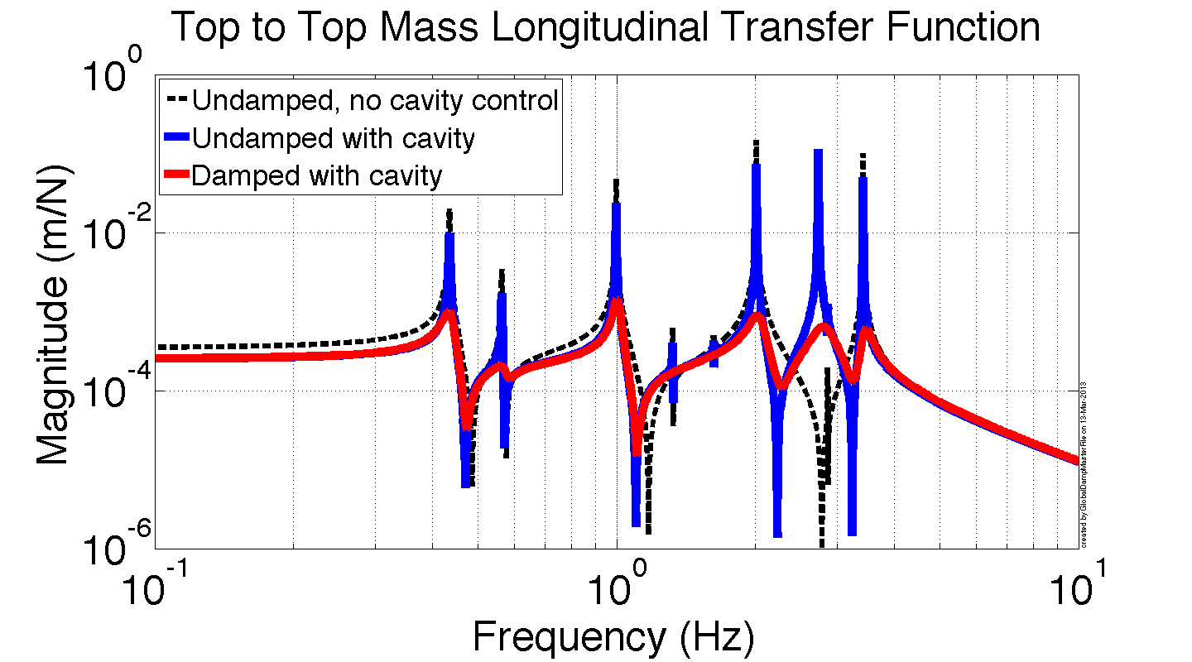
Usual Local Damping
ETMX
ETMY
-1
-1
u_{x,1}
u_{y,1}
u_{x,2}
u_{y,2}
Local damping
Local damping
u_{x,3}
u_{y,3}
The nominal way of damping
OSEM sensor noise coupling to the cavity is non-negligible for these loops.
The cavity control influences the top mass response.
Damping suppresses all Qs
u_{x,4}
u_{y,4}
0.5
Cavity control
0.5

Slide 4
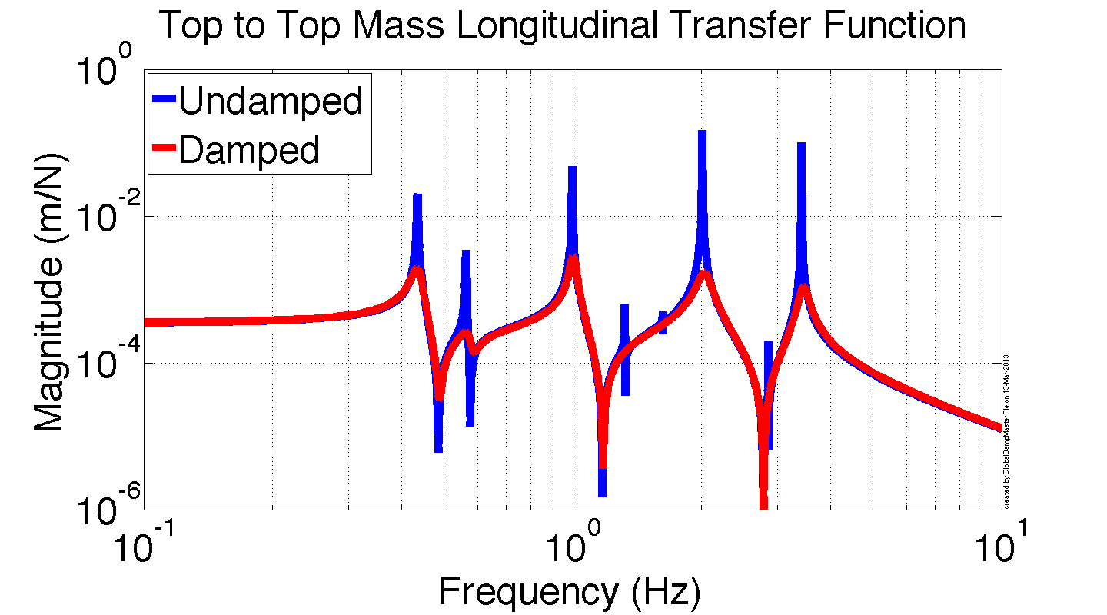
Common Arm Length Damping
ETMX
ETMY
-0.5
+
-0.5
u_{x,1}
u_{y,1}
u_{x,2}
u_{y,2}
Common length damping
Common length DOF independent from cavity control
The global common length damping injects the same sensor noise into both pendulums
Both pendulums are the same, so noise stays in common mode, i.e. no damping noise to cavity!
u_{x,3}
u_{y,3}
u_{x,4}
u_{y,4}
0.5
Cavity control
0.5

Slide 5
Differential Arm Length Trans. Func.
*
*
ETMX
ETMY
longitudinal
-0.5
-
-0.5
u_{x,1}
u_{y,1}
u_{x,2}
u_{y,2}
* Differential top to differential top transfer function
u_{x,3}
u_{y,3}
The differential top mass longitudinal DOF behaves just like a cavity-controlled quad.
Assumes identical quads (ours are pretty darn close).
See `Supporting Math’ slides.
u_{x,4}
u_{y,4}
0.5
Cavity control
0.5

Slide 6
Simulated Common Length Damping
ETMX
ETMY
Realistic quads - errors on the simulated as-built parameters are:
Masses: ± 20 grams
d’s (dn, d1, d3, d4): ± 1 mm
Rotational inertia: ± 3%
Wire lengths: ± 0.25 mm
Vertical stiffness: ± 3%
-0.5
+
-0.5
u_{x,1}
u_{y,1}
u_{x,2}
u_{y,2}
Common length damping
u_{x,3}
u_{y,3}
u_{x,4}
u_{y,4}
0.5
Cavity control
0.5

Slide 7
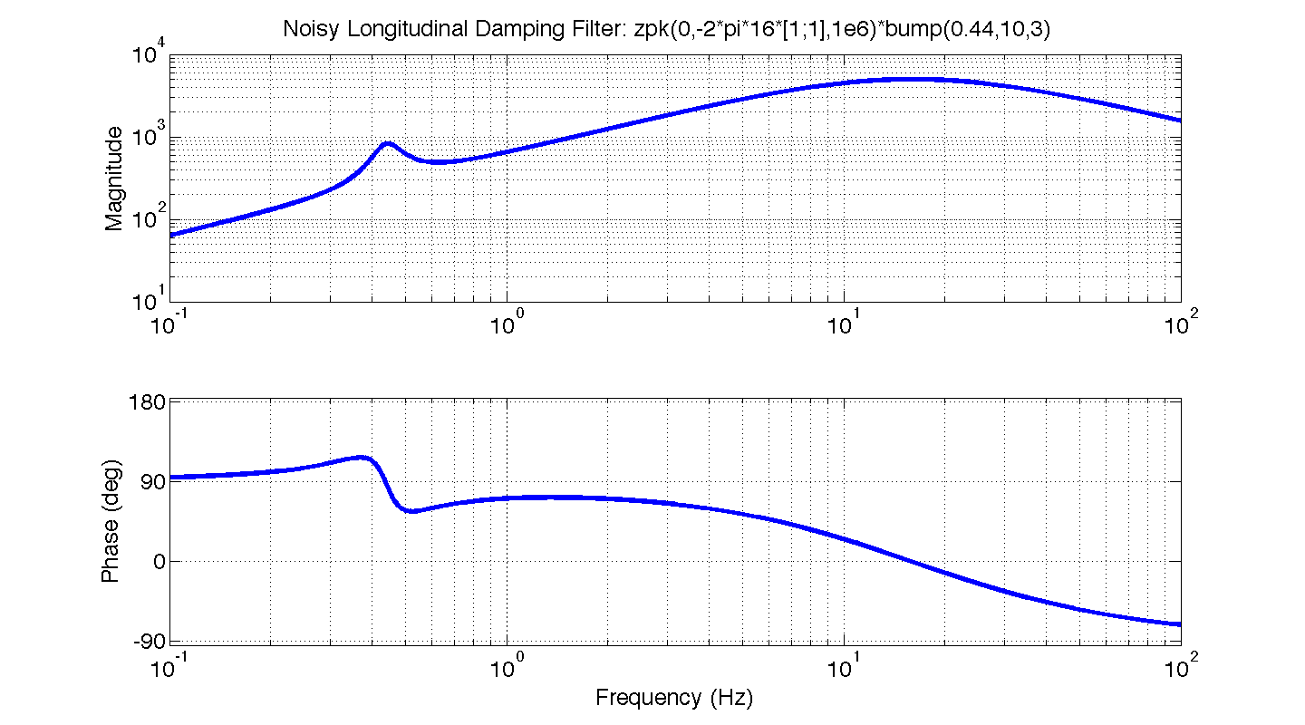
Simulated Common Length Damping

Slide 8
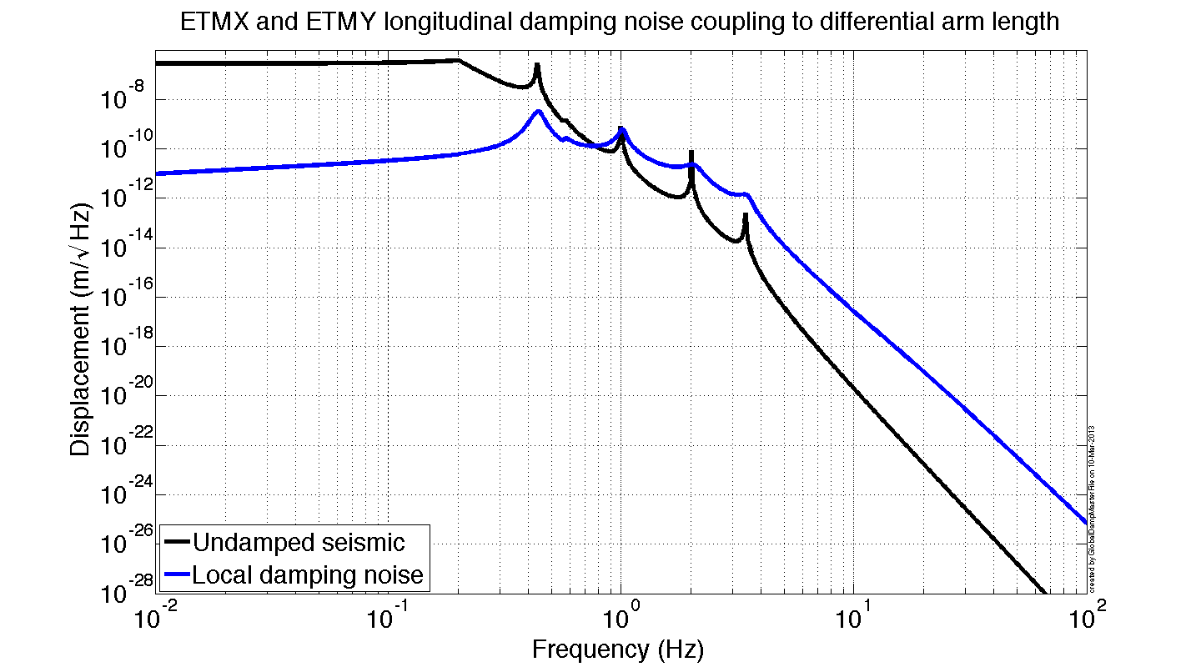
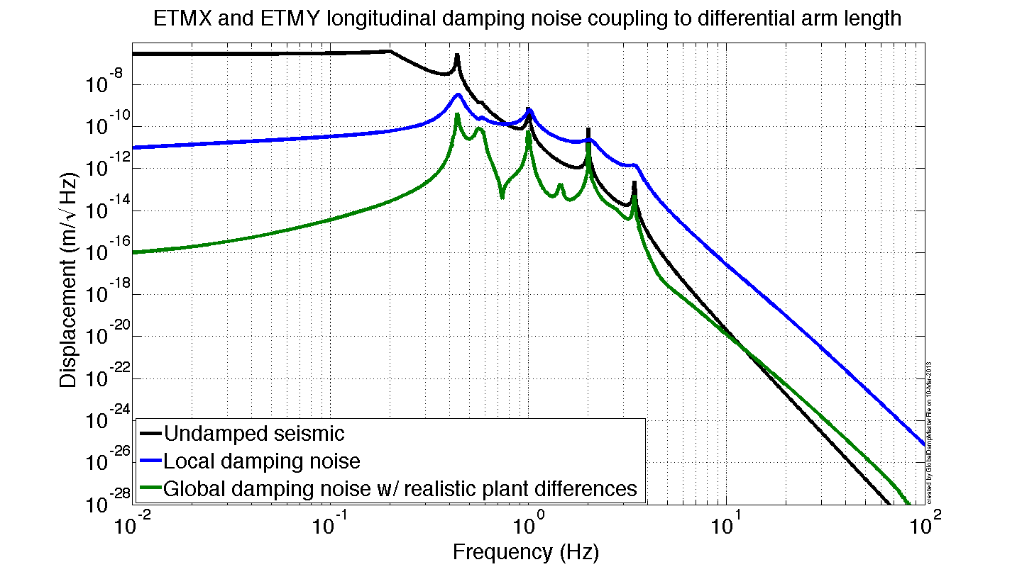
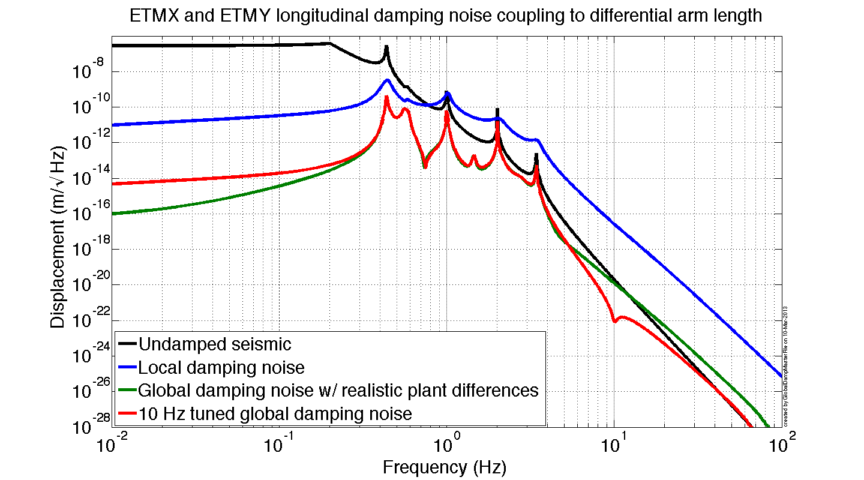
Simulated Damping Noise to Cavity
Red curve achieved by scaling top mass actuators so that TFs to cavity are identical at 10 Hz.

Slide 9
Simulated Damping Ringdown

Slide 10
40 m Lab Noise Measurements
Seismic noise
OSEM sensor noise
Laser frequency noise

Slide 11
40 m Lab Noise Measurements
Ratio of local/global
Local ITMY damping
Global common damping
OSEM noise
+
Damp control
Ideally zero. Magnitude depends on quality of actuator matching.
Plant
cavity signal
Cavity control

Slide 12
40 m Lab Damping Measurements

Slide 13
Differential Arm Length Damping
ETMX
ETMY
*
*
0.5
-
0.5
longitudinal
?
u_{x,2}
u_{y,2}
* Differential top to differential top transfer function
u_{x,3}
u_{y,3}
If we understand how the cavity control produces this mode, can we design a controller that also damps it?
If so, then we can turn off local damping altogether.
u_{x,4}
u_{y,4}
0.5
Control Law
0.5

Slide 14
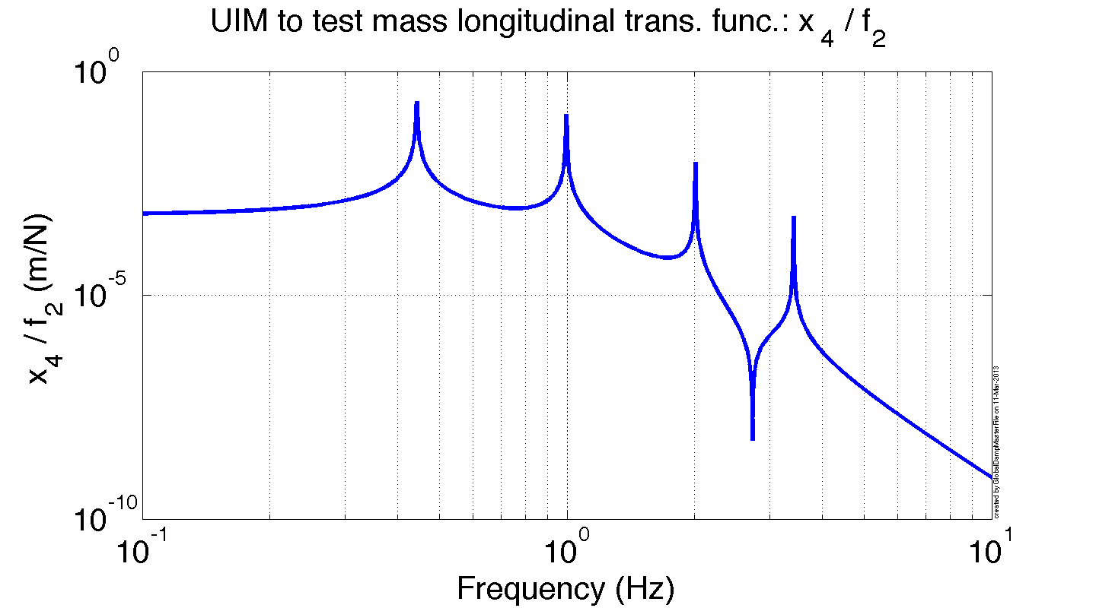
Differential Arm Length Damping
Pendulum 1
f₂
x₄
The new top mass modes come from the zeros of the TF between the highest stage with large cavity UGF and the test mass. See more detailed discussion in the ‘Supporting Math’ section.
This result can be generalized to the zeros in the cavity loop gain transfer functions (based on observations, no hard math yet).

Slide 15
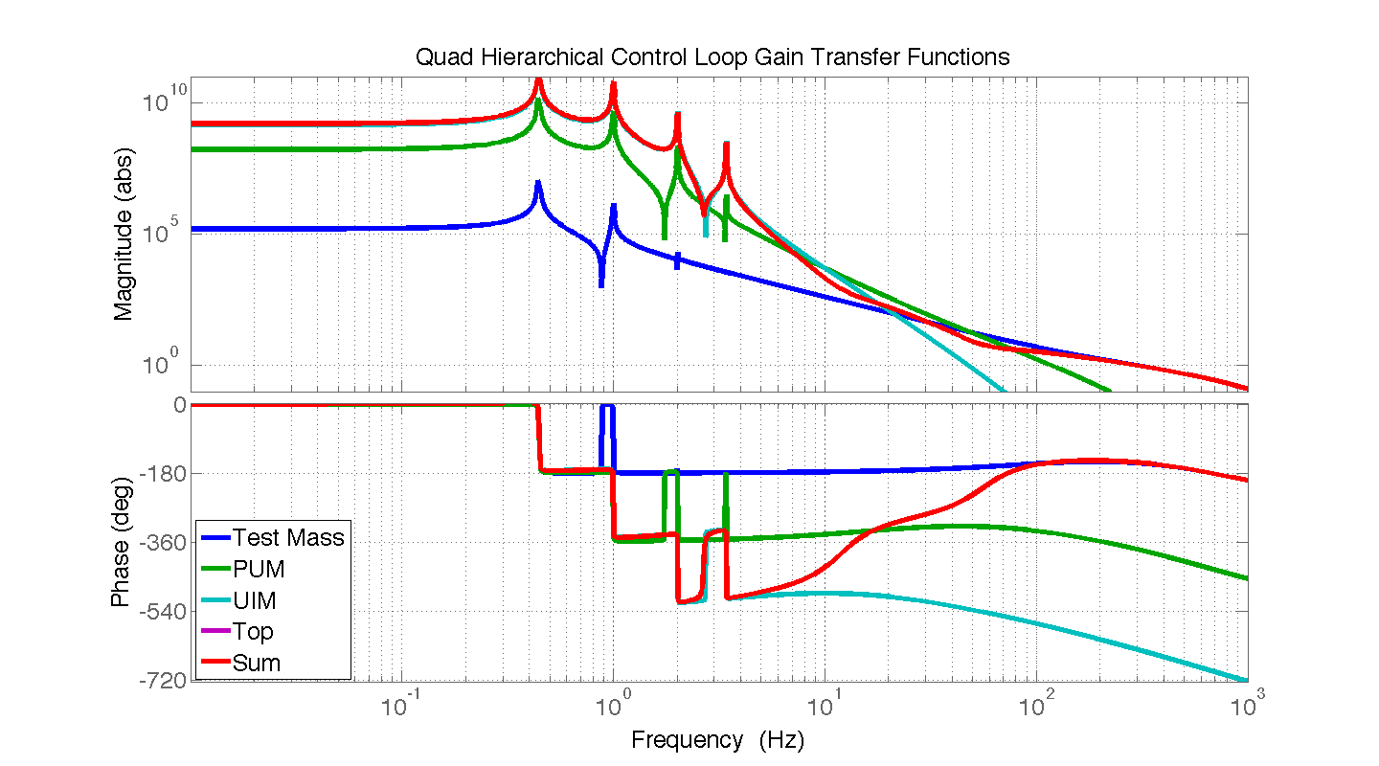
Differential Arm Length Damping
Test UGF: 300 Hz
PUM UGF: 50 Hz
UIM UGF: 10 Hz

Slide 16
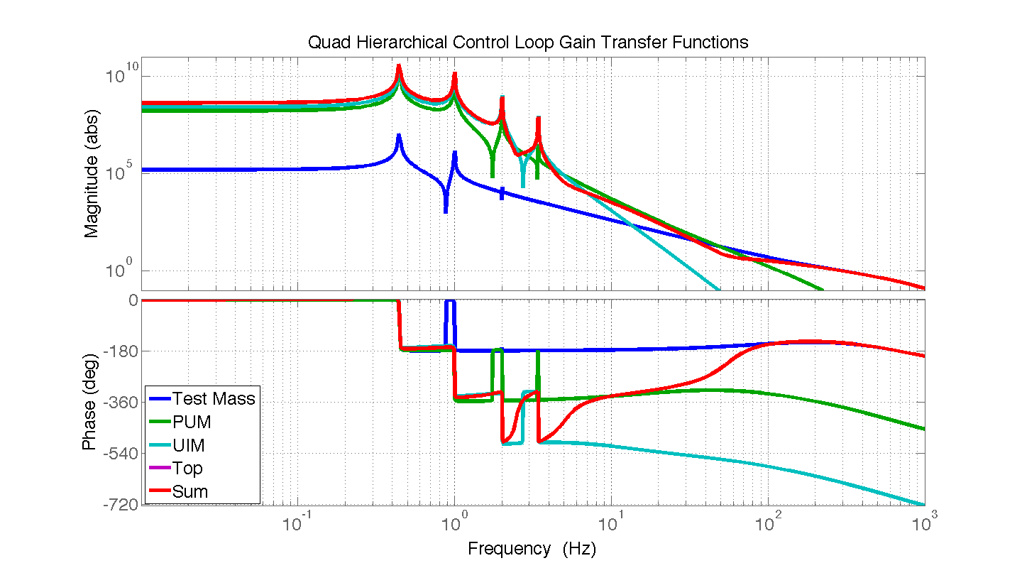
Differential Arm Length Damping
Test UGF: 300 Hz
PUM UGF: 50 Hz
UIM UGF: 5 Hz

Slide 17
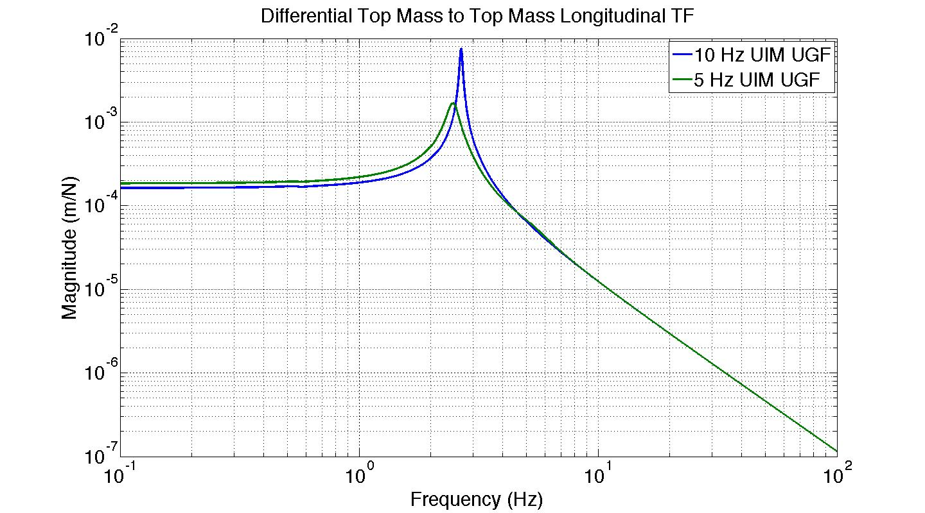
Differential Arm Length Damping
The top mass longitudinal differential mode resulting from the cavity loop gains on the previous slides. Damping is OFF!

Slide 18
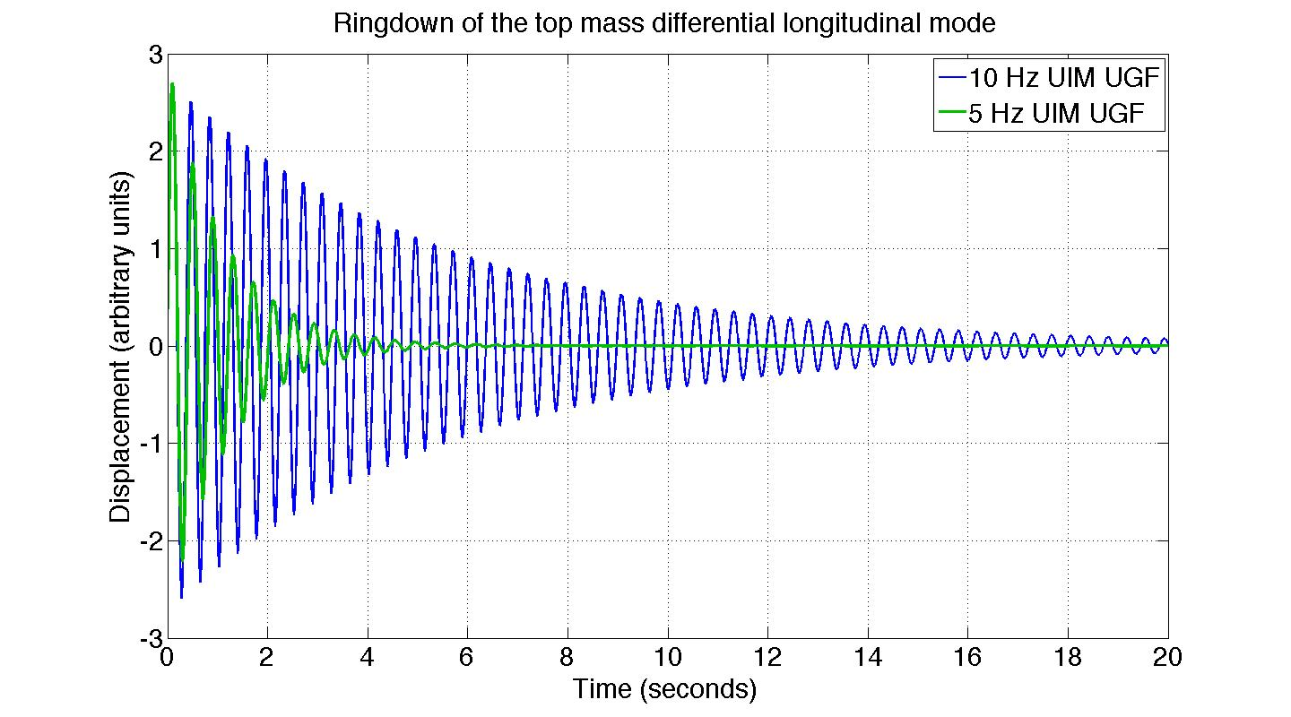
Differential Arm Length Damping
Top mass damping from cavity control. No OSEMs!

Slide 19
LHO Damping Measurements
Setup
MC2 triple suspension
Test procedure
Vary g₂ and observe the changes in the responses of x₁ and the cavity signal to f₁.
Variable gain
f₁
x₁
M1
f₂
Terminology Key
IMC: input mode cleaner,
the cavity that makes the laser beam nice and round
M1: top mass
M2: middle mass
M3: bottom mass
MC2: Mode cleaner triple suspension #2
C₂: M2 feedback filter
C₃: M3 feedback filter
g₂
C₂
M2
f₃
IMC Cavity signal
C₃
M3
-1

Slide 20
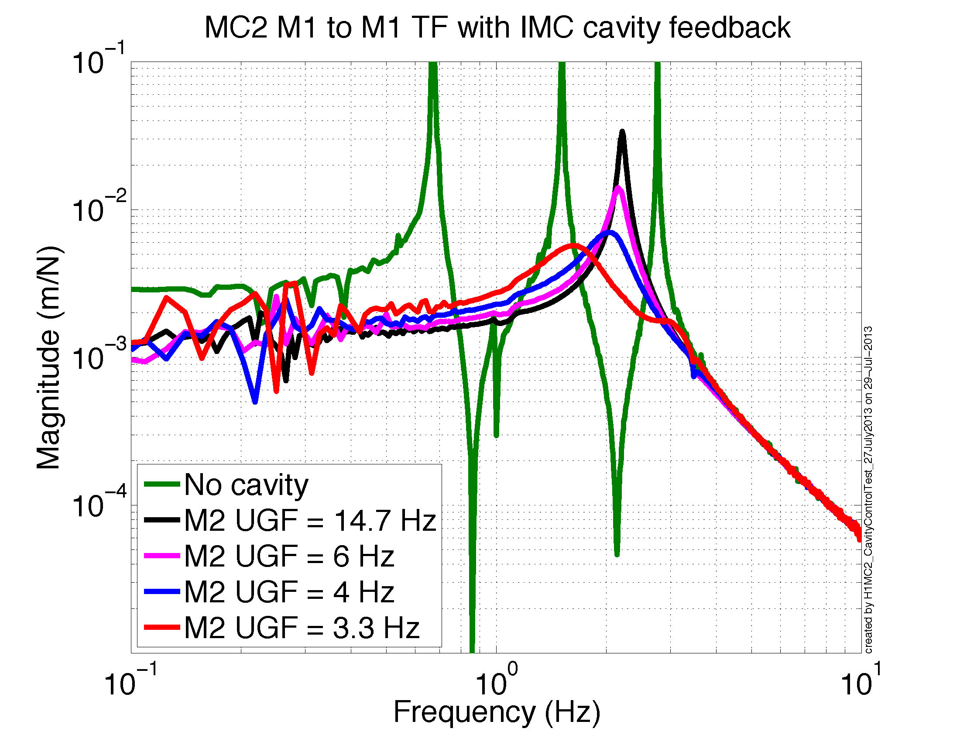
LHO Damping Measurements
Terminology Key
M1: top mass
M2: middle mass
M3: bottom mass
MC2: triple suspension
UGF: unity gain frequency or bandwidth

Slide 21
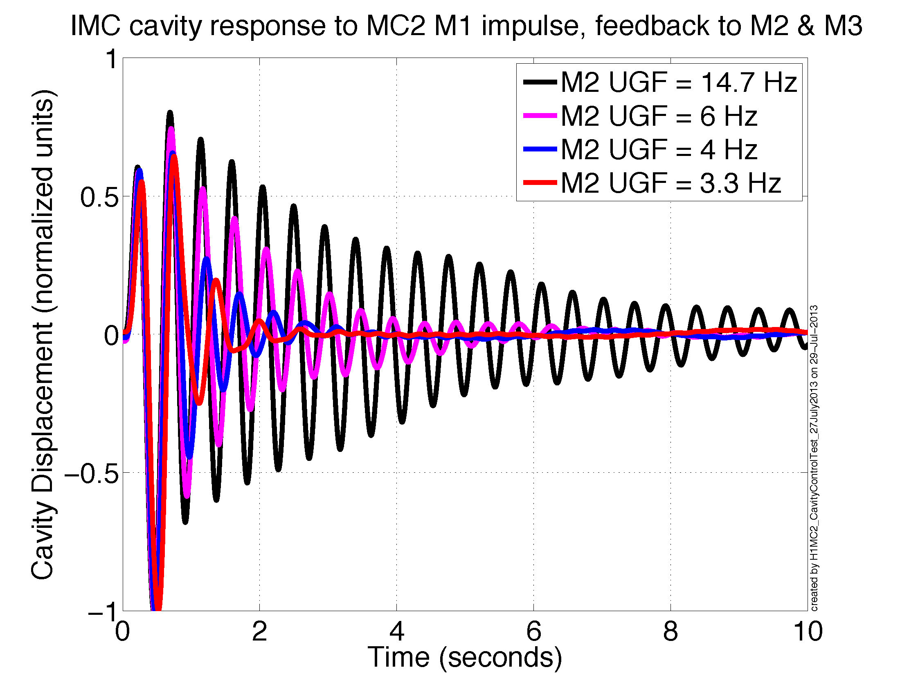
LHO Damping Measurements
Terminology Key
IMC: cavity signal, bottom mass sensor
M1: top mass
M2: middle mass
M3: bottom mass
MC2: triple suspension
UGF: unity gain frequency or bandwidth

Slide 22
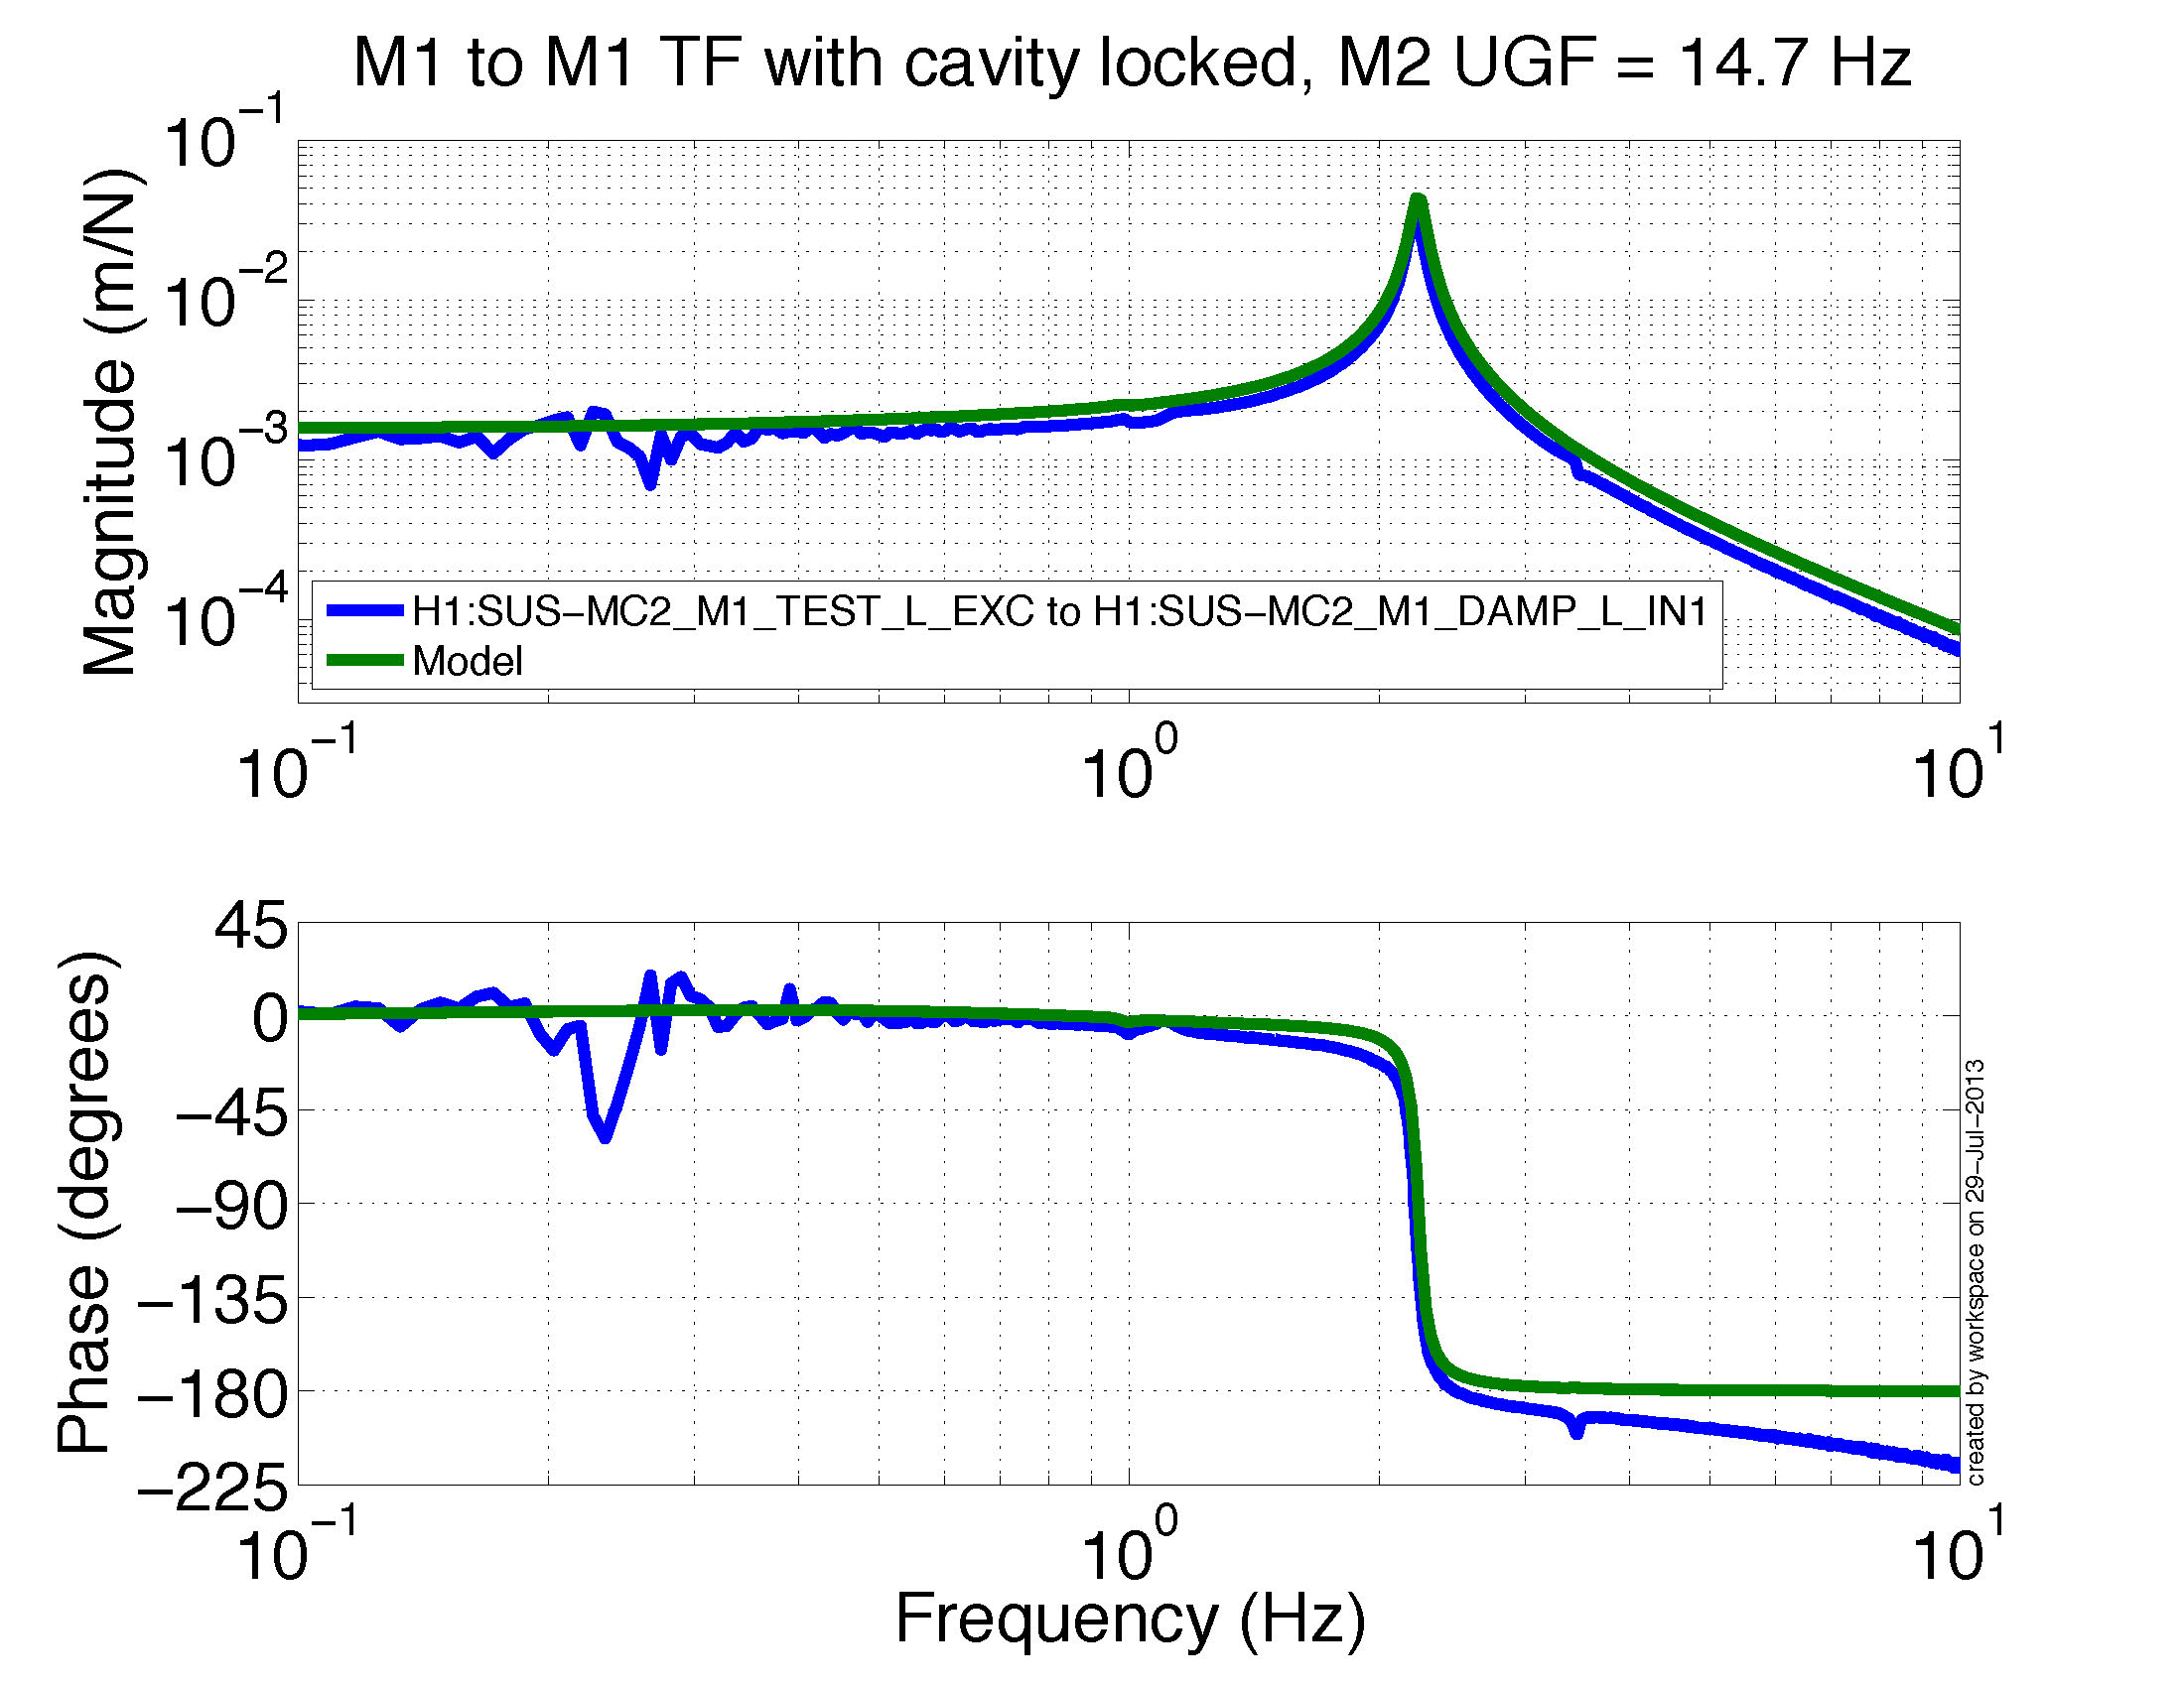

Slide 23
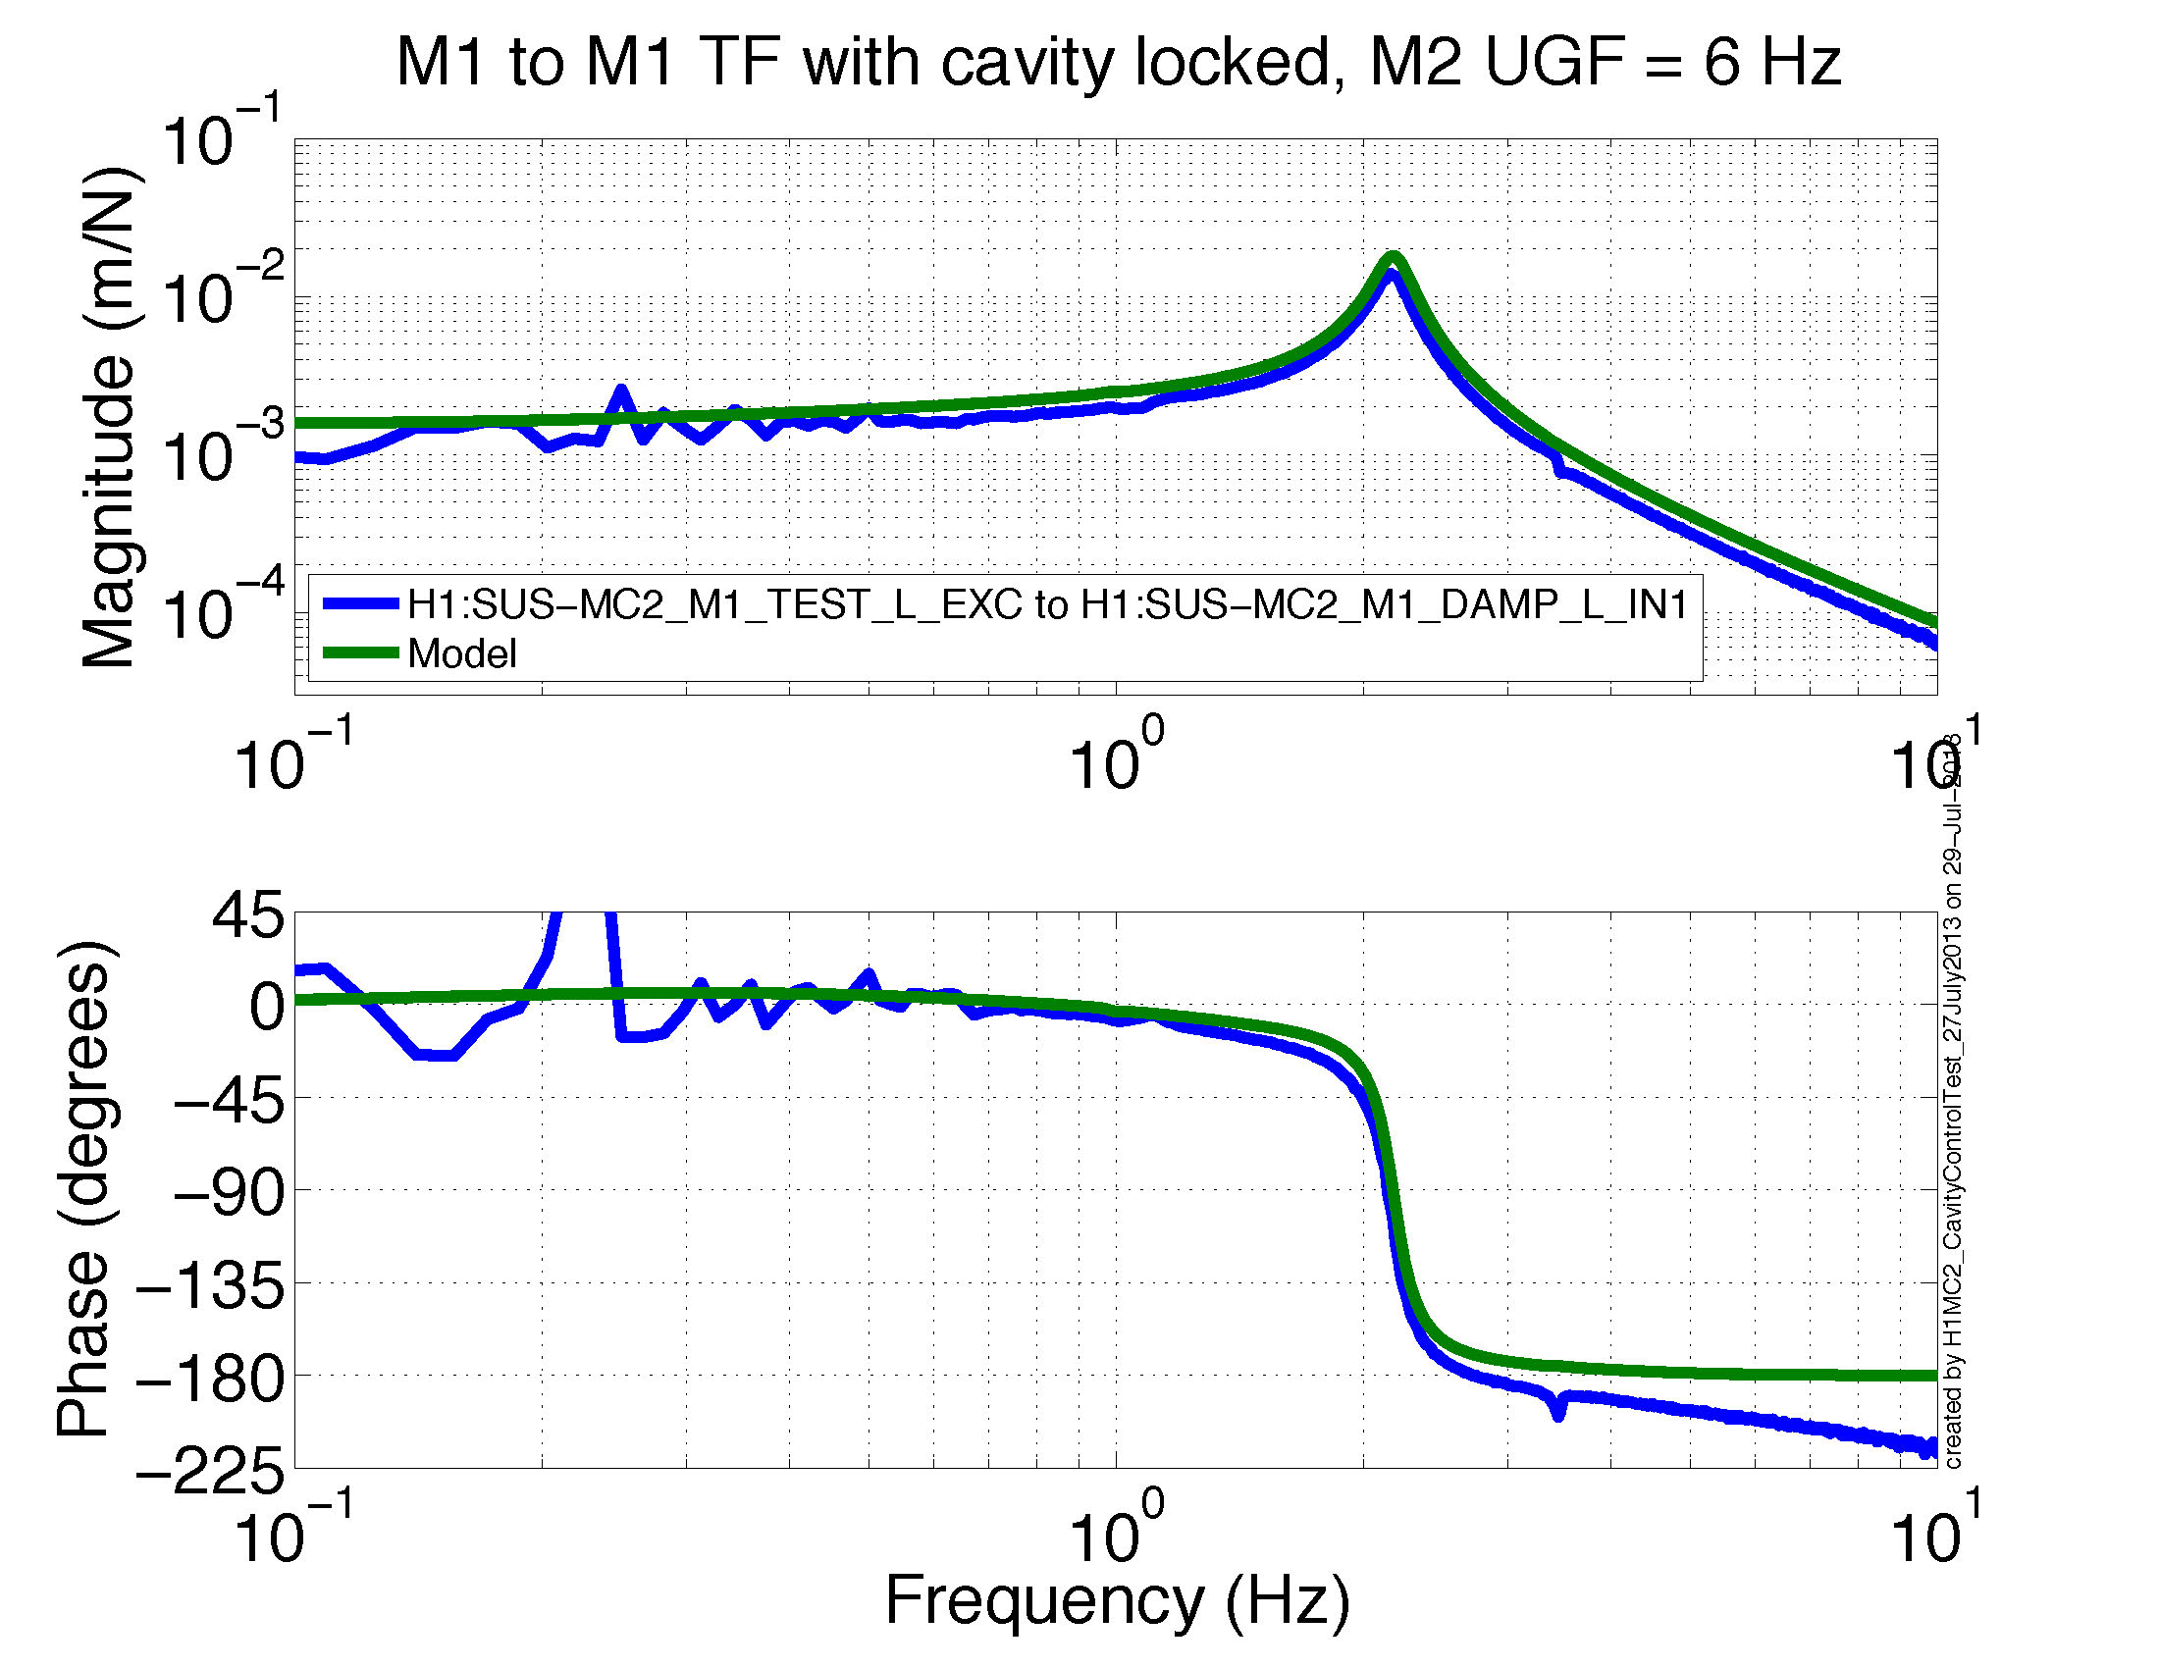

Slide 24
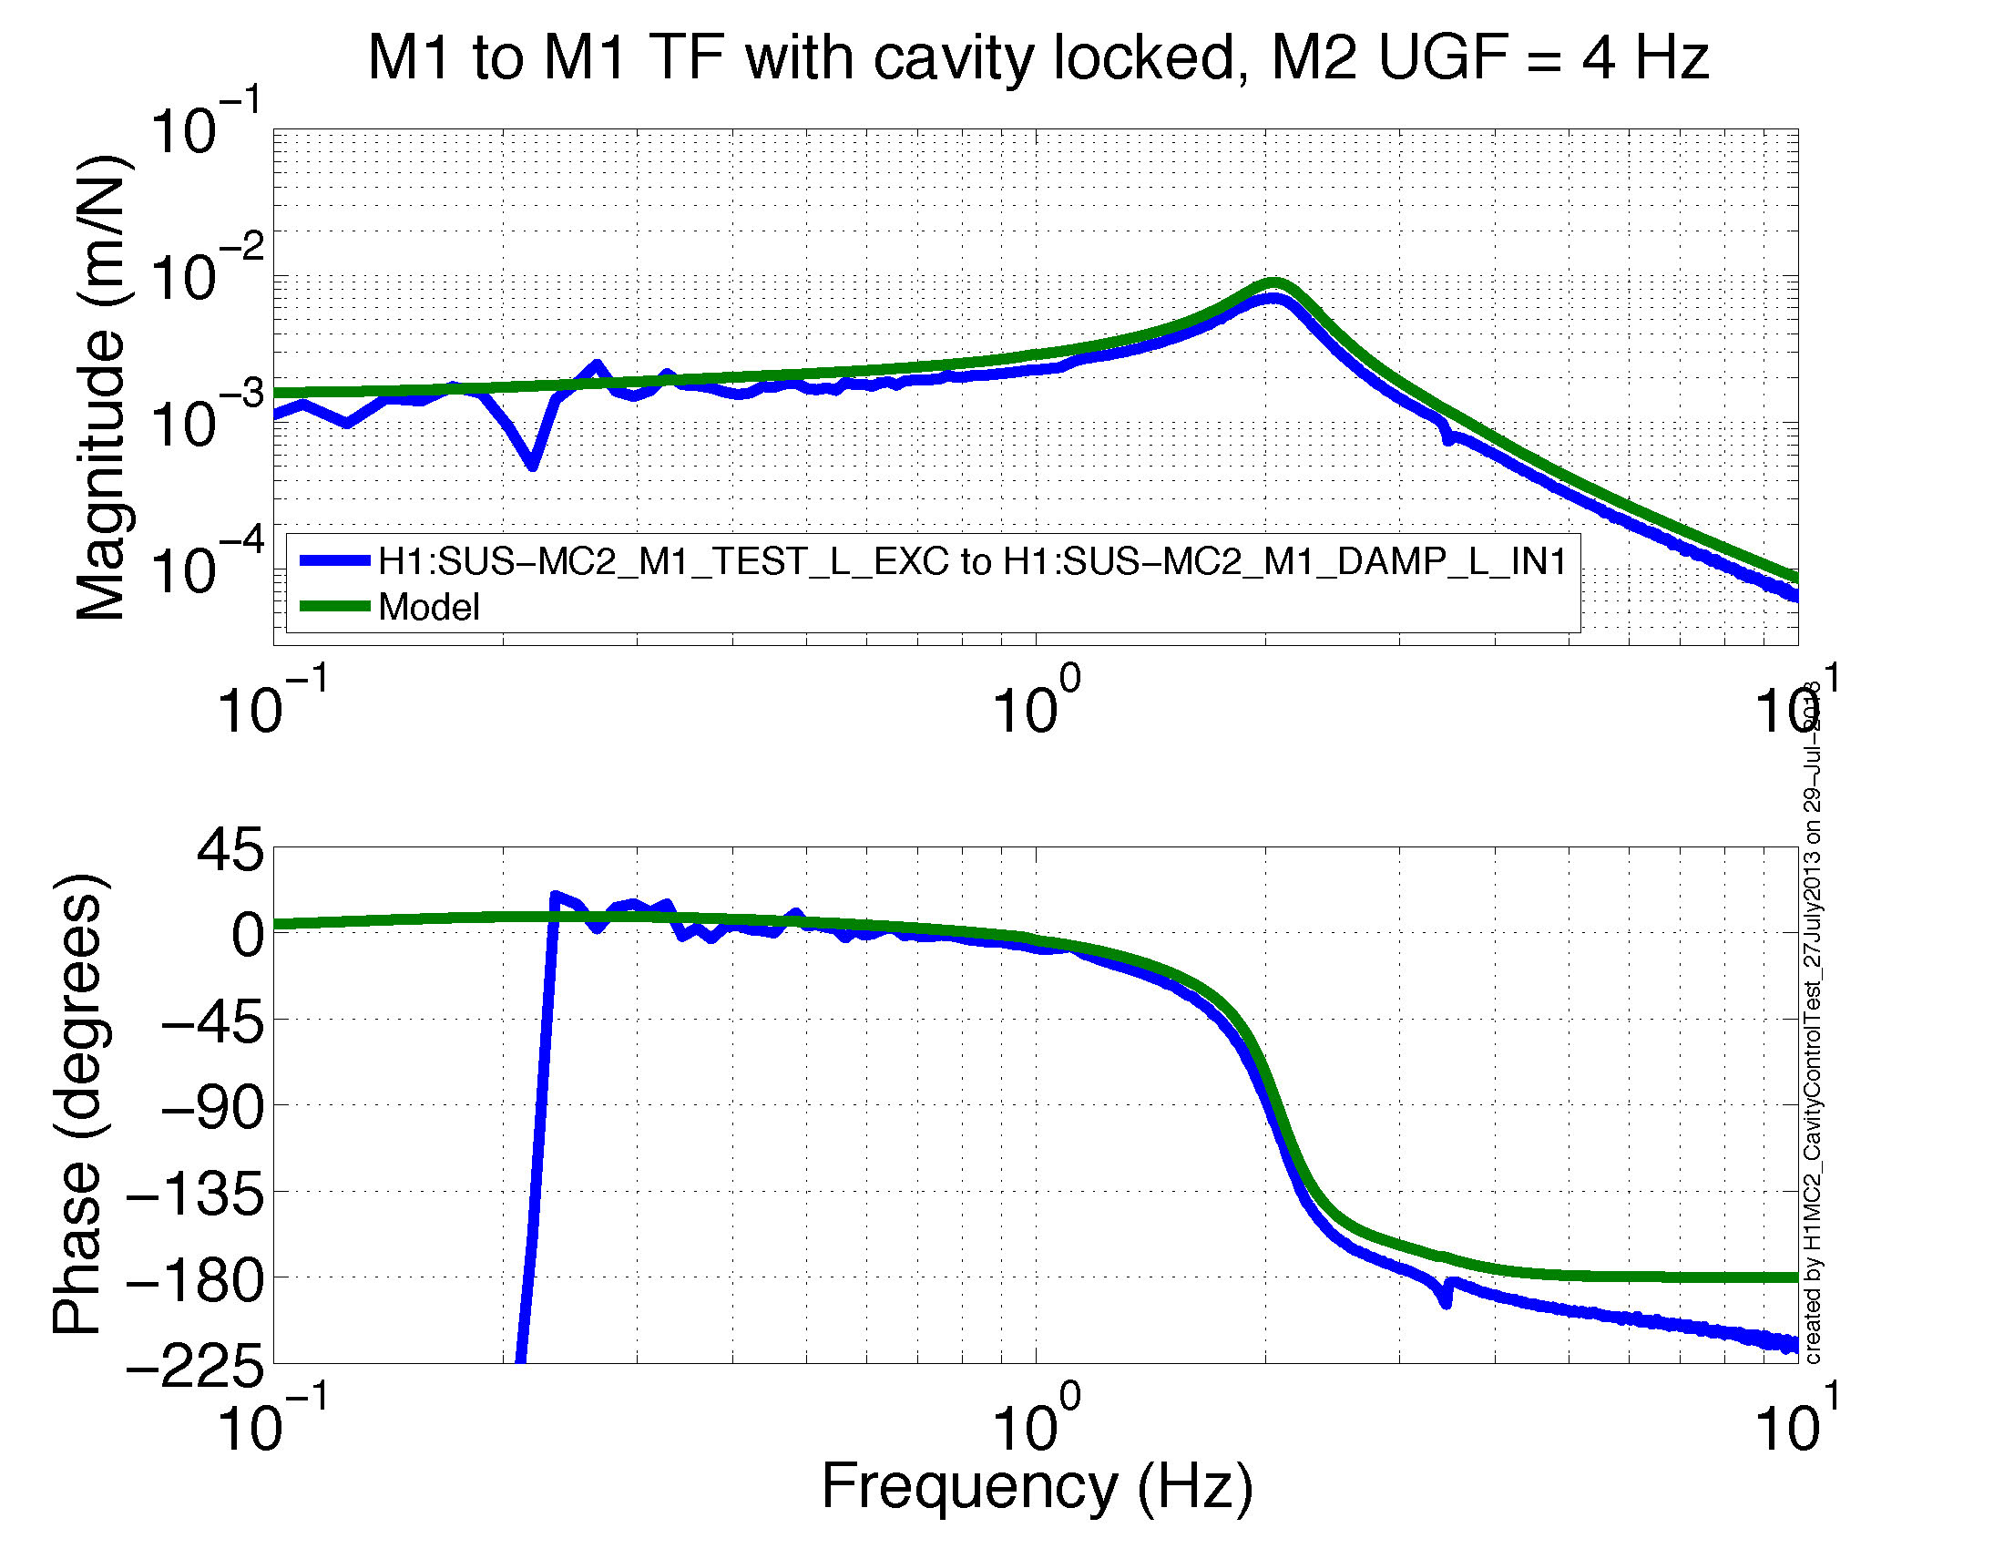

Slide 25
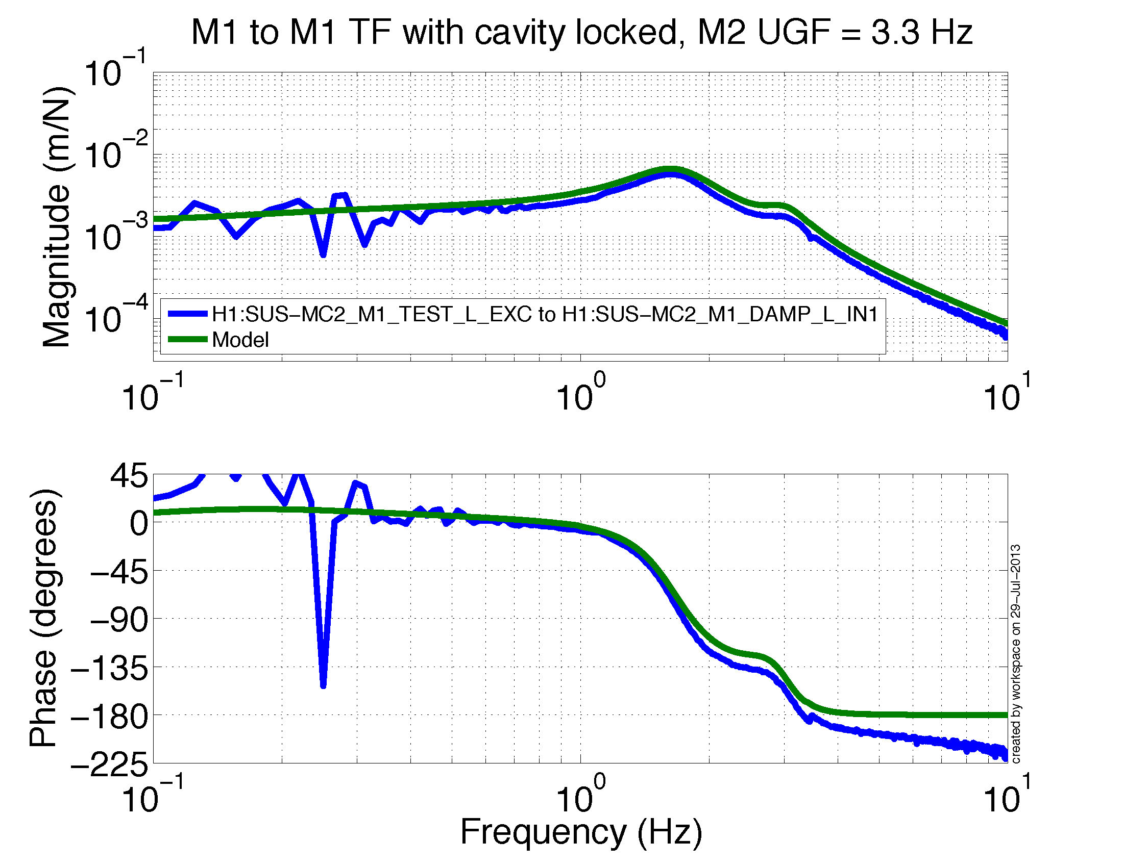

Slide 26
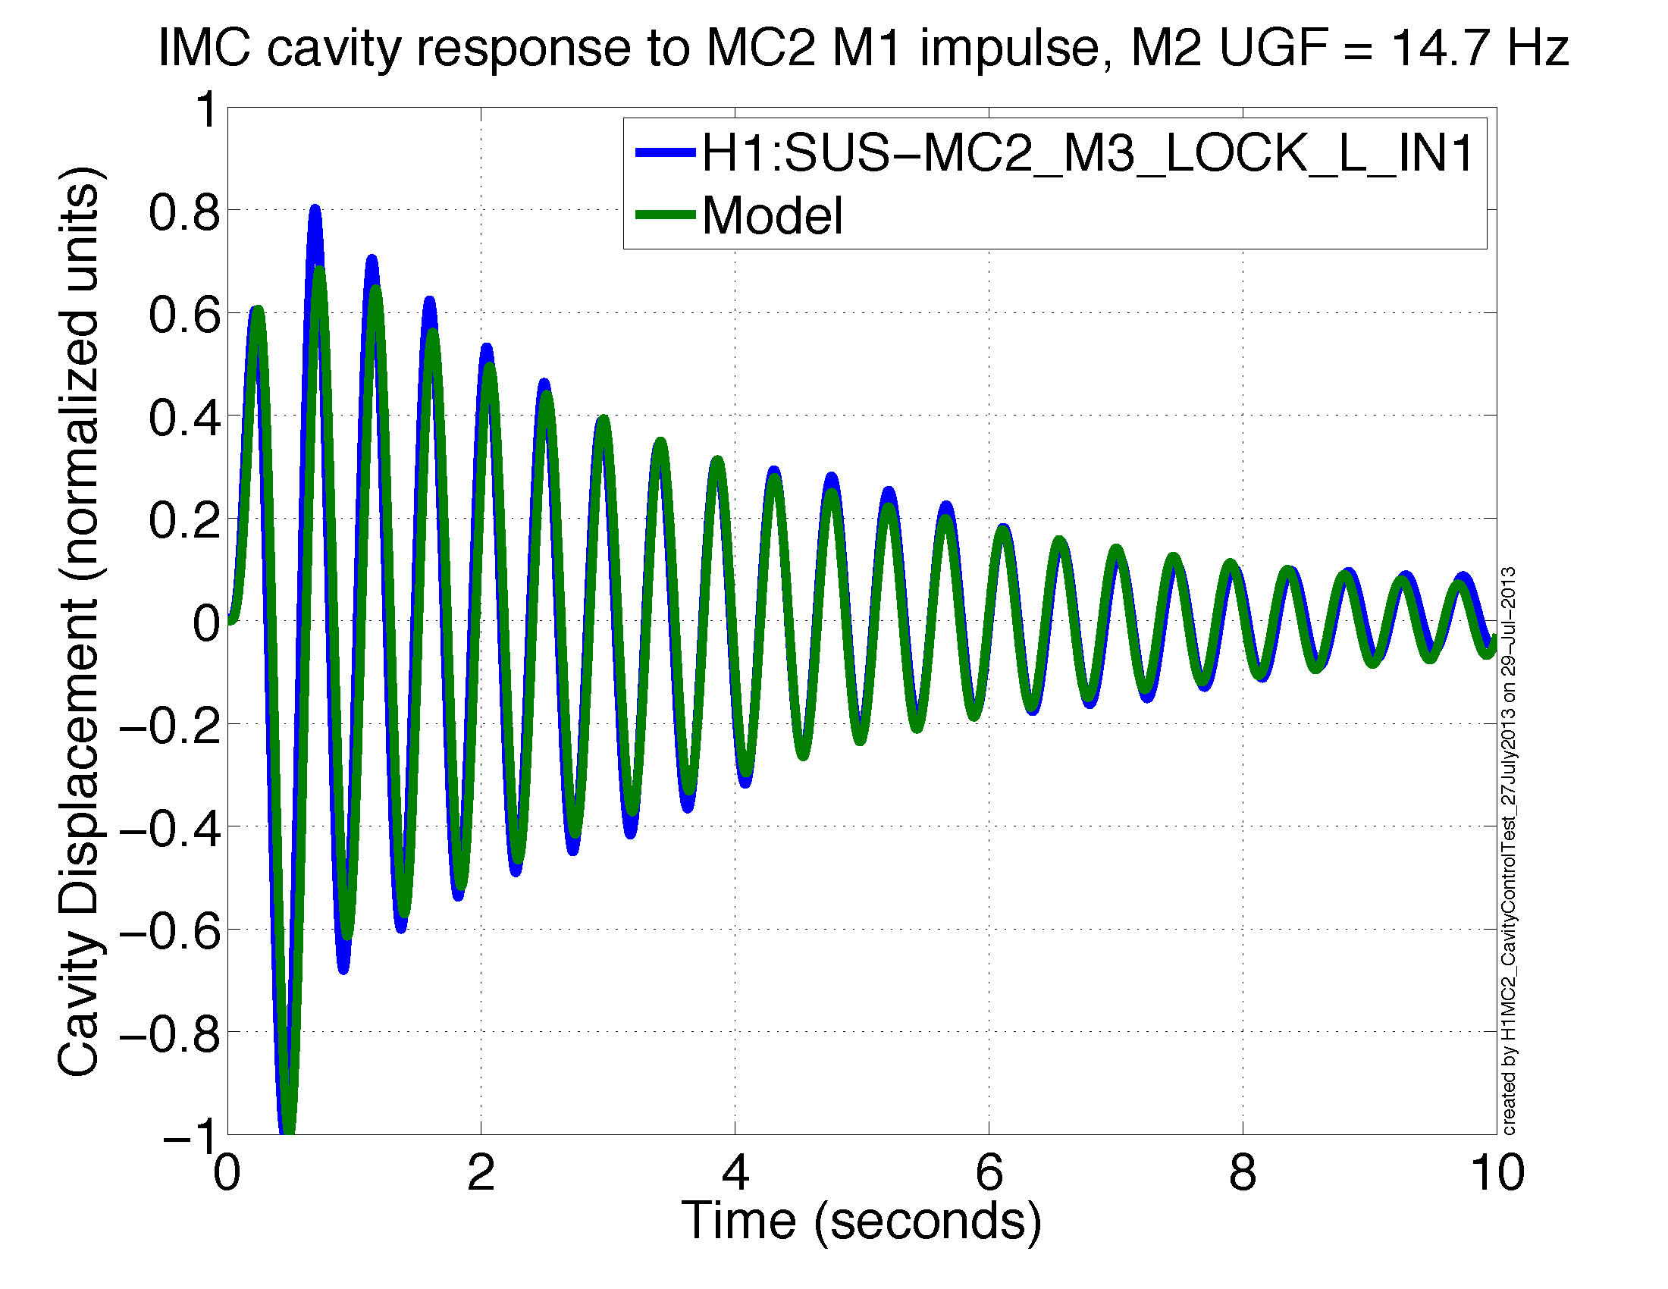

Slide 27
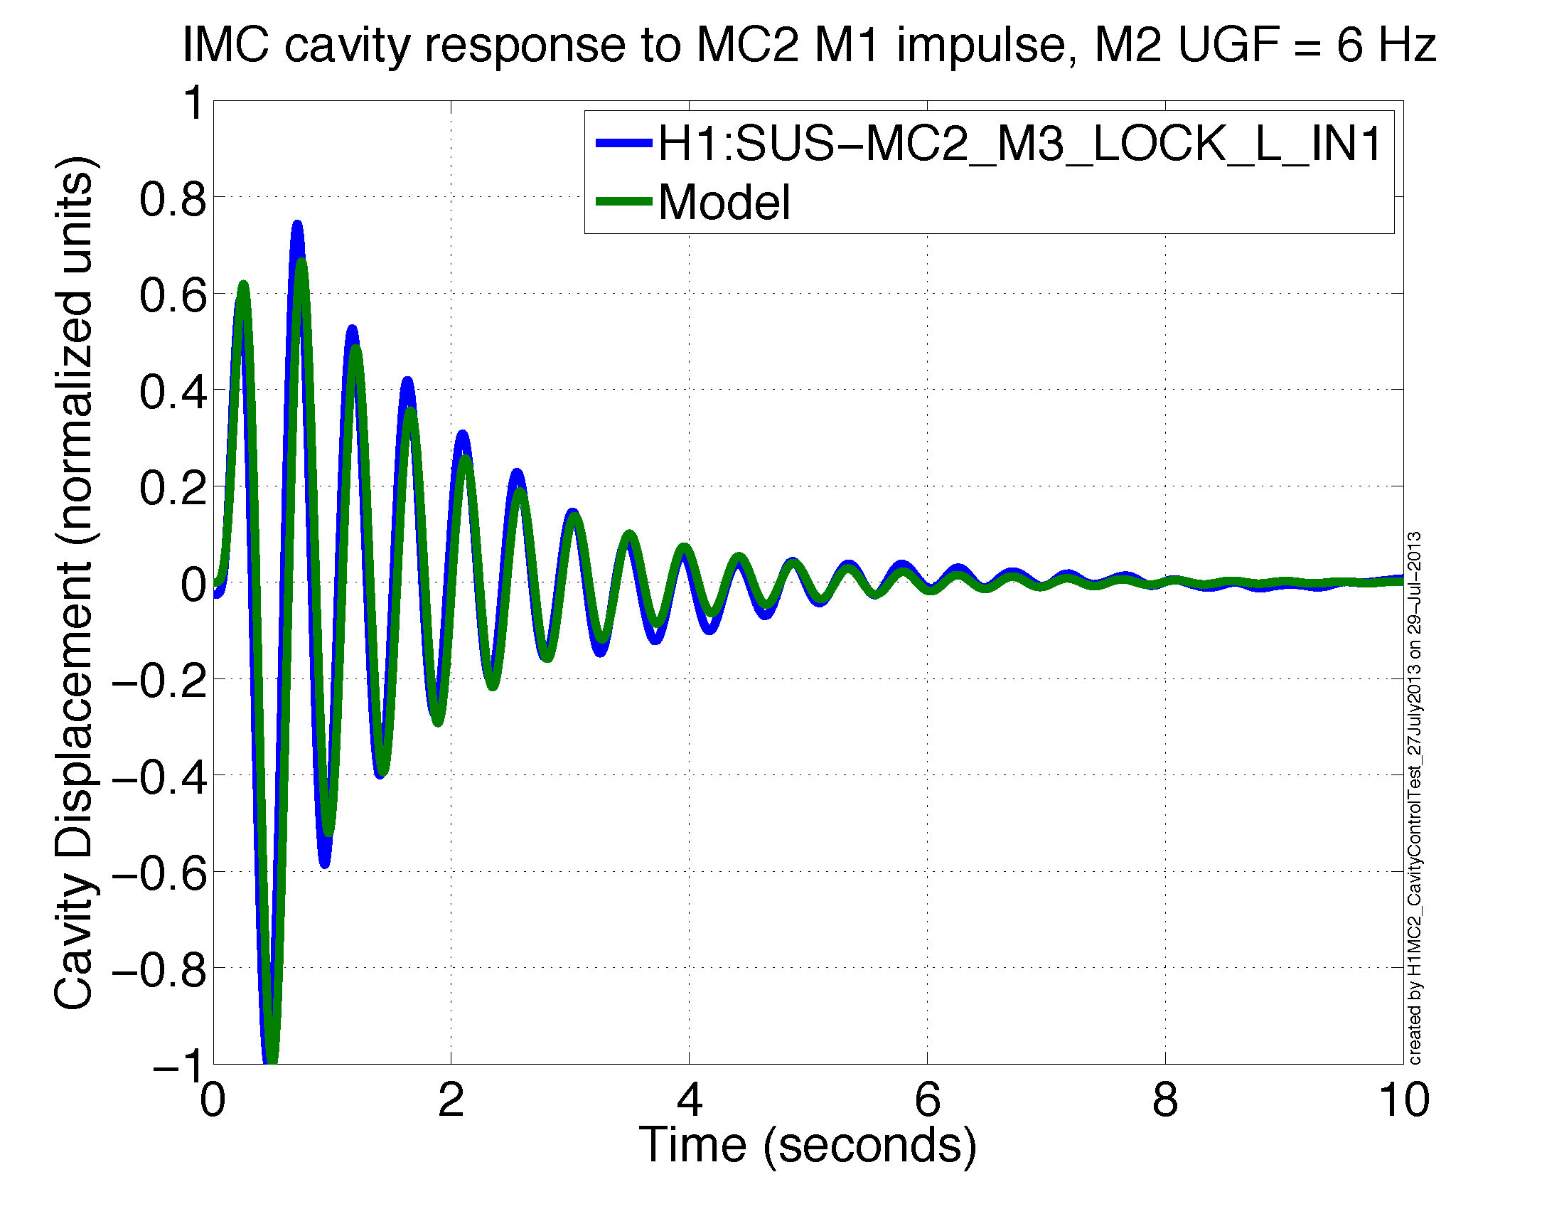

Slide 28
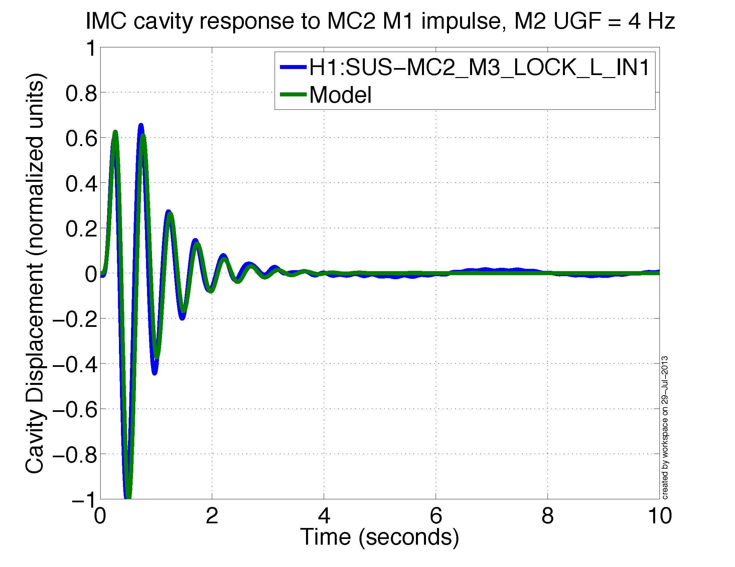

Slide 29
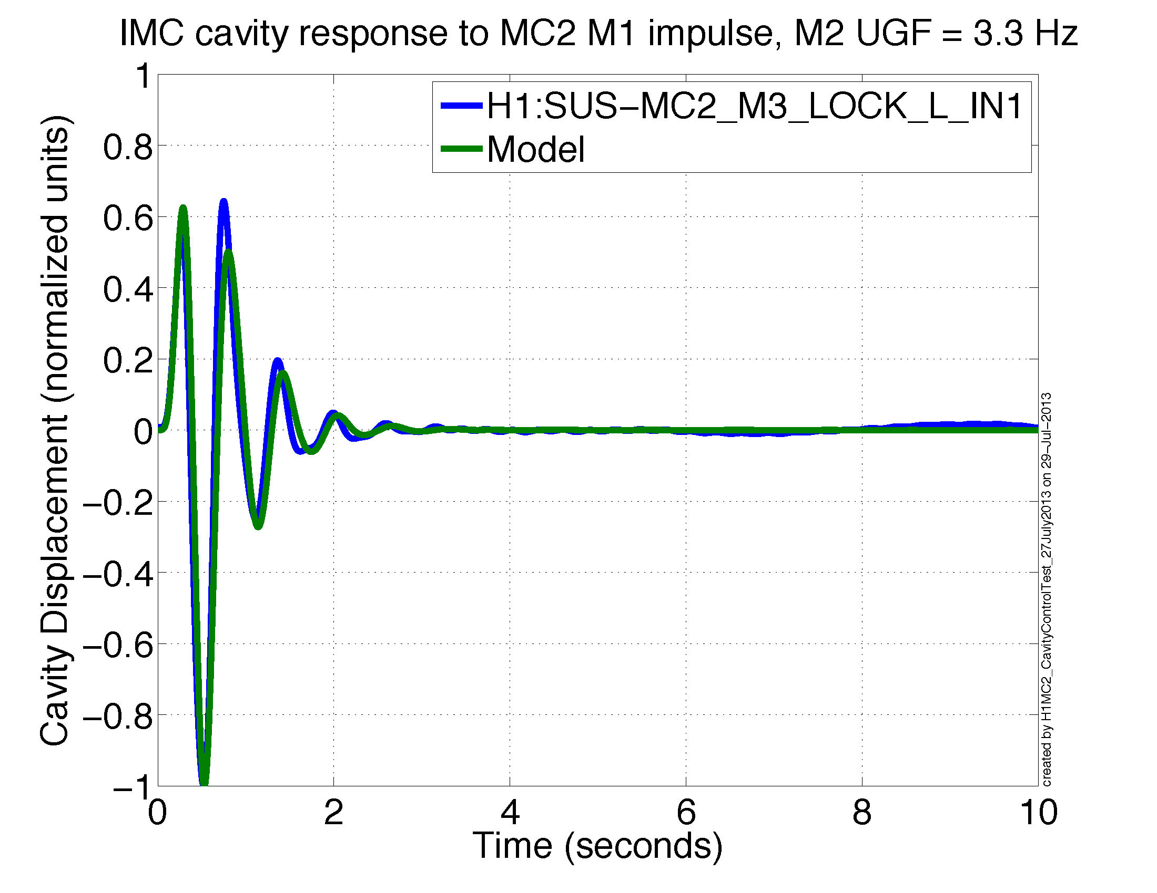

Slide 30
Conclusions
LIGO
Very simple implementation. A matrix transformation and a little bit of actuator tuning.
Overall, global damping isolates OSEM sensor noise in two ways:
  1: common length damping -> damp global DOFs that couple weakly to the cavity
  2: differential length damping -> cavity control damps its own DOF
Can isolate nearly all longitudinal damping noise.
If all 4 quads are damped globally, the cavity control becomes independent of the damping design.

Slide 31
Conclusions cont.
LIGO
Broadband noise reduction, both in band (>10 Hz) and out of band (<10 Hz).
Can still do partial global damping if some quads are not available.
Might apply global damping to other DOFs and/or other cavities. E.g. Quad pitch damping, IMC length, etc.

Slide 32
Acknowledgements
LIGO
Caltech: 40 m crew, Rana Adhikari, Jenne Driggers, Jamie Rollins
LHO: commissioning crew
MIT: Kamal Youcef-Toumi, Jeff Kissel.

Slide 33
Backups
LIGO

Slide 34

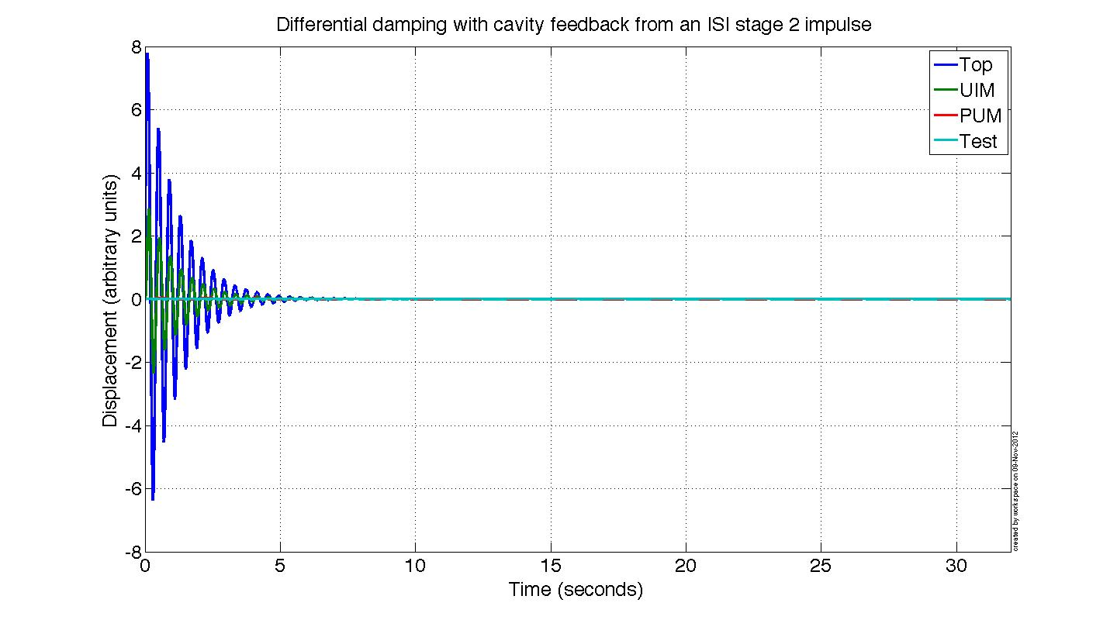
Differential Damping – all stages

Slide 35
Supporting Math
Dynamics of common and differential modes
  Rotating the pendulum state space equations from local to global coordinates
  Noise coupling from common damping to DARM
  Double pendulum example
Change in top mass modes from cavity control – simple two mass system example.

Slide 36
Dynamics of common and differential modes

Slide 37
Rotating all ETMX and ETMY local long. DOFs into global diff. and comm. DOFs
R = sensing matrix
n = sensor noise
Local to global transformations:

Slide 38
Rotating all ETMX and ETMY local long. DOFs into global diff. and comm. DOFs
Determining the coupling of common mode damping to DARM
Now, substitute in the feedback and transform to Laplace space:
Grouping like terms:

Slide 39
Rotating all ETMX and ETMY local long. DOFs into global diff. and comm. DOFs
Solving c in terms of d and :
Plugging c in to d equation:
Defining intermediate variables to keep things tidy:
Then d can be written as a function of :

Slide 40
Rotating all ETMX and ETMY local long. DOFs into global diff. and comm. DOFs
Then the transfer function from common mode sensor noise to DARM is:
As the plant differences go to zero, N goes to zero, and thus the coupling of common mode damping noise to DARM goes to zero.

Slide 41
Simple Common to Diff. Coupling Ex.
To show what the matrices on the previous slides look like.
ETMX
Common damping
ETMY
k_{x1}
u_{x1}
c₁
u_{y1}
k_{y1}
m_{x1}
x₁
0.5
+
0.5
x₂
m_{y1}
k_{x2}
k_{y2}
m_{x2}
d₂
m_{y2}
DARM Error

Slide 43
Simple Common to Diff. Coupling Ex

Slide 44
Simple Common to Diff. Coupling Ex
Plugging in sus parameters for N:

Slide 45
Change in top mass modes from cavity control – simple two mass system example.

Slide 46
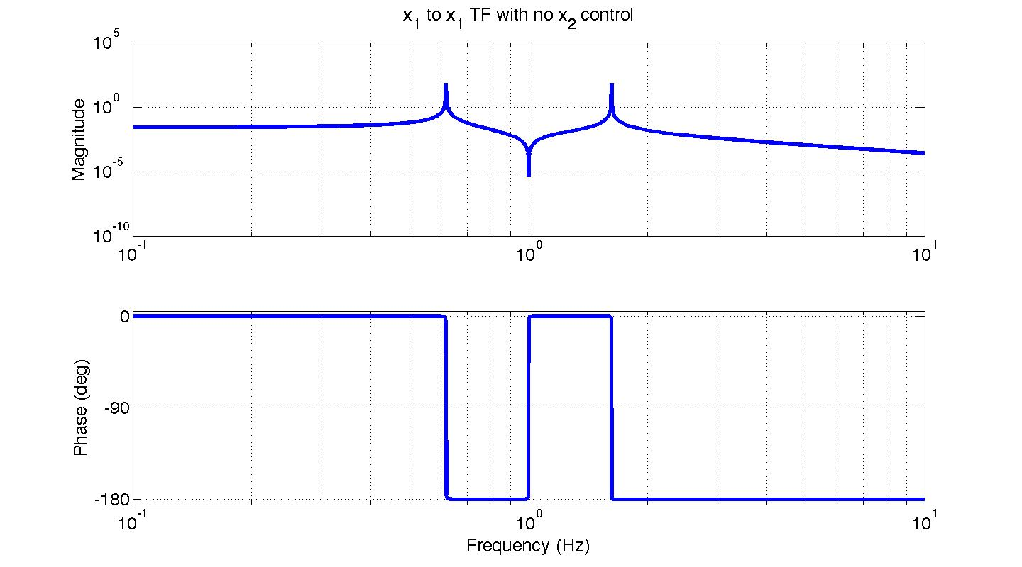
Change in top mass modes from cavity control – simple two mass ex.
Question: What happens to x₁ response when we control x₂ with f₂?
x₁
f₁
x₂
k₁
k₂
f₂
m₁
m₂
When f₂ = 0,
The f₁ to x₁ TF has two modes

Slide 47
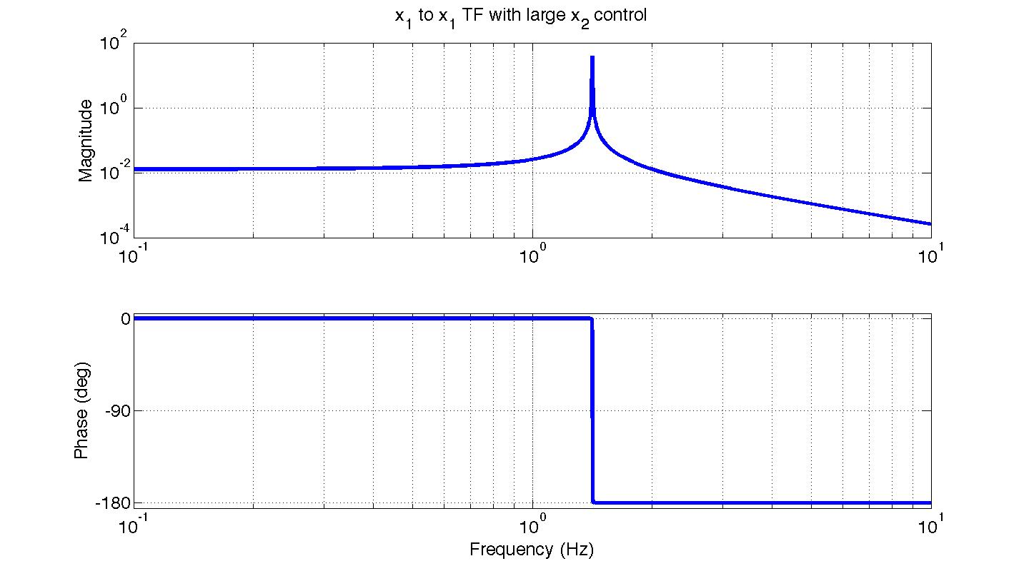
Change in top mass modes from cavity control – simple two mass ex.
The f₁ to x₁ TF has one mode. The frequency of this mode happens to be the zero in the TF from f₂ to x₂.
This is equivalent to
x₁
x₂
k₁
k₂
C
m₁
m₂
As we get to C >> k₂, then x₁ approaches this system
x₁
k₁
k₂
m₁

Slide 48
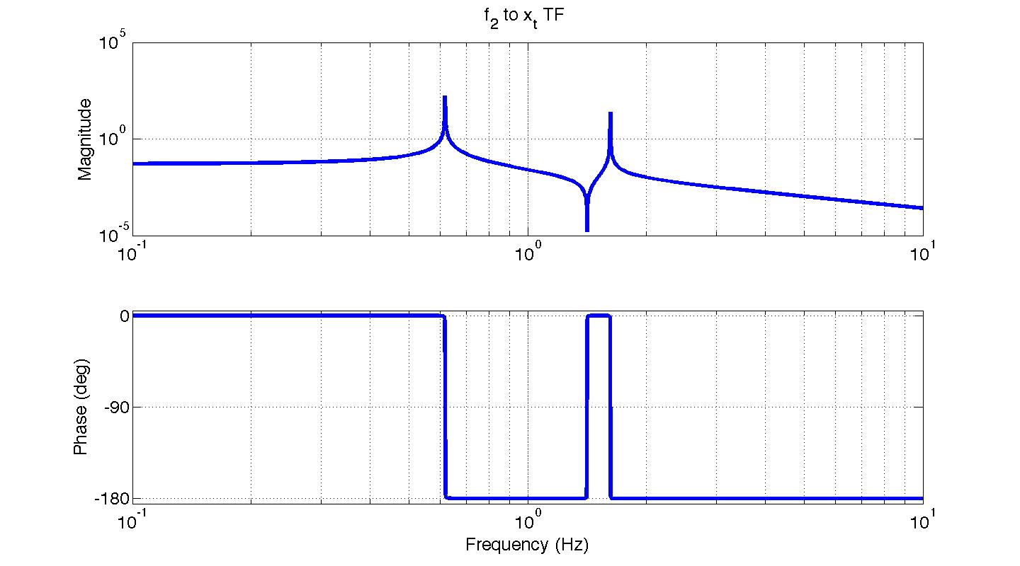
Change in top mass modes from cavity control – simple two mass ex.
Discussion of why the single x₁ mode frequency coincides with the f₂ to x₂ TF zero:
The f₂ to x₂ zero occurs at the frequency where the k₂ spring force exactly balances f₂. At this frequency any energy transferred from f₂ to x₂ gets sucked out by x₁ until x₂ comes to rest. Thus, there must be some x₁ resonance to absorb this energy until x₂ comes to rest. However, we do not see x₁ ‘blow up’ from an f₂ drive at this frequency because once x₂ is not moving, it is no longer transferring energy. Once we physically lock, or control, x₂ to decouple it from x_{1,} this resonance becomes visible with an x₁ drive.
The zero in the TF from f₂ to x₂. It coincides with the f₁ to x₁ TF mode when x₂ is locked.
x₂
f_{k2}
k₂
f₂
…
m₂

Slide 49
Change in top mass modes from cavity control – Full Quad example.

Slide 50
Cavity Control Influence on Damping
- Case 1: All cavity control on Pendulum 2
ETMX
ETMY
*
* Top to top mass transfer function
longitudinal
u_{x,2}
u_{y,2}
u_{x,3}
u_{y,3}
What you would expect – the quad is just hanging free.
Note: both pendulums are identical in this simulation.
u_{x,4}
u_{y,4}
0
Cavity control
1

Slide 51
Cavity Control Influence on Damping
- Case 2: All cavity control on Pendulum 1
ETMX
ETMY
*
* Top to top mass transfer function
longitudinal
u_{x,2}
u_{y,2}
u_{x,3}
u_{y,3}
The top mass of pendulum 1 behaves like the UIM is clamped to gnd when its ugf is high.
Since the cavity control influences modes, you can use the same effect to apply damping (more on this later)
u_{x,4}
u_{y,4}
1
Cavity control
0

Slide 52
Cavity Control Influence on Damping
- Case 3: Cavity control split evenly between both pendulums
ETMX
ETMY
*
* Top to top mass transfer function
longitudinal
u_{x,2}
u_{y,2}
u_{x,3}
u_{y,3}
The top mass response is now an average of the previous two cases -> 5 resonances to damp.
Control up to the PUM, rather than the UIM, would yield 6 resonances.
aLIGO will likely behave like this.
u_{x,4}
u_{y,4}
0.5
Cavity control
0.5

Slide 53
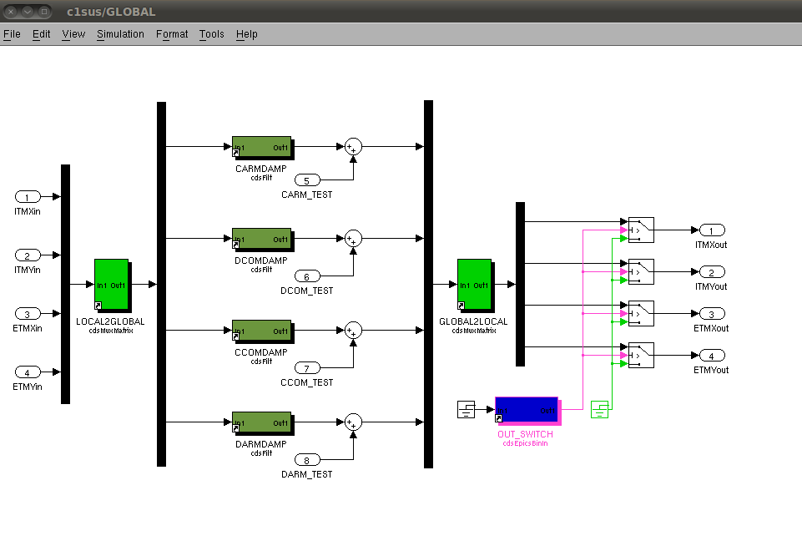
Global Damping RCG Diagram

Slide 55
Scratch

Slide 57
Scratch: Rotating all ETMX and ETMY local long. DOFs into global diff. and comm. DOFs
Now, substitute in the feedback and transform to Laplace space:
For DARM we measure the test masses with the global cavity readout, no local sensors are involved. The cavity readout must also have very low noise to measure GWs. So make the assumption that n_{x}-n_{y}=0 for cavity control and simplify to:

