Slide 1
Dual PD Amp Circuit Board Test Results
By Alexa Staley
LIGO G1200781-v1

Slide 2
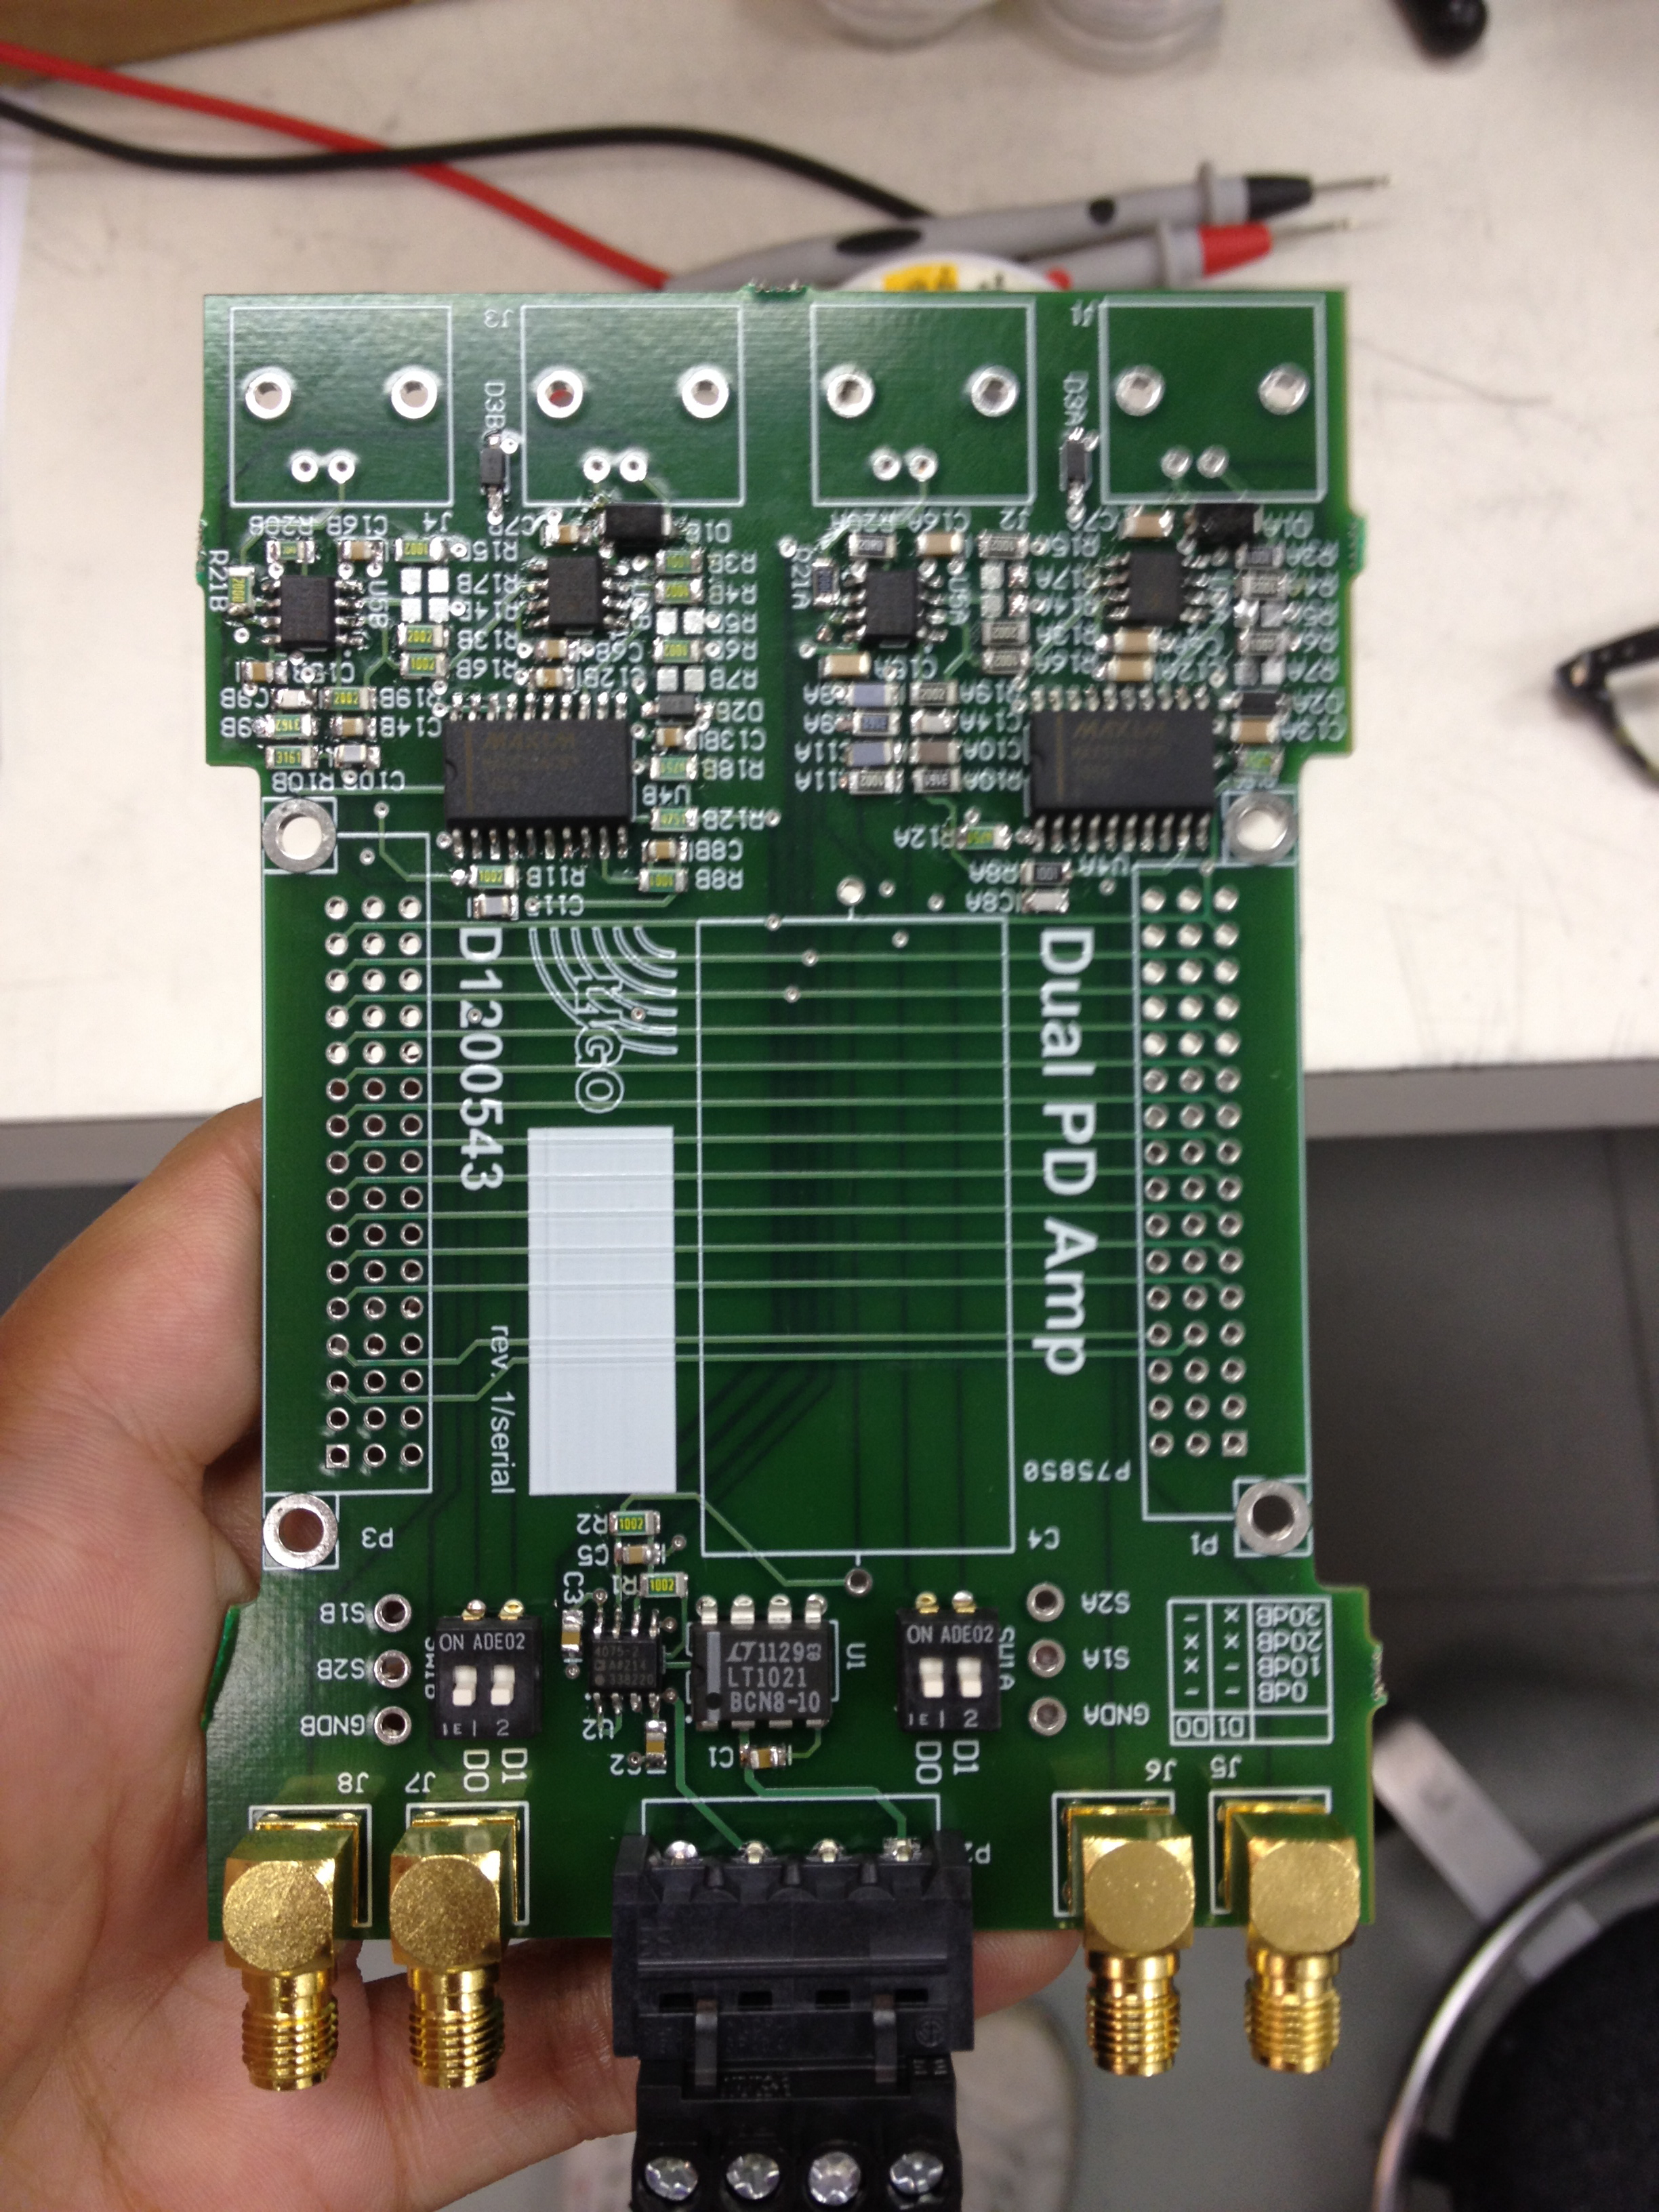
What is the Dual PD Amplifier?
Will be placed in the five ALS Fiber Distribution Chassis
Has two channels that amplify a given source via four different gain settings
D1200543-v1

Slide 3
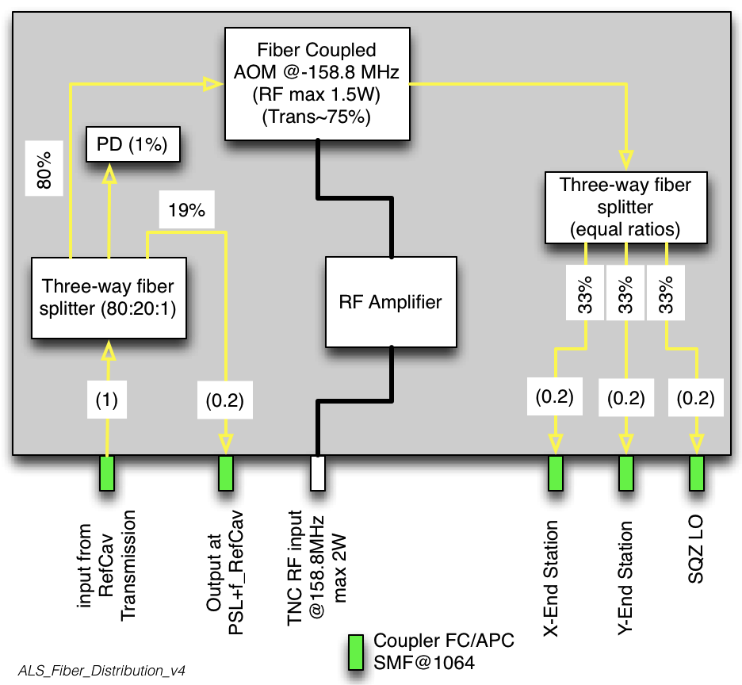
ALS Fiber Distribution (brief)
Shifts the frequency of the PSL laser light after the reference cavity
Splits the input into four output fibers

Slide 4
Some Specs.
When connected to a power supply with no source
DC offset is measured to be less than 10mV for each gain settings
See less than 20uV AC variations
Minimal signal drift (but needs to be tested for longer period of time)

Slide 5
Optical Transfer Function

Slide 6
Transfer Functions

Slide 7
Optical Transfer Function with Long Cable

Slide 8
Shot Noise

Slide 9
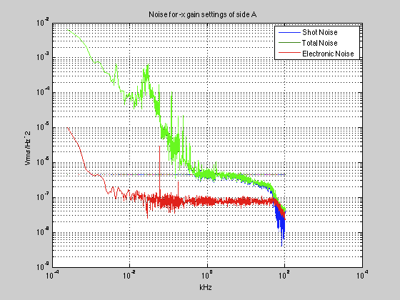
Total, Shot, & Electronics Noise

Slide 10
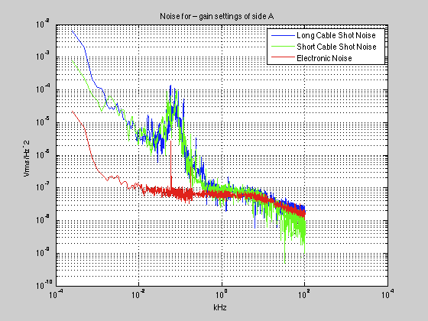
Noise for Different Cable Lengths

Slide 11
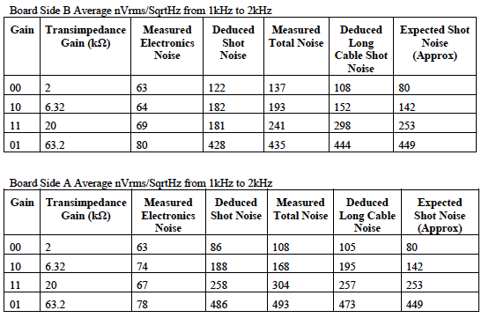
Noise Data

Slide 12
Next Steps…
Possibly take measurements with more data points
Take shot noise measurements with a better light source
Replace 1206 10k resistors that remain with 0805 size – could reduce noise even further
Test long term drift
Produce 5 PCBs and place into ALS Fiber Distribution Chassis → test chassis

