Slide 1
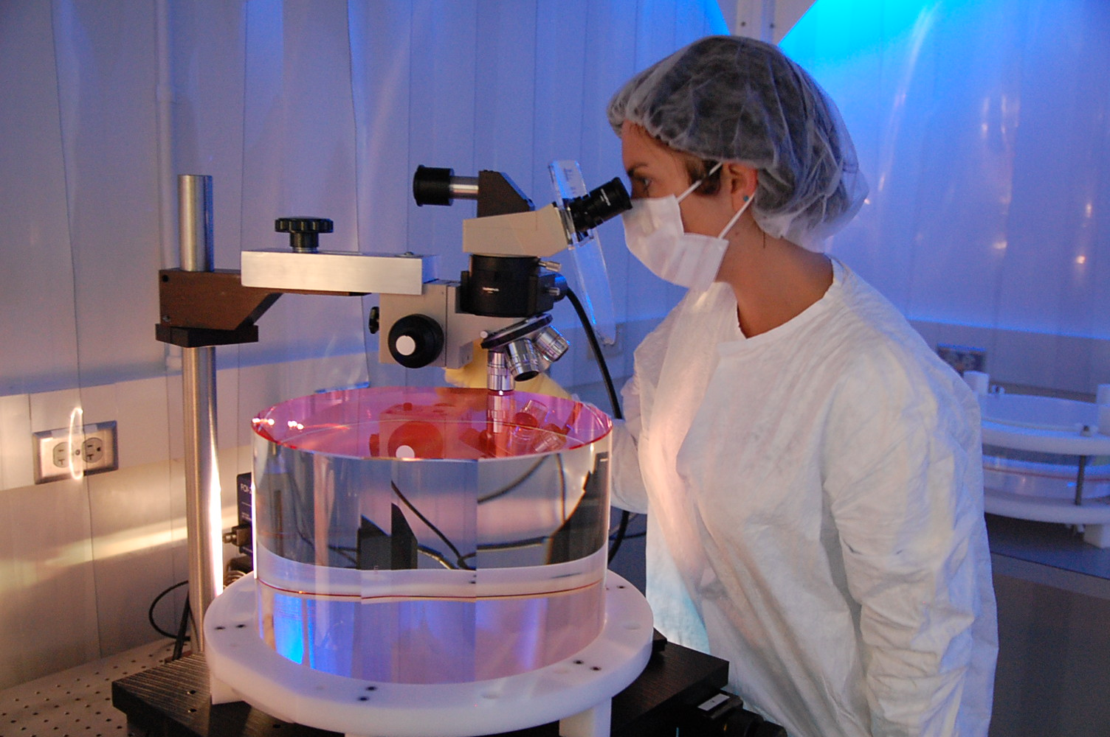
Adventures in AR Absorption with aLIGO Core Optics
Optical Coatings
LSC-VIRGO , 2012
Margot Phelps
GariLynn Billingsley
Liyuan Zhang

Slide 2
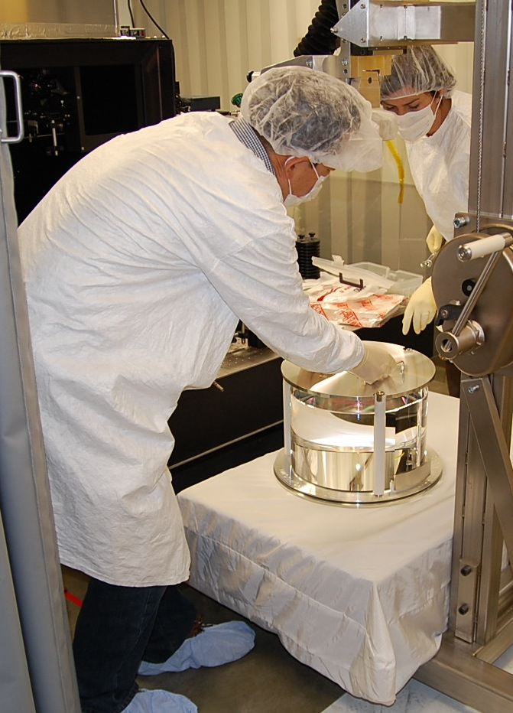
Outline
AR and HR
Tantala thin films
Compensation Plate Coating loss
Anneal Temperature
AR coatings- aLIGO Beamsplitter
AR coatings- aLIGO Compensation Plate
Trial and error!
Real mechanisms behind AR absorption
Notes:
Purpose of talk! Theorical vs engineering channel Feynman, conversational dinner, exciting!!

Slide 3
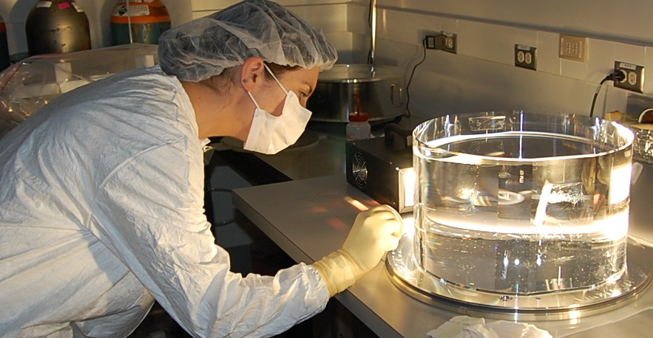
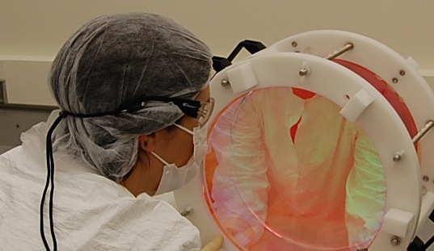
HR and AR Coatings on Recycling Cavity Optics
aLIGO COC optical coatings- made up of silica (SiO2) and tantala (Ta205) layers of varying width.
Coating absorption- Strict absorption requirements for all aLIGO coatings on optics, <1ppm
Harder to meet this on AR than on HR
Can achieve <1ppm for HR, AR is much more sensitive.
HR coatings-not worried about transmission
Tantala is used deeper in the stack, and in thicker layer
AR coatings- power transmission throughout all layers, not just the top as in HR.
Notes:
Basic view of optical coatings. Want HR caotings to be highly reflective and ar coatings not to reflect. Simple enough.
But we want them to do this as perfectly as possible. Coatings cannot absorb, scatter, or reflect/transmit more than they should.

Slide 4
Why use thin film tantala?
Stress Balance
beam splitter design
Aspect ratio
Test masses: ~2:1
Beamsplitters ~6:1
Power term measured before coating BS02: 4.66nm
Measured after coating BS02: 5.8nm (G. Billingsley)
But the downsides..
Mismatched IBS coating stress
HR
AR
HR > AR
Notes:
Power term means sag…elaborate

Slide 5
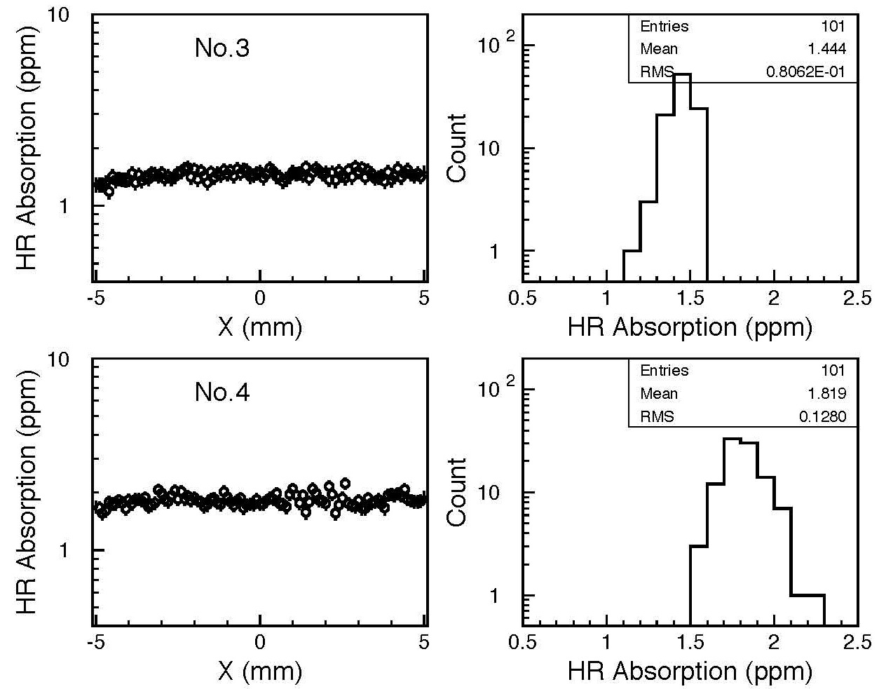
4 Examples-HR side of each

Slide 6
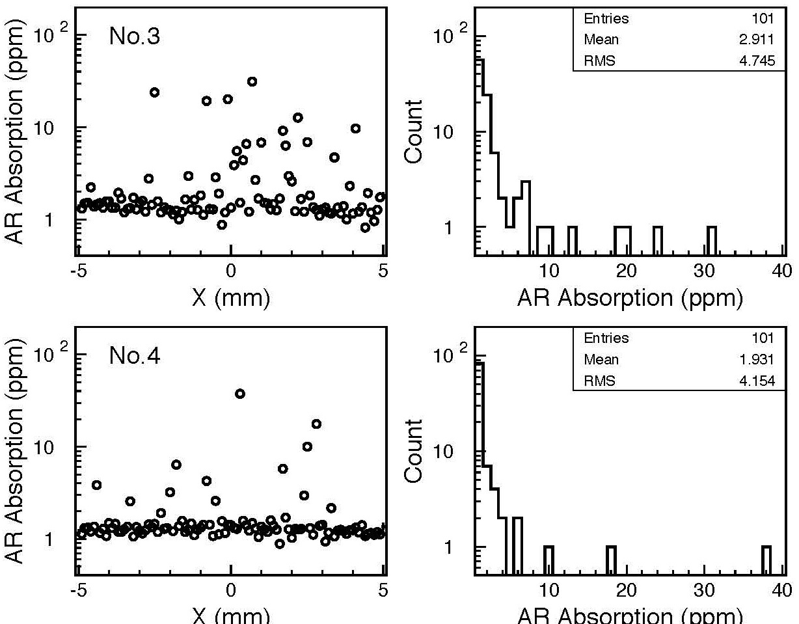
Same optics-AR side

Slide 7
Comparison of Beamsplitter HR Absorption(measured at Caltech)
Arrow
+y
Optic serial number | -x(avg) | +x(avg) | -y(avg) | +y(avg)
BS03 | 0.48ppm | 0.45ppm | 0.5ppm | 0.37ppm
BS05 | 0.29ppm | 0.29ppm | 0.29ppm | 0.29ppm
BS06 | 0.29ppm | 0.29ppm | 0.29ppm | 0.29ppm
-x
+x
-y
Measured a 20mm line
on each axis

Slide 8
Comparison of Beamsplitter AR Absorption(measured at Caltech)
Arrow
+y
Optic serial number | -x(avg) | +x(avg) | -y(avg) | +y(avg)
BS03 | 4ppm | 2.7ppm | 11ppm | 2ppm
BS05 | 16ppm | 16ppm | 50ppm | 4ppm
BS06 | 1.6ppm | 1.8ppm | 0.9ppm | 1.4ppm
Optic serial number | -x(avg) | +x(avg) | -y(avg) | +y(avg)
BS03 | 4ppm | 2.7ppm | 11ppm | 2ppm
BS05 | 16ppm | 16ppm | 50ppm | 4ppm
BS06 | 1.6ppm | 1.8ppm | 0.9ppm | 1.4ppm
-x
+x
-y
Measured a 20mm line
on each axis

Slide 9
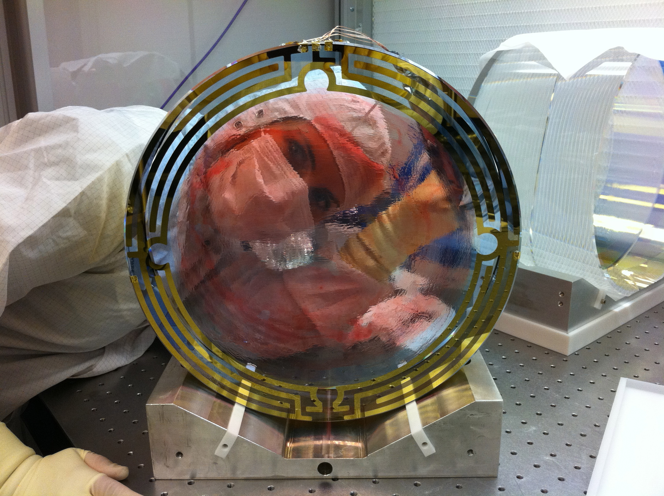
Is it impossible to get a low loss AR? Actually, no.
We have optimized our CP design through trial and error

Slide 10
Differences in BS and CP coating Designs
CP BS
Coating
Air
SiO2
Ta205
SiO2
SiO2
Ta205
Ta205
Substrate

Slide 11
CPs: Exploring AR Absorption layer by layer
Notes:
Thickness calculation based on the spectrum measured after each etch

Slide 12
Goldilocks and the AR Absorption 300 C°, Too cold
No initial anneal
Anneal and absorption measurements done at CIT: Phelps and Zhang
Advanced LIGO
Notes:
As is = no post deposition anneal
Design < 1/20 wave Tantala + ¼ wave Silica

Slide 13
AR Absorption 350 C° Still too cold
No initial anneal
Anneal and absorption measurements done at CIT: Phelps and Zhang
Advanced LIGO
Notes:
As-Is = No post deposition anneal

Slide 14
AR Absorption 375 C° getting warmer
350 C initial anneal
Anneal and absorption measurements done at CIT: Phelps and Zhang
Advanced LIGO
Notes:
350C post deposition

Slide 15
AR Absorption 425 C° too hot
350 C initial anneal
Anneal and absorption measurements done at CIT: Phelps and Zhang
Advanced LIGO

Slide 16
AR Absorption 400 C° Just right!
350 C initial anneal
Anneal and absorption measurements done at CIT: Phelps and Zhang
Advanced LIGO
Notes:
350 C. post depsition anneal

Slide 17
Conclusion
Found clues to mechanisms behind AR absorption
Absorption is either in the tantala layers or in the interfacial layer between the tantala and silica(from etching tests)
Anneal environment is important, esp. temperature(from anneal tests)
Tantala film thickness and position in coating stack(looking at CP vs BS)
HR behaves differently than AR(no energy in deeper layers of HR)
the CP design has been optimized, now applying those lessons to correct the beamsplitter absorption
Hope to help answer some fundamental questions about how tantala coatings work

