Slide 1
aLIGO EOM at LLO and LHO Assembly/testing/installation
Volker Quetschke, Gregorio Tellez, Joseph Coleman,
Center for Gravitational Wave Astronomy
& Department of Physics and Astronomy
The University of Texas at Brownsville
and the LIGO-UF group
Department of Physics
University of Florida

Slide 2
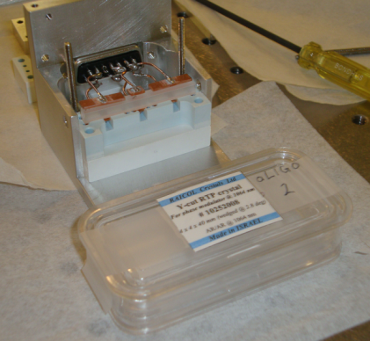
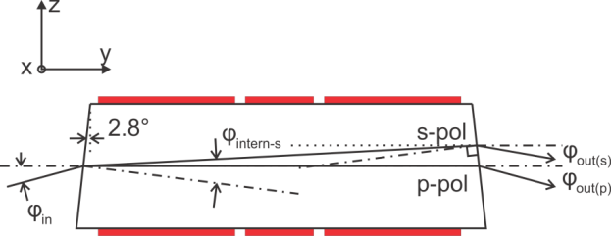
Assembly/testing/installation of the aLIGO phase modulators
aLIGO modulators follow the design of the eLIGO modulators, but were adjusted to follow aLIGO specifications:
Three electrode, wedged RTP crystal (rubidium titanyl phosphate - RbTiOPO4)
Wedged avoids cavity effects and reduces amplitude modulation
RTP has low absorption, is capable to handle 200W exhibits a small thermal lens
Three electrodes on one crystal minimize the number of optical surfaces (and the price)
15 mm
7 mm
15 mm
Polarization | Angle [degrees]
p | 5.2
s | 4.7

Slide 3
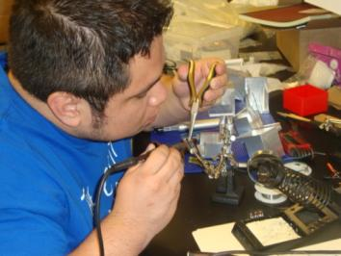
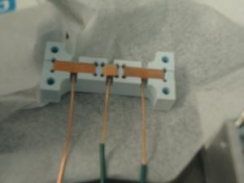
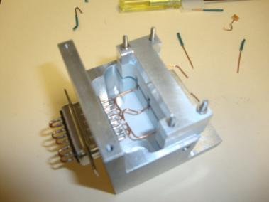
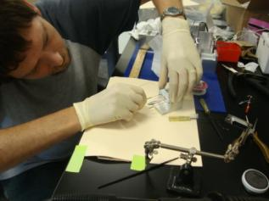
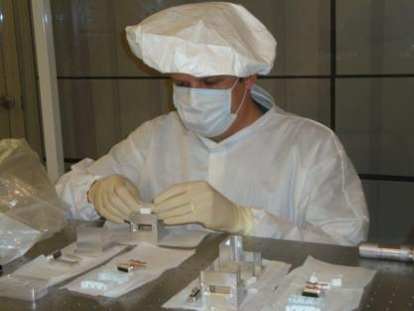
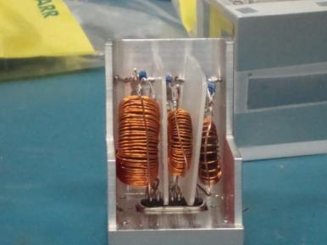
Assembly/tuning at UTB
Assemble modulators in clean environment
Build and tune three simultaneous pi-network resonant circuits with 50 Ω input impedance. (9.1 / 24.1 / 45.5 MHz)

Slide 4
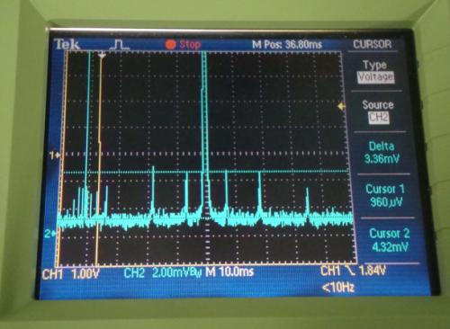
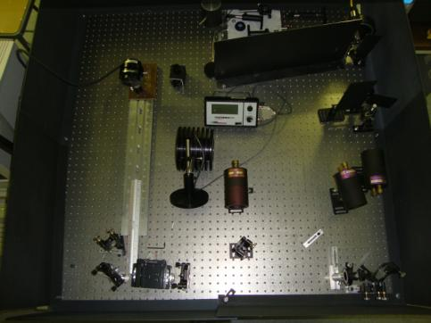
Test at UF
Finalize tuning at UF
Measure sidebands
Test high power compatibility
Frequency [MHz] | EOM-1: Number of turns per coil | EOM-1pi network shunt capacitance | EOM-2: Number of turns per coil | EOM-2 pi network shunt capacitance
9.1 | 108 | 820 pF | 102 | 680 pF
24.1 | 67 | 270 pF | 68 | 270 pF
45.5 | 31 | 210 pF | 30 | 190 pF
Frequency [MHz] | EOM 1 | EOM 2
9.1 | 0.325 | 0.388
24.1 | 0.117 | 0.184
45.5 | 0.310 | 0.299
Sidebands measured with three 24 dBm signals simultaneously driving all three electrodes
Setup with 150W laser and realistic beam parameters to verify high-power compatibility

Slide 5
Installation at LHO H2 12/2011
Was installed, but shortly after uninstalled and retuned for H1 frequencies

Slide 6
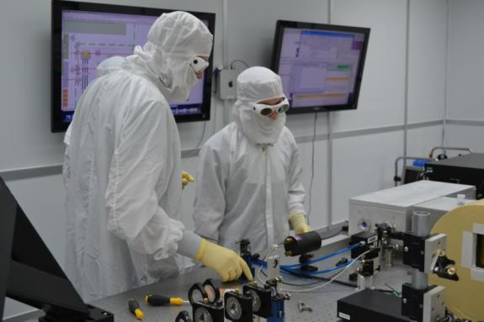
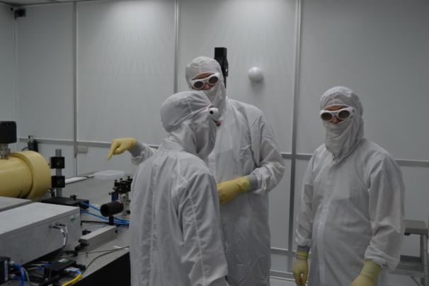
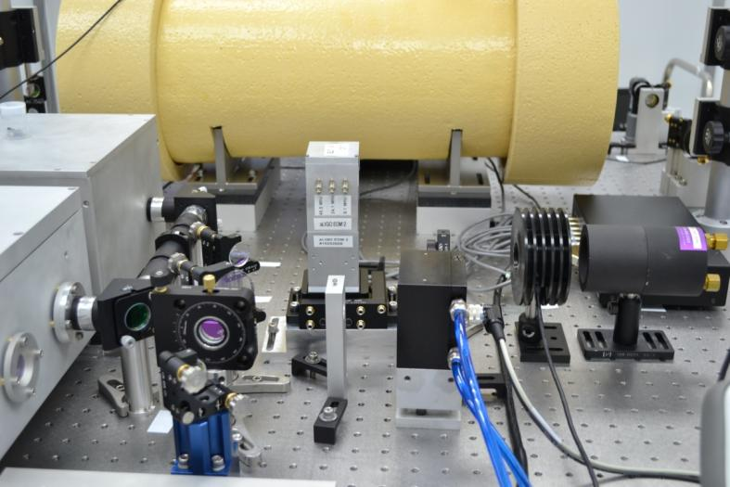
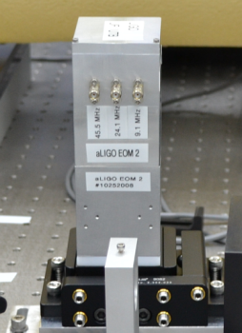
Installation at LLO 07/2011
L1 modulator install

Slide 7
Modulation depth for 24 dBm drive
Some re-tuning was done 04/2012 https://alog.ligo-la.caltech.edu/ aLOG/index.php?callRep=3027

Slide 8
RFAM vs. PM
RFAM measurements with 24dBm drive
https://alog.ligo-la.caltech.edu/aLOG/index.php?callRep=3034
Freq. | PM | RFAM | RFAM/PM
45.3 | 0.15 | 6.2E-06 | 0.000041
9.18 | 0.39 | 3.9E-05 | 0.000100
24.0 | 0.09 | 1.0E-06 | 0.000012

Slide 9
Installation at LHO 08/2012 Modulation depth for 24 dBm drive
https://alog.ligo-wa.caltech.edu/ aLOG/index.php?callRep=3693

Slide 10
RFAM vs. PM
All went well
https://alog.ligo-wa.caltech.edu/aLOG/index.php?callRep=3695
Freq. | PM | RFAM | RFAM/PM
45.5 | 0.31 | 5.5E-05 | 0.000177
9.1 | 0.39 | 9.13E-05 | 0.000234
24.1 | 0.14 | 3.17E-05 | 0.000226

Slide 11
What’s Next?
Re-tuning for LIGO India?

Slide 12
Modulation depth / RFAM LLO
LLO - Chris explanation: < https://alog.ligo-la.caltech.edu/aLOG/index.php?callRep=2901 >
PM vs freq: < https://alog.ligo-la.caltech.edu/aLOG/index.php?callRep=3027 >
AM at peak: < https://alog.ligo-la.caltech.edu/aLOG/index.php?callRep=3034 >
LHO - PM vs freq: < https://alog.ligo-wa.caltech.edu/aLOG/index.php?callRep=3693 >
AM at peak: < https://alog.ligo-wa.caltech.edu/aLOG/index.php?callRep=3695 >

