Slide 1
Magnetic Coupling to Test Mass Suspensions
Analysis of R. Schofield’s B-field coupling measurements at LHO,
December 2012

Slide 2
Latest Schofield measurements:
H1 ITMY (LHO log entry 4944)
TOP ECD magnets removed (many); UIM blade ECD magnets removed (2x per blade)
1/f⁴, consistent w/ coupling to penultimate stage

Slide 3
How did we set max PM stage magnet size? (T050271)
Coupling measurements from iLIGO (2005):
Used 10 N/T/A-m² to set limits

Slide 4
Magnetic field noise
Used 10⁻¹¹ T/rtHz to set limits
Vault Coil magnetometer
Flux-gate magnetometer,
Noise floor: 2-3 pT/rtHz

Slide 5
PM stage coupling
PM_{force} → TM_{displacement}: T= 2.8e-8 m/N @10 Hz
Cplg * mu * B_{noise} * T(10 Hz) < 1e-20 m/rtHz
Mu < 3.6 mA-m²
Actual PM magnets:
  2mm diam x 6mm long, SmCo
  Mu = 0.015 A-m²
  Paired with a compensation magnet, 30 mm axial separation
  Yes, magnet Mu is bigger than limit, but effective Mu thought/hoped to be several times smaller due to compensating magnet

Slide 6
Observed coupling
 | PM → TM torque-to-angle (SUS model) | Measured coupling | Implied torque coupling | B → Force (12cm lever; normalized by mu)
Pitch | 2e-5 rad/N-m | 2.5e-6 rad/T | 0.125 N-m/T | 70 N/T/A-m²
Yaw | 7e-6 rad/N-m | 2.5e-5 rad/T | 3.5 N-m/T | 2000 N/T/A-m²
Compare to
10 N/T/A-m² used to set limits
Implied B-field gradients:
  Pitch: (1/B)dB/dx = 70 m⁻¹ (1.5 cm scale)
  Yaw: (1/B)dB/dx = 2000 m⁻¹ (1/2 mm scale ??)

Slide 7
Extrapolation to longitudinal motion
For force applied at PM magnets, relation between displacement and angle (above 5 Hz):
  Pitch: 0.01 m/rad
  Yaw: 0.03 m/rad
Potential longitudinal coupling, inferred from measured pit/yaw coupling, is thus, @10 Hz:
  7.5e-7 m/Tesla, from yaw measurement
  2.5e-8 m/Tesla, from pitch measurement

Slide 8
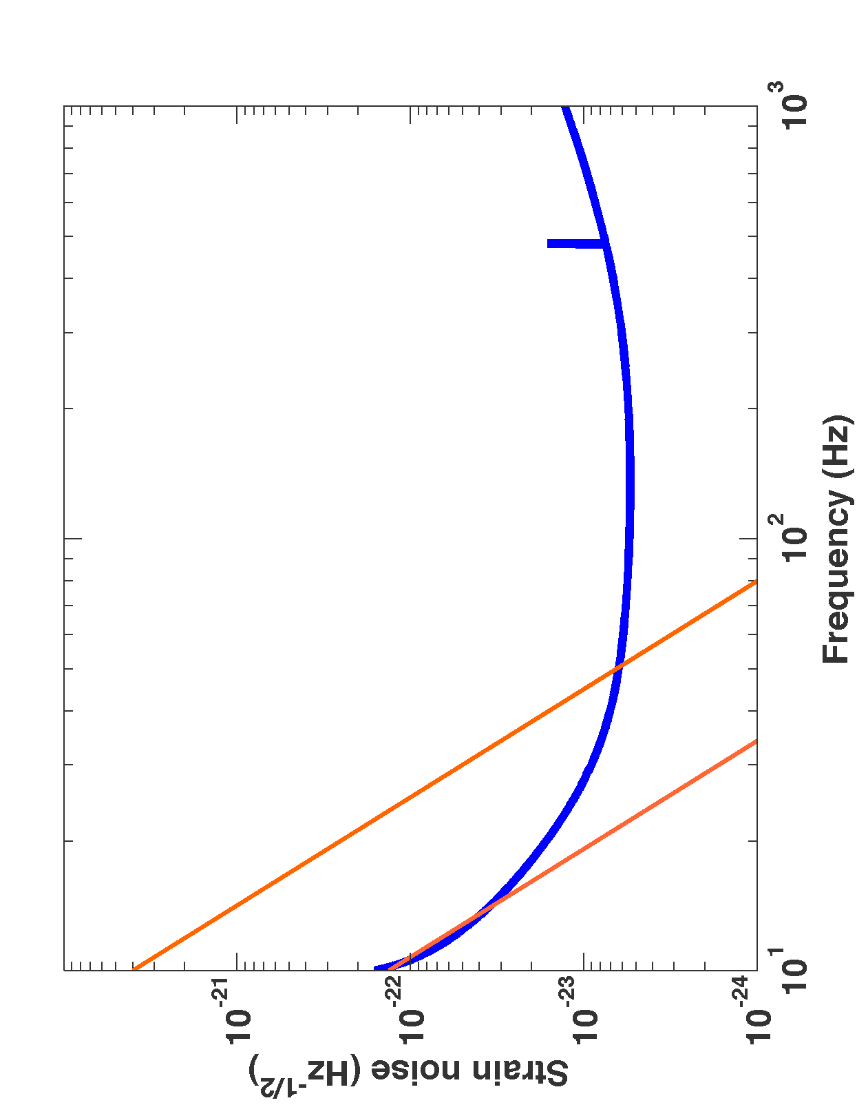
Strain noise, assuming 10 pT/rtHz
From yaw
coupling
25 W, T=35% SRM
From pitch
coupling

Slide 9
Next steps
aOSEM holders on the reaction chain PM stage (L2) will be replaced with slit parts (reduce eddy currents)
  H1 ITMY: can be replaced in-situ, but may wait for an opportune time
  L1 ITMX: parts being prepared now
Prospect for measuring Longitudinal coupling
  Applied fields are ‘tens of micro-Tesla’
  Longitudinal motion of 10⁻¹² – few 10⁻¹¹ meters
  H2OAT sensitivity at 10 Hz: ~10⁻¹⁰ m/rtHz
  L1 will have Michelson sensing, ~10⁻¹⁶ m/rtHz or better

