Slide 1
Prudential Body Box Results
Kate Gushwa
Margot Phelps
Calum Torrie

Slide 2
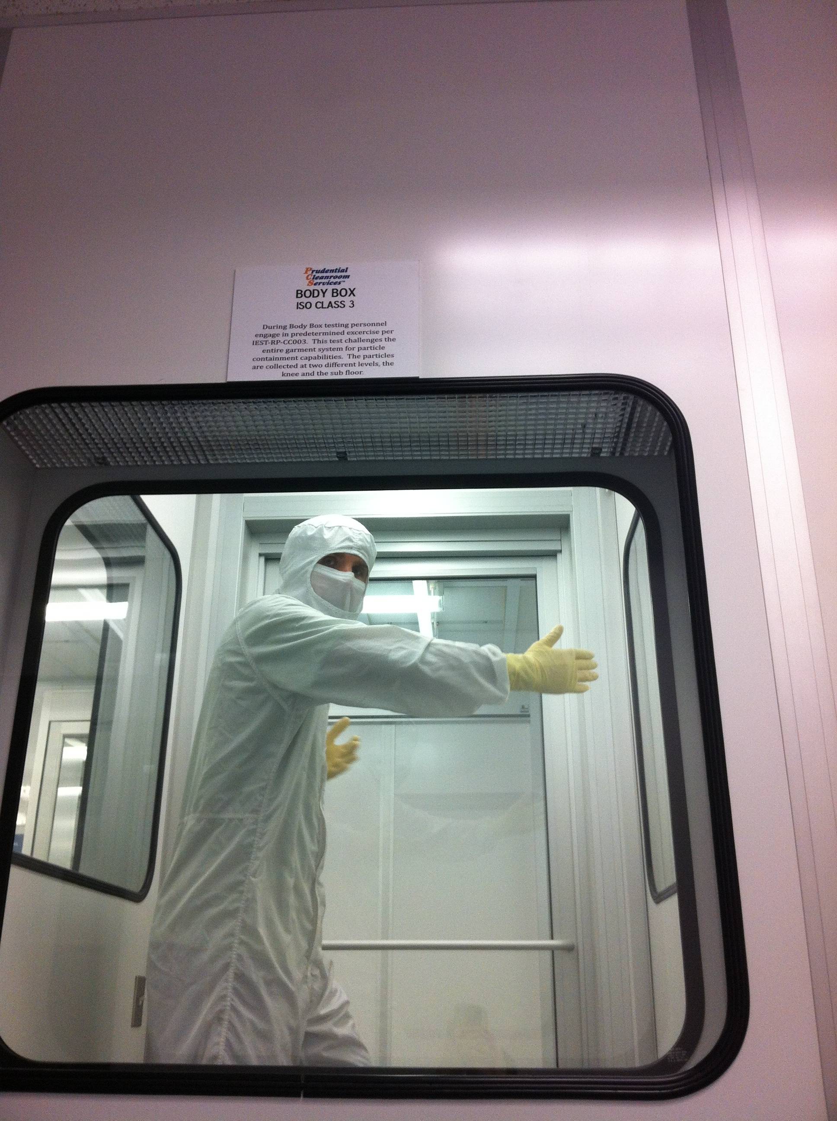
Body Box
Series of exercises performed inside an ISO Class 3 box.
Particles collected at knee and sub floor levels.

Slide 3
Exercises
During each test:
Stand still (1 min)
Reach arms out then touch shoulders (5 min)
Stand still (1 min)
March and touch shoulders (5 min)
Stand still (1 min)
Bend knees (1 min)
Stand still (1 min)

Slide 4
Constants
Wore:
Bouffant cap
Booties
Same activities performed during each test.
Garb removed immediately after tests.
Subjects were tested in the same order to allow a cool down period between tests.

Slide 5
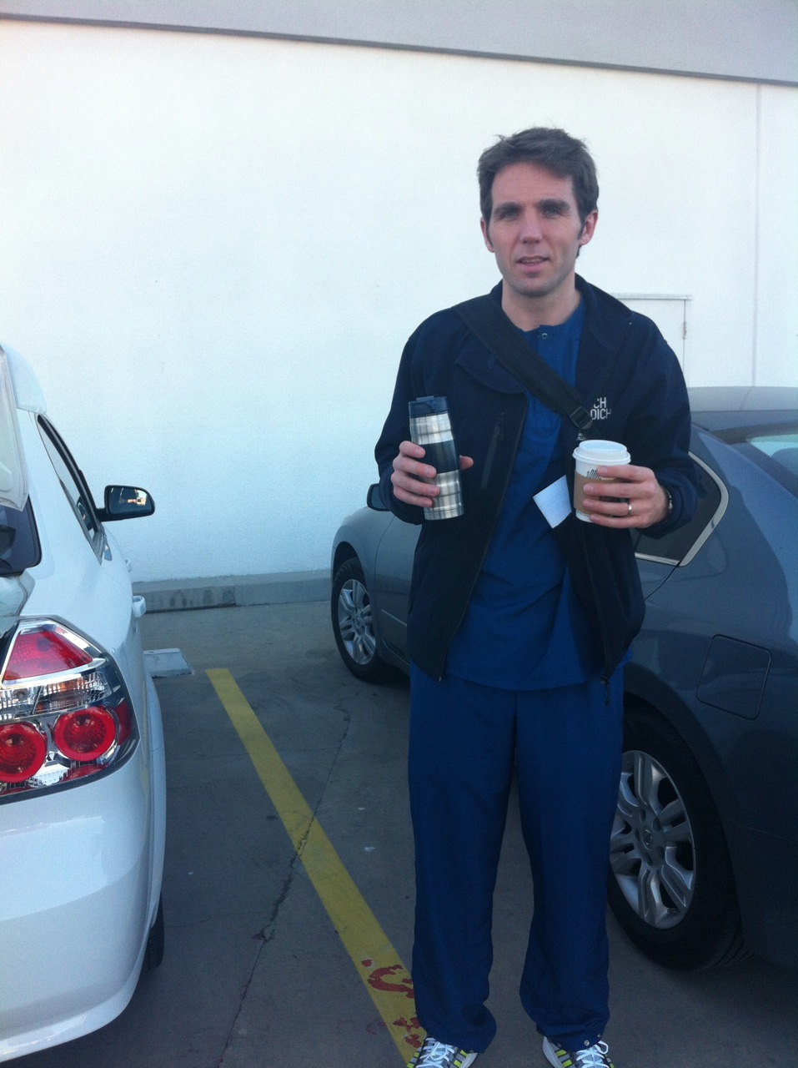
Constants
Short wait after each test while the particle count stabilized in the empty Body Box.
Subjects had breakfast and drove to Prudential in scrubs to better simulate normal use.

Slide 6
Prudential Trips
Trip #1
Trip #2
Participants: Calum, Margot, Kate
Tests:
2010 garb w/ scrubs
LHO hood & new veils
2008 garb w/ scrubs
LHO hood disposable mask
2010 garb w/ street clothes
Calum: shorts
Margot: slacks
Kate: jeans
*Assume 15-17 washes per year
Participants: Calum, Margot, Kate, Betsy
Tests:
Brand new garb w/ scrubs
LHO hood (one size fits all)
New veils (Betsy in mask)
Brand new garb w/ street clothes
Calum: shorts
Margot: slacks
Kate & Betsy: jeans
*Virgin garb washed 3x (customary before first use)

Slide 7
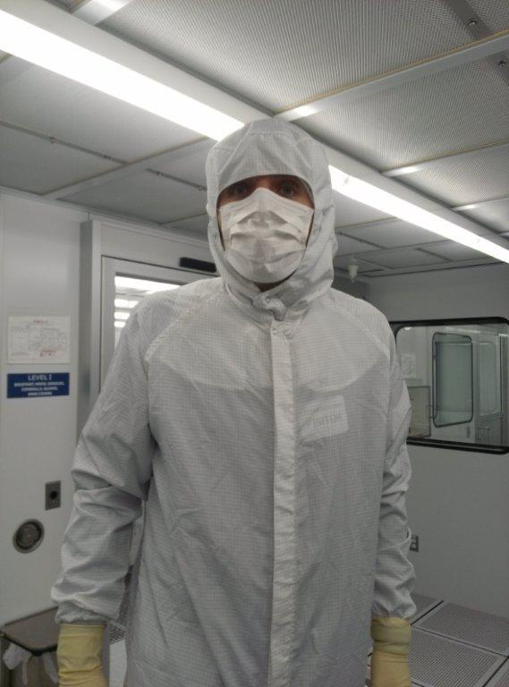
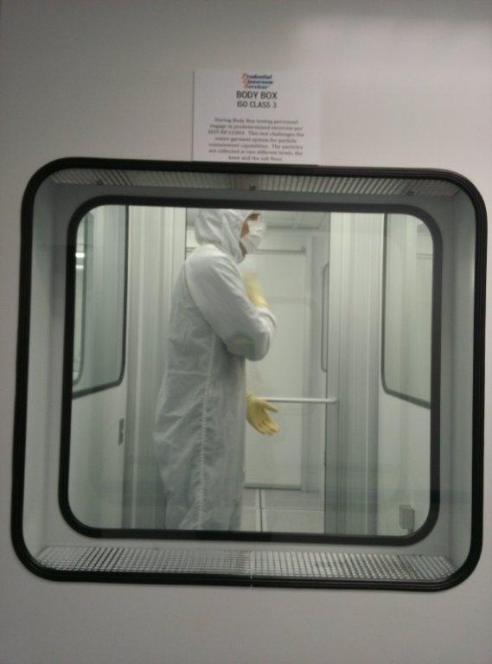
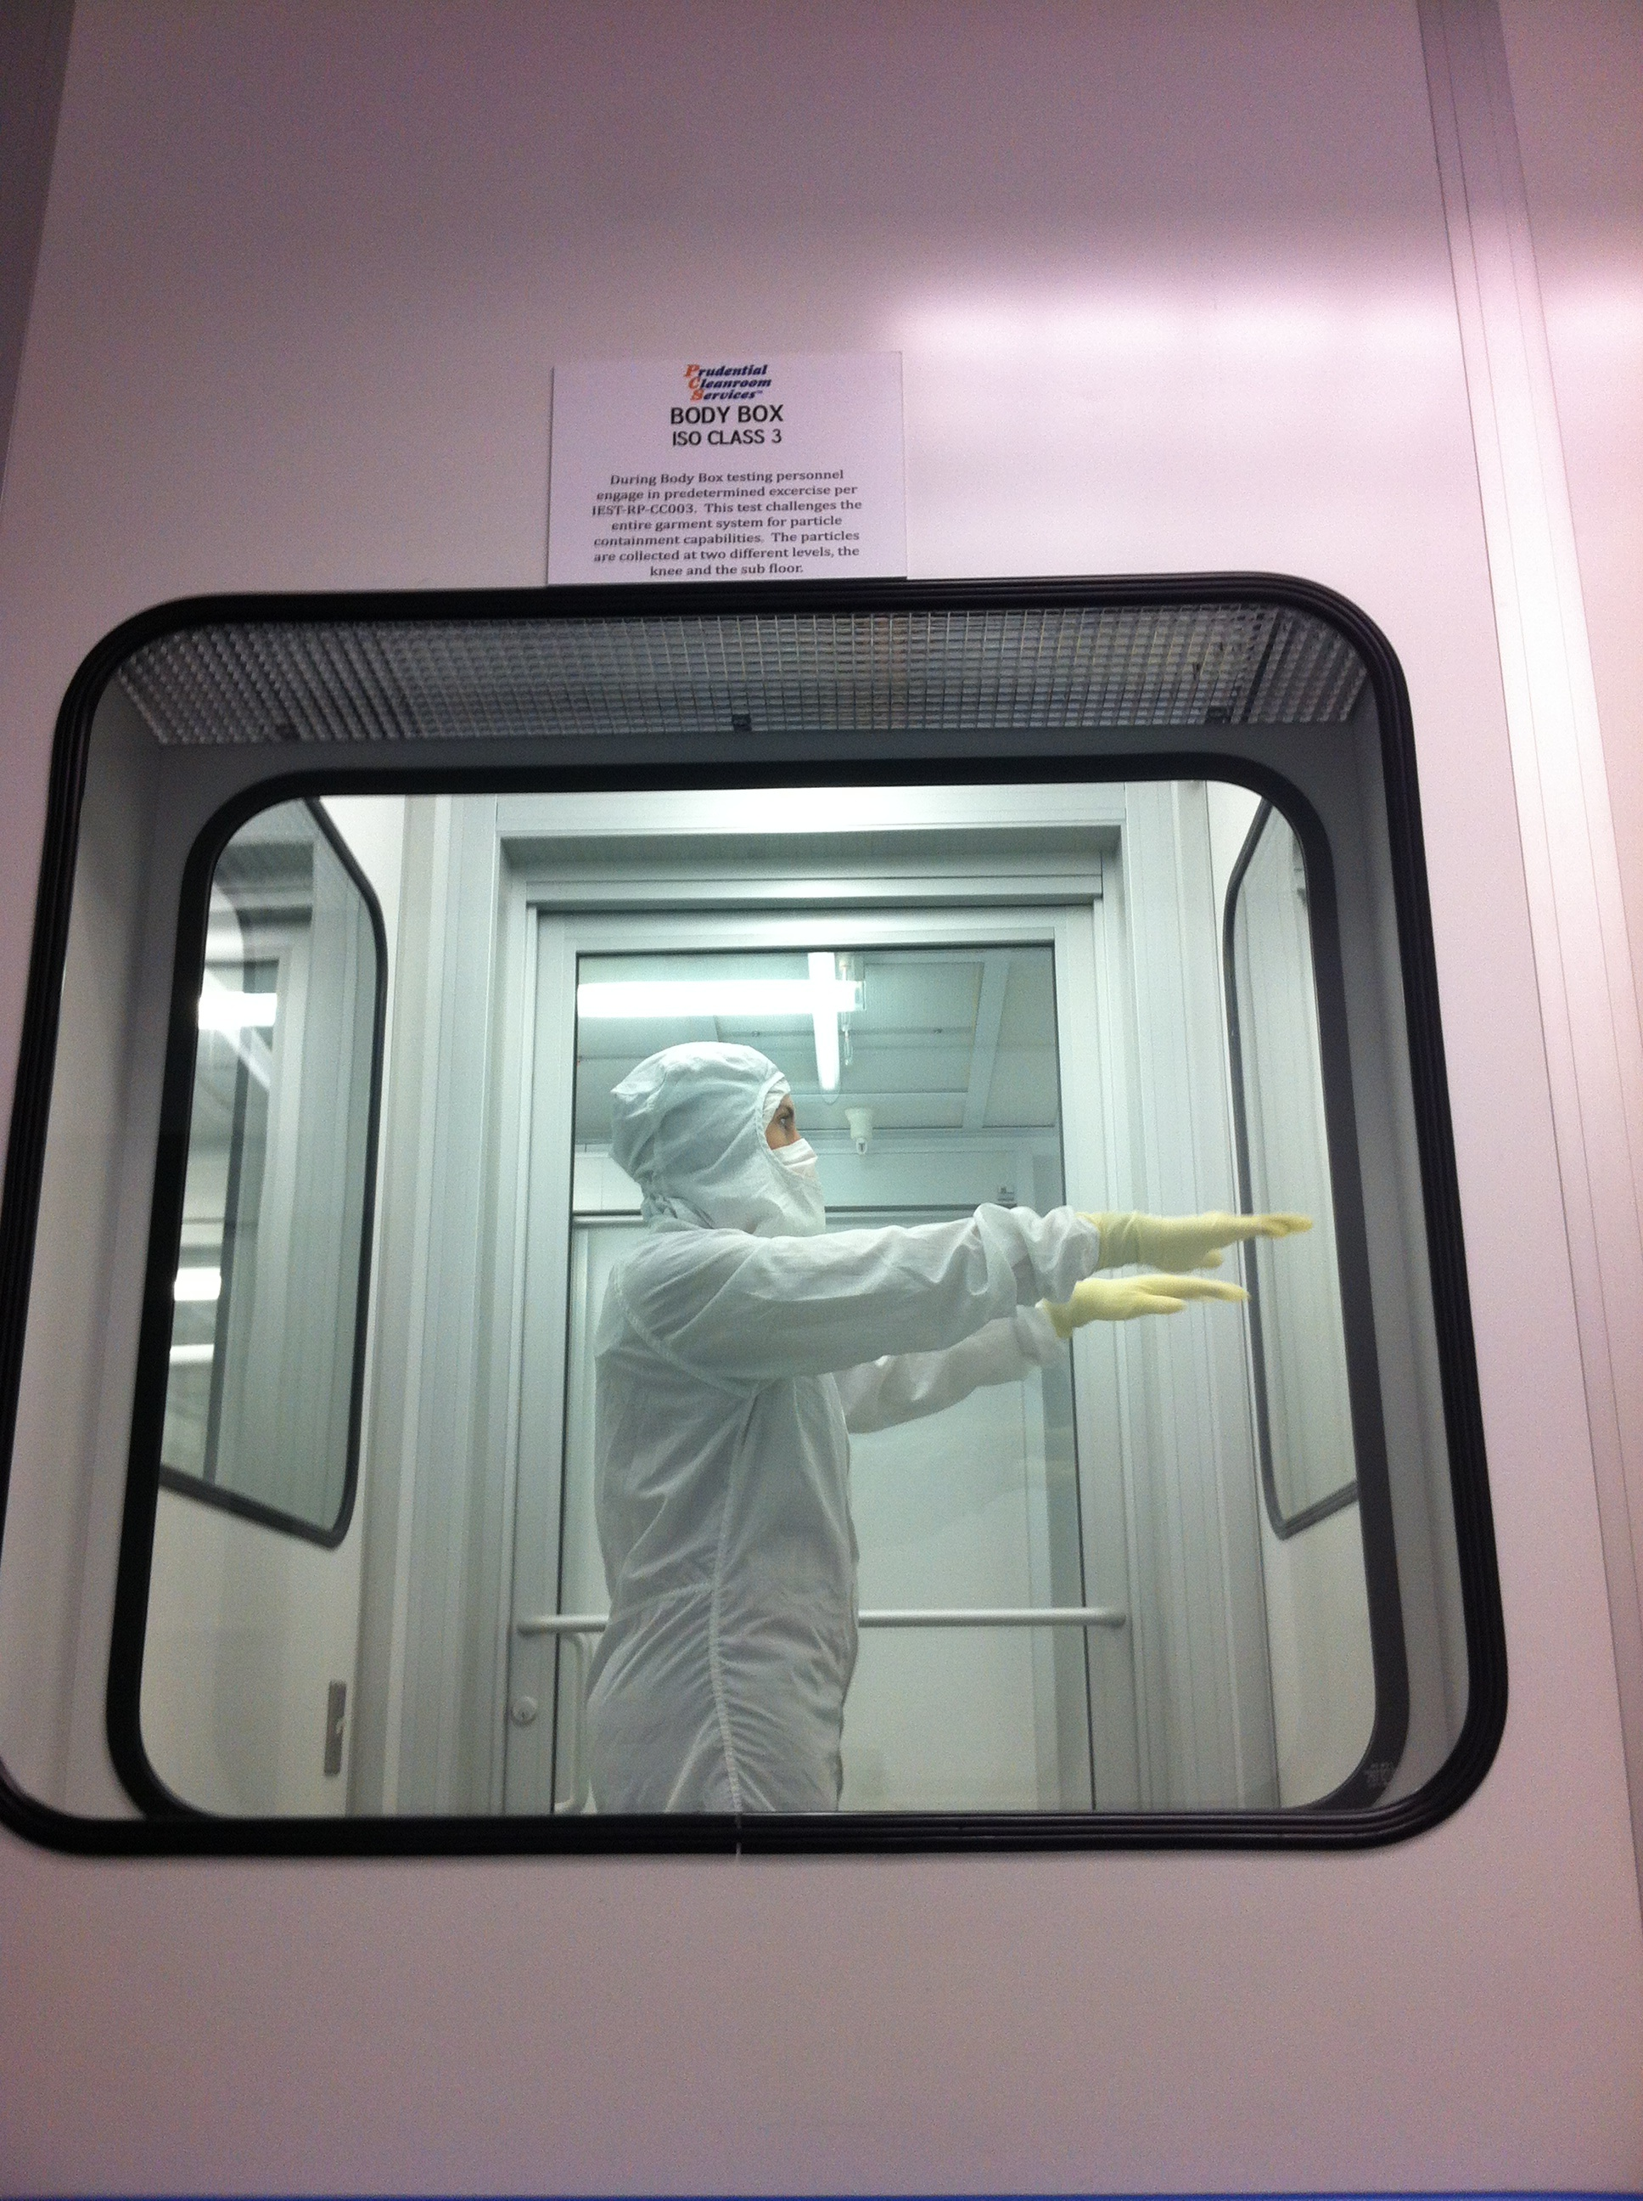
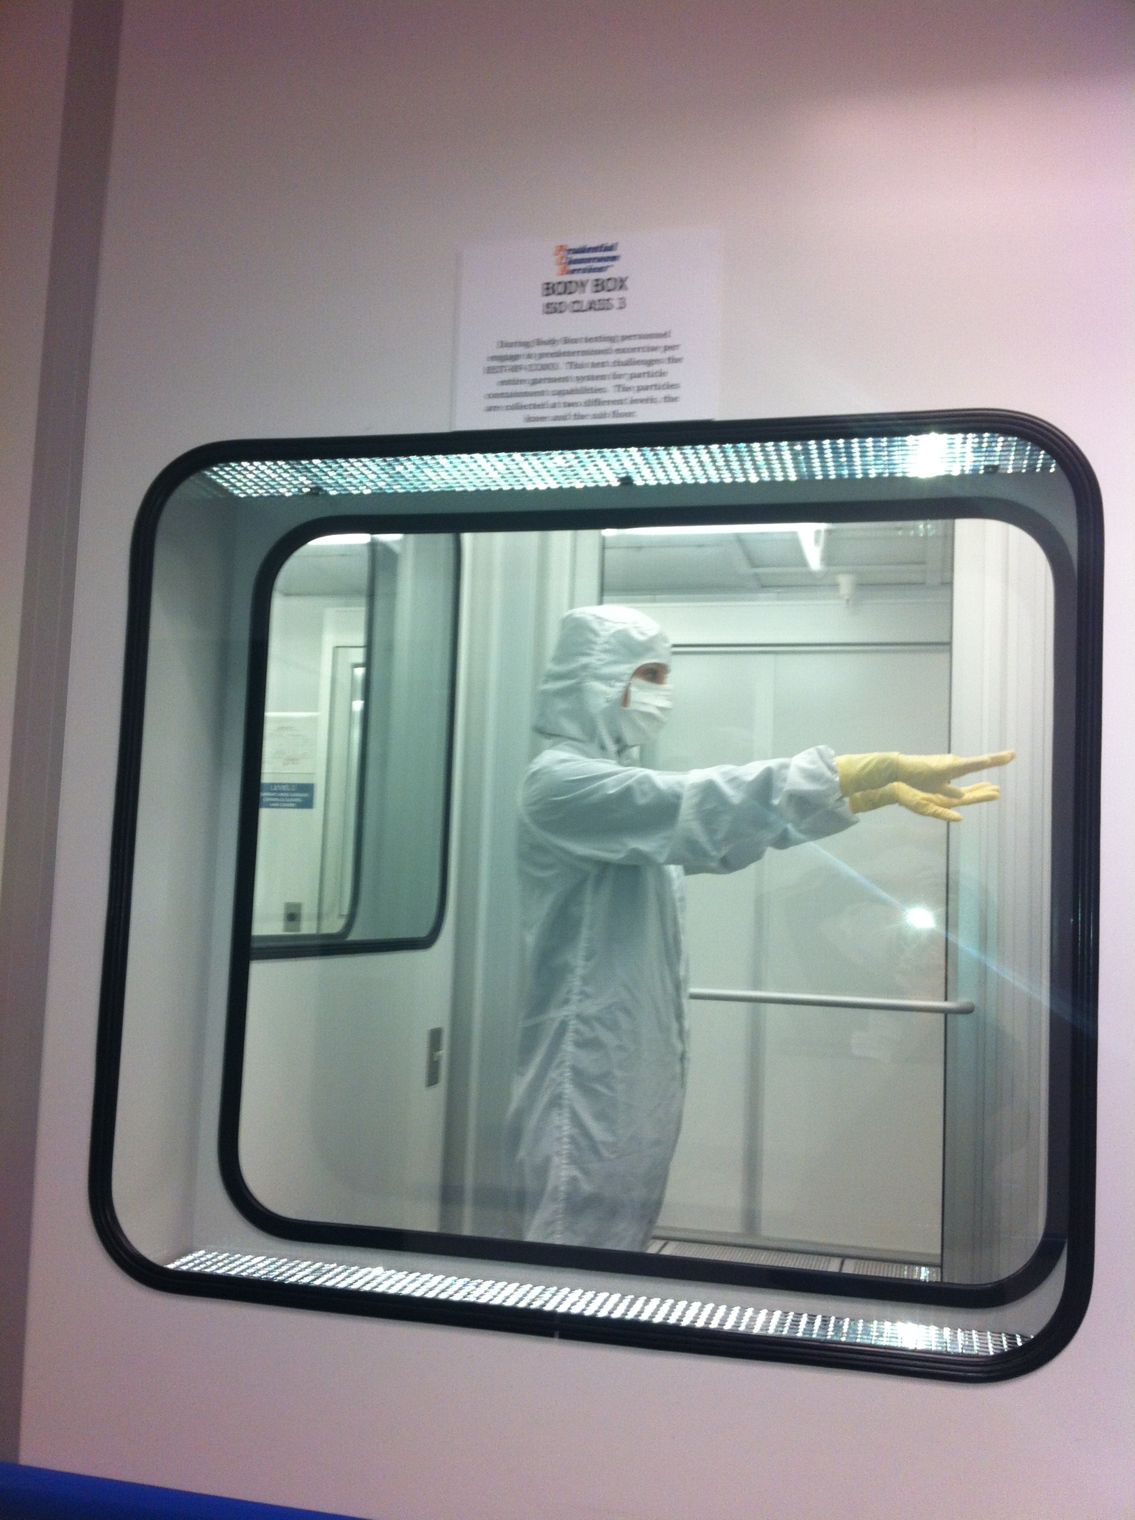
2008 Garb
Size of gaps between mask and hood varied between subjects.
Was “best case” test of old garb because subjects had well-fitting hoods.
Sometimes have to wear wrong size at observatories, resulting in bigger gaps.

Slide 8
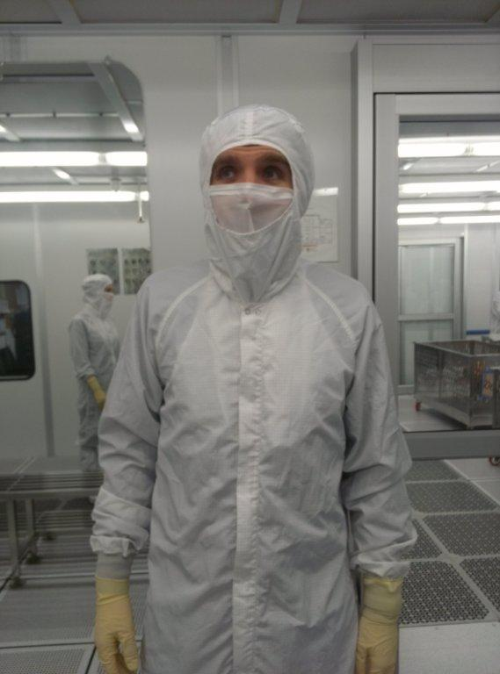
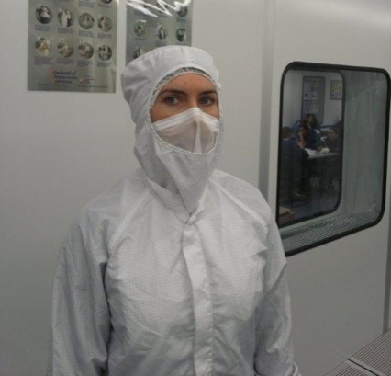
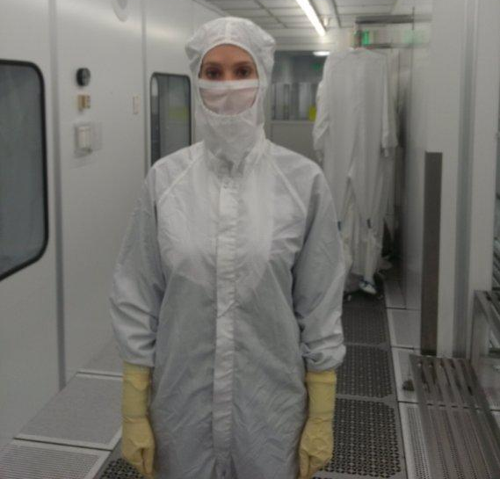
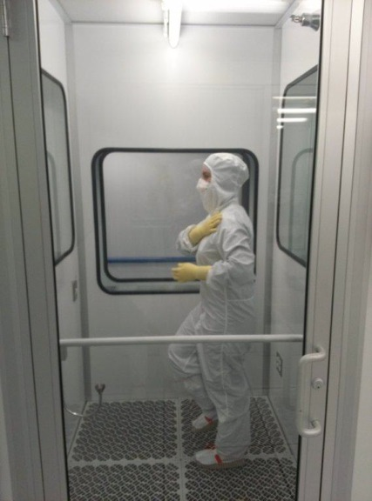
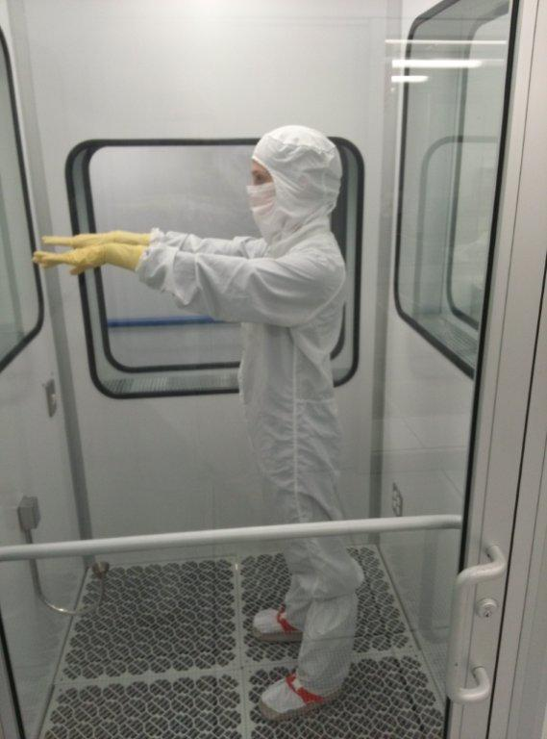
2010 Garb
Calum – hole in suit covered with tape.
Kate – noticeable shedding and loose threads.

Slide 9
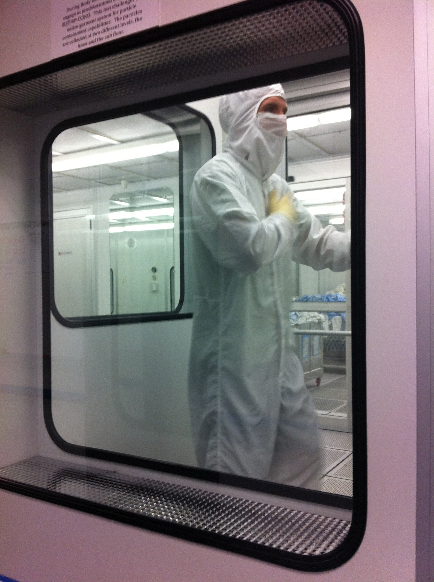
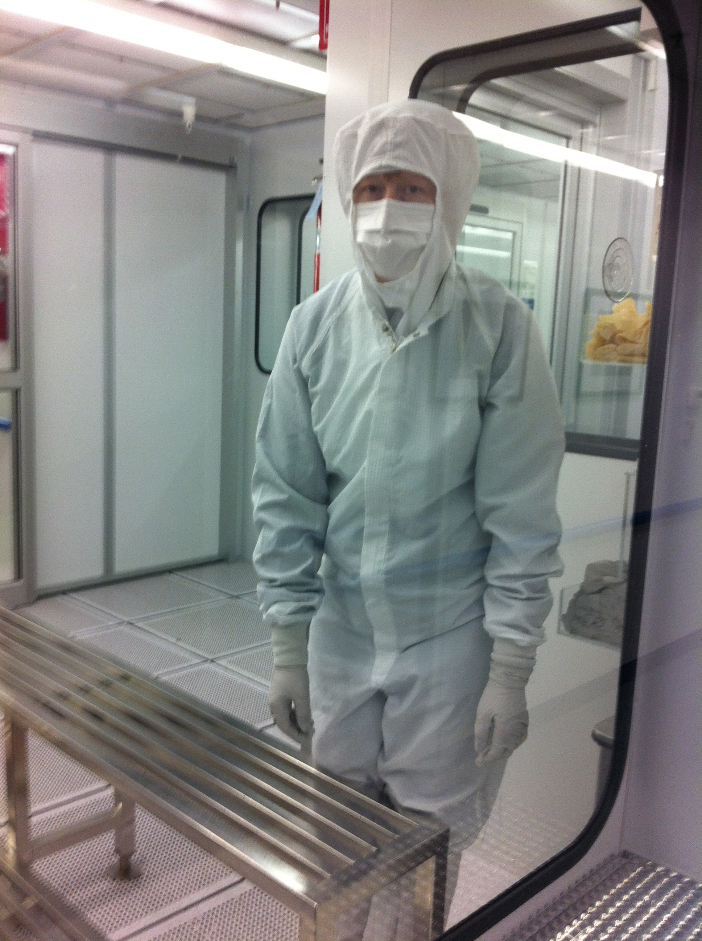
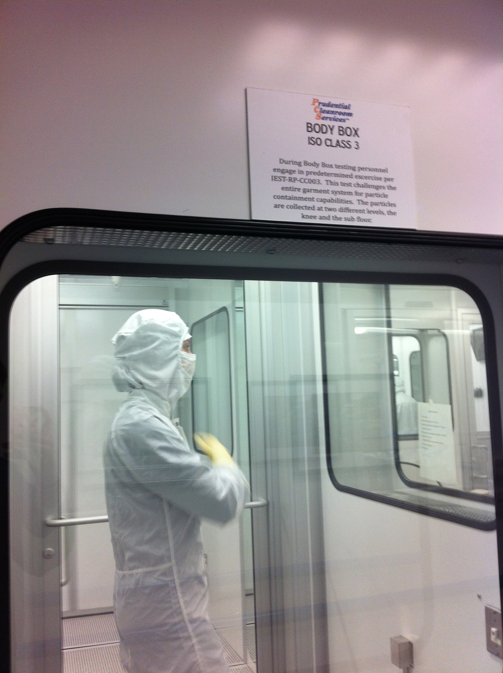
New Garb
Never worn before test.
Washed 3 times.
One size fits all hood (adjustable).

Slide 10
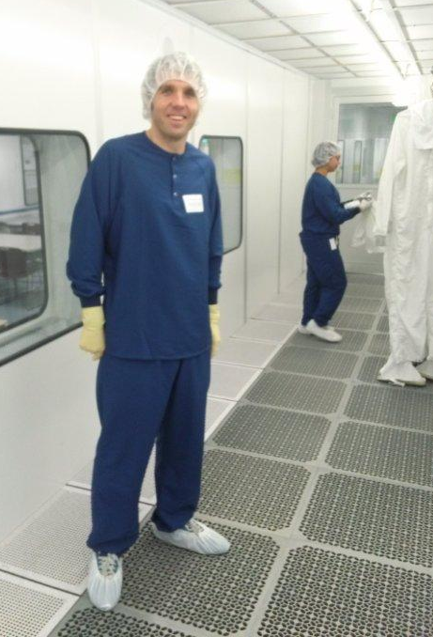
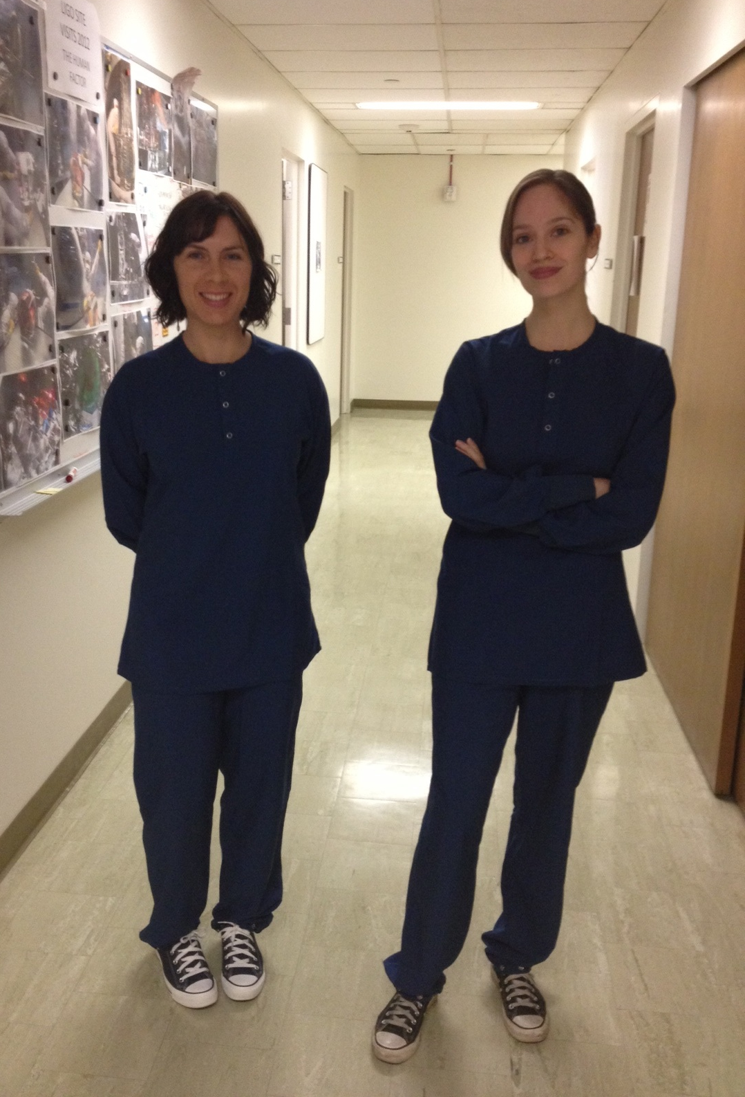
Scrubs
ESD Micro Denier polyester

Slide 11
Important Notes
“Adjusted” particle count:
Initial count (measured before subject entered) subtracted from counts for each activity.
Negative counts:
In Margot’s 1st test & Kate’s 3rd test, the adjusted particle count for some of the activities was a negative number. The count was zeroed for these cases.
Anomaly:
Calum was an anomaly. He shed more in 2010 garb (which had a hole) than 2008 garb.

Slide 12
Interpreting Data
Each subject’s counts (like graph below) were averaged for comparison.

Slide 13
Body Box Averages

Slide 14
What we’re looking for
 |  | What is it? | What is learned? | How it's evaluated?
Garb | C3 Shedding | Particle generation by C3 garb | How LIGO's garb is holding up. Whether we need to purchase new garb. | New vs. 2010 vs. 2008 garb, constant = scrubs
 | Shielding | Particle penetration through garb | How effectively LIGO's garb contains particles generated by clothes (linting) and people. | New garb vs. 2010 garb, constant = street clothes
Clothing | Scrubs? | Particle generation by clothes worn under garb | Whether implementing scrubs under garb will significantly reduce contamination. | Scrubs vs. street clothes, i) constant = new garb ii) constant = 2010 garb
Note: Can never fully separate variables (ex: shedding, shielding). This is just our best attempt.

Slide 15
C3 Shedding
New vs. 2010 vs. 2008 garb
constant = scrubs

Slide 16
C3 Shedding
Number of particles per cubic meter
Number of particles per cubic meter

Slide 17
C3 Shedding
Compare blue to blue, red to red, green to green.
In terms of shedding, our old garb is holding up well.

Slide 18
C3 Shedding
CALUM: | Avg # of Particles (um)
 | 0.3 | 0.5 | 0.1 | Total Particles | Highest Class
2008 garb w/ scrubs | 1,152 | 437 | 163 | 22,884 | 4.8
2010 garb w/ scrubs | 1,937 | 845 | 323 | 40,577 | 5.1
New garb w/ scrubs | 2,084 | 883 | 394 | 44,285 | 5.8
MARGOT: | Avg # of Particles
 | 0.3 | 0.5 | 1 | Total Particles | Highest Class
2008 garb w/ scrubs | 704 | 81 | 16 | 10,418 | 4.3
2010 garb w/ scrubs | 228 | 49 | 0 | 3,602 | 4.0
New garb w/ scrubs | 758 | 73 | 41 | 11,336 | 4.4
KATE: | Avg # of Particles
 | 0.3 | 0.5 | 1 | Total Particles | Highest Class
2008 garb w/ scrubs | 1,983 | 448 | 87 | 32,737 | 4.6
2010 garb w/ scrubs | 543 | 149 | 33 | 9,429 | 4.2
New garb w/ scrubs | 845 | 19 | 3 | 11,265 | 4.5

Slide 19
Shielding
New garb vs. 2010 garb
constant = street clothes

Slide 20
Shielding
Number of particles per cubic meter
Number of particles per cubic meter

Slide 21
Shielding
Brand new garb is a better barrier.
Did not test 2008 garb w/ street clothes, so had to use Calum’s anomalous 2010 garb data.

Slide 22
Scrubs?
Scrubs vs. street clothes
constant = new garb
constant = 2010 garb

Slide 23
Scrubs vs. Street Clothes (New Garb)
Number of particles per cubic meter
Number of particles per cubic meter

Slide 24
Scrubs vs. Street Clothes (New Garb)
Kate shed less in scrubs.
Subtler difference for Calum, Margot, and Betsy.
New garb is better at shielding, and masks the contamination from people and clothes. OR new garb sheds more, and masks the benefits of scrubs.

Slide 25
Scrubs vs. Street Clothes (2010 Garb)
* Used Calum’s 2008 garb w/ scrubs data due to anomalous test with 2010 garb (had a hole).
Number of particles per cubic meter
Number of particles per cubic meter

Slide 26
Scrubs vs. Street Clothes (2010 Garb)
Wearing scrubs made a difference in cleanroom class for Margot and Kate.
* Used Calum’s 2008 garb w/ scrubs data due to anomalous test with 2010 garb (had a hole).

Slide 27
Scrubs vs Street Clothes (2010 Garb) Cumulative Results
Graph highlights benefits of scrubs for compounded contamination.

Slide 28
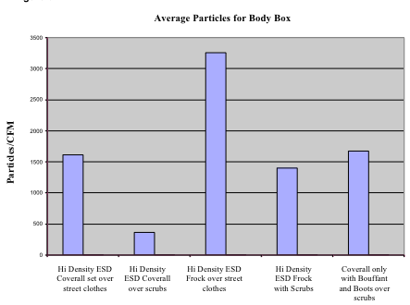
Further Evidence for Scrubs
Amarak study showed coveralls over street clothes shed more than frocks over scrubs.

Slide 29
LLO High Bay Particle Count
People are the largest source of contamination in a cleanroom.

Slide 30
LLO High Bay vs Margot & Kate
Apples to oranges comparison, but gives idea of scale of improvement.

Slide 31
LLO Banquet Room Particle Count

Slide 32
LLO Banquet Room vs Margot & Kate

Slide 33
Conclusions
Garb Shedding:
Old LIGO garb holding up well.
Additional washes may reduce shedding for brand new garb. (Discussing with Prudential)
Garb Shielding:
2010 garb shed 10,300 – 12,500 more particles than new garb (ignoring Calum’s anomalous 2010 data).
New garb is a better barrier.
Scrubs:
Street clothes shed 15,400 – 19,300 more particles than scrubs.
Made a difference in cleanroom class for Margot and Kate.

Slide 34
Input from Prudential
Garb Shedding:
C3 sheds larger amounts of particles initially.
3 washes brings shedding down to an acceptable level.
Garb sheds less and less up until 20-25 washes, then it sheds again, then it slows again.
Waiting for additional input from test lab.
Garb Shielding:
Fabric weave tightens over time, and there is less penetration between the fibers.
Older garb is a much better barrier than newer garb until the fabric begins to breakdown somewhere above 150 cycles.

Slide 35
Recommendations
Ideal
Backup
Implement scrubs.
Should offer at least ½ a cleanroom class improvement (log graph, factor of ~3 reduction in particles).
Plan upcoming purchase of new garb.
Investigating total number of washes before retirement.
Buy new garb now.
Body Box selection tests or Helmke drum tests (material, type)

Slide 36
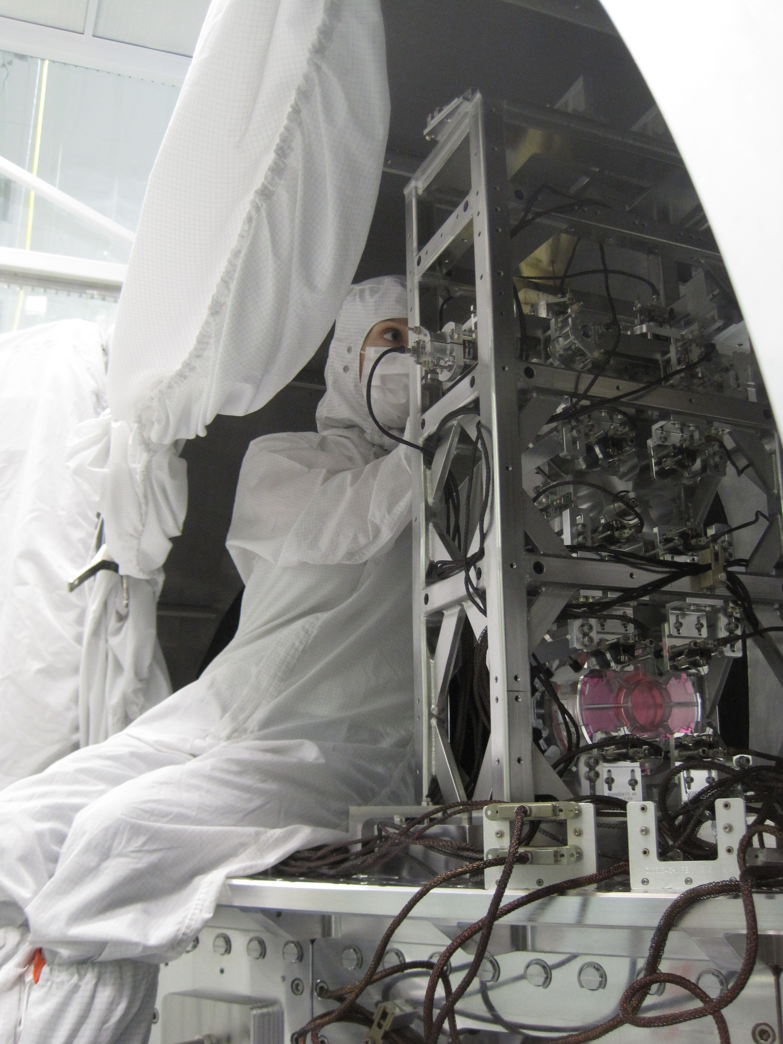
Old Garb in Action at LHO
Photos highlight effects of movement on garb.
Best case
Cheek & hair exposed, bouffant cap slipped

Slide 37
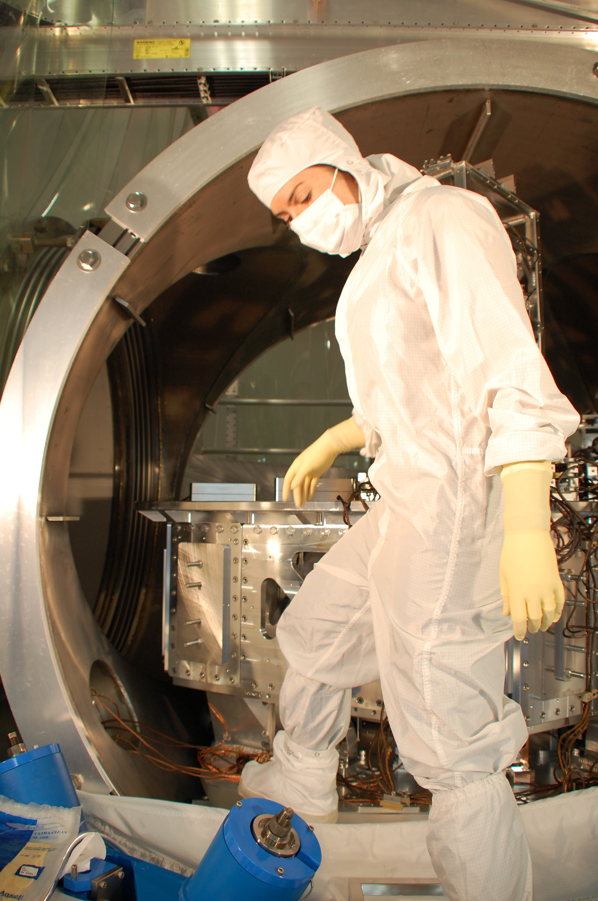
Old Garb in Action at LHO
Photos highlight effects of movement on garb.
Best case
Cheek and hair exposed
Cheek, hair, chin exposed

