Slide 1
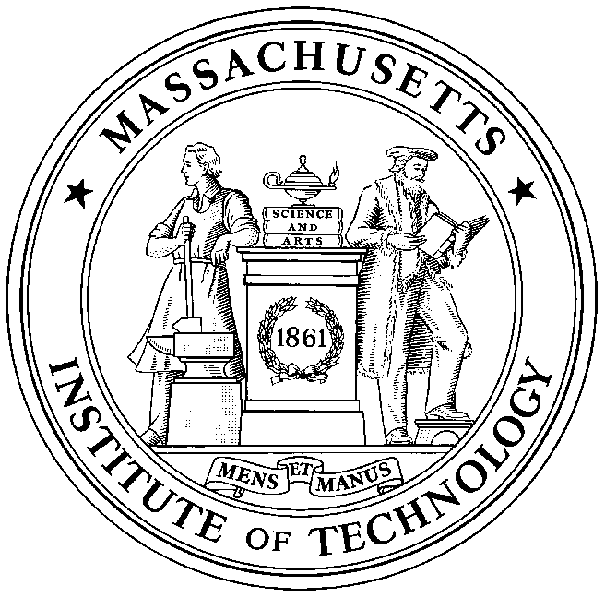
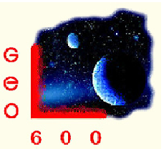
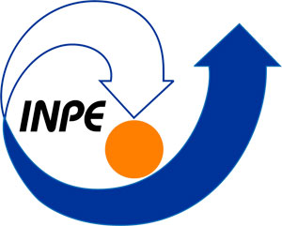
LIGO Scientific Collaboration
Abilene Christian University
Albert-Einstein Institut
Andrews University
American University
California Institute of Technology California State Univ., Fullerton Canadian Inst. Th. Astrophysics
Carleton College
College of William and Mary
Columbia U. in the City of New York
Embry-Riddle Aeronautical Univ.
Eötvös Loránd University
Georgia Institute of Technology
Goddard Space Flight Center
Hobart & William Smith Colleges
ICTP-SAIFR
IndIGO
IAP-Russian Acad. of Sciences
Inst. Nacional Pesquisas Espaciais
Kenyon College
Korean Gravitational-Wave Group
Louisiana State University
Montana State University
Montclair State University
Moscow State University
National Tsinghua University
Northwestern University
Penn State University
Rochester Institute of Technology
Sonoma State University
Southern Univ. and A&M College
Stanford University
Syracuse University
Szeged University
Texas Tech University
Trinity University
Tsinghua University
Universitat de les Illes Balears
University of Alabama in Huntsville
University of Brussels
University of Chicago
University of Florida
University of Maryland
University of Michigan
University of Minnesota
University of Mississippi
University of Oregon
University of Sannio
Univ. of Texas-Rio Grande Valley
University of Washington
University of Wisconsin-Milwaukee
Washington State University
West Virginia University
Whitman College
LIGO Laboratory: California Institute of Technology, Massachusetts Institute of Technology, LIGO Hanford Observatory, LIGO Livingston Observatory
Australian Consortium for Interferometric Gravitational Astronomy (ACIGA):
Australian National University, Charles Sturt University, Monash University, University of Adelaide, University of Melbourne, University of Western Australia
German/British Collaboration for the Detection of Gravitational Waves (GEO600):
Cardiff University, Leibniz Universität Hannover, Albert-Einstein Institut, Hannover, King's College London, Rutherford Appleton Laboratory, University of Birmingham, University of Cambridge, University of Glasgow, University of Hamburg, University of Sheffield, University of Southampton, University of Strathclyde, University of the West of Scotland

