Slide 1
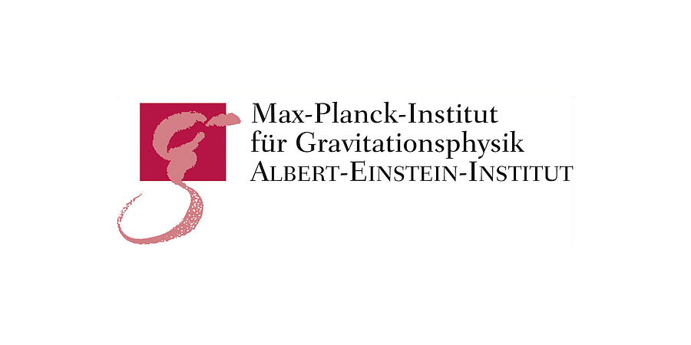
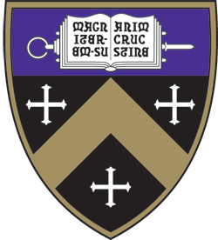
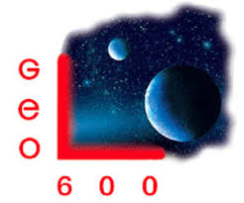
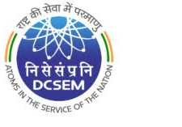
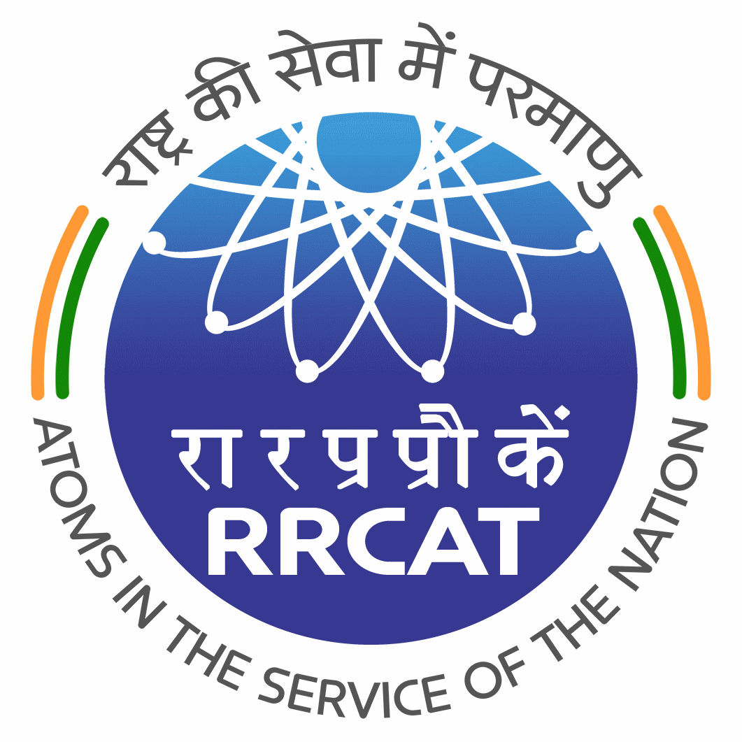
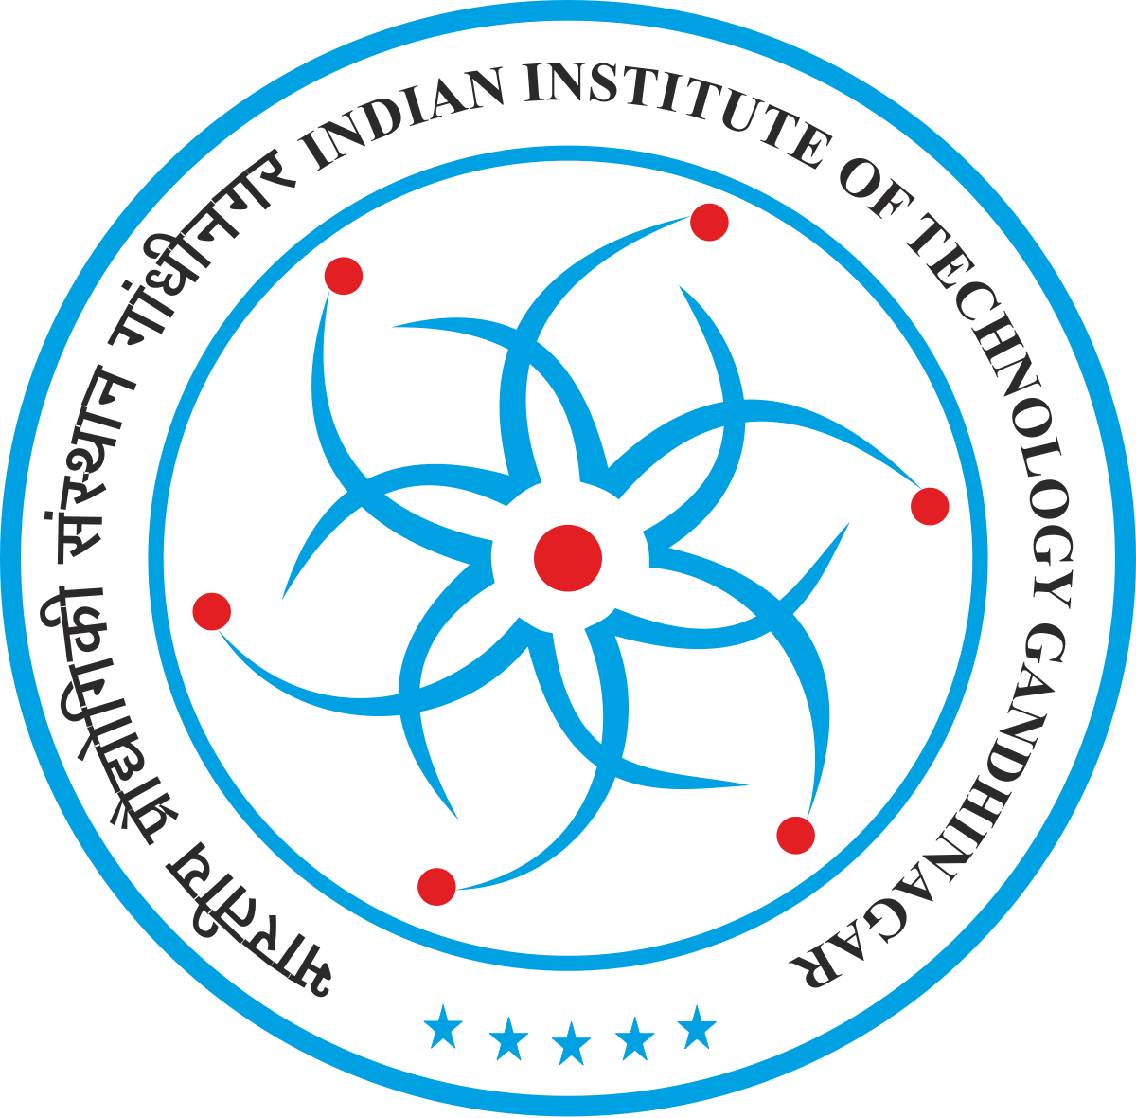
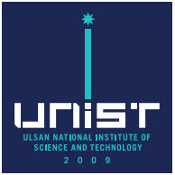
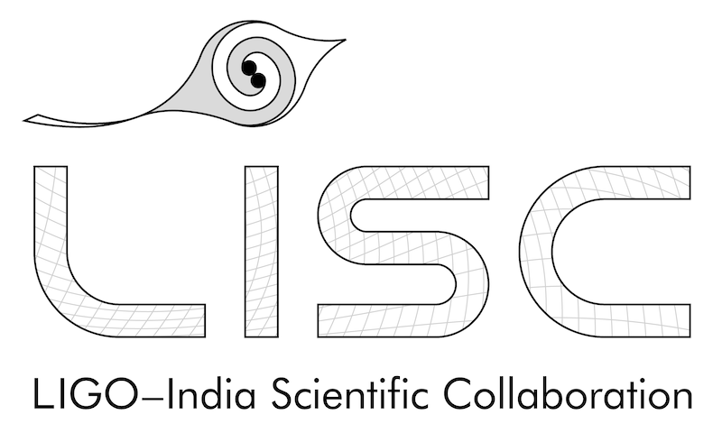
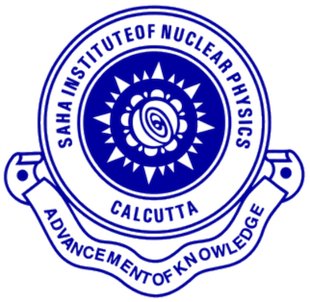
LIGO Scientific Collaboration
Albert-Einstein-Institut
American University
Andrews University
Bar-Ilan University
Bard College
Bellevue College
California Institute of Technology
California State Univ., Fullerton
California State Univ., Los Angeles
Carleton College
Chinese University of Hong Kong
Christopher Newport University
Colorado State University
Columbia U. in the City of New York
Concordia University, Wisconsin
Cornell University
Embry-Riddle Aeronautical Univ.
Eötvös Loránd University
Georgia Institute of Technology
Goddard Space Flight Center
GW-INPE, Sao Jose Brasil
Haverford College
Hillsdale College
Hobart & William Smith Colleges
IAP – Nizhny Novogorod
IFT-UNESP
Kenyon College
Louisiana State University
Maastricht University
Marquette University
Marshall Space Flight Center
Missouri University of Science
& Technology
Montana State University
Montclair State University
Moscow State University
National Central University
National Tsing Hua University
Northwestern University
Penn State University
Perimeter Institute
Rochester Institute of Technology
Sonoma State University
Stanford University
Stony Brook / CCA
Syracuse University
Szeged University
Texas A&M University
Texas Tech University
Tsinghua University
U. Montreal / Polytechnique
University of Antioquia
University of Arizona
University of Arkansas
University of Bonn and AIP
University of British Columbia
University of Brussels
University of California, Berkeley
University of California, Riverside
University of Chicago
University of Florida
University of Maryland
University of Massachusetts Dartmouth
University of Michigan
University of Minnesota
University of Mississippi
University of Oregon
University of Rhode Island
University of Sannio
University of Santiago de Compostela
University of Texas at Austin
University of Texas Rio Grande Valley
University of the Balearic Islands
University of Tokyo
University of Utah
University of Washington
University of Washington Bothell
University of Wisconsin – Milwaukee
USC – Information Sciences Institute
Vanderbilt University
Villanova University
Vrije Universiteit Amsterdam
West Virginia University
Western Washington University
LIGO Laboratory: California Institute of Technology; Massachusetts Institute of Technology; LIGO Hanford Observatory; LIGO Livingston Observatory
ARC Centre of Excellence For Gravitational Wave Discovery (OzGrav):
Australian National University; Charles Sturt University; Monash University; Swinburne University of Technology; University of Adelaide;
The University of Melbourne; University of Western Australia
German/British Collaboration for the Detection of Gravitational Waves (GEO600):
Albert-Einstein-Institut, Hannover; Cardiff University; King's College, University of London; Lancaster University, Leibniz Universität, Hannover;
Royal Holloway, University of London; Rutherford Appleton Laboratory; University of Birmingham; University of Cambridge; University of Glasgow;
University of Hamburg; University of Portsmouth; The University of Sheffield; University of Southampton; University of Strathclyde;
University of Warwick; University of the West of Scotland; University of Zurich
Korean Gravitational Wave Group (KGWG)
Chung-Ang University; Ewha Womans University; Hanyang University; Inje University; Korea Astronomy and Space Science Institute;
Korea Institute of Science and Technology Information; National Institute for Mathematical Sciences; Pusan National University; Seoul National University; Sungkyunkwan University; Ulsan National Institute of Science and Technology
LIGO India Scientific Collaboration (LISC)
Chennai Mathematical Institute; CSIR-CGCRI; DCSEM, Mumbai; IISER-Kolkata; IISER-Pune; IIT-Bombay; IIT-Gandhinagar; IIT-Hyderabad; IIT-Madras; IPR-Bhat;
ICTS-TIFR, Bengaluru; IUCAA, Pune; RRCAT, Indore; Saha Institute of Nuclear Physics; TIFR, Mumbai

