Slide 1





























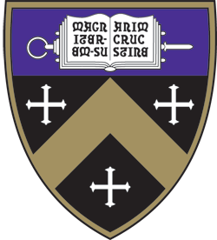






























































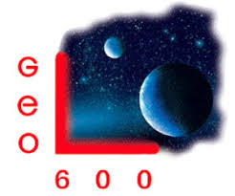













































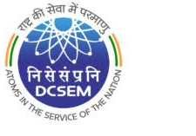

















LIGO Scientific Collaboration
Albert-Einstein-Institut
American University
Bar-Ilan University
Bard College
Barry University
California Institute of Technology
California State Univ., Fullerton
California State Univ., Los Angeles
Carleton College
Chinese University of Hong Kong
Christopher Newport University
CITA
Colorado State University
Concordia University, Wisconsin
Cornell University
Embry-Riddle Aeronautical Univ.
Eötvös Loránd University
Georgia Institute of Technology
Goddard Space Flight Center
GW-INPE, Sao Jose Brasil
Haverford College
Hobart & William Smith Colleges
IFT-UNESP
Institut de Fisica d’Altes Energies
Johns Hopkins University
Kennesaw State University
Kenyon College
Louisiana State University
Maastricht University
Marquette University
Marshall Space Flight Center
Missouri University of Science
& Technology
Montana State University
Montclair State University
Moscow State University
Nagoya University
National Central University
National Tsing Hua University
Niels Bohr Institute
Northeastern University
Northwestern University
Penn State University
Perimeter Institute
Rochester Institute of Technology
Sonoma State University
St Thomas University
Stanford University
Stony Brook / CCA
Syracuse University
Szeged University
Trinity College
Tsinghua University
U. Montreal / Polytechnique
UCAS / ICTP-AP
University of Antioquia
University of Arizona
University of Arkansas
University of Bonn and AIP
University of British Columbia
University of Brussels
University of California, Berkeley
University of California, Davis
University of California, Riverside
University of Chicago
University of Florida
Universidad de Guadalajara
University of Manitoba
University of Maryland, Baltimore County
University of Maryland, College Park
University of Massachusetts Dartmouth
University of Michigan
University of Minnesota
University of Mississippi
University of Nevada Las Vegas
University of Oregon
University of Rhode Island
University of Sannio
University of Santiago de Compostela
University of Texas at Austin
University of Texas Rio Grande Valley
University of the Balearic Islands
University of Tokyo
University of Utah
University of Washington
University of Washington Bothell
University of Wisconsin – Milwaukee
USC – Information Sciences Institute
Vanderbilt University
Villanova University
Vrije Universiteit Amsterdam
Washington State University - Pullman
Western Washington University
LIGO Laboratory: California Institute of Technology; Massachusetts Institute of Technology; LIGO Hanford Observatory; LIGO Livingston Observatory
ARC Centre of Excellence For Gravitational Wave Discovery (OzGrav):
Australian National University; Charles Sturt University; Monash University; Swinburne University of Technology; University of Adelaide; The University of Melbourne; University of Western Australia
German/British Collaboration for the Detection of Gravitational Waves (GEO600):
Albert-Einstein-Institut, Hannover; Cardiff University; Helmut Schmidt Universitat; Kings College, University of London; Leibniz Universität, Hannover; Queen Mary University of London; Rutherford Appleton Laboratory;
Royal Holloway, University of London; Technical University of Braunschweig; University College, London; University of Birmingham; University of Cambridge; University of Glasgow; University of Hamburg; University of Nottingham; University of Portsmouth; The University of Sheffield; University of Southampton; University of Stavanger; University of Strathclyde; University of Warwick; University of the West of Scotland; University of Zurich
Korean Gravitational Wave Group (KGWG)
Chung-Ang University; Ewha Womans University; Hanyang University; Inje University; Korea Astronomy and Space Science Institute; Korea Institute of Science and Technology Information;
National Institute of Mathematical Sciences; Seoul National University; Sungkyunkwan University; Ulsan National Institute of Science and Technology
LIGO India Scientific Collaboration (LISC)
Chennai Mathematical Institute; CSIR-CGCRI; DCSEM, Mumbai; Government Victoria College, Palakkad; IISER-Kolkata; IISER-Pune; IIT-Bombay; IIT-Gandhinagar; IIT-Hyderabad;
IIT-Madras; IPR-Bhat; ICTS-TIFR, Bengaluru; IUCAA, Pune; NIT, Calicut; RRCAT, Indore; Saha Institute of Nuclear Physics; TIFR, Mumbai

