Slide 1


Enhancing the astrophysical reach of LIGO with squeezed light
Lisa Barsotti
(Massachusetts Institute of Technology / LIGO Laboratory)
For the LIGO Scientific Collaboration
APS meeting, Denver, CO
April 14, 2013

Slide 2
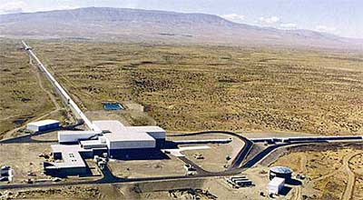
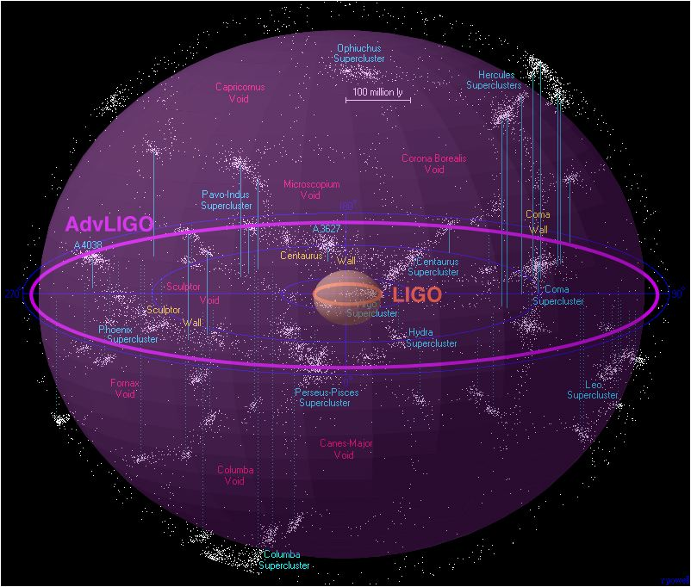
Beating quantum noise with squeezed light
The quantum nature of light limits our ability to detect gravitational waves
Quantum noise can be reduced by using non classical (squeezed) states of light
We injected squeezed light in the most sensitive gravitational wave detector in the world…and we made it even better!
This result gives us confidence that we can use squeezed light to improve the next generation of LIGO detectors, Advanced LIGO
New opportunity for extending the Advanced LIGO astrophysical reach and observe the gravitational wave Universe with unprecedented sensitivity

Slide 3
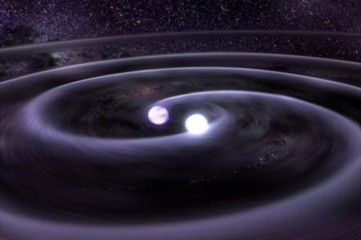
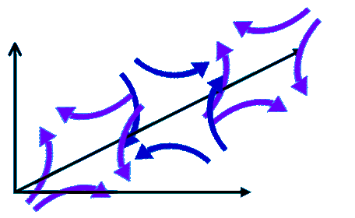
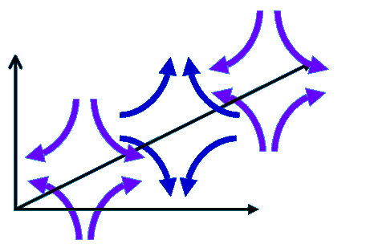
How we detect gravitational waves
Astrophysical Sources
emitting gravity waves
Differential displacement of the mirrors
Gravitational waves: ripples in the space-time propagating at the speed of light
Amplitude of the gravitational wave
Interferometer arm length
LASER
Michelson Interferometer

Slide 4

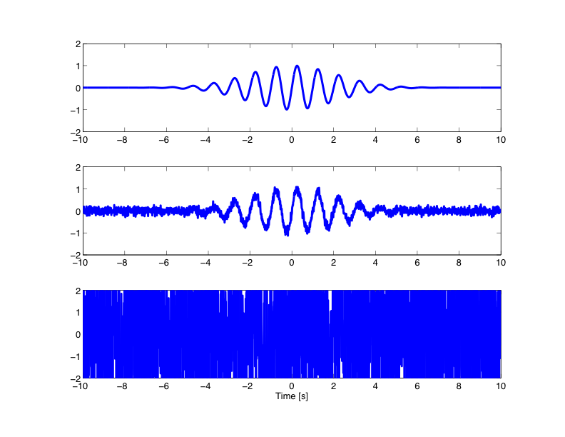
How “noise” affects our measurement
External disturbances (“noise”) will mask the displacement induced by the wave…
Noise free
signal
A little bit
of noise
Signal buried by the noise

Slide 5
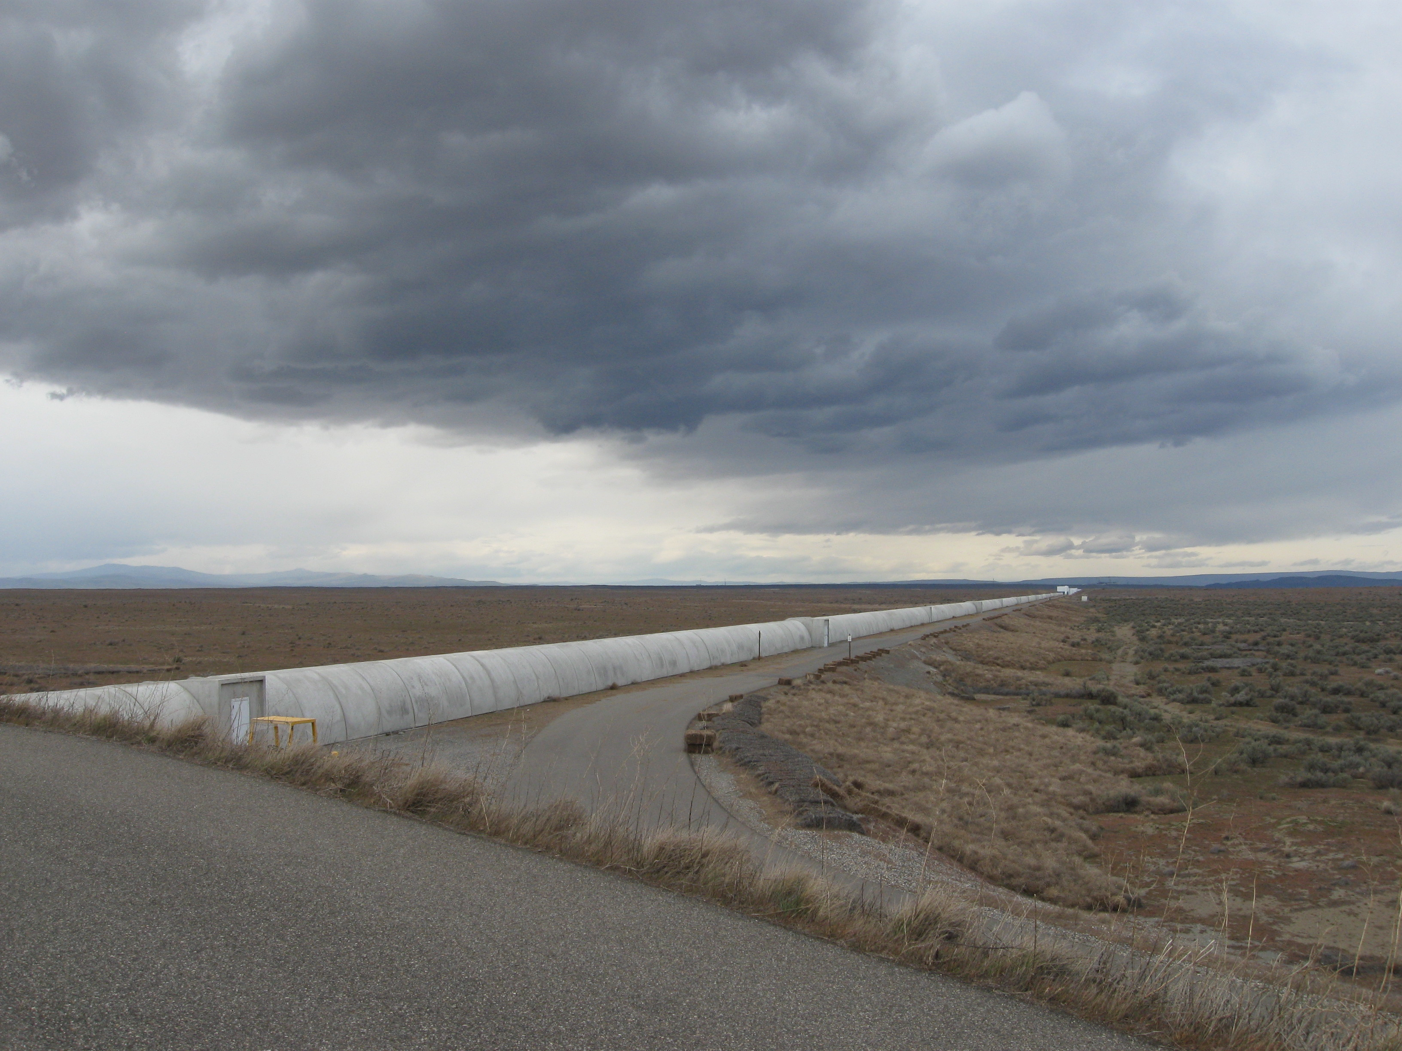
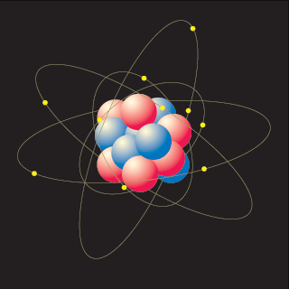
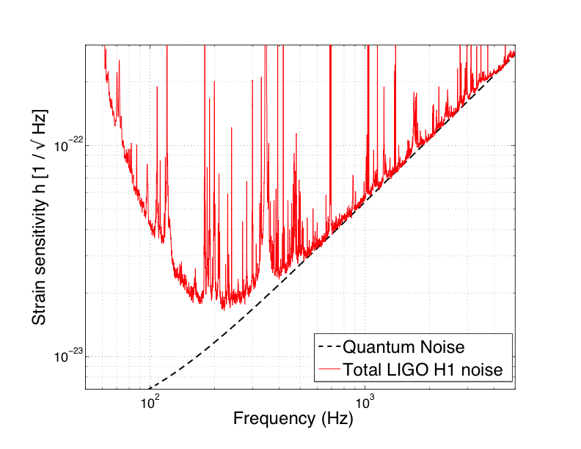
Even “noise” caused by the quantum nature of light limits our measurement!
We want to measure displacements 1000 times smaller than the radius of a proton, over 4 kilometers…
…anything you can think of is a noise source!
Amplitude Spectral Density of LIGO noise

Slide 6
Quantum noise: fluctuations of the vacuum
Heisenberg Uncertainty Principle
the more precisely the position of some particle is determined, the less precisely its momentum can be known, and vice versa
LASER
Same principle applies for the amplitude and phase of the electromagnetic field..
…and even for the amplitude and phase of the vacuum!
Phase
Phase
Signal
Amplitude
Amplitude

Slide 7
Vacuum Getting Squeezed
Reduce quantum noise by injecting squeezed vacuum: less uncertainty in one of the two quadratures (amplitude or phase)
Heisenberg Uncertainty Principle:
if the noise gets smaller in one quadrature,
it gets bigger in the other
You can squeeze the vacuum so as to reduce the noise in the quadrature you care about
LASER
Squeezed Field
Phase
IN THEORY…
C. M. Caves, Phys. Rev. Lett. 45, 75 (1980).
C. M. Caves, Quantum-mechanical noise in an interferometer. Phys. Rev. D 23, p. 1693 (1981).
IFO Signal
Amplitude

Slide 8
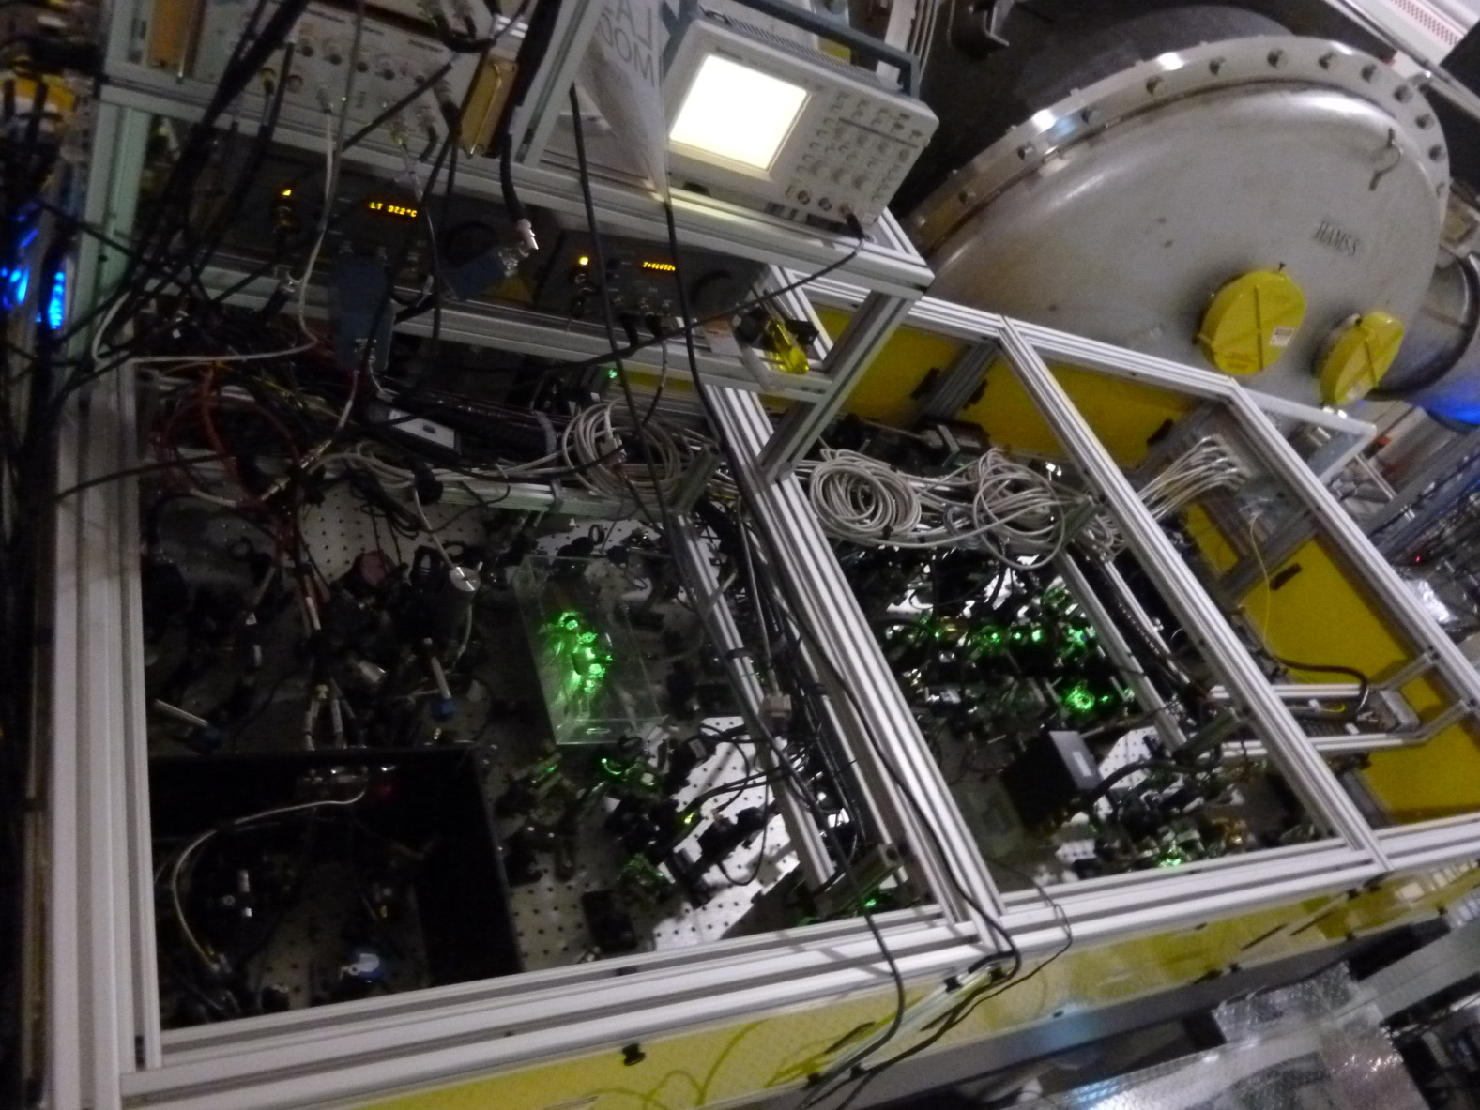
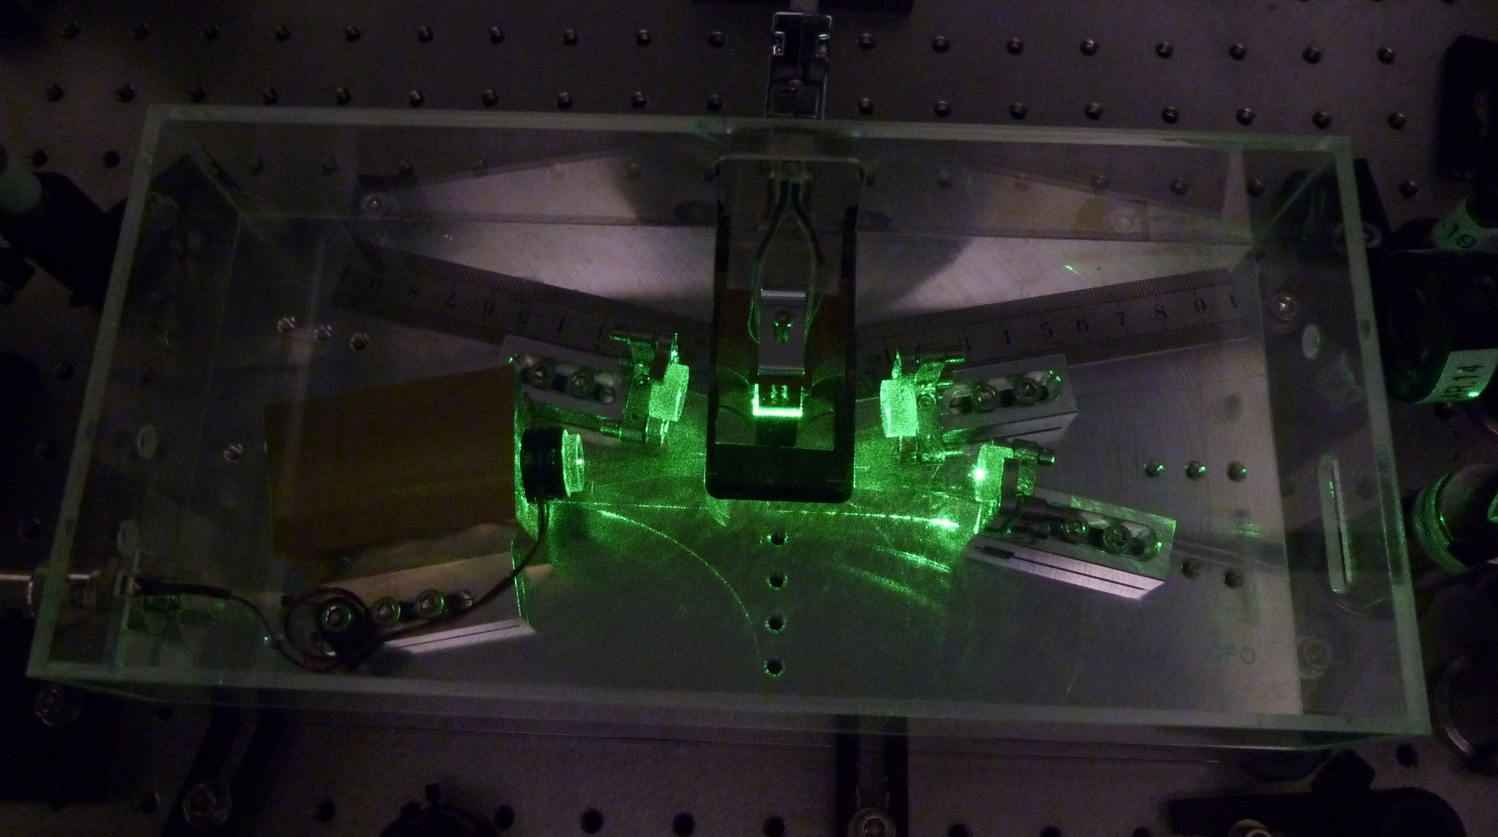
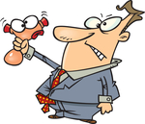
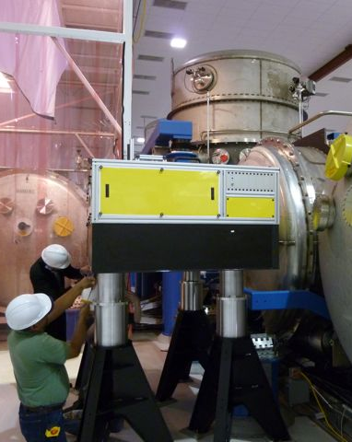
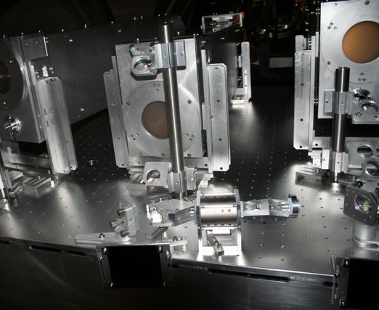
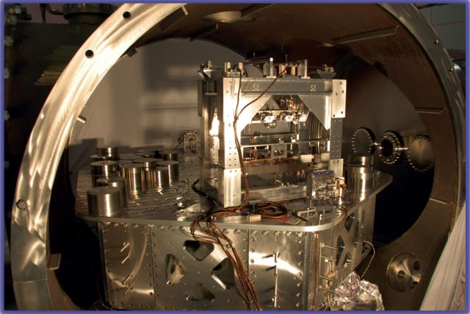
“In theory, theory and practice are the same. In practice, they are not.” - A. Einstein
World wide effort and many years of development to make squeezing compatible with gravitational wave detectors
LIGO Squeezer table
The squeezer source
(design of Australian National University)
Installation of the squeezer table
A glance into the LIGO chambers

Slide 9
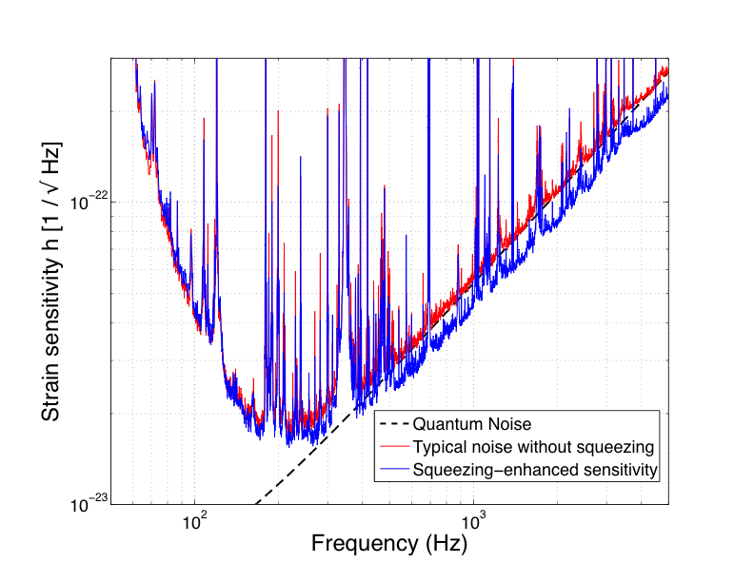
IN PRACTICE: Quantum noise reduction in the 4-km LIGO H1 Interferometer
PRELIMINARY

Slide 10
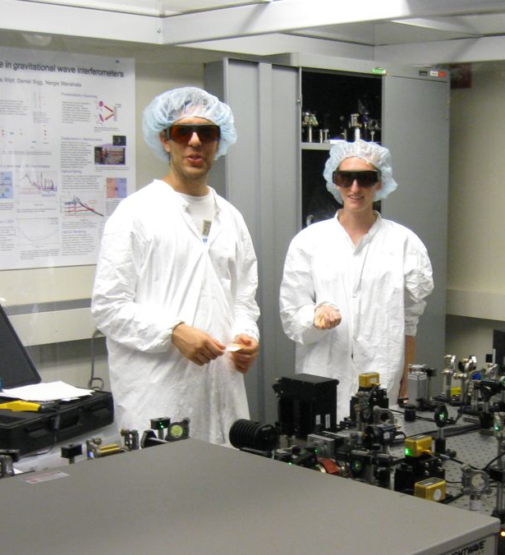
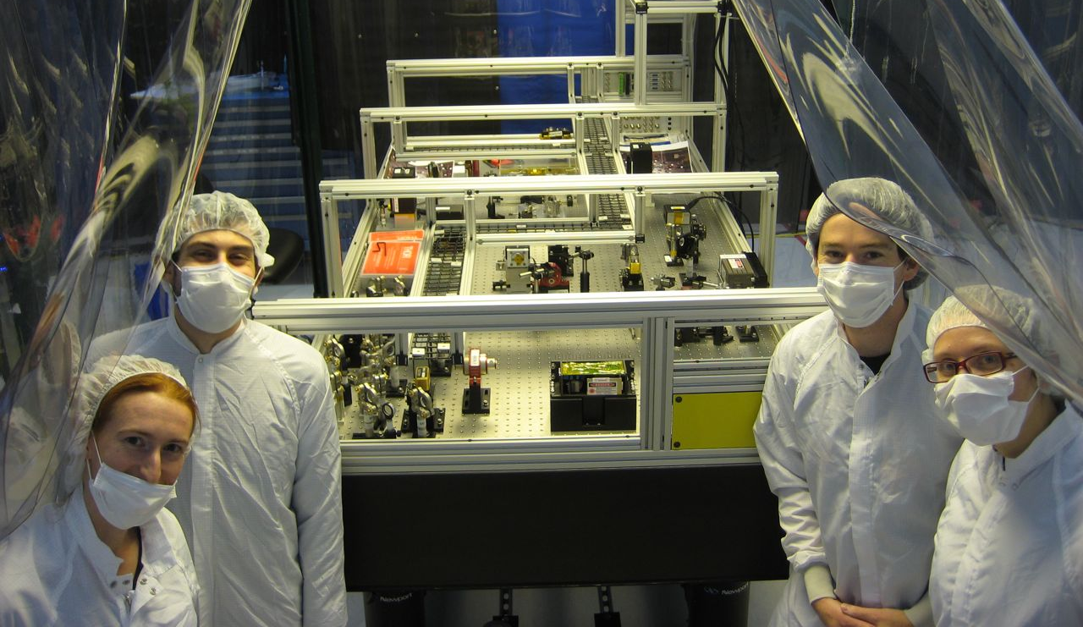
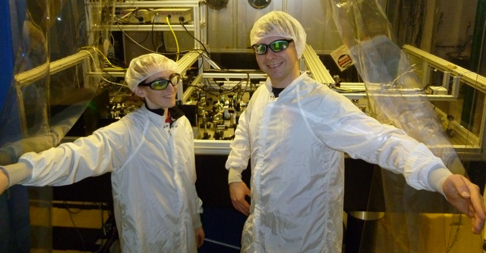
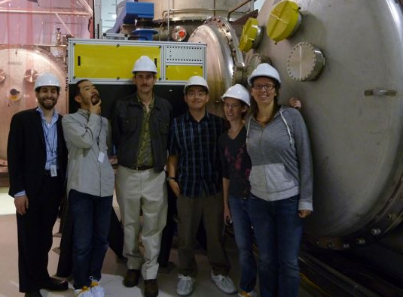
LIGO H1 Squeezing Experiment
LIGO Hanford Observatory (US)
Massachusetts Institute of Technology (US)
Australian National University (Australia)
Albert Einstein Institute (Germany)
MIT: Sheila Dwyer, L. Barsotti, Nergis Mavalvala, Nicolas Smith-Lefebvre, Matt Evans
LHO: Daniel Sigg, Keita Kawabe, Robert Schofield, Cheryl Vorvick, Dick Gustafson (Univ Mitchigan), Max Factourovich (Columbia), Grant Meadors (Univ Mitchigan),
M. Landry and the LHO staff
ANU: Sheon Chua, Michael Stefszky, Conor Mow-Lowry, Ping Koy Lam, Ben Buchler, David McClelland
AEI: Alexander Khalaidovski, Roman Schnabel

