Slide 1
Quantum noise reduction using squeezed states in LIGO
LIGO-G1300698-v1
Sheila Dwyer
for the LIGO Scientific Collaboration

Slide 2
Quantum noise will limit the sensitivity of advanced detectors

Slide 3
Quantum noise in an interferometer
Laser

Slide 4
Quantum noise in an interferometer
Laser

Slide 5
Squeezing in an interferometer
Laser

Slide 6
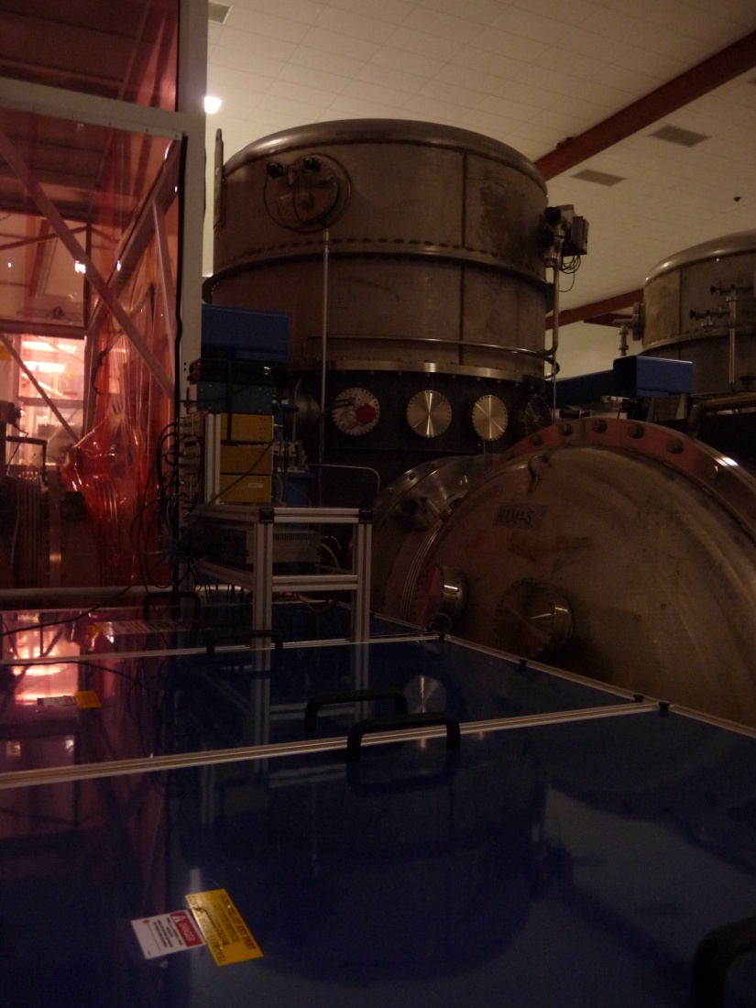
Enhanced LIGO squeezing goals:
Demonstrate that squeezing does not add noise in the LIGO band
Study environmental noise couplings
Understand limits to measured squeezing
Enable planing for aLIGO+ squeezing

Slide 7
Squeezing in Enhanced LIGO

Slide 8
Squeezing in Enhanced LIGO
2.1dB
20% improvement in SNR
Accepted at Nature Photonics

Slide 9
Best broadband sensitivity to date

Slide 10
Squeezing in Enhanced LIGO
1Mpc range added to NS range
24% increase in volume

Slide 11
Backscatter noise
Light from interferometer is scattered towards squeezer
LASER
See poster by Sheon Chua, presented by Lisa Barsotti

Slide 12
Backscatter noise
Light from interferometer is scattered towards squeezer
Squeezer scatters light back towards IFO
LASER
See poster by Sheon Chua, presented by Lisa Barsotti

Slide 13
Backscatter noise
Light from interferometer is scattered towards squeezer
Squeezer scatters light back towards IFO
Spurious interferometer adds noise
LASER
See poster by Sheon Chua, presented by Lisa Barsotti

Slide 14
Noise Coupling
260±40 fW of backscattered power at detector

Slide 15
Backscatter in ALIGO

Slide 16
Backscatter in ALIGO
Total Losses:

Slide 17
Backscatter in ALIGO
Total Losses: 20%
Total Losses:

Slide 18
What’s the catch? Losses

Slide 19
Loss budget and goals
 | Enhanced LIGO squeezing | Advanced LIGO assumptions
3 faraday passes | 5% each | 3% each
Mode matching | 30% | 4%
Output mode cleaner | 19% | 3%
Total losses | 55-60% | 20-25%
Based on a tally of 11 different loss sources
Reducing losses is a major challenge for squeezing commissioning

Slide 20
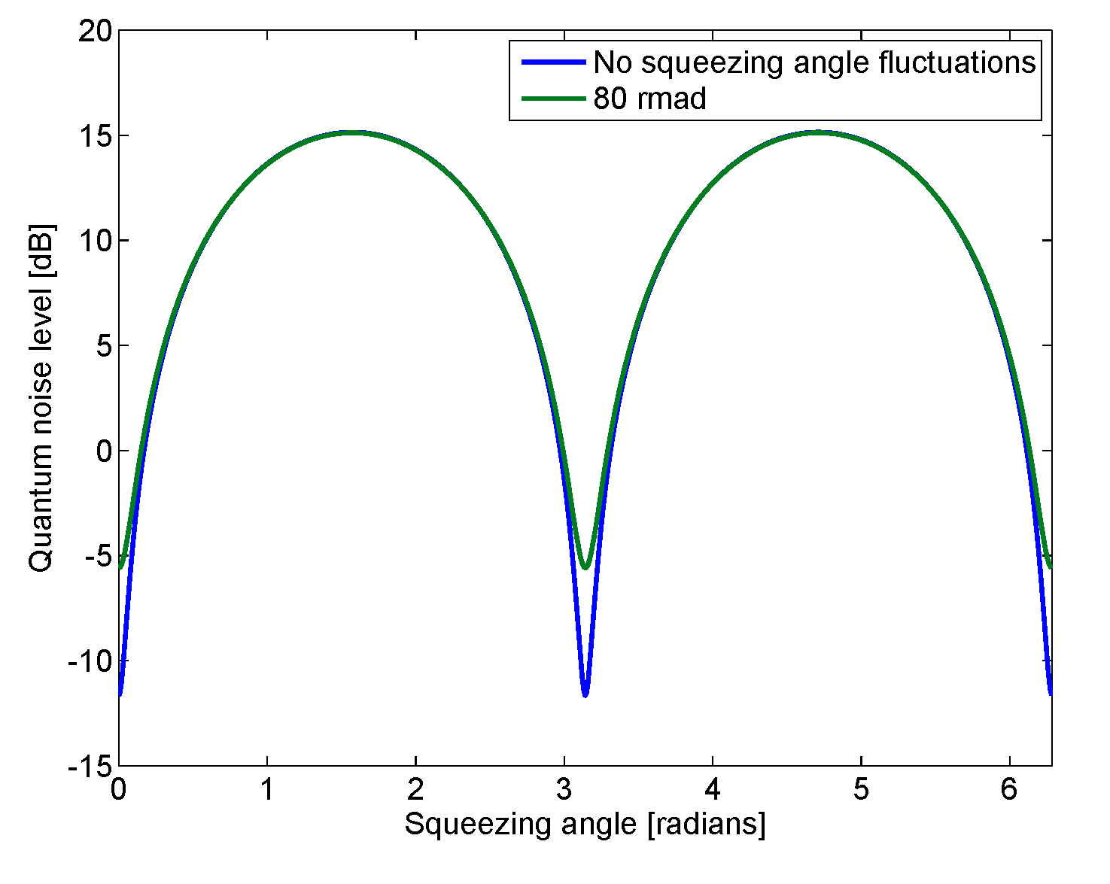
Squeezing Angle Fluctuations
X₂
X₁

Slide 21
Losses and squeezing angle fluctuations limit squeezing level

Slide 22
Losses and squeezing angle fluctuations limit squeezing level
Enhanced LIGO

Slide 23
Losses and squeezing angle fluctuations limit squeezing level
Enhanced LIGO
Advanced LIGO
See poster session

Slide 24
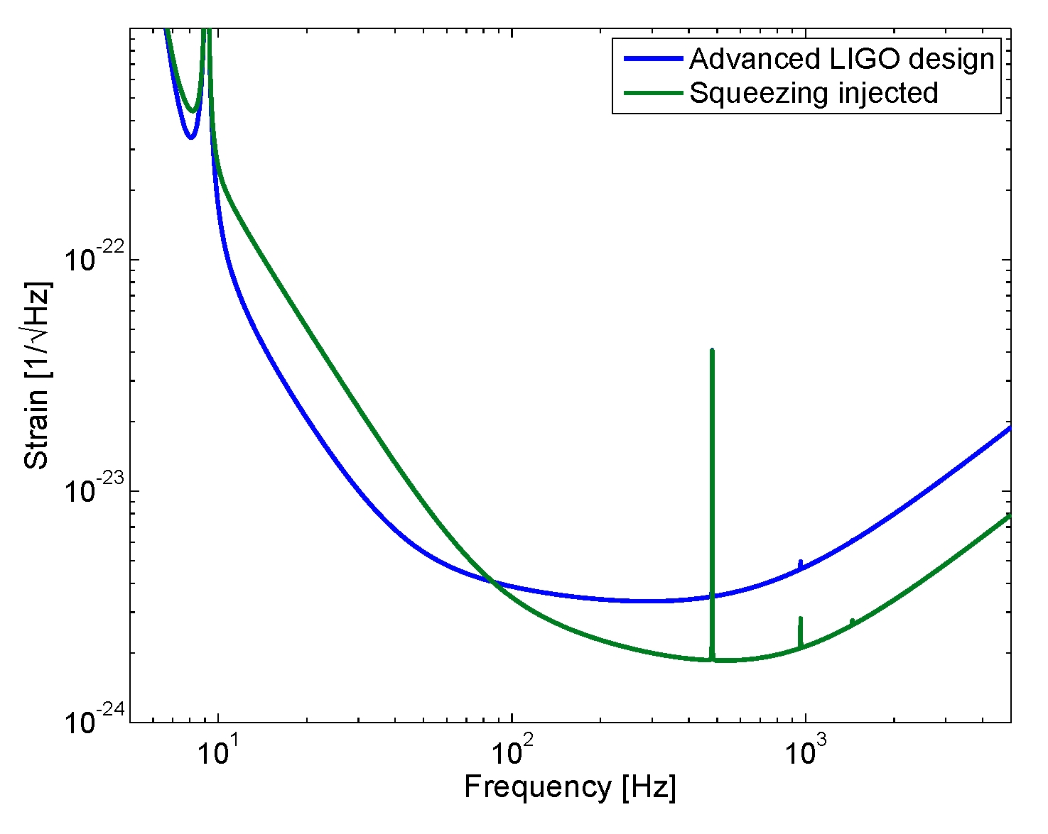
Squeezing with a radiation pressure limited interferometer

Slide 25
Squeezing level and angle optimized for NS binaries
Notes:
30Watts+Sqz=75Watts
Under 60Watts +Squeezing=120Watts

Slide 26
Frequency Dependent Squeezing
10 meter Filter Cavity
60 ppm round trip losses

Slide 27
Summary
Squeezing works in the LIGO band!
Backscatter reduction will allow squeezing to be used as an alternative to high power in aLIGO
Losses and squeezing angle jitter limit squeezing
Frequency dependent squeezing could improve sensitivity beyond advanced LIGO design

Slide 28
Squeezing angle fluctuations

Slide 29
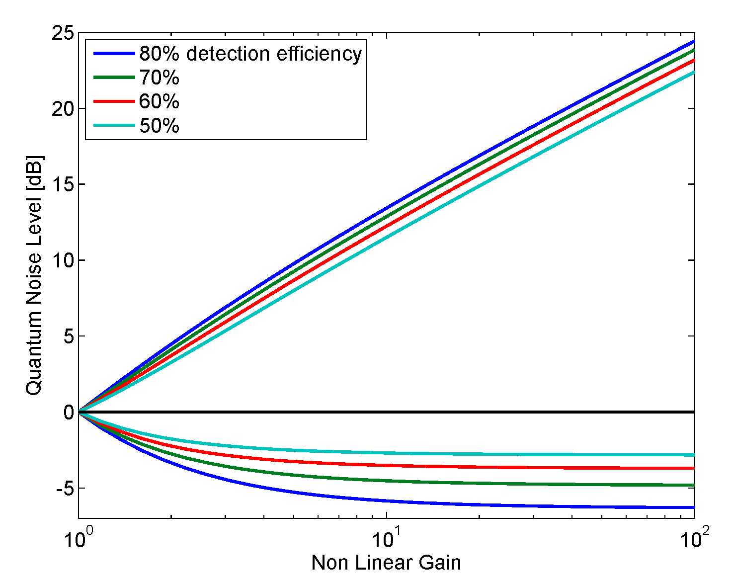
Measurement of squeezing angle fluctuations and losses

Slide 30
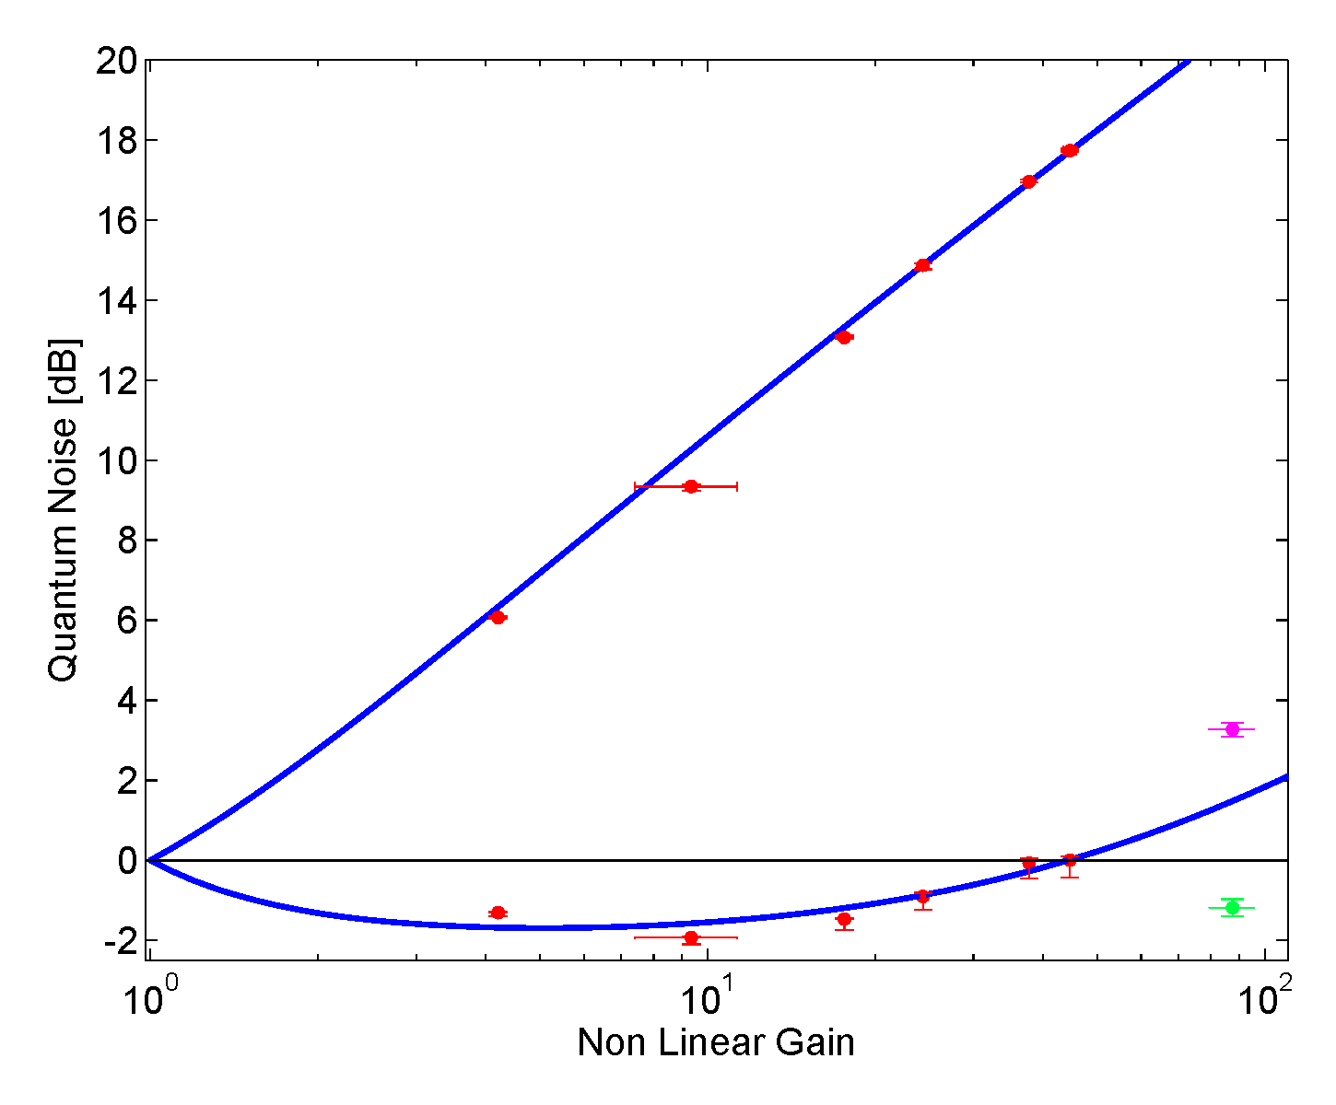
Squeezing angle fluctuations
Fit: 62% losses
81±13 mrad
109±9 mrad
37±6 mrad
Notes:
Log scale!!

Slide 31
An alternative to high power operation in Advanced LIGO

Slide 32
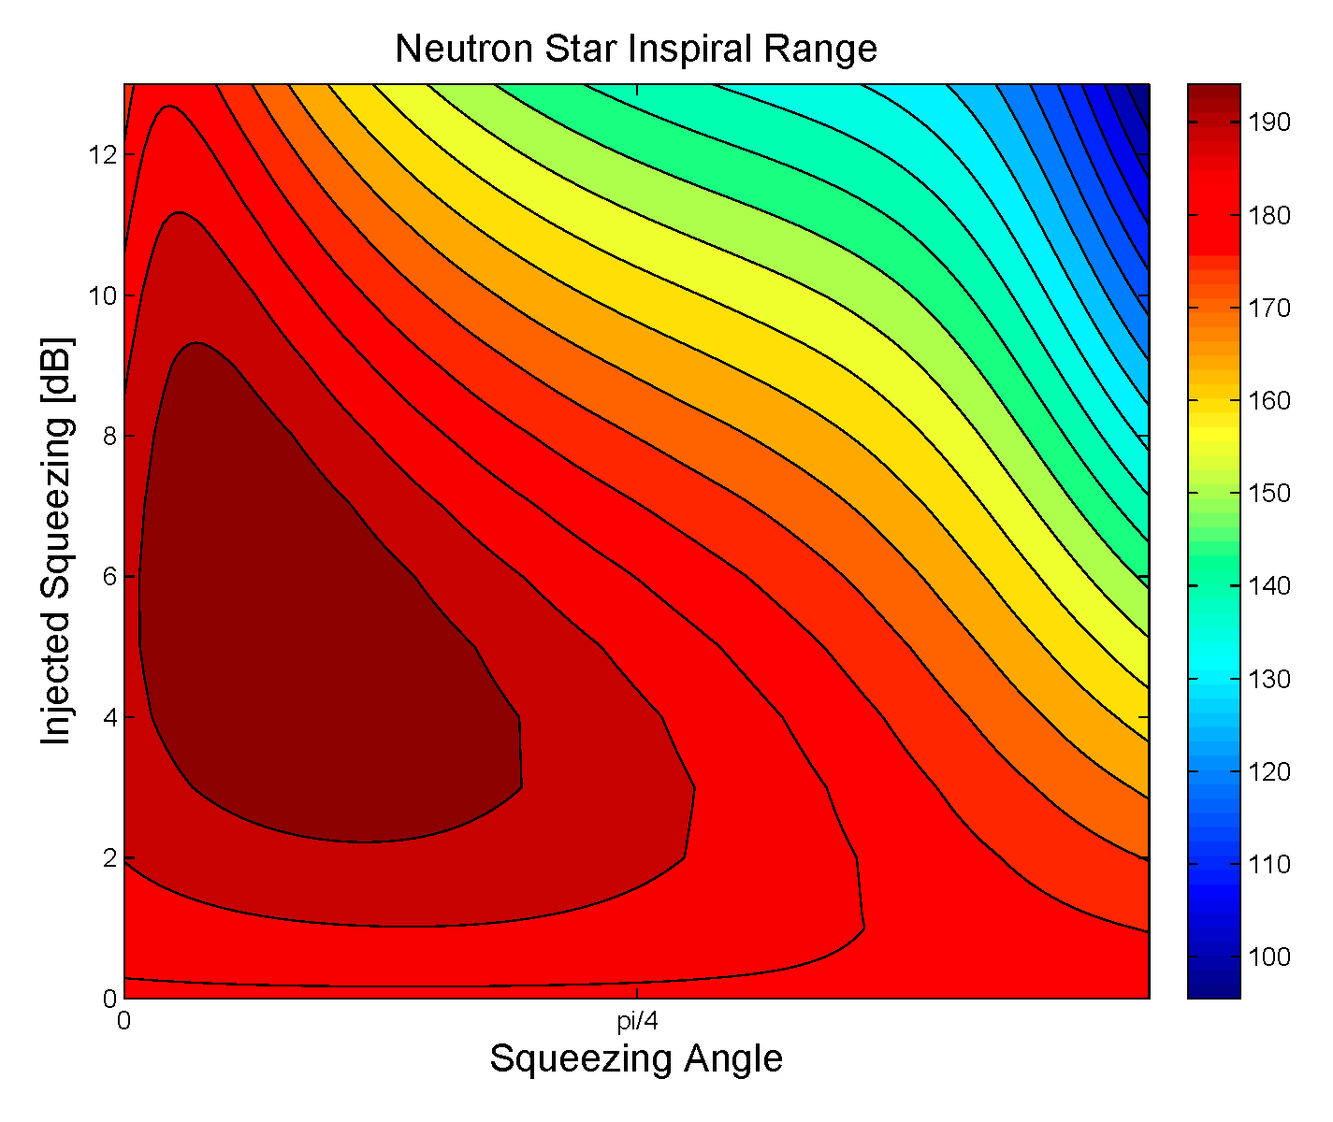
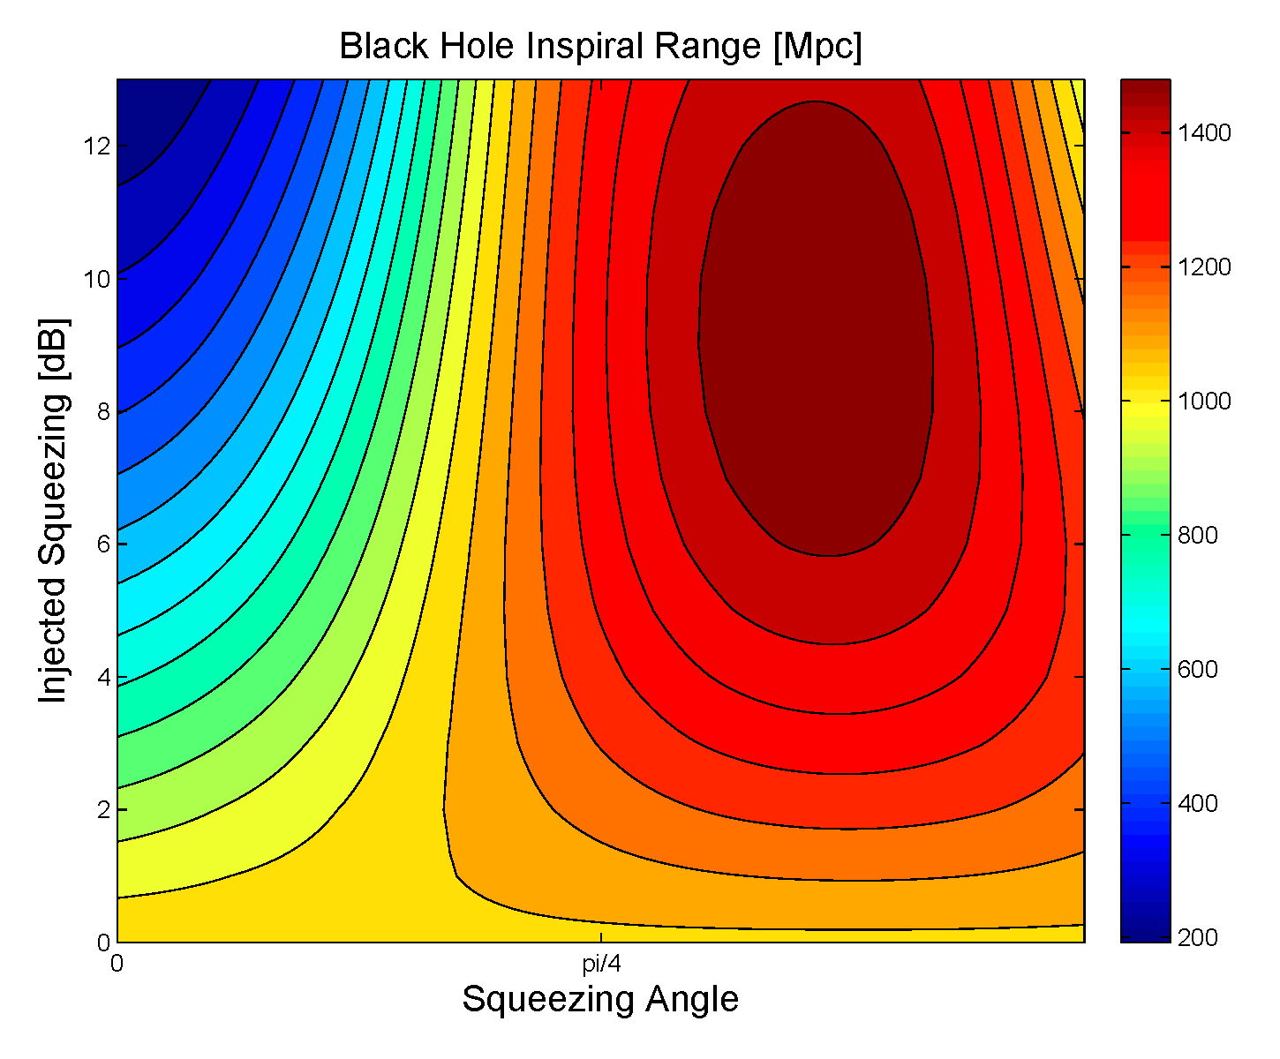
Squeezing in Advanced LIGO

Slide 33
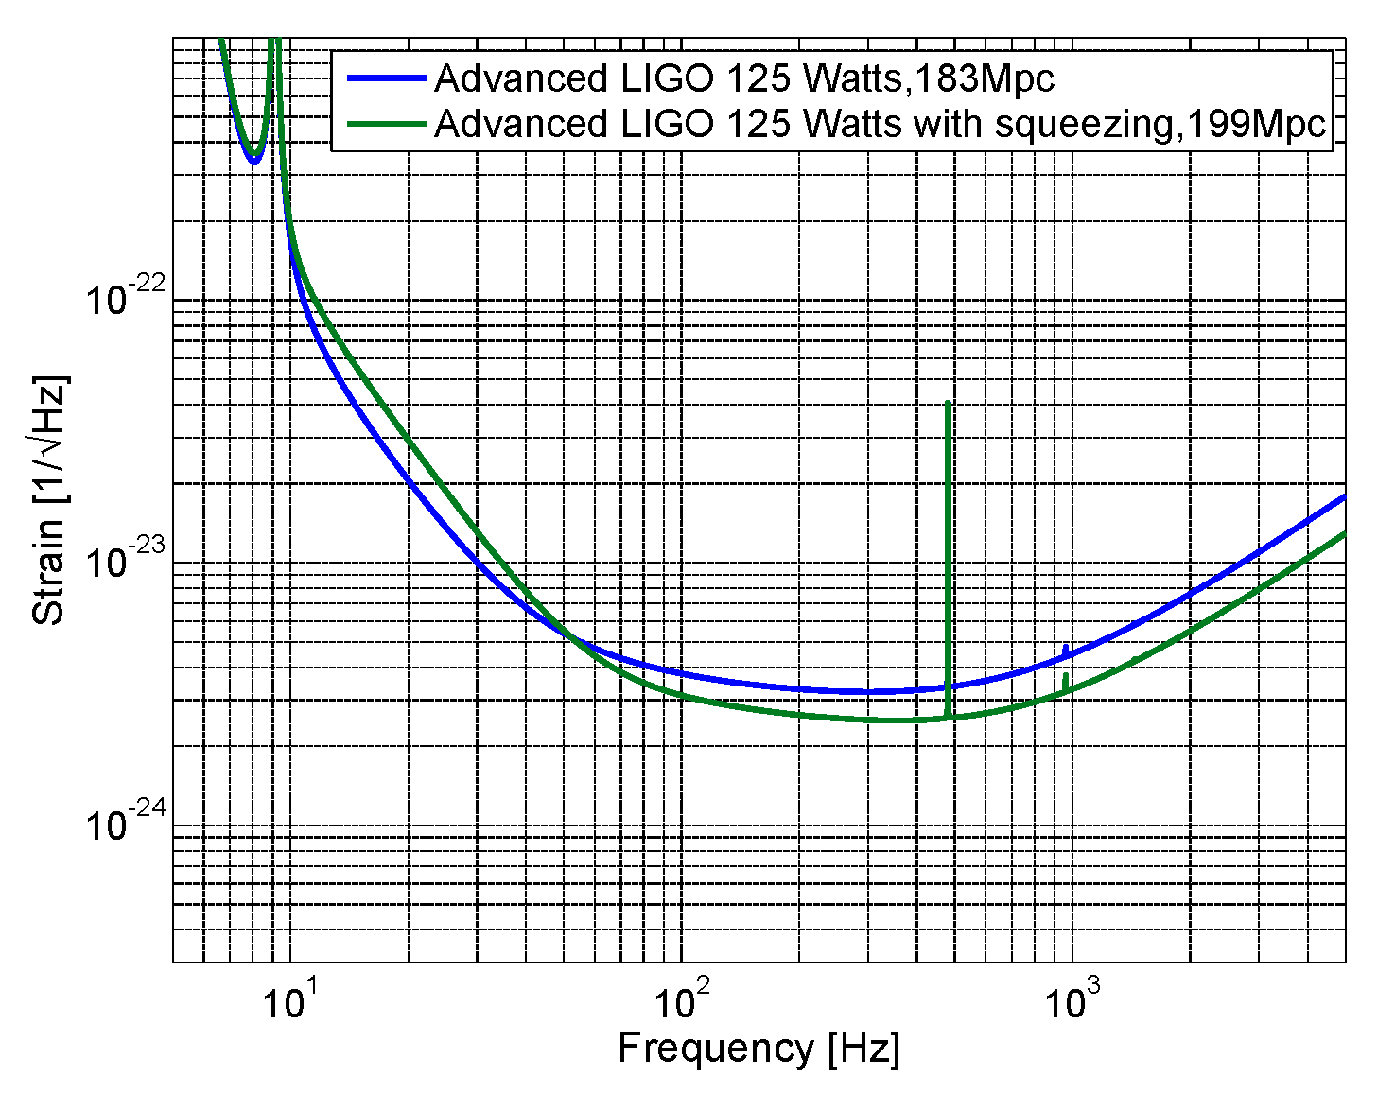
Squeezing with full power
28% increase in volume
Notes:
10-22-10-24

Slide 34
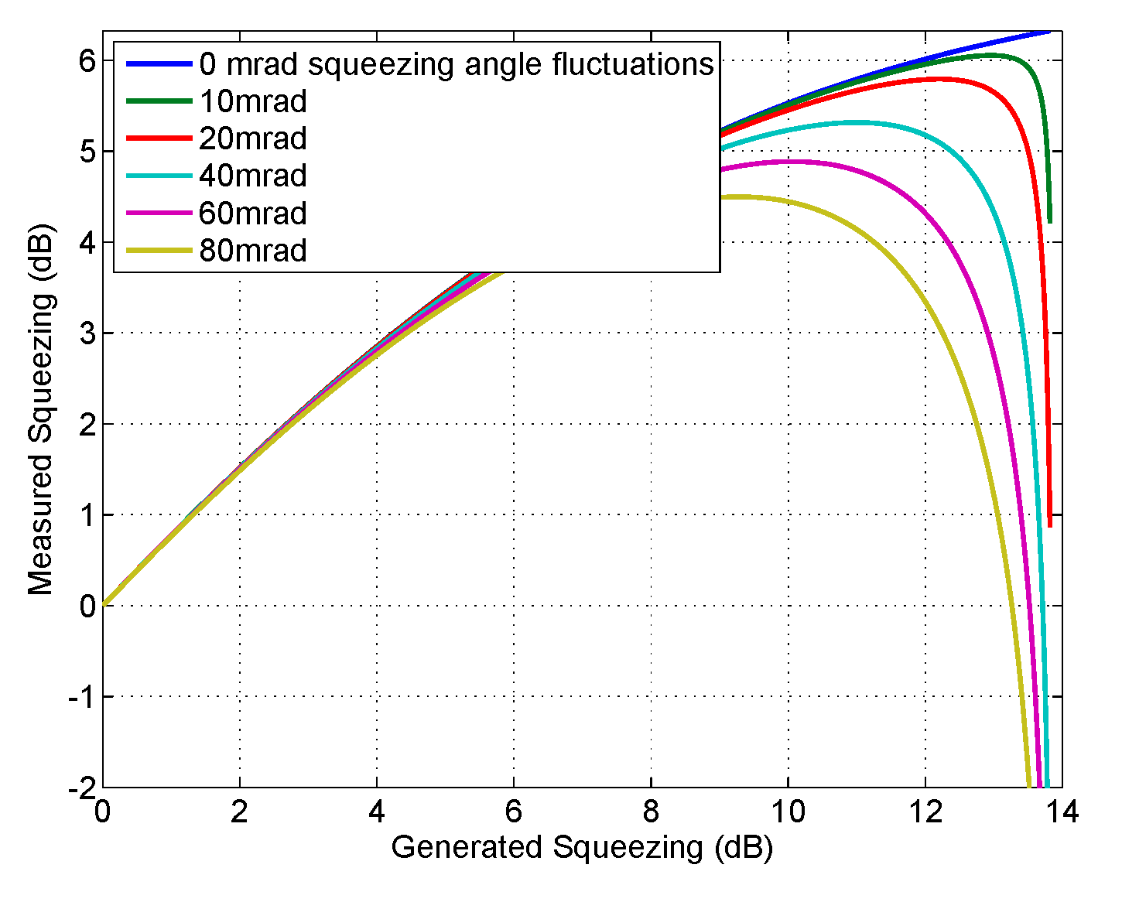
Squeezing Angle Fluctuations

