Slide 1



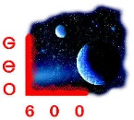
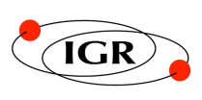



Photographic and Ultra-Fast Video Imaging of Fracture of Pristine Silica Glass Fibers
23rd International Congress on Glass
Prague 2013
Kirill Tokmakov^{1,2}
Cumming¹, J. Hough¹, R. Jones¹, R. Kumar¹, S. Reid⁴, S. Rowan¹, N.A. Lockerbie², A. Wanner³, G.D. Hammond¹
¹University of Glasgow, Glasgow, UK.
²University of Strathclyde, Glasgow, UK.
³Max-Planck-Institut für Gravitationsphysik (Albert-Einstein-Institut), Hannover, Germany.
⁴University of the West of Scotland, Paisley, UK.
LIGO-G1300798-v1

Slide 2
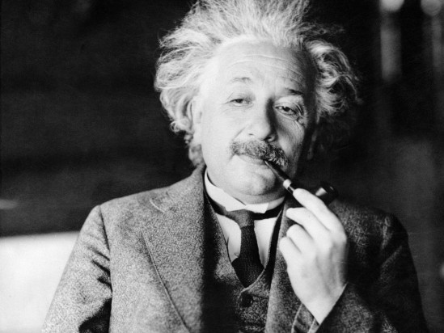
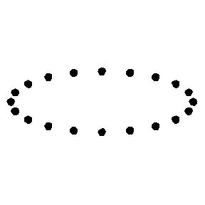
Gravitational waves emitted by astrophysical sources
and techniques for their experimental detection
Einstein equations describing the gravitational field for an accelerating object have a wave solution.
Hypothetic situation:
The masses located in space outside of the Earths gravitational field
Einstein, A.: Näherungsweise Integration der Feldgleichungen der Gravitation. Berlin 1916
Einstein, A.: Über Gravitationswellen. Berlin 1918

Slide 3

Gravitational waves emitted by astrophysical sources
and techniques for their experimental detection
Laser Interferometer GW detector LIGO (USA)
Distance between test masses
is measured by a laser interferometer
LIGO Livingston
The measurement of such small displacements is still possible;
to gain appropriate sensitivity modern interferometric detectors utilise arm lengths of up to 4 km

Slide 4
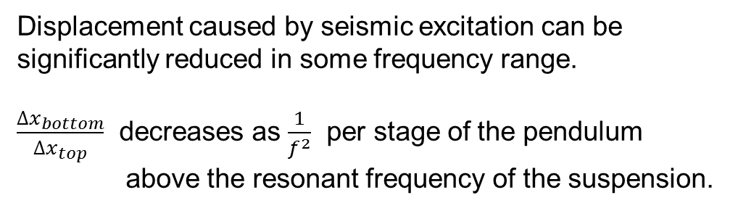
Noise Reduction
Δx_{top}
Seismic force
Δx_{bottom}
The nearest practical concept that
approaches an ideal free mass is the use of a pendulum suspension

Slide 5
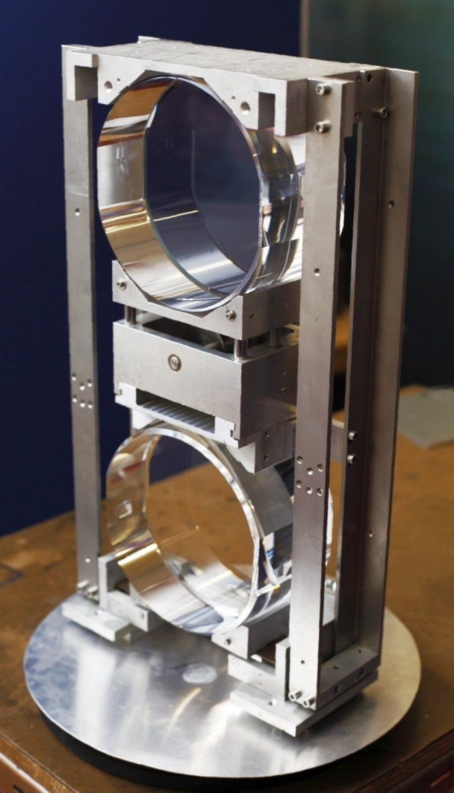
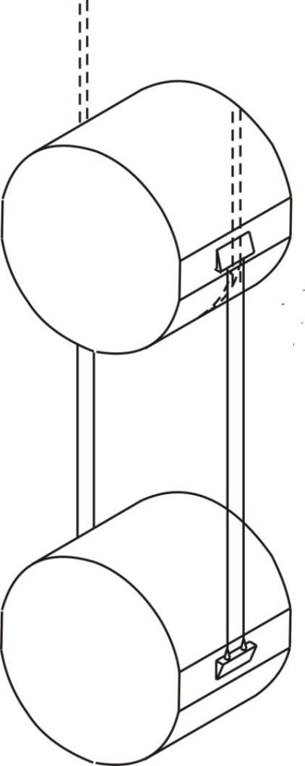
The lower stage of the test mass suspension is made from pure silica glass Suprasil 300 and Suprasil 2.
Fibres are pulled and welded by a CO₂ laser.
The top mass is suspended on metal wire.
The bottom mass is suspended on four silica glass fibres.
Mirror suspension of the GEO-600 interferometric detector (UK/Germany).
Mass of each cylinder is 5.6 kg, diameter of each fibre ≈ 200 µm. This suspension has been hanging since 2003.

Slide 6
Thermal Noise Reduction
To reduce thermal fluctuations of test mass position
(E=kT per degree of freedom) we should decrease the temperature OR use a material with low mechanical losses.
This can be:
Pure silica glass (room temperature).
Monocrystalline sapphire (room temperature).
Monocrystalline silicon (cryogenic temperatures).
Silica glass is one of the best low-loss materials.
Fibres for the suspension can also be fabricated from the silica glass and welded to the test mass. ¹
1. Heptonstall A et al, Rev. Sci. Instrum. 82, 011301 (2011)

Slide 7
Thermal Noise Reduction
Displacement of the test mass caused by the thermal fluctuations in pendulum and violin modes
Decreasing the temperature
Total energy E=kT
per degree of freedom.

Slide 8
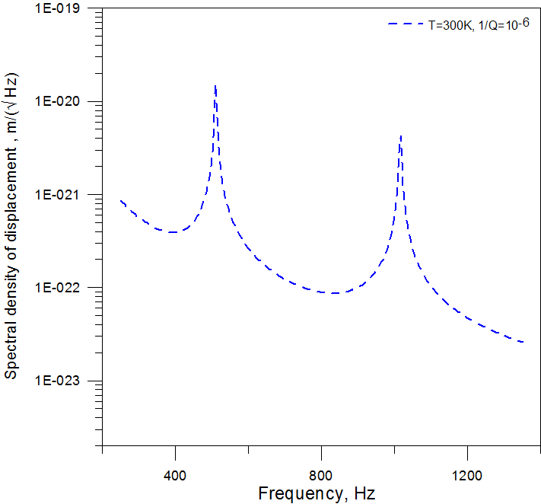
Thermal Noise Reduction
Displacement of the test mass caused by the thermal fluctuations in pendulum and violin modes
Decreasing the mechanical loss
Total energy E=kT
per degree of freedom.

Slide 9
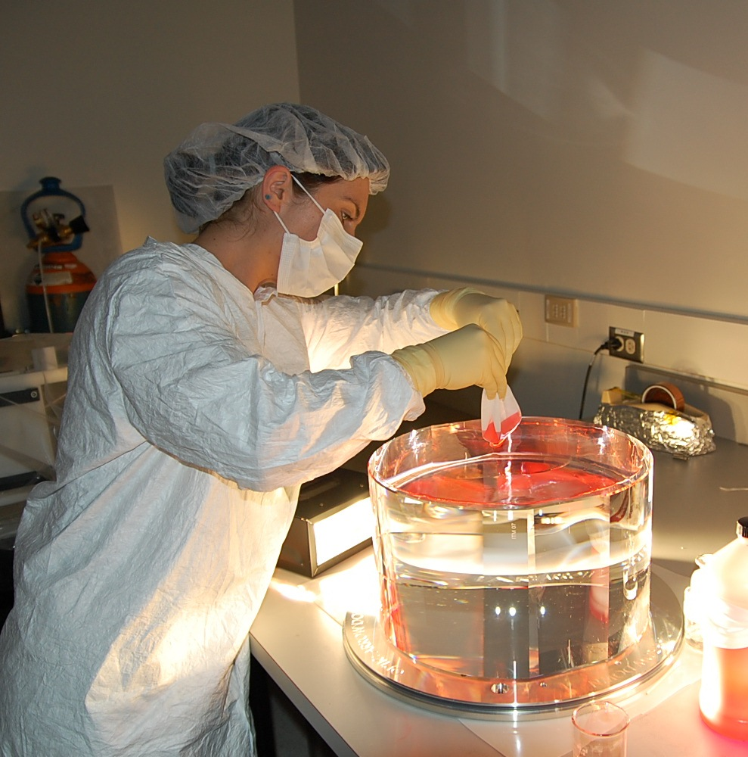
To increase ‘Signal to Noise’ ratio we should use heavy masses
The fused silica test mass used in the Advanced LIGO gravitational wave detector is 40 kg.

Slide 10
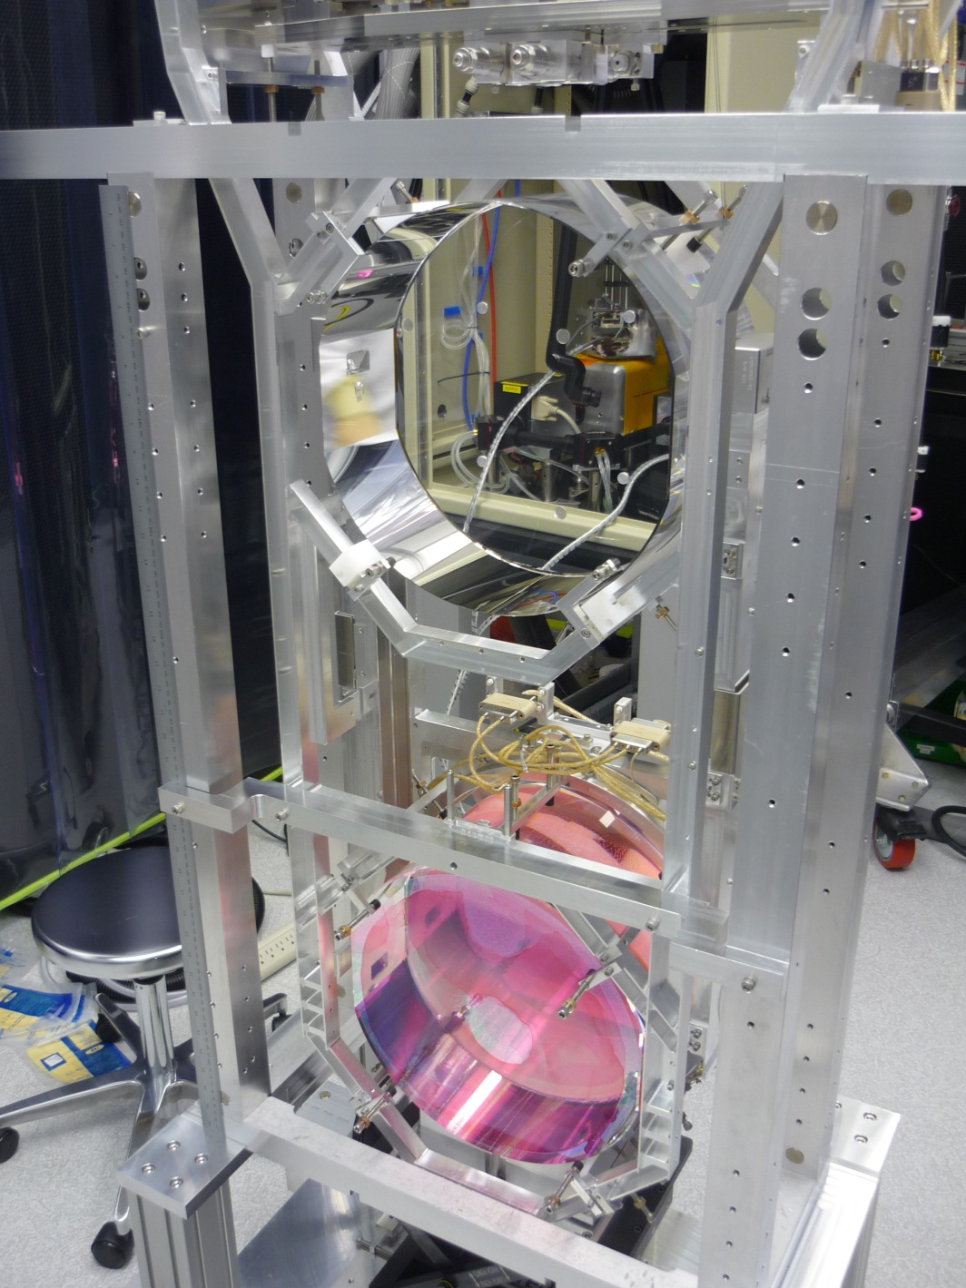
The Advanced LIGO project comprises two interferometric detectors.
3 silica suspensions from required 8 have been installed already.

Slide 11
Diameter of each fibre is 400 µm.
The stress ≈ 0.8 Gpa is far from the high values of breaking stress reported in the literature (∼ 6 Gpa).
Repetitive fabrication of strong silica fibres requires some practical skill.
We need to retain the strength of 4 welded fibres for the suspension, i.e. provide good alignment, parallelism as well as good strength of welds.
We are interested in fibres of 400 µm in diameter, this diameter range is not typical for strength experiments.
We need reliability and longevity to ensure long operating life of the detector suspensions.
Each detector comprises 4 suspensions. Each suspension is made up of 4 fibres.The strength of each fibre is crucial — breaking one fibre from sixteen disrupts the normal operation of the detector.
Furthermore, breaking of one fibre would lead to damage of the surface of the surrounding fibres and mirror due to shrapnel.

Slide 12



To improve our understanding of the strength and find reasons for the weakening of fibres we conducted preliminary experiments with flame pulled fibres.
The metal cup nut
The thick silica glass rod 5mm diameter with a ball shaped end
The silica rod 3mm in diameter was welded; after that its surface was polished by the flame

Slide 13
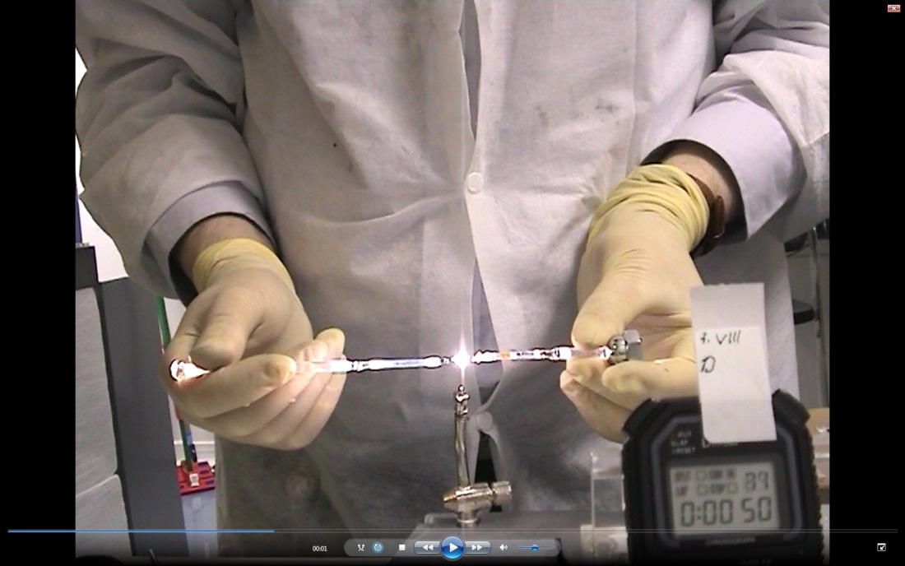
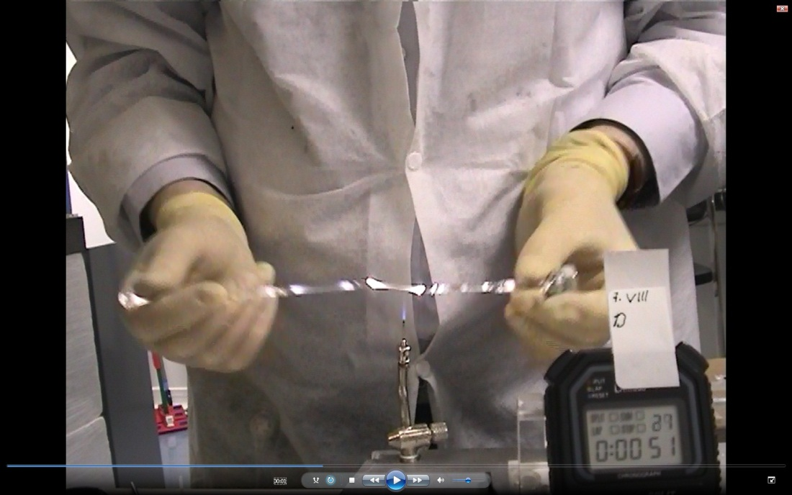
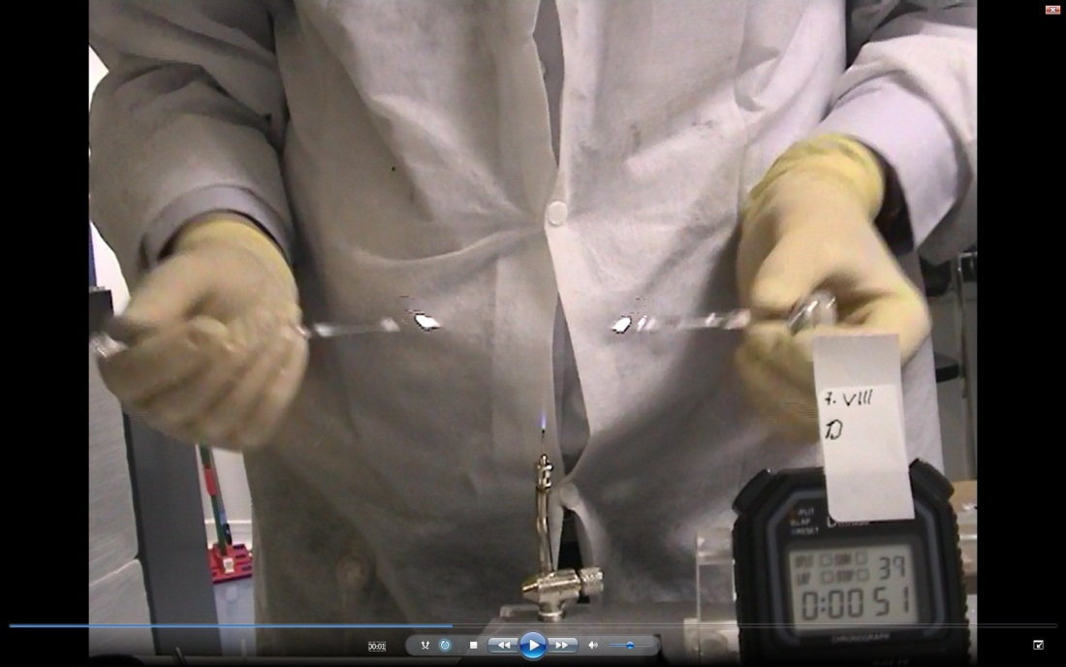
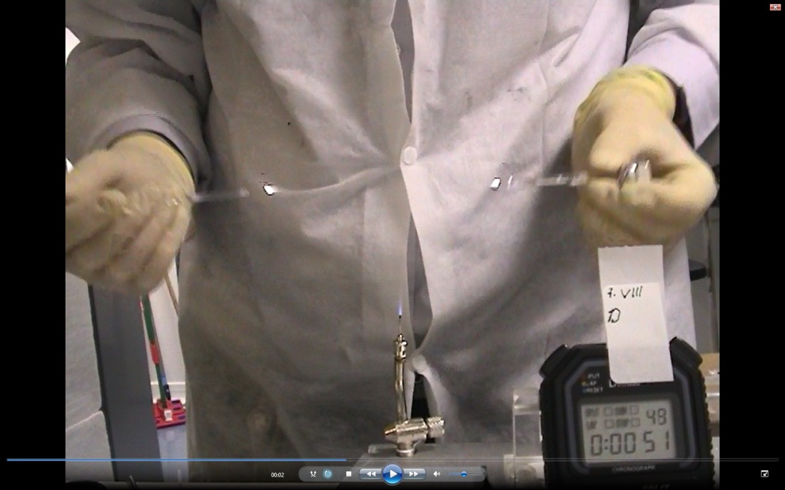
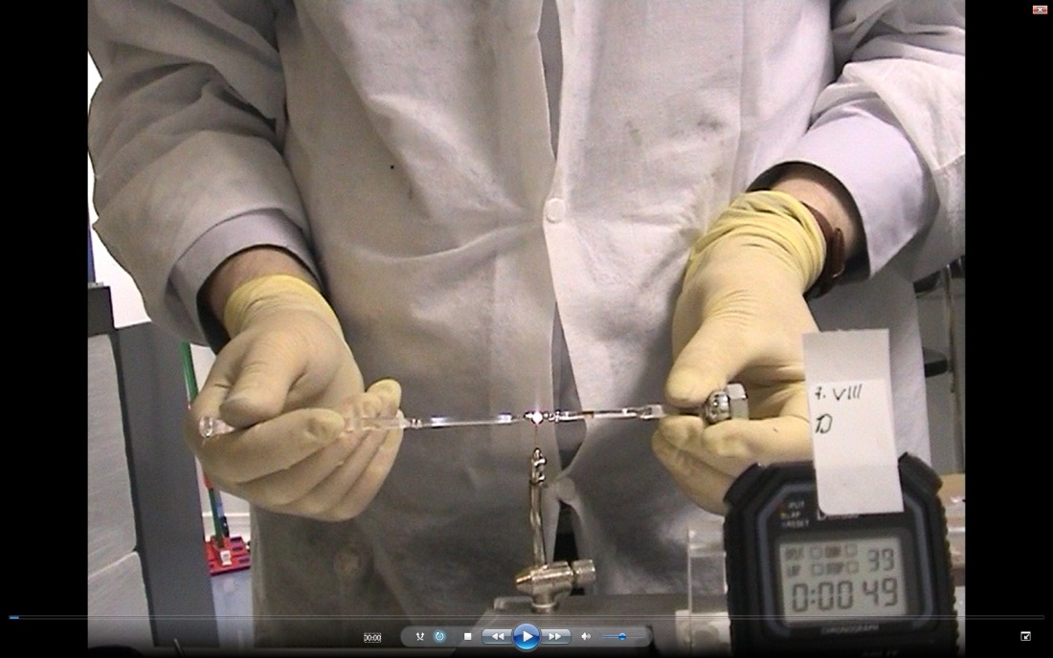
Preliminary experiments with hand pulled fibres
Pulling of the fibre in the flame of a H₂-O₂ torch

Slide 14
The majority of fibres are strong, but some fibres are weak, especially if d>250 µm
K. Tokmakov et al, J Non-Cryst Solids,
358 (14). pp. 1699-1709 (2012)
Statistics does not fully reveal the mechanisms of breaking

Slide 15
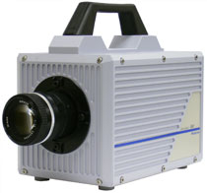
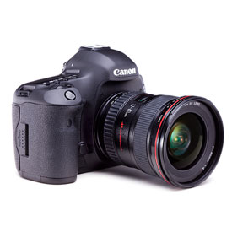
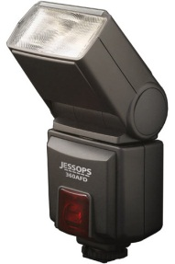
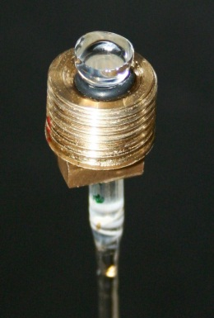
Imaging apparatus
1) High speed video camera
Photron Fastcam SA-1
Offered by EPSRC Instrument Loan Pool (UK)
A laser beam was inputted into fibre
2) Custom made photo apparatus
Breaking of the fibre interrupts a laser beam passing through the fibre. This activates the flash gun while the camera was installed with an open shutter.
A camera with opened shutter
Trigger circuit

Slide 16
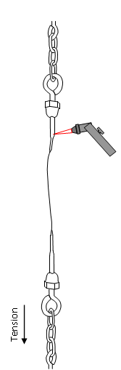
Alignment Procedure
The stub of stock
The fibre
The flame
Tension

Slide 17
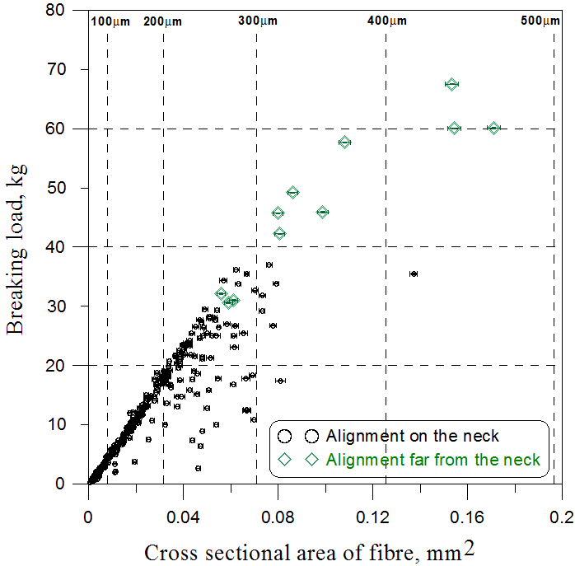
Alignment Procedure
The stub of stock
The fibre
The flame
Tension
K. Tokmakov et al, J Non-Cryst Solids,
358 (14). pp. 1699-1709 (2012)

Slide 18
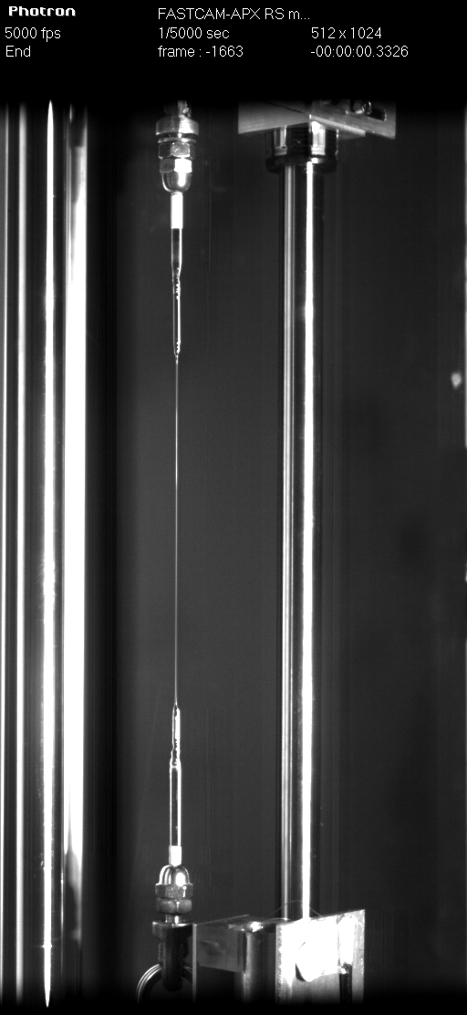
Rate is 5000 frames per second
-1663 — -1624

Slide 19
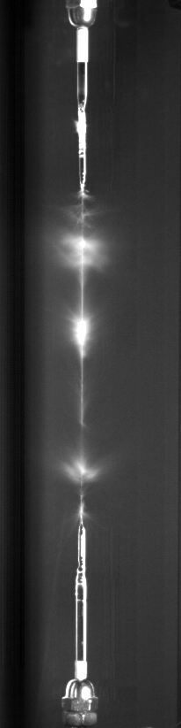
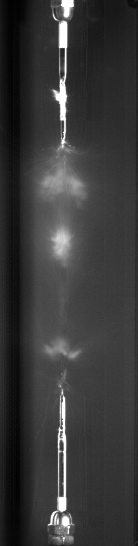
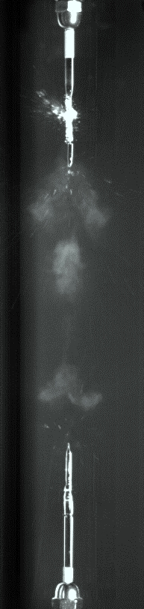
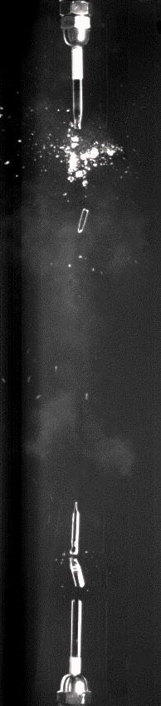
№ of frame
1
2
6
26
The clouds of small glass particles are expanding and moving upwards.
Large particles are moving towards the centre of the fibre.

Slide 20
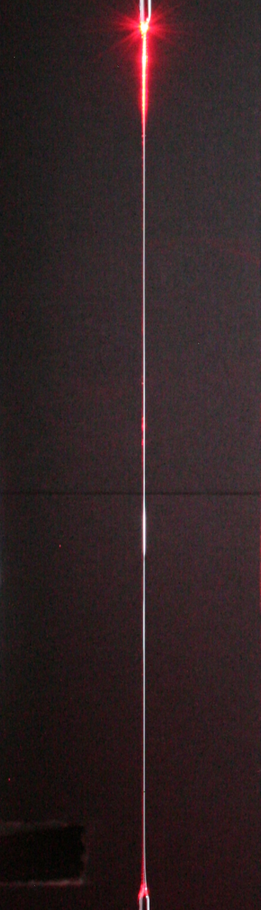
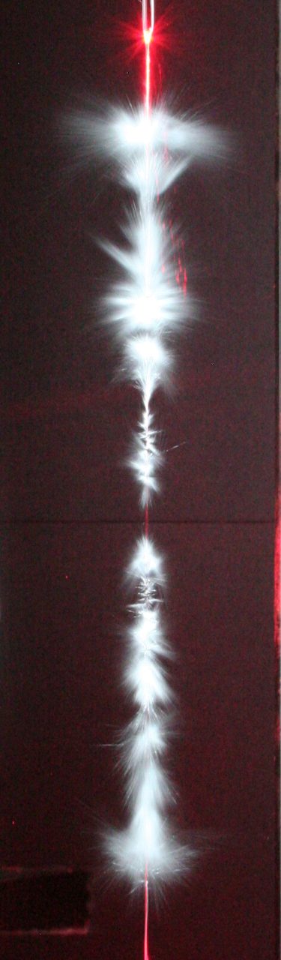

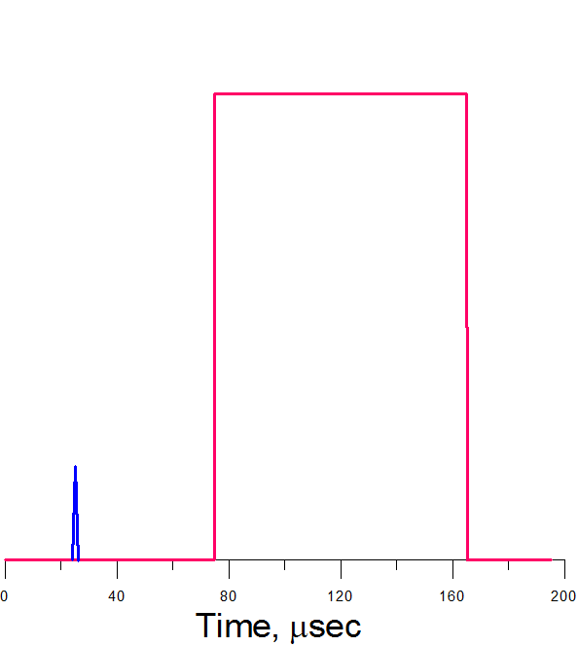
Fracture:
m ≈ 17 kg, σ ≈ 5.37 GPa
Timescale
Flash of light
g & Tension
Breaking
The flash was activated 50 µsec after breaking. Duration of the flash is ≈90 µsec.

Slide 21
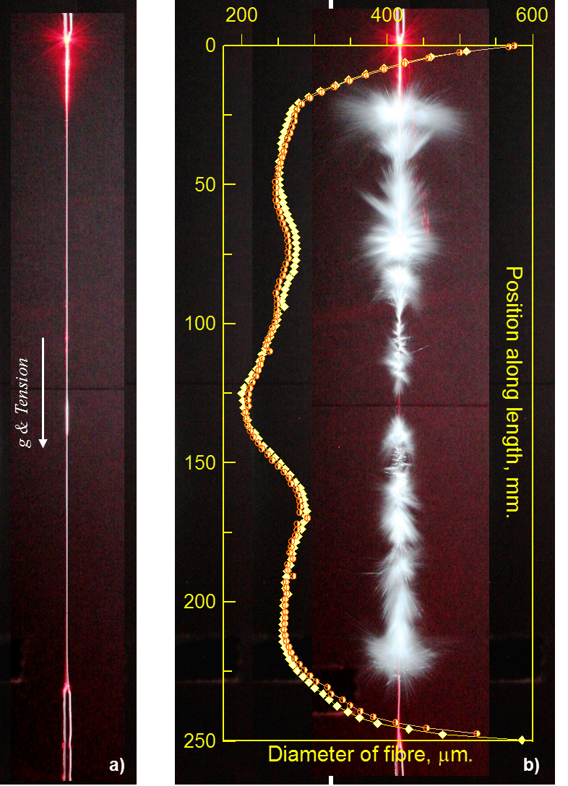
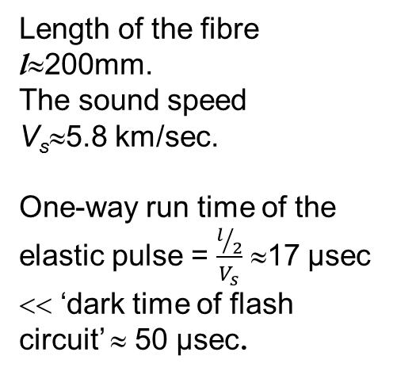
Fracture:
m ≈ 17 kg, σ ≈ 5.37 GPa

Slide 22
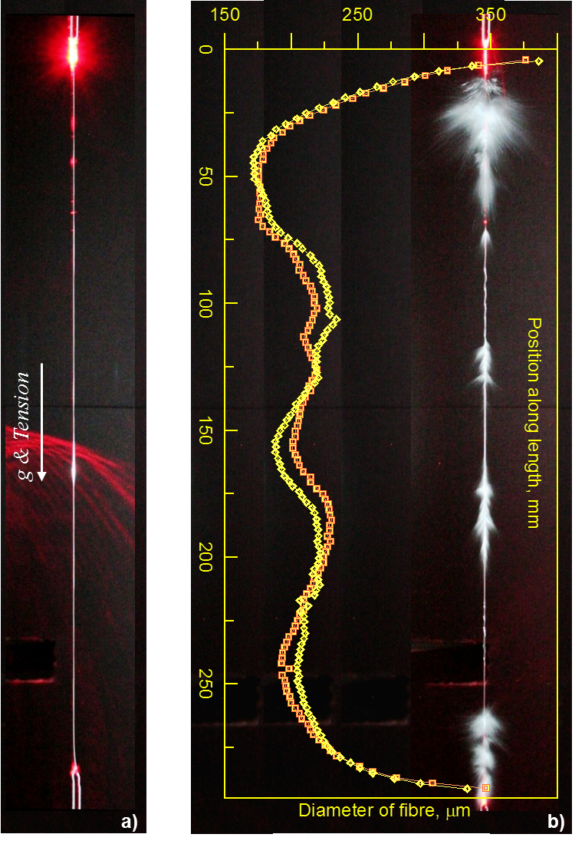
Fracture:
m ≈ 11.7 kg, σ ≈ 5.21 GPa
The point of initial breaking
The end of the fibre was broken due to pulse of compression

Slide 23
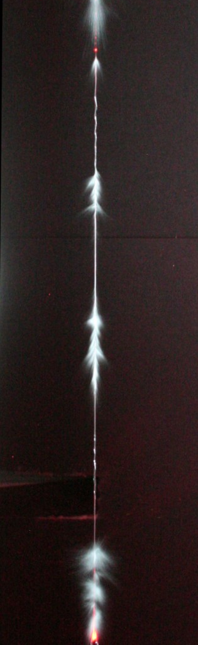
The fragment of the fibre with now unattached ends

Slide 24
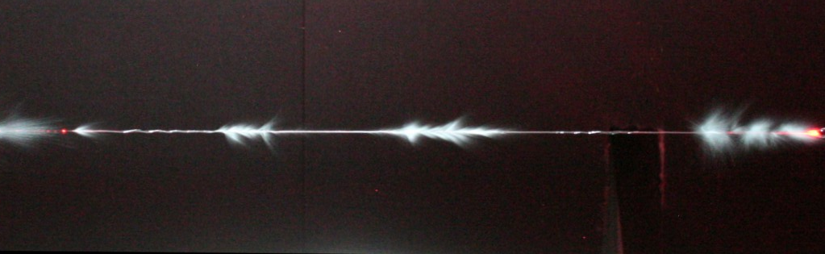
Longitudinal vibration of the fibre fragment
with free ends
The largest tension is in the middle of the oscillating rod
The fracture zone is also in the middle

Slide 25
Longitudinal vibration of the fibre fragment
with free ends
The fibre remainder should oscillate too
The fracture is in the middle again

Slide 26
Conclusion
Laser gravitational interferometric detectors comprise four test masses fabricated from pure silica glass. Each test mass is suspended on four silica fibres as a pendulum. The fibres are pulled and welded using CO₂ laser. The mass of each mirror in the Advanced LIGO project is 40 kg. Two detectors (aLIGO Livingston and aLIGO Hanford) require eight suspensions in total. Three monolithic suspensions have been installed already.
To develop the technology of test mass suspending we conducted experiments to measure the strength of hand pulled fibres. The majority of the fibres are strong (≈ 5GPa), however some fibres fabricated using the same technology are found to be weaker.
To understand the reason of weakening we conducted a series of experiments included video and photo imaging of fibre breaking. One reason of weakening was found that allowed us to restore the strength for fibres thicker than 250 µm.
We also observed some interesting effects which were visualized during the process of fibre fracture. Analysis of these effects improves our understanding of the nature of the fracture of silica fibres. Many observed effects still need to be explained.

Slide 27
Conclusion
Laser gravitational interferometric detectors comprise four test masses fabricated from pure silica glass. Each test mass is suspended on four silica fibres as a pendulum. The fibres are pulled and welded using CO₂ laser. The mass of each mirror in the Advanced LIGO project is 40 kg. Two detectors (aLIGO Livingston and aLIGO Hanford) require eight suspensions in total. Three monolithic suspensions have been installed already.
To develop the technology of test mass suspending we conducted experiments to measure the strength of hand pulled fibres. The majority of the fibres are strong (≈ 5GPa), however some fibres fabricated using the same technology are found to be weaker.
To understand the reason of weakening we conducted a series of experiments included video and photo imaging of fibre breaking. One reason of weakening was found that allowed us to restore the strength for fibres thicker than 250 µm.
We also observed some interesting effects which were visualized during the process of fibre fracture. Analysis of these effects improves our understanding of the nature of the fracture of silica fibres. Many observed effects still need to be explained.
Thank you for your attention
Kirill.Tokmakov@glasgow.ac.uk

