Slide 1
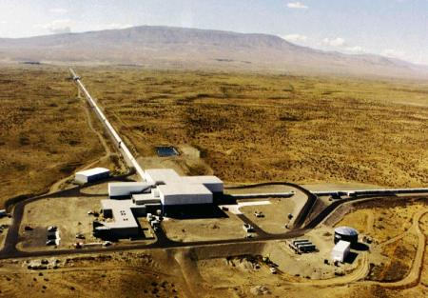
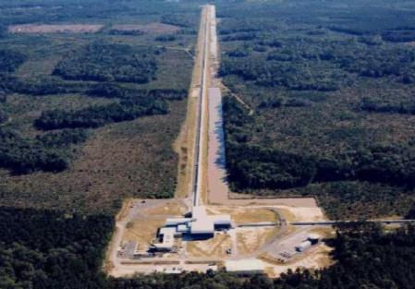
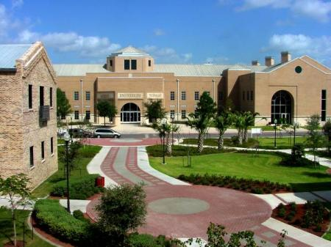




The Advanced LIGO GW detector
Volker Quetschke
Center for Gravitational Wave Astronomy
& Department of Physics and Astronomy
The University of Texas at Brownsville
for the LIGO Input-Optics group
and the LIGO Scientific Collaboration
LIGO is funded by NSF
University of Texas at Austin, Department of Physics
AMO seminar, Friday, September 13 2013.
THE UNIVERSITY
OF TEXAS AT
BROWNSVILLE
Department of
Physics and
Astronomy
Center for
Gravitational
Wave
Astronomy

Slide 2
Outline
Primer on Gravitational Waves Interferometry
Status/timeline of Advanced LIGO (aLIGO)
  With some more details on the input optics

Slide 3
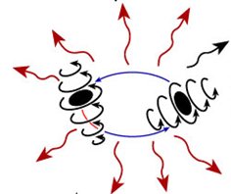
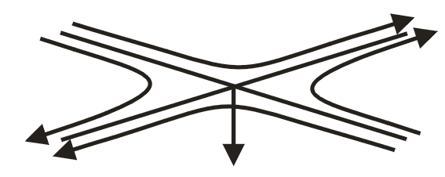
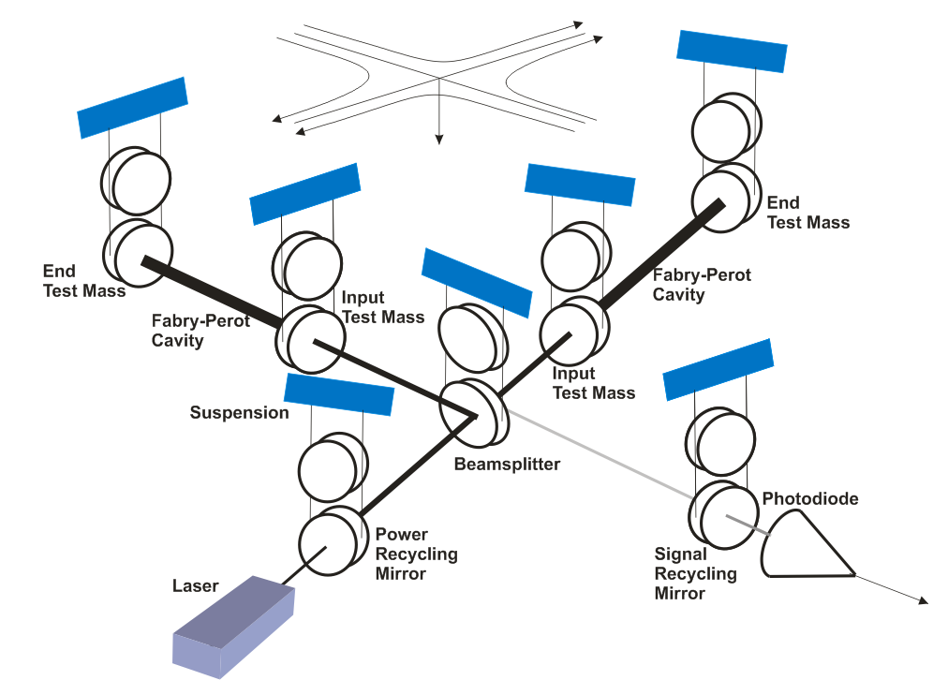
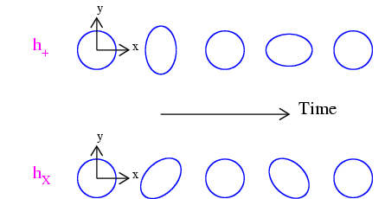
Primer on Gravitational-wave Interferometry
Gravitational waves are propagating dynamic fluctuations in the curvature of space-time
  Physically manifested as strains
  Emitted from accelerating mass distributions, unimpeded by matter
  Possess two polarizations, h₊ and h_{x}
GW interferometers use enhanced Michelson interferometry
  With suspended (‘freely falling’) mirrors
Passing GWs ‘stretch’ and ‘compress’ the distance between the end test mass and the beam splitter

Slide 4
And how big?
We can calculate the expected strain at Earth for, say, an orbiting binary system:
If we make our interferometer very big, say 4,000 meters long, then

Slide 5

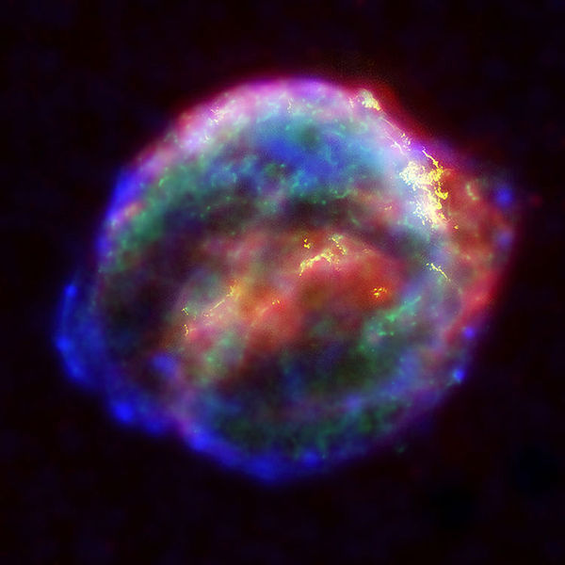

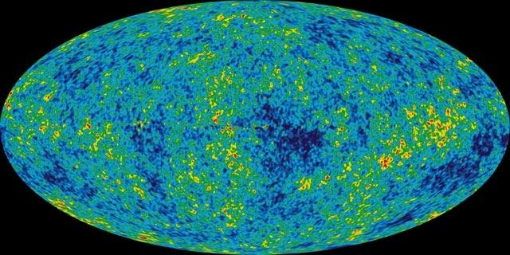
Astrophysical Sources of Gravitational Waves
Coalescing Compact Binary Systems: Neutron Star-NS, Black Hole-NS, BH-BH
- Strong emitters, well-modeled,
- (effectively) transient
Asymmetric Core Collapse Supernovae
- Weak emitters, not well-modeled (‘bursts’), transient
- Cosmic strings, soft gamma repeaters, pulsar glitches also in ‘burst’ class
Chandra X-ray Observatory
Credit: AEI, CCT, LSU
Spinning neutron stars with a mountain
- (effectively) monotonic waveform
- Long duration
Cosmic Gravitational-wave Background
- Residue of the Big Bang, long duration
- Long duration, stochastic background
NASA/WMAP Science Team
Insights into astrophysics inaccessible to photon and neutrino astronomy, and provides unique test of extreme relativity
Casey Reed, Penn State
Notes:
LIGO is designed to be an observatory, not a one-off proof that GWs exist. What do we look for?
There are number of predicted astrophysical sources of gravitational radiation, and most of them involve cataclysmic events.
Binary systems – NSs and BHs, most likely source, theoretically well understood with known waveforms
Bursts – GW emissions that are not well modeled or understood. These include asymmetrically core collapse supernova, cosmic strings, and perhaps unknown sources
The residual GW background
Continuously emitting sources such as spinning neutron stars, which have a pure monotone emission.

Slide 6
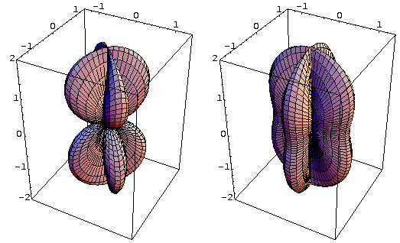
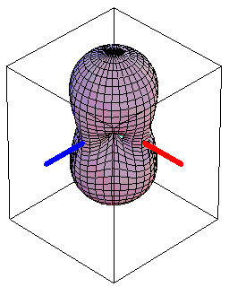
An individual GW interferometer has omnidirectional sensitivity
Sensitivity depends both on propagation direction and polarization
→ Global network needed to localize signals
“×” polarization
“+” polarization
RMS sensitivity

Slide 7


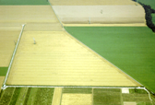

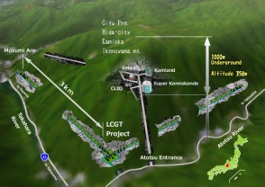

The Advanced GW Detector Network
Advanced LIGO
Hanford
2015
GEO600 (HF)
2011
KAGRA
2017
Advanced LIGO
Livingston
2015
Advanced
Virgo
2016
LIGO-India
~2021
7
7
Notes:
Motivation for LIGO-India is the network
More detectors provides better localization
(GEO600 is not as sensitive so will not contribute to the network)

Slide 8
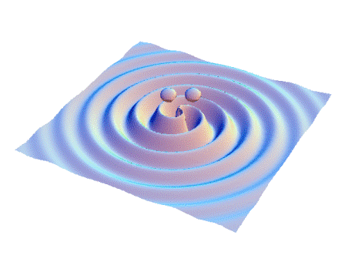
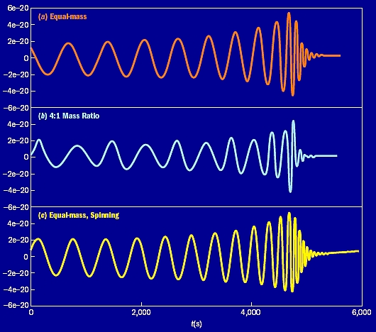
Standard Candle: Compact binary inspiral, merger, ringdown
Inspiral Merger Ringdown
This source has the best understood waveform and rate
There’s a lot of physics and astrophysics in the waveforms
Now, how does it really look …

Slide 9
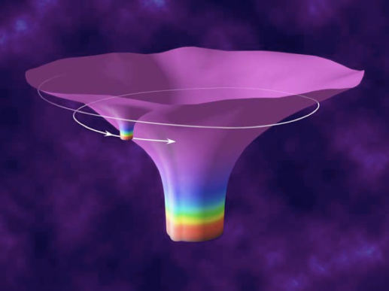
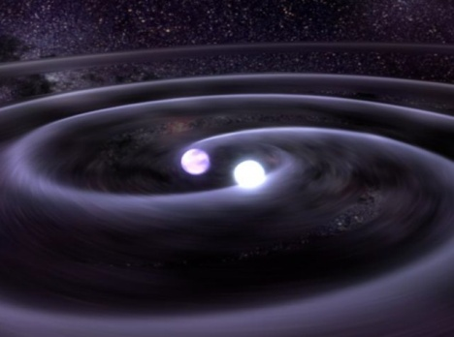
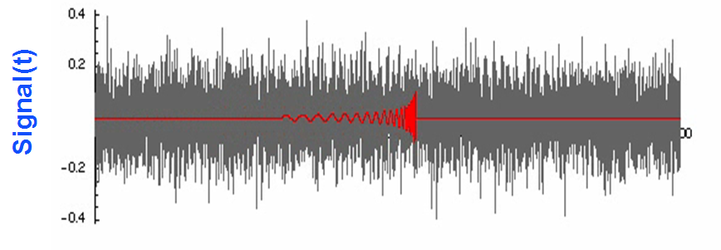
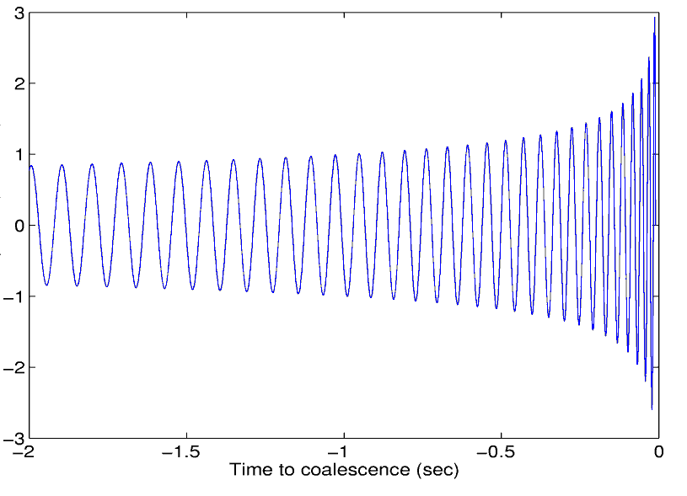
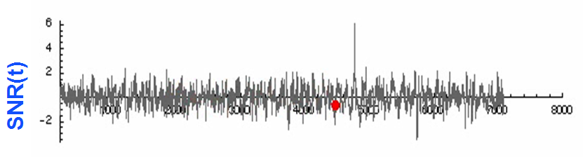
Searches for
Binary Mergers
This source:
Buried in this noise stream:
Binary NS-NS system
Produces this waveform:
We use different methods (in this case optimal Wiener filtering using matched templates) to pull these signals from the noise:
h
“Chirp” waveform
The problem is that non-astrophysical sources also produces signals (false positives)

Slide 10
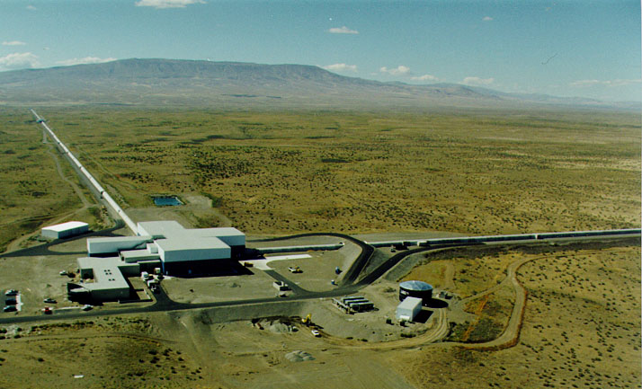
The LIGO detectors:
Washington state…

Slide 11

and LIGO in Louisiana
The (initial and enhanced) LIGO detectors were working according to specifications, but …

Slide 12
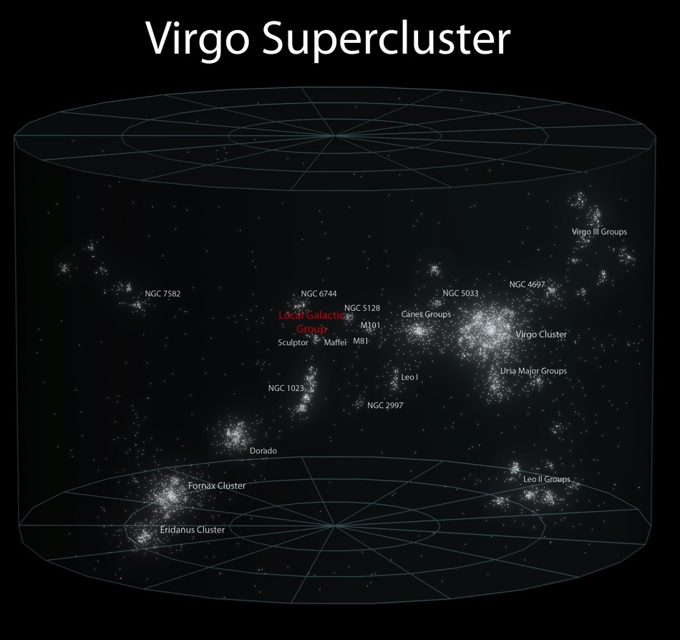
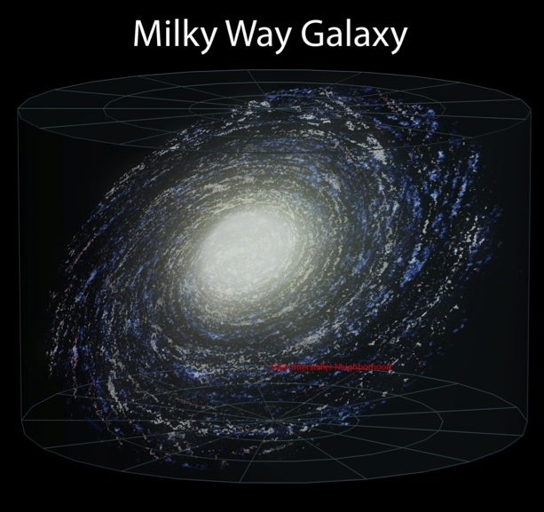

Sensitivity of eLIGO
First generation detectors reached about 100 galaxies
Events happen once every 10,000 years per galaxy…
Need to reach more galaxies to see more than one signal per lifetime
(considering NS-NS mergers)
Notes:
at 20 minutes here.

Slide 13

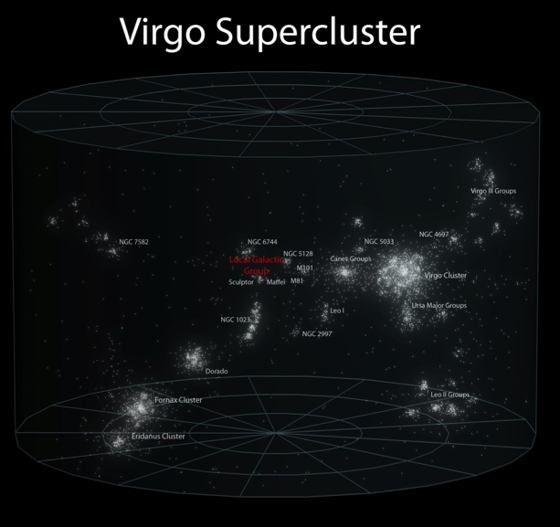
Targets for aLIGO
What would a tenfold increase in range change?
Advanced detectors will reach about 100,000 galaxies
Events happen once every 10,000 years per galaxy…
Order of 1 per month!
Advanced Range
Initial Range

Slide 14

Advanced LIGO Overview
Improvements:
Parameter | Initial LIGO | Advanced LIGO
Mirror Mass | 10 kg | 40 kg
Input Laser Power | 10 W (10 kW arm) | 180 W (>700 kW arm)
Interferometer Topology | Power-recycled Fabry-Perot arm cavity Michelson | Dual-recycled Fabry-Perot arm cavity Michelson (stable RC)
GW Readout Method | RF heterodyne | DC homodyne
Optimal Strain Sensitivity | 3 x 10⁻²³ / rHz | Tunable, better than 5 x 10⁻²⁴ / rHz in broadband
Seismic Isolation Performance | f_{low} ~ 50 Hz | f_{low} ~ 12 Hz
Mirror Suspensions | Single Pendulum | Quadruple pendulum

Slide 15
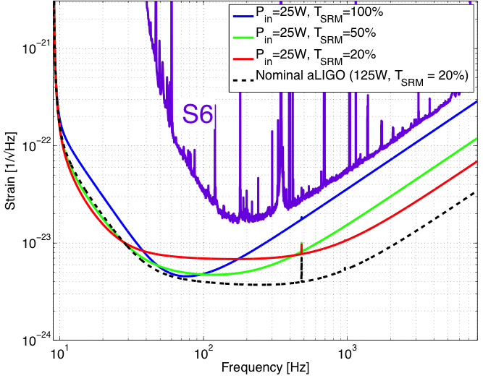
What does it get us?
Improvement depends on:
  Frequency
  range
  Laser power
  Signal recycling
  mirror
photodiode

Slide 16
The real instrument is far more complex…
Reality axis
photodiode

Slide 17
A look at the hardware – with a focus on things unique to Advanced LIGO

Slide 18

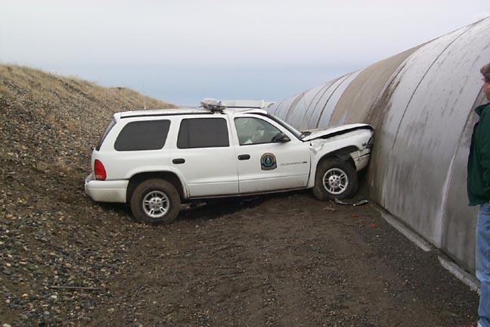
4km Beam Tubes
Light must travel in an excellent vacuum
  Just a few molecules traversing the optical path makes a detectable change in path length, masking GWs!
  1.2 m diameter – avoid scattering against walls
Cover over the tube – hunters’ bullets and the stray car
Tube is straight to a fraction of a cm…not like the earth’s curved surface
Notes:
Walk through slide

Slide 19
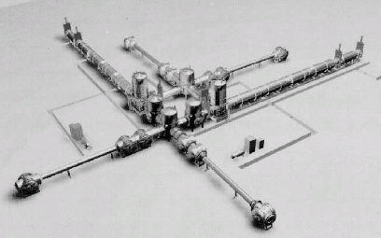
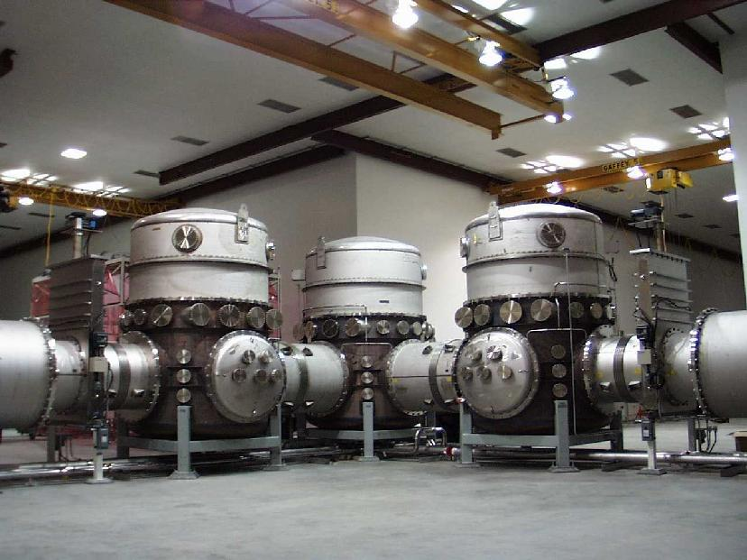
LIGO Vacuum Equipment – designed for several generations of instruments

Slide 20
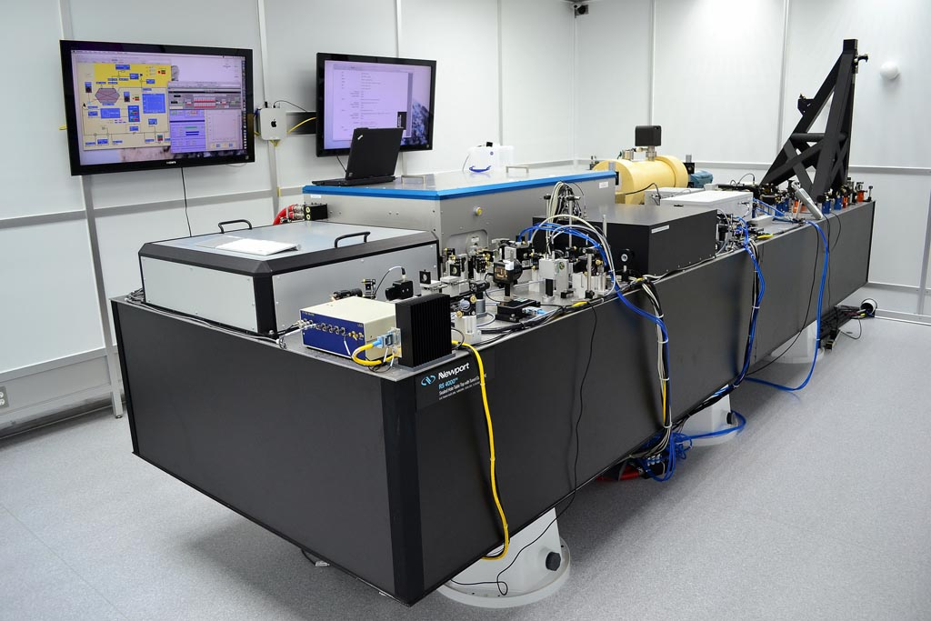
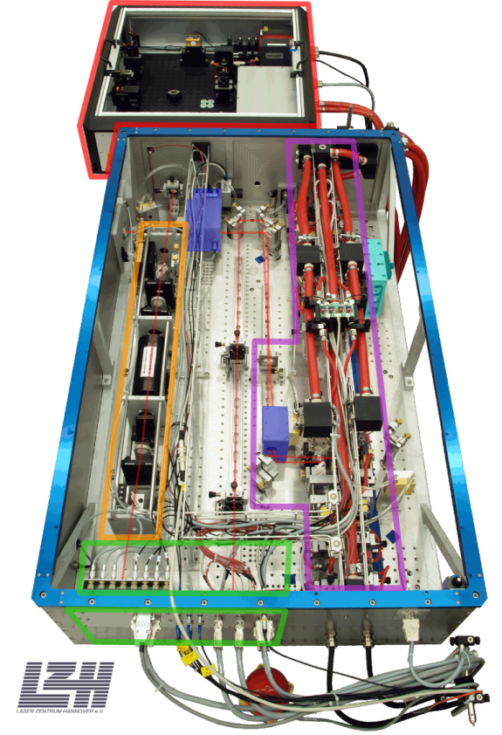
200W Nd:YAG laser, stabilized in power and frequency
Designed and contributed by Max Planck Albert Einstein Institute
Uses a monolithic master oscillator followed by injection-locked rod amplifier

Slide 21
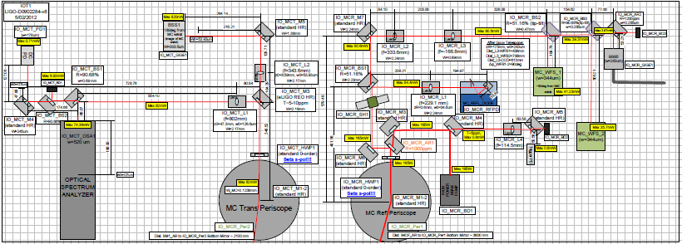
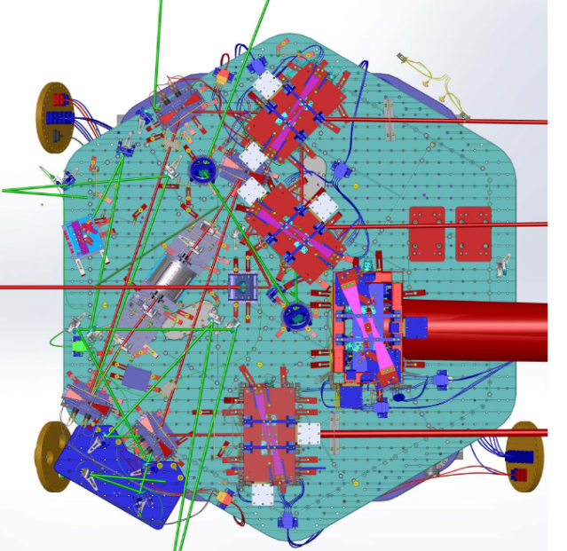
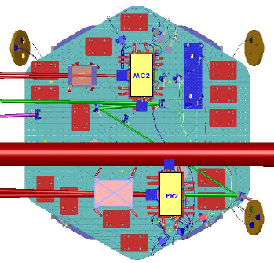
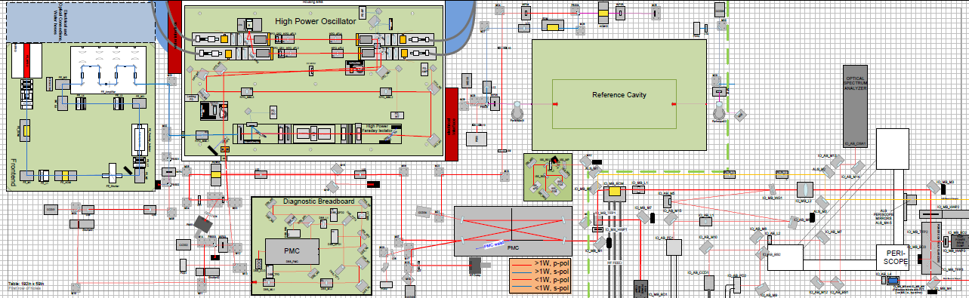
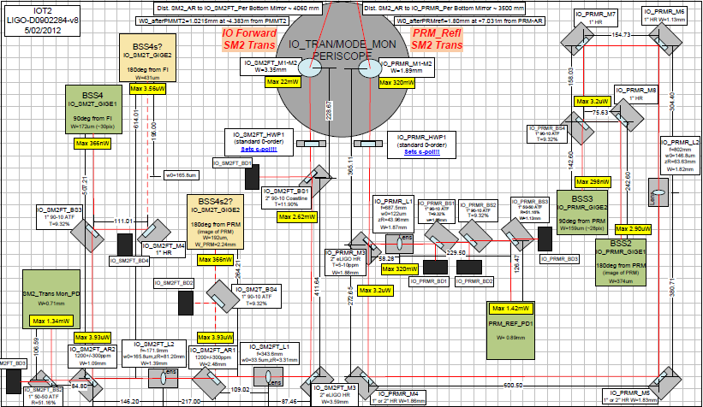
High-power input optics
(in some more detail)
Notes:
21

Slide 22
IO Components
(as schematic as possible)
In air optics:
- EOM system for IMC and IFO
- IMC mode-matching telescope
- Input power control system
- Beam pointing control
- Beam analysis (camera, PDs, OSA)
Post-vacuum in air optics:
- MC-REFL PDs
- Wave-front sensors
- MC-TRANS PDs
- MC-TRANS OSA
- Cameras
IO Table 2L
PSL
HAM3
HAM2
In vacuum optics:
- Beam position control
- Input Mode Cleaner
- Alignment to Power Recycling Cavity
- Mode-matching to PRC
- Optical isolation between IMC and PRC
IO Table 2R
Post-vacuum in air optics:
- IO-TRANS PD
- IO-TRANS GigeCams
- PRC-REFL PDs
- PRC-REFL GigeCams

Slide 23
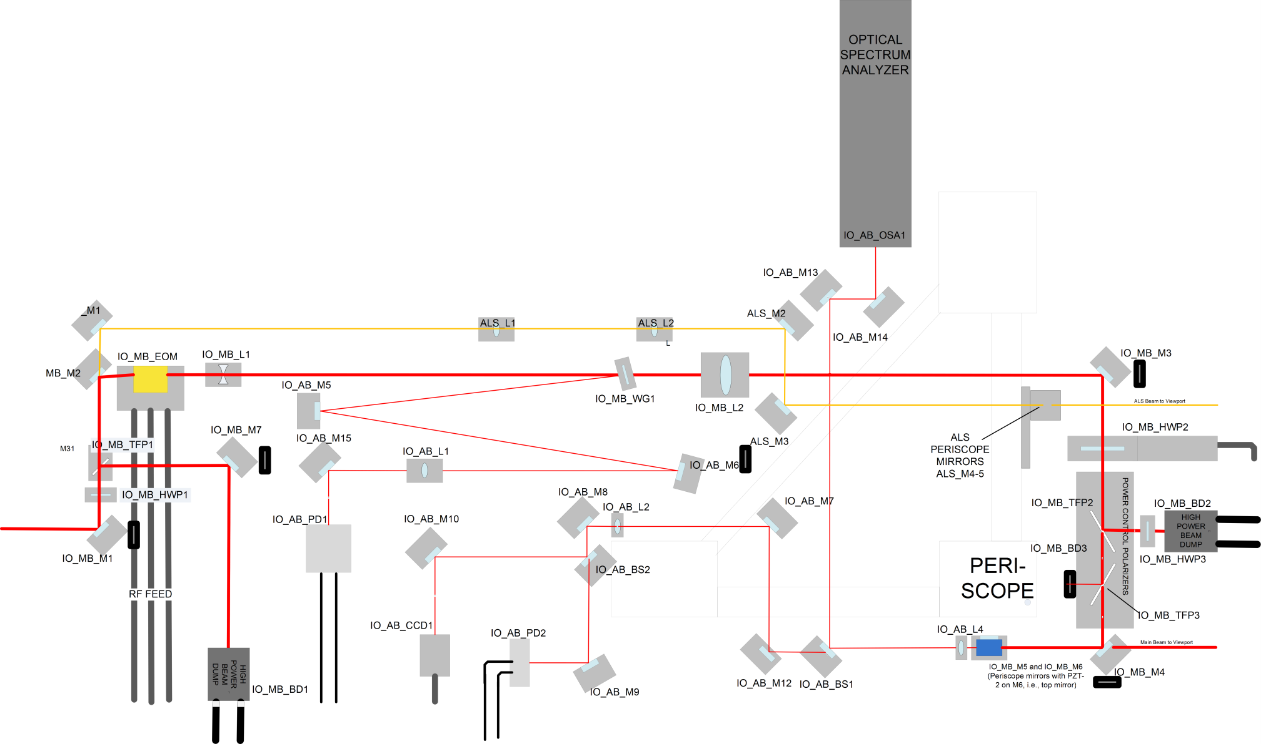
IO on the Power Stabilized Laser table
In air optics:
- EOM system for IMC and IFO
- IMC mode-matching telescope
- Input power control system
- Beam pointing control
- Beam analysis (camera, PDs, OSA)

Slide 24
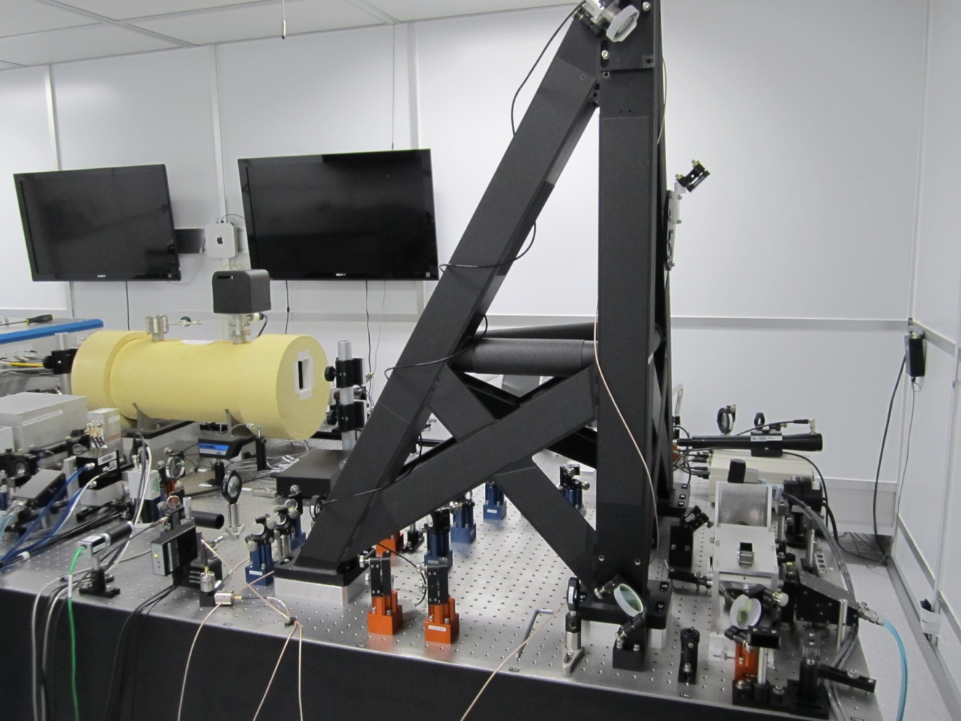
IO on the PSL table LLO today
Electro-optic modulator
- no changes
Mode matching telescope
- no changes, up to 97% MM
RFAM photodiode
- switched to PSL team's
Power control
- working as intended
Beam positioning piezo
- used for slow control
Beam viewing camera
- may be used for beam alignment

Slide 25
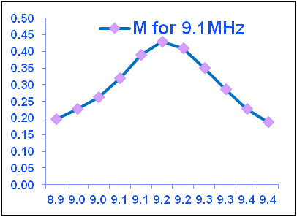
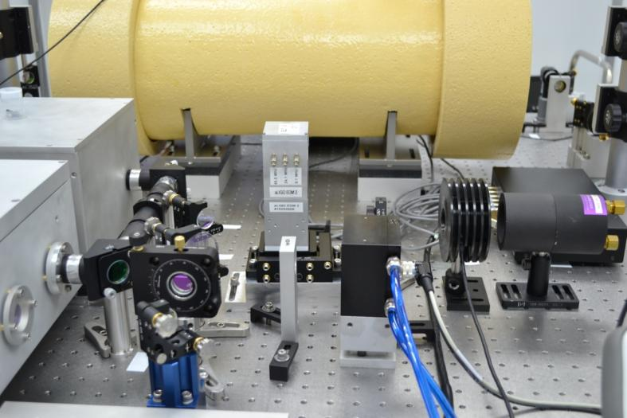
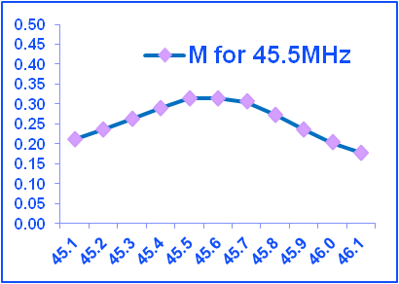
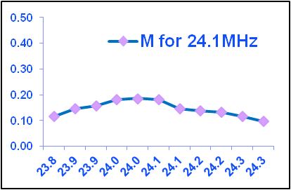
Electro-optic Modulator
All 3 EOM RF inputs are connected.
24.5 MHz – non-resonant. IMC locking
45.5 MHz input is used for “sideband sweeps” of IMC
Notes:
25

Slide 26
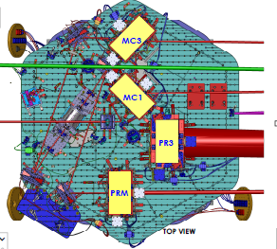
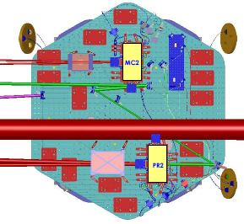
In vacuum IO systems
HAM2
HAM3

Slide 27
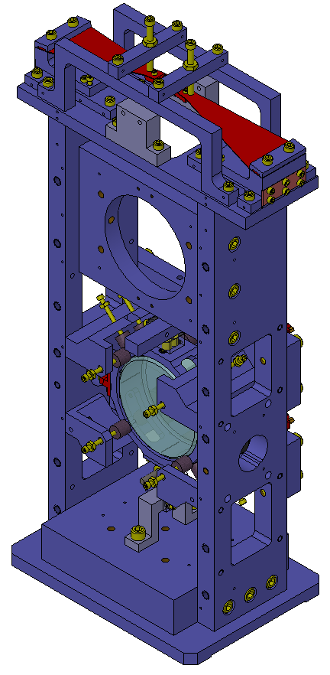
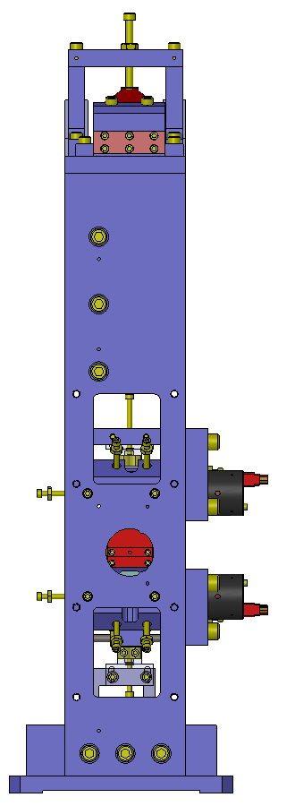
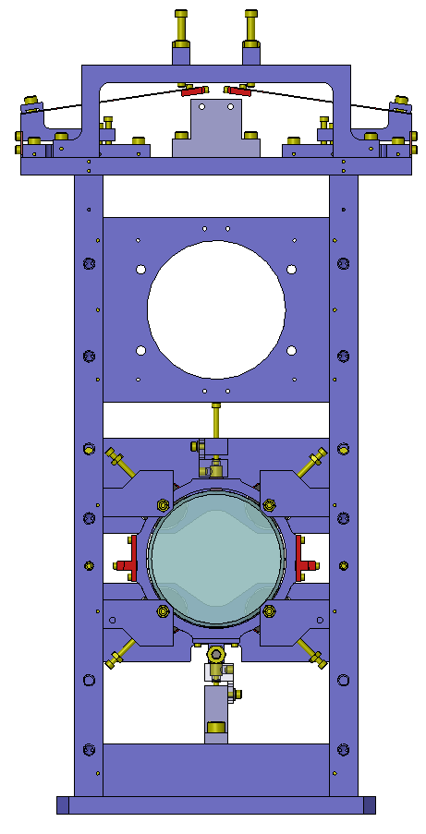
HAUX suspensions
Scales down version of main suspensions

Slide 28
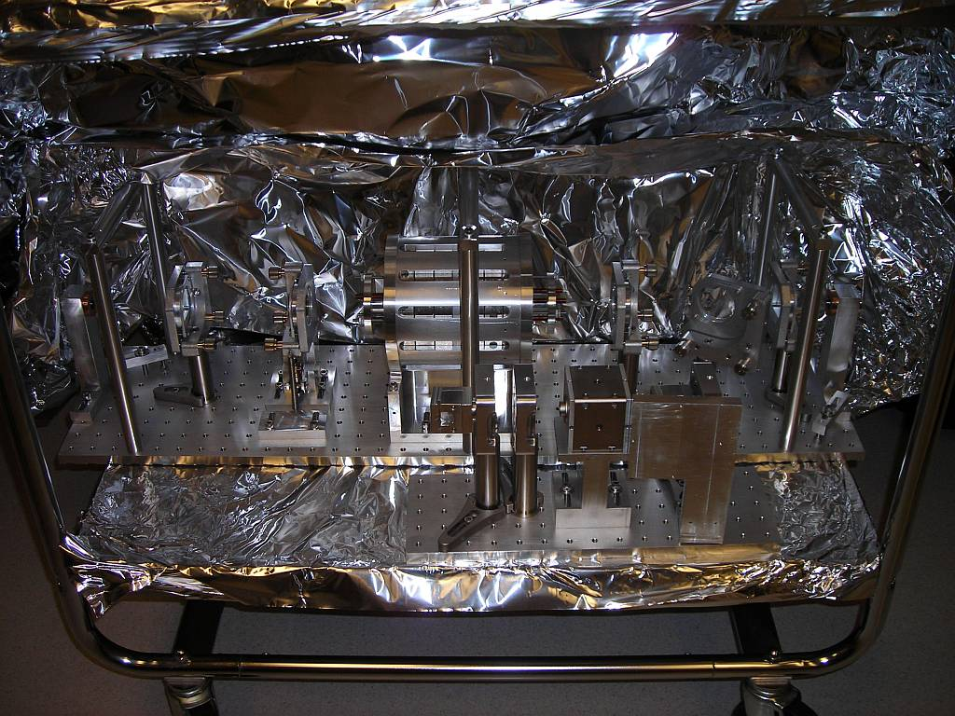
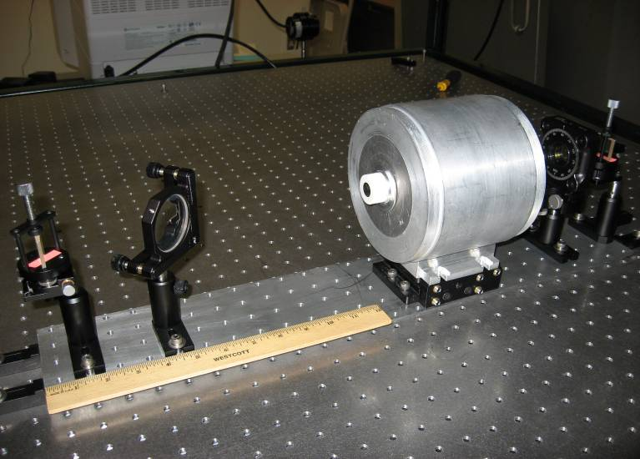
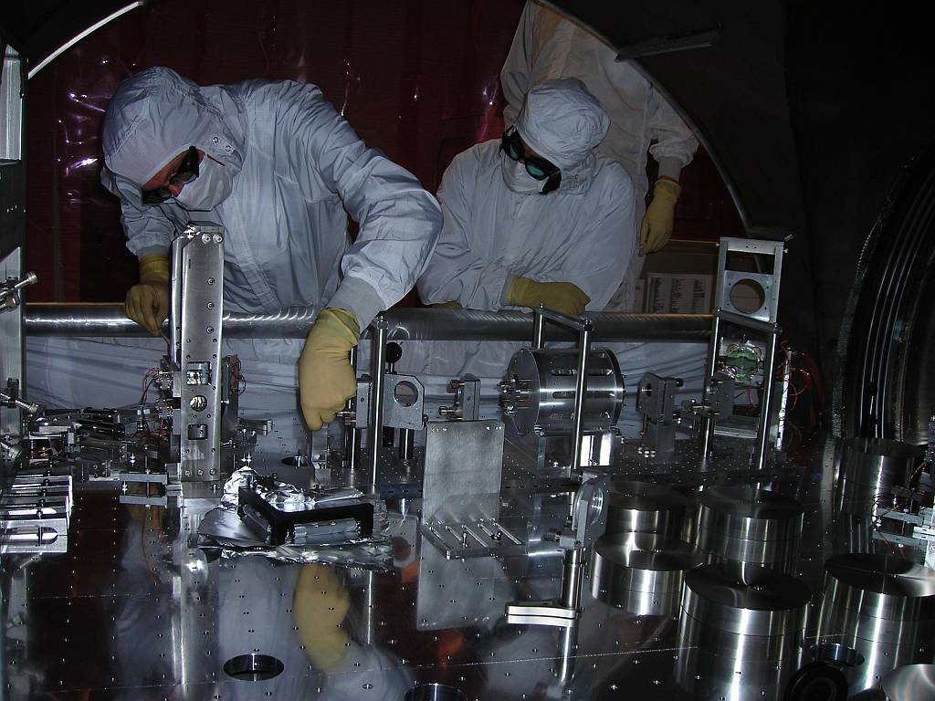
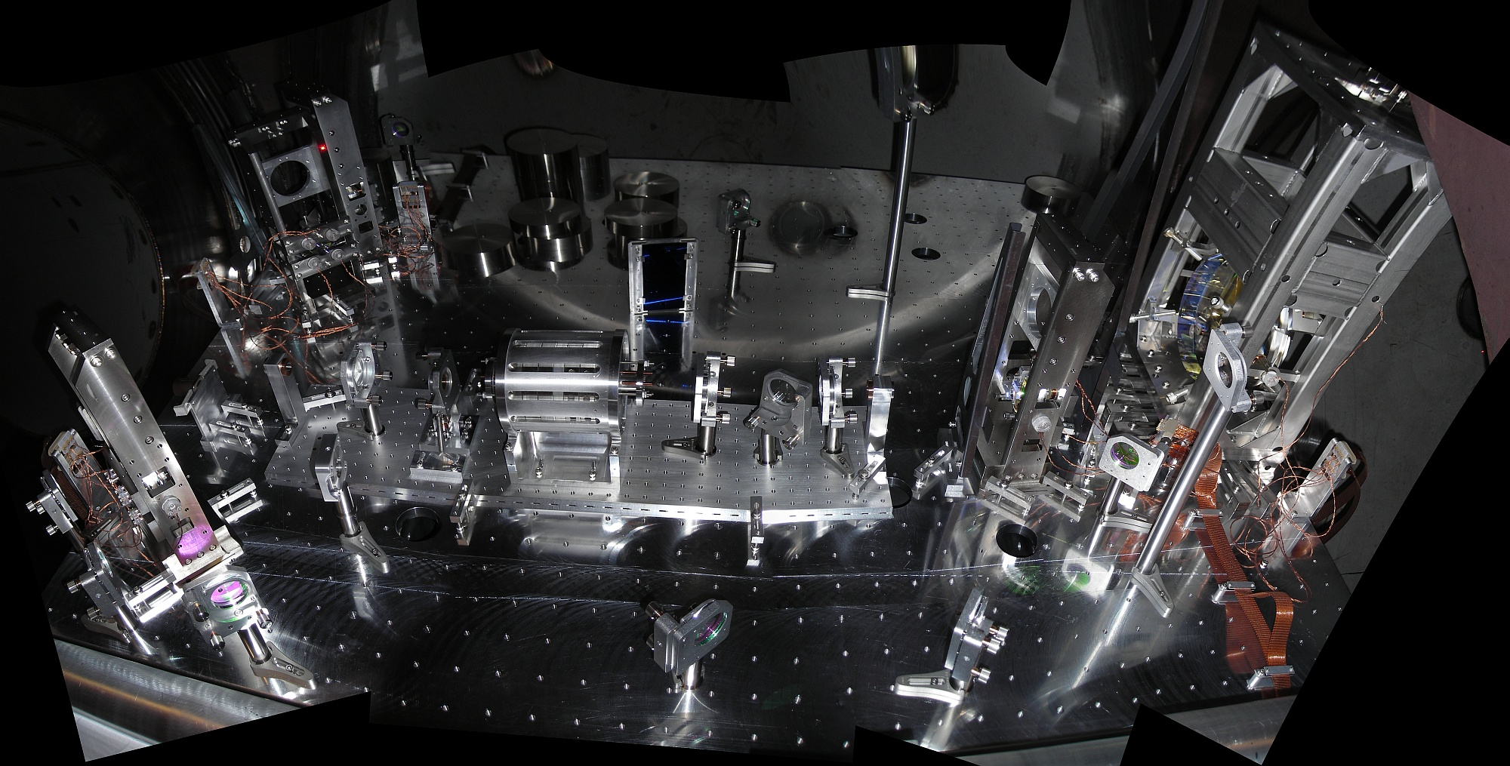
aLIGO Faraday isolator
FOMs: Isolation Ratio
AND Forward Rejection
Capable of producing isolation ~45 dB
Capable of forward rejection ~45 dB
  Thermal lens compensation via negative dn/dT material: deuterated potassium dihydrogen phosphate, KD₂PO₄, or ‘DKDP’).
FR
CWP
λ/2
CWP
TFP
TGG Crystals
Faraday Crystal
DKDP Thermal Lens Compensation
Polarizer
QR
λ/2
Polarizer
H
H

Slide 29

Test Masses
Requires the state of the art in substrates and polishing
Pushes the art for coating!
40 kg
Test Masses:
34cm φ x 20cm
Round-trip optical loss: 75 ppm max
40 kg
Both the physical test mass, a free point in space-time, and a crucial optical element
Mechanical requirements: bulk and coating thermal noise, high resonant frequency
Optical requirements: figure, scatter, homogeneity, bulk and coating absorption
Compensation plates:
34cm φ x 10cm
BS:
37cm φ x 6cm
ITM
T = 1.4%

Slide 30


Test Mass Polishing, Coating
Heraeus substrates: low absorption, excellent homogeneity, stability under annealing
Superpolished; then, cycle of precision metrology and ion-beam milling to correct errors; surface is flat to < 1/10 nm RMS over 300 mm aperture (Tinsley)
Ion-beam assisted sputtered coatings, ~0.6 ppm/bounce absorption, and showing 0.31 nm RMS over 300 mm aperture (LMA Lyon)
Meets requirements of projected 75 ppm round-trip loss in 4km cavity

Slide 31



Compensation of focus induced by laser-induced substrate heating
Measure & Control thermal lens in the Input Test Mass
  ~1 MW of light circulating in arm cavities….
Control the Radius Of Curvature (ROC) in the Input and End Test Masses
  Provide 35 km ROC range
Hartmann Wavefront Sensor
  Corner Station
  End Station
Ring Heater,
CO2 Laser Projector
  Corner Station

Slide 32



Pre-Lock Arm
Length Stabilization
How to reliably bring a 4km
Fabry-Perot cavity
into resonance, and align it
over 4km?
Green light injected through
End Test Mass
Forms low-finesse 4km cavity, provides robust and independent locking signal for 4km cavities
Sidesteps ‘locking’ challenge seen in first-generation detectors
Off-axis parabolic telescope to couple light in/out; in-vacuum and seismically isolated

Slide 33
Seismic Isolation: Multi-Stage Solution
Objectives:
  Render seismic noise a negligible limitation to GW searches
  Reduce actuation forces on test masses
Both suspension and seismic isolation systems contribute to attenuation
Choose an active isolation approach, 3 stages of 6 degrees-of-freedom :
  1) Hydraulic External Pre-Isolation
  2) Two Active Stages of Internal
  Seismic Isolation
Low noise sensors (position, velocity, acceleration) are combined, passed through a servo amplifier, and delivered to the optimal actuator as a function of frequency to hold platform still in inertial space

Slide 34


Seismic Isolation: two models
Sensors are capacitive for ‘DC’, and seismometers to sense acceleration
Electromagnetic motors for actuation
Control system is digital, and fully multiple- input multiple-output to
optimize for complex figures of merit
Type I: Single stage (6 DOF) isolator
Type II: Two-stage system, each with 6 DOF measured and actuated upon – 18 DOF including hydraulic pre-actuator!
Suspensions, baffles, etc. hung from
quiet optical table
Part of a hierarchical control system, with distribution of forces for best performance
Provides a quiet versatile optical table;
can carry multiple suspensions, baffles, detectors, etc.

Slide 35






Optics suspensions: Pendulums

Slide 36


Test Mass Quadruple Pendulum suspension a UK contribution
Choose quadruple pendulum suspensions for the main optics; second ‘reaction’ mass to give quiet point from which to push
Create quasi-monolithic pendulums using
fused silica fibers to suspend 40 kg test mass
  VERY Low thermal noise!
Another element in hierarchical control system
Optics Table Interface
(Seismic Isolation System)
Damping Controls
Hierarchical Global
Controls
Final elements
All Fused silica
Electrostatic
Actuation

Slide 37
Timeline From Now to Advanced LIGO Science Operations
Formal hand-off of the interferometers to observatory operations requires each to interferometer lock for 2 hours
We expect both Hanford and Livingston interferometers to be turned over to observatory operations in late 2014
    Very important point: hand-off does not imply astrophysically interesting sensitivity
Advanced LIGO Project formally ends March 2015 after installation of storage and analysis computers
The inaugural Advanced LIGO science run will take place after interferometers have been tuned to reach ‘good sensitivity’ → likely the latter half of 2015

Slide 38
And then?
Getting from parts to a complete instrument:
TENTATIVE TIMELINE:
Complete integration by 2014
(interferometer “locked”)
“Early” Science Run in 2015
(~60 Mpc)
Within a factor of 2 of design sensitivity by 2016 (~100 Mpc)
…Does it seem slow?
http://arxiv.org/abs/1304.0670

Slide 39

For comparison:
Initial LIGO: first lock in 2000 – 7 years to reach goal
2002
2003
2004
2005
2007
Design

Slide 40
“Half Interferometer” in progress at Hanford
(now one arm, in the fall the other)
LHO
1064
532


Auxiliary green laser to initially stabilize the arm cavity length
1.06 micron detection light held precisely on, or off resonance
First measurement of arm cavity motion

Slide 41

“Short” Interferometer in progress at Livingston
(Dual Recycled Michelson Interferometer)
LLO
Lock of the central part of the interferometer
(“everything except the arms”)
Will be first configuration with
interesting sensitivity

Slide 42
And after the Project per se:
Tuning for Astrophysics, and Observation
Transition from Project back to Lab/collaboration after two-hour lock
  Planned for 2014
First work with low laser power
  No heating problems
  No optically-driven torques
  Focus on low frequencies
Ideal for first astrophysics as well
  Standard candles are binary neutron stars
  Most SNR in the 20-200 Hz region
Focus later on high power,
high frequency range

Slide 43
Conclusions
Advanced LIGO is well on the way
Gravitational wave detection pushes state-of-the art in CW solid state laser technology, optical fabrication and metrology, and control systems
Acknowledgments:
and the Members of the LIGO Laboratory, members of the
LIGO Science Collaboration, National Science Foundation.
Special thanks to D. Shoemaker, D. Reitze, D. Feldbaum and
the many other people that provided content and slides for
this talk.
More Information:
http://www.ligo.caltech.edu; http://www.ligo.org

