Slide 1
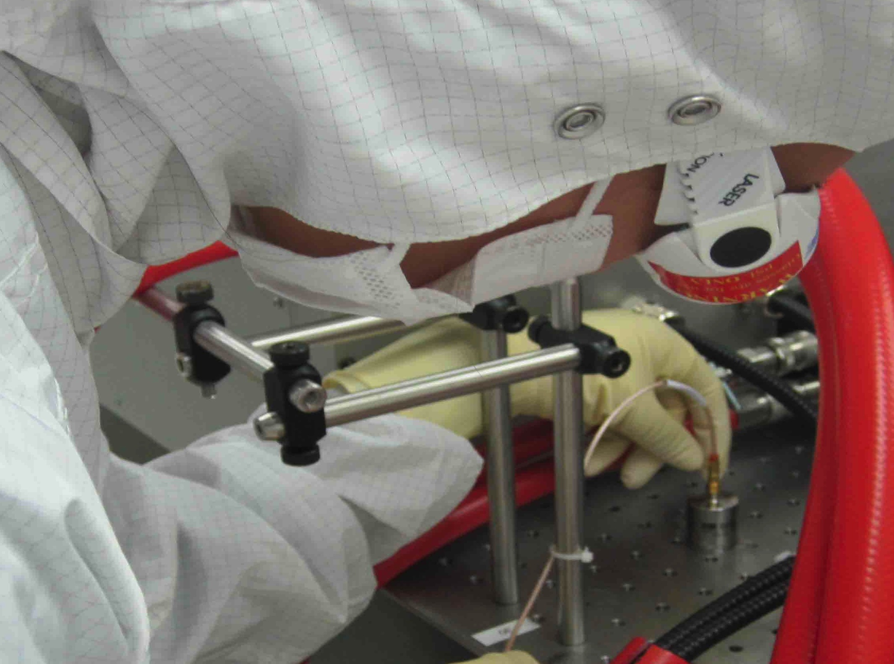
PEM update, September 2013
Robert Schofield,
Vinny Roma, Terra Hardwick (Oregon)
Emily Maaske (Seattle Pacific),
Dominick Ghirado(Notre Dame)
Brian Dawes (Columbia),
Anamaria Effler (LSU),
Tristan Shoemaker (Boston),
David Shoemaker (MIT),
Thomas Vo, Richard McCarthy (LHO)
Stefan Ballmer (Syracuse)
LIGO-G1301067

Slide 2
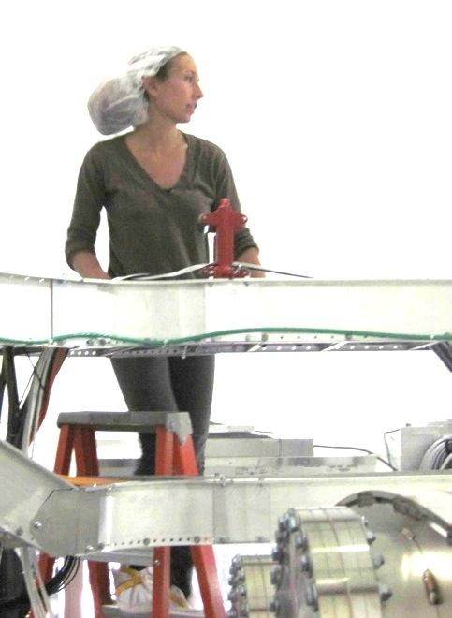
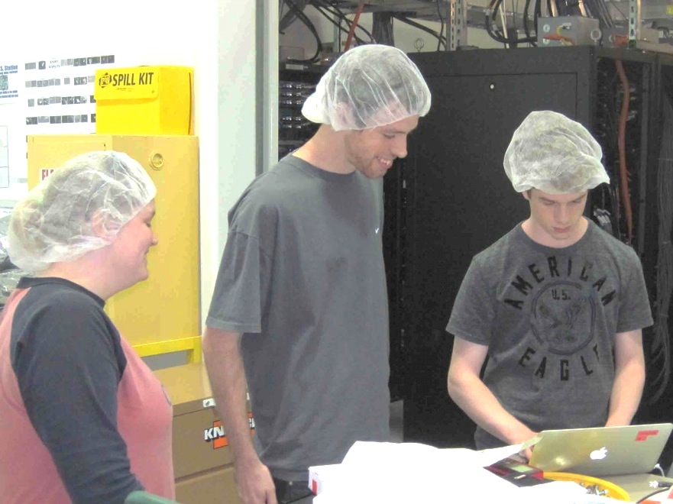
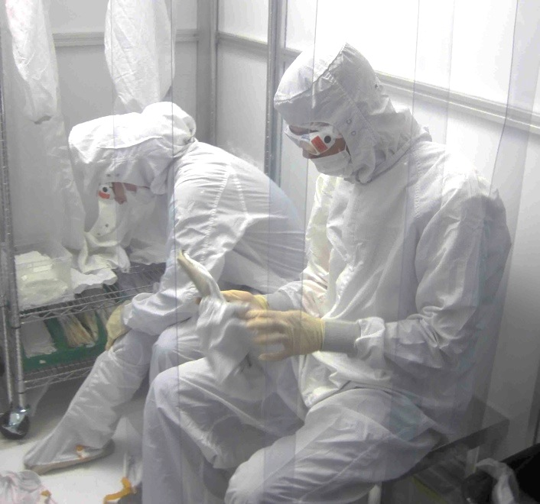
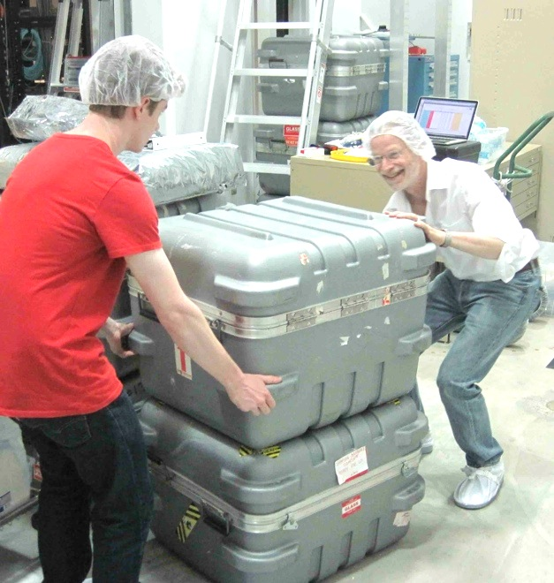
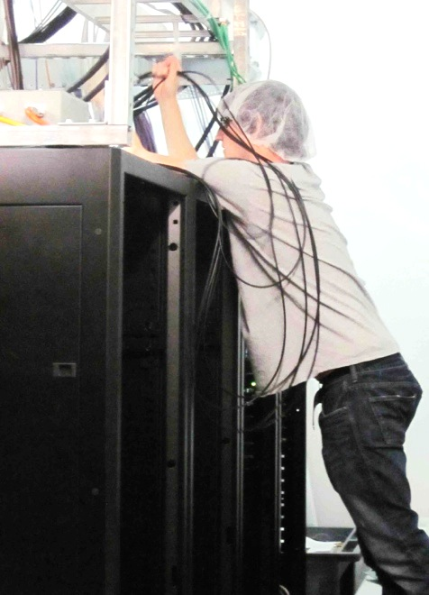
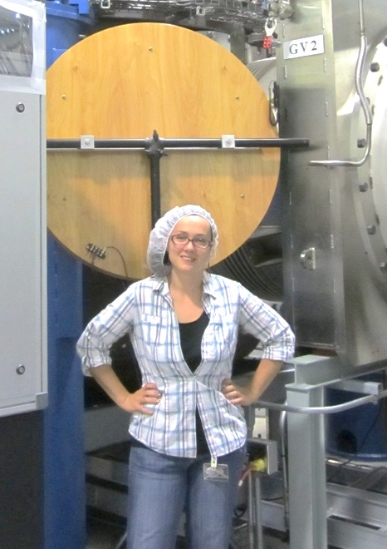
2013 Summer PEM Crew
Emily Maaske
Terra Hardwick
Vinny Roma
Dominick Ghirardo
Brian Dawes
Tristan Shoemaker
David Shoemaker
Anamaria Effler
Robert Schofield

Slide 3
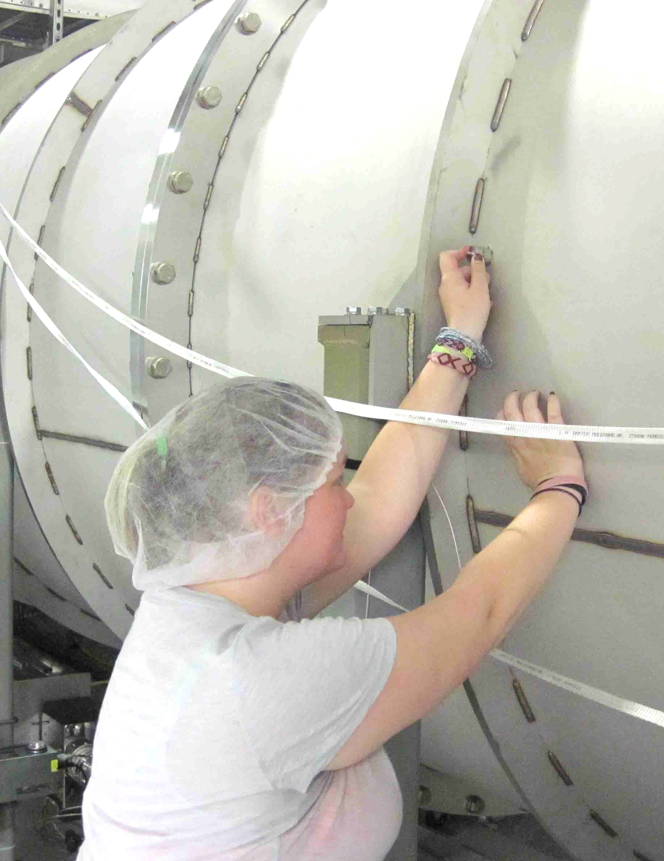
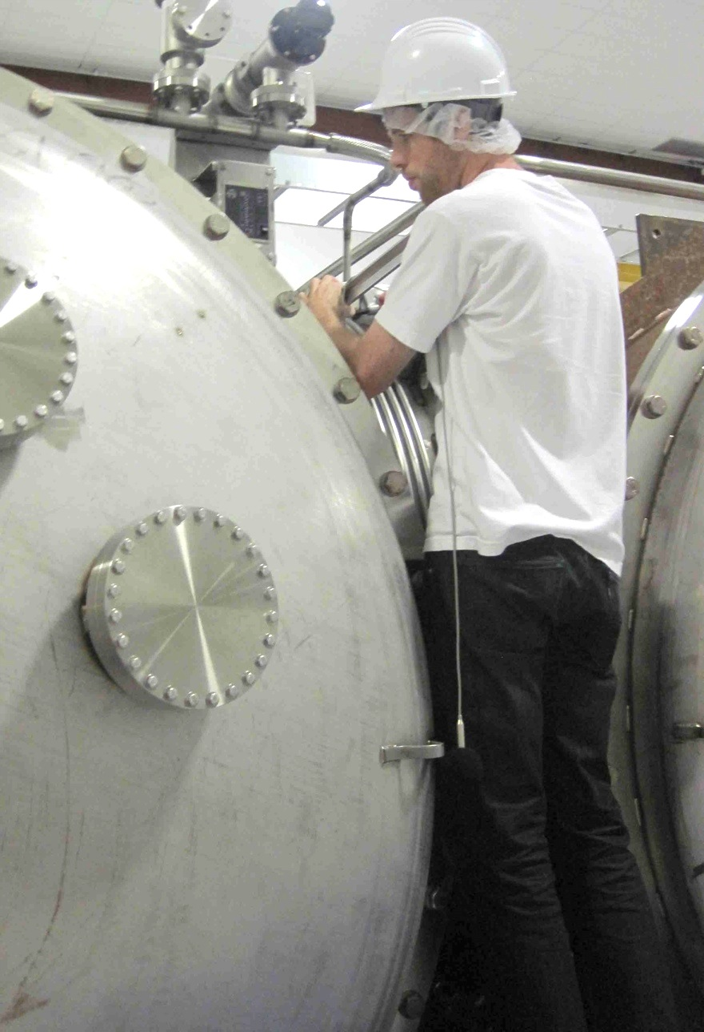
Installing sensors
Emily epoxies accelerometer on beam tube, Vinny installs microphone on HAM

Slide 4
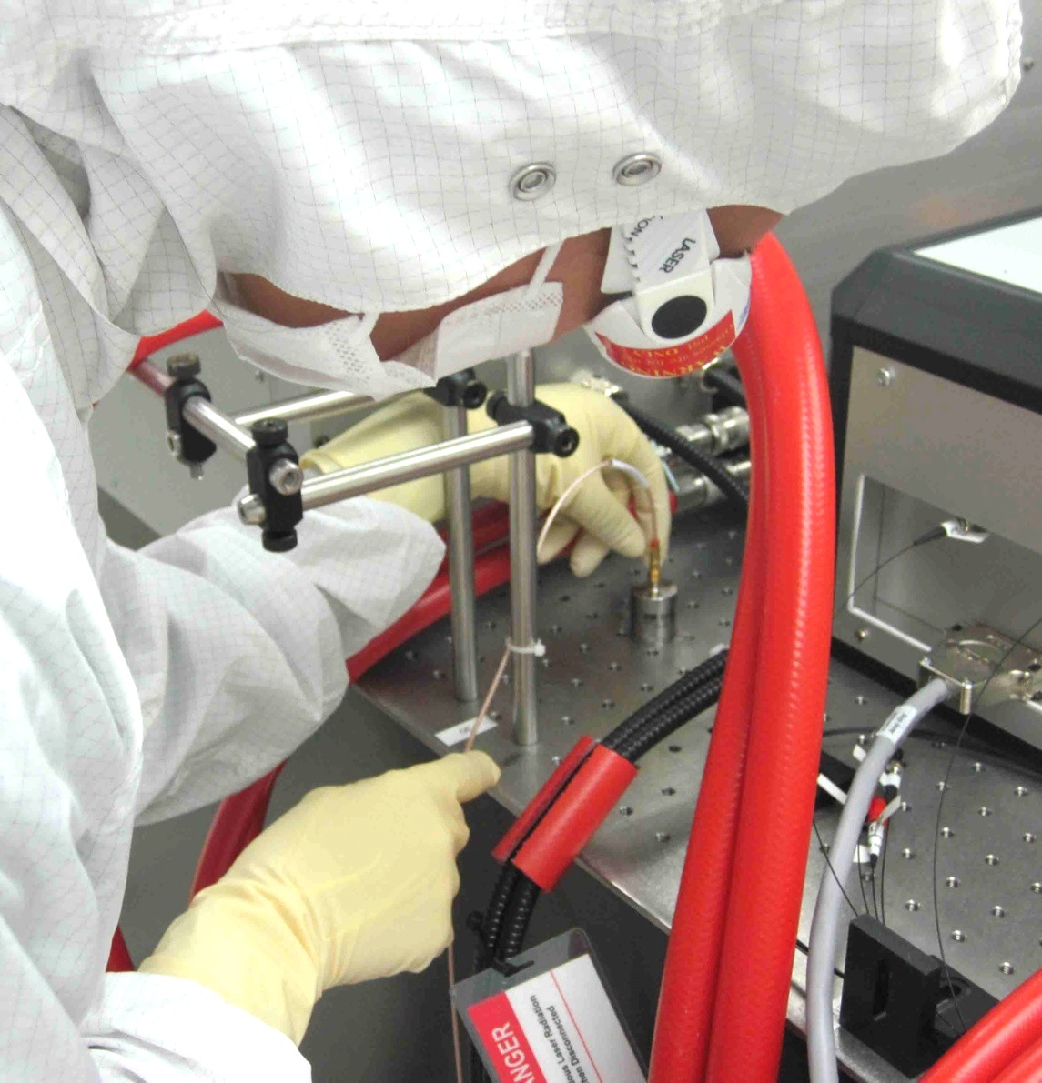
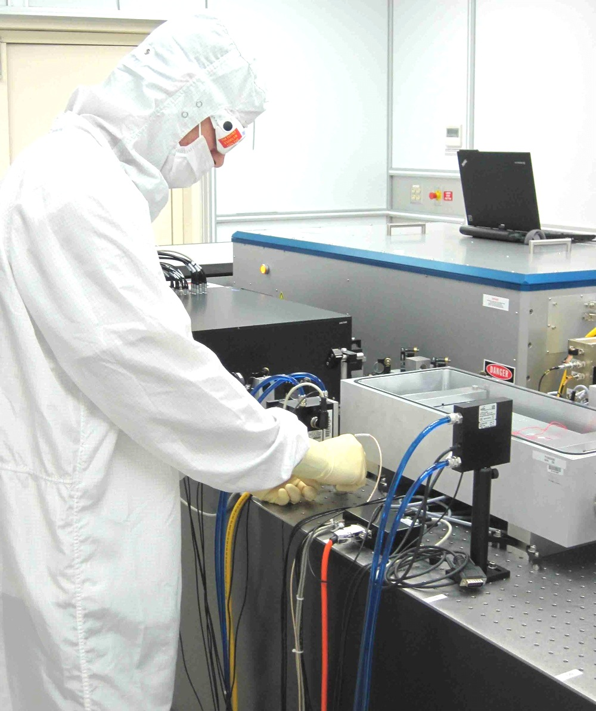
Installing sensors
Terra and Vinny install accelerometers on PSL table

Slide 5
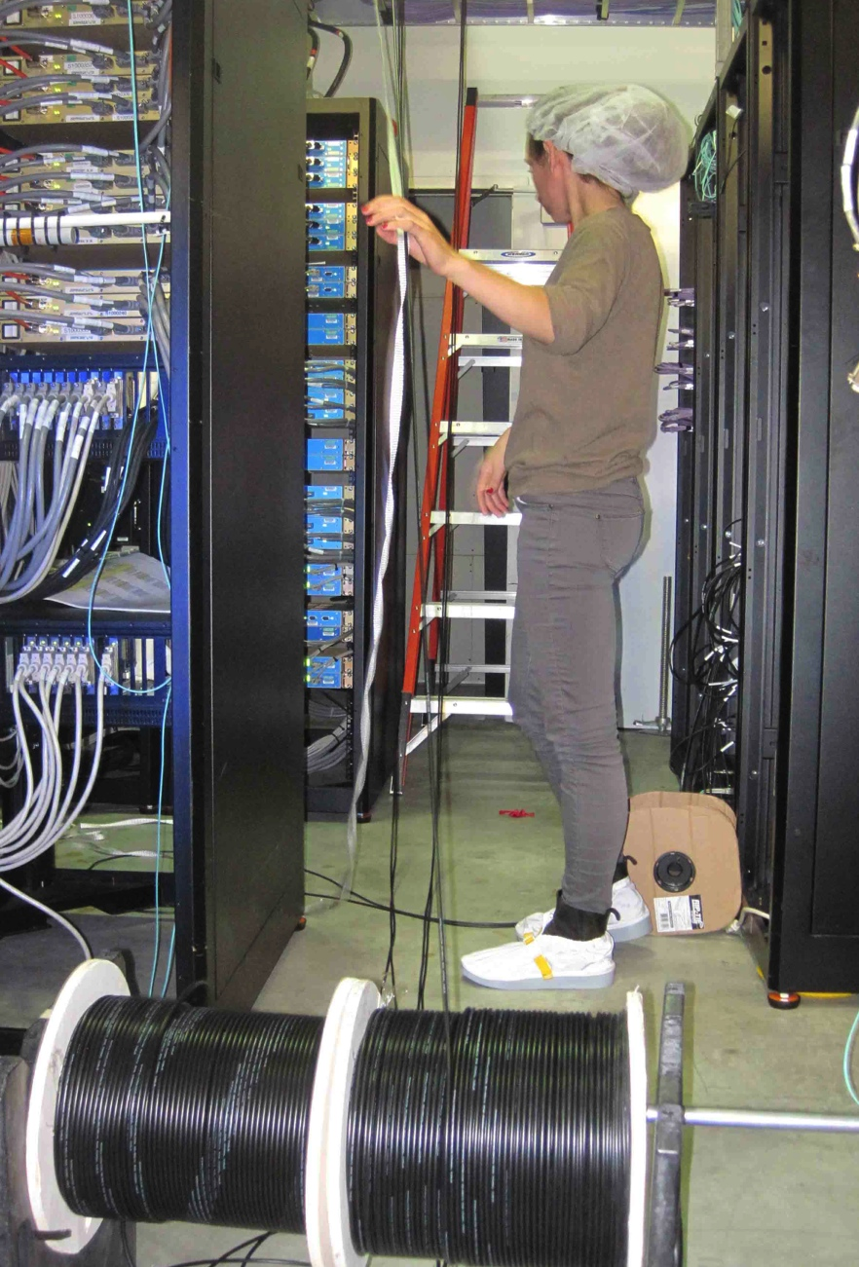
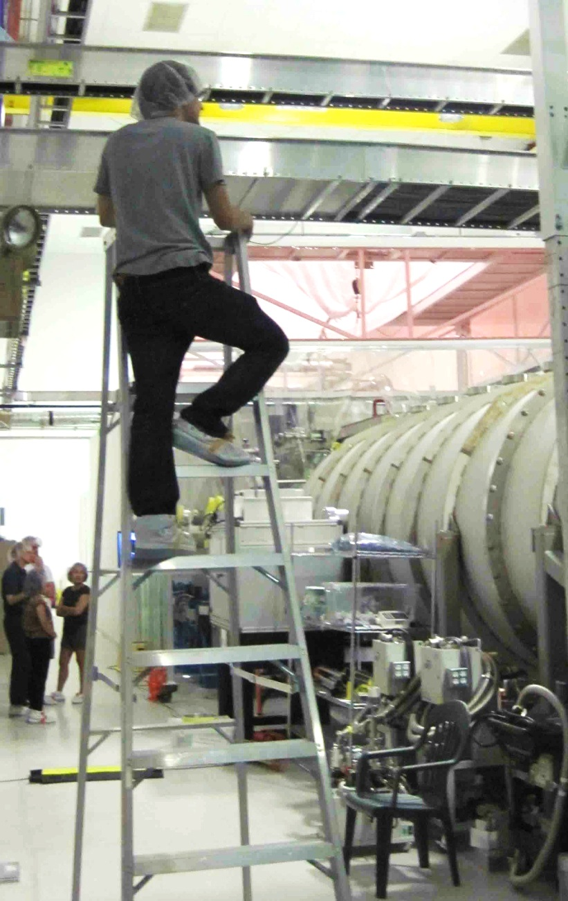
Pulling cables
Terra pulling and guiding in e-bay
Brian guiding in LVEA

Slide 6
Cross-talk studies of new channels
Emily Maaske, Seattle Pacific
This Endevco multi-accelerometer signal conditioner was so bad we replaced it

Slide 7
Monitoring all the new PEM channels
Development of LIGOCAM (Dipongkar Talukder, U of O)

Slide 8
Populating PEM web page
Link

Slide 9
Magnetic

Slide 10
Magnetic

Slide 11
Magnetic

Slide 12
Magnetic

Slide 13
Calibration
Accelerometers calibrated to match LVEA seismometer
Microphones calibrated with pressure piston
Factory calibration given if not calibrated through DAQ

Slide 14
Grid location
Grid location gives distance from the projection of the vertex onto the LVEA floor. Useful for source pointing and propagation velocities.

Slide 15
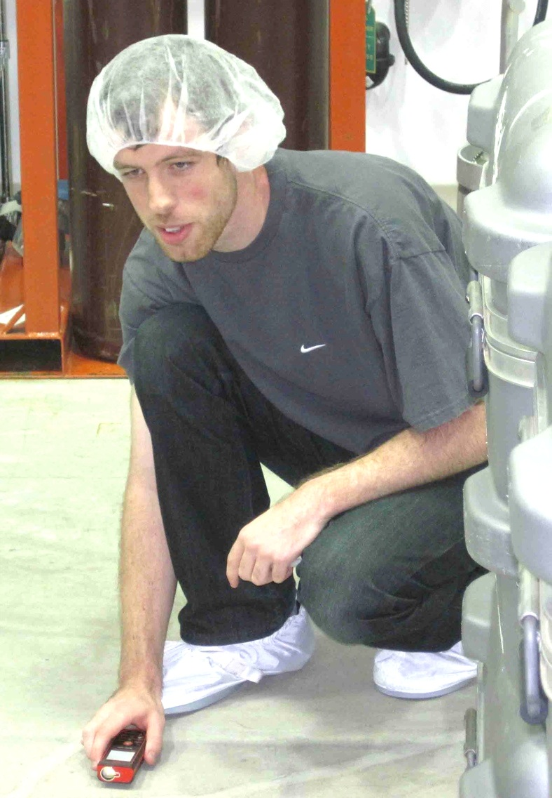
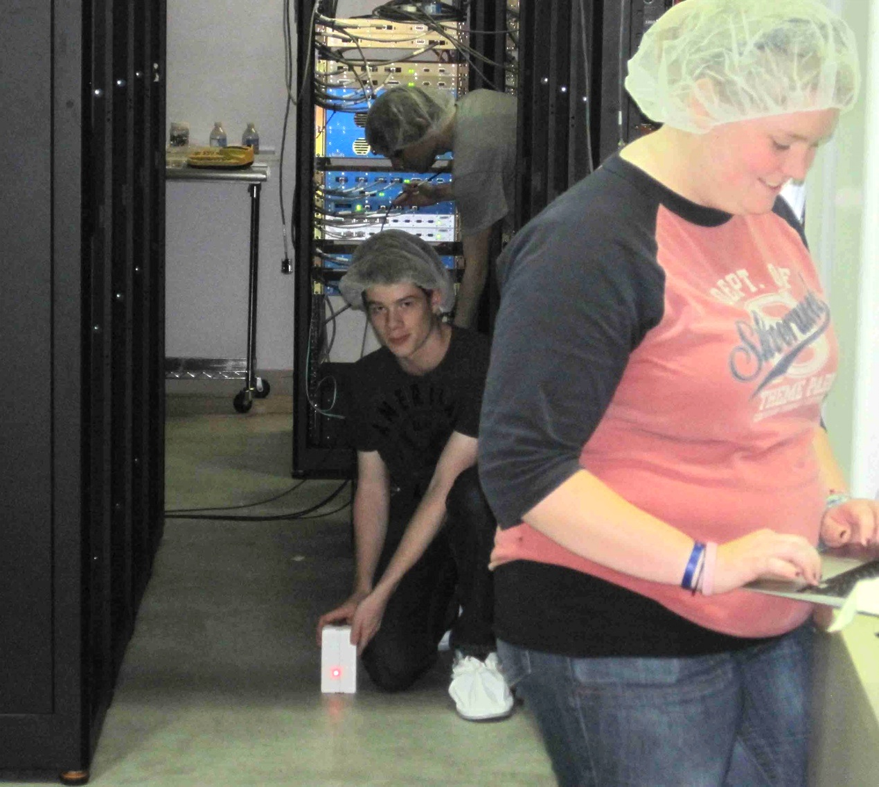
Trilateration of sensor location
Vinny and Tristan using monuments and laser distance finder

Slide 16
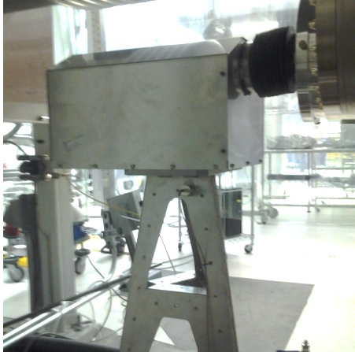
Picture

Slide 17
Calibrated spectrum

Slide 18
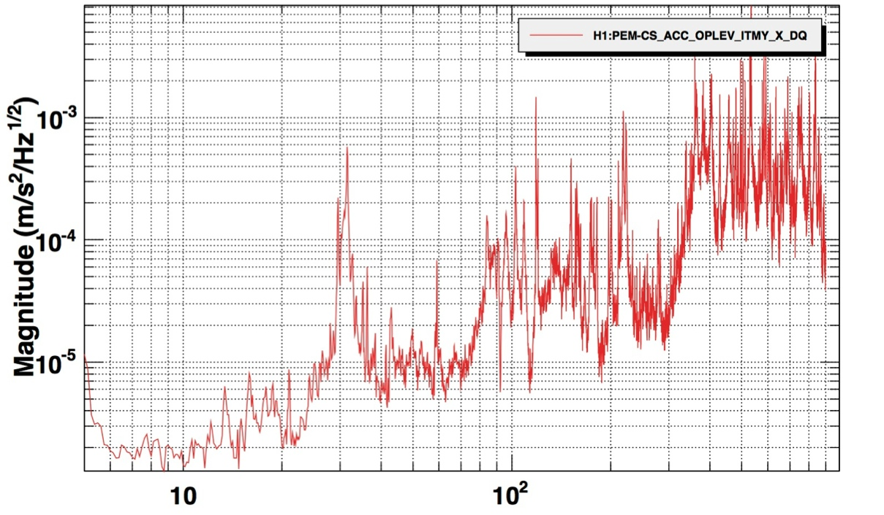
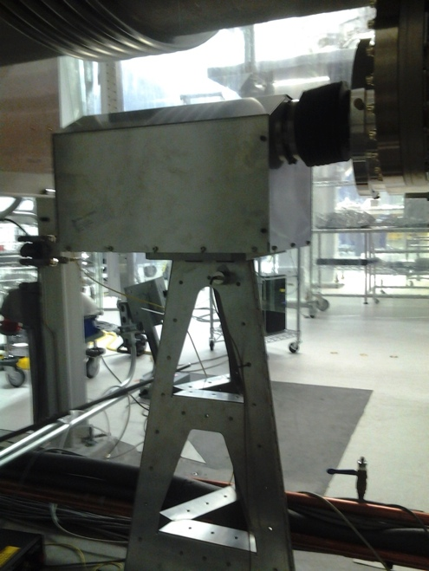
Early investigations with the new PEM system
Web page spectrum suggest op-lev transmitter pier resonances may be too low

Slide 19
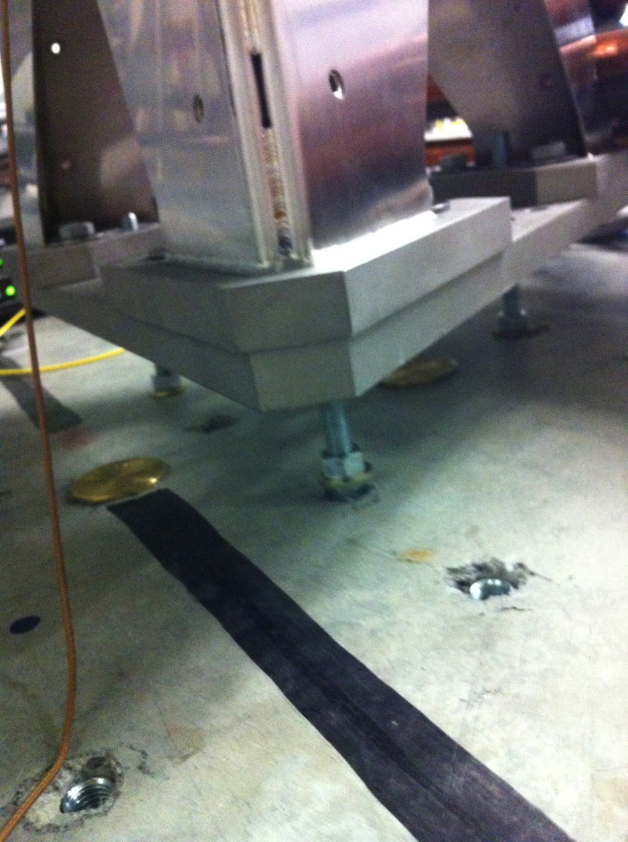
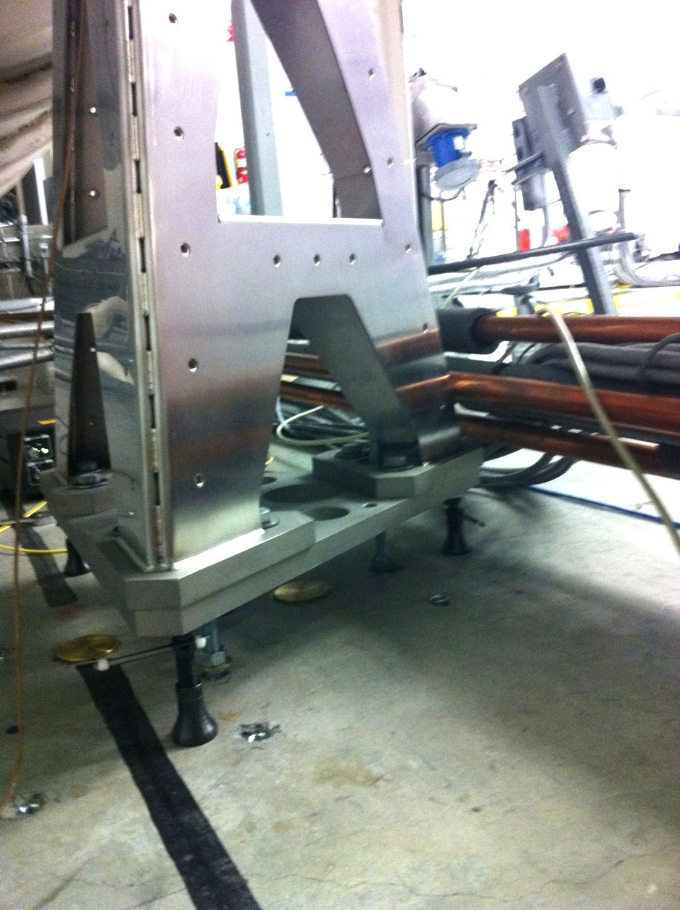
Test to see if grouting will help
Added machine jacks stiffen floor connection (with T. Vo)

Slide 20
Peak moves up
Resonance given by connection to floor, so grouting should help

Slide 21
Excess noise in HIFO-Y ALS test

Slide 22
Low-f coherence with seismic and OSEMs
Magnetic

Slide 23
Accelerometer coherence at higher f
Black: HIFO-Y
Red: ISCT1 periscope
Blue: PSL periscope

Slide 24
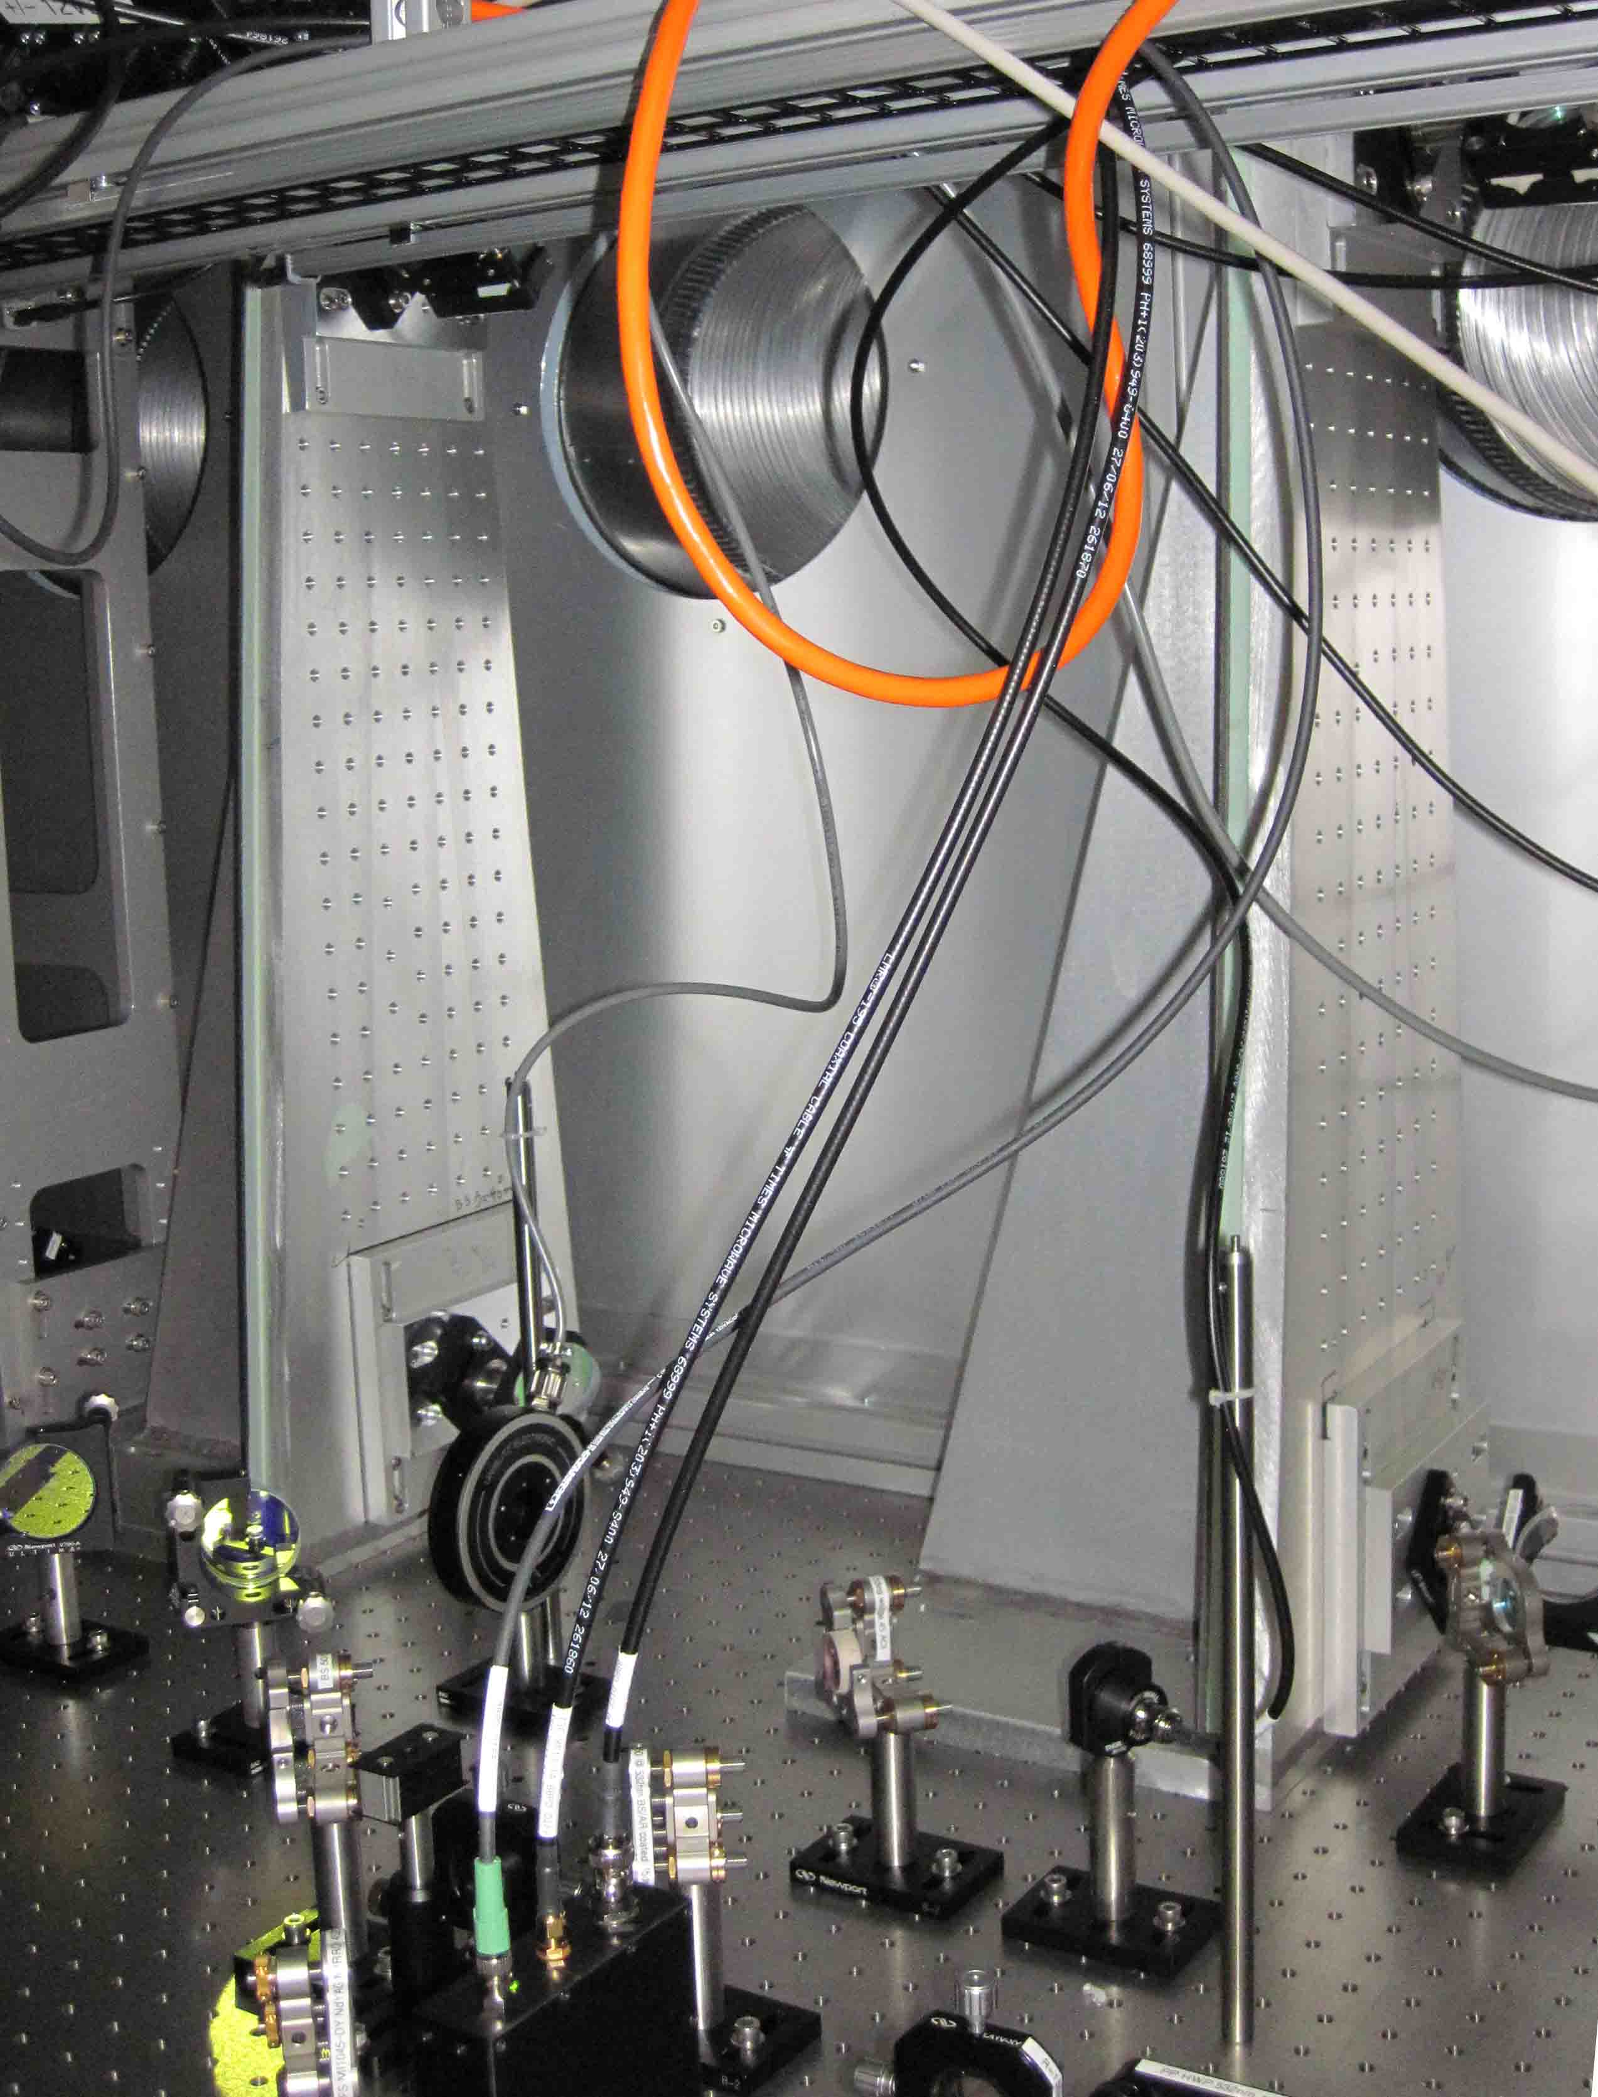
ISCT1 ALS periscopes
Green light from Y-end
Infra-red light from PSL
Red doubled and beat against green – differential path length changes show up in beat note

Slide 25
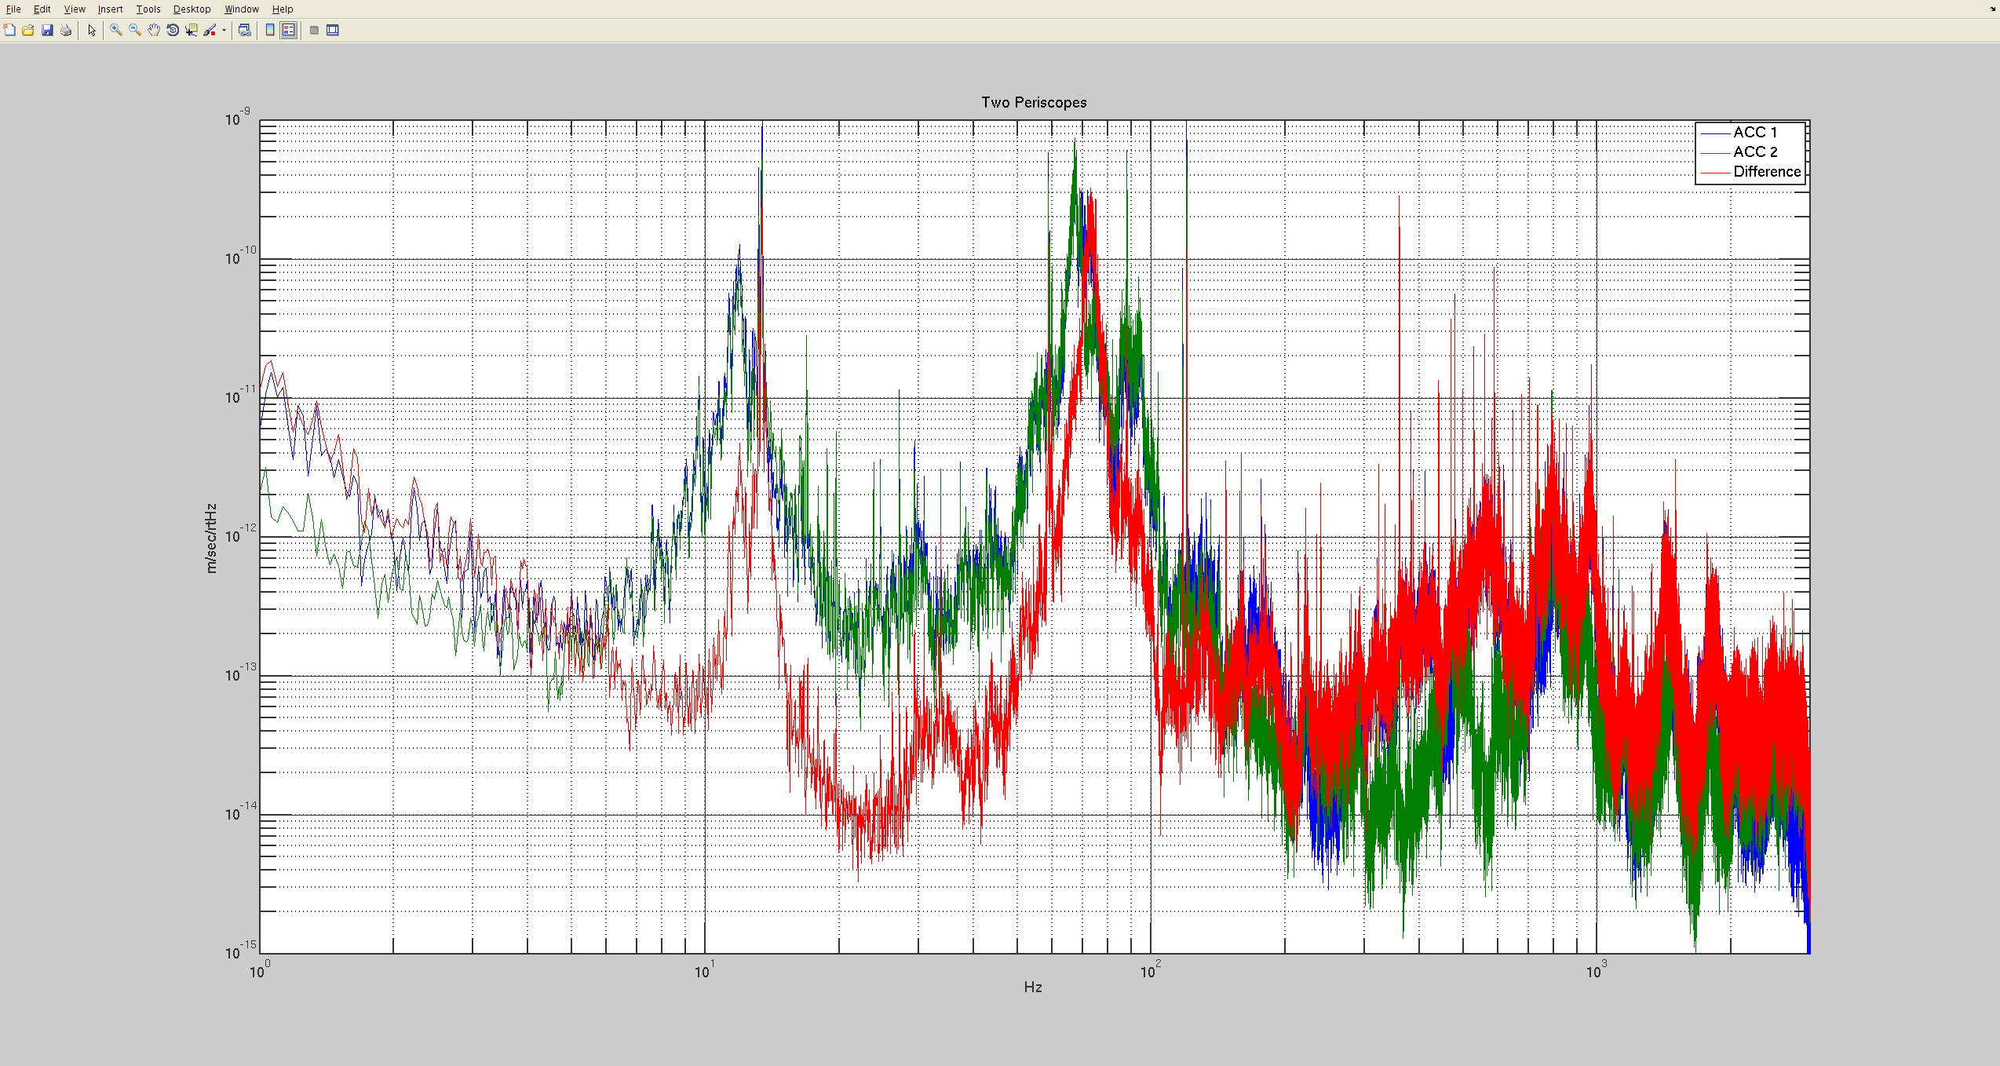
Differential motion between periscopes
Accelerometer on each periscope
Table sway resonance
Periscope resonances
Difference between the two signals

Slide 26
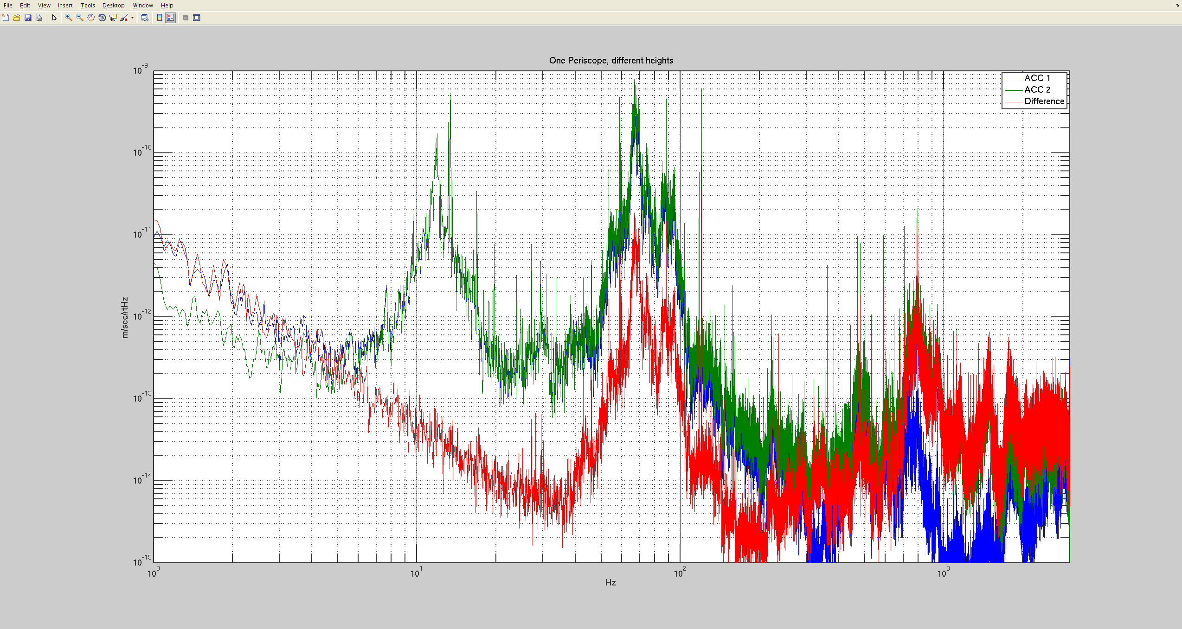
Differential motion same periscope
accelerometers at different heights - potential location of mirrors
Difference between the two signals

Slide 27
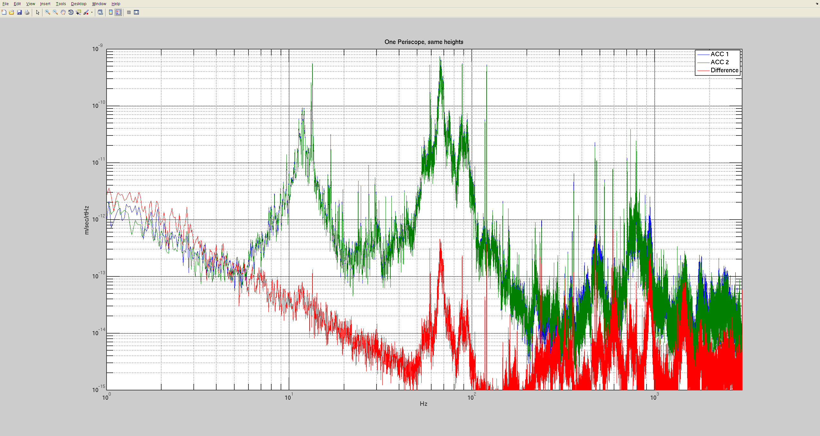
Differential motion same periscope
Accelerometers at same height as if on one mirror
We will try to run both beams on one periscope on one top mirror.
Difference between the two signals

Slide 28
More PEM updates: PEM Projects on web page
Link

Slide 29
PEM Hardware Projects
RF
Power meters for roof radio monitors. Monitor RF in modulation frequency bands (e.g. 9MHz 45MHz) etc. A unit would monitor 6 frequencies at once and output 6 analog signals proportional to the power in the band.
RF monitors at the main modulation frequencies for inside the LVEA (Richard @ LHO). These would use signals from the RF distribution system as the local oscillators. They would be attached to lamda/2 antennas in the LVEA.
An RF spectrum monitoring system that sweeps from a few KHz to a couple of GHz (U of O). It would monitor the RF environment and output spectrograms using a spectrum analyzer and a laptop. The motivation for this is that coupling can occur at frequencies outside our 100kHz bands (e.g. 10 MHz).
An audio frequency RF system (1 Hz to 10,000 Hz). Would use a Marconi antenna and audio amp into the DAQ system.



Slide 30
PEM Hardware Projects
Non-RF
6 more coil magnetometers. One in each building, would reproduce design of vault coil magnetometers.
Eotvos infrasound microphones.
A temporary monitor for electrostatic fields inside the BSCs (U of O). Would be connected to a dead-end wire that goes into the BSC.
Develop mounting system for chamber accelerometers.




Slide 31
PEM Software Projects

Dead channel monitor and more sophisticated band change monitor / coherence monitor (Dipongkar Talukder, U of O)
Modify DAQ system to produce channels containing the sum in quadrature for all 3-axis sensors. The quadrature channels would each replace 3 single-axis channels in the RDS.
Channel location documentation web page. Enter channel name to light up sensor location on sensor map, also shows photos of sensor in its location.
Channel calibration documentation
Direction to source finder (V Roma, U of O). Uses propagation delays to point in source direction.
Serving PEM calibrations to glitch detectors





Slide 32
PEM Software Projects
With emphasis on stochastic and CW searches
Search for pulsars in selected auxiliary channels with modified all-sky and/or specific pulsar search code.
Modify stochastic code to search for signal between aux channels (Violet Poole, WSU). Compare empty channels between sites, coil magnetometer channels, and other aux channels.
Add significance FOM to Carleton DARM-aux coherence line monitor (Greg Mendell, LHO).
Modify coherence code to look between auxiliary channels instead of just DARM-aux (U of O).
1Hz (and other) comb monitor (Ryan Magee, WSU, Greg Mendell, LHO). Searches for combs in DARM and auxiliary channels and monitors f-dependent amplitude.





Slide 33
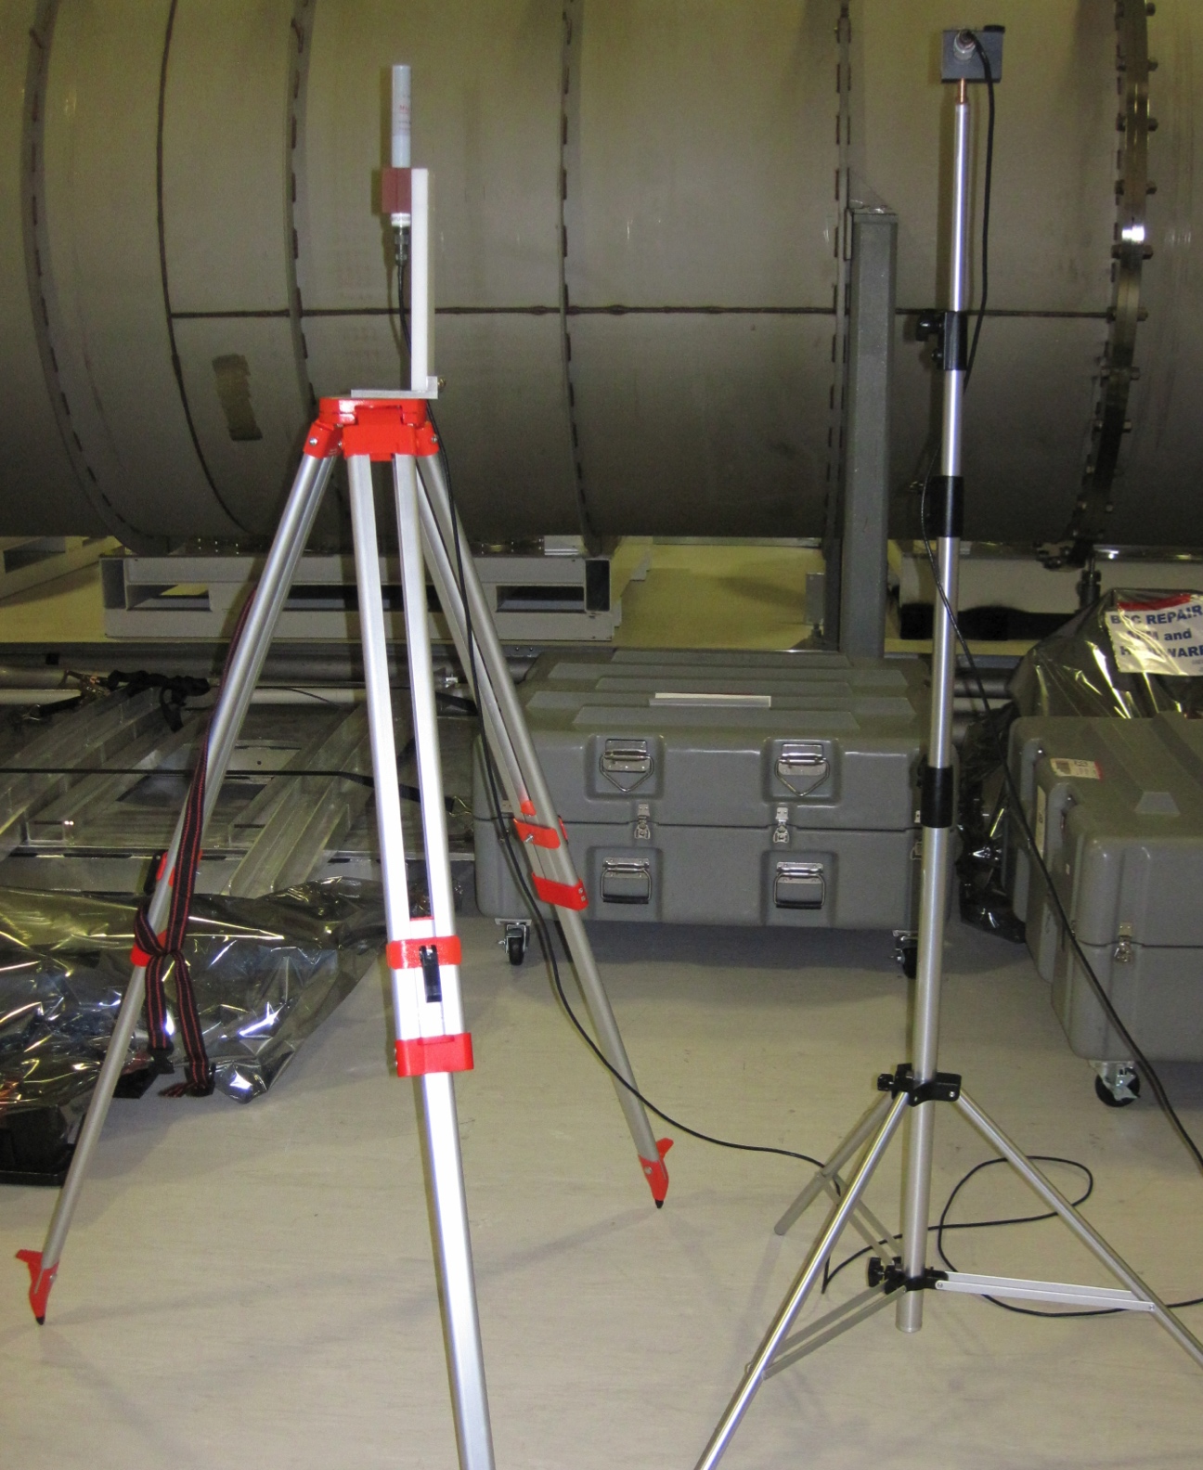
Test of Fullerton magnetometer mount and surveyors tripod
Fullerton
iLIGO
Design: Gabe Islas

Slide 34
Tripod resonance gone
Magnetometers read about the same except that LHO iLIGO one has extra peak (flagpole resonance)

Slide 35
PSL chiller vibration problem solved by removing quick-connects
PSL table motion
Red: quick connects in
Blue: quick connects replaced with burred connects
Black: chiller off

Slide 36
PSL vibration problem solved
My theory: short term imbalances in the momentum flow on and off the table cause varying forces on the table. Chaotic streams from the quick-connect nozzles cause the imbalance.
Before
After
Note that we didn’t modify the low-flow quick-connects
With O. Punken, M. Rodruck and R. Savage

Slide 37
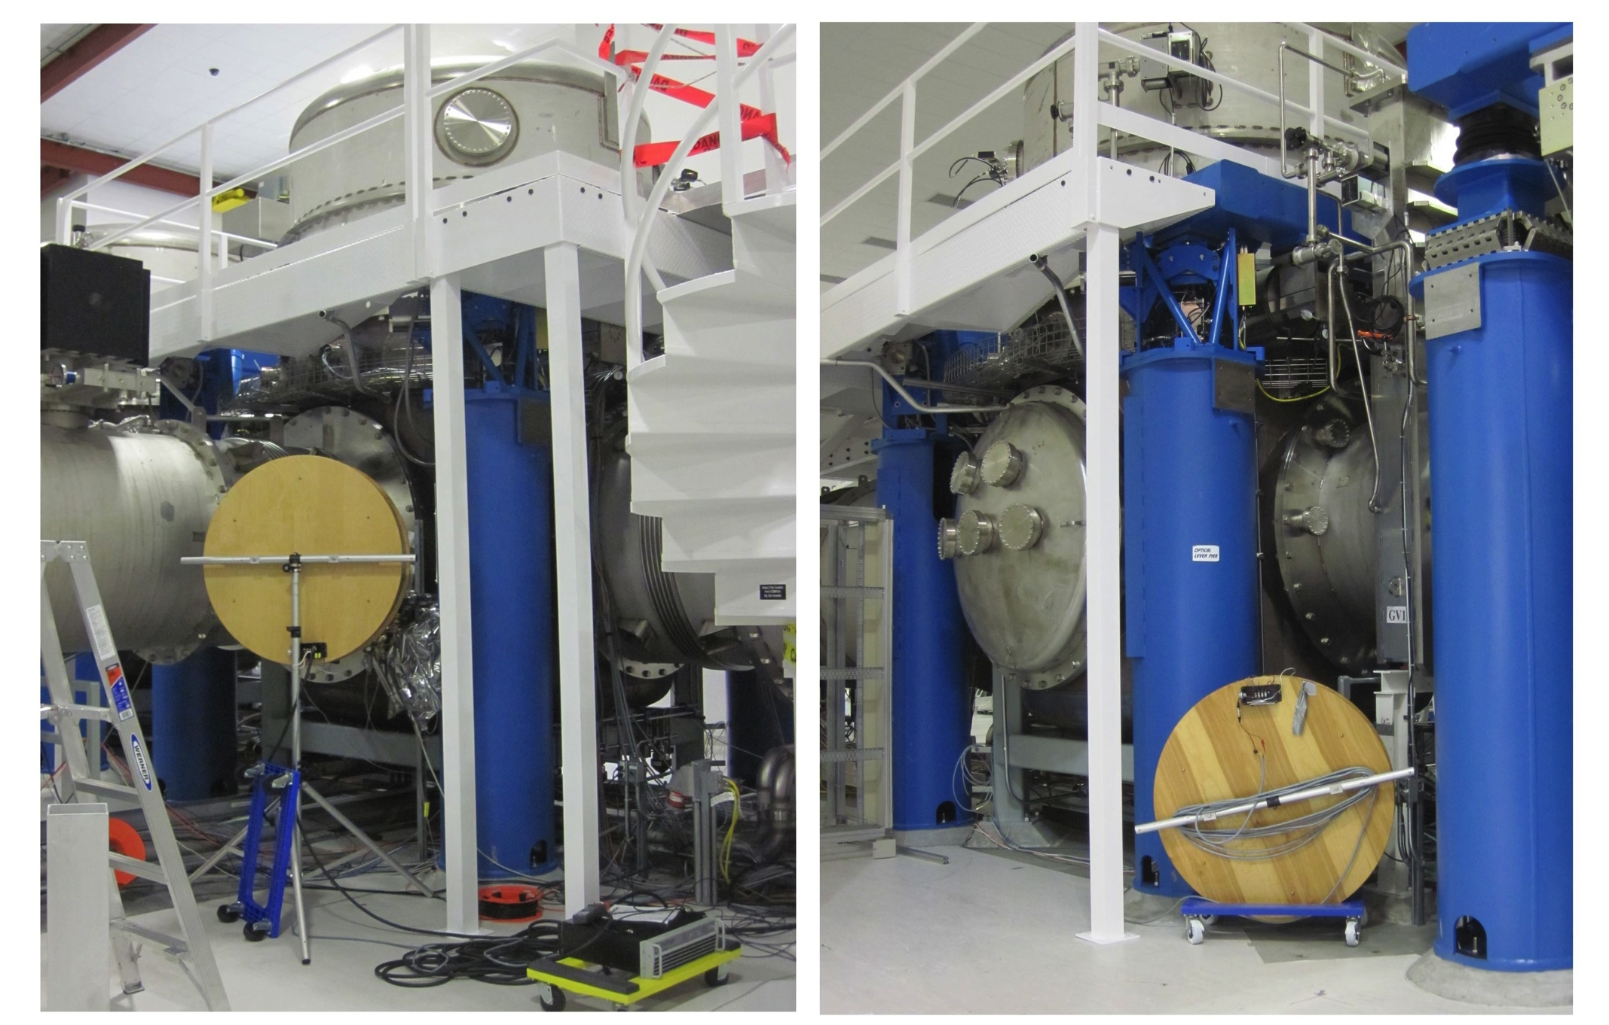
Excess magnetic coupling in OAT
Injection coils at ITMY in pseudo-Helmholtz configuration

Slide 38
First results
Magnetic
Assumes beam
centering to 1 mm

Slide 39
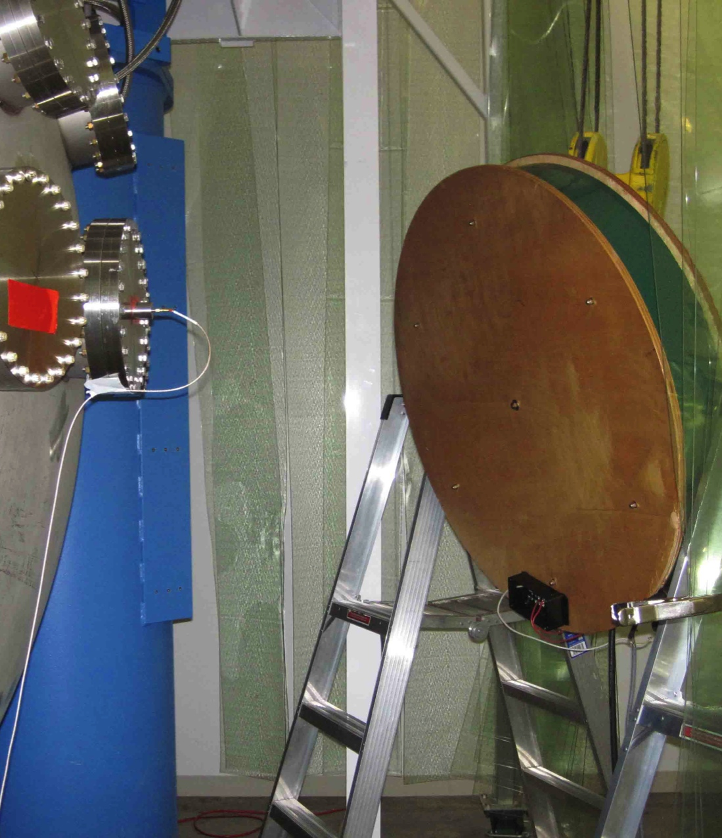
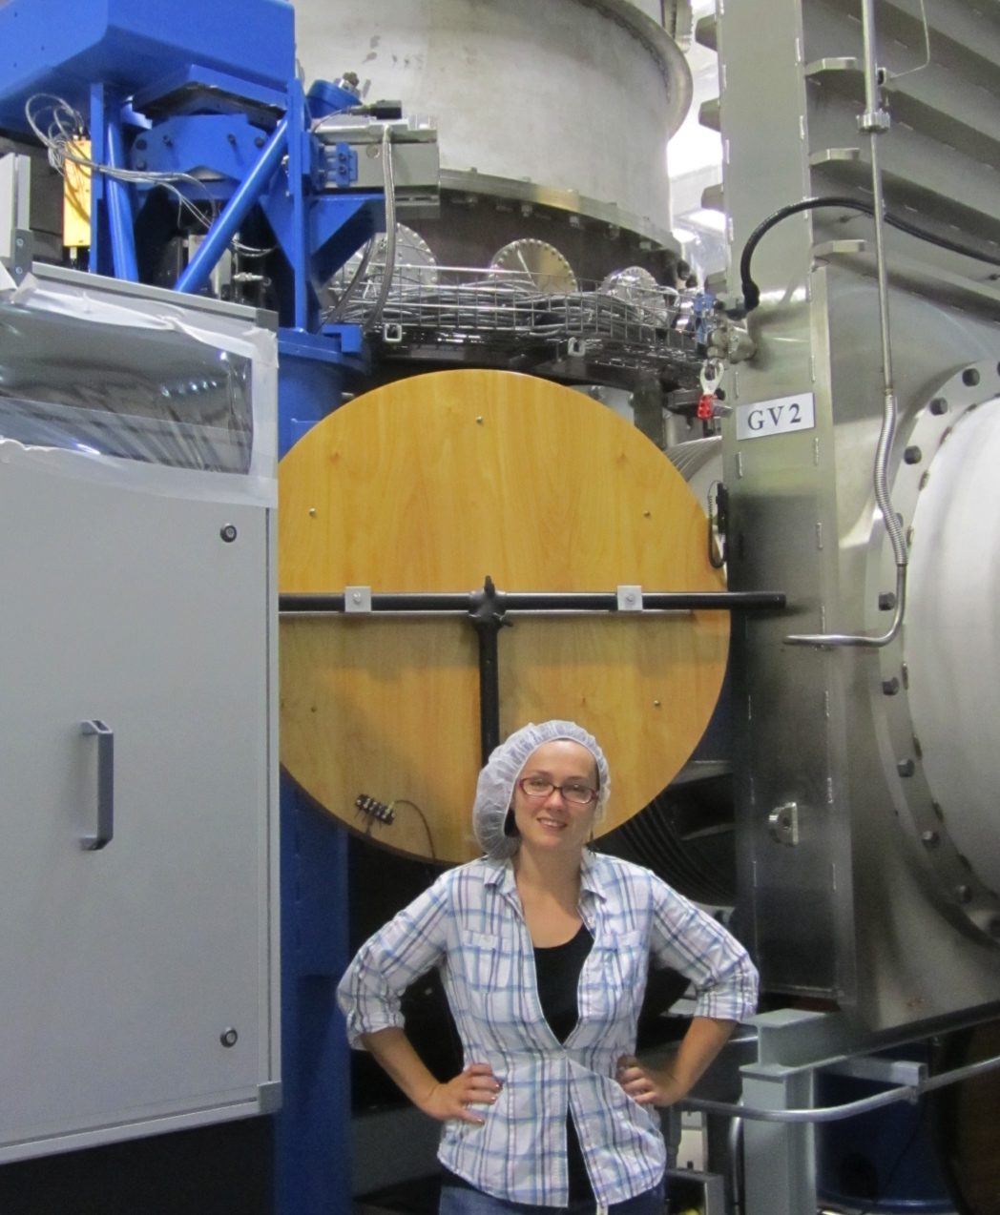
Repeated at ETMY and LLO ITMX

Slide 40
New LLO results with all LHO results
Angular results are for coupling with no SUS actuation

Slide 41
This morning’s displacement measurement results from Anamaria
This includes coupling to cables etc.
We need to separate out the couplings

Slide 42
Summary of magnetic coupling status
The scariest estimate of length noise from magnetic coupling to suspensions is an extrapolation from low-f injections made during OAT. The DRMI is more sensitive and recent LLO results suggests that, in band, coupling is close to the aLIGO noise floor.
Estimates of angular noise from magnetic coupling to suspensions are similar, at about the aLIGO noise floor (and thus 10x spec) except for an anomalous yaw measurement.
Estimates of length coupling from measured moments of the suspension parts are also close to the noise floor.
The worst estimated coupling is to the UIM steel blade springs, not the 304 steel on the UIM and PUMre (2e-19/sqrt(Hz) @ 10 Hz, about 10 x spec. and right at the aLIGO noise floor at 10 Hz)
We need to separate suspension coupling from electronics coupling for length noise measurements.

Slide 43
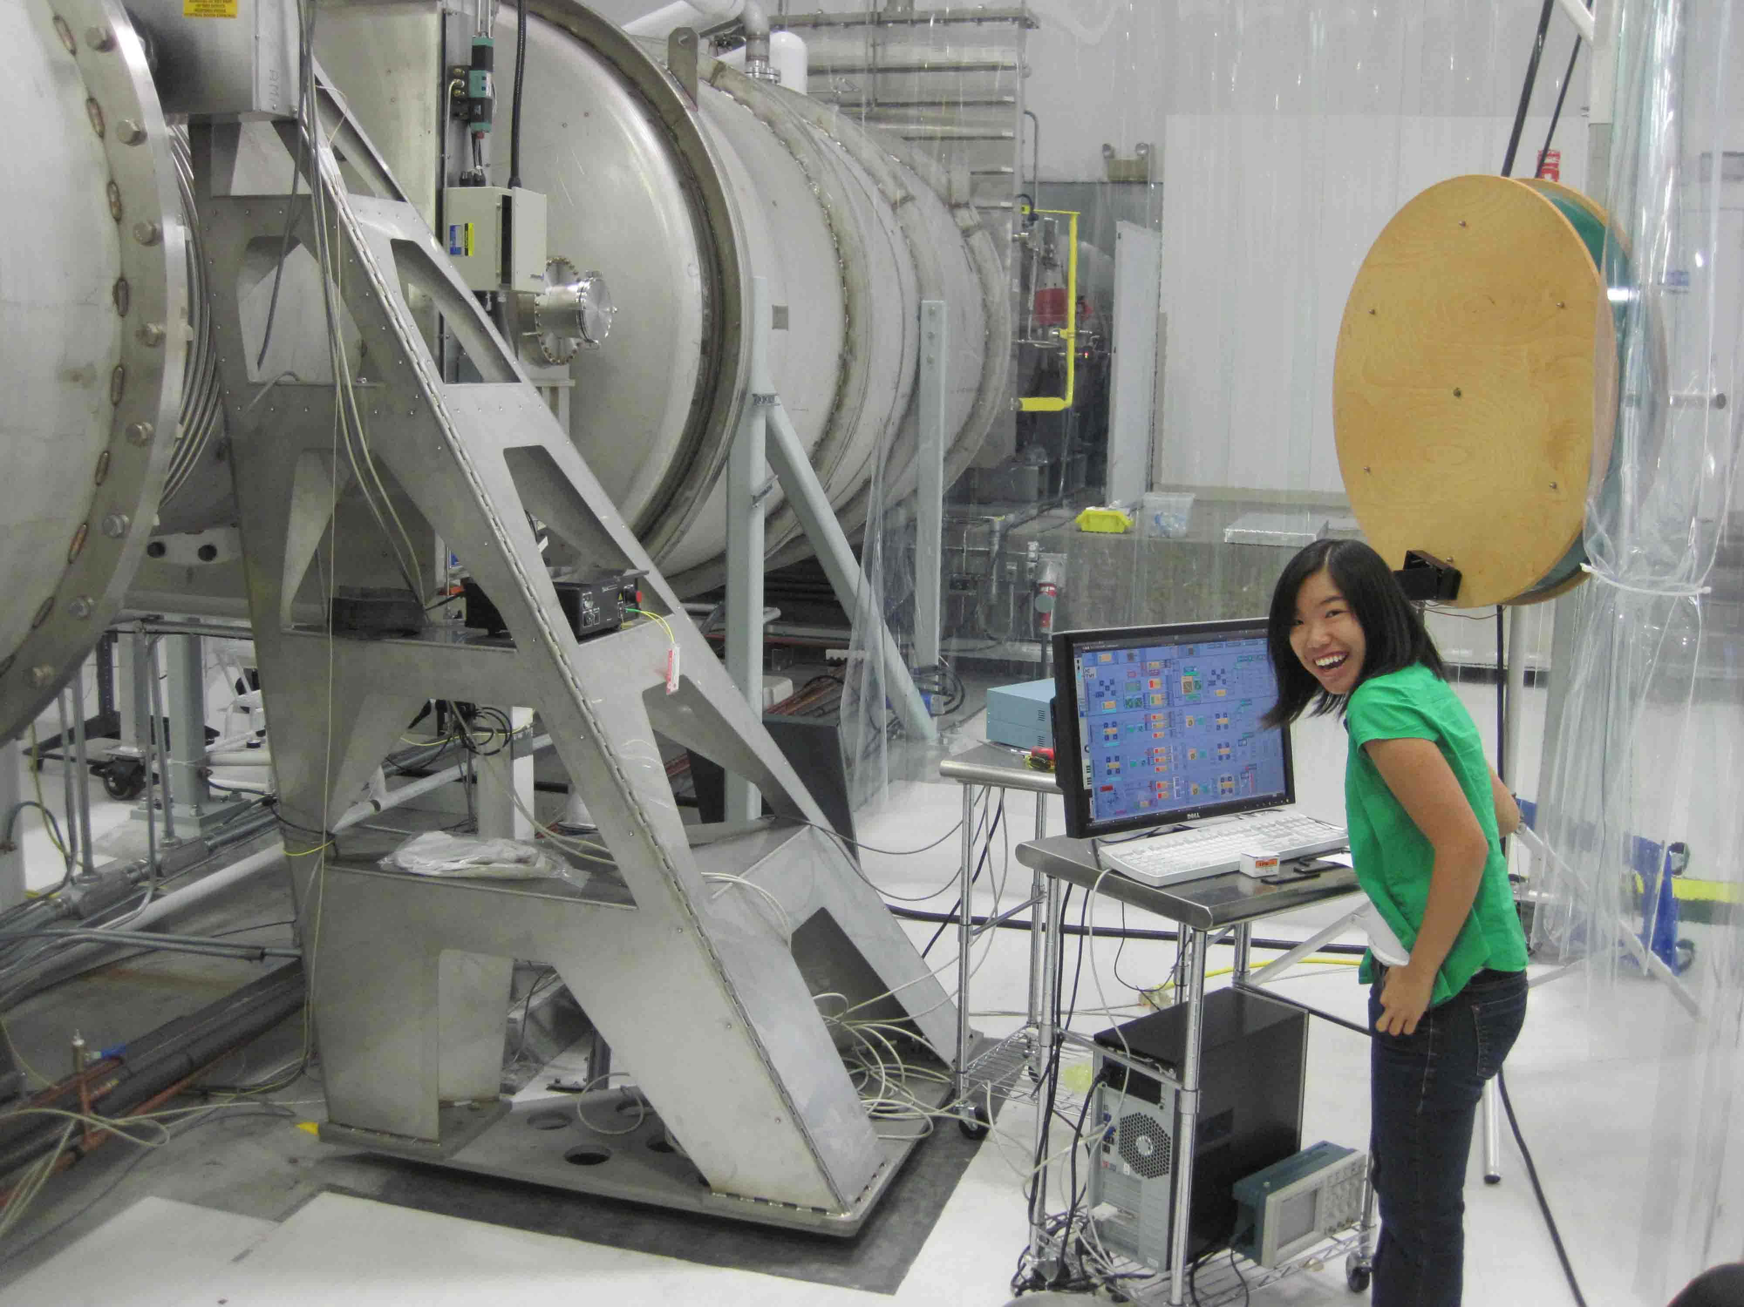
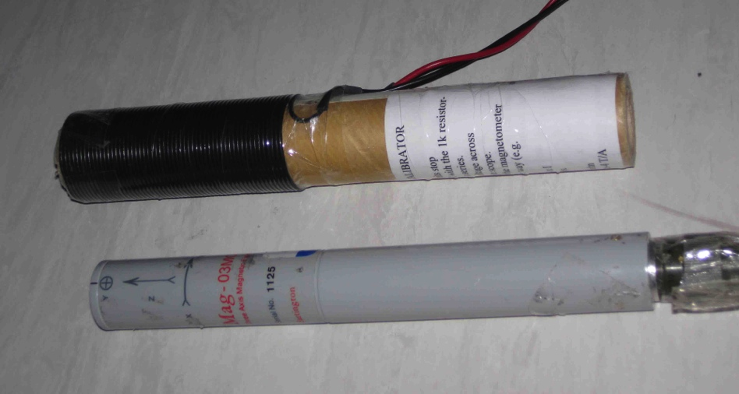
Checks
1) Coupling to optical lever? Much higher fields at optical lever and its electronics produced smaller peak in optical lever channel. Signal went away when laser blocked.
2) Linear coupling? Increased field by 2.98 increased motion by 3.00 (would go as B² for induced moments).
3) Calibration? In-situ magnetometer calibration

Slide 44
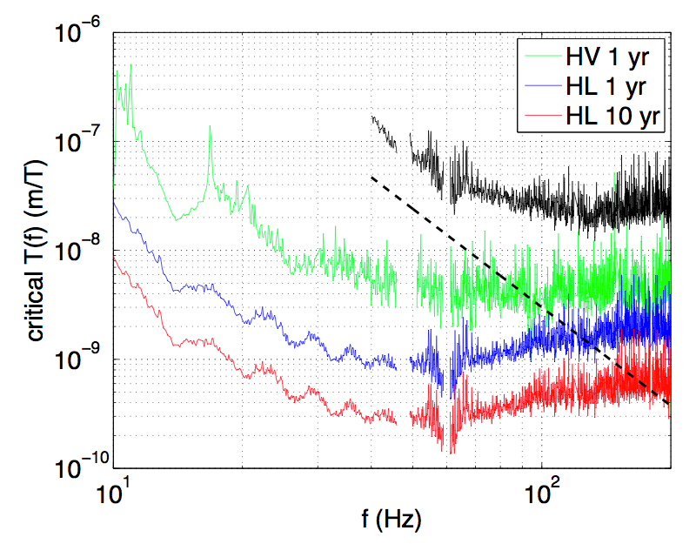
Critical coupling
iLIGO coupling
UIM blade spring
PUM magnets

