Slide 2
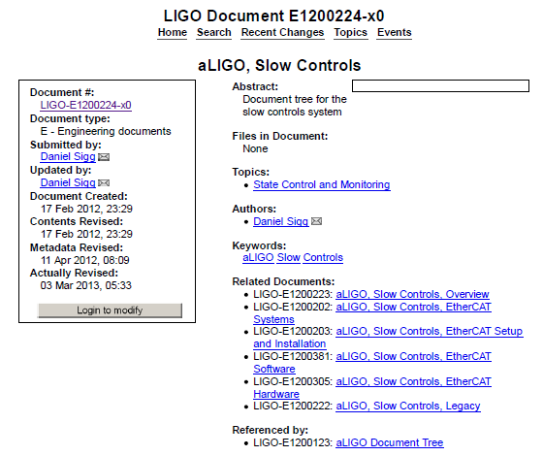
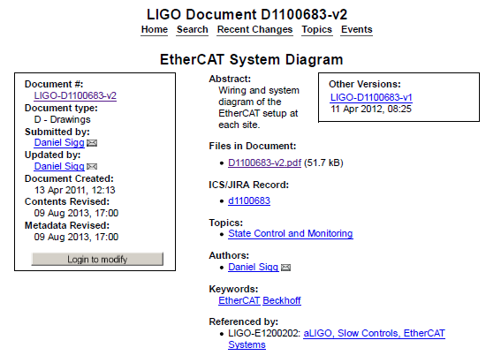
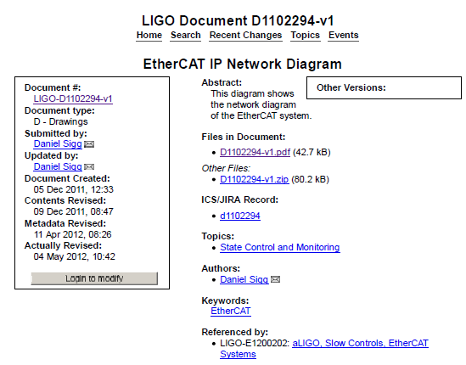
Experience & Status of the LIGO Slow Controls System(s)
E1200224, aLIGO, Slow Controls A few specific links that may prove generally useful: D1100683, Block Diagram D1102294, Network Diagram G1200005, EtherCAT for advanced LIGO G1100098, EtherCAT (Beckhoff) for advanced LIGO E1200225, Coding Standard for TwinCAT Slow Controls Software F1200003, Template for TwinCAT Library Documentation
Working Documentation is in the aLIGO WIKI

Slide 3
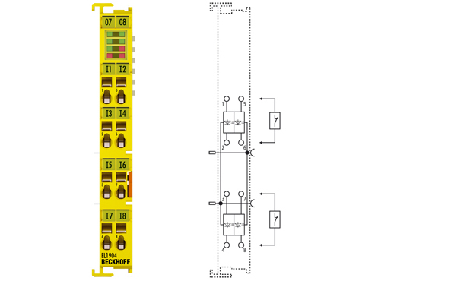
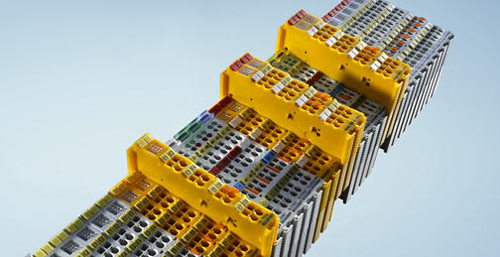
TwinSafe
Allows Safety interlock to be used without having to install separate chassis though you can

Slide 4
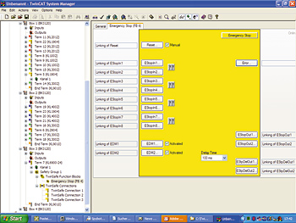
EASY Setup with Pre-Existing Function Blocks
Select Function block like
E-Stop
Allows you to select what inputs you are monitoring from any of the Safety input cards either in the corner station or end station. Allows the you to change the state of any of the safety outputs either in the corner or end station. Monitors the network connections to safety inputs and disables outputs if lost. Very flexible and allows variables to communicate with MEDM screens.

Slide 5
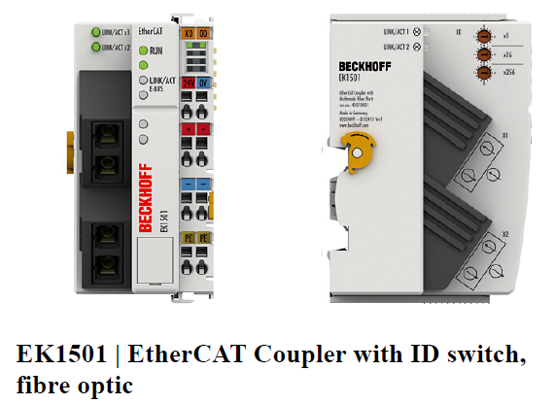
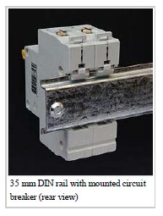
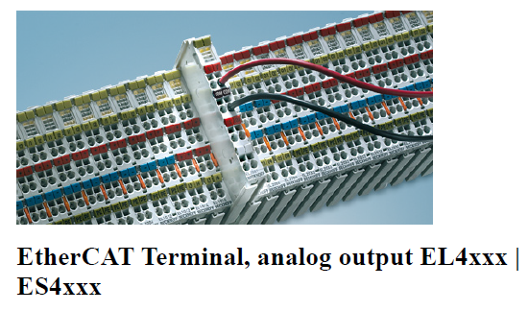
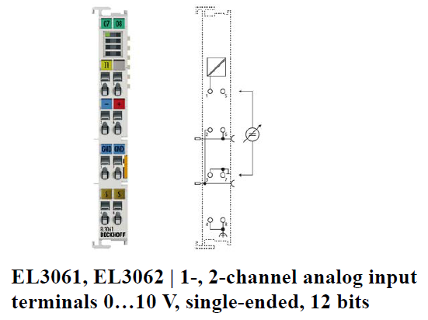
DIN Rail and Packaging System

Slide 6
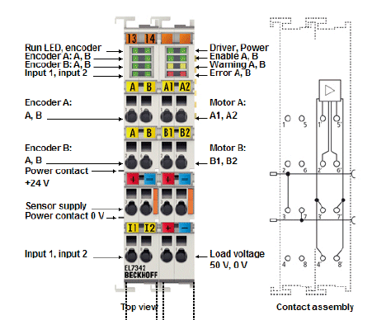
EL7342 Parameter Table
Index | Name | Flags | Value
8000:0 | ENC Settings Ch.1 | RW | > 15 <
8000:08 | Disable filter | RW | FALSE
8000:0A | Enable micro increments | RW | FALSE
8000:0E | Reversion of rotation | RW | FALSE
8010:0 | ENC Settings Ch.2 | RW | > 15 <
8020:0 | DCM Motor Settings Ch.1 | RW | > 15 <
8020:01 | Maximal current | RW | 0x0096 (150)
8020:02 | Nominal current | RW | 0x0096 (150)
8020:03 | Nominal voltage | RW | 0x5DC0 (24000)
8020:04 | Motor coil resistance | RW | 0x1982 (6530)
8020:05 | Reduced current (positive) | RW | 0x0000 (0)
8020:06 | Reduced current (negative) | RW | 0x0000 (0)
8020:07 | Encoder increments (4-fold) | RW | 0x7D00 (32000)
8020:08 | Maximal motor velocity | RW | 0x0E10 (3600)
8020:0C | Time for switch-off at overload | RW | 0x00C8 (200)
8020:0D | Time for current lowering at overload | RW | 0x07D0 (2000)
8020:0E | Torque auto-reduction threshold (positive) | RW | 0x00 (0)
8020:0F | Torque auto-reduction threshold (negative) | RW | 0x00 (0)
8021:0 | DCM Controller Settings Ch.1 | RW | > 18 <
8021:01 | Kp factor (curr.) | RW | 0x00C8 (200)
8021:02 | Ki factor (curr.) | RW | 0x0002 (2)
8021:03 | Inner window (curr.) | RW | 0x00 (0)
8021:05 | Outer window (curr.) | RW | 0x00 (0)
8021:06 | Filter cut off frequency (curr.) | RW | 0x0064 (100)
8021:11 | Voltage adjustment enable | RW | FALSE
8021:12 | Current adjustment enable | RW | FALSE
8022:0 | DCM Features Ch.1 | RW | > 62 <
8022:01 | Operation mode | RW | Position controller (3)
8022:09 | Invert motor polarity | RW | FALSE
8022:0A | Torque error enable | RW | FALSE
8022:0B | Torque auto reduce | RW | FALSE
8022:11 | Select info data 1 | RW | Motor coil voltage (1)
8022:19 | Select info data 2 | RW | Motor coil current (2)

Slide 7
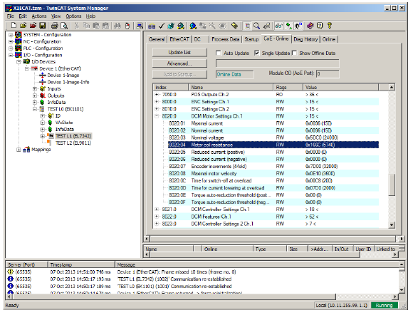
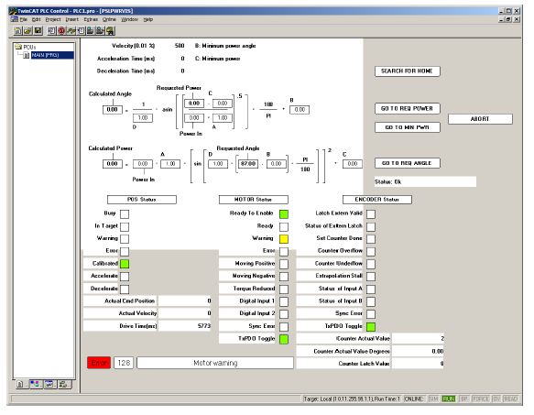

Slide 8
EPICS to Beckhoff Communication
Hardware Bus (fieldbus) = EtherCAT
Communications & Control Software = TwinCAT
Export Modules: OPC, ADS
Old Design
EPICS
OPC
TwinCAT
Beckhoff
BESSY_IOC
database
New Design
OPC
EPICS
ADS
TwinCAT
Beckhoff
TC_IOC
read (e.g., 44 records)
1000 records at a time in 1.1 msec
write (e.g., 1 record)
T1300690-v1, TwinCAT EPICS IOC Documentation

Slide 9
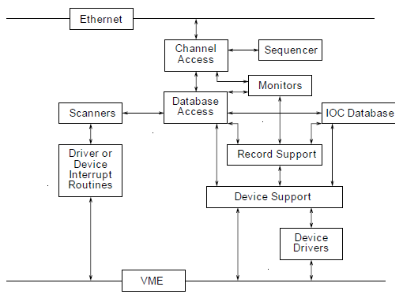
EPICS IOC Software Components
rt front-end
we use the real time linux system
created by Alex Ivanov

Slide 11
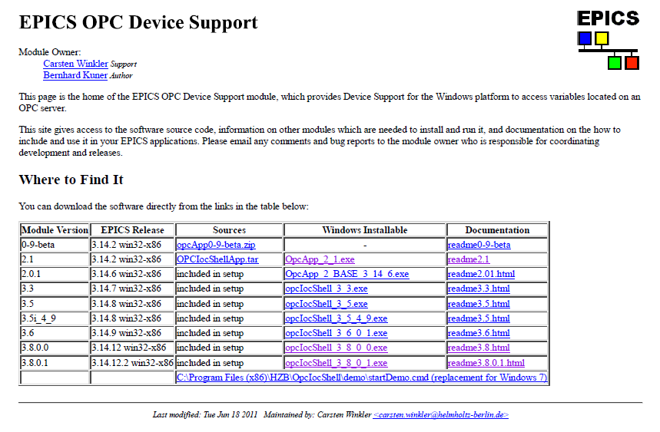

Slide 12
TS6000 | TwinCAT ADS Communication Library
Overview
"TwinCAT ADS Communication Library" is a collection of all ADS components and is delivered with default TwinCAT installation. It enables to develop own application (e.g. visualization, scientific automation), which can communicate with TwinCAT devices (e.g. PLC, NC or IO-devices). Alternatively we provide the free of charge TC1000 | TC3 ADS Setup with all libraries and the ADS router, if you only need the ADS functionalties.
Components of "TwinCAT ADS Communication Library"
After installation these components will be available in folder "..\TwinCAT\AdsApi".
The ADS libraries are provided for following operating systems and technologies:
Windows (32-Bit/64-Bit)
TcAdsDll C/C++ Windows XP, Vista, 7, 8 ADS components (DLL / Header / Library) to create C/C++ applications ..\TwinCAT\AdsApi\TcAdsDll
http://infosys.beckhoff.com/english.php?content=../content/1033/tcadscomlib/html/tcadscomlib_intro.htm&id=

Slide 13
IEC-1131 - The First Universal Process Control Language
INTRODUCTION
IEC-1131 is the first international standard for process control software. By using IEC-1131, a programmer can develop a control algorithm for a particular brand of controller, and import that same program to another brand with minimum modifications, primarily to process input/output
subsystems.
DESCRIPTION OF THE FUNDAMENTAL CONCEPTS OF IEC-1131
The basic principle of IEC-1131 is that a programmer can develop a control algorithm (referred to as a "Project") using any combination of five control languages; Instruction List, Structured Text, Ladder Diagram, Function Block Diagram, and Sequential Function Chart.
EtherCAT - Ethernet for Control Automation Technology - is an open high performance Ethernet-based fieldbus system. The development goal of EtherCAT was to apply Ethernet to automation applications which require short data update times (also called cycle times) with low communication jitter (for synchronization purposes) and low hardware costs.

Slide 14
Test system
Hardware:
Processor: Intel Xeon CPU X5650
Cores: 6 HT
Threads: 12
Speed: 2.67GHz
Mmeory: 12 GB; 2.99GB usable
Software:
OS: Windows 7
Version: 32-bit operating system
TwinCAT: 2.11
Speed tests
TwinCAT (test performed on 6/21/2013) This test was performed to see how much data we can read from TwinCAT in a single request before overloading the system.
1 channel
1.076ms to read data
TwinCAT System Real Time Usage: was not monitored
1000 channels (~10kB)
1.084ms to read data out in one request

Slide 15
Speed tests continued
TwinCAT (test performed on 6/21/2013) This test was performed to see how much data we can read from TwinCAT in one request before overloading the system.
1 channel
1.076ms to read data
TwinCAT System Real Time Usage: was not monitored
1000 channels (~10kB)
1.084ms to read data out in one request
TwinCAT System Real Time Usage: no noticeable change
3,200 channels (~30kB)
1.087ms to read data out in one request
TwinCAT System Real Time Usage: +1-2%
7,500 channels (~70kB)
1.099ms to read data out in one request
TwinCAT System Real Time Usage: +3-4%
15,000 channels (~150kB)
1.121ms to read data out in one request
TwinCAT System Real Time Usage: +4-5%

Slide 16
Speed Tests continued
TwinCAT (test performed on 6/20/2013) This test was performed to see how generating individual requests for each channel can overload the TwinCAT system. In this example we specified the memory location for each channel, instead of requesting one large memory region as above. This method proved to be too taxing on the TwinCAT system, so we do not recommend using this mode. Compare to the above performance figures.
1000 channels
1.306ms to get data for all channels
TwinCAT System Real Time Usage: +20%
4000 channels
1.483ms to get data for all channels
TwinCAT System Real Time Usage: +60-80%
EPICS record transfer (test performed on 7/30/2013)
It takes ~1.33s to process 1,000,000 records
Thus in a 10ms cycle it can process ~7500 records

