Slide 1

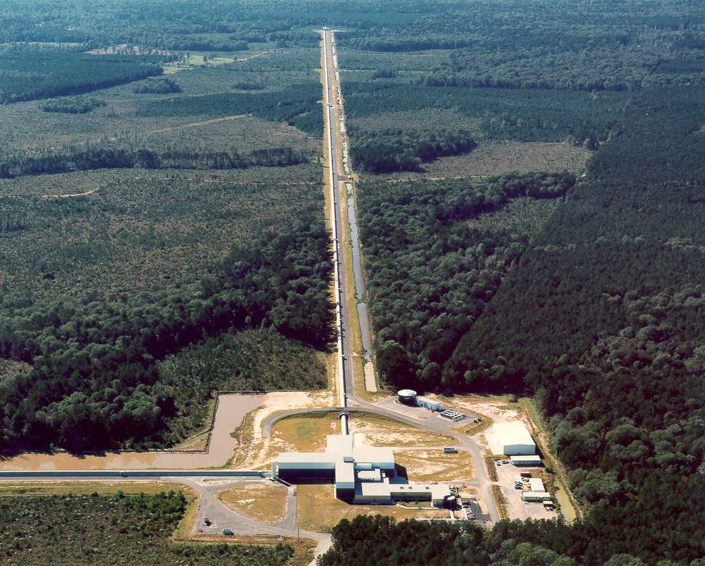
The Status of Advanced LIGO:
Light at the end of the Tunnels
Hanford, WA
Livingston, LA
Jeffrey S. Kissel,
for the LIGO Scientific Collaboration
April APS Meeting, Savannah, GA
April 6th 2014
Notes:
Clean up make pretty

Slide 2
Outline
Introduction
Advanced LIGO Detectors
Installation and Commissioning Progress
The Future and Conclusions

Slide 3
Outline
Introduction
Advanced LIGO Detectors
Installation and Commissioning Progress
The Future and Conclusions

Slide 4
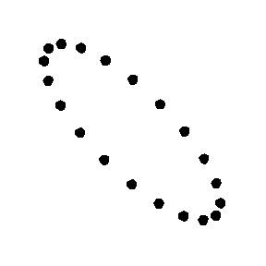
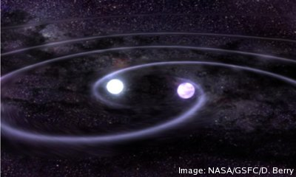
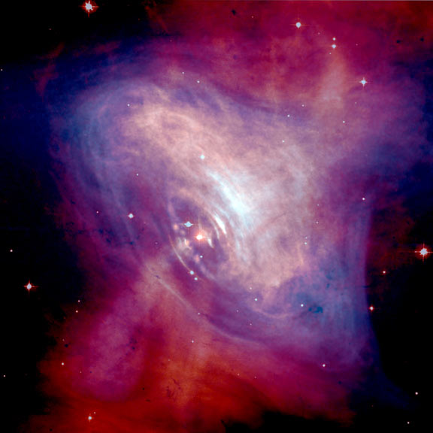
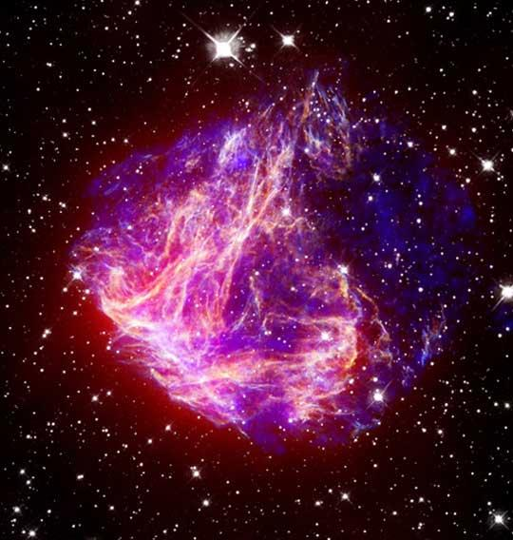
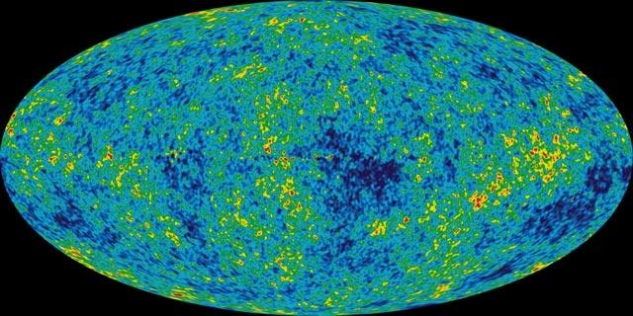
Introduction
Gravitational Waves and Astrophysical Sources
General relativity predicts the existence of gravitational waves
Produce quadrupolar strain on space-time
Astrophysical sources for ground-based interferometers:
Short Duration
Long Duration
Compact Binary Coalescences
Non-Spherical, Rotating Compact Objects
Modeled
J Abadie et al 2010 Class. Quantum Grav. 27 173001
L. Bildsten 1998 ApJ 501 L89
Bursts from Supernova and other Unmodeled Sources
Stochastic Background
Unmodeled
C. D. Ott et al 2004 ApJ 600 834
B. Allen 1996 arXiv:gr- qc/9604033v3
Notes:
Get rid of extra numbers on variables
Remove complete sentences
Astrophysical rate, R = [1 100 1000 4000]
[low realistic optimistic maximum]
Number of galaxies, Ng = 4pi/3 D^3 (0.0116)
Detection Rate Ndot = R * Ng

Slide 5
Introduction
Basic Observation of Gravitational Waves
Michelson interferometer is ideal for detecting strain
Differential changes in arm length measure strain
Suspended Mirrors act as inertial particles or “test masses”
Wave Phase
Signal
Amplitude
BUT – with Michelson arms are 1 km long,
Notes:
10^-18 is smaller than nuclear scale
1 cm 0.2cm

Slide 6
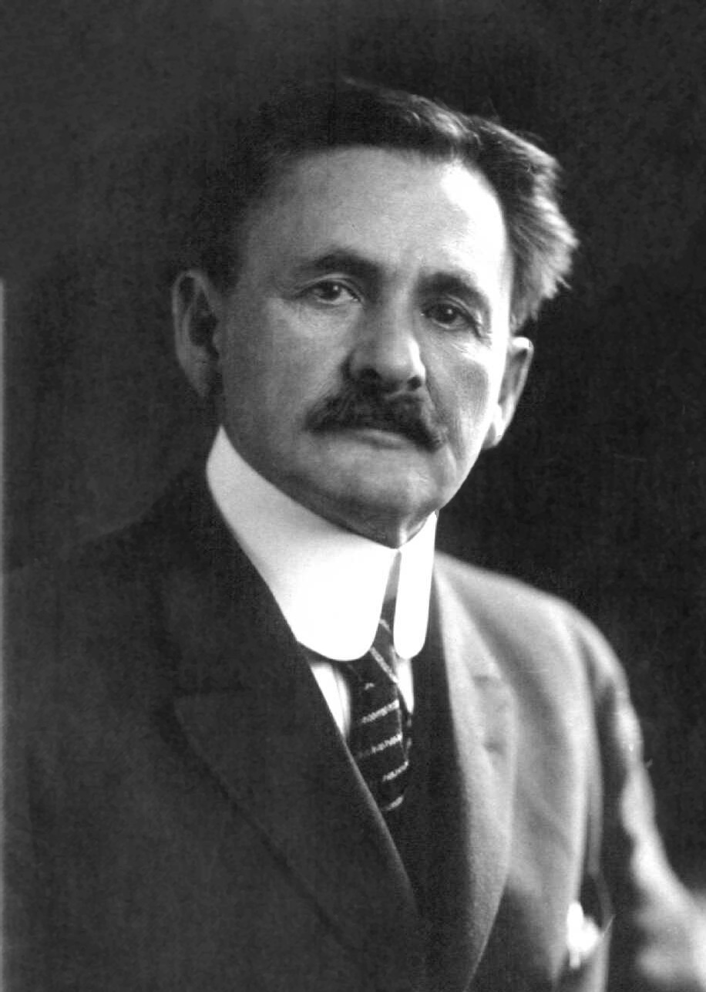
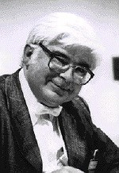
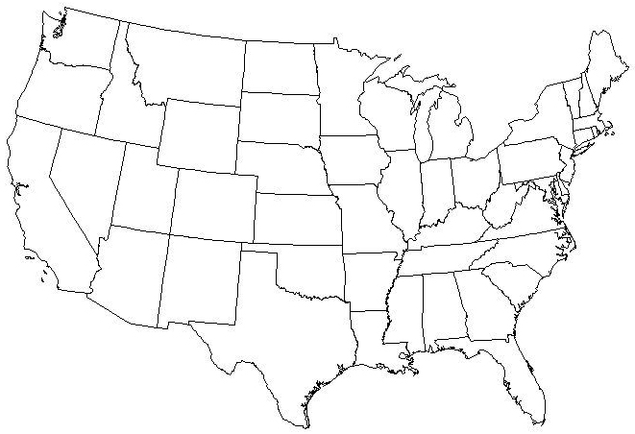
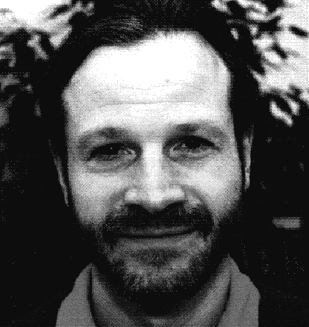

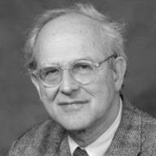
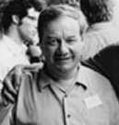
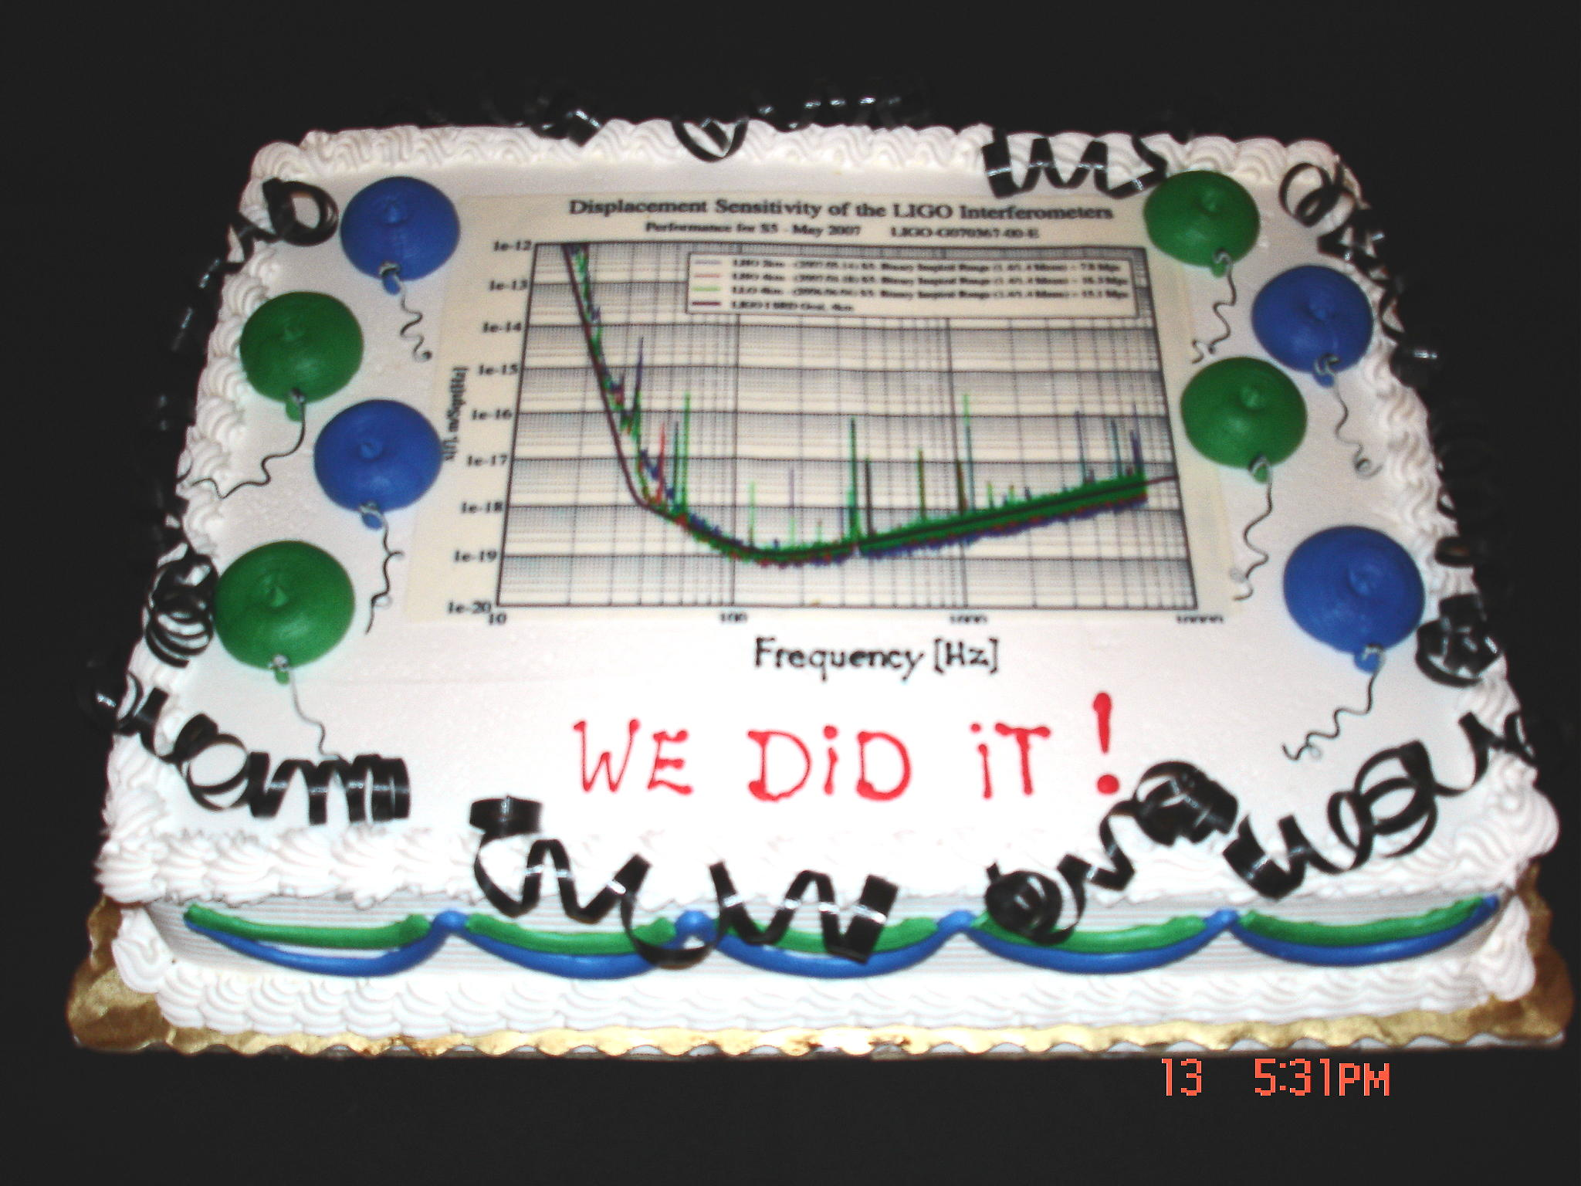


Introduction
Improving the Michelson Interferometer
Michelson-like interferometer,
signal response is proportional to the input power and the length of the arms,
Adhikari, R. 2013 arXiv:1305.5188
Notes:
Say the names of the people in the picture
Make CAKE bigger!
Forward : 1 [m] 1 [mW]
Garching : 30 [m] 0.5 [W]
S5 : 4 [km] 250 [W]
aLIGO : 4 [km] 5 [kW]

Slide 7
Outline
Introduction
Advanced LIGO Detectors
Installation and Commissioning Progress
The Future and Conclusions

Slide 8
The Advanced LIGO Detectors
Predicted Sensitivity
Major upgrade to all detectors, all internal components replaced
Two of which are being installed and commissioned now
Distance out to which we can see Binary Neutron Star Coalescence:
~180 Mpc
Advanced LIGO Detection Rate:
Better
Seismic
Isolation
Reduced
Brownian
Noise
Increased
Laser Power
and Signal Recycling
Abadie, J., et al. CQG 27.17 (2010): 173001.
Notes:
Get rid of numbers on variable
Get rid of timelines
Date ONE Best data taken on the two observatories
Date TWO Advanced LIGO
Go slow on rate
Astrophysical rate, R = [1 100 1000 4000]
[low realistic optimistic maximum]
Number of galaxies, Ng = 4pi/3 D^3 (0.0116)
Detection Rate Ndot = R * Ng
NS - NS = [0.4 40 400 1000]
BH - BH = [0.2 10 300 -- ]

Slide 9


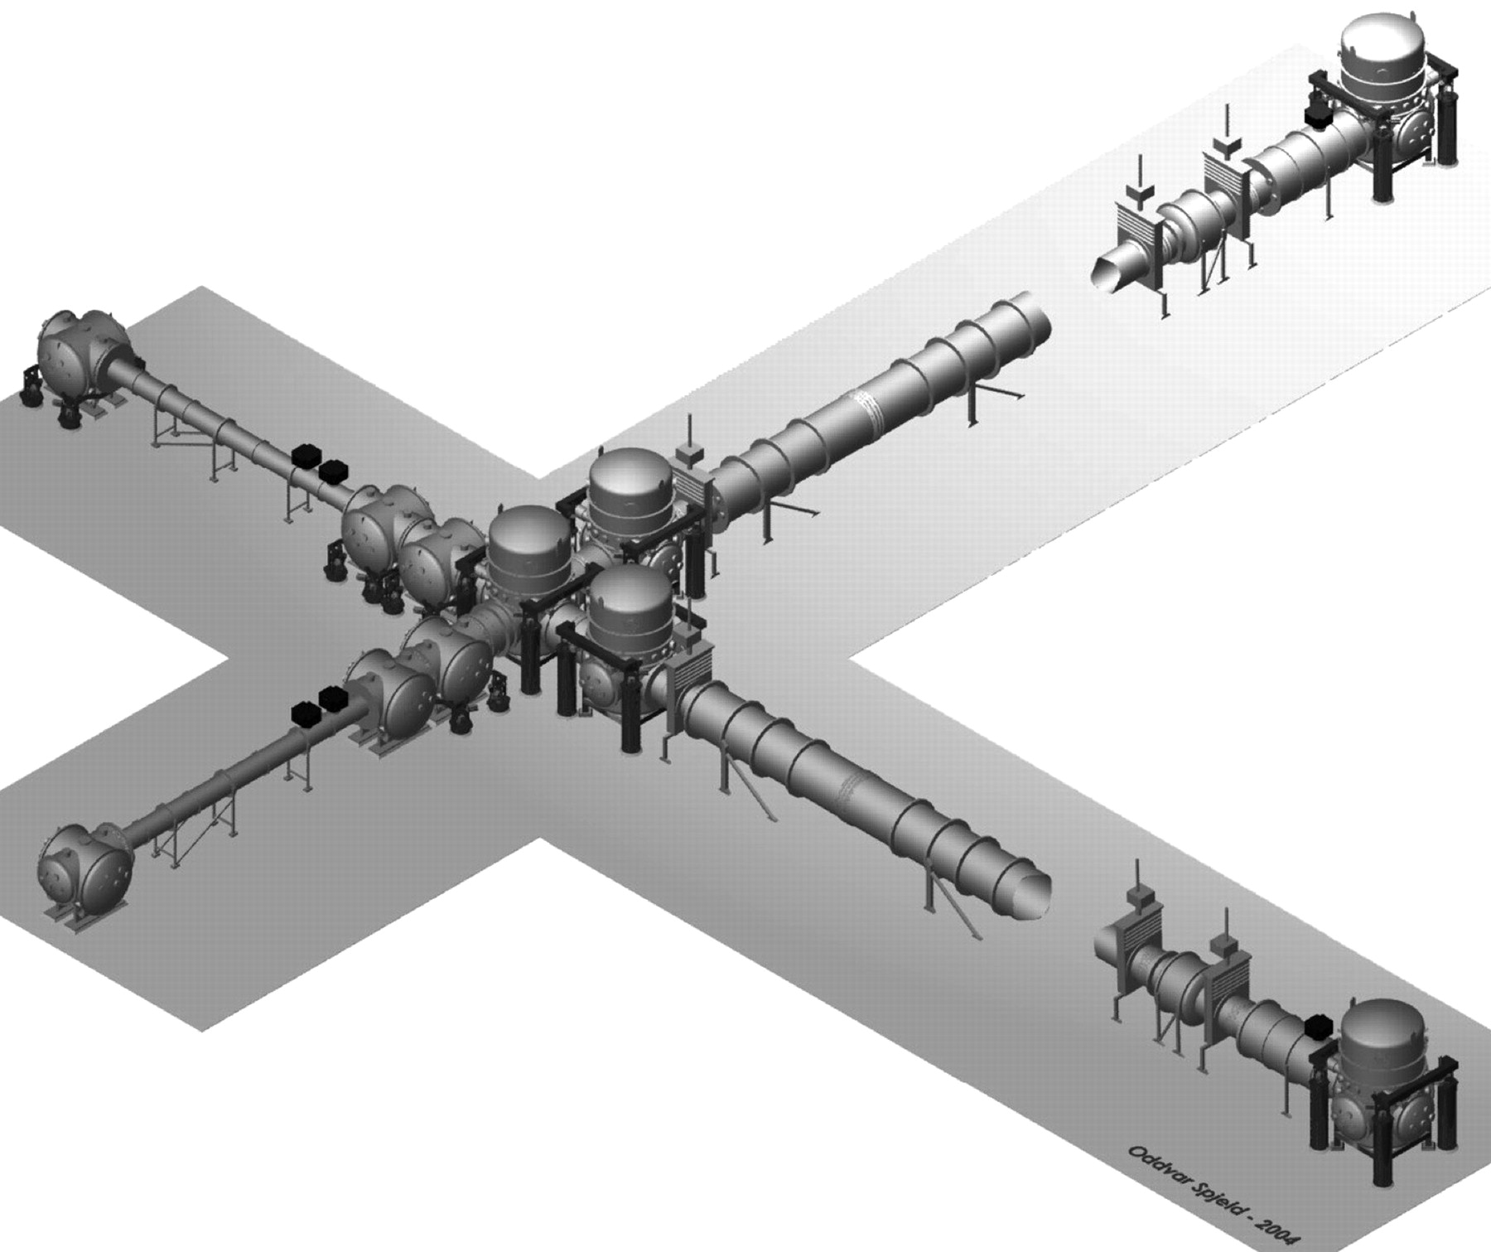
The Advanced LIGO Detectors
Optical Layout
Harry, G. M., et al. CQG 27.8 (2010): 084006.
P. Fritschel, et. al (2010) https://dcc.ligo.org/LIGO-T010075/public
LIGO Vacuum System
Notes:
“The detector is actually significantly more complicated that what I’ve shown”
Take out compensation plates

Slide 10
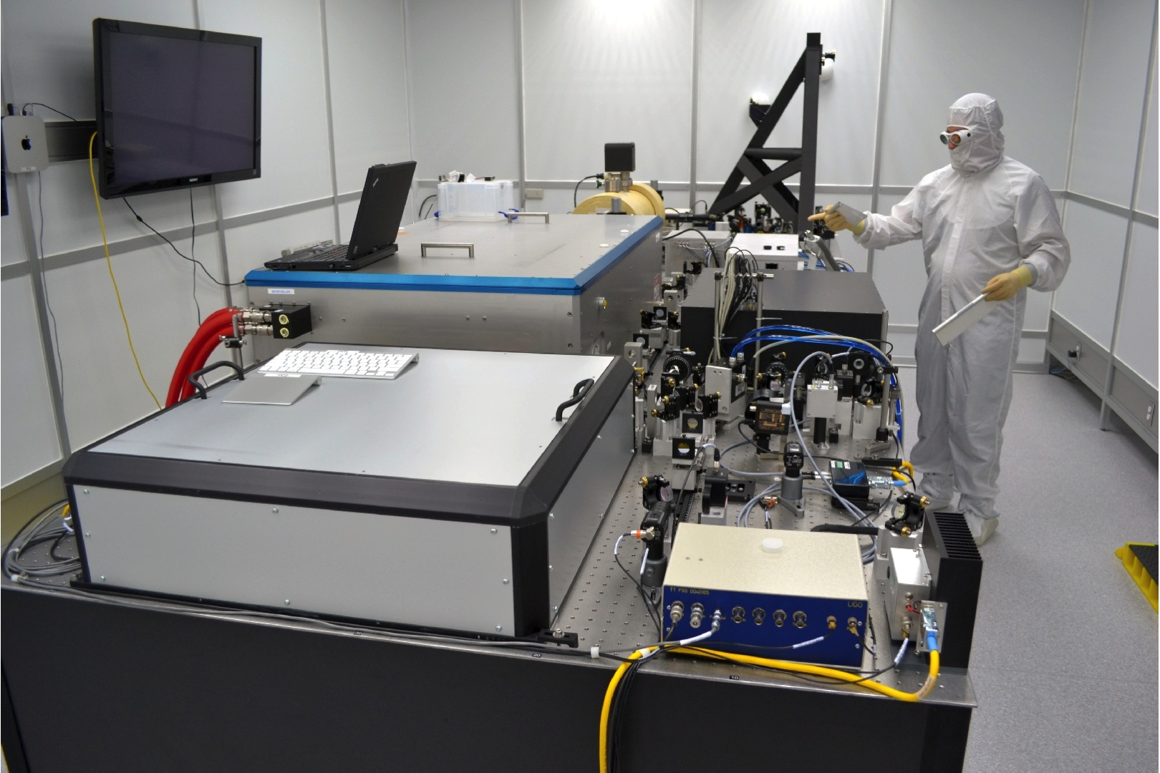
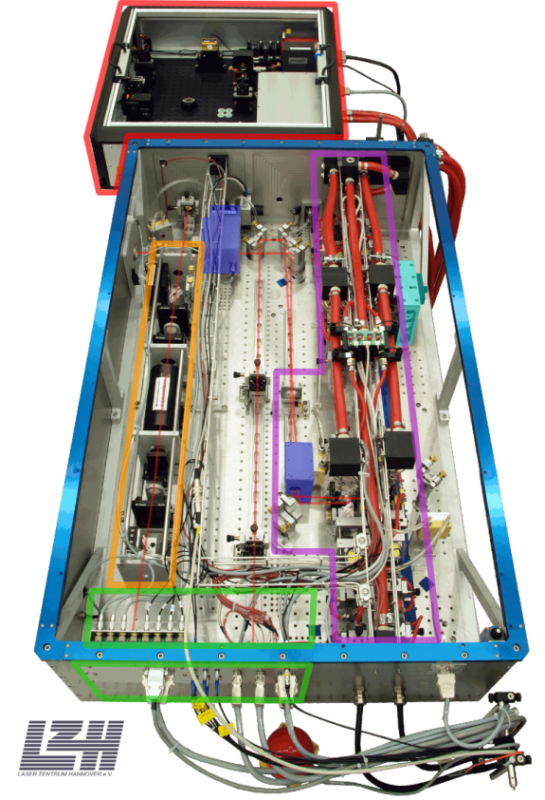
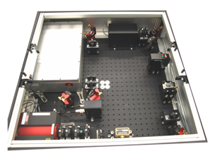
The Advanced LIGO Detectors
High-power Pre-Stabilized Laser
Multi-stage, low-noise Nd:YaG, λ=1[um] laser
Power increased by a factor of 5
Power and frequency noise are better
Max Power | 180 W
Power Noise | 10⁻⁷ W/Hz^{-1/2}
Frequency Noise | 0.1 Hz/Hz^{-1/2}
(*Noise at 10 Hz)
2W
35W
180W
165W to Interferometer
Willke, B., et al. CQG 25.11 (2008): 114040.
Notes:
Take out premode cleaner
Take out the NPRO pictures
3 Tera Hz stabilized to 0.1
Get rid of iLIGO stuff

Slide 11
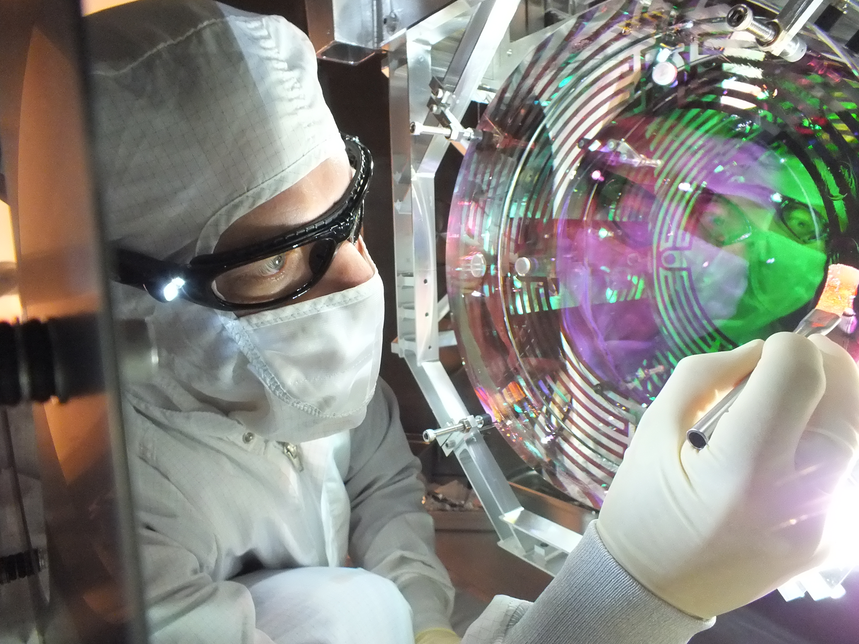
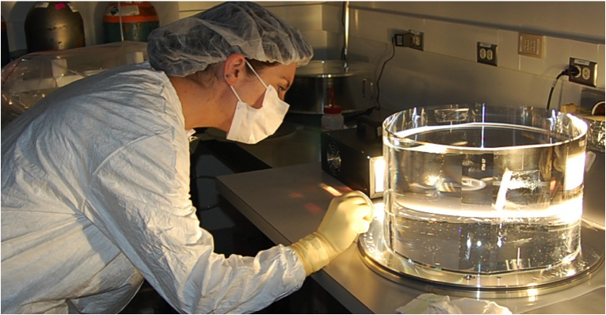
The Advanced LIGO Detectors
The Test Masses
Heavy Mirrors → Insensitive to photon pressure from high power
Brownian noise of test masses dominate strain sensitivity in the most sensitive region (~100 [Hz])
Better Mirrors → Lower Mechanical Loss
  Biggest possible fused silica
Bigger Mirrors → Increase Spot Size
  Average over more surface area
Diameter | 34 cm
Thickness | 20 cm
Mass | 40 kg
1/e Beam Size | 6.2 cm
Harry, G. M., et al. CQG 27.8 (2010): 084006.
Notes:
Brownian Noise not Thermal Noise
Biggest, highest quality fused silica
Photon Radiation
Get rid of iLIGO stuff

Slide 12
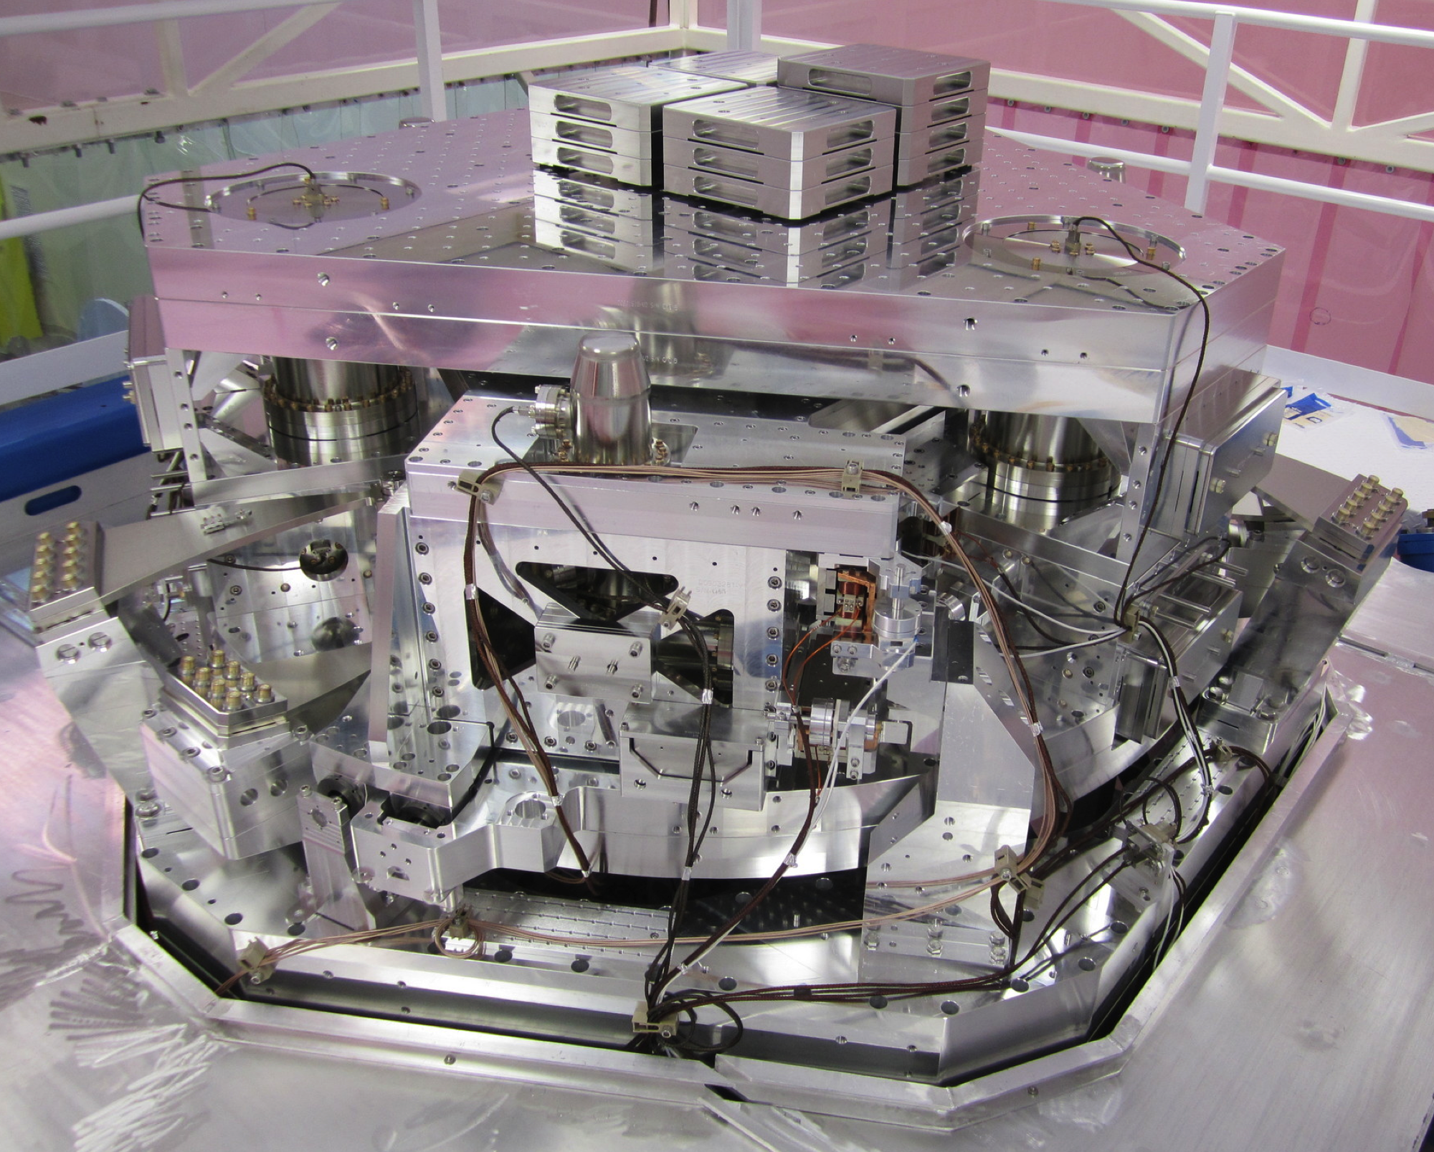
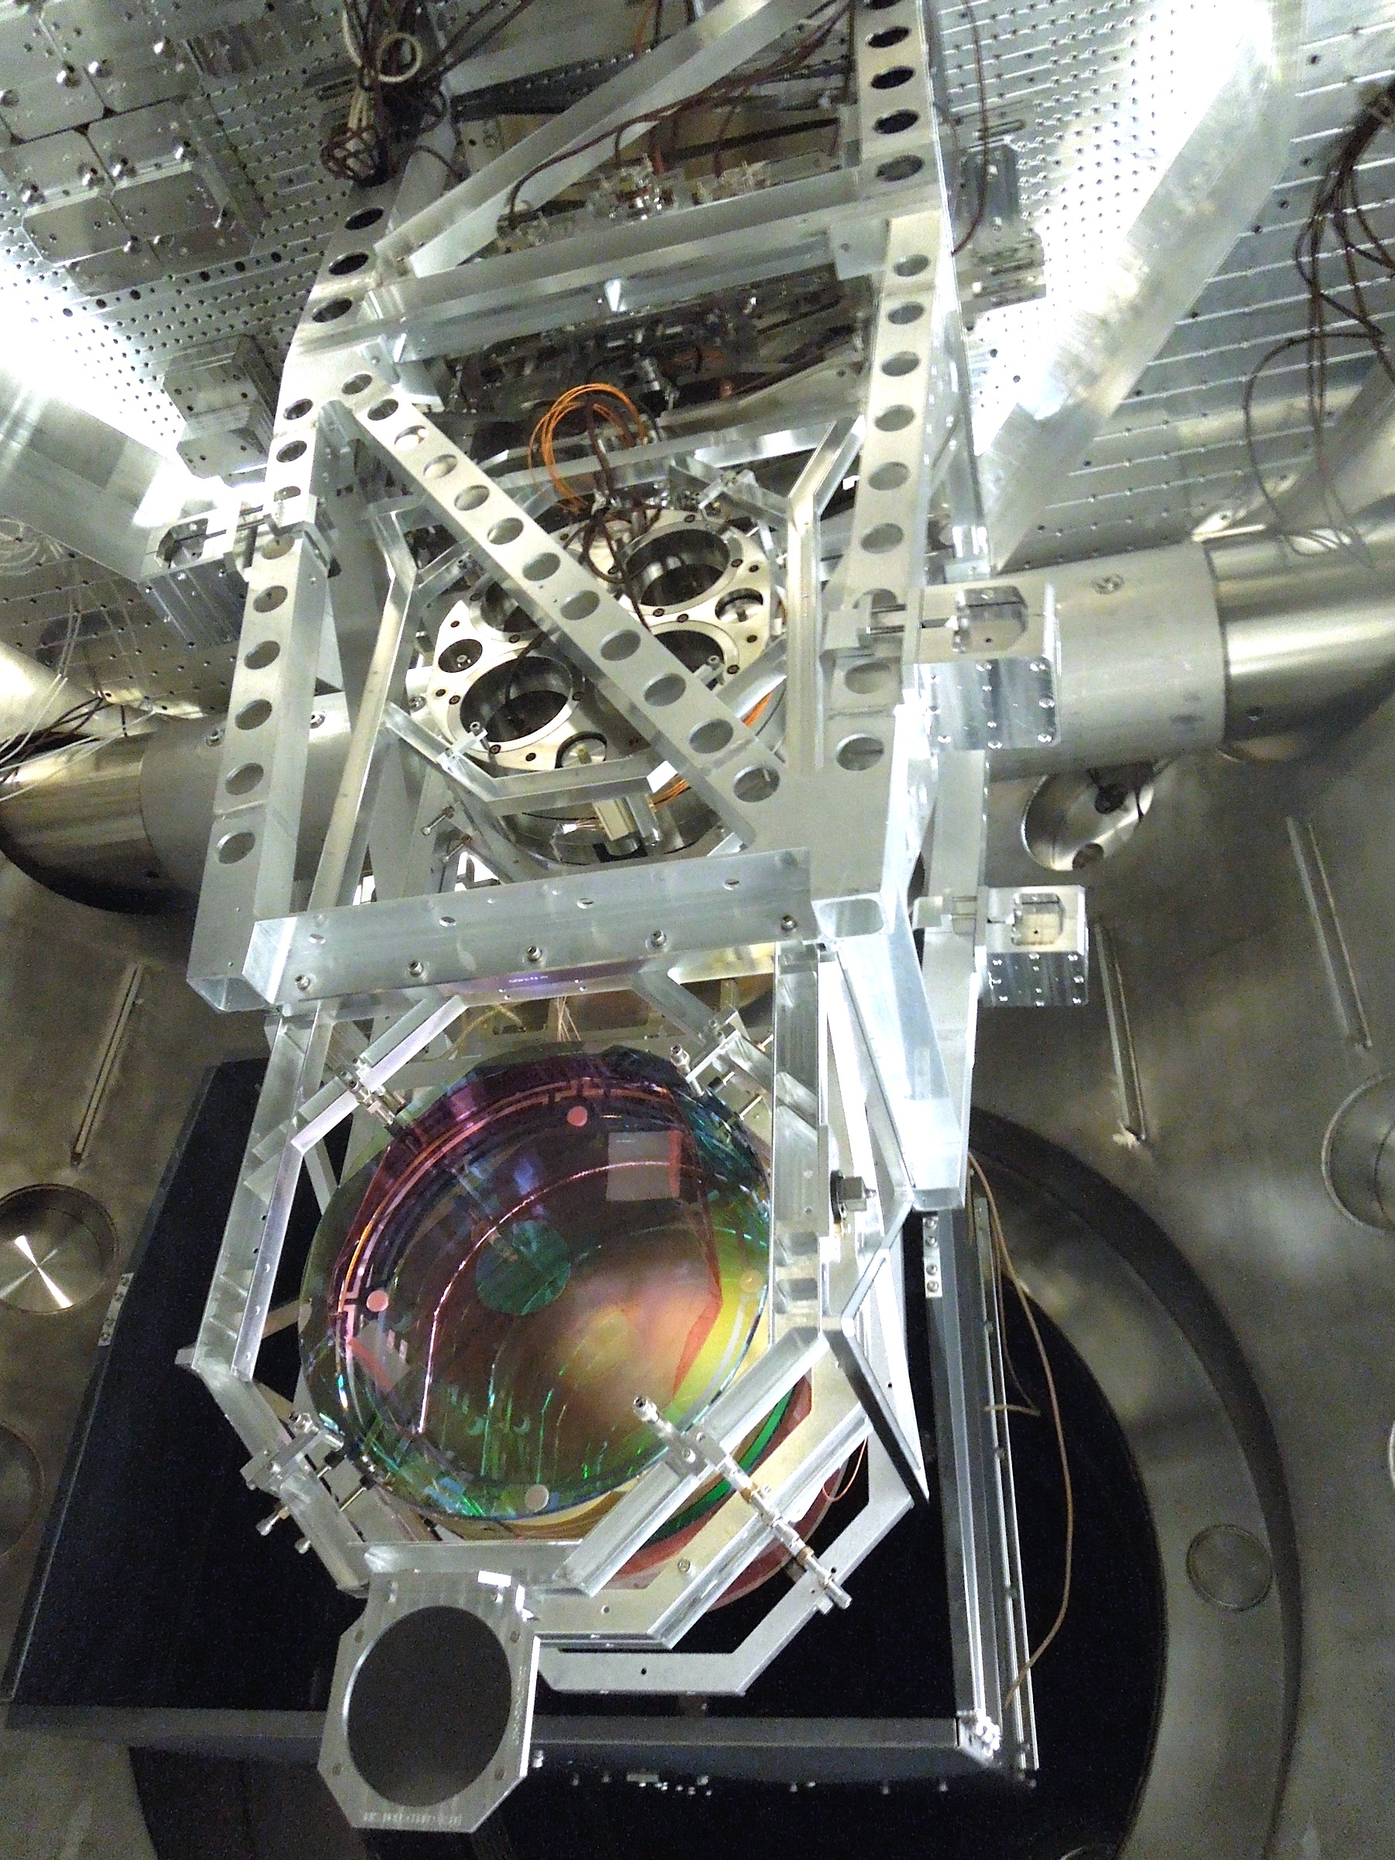
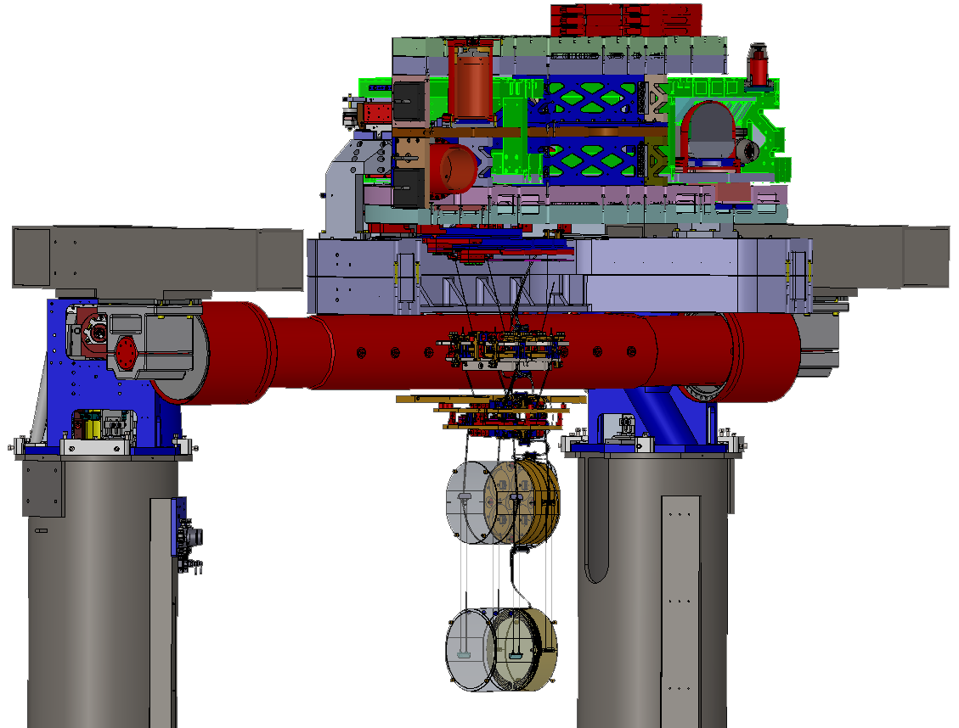
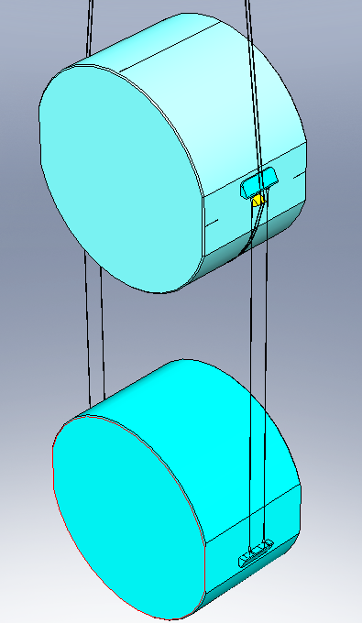
The Advanced LIGO Detectors
Seismic Isolation
Ground Motion at 10 [Hz] ~ 10⁻⁹ [m/rtHz]
Need 10 orders of magnitude!
Test masses are suspended from 7 stages of active and passive vibration isolation
Matichard, F., et al. Proc. ASPE (2010)
2
Aston, S. M., et al. CQG 29.23 (2012): 235004.
3
Last two stages are monolithic
to improve Brownian noise
4
5
1
6
Cumming, A. V., et al. CQG 29.3 (2012): 035003.
7

Slide 13
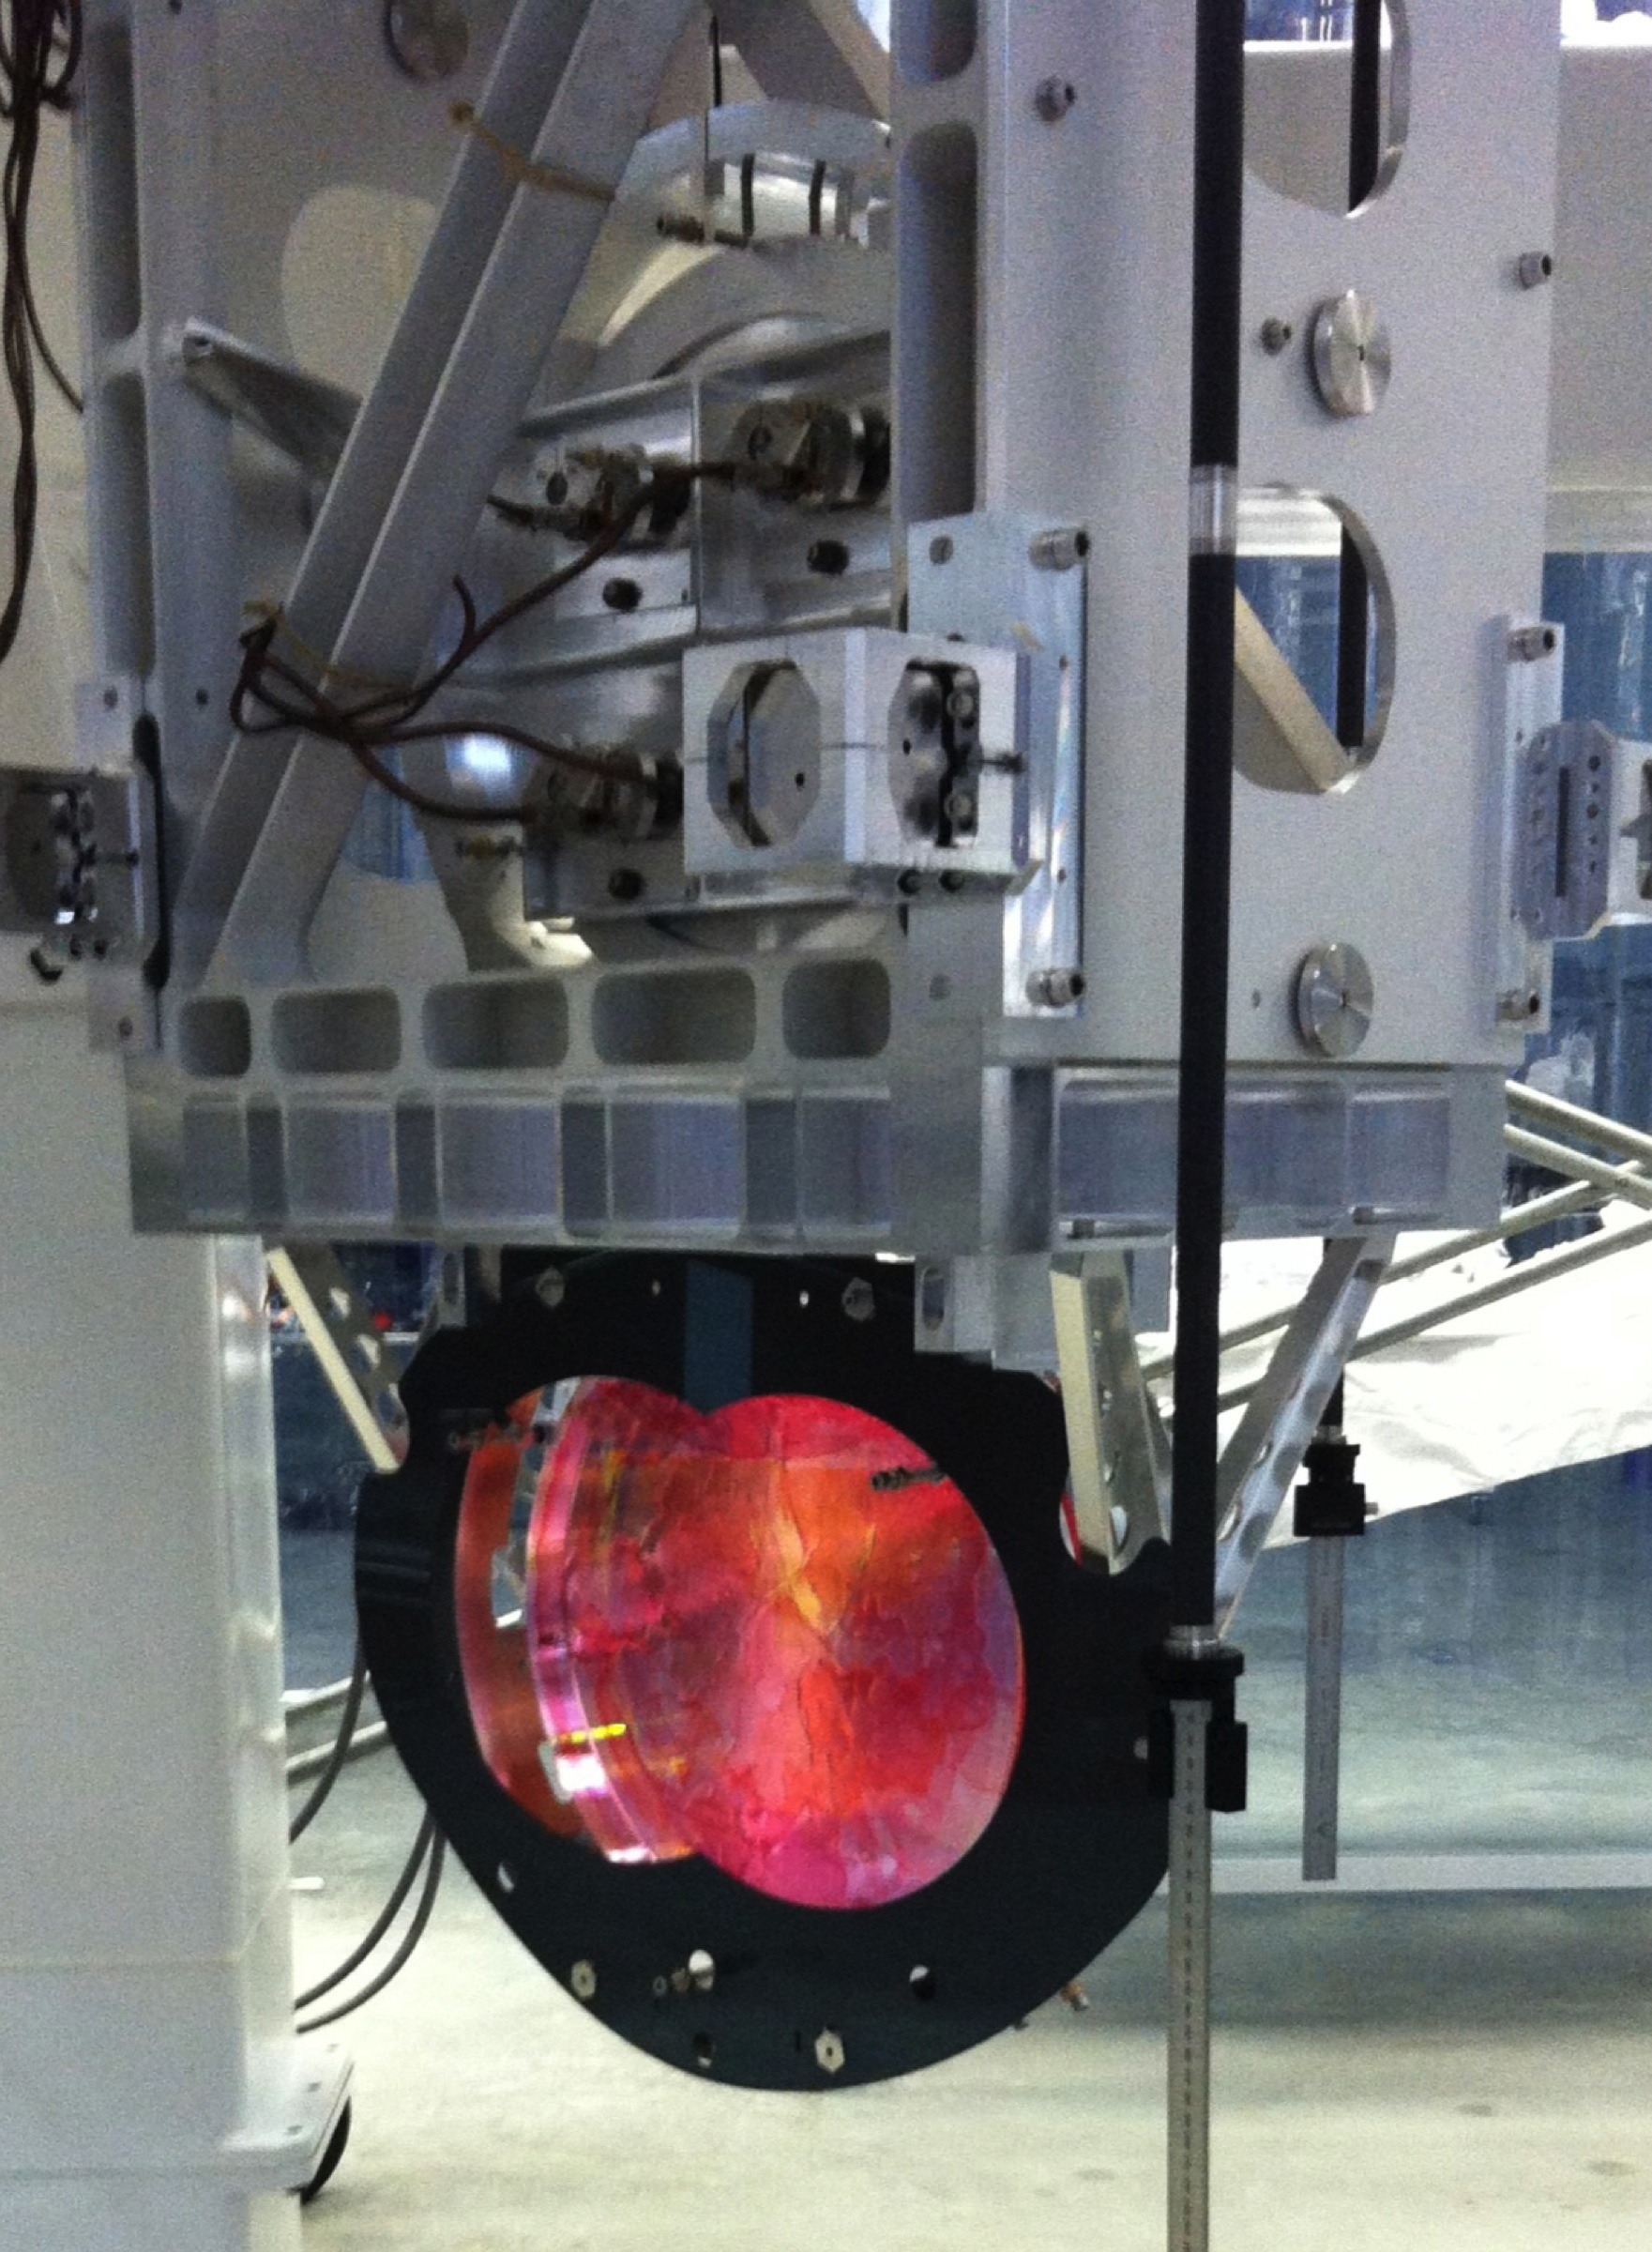
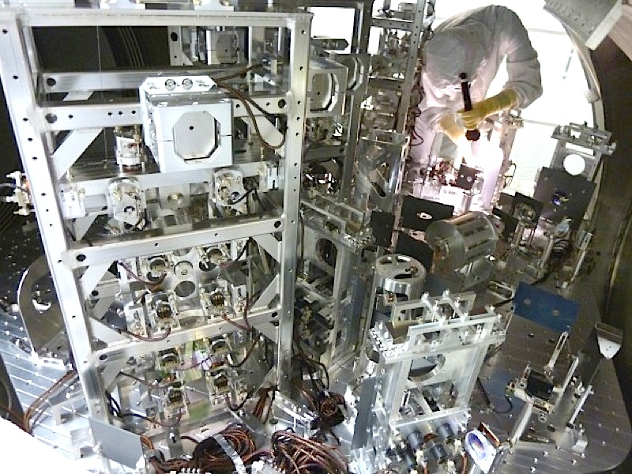
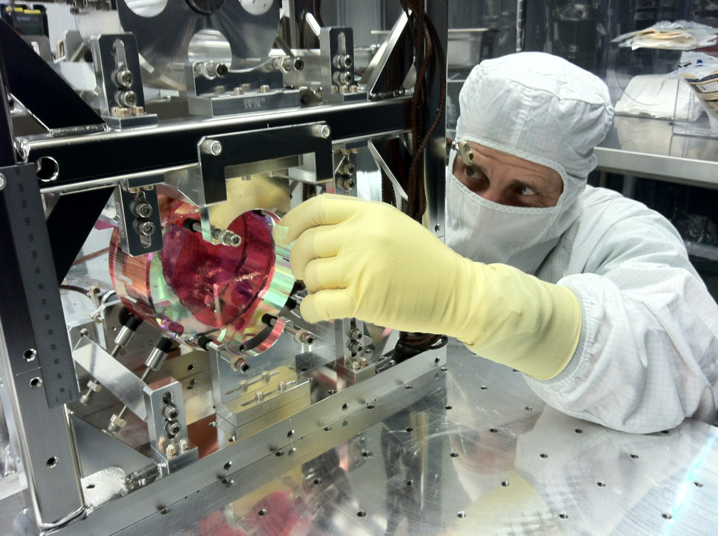
The Advanced LIGO Detectors
Seismic Isolation
Test Masses are not the only thing that needs isolation…
Interferometer is a zoo of seismic isolation!
Notes:
Make a lot less complicated. Try simple IFO and pictures.

Slide 14
Outline
Interferometric Gravitational Wave Detectors
Advanced LIGO Detectors
Installation and Commissioning Progress
The Future and Conclusions

Slide 15

Installation and Commissioning Progress
Two Observatories, Two Interferometers, Two Paths
Hanford, WA
 | 2010 | 2011 | 2012 | 2013 | 2014 | 2015
Upgrading
Advance!
Livingston, LA
Hanford
Livingston
Complicated apparatus!
Many integrated components testable only at full scale
Strategy: two observatories, each path-find on two different systems critical to design

Slide 16
Installation and Commissioning Progress
Two Observatories, Two Interferometers, Two Paths
De-installation
2011
Laser
2012
Y Arm Path Finder
Laser
Input Mode Cleaner
Input Mode Cleaner
2013
Power-Recycled Michelson
Y Arm
Dual-Recycled Michelson
2014
X-Arm + Power-Recycled Michelson
now
X Arm
2 Arms
Y Arm
Dual-recycled Michelson
2 Arms
Full Interferometer
2015
Full Interferometer
Notes:
H2 OAT Jun-Sep 2012
H1 PSL Spring 2012
H1 IMC Jan-Apr 2013
H1 HIFOY Apr-Oct 2013
H1 HIFOX Jan 2014 – now
H1 HIFOXY Early Summer 2014
H1 DRMI Fall 2014
H1 Full IFO Winter 2014
L1 PSL Summer 2011
L1 IMC Jul-Oct 2012
L1 PRMI May-Jul 2013
L1 DRMI Jul-Dec 2013
L1 HIFOX Feb 2014 – now
L1 HIFOY Early Summer 2014
L1 HIFOXY Fall 2014
L1 Full IFO Winter 2014

Slide 17
Installation and Commissioning Progress
Livingston Detector, L1
Installation
Installation of all in-vacuum components COMPLETE as of March 31st 2014 !
Commissioning
Studies of Corner Station Dual-recycled Michelson are complete
Noise models match data – we know what to fix!
Beginning to commission
the X Arm
Michelson DOF of Dual-Recycled Corner
10⁻¹³
Laser
Input Mode Cleaner
Power-Recycled Corner
Dual-Recycled Corner
X ARM
Y ARM
2 ARMs
Full IFO
10⁻¹⁴
10⁻¹⁵
Model Noise Terms
Current Sensitivity
Modeled Sensitivity
Fundamental Limit
Displacement [m/rtHz]
10⁻¹⁶
10⁻¹⁷
10⁻¹⁸
10⁻¹
10⁰
10¹
10²
10³
Frequency [Hz]
Notes:
Ask Den for Source
Get rid of all the noise sources
Simplify Simplify Simplify – Get rid / simplify of IFO diagram

Slide 18
Installation and Commissioning Progress
Hanford Detector, H1
Installation
Only remaining in-vacuum installation are some optics on the output arm
Commissioning
Studies of Corner Station Power-recycled Michelson are complete
X Arm studies are wrapping up
Loop-suppressed X-arm Equivalent Displacement Noise
10⁻¹⁰
YARM Path Finder
Laser
Input Mode Cleaner
Y ARM
X ARM + Power-Recycled Corner
2 ARMs
Dual-Recycled Corner
Full IFO
10⁻¹¹
Displacement
[m/rtHz]
10⁻¹²
10⁻¹³
10⁻¹
10⁰
10¹
10²
10³
Frequency [Hz]
Notes:
Simplify Simplify Simplify – Get rid / simplify of IFO diagram

Slide 19
Outline
Interferometric Gravitational Wave Detectors
Advanced LIGO Detectors
Installation and Commissioning Progress
The Future and Conclusions

Slide 20
The Future
Projected Sensitivity vs. Time
1st generation detectors:
5 years from “first light” (full interferometer lock) to get to 15 Mpc range with
Aasi, J., et al. arXiv:1304.0670 (2013).
2nd generation detectors:
Astrophysically interesting sensitivity in as little as a year from now – much sooner than the first detectors!
Notes:
Make sure to call out what the lines in the range vs. number of events plot
Try just left plot, talk through it twice as slowly.

Slide 21
The Future
What is a Good Compromise?
Abadie, J., et al. CQG 27.17 (2010): 173001.
Strike a balance between observing uptime and commissioning downtime!

Slide 22
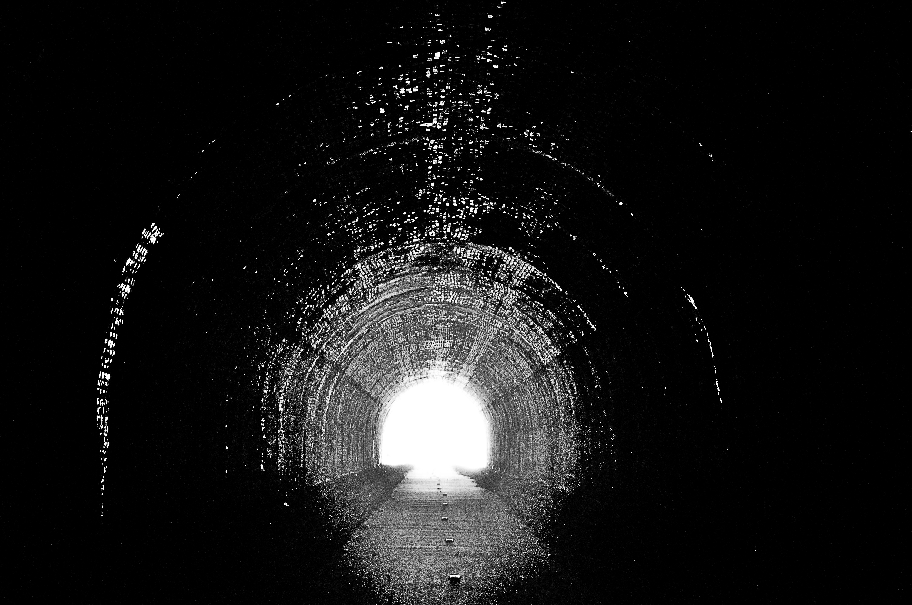
Conclusions
Interferometric gravitational wave detectors have come a long way since Michelson
Over a decade in the making, Advanced LIGO is within a year of being fully functional
Large portions of the interferometers are complete and function as expected already
New era of sensitivity is about to begin
Thank You!

Slide 23
Supplementary Material

Slide 24

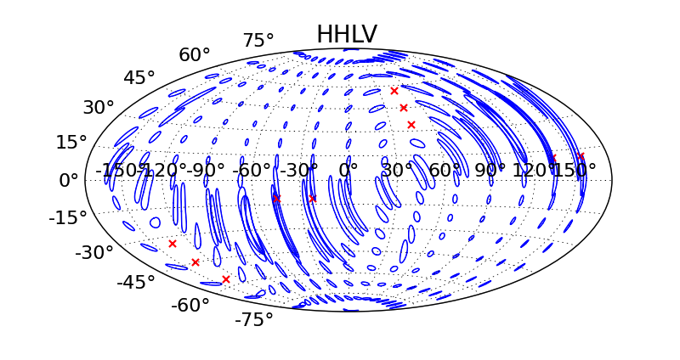
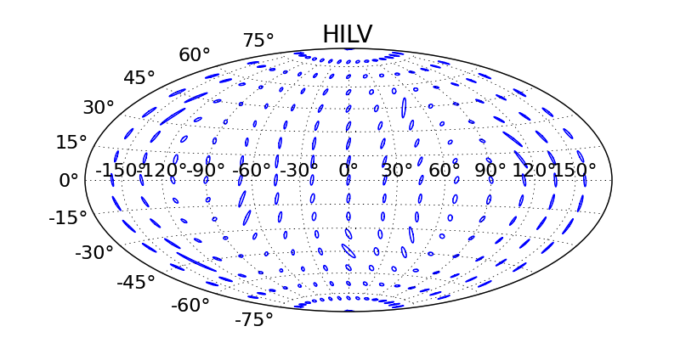
The Advanced LIGO Detectors
The Third Detector
H1
H2
I1
As in the first generation of detectors, initial plans called for the Hanford site to have two interferometers
However, astrophysical benefits for moving the detector to the Eastern Hemisphere are great
Formed international collaboration to move this third detector to India in 2011
  US provides in-vacuum hardware
  India provides infrastructure and vacuum system
Funding approval almost complete, site selection process underway
Expect LIGO-India detector to be operational by 2022

Slide 25
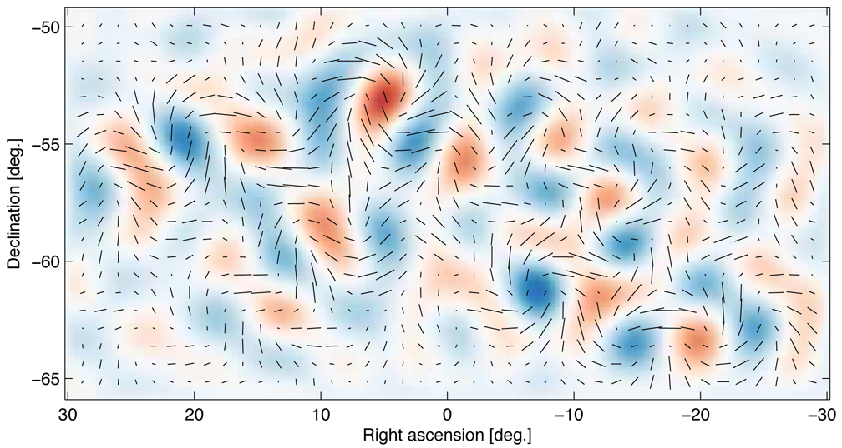
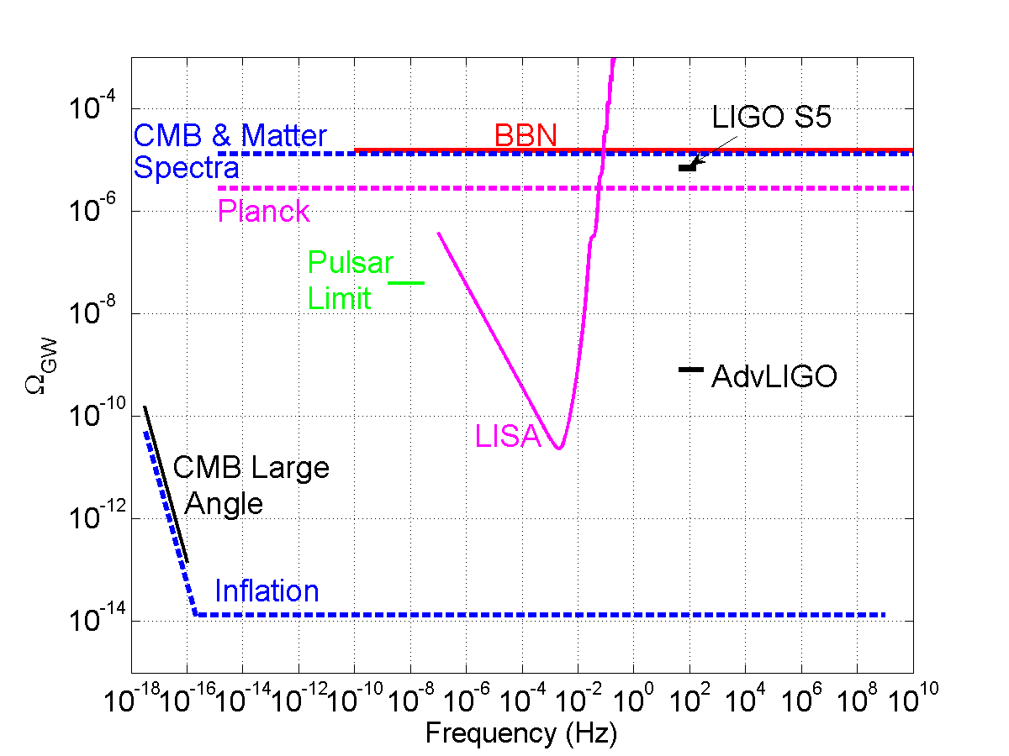
Implications of the BICEP2 Result
Check out
Ade, P. A., et al.
arXiv:1403.3985 (2014).
and [J4.00001]
Fantastic for the field of Gravitational Wave Astronomy and Cosmology!
LIGO will make direct detections of gravitational waves from completely different sources in at much higher frequencies
Not competing, but complementary telescopes!

