Slide 1

A Preview of Future Cryogenic Suspensions for aLIGO Upgrades
LIGO
Brett Shapiro
Stanford cryo people:
Brian Lantz, Tim MacDonald, Dakota Madden-Fong (summer ‘13)
Notes:
Don’t hold onto the podium so much
Look around the audience more, don’t just stare at one person
Take a few more moments to explain plots. E.g. this is a plot of the temperature vs time …. The goal is for the test mass to reach the dotted line at 124 Kas fast as possible
Explain the steady state vs rapid cooling operation more clearly

Slide 2

Summary
Moving from Advanced LIGO to LIGO III
LIGO III quad suspension design
Steady state cooling (science mode)
  System layout
  Length of heat shield extending into beam tube
Initial Cool down
  Stanford initial cool down experiments
Future work

Slide 3

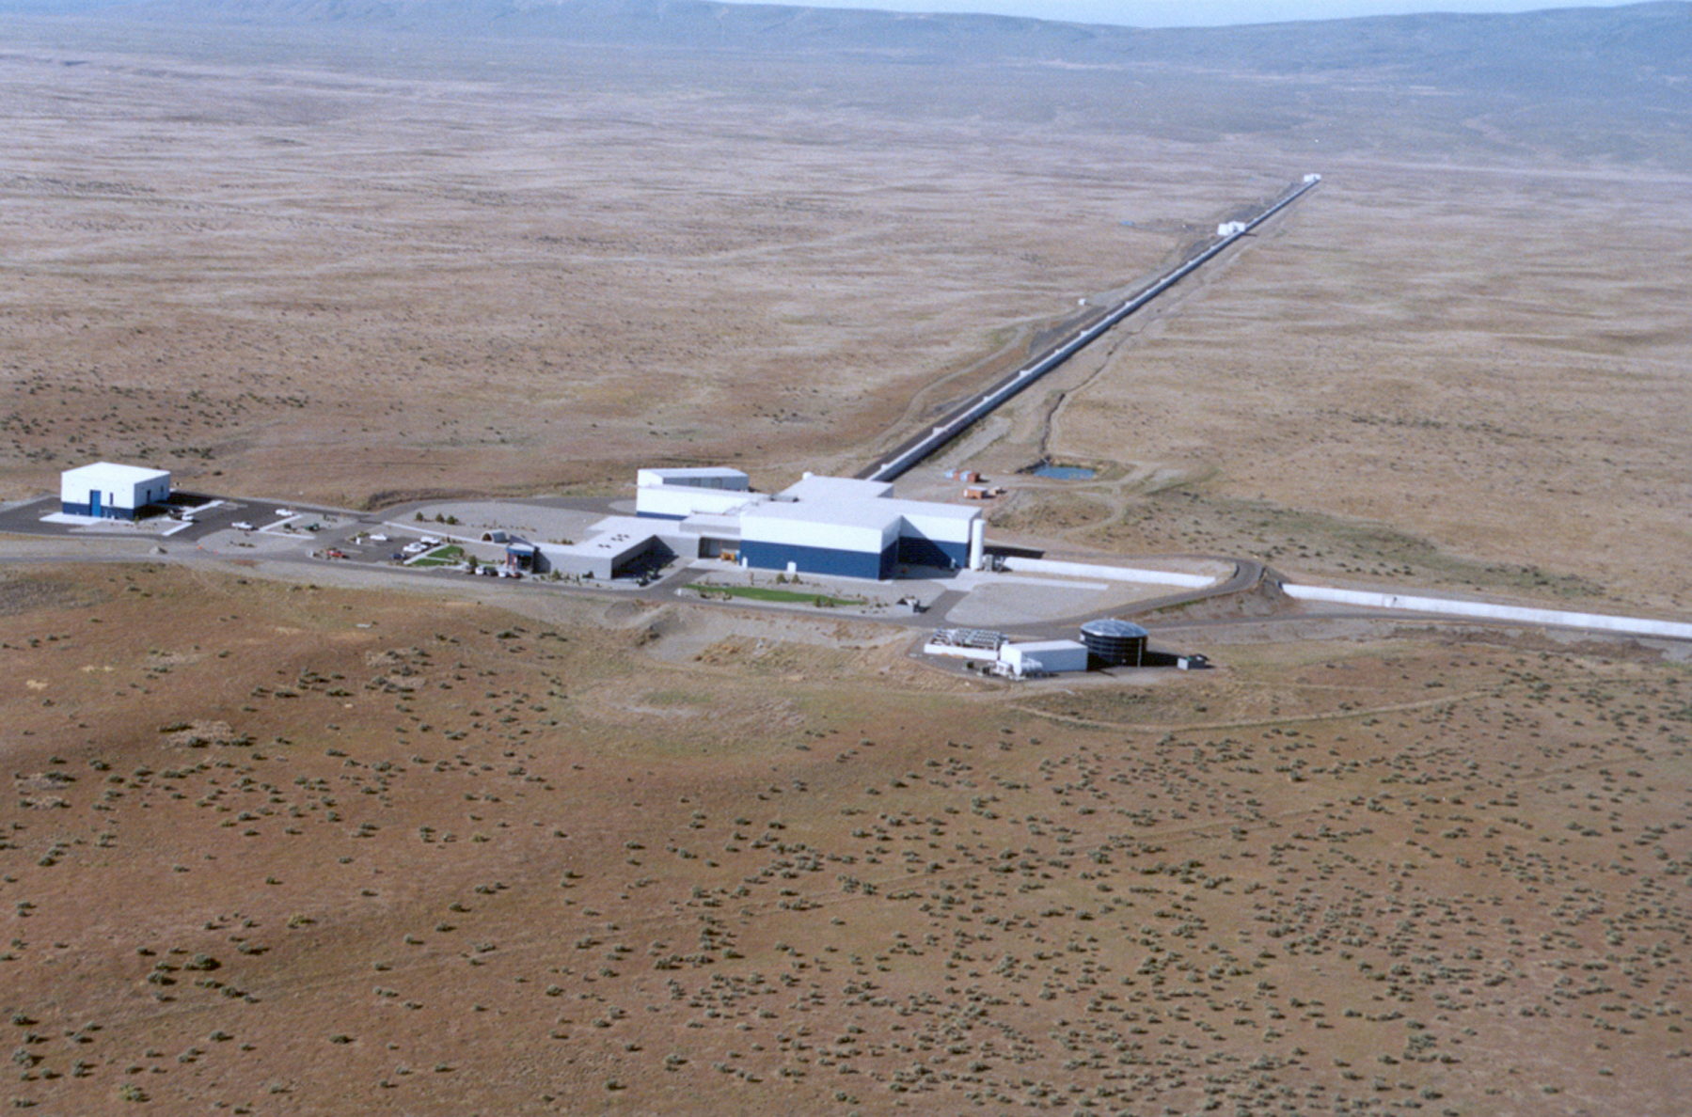
Advanced LIGO Timeline
Livingston, LA
Hanford, WA
Full lock testing
1st science run
GW
astronomy
Build LIGO III
Last core optics
March 2014
Aug-Sept 2014
Sept-Dec 2015
Soon after
Far after

Slide 4
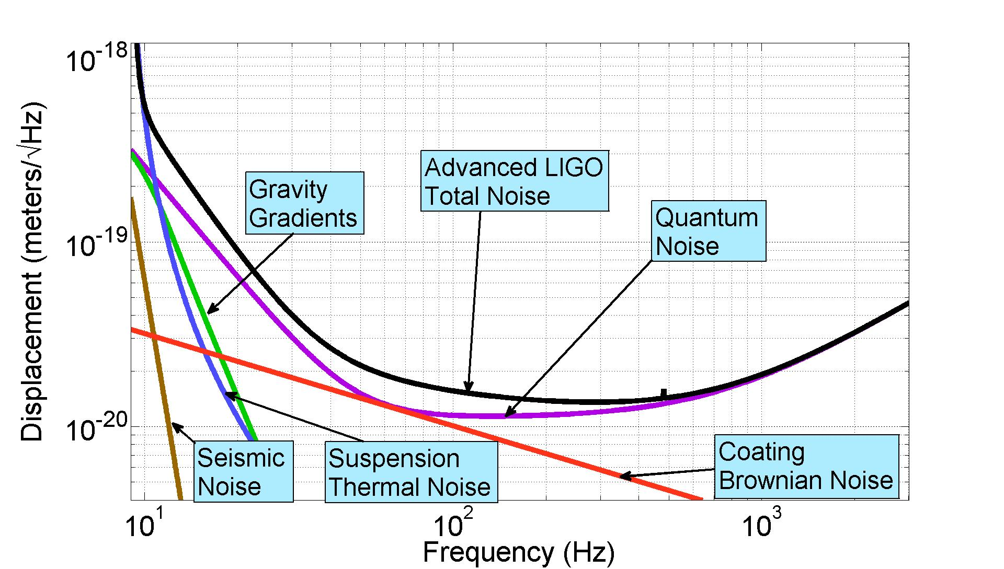
Predicted Advanced LIGO Sensitivity

Slide 5
Predicted Advanced LIGO Sensitivity
LIGO III aims to do better by a factor of 3

Slide 6
Predicted Advanced LIGO Sensitivity
Use cryogenics to push thermal noise down
LIGO III aims to do better by a factor of 3

Slide 7
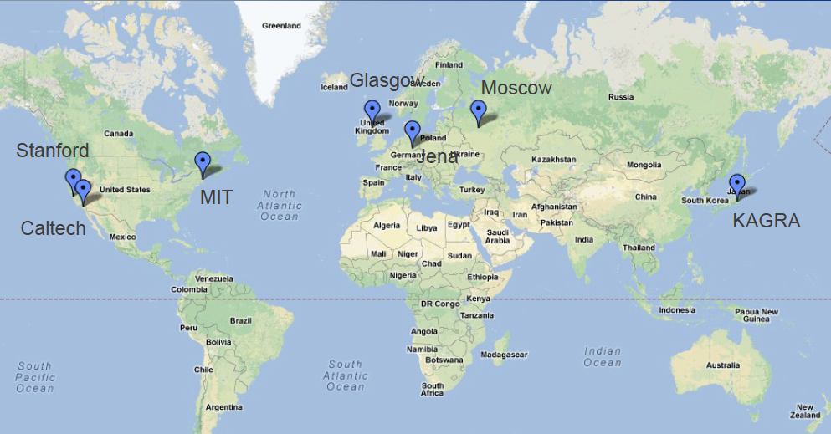
LIGO III cryo work distribution
Caltech - cryogenic reference cavities; direct thermal noise measurements
Jena/Glasgow/Moscow - mechanical loss
MIT – high emissivity coatings
KAGRA – 20 K sapphire suspensions
INPE Brazil – Cryogenic multi-nested pendulum
Stanford – optical coatings; cryogenic technology
Courtesy of Nicolas Smith

Slide 8
Cyro Test Mass Problem Statement
* For LIGO III, reduce suspension and coating thermal noise by cooling the lower quad to 124 K (-149.15 C)
  Si test masses (blue team in LIGO-T1200031)
2 cooling regimes:
  Initial cool down - get to 124 K quickly <- Stanford experiment
  Steady state - maintain 124 K once you get there
Include a warm-up scheme (don’t forget!)
Use the same seismic isolation platforms (ISIs, HEPIs)
  Limit the amount of extra weight on these plaforms
  Leave the rest of the vacuum chamber warm
Do not increase the test mass lossiness
  Emissive coatings, heat links, thick sus fibers, optical coatings, substrate, suspension fiber bonding, etc
Do not compromise passive seismic isolation
  Cables, hoses, links, etc

Slide 9
Quad Suspension Design
Must incorporate much larger test mass

Slide 10
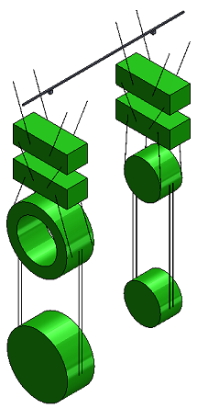
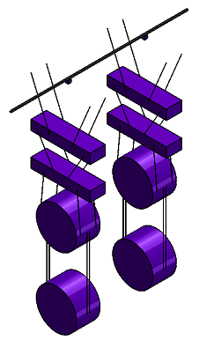
LIGO III Quad Suspension Design
Advanced LIGO quad pendulum
Preliminary LIGO III quad pendulum
Reaction
chain
Reaction
chain
Main
chain
Main
chain
2.14 m
1.626 m
10 kg
20 kg
? kg
? kg
20 kg
20 kg
40 kg
? kg
40 kg
143 kg
Fused silica, 295 K
Silicon, 124 K (-149 C)

Slide 11
Quad Design Requirements

Slide 12
Quad Design Requirements
Payload P ≤ 270 kg for the main chain for aLIGO BSC-ISI

Slide 13
Quad Design Requirements
Payload P ≤ 270 kg for the main chain for aLIGO BSC-ISI
Test mass m₄ ≈ 143 kg to minimize radiation pressure and thermal noise

Slide 14
Quad Design Requirements
Payload P ≤ 270 kg for the main chain for aLIGO BSC-ISI
Total length L ≤ 2.14 m to fit in vacuum system
Test mass m₄ ≈ 143 kg to minimize radiation pressure and thermal noise

Slide 15
Quad Design Requirements
Payload P ≤ 270 kg for the main chain for aLIGO BSC-ISI
Total length L ≤ 2.14 m to fit in vacuum system
Seismic isolation as good as aLIGO
Test mass m₄ ≈ 143 kg to minimize radiation pressure and thermal noise

Slide 16
Quad Design Requirements
Payload P ≤ 270 kg for the main chain for aLIGO BSC-ISI
Total length L ≤ 2.14 m to fit in vacuum system
Vertical bounce mode f_{bounce} ≤ aLIGO
Seismic isolation as good as aLIGO
Test mass m₄ ≈ 143 kg to minimize radiation pressure and thermal noise

Slide 17
Quad Design Requirements
Payload P ≤ 270 kg for the main chain for aLIGO BSC-ISI
Total length L ≤ 2.14 m to fit in vacuum system
Vertical bounce mode f_{bounce} ≤ aLIGO
Seismic isolation no worse than aLIGO
Test mass m₄ ≈ 143 kg to minimize radiation pressure and thermal noise
Si fiber stress σ₄ ≤ 1400 Mpa
Very rough guess

Slide 18
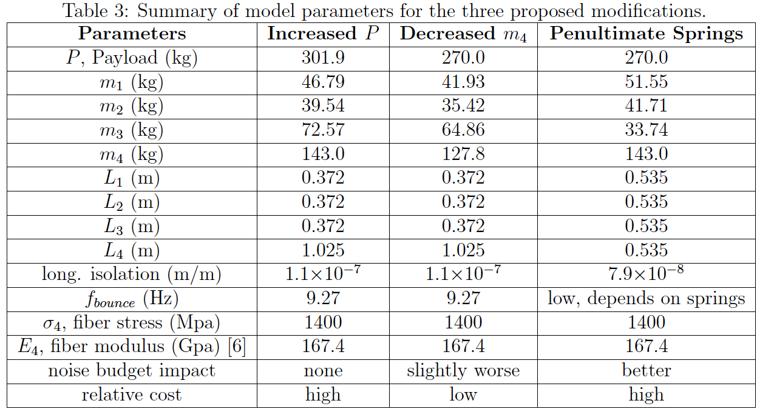
3 Optimal Quad Designs
Higher payload
Lighter
Test mass
PUM Si springs
10Hz
Note: these results are highly dependent on the allowed Si fiber stress, σ₄. There is still much uncertainty in this value.
See T1300786

Slide 19
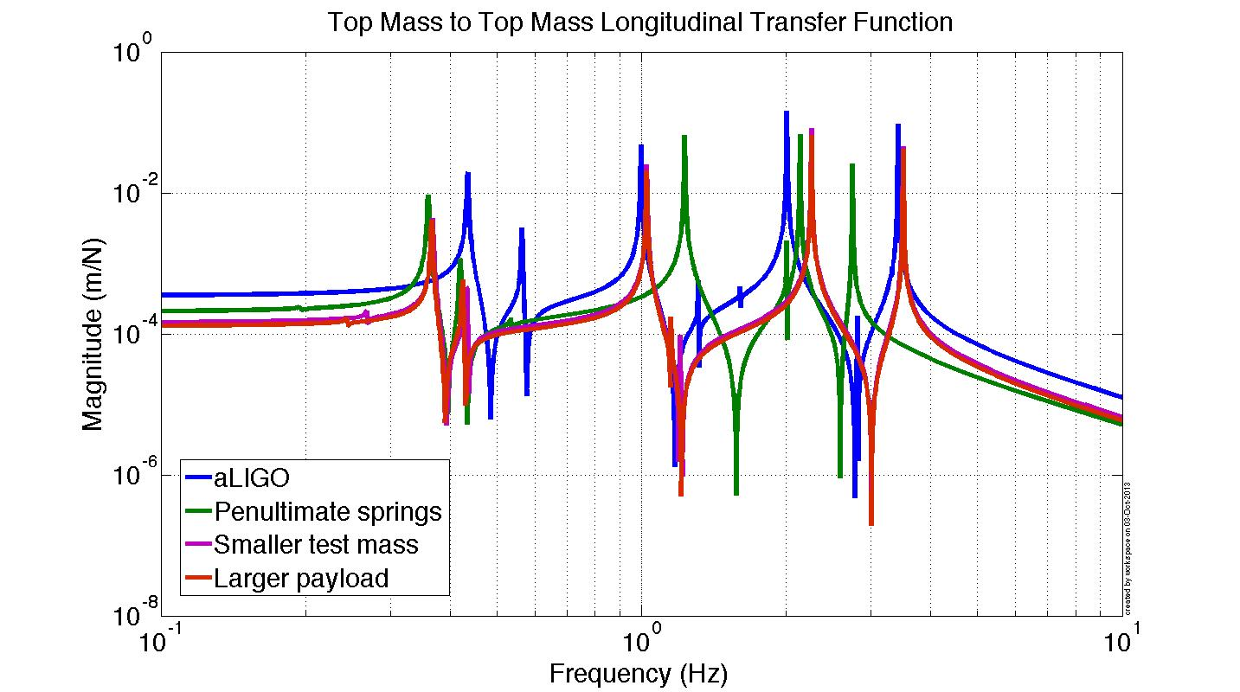
All designs permit top mass damping

Slide 20
Steady State Cooling
Keeping the test mass temperature at the operating point

Slide 21
LIGO III Steady State Cooling
chiller
Active Seismic Isolation Table
…
…
clamp
295 K
ISI stage 2
Flexible liquid nitrogen hoses,
1 mL/s laminar flow:
Supply (65 K) and return (75 K);
or Cu cables
Vacuum flange
124 K
≤ 10 m
≈ 3 W absorption at 124 K
Heat shield at
80 K maintains 124 K through radiative coupling
1560 nm MW laser
143 kg Si test mass
See also G1200246-v1

Slide 22
Pros and Cons of LN₂ pipe vs. Cu cable
Cu cable
Pros:
No fluid to make noise
No LN₂ pumping mechanism
No risk of N₂ leaks
Cons:
Low heat transfer
...
LN₂ pipe
Pros:
High heat transfer
No length / heat transfer trade-off
Low weight
…
Cons:
Risk of leaking
Fluid flow could contribute noise
…
ISI
ISI
Heat shield
Heat shield
Copper cable
Liquid N₂ pipe, supply and return

Slide 23
Pros and Cons of LN₂ pipe vs. Cu cable
Cu cable
Pros:
No fluid to make noise
No LN₂ pumping mechanism
No risk of N₂ leaks
Cons:
Low heat transfer
Cryo refrigerator must be placed near feedthrough
High bulk: stiffness, weight, etc
  Q = K(A/L)ΔT
    Big L means big A
    Can reduce A by making cold end less than LN₂ (77 K). E.g. Cryomech’s PT407 can pull 25W at 55 K.
  - Minimize stiffness by using lots of this wires, but wire dia must be > electron m.f.p.
Thermal conductivity decreases when wire dia becomes smaller than electron m.f.p.
Hysteresis
  - Lots of small wires sliding past each other
High difficulty in minimizing seismic shorting
- Minimize using:
    Lots of thin wires
    Intermediate masses along length
LN₂ pipe
Pros:
High heat transfer
Low bulk
Moderate difficulty in minimizing seismic shorting
Length of pipe in vacuum not an issue for net heat transfer (longer pipes do require more pressure to push fluid)
Vibrating cryorefrigerator can be placed further from vacuum feedthrough.
Cons:
Complex LN₂ pumping mechanism
Risk of leaking
Fluid flow could contribute noise
  Minimize by:
    Cooling the LN₂ so it doesn’t boil
    Ensuring laminar flow
Pressure of flow and thermal contraction can influence table displacement
  - Minimize by locating pipes in strategic locations

Slide 24
Beam Tube Heat Shield Length
Beam tube
Blackbody disc model
Heat Shield
T = 80K
T_{j} = 120 K
Ε_{j} = 0.1
Ε_{i} = 1
r_{j} = 0.28 m
r_{i} = 0.6225m
T_{i} = 295 K
Test Mass
L
What is the optimal heat shield length in the beam tube?
See T1300556

Slide 25
Beam Tube Heat Shield Length
Black body power from beam tube arriving at test mass
≈1/3 drop for every factor of 2 L
Test mass emissivity = 0.1
Beam tube shield length L (m)
See T1300556

Slide 26
End Station Vacuum System
End Station
Gate valves
10 m
5 m
0 m

Slide 27
Initial Cooldown
Acquiring the operating temperature

Slide 28

A Lot of Heat to Remove
2.7 days to 124 K (295 K) at a constant 60 W
60 W
143 kg Test Mass:
14 MJ to get cold (warm)
Maybe there is another way to cool the test mass quickly
* Radiation to the heat shield alone would take ≈ 2 weeks.

Slide 29
Initial Cool Down Cold Link – 2 Designs
Conductive cooling, low pressure N₂ gas
Pros and Cons
liquid N₂ pipe flexures
Pros
Operates in partial vacuum.
Low heat transfer between cold and warm parts of vacuum system.
Fine temperature control – just back away when at desired temperature
Versatility, design permits both conductive and convective cooling.
Cons
Requires moving parts:
  flexible pipes
  actuators
Physically contacts barrel of test mass
return
supply
Test mass
thermally conductive plate with variable gap

Slide 30
Initial Cool Down Cold Link – 2 Designs
Pros and Cons
Convective cooling, up to 1 atm N₂ gas
Pros
No moving parts or actuators
No contact with test mass
Faster cooling than conduction
Cons
Convection between cold and warm parts of vacuum system
No fine temperature control – must return to vacuum to ‘turn off’ cold link.
Does not operate under vacuum
return
supply
liquid N₂
pipes
convective N2 gas
Test mass
thermally conductive plate with large fixed gap

Slide 31
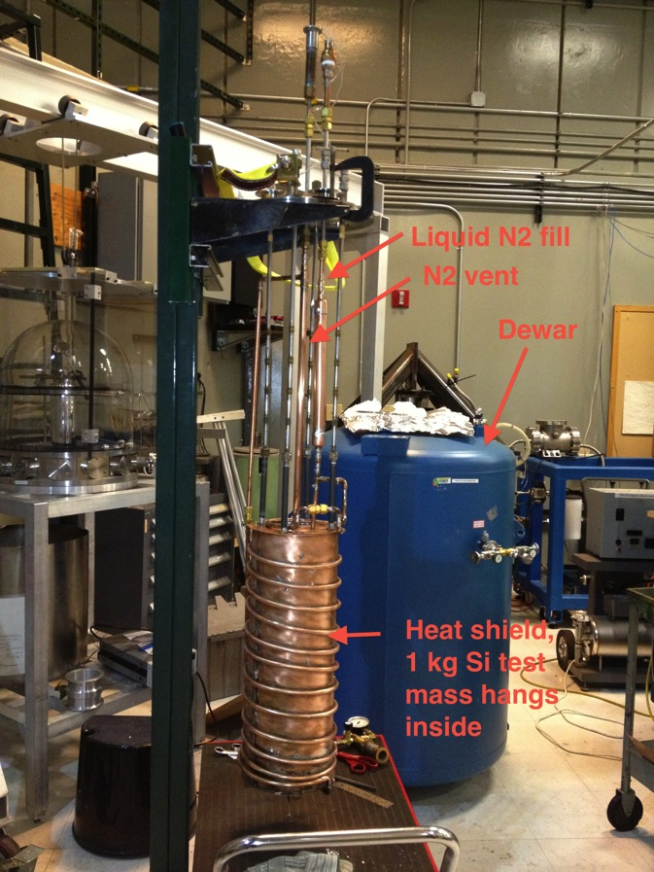
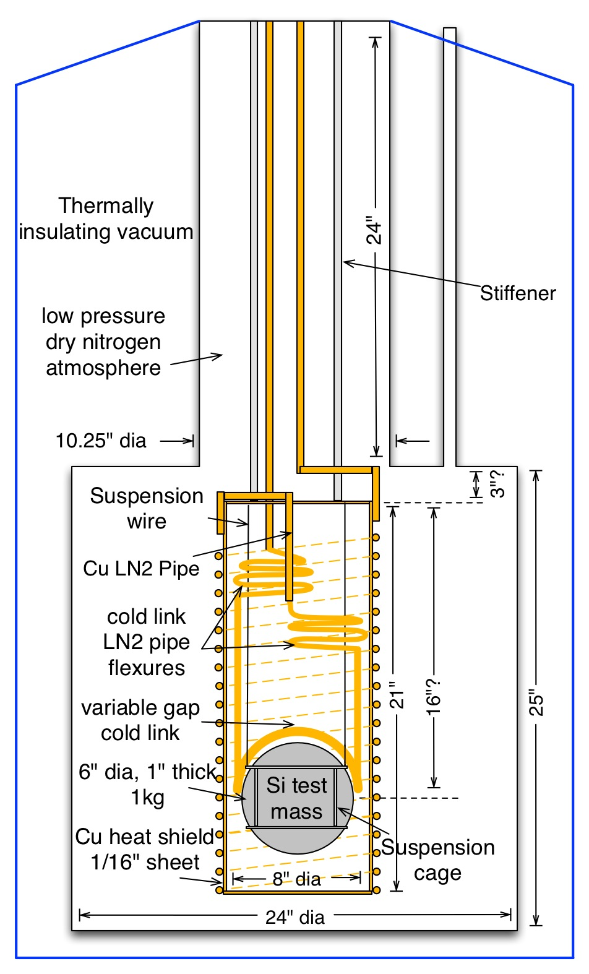
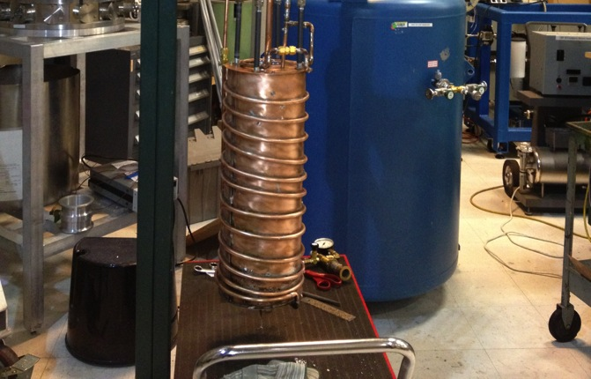
Experimental Setup
Test dewar
Heat shield

Slide 32
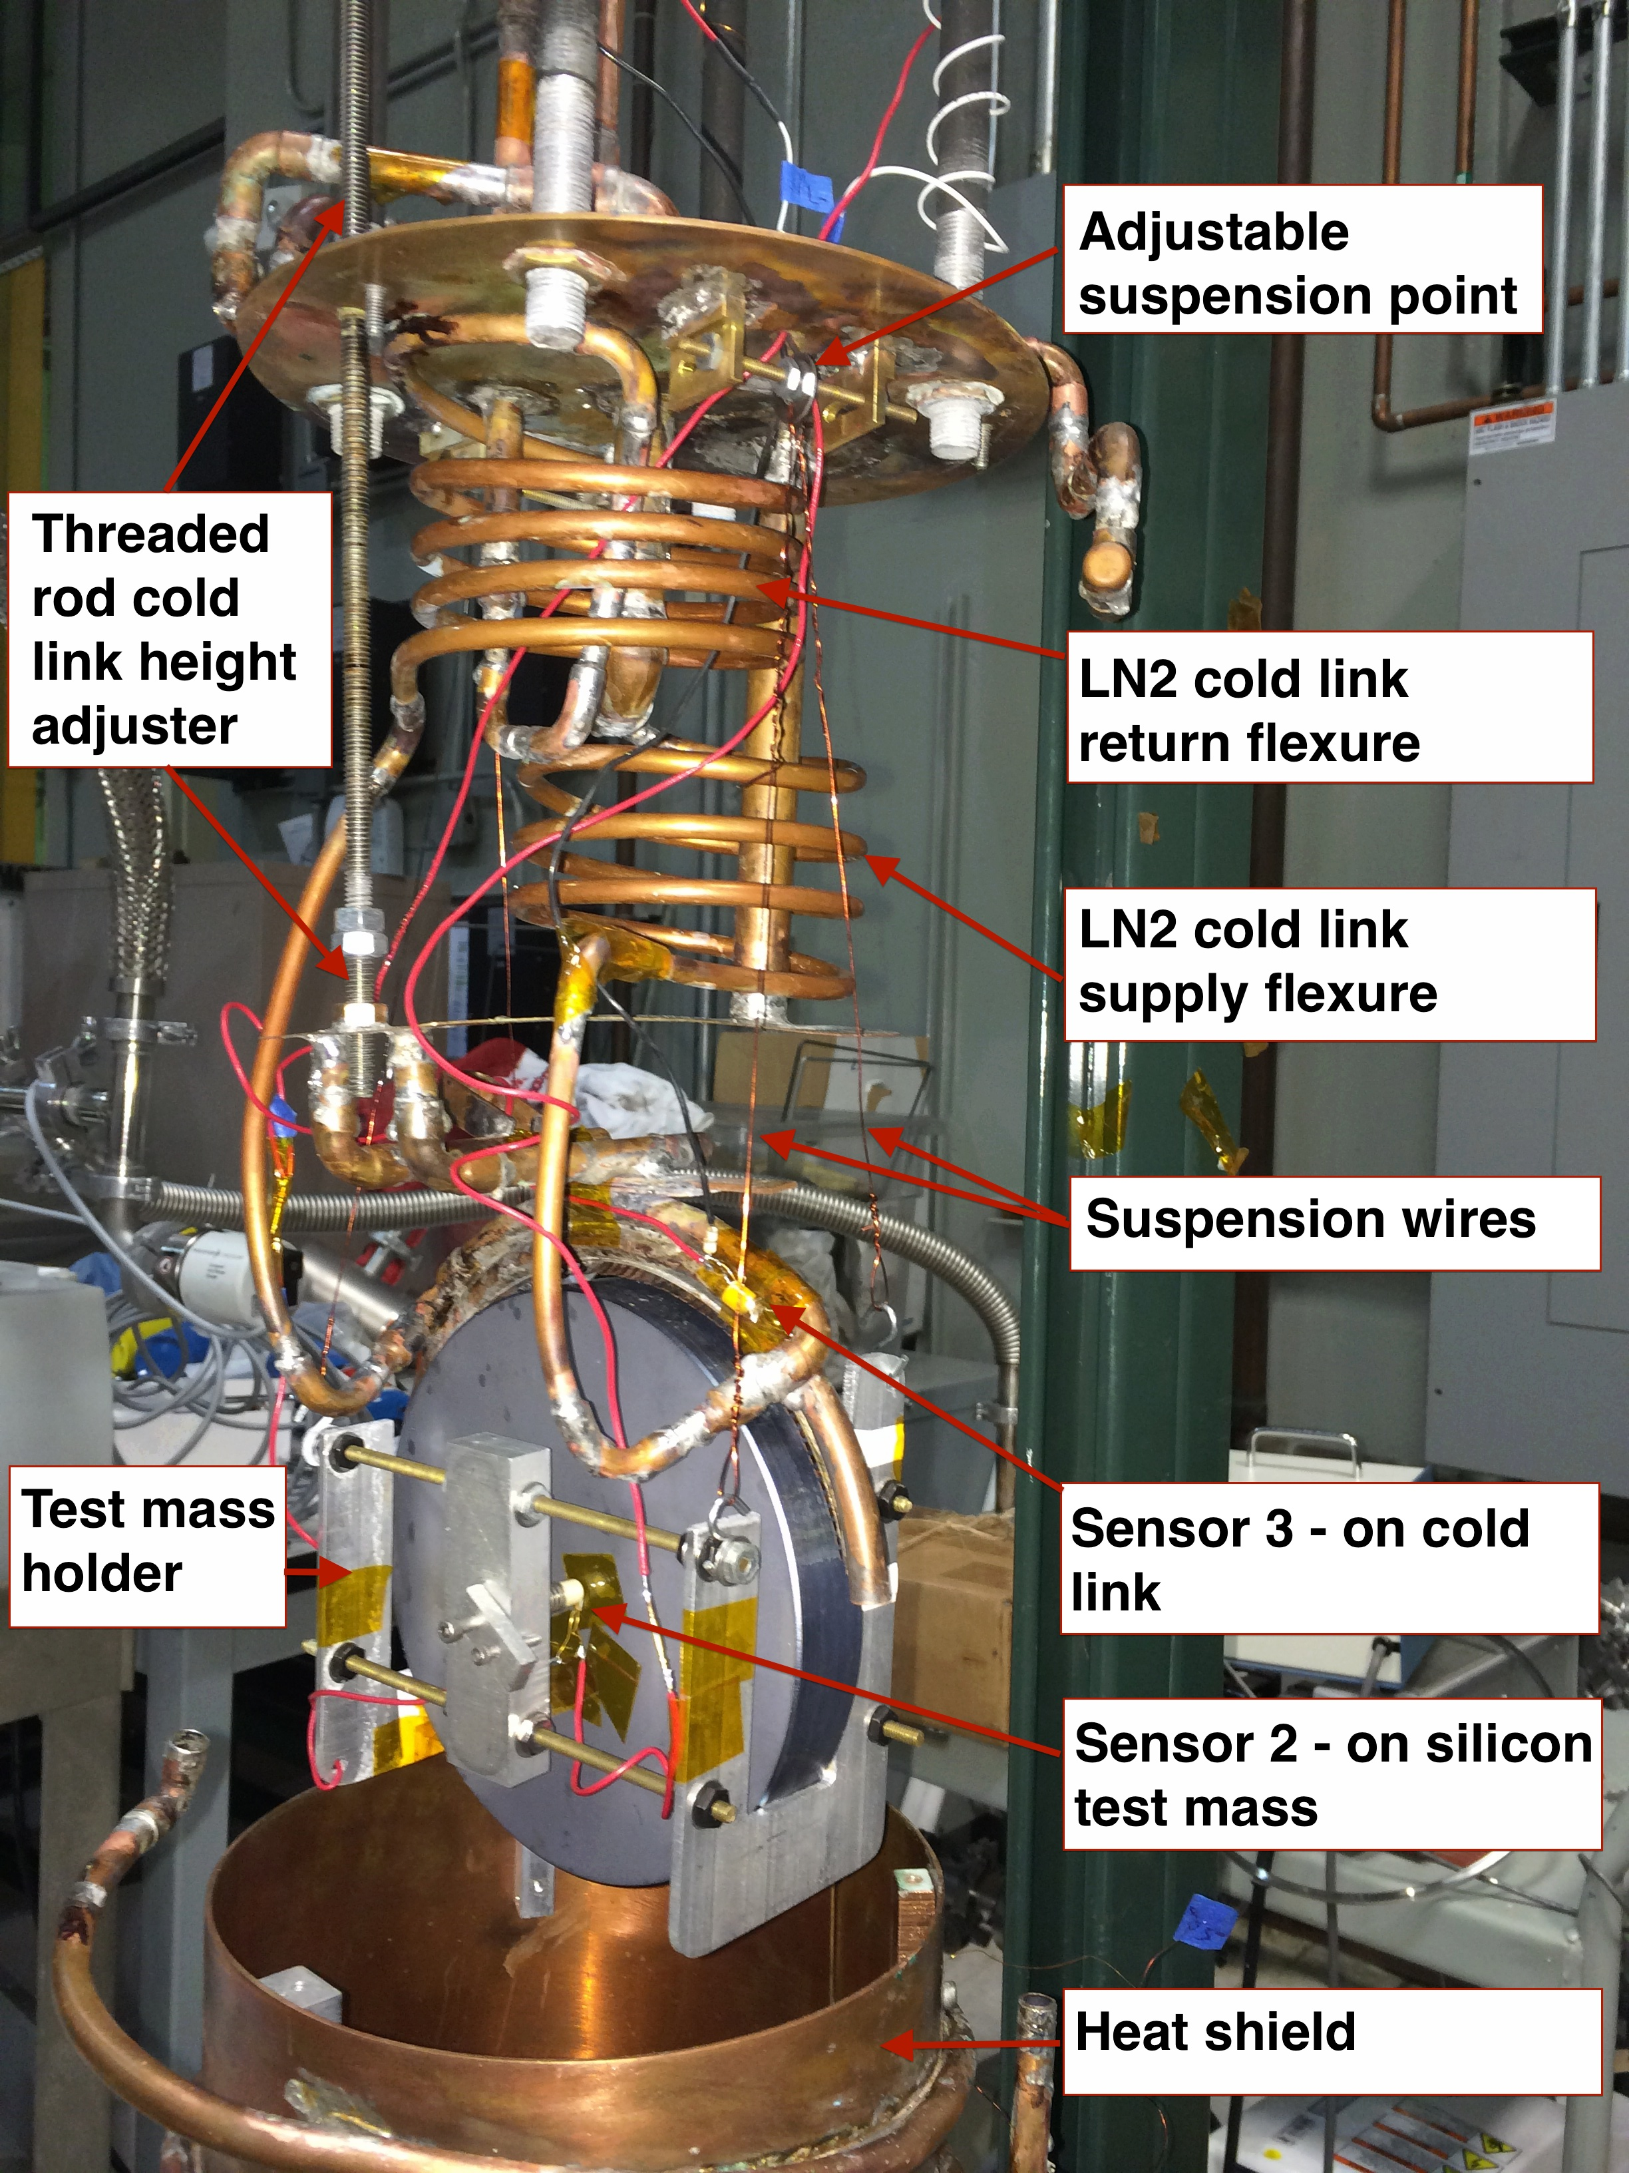

Slide 33
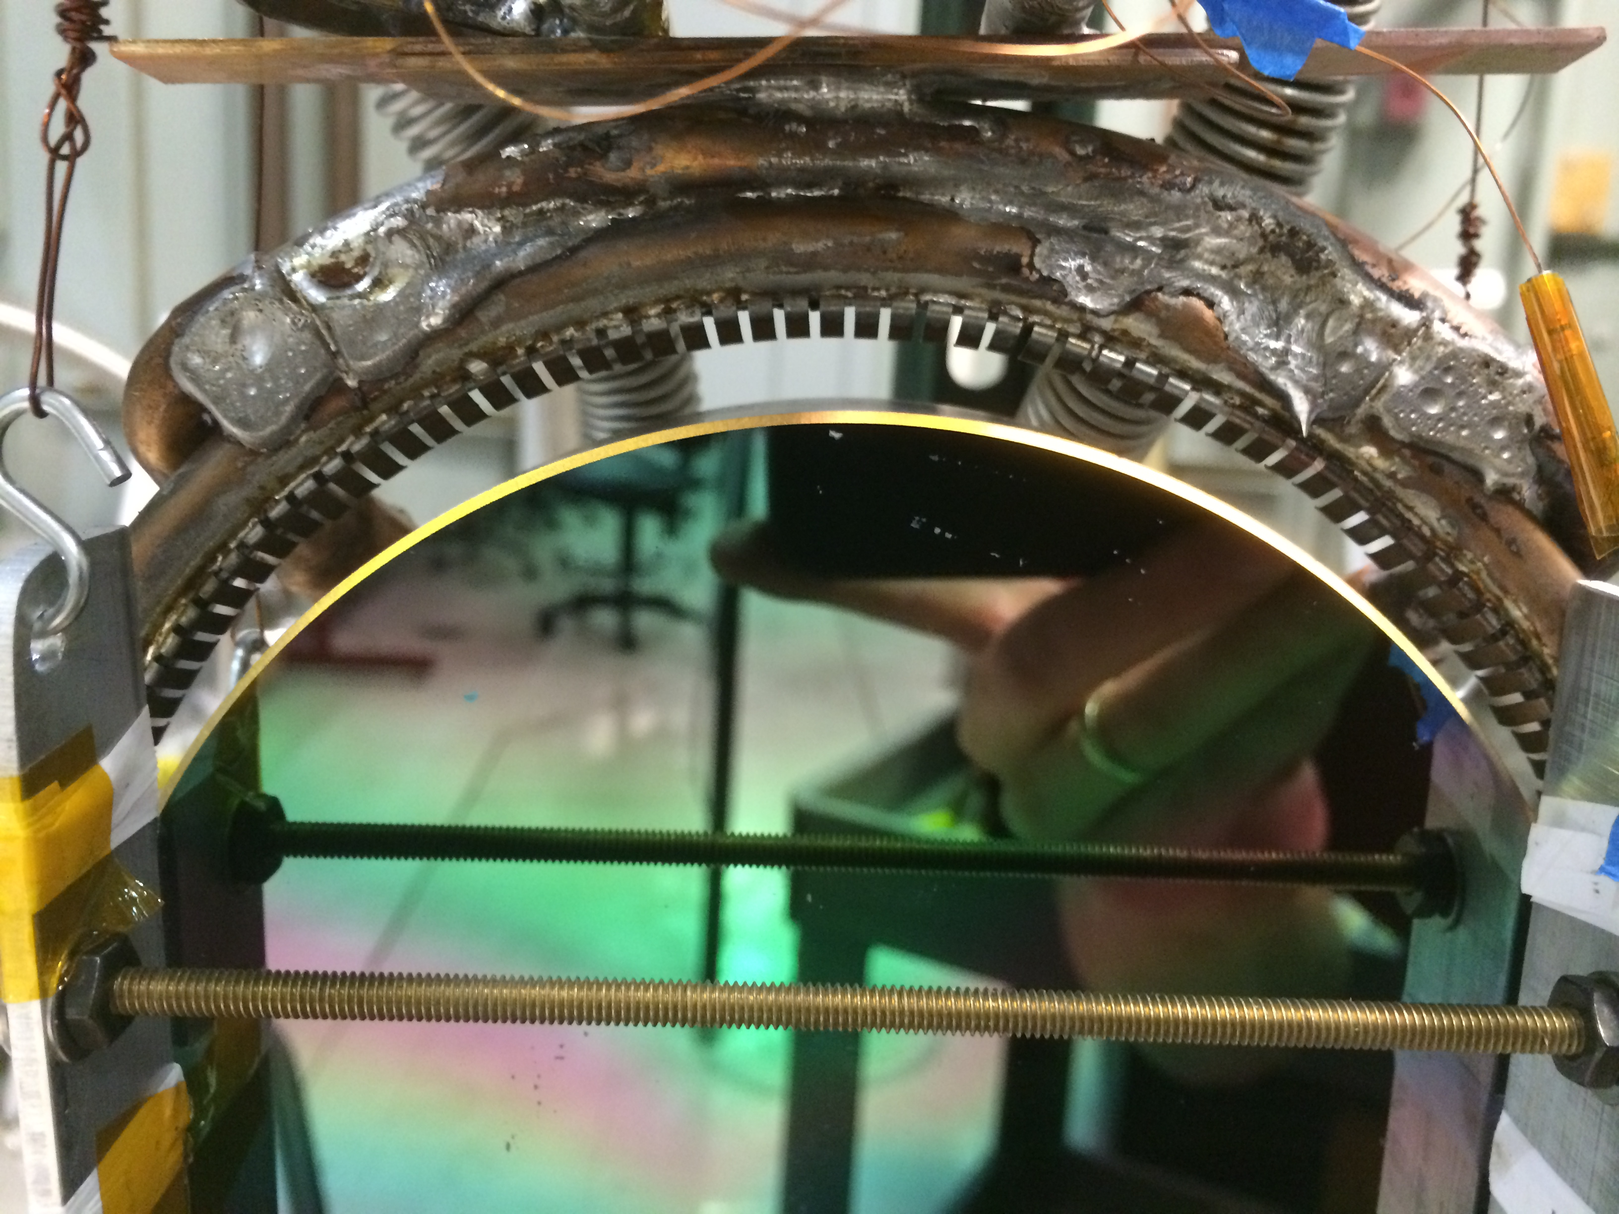
Close up of cold link
Cold link
Variable gap
Flexure ‘point’ contacts
Test
mass

Slide 34
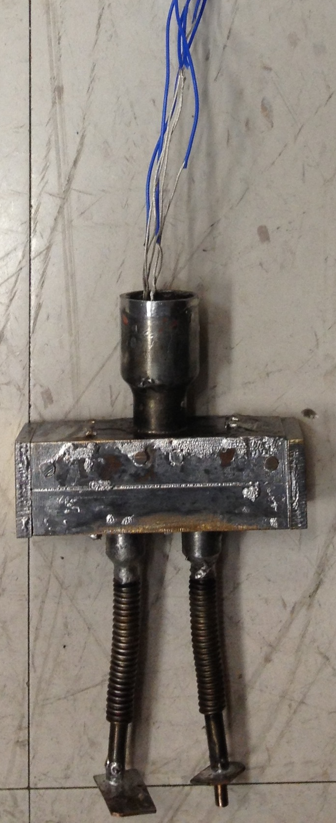
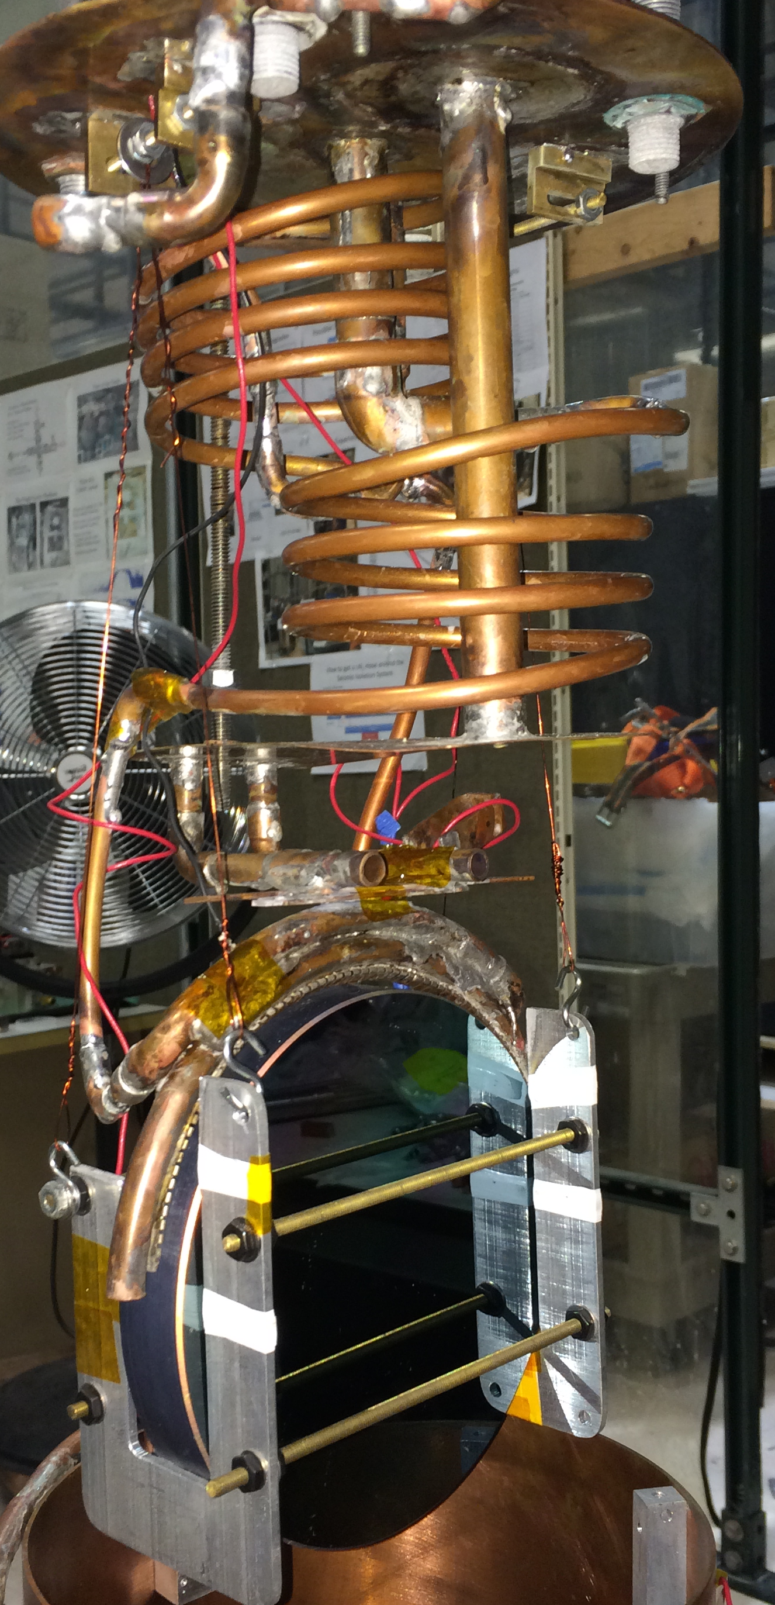
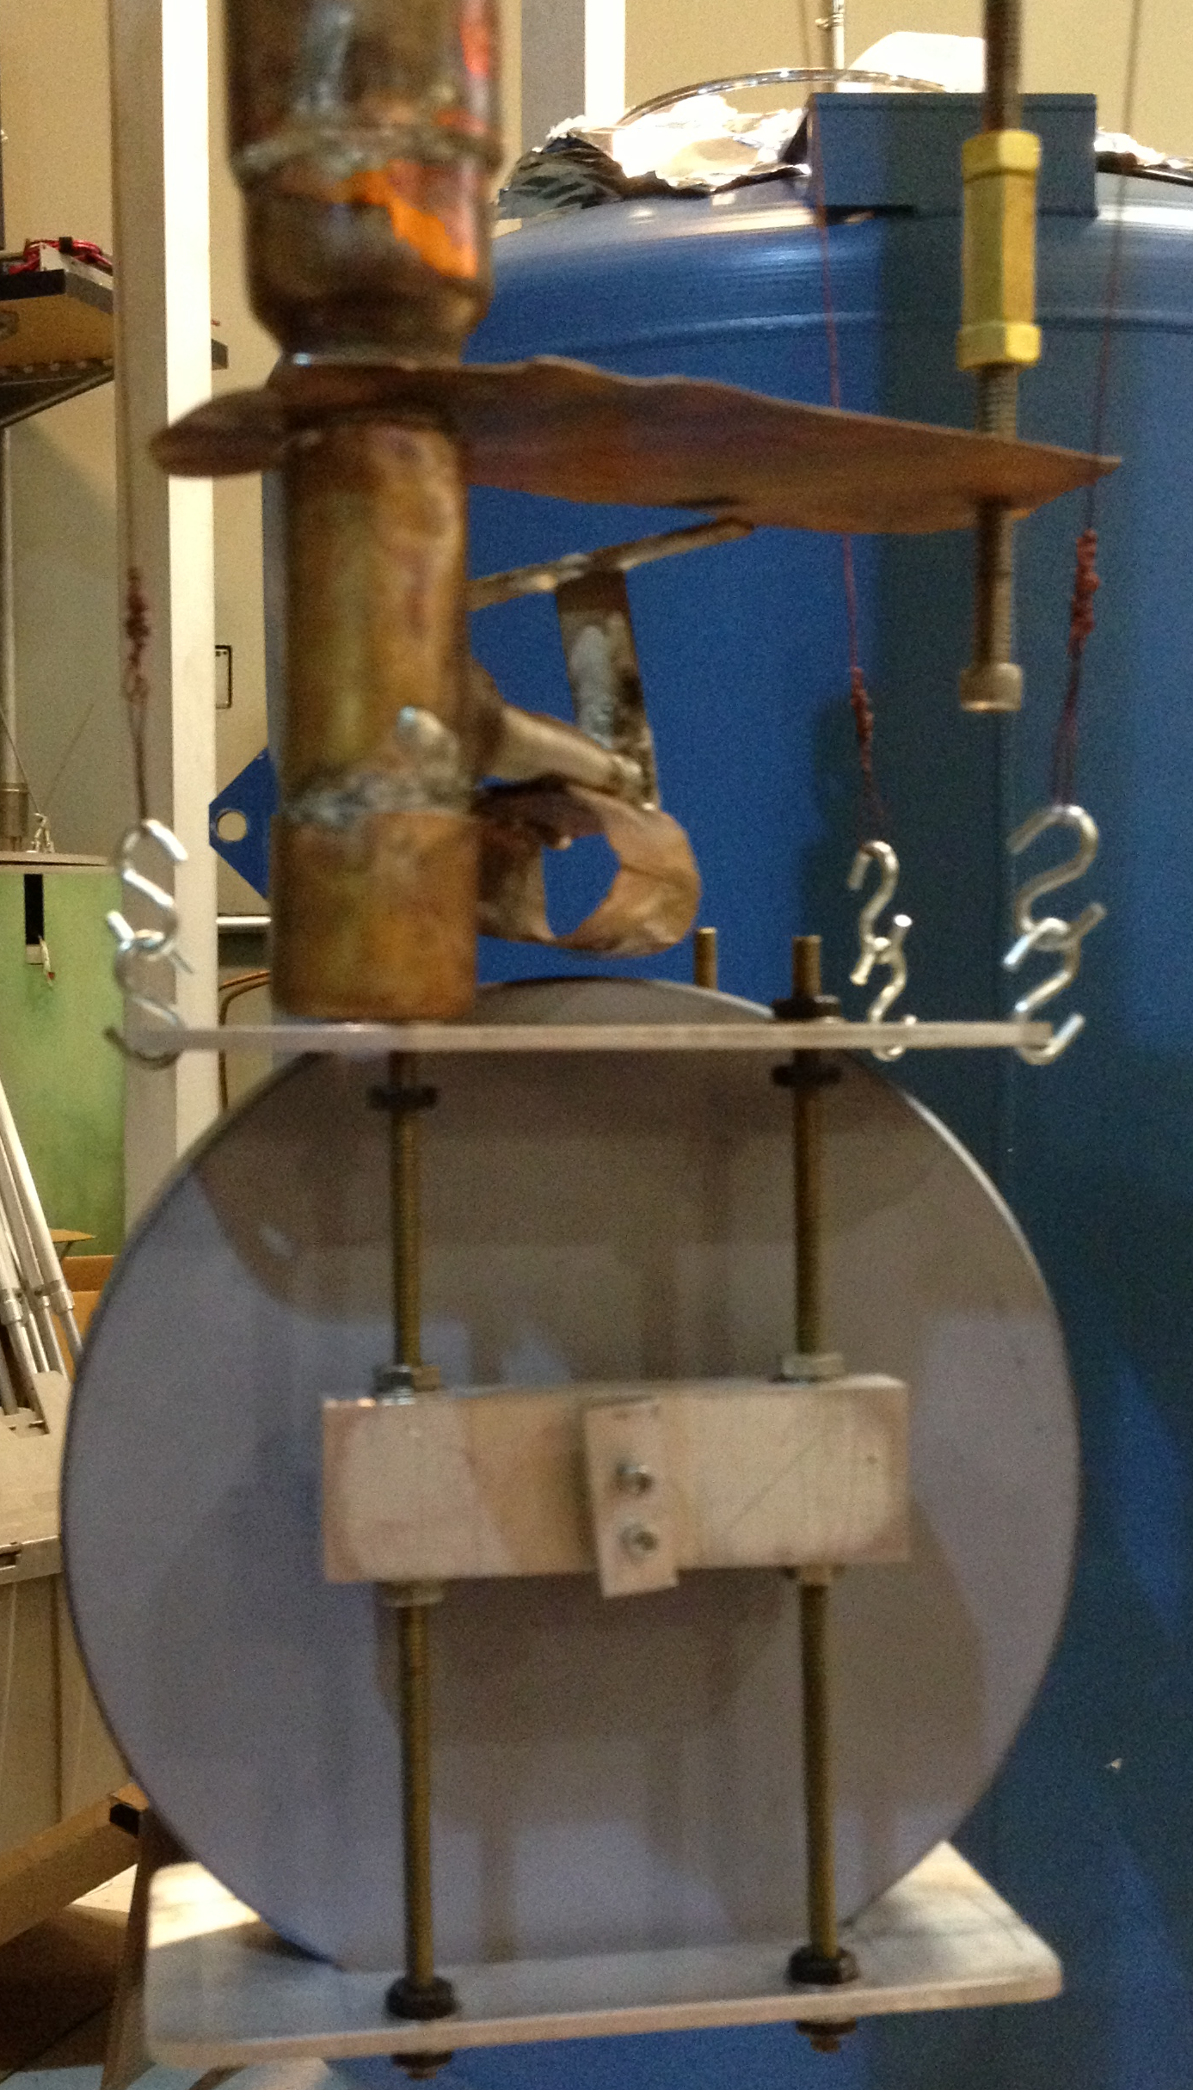
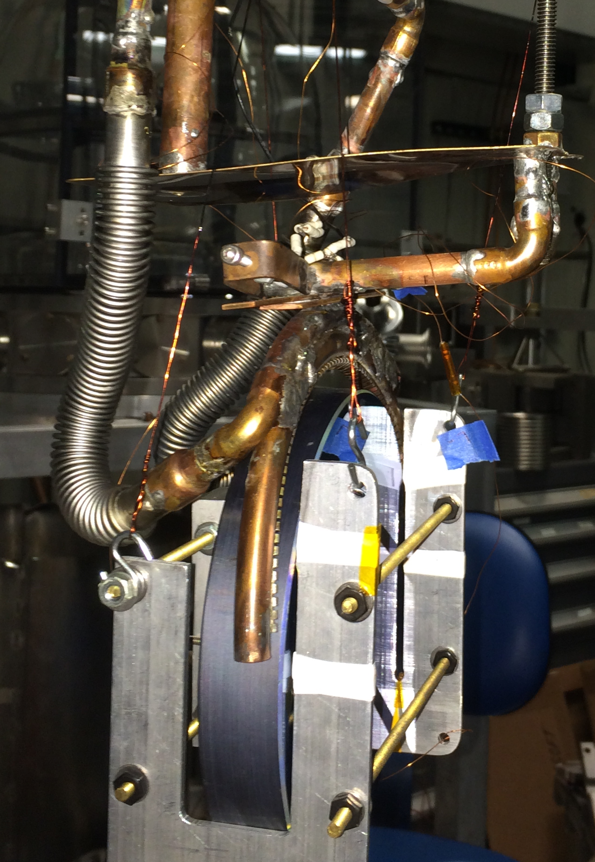
Flexible cold link evolution
Time

Slide 35
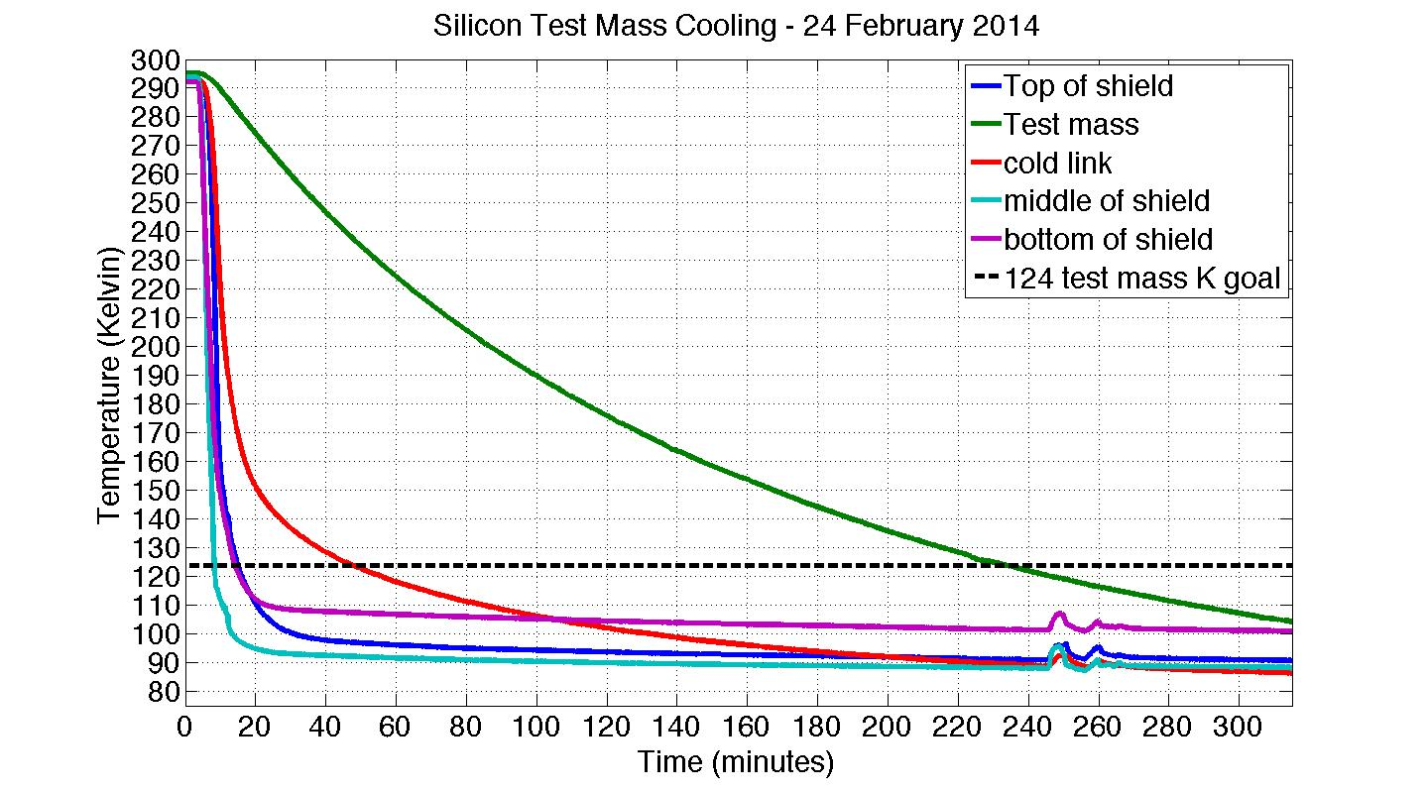
Measurement – cold link engaged
140 min time constant

Slide 36
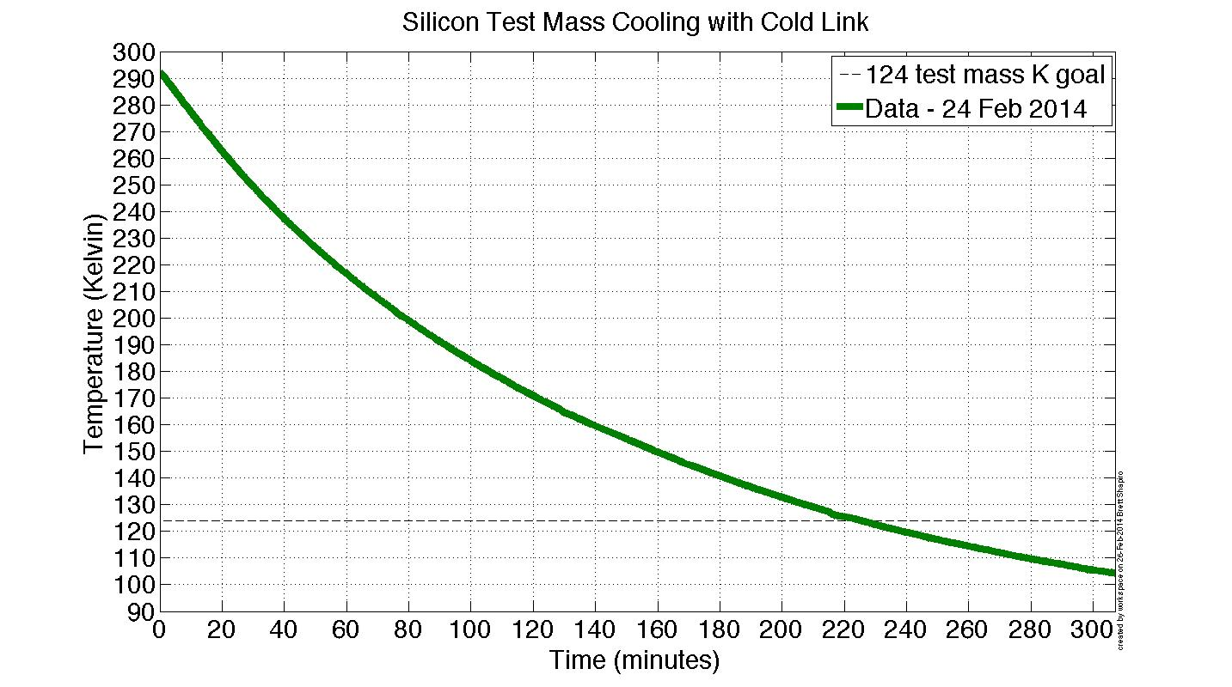
Test mass temperature modeling

Slide 37
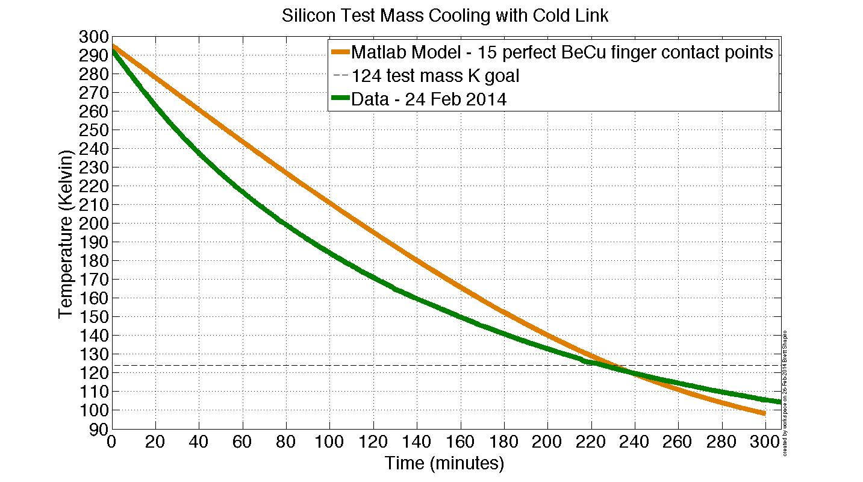
Test mass temperature modeling

Slide 38
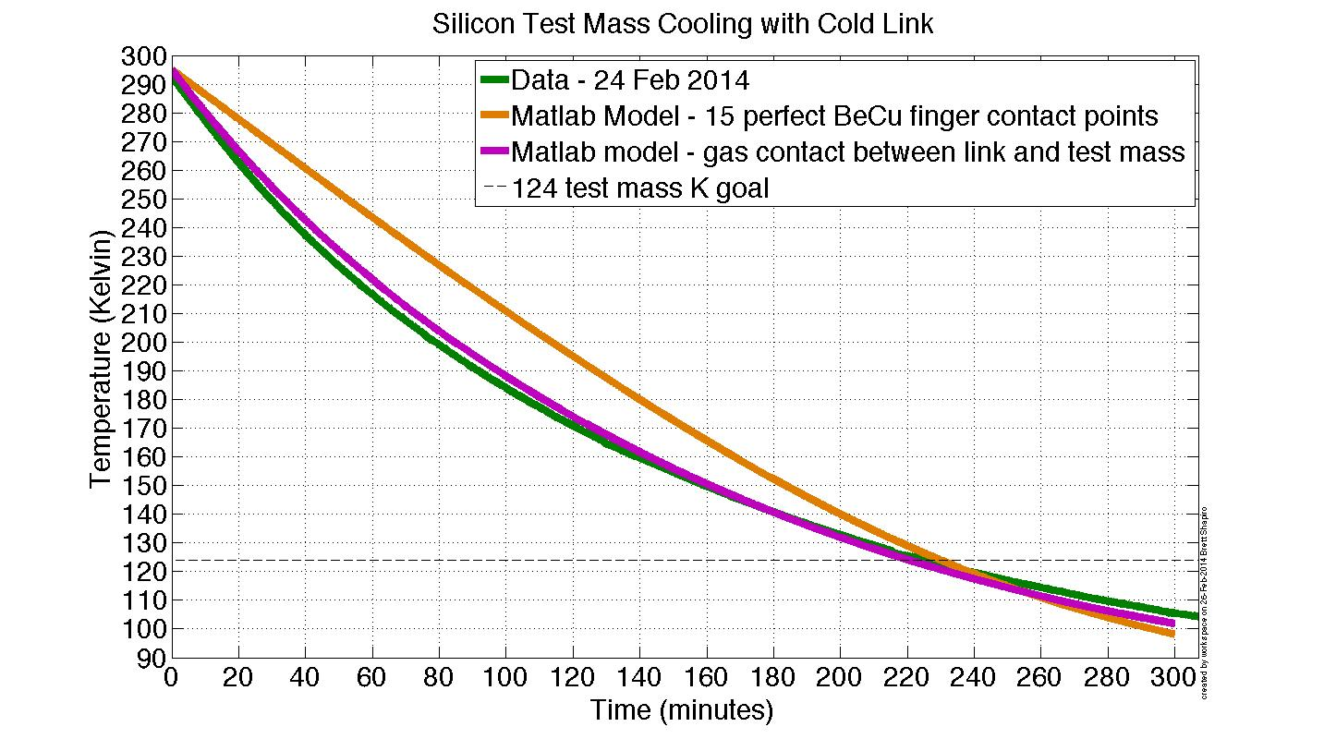
Test mass temperature modeling
Heat transfer goes through residual N₂ gas between test mass and cold link!

Slide 39
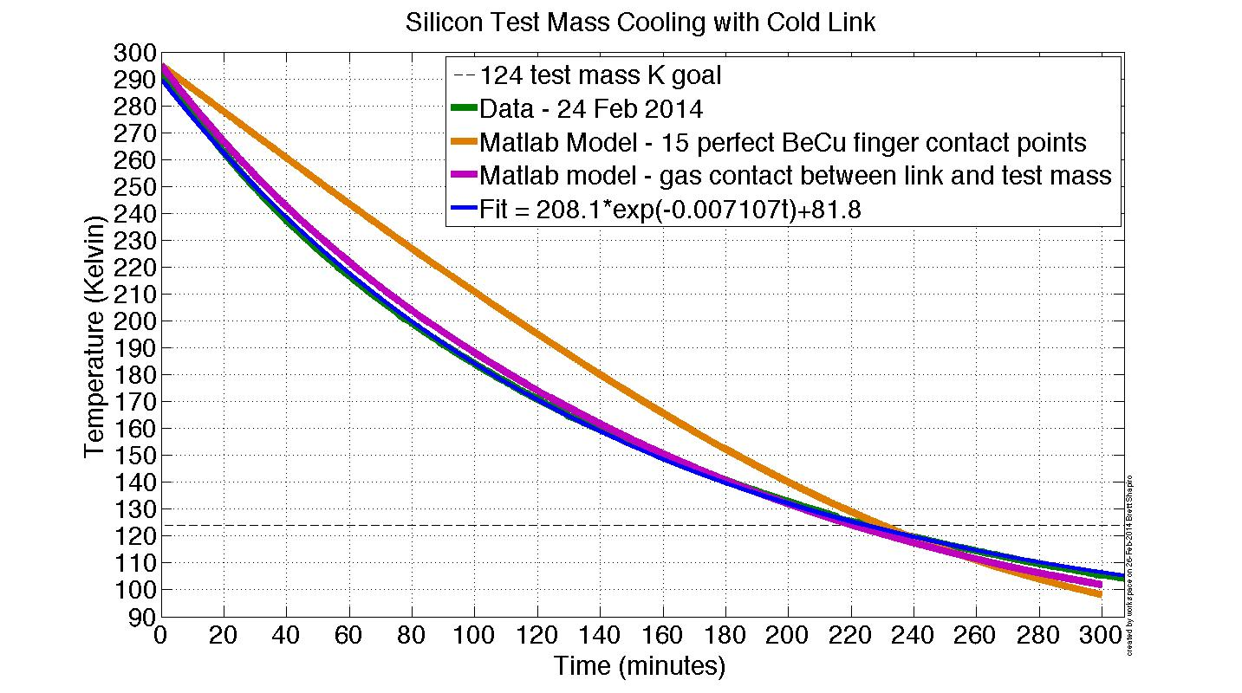
Test mass temperature modeling
This is a perfect exponential decay…
Heat transfer goes through residual N₂ gas between test mass and cold link!

Slide 40
Exponential Temperature Decay
These are both functions of temperature.
In general, the solution is not truly exponential since the time ‘constant’ changes.

Slide 41
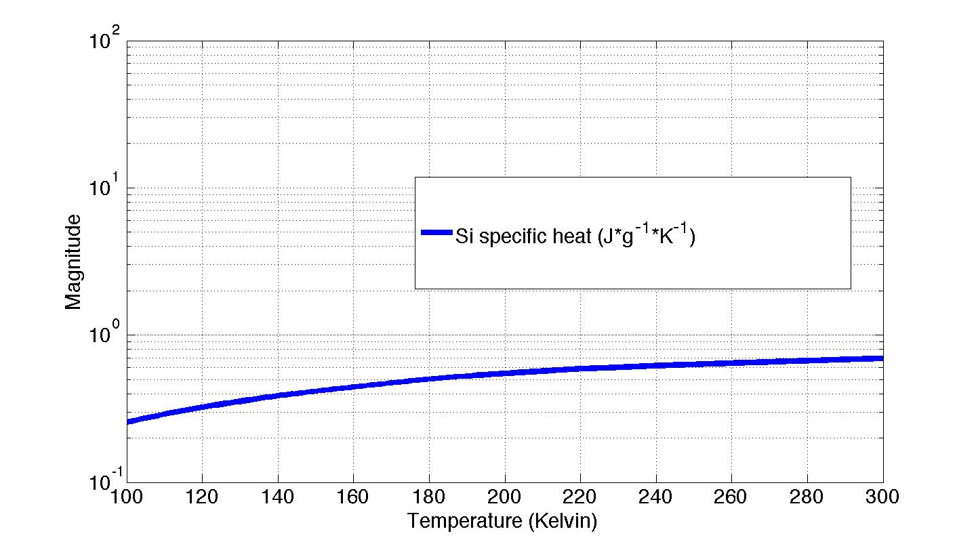
Exponential Temperature Decay

Slide 42
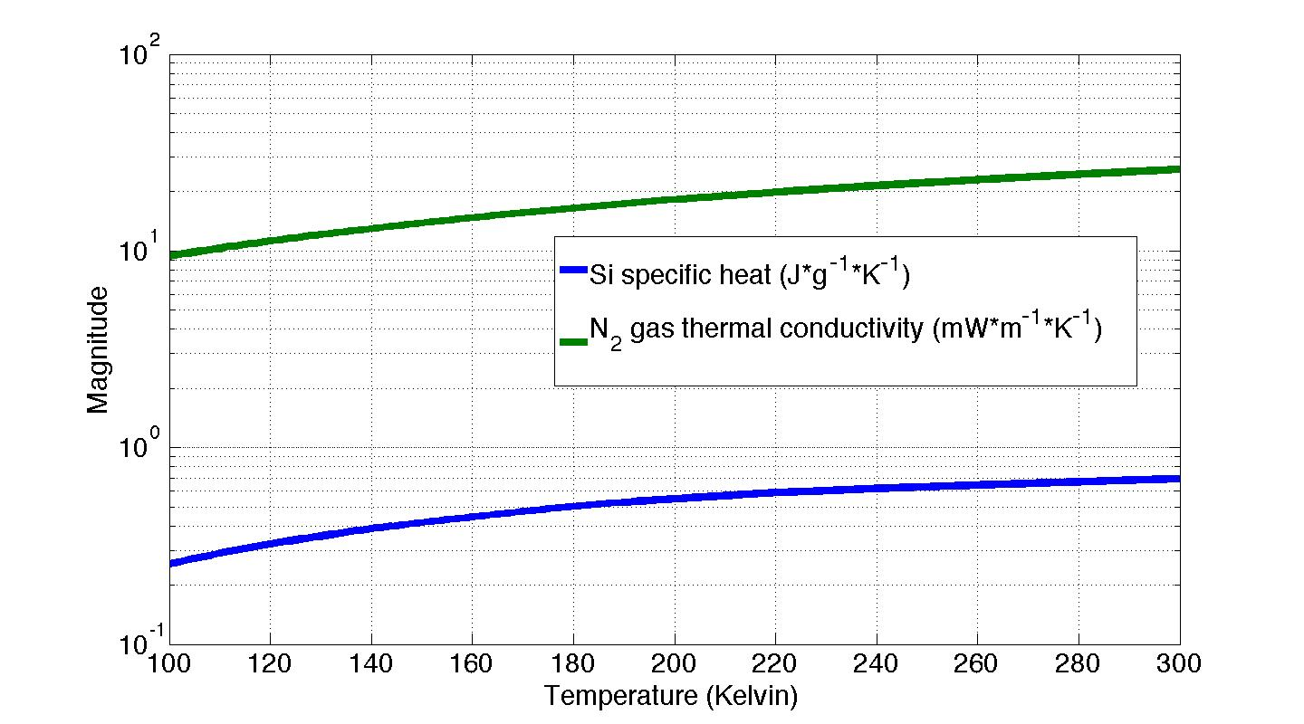
Exponential Temperature Decay

Slide 43
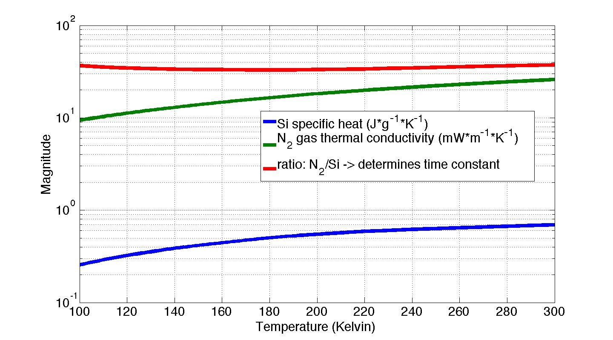
Exponential Temperature Decay

Slide 44
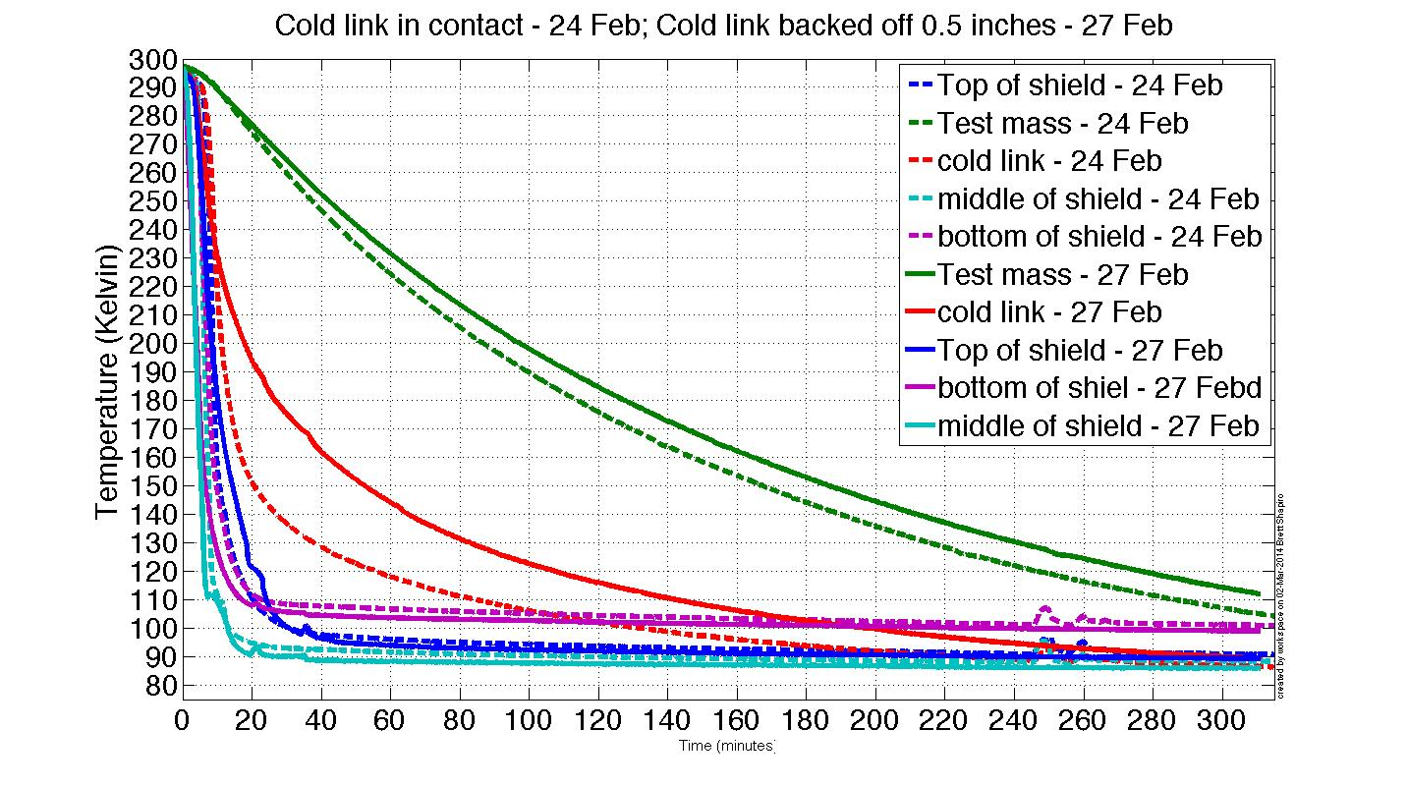
Measurement – cold link disengaged
160 min time constant

Slide 45
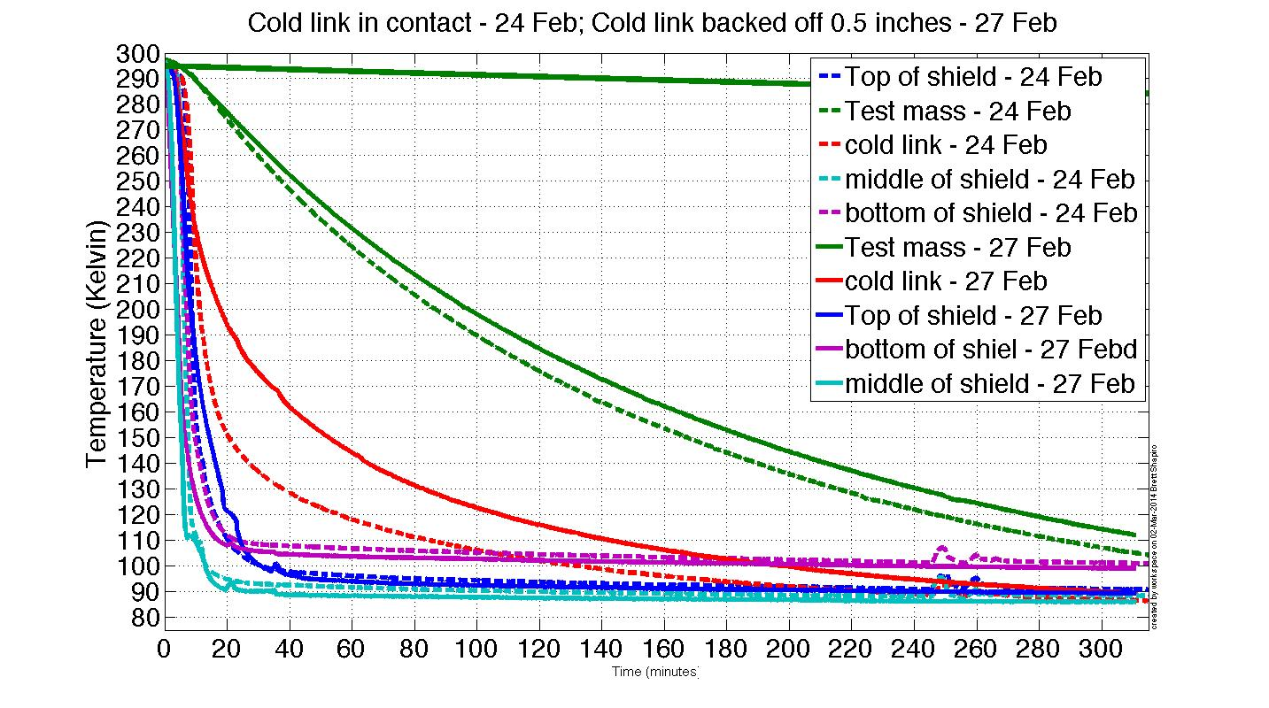
Measurement – cold link disengaged
Simulation assuming only N₂ gas conduction
160 min time constant

Slide 46
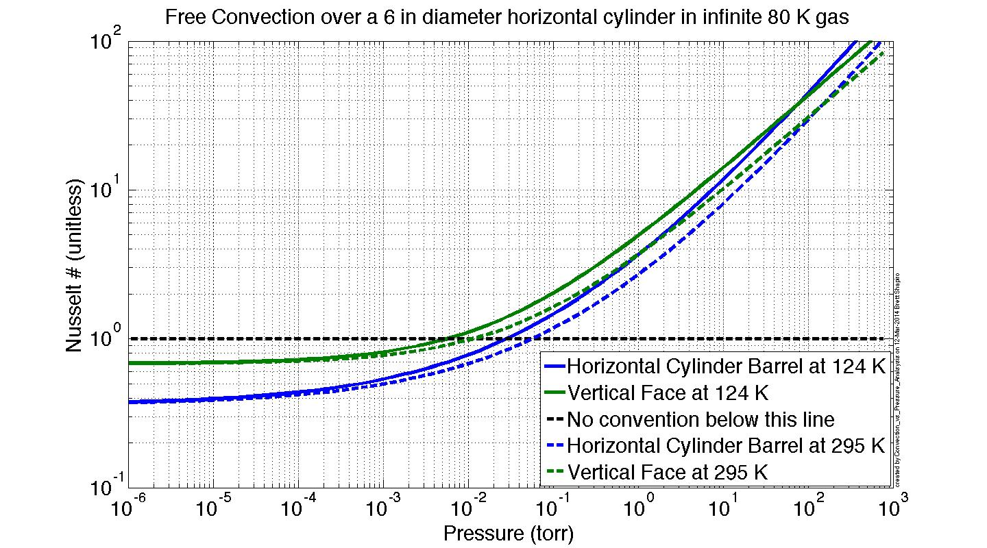
Conductive vs Convective Regimes
Convection

Slide 47
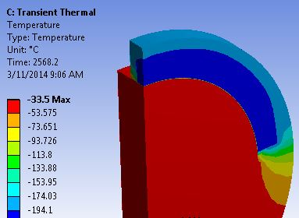
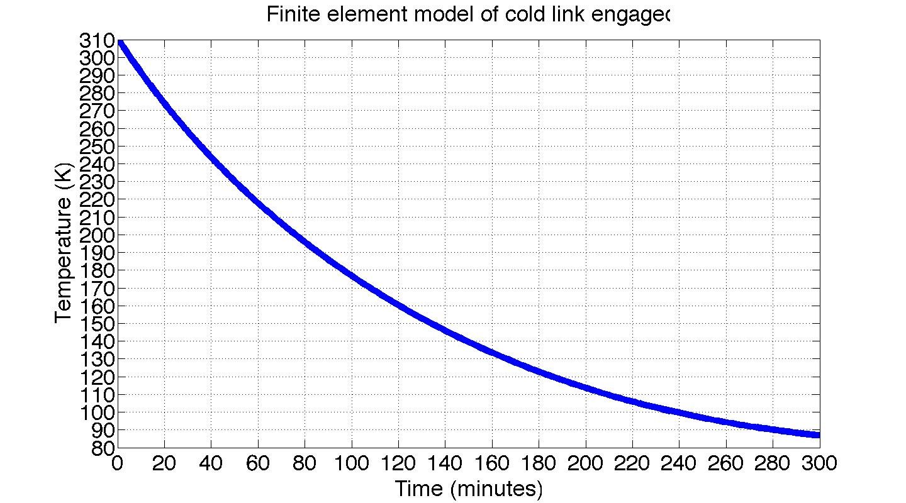
Finite Element Modeling
Due to complexity, LIGO III designs must be verified with modeling or FEM
Below: FEM of conduction through N₂ gas to cold link for Stanford experiment
N₂ gas
Cold link
Test mass
≈ 43 min into cool down
Convective FEM is proving to require large amounts of computing power
Images courtesy of Tim MacDonald

Slide 48
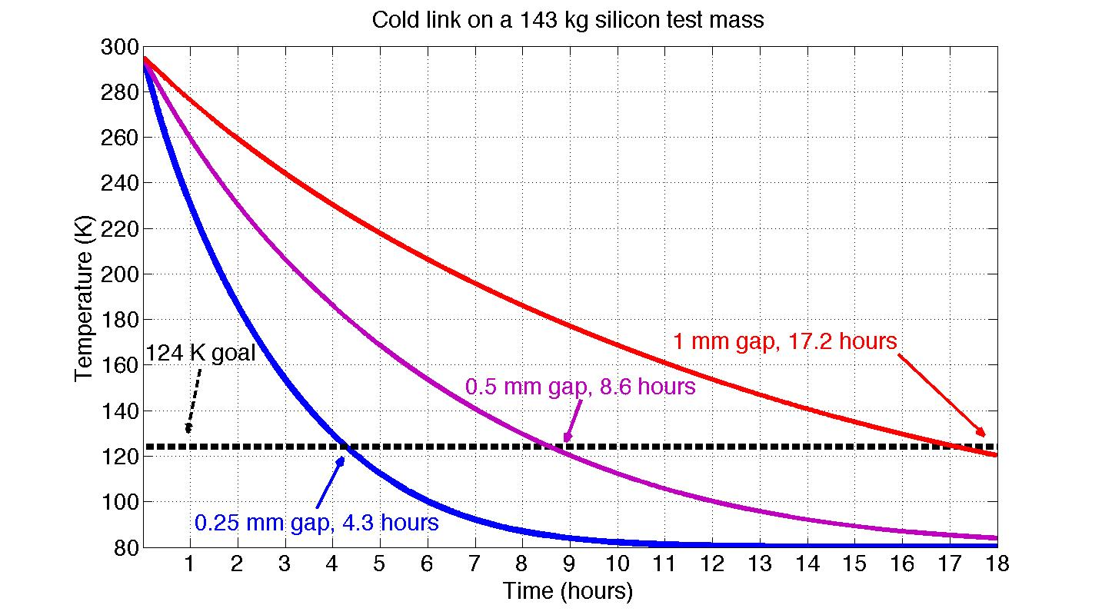
Cold link on a LIGO III test mass
Conduction limit, no convection
Test mass radius = 280 mm
Test mass thickness = 250 mm
Cold link covers 2/3 of top barrel

Slide 49
Stanford Next Gen Experiment

Slide 50
Stanford Next Gen Experiment Layout
Vacuum wall
Maraging steel blade spring
Cold link
Cold link
motor
Heat shield
GN₂ feedthrough
Test mass
LN₂ pipe around shield
LN₂ return
LN₂ supply
Stainless steel legs
LN₂ feedthrough
ISI Stage 2
ISI Stage 1
chiller

Slide 51
Future work
LIGO
Next generation experiment using the Stanford ETF (experimental test facility)
More realistic LIGO setup
Measure temperature drifts on LIGO hardware, e.g. blade springs
Measure seismic noise of nitrogen delivery and/or copper cables
Test heat shield design
  Black coatings
  baffles
Test a variety of cooling techniques
System integration: how to make all this stuff work together
Implement in stages
  Cables/hoses first – test seismic noise
  Heat shield and suspended optic
  Install cryogenic refrigerator
  Cavity?
  Anything we haven’t thought of yet

Slide 52
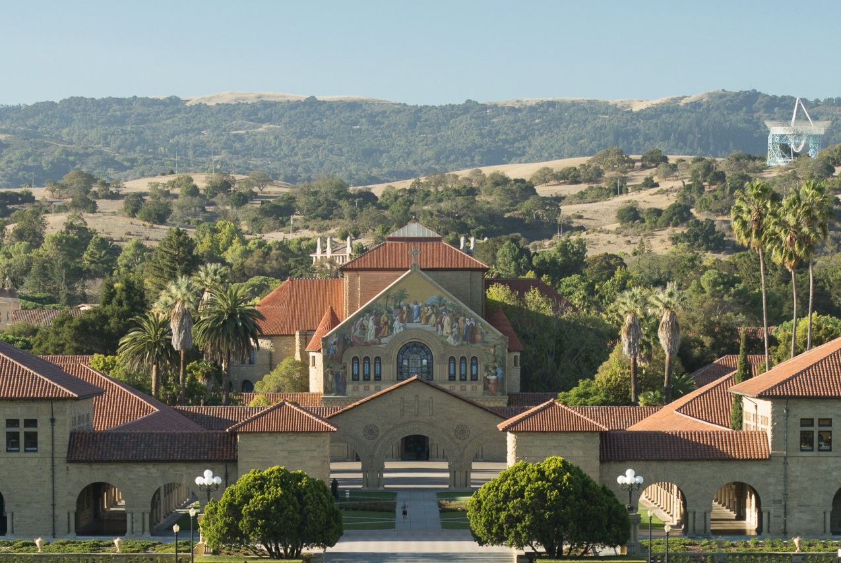
LVC STANFORD
August 25-29 2014

Slide 53
LVC STANFORD
August 25-29 2014
Accommodations
Registration – webpage coming soon
$250 Student rate
$500 Non-student rate
Includes:
Breakfast and lunch
Banquet dinner
Conference rooms
AV and AV Technicians
Poster session
Does not include:
Parking passes ($10/day)
Transportation to/from airport
Poster printing
Carothers Hall
(30) Single Rooms: $77.20 per person/night
(85) Double Rooms: $56.70 per person/night
Benefits:
5 minute walk to conference.
Outdoor facilities available:
Telephone in each
Comfortable and clean facility.
Onsite management.
Free laundry facilities.
Linens provided
Quiet areas including business center/lounge.
Crothers Hall is exclusive to LVC.
Free shuttle service to shopping/restaurants
Alternate accommodations (hotel)
$180-350/night
Contact Claudette Earl
cearl@stanford.edu

Slide 54
Backups
LIGO

Slide 55
Test Mass in Next Gen Prototype
LN₂ pipe flexure
(2nd one not shown)
LN₂ pipe
Cold plate
Si test mass
6” dia, 1” thick, 1 kg

Slide 56
Experimentation lessons learned
Air dominates most heat flow across contacts
Cold links should have distributed contacts
Solder is not leak tight against high pressure cryogenic fluids – welding is probably best
Cryogenic fluid should have 1 flow path
Send fluid from bottom up
Use fatter pipes to minimize fluid pressure
Minimize the number of materials in the plumbing – joining and contraction issues
Leave room for differential contraction
Silicon diode temperature sensors are great

Slide 57
Steady State LN₂ flow rate
What flow rate do we need to maintain the shield at about ≈ 80 K?
H_{L} [W/m]
LN₂ flow
r
dx
Differential fluid element
Simplified LN₂ shield pipe
L

Slide 58
H_{L} [W/m]
LN₂ flow
r
dx
Differential fluid element
Simplified LN₂ shield pipe
L

Slide 59
H_{L} [W/m]
LN₂ flow
r
dx
Differential fluid element
Simplified LN₂ shield pipe
L

Slide 60
Scaling laws of LN₂ pipes vs. Cu cables
Cu cable
LN₂ pipe

Slide 61
Scaling laws cont.
Cu cable
LN₂ pipe

Slide 62
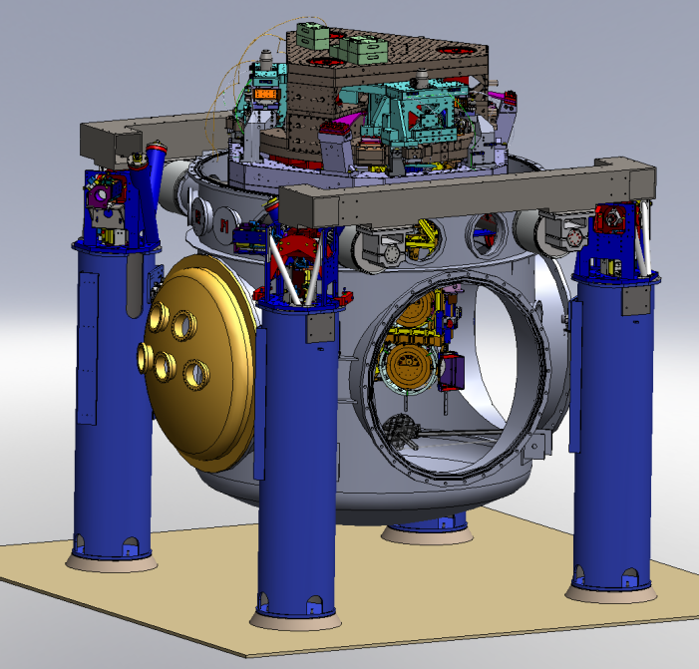
Advanced LIGO Layout
ETM
4 km
Input
Mode
Cleaner
Power Recycling
ITM
Φ
FI
CP
ITM
Laser
m
125 W
815 kW
ETM
5.7 kW
BS
Signal Recycling Cavity
FI
PD
Installation complete in 2014
Observing GWs in 2015
GW readout
Output
Mode
Cleaner

Slide 63
How to get a LN2 Hose to ST2
Vacuum flange
LN₂ hoses: Supply and return
Stage 0
Actuators
Stage A
Stage 1
Sensors
Stage 2
clamps
Extra stage, A, in parallel with stage 1 carries hose. Stage A is actuated to follow stage 2 so the hose has does not short seismic isolation. Stage A sensor noise is set by the stage 2 isolation requirement (so it follows stage 2 and not the sensor noise).

Slide 64
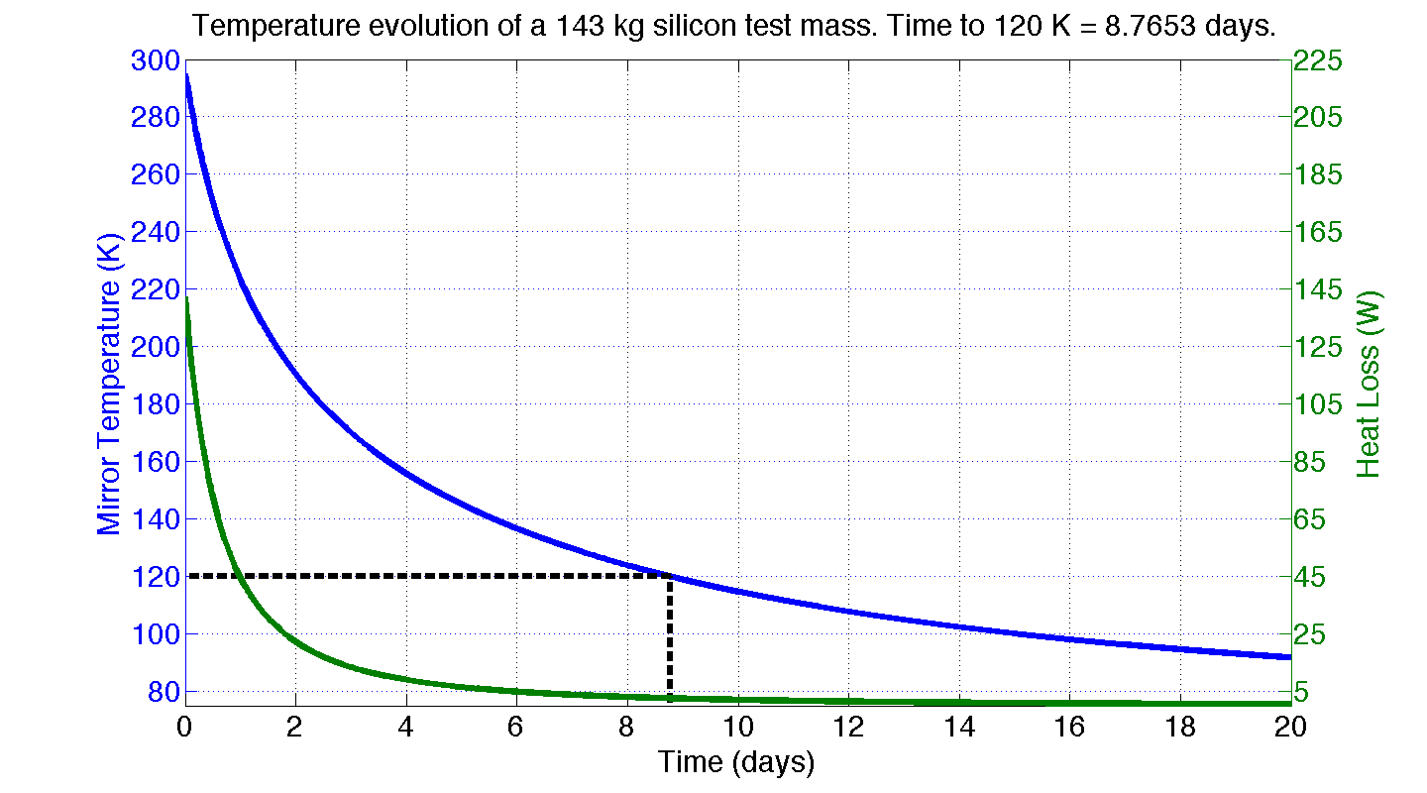
Test Mass Radiation Simulation
Ideal radiation shield:
Fully encloses test mass
77 K (liquid N₂)
Shield emissivity = 1
Test mass barrel emissivity = 0.5
Laser power = 0
Power α (Temperature)^4

Slide 65
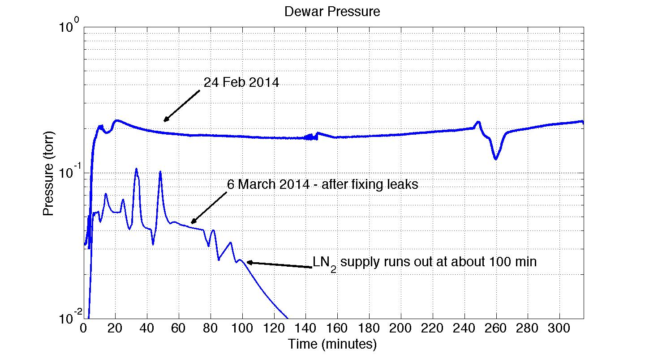
Dewar pressure during measurements

Slide 66
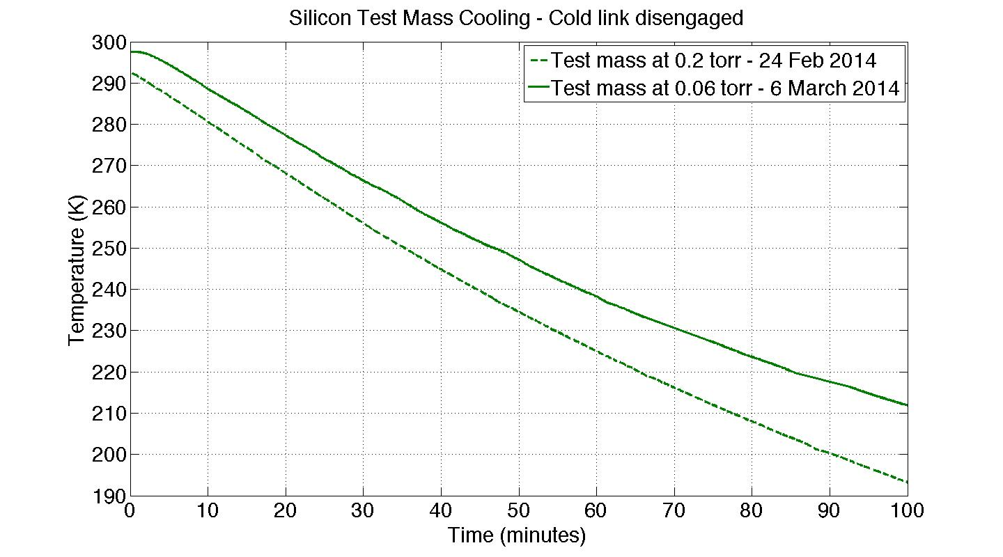
Effect of pressure on test mass temp

Slide 67
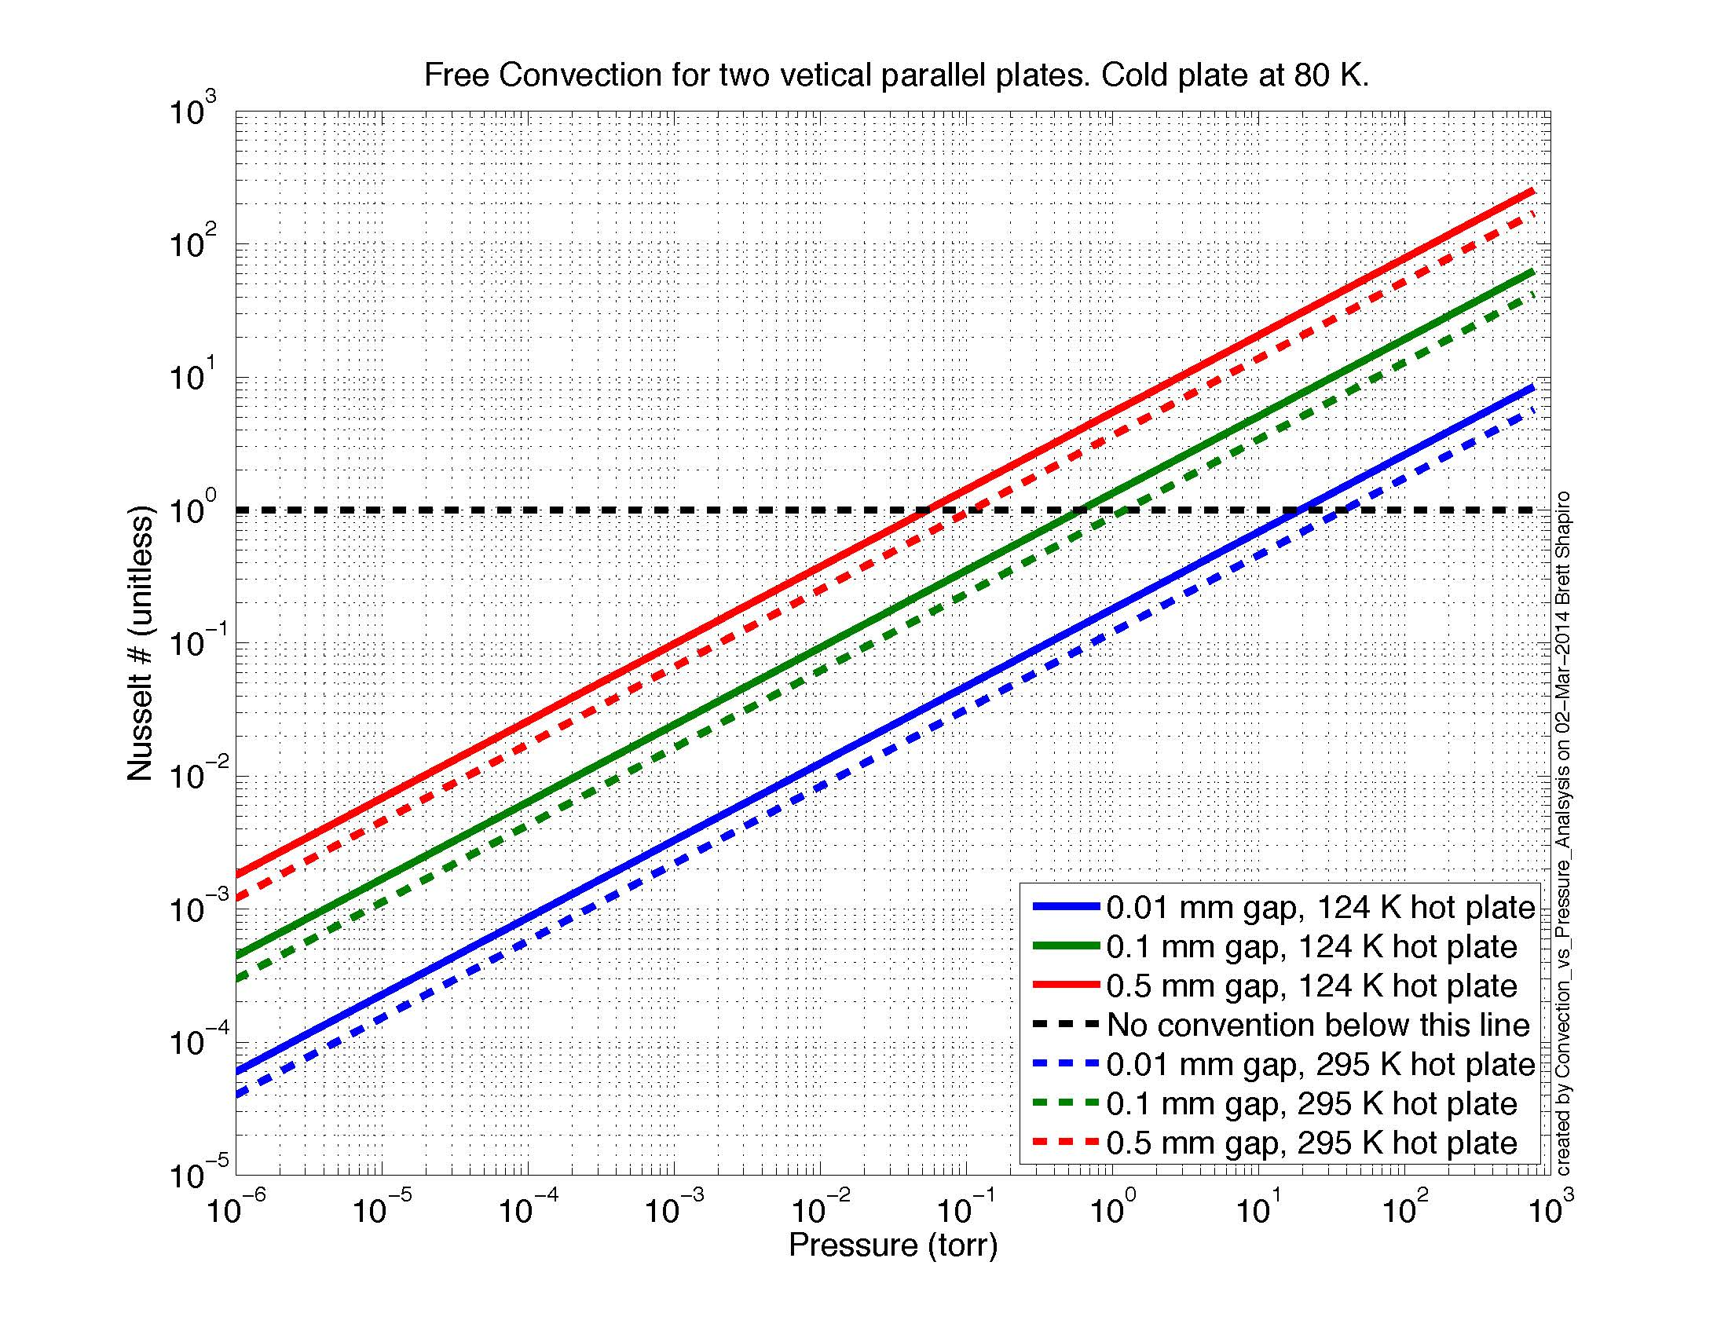

Slide 68
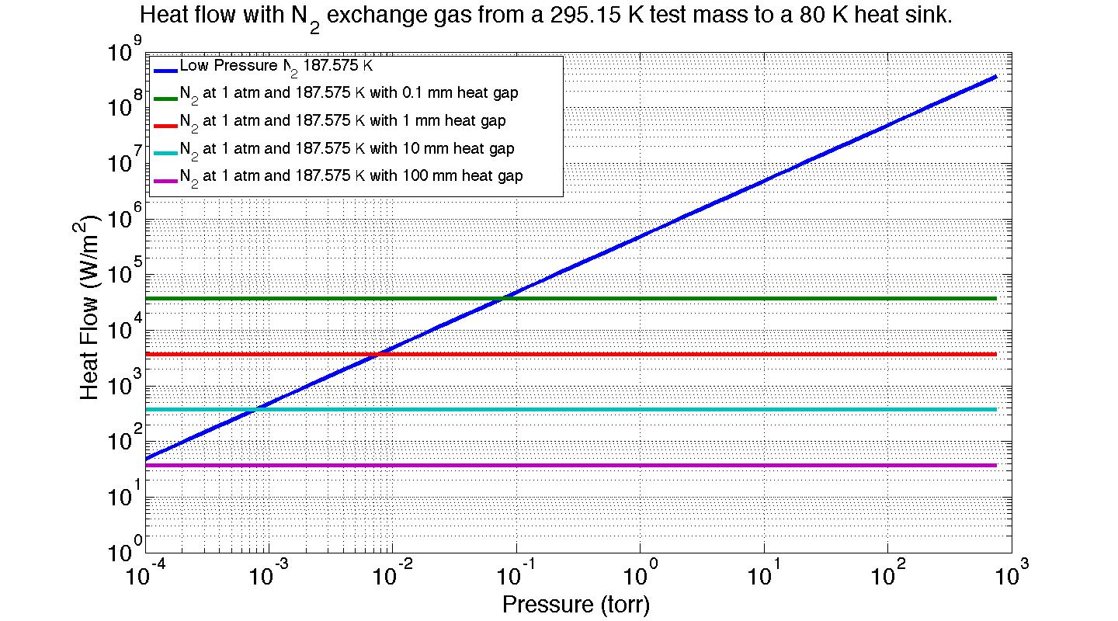
N₂ gas therm. cond. vs pressure

Slide 69
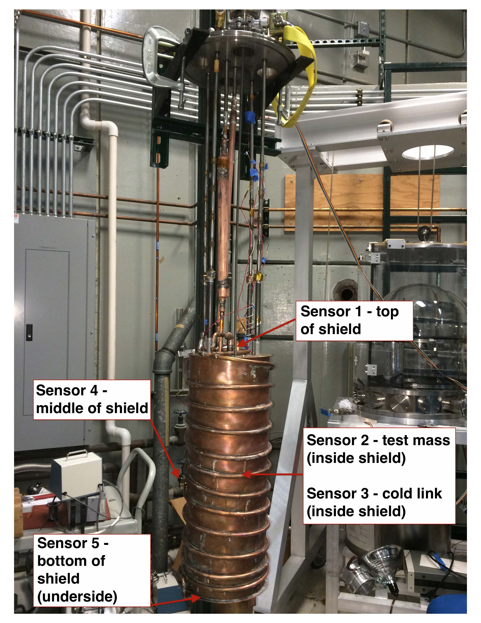
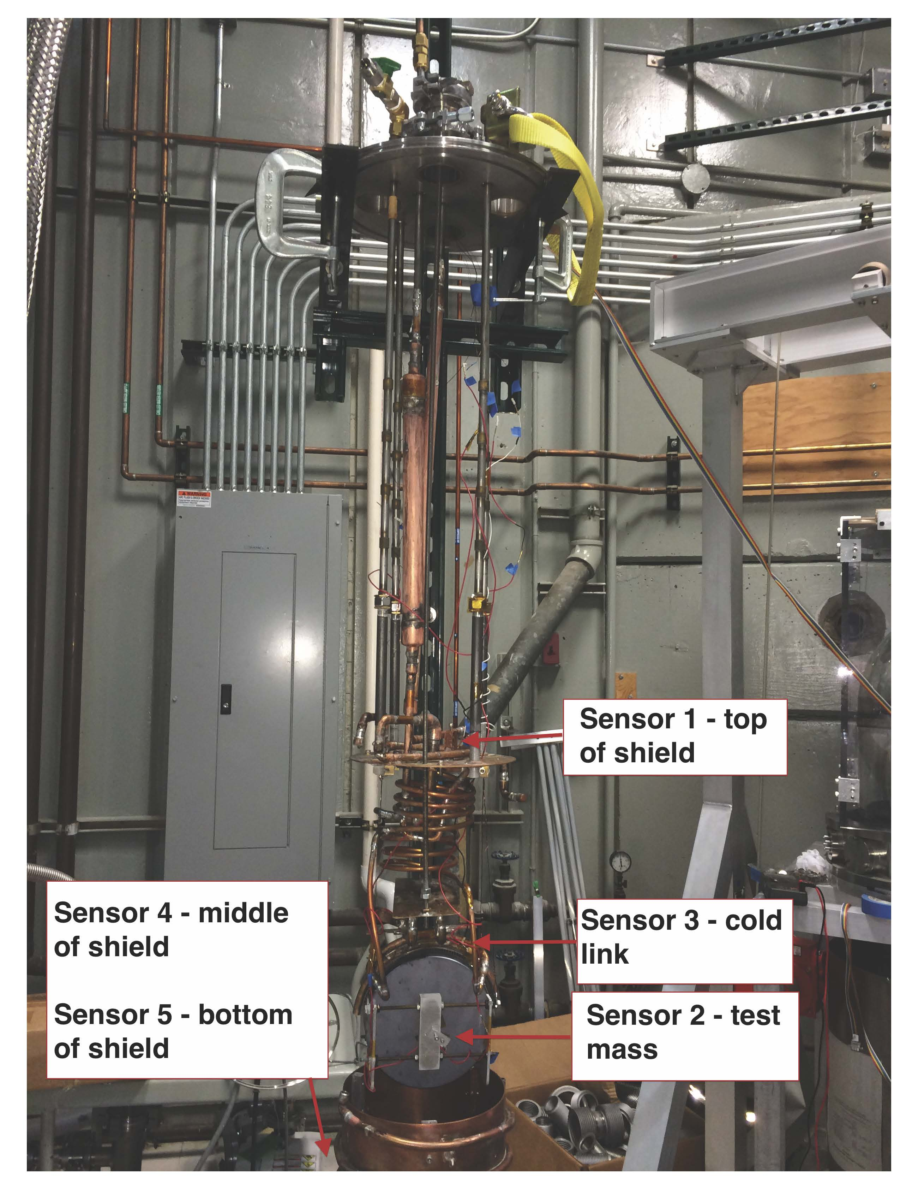
Temperature Sensor Locations

Slide 70
Test Mass Temperature Equations

Slide 71
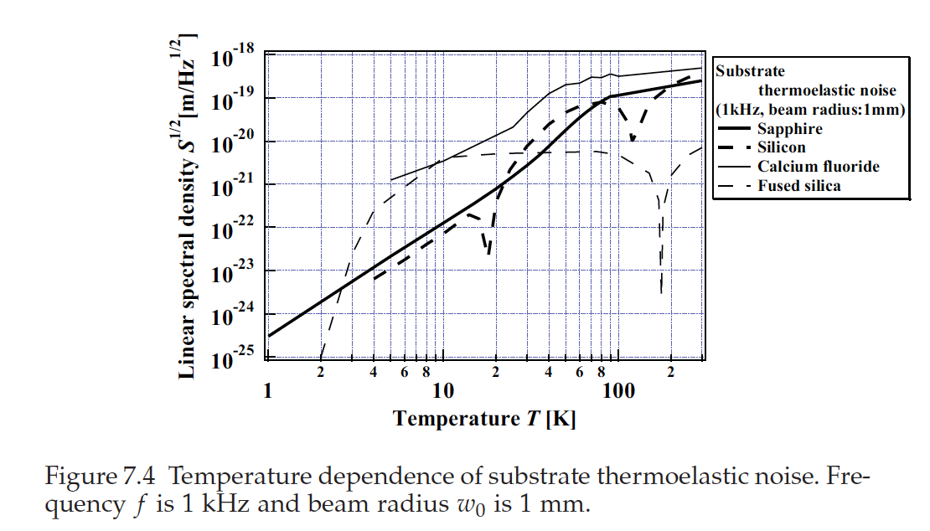
ref: Harry, Bodiya, Desalvo. Optical Coatings and Thermal Noise in Precision Measurement. 2012. pg 113.

Slide 72
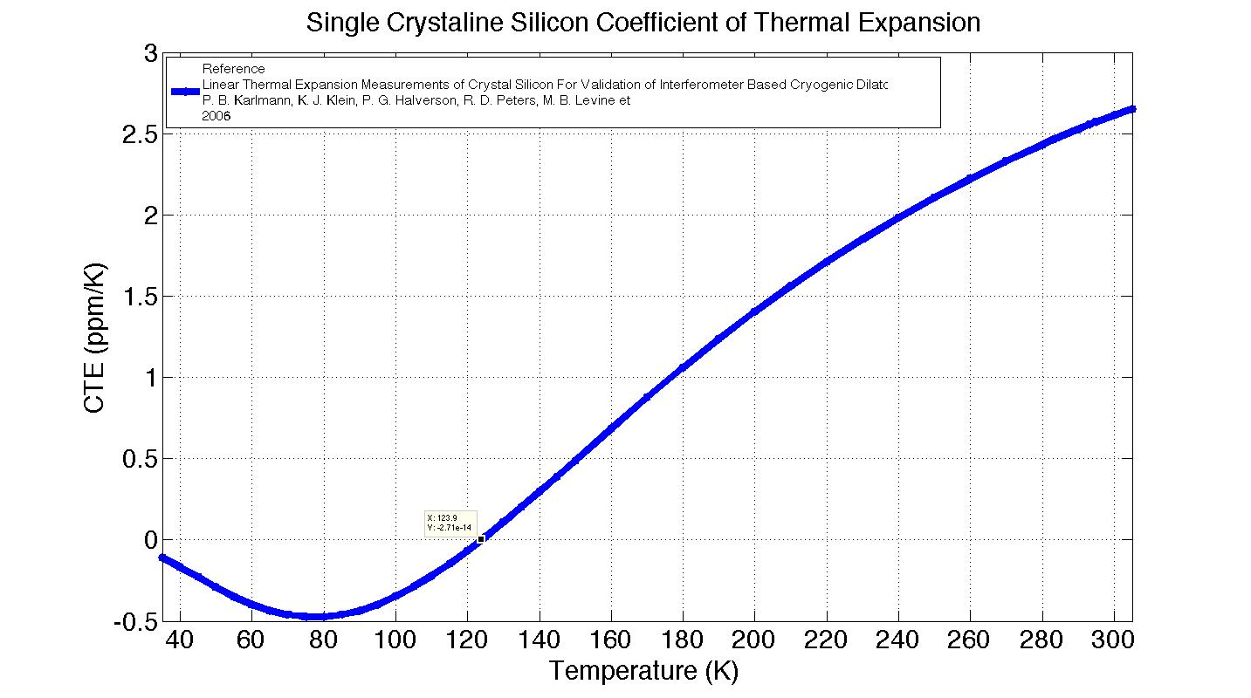
Si CTE vs Temperature
Thermoelastic component of thermal noise goes to zero with CTE.

Slide 73
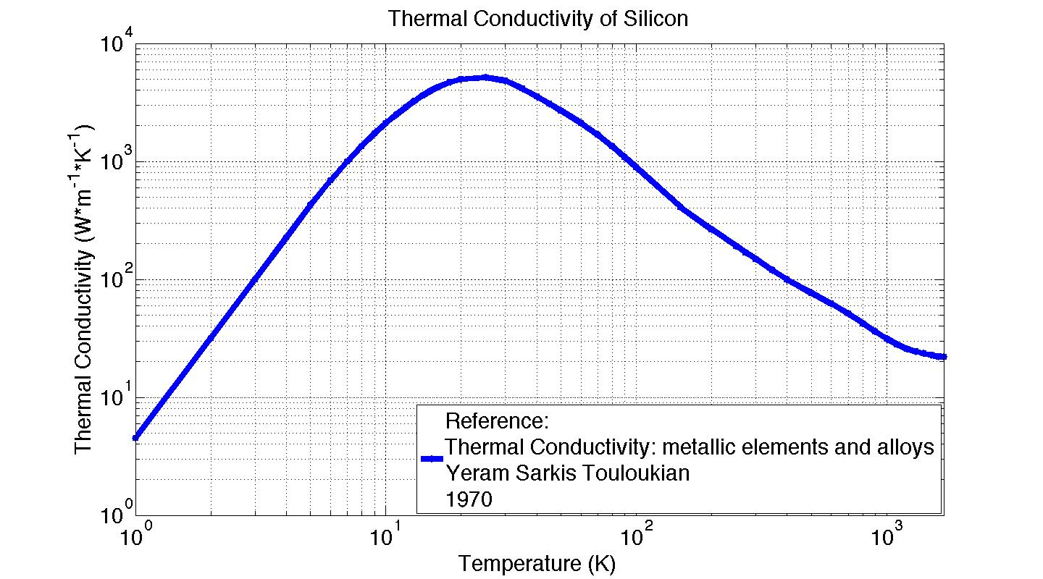
Si Thermal Conductivity vs Temp.

Slide 74
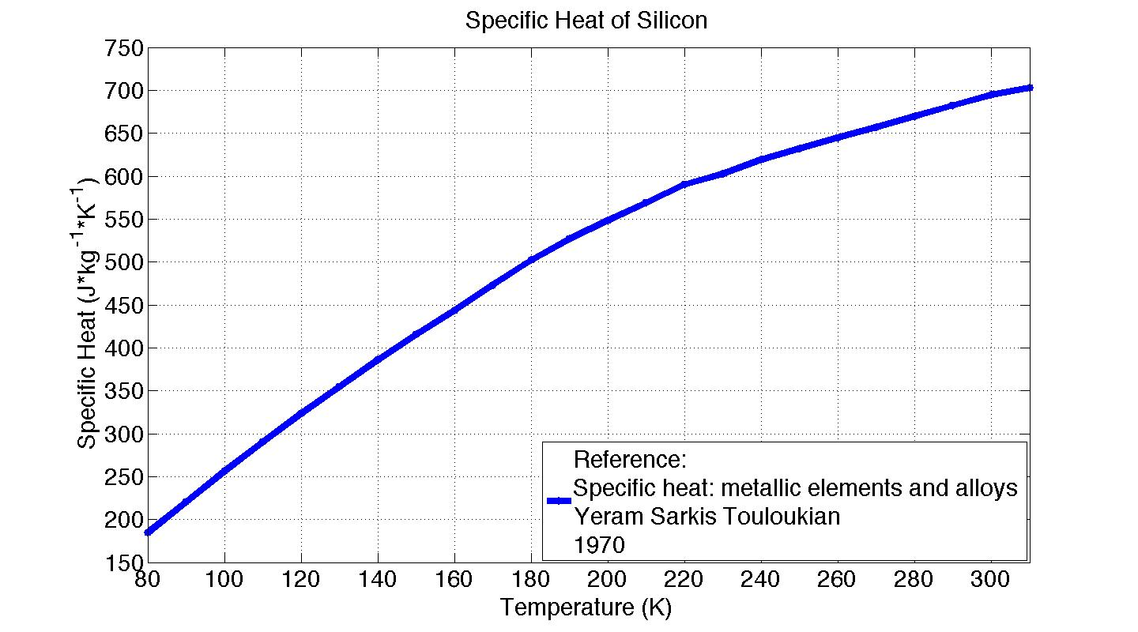
Si Specific Heat vs Temperature

Slide 75
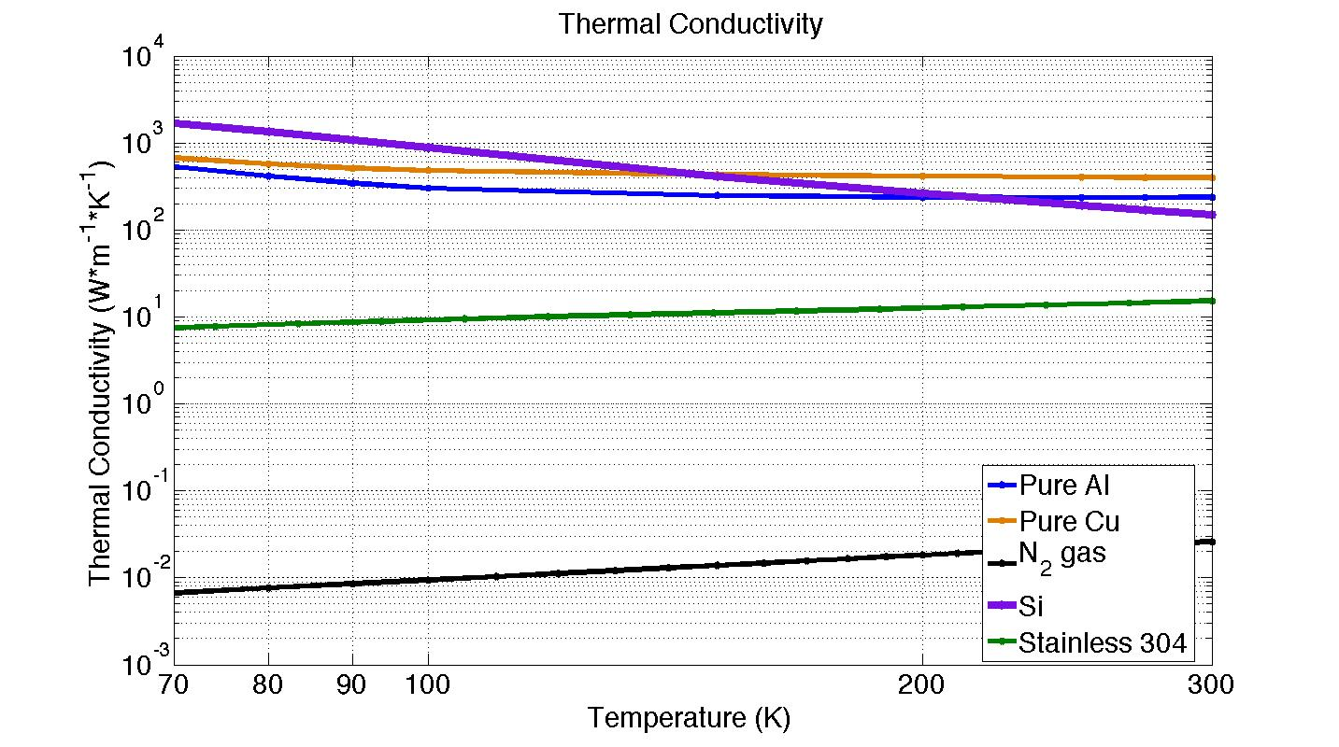
Thermal Conductivity of Materials
References: Stainless: NIST, CRYOGENICS TECHNOLOGIES GROUP, http://cryogenics.nist.gov/
Al, Cu, Si: Thermal Conductivity: metallic elements and alloys, Touloukian 1970
N₂ gas: Thermal conductivity: nonmetallic liquids and gases, Touloukian 1970

Slide 76
Other Problems To Solve
Flexibility if liquid N₂ hoses or Cu cables
Temperature/height control of blade springs
Test mass temperature control
Test mass temperature tolerance
How to measure temperature?
  Measure acoustic modes – Young’s modulus is temp. dependent
  Measure test mass diameter – combined with CTE data gives temperature
  Infrared camera
Emissivity of optical coatings
Lossiness of emissive coatings
Good emissivity estimates/measurements of Si?
Power absorption in Si and Si coatings (ppm, W, etc)?
How noisy is flowing laminar liquid nitrogen: seismic, Newtonian?
Optical coating thermal noise at 124 K
How to actuate the test mass – is the ESD out?
Can we put viewports in the heat shield?

