Slide 1
LIGO Open Science Center Workshop
Jonah Kanner, Branson Stephens, Michele Vallisneri, Alan Weinstein, Roy Williams
LIGO-G1400509v4

Slide 2
Why LOSC?
Access data with ease
No need to login to LDAS cluster
Point and click download of LIGO data
Complete documentation and tutorials
Easy start-up for new students
Everything we do today (and more!) in online tutorials
Easy access to segment and DQ information
Load data in GW Frame or HDF5 format
LSC software stack is optional
Compatible with Python, Matlab, C, and many others

Slide 3
Step 0: Software Setup
Workshop assumes you have installed python, along with h5py, numpy, matplotlib
Software set-up instruction is at:
https://losc.ligo.org/tutorial00/
Create a directory for this workshop
Let’s call it “workshop”
Download the LOSC API, readligo.py, to the workshop directory: https://losc.ligo.org/s/sample_code/readligo.py

Slide 4
Step 1: Find data with “Timeline”
Timeline contains segment information
DATA available, Data Quality, and injections
Timeline can be used to:
Find times of good (or bad) data quality
Learn when GW detectors were running
Download segment lists
Download LIGO data files

Slide 5
Step 1: Find data with “Timeline”
Go to the S5 Data Page:
https://losc.ligo.org/S5/
Click “S5 Timeline Query Form” near the bottom
Enter a start time of 843895500
Enter a duration of 3600
Choose the Plot option
Choose the H1_CBCHIGH_CAT2 and H1_HW_BURST flags
Click the link at the bottom to see the timeline

Slide 6
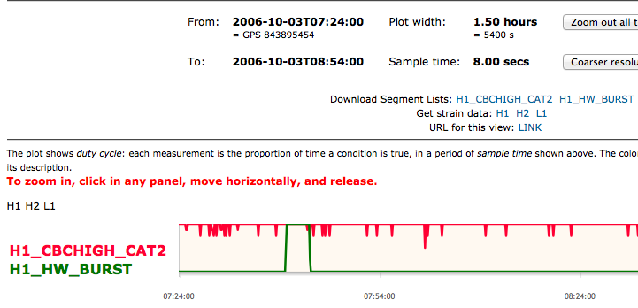
Step 1: Find data with “Timeline”
Links to download segment lists and data
The red curve shows that this data “passes” CAT 2 flags for the CBC High mass search most, but not all, of the time.
The green curve shows the time of a burst hardware injection

Slide 7
Step 1: Find data with “Timeline”
Can use buttons to “zoom out” to see all of S5
Click and drag on plot to “zoom in” on any time

Slide 8
Step 2: Download data
From the timeline page, click the link for “Get the strain data” for “H1”
Each line represents 4096 s of LIGO data
Click the links that say “HDF5” to download the files
Notice GW frame, or .GWF, format is also available
Save the files to your “workshop” directory or a sub directory
Directions for automated downloads are in the tutorials

Slide 9
Segment Lists
Most data analysis projects start with a segment list
May be times of SCIENCE mode data
May also be times of passing some data quality level (For example, BURST_CAT2)
LOSC provides segment information in 2 ways:
Segment lists may be downloaded from web through “Timeline” (See Slide 6)
OR
Segment lists may be constructed from bit masks in LOSC data files

Slide 10
Step 3: Create a segment list
Start python (or iPython, or Canopy, or Anaconda, or an iPython notebook)
Make sure your working directory is the ‘workshop’ directory you created
Enter commands as a script in a text file
Not directly in the interpreter
Import the modules we’ll use:
import readligo as rl
import numpy as np
import matplotlib.pyplot as plt
import matplotlib.mlab as mlab
plt.ion()

Slide 11
Step 3: Create a segment list
Define the times that you have downloaded data.
dstart = 843894784
dstop = dstart + 4096
Use the LOSC API to create a segment list
# -- Create a CBC High mass post CAT 2 segment list
seglist = rl.getsegs(dstart, dstop, 'H1’,flag='CBCHIGH_CAT2')
print seglist
Note: The data for the segment lists are contained in the files you already downloaded. There are no calls to a segment data base.

Slide 12
Step 4: Load LIGO data
We’ll write a loop over each segment in the list we just made
# -- Load the data for each of the first 3 segments
for (start, stop) in seglist[0:3]:
strain, meta, dq = rl.getstrain(start, stop, 'H1')
The variable “strain” now contains this segment of data as a numpy array
You got the data. That’s it!
But, we’ll work a few more examples just for fun ☺

Slide 13
Step 4: Load LIGO data
Now that we’ve got a loop to load data, let’s add a few lines to plot an ASD for each segment
# -- Load the data for each of the first 3 segments
for (start, stop) in seglist[0:3]:
strain, meta, dq = rl.getstrain(start, stop, 'H1')
#-- For each segment, plot the ASD
fs = int(1.0/meta['dt'])
Pxx, freqs = mlab.psd(strain, Fs = fs, NFFT=4*fs)
plt.loglog(freqs, np.sqrt(Pxx), label=str(start))
# -- Make the plot look nice
plt.axis([10, 2000, 1e-23, 1e-18])
plt.grid('on')
plt.xlabel('Freq (Hz)')
plt.ylabel('Strain / Hz$^{1/2}$')
plt.legend()

Slide 14
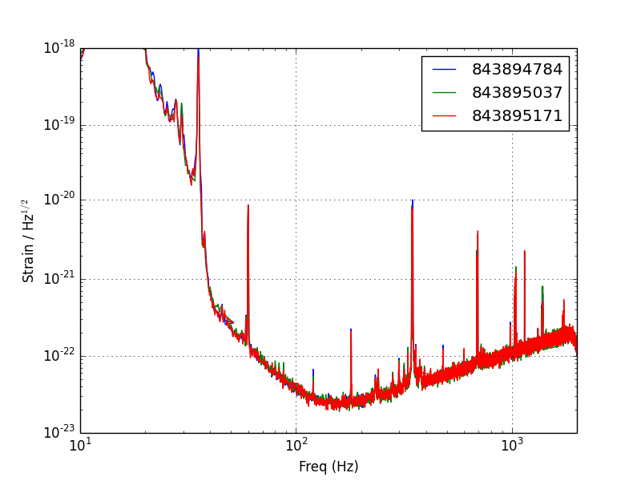
Step 4: Load LIGO data

Slide 15
Hardware Injection Documentation
The LOSC web site includes hardware injection documentation
Burst, CW, Stochastic, and CBC
Includes detailed lists of injection times & parameters
Hardware Injection times are marked in data quality segments
Tutorial with complete instructions for finding a CBC hardware injection
https://losc.ligo.org/tutorials/

Slide 16
Find a hardware injection
We can use the LOSC segment information to find times of hardware injections
The full list of S5 DQ flags is at:
https://losc.ligo.org/archive/dataset/S5/
# -- Define a segment list of hardware injection times
seglist = rl.getsegs(dstart, dstop, 'H1', flag='HW')
print seglist

Slide 17
Find a hardware injection
This is a burst hardware injection, so maybe it will show up in a spectrogram. We can load the data the same way we did earlier.
# -- As before, load the data for each segment
for (start, stop) in seglist:
strain, meta, dq = rl.getstrain(start, stop, 'H1')
# -- Make a spectragram of the data
fs = int(1.0/meta['dt'])
NFFT = fs/2
window = np.blackman(NFFT)
spec_power, freqs, bins = mlab.specgram(strain, NFFT=NFFT, Fs=fs,
window=window)

Slide 18
Find a hardware injection
Before plotting the spectrogram, we’ll normalize each frequency bin by its median power
# -- Normalize each frequency bin to the median power in that bin
for n in range(spec_power.shape[0]):
spec_power[n] = spec_power[n] / np.median(spec_power[n])
# -- Plot the spectragram
plt.figure()
ax = plt.subplot(111)
ax.pcolormesh(bins, freqs, np.log10(spec_power))
plt.xlabel('Time since GPS {0} (s)'.format(start))
plt.ylabel('Freq (Hz)')
plt.axis([0, stop-start, 0, fs/2])

Slide 19
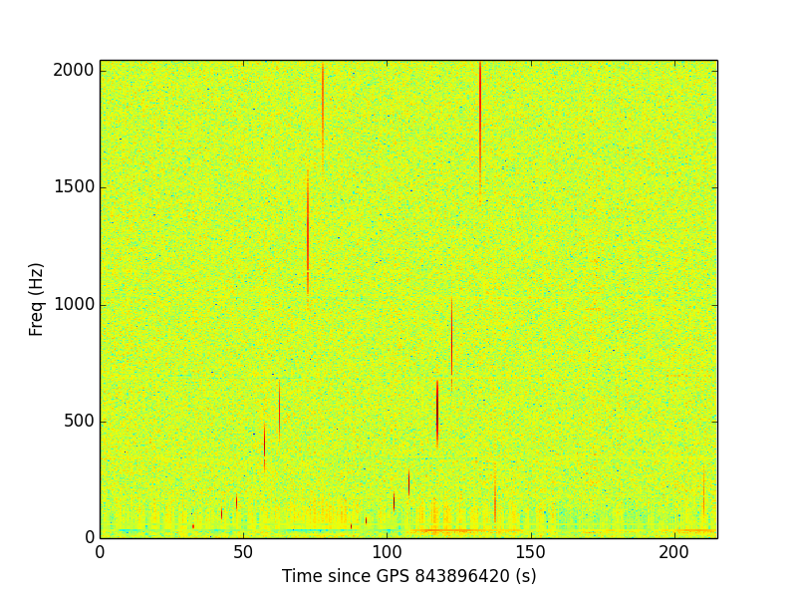
Find a hardware injection

Slide 20
Find a hardware injection
That looks like a bunch of injections. Can that be right?
The LOSC website hosts complete injection information. Let’s take a look, and see what we can find around this time

Slide 21
Hardware Injection Documentation
Return to the S5 Data Release page: https://losc.ligo.org/S5/
Near the bottom, click the link for Burst Hardware Injections
Find the annotated log for H1 S5 Burst Injections: HTML
Scroll or search the table for times included on the plot (near GPS 843896420)
Notice these tables can also be downloaded in machine readable formats

Slide 22
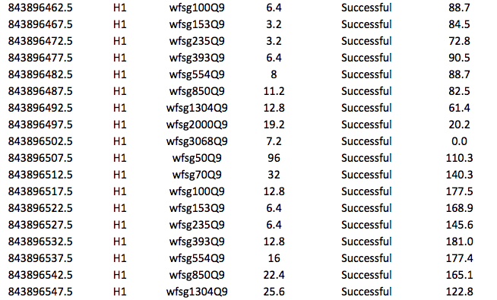
Hardware Injection Logs
GPS IFO Waveform Scale Message SNR

Slide 23
Hardware Injection Logs
The log confirms what we see in the spectrogram
There is a series of Burst injections
They are spaced in ~5 second intervals
There are 2 sets of injections which each rise in frequency
The SNRs are very loud (~100)
Similar information is included for all 4 data analysis working groups

Slide 24
Summary
The LOSC web site allows access to LIGO data with little or no training. Documentation includes:
Data access
Working with segments
Basic data analysis techniques
LOSC data is stand-alone
Can be read with off-the-shelf tools
Includes segment and DQ information
LOSC data is available both on the CIT cluster and on your laptop

Slide 25
Everything you (or your students) need to get started is on the web
https://losc.ligo.org/
Thank you!

Slide 26
Extra Slides

Slide 27
LOSC on the LIGO Data Grid
LOSC data is currently available on CIT cluster
LOSC Frame files can be accessed via ligo_data_find, exactly as other LIGO data
Use LOSC API on LDG
Access LIGO data with ease
Move seamlessly between laptop and cluster
https://losc-dev.ligo.org/tutorial_gmtd/
$ export PYTHONPATH=$PYTHONPATH:/home/losc/py
$ ipython
> import readligo as rl
> strain, meta, dq = rl.getstrain(860000000, 860005000,'H1')

