Slide 1


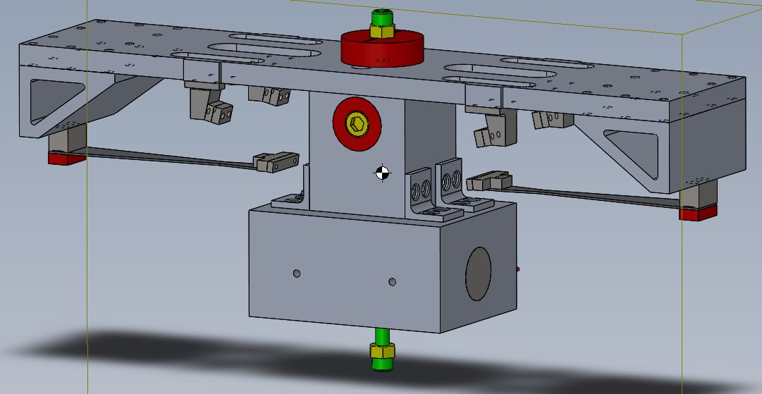
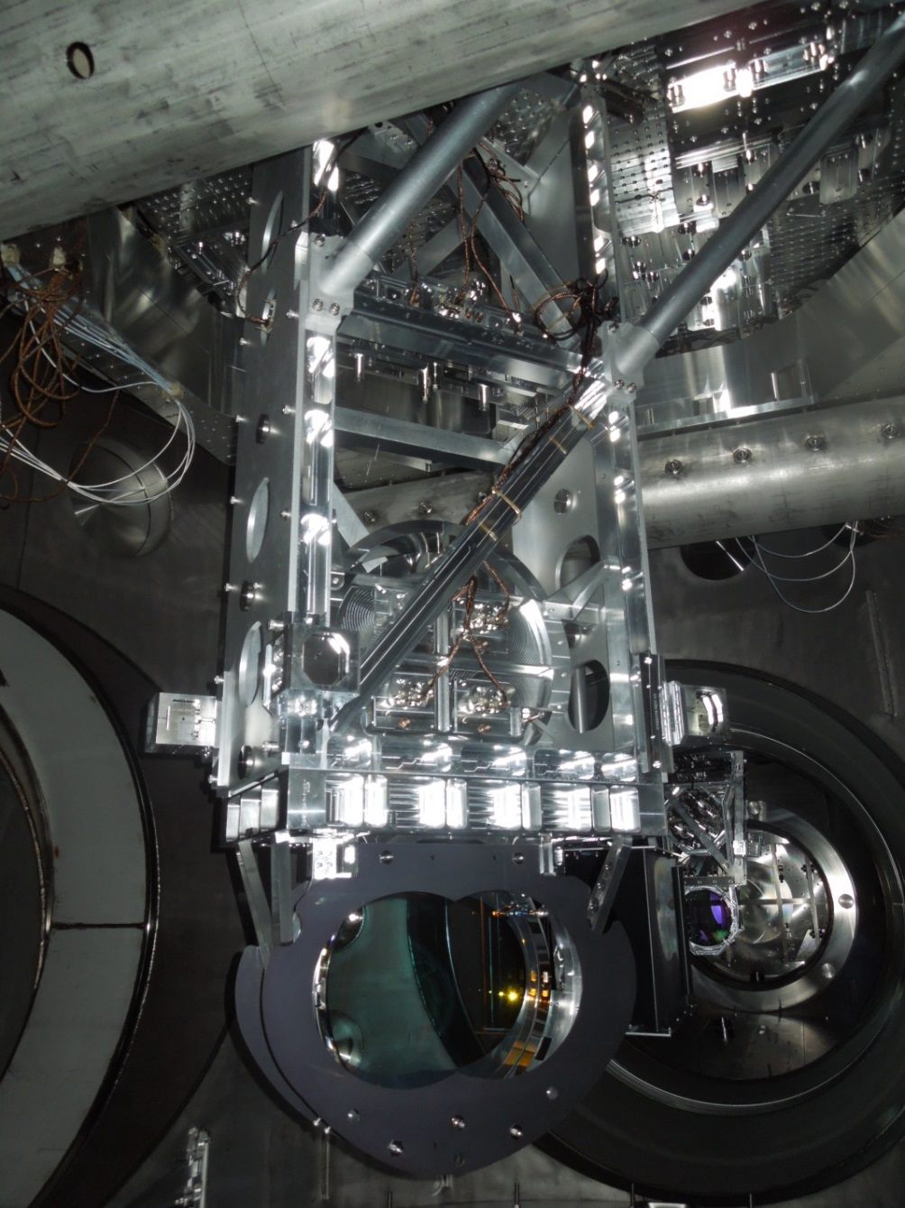
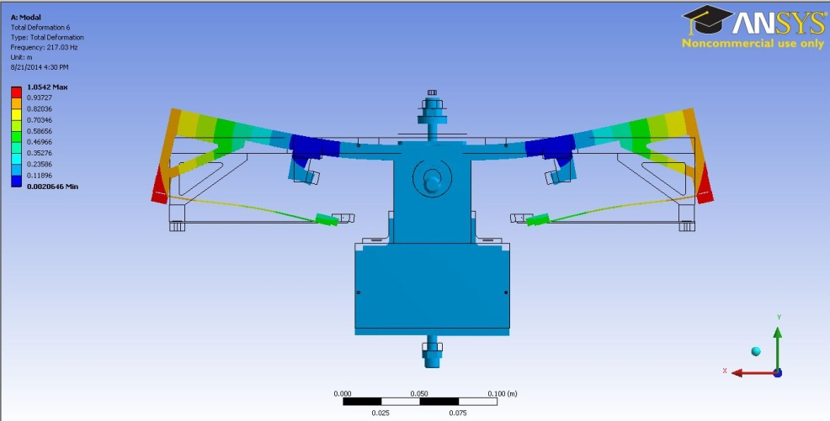
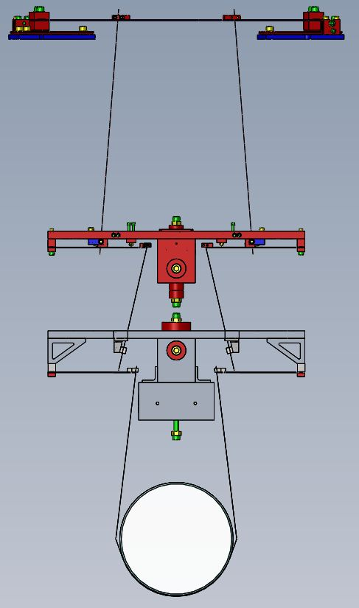
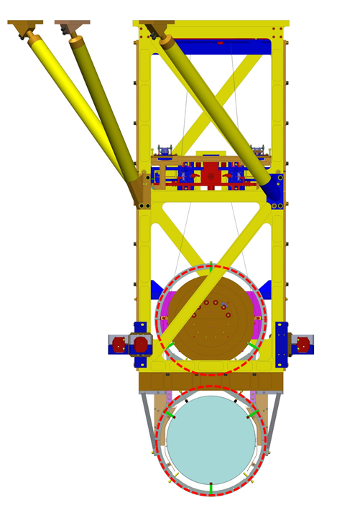
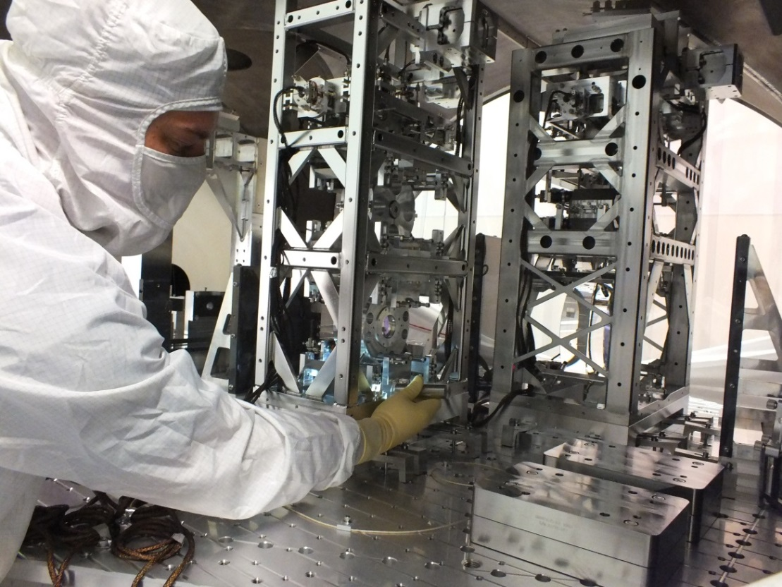
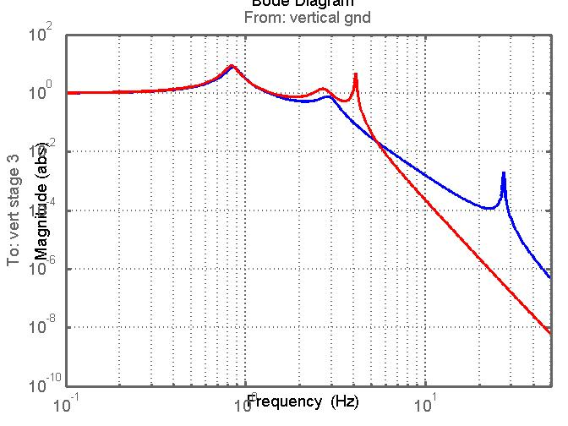
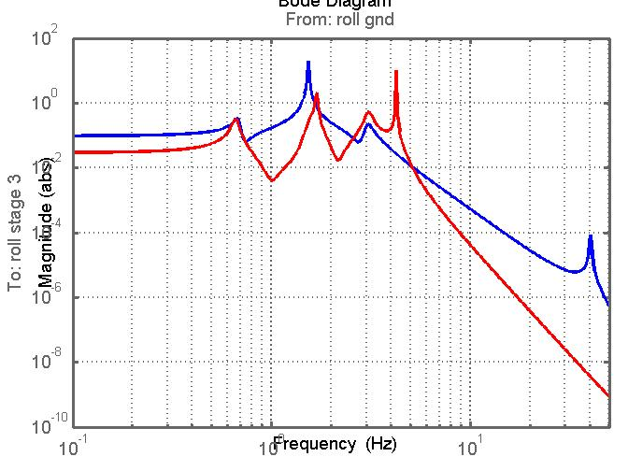
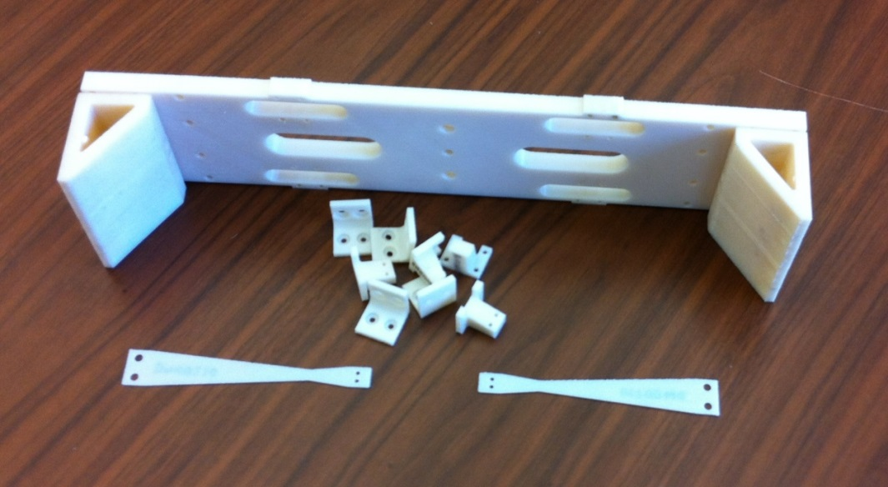
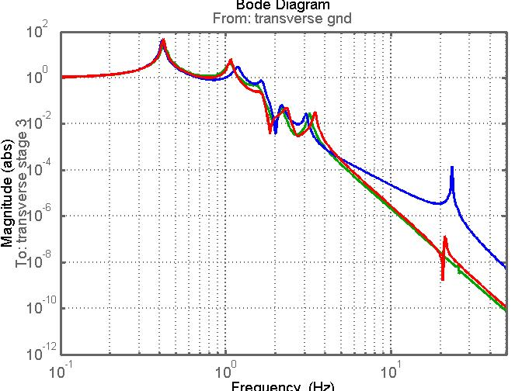
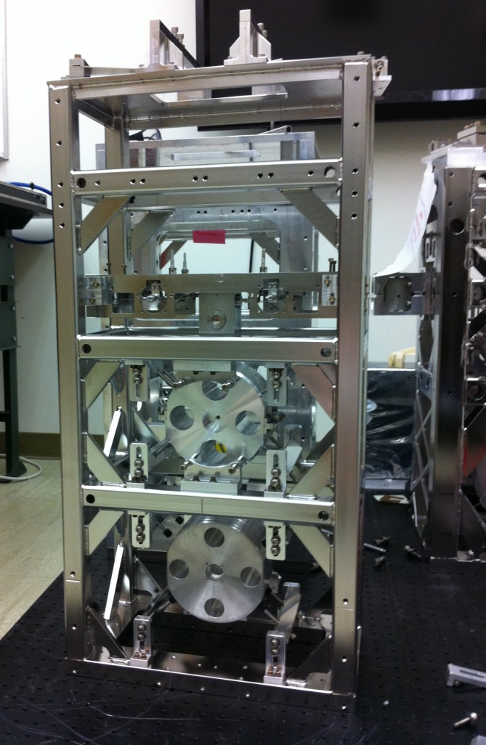
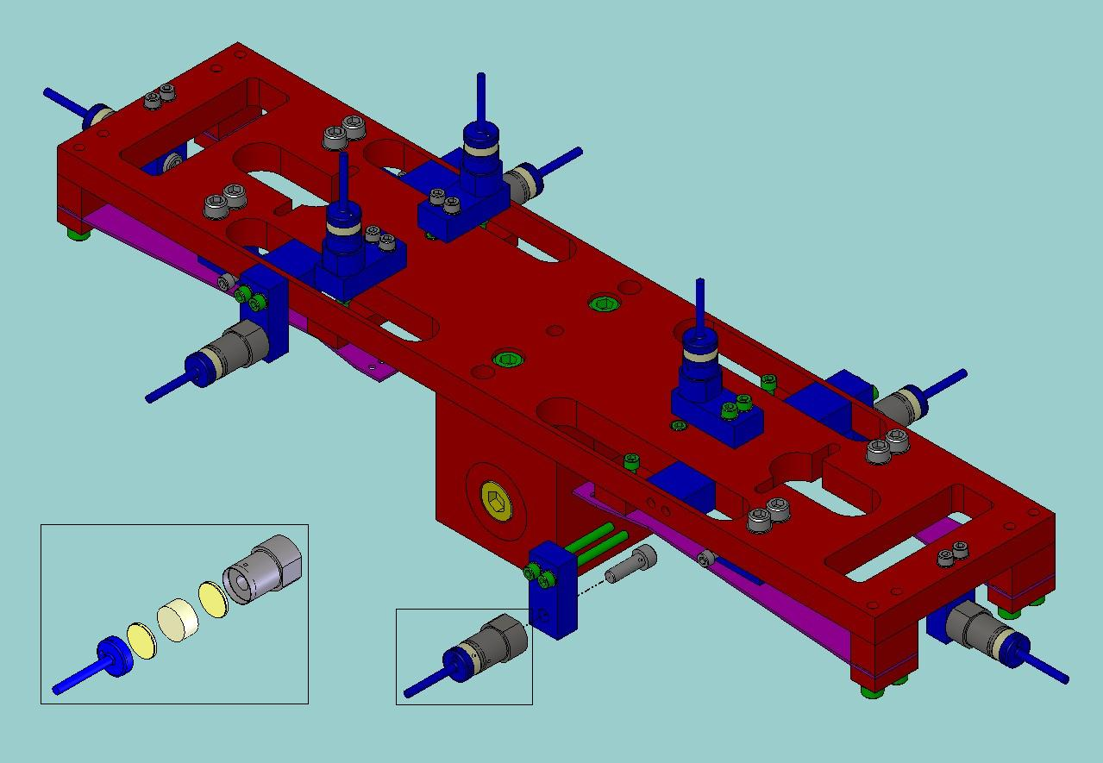
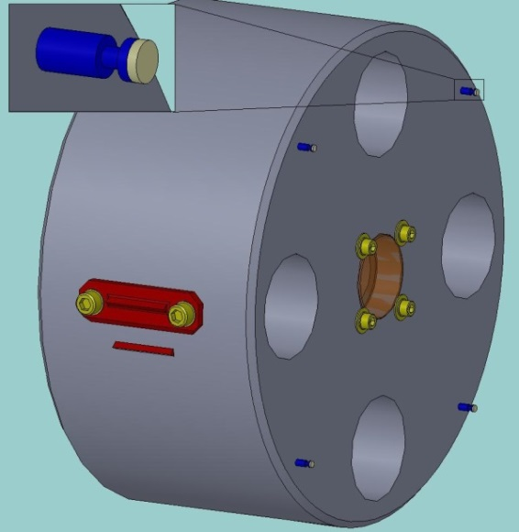
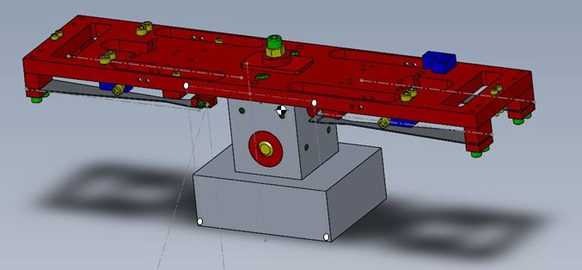
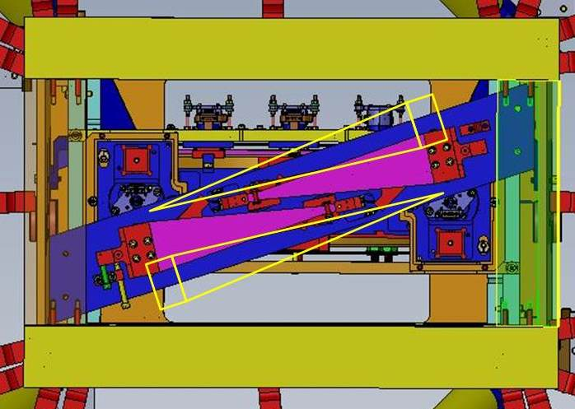
Risk Reduction Work on
Advanced LIGO Suspensions
Norna A Robertson, Harrison Miller and Calum Torrie: Caltech
G1400804
1
4
7
Introduction
All Advanced LIGO (aLIGO) suspensions are now installed at both observatories.
Measurements of dynamical behaviour (mode frequencies, transfer functions, violin mode Qs, actuation levels etc.) show that the suspensions should meet their requirements.
However some modifications have been proposed as risk reduction steps to improve the performance of aLIGO:
Increased vertical isolation in signal recycling cavity triple suspensions
Revised design of beamsplitter triple suspension for a larger beamsplitter
Further Development of New HSTS Middle Mass
Revised Design of Suspension for Larger Beamsplitter (BS)
Minimise impact on current design and operation of suspension
Use two blades instead of four to keep current wire separation around mirror, and shorten blade length for wire clearance to lower mass
Redistribute mass and change steel to Al to locate centre of mass (CofM) at centre of layout of actuation magnets, keeping overall mass same
Move blades down to below CofM for stability (lowers wire breakoff points)
Re-angle wire clamps as needed
Carry out FEA to check mass and blade internal resonances
Size of beamsplitter (BS) was frozen relatively early: trade-off between clear aperture and manufacturability
It is the limiting optical aperture in the interferometer
Enhanced optical simulations indicate the aperture may compromise performance
consider implications on triple suspension design for larger beamsplitter
possible new size 45 cm diameter, thickness TBD (current size 37 cm diam. x 6 cm thick)
New middle mass design
FEA to check stiffness of new design: first resonance ~217 Hz
Beamsplitter installed at LHO
2
5
8
Increased Vertical Isolation for Signal Recycling Cavity (SRC) Suspensions
MATLAB Analysis of Redesigned HSTS Suspension
Revised BS Suspension
Compare new dynamical behaviour to that of current suspension:
Add extra blades, change transverse separation of wires and moments of inertia of middle mass
All transfer functions acceptable: significant differences only in vertical and roll
highest modes now below 10 Hz
Implications of larger optic:
All blades need to be redesigned to take heavier mass and maintain isolation
Some structural elements will need enlarged, e.g. “figure of 8” around middle and bottom mass, baffles
Minimise other changes e.g. keep top mass same, minor changes to box structure as needed
However If new optic is larger than indicated here (45 cm diam.), changes may need to be more significant
Noise in the SRC length, coupling into the GW readout through radiation pressure, may be higher than desired
In particular noise coupling from vertical to horizontal in the three triple suspensions (SRM, SR2, SR3) at their highest vertical mode (28 Hz) is significant
Improve vertical isolation by adding
third stage of blades at middle mass:
all vertical modes < 10 Hz.
Start with SRM (HAM Small Triple Suspension). Coupling in SRM is larger due to optic pitch
HAM5 Chamber at LLO showing SRM (foreground) and SR3
Full triple suspension with new mass
Blue is current design, red is new design. Vertical isolation improved: x 7 at 10 Hz, x 100 above ~ 30 Hz.
Current design with resized optic and middle mass Indicated in red
3
6
9
HAM Small Triple Suspension (HSTS) Redesign
Future Work On HSTS Redesign
Future Work on BS Suspension
Primary design considerations: minimise changes and make use of proven design elements
Consider reusing top mass at middle stage, replacing current cylindrical mass: top mass already incorporates blades
Extend size vertically to hold magnets for actuation at
correct spacing
Check basic assembly of new middle mass using 3D printing
Make metal prototype of mass with blades. Reassemble an existing spare HSTS with new mass: check assembly, alignment, mode frequencies, transfer functions etc
Incorporate lessons learned into design where possible, based on experience with current HSTSs
Final design review and potential implementation into aLIGO
Continue MATLAB modeling as design develops
e.g. see strong coupling of highest roll mode into transverse unless middle mass width = optic width
Investigate fitting larger blades into existing layout, minimise new parts
After decision on optic size, finalise design work
FEA of revised structure including attachments (baffles etc)
Build full scale mock-up: test fit and assembly
Final design review and potential implementation into aLIGO
Transverse transfer function: green = current design, blue = larger optic, red = larger optic and larger middle mass
Current top mass
Current middle mass
Initial idea for new middle mass
Further details in T1400450 and T1400290
Spare HSTS in Caltech lab
Further details in T1400296
Top view of suspension with possible revised blade size and position in yellow

