Slide 1
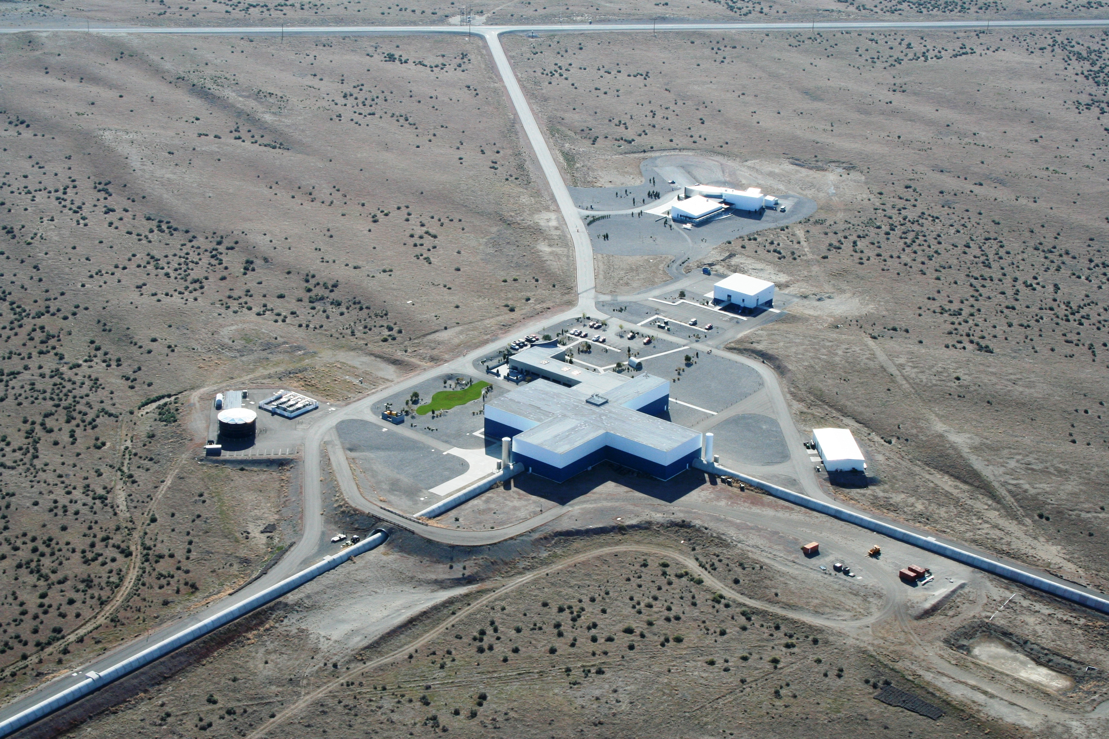



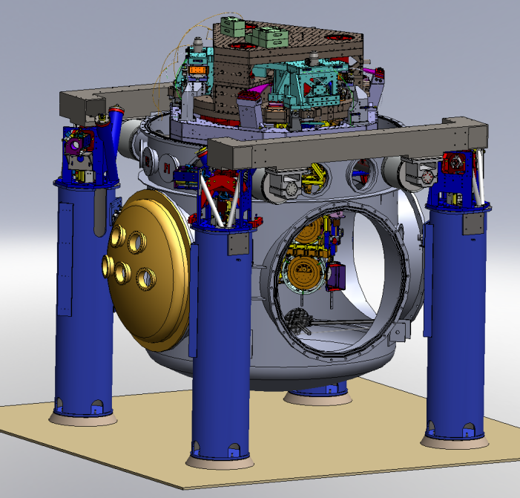
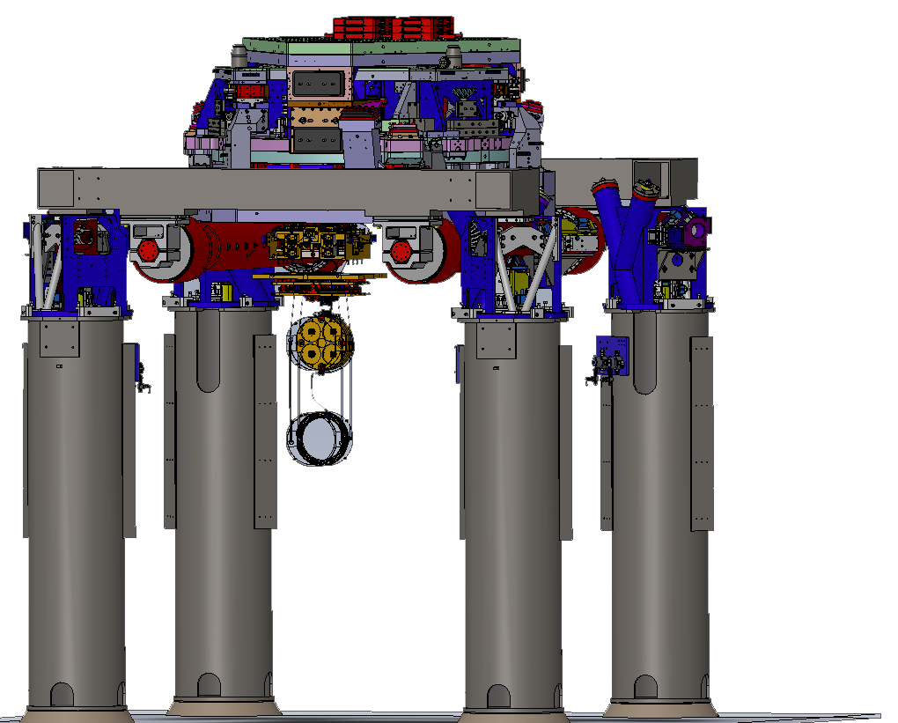
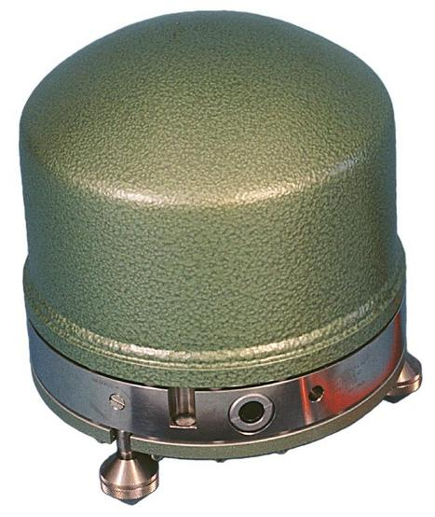
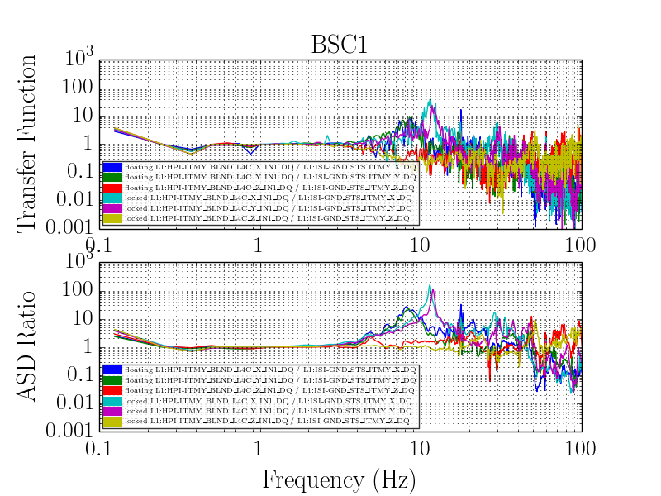
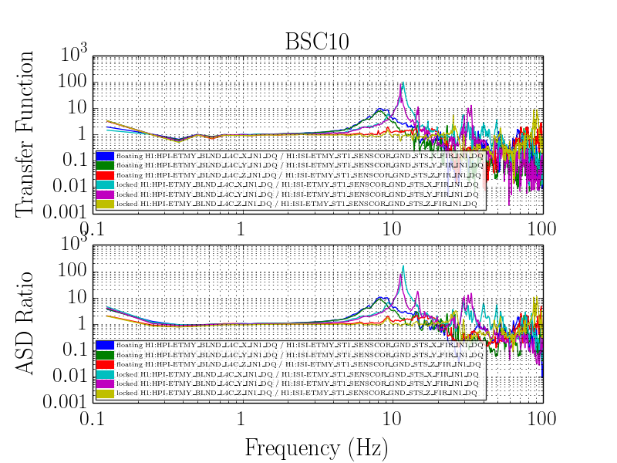
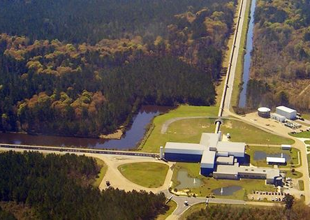
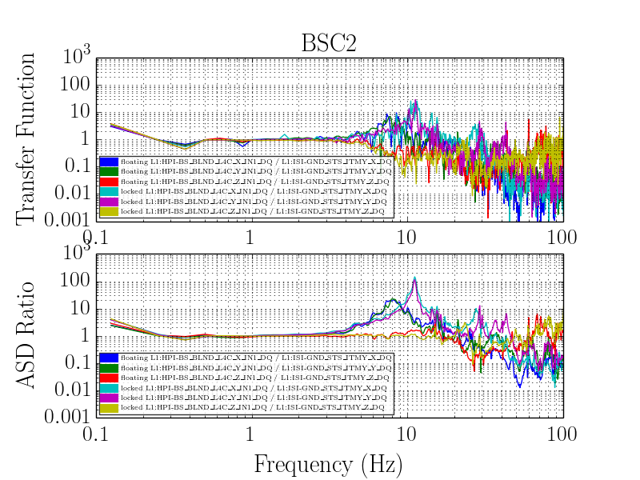
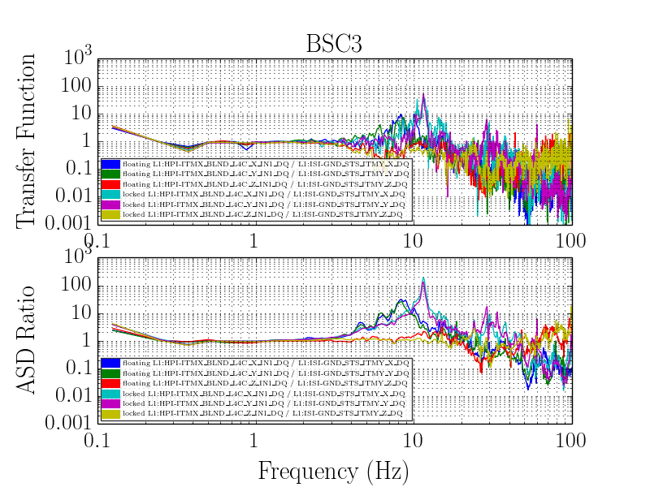
BSC HEPI Pier Amplification
Laura Nuttall, Christophe Collette, and David Tshilumba for the Seismic Team
LIGO-G1400858
Five large vacuum chambers or basic symmetric chambers (BSCs) house the core optics of a LIGO interferometer. An hydraulic external pre-isolator (HEPI) system surrounds each BSC; it is a 6 degree of freedom (DOF) active seismic
isolation system as shown by 4 red
actuator-sensor units located between the
top of the blue piers and grey support
beams. In this work we are investigating a
resonant mode of the entire support
structure, vacuum chamber and concrete
slab, appearing in frequency range 8-12 Hz.
We have compared the ground motion recorded by the closest STS with the motion recorded by the L4Cs at the top of the piers. We have compared times when the HEPI system is:
L4C
locked – HEPI on mechanical stops; clamped to the pier
floating – HEPI is free (position loops not closed)
STS
Due to availability of HEPI being in these states recently, we have looked at BSC10 at LHO and BSC1/2/3 at LLO.
LHO
BSC10
LLO
BSC3
BSC4/9
The plots represent 8 hours of data (taken in July 2014) averaged every minute. From the plots it can be seen:
The resonance is only seen in the X and Y DOF.
When HEPI is floating compared to in a locked state, the resonance is reduced by ~an order of magnitude at both sites and shifts from a peak frequency of ~11Hz to ~9Hz
The harmonic of the resonance at ~30Hz is greatly suppressed when HEPI is floating at both sites
Even when HEPI is floating the magnitude of the resonance at LLO is double that at LHO.
At LIGO-MIT Advanced Systems Test Interferometer (LASTI):
testing and modelling show coupling between the chamber and heavy equipment mounted on the piers happens through the floor’s flexibility.
several active and passive control techniques have been tested to reduce the amplification at 9Hz, such as dynamic vibration absorbers, active mass dampers, and active tie rods.
Investigations are ongoing to further understand these techniques in reducing the 9Hz amplification.
More information: Tshilumba, D. et al. (P1400109)
Recently at LHO - Tim MacDonald and Jeff Kissel have been characterising this effect by whacking the piers/floor with a sledge hammer. Results suggest the motion is the two crossbeams moving in concert along the beam direction and NOT due to the piers/slab/chamber. See alog 13476

