Slide 1
Interferometer configurations for Gravitational Wave Detectors
LIGO-G1401144-v2
Koji Arai – LIGO Laboratory / Caltech

Slide 2
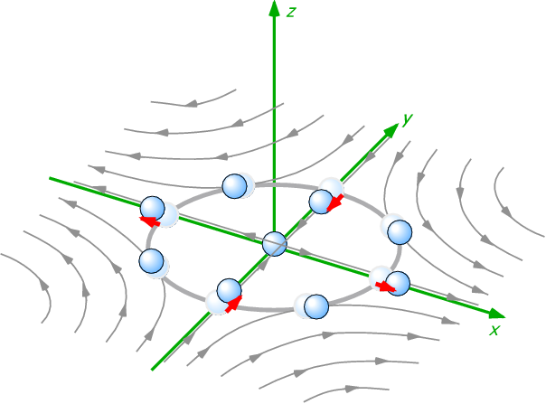
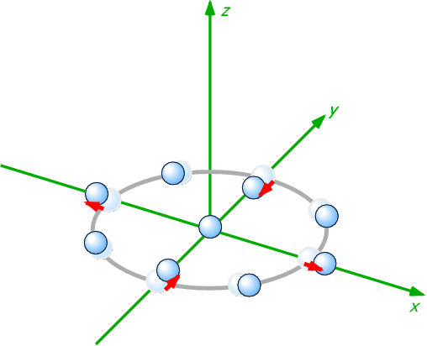
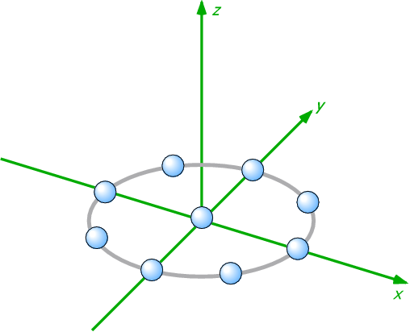
Gravitational wave
General Relativity
  Gravity = Spacetime curvature
  Gravitational wave = Wave of spacetime curvature
Gravitational waves
  Generated by motion of massive objects
  Propagates with speed of light
  Cause quadrupole deformation
  of the spacetime
  Measure strain between
  free masses to detect GWs
GW
Free mass

Slide 3
Introduction ~ Interferometer?
Longer the baseline, the better
  (displacement dx) = (Strain h) x (baseline L)
  Let’s use laser ranging for the measurement
e.g. Send pulses to measure the travel time?
  Target: h=10⁻²³, L=10km => dx = 10⁻¹⁹ m
  Pulse timing resolution needs to be 3x10⁻²⁸ s (!)
  Current state-of-art pulse timing technology is
  25 zepto s/rtHz (= 25 x 10⁻²¹ s/rtHz) Nature Photonics 7, 290-293 (2013).
We need to measure phase of the laser light
=> use “laser interferometry”

Slide 4
Introduction ~ Interferometer?
Interferometry
  Utilize characteristic of a Michelson
  interferometer as a length comparator
Michelson
Interferometer
In reality...
Fabry-Perot cavity
Advanced LIGO
Dual-Recycled Fabry-Perot Michelson Interferometer
No worries: It’s just a combination of MI and FPs

Slide 5
Michelson interferometer
Light intensity at the output port
  Difference of the electric fields from the arms
  Output intensity is sensitive
  to the differential phase

Slide 6
Michelson interferometer
Frequency response of the Michelson to GWs
Frequency response
of the Michelson interferometer
Ω: optical angular frequency, λ_{OPT} laser wavelength
ω: angular frequency of GW, λ_{GW} wavelength of GW
Jean-Yves Vinet,et al
Phys. Rev. D 38, 433 (1988)

Slide 7
Michelson interferometer
Frequency response of the Michelson to GWs
Cut off freq
longer -> lower
DC Response
longer -> larger
Notch freq
f = n c / (2 L)
  Michelson arm length optimized for 1kHz GW
  -> 75km, too long!

Slide 8
Fabry-Perot optical resonator
Storing light in an optical cavity
  Field equations
Very fast phase response

Slide 9
Fabry-Perot optical resonator
Storing light in an optical cavity
Finesse
Cutoff freq “Cavity pole”
DC Response
amplification
  1. FP increases stored power in the arm
  2. FP increases accumulation time of the signal
  => Above the roll-off, increasing F does not improve the response

Slide 10
Fabry-Perot Michelson Interferometer
Differential nature of the Michelson
+ Longer photon storage time of Fabry-Perot cavities
= Fabry-Perot Michelson Interferometer
Basic form of the modern interferometer GW detector

Slide 11
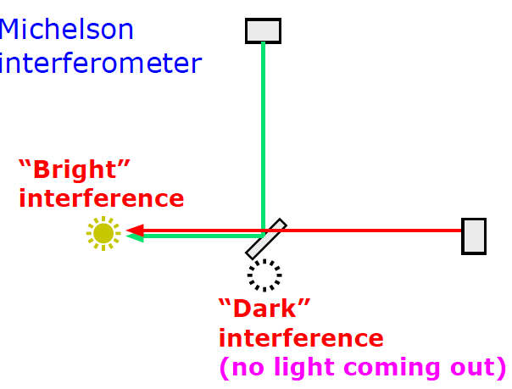
Optical Recycling Technique
Power recycling
  When the Michelson interferometer is operated
  at a “dark fringe”, most of the light goes back to the laser side

Slide 12
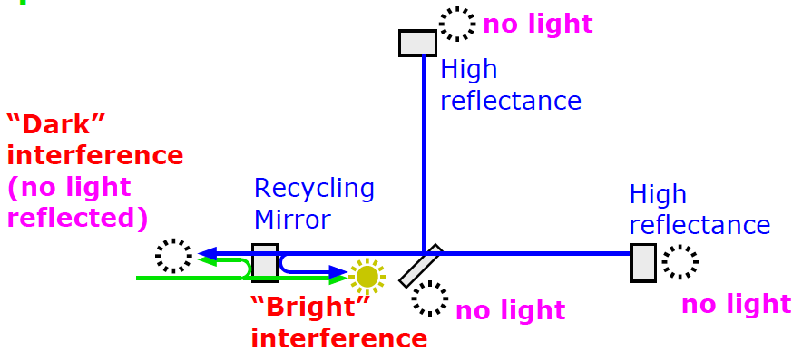
Optical Recycling Technique
Power recycling
  Let’s reuse the reflected light
  Place a mirror in front of the interferometer
  to form a cavity with the Michelson (compound mirror)
  “Power Recycling Mirror”
  The internal light power is increased
  = equivalent to the increase of the input laser power
compound mirror

Slide 13
Optical Recycling Technique
Power recycling
  BTW, all the output ports are made dark.
  Where does the light go?
  In the ideal power recycling, all input power is internally
  consumed via optical losses (absorption & scattering)

Slide 14
Optical Recycling Technique
Power-recycled Fabry-Perot Michelson Interferometer
  Internal light power in the arms is increased
From the laser side /
common arm length change
It looks like a three mirror caivty
= high finesse cavity
For the differential motion (=GW)
It looks like just an arm cavity

Slide 15
Optical Recycling Technique
Dual-recycled Fabry-Perot Michelson Interferometer
  Another mirror is added at the dark port
  “Signal Recycling Mirror”
  Dual recycling allows us to set different storage times
  for common and differential modes
Common mode
= high finesse three mirror cavity
Differential mode (=GW)
= low (or high) finesse three mirror cavity

Slide 16
To tuned or not to tune
Bandwidth of the detector can be changed
  by changing the resonant phase of the signal recycling cavity (SRC)
Optimize the curve depending on the noise shape
Dynamic signal tracking
Signals: resonant in SRC
(Resonant Sideband Extraction)
Signals: anti-resonant in SRC
(Signal Recycling)

Slide 17
Summary
Optical phase measurement => Interferometry
Michelson interferometer: requires too long arm
Fabry-Perot arm: longer light storage time
Optical recycling technique:
allows us to set different storage time for the incident light and the GW signals
  Power recycling: maximize the stored light power
  Resonant sideband extraction: optimize the signal bandwidth

Slide 18
Advanced topics
Angular & frequency response of an interferometer
  Up to this point GWs from the zenith was assumed.
  What is the response to GWs with an arbitrary angle?
  What is the frequency response of the detector for such GWs?
  Draw an arbitrary optical path.
  What is the angular and frequency
  response of such a path?
  Can we use numerical “optimization”
  for certain criteria?
  e.g.
  better sky coverage, directive beaming,
  for certain source frequency, etc…
GW
GW
GW

Slide 19
Advanced topics
Angular & frequency response of an interferometer
  R. Schilling, Class. Quantum Grav. 14 (1997) 1513-1519

